Slide 1
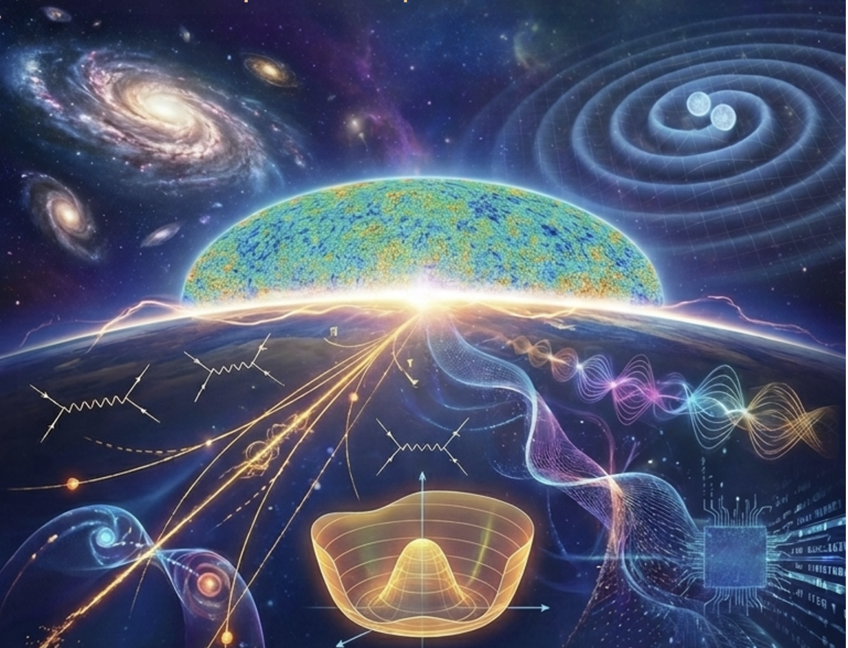
Measure Gravitational Wave with a Novel Mössbauer Spectrometer
Huaqiao ZHANG (IHEP)
张华桥 （高能所）
In collaborate with Yu GAO, Wei XU
Science Bulletin 2024; 69(18): 2795-2798
10.1016/j.scib.2024.07.038
NphiS 2026 @ Nanjing

Slide 2
Outline
Introduction
How to achieve precision and speed needed for gravitational wave use novel Mossbauer Spectrometer
Setup for Multi-band gravitational wave detection use this novel Mossbauer Spectrometer
Summary and proposals

Slide 3
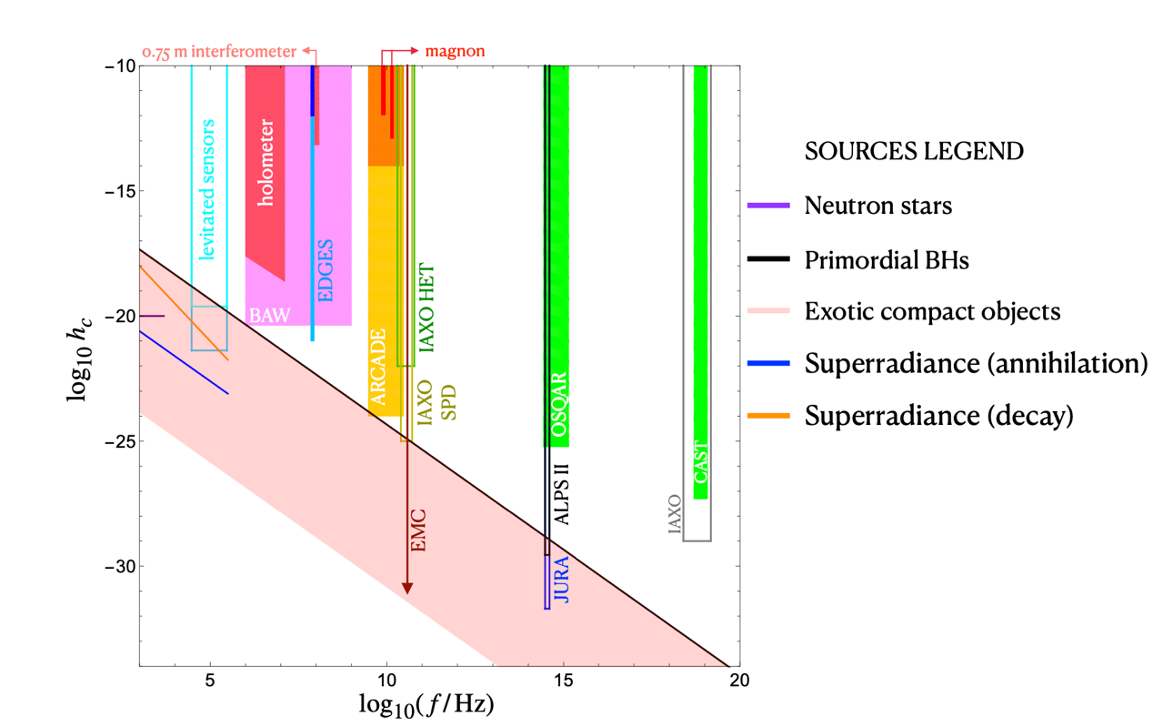
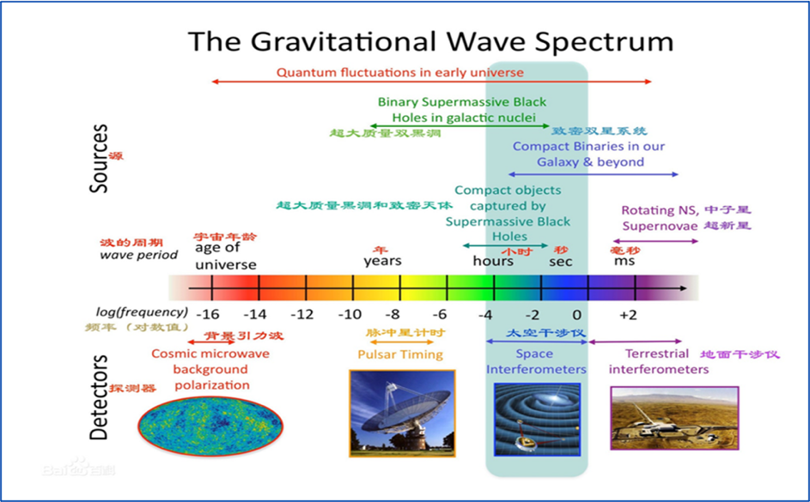
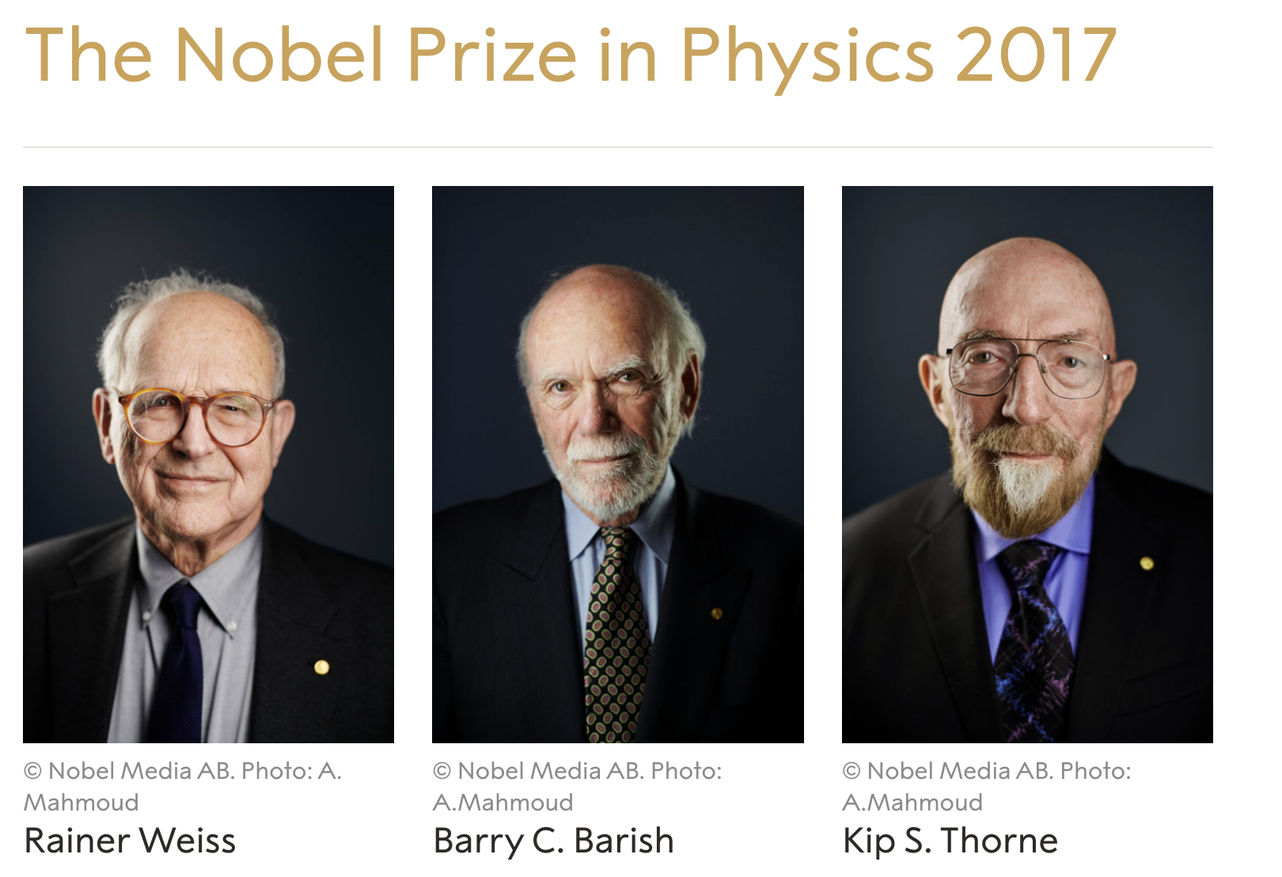
Gravitational Wave
GW： a new way to explore our universe
PBH/SR
ALi
PTA
(Fast)
Taiji，Tianqin
Lisa
Ligo,Virgo
Kargra,ET…
Accuracy needed at the order of thickness of a paper over the diameter of solar system

Slide 4
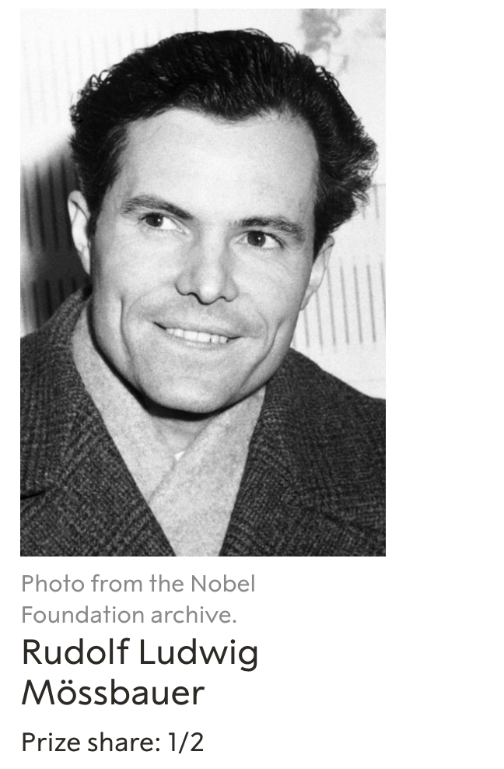

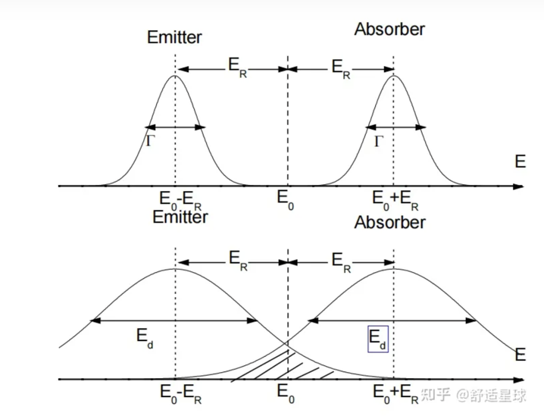
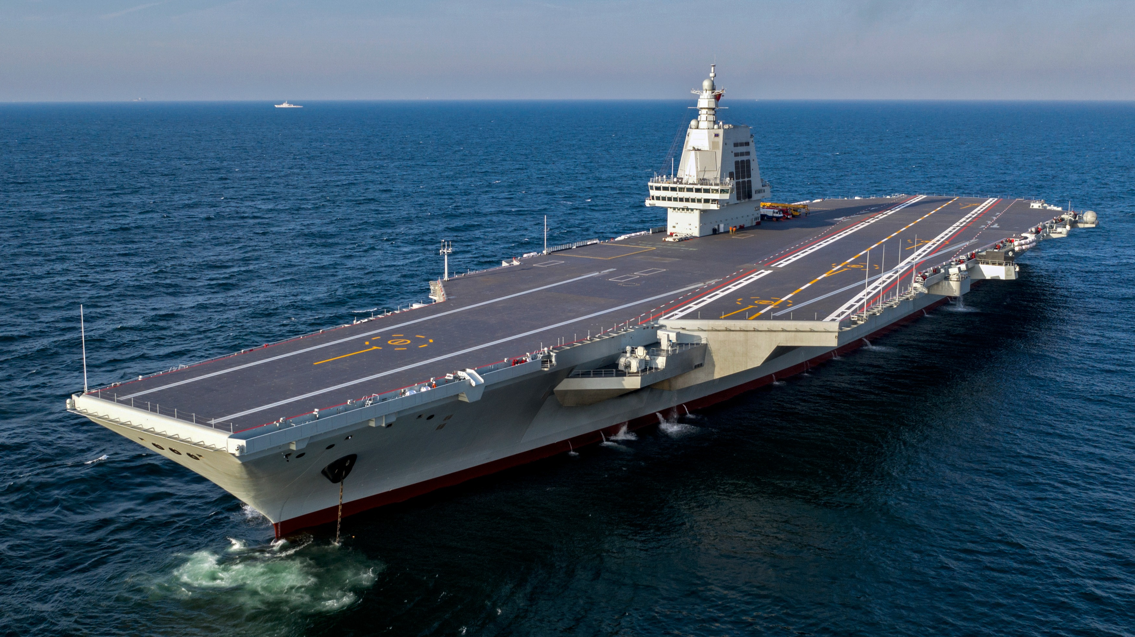
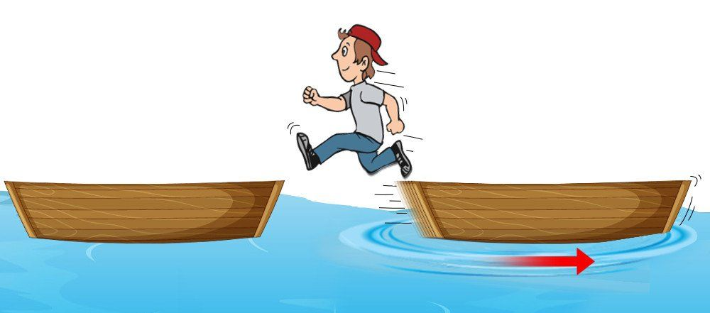
Mössbauer effect
Recoil-less emission and resonant absorption of nuclear transition photons
  Mössbauer active nucleus bound to solid state lattice
  Thermal vibration(~10¹³ Hz) much faster than nuclear transitions (lifetime ~>10⁻⁷ s)
    Effect averages to zero, no 1st Doppler broadening
    Recoil to the whole crystallite(>10¹⁴ atom)
    Without phonon excitations➔ recoil free
1961
recoil

Slide 5
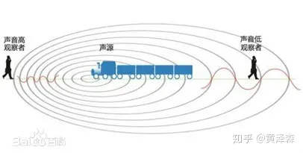
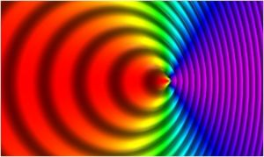
Doppler shift
Sound
Photon： E=hv
Red shift
Notes:
精密移动探针，来测量极小的能量变化

Slide 6
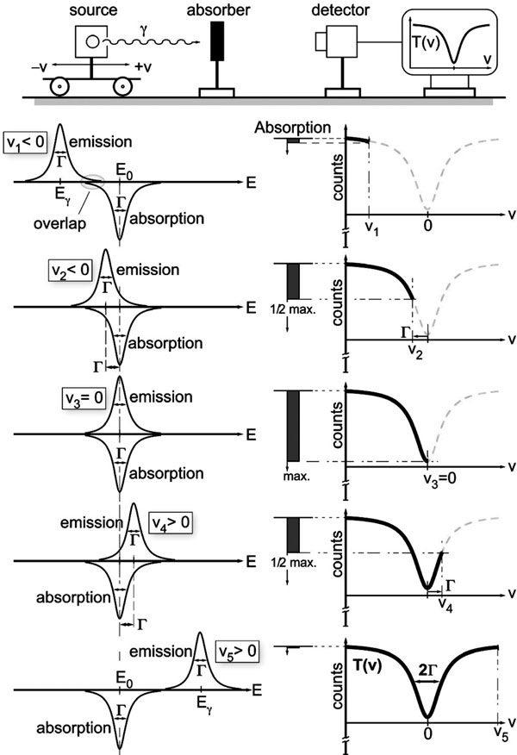
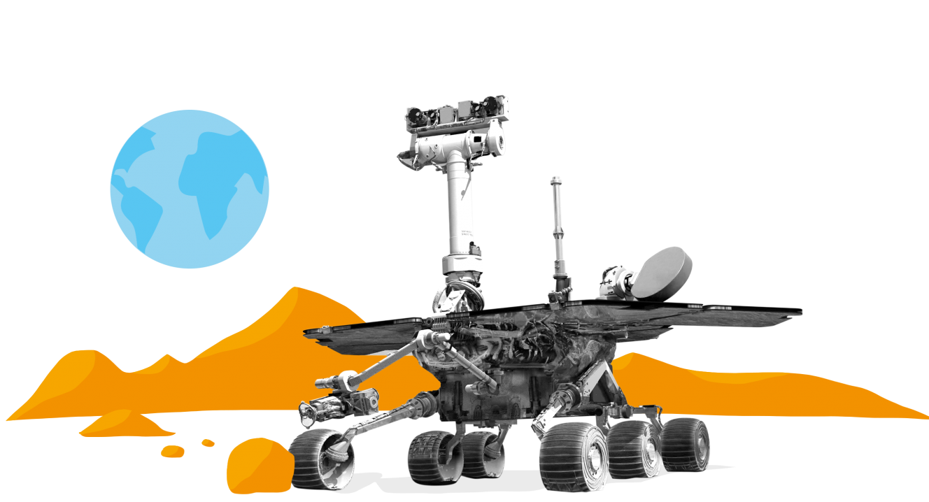
“Traditional” Mössbauer Spectrometer
Change the recoil-less emission and absorption overlap with doppler effects
Strength of recoilless nuclear resonant absorption as determined by the “overlap” of emission and absorption lines when the emission line is shifted by Doppler modulation
High accuracy of the resonant absorption width w.r.t. photon energy
Widely used in material science, chemistry, and even on mars rovers
Notes:
穆斯堡尔谱仪原理
源，吸收体，计数探测器，运动控制： 简单可靠，精度高，灵敏度高

Slide 7
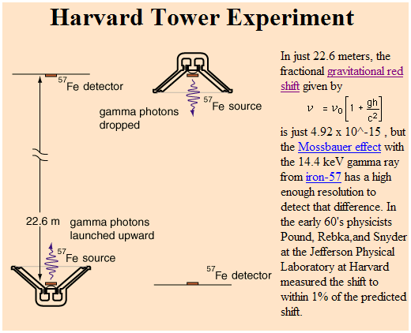
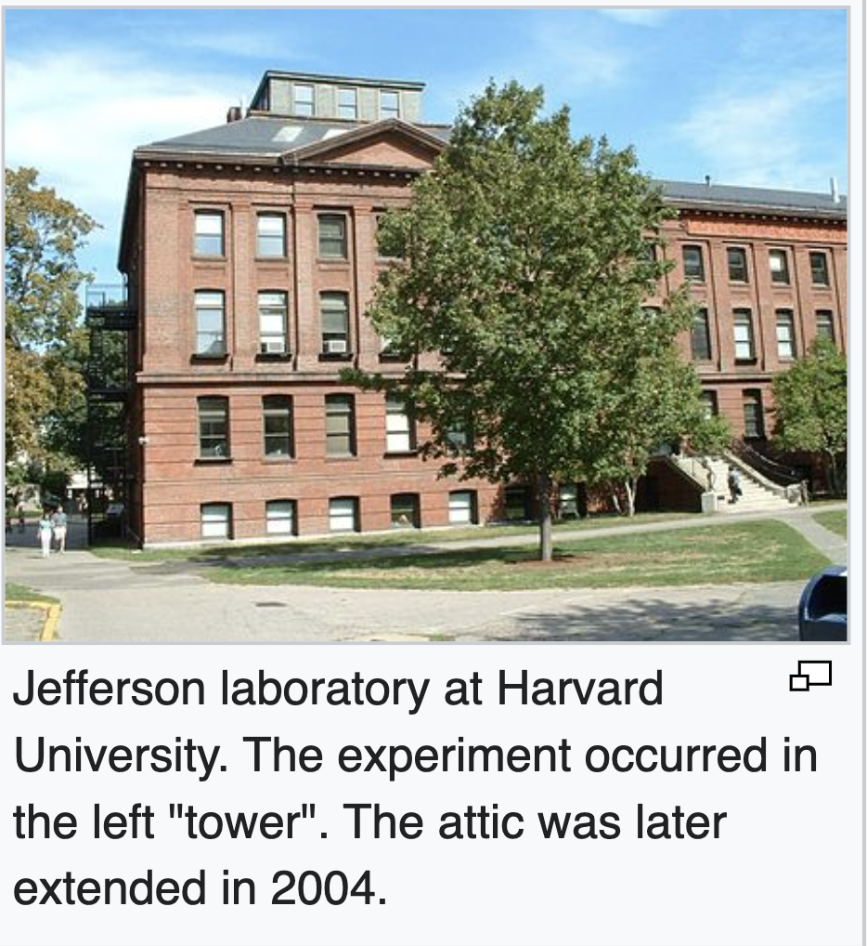
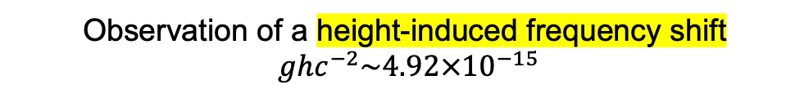
Relativity test with Mössbauer effect
Gravitational redshift test with Mössbauer effect
Pound, Rebka & Snyder (1960-1965)
Observation of a height-induced frequency shift
$ghc^{−2}\sim 4.92×{10}^{−15}$

Slide 8
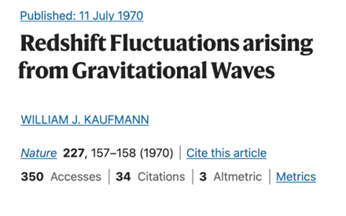
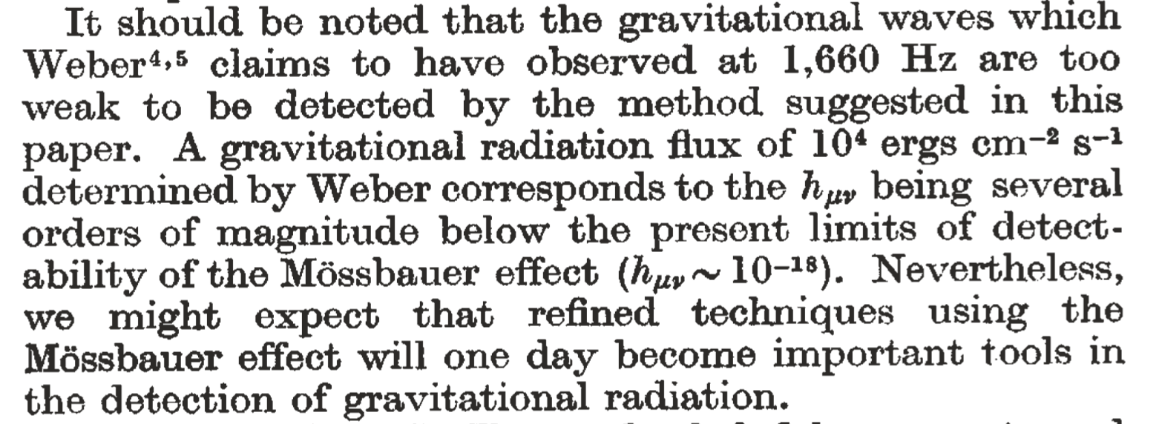
Mössbauer for Gravitational Wave
Idea since 1970
  Photon frequency varies when it propagates in an un-even space-time background.
  No experimental proposal till our work
Gave way to clock-based experiments in later tests of “static” gravity.
  See K. Hentschel, Annals of Science 53, 269–295 (1996)

Slide 9
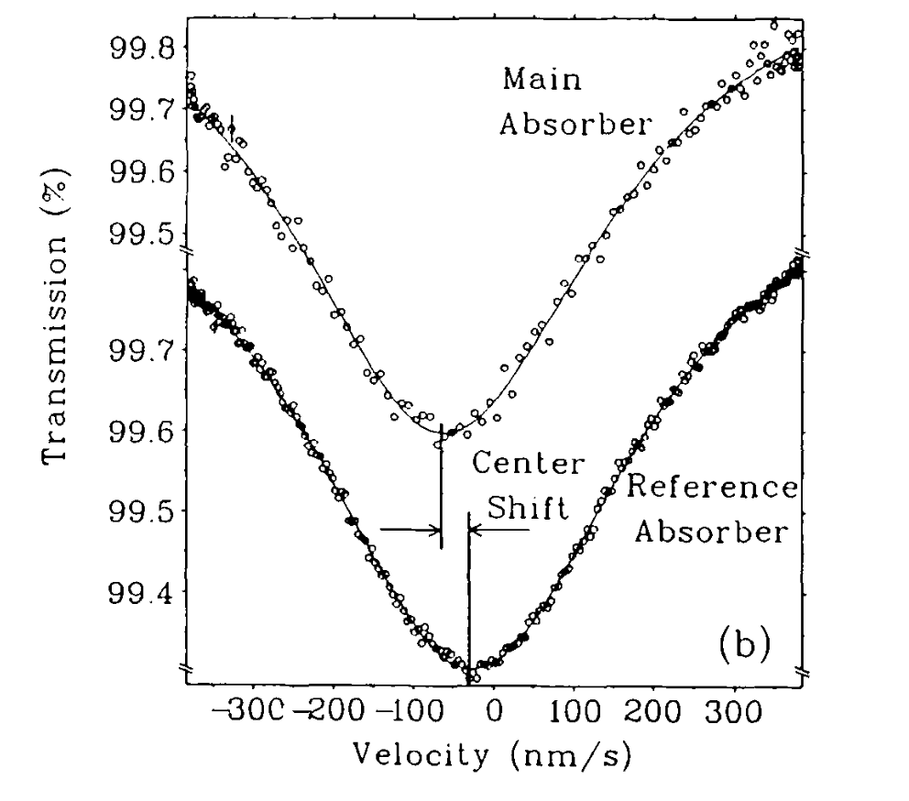
Issues in traditional Mössbauer Gravity tests
A cryogenic ⁶⁵Zn measurement of the local g-value
(Potzel et.al. 1992)
Differential measurement
of the resonance with a
sinusoidal oscillator
  Resonance is achieved
  g-value is off, possibly
  due to various line-shifts
  Take hours-days to achieve high acc.
“such solid-state effects might be difficult ……
there might exist two exceptions. The first are null redshift experiments,
in particular measurements with stationary source and absorber”.
Can be improved with
a stationary scheme：
Quoted from the paper

Slide 10
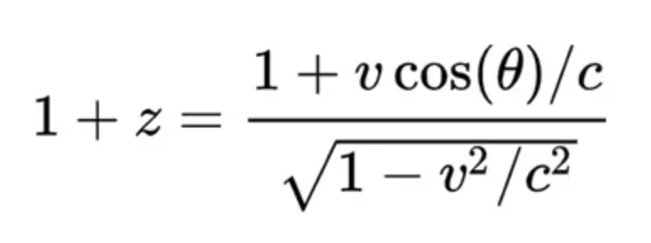
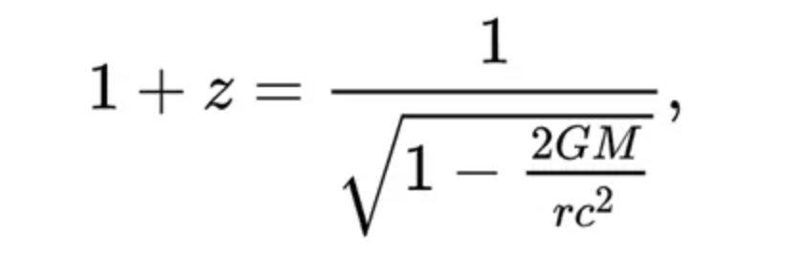
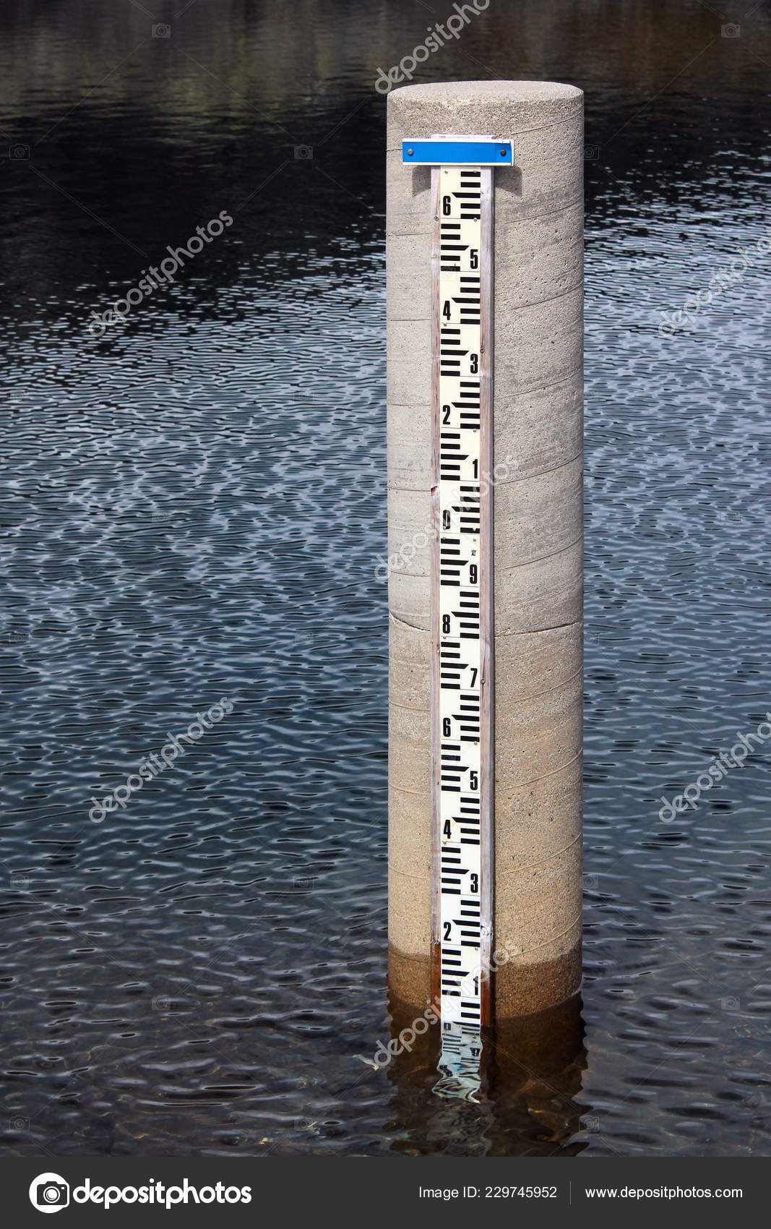
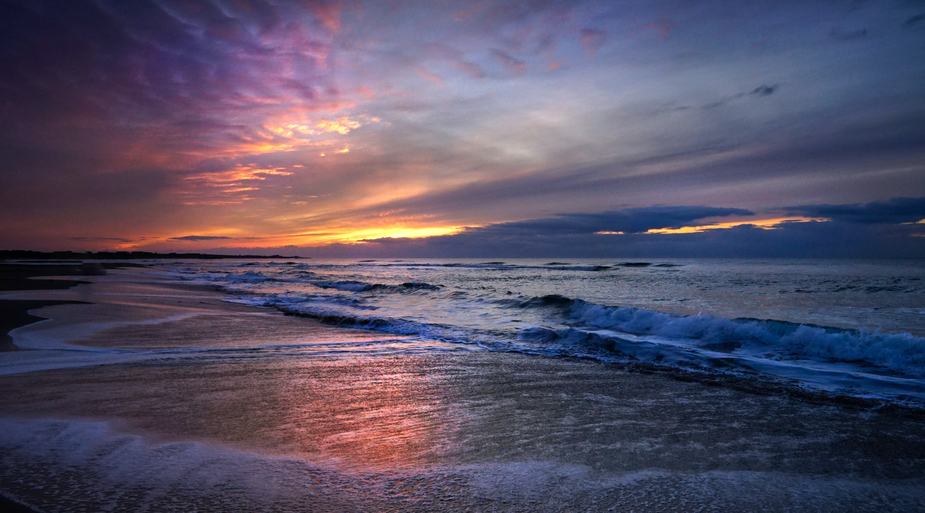

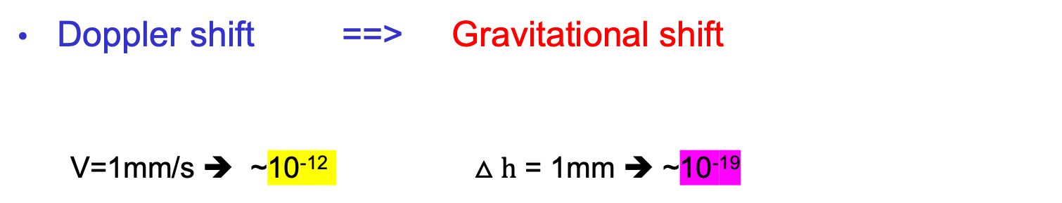
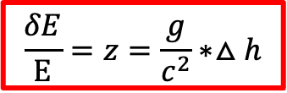
Idea of the stationary measurement
Doppler shift ==> Gravitational shift
  V=1mm/s ➔ ~10⁻¹² $△h$ = 1mm ➔ ~10⁻¹⁹
$△h$<<r
$$\frac{δE}{E}=z=\frac{g}{c^{2}}∗△h$$
Improve on sensitivity to energy shift

Slide 11
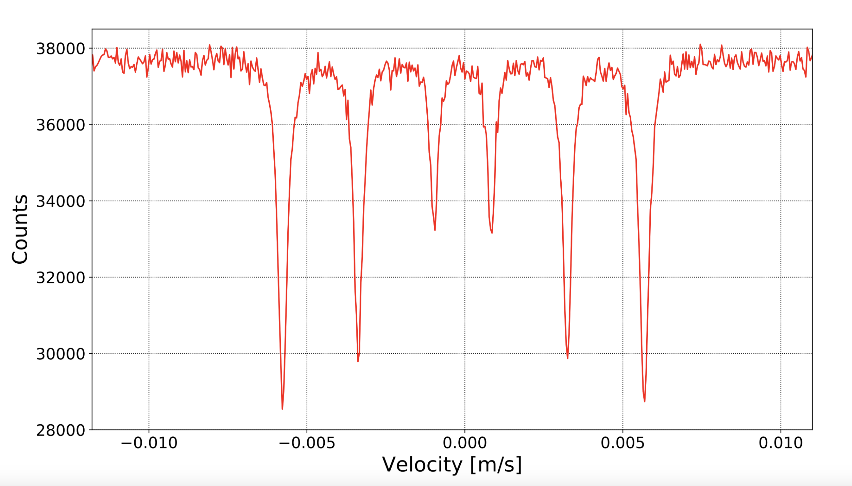
Design of a gravitational shift Mössbauer Spectrometer
Replace Doppler shift with gravitational shift
Parallel readout the resonant absorption shape
Time dependent resonance’s height-shift （not absolute height）
  Frequency of resonance peak hight shift ➔ GW frequency: multi-band
Photon counters with proper Z resolution,
¼ cut view
Z
Demo. Only
Energy loss E_{R} is compensated by a slight height difference between absorber and source:
can be calibrated in advance.
--- the absolute height of resonance (Z₀) is affected by
large systematics: 2nd Doppler,
chemical composition, etc.
--- but its time-dependent shift under GW is not affected.
h
horizontal→
distance (d)
Resonance peak(s)
0
x
Radioactive source
(intensity R_{S})
-h
absorption layer

Slide 12
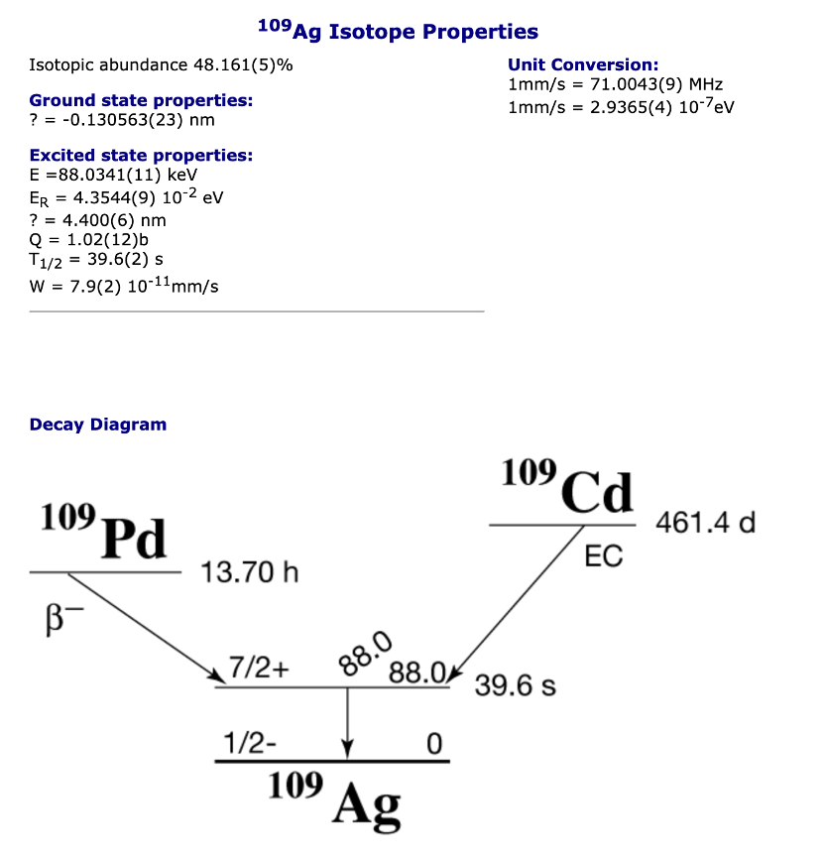
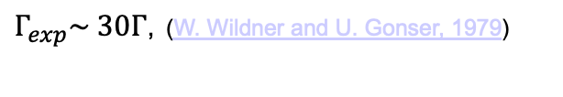
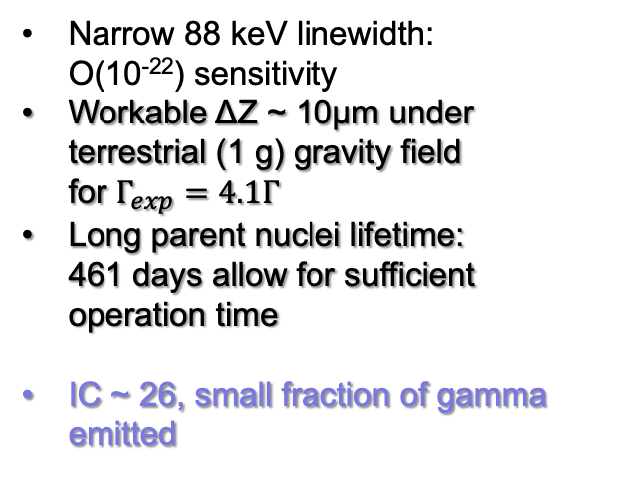
The choice of isotope source: ¹⁰⁹Ag
Narrow 88 keV linewidth:
O(10⁻²²) sensitivity
Workable ΔZ ~ 10μm under terrestrial (1 g) gravity field
for $Γ_{exp}=4.1Γ$
Long parent nuclei lifetime:
461 days allow for sufficient operation time
IC ~ 26, small fraction of gamma emitted
The quest of the ¹⁰⁹Ag resonance:
$Γ_{exp}\sim 30Γ$, (W. Wildner and U. Gonser, 1979)
Improved resonance resolution, w
broadening factors down to 16 (US)
R. D. Taylor and G. R. Hoy, SPIE 875, 126 (1988).
S.RezaieSerej, G. R. Hoy, and R. D. Taylor, Laser Phys. 5, 240 (1995).
Russian group: improvements with Grav. Effects
V. G. Alpatov, et.al. Laser Physics 17, 1067–1072 (2007).
Yu. D. Bayukov, et.al. JETP Letters 90, 499–503 (2009).
Mössbauer database (DICP, CAS)

Slide 13
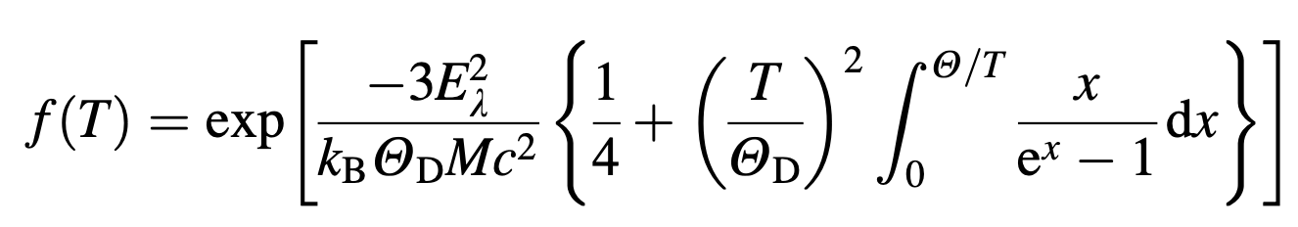
The transmission integral
Photon emission at source
  Fractional recoil-less : f_{s},
  Fractional recoiled:1-f_{s}
Photon absorption at absorber
  Mass attenuation effect: all photons
  Resonant absorption: only resonant emitted photons
The transmission integral (textbook)
  Replaced the doppler shift with gravitational shift

Slide 14
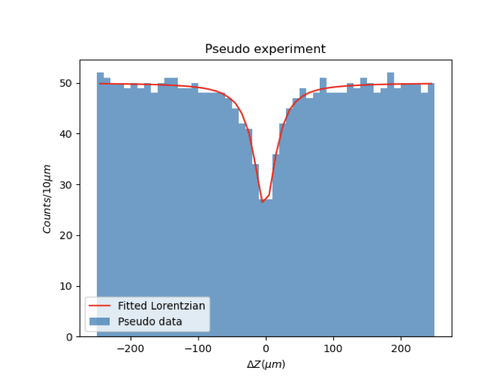
Accuracy from Pseudo experiments
Pseudo experiment simulation with reasonable parameter
  Ex: vertical z-position resolution 10 μm, detection efficiency ~100%
  Readout frequency ~10 f_{GW}, Energy resolution exclude non-88 keV BG
Sensitivity extracted by fitting the resonance absorption peak
Silver alloy/compound with higher T_{deBye} helps improve f_{S}
e.g. AgB₂ has a higher T_{deBye} and f_{S} =0.2 (@ 4K)
Accuracy compatible to the accuracy needed for GW strain
Parallel measure of resonance absorption shape: fast enough for GW

Slide 15
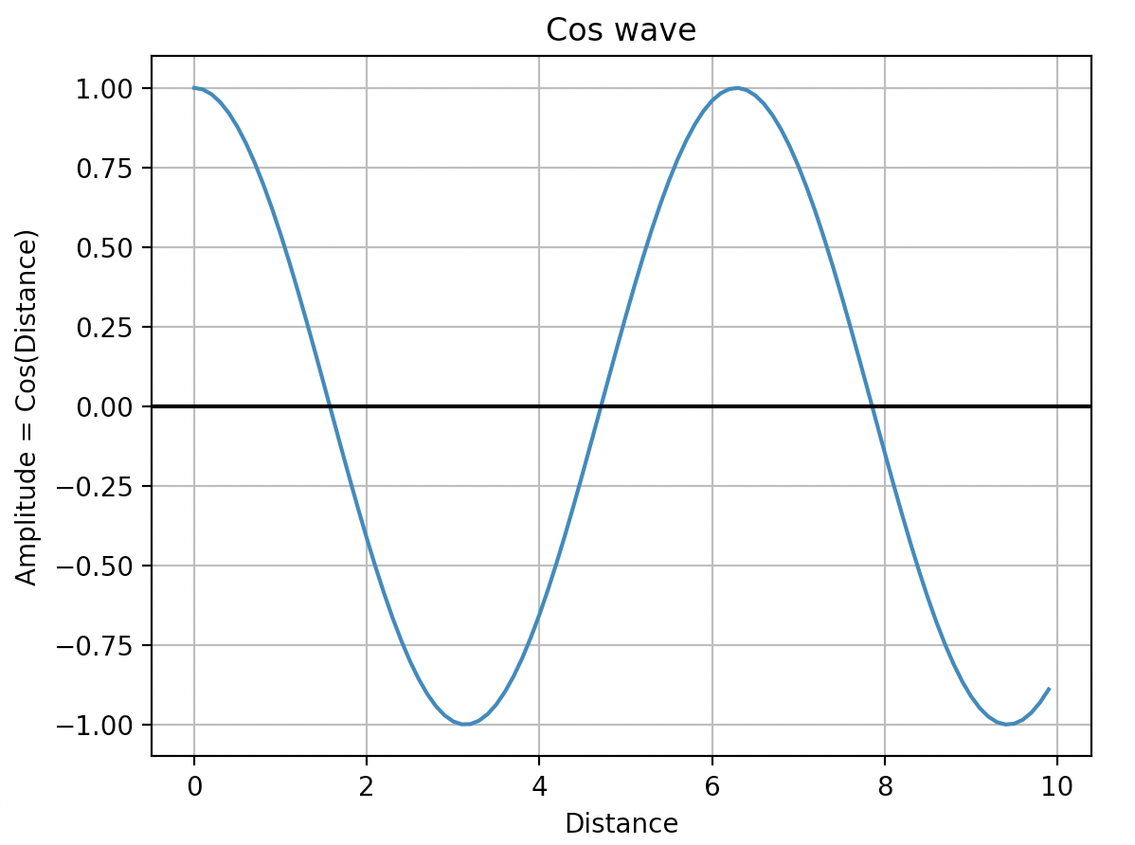
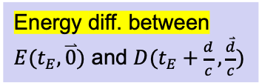
The GW signal: photon energy shifts
Energy shift due to different space-time matrix for photon emission and absorption
Estabrook and Wahlquist, Gen. Relat.
Gravit. 6, 439–447 (1975);
Hellings, Phys. Rev. D 23, 832–843 (1981).
Consider a plain-wave strain perturbation
Energy diff. between
$E(t_{E},\overset{⃑}{0})$ and $D(t_{E}+\frac{d}{c},\frac{\overset{⃑}{d}}{c})$
$$h\left(x,t\right)=h_{0} e^{i(ωt−k∙x)}$$
$$ds^{2}=c^{2}dt^{2}−\left[1+h\right]dx^{2}−\left[1−h\right]dy^{2}−dz^{2}$$
source
A particle’s 4-momentum response to GW strain
after one-way propagation:
absorber
(figure from Hellings paper)

Slide 16
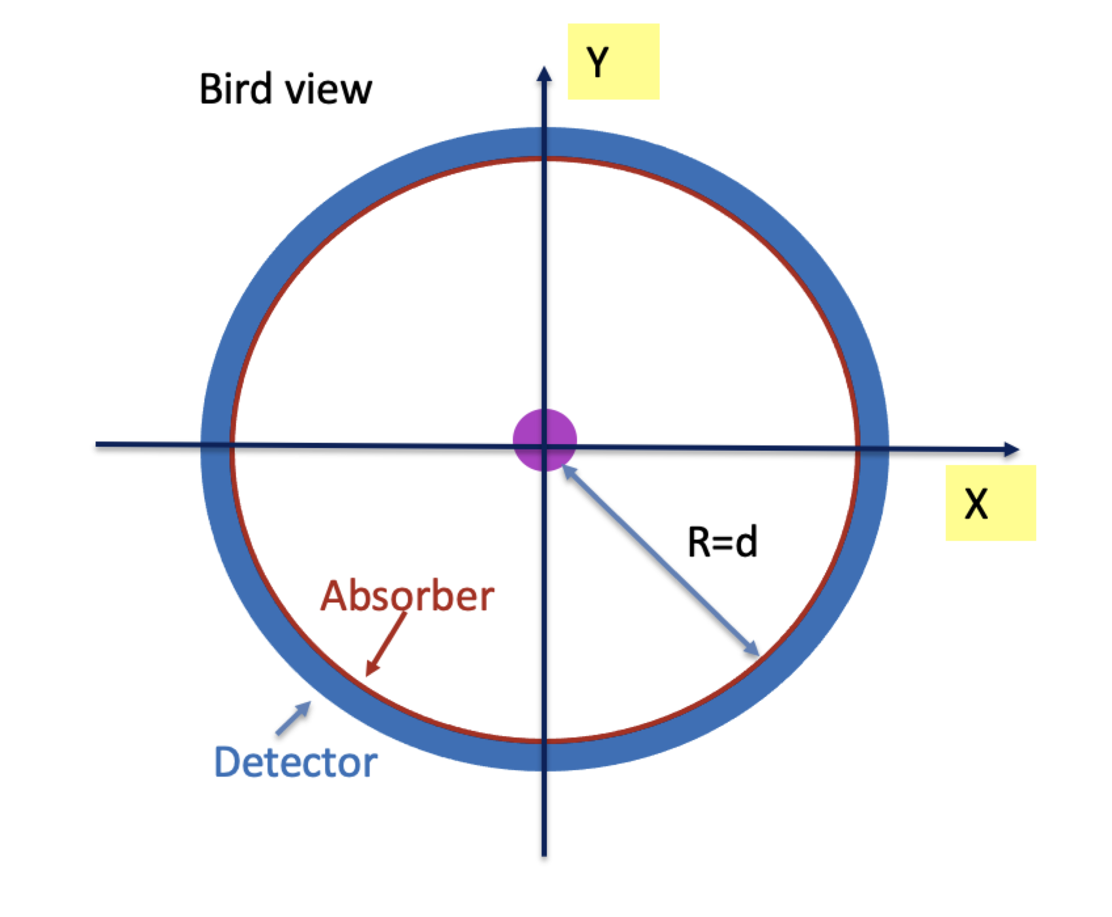
Stationary Mössbauer GW setup
Absorber+detectors are in the resonance plane around source
  At least two perpendicular directions relative to any GW incident θ angle.
  Enhance acceptance of resonances photons
* highest sensitive to GW wavelength ~d/2
* The distance d between source and absorber can be tabletop size

Slide 17
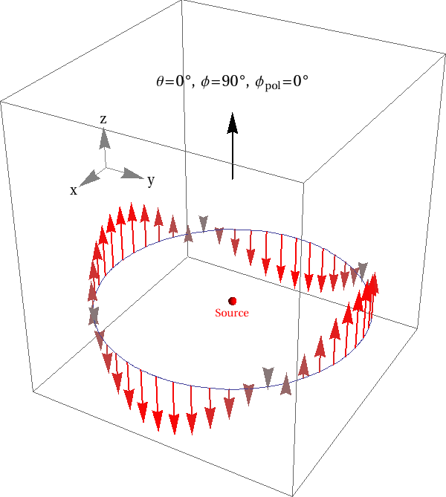
Hypothetical GW signal “seen” by our experiment
Modulation of resonance peak shifts in the ring
  Allow GW direction and polarization reconstruction

Slide 18
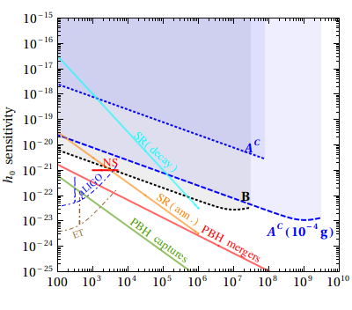
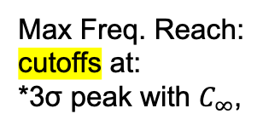
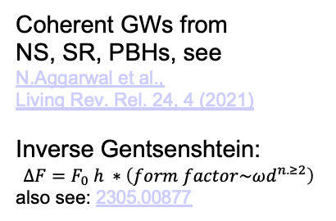
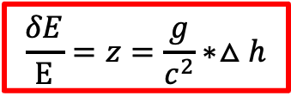

Expected sensitive on GWs
Science Bulletin 2024; 69(18): 2795-2798
A^{C}: 10⁶ periods: table top
B: single period
$$\frac{δE}{E}=z=\frac{g}{c^{2}}∗△h$$
Max Freq. Reach:
cutoffs at:
*3σ peak with $C_{∞}$,
10¹¹ Bq. 1m, ground
* $2πfd<O(10)$
10¹⁴ Bq., 100m, 10⁻⁴g
Coherent GWs from
NS, SR, PBHs, see
N.Aggarwal et al.,
Living Rev. Rel. 24, 4 (2021)
Inverse Gentsenshtein:
$$∆F=F_{0} h ∗\left(form factor\sim {ωd}^{n.≥2}\right)$$
also see: 2305.00877
Region of interests
Limited by photon counter and readout

Slide 19
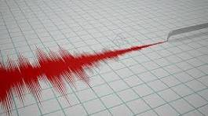
Summary
Conceptional design GW experiment use novel gravitational redshift Mössbauer spectrometer:
  Measure the spatial resonance absorption peak shift under GW.
  Allow direction and polarization reconstruction.
  Relatively small-scale setup (meter – 100 meter for your preference)
  ¹⁰⁹Ag source gives 10⁻²² strain sensitivity, long lived mother particle.
  Multiband sensitivity（Sensitive to f_{GW} > kHz）
Possible extension on sensitivity
  low-g, focusing of photons…
Larger source-absorber distance:
  Aiming for lower frequency GWs

Slide 20
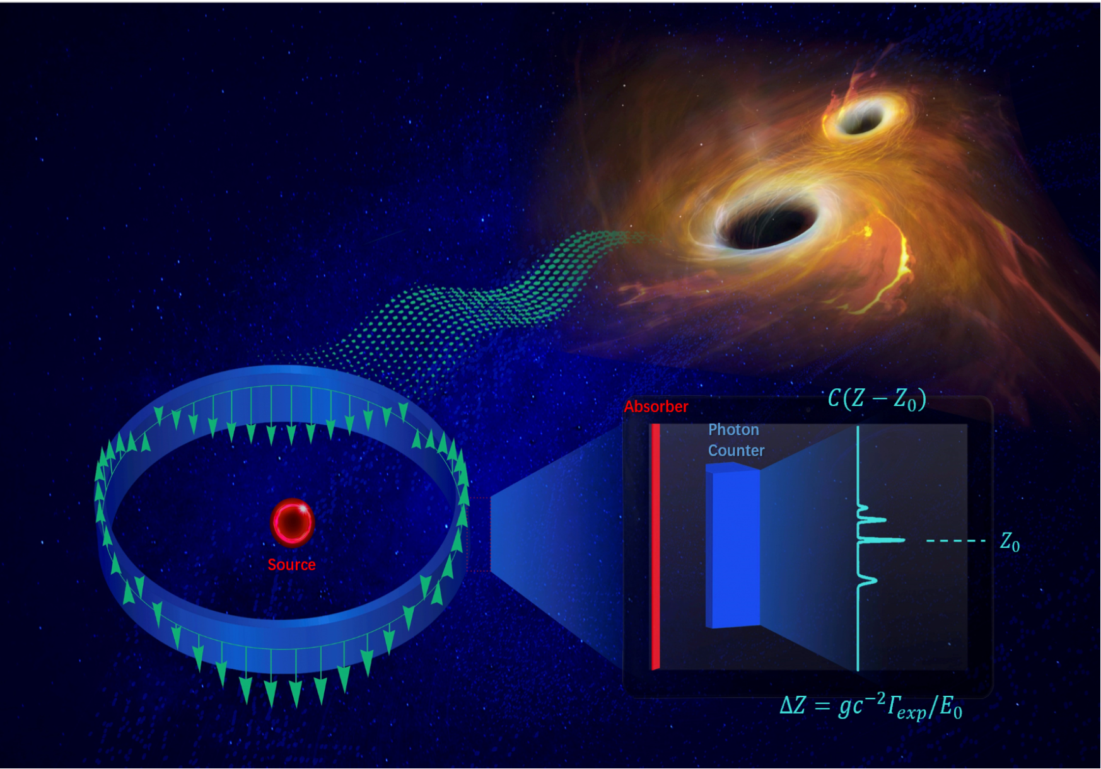
Phase 0: Tabletop exotic/Axion(arXiv:2511.14851，arXiv:2512.18960） physics searches
Phase 1: Tabletop Ground based GW experiment
Phase 2: low-g GW experiment (higher sensitivity)
Space based experiment
Moon/Asteroid based experiment
saddle/Lagrangian point based experiment？

