Slide 1

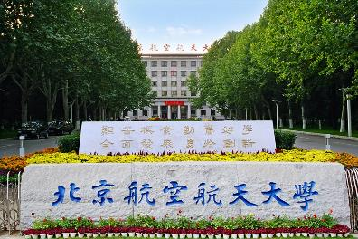

2026 年轻强子专题研讨会，河南商丘， 2025 年 5 月 14日-18 日
Two $Σ^{∗} (1/2^{−})$states in unitary chiral effective theory
Li-Sheng Geng（耿立升）@ Beihang U.
Jia-Ming Xie, Jun-Xu Lu， LSG, Bing-Song Zou, PRD108(2023)L111502
Jia-Ming Xie, Zhi-Wei Liu, Jun-Xu Lu, Haozhao Liang, Raquel Molina, and LSG, PRD113(2026)074002
Jia-Ming Xie, Zhi-Wei Liu, Jun-Xu Lu, Haozhao Liang, and LSG, 2604.00791

Slide 2
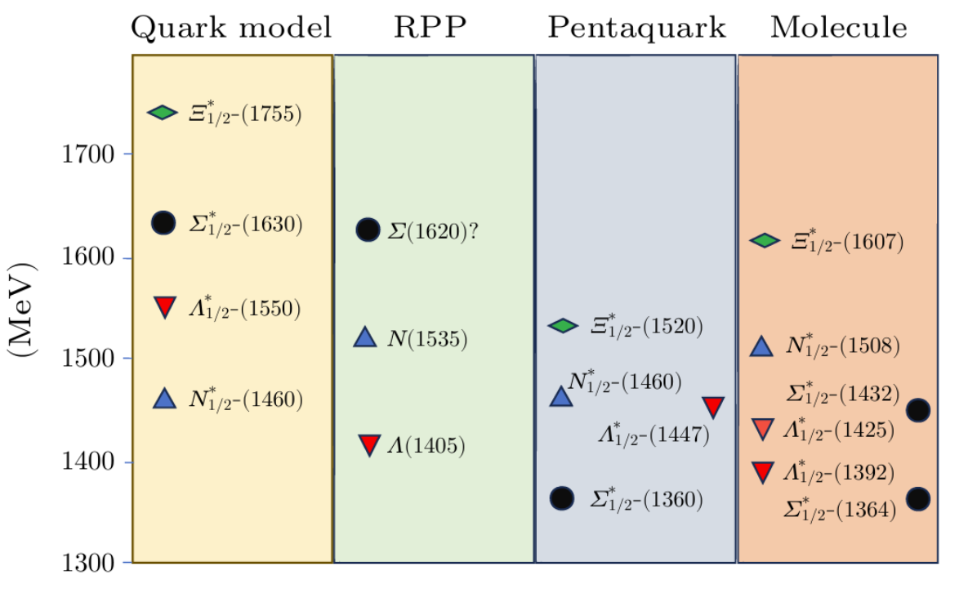
Review of the Low-Lying Excited Baryons Σ*(1/2−)
En Wang, LSG, Jia-Jun Wu, Ju-Jun Xie, and Bing-Song Zou, CPL41(2024)101401
Mol:
Garzon E J and Oset E 2015 PRC 91 025201
Lu J X, Geng L S, Doering M, and Mai M 2023 PRL130 071902
Ramos A, Oset E, and Bennhold C 2002 PRL 89 252001
QM: Capstick S and Isgur N 1986 PRD 34 2809
PQ: Zhang A, Liu Y R, Huang P Z, Deng W Z, Chen X L, and Zhu S L 2005 arXiv:hep-ph/0403210

Slide 3
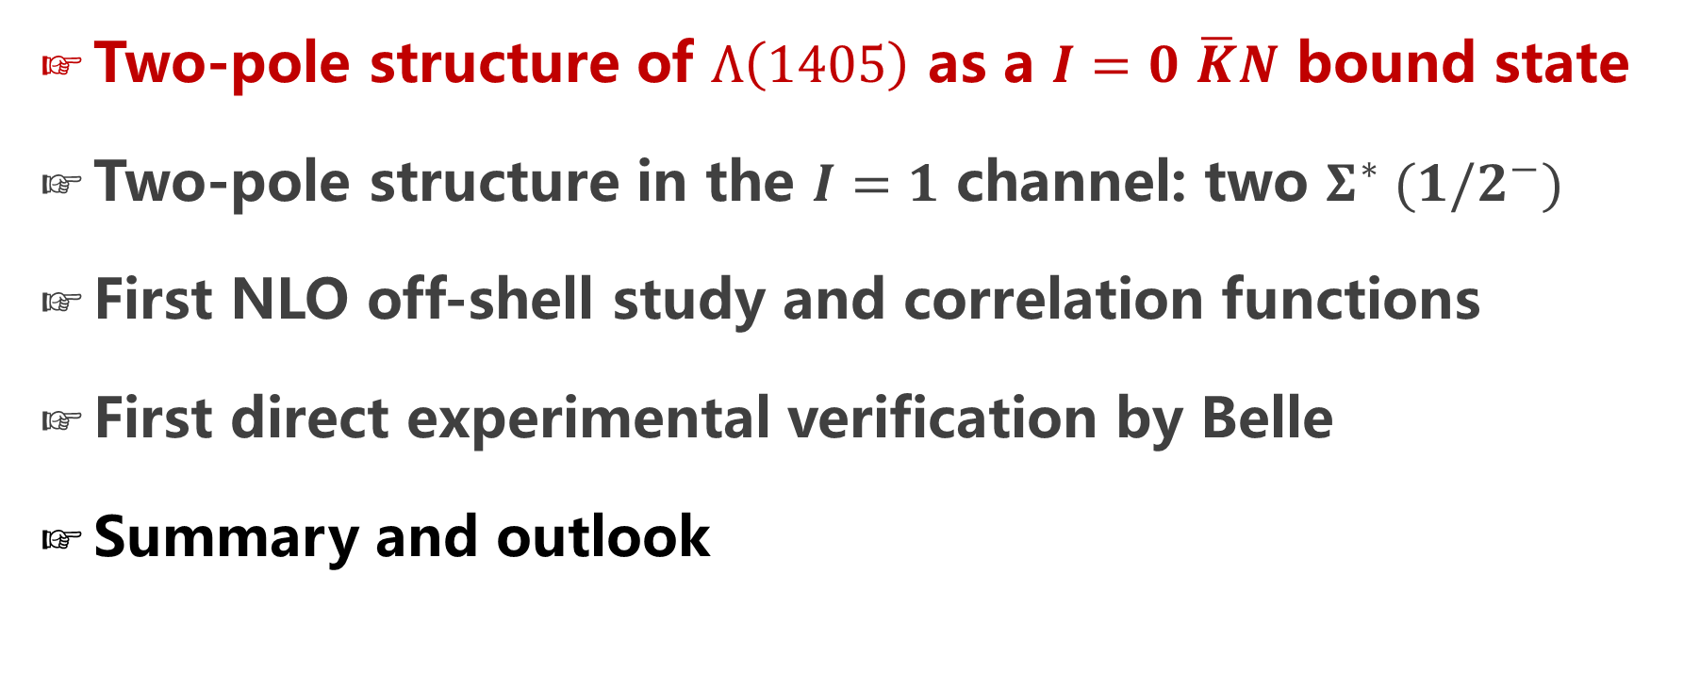
Contents
Two-pole structure of $Λ\left(1405\right)$ as a $I=0$ $\overline{K}N$ bound state
Two-pole structure in the $I=1$ channel: two $Σ^{∗} (1/2^{−})$
First NLO off-shell study and correlation functions
First direct experimental verification by Belle
Summary and outlook

Slide 4
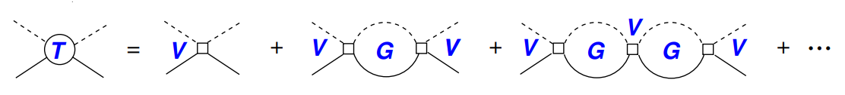
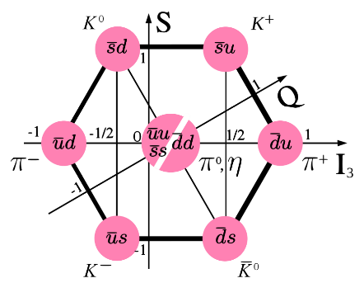
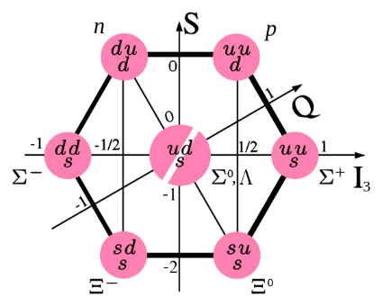
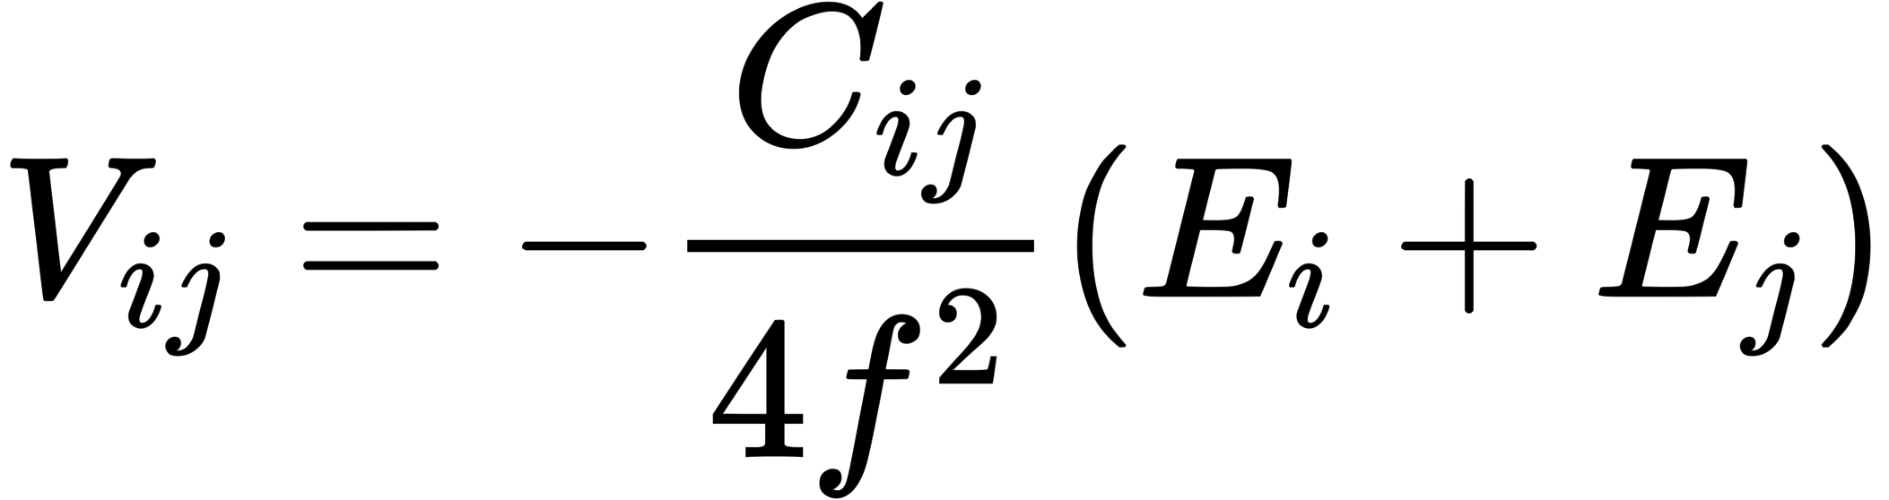
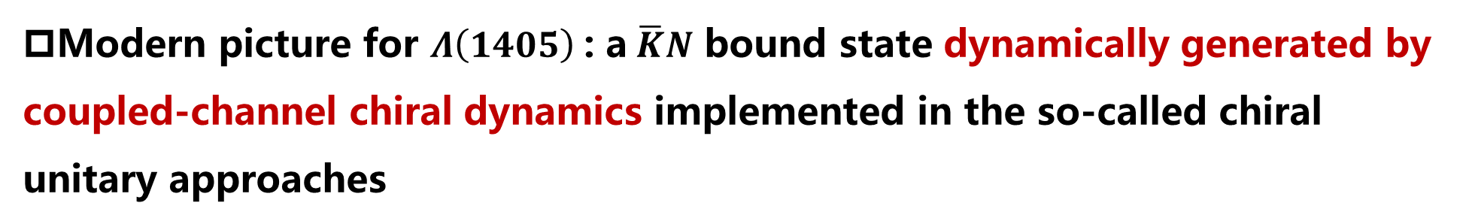
$Λ\left(1405\right)$ as a dynamically generated state
Modern picture for $Λ\left(1405\right)$: a$\overline{K}N$ bound state dynamically generated by coupled-channel chiral dynamics implemented in the so-called chiral unitary approaches
Bethe-Salpeter Equation
Weinberg-Tomozawa potential
LO&NLO, Kaiser, Siegel, Weise, NPA594, 325(1995), 795 citations
LO, Oset and Ramos, NPA635, 99(1998), 947 citations
NLO, Oller and Meissner, PLB500, 263(2001), 1032 citations
as of 2026.05.15

Slide 5
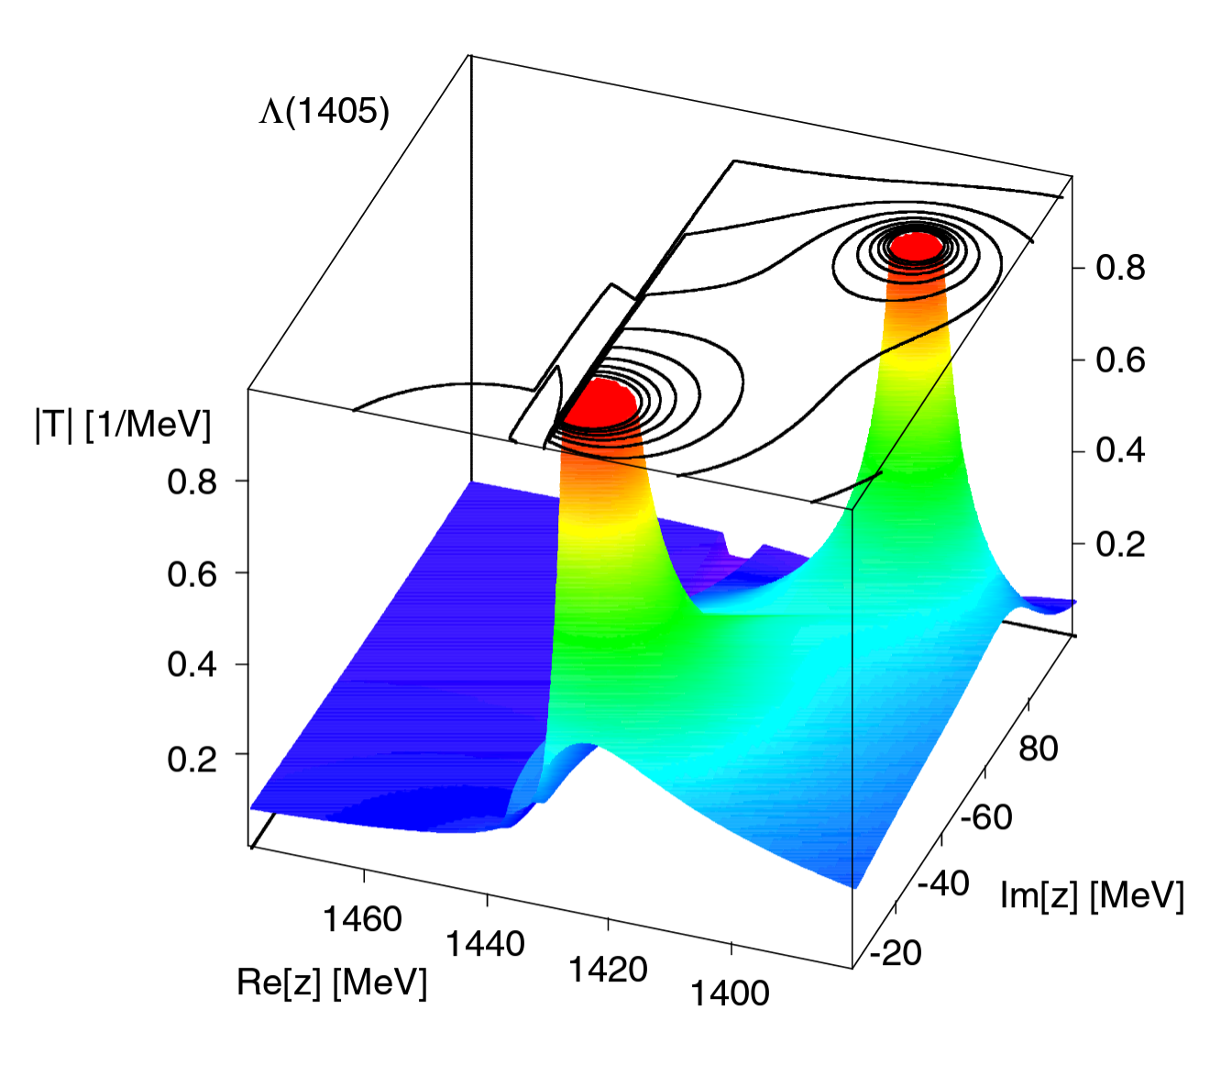
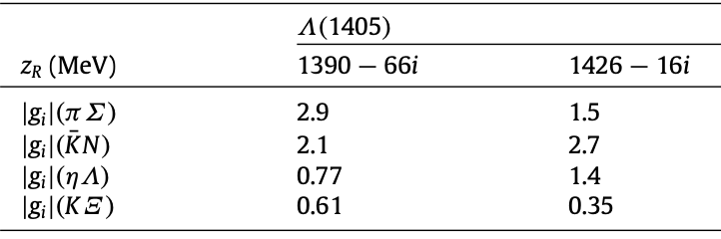
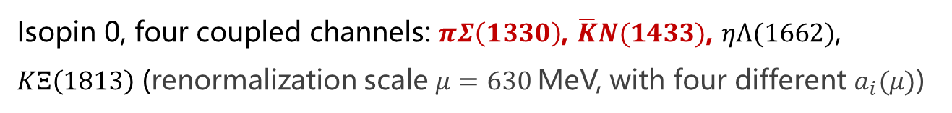
Unexpected two-pole structure!
Two poles: $W_{H}=1424.3−17.1i$, $W_{L}=1389.1−64.1$
Isopin 0, four coupled channels: $πΣ\left(1330\right)$, $\overline{K}N(1433)$, $ηΛ(1662)$, $KΞ\left(1813\right)$ (renormalization scale $μ=630$MeV, with four different $a_{i}(μ)$)
Oller and Meissner, PLB500, 263(2001)
Jido, Oller, Oset, Ramos, and Meissner, NPA725, 181 (2003)
Hyodo and Jido, PPNP67, 55 (2012)

Slide 6
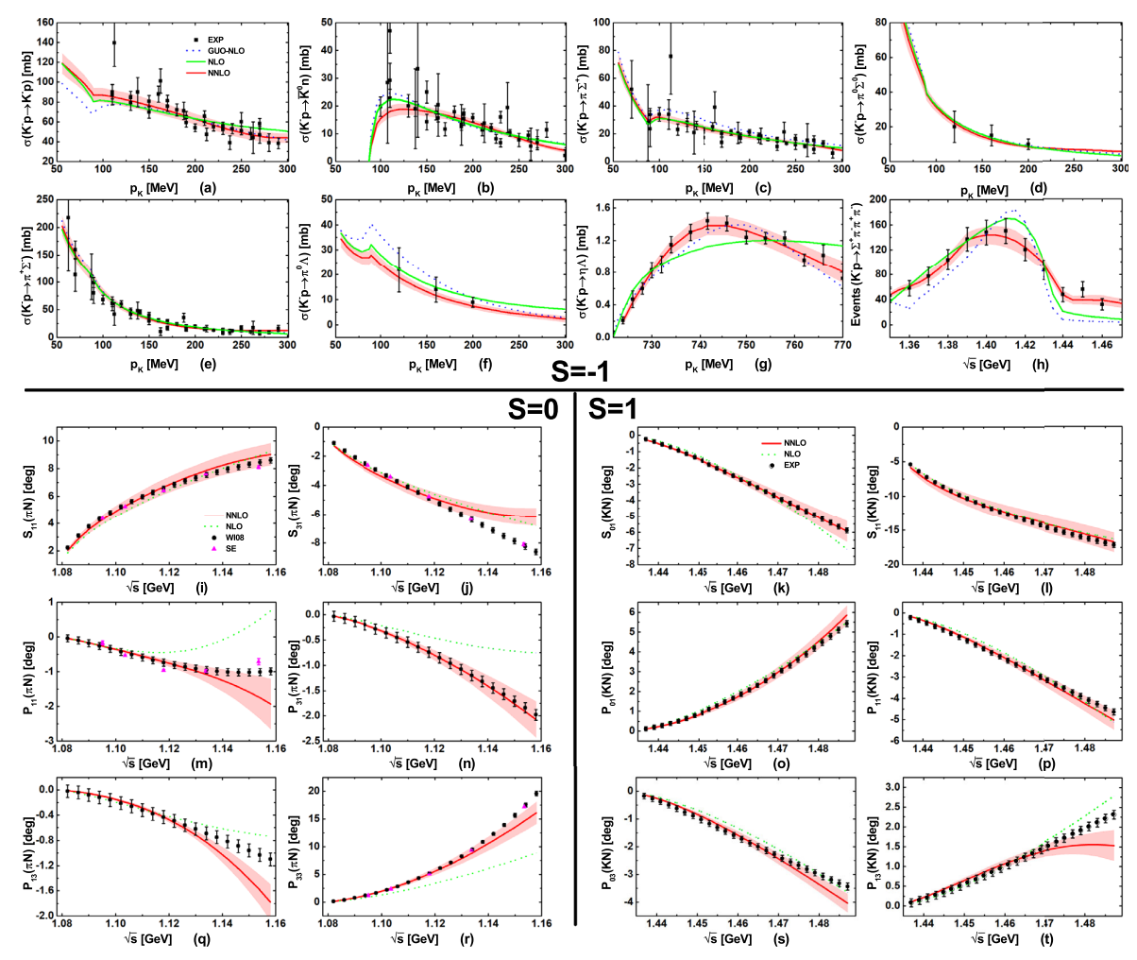
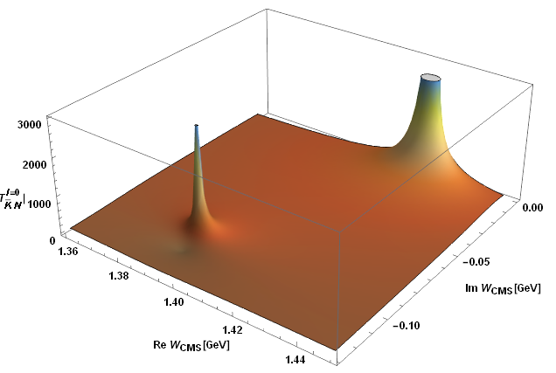





The two-pole structure persists at N2LO
Meson-baryon scattering up to N2LO, Jun-Xu Lu, LSG*, M. Doering and M. Mai, PRL130, 071902(2023)
$$S=−1$$
$Λ$(1405)
$Λ$(1380)
$$S=0$$
$$S=1$$

Slide 7
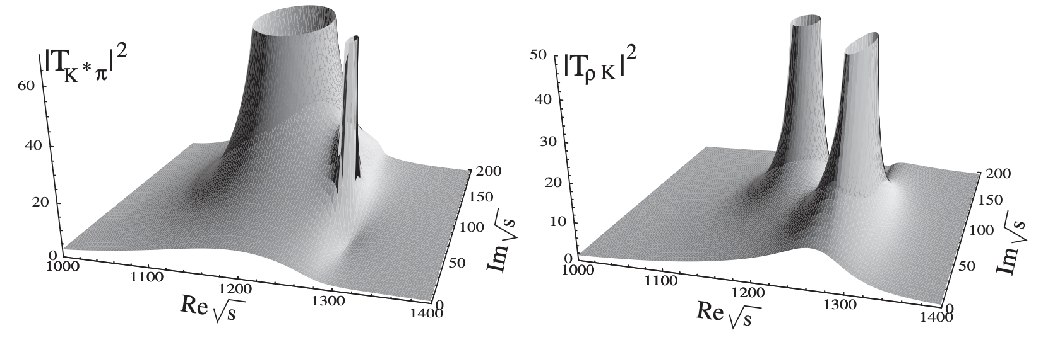


Two-pole structures are not simply two states!
Two-pole structures refer to the fact that two dynamically generated states, one resonant and one bound, are located close to each other between two coupled channels and with a mass difference smaller than the sum of their widths.
Two poles overlap, which creates the impression that there is only one state in the invariant mass distribution of their decay products.
$Λ(1405)$
$$K_{1}(1270)$$
Hyodo and Jido, PPNP67, 55 (2012)
LSG, Oset, Roca, and Oller, PRD75, 014017 (2007)

Slide 8
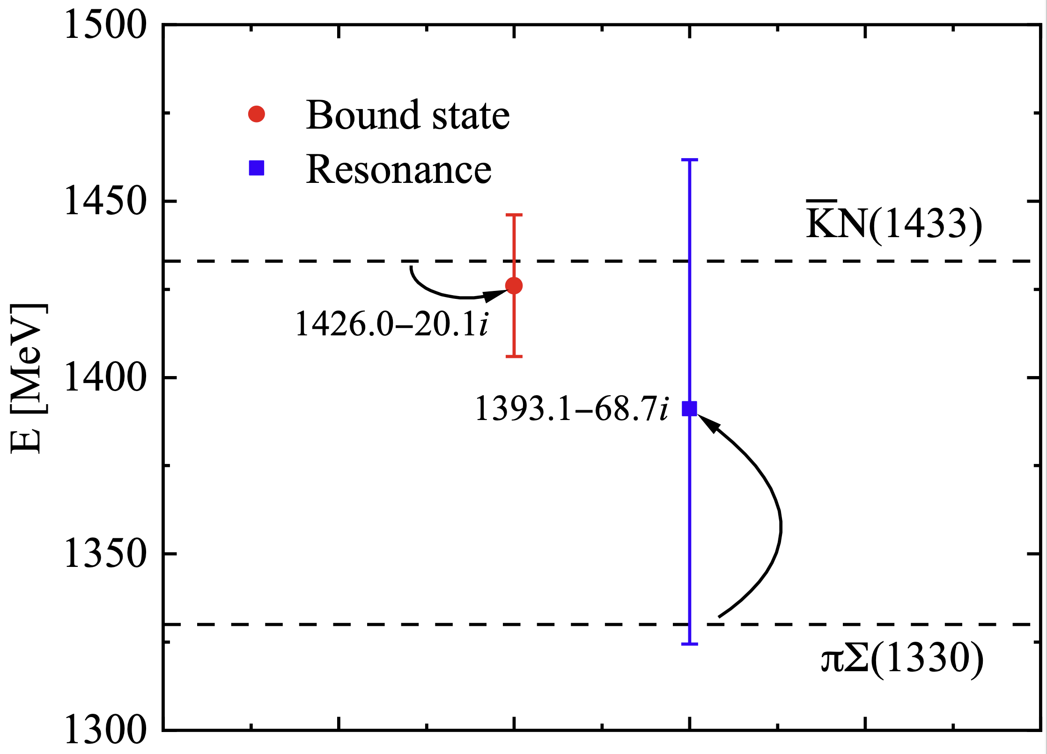
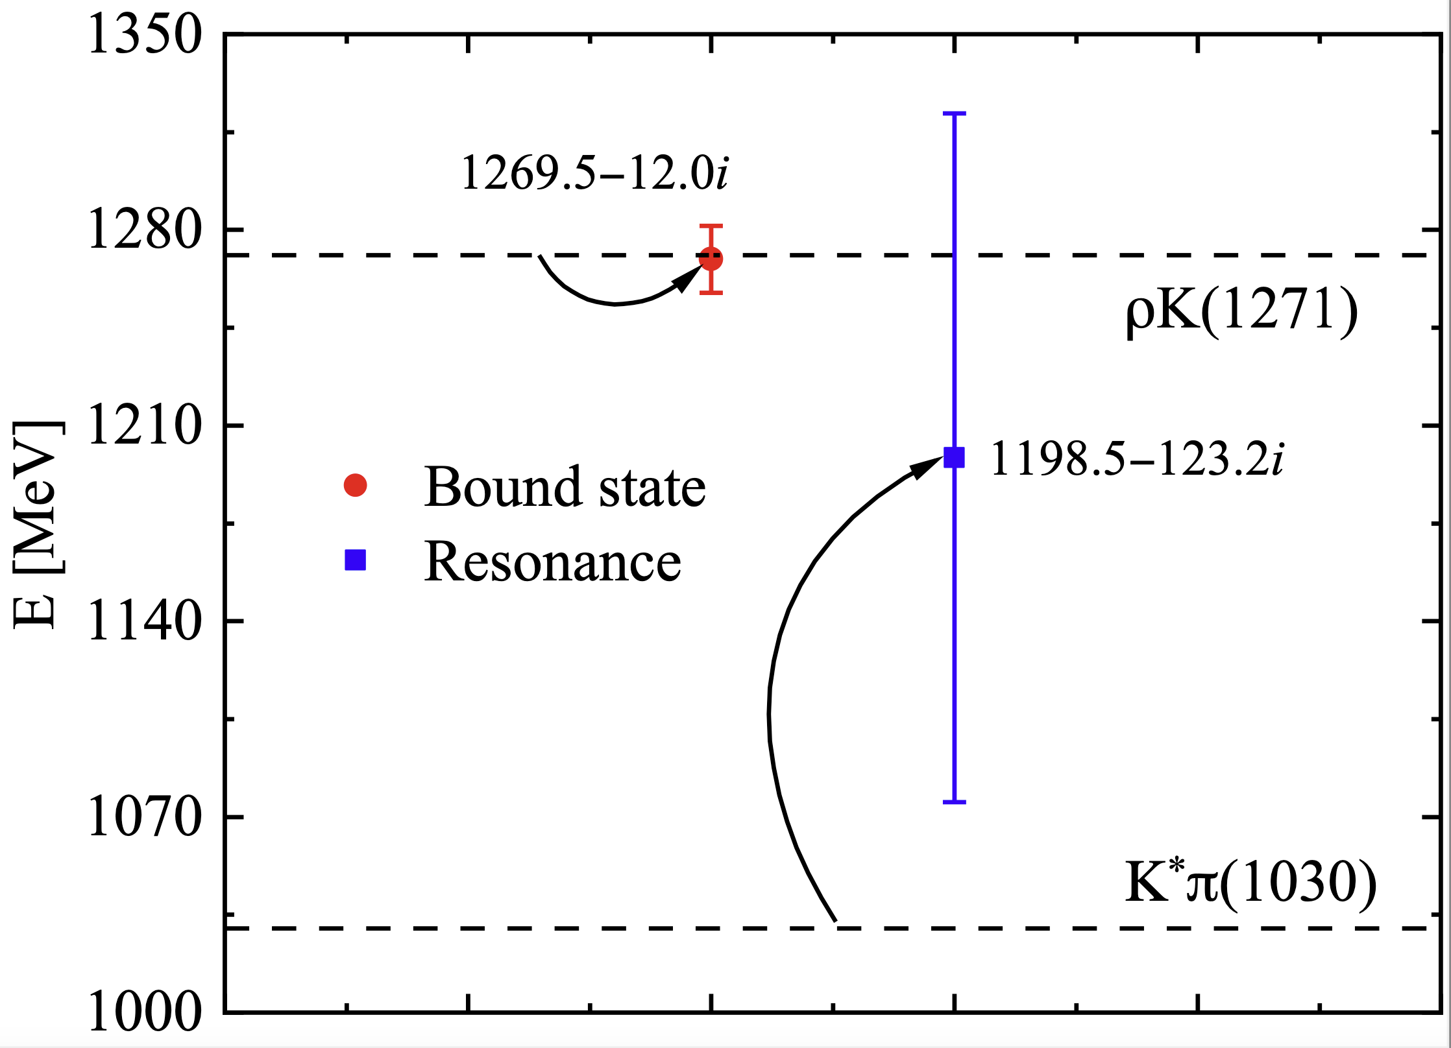
Two prominent examples: $Λ(1405)$ and $K_{1}(1270)$

Slide 9
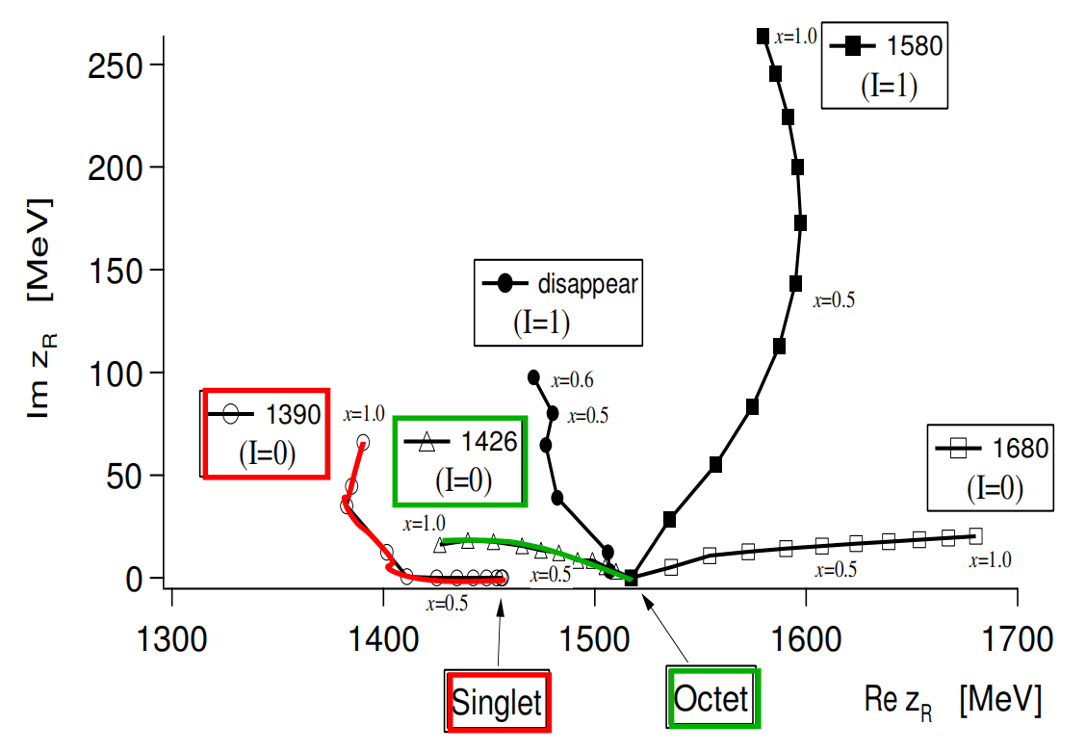

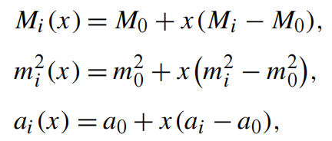
SU(3) group-theoretical explanation
SU(3) symmetry decomposition
Baryon octet-NGB octet
Potential in this basis
attractive
SU(3) symmetry breaking
Jido, Oller, Oset, Ramos, and Meissner, NPA725, 181(2003)
Notes:
The direct product of two octet states are decomposed into the direct sum of the irreducible representations of SU(3).
It is similarity transformations from particle basis to SU(3) symmetric basis, under which this SU(3)-symmetric potential is diagonal.
In our convention, the plus sign represents attractive potential, while the minus sign the repulsive.
Three SU(3) channels are possible to generate bound states, i.e. belonging to one singlet and two degenerate octets respectively.
In SU(3) symmetry limit, different channels share the same values of meson mass m_0, baryon mass M_0, and subtraction constant a_0.
SU(3) breaking still preserves the SU(2) isospin and U(1) hypercharge conservation.

Slide 10

More can be asked
Two-pole structures are not just two states
Many questions can be asked
Why are there two?
Why can they be mistaken for one state?
Why are they located between the two channels?
What kind of interactions can generate such two poles?
……

Slide 11
Three questions to ask/answer (not by flavor sym.)
How does the nature of the Nambu-Goldstone bosons play a role?
Whether is the energy dependence of the WT potential relevant?
Is the coupling between $\overline{K}N$ and $πΣ$ important?
Is the coupling between 𝐾 ̅𝑁 and 𝜋Σ important?
Q1
Q2
Q3
Jia-Ming Xie, Jun-Xu Lu，LSG*, Bing-Song Zou, PRD108(2023)L111502

Slide 12
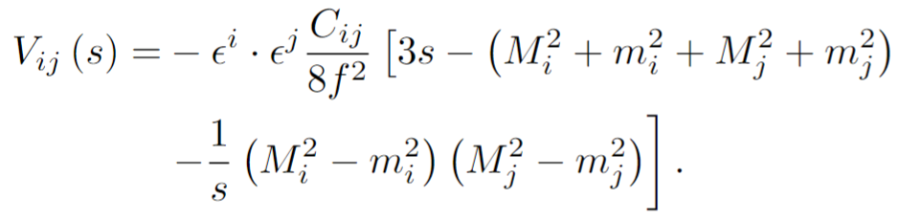
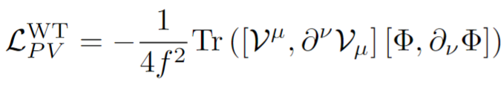
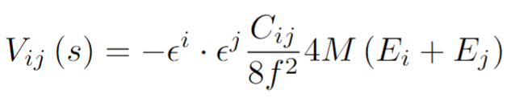
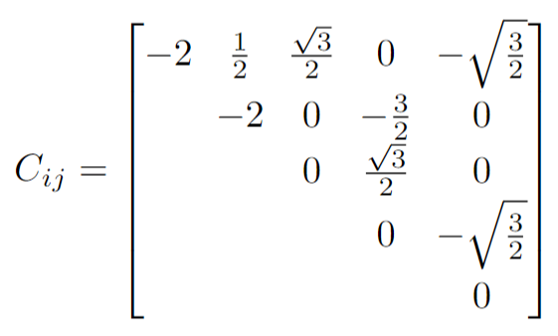
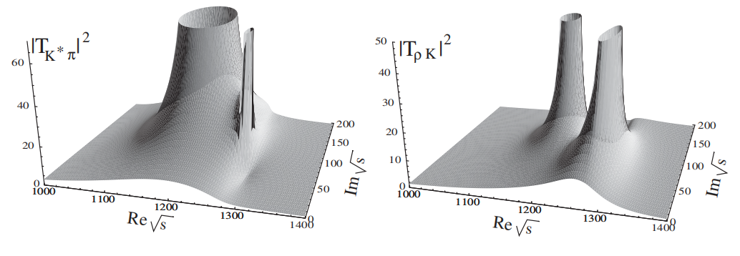
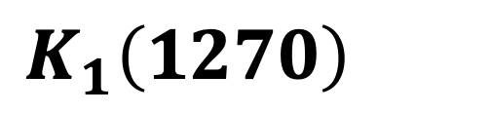
$$K_{1}\left(1270\right)$$
$$I\left(J^{P}\right)=1/2\left(1^{+}\right)\text{,} S=1; M=1253±7 \text{MeV}\text{, }Γ=90±20 \text{MeV}$$
Replace the baryon octet with the vector nonet
Simplified as the light mass of NGB and in the chiral limit of $M_{i}=M_{j}≡M$
Coupled channels: $K^{∗}π(1030)$, $ρK\left(1271\right),$ $ωK(1278)$, $K^{∗}η(1440)$, $φK(1515)$
Roca, Oset, and Singh, PRD72, 014002 (2005)
LSG, Oset, Roca, and Oller, PRD75, 014017 (2007)
Notes:
Left panel:
different convention: minus sign represents attractive potential.

Slide 13
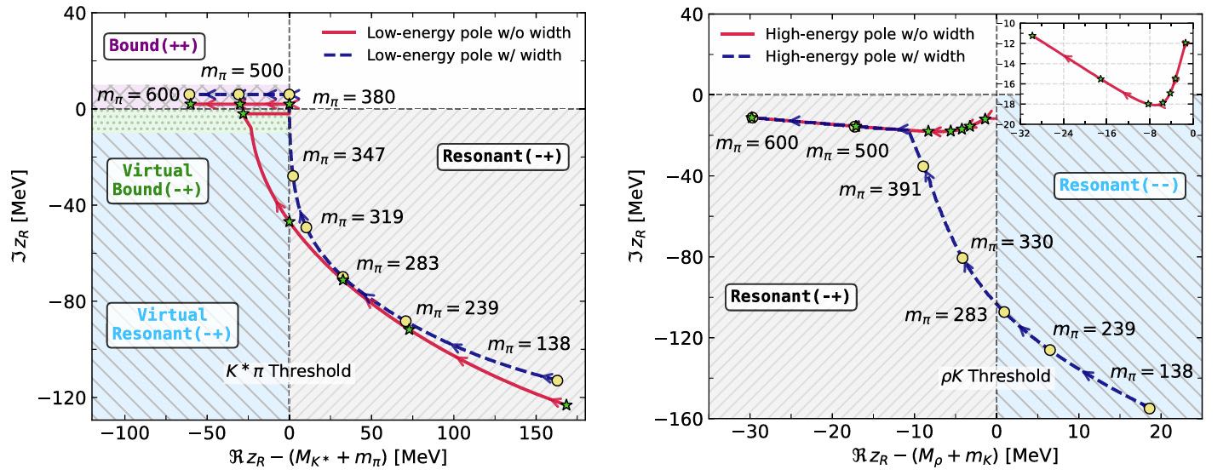
Light quark mass evolution of two poles $K_{1}\left(1270\right)$
J.M. Xie, Z.W. Liu, J.X. Lu, H. Liang, R. Molina, and LSG*, PRD113(2026)074002

Slide 14
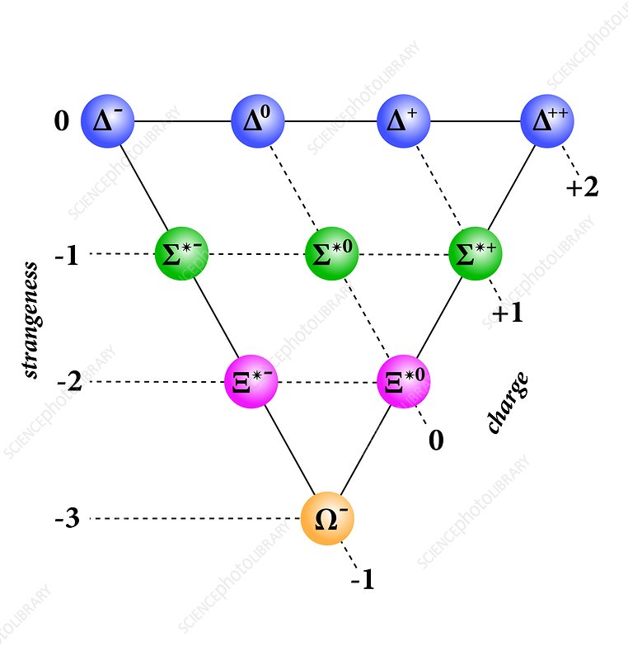

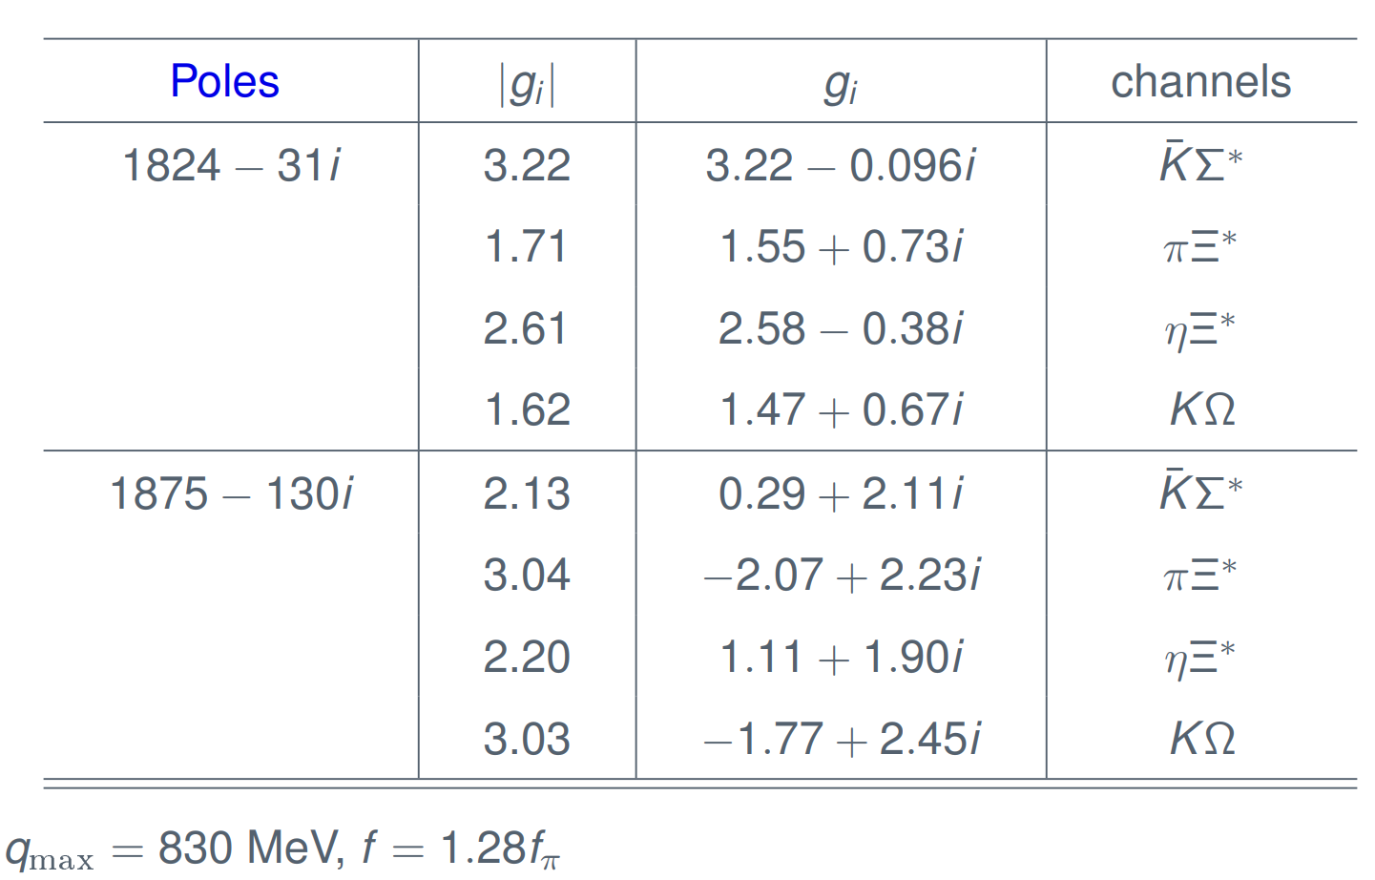
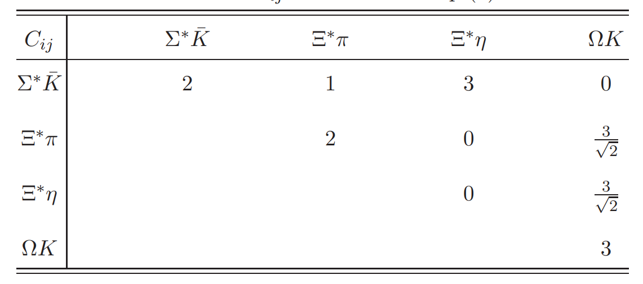
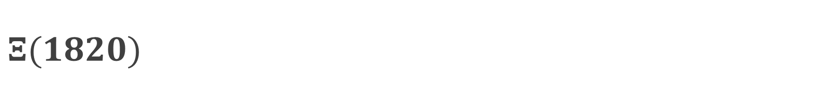
$$Ξ(1820)$$
$$I\left(J^{P}\right)=1/2\left(3/2^{−}\right)\text{,} S=2; M=1823±5 \text{MeV}\text{, }Γ={24}_{−10}^{+15} \text{MeV}$$
S. Sarkar, E. Oset, M.J. Vicente Vacas, NPA750 (2005) 294-323
Notes:
Sourav Sarkar, E. Oset, M.J. Vicente Vacas

Slide 15
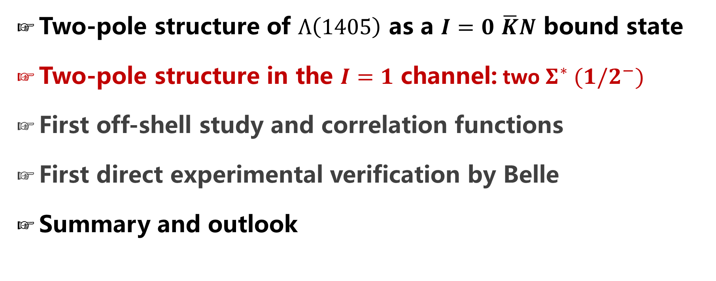
Contents
Two-pole structure of $Λ\left(1405\right)$ as a $I=0$ $\overline{K}N$ bound state
Two-pole structure in the $I=1$ channel: two $Σ^{∗} (1/2^{−})$
First off-shell study and correlation functions
First direct experimental verification by Belle
Summary and outlook

Slide 16
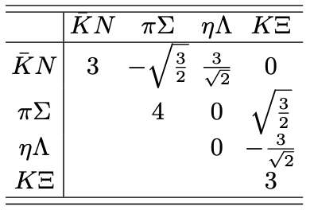
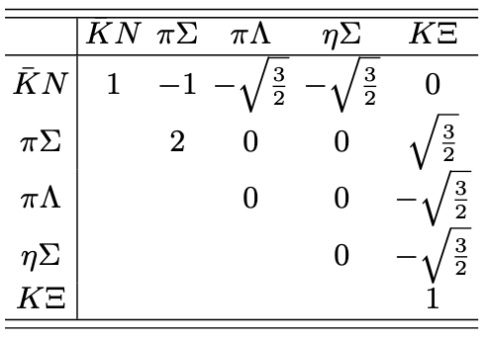
Weaker interactions in the isospin 1 channel
Isospin 0
Isospin 1
Notes:
Sourav Sarkar, E. Oset, M.J. Vicente Vacas

Slide 17
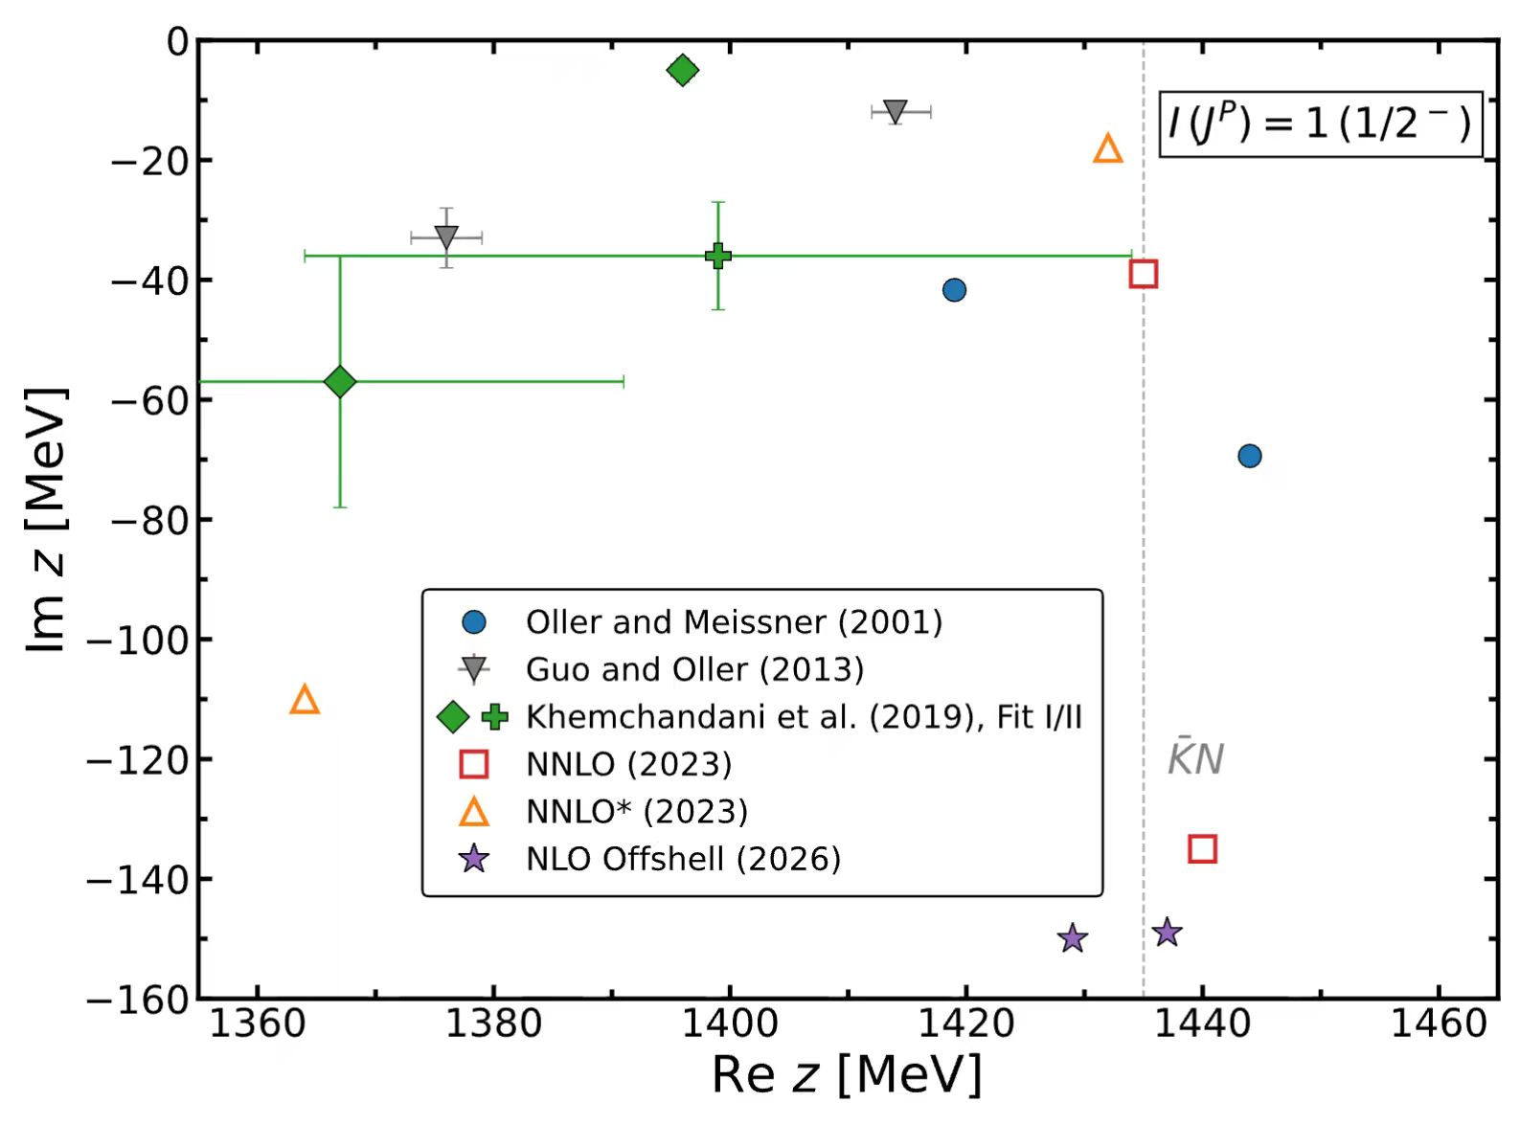
Poles in the I=1 channel

Slide 18
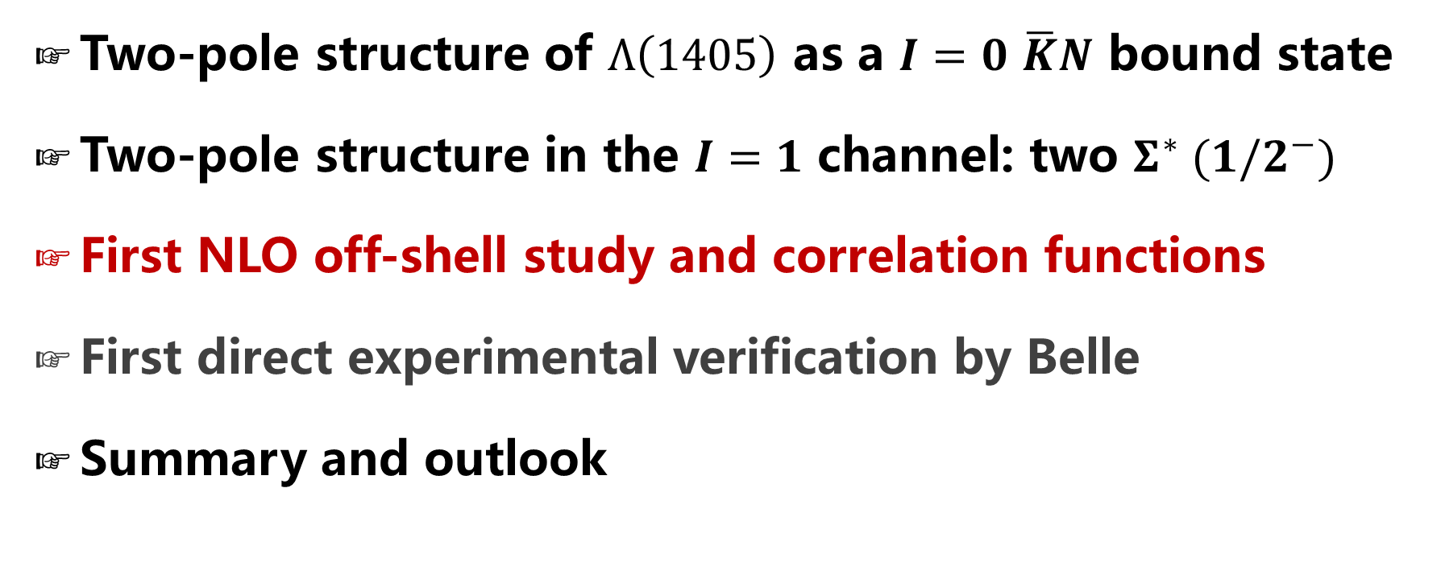
Contents
Two-pole structure of $Λ\left(1405\right)$ as a $I=0$ $\overline{K}N$ bound state
Two-pole structure in the $I=1$ channel: two $Σ^{∗} (1/2^{−})$
First NLO off-shell study and correlation functions
First direct experimental verification by Belle
Summary and outlook

Slide 19
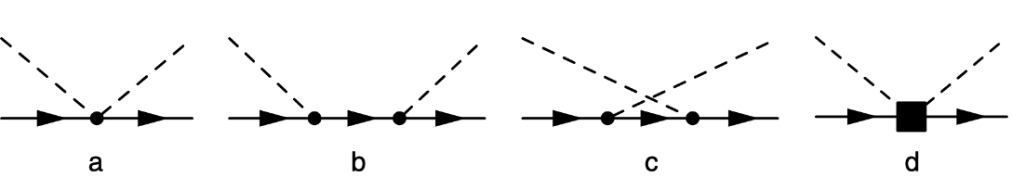
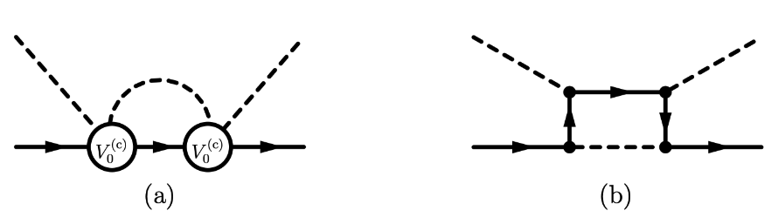
First off-Shell study up to NLO
Potential: V_{ij} = V^{WT}_{ij} + V^{Born}_{ij} + V^{NLO}_{ij}
Born terms (s- and u-channel): non-trivial off-shell structure
NLO contact: 7 LECs {b₀,b_{D},b_{F} ,b_{1,2,3,4}}
Integral BSE T = V + VGT with finite cutoff regulator f_{Λ}(p_{j},p_{i})
Key advantage: smooth subthreshold amplitude, free from on-shell artifact

Slide 20
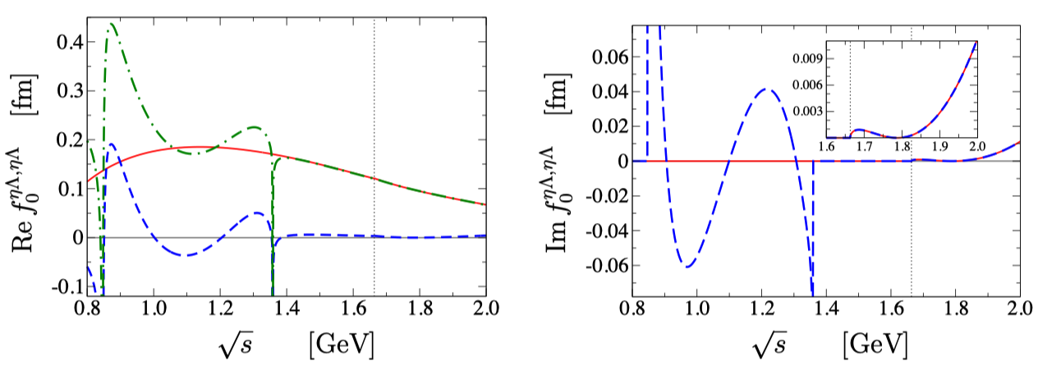

Left-Hand Cuts in Couple-Channel Calc.
For u-channel Born:
Analytic structure of BSE amplitude ≠ full field-theory amplitude
Unphysical subthreshold cut between $s_{1}$ and $s_{2}$
B. Borasoy, R. Nissler, W. Weise, EPJA 25 (2005) 79.
Puzzle：
Singularity of heavy channel (e.g. $s_{2}\left(ηΛ\right)≈1.36$ GeV) lies above lighter thresholds (πΣ)
Im V(s) ≠ 0 for $s_{1}<s<$ $s_{2}$ ⇒ unitarity of S-matrix violated

Slide 21
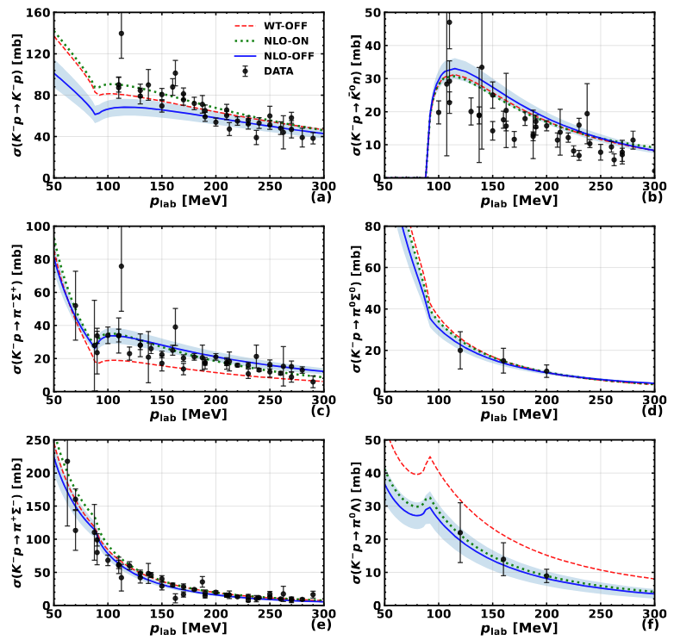
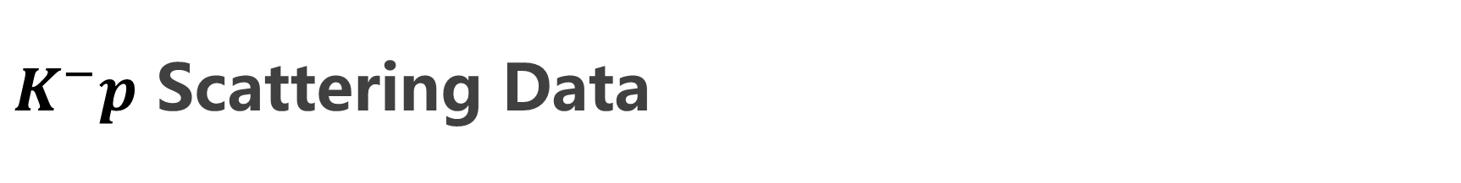
$K^{−}p$ Scattering Data
LO (WT): common cutoff Λ
⇒ preserve SU(3) symmetry
NLO: 6 channel-dependent cutoffs + 7 LECs {b₀,b_{D},b_{F},b_{1–4}}
Fitting: conventional χ²_{d.o.f.} at WT
E. Oset, A. Ramos, NPA 635 (1998) 99
At NLO: refined error，larger weights on threshold obsevables.
Z.-H. Guo, J.A. Oller, PRC 87 (2013) 035202

Slide 22
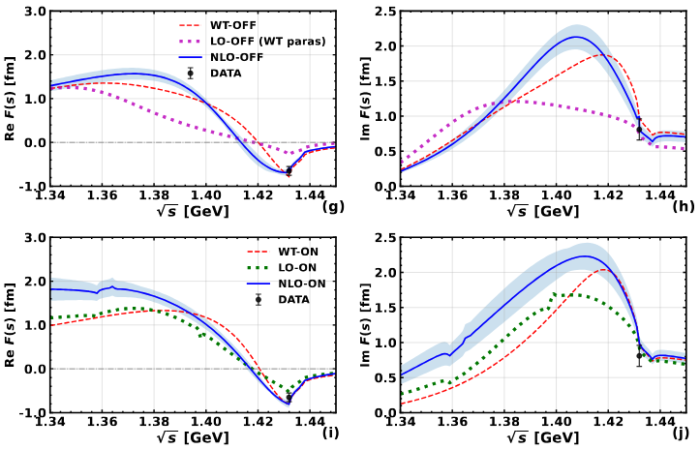
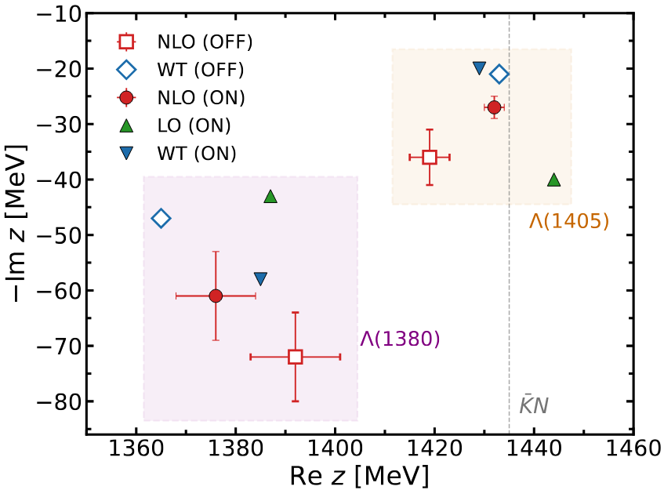
Subthreshold Amplitudes and Two-Pole Structures
Off-shell scheme: free from left-hand cut artifacts
Born terms play a qualitatively different role than in the on-shell case
Pole positions relatively stable against changes in chiral order

Slide 23
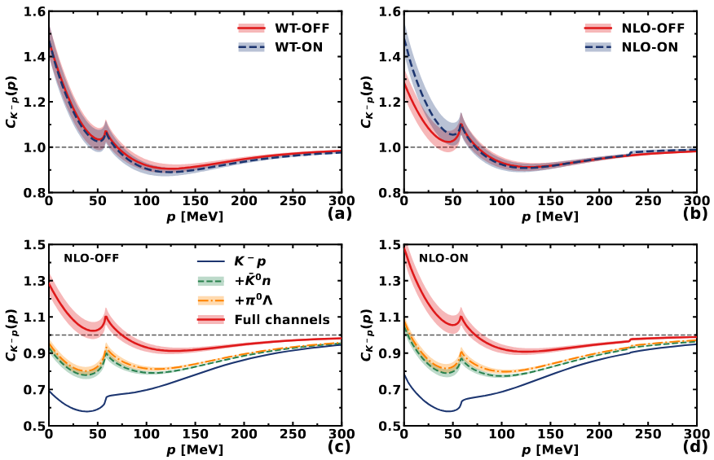
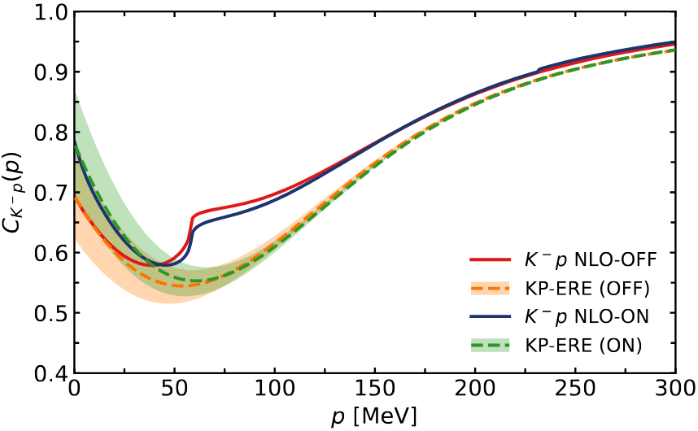
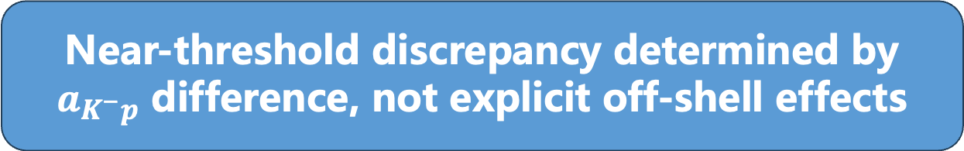
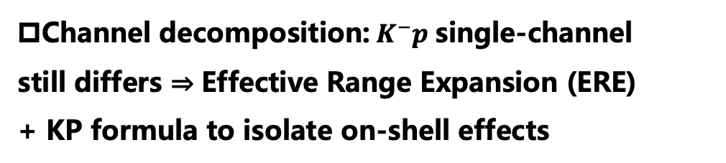
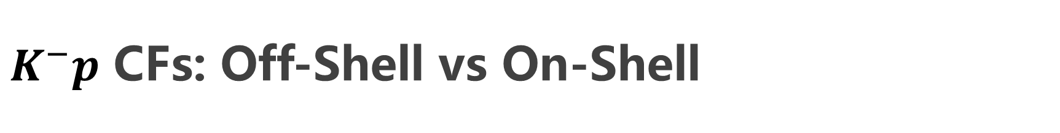
$K^{−}p$ CFs: Off-Shell vs On-Shell
Near-threshold discrepancy determined by $a_{K^{−}p}$ difference, not explicit off-shell effects
WT level: off-shell ≈on-shell; off-shell effects reabsorbed into {Λ,f_{decay}}
NLO level: visible variations from Born & NLO
Channel decomposition: $K^{−}p$ single-channel still differs ⇒ Effective Range Expansion (ERE) + KP formula to isolate on-shell effects

Slide 24
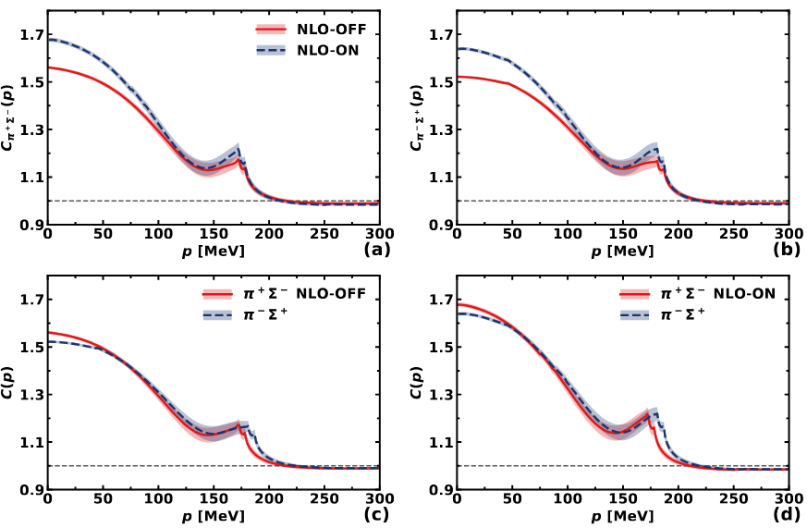
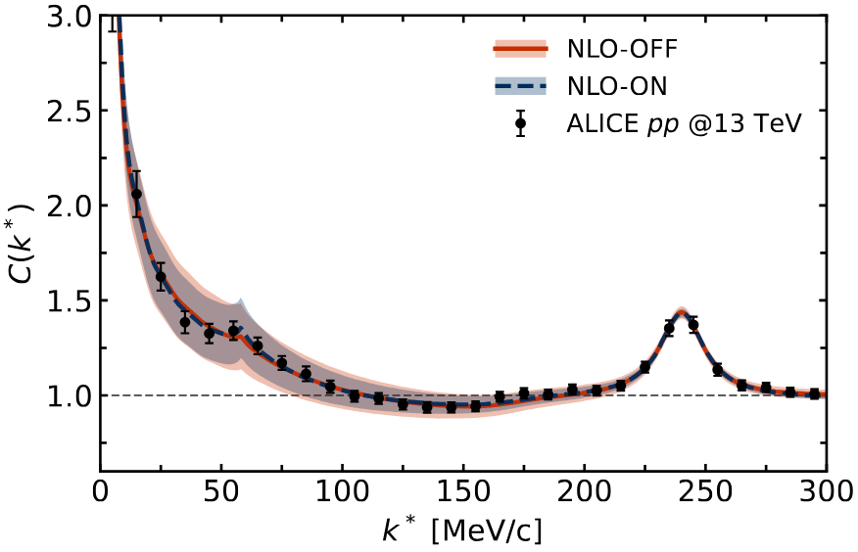
π±Σ∓ CFs: Off-Shell vs On-Shell
Off-shell effects are indistinguishable from on- shell in the current ALICE data; source sizes from both approaches are mutually consistent.
First prediction: π±Σ∓CFs
On-shell: discontinuity at p≈75/90 MeV from u-channel left-hand cut
Both describe data; degeneracy due to interplay of R and channel weights

Slide 25
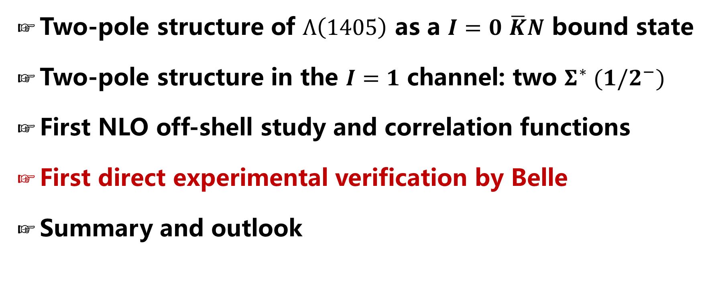
Contents
Two-pole structure of $Λ\left(1405\right)$ as a $I=0$ $\overline{K}N$ bound state
Two-pole structure in the $I=1$ channel: two $Σ^{∗} (1/2^{−})$
First NLO off-shell study and correlation functions
First direct experimental verification by Belle
Summary and outlook

Slide 26

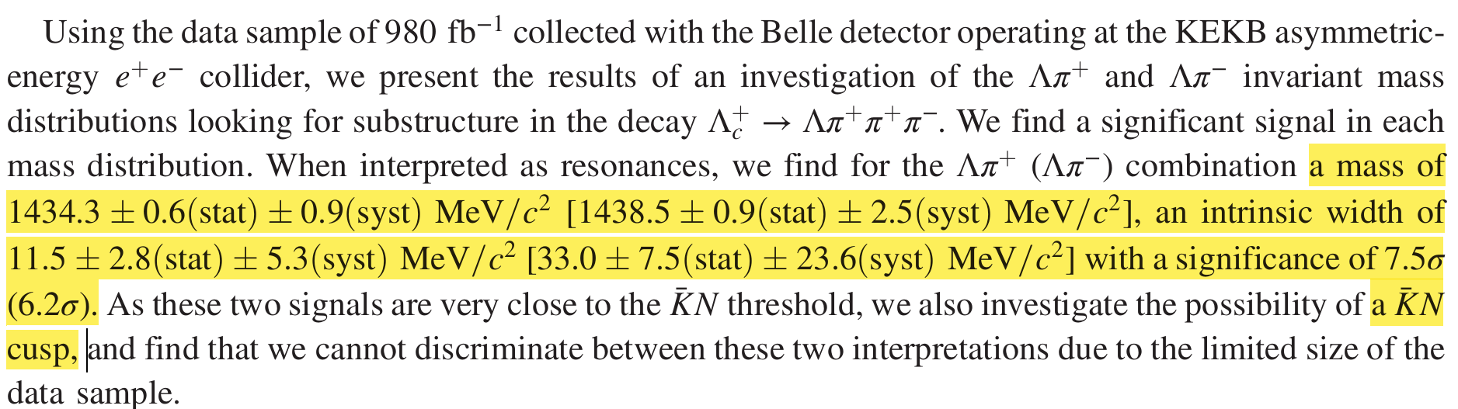
First observation of a $Σ(1/2^{−})$ state or cusp near the $\overline{K}N$ threshold
Phys.Rev.Lett. 130 (2023) 151903

Slide 27

Two scenarios studied: resonance vs. cusp
Resonance
Cusp

Slide 28






Two scenarios studied: res. vs. cusp--indistinguishable

Slide 29


Two $Σ^{∗} (1/2^{−})$ are needed to explain the data
Jun He, PRC 112, 015205 (2025)
These results underscore the essential roles of the two $Σ^{∗}$(1/2−) states in accurately describing the invariant mass distributions in the decay $Λ_{c}→Λπ^{+}$ $π^{+}$ $π^{−}$.

Slide 30






Two $Σ^{∗} (1/2^{−})$ are needed to explain the data
W/O $Σ^{∗} (1380)$
W/ $Σ^{∗} (1380)$

Slide 31

Summary and outlook
The two poles of the Lambda(1405) can be naturally explained. The explicit chiral and SU(3) flavor symmetry breaking dictates that the two relevant coupled channels are close to each other, such that the lineshapes of the two states overlap and create the impression that there is only one state.
The same chiral dynamics predict two $Σ^{∗} (1/2^{−})$ states, which seem to be supported by the Belle data and the following analysis
More studies are needed to establish the existence of the two Sigma states.

Slide 32
Thanks a lot for your attention!

