Slide 1



Searching for long-lived axion-like particles via displaced vertices at the high-energy colliders
Xin-Yang Li（李欣洋）
Liaoning Normal University
2026.5.16
Eur.Phys.J.C 85 (2025) 12, 1442; Phys.Rev.D 113 (2026) 3, 035020; arXiv: 2603.13746
with Chong-Xing Yue, Shuo Yang, Mei-Shu-Yu Wang, Yang-Yang Bu

Slide 2
1
Introduction
2
The theory framework
Outline
3
Searching for long-lived axion-like particles via displaced vertices at the HL-LHC
CONTEXT
4
Searching for long-lived axion-like particles via displaced vertices at the CEPC
5
Summary
1

Slide 3
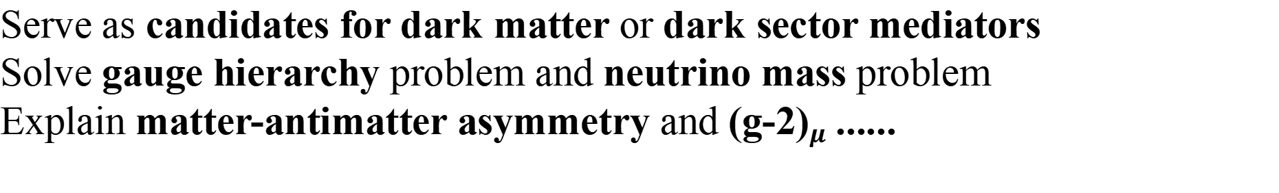
1. Introduction
the effective theory
The Standard Model （SM）
Dark matter (DM)
Strong CP problem
Gauge hierarchy problem
. . .
ultimate theory of nature
QCD axion: solution to the strong CP problem
Axion-like particles (ALPs): generalizations of QCD axions, pseudo-Nambu-Goldstone bosons that emerge from spontaneously broken approximate global symmetries
The masses and couplings to the SM particles of the ALPs are independent free parameters
Predicted in many BSM theories: string theories, supersymmetric theories, composite models as well as extra dimension models
Serve as candidates for dark matter or dark sector mediators
Solve gauge hierarchy problem and neutrino mass problem
Explain matter-antimatter asymmetry and (g-2)$μ$ ......
2

Slide 4
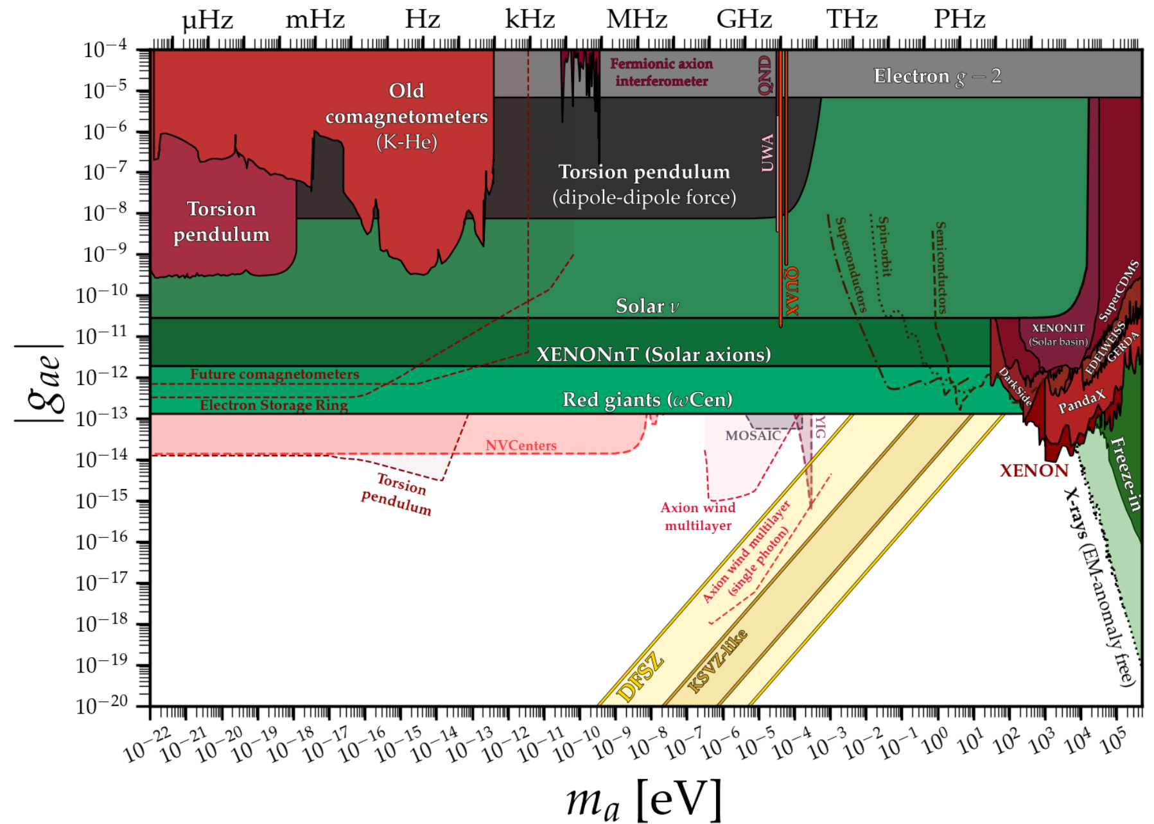
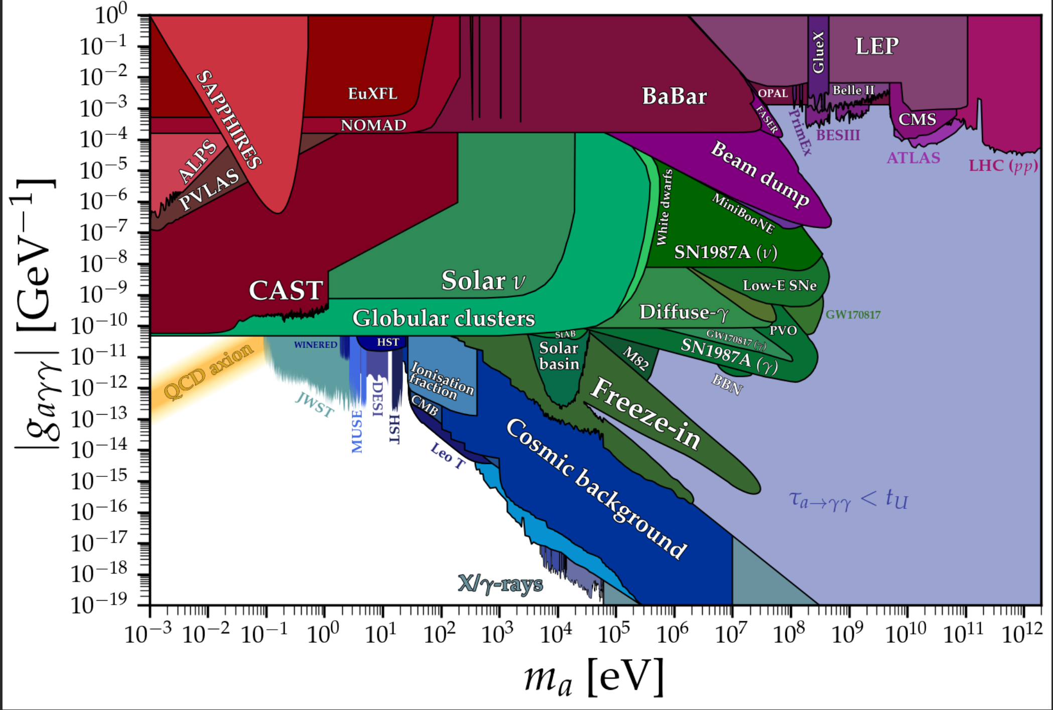
1. Introduction
Experimental constraints on the ALP parameter space
https://cajohare.github.io/AxionLimits/
3

Slide 5
1. Introduction
ALP Scenarios: Generic & Constrained
Most ALP searches are model-independent, based on generic EFT couplings
Nonetheless, special constrained ALP scenarios also exist, including:
Leptophilic ALPs:
......
Top-philic ALPs:
S. Blasi, F. Maltoni, A. Mariotti, K. Mimasu, D. Pagani, and S. Tentori, JHEP 06, 077 (2024), 2311.16048.
L. Rygaard, J. Niedziela, R. Schäfer, S. Bruggisser, J. Alimena, S. Westhoff, and F. Blekman, JHEP 10, 138 (2023), 2306.08686.
......
Photophobic ALPs:
......
4

Slide 6
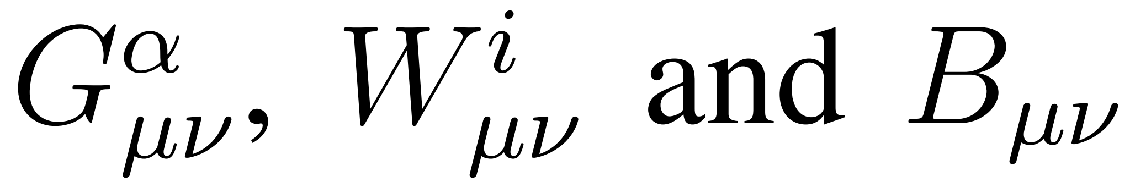
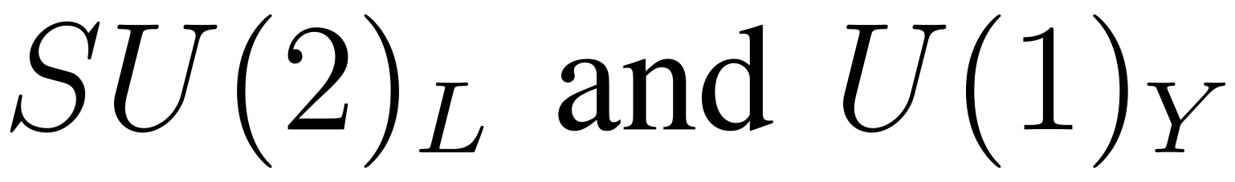

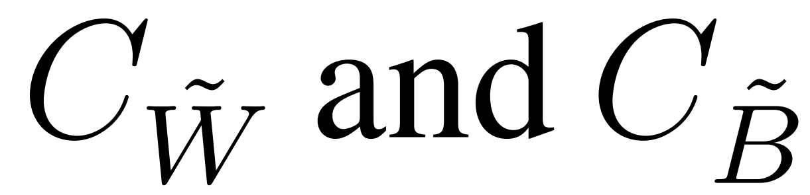

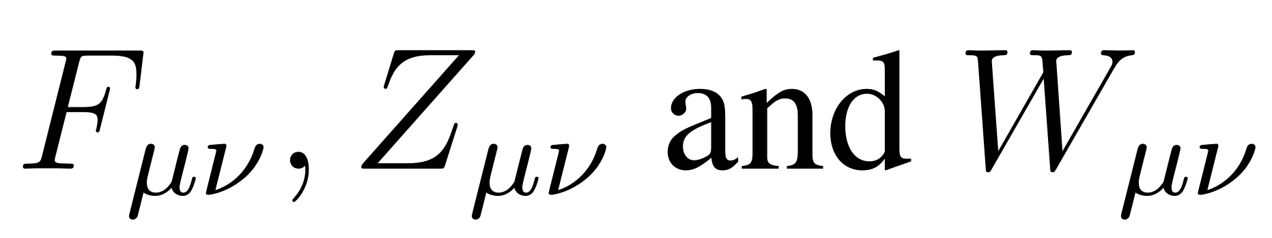
2. The theory framework
  ALP couples exclusively to SU(2)_{L} and U(1)_{Y} gauge bosons
with no direct couplings to the fermions and gluons
The photophobic ALP scenario:
The effective interactions of ALP with the SM particles:
: the field strength tensors of
: the ALP field
: the respective coupling constants
the mass of ALP
: the decay constant of ALP
After electroweak symmetry breaking:
: the photon, Z boson and W boson field strength tensors
5

Slide 7
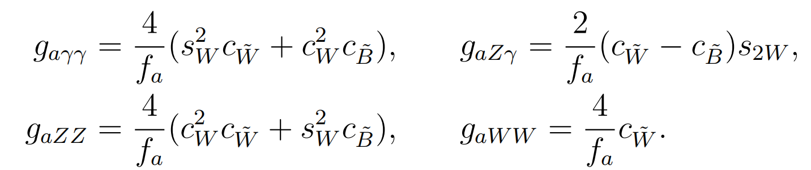

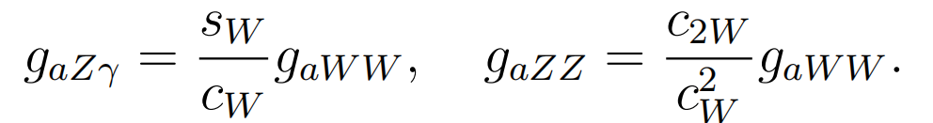
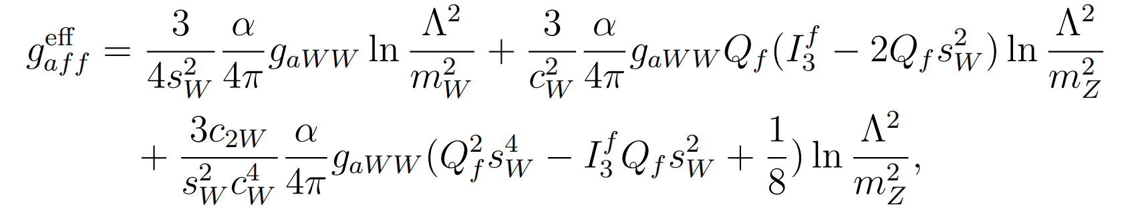
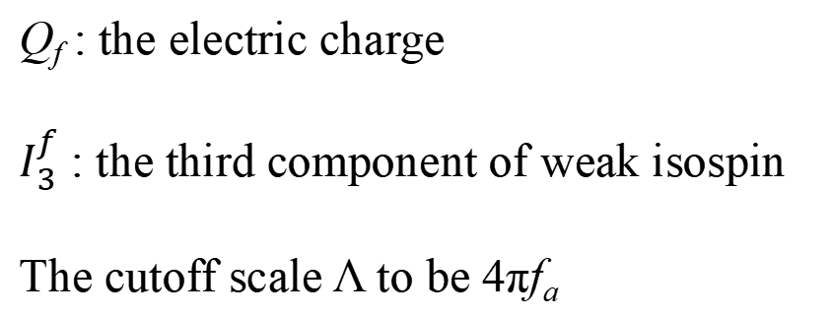
2. The theory framework
The coupling coefficients
:
The UV boundary conditions of the photophobic ALP scenario:
The couplings of ALP with Zγ and ZZ are expressed solely in terms of
The ALP-fermion coupling can be generated at one loop via renormalization group evolution (RGE)
Q_{f} : the electric charge
$I_{3}^{f}$ : the third component of weak isospin
The cutoff scale Λ to be 4πf_{a}
6

Slide 8
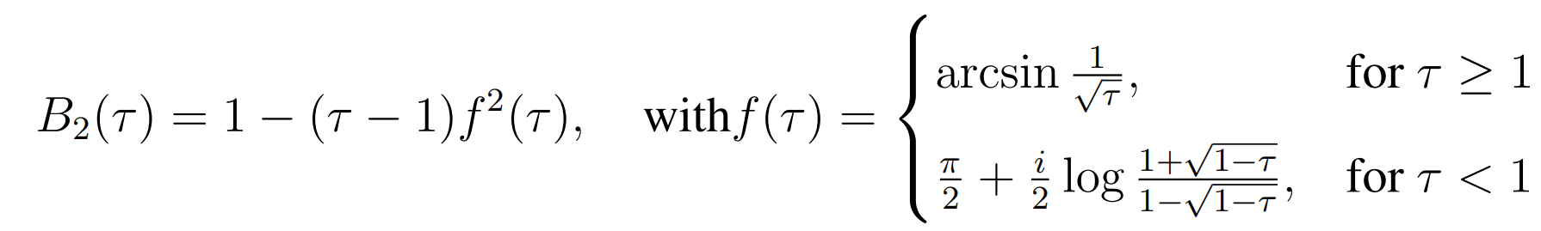
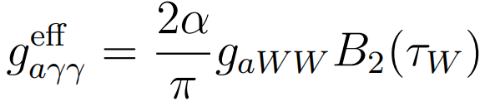
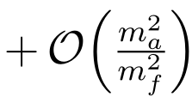

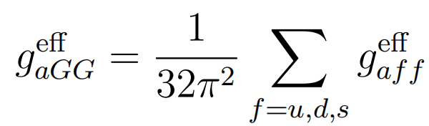
2. The theory framework
the effective ALP-photon coupling
the effective ALP-gluon coupling
If m_{a} ≠ 0
the shift symmetry is softly broken
The effective ALP-photon coupling:
The effective ALP-gluon coupling:
The ALP can decay into electroweak gauge bosons and fermions
a → Zγ, ZZ and W⁺W⁻ tree level
a → f f and γγ loop level
7

Slide 9
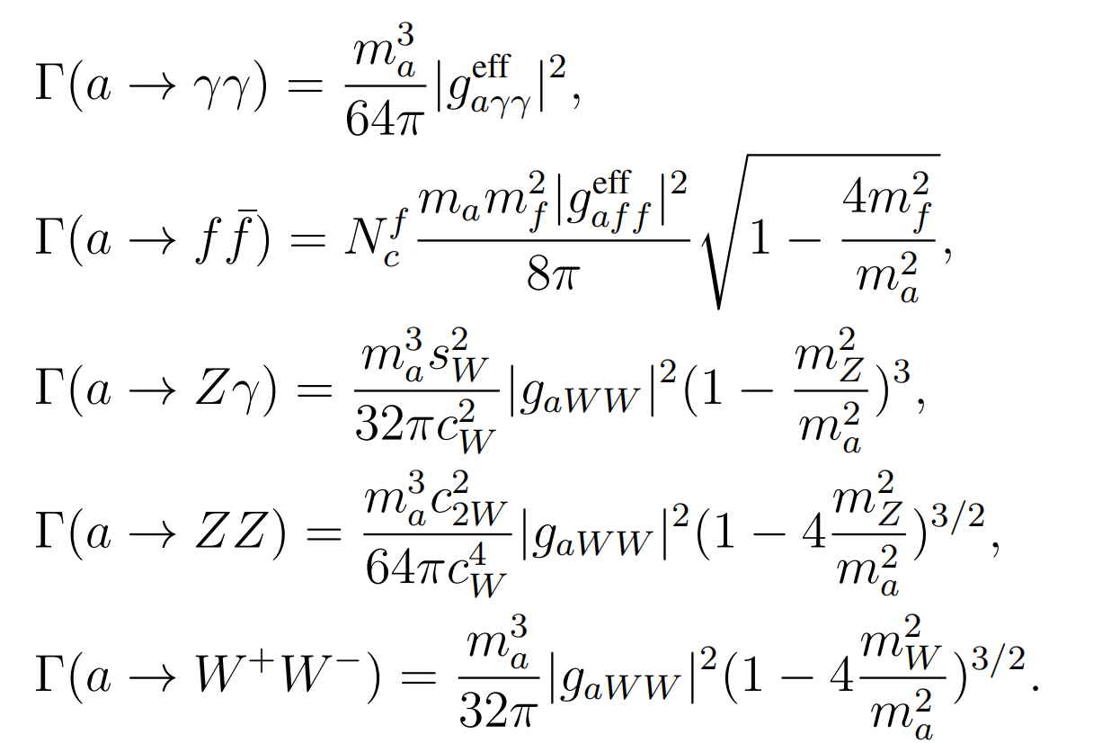
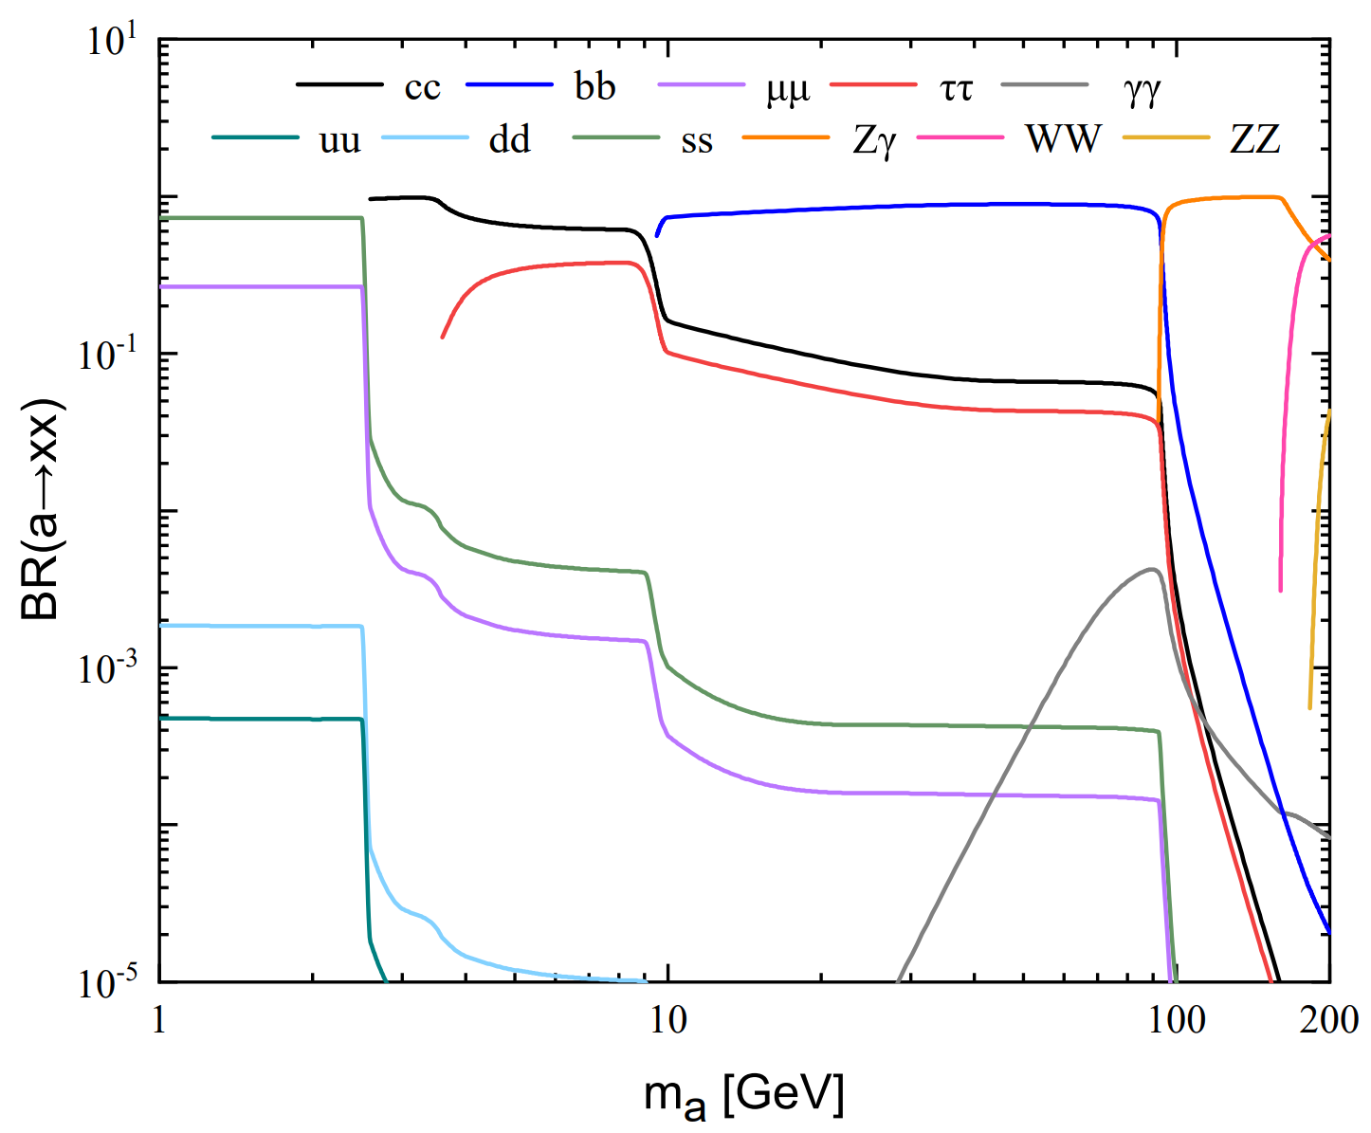
2. The theory framework
The relevant decay widths of ALP into fermions and EW gauge bosons:
The ALP phenomenology: the ALP mass m_{a} and the coupling g_{aWW}
8

Slide 10
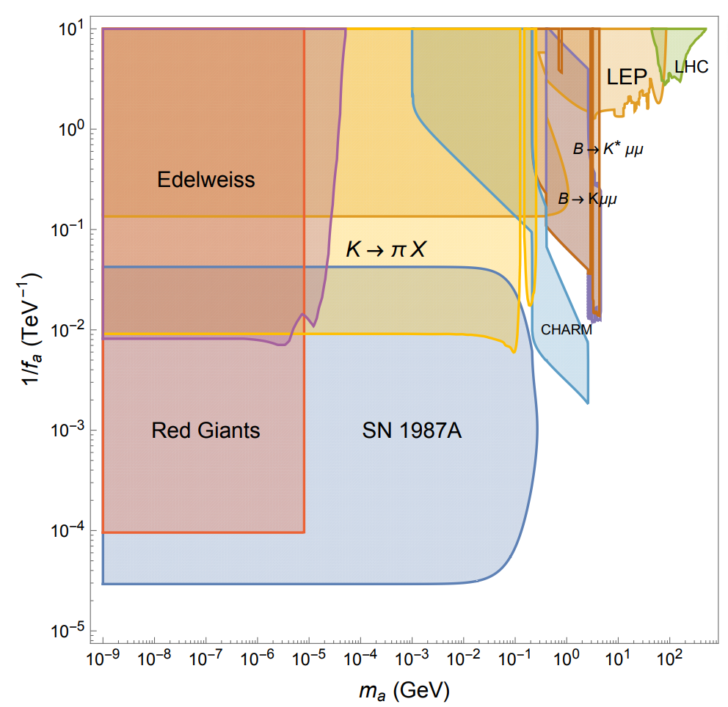
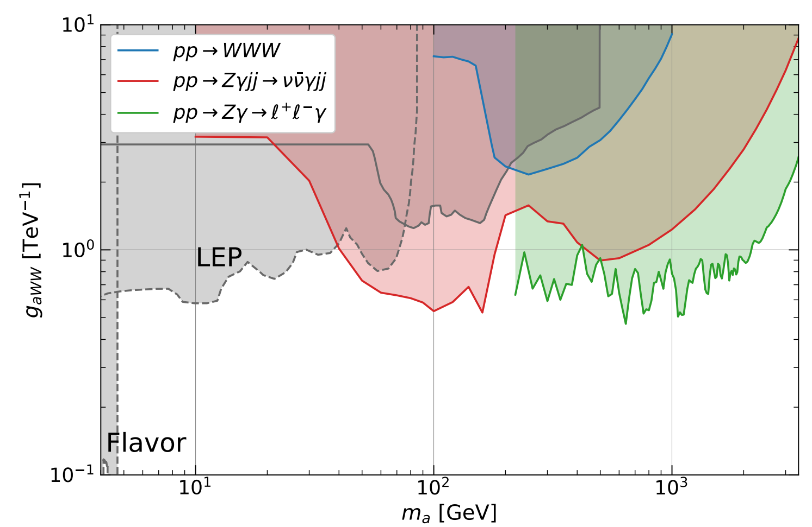
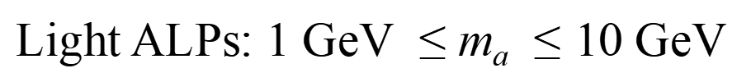
2. The theory framework
Experimental constraints on the photophobic ALP parameter space
Light photophobic ALPs exhibit rich phenomenology
heavy photophobic ALPs
Light ALPs: 1 GeV$≤$ m_{a}$≤10$GeV
9

Slide 11
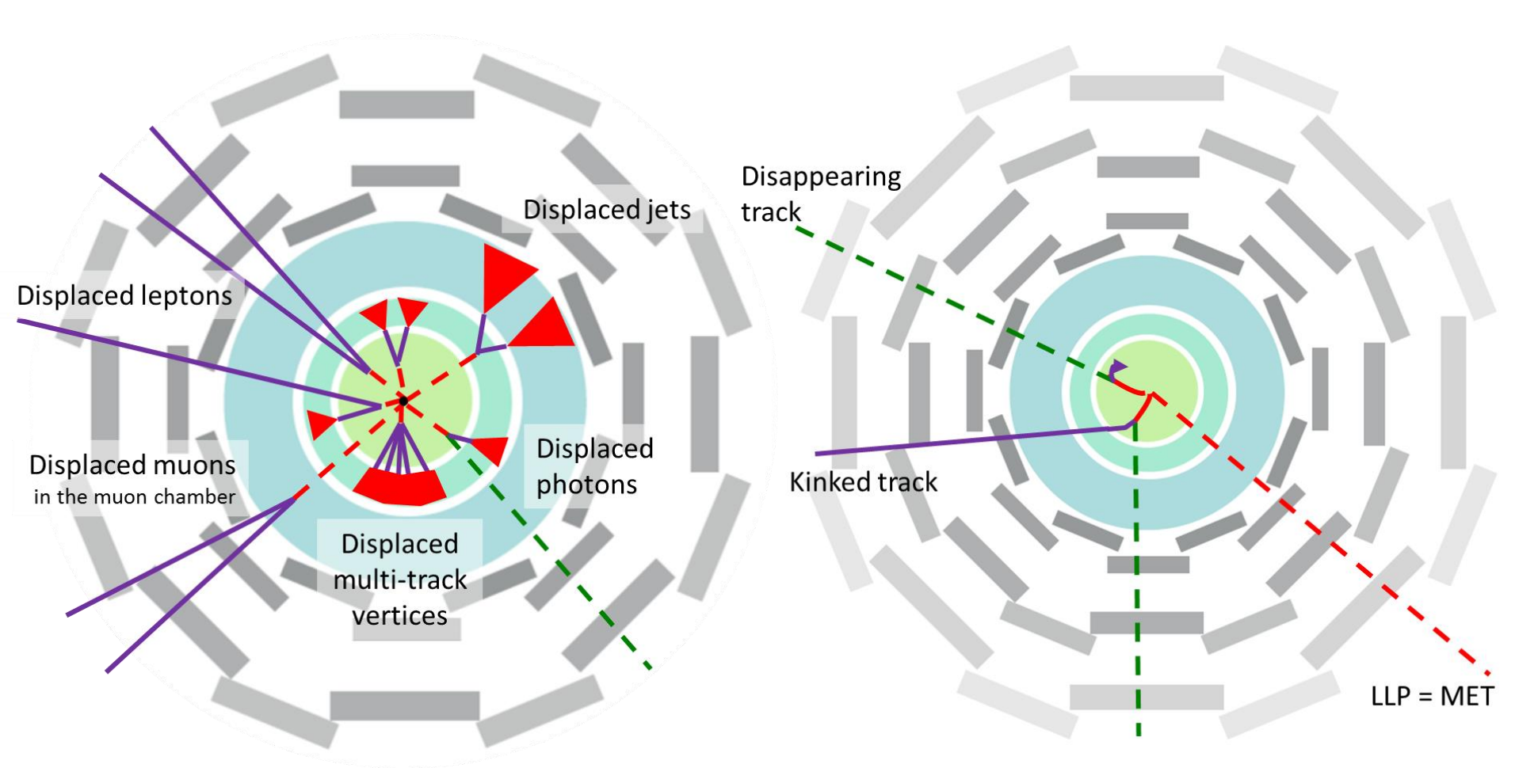
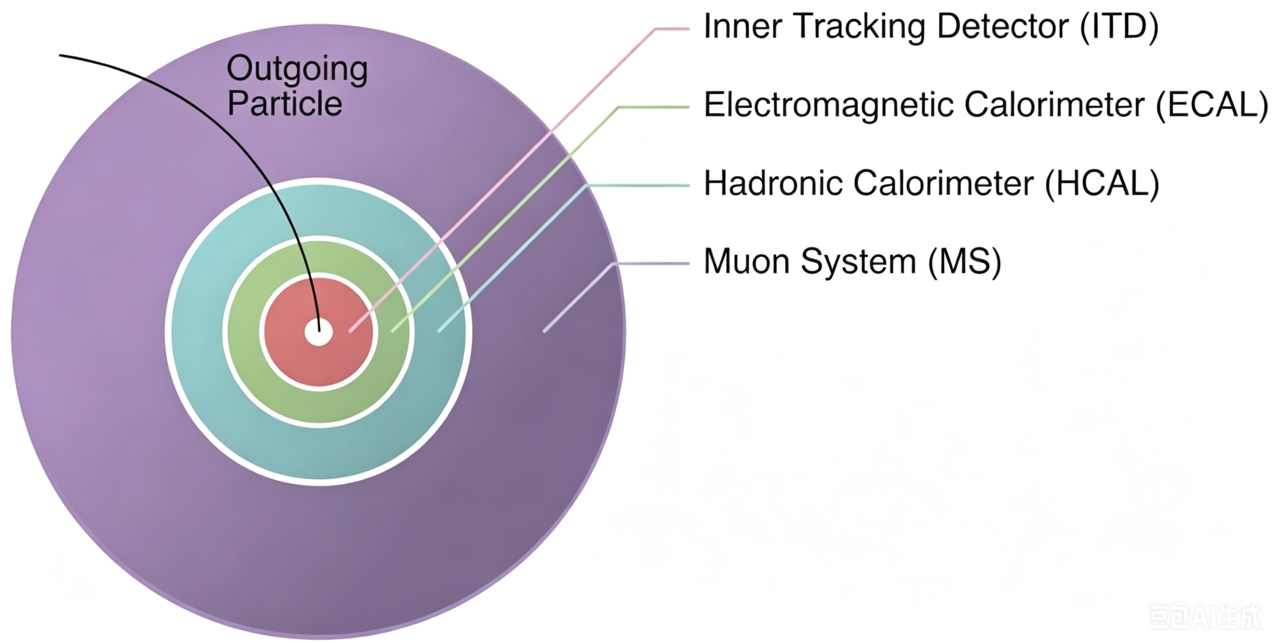
3. Searching for long-lived axion-like particles via displaced vertices at the HL-LHC
Long-lived ALPs: travel a macroscopic distance from their production point and then decay
Many LHC sub-detectors can distinguish long-lived ALP decays
Typical sub-detectors
There are several categories of signatures that can be used for discovering long-lived ALPs and measuring their properties:
Displaced leptons
Displaced jets
Displaced photons
Displaced muons
Disappearing track
Kinked track
Missing transverse energy (MET)
......
When Long-lived ALPs decay into charged particles, they can leave tracks with large impact parameters relative to the primary vertex within the inner tracking detector.
HL-LHC: higher integrated luminosity and improved detector performance
10

Slide 12
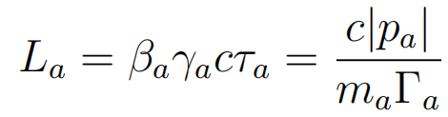


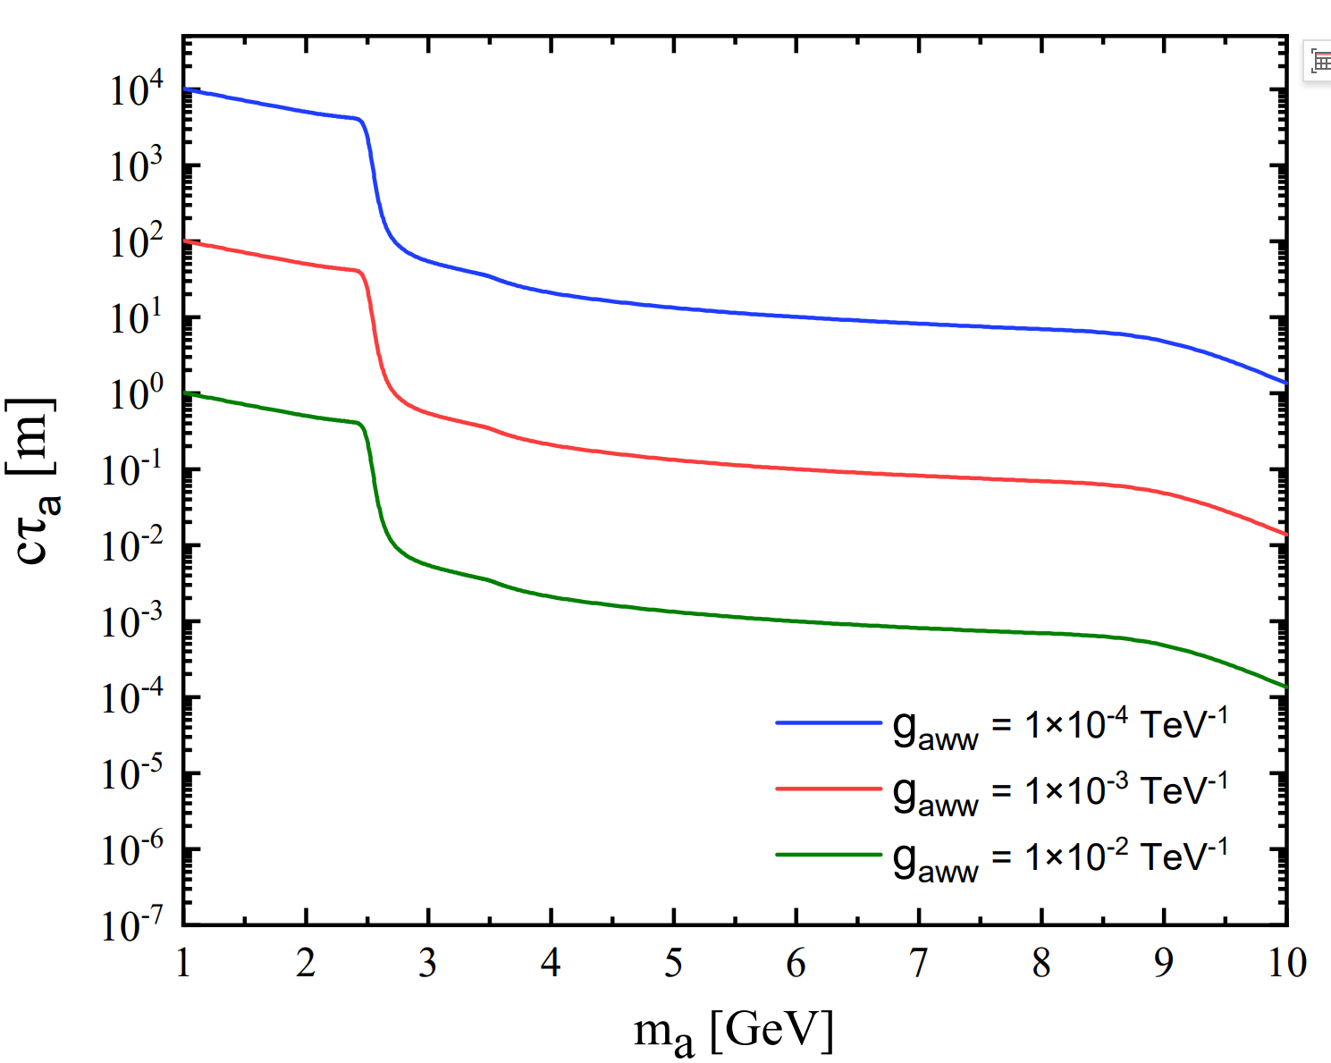
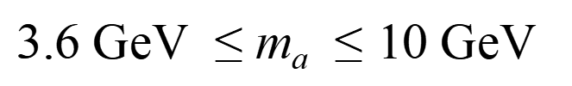
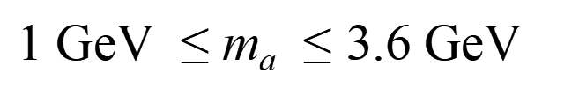
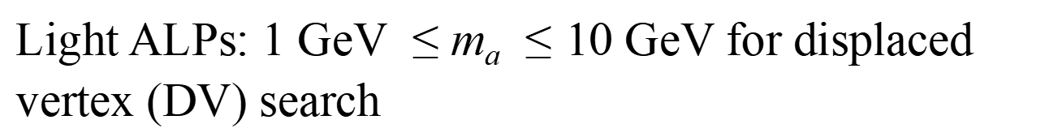
3. Searching for long-lived axion-like particles via displaced vertices at the HL-LHC
The observed decay length of the ALP in the laboratory frame :
: ALP lifetime
: proper decay length
β_{a} : velocity γ_{a} : Lorentz boost factor
Light ALPs: 1 GeV$≤$ m_{a}$≤10$GeV for displaced vertex (DV) search
1 GeV$≤$ m_{a}$≤3.6$GeV
3.6 GeV$≤$ m_{a}$≤10$GeV
The proper decay length of the ALP as a function of
m_{a} for different values of g_{aWW}
11

Slide 13



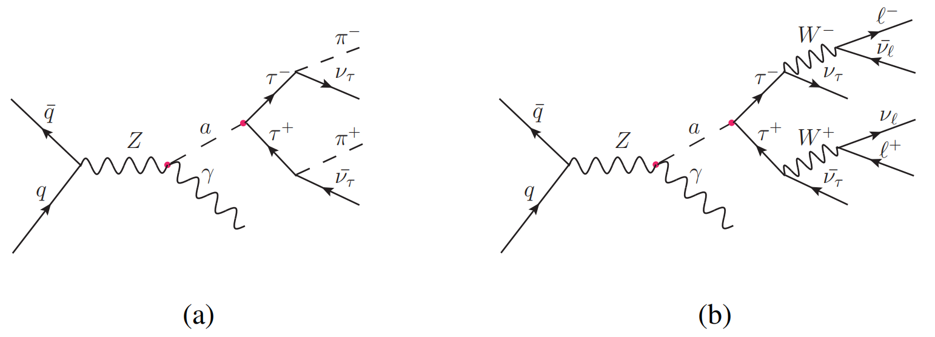




3. Searching for long-lived axion-like particles via displaced vertices at the HL-LHC
3.1 Searching for a light long-lived ALP via its production associated with photon
HL-LHC
The Feynman diagrams for the process with subsequent hadronic and leptonic tau decay
The dominant SM backgrounds arise from the Drell-Yan process
The subleading contributions come from the process
12

Slide 14
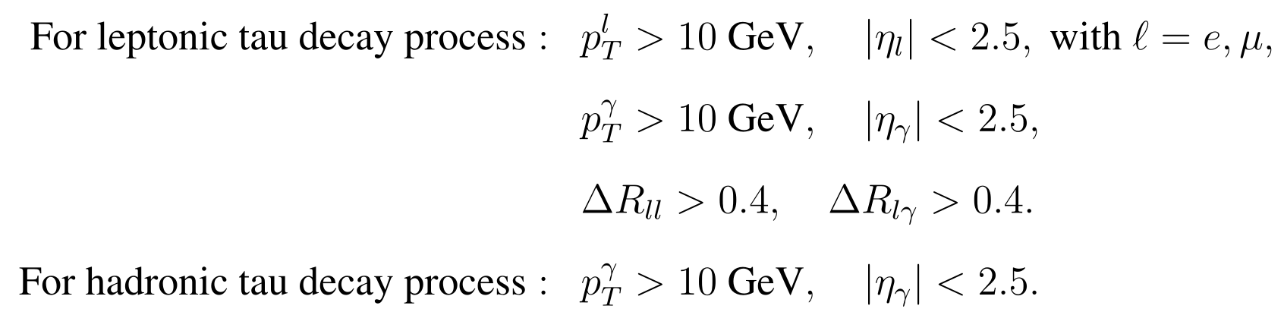
3. Searching for long-lived axion-like particles via displaced vertices at the HL-LHC
HL-LHC
FeynRules generate the model file for the effective Lagrangian
Madgraph5-aMC@NLO generate signal and background events and calculate the production cross sections of both the signal and background
Pythia 8 the parton shower and hadronization
Simplified fast simulation (SFS) framework the detector simulation
The detector configuration: CMS-EXO-16-022 analysis template
Madanalysis5 the signal and background analysis
Basic cuts:
13

Slide 15
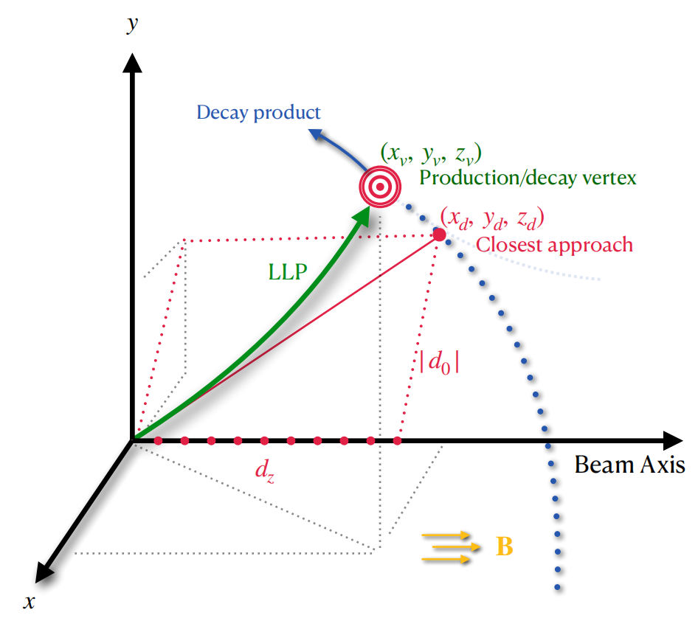
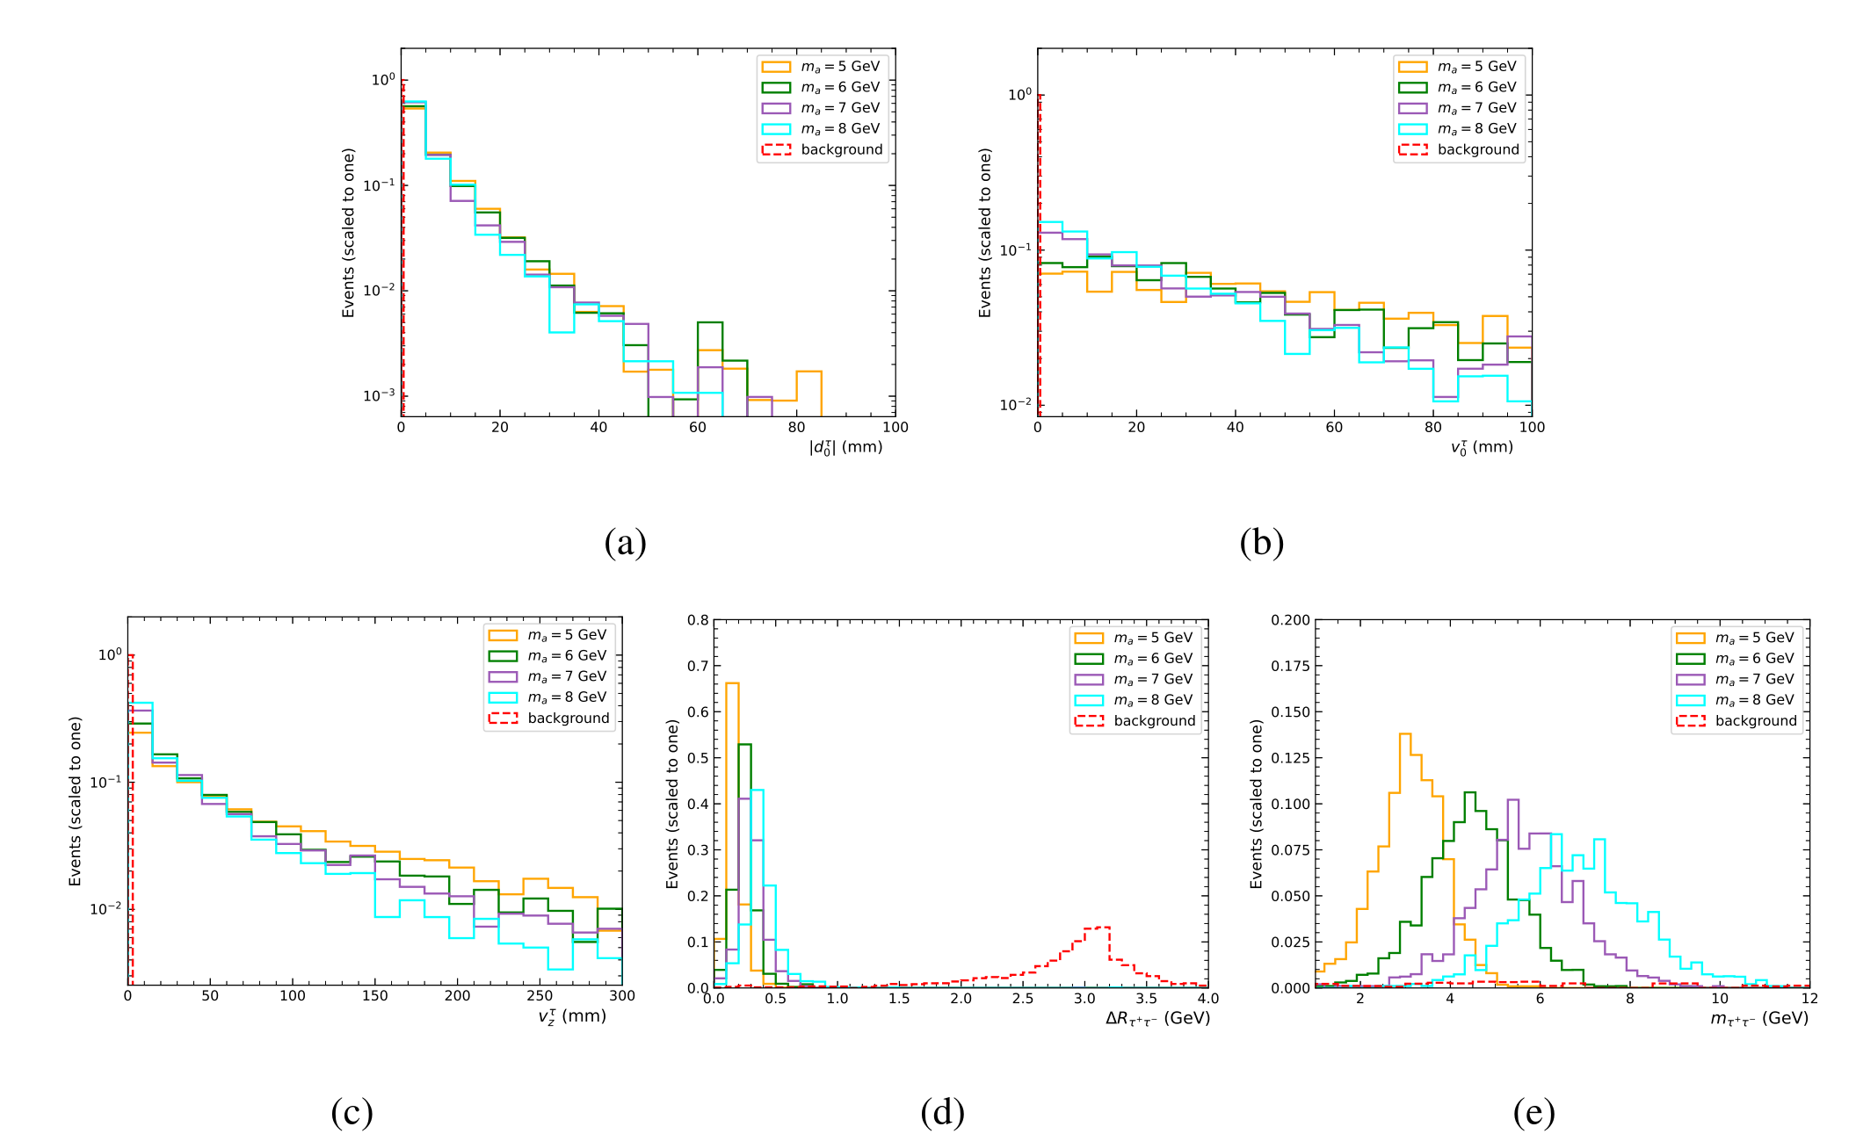
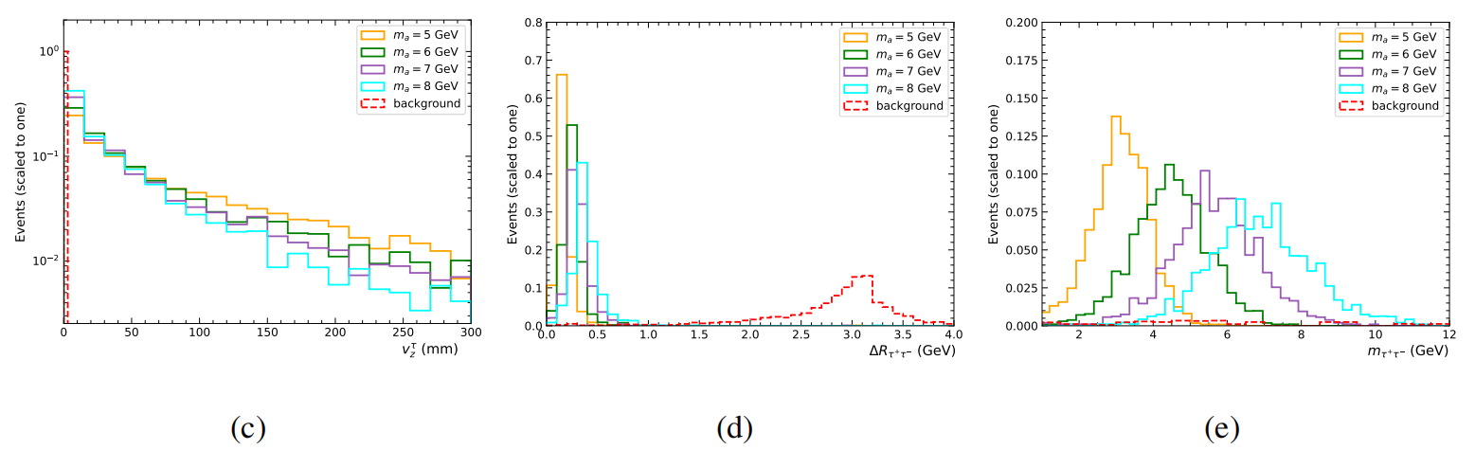

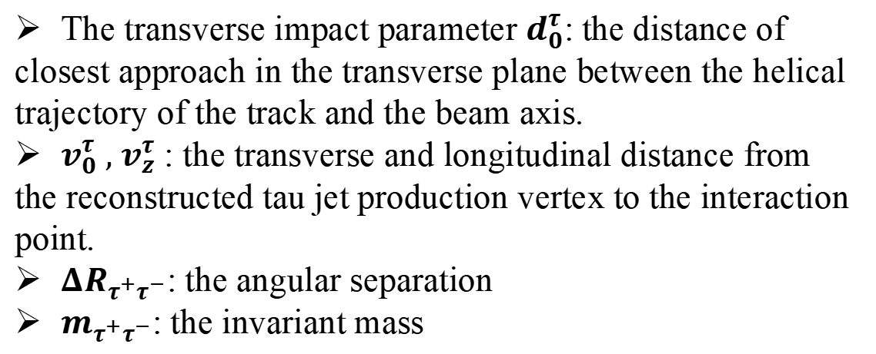
3. Searching for long-lived axion-like particles via displaced vertices at the HL-LHC
Searching for long-lived ALPs via the signal
The transverse impact parameter $d_{0}^{τ}$: the distance of
closest approach in the transverse plane between the helical
trajectory of the track and the beam axis.
$v_{0}^{τ} , v_{z}^{τ}$ : the transverse and longitudinal distance from
the reconstructed tau jet production vertex to the interaction point.
${ΔR}_{τ^{+}τ^{−}}$: the angular separation
$m_{τ^{+}τ^{−}}$: the invariant mass
14

Slide 16
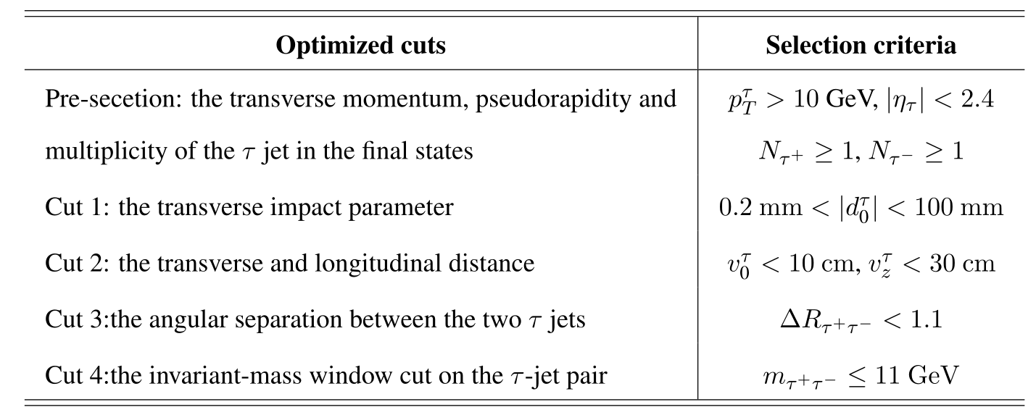
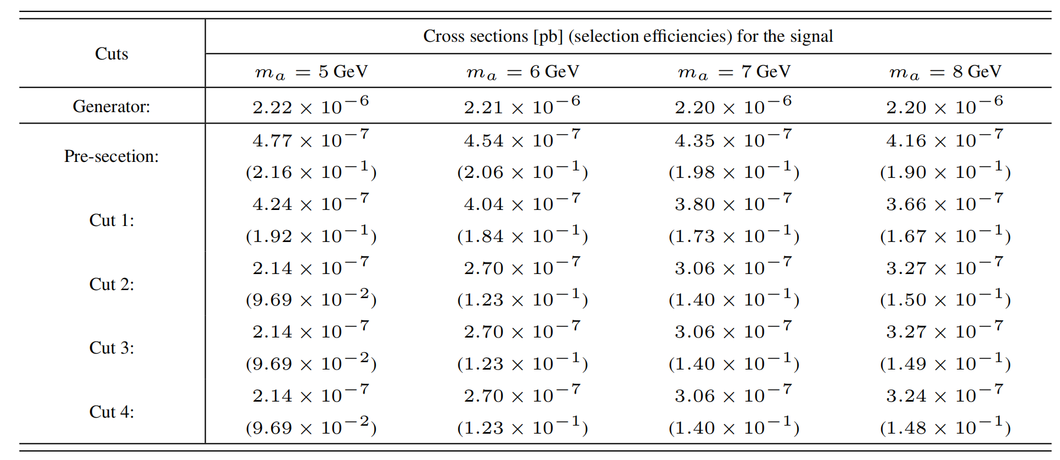
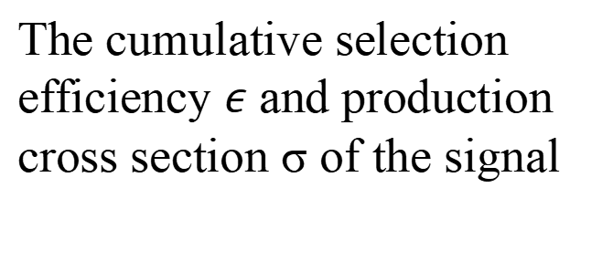
3. Searching for long-lived axion-like particles via displaced vertices at the HL-LHC
The improved cuts:
To ensure that the ALP decays within ITD
The cumulative selection efficiency $ε$ and production cross section σ of the signal
15

Slide 17
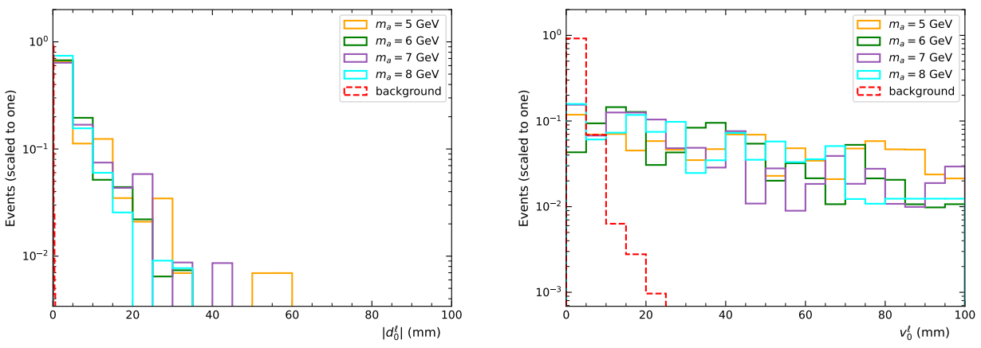
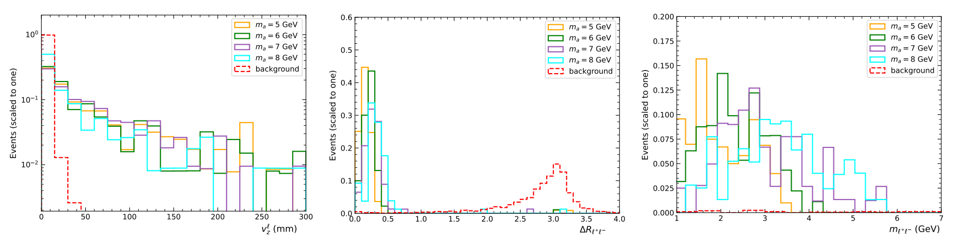
3. Searching for long-lived axion-like particles via displaced vertices at the HL-LHC
Searching for long-lived ALPs via the signal
16

Slide 18
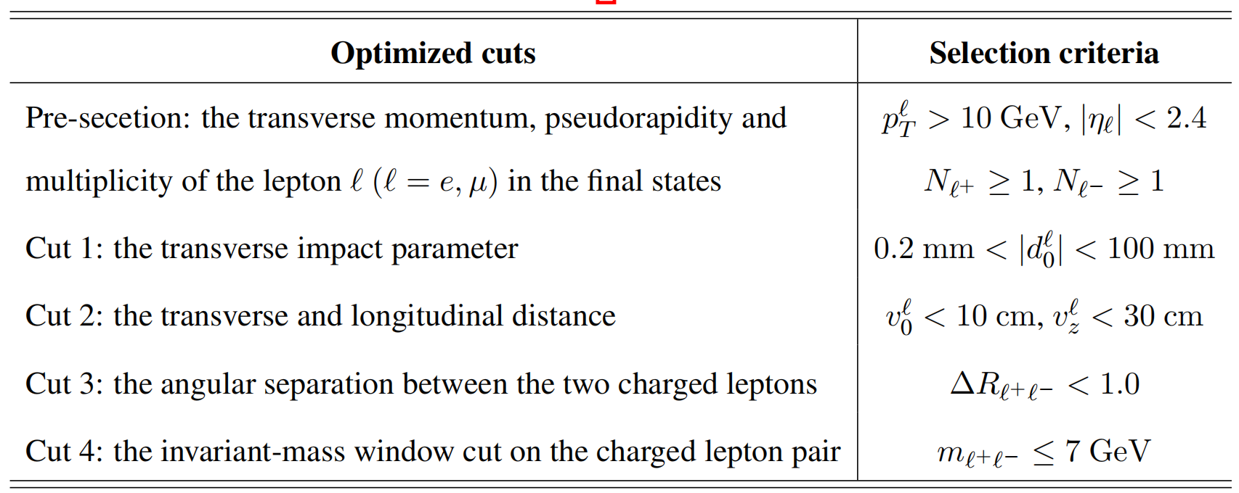
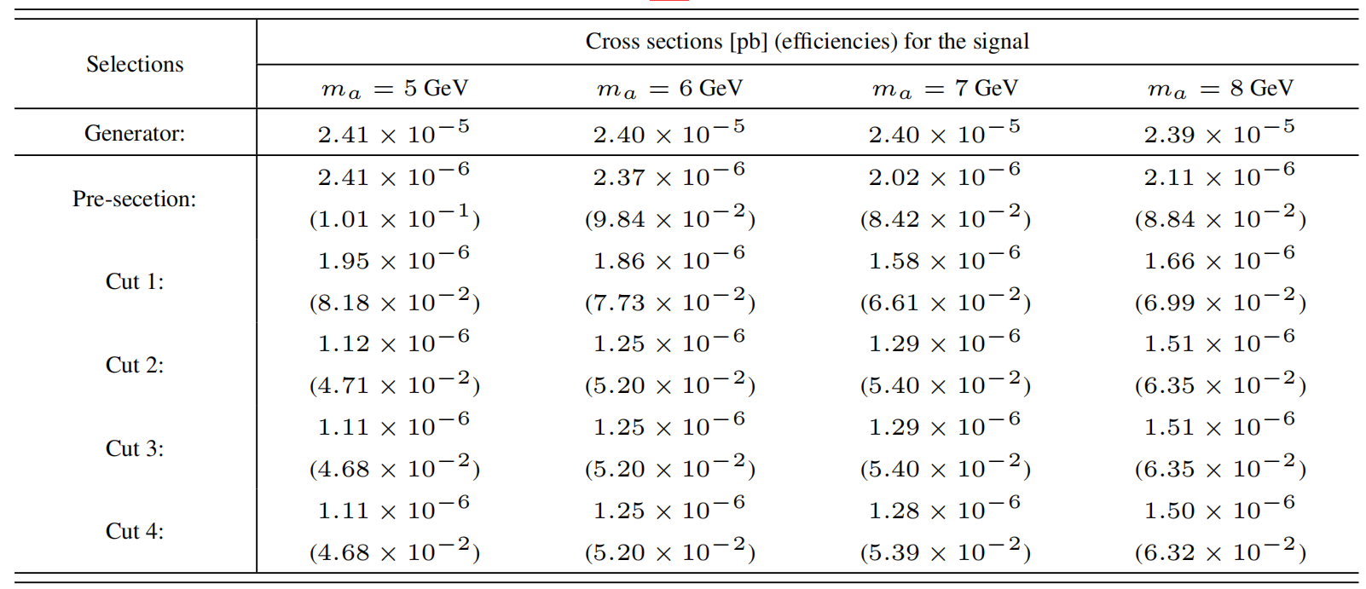
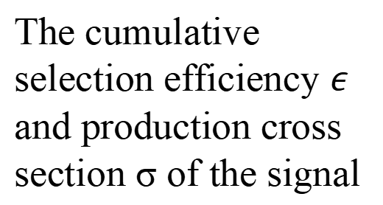
3. Searching for long-lived axion-like particles via displaced vertices at the HL-LHC
Searching for long-lived ALPs via the signal
The improved cuts :
The cumulative selection efficiency $ε$ and production cross section σ of the signal
17

Slide 19

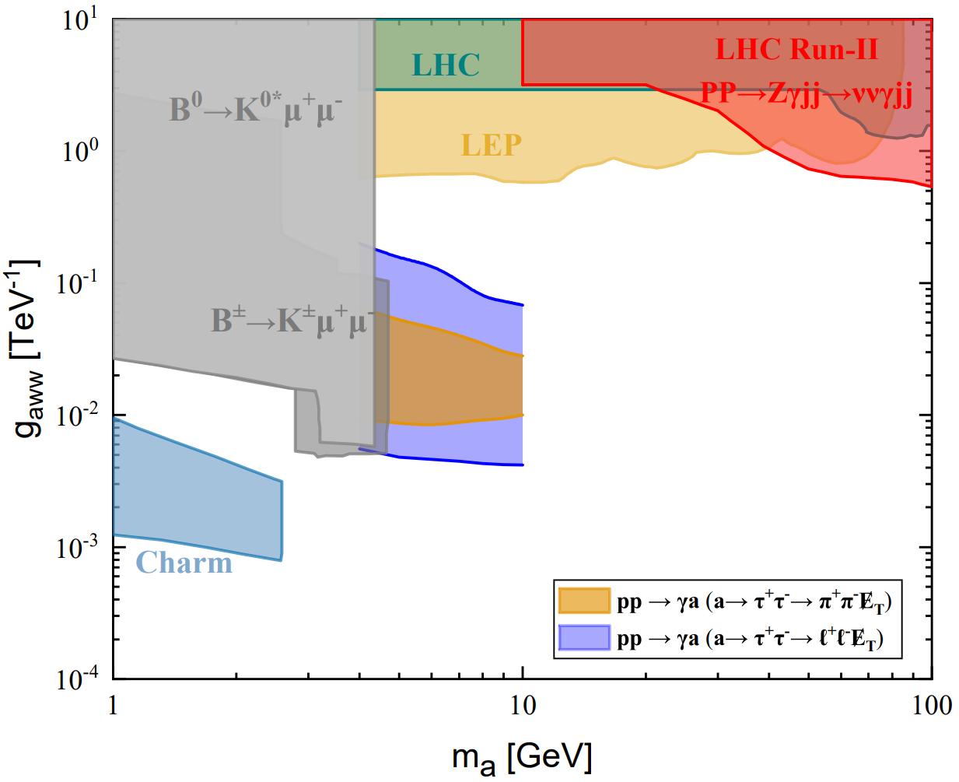

3. Searching for long-lived axion-like particles via displaced vertices at the HL-LHC
The number of signal events meeting the selection criteria:
The SM background is expected to be highly suppressed and considered negligible
N_{sig} = 3 corresponds to 95% C.L. exclusion bounds
The projected 95% C.L. sensitivities of the 14 TeV HL-LHC with $ℒ$ = 3 ab⁻¹ to long-lived ALPs
18

Slide 20

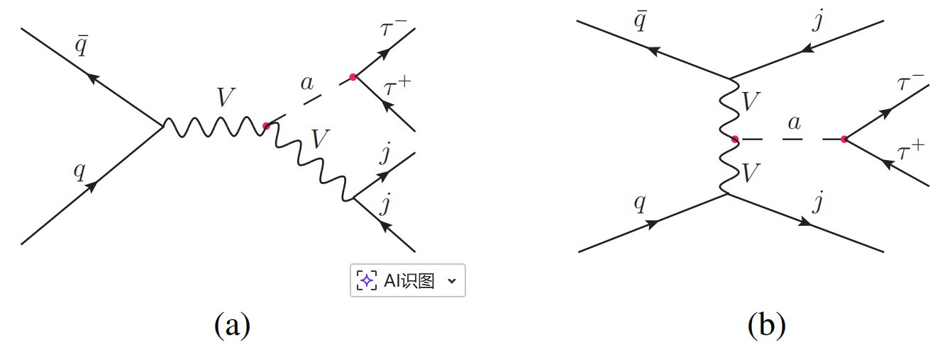




3. Searching for long-lived axion-like particles via displaced vertices at the HL-LHC
3.2 Searching for a light long-lived axion-like particle via its production associated with two jets
HL-LHC
The Feynman diagrams for the process
1-prong hadronic tau decay mode
The dominant SM background: with each tau decaying via 1-prong hadronic decay mode
Basic cuts:
19

Slide 21
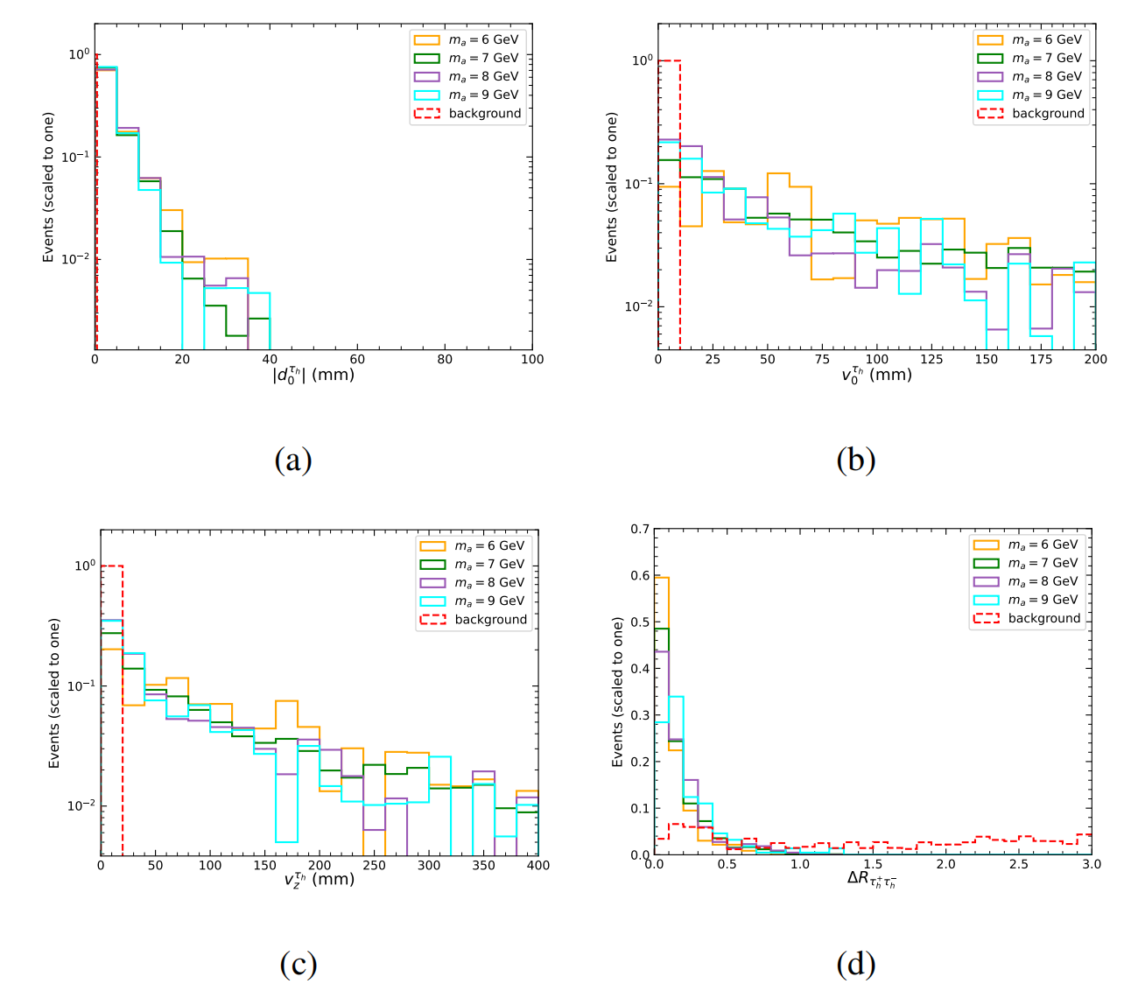
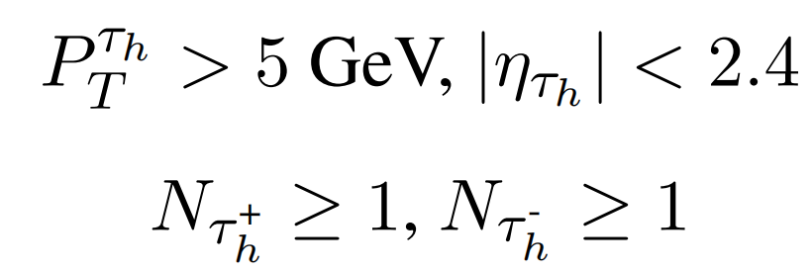
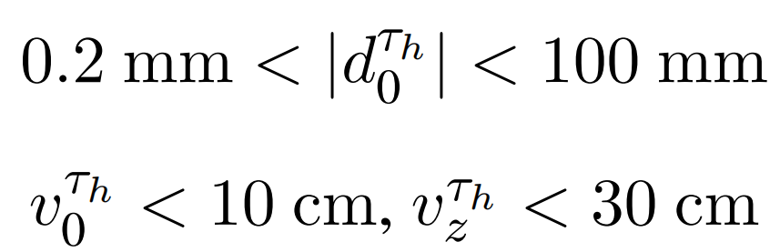

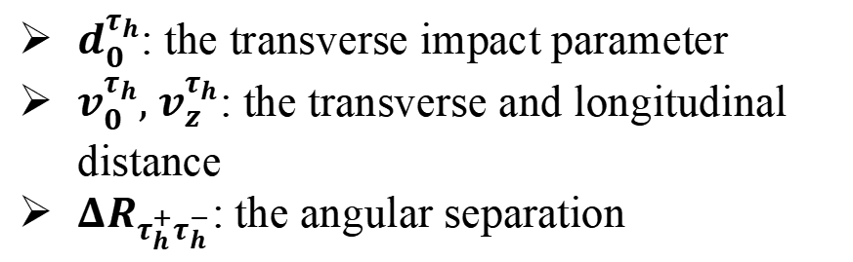
3. Searching for long-lived axion-like particles via displaced vertices at the HL-LHC
Searching for long-lived ALPs via the signal
pre-selection :
$d_{0}^{τ_{h}}$: the transverse impact parameter
$v_{0}^{τ_{h}}, v_{z}^{τ_{h}}$: the transverse and longitudinal distance
${ΔR}_{τ_{h}^{+}τ_{h}^{−}}$: the angular separation
To ensure that the ALP decays within ITD
20

Slide 22
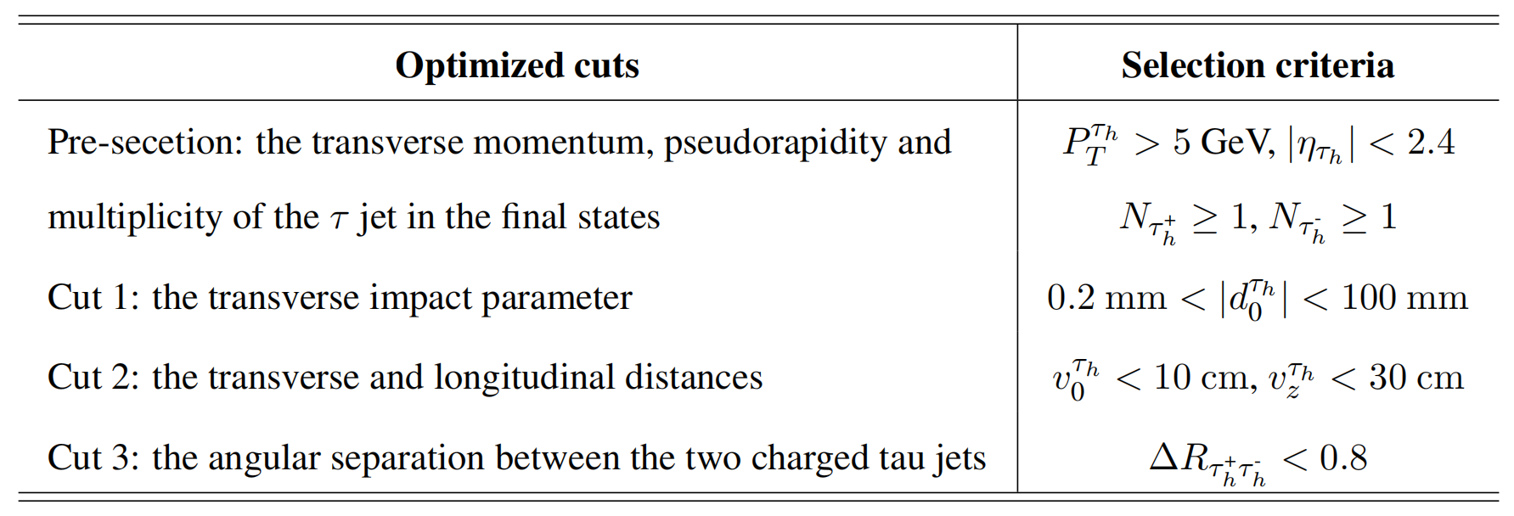
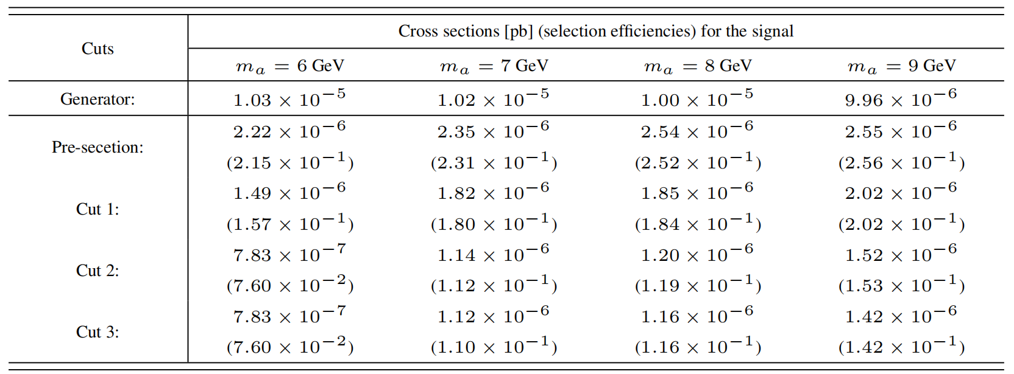
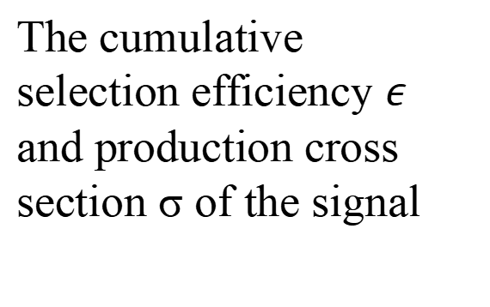
3. Searching for long-lived axion-like particles via displaced vertices at the HL-LHC
Searching for long-lived ALPs via the signal
The improved cuts:
The cumulative selection efficiency $ε$ and production cross section σ of the signal
21

Slide 23

3. Searching for long-lived axion-like particles via displaced vertices at the HL-LHC
The projected 95% C.L. sensitivities of the 14 TeV HL-LHC with $ℒ$ = 3 ab⁻¹ to long-lived ALPs
22

Slide 24





4. Searching for long-lived axion-like particles via displaced vertices at the CEPC
CEPC
the single-production processes of the photophobic ALP
23

Slide 25







4. Searching for long-lived axion-like particles via displaced vertices at the CEPC
CEPC
The Feynman diagrams for the process with the ALP subsequently decaying into a pair of displaced charged leptons.
For the dimuon channel ：
The SM background ，
Basic cuts:
For the ditau channel ：
The SM background
Basic cuts:
24

Slide 26



4. Searching for long-lived axion-like particles via displaced vertices at the CEPC
Searching for long-lived ALPs via the signal
25

Slide 27


4. Searching for long-lived axion-like particles via displaced vertices at the CEPC
Searching for long-lived ALPs via the signal
The improved cuts :
The cumulative selection efficiency $ε$ and production cross section σ of the signal
26

Slide 28



4. Searching for long-lived axion-like particles via displaced vertices at the CEPC
Searching for long-lived ALPs via the signal
27

Slide 29


4. Searching for long-lived axion-like particles via displaced vertices at the CEPC
Searching for long-lived ALPs via the signal
The improved cuts :
The cumulative selection efficiency $ε$ and production cross section σ of the signal
28

Slide 30



4. Searching for long-lived axion-like particles via displaced vertices at the CEPC
The projected 95% C.L. sensitivities of the 91.2 GeV CEPC with $ℒ$ = 100 ab⁻¹ to long-lived ALPs
29

Slide 31

5. Summary
Summary
ALPs are well motivated BSM candidates
Detect long-lived ALPs with masses in the range 1 GeV ≤ m_{a} ≤ 10 GeV predicted by the photophobic ALP scenario within the ITD at the HL-LHC and CEPC
with subsequent hadronic and leptonic tau decay
HL-LHC
with each tau decaying via 1-prong hadronic decay
CEPC
with the ALP decaying into a pair of displaced charged leptons
: CEPC provides complementary coverage compared to LHCb and CHARM
: HL-LHC provides complementary coverage to LEP/LHC searches
CEPC provides complementary coverage to LEP/LHC searches and the
projected HL-LHC reach
53
30

Slide 32
THANKS FOR YOUR LISTENING!
Xin-Yang Li （李欣洋）
2026.5.16

Slide 33


4. Searching for long-lived axion-like particles via displaced vertices at the CEPC
Searching for long-lived ALPs via the signal
Proﬁle sketch of the ITD of the CEPC
Summary of parameters of the ITD of the CEPC
31

Slide 34






4. Searching for long-lived axion-like particles via displaced vertices at the CEPC
Searching for long-lived ALPs via the signal
32

