Slide 1


2026轻强子专题研讨会
Phys.Rev.C 112,065201 (2025)
Production of $Ξ(1530)$ in $K^{−}p$ scattering process
Speaker：Quan-Yun Guo
Supervisor：Dian-Yong Chen
Collaborator：Jing Liu, Pei-wen Wu.

Slide 2


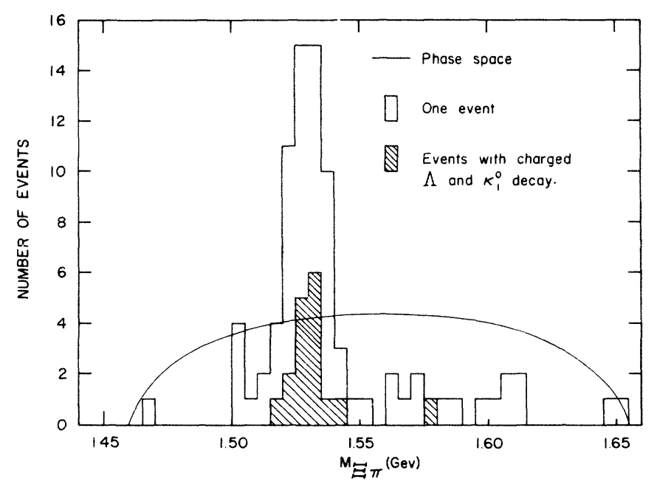
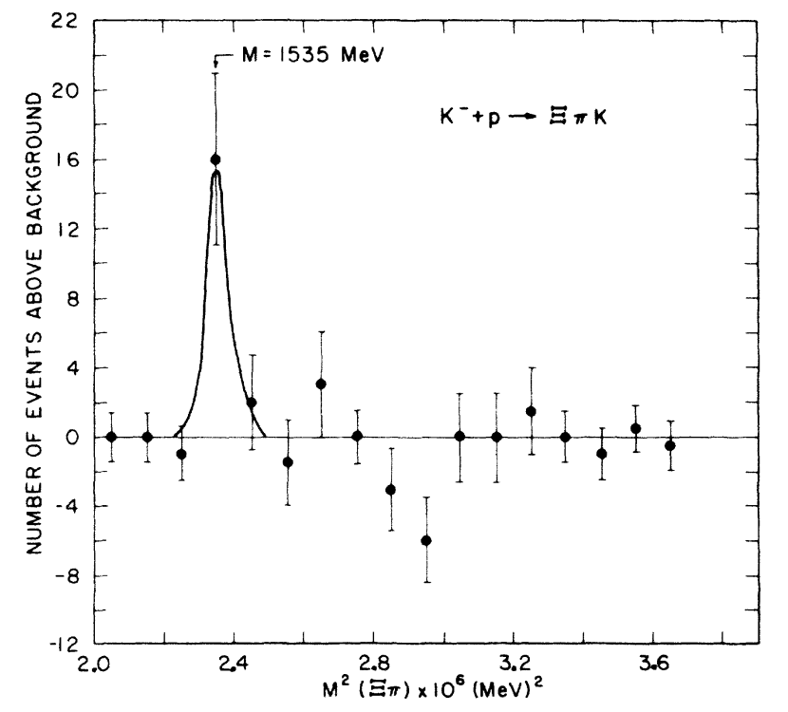
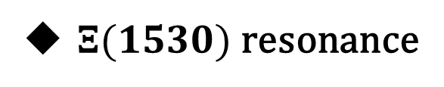

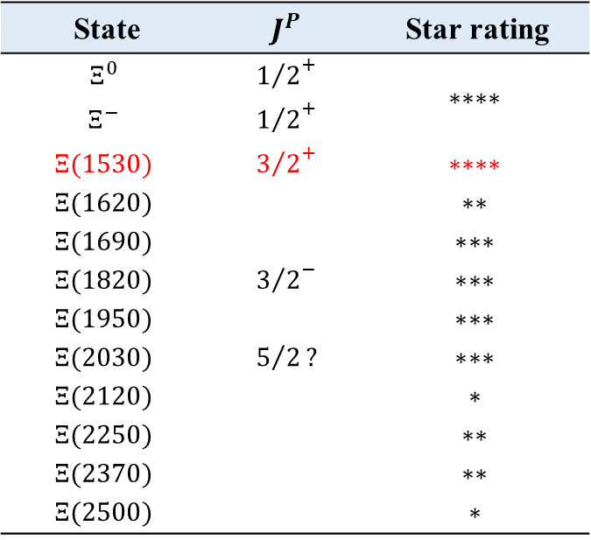


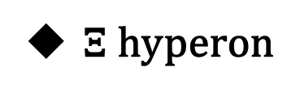
Background
$Ξ$ hyperon
$Ξ(1530)$ resonance
Consist of one light quark and two strange quarks.
$$1962$$
Phys.Rev.D 110, 030001 (2024)
A group at UCLA
Brookhaven-Syracuse
State | $$J^{P}$$ | Star rating
$$Ξ^{0}$$ | $${1/2}^{+}$$ | $$∗∗∗∗$$
$$Ξ^{−}$$ | $${1/2}^{+}$$
$$Ξ(1530)$$ | $${3/2}^{+}$$ | $$∗∗∗∗$$
$$Ξ(1620)$$ |  | $$∗∗$$
$$Ξ(1690)$$ |  | $$∗∗∗$$
$$Ξ(1820)$$ | $${3/2}^{−}$$ | $$∗∗∗$$
$$Ξ(1950)$$ |  | $$∗∗∗$$
$$Ξ(2030)$$ | $$5/2?$$ | $$∗∗∗$$
$$Ξ(2120)$$ |  | $$∗$$
$$Ξ(2250)$$ |  | $$∗∗$$
$$Ξ(2370)$$ |  | $$∗∗$$
$$Ξ(2500)$$ |  | $$∗$$
Phys.Rev.Lett. 9 (1962) 114-117
Phys.Rev.Lett. 9 (1962) 180-183
$$K^{−}p→K^{+}{(Ξ^{−}π^{0})}_{{Ξ(1530)}^{−}}$$
$$K^{−}p→K^{0}{(Ξ^{−}π^{+})}_{{Ξ(1530)}^{0}}$$

Slide 3
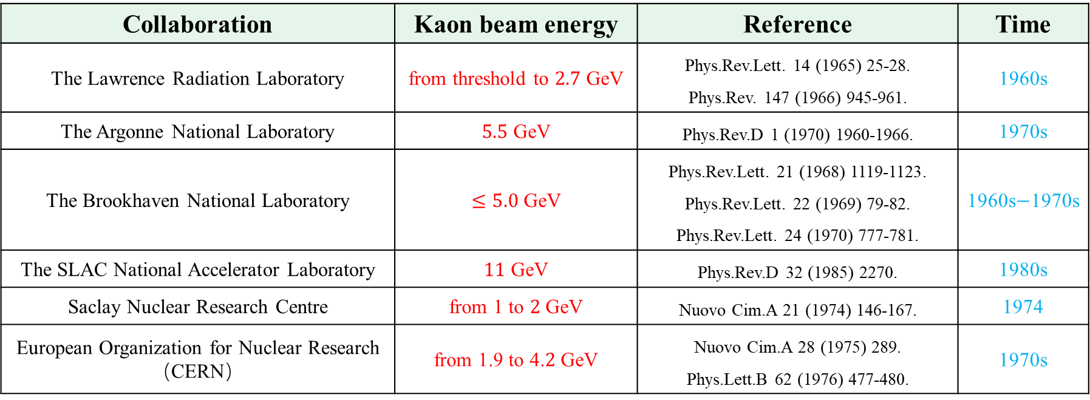
Background
$Kaon−induced fixed−target experiments$
Collaboration | Kaon beam energy | Reference | Time
The Lawrence Radiation Laboratory | from threshold to $2.7$ GeV | Phys.Rev.Lett. 14 (1965) 25-28. Phys.Rev. 147 (1966) 945-961. | 1960s
The Argonne National Laboratory | $5.5$ GeV | Phys.Rev.D 1 (1970) 1960-1966. | 1970s
The Brookhaven National Laboratory | $≤5.0$ GeV | Phys.Rev.Lett. 21 (1968) 1119-1123. Phys.Rev.Lett. 22 (1969) 79-82. Phys.Rev.Lett. 24 (1970) 777-781. | 1960s$−$1970s
The SLAC National Accelerator Laboratory | $11$ GeV | Phys.Rev.D 32 (1985) 2270. | 1980s
Saclay Nuclear Research Centre | from 1 to $2$ GeV | Nuovo Cim.A 21 (1974) 146-167. | 1974
European Organization for Nuclear Research （CERN） | from 1.9 to 4.$2$ GeV | Nuovo Cim.A 28 (1975) 289. Phys.Lett.B 62 (1976) 477-480. | 1970s
(1) $Ξ$ resonances were discovered using bubble chambers, the scanning and measurement were inefficient.
(2) As a secondary beam, the high-energy, high-intensity, and high-purity Kaon beam cannot be achieved.

Slide 4
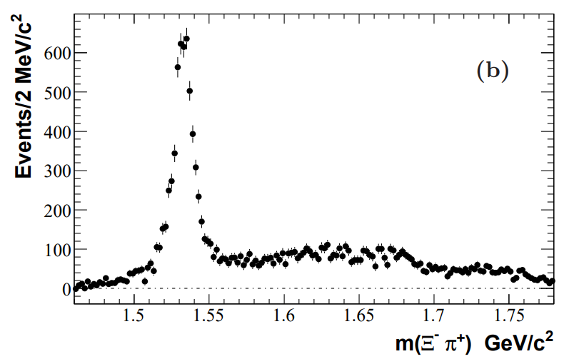
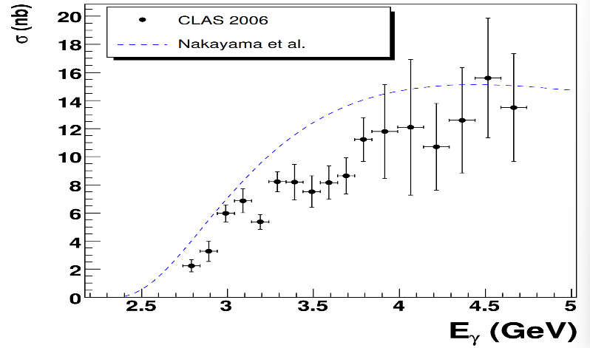
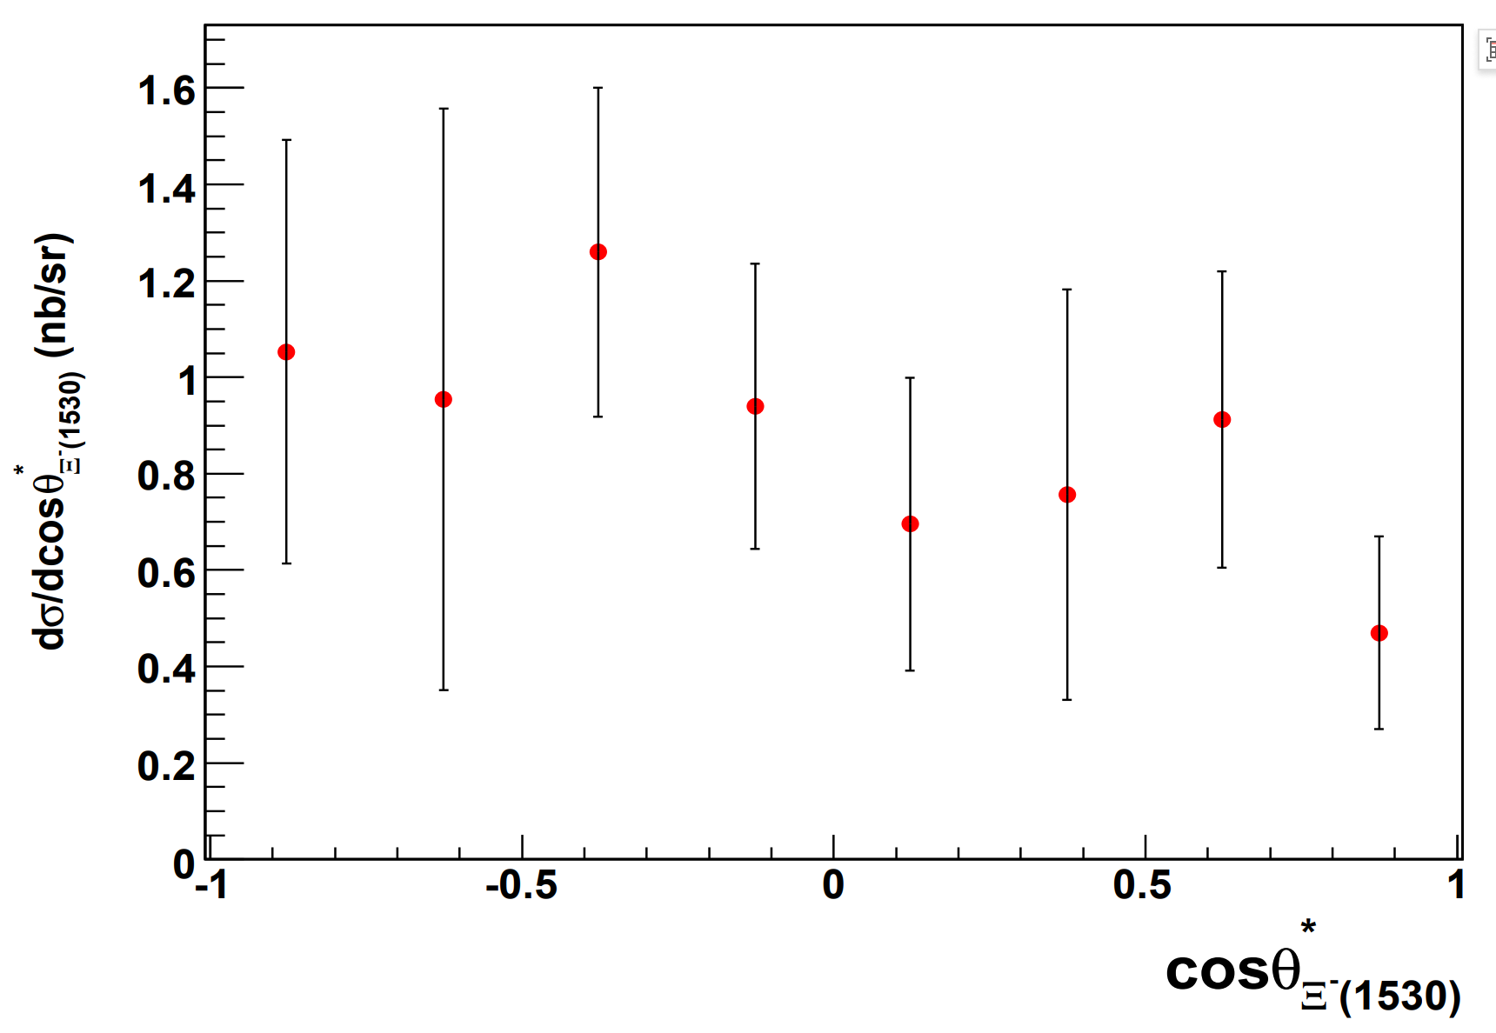
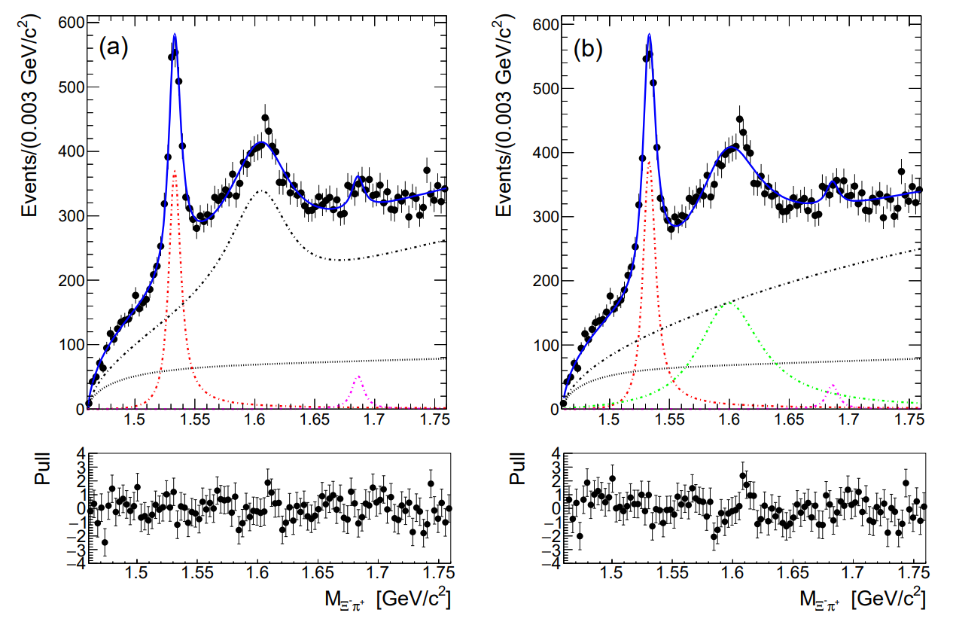
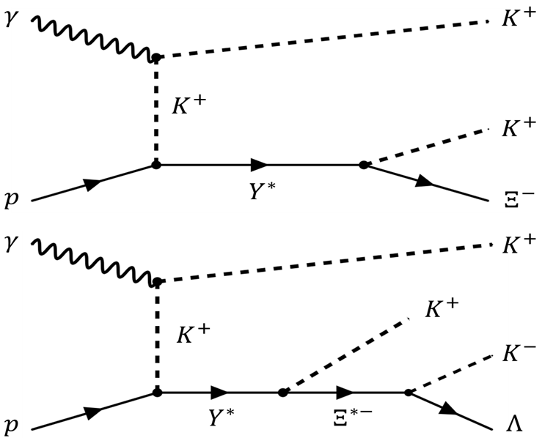
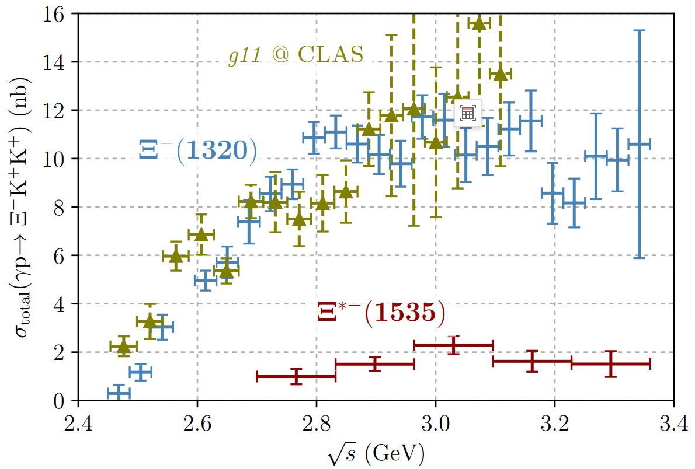

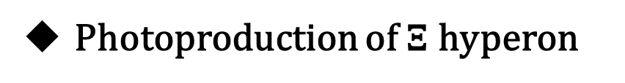
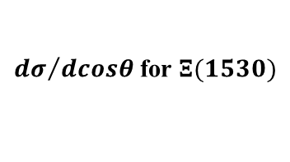




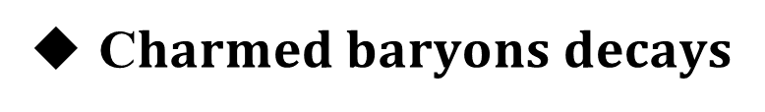

Background
C$harmed baryons decays$
Photoproduction of $Ξ$ hyperon
Phys.Rev.D 78 (2008) 034008.【BaBar】
Phys.Rev.C 76 (2007) 025208. 【CLAS】
$$γp→K^{+}K^{+}Ξ^{−} and γp→K^{+}K^{+}Ξ^{0}π^{−}$$
${dσ}/{dcosθ}$for $Ξ(1530)$
$$Λ_{c}^{+}→Ξ^{−}π^{+}K^{+}$$
$$Ξ(1530)$$
Phys.Rev.Lett. 122 (2019) 7, 072501.【Belle】
Phys.Rev.C 98 (2018) 6, 062201. 【CLAS】
$$Ξ_{c}^{+}→Ξ^{−}π^{+}π^{+}$$
$$γp→K^{+}K^{+}Ξ^{−} and γp→K^{+}K^{+}K^{−}Λ$$
$dσ$for ${Ξ(1320)}^{−}$ and ${Ξ(1535)}^{−}$
$$Ξ(1620)$$
$M_{Ξ^{−}π^{+}}$ $GeV/c^{2}$

Slide 5
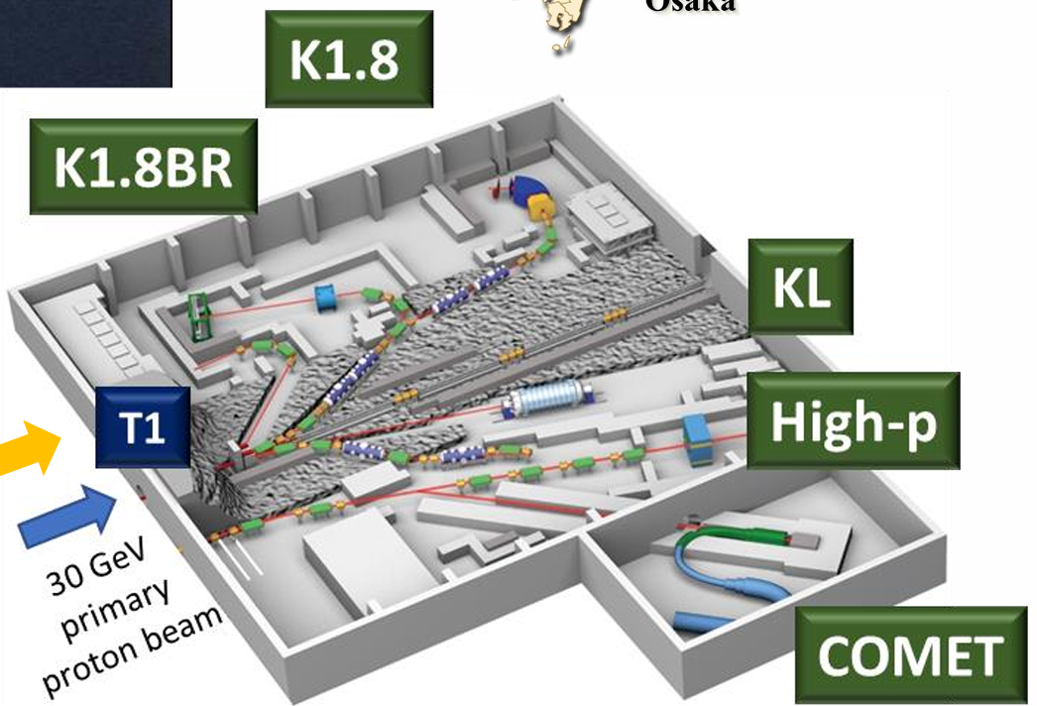
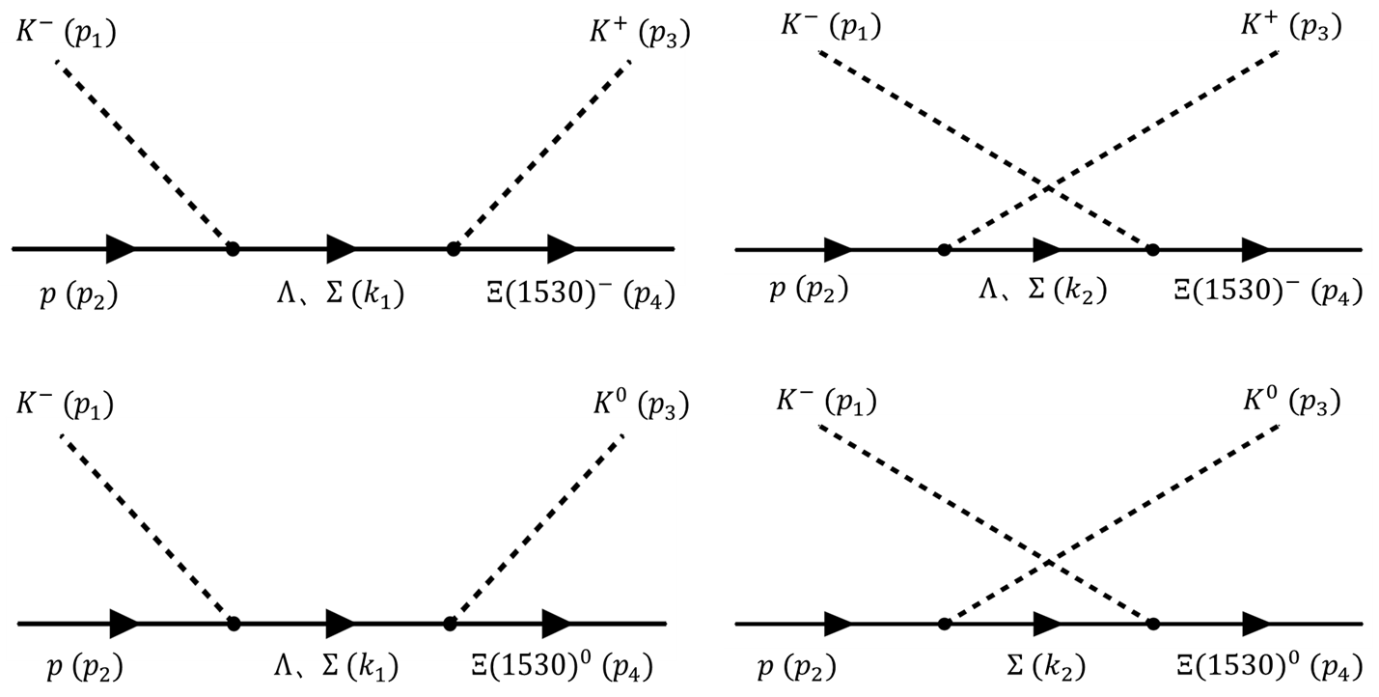
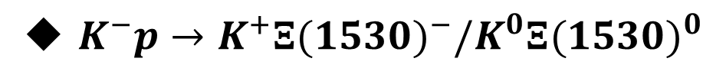

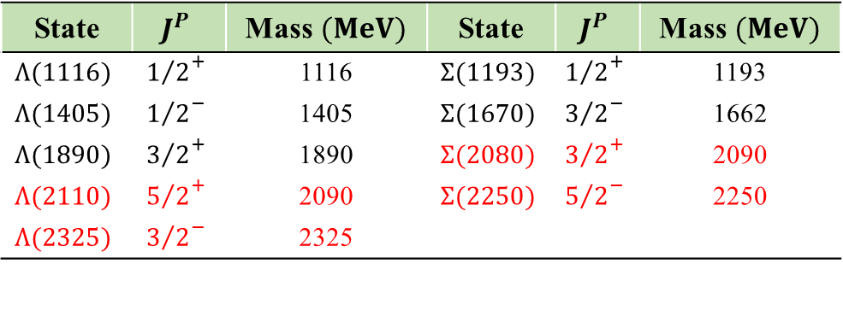
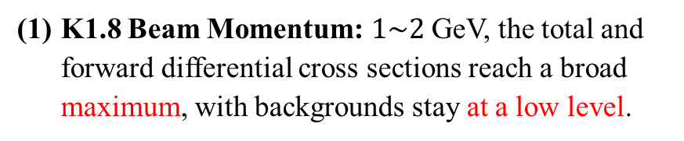

$$.$$
$$.$$
Experimental advance at J-PARC
J-PARC--K1.8
e-Print: 2110.04462
$K^{−}p→K^{+}{Ξ(1530)}^{−}/K^{0}{Ξ(1530)}^{0}$
“The existing K1.8 beam line is optimized for studying nuclei with two strange quarks.”
K1.8 Beam Momentum: $1\sim 2$GeV, the total and forward differential cross sections reach a broad maximum, with backgrounds stay at a low level.
State | $$J^{P}$$ | Mass$(MeV)$ | State | $$J^{P}$$ | Mass$(MeV)$
$$Λ(1116)$$ | $${1/2}^{+}$$ | 1116 | $$Σ(1193)$$ | $${1/2}^{+}$$ | 1193
$$Λ(1405)$$ | $${1/2}^{−}$$ | 1405 | $$Σ(1670)$$ | $${3/2}^{−}$$ | 1662
$$Λ(1890)$$ | $${3/2}^{+}$$ | 1890 | $$Σ(2080)$$ | $${3/2}^{+}$$ | 2090
$$Λ(2110)$$ | $${5/2}^{+}$$ | 2090 | $$Σ(2250)$$ | $${5/2}^{−}$$ | 2250
$$Λ(2325)$$ | $${3/2}^{−}$$ | 2325
(2) K1.8 Beam Intensity: ${\sim 10}^{6} K^{−}/spill$.
(3) Why $Kp$ scattering is preferred ?

Slide 6
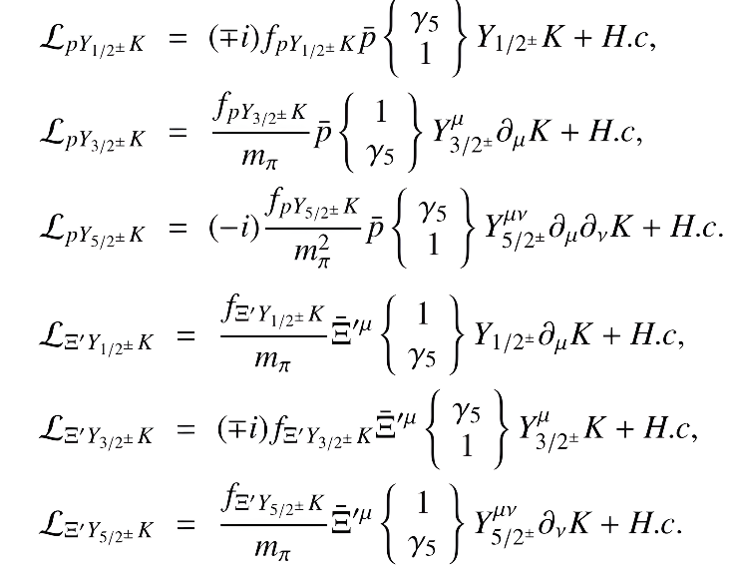
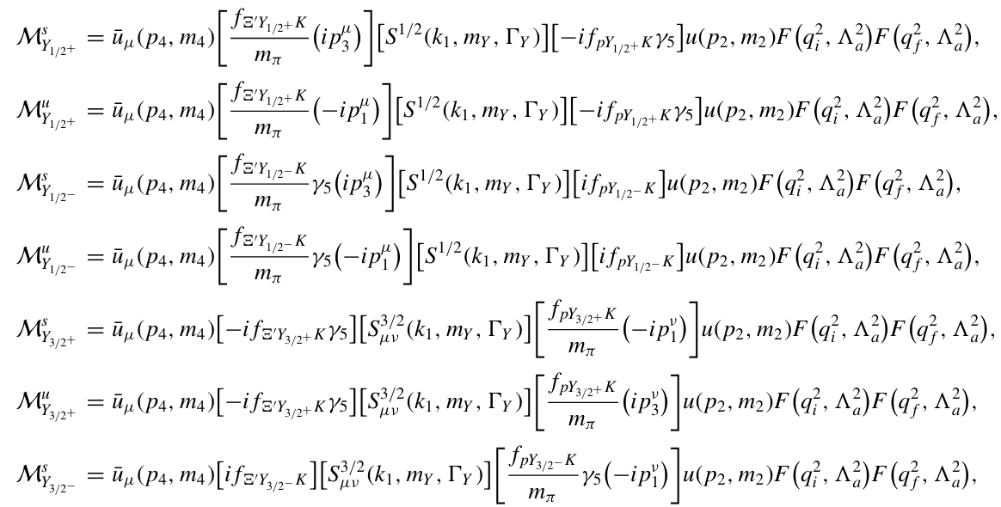
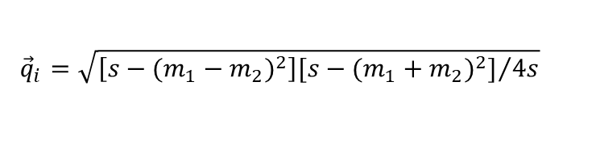


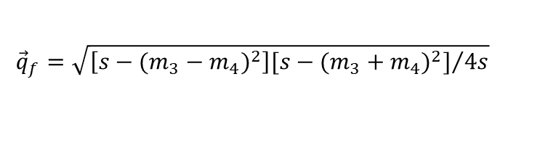
Formalism
The effective Lagrangian
Form factor
Eur. Phys. J. A 47,109 (2011).
The fitted parameters
$$F\left({\vec{q}}^{2},Λ_{i}^{2}\right)=exp\left(−{\vec{q}}^{2}/Λ_{i}^{2}\right)$$
$$ℳ_{Y}={\overline{u}}_{μ}\left(p_{4},m_{4}\right)\left[\frac{f_{Ξ^{′}YK}}{m_{π}}\left(ip_{3}^{μ}\right)\right]\left[S^{J}\right]\left[−if_{pYK}γ_{5}\right]u\left(p_{2},m_{2}\right)F_{1}F_{2}$$
$${\vec{q}}_{i}=\sqrt{{\left[s−{(m_{1}−m_{2})}^{2}\right][s−{(m_{1}+m_{2})}^{2}]}/{4s}}$$
$${\vec{q}}_{f}=\sqrt{{\left[s−{(m_{3}−m_{4})}^{2}\right][s−{(m_{3}+m_{4})}^{2}]}/{4s}}$$
$$g_{Y}=f_{Ξ^{′}YK}×f_{pYK}$$

Slide 7
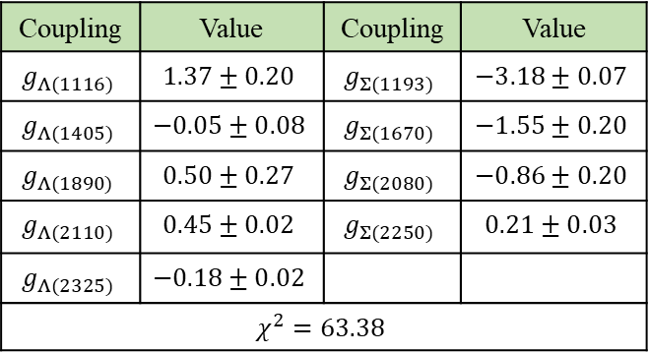


Formalism
Experimental data
$$\left(1\right){ K}^{−}p→K^{+}{Ξ(1530)}^{−}$$
34 points
Phys. Rev. 147, 945 (1966).
Phys. Rev. D 16, 2706 (1977).
$$\left(2\right){ K}^{−}p→K^{0}{Ξ(1530)}^{0}$$
25 points
Phys. Rev. 179, 1262 (1969).
CERN-HERA-79-02 (1979).
Cross sections: Scenario A
The fitted parameters
Coupling | Value | Coupling | Value
$$g_{Λ(1116)}$$ | $$1.37±0.20$$ | $$g_{Σ(1193)}$$ | $$−3.18±0.07$$
$$g_{Λ(1405)}$$ | $$−0.05±0.08$$ | $$g_{Σ(1670)}$$ | $$−1.55±0.20$$
$$g_{Λ(1890)}$$ | $$0.50±0.27$$ | $$g_{Σ(2080)}$$ | $$−0.86±0.20$$
$$g_{Λ(2110)}$$ | $$0.45±0.02$$ | $$g_{Σ(2250)}$$ | $$0.21±0.03$$
$$g_{Λ(2325)}$$ | $$−0.18±0.02$$
$$χ^{2}=63.38$$
(1) The fitted cross sections for $K^{−}p→K^{+}{Ξ(1530)}^{−}$ in the range $\left[2.087, 2.168\right]$ GeV are in whole smaller.
(2) There are two clear peak structures around 2.1 GeV and 2.3 GeV in both neutral and charged processes.

Slide 8
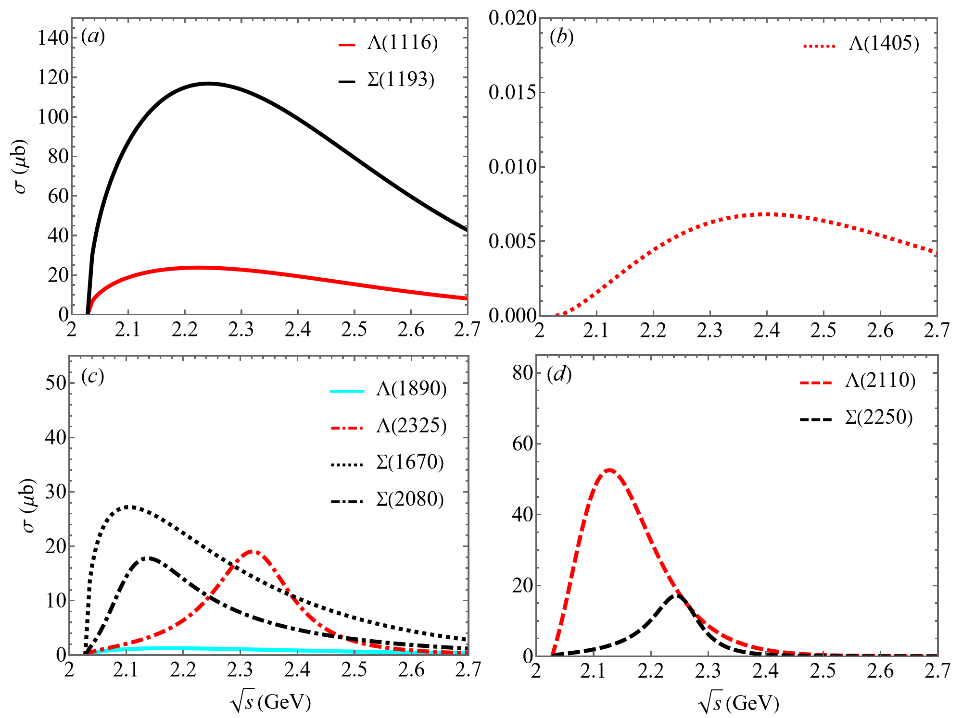
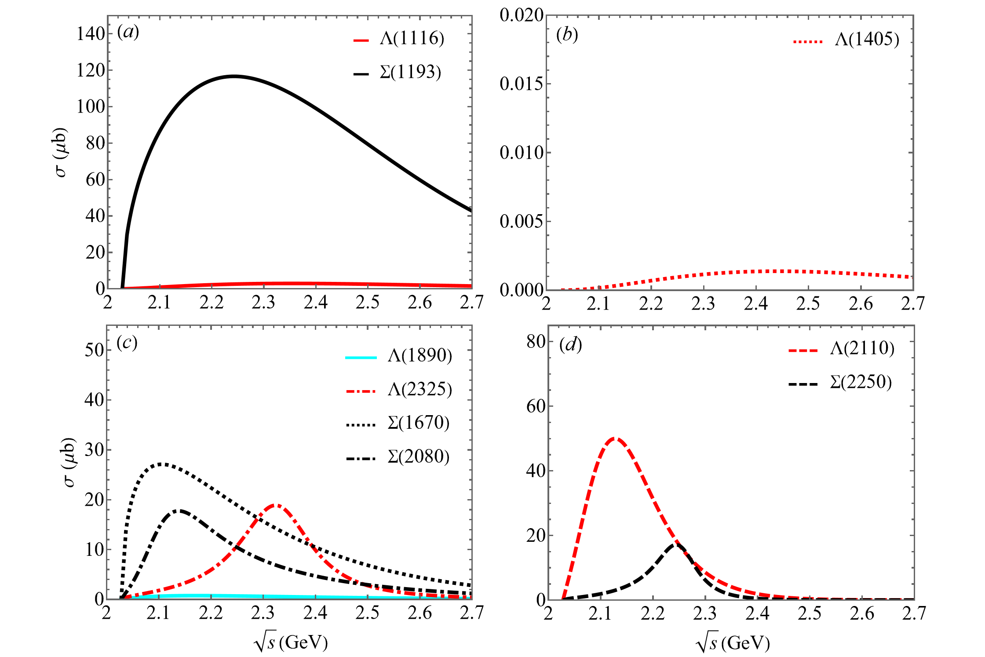


Formalism
Individual cross sections
$$K^{−}p→K^{+}{Ξ(1530)}^{−}$$
$$K^{−}p→K^{0}{Ξ(1530)}^{0}$$
(1) The maximum of the cross sections resulted from $Λ(2110)$ is estimated to be around 50 $μb$.
(2) The peak values of cross sections for $Λ(2325)$ and $Σ(2250)$ are about 20 $μb$.

Slide 9
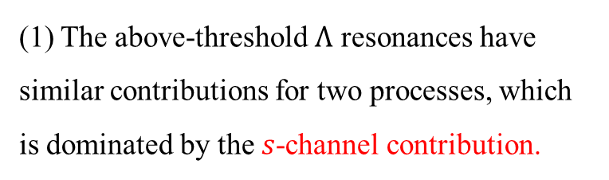
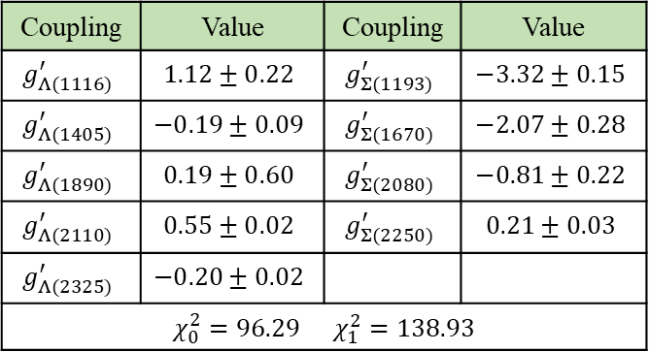
Formalism
Cross sections: Scenario B
The fitted parameters
Coupling | Value | Coupling | Value
$$g_{Λ(1116)}^{′}$$ | $$1.12±0.22$$ | $$g_{Σ(1193)}^{′}$$ | $$−3.32±0.15$$
$$g_{Λ(1405)}^{′}$$ | $$−0.19±0.09$$ | $$g_{Σ(1670)}^{′}$$ | $$−2.07±0.28$$
$$g_{Λ(1890)}^{′}$$ | $$0.19±0.60$$ | $$g_{Σ(2080)}^{′}$$ | $$−0.81±0.22$$
$$g_{Λ(2110)}^{′}$$ | $$0.55±0.02$$ | $$g_{Σ(2250)}^{′}$$ | $$0.21±0.03$$
$$g_{Λ(2325)}^{′}$$ | $$−0.20±0.02$$
$χ_{0}^{2}=96.29$ $χ_{1}^{2}=138.93$
(1) The above-threshold $Λ$ resonances have similar contributions for two processes, which is dominated by the $s$-channel contribution.
(2) Consistent with Scenario A, two peak structures are clearly observed in the results.

Slide 10


Formalism
Differential cross sections
$$K^{−}p→K^{+}{Ξ(1530)}^{−}$$
$$K^{−}p→K^{0}{Ξ(1530)}^{0}$$

Slide 11
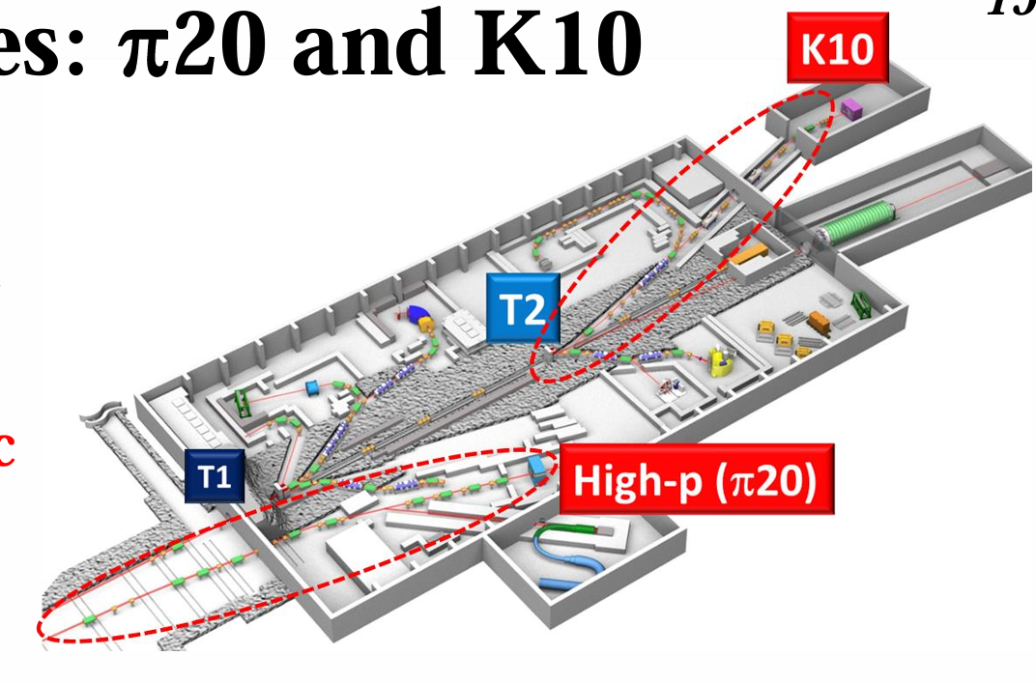
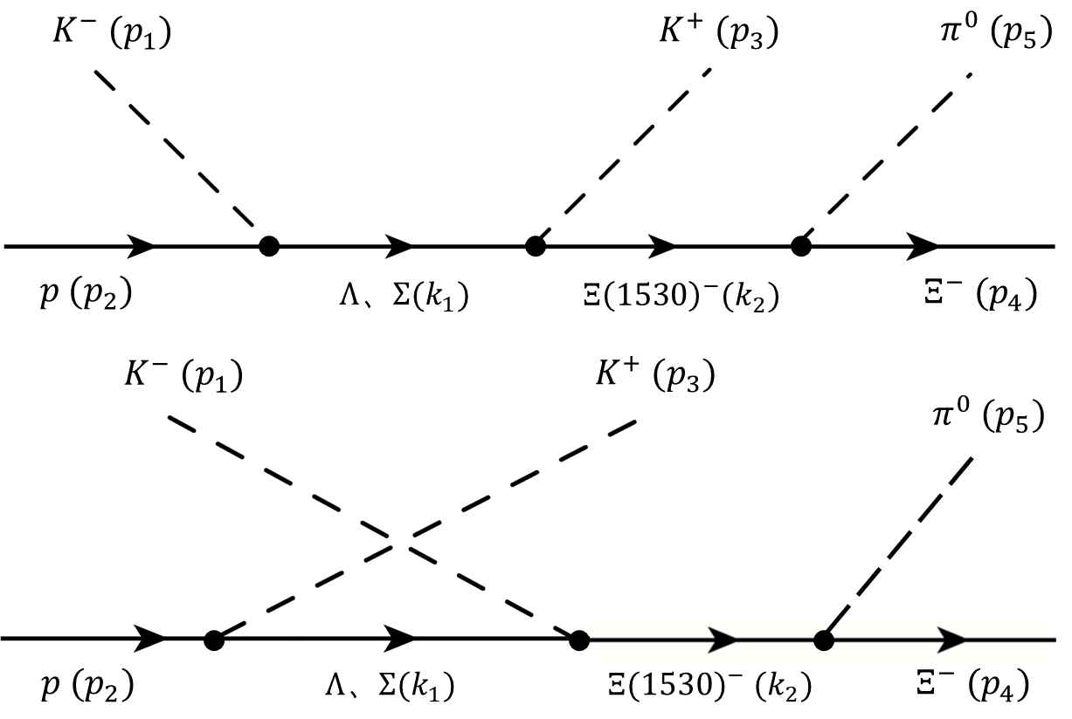
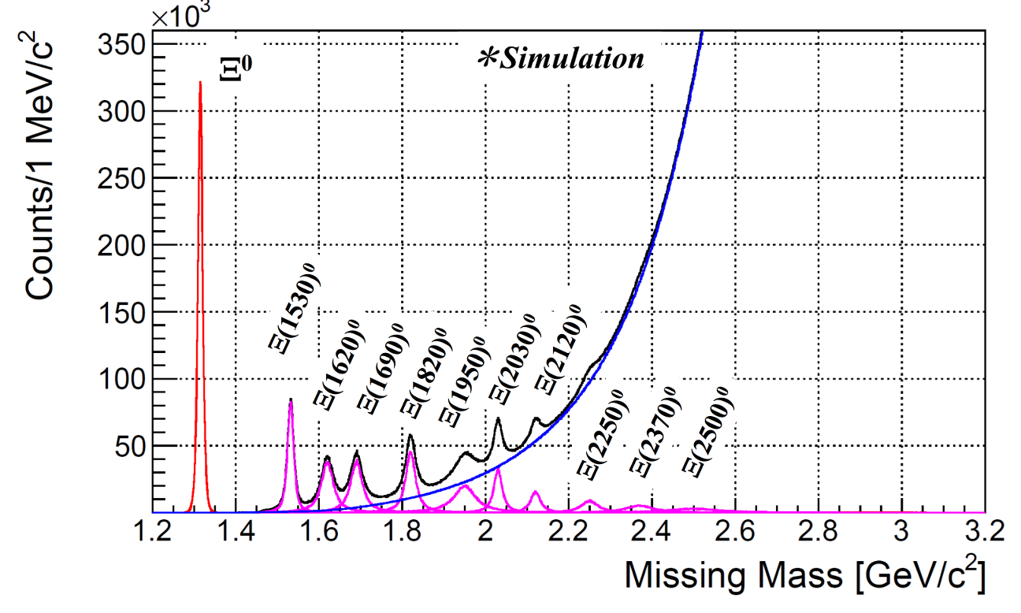
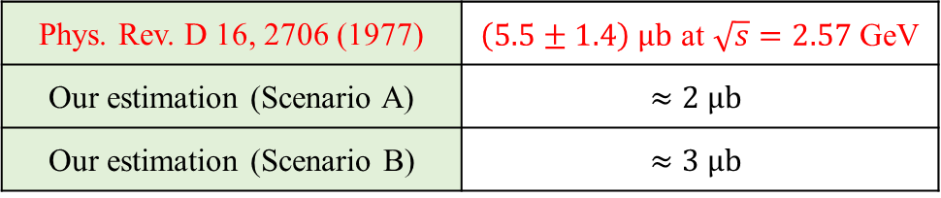



Formalism
$K^{−}p→K^{−}{Ξ(1530)}^{−}→K^{−}Ξ^{−}π^{0}$
J-PARC--K10
e-Print: 2110.04462
(1) K10 Beam Momentum: $<10$GeV.
(2) K10 Beam Intensity: ${\sim 7×10}^{6} K^{−}/spill$.
$$Br\left[{Ξ(1530)}^{−}→Ξ^{−}π^{0}\right]≈33.3\%$$
CERN-HERA-79-02 (1979).
Phys. Rev. D 16, 2706 (1977) | $\left(5.5±1.4\right) μb$ at $\sqrt{s}=2.57$GeV
Our estimation (Scenario A) | $$≈2 μb$$
Our estimation (Scenario B) | $$≈3 μb$$

Slide 12

Thank you very much

Slide 13
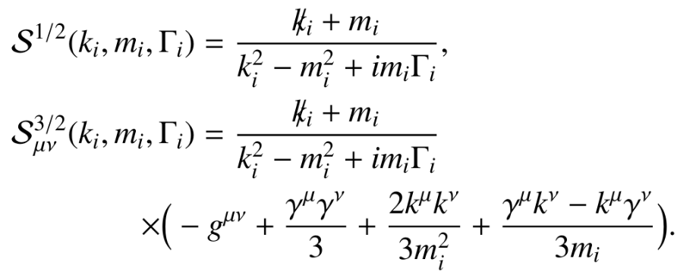
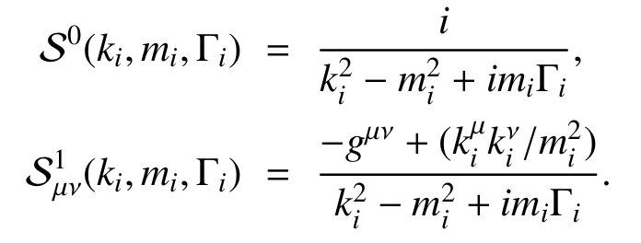
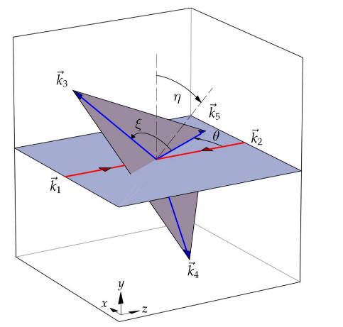
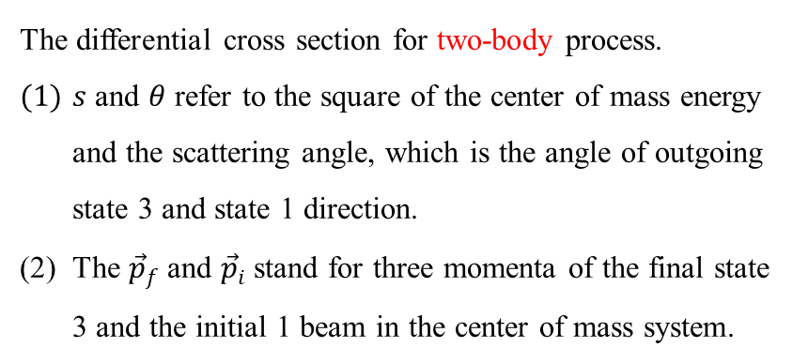


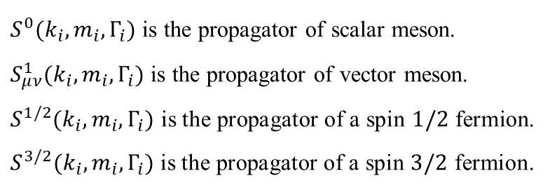
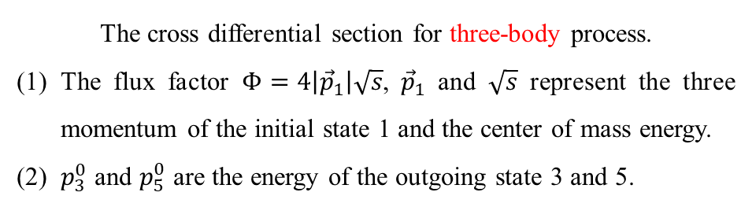

Appendix 1
The expressions of the propagators
$S^{0}(k_{i}, m_{i}, Γ_{i})$ is the propagator of scalar meson.
$S_{μν}^{1}(k_{i}, m_{i}, Γ_{i})$ is the propagator of vector meson.
$S^{1/2}(k_{i}, m_{i}, Γ_{i})$ is the propagator of a spin $1/2$ fermion.
$S^{3/2}(k_{i}, m_{i}, Γ_{i})$ is the propagator of a spin $3/2$ fermion.
The cross section calculation formula
$$\frac{dσ}{dcosθ}=\frac{1}{32πs}\frac{\left|{\vec{p}}_{f}\right|}{\left|{\vec{p}}_{i}\right|}{\left|\overline{ℳ}\right|}^{2}$$
$$dσ=\frac{1}{8{(2π)}^{4}}\frac{1}{Φ}{\left|\overline{ℳ}\right|}^{2}dp_{5}^{0}dp_{3}^{0}dcosθdη$$
The differential cross section for two-body process.
$s$ and $θ$ refer to the square of the center of mass energy and the scattering angle, which is the angle of outgoing state 3 and state 1 direction.
The ${\vec{p}}_{f}$ and ${\vec{p}}_{i}$ stand for three momenta of the final state 3 and the initial 1 beam in the center of mass system.
$$dσ=\frac{1}{8{(2π)}^{4}s}\frac{1}{Φ}{\left|\overline{ℳ}\right|}^{2}m_{34}m_{45}dm_{34}dm_{45}dcosθdη$$
The cross differential section for three-body process.
The flux factor $Φ=4\left|{\vec{p}}_{1}\right|\sqrt{s}$, ${\vec{p}}_{1}$ and $\sqrt{s}$ represent the three momentum of the initial state 1 and the center of mass energy.
(2) $p_{3}^{0}$ and $p_{5}^{0}$ are the energy of the outgoing state 3 and 5.

Slide 14
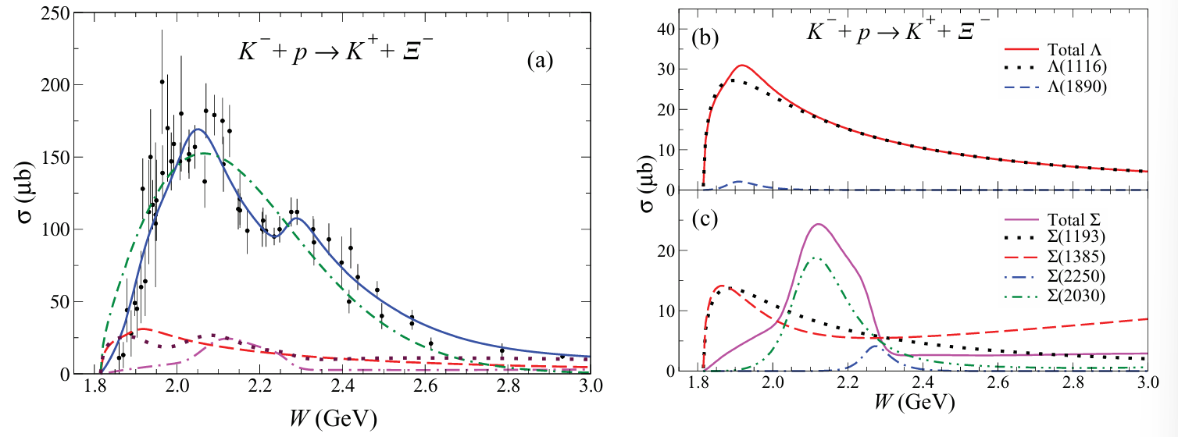
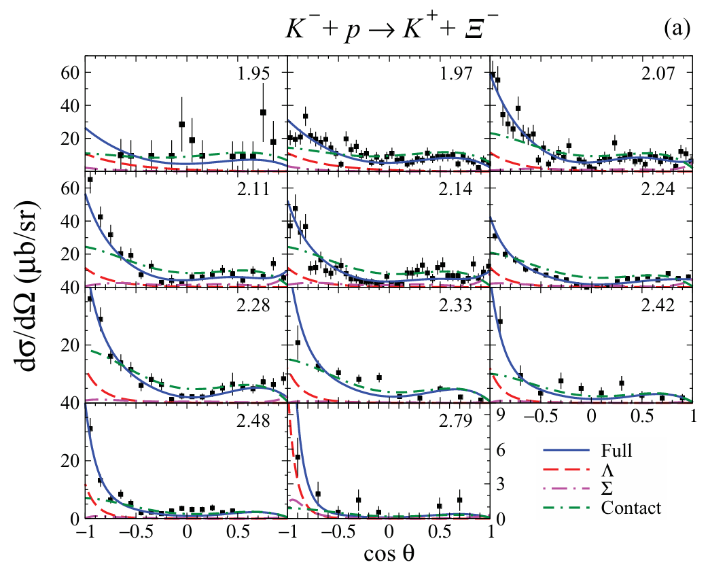
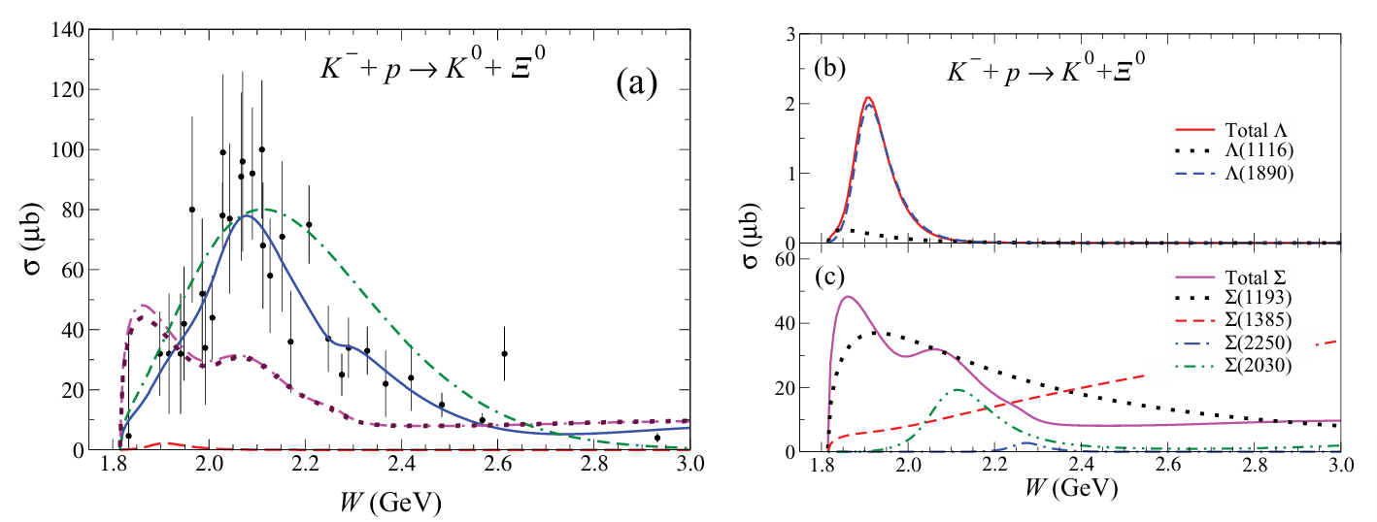
Appendix 2
Phys. Rev. C 91 (2015) 6, 065208

Slide 15
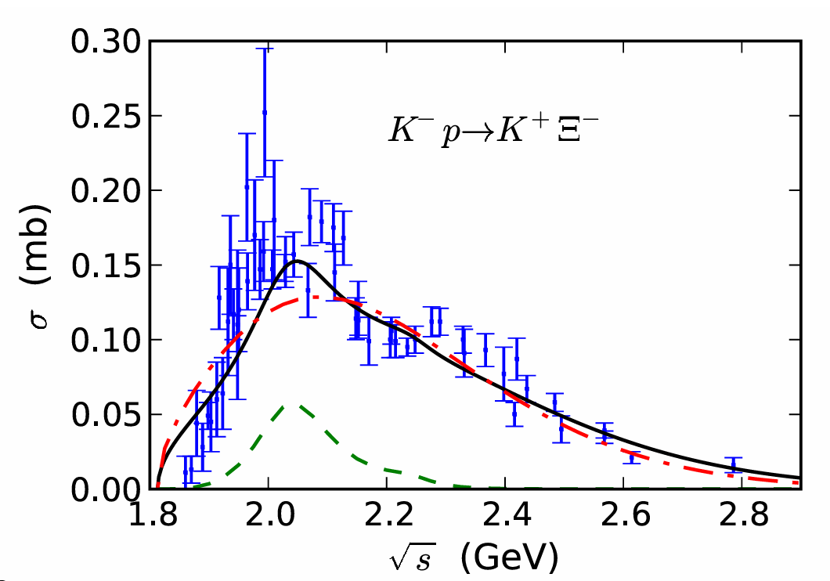
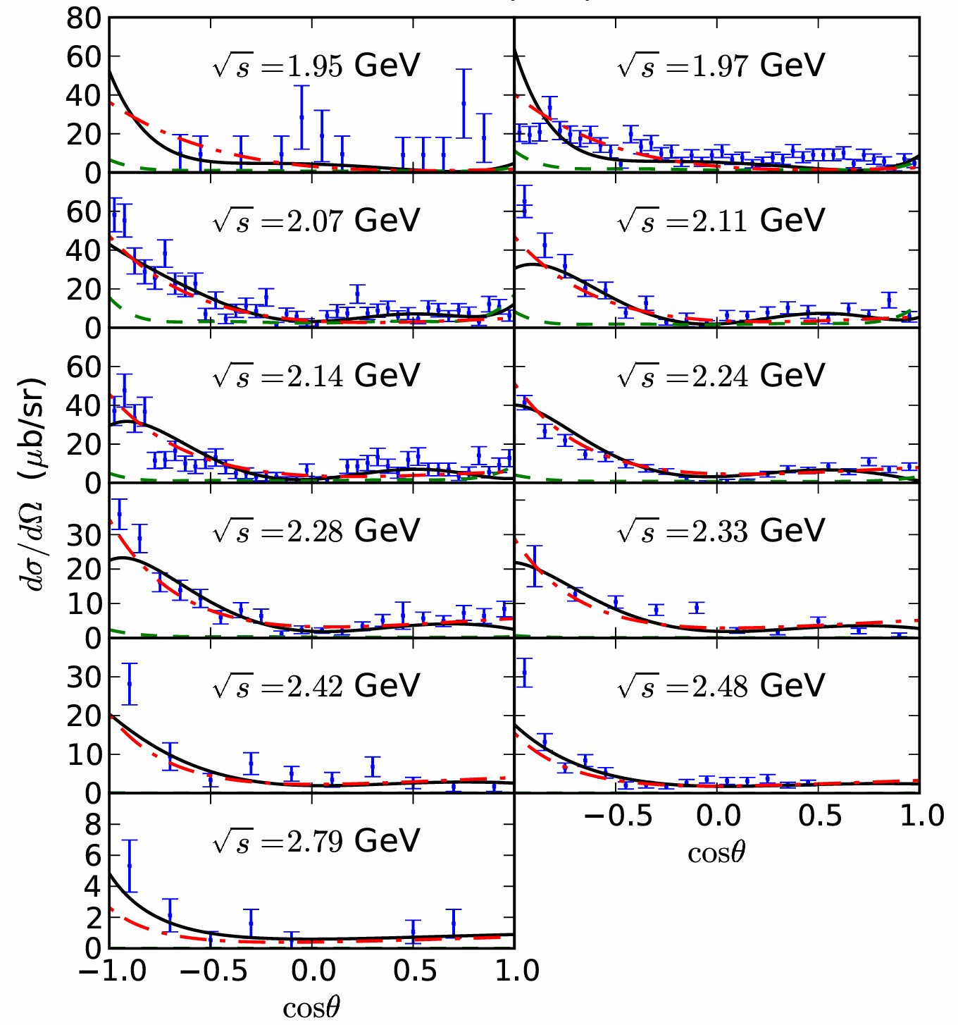
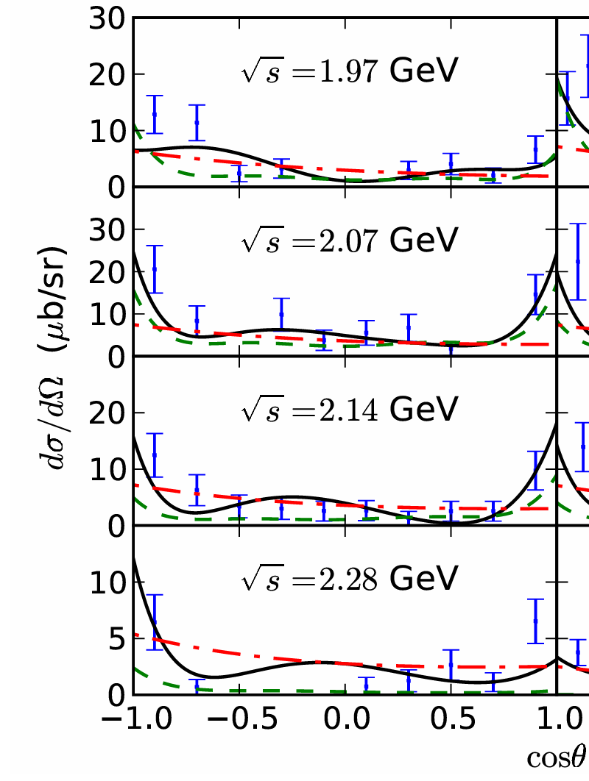
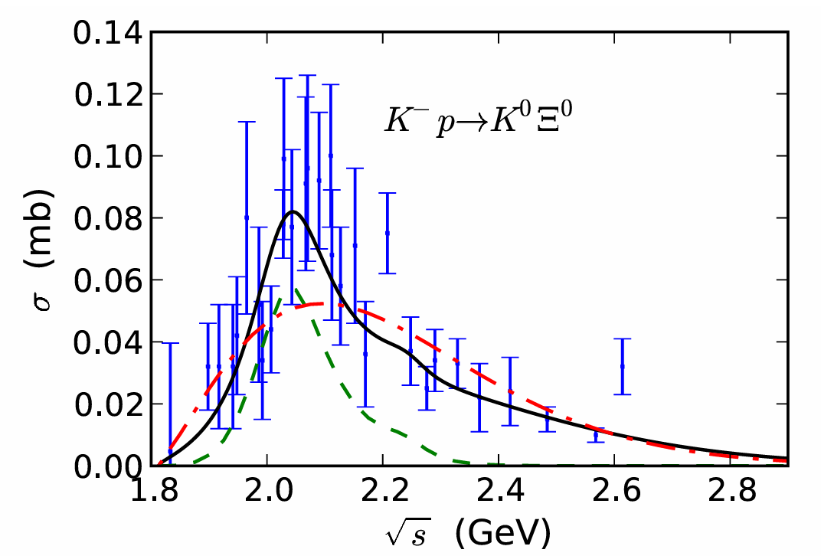


Appendix 3
Eur. Phys. J. A 47,109 (2011).
$$K^{−}p→K^{+}Ξ^{−}$$
$$K^{−}p→K^{0}Ξ^{0}$$

Slide 16

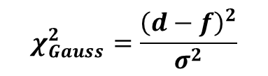
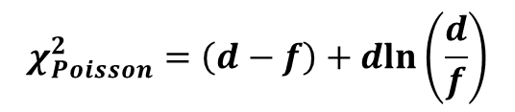
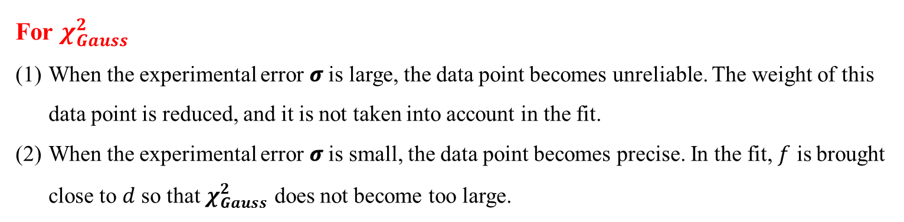


Appendix 4：Error calculation
$$χ_{Poisson}^{2}=\left(d−f\right)+dln\left(\frac{d}{f}\right)$$
$$χ_{Gauss}^{2}=\frac{{\left(d−f\right)}^{2}}{σ^{2}}$$
$$χ_{total}^{2}=χ_{Poisson}^{2}+χ_{Gauss}^{2}$$
$$d:central value of experimental data$$
$$f:theoretical results on predicted values of data point$$
$$σ:error of data point$$
For $χ_{Gauss}^{2}$
When the experimental error 𝝈 is large, the data point becomes unreliable. The weight of this data point is reduced, and it is not taken into account in the fit.
When the experimental error 𝝈 is small, the data point becomes precise. In the fit, $f$ is brought close to $d$ so that $χ_{Gauss}^{2}$ does not become too large.

