Slide 1
The multi-solution problem in experimental fitting
Dian-Yong Chen
Southeast University
Yu Bai and Dian-Yong Chen, Phys. Rev. D 99, 072007 (2019)
Yu Bai and Dian-Yong Chen, Preparing
Shangqiu 2026-05-15

Slide 2
Outline
1. Introduction
2. multiple solutions of interfering resonances combinations
General analysis/ Geometric solution
3. (Approximate) Multiple solutions due to Interfering Backgrounds
General analysis/ Exponential Background Case
4. Summary

Slide 3
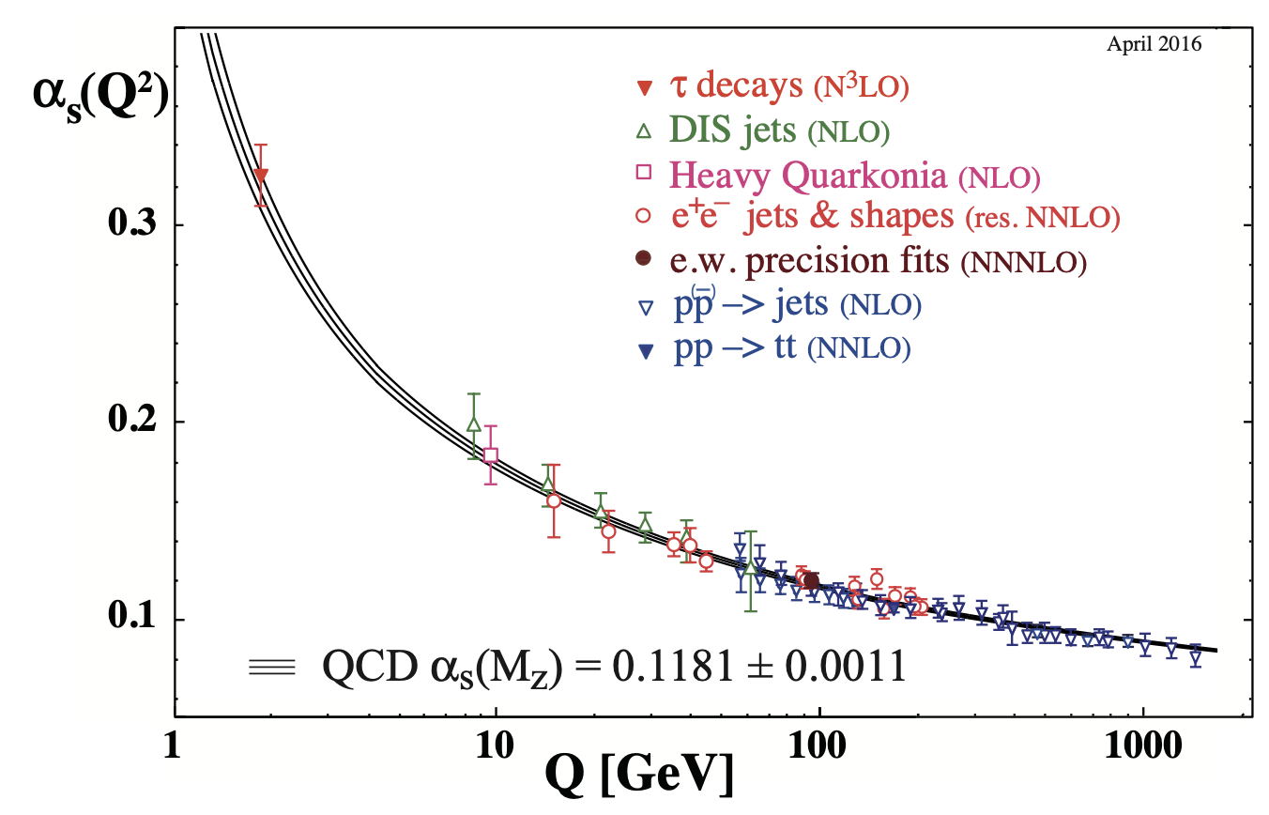

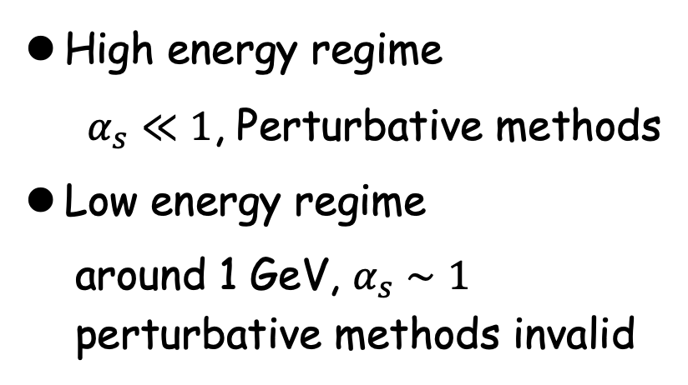
1. Introduction
QCD and Running strong coupling constant
High energy regime
$α_{s}≪1$, Perturbative methods
Low energy regime
around 1 GeV, $α_{s}∼1$
perturbative methods invalid
Hadron physics is the powerful and promising tools of understanding non-perturbative properties of QCD.
$α_{s}$ as a function of the energy scale

Slide 4
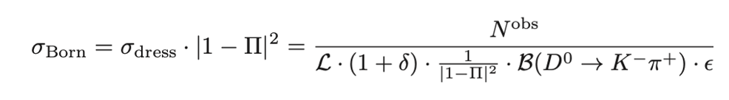
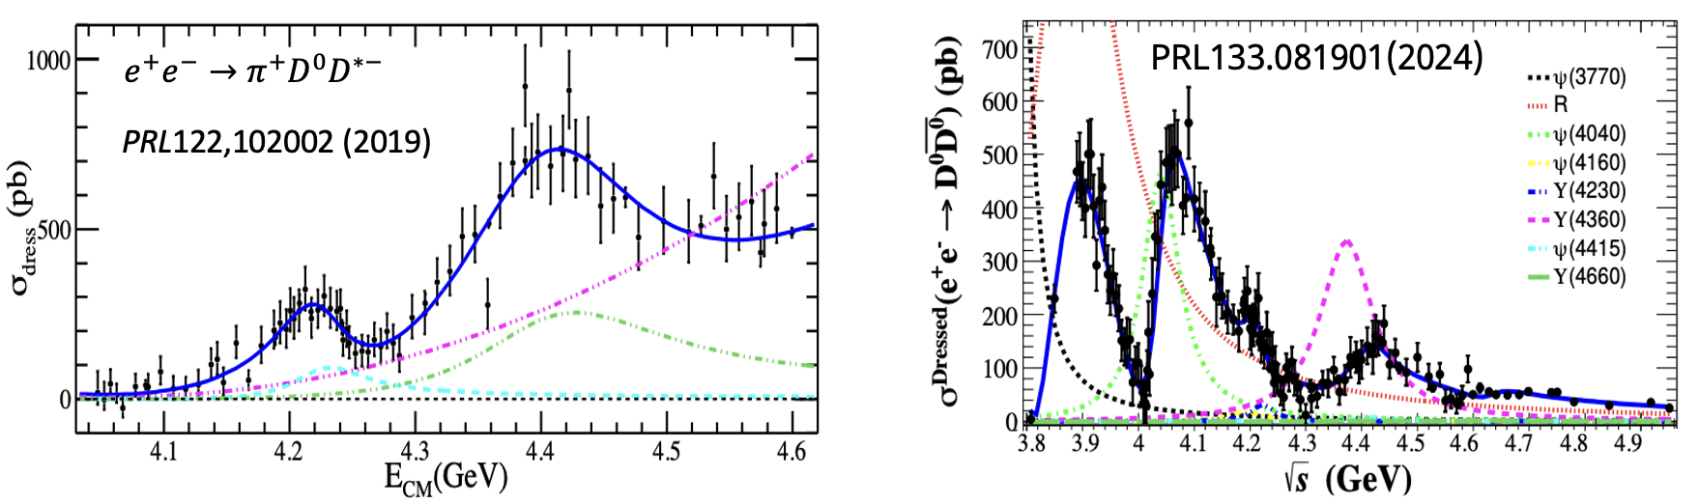
1. Introduction
Experimental measurements: Events -> cross sections
Examples:

Slide 5
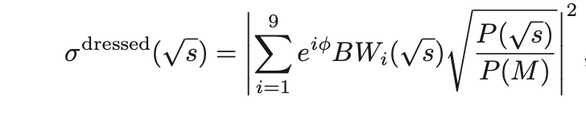
1. Introduction
Physical descriptions of experimental data:
Coherent sum of resonances contributions and
non-resonant background contributions if needed
Examples
Without non-resonant background [$e^{+}e^{−}→\overline{D}D$]
With non-resonant background [$e^{+}e^{−}→π^{+}D^{0}D^{∗−}$]

Slide 6
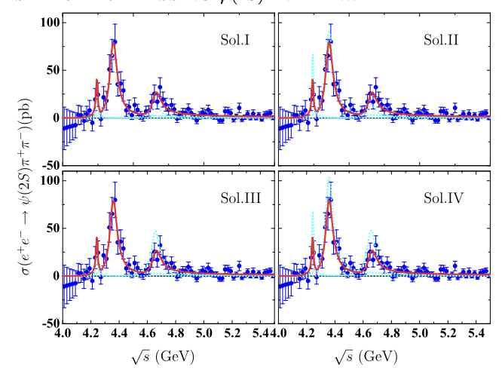
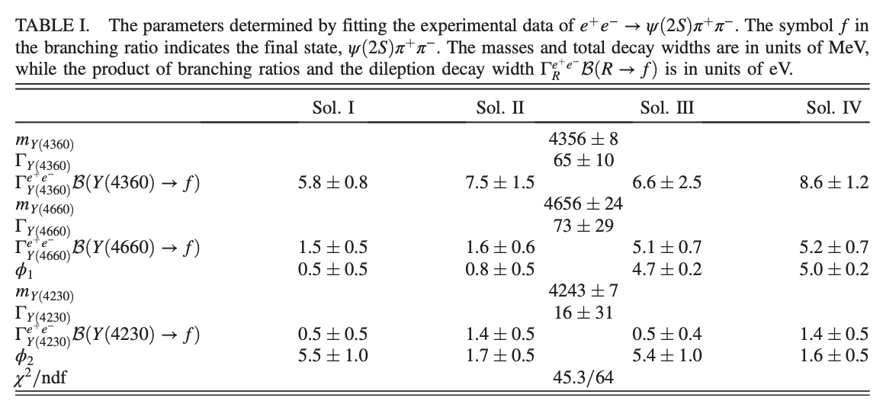
1. Introduction
Destructive and constructive interference lead to multisolutions with equally good quality;
Fit the cross sections of $e^{+}e^{−}→π^{+}π^{−}ψ\left(2S\right)$ with 3 resonances PRD93,034028 (2016)
Before determining which one is the “physically real” solution, we need to ensure that all possible solutions have been found.
Only one solution is ”PHYSICAL REAL”;

Slide 7
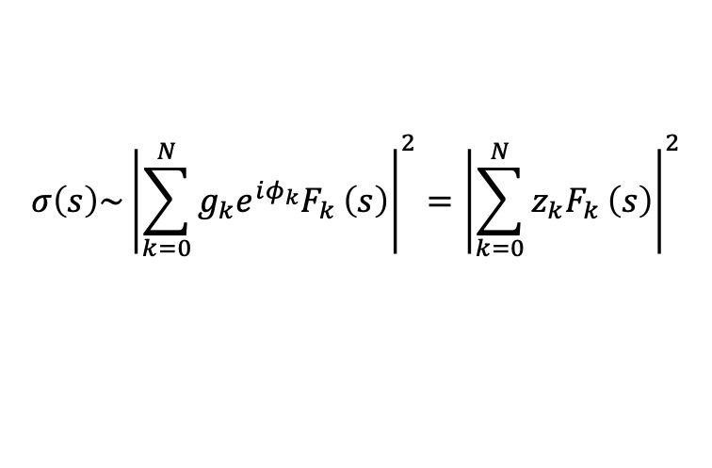
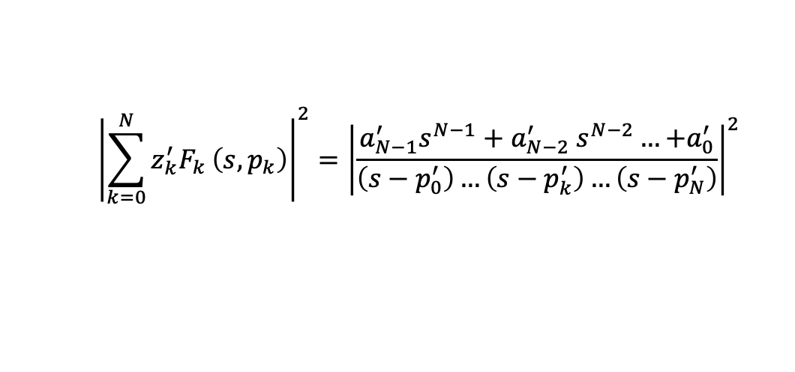
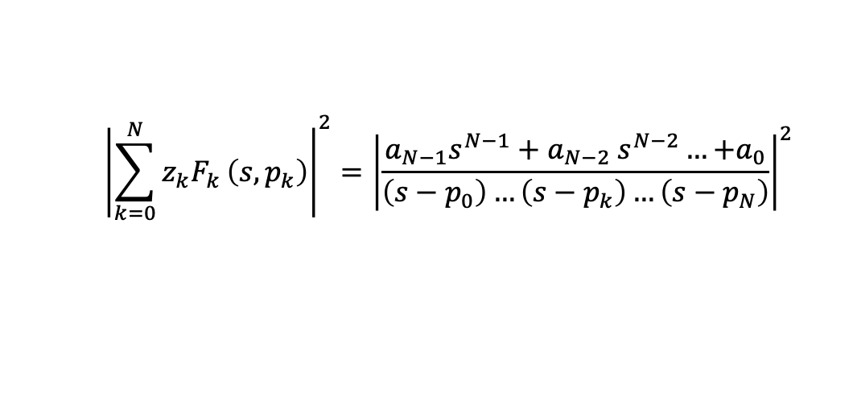
2. Interfering resonances combinations
Simple Breit-Wigner case:
$$σ\left(s\right)\sim {\left|\sum_{k=0}^{N}{{g_{k}e^{iφ_{k}}F}_{k}}\left(s\right)\right|}^{2}={\left|\sum_{k=0}^{N}{{z_{k}F}_{k}}\left(s\right)\right|}^{2}$$
With $F_{k}\left(s\right)=\frac{1}{s−p_{k}}$, $p_{k}=m_{k}^{2}−im_{k}Γ_{k}$, $z_{k}=g_{k}e^{iφ_{k}}$
$${\left|\sum_{k=0}^{N}{{z_{k}F}_{k}}\left(s,p_{k}\right)\right|}^{2}={\left|\frac{{a_{N−1}s}^{N−1}+a_{N−2} s^{N−2}…{+a}_{0}}{\left(s−p_{0}\right)…\left(s−p_{k}\right)…\left(s−p_{N}\right)}\right|}^{2}$$
Solution I (Input):
$${\left|\sum_{k=0}^{N}{{z_{k}^{′}F}_{k}}\left(s,p_{k}\right)\right|}^{2}={\left|\frac{{a_{N−1}^{′}s}^{N−1}+a_{N−2}^{′} s^{N−2}…{+a}_{0}^{′}}{\left(s−p_{0}^{′}\right)…\left(s−p_{k}^{′}\right)…\left(s−p_{N}^{′}\right)}\right|}^{2}$$
Solution II(Output):

Slide 8
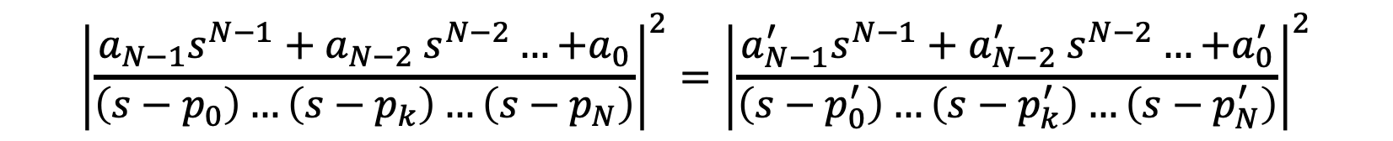
2. Interfering resonances combinations
Multisolutions with equally good quality:
$${\left|\frac{{a_{N−1}s}^{N−1}+a_{N−2} s^{N−2}…{+a}_{0}}{\left(s−p_{0}\right)…\left(s−p_{k}\right)…\left(s−p_{N}\right)}\right|}^{2}={\left|\frac{{a_{N−1}^{′}s}^{N−1}+a_{N−2}^{′} s^{N−2}…{+a}_{0}^{′}}{\left(s−p_{0}^{′}\right)…\left(s−p_{k}^{′}\right)…\left(s−p_{N}^{′}\right)}\right|}^{2}$$
(1) Extend to complex plane, the above function will be infinity at$s=p_{k}^{(′)}$
pole position should be the same. $⇒$ $p_{0}=p_{0}^{′}, …p_{k}=p_{k}^{′},…p_{N}=p_{N}^{′}.$
$⇒$ resonance parameters ($m_{k},Γ_{k}$) are the same for different solutions
Then we need:
$$\left|{a_{N−1}s}^{N−1}+a_{N−2} s^{N−2}…{+a}_{0}\right|=\left|{a_{N−1}^{′}s}^{N−1}+a_{N−2}^{′} s^{N−2}…{+a}_{0}^{′}\right|$$

Slide 9
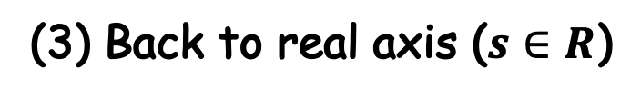
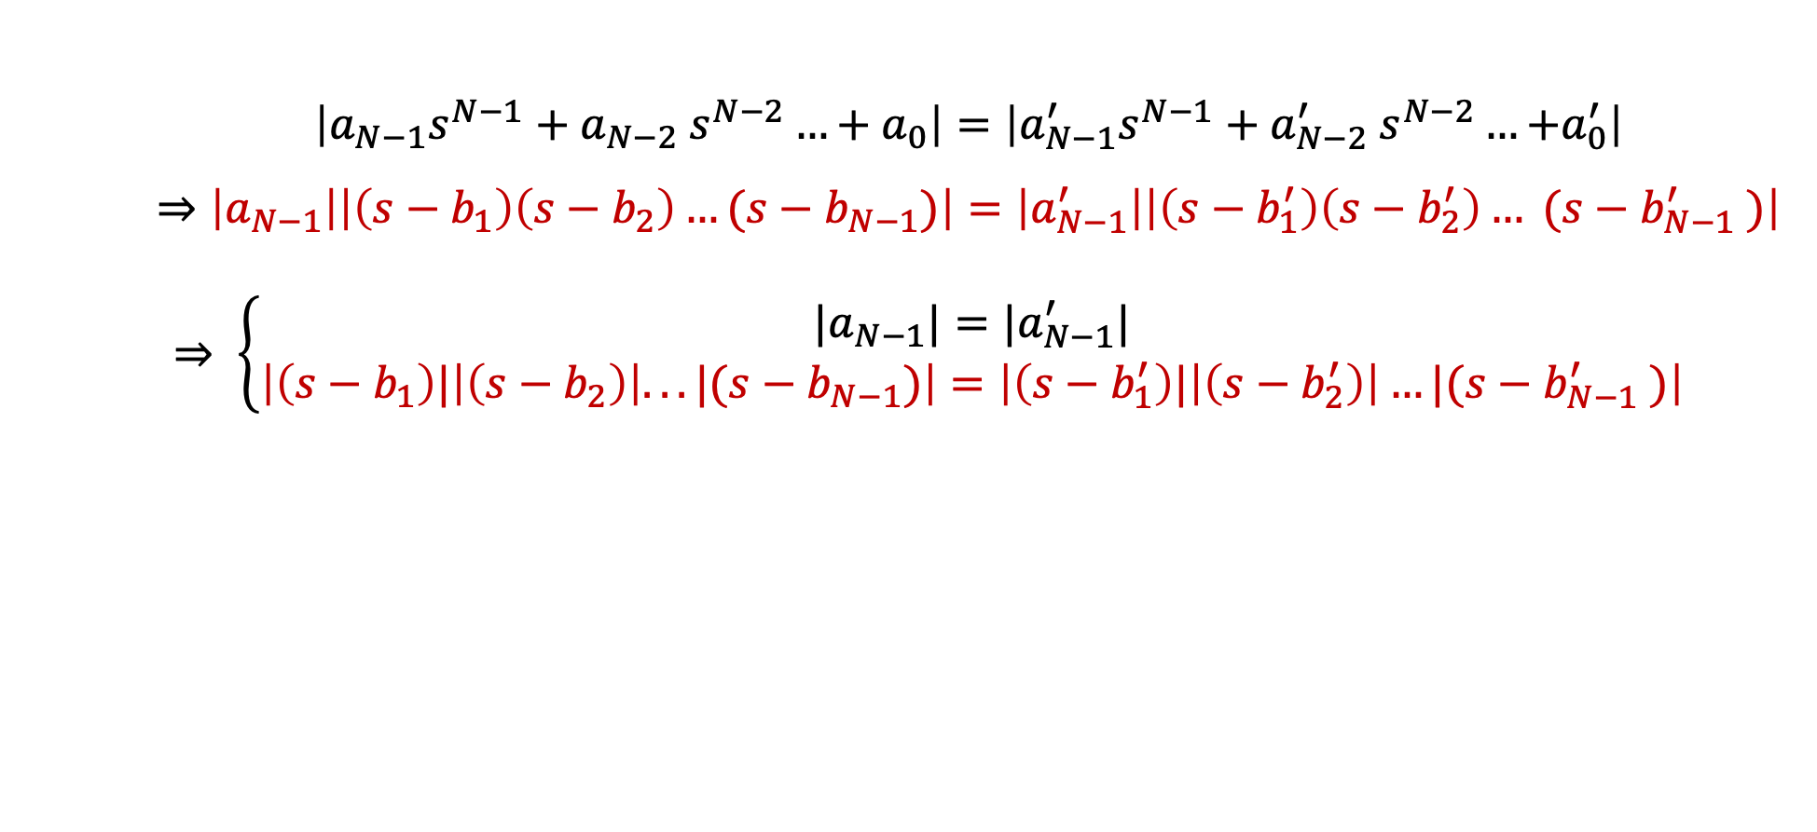

2. Interfering resonances combinations
(2) Factorization： N-1 zeros
$$\left|{a_{N−1}s}^{N−1}+a_{N−2} s^{N−2}…+a_{0}\right|=\left|{a_{N−1}^{′}s}^{N−1}+a_{N−2}^{′} s^{N−2}…{+a}_{0}^{′}\right|$$
$$⇒\left|a_{N−1}\right|\left|\left(s−b_{1}\right)\left(s−b_{2}\right)…(s−b_{N−1})\right|=\left|a_{N−1}^{′}\right|\left|\left(s−b_{1}^{′}\right)\left(s−b_{2}^{′}\right)… (s−b_{N−1}^{′} )\right|$$
$⇒ \left\{\begin{matrix}{|a}_{N−1}|={|a}_{N−1}^{′}| \\ \left|\left(s−b_{1}\right)|\left|\left(s−b_{2}\right)\right|...|(s−b_{N−1})\right|=\left|\left(s−b_{1}^{′}\right)|\left|\left(s−b_{2}^{′}\right)\right|…|(s−b_{N−1}^{′} )\right|\end{matrix}\right.$
(3) Back to real axis ($s∈R$)
Set one or more zeros to its complex conjugate, i.e., $b_{k}^{′}=b_{k}^{∗}$
For N resonances, solutions with equally good quality:
$1+\left(\begin{matrix}N−1 \\ 1\end{matrix}\right)+\left(\begin{matrix}N−1 \\ 2\end{matrix}\right)$+… $\left(\begin{matrix}N−1 \\ N−1\end{matrix}\right)=2^{N−1}$

Slide 10
2. Interfering resonances combinations
(4) Keypoint:
Find all the zeros of ${a_{N−1}s}^{N−1}+a_{N−2} s^{N−2}…+a_{0}$
N=2: K. Zhu, X.H.Mo, and C.Z.Yuan, Int.J.Mod.Phys.A26 4511 (2011);
(Analytically expression for two different solutions)
N=3: X. Han and C. P. Shen, Chin. Phys. C 42, 043001 (2018);
(No analytical relations between the parameters in different solutions,
present some constraint equations for the parameters)
N>3: More difficult and complicated.
If we have obtained one solution, how to get all the rest solution

Slide 11

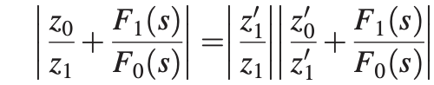
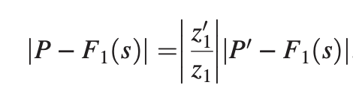
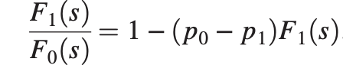
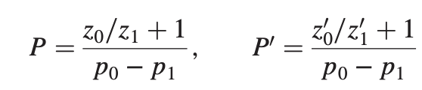



2. Interfering resonances combinations
Geometric solution
Two resonances case;
Divide by $z_{1}F_{0} (s)$
$$⇒$$
$$⇒$$
With

Slide 12
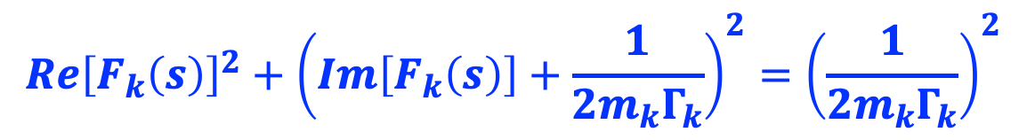
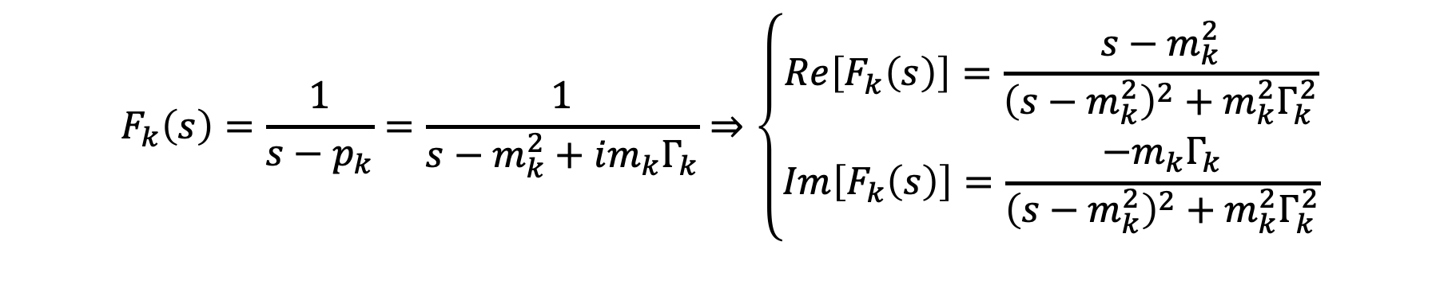

2. Interfering resonances combinations
(1) Geometric meaning：
$$F_{k}\left(s\right)=\frac{1}{s−p_{k}}=\frac{1}{s−m_{k}^{2}+im_{k}Γ_{k}}⇒\left\{\begin{aligned}Re\left[F_{k}\left(s\right)\right]=\frac{s−m_{k}^{2}}{{\left(s−m_{k}^{2}\right)}^{2}+m_{k}^{2}Γ_{k}^{2}} \\ Im\left[F_{k}\left(s\right)\right]=\frac{−m_{k}Γ_{k}}{{\left(s−m_{k}^{2}\right)}^{2}+m_{k}^{2}Γ_{k}^{2}}\end{aligned}\right.$$
$$Re{\left[F_{k}\left(s\right)\right]}^{2}+{\left(Im\left[F_{k}\left(s\right)\right]+\frac{1}{2m_{k}Γ_{k}}\right)}^{2}={\left(\frac{1}{2m_{k}Γ_{k}}\right)}^{2}$$
A circle with center $(0, −i/2m_{k}Γ_{k})$and radius $1/(2m_{k}Γ_{k})$ in the complex plane
when we extend s from positive to negative infinity.

Slide 13
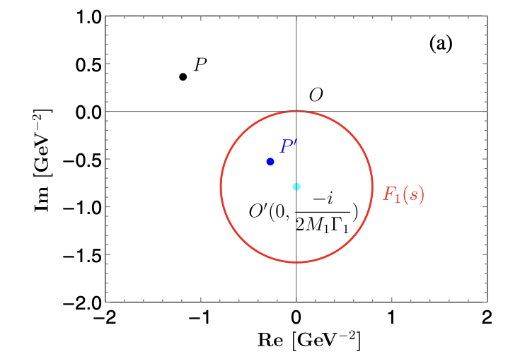
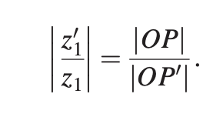
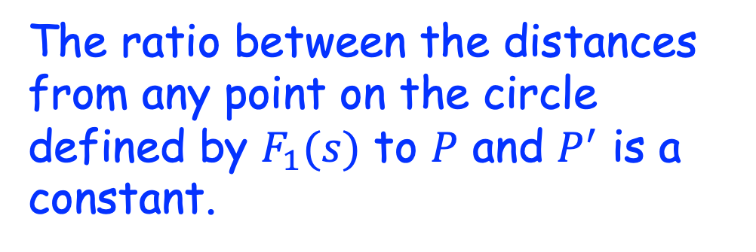
2. Interfering resonances combinations
(1) Geometric meaning：
The ratio between the distances from any point on the circle defined by $F_{1}(s)$ to $P$ and $P^{′}$ is a constant.
Then,

Slide 14
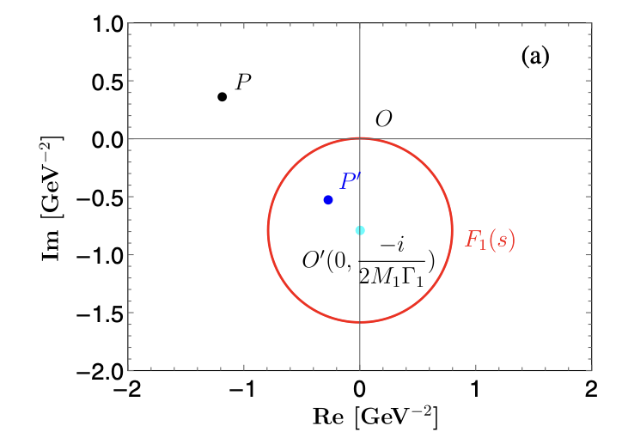
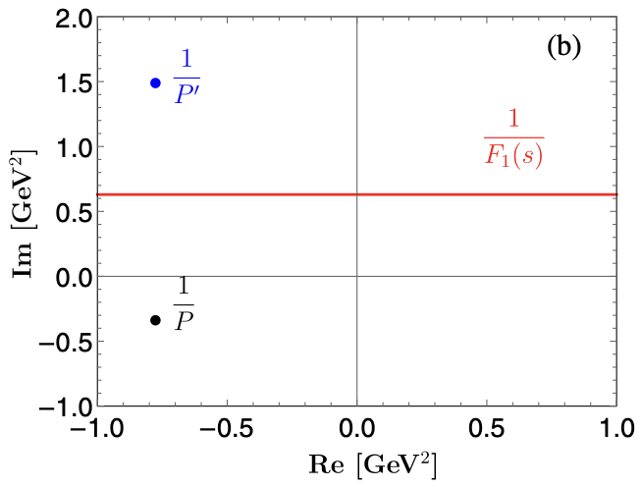

2. Interfering resonances combinations
(2) Reflection points
if $P$ and $P^{′}$ are a pair of reflection points on the circle of $F_{1}(s)$, $1/P$ and $1/P^{′}$ are a pair of reflection points on $1/F_{1}(s)$
$$⇒$$

Slide 15
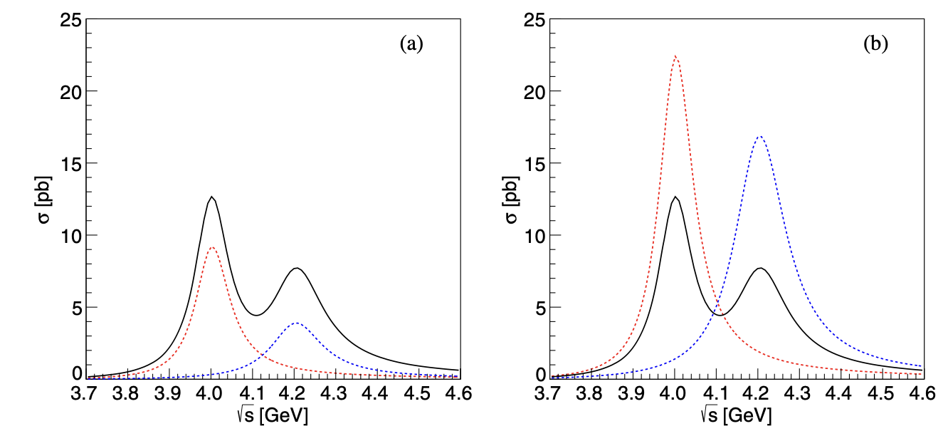
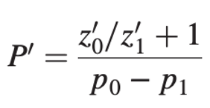

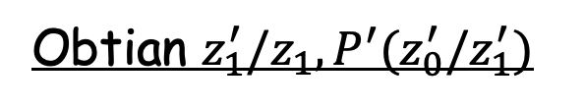
2. Interfering resonances combinations
(3) Example
Input
Input solutions.
Obtian $z_{0}, z_{1},P.$
output
Obtian $z_{1}^{′}/z_{1},P^{′}(z_{0}^{′}/z_{1}^{′})$
Output solutions

Slide 16
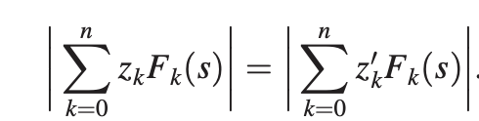
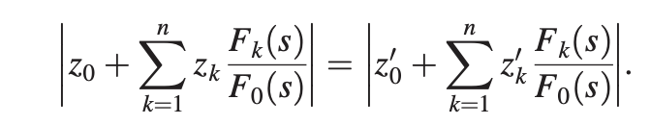
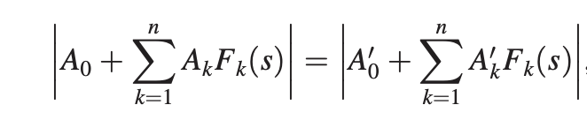
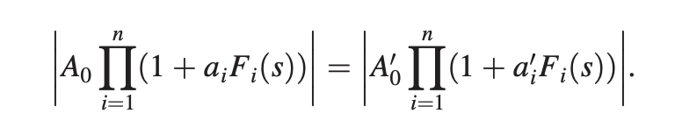


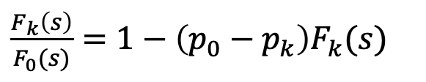

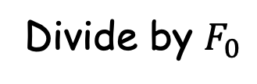

2. Interfering resonances combinations
More resonances case (n+1);
Divide by $F_{0}$
$$⇒$$
$\frac{F_{k}\left(s\right)}{F_{0}(s)}=1−\left(p_{0}−p_{k}\right)F_{k}(s)$
Factor out $A_{0}$ and $A_{0}^{′}$
$$⇒A_{0}=A_{0}^{′}$$
$$F_{i}\left(s→∞\right)=0$$

Slide 17
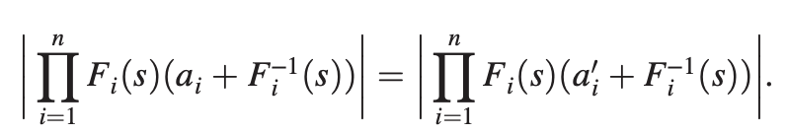
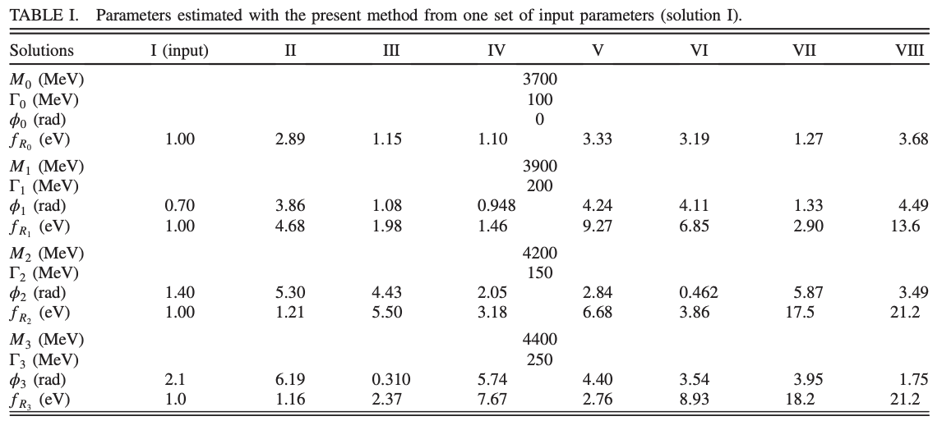
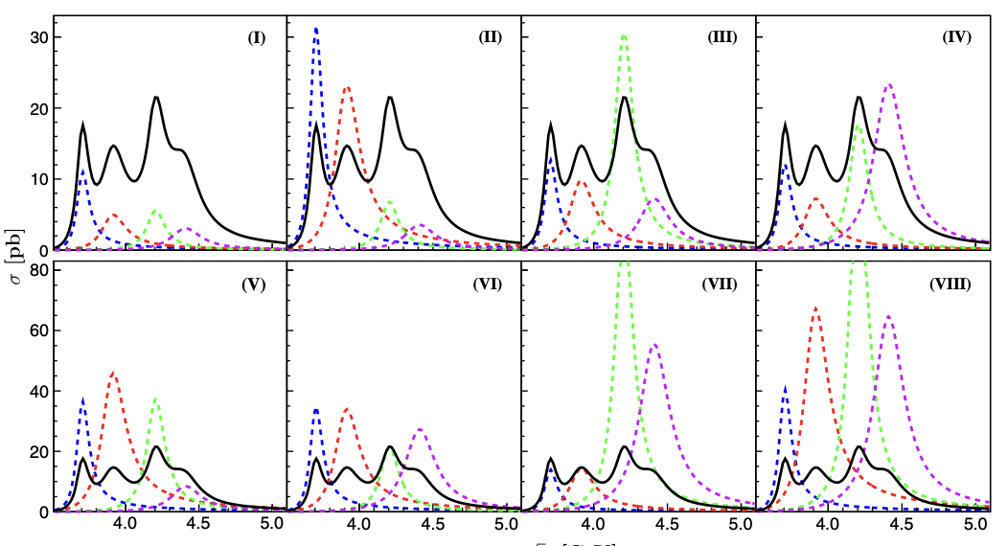
2. Interfering resonances combinations
−$a_{i}$ and ${−a}_{i}^{′}$ are a pair of reflections at $F_{i}^{−1}(s)$
Example (4 resonances)

Slide 18
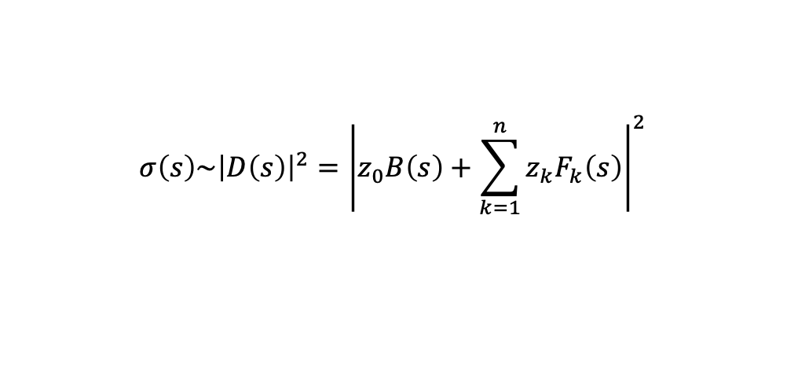
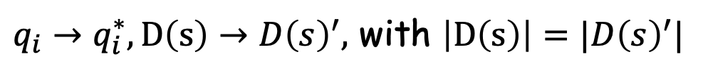
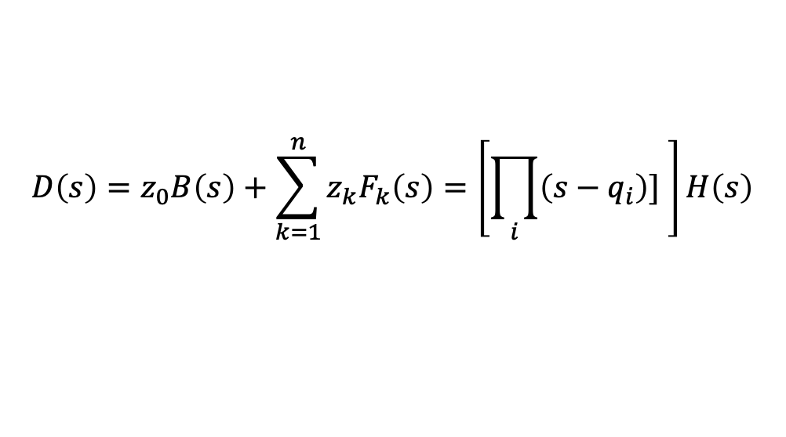
3. Interfering background
Resonances + interfering background
$$σ\left(s\right)\sim {\left|D\left(s\right)\right|}^{2}={\left|z_{0}B\left(s\right)+\sum_{k=1}^{n}{z_{k}F_{k}\left(s\right)}\right|}^{2}$$
Weierstrass factorization theorem (assuming $D(q_{i})=0$)
$$D\left(s\right)=z_{0}B\left(s\right)+\sum_{k=1}^{n}{z_{k}F_{k}\left(s\right)}=\left[\prod_{i}{\left(s−q_{i}\right)] }\right]H\left(s\right)$$
$q_{i}→q_{i}^{∗}, D\left(s\right)→D{\left(s\right)}^{′},$ with $\left|D\left(s\right)\right|=|D{\left(s\right)}^{′}|$
Input
Output
Q: can we write $D{\left(s\right)}^{′}$ as “Resonances + interfering background” form?

Slide 19



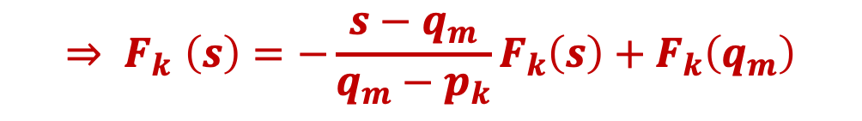

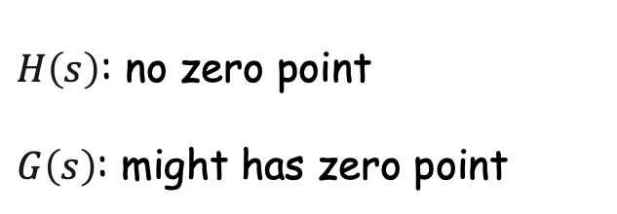
3. Interfering background: Strictly Solutions
Suppose $q_{m}$ is one of zeros of $D(s)$
then
$H\left(s\right)$: no zero point
$G\left(s\right)$: might has zero point
With
$$F_{k}\left(s\right)−F_{k}\left(q_{m}\right)=\frac{1}{s−p_{k}}−\frac{1}{q_{m}−p_{k}}=−\frac{s−q_{m}}{\left(s−p_{k}\right)\left(q_{m}−p_{k}\right)}=−\frac{s−q_{m}}{q_{m}−p_{k}}F_{k}\left(s\right)$$
$${⇒ F}_{k}\left(s\right)=−\frac{s−q_{m}}{q_{m}−p_{k}}F_{k}\left(s\right)+F_{k}\left(q_{m}\right)$$

Slide 20
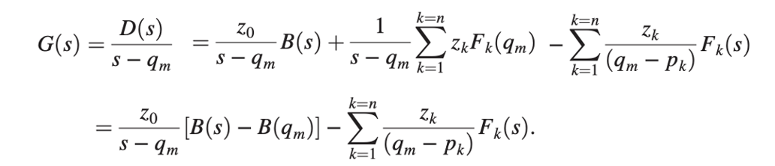
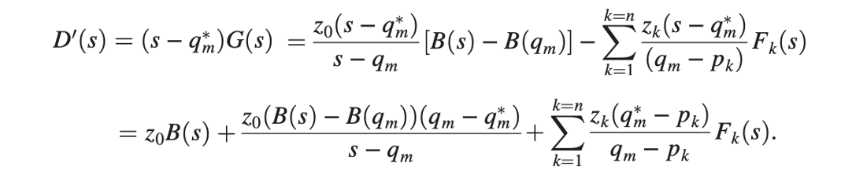
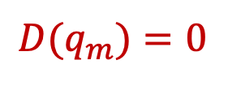
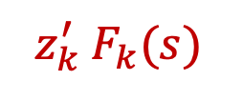

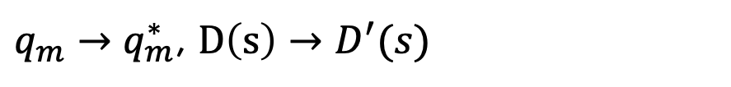
3. Interfering background : Strictly Solutions
then
$$D(q_{m})=0$$
$q_{m}→q_{m}^{∗}$, $D\left(s\right)→D^{′}(s)$
$$= z_{0} B^{′}\left(s\right) +$$
$$z_{k}^{′} F_{k}(s)$$
Strictly equal but generally change the form of the background

Slide 21
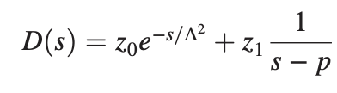

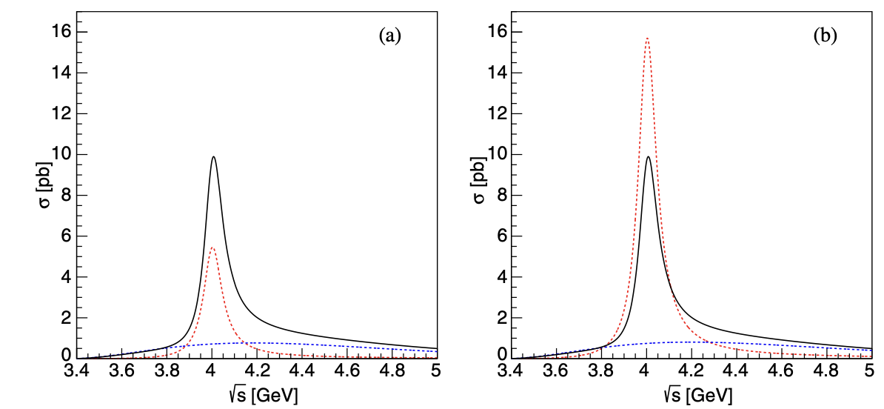

3. Interfering background : Strictly Solutions
Example 1: exponential background+ resonance
$$⇒$$
Input
Output

Slide 22

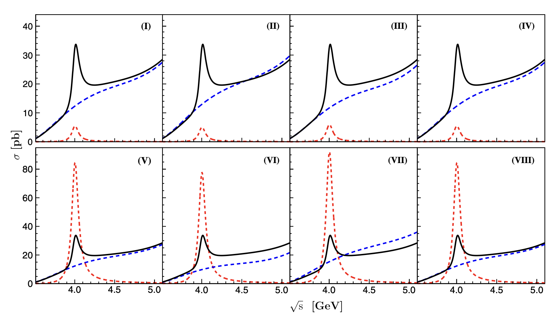
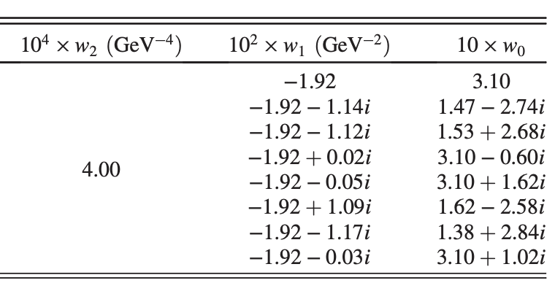
3. Interfering background : Strictly Solutions
Example 2: polynomial background+ resonance:
Unchanged
Input
Unchanged
Changed

Slide 23
3. Interfering background: approximately Solutions
Strictly Solutions：
Exponential background: change the form of the background.
Polynomial background: complex coefficients.
Approximate Solutions:
(1) Don’t change the form of the background
(2) The parameters in the background are real

Slide 24


3. Interfering background: approximately Solutions
BW-only Case
Exponential background case
Hadamard Factorization Theorem

Slide 25



3. Interfering background: approximately Solutions
Assuming two amplitude function $A_{1}(s)$ and $A_{2}(s)$ is a pair of equivalent solutions
$A_{1}(s)=A_{2}(s)$ implies:
(1) $p_{k}=p_{k}^{′}$ : the poles of two amplitudes are the same;
(2) $Λ=Λ^{′}$, if they are real (otherwise $Re[Λ]=Re[Λ^{′}]$)
(3) $(\prod_{i=1}^{i=∞}{(1−s/r_{i}))/(\prod_{i=1}^{i=∞}{(1−s/r_{i}^{′})) }}$ is a constant,
NOT possible generally, but can be true approximately

Slide 26




3. Interfering background: approximately Solutions
Example: exponential background + one resonance
Zeros:
$W_{i}\left(z\right):$Lambert W-function, defined as the inverse function of $g(z)=ze^{z}$,
multiple value function, infinite values indexed by integer $i$.
zeros near pole are important

Slide 27





3. Interfering background: approximately Solutions
Example: exponential background + one resonance
Zeros distribution in s-plane
Parameters
$${r_{1}^{′}=r}_{1}^{∗}$$
Pole
$$r_{1}$$

Slide 28




3. Interfering background: approximately Solutions
Example: exponential background + three resonance
$e^{+}e^{−}→η J/ψ$ [BESIII Phys. Rev. D 109, 092012 (2024)]
Solutions I as input
Zero in $\sqrt{s}$plane

Slide 29

3. Interfering background
Predict 4 solutions, well consistent with the fit result
4 More Solutions also predict, but too close to the other 4

Slide 30

summary
1. Strictly solutions for interfering resonances combinations.
2. Strictly solutions for interfering background:
change the form of the background
introduce complex parameter in the background
3. Approximately solutions for interfering background:
strongly connect to the zeros of the amplitudes

Slide 31

Thank you for your attention!

