Slide 1



Revising the Mass of Light Hybrid Mesons: NLO QCD Sum Rules Point to ϕ(2170) as a Prime Candidate
Zhuo-Ran Huang
In collaboration with:
Shuang-Hong Li, Wei Chen, Hong-Ying Jin
JHEP 03 (2026) 087

Slide 2

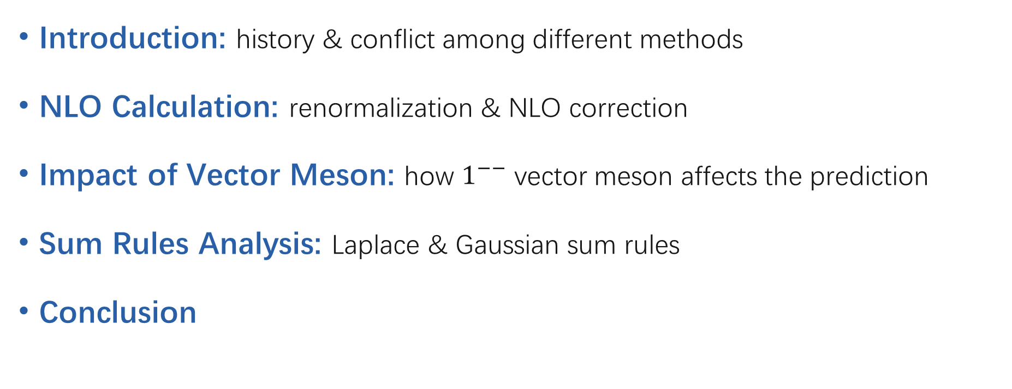
Outline
Introduction: history & conflict among different methods
NLO Calculation: renormalization & NLO correction
Impact of Vector Meson: how $1^{−−}$ vector meson affects the prediction
Sum Rules Analysis: Laplace & Gaussian sum rules
Conclusion

Slide 3
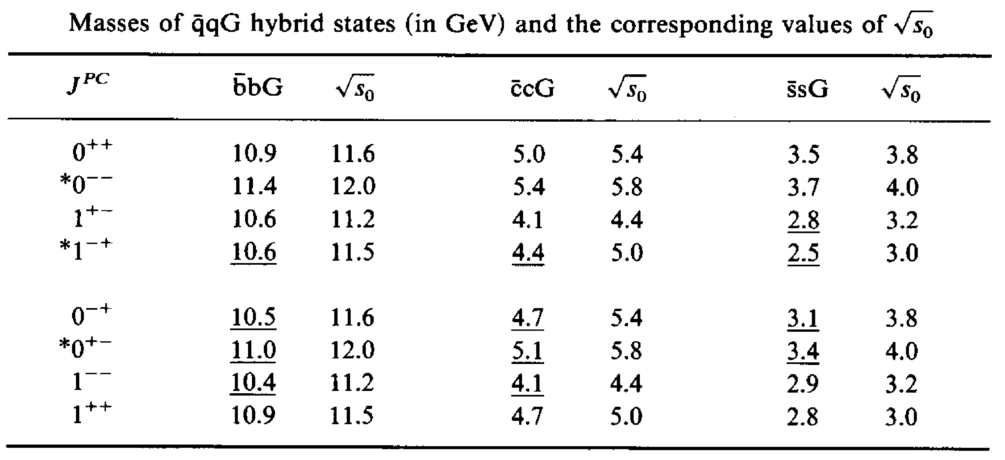
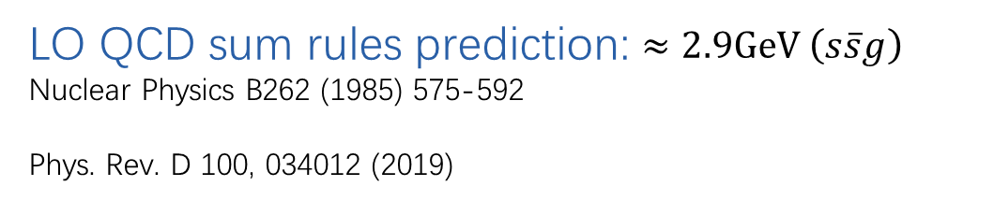
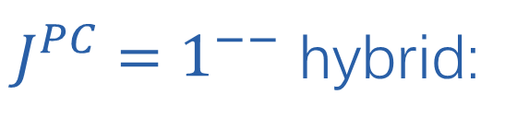
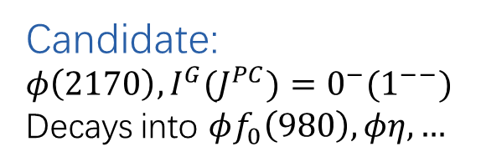
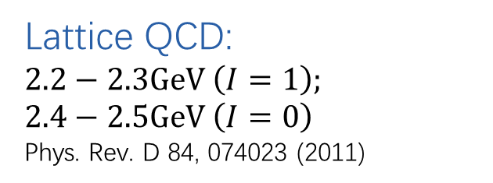
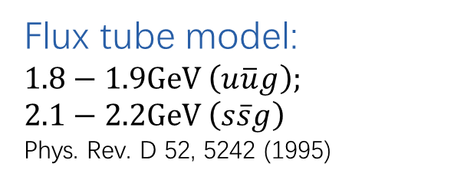
History & conflict
$J^{PC}=1^{−−}$ hybrid:
Flux tube model:
$1.8−1.9GeV \left(u\overline{u}g\right);$
$2.1−2.2GeV \left(s\overline{s}g\right)$
Phys. Rev. D 52, 5242 (1995)
Lattice QCD:
$2.2−2.3GeV \left(I=1\right);$
$2.4−2.5GeV \left(I=0\right)$
Phys. Rev. D 84, 074023 (2011)
Candidate:
${φ\left(2170\right), I^{G}{(J}^{PC})=0^{−}(1}^{−−})$
Decays into $φf_{0}\left(980\right), φη,…$
LO QCD sum rules prediction: $≈2.9GeV \left(s\overline{s}g\right)$
Nuclear Physics B262 (1985) 575-592
Phys. Rev. D 100, 034012 (2019)
different states?
missing something?

Slide 4
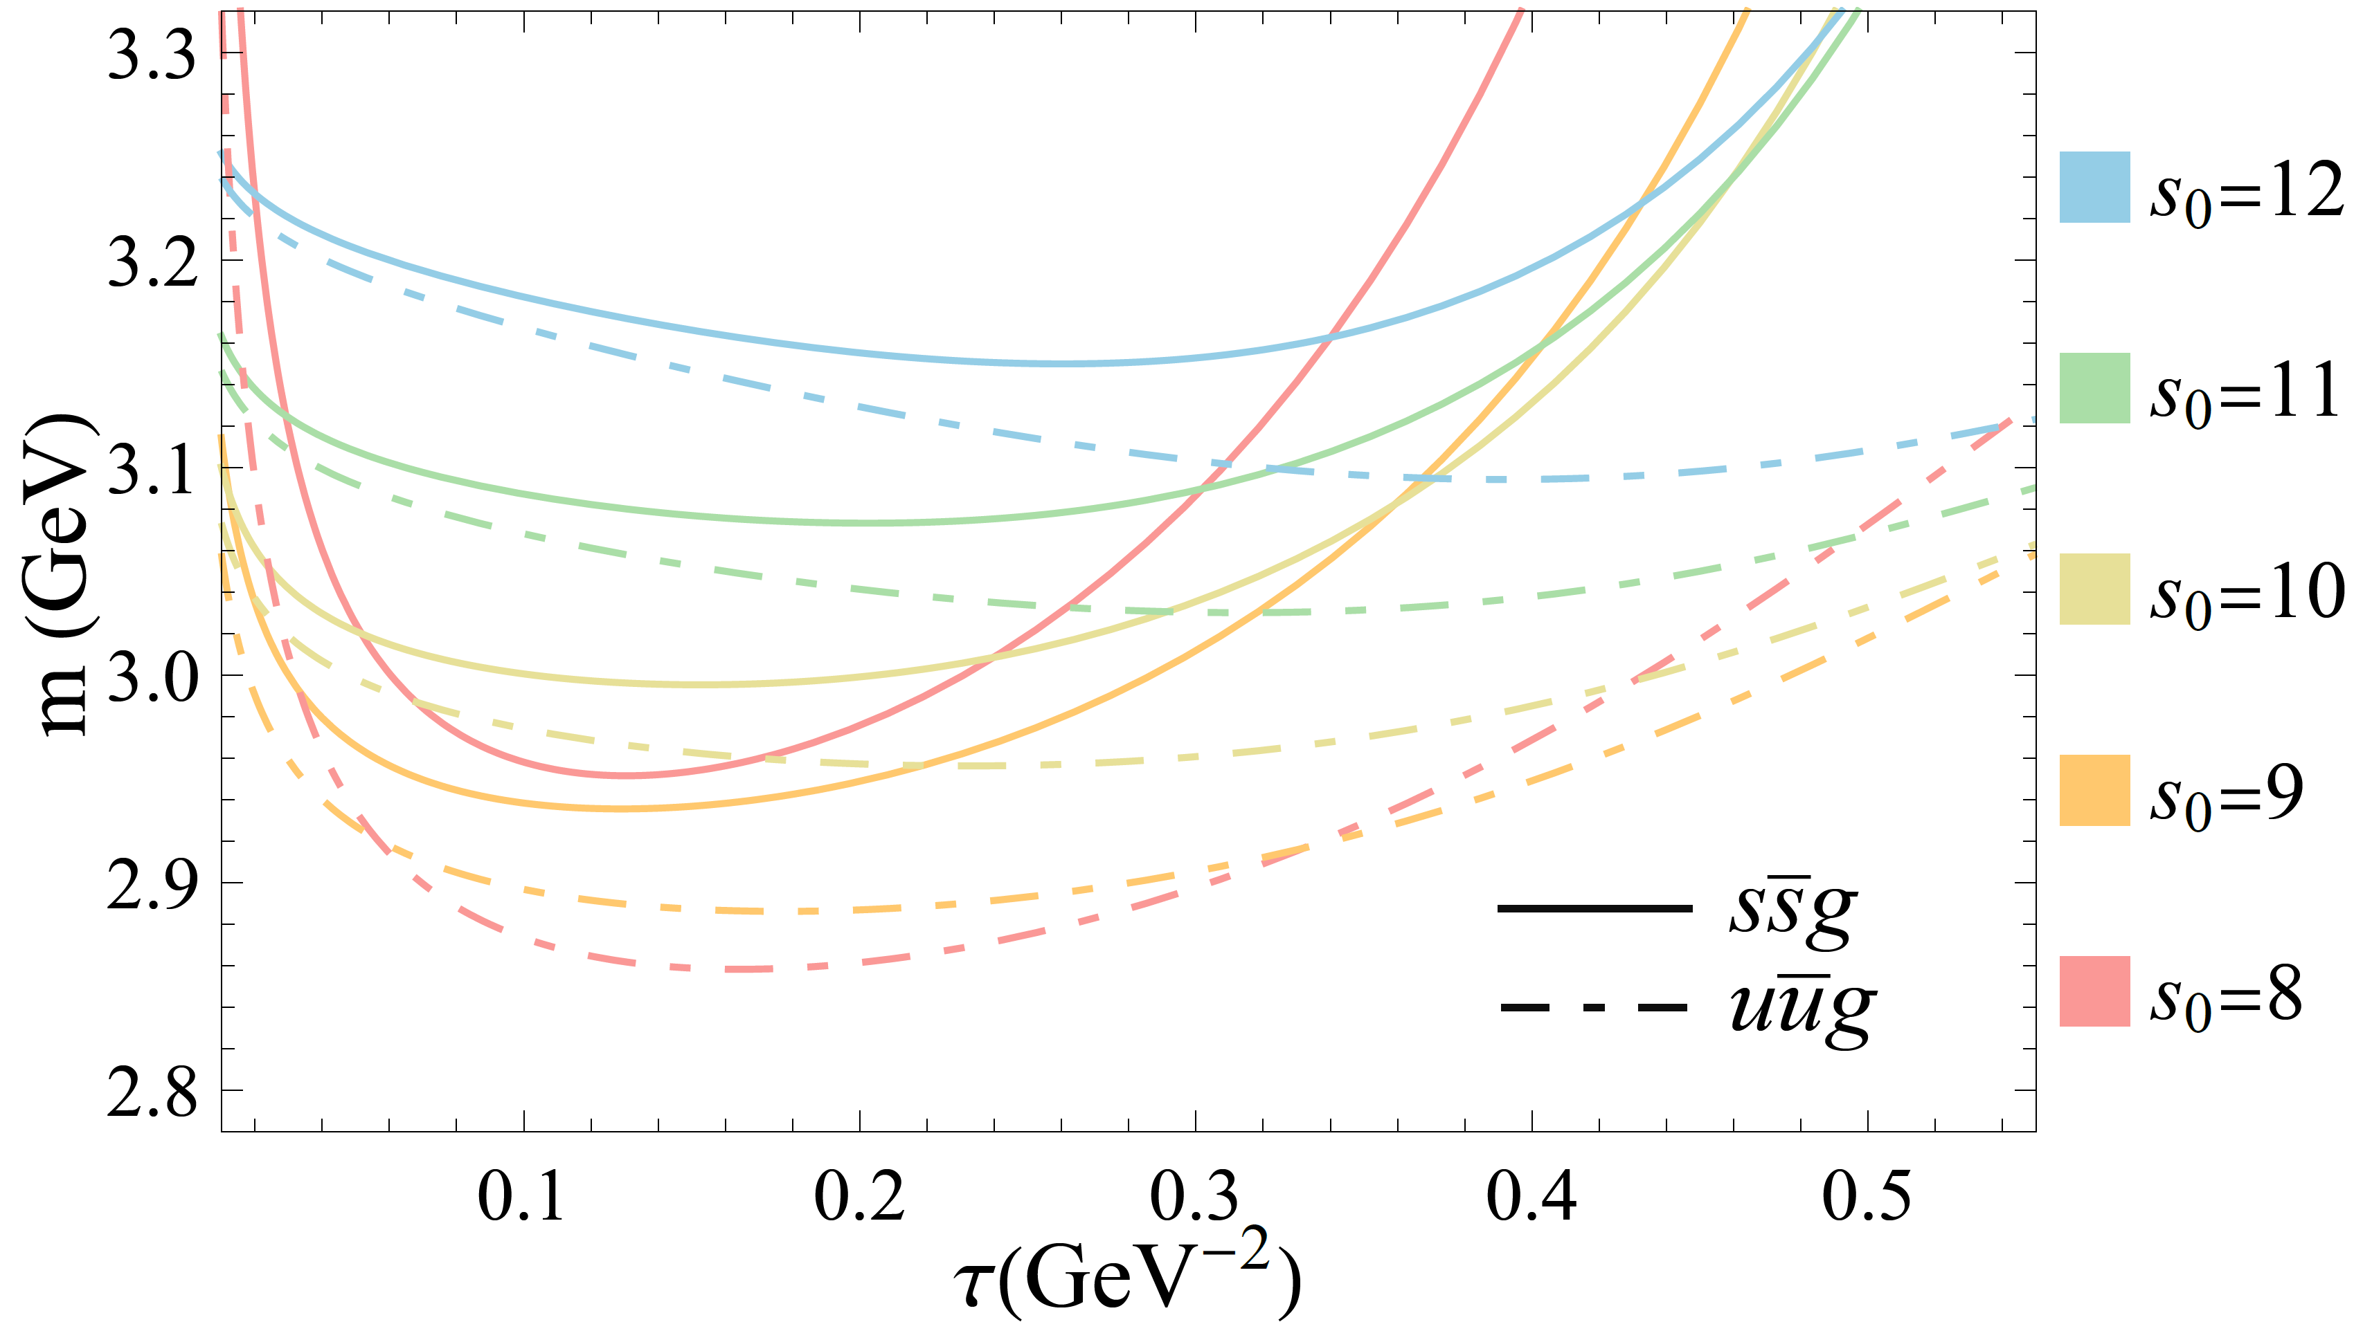

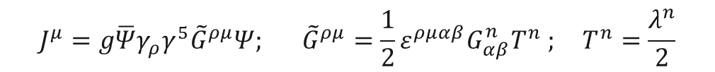
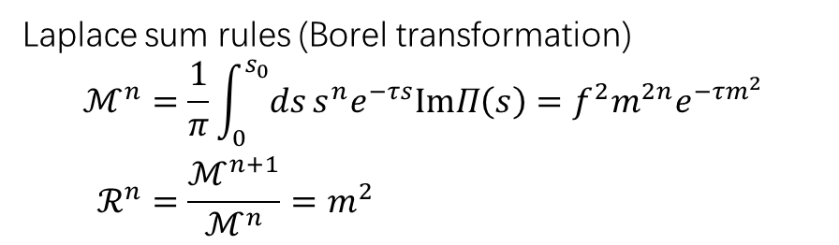
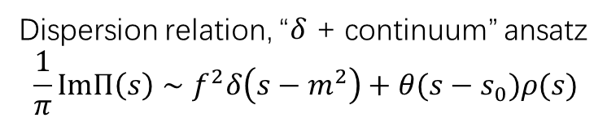
QCD (SVZ) Sum Rules of Hybrid
$$J^{μ}=g\overline{Ψ}γ_{ρ}γ^{5}{\tilde{G}}^{ρμ}Ψ; {\tilde{G}}^{ρμ}=\frac{1}{2}ε^{ρμαβ}G_{αβ}^{n}T^{n} ; T^{n}=\frac{λ^{n}}{2}$$
$$Π^{μν}(q)=i∫d^{4}x e^{−ipx}\left\langle Ω\right|T J^{μ}\left(x\right) J^{ν}\left(0\right)\left|Ω\right\rangle =\left(\frac{q^{μ}q^{ν}}{q^{2}}−g^{μν}\right)Π_{v}\left(q^{2}\right)+\frac{q^{μ}q^{ν}}{q^{2}}Π_{s}\left(q^{2}\right)$$
Dispersion relation, “$δ$ + continuum” ansatz
$$\frac{1}{π}ImΠ\left(s\right)∼f^{2}δ\left(s−m^{2}\right)+θ(s−s_{0})ρ(s)$$
$${ (GeV}^{2})$$
Laplace sum rules (Borel transformation)
$$\begin{aligned}ℳ^{n}&=\frac{1}{π}\int_{0}^{s_{0}}{ds}s^{n}e^{−τs}ImΠ\left(s\right)=f^{2}m^{2n}e^{−τm^{2}} \\ ℛ^{n}&=\frac{ℳ^{n+1}}{ℳ^{n}}=m^{2}\end{aligned}$$
LO Laplace sum rules prediction,
including dimension-8 condensate

Slide 5
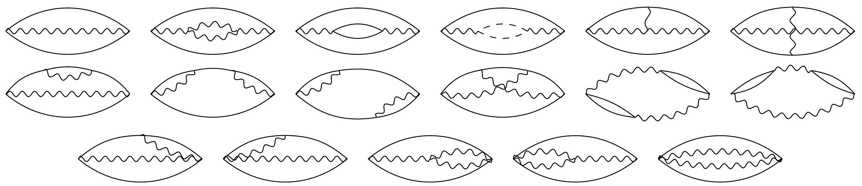
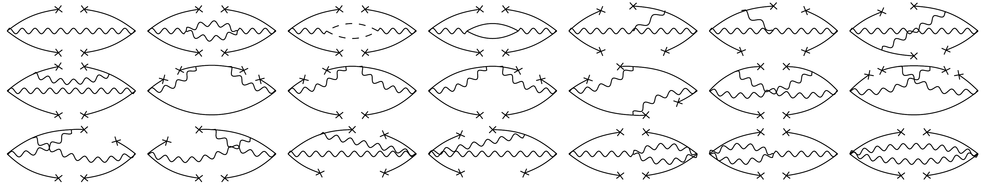
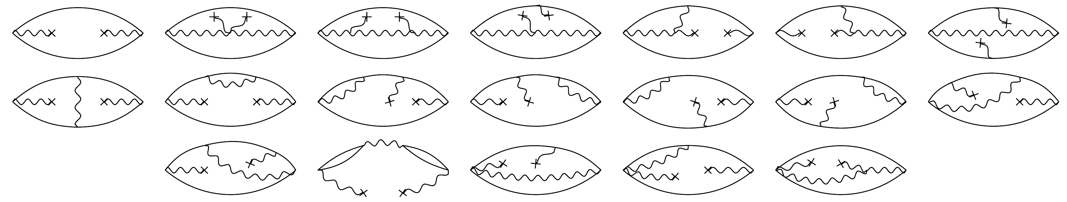

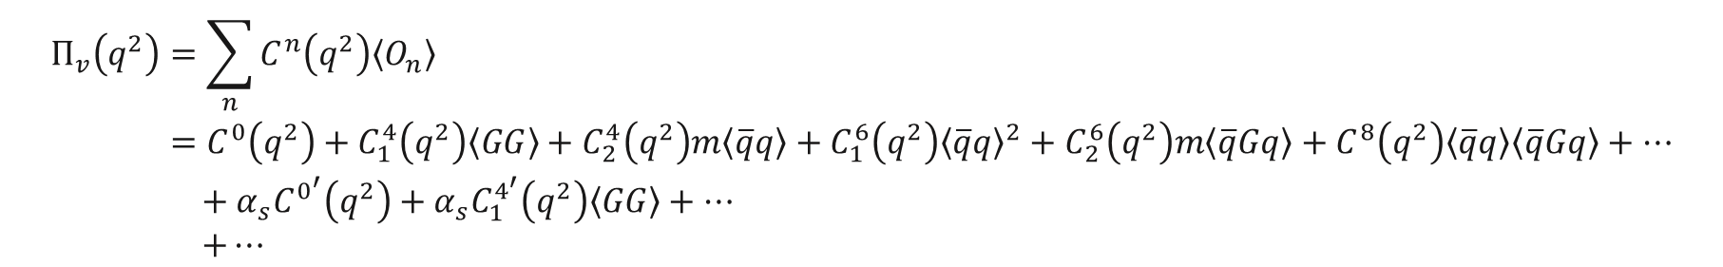

NLO Calculation
$$\begin{aligned}Π_{v}\left(q^{2}\right)&=\sum_{n}{C^{n}\left(q^{2}\right)\left\langle O_{n}\right\rangle } \\ &=C^{0}\left(q^{2}\right)+C_{1}^{4}\left(q^{2}\right)\left\langle GG\right\rangle +C_{2}^{4}\left(q^{2}\right)m\left\langle \overline{q}q\right\rangle +C_{1}^{6}\left(q^{2}\right){\left\langle \overline{q}q\right\rangle }^{2}+C_{2}^{6}\left(q^{2}\right)m\left\langle \overline{q}Gq\right\rangle +C^{8}\left(q^{2}\right)\left\langle \overline{q}q\right\rangle \left\langle \overline{q}Gq\right\rangle +… \\ & + α_{s}C^{0^{′}}\left(q^{2}\right)+{α_{s}C}_{1}^{4^{′}}\left(q^{2}\right)\left\langle GG\right\rangle +… \\ & +…\end{aligned}$$
Higher order correction
perturbative
$${\left\langle \overline{q}q\right\rangle }^{2}$$
$$⟨GG⟩$$

Slide 6
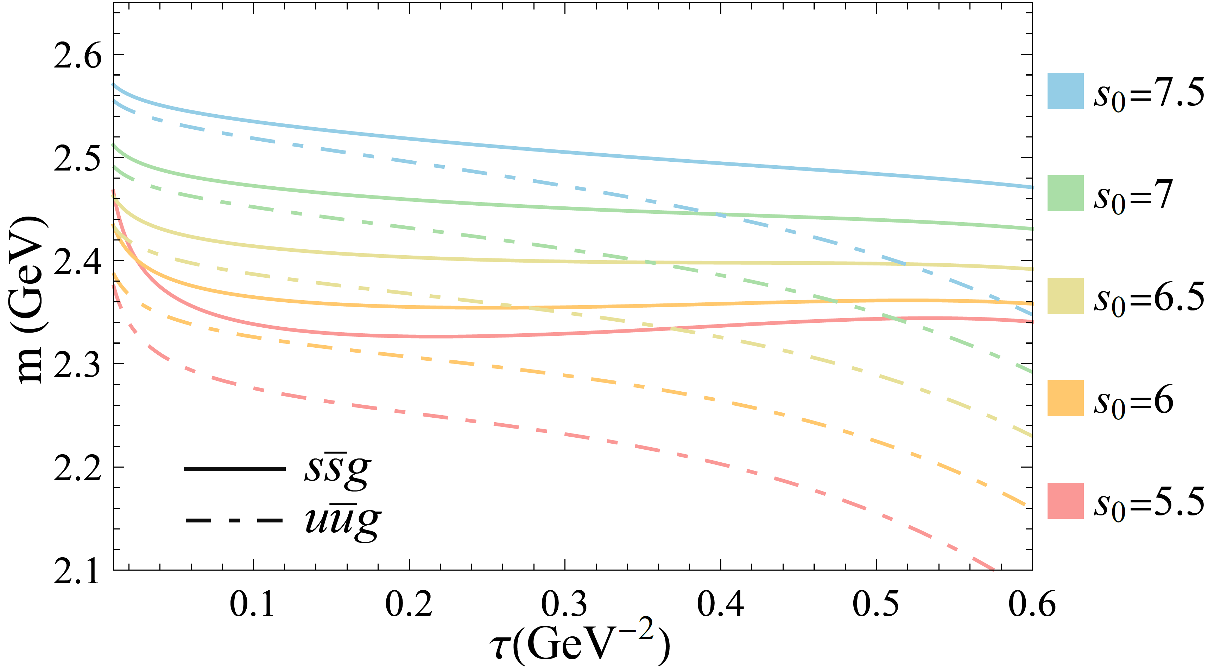
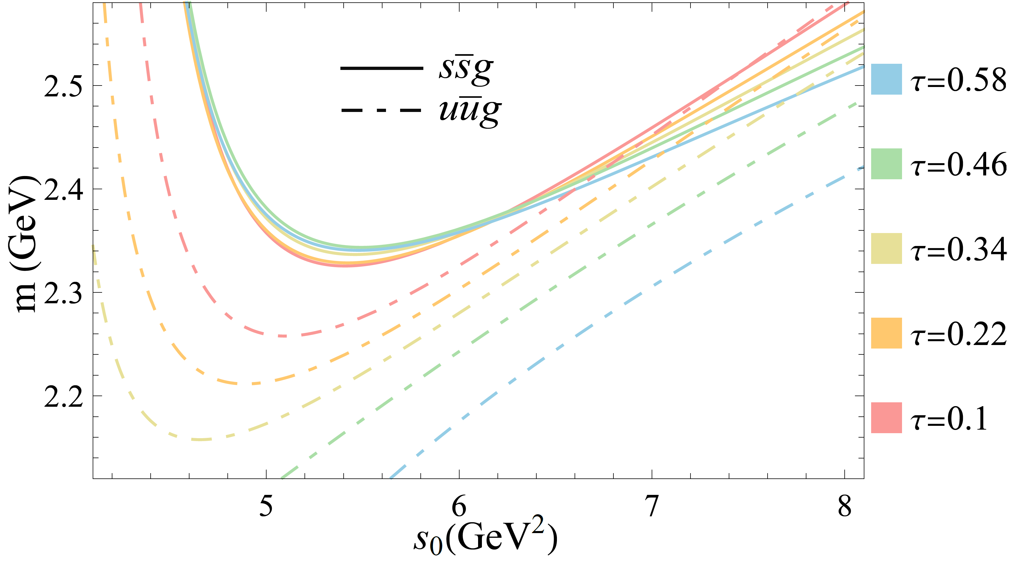



NLO Result
$${ (GeV}^{2})$$
$${(GeV}^{−2})$$
Lattice QCD:
$2.2−2.3GeV \left(I=1\right);$
$2.4−2.5GeV \left(I=0\right)$
Phys. Rev. D 84, 074023 (2011)

Slide 7
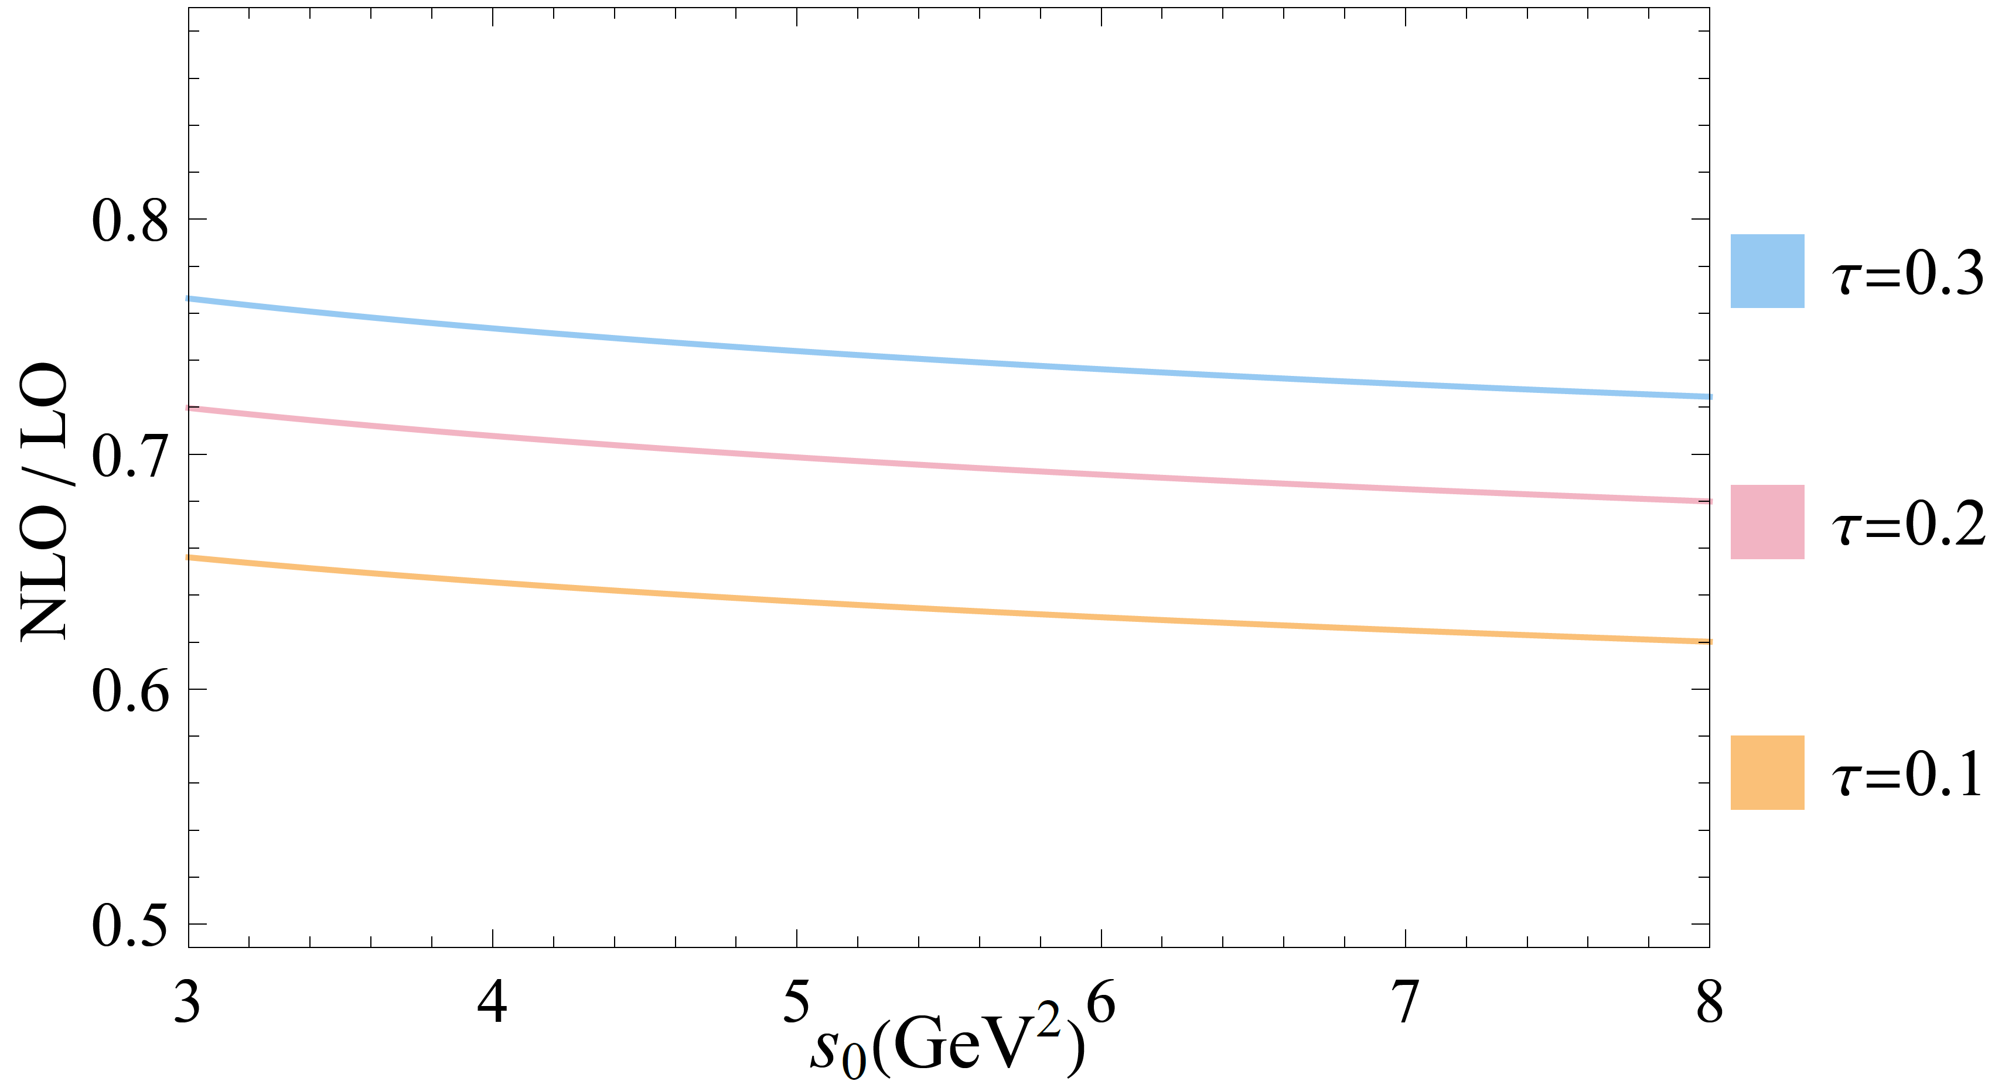
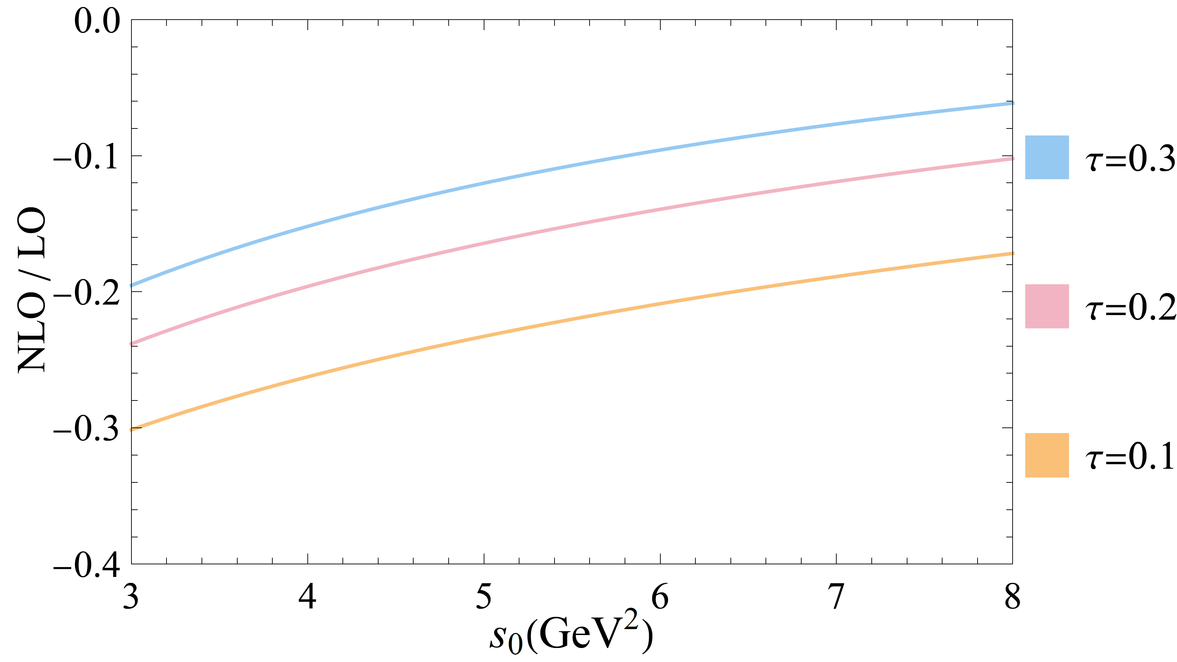

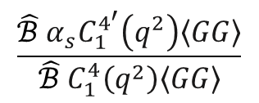
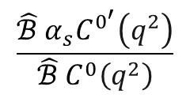

NLO Impact
NLO contribution vs LO contribution (after Borel transformation)
NLO perturbative / LO perturbative
NLO $⟨GG⟩$ / LO $⟨GG⟩$
$${(GeV}^{−2})$$
$${(GeV}^{−2})$$
$$\frac{\hat{ℬ}{ α}_{s}C^{0^{′}}\left(q^{2}\right)}{\hat{ℬ}{ C}^{0}\left(q^{2}\right)}$$
$$\frac{\hat{ℬ} {α_{s}C}_{1}^{4^{′}}\left(q^{2}\right)\left\langle GG\right\rangle }{\hat{ℬ} C_{1}^{4}\left(q^{2}\right)\left\langle GG\right\rangle }$$

Slide 8
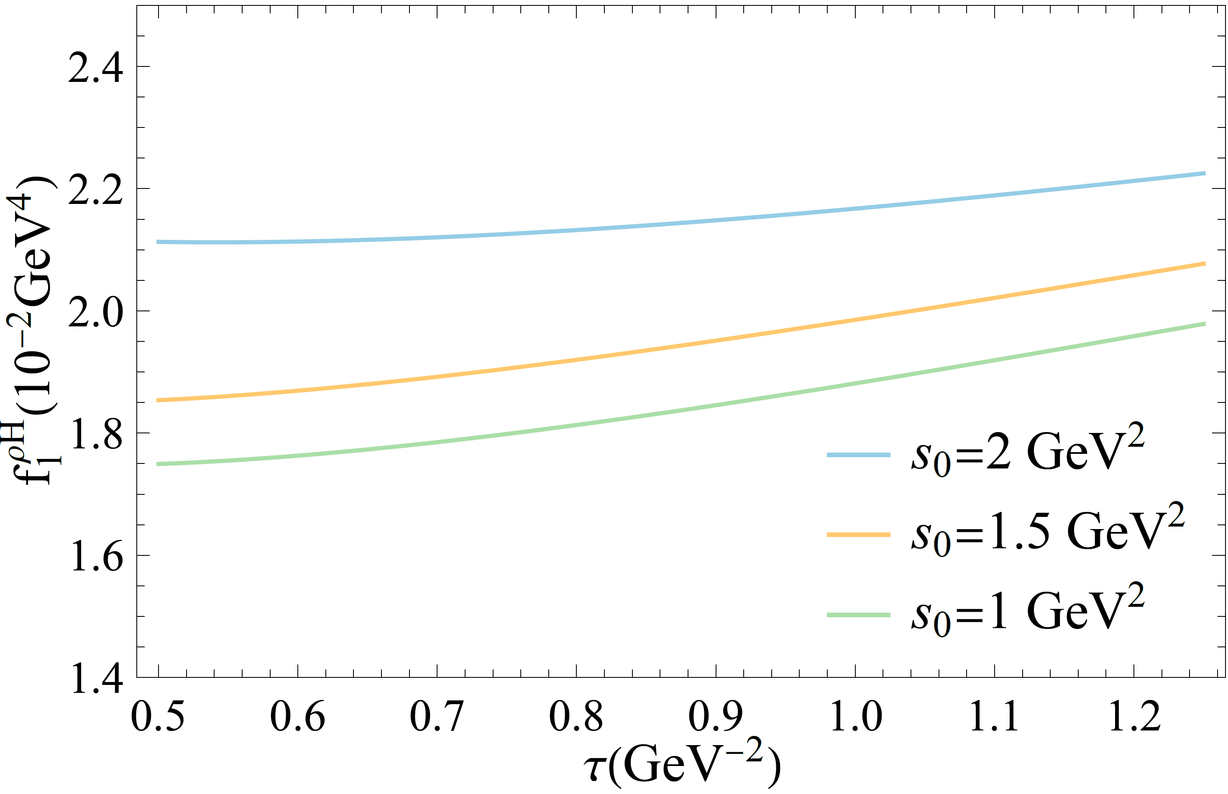
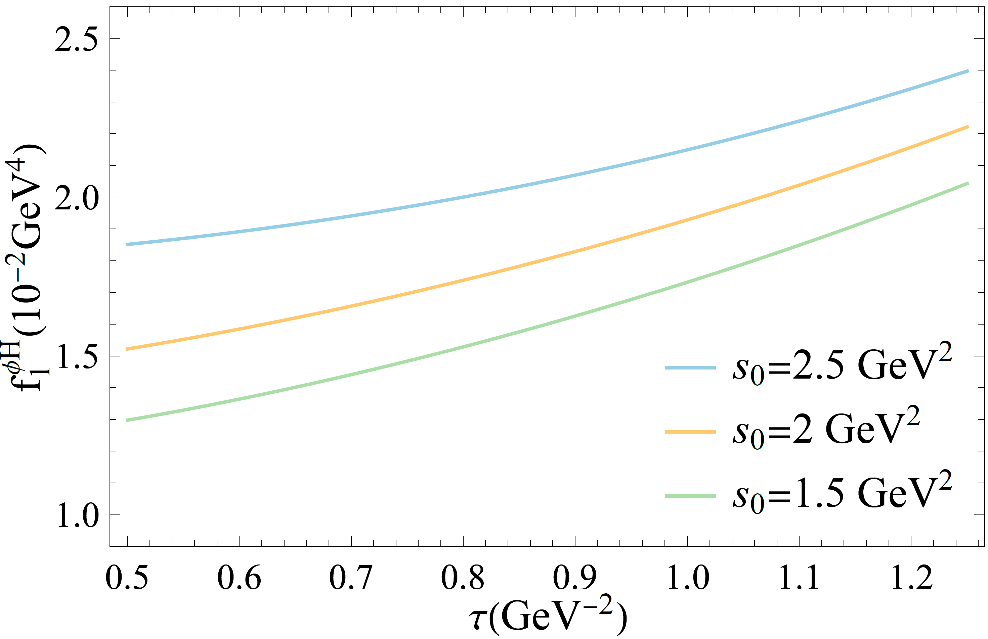
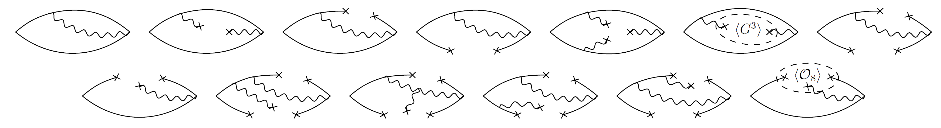


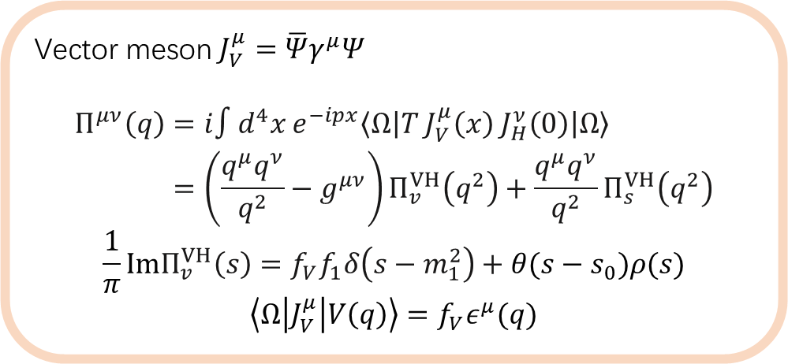
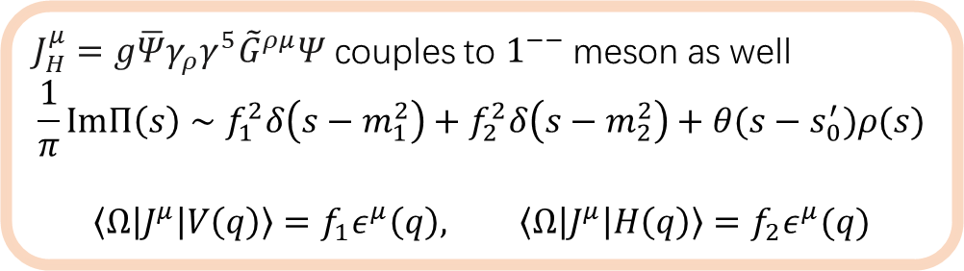
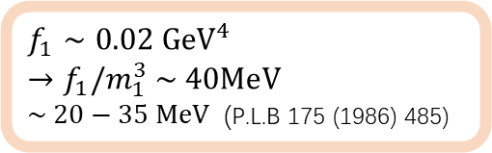
Impact of Vector Meson
$J_{H}^{μ}=g\overline{Ψ}γ_{ρ}γ^{5}{\tilde{G}}^{ρμ}Ψ$ couples to $1^{−−}$ meson as well
$$\frac{1}{π}ImΠ\left(s\right)∼f_{1}^{2}δ\left(s−m_{1}^{2}\right)+f_{2}^{2}δ\left(s−m_{2}^{2}\right)+θ(s−s_{0}^{′})ρ(s)$$
$$\left\langle Ω\left|J^{μ}\right|V\left(q\right)\right\rangle =f_{1}ε^{μ}\left(q\right), \left\langle Ω\left|J^{μ}\right|H\left(q\right)\right\rangle =f_{2}ε^{μ}(q)$$
$ρ$, $f_{V}≈0.171{GeV}^{2}$, $f_{1}$:
Vector meson $J_{V}^{μ}=\overline{Ψ}γ^{μ}Ψ$
$$\begin{aligned}Π^{μν}\left(q\right)&=i∫d^{4}x e^{−ipx}\left\langle Ω\right|T J_{V}^{μ}\left(x\right) J_{H}^{ν}\left(0\right)\left|Ω\right\rangle \\ &=\left(\frac{q^{μ}q^{ν}}{q^{2}}−g^{μν}\right)Π_{v}^{VH}\left(q^{2}\right)+\frac{q^{μ}q^{ν}}{q^{2}}Π_{s}^{VH}\left(q^{2}\right)\end{aligned}$$
$$\frac{1}{π}ImΠ_{v}^{VH}\left(s\right)=f_{V}f_{1}δ\left(s−m_{1}^{2}\right)+θ(s−s_{0})ρ(s)$$
$$\left\langle Ω\left|J_{V}^{μ}\right|V\left(q\right)\right\rangle =f_{V}ε^{μ}(q)$$
$φ$, $f_{V}≈0.235{GeV}^{2}$, $f_{1}$:
$f_{1}∼0.02 {GeV}^{4}$
${→f}_{1}/m_{1}^{3} \sim 40MeV$
$\sim 20−35 MeV$ (P.L.B 175 (1986) 485)

Slide 9
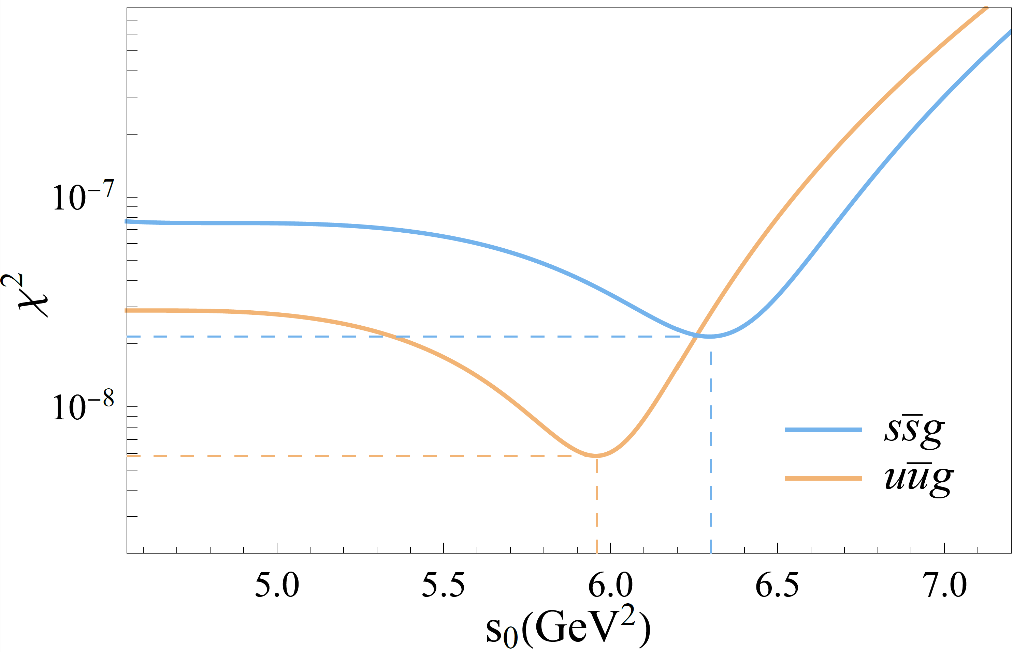
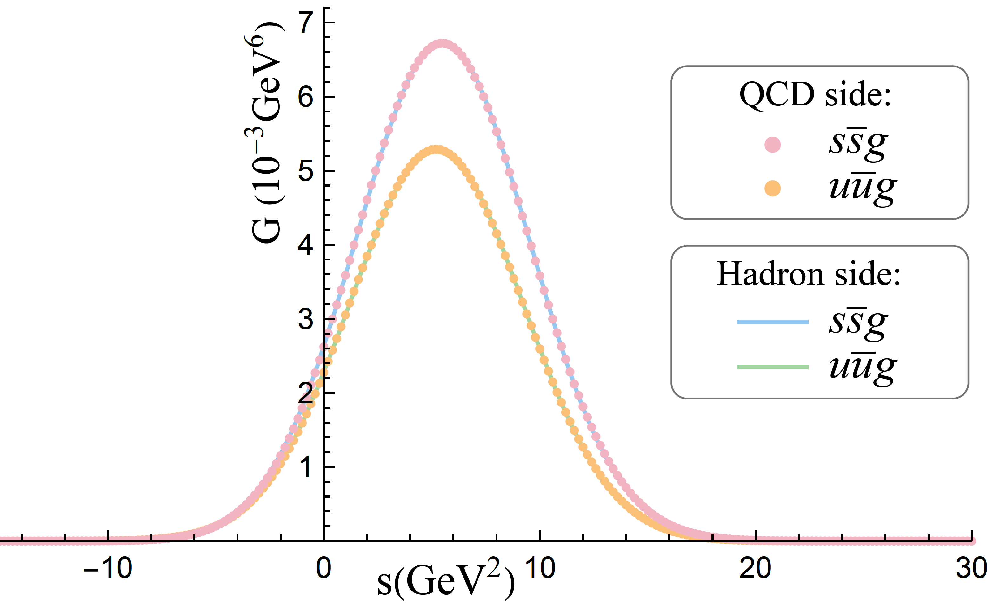
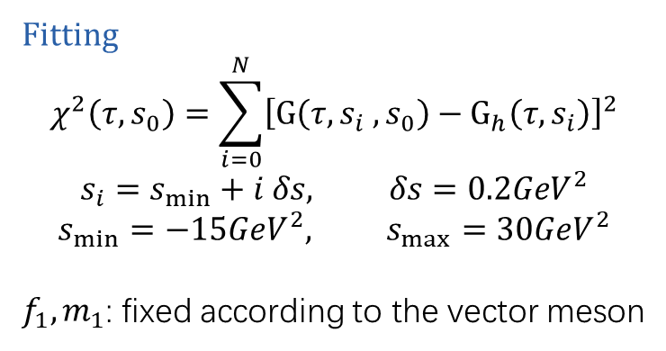
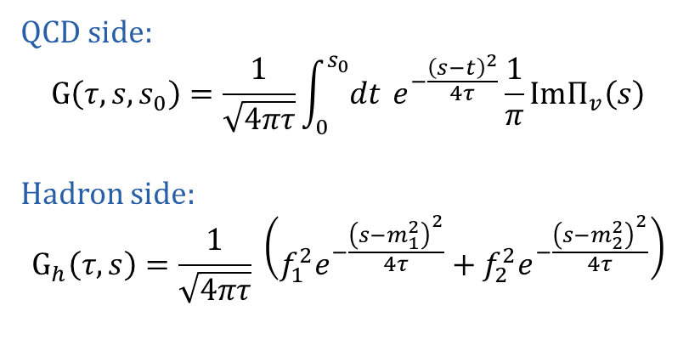
Gaussian Sum Rules
QCD side:
$$G\left(τ,s,s_{0}\right)=\frac{1}{\sqrt{4πτ}}\int_{0}^{s_{0}}{dt} e^{−\frac{{\left(s−t\right)}^{2}}{4τ}}\frac{1}{π}ImΠ_{v}\left(s\right)$$
Hadron side:
$$G_{h}\left(τ,s\right)=\frac{1}{\sqrt{4πτ}} \left(f_{1}^{2}e^{−\frac{{\left(s−m_{1}^{2}\right)}^{2}}{4τ}}+f_{2}^{2}e^{−\frac{{\left(s−m_{2}^{2}\right)}^{2}}{4τ}}\right)$$
Fitting
$$χ^{2}\left(τ,s_{0}\right)=\sum_{i=0}^{N}{{\left[G\left(τ,s_{i} ,s_{0}\right)−G_{h}\left(τ,s_{i}\right)\right]}^{2}}$$
$$s_{i}=s_{min}+i δs, δs=0.2GeV^{2}$$
$$s_{min}=−15GeV^{2}, s_{max}=30GeV^{2}$$
$f_{1}, m_{1}$: fixed according to the vector meson

Slide 10
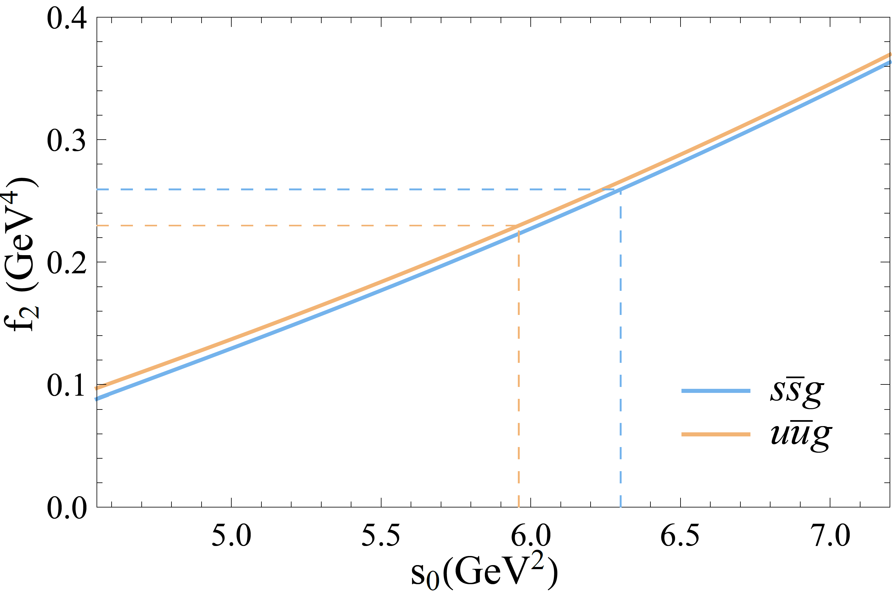
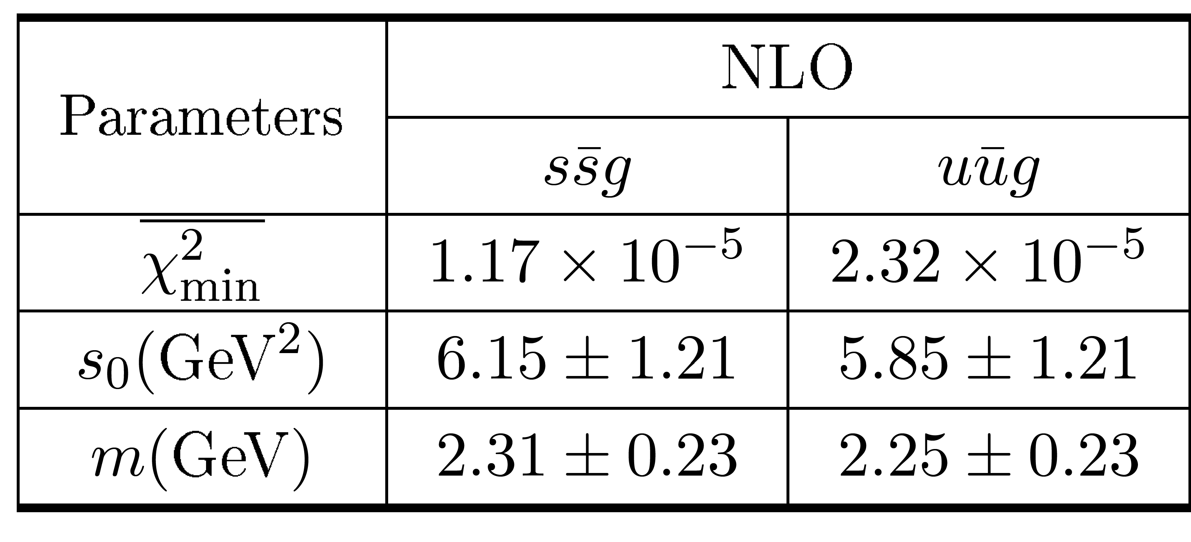
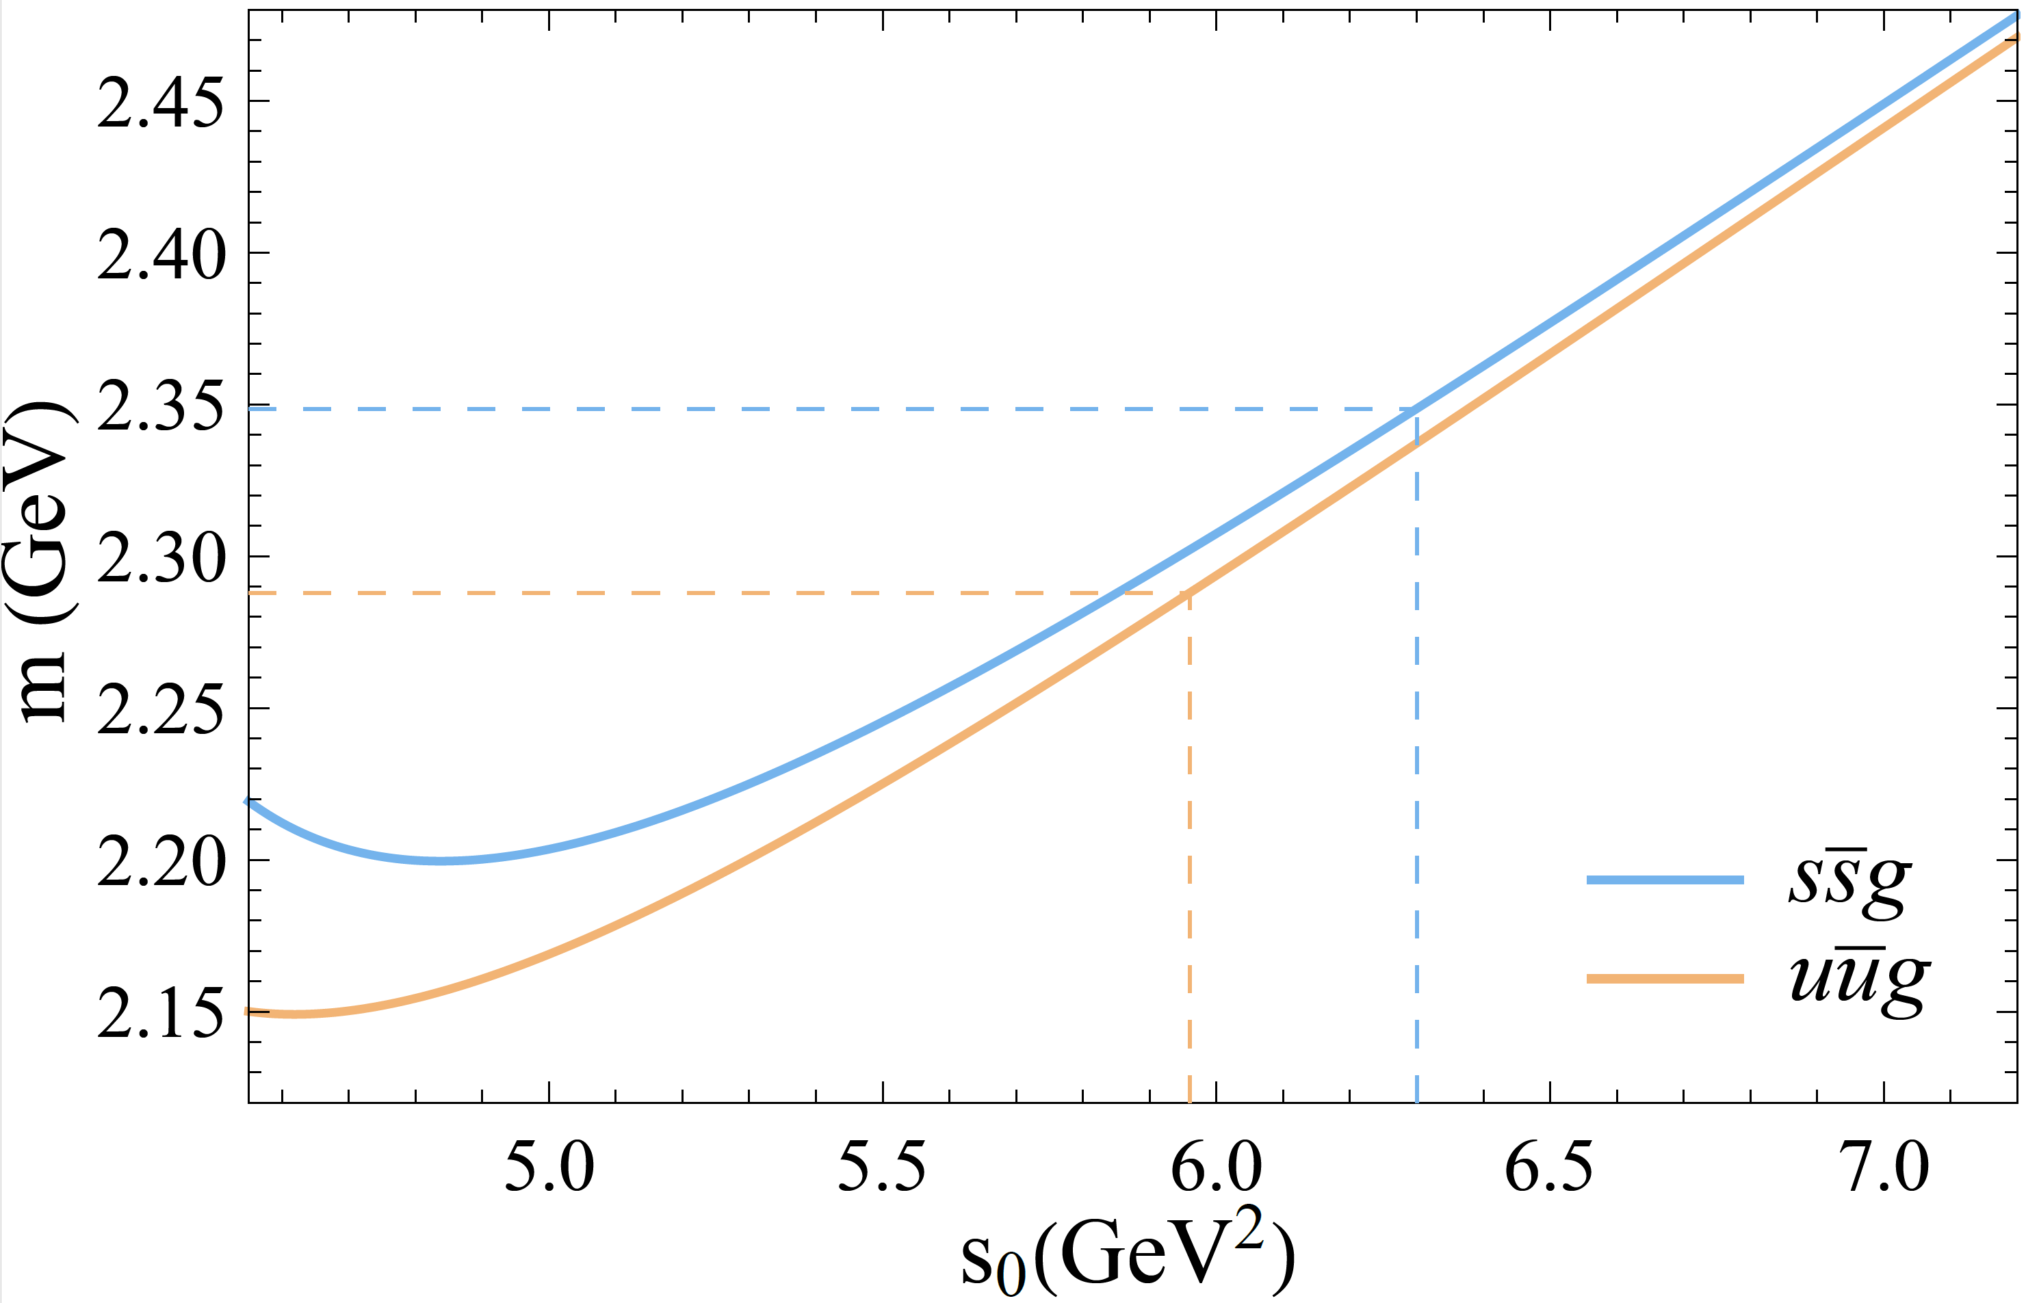

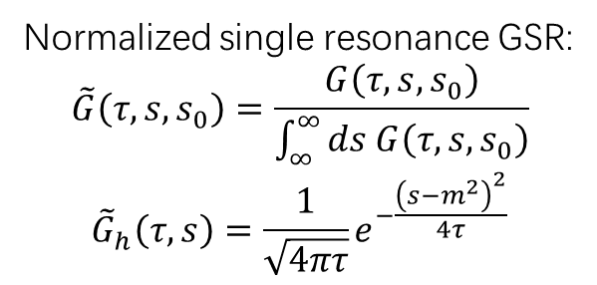
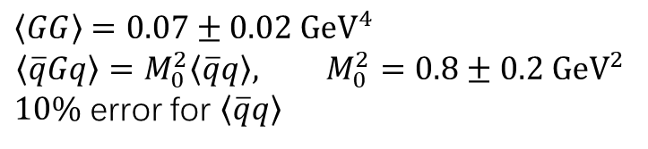
Gaussian Sum Rules
Normalized single resonance GSR:
$$\tilde{G}\left(τ,s,s_{0}\right)=\frac{G\left(τ,s,s_{0}\right)}{\int_{∞}^{∞}{ds G\left(τ,s,s_{0}\right)}}$$
$${\tilde{G}}_{h}\left(τ,s\right)=\frac{1}{\sqrt{4πτ}}e^{−\frac{{\left(s−m^{2}\right)}^{2}}{4τ}}$$
$\frac{f_{1}^{2}}{f_{2}^{2}}\sim \frac{1}{200}$
single resonance fitting with Monte Carlo uncertainty analysis (2000 random samples)
$\left\langle GG\right\rangle =0.07±0.02 {GeV}^{4}$
$$\left\langle \overline{q}Gq\right\rangle =M_{0}^{2}\left\langle \overline{q}q\right\rangle , M_{0}^{2}=0.8±0.2 {GeV}^{2}$$
$10\%$ error for $\left\langle \overline{q}q\right\rangle$

Slide 11
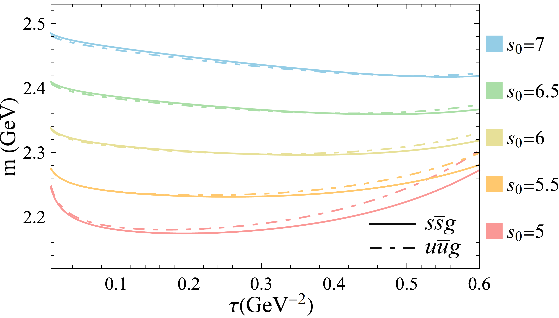
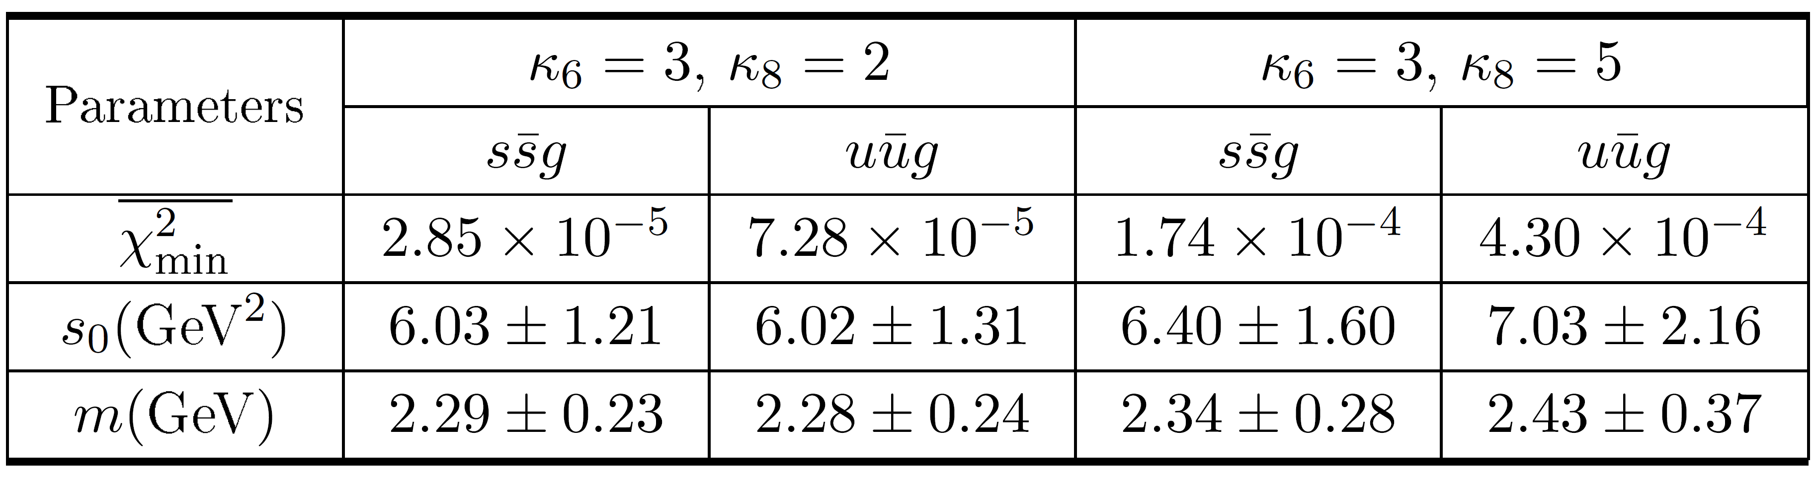
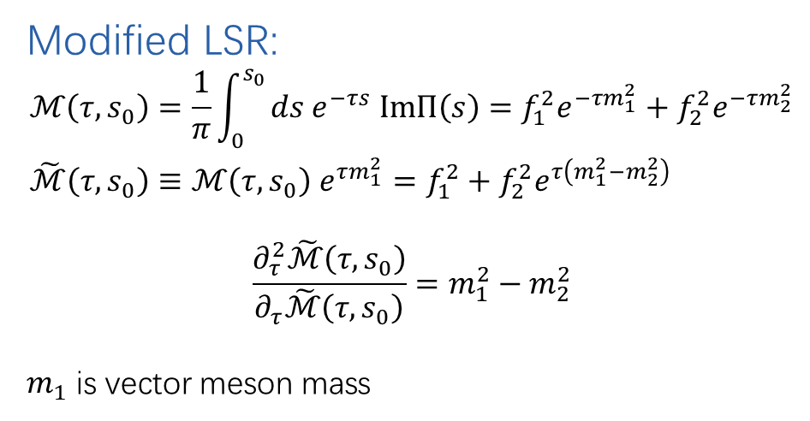
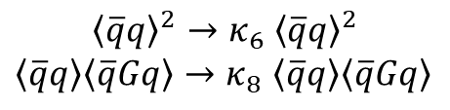

Robustness of Results
Modified LSR:
$$\begin{aligned}ℳ\left(τ,s_{0}\right)&=\frac{1}{π}\int_{0}^{s_{0}}{ds e^{−τs} ImΠ\left(s\right)=f_{1}^{2}e^{−τm_{1}^{2}}+f_{2}^{2}e^{−τm_{2}^{2}}} \\ \tilde{ℳ}\left(τ,s_{0}\right)&≡ℳ\left(τ,s_{0}\right) e^{τm_{1}^{2}}=f_{1}^{2}+f_{2}^{2}e^{τ\left(m_{1}^{2}−m_{2}^{2}\right)}\end{aligned}$$
$$\frac{∂_{τ}^{2}\tilde{ℳ}\left(τ,s_{0}\right)}{∂_{τ}\tilde{ℳ}\left(τ,s_{0}\right)}=m_{1}^{2}−m_{2}^{2}$$
$m_{1}$ is vector meson mass
$${ (GeV}^{2})$$
Factorization deviation
$${\left\langle \overline{q}q\right\rangle }^{2}→κ_{6} {\left\langle \overline{q}q\right\rangle }^{2}$$
$\left\langle \overline{q}q\right\rangle \left\langle \overline{q}Gq\right\rangle →κ_{8}$ $\left\langle \overline{q}q\right\rangle \left\langle \overline{q}Gq\right\rangle$

Slide 12
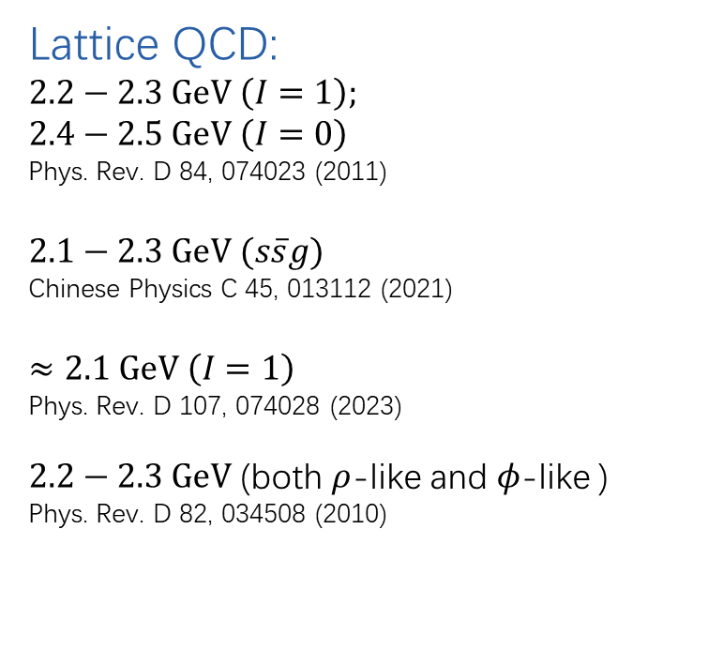
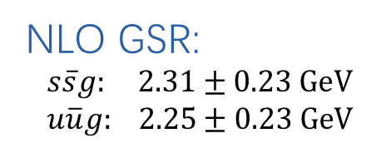
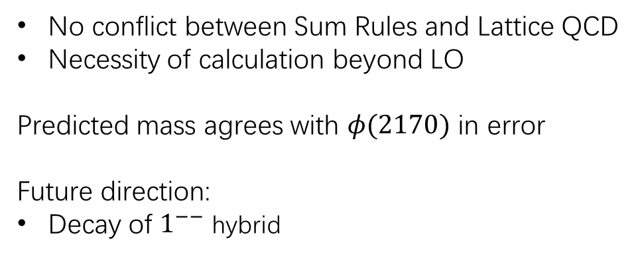
Conclusion
NLO GSR:
$$s\overline{s}g: 2.31±0.23 GeV$$
$$u\overline{u}g: 2.25±0.23 GeV$$
Lattice QCD:
$2.2−2.3 GeV \left(I=1\right);$
$2.4−2.5 GeV \left(I=0\right)$
Phys. Rev. D 84, 074023 (2011)
$2.1−2.3 GeV (s\overline{s}g)$
Chinese Physics C 45, 013112 (2021)
$≈2.1 GeV \left(I=1\right)$
Phys. Rev. D 107, 074028 (2023)
$2.2−2.3 GeV$ (both $ρ$-like and $φ$-like )
Phys. Rev. D 82, 034508 (2010)
No conflict between Sum Rules and Lattice QCD
Necessity of calculation beyond LO
Predicted mass agrees with $φ(2170)$ in error
Future direction:
Decay of $1^{−−}$ hybrid

Slide 13
Thank You

Slide 14
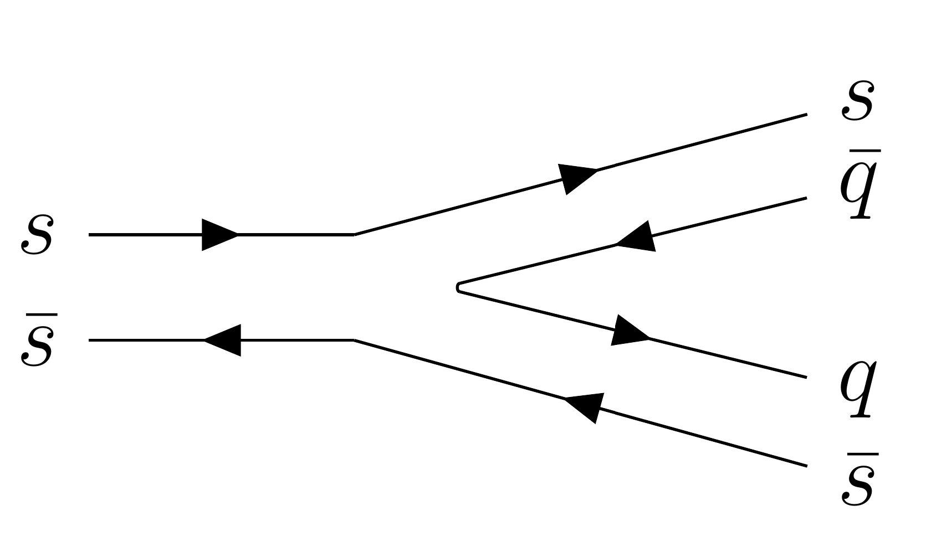
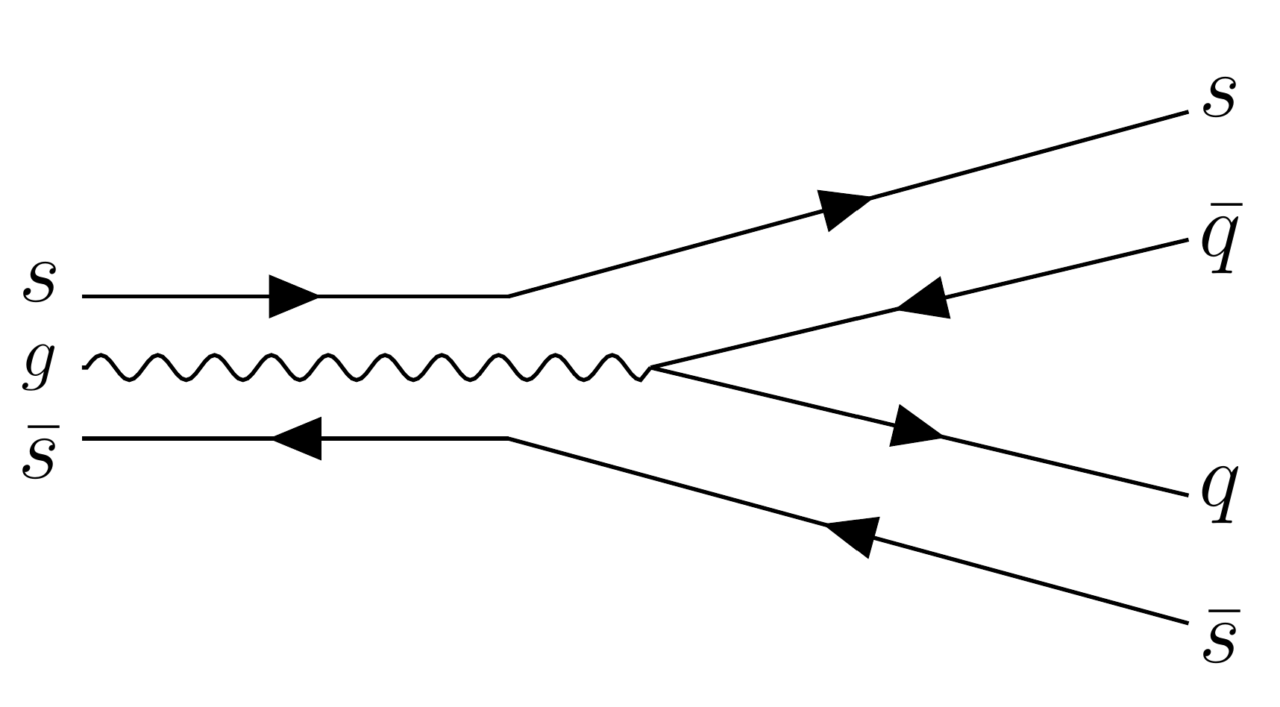
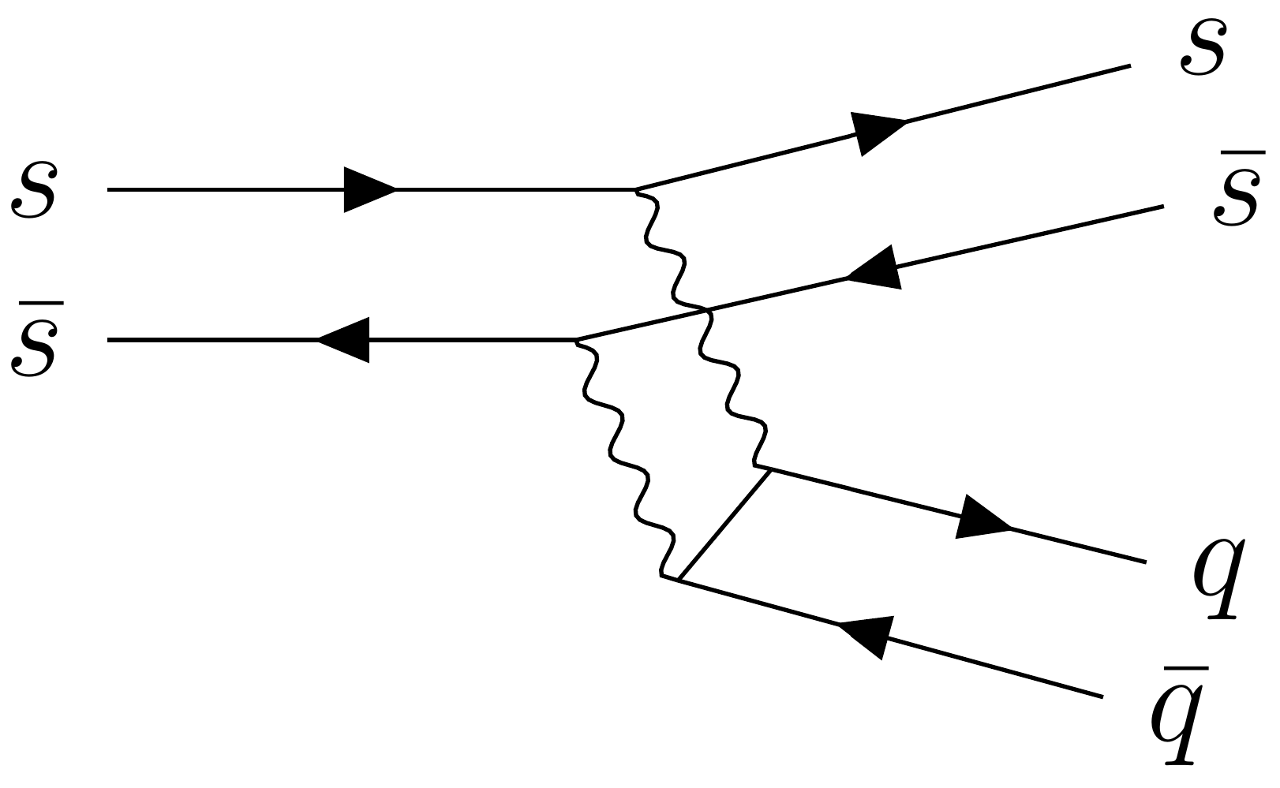
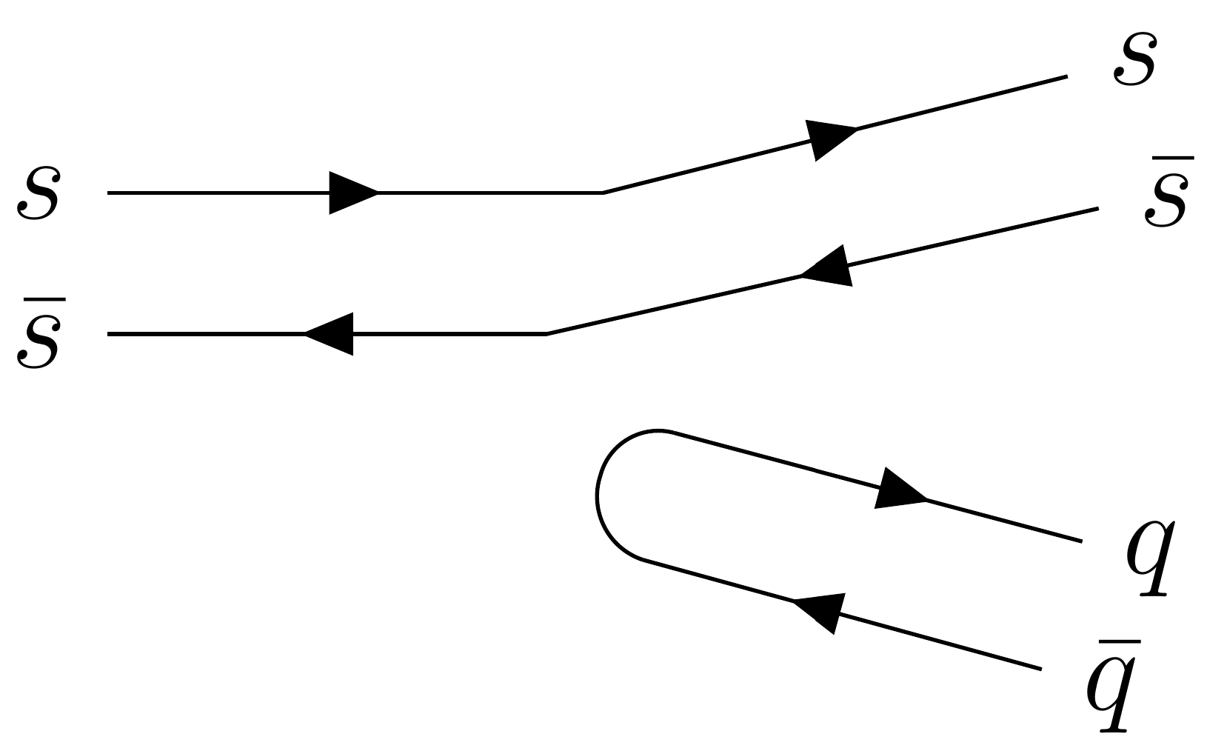
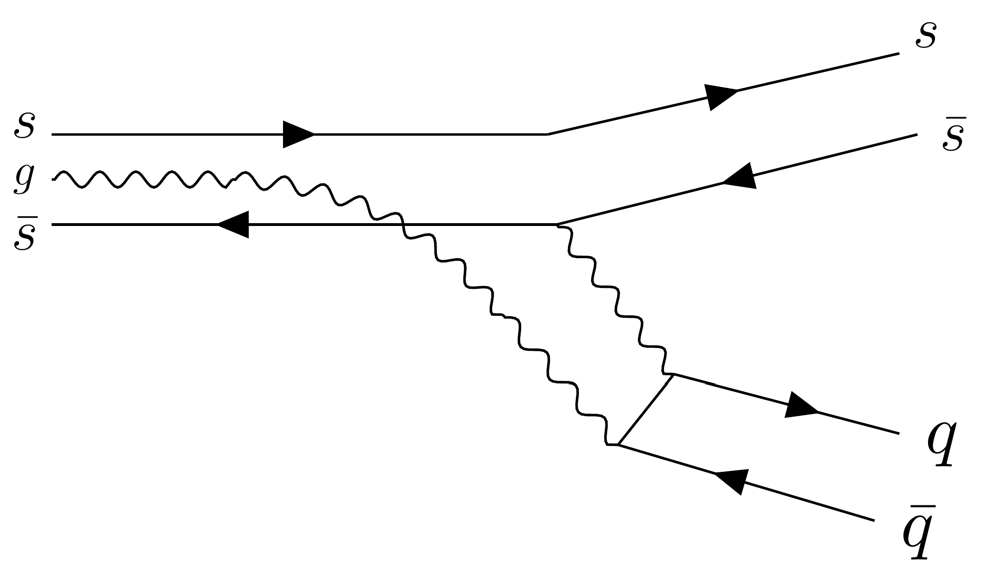
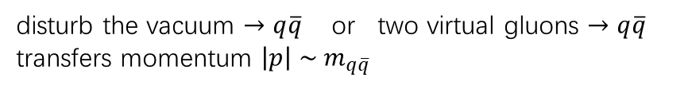



Backup: Decay
Suppressed
($1^{−−} c\overline{c}g → D^{(∗)}{\overline{D}}^{(∗)}$ is forbidden by symmetry
Physics Letters B 631 (2005) 164–169)
Favored
Suppressed
Allowed
disturb the vacuum $→q\overline{q}$ or two virtual gluons $→q\overline{q}$
transfers momentum $\left|p\right| \sim m_{q\overline{q}}$
$1^{−−}$ strangeonium state ($2D$or $3S$ )
decay into open strangeness states ($K{\overline{K}}^{∗}$...)
branching ratio to $φf_{0}(980)$should be small
broad width (large phase space)
$φ\left(2170\right)$
decay into closed strangeness states ($φf_{0}(980)$ ...)
Narrower width $\sim 100 MeV$(selection rules)

Slide 15










Backup: Renormalization of Generic Hybrid Current
$J=g\overline{Ψ}ΓGΨ$
$⟨T J\left(0\right) Ψ\left(q_{1}\right) A(q_{2}) \overline{Ψ}(q_{3})⟩$
$⟨T J\left(0\right) Ψ\left(q_{1}\right) \overline{Ψ}(q_{2})⟩$
$⟨T J\left(0\right) A\left(q_{1}\right) A(q_{2})⟩$
Observation:
$\overline{Ψ}ΓT^{n}Ψ×{\frac{1}{ε}G}_{μν}^{n}$
Corresponding counter terms ~ $\frac{1}{ε}\overline{Ψ}Γ×\{opeators acting on Ψ\}$
Counterterm bases:
$\frac{1}{ε}\overline{Ψ}Γ.Γ′GΨ$, $\frac{1}{ε}\overline{Ψ}Γ.Γ′∇∇Ψ$, $\frac{1}{ε}\overline{Ψ}Γ.Γ′A({γ_{μ}∇}^{μ}+i m) Ψ$, $\frac{1}{ε}\overline{Ψ}Γ.Γ^{′}m^{2}Ψ$
non-gauge-invariant counterterms must vanish under equation of motion
$\frac{1}{ε}\overline{Ψ}Γ_{1}.Γ.Γ_{2} T^{n}Ψ×G_{μν}^{n}$
$\frac{1}{ε}mGG$, $\frac{1}{ε}GDG$
$Γ^{′}G \sim G^{μν}, σ^{μρ}{G_{ρ}}^{ν}, i γ^{5}ε^{μνρη}G_{ρη}$ ; $Γ^{′}∇∇ \sim {σ^{ν}}_{ρ} ∇^{μ}∇^{ρ} , σ^{μν}∇^{2}$ ; …

Slide 16



Backup: Renormalization of Generic Hybrid Current
$J=g\overline{Ψ}ΓG^{μν}Ψ$
In Feynman gauge

Slide 17































Backup: Infrared divergence
Perturbative $⟨GG⟩$
$$\left\langle T G^{μν}\left(k\right)G^{αβ}\left(k\right)\right\rangle \sim \frac{\left\langle GG\right\rangle }{k^{4}}\left(g^{μα}g^{νβ}+…\right)$$
$$∫d^{d}k \frac{1}{k^{4}}, d=4−2ε, ⇒\sim \frac{1}{ε} for k≈0$$
$$J_{r}=\left(1+C_{0}+C_{4}\right)Z_{2}^{−1}Z_{3}^{−1/2}g\overline{Ψ}ΓG^{μν}Ψ+…$$
$$Z_{3} ↔$$
$$A_{0}^{μ}=Z_{3}A^{μ}$$
$$\left(C_{0}+Z_{3}^{−1/2}Z_{g}^{−1}−1\right)g_{0}\overline{Ψ}ΓG^{μν}Ψ$$
$$C_{0}g\overline{Ψ}ΓGΨ ↔$$
$$Z_{3}=1−\frac{g^{2}}{16π^{2}ε}\left[−\frac{5}{3}C_{A}+\frac{2}{3}n_{f}\right] , Z_{g}=1+\frac{g^{2}}{16π^{2}ε}\left(\frac{11}{6}C_{A}−\frac{1}{3}n_{f}\right)$$

Slide 18






Backup: Error Estimation
$$χ^{2}\left(τ,s_{0}\right)=\sum_{i=0}^{N}{{\left[\tilde{G}\left(τ,s_{i} ,s_{0}\right)−{\tilde{G}}_{h}\left(τ,s_{i}\right)\right]}^{2}}$$
$$s_{i}=s_{min}+i δs, δs=0.2 {GeV}^{2}$$
$$s_{min}=−15 {GeV}^{2}, s_{max}=30 {GeV}^{2}$$
Error is defined by:
$$σ=\sqrt{{\hat{σ}}^{2}+ \overline{Δ^{2}}}$$
for small $δs$
$$χ^{2} \sim \frac{1}{δs} , H^{−1} \sim δs → χ^{2}H^{−1} \sim 1$$
for $s_{min}$ and $s_{max}$ away from the peak
$\tilde{G}\left(τ,s_{i} ,s_{0}\right), {\tilde{G}}_{h}\left(τ,s_{i}\right)→0$, irrelevant to the specific $s_{min},s_{max}$
(if average the $Δ$ as $Δ/(s_{max}−s_{min})$, choose large $s_{max}−s_{min}$ manually reduce the error)
$⇒$
$Δ$ in the left is irrelevant to the choice of $δs,s_{min},s_{max}$
reflect the intrinsic error of the fitting procedure
${\hat{σ}}^{2}$: variance of 2000 fitted values $\sim$ statistic error
$$Δ=\sqrt{2χ_{min}^{2}H^{−1}(χ_{min}^{2})}$$
$$H\left(χ^{2}\right)=\left[\begin{matrix}\frac{∂^{2}χ^{2}}{∂s_{0}^{2}} & \frac{∂^{2}χ^{2}}{∂s_{0}∂m} \\ \frac{∂^{2}χ^{2}}{∂s_{0}∂m} & \frac{∂^{2}χ^{2}}{∂m^{2}}\end{matrix}\right]$$
$\sim$ systemtic error

