Slide 1
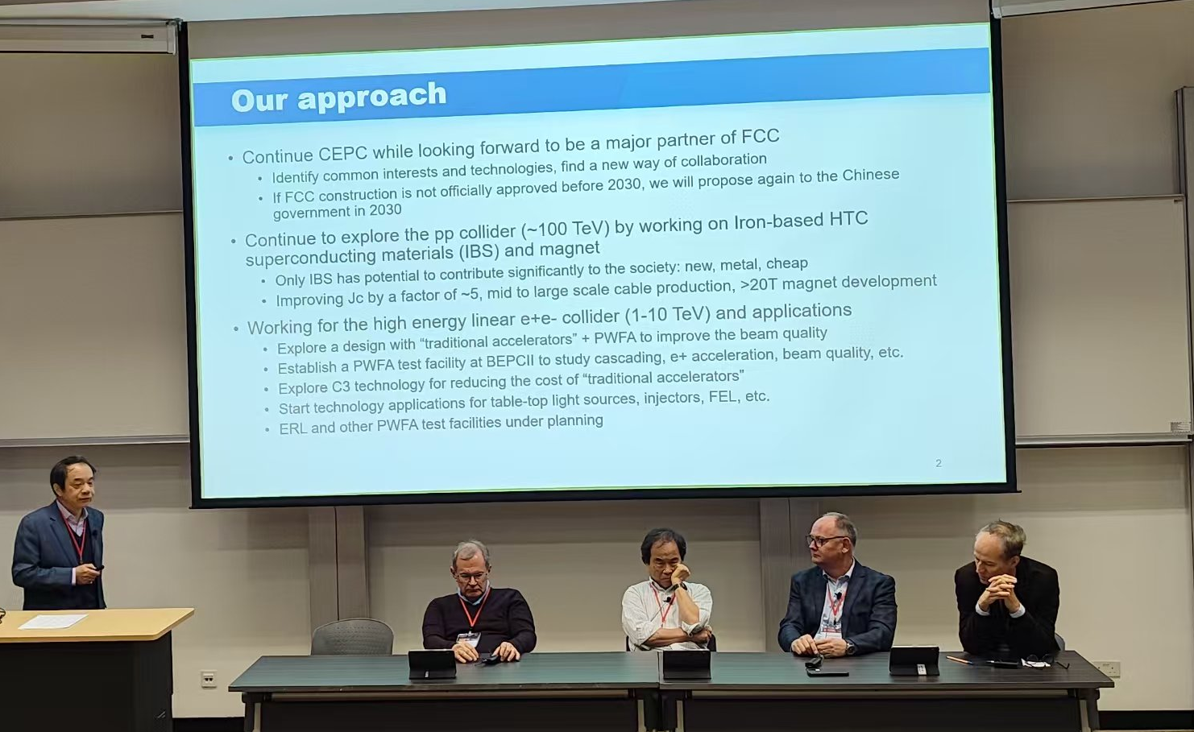
Post-TDR plan

Slide 2
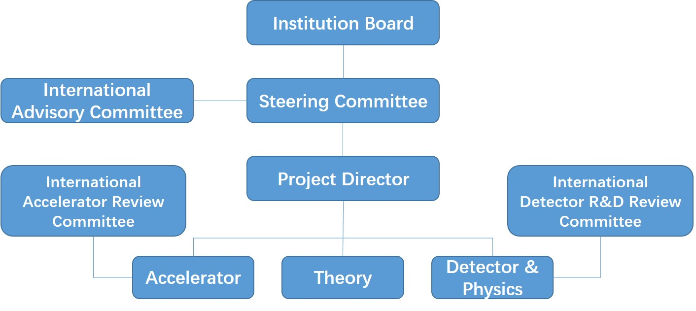
Organization
• Higgs physics
• BSM physics
• Flavour physics
• Electroweak physics
• Top-quark physics
• QCD physics
• High-level reconstruction: Objects
• Monte Carlo tools
• Analysis and visualisation tools
• Beam background
Higgs Physics
Flavor Physics
………..
Vertex
……....
TDAQ
Software
Phys. Perf.
High-level reconstruction
Beam Background

Slide 3
Detector & Physics Performance
Iterate closely with detector design and optimization, update relevant object/benchmark performance
Work closely with software group, MDI group for studies with more realistic conditions: beam-induced background, mis-alignment, noise, non-uniform magnetic field, etc. (IDRC recommendation)
  Some tools to be further developed and integrated into CEPCSW, e.g. ACTS
  Computing speed to be improved for beam background simulation
  Independent cross checks for certain major issues, e.g. alternative beam background generator
Further develop existing physics benchmarks and add new benchmarks
  E.g. H->ss, Z->ss (IDRC recommendation)
Explore further AI/ML/QC to improve sensitivities
Investigate LEP dada, to validate some CEPC performance

Slide 4
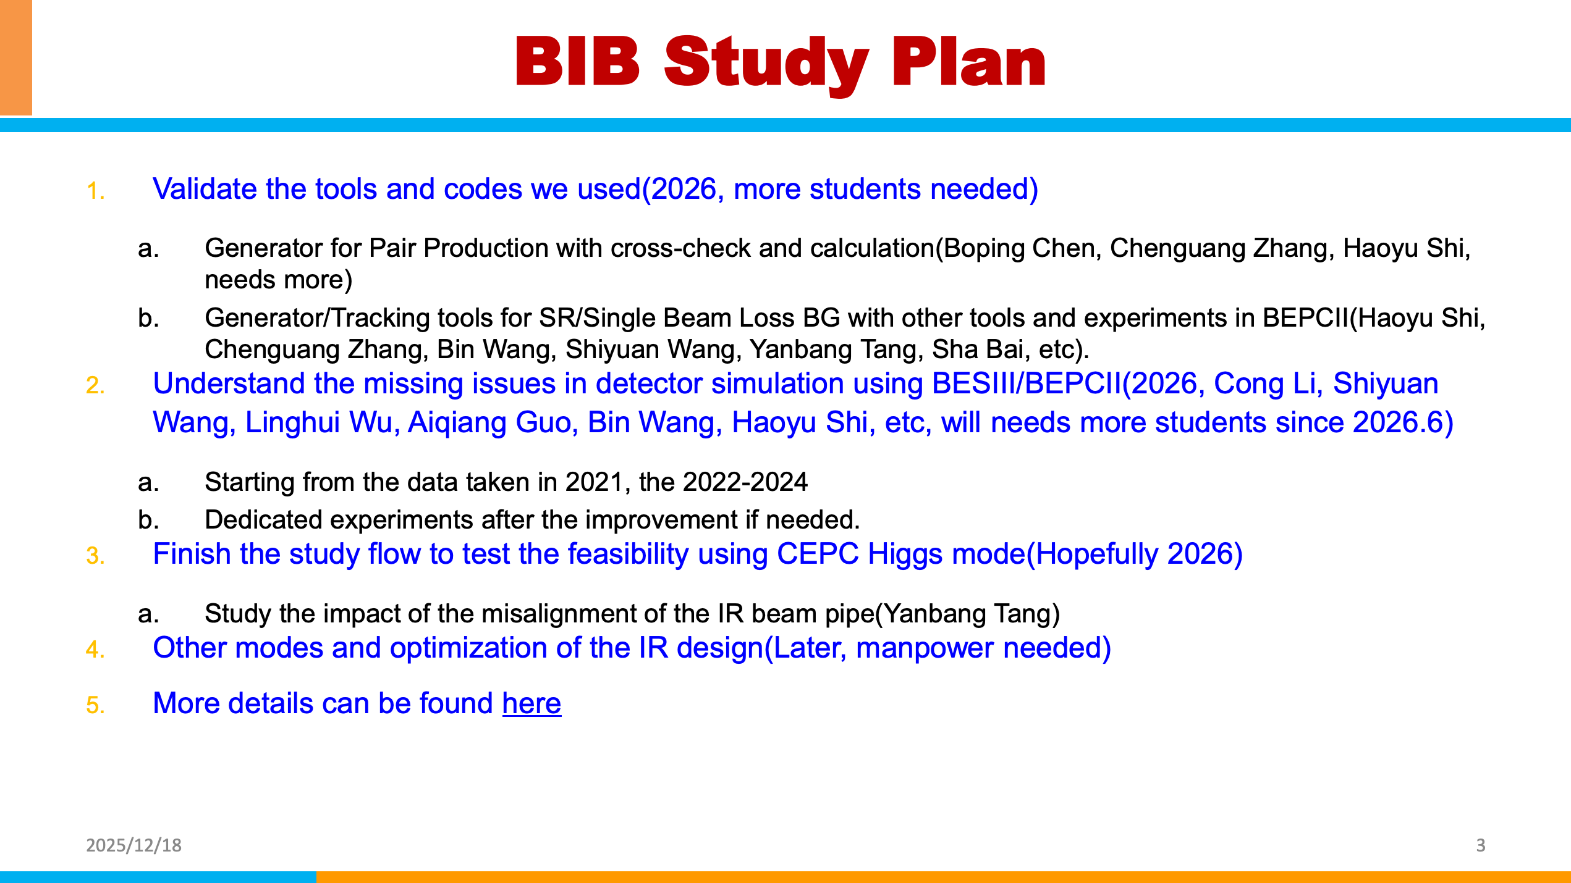
Beam Background

