Slide 1
Tuesday, November 18, 2025

Slide 2
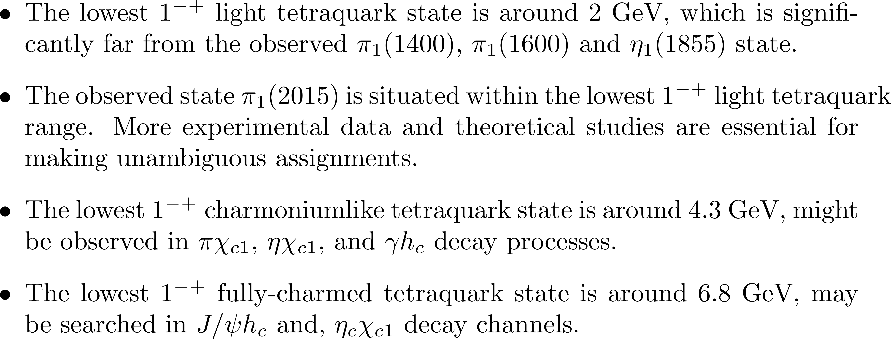





Prediction

Slide 3
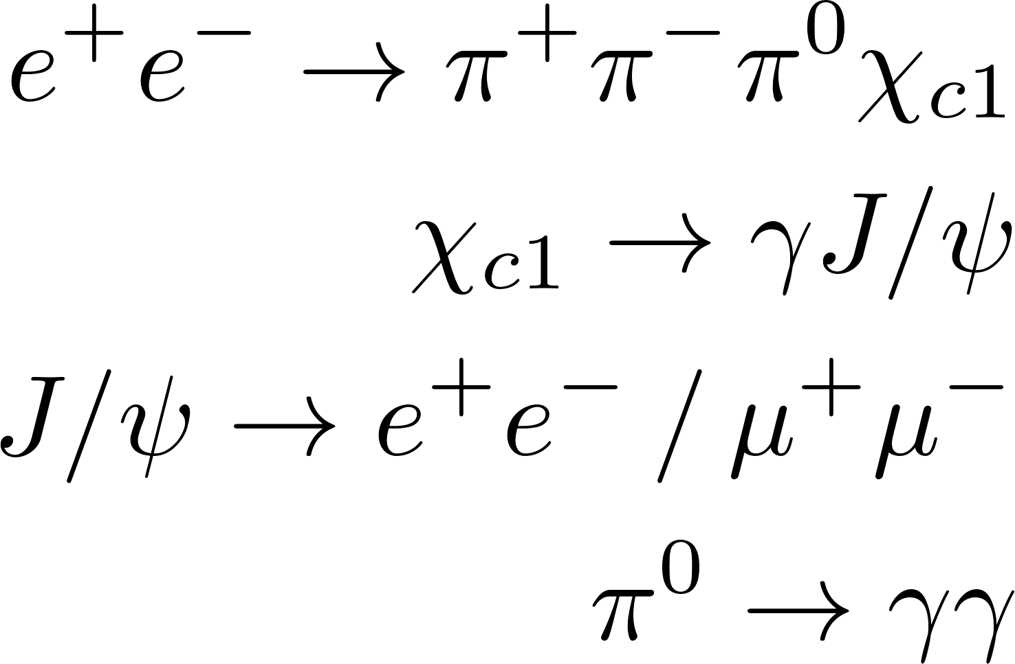


Event Selection
Final state$:$
BOSS version: 7.0.9
1) Charged tracks (MDC)
$\left|cos θ\right|$ < 0.93
$R_{xy}<1.0 cm,$ $R_{z}<10 cm$ (the beam line)
nGood $≥$ 4
total charge is 0
2) Neutral track
$E_{barrel}>25 MeV,\left|cosθ\right|<0.8$
$E_{endcap}>50 MeV,0.86<\left|cosθ\right|<0.92$
EMC time $0≤t≤14$ (50 ns)
the angle between the cluster and
the nearest charged track < 10 degree
$N_{γ}≥$ 3
Data sets
Data : 2020 (@4640) run no. 63516-63715
Inclusive MC : XYZ sample run no. 35227-36213 (@4600)

Slide 4
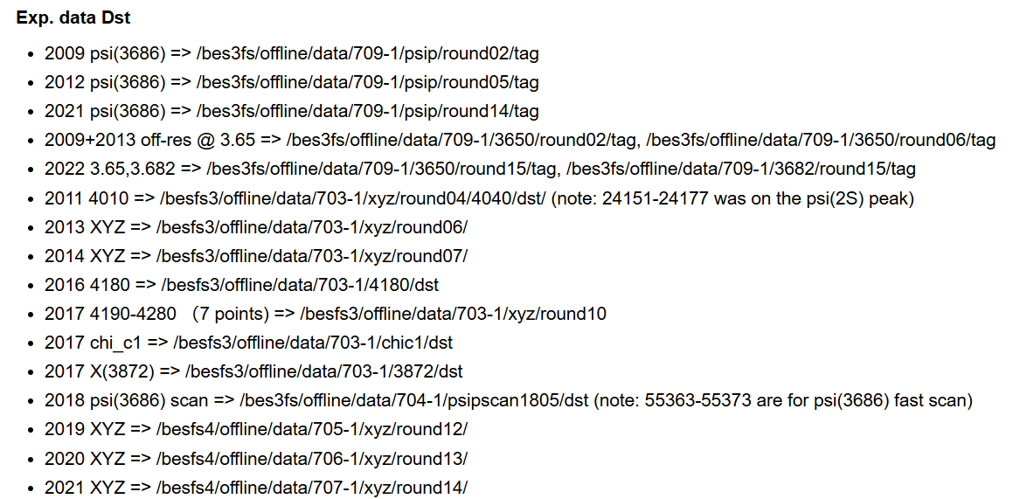

Slide 5
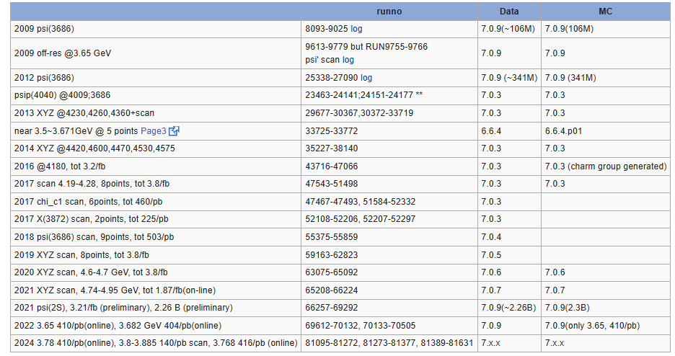

Slide 6
Tuesday, January 20, 2026

Slide 7
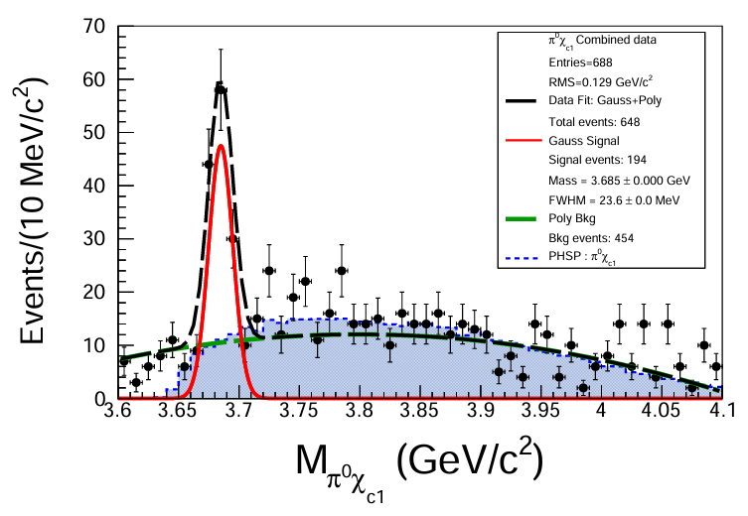
Fit data with Gaussian and polynomial functions.

Slide 8
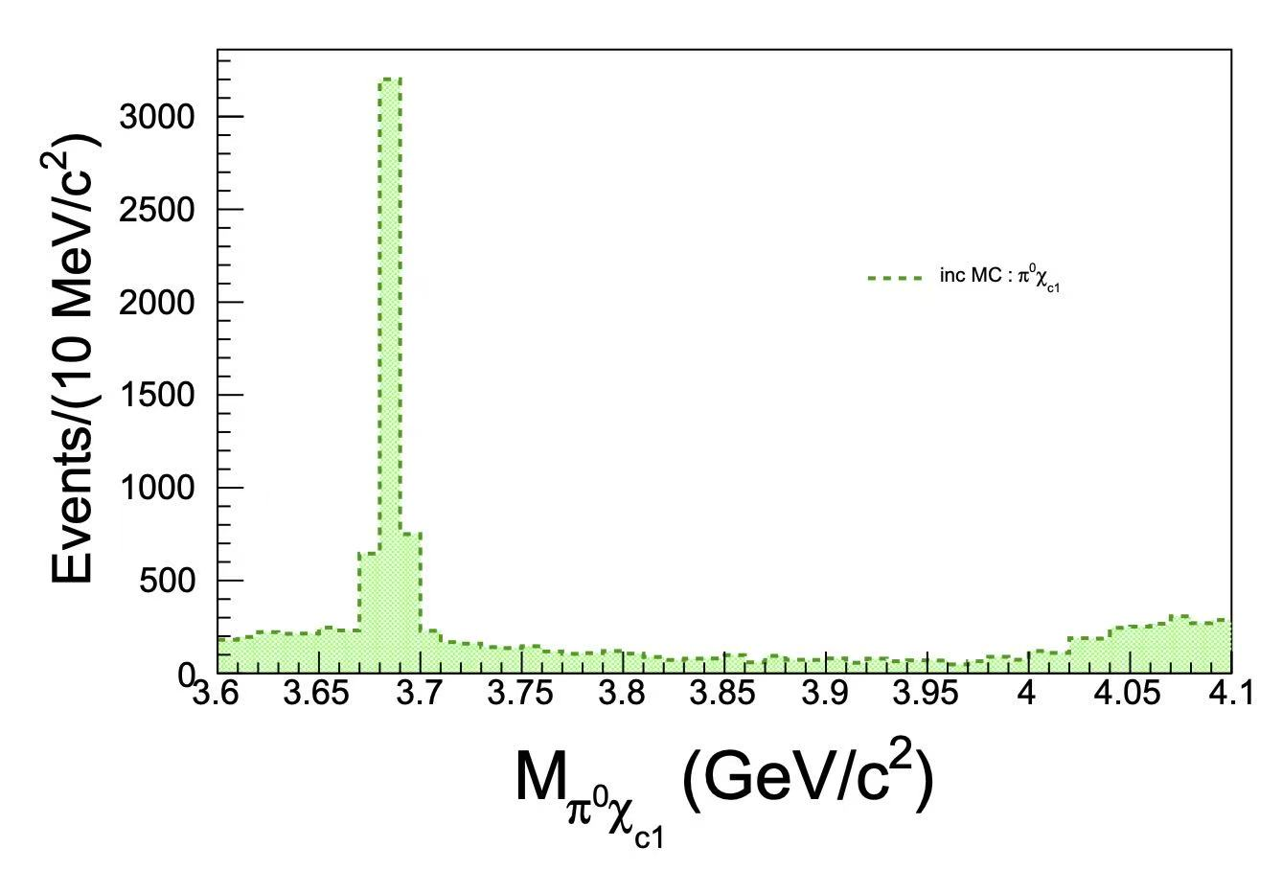
Consider events in the region [3.630, 3730] GeV

Slide 9
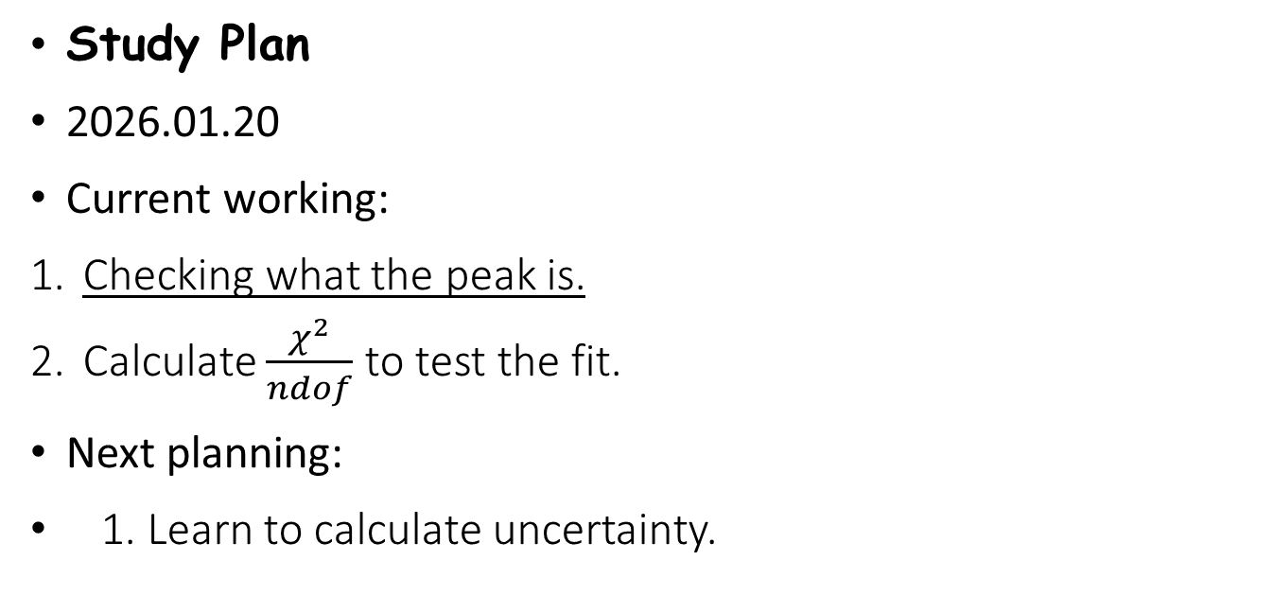
Study Plan
2026.01.20
Current working:
Checking what the peak is.
Calculate $\frac{χ^{2}}{ndof}$ to test the fit.
Next planning:
1. Learn to calculate uncertainty.

Slide 10
Back up

Slide 11
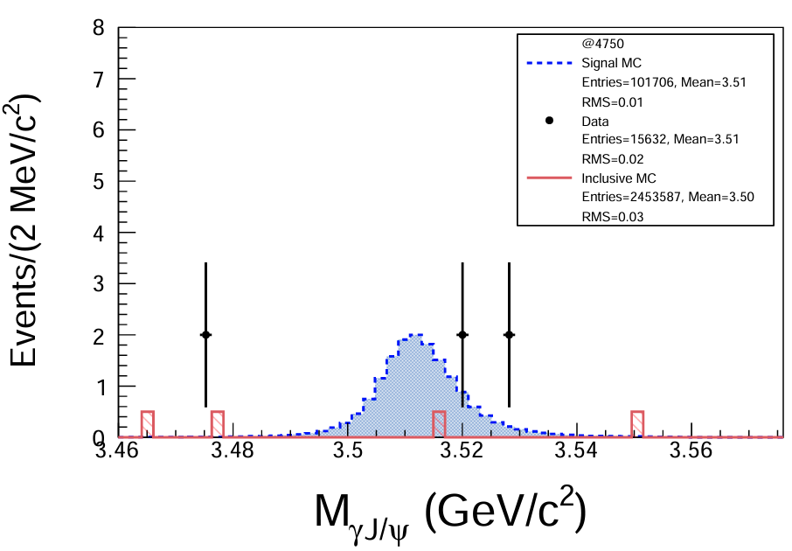
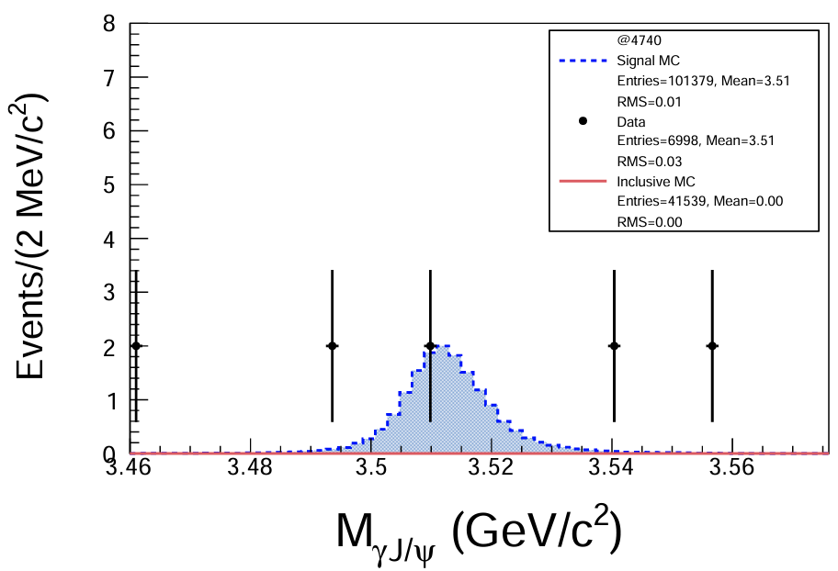
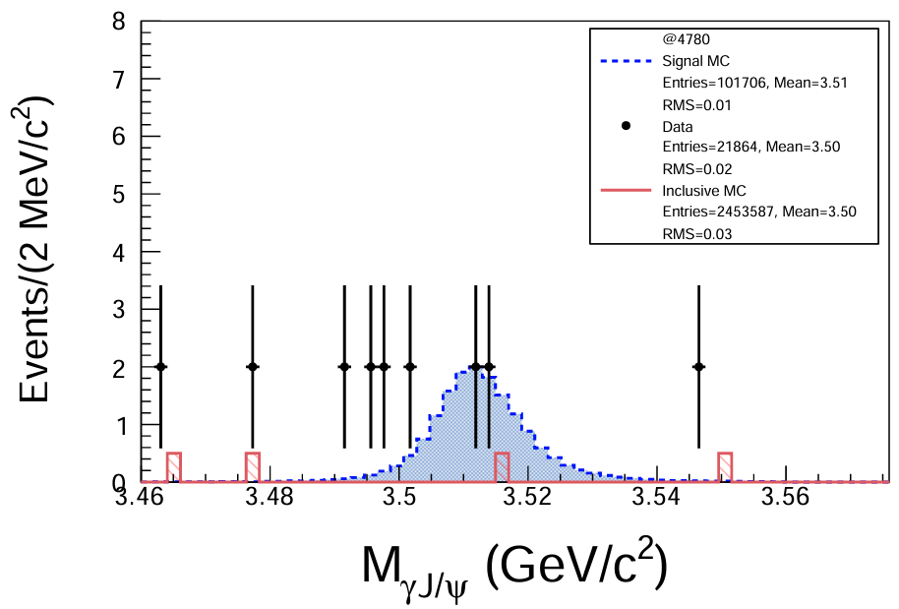
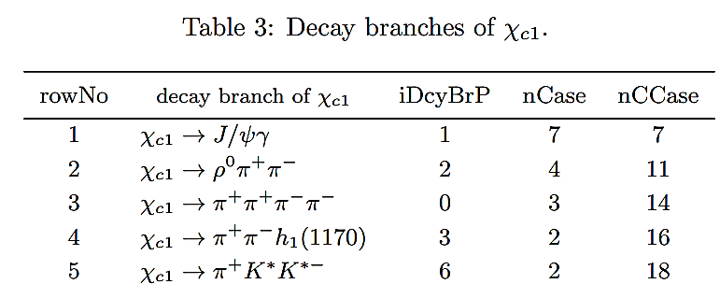
Data in 2021 @4740 - 4946

Slide 12
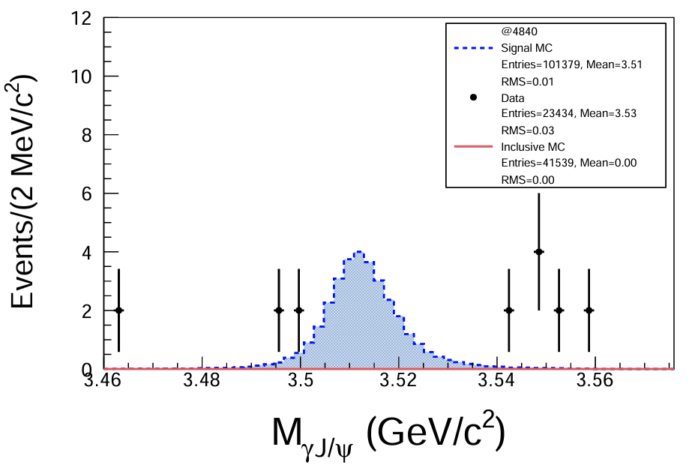
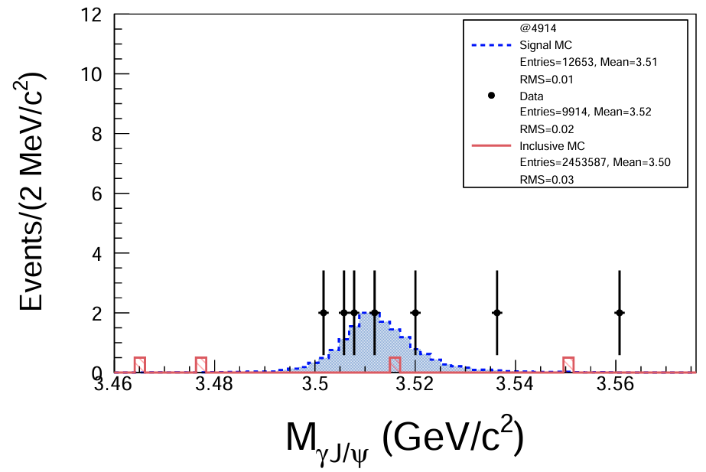
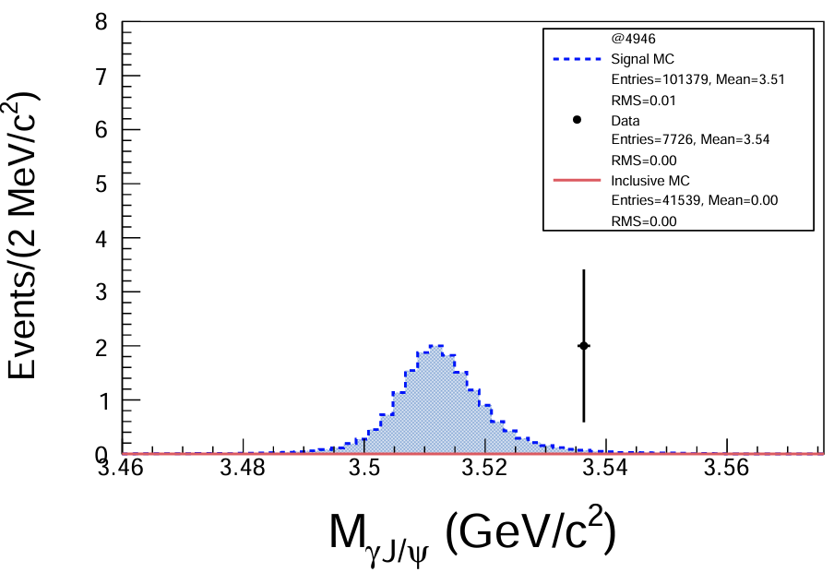

Slide 13
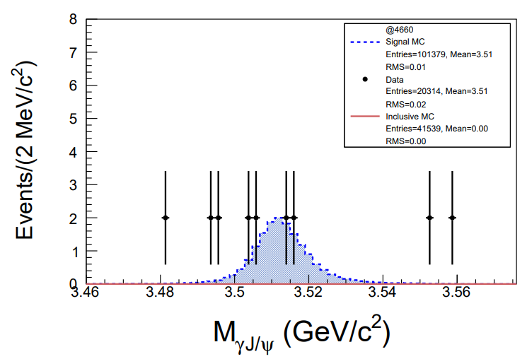
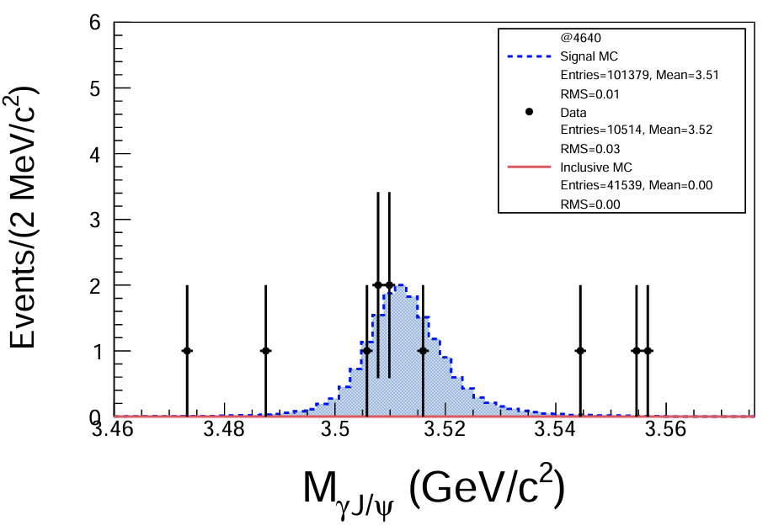
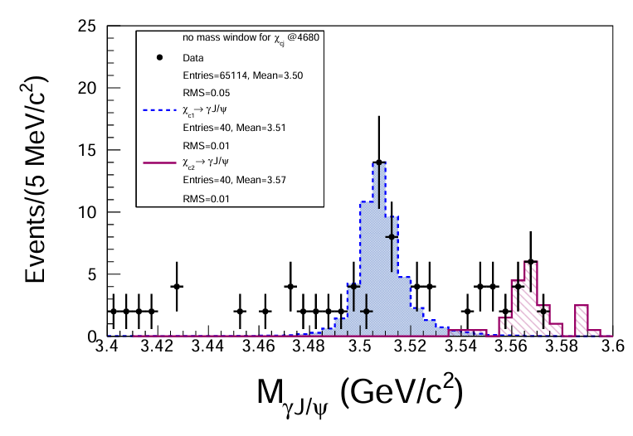
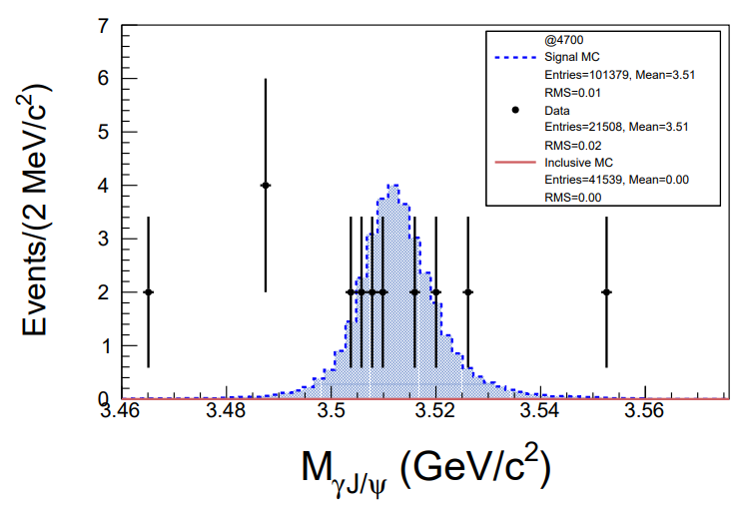
Data in 2020

Slide 14

No mass window for $χ_{cj}$

Slide 15
Next to do
Combine events from several energy points.

Slide 16
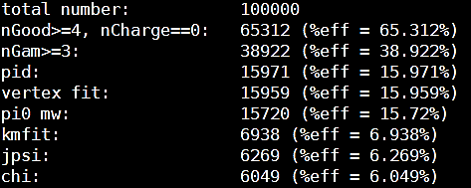
Cut flow

Slide 17
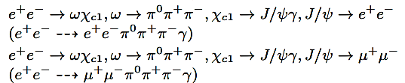

Next to do
Find
Perform $χ_{c1}$ invariant mass distribution.
Study and suppress background.
Prepare .dst files for signal MC at Ecms = 4.700 GeV.

Slide 18
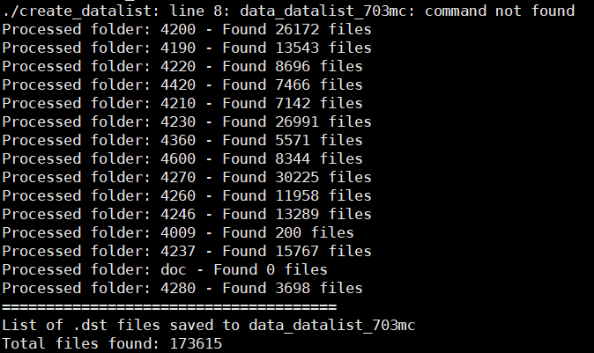
Mc 703

