Slide 1
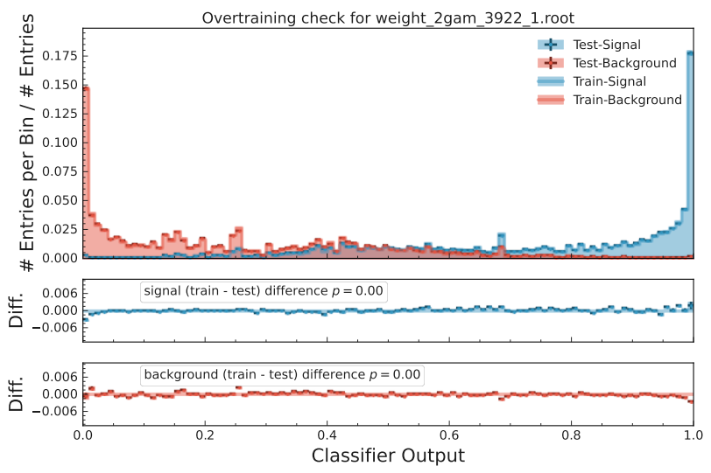
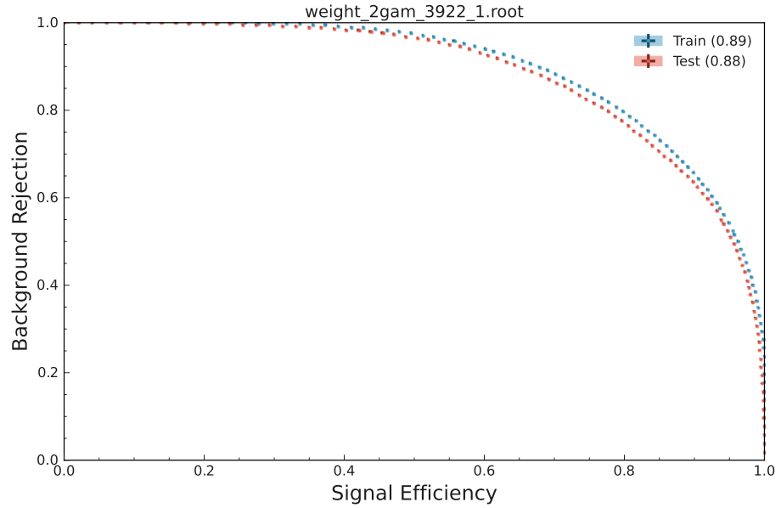
Pt MVA

Slide 2
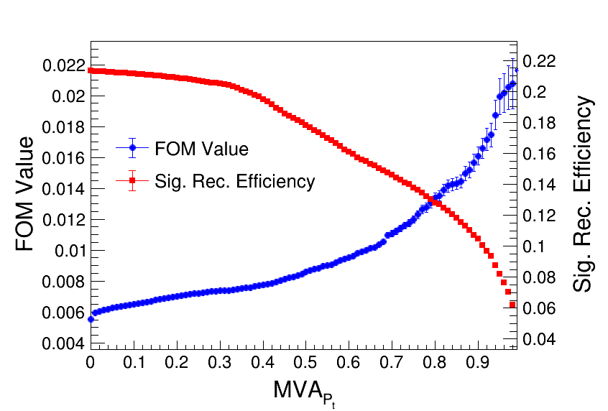
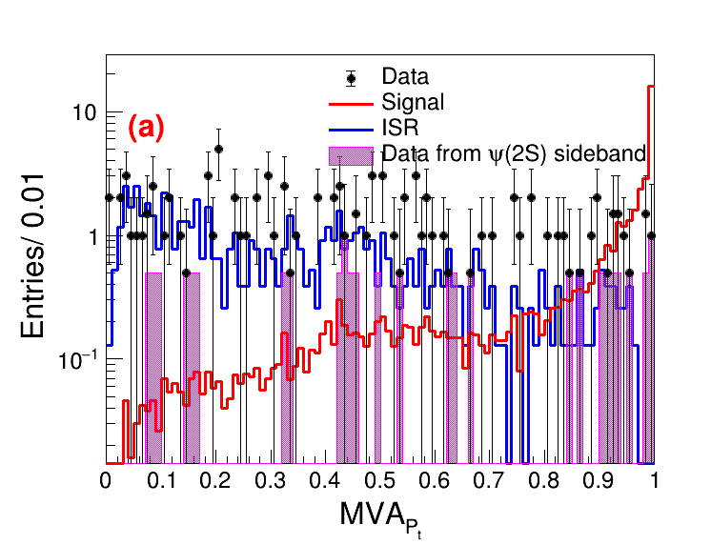
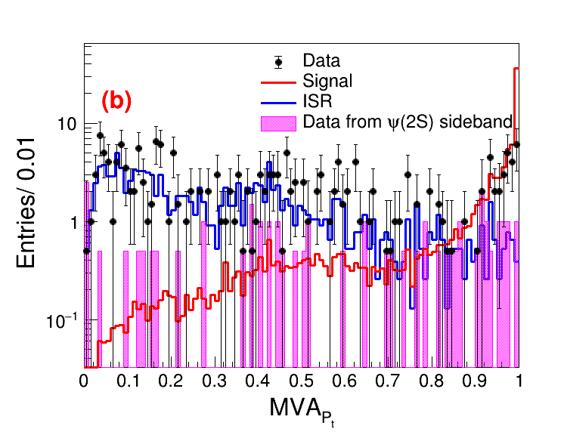
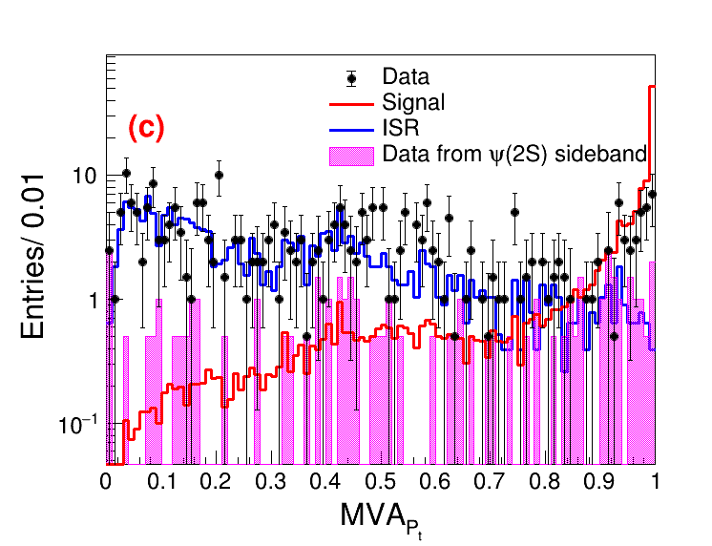
Pt MVA
(a)-ee mode; (b)-mumu mode; (c)-both mode

Slide 3
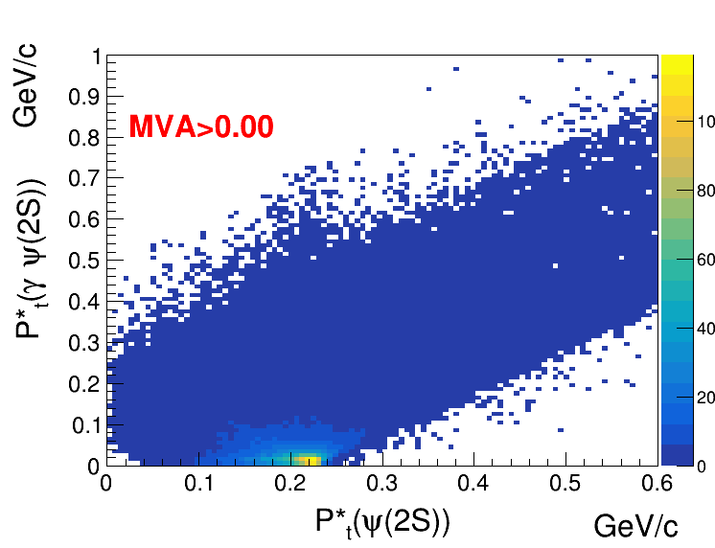
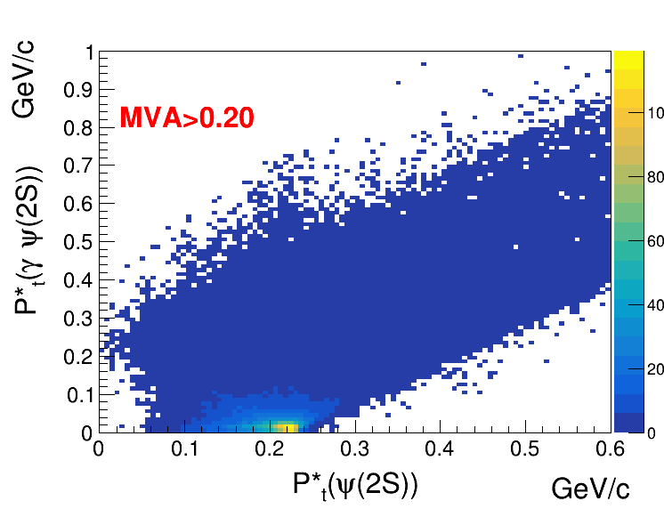
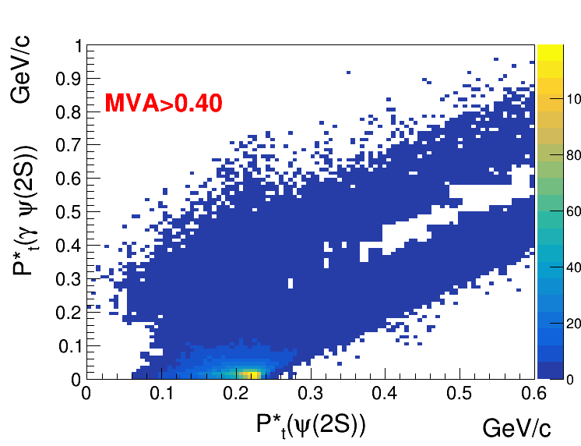
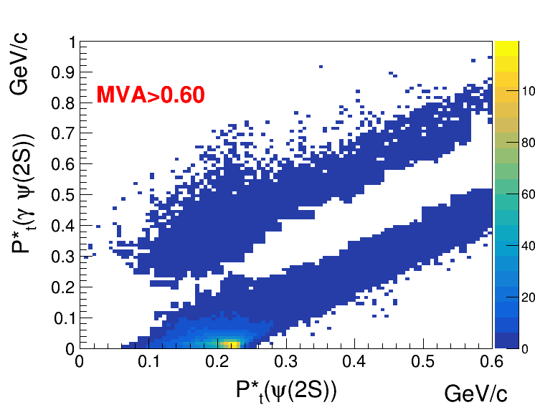
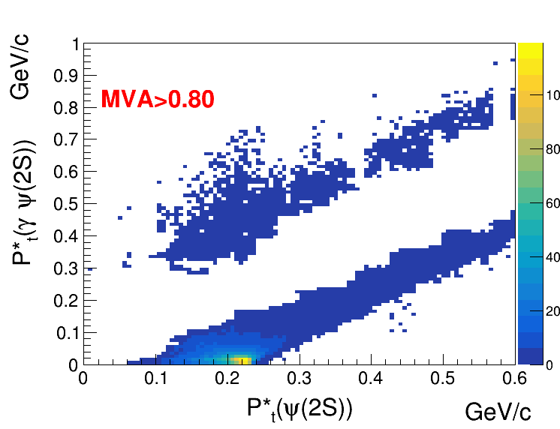
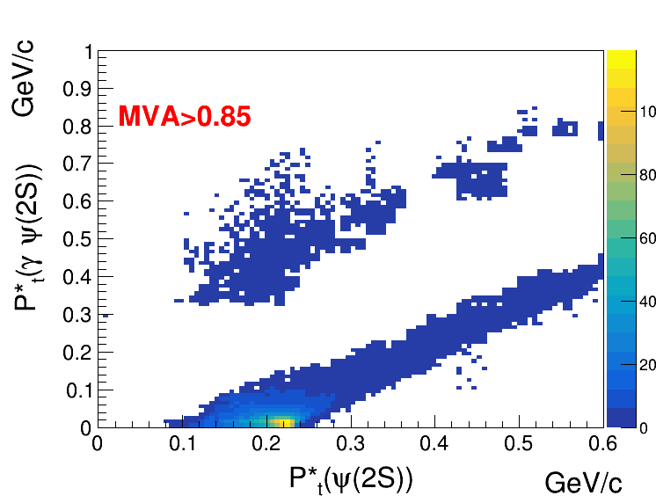
Different MVA selections for signal MC sample:

Slide 4
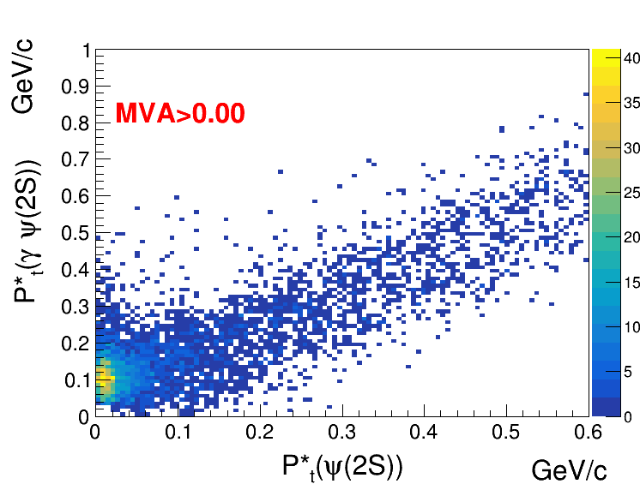
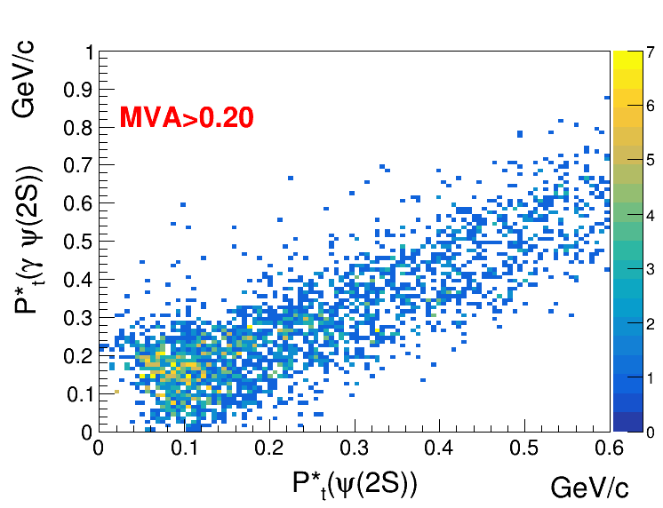
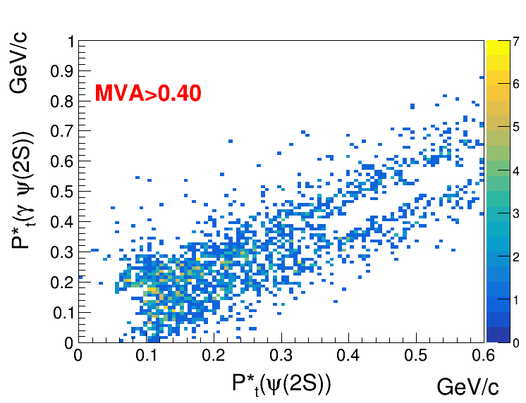
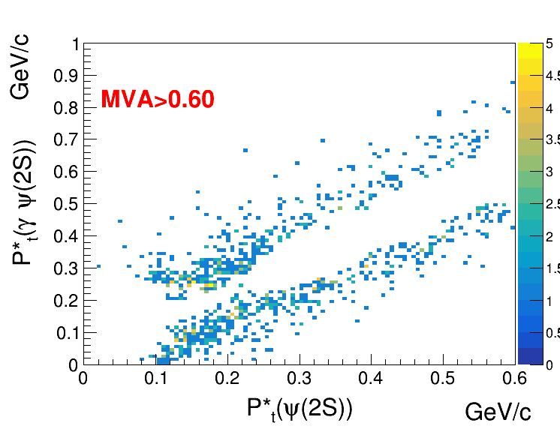
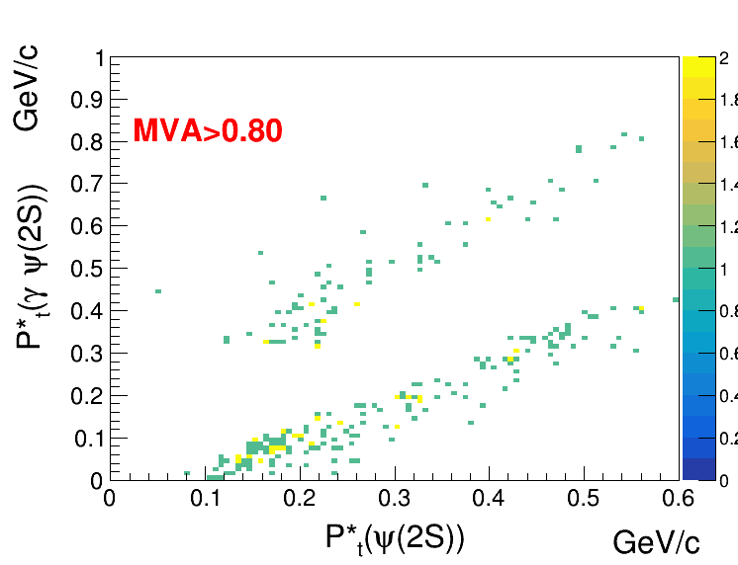

Different MVA selections for ISR MC sample:

Slide 5
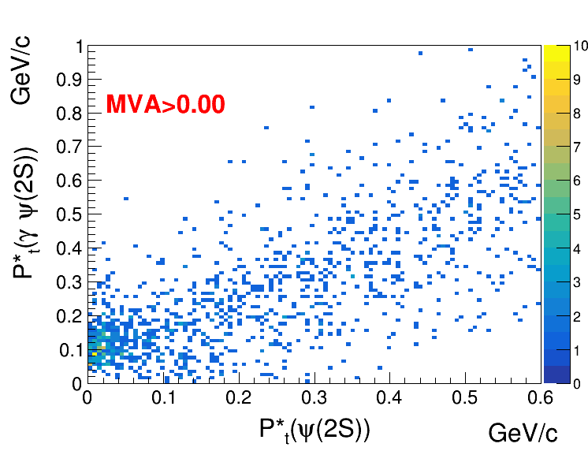
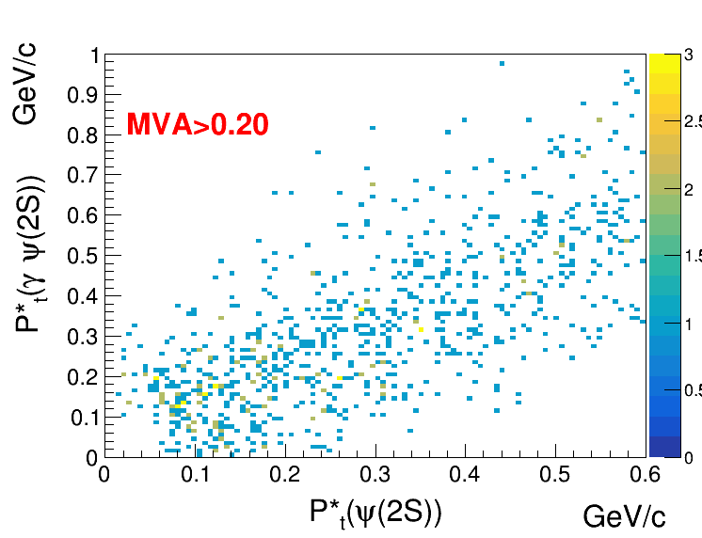
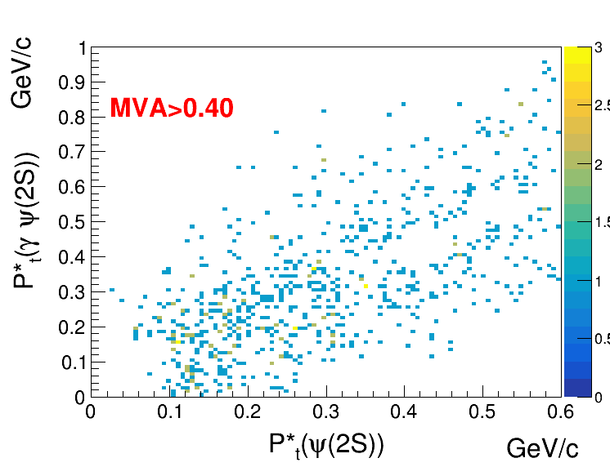
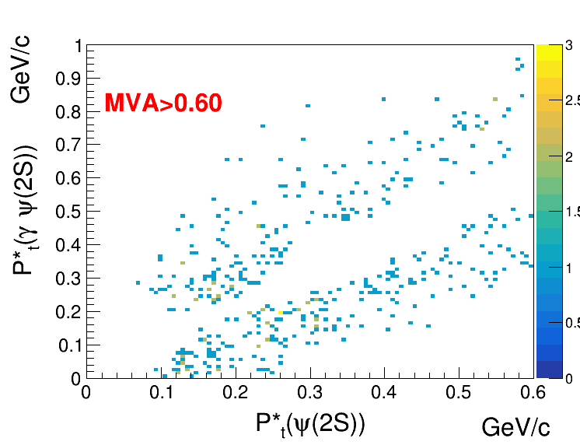
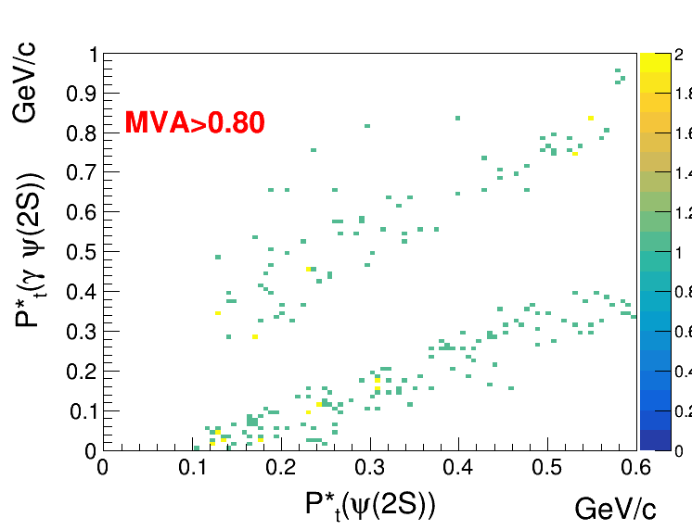

Different MVA selections for run1 data sample:

Slide 6
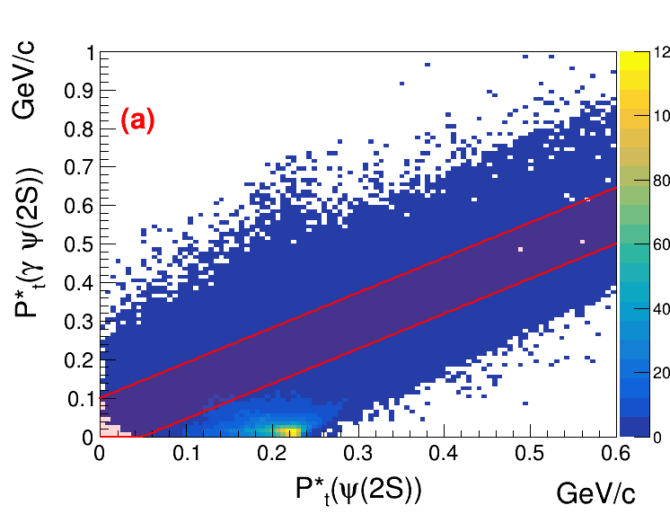
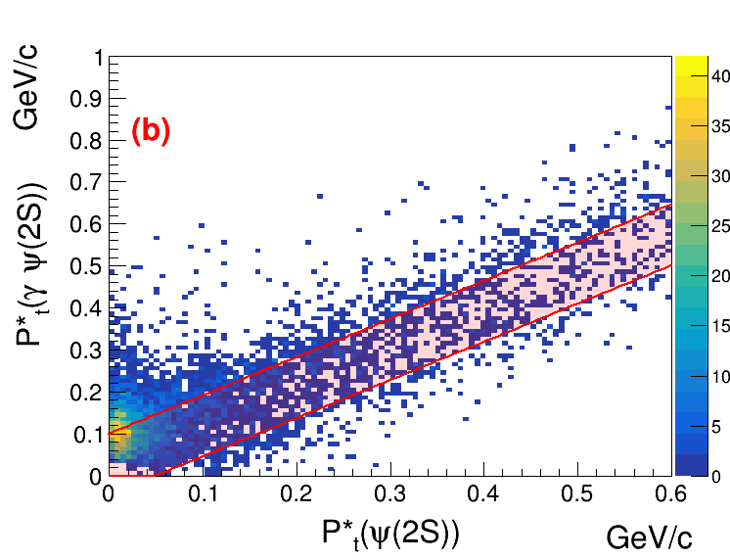
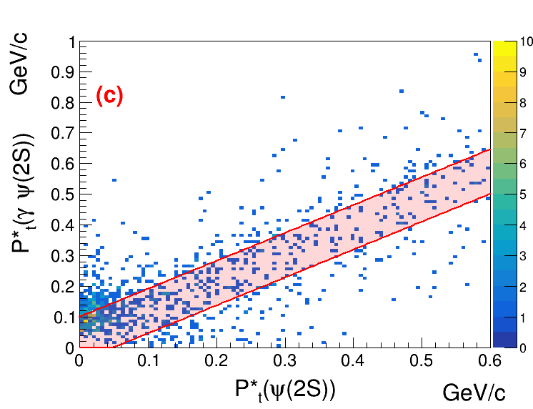
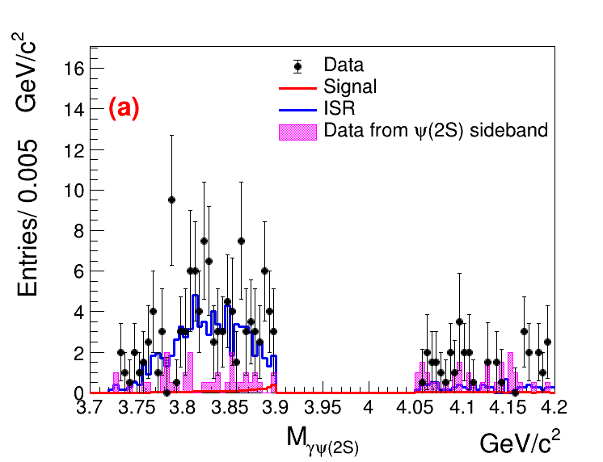
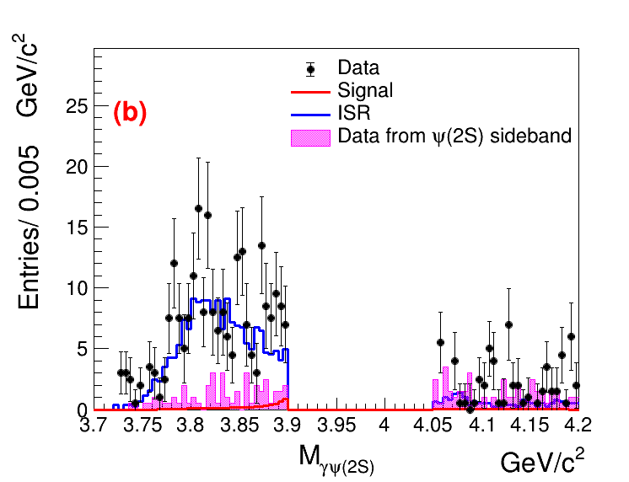
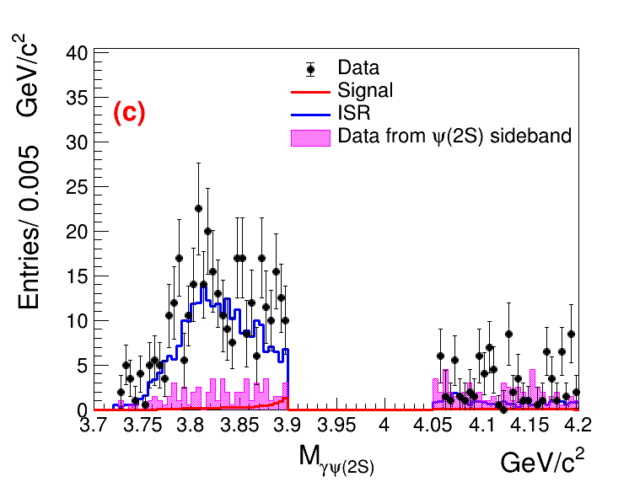
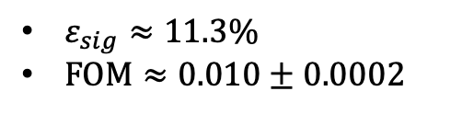
From MVA selections to 2D Pt selections:
$ε_{sig}≈11.3\%$
$FOM≈0.010±0.0002$
(a)-Signal; (b)-ISR; (c)-Data
(a)-ee mode; (b)-mumu mode; (c)-both mode

Slide 7
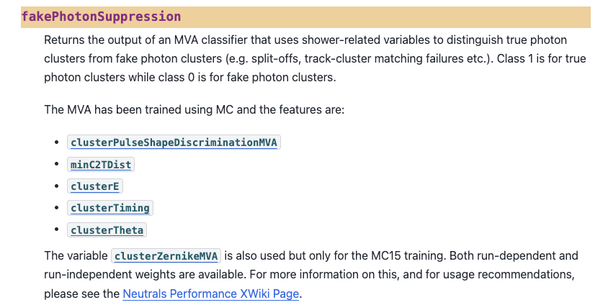
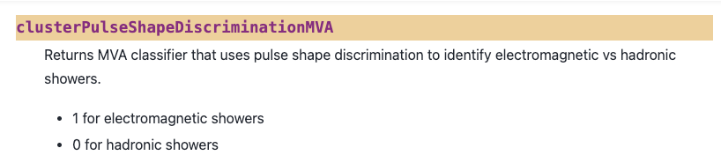
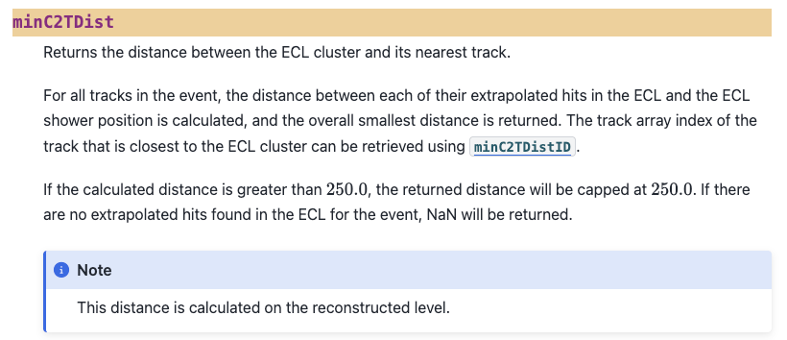

Slide 8
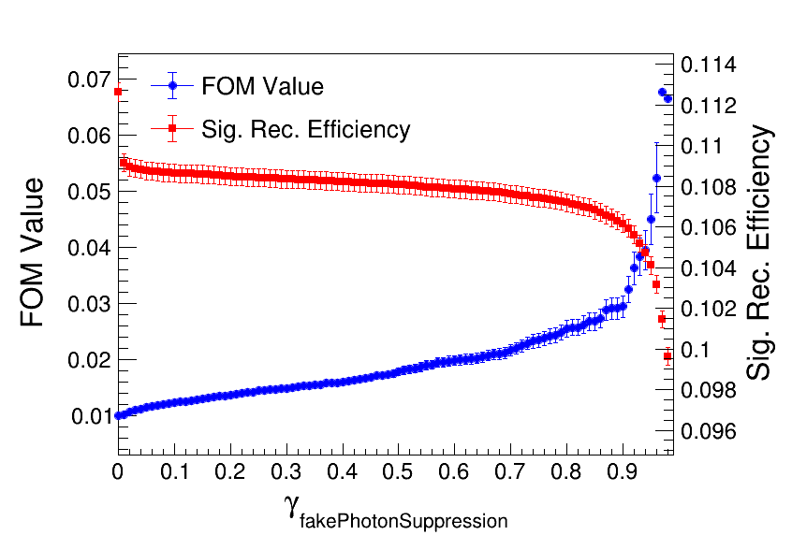
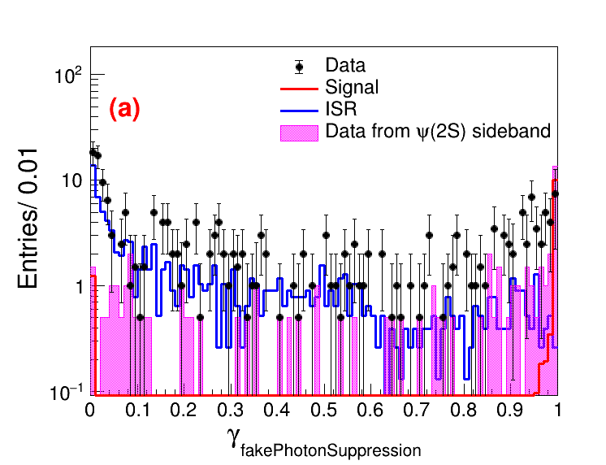
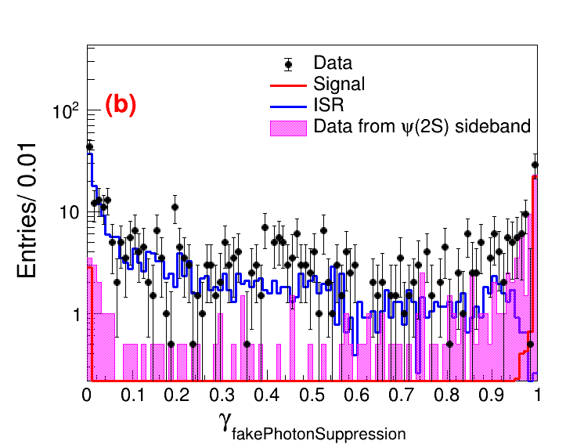
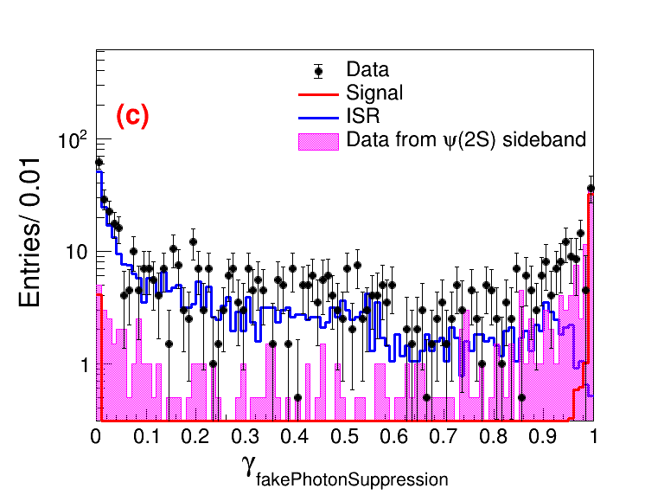
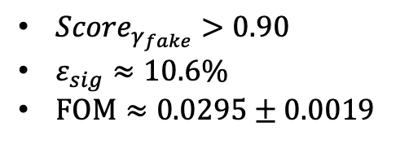
Based on 2D pt selection
${Score}_{γ_{fake}}>0.90$
$ε_{sig}≈10.6\%$
$FOM≈0.0295±0.0019$
(a)-ee mode; (b)-mumu mode; (c)-both mode

Slide 9
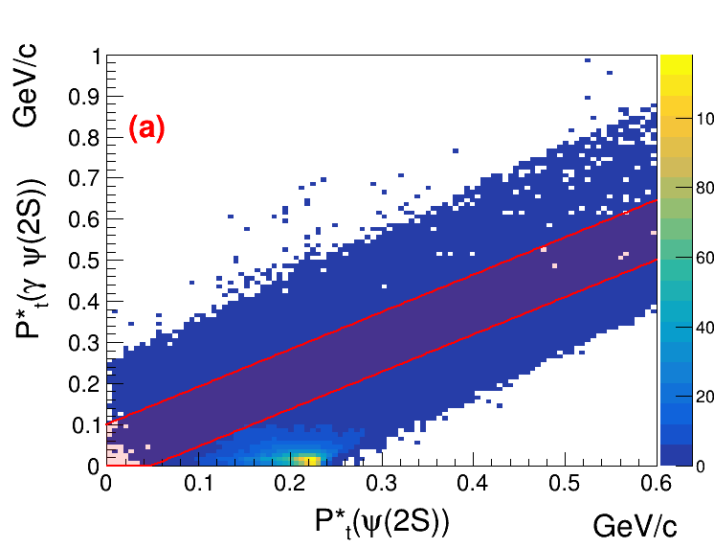
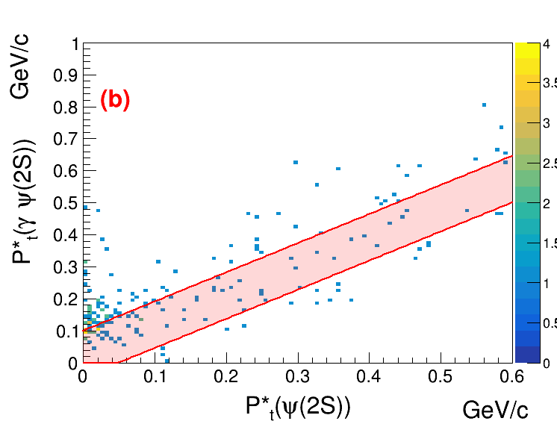
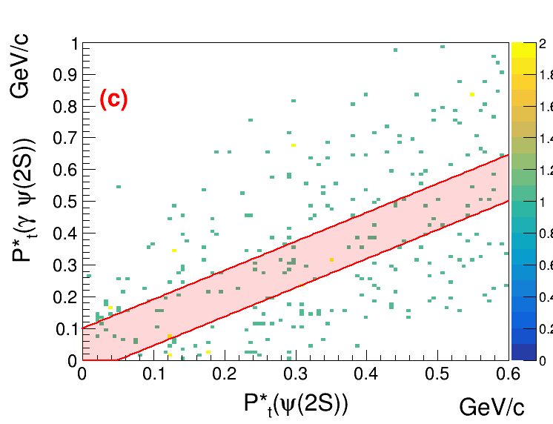
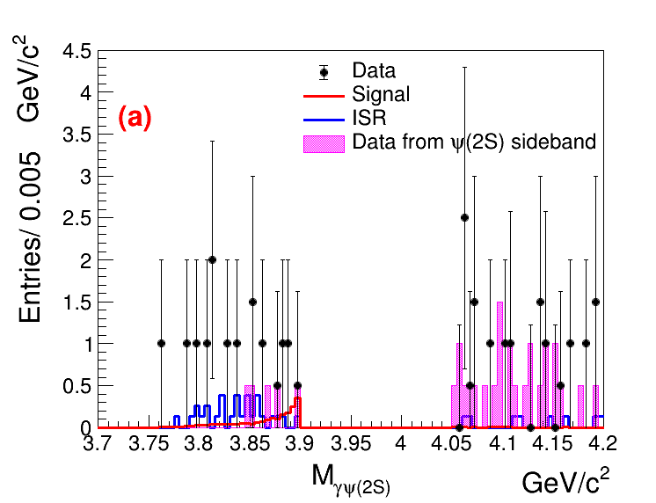
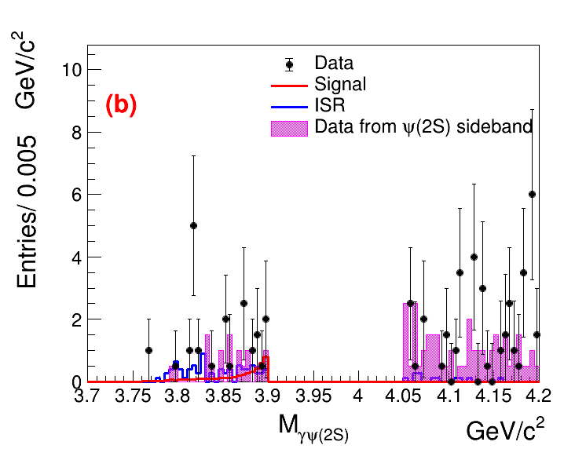
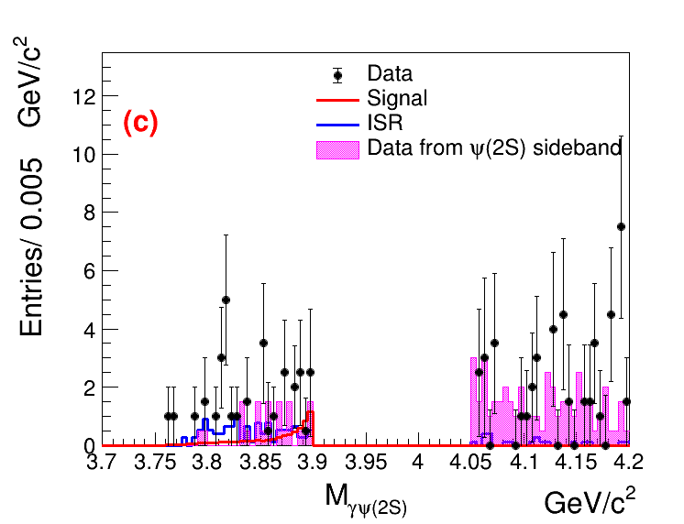
2D Pt scatter plots:(${Score}_{γ_{fake}}$>0.9)
(a)-Signal; (b)-ISR; (c)-Data
(a)-ee mode; (b)-mumu mode; (c)-both mode

Slide 10
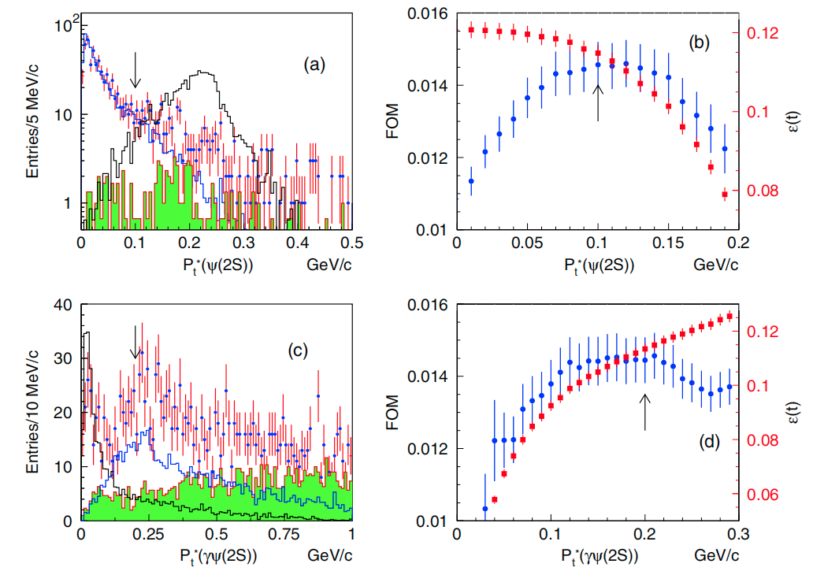
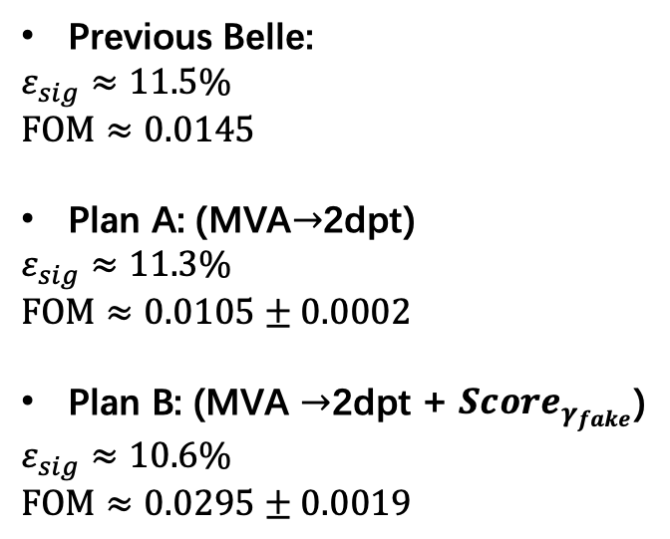
Previous Belle analysis
Previous Belle:
$$ε_{sig}≈11.5\%$$
$$FOM≈0.0145$$
Plan A: (MVA$→$2dpt)
$$ε_{sig}≈11.3\%$$
$$FOM≈0.0105±0.0002$$
Plan B: (MVA $→$2dpt + ${Score}_{γ_{fake}}$)
$$ε_{sig}≈10.6\%$$
$$FOM≈0.0295±0.0019$$

Slide 12
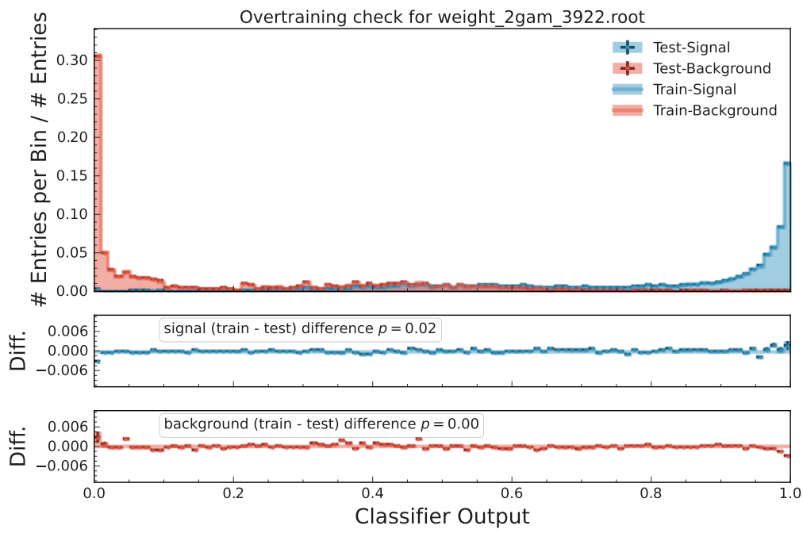
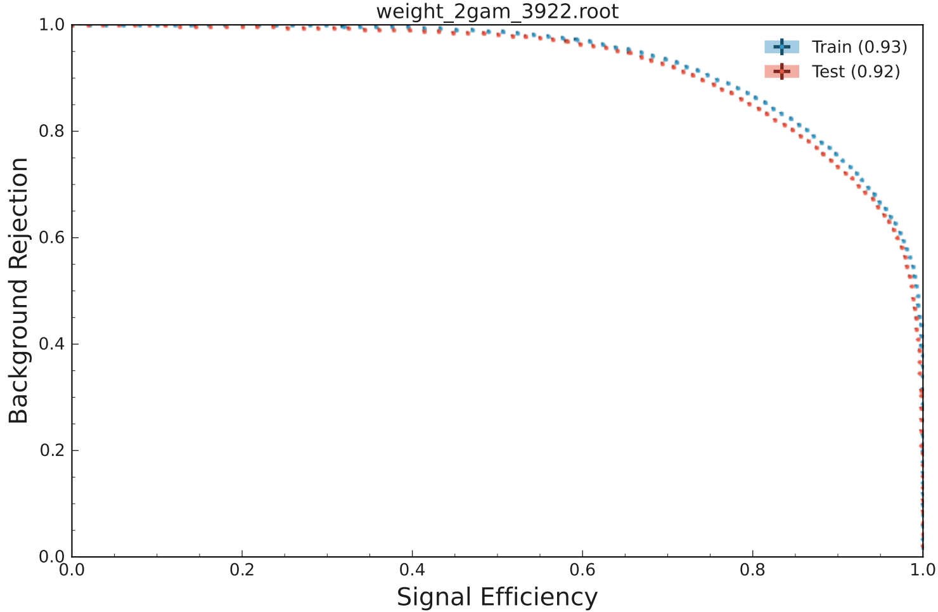
Pt MVA(Belle)

Slide 13
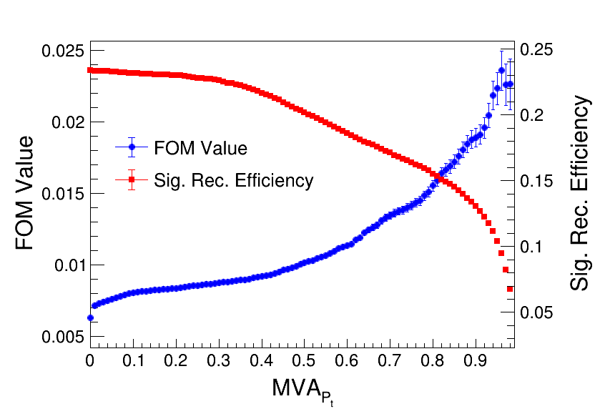
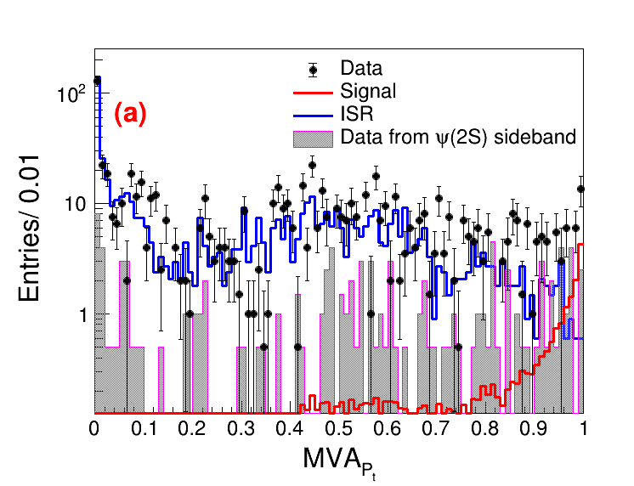
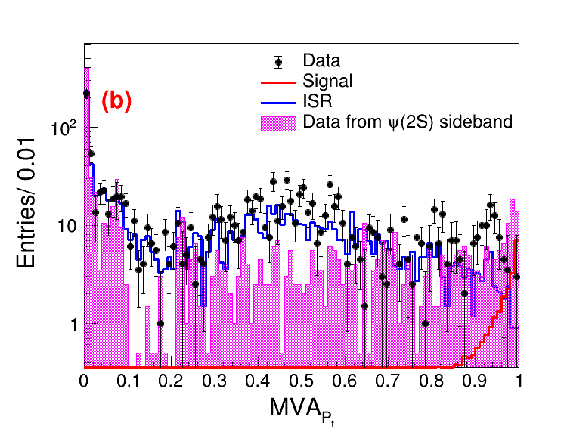

Pt MVA (Belle)
(a)-ee mode; (b)-mumu mode; (c)-both mode

Slide 14






Different MVA selections for signal MC sample:

Slide 15






Different MVA selections for ISR MC sample:

Slide 16






Different MVA selections for run1 data sample:

Slide 17






From MVA selections to 2D Pt selections:
(a)-Signal; (b)-ISR; (c)-Data
(a)-ee mode; (b)-mumu mode; (c)-both mode

Slide 18

Previous Belle analysis
Previous Belle:
$$ε_{sig}≈11.5\%$$
$$FOM≈0.0145$$
MVA$→$2dpt
$$ε_{sig}≈18.8\%$$
$$FOM≈0.0063$$

Slide 19





