Slide 1
Solenoid field compensation scheme
Yiwei Wang, Yixian Dai, Yuan Zhang
23 Jan 2026
CEPC beam dynamics meeting

Slide 2
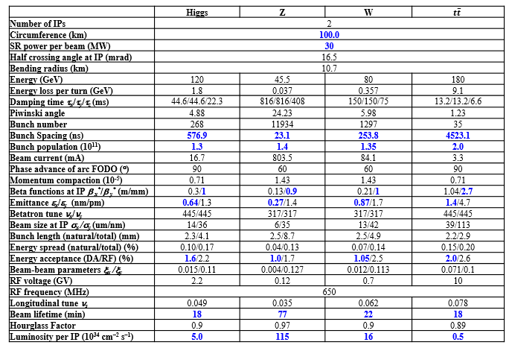
Introduction
Goal
vertical emittance due to solenoid field < 0.5*nominal value=0.7pm @ 3T detector solenoid
good beam dynamics performance: dynamic aperture, peak luminosity, polarization, …

Slide 3
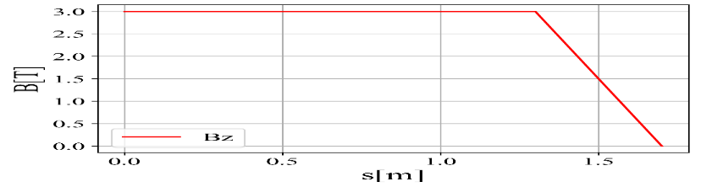
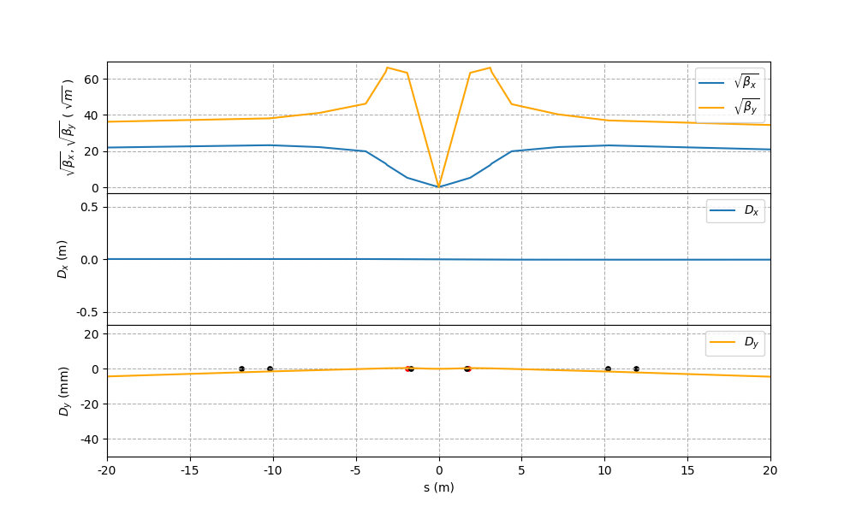
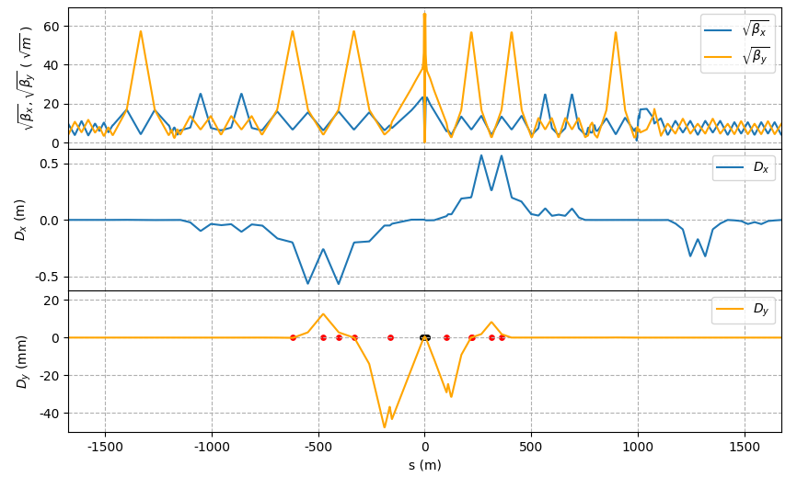
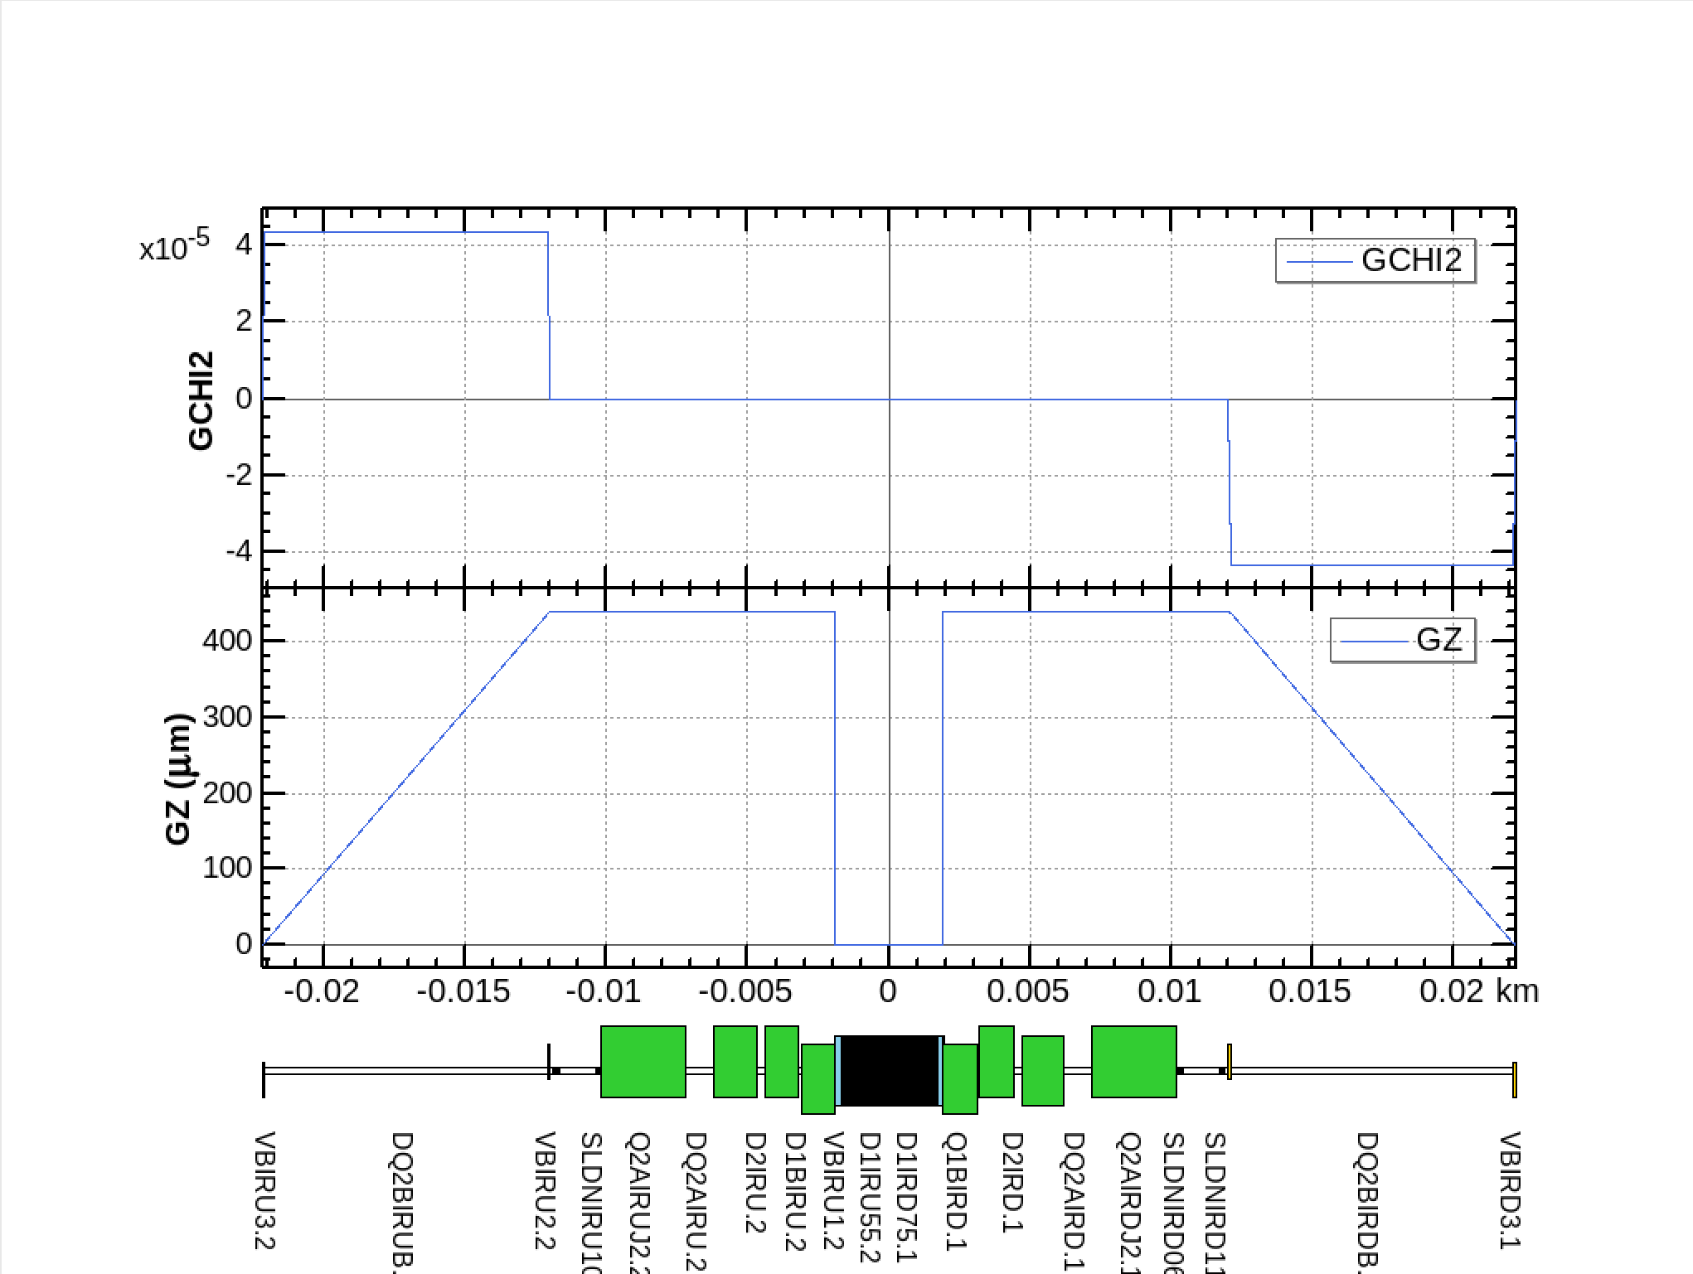
3T solenoid detector field for CEPC Z pole operation (non local compensation scheme)
Yixian Dai, Yiwei Wang, Yuan Zhang
1.7m
If non-local compensation scheme with Bz0=3 T
Anti solenoid
assuming anti-solenoid in front of the final quadrupoles from 1.3m to 1.7m to cancel the Bz to be zero and kept zero until the end of the final quadrupoles
One bend in front of the final quadrupoles to partly correct the vertical angle
Add Skew quadrupole coils on the final quadrupoles thus the beam will match the quadrupole
Anti solenoid to cancel the ∫Bzdz to be zero right at down stream of the final quadrupole cryo-module
5 more bends at the down stream to correct the orbit and dispersion y, y’, Dy, Dy’
Anti solenoids
Skew quad coils
Vertical bends
Anti solenoids
Vertical bend
全环垂直发射度0.3 pm

Slide 4
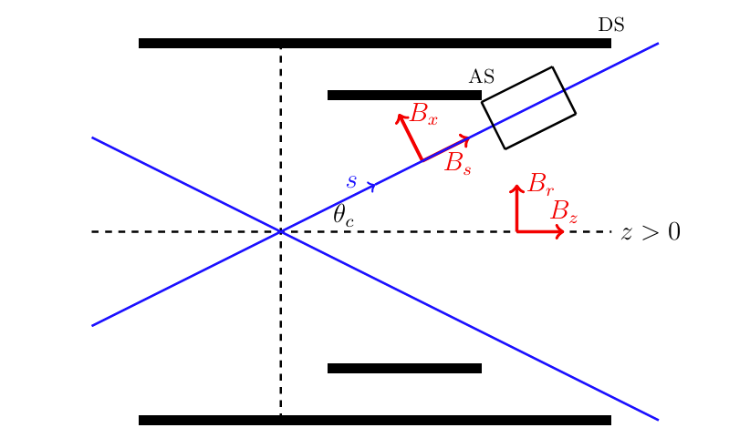
Closed orbit in the quadrupole
在两个Q铁孔径中垂直轨道相反，且因为CEPC需运行于不同能量，无法通过分别调整两个孔径的四极铁磁中心解决。
qV×Bx：对两个孔径中的束流q, V , B均相反
研究该情形下的non local补偿方案

Slide 5
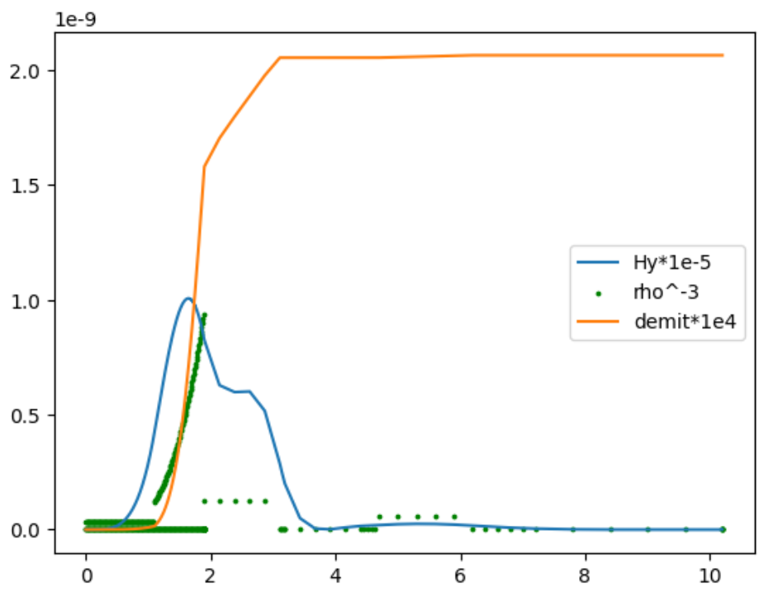
研究进展
模拟方法
在lattice中，尝试了最终聚焦系统中各种不同垂直校正子位置
研究过程中，遇到并逐一解决轨道GY、耦合计算、色散的bug
最新结果：一共有五个矫正子，通过改变离IP最近的矫正子的强度来扫描发射度最小值，全环垂直发射度0.8 pm
垂直发射度分析

Slide 6
下一步
模拟方法受限于匹配难度、程序bug等，因此我们同时在进行理论方法研究：放置校正子于任意位置（不受其他铁位置限制），通过传输矩阵建模，寻找最小解。
及时检查新版本的动力学孔径。
整理Z@3T、12.1MW和30MW条件下，local和non-local方案的优缺点。

