Slide 1
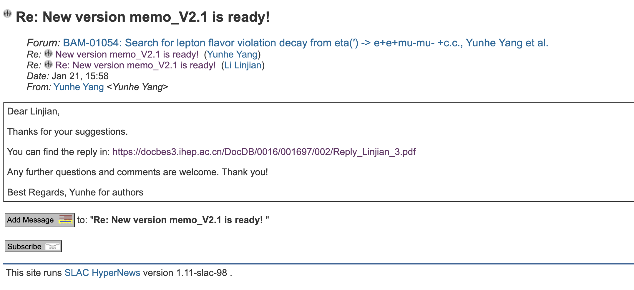
CLFV
Reply to Li Linjian

Slide 2
CPV
Waiting for group review.

