Slide 1
极端核物质前沿研讨会
QCD phase transition at finite isospin density and magnetic field
曹高清
School of Physics and Astronomy Sun Yat-sen University
GC, et. al. , Phys. Rev. D 104, 054007 (2021); 107, 014021 (2023);
110, 034004 (2024); NST (2026).
2026.4.25 @ Three Gorges University

Slide 2
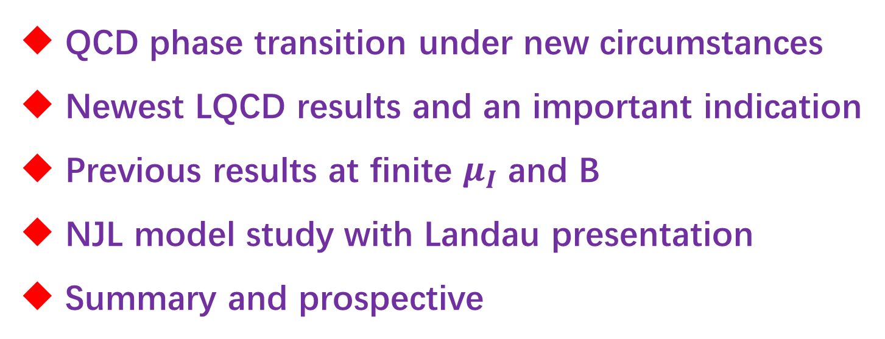
Outline
QCD phase transition under new circumstances
Newest LQCD results and an important indication
Previous results at finite $μ_{I}$ and B
NJL model study with Landau presentation
Summary and prospective

Slide 3
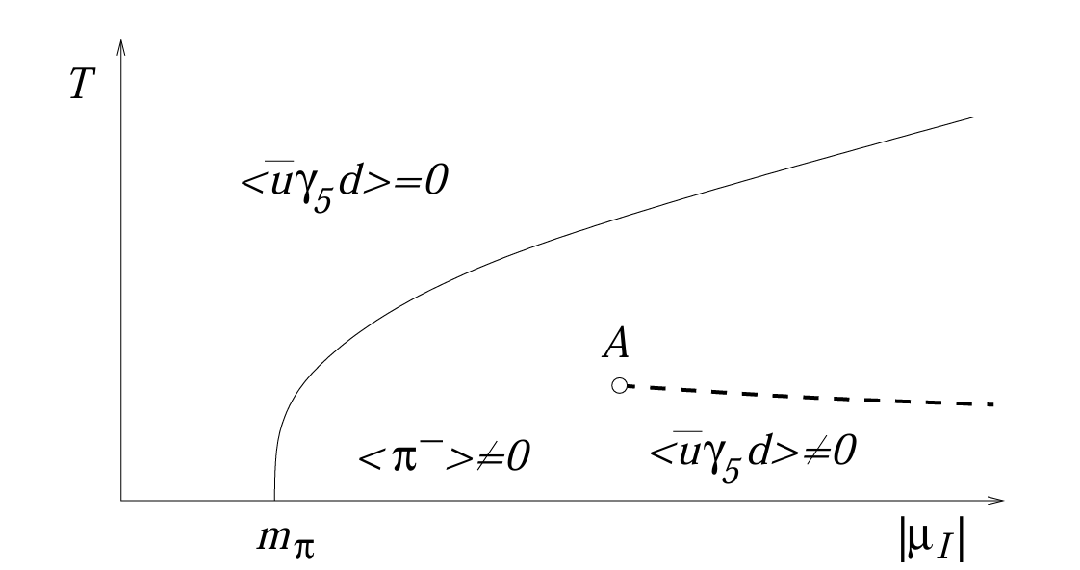
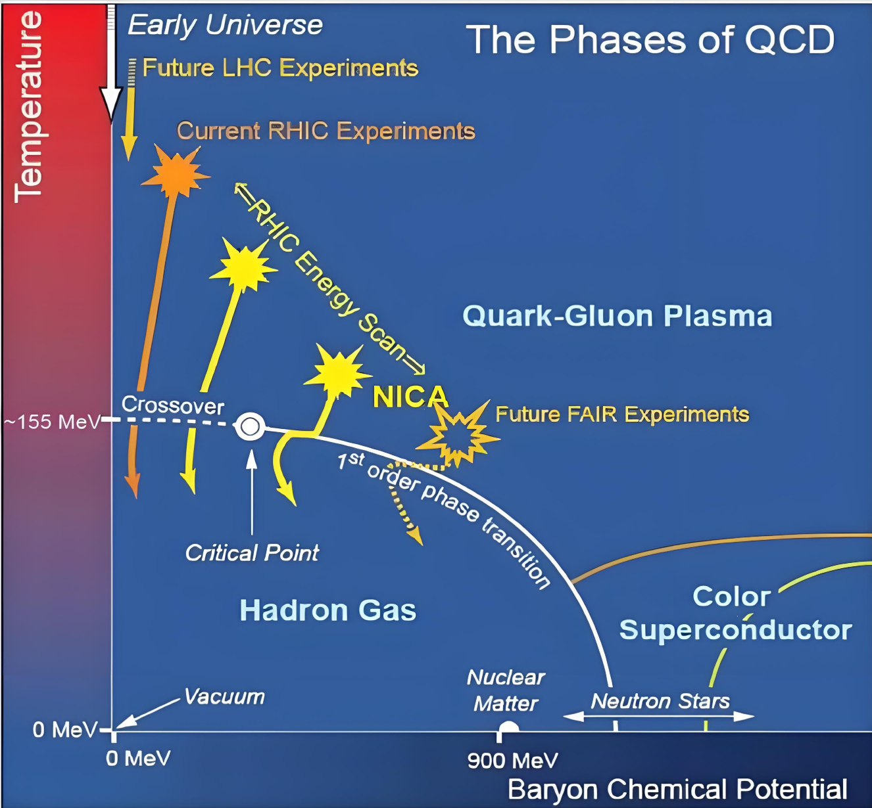
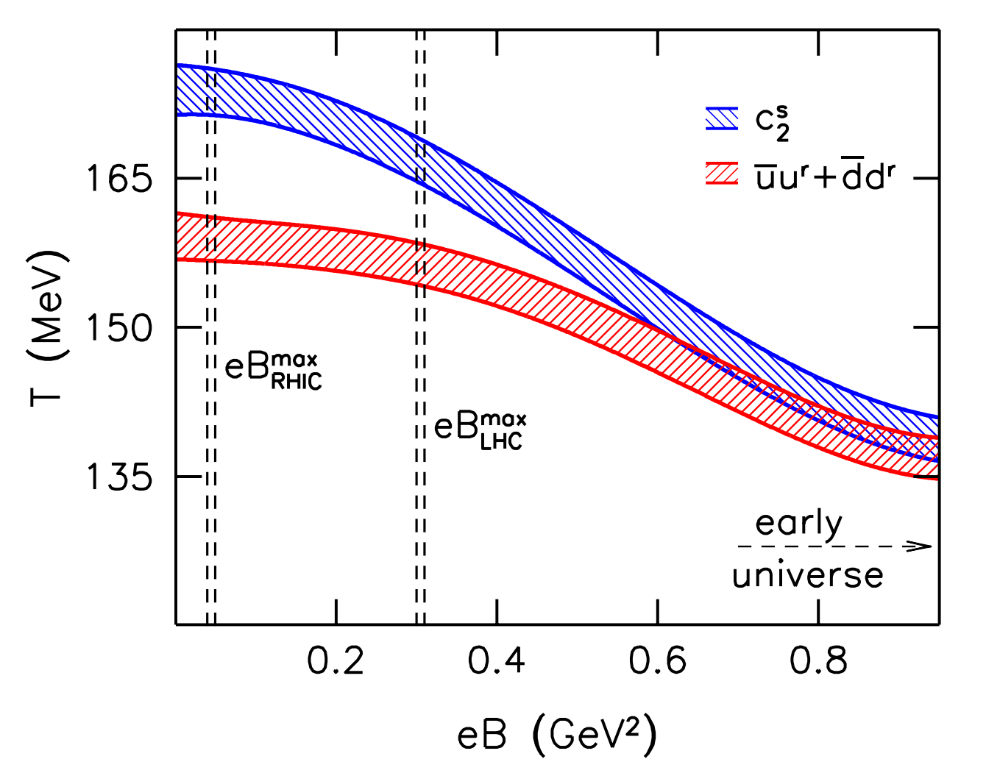
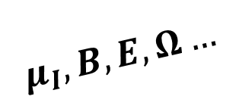
QCD phase transition under new circumstances
D.T. Son and M.A. Stephanov, PRL. 86, 592-595 (2001)
G. Bali et al., JHEP 2012.
$$μ_{I}, B, E, Ω…$$

Slide 4
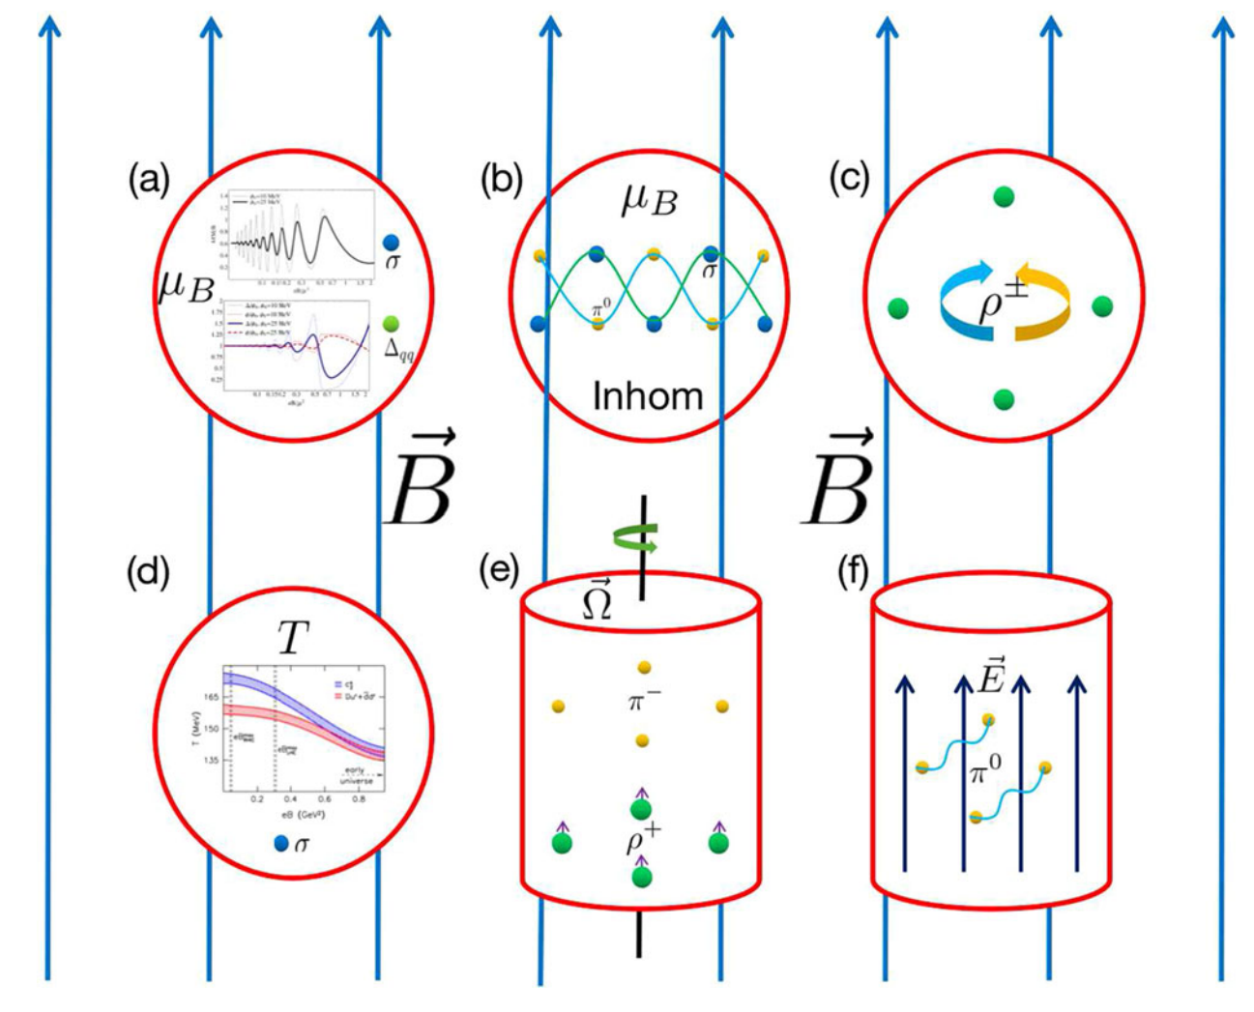
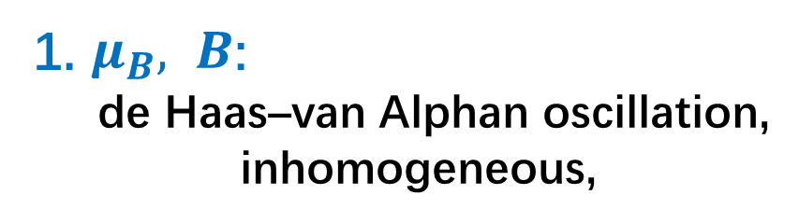
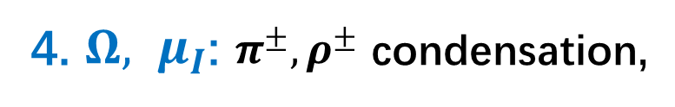

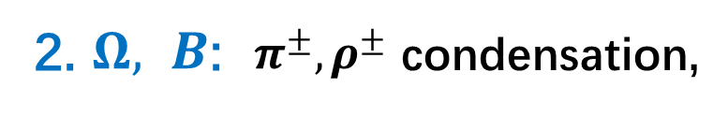
1. $μ_{B}, B$:
de Haas–van Alphan oscillation,
inhomogeneous,
2. $Ω, B$: $π^{±}, ρ^{±}$ condensation,
3. E$, B$: $π^{0}, K^{0}…$ condensation,
4. $Ω, μ_{I}$: $π^{±}, ρ^{±}$ condensation,
H. Zhang, D. Hou and J. Liao,
Chin. Phys. C 44, 111001 (2020)
GC, Eur. Phys. J. A (2021) 57:264

Slide 5
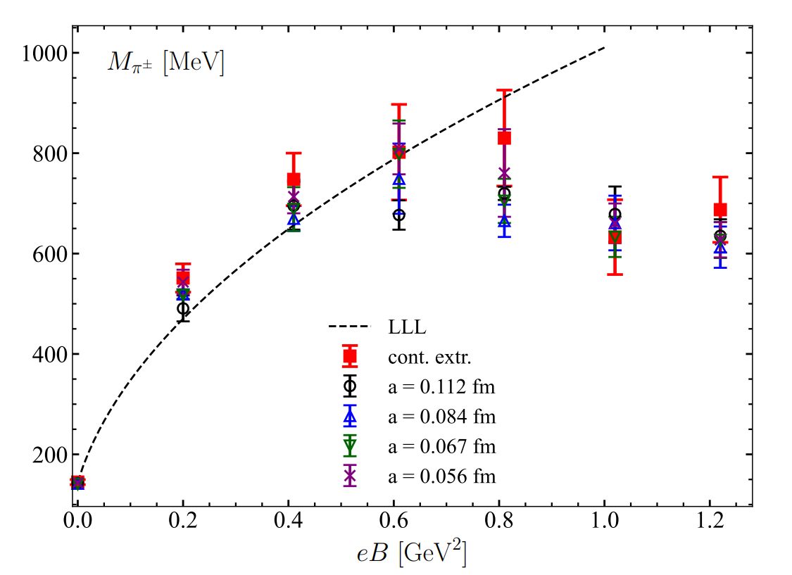
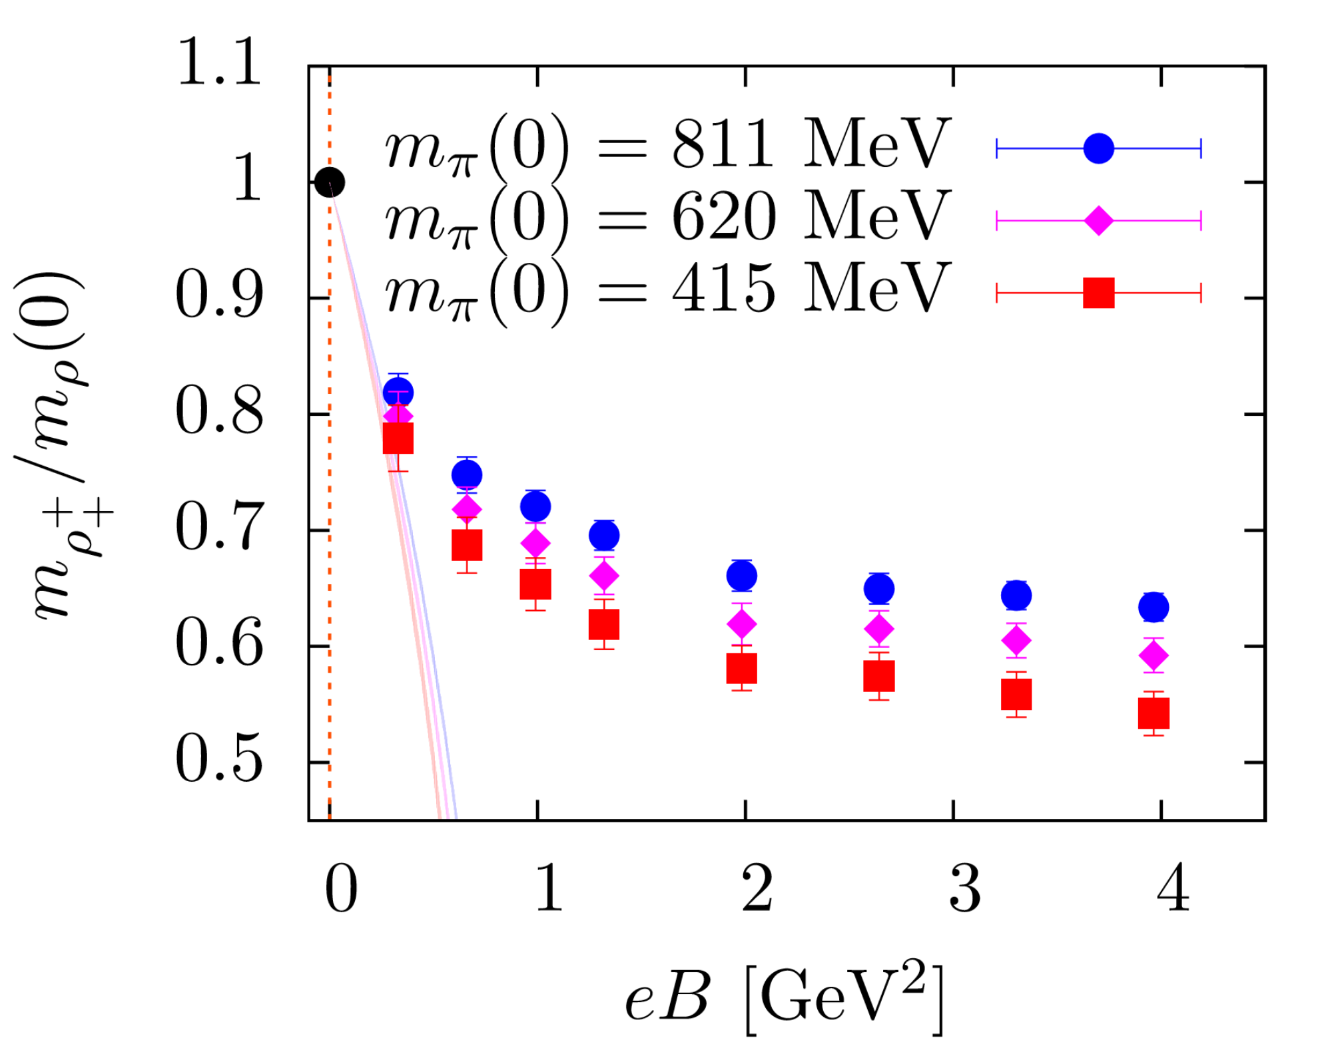








Newest LQCD results and an important indication
$$π^{+}$$
unstable with both $Ω$ and $B$
stable with both $Ω$ and $B$
$$u$$
$$\overline{d}$$
$$ρ^{+}$$
$$u$$
$$\overline{d}$$
G. Bali et al.,(PRD2018).
reversal
H.T. Ding and D. Zhang, arXiv: 2601.1835

Slide 6
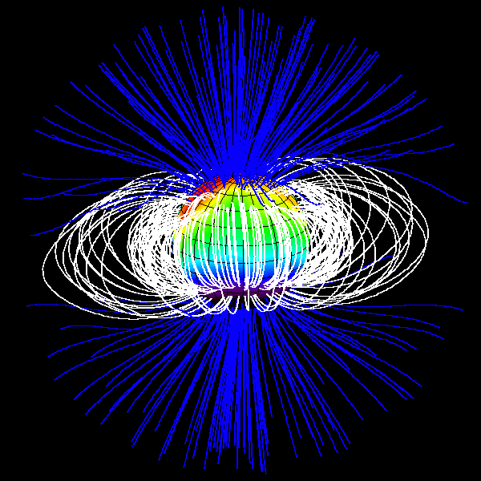
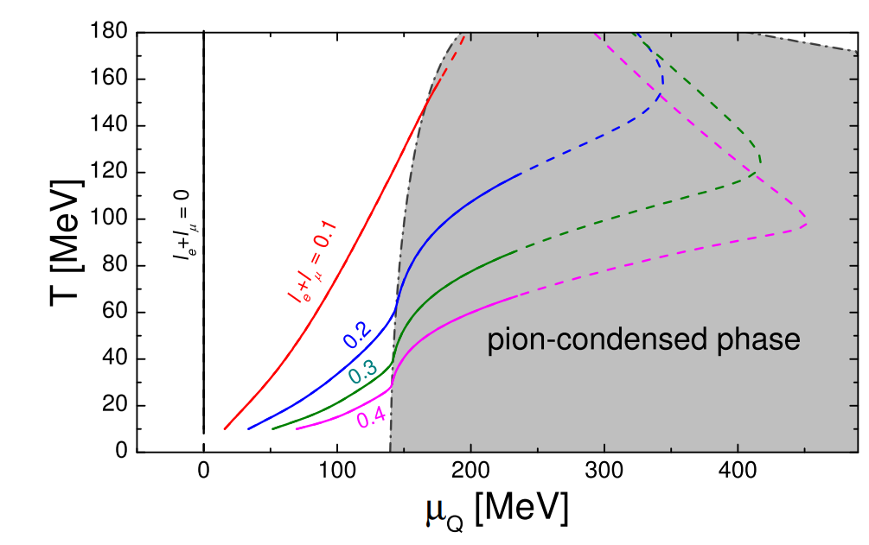
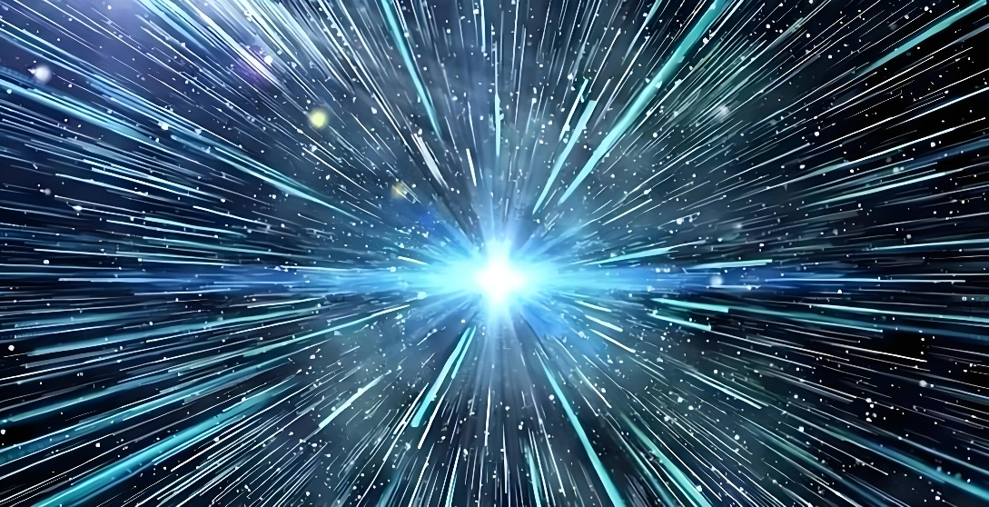


Relevant physical systems
magnetar
Big bang
$$l=0, Q=0$$
$$π^{+}+e^{−}↔ ν_{e}$$
V. Vovchenko et al., Phys. Rev. Lett. 126, 012701 (2021)

Slide 7
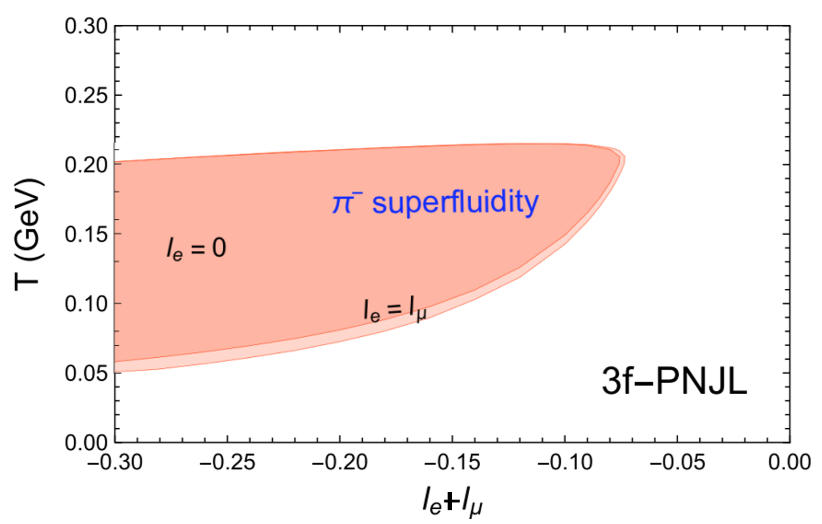
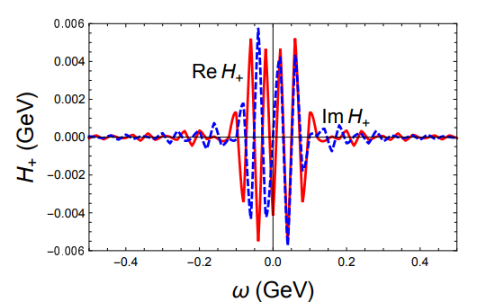
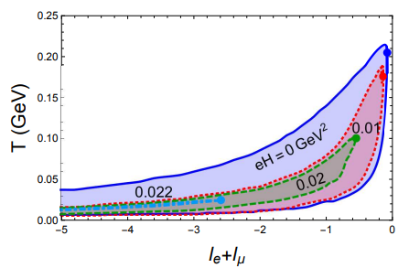


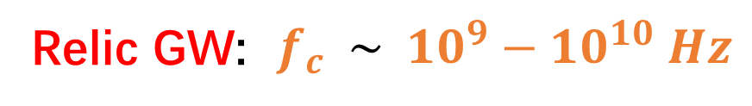

Previous results at finite $μ_{I}$ and B
$ω_{c}\sim 0.1 GeV$, consistent with $Λ_{QCD}$
Relic GW: $f_{c} \sim 10^{9}−10^{10} Hz$
or $0.1−1 K$
GC, Phys. Rev. D 107, 014021 (2023).

Slide 8
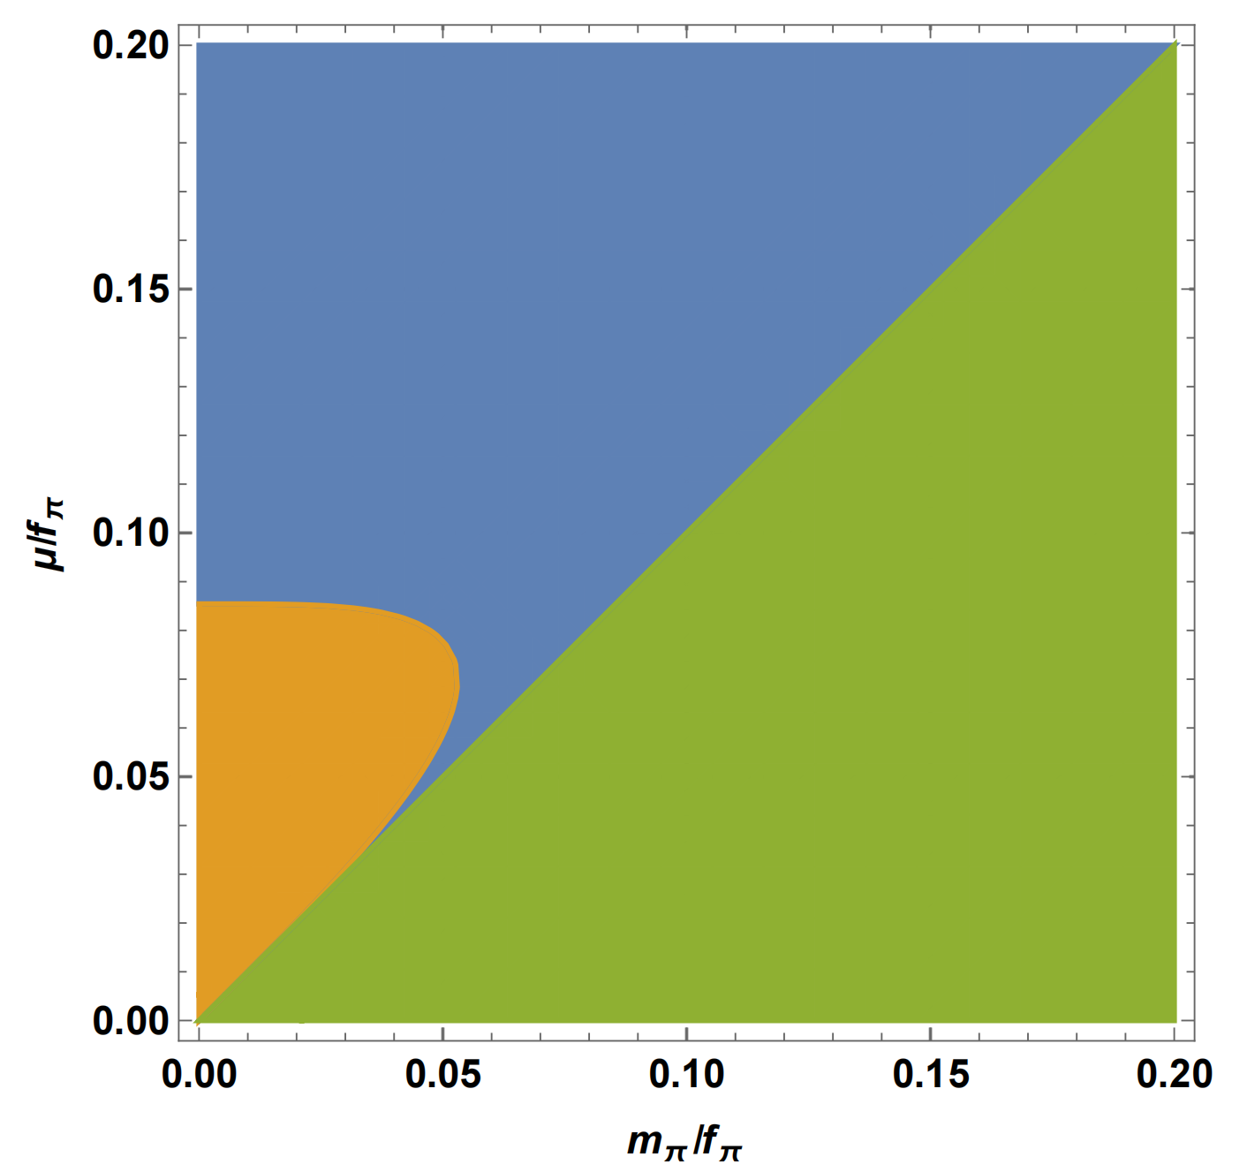
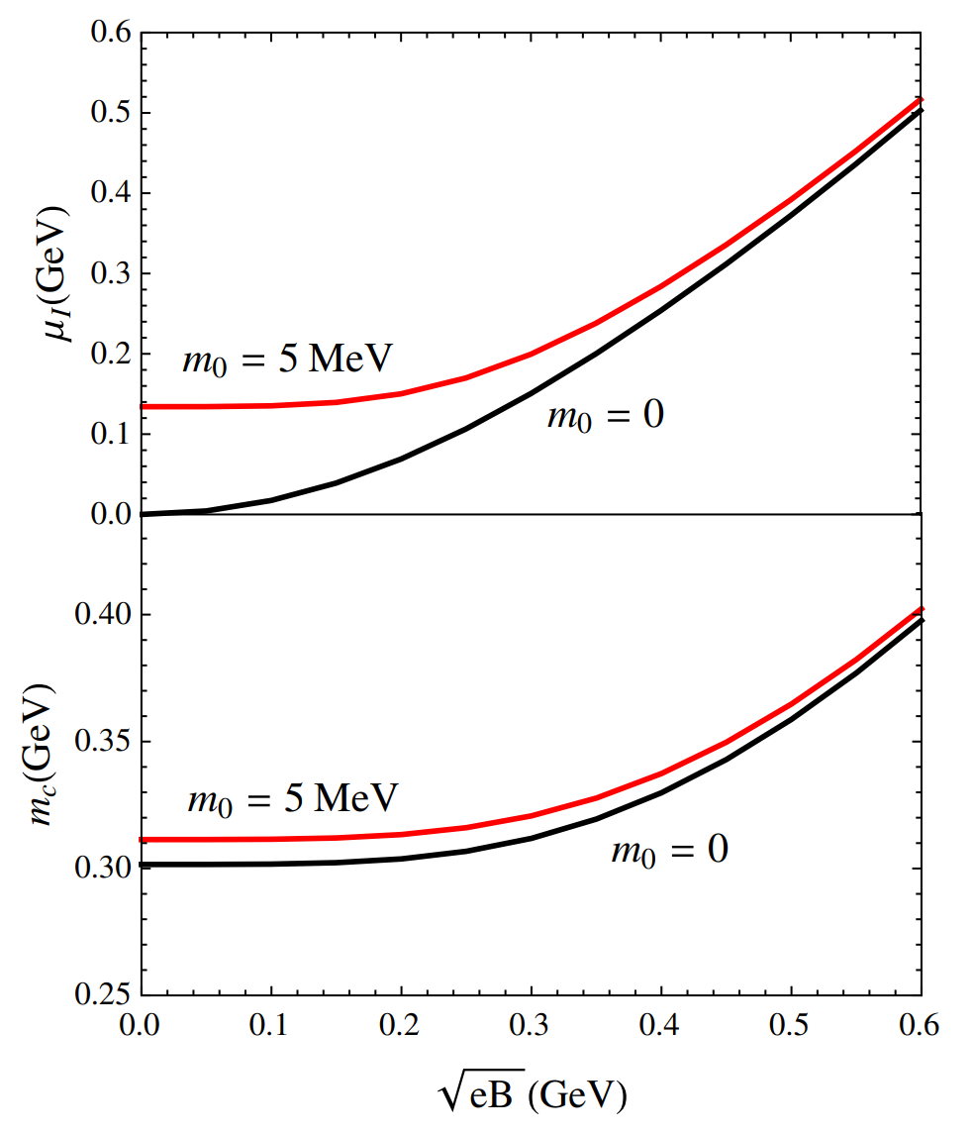
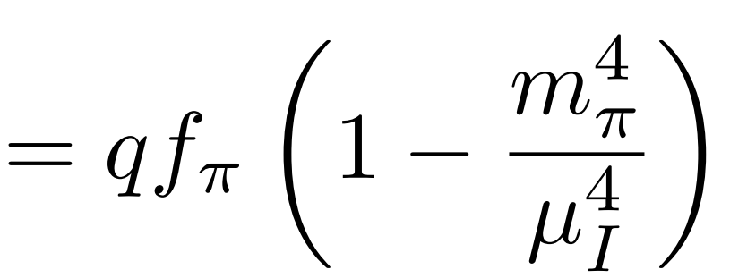
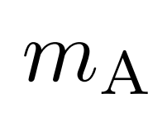
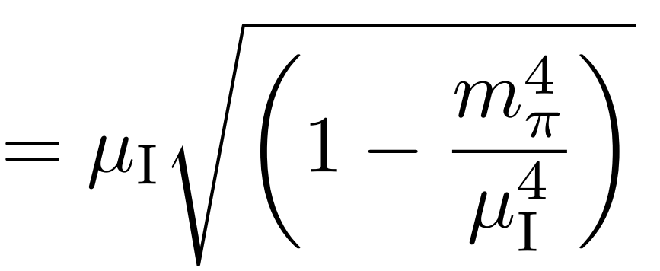
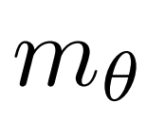

Previous results at finite $μ_{I}$ and B
Type-II
Type-I
Normal
$χ$PT
P. Adhikari et. al., Phys. Rev. C 91 (4) (2015) 045202.
GC and P. Zhuang, 92, 105030 (2015)

Slide 9
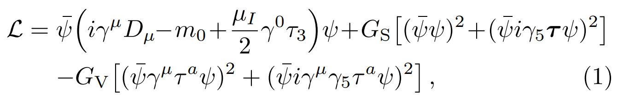
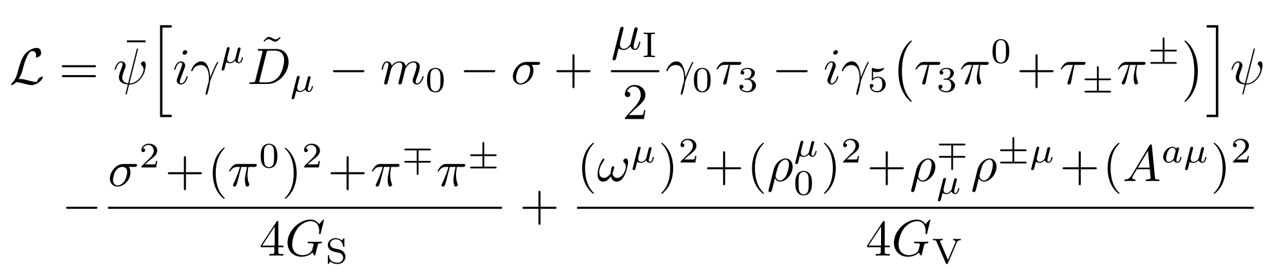
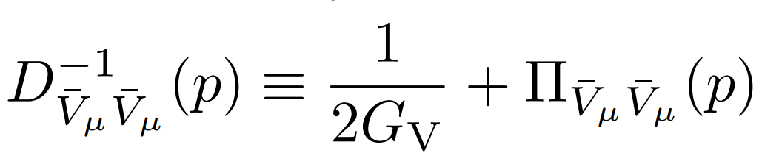
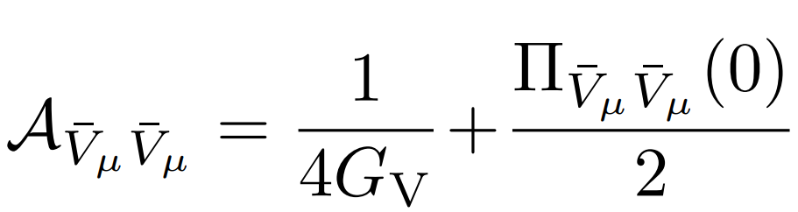
Two-flavor PNJL model
Lagrangian
Hubbard-Stratonovich transformation
Inverse propagator
GL coefficient

Slide 10
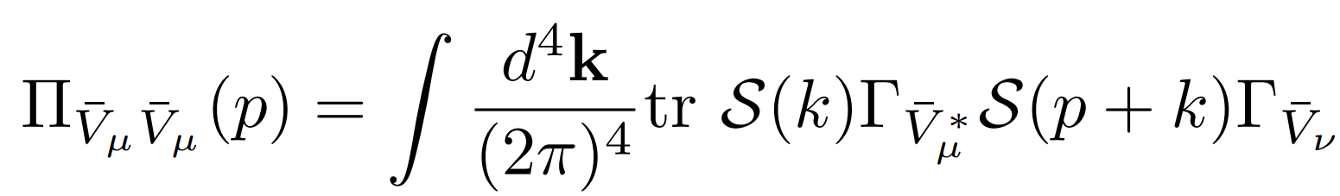
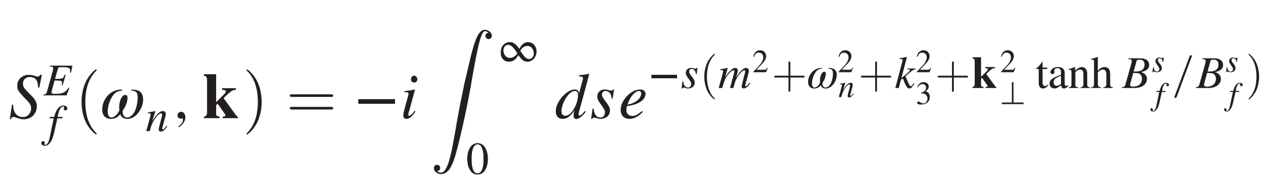
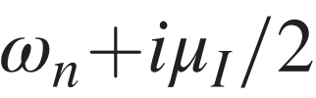

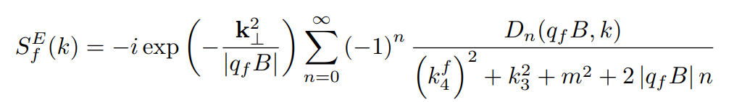
Self-energy without Schwinger phase
Self-energy
Schwinger representation
Landau level representation —— suitable for large $μ_{I}$

Slide 11
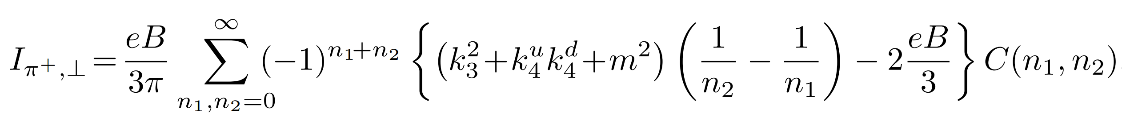
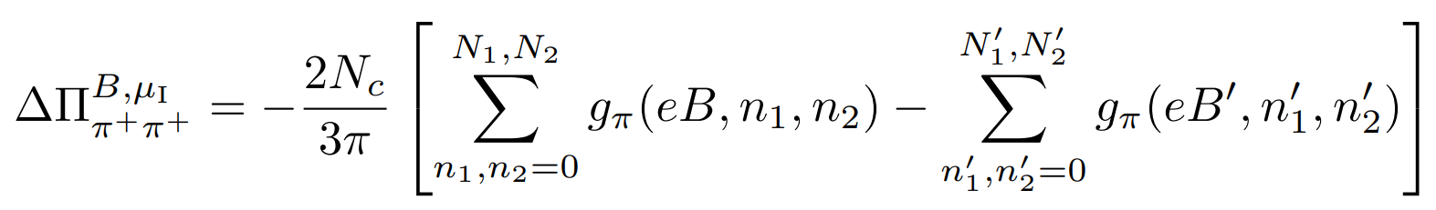
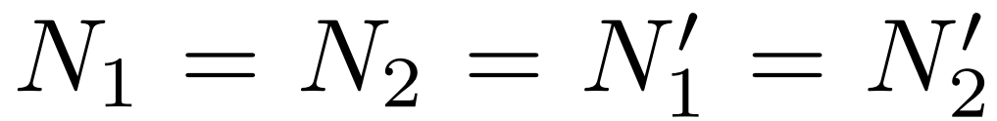
Landau-energy regularization
divergent
Two schemes
More physical
convergent

Slide 12
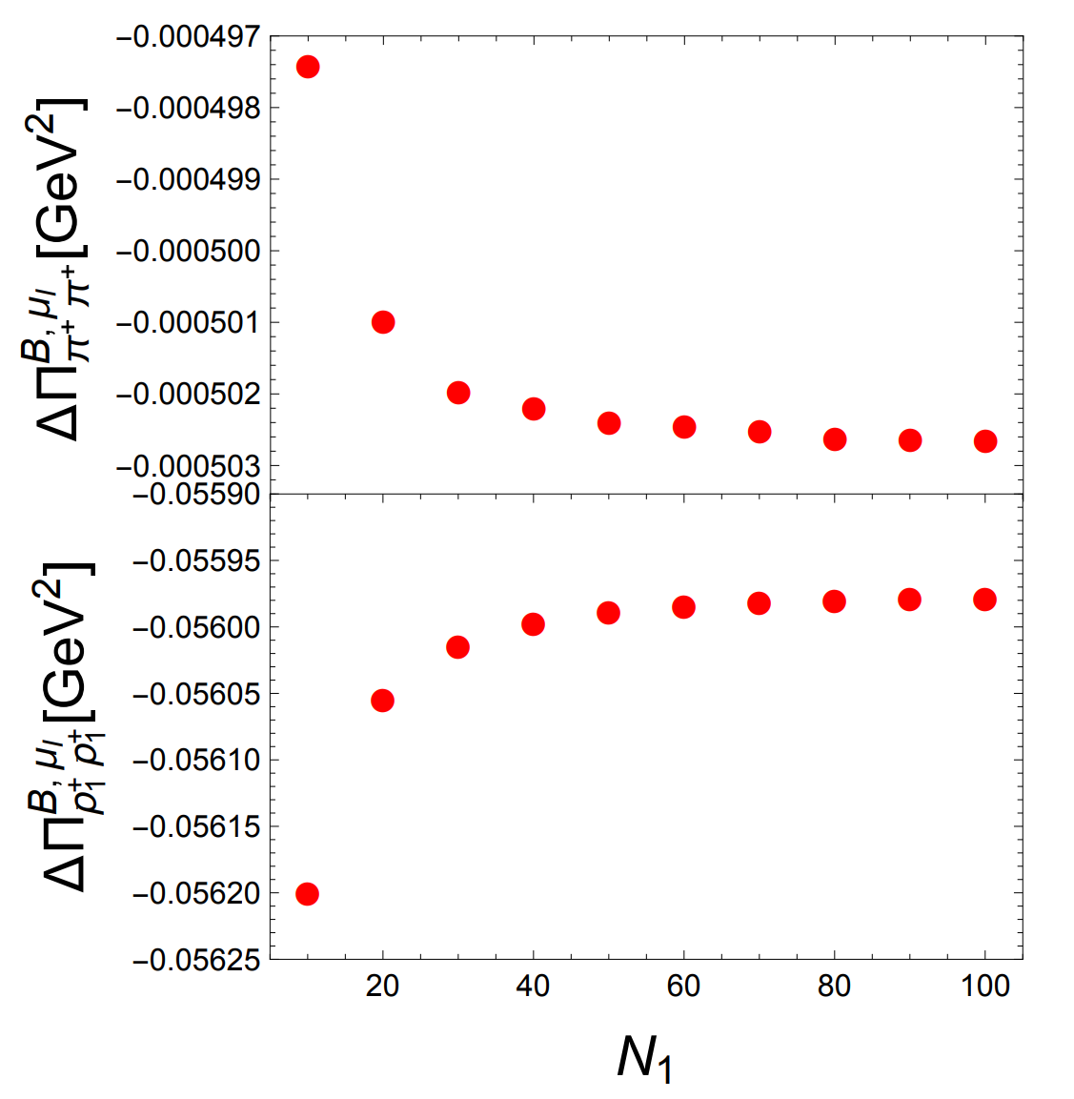

Slide 13
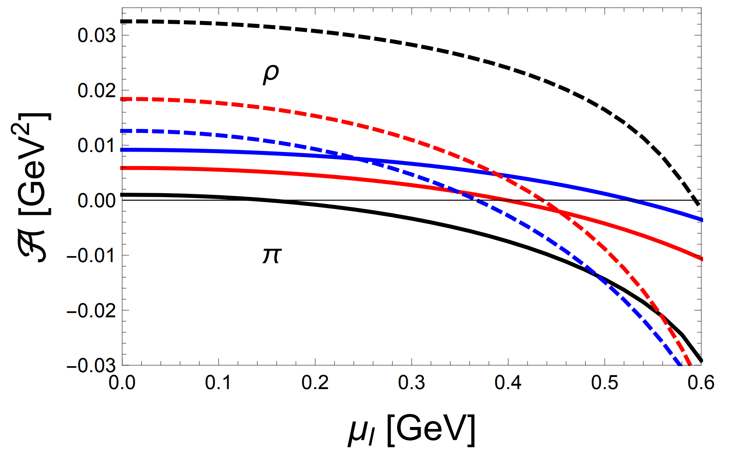
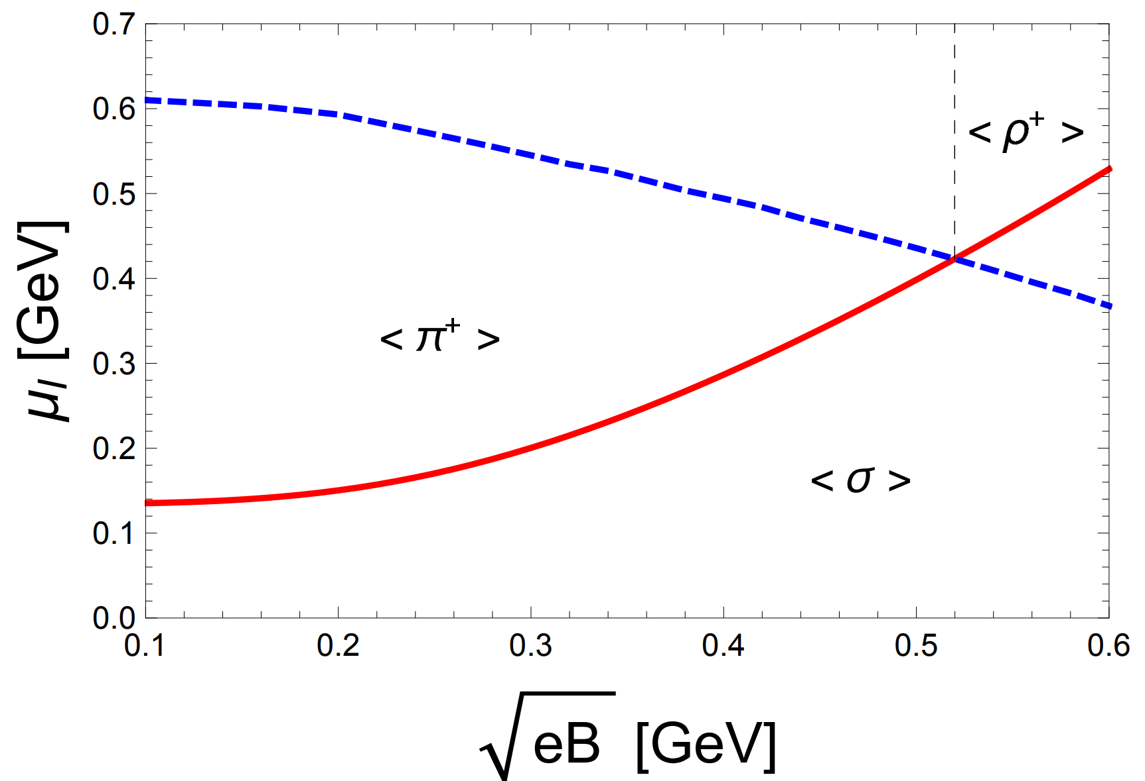



Numerical results
$\sqrt{eB}$=0
$$0.2 GeV$$
$$0.5 GeV$$

Slide 14

Summary and prospective
Landau representation for finite $μ$ and $B$
rho superconductor at larger B due to energy reversal
More realistic three-flavor NJL model
Check rho superconductivity in the early Universe
magnetic vortical and homogeneous phase boundary
pion superfluidity and rho superconductivity boundary
Thanks!

