Slide 1
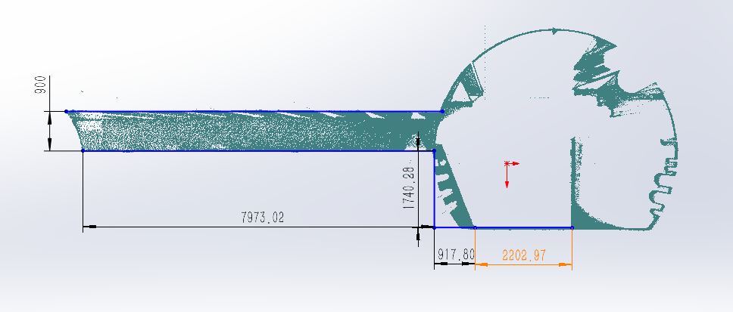
Raw data of point cloud
Diameter: φ900
Length: 7973mm

Slide 2
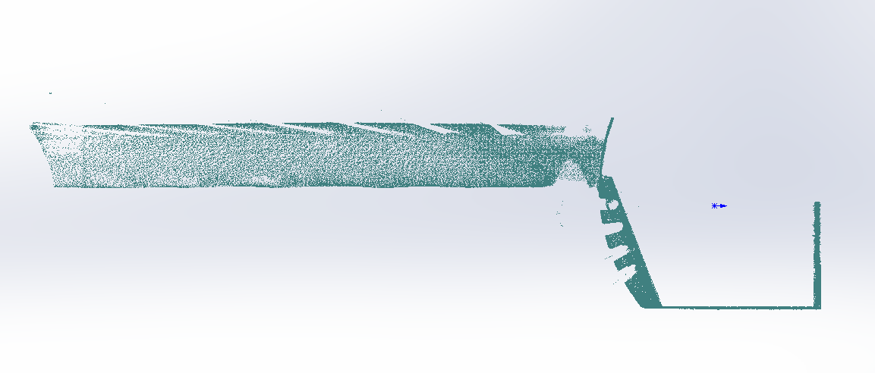
Holes in the model

Slide 3
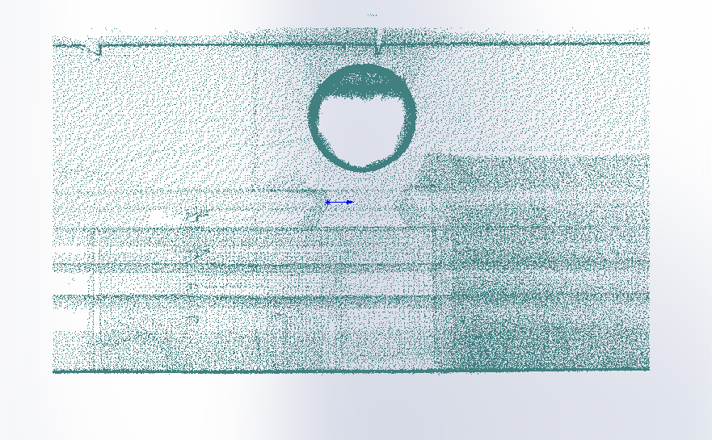
Side view

Slide 4
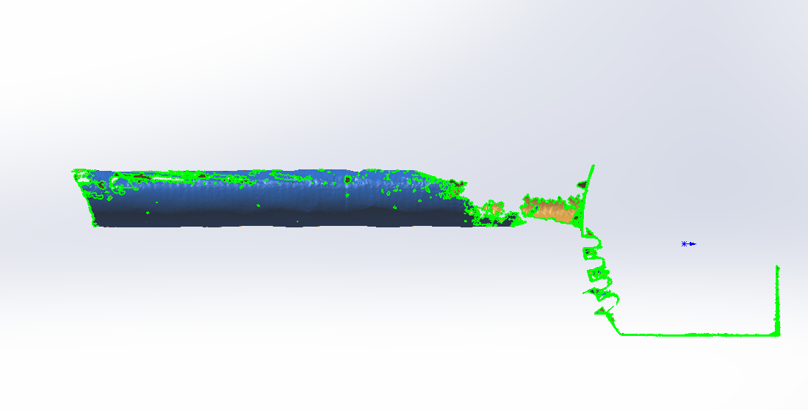
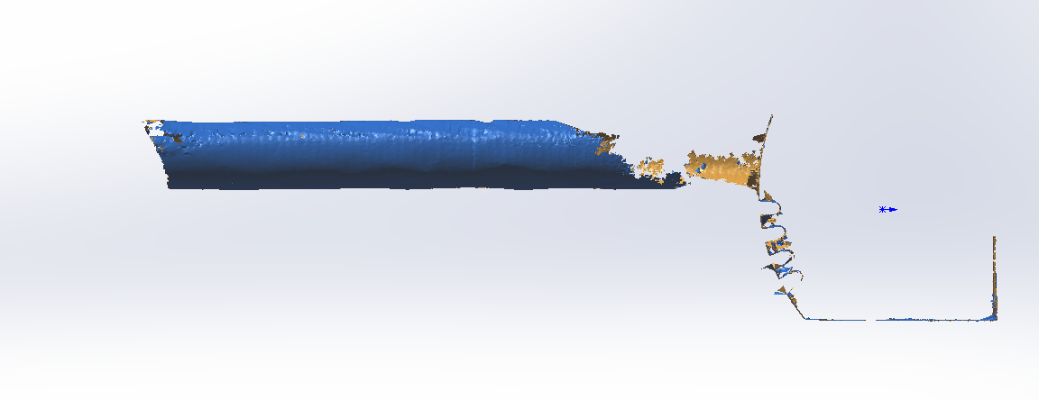
Surface fitting result

Slide 5
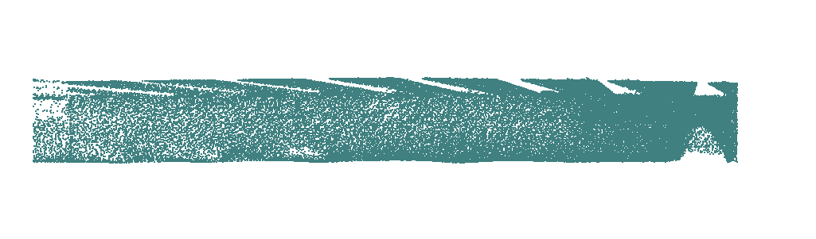
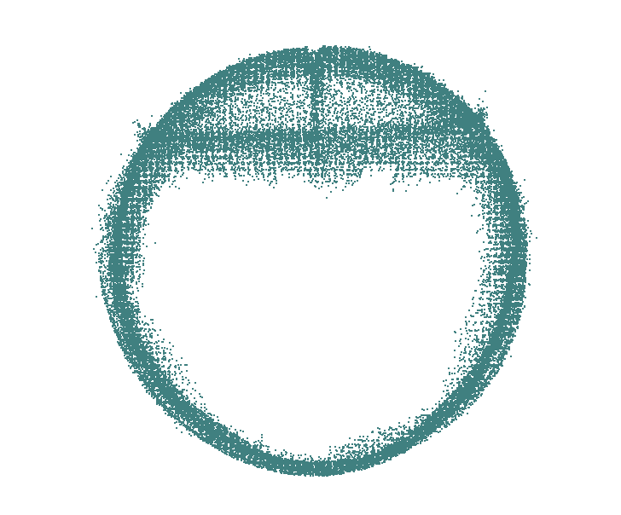
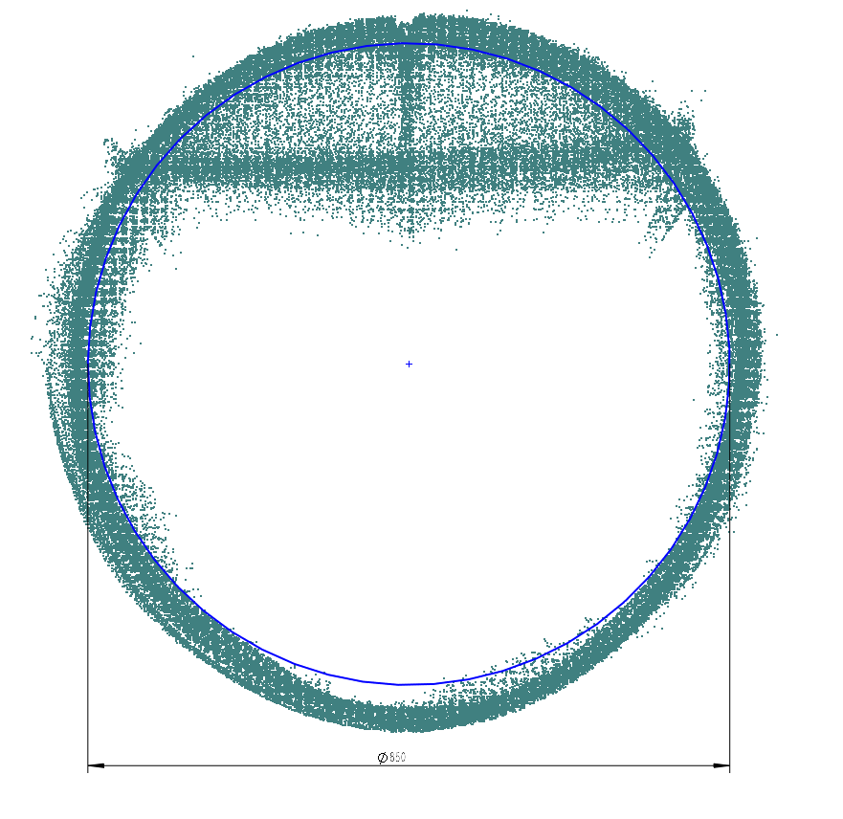
Passable diameter φ850mm

Slide 6
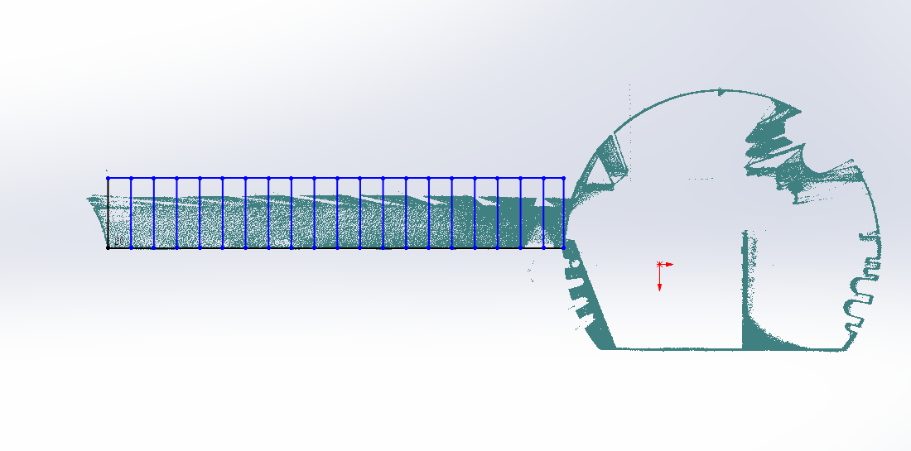
20 slices
1
2
3
4
5
6
7
8
9
10
11
12
13
14
15
16
17
18
19
20

Slide 7
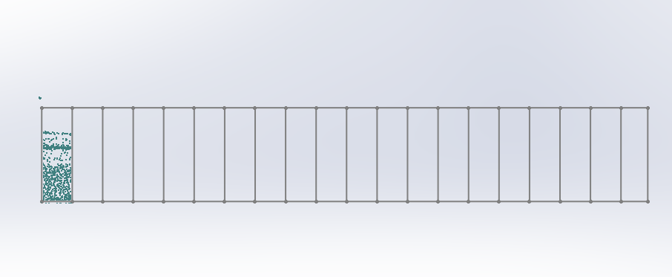
1st slice

Slide 8
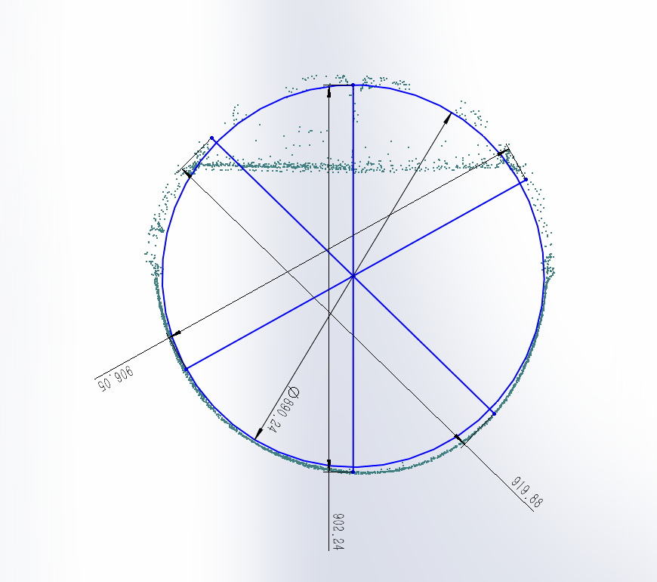
1st slice
UP
Left
Right
Down
The passable diameter is 890mm.

Slide 9
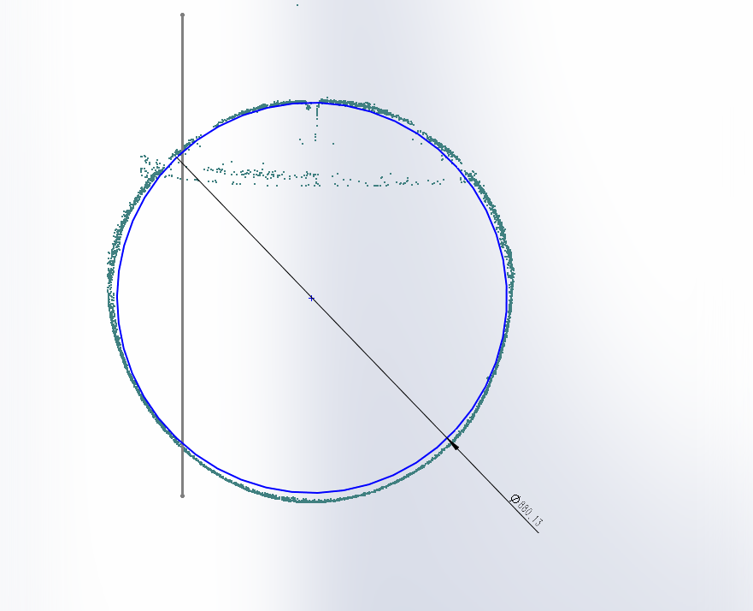
2

Slide 10
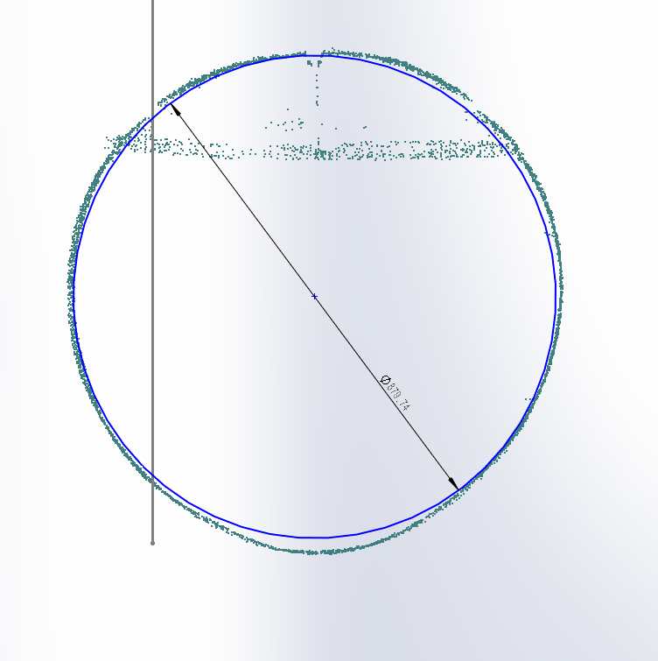
3

Slide 11
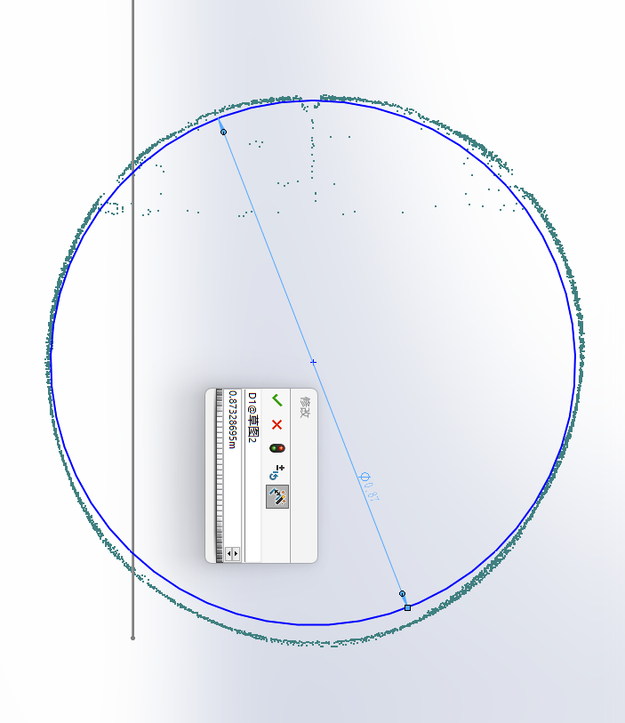
4

Slide 12
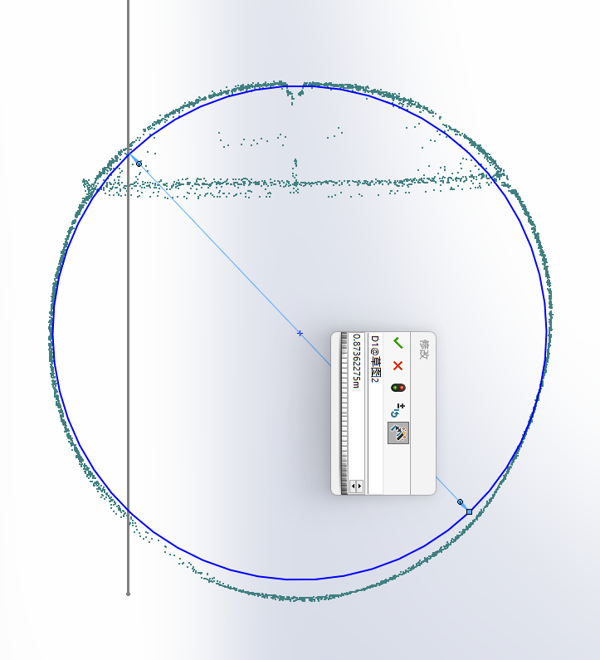
5

Slide 13
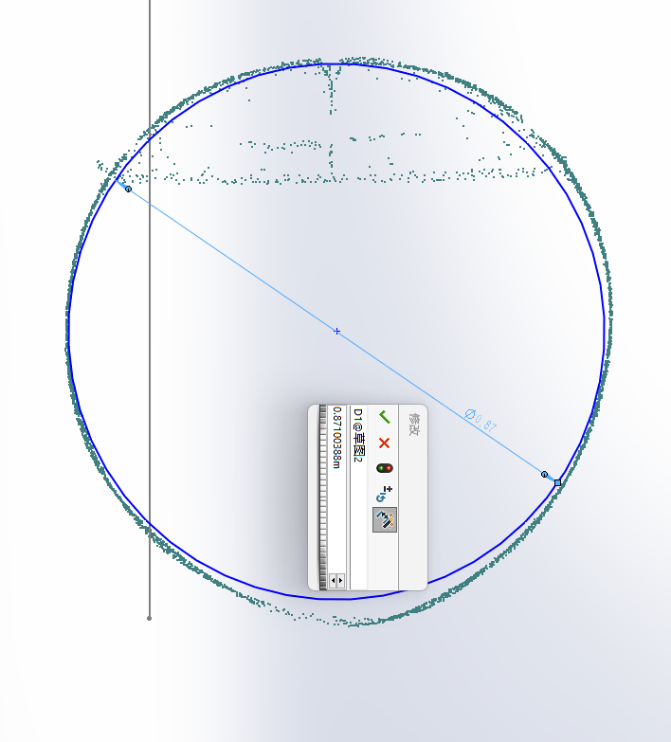
6

Slide 14
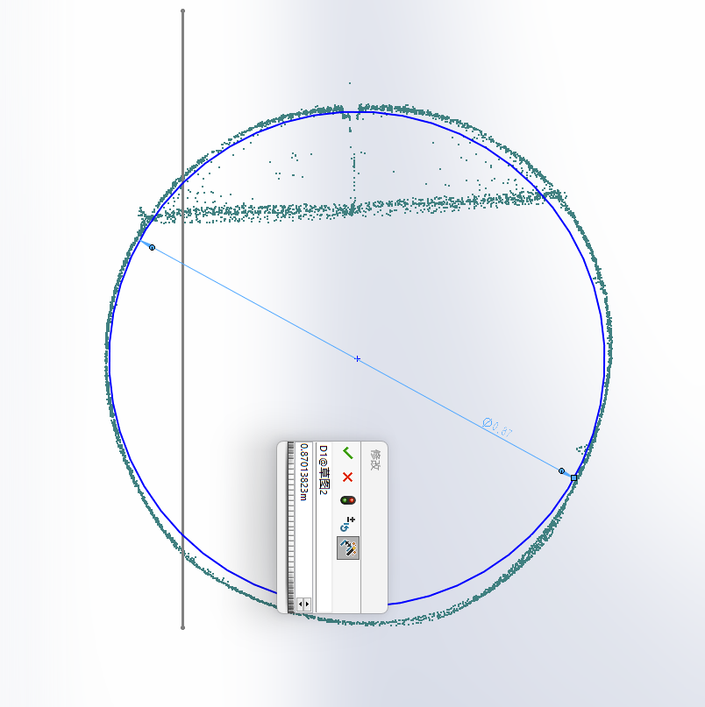
7

Slide 15
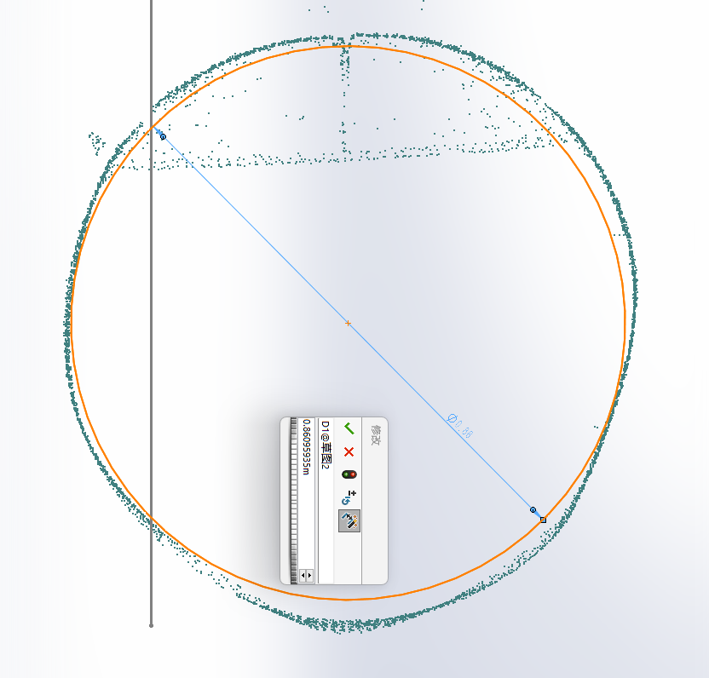
8

Slide 16
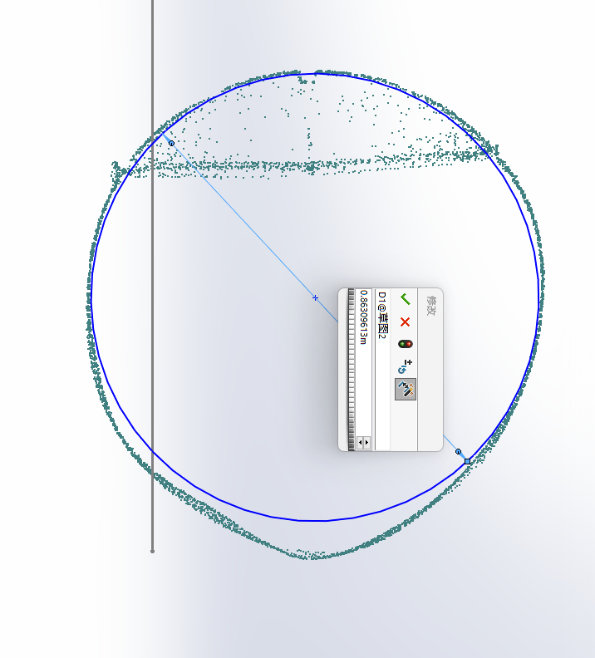
9

Slide 17
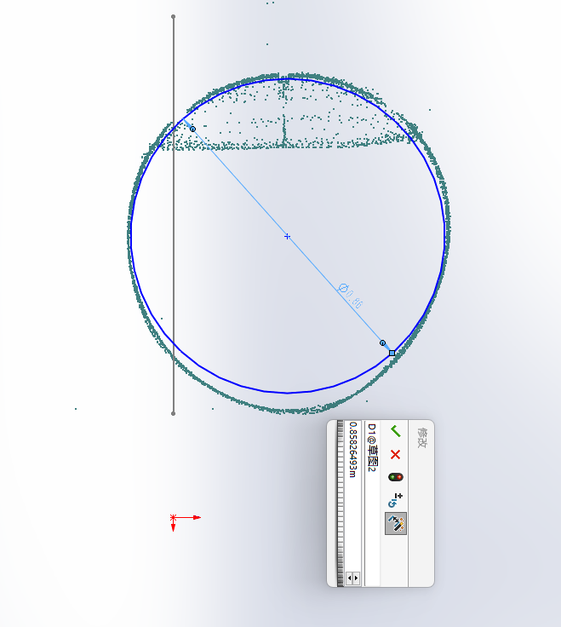
10

Slide 18
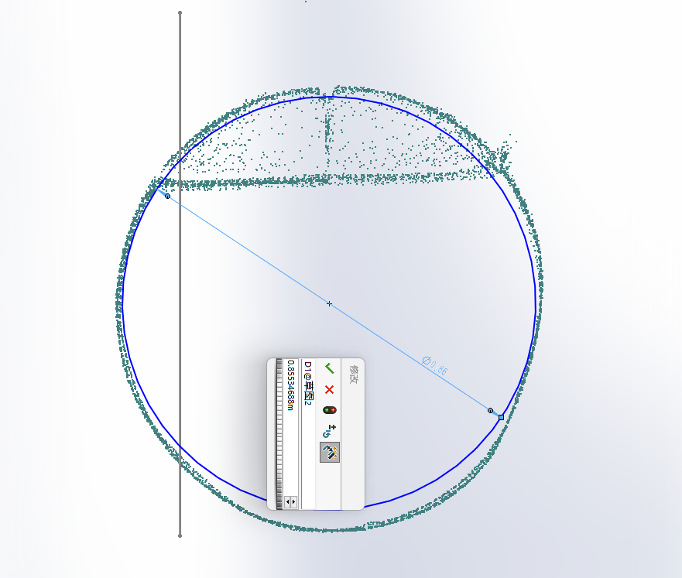
11

Slide 19
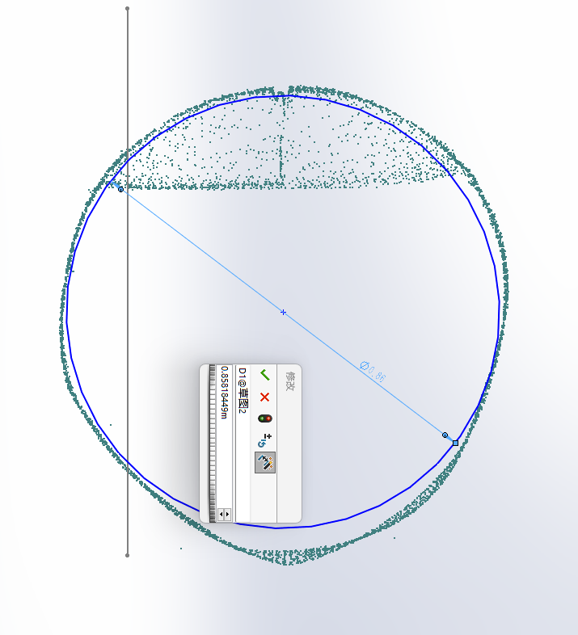
12

Slide 20
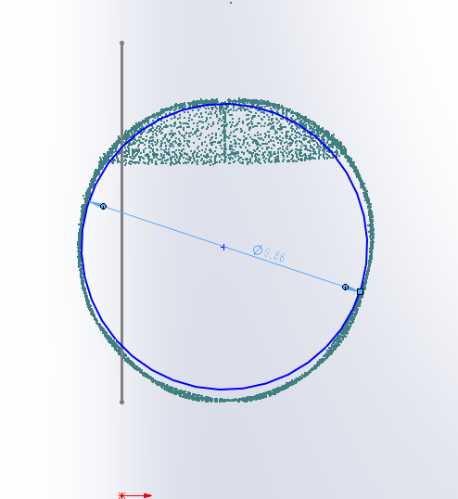
13

Slide 21
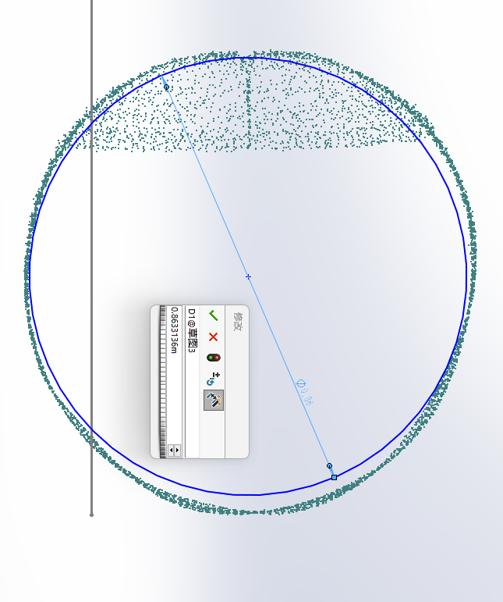
14

Slide 22
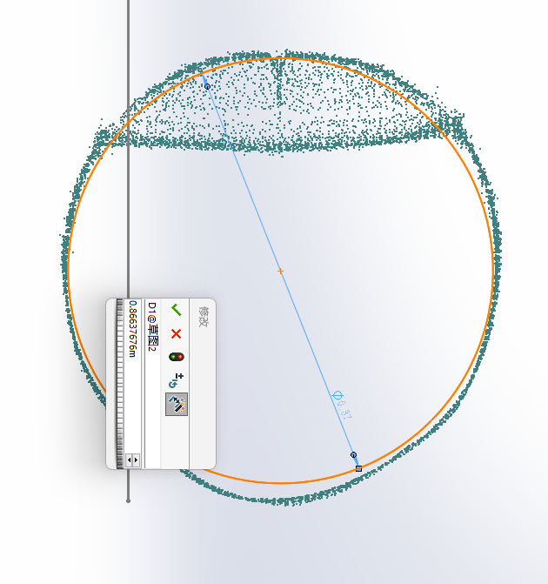
15

Slide 23
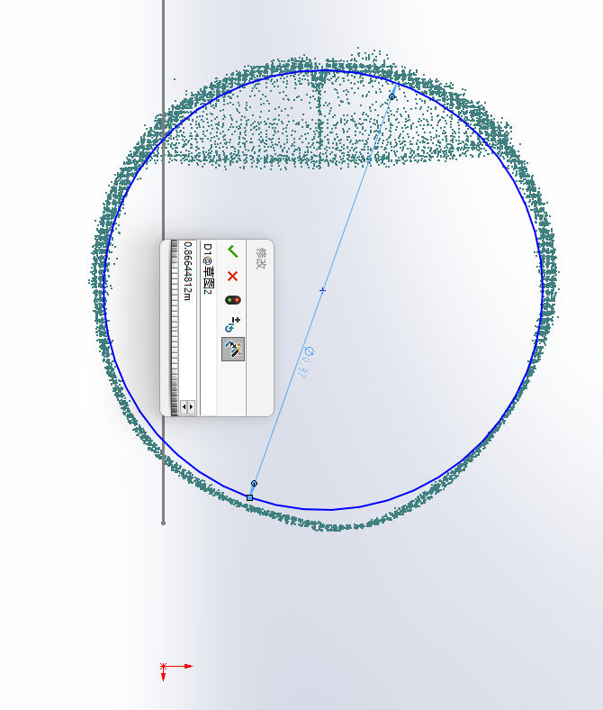
16

Slide 24
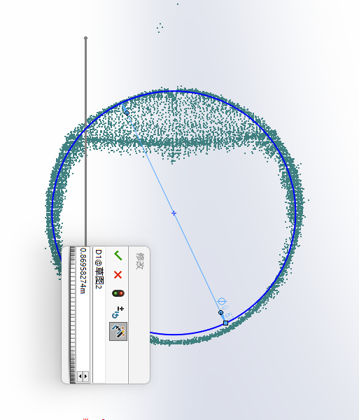
17

Slide 25
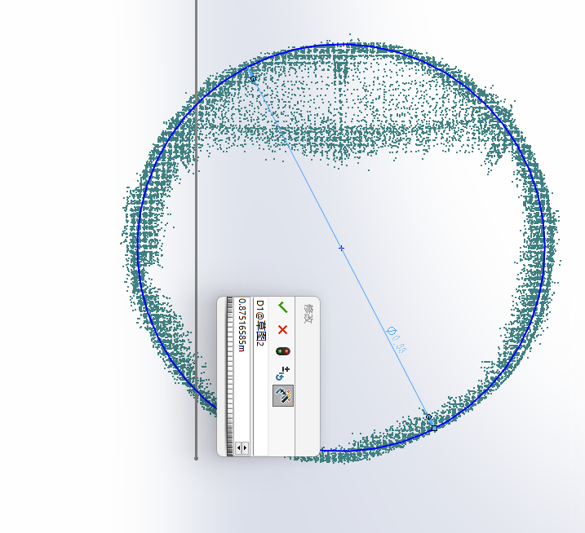
18

Slide 26
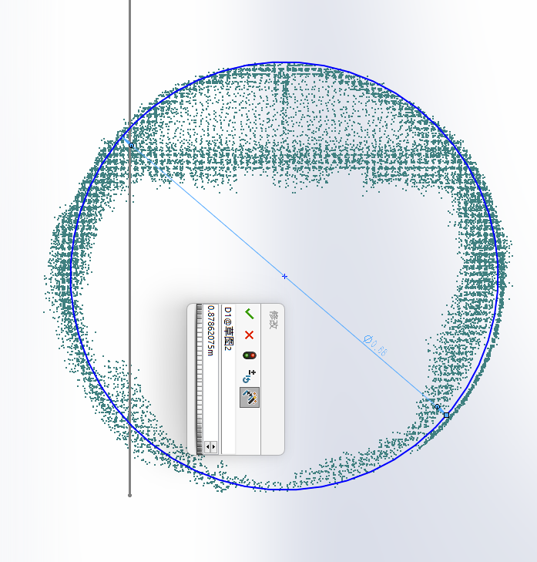
19

Slide 27
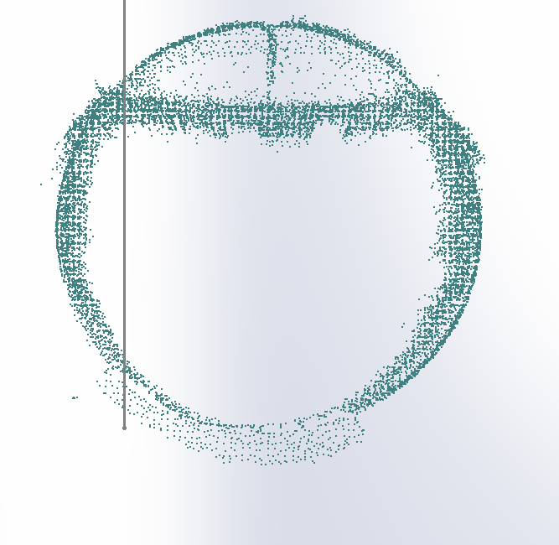
20

Slide 28
890 | 880 | 879 | 873 | 873 | 871 | 870 | 860 | 860 | 858 | 855 | 858 | 861 | 863 | 866 | 866 | 870 | 875 | 878
1
2
3
4
5
6
7
8
9
10
11
12
13
14
15
16
17
18
19
20
The diameter of the slices

Slide 29
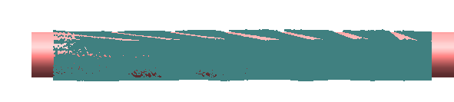
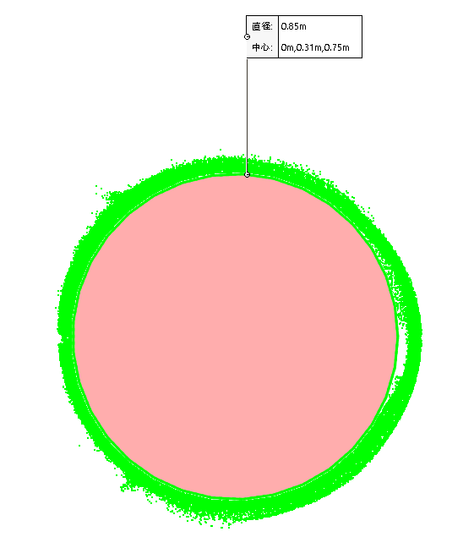
The maximum passable diameter of the DUCT is 850 mm

