Slide 1
CLFV
Wait for further question.

Slide 2
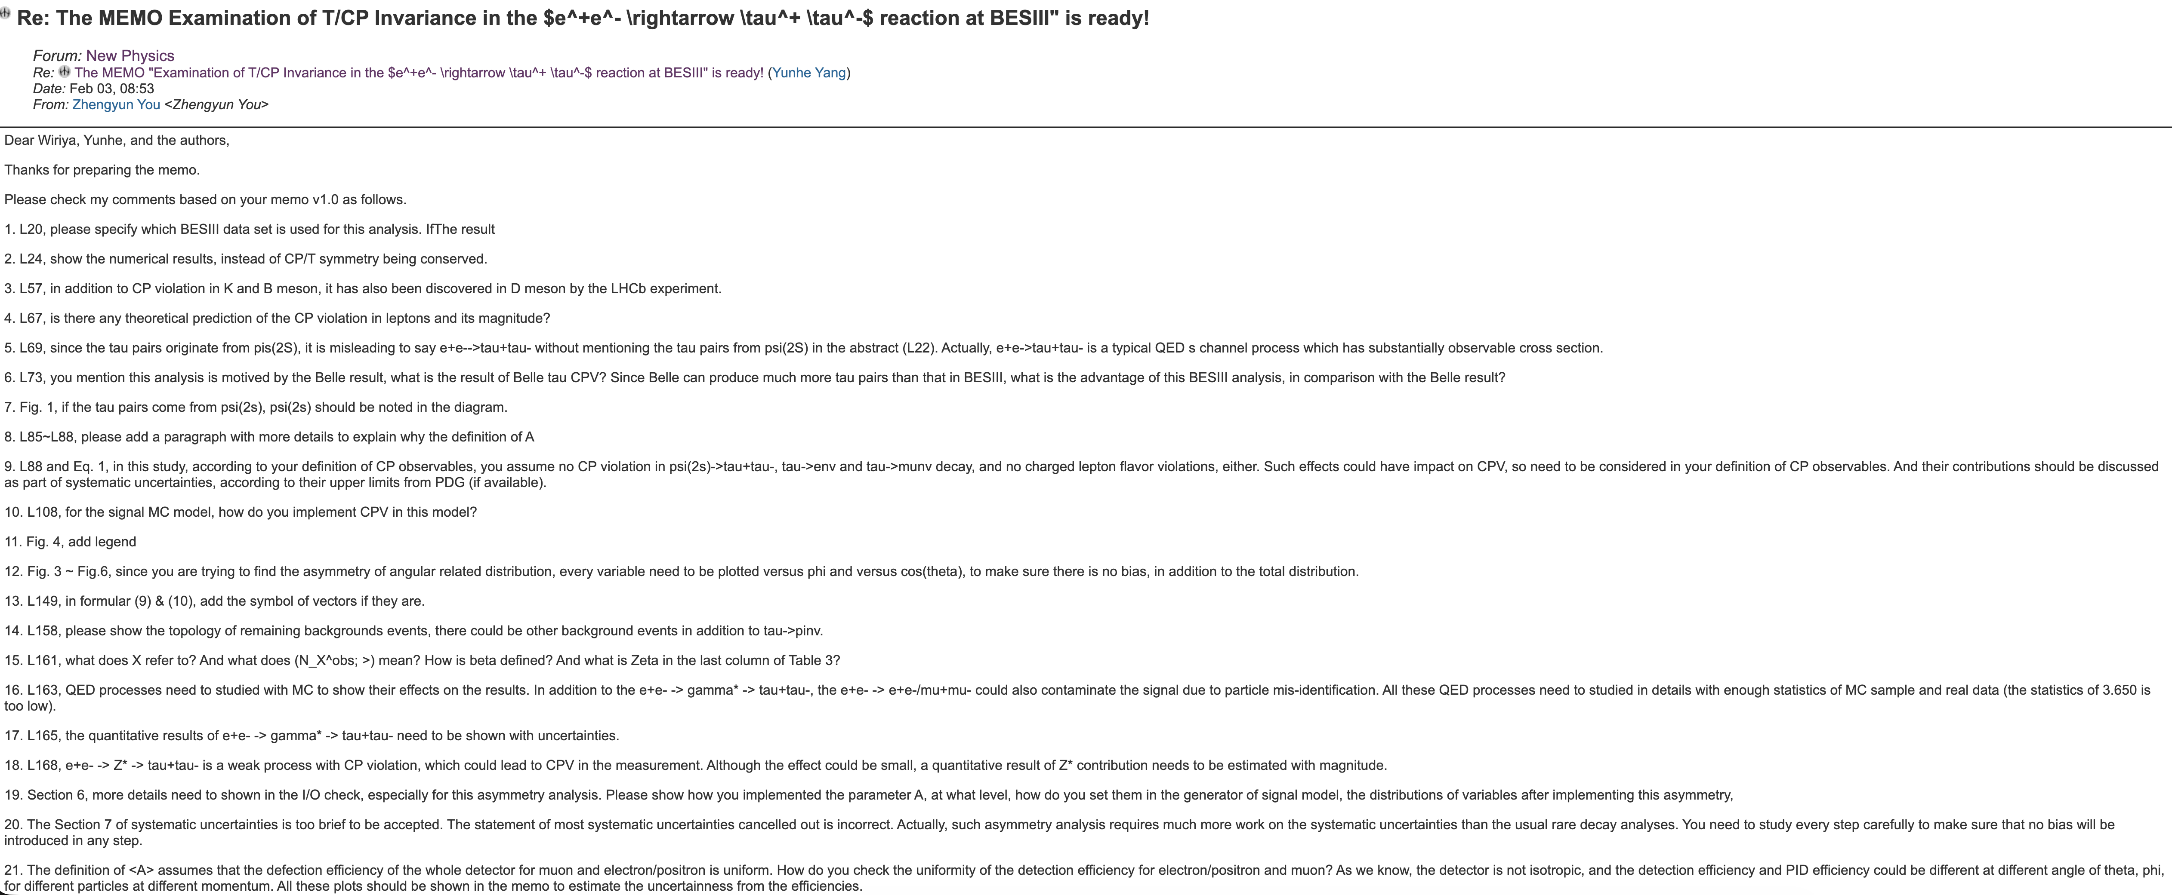
CPV
Prepare prof. You’s question.

