Slide 1





LHCb实验上双粲重子的研究
童星昱
On behalf of the LHCb Collaboration
中国科学院高能物理研究所
第十一届XYZ粒子研讨会
贵州 贵阳
2026年7月24日

Slide 2
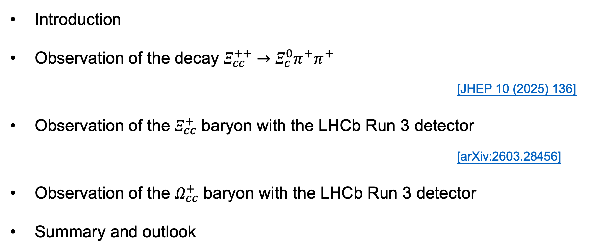
Outlines
Introduction
Observation of the decay $Ξ_{cc}^{++}→Ξ_{c}^{0}π^{+}π^{+}$
[JHEP 10 (2025) 136]
Observation of the $Ξ_{cc}^{+}$ baryon with the LHCb Run 3 detector
[arXiv:2603.28456]
Observation of the $Ω_{cc}^{+}$ baryon with the LHCb Run 3 detector
Summary and outlook

Slide 3
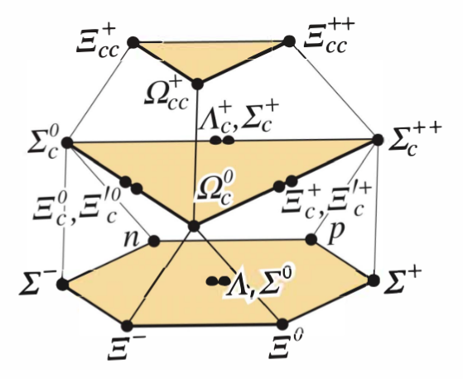
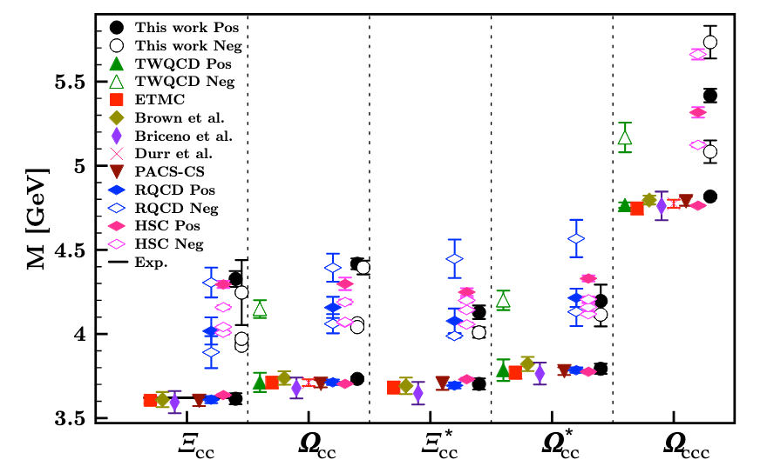
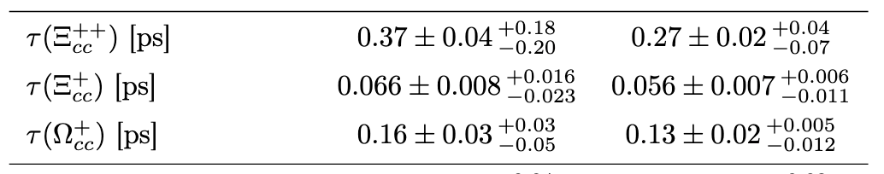
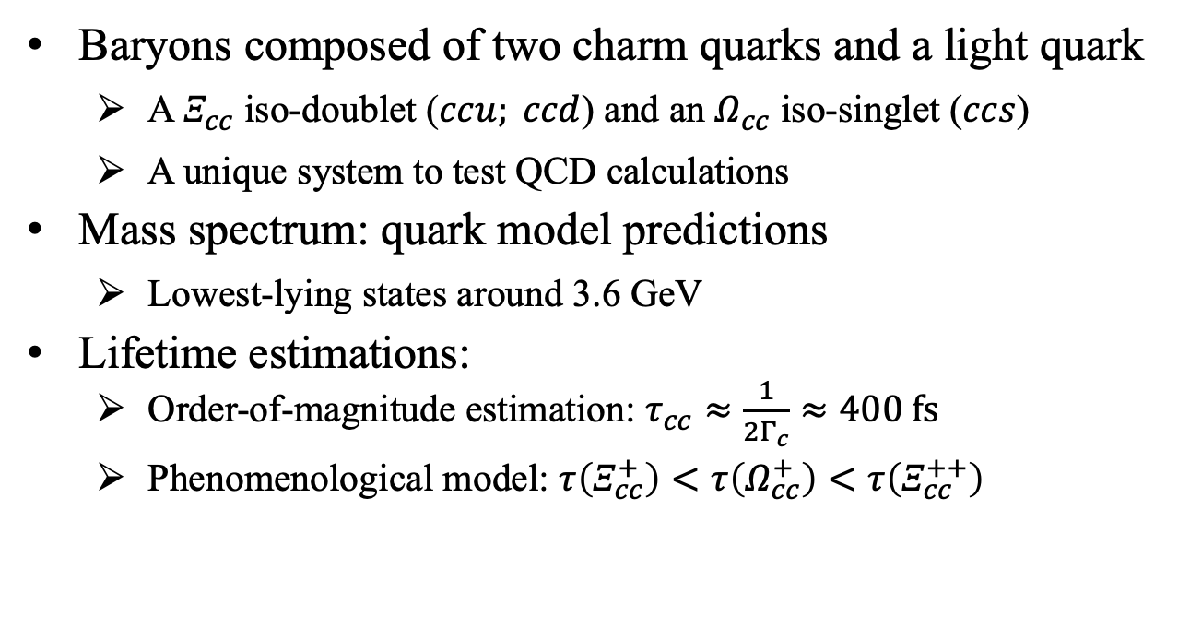
Doubly charmed baryons
Baryons composed of two charm quarks and a light quark
  A $Ξ_{cc}^{ }$ iso-doublet ($ccu; ccd$) and an $Ω_{cc}^{ }$ iso-singlet ($ccs$)
  A unique system to test QCD calculations
Mass spectrum: quark model predictions
  Lowest-lying states around 3.6 GeV
Lifetime estimations:
  Order-of-magnitude estimation: $τ_{cc}≈\frac{1}{2Γ_{c}}≈400 fs$
  Phenomenological model: $τ\left(Ξ_{cc}^{+}\right)<τ\left(Ω_{cc}^{+}\right)<τ\left(Ξ_{cc}^{++}\right)$
[PRD 102 (2020) 054513]
[arXiv:2605.04967]

Slide 4
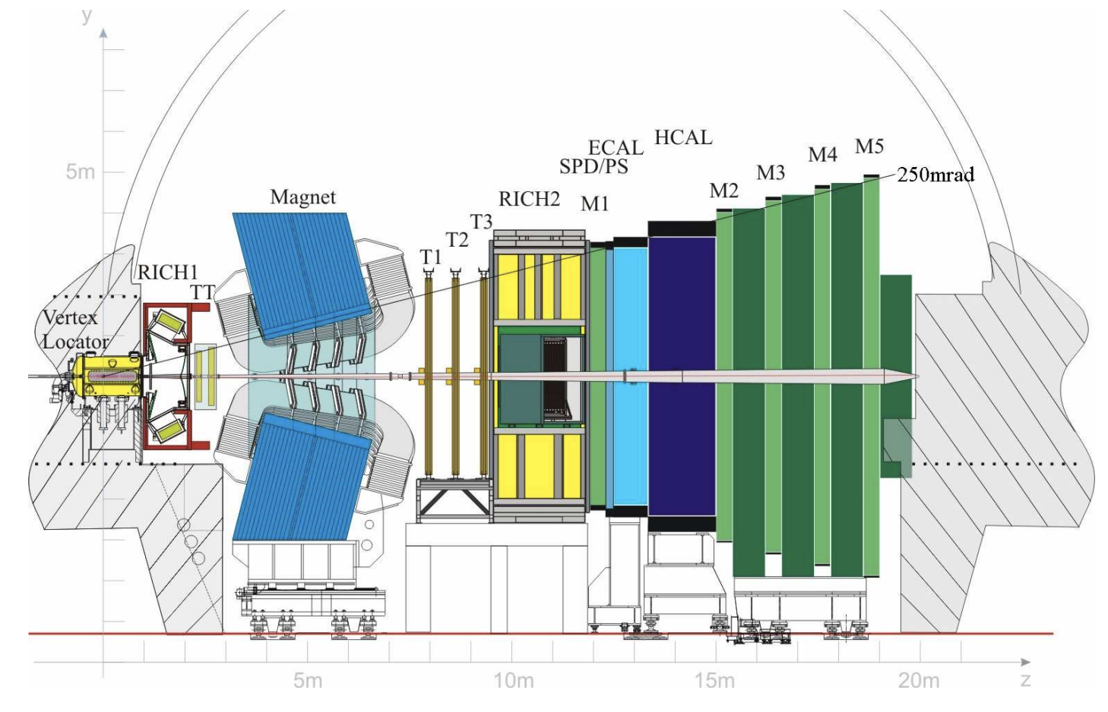
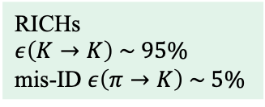


LHCb detector (for run 2)
A single-arm forward spectrometer covering 2<𝜂<5
Designed for heavy-flavour physics:
  Precise vertex resolution
  High-precision tracking
  Powerful particle identification
Vertex Locator
$σ_{IP}\sim 20 μm$
$σ_{τ}\sim 45 fs$
Tracking stations
$ε_{tracking}\sim 96\%$
$$σ_{p}/p\sim 0.5\%−1\%$$
RICHs
$ε\left(K→K\right) \sim 95\%$
mis-ID $ε\left(π→K\right) \sim 5\%$
[JINST 3 (2008) S08005]
[IJMPA 30 (2015) 1530022]

Slide 5
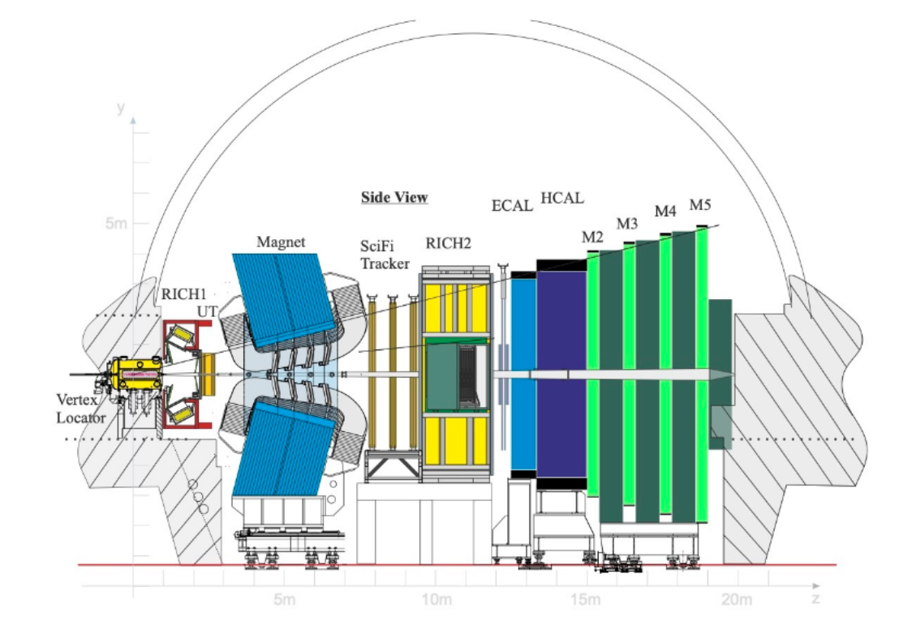
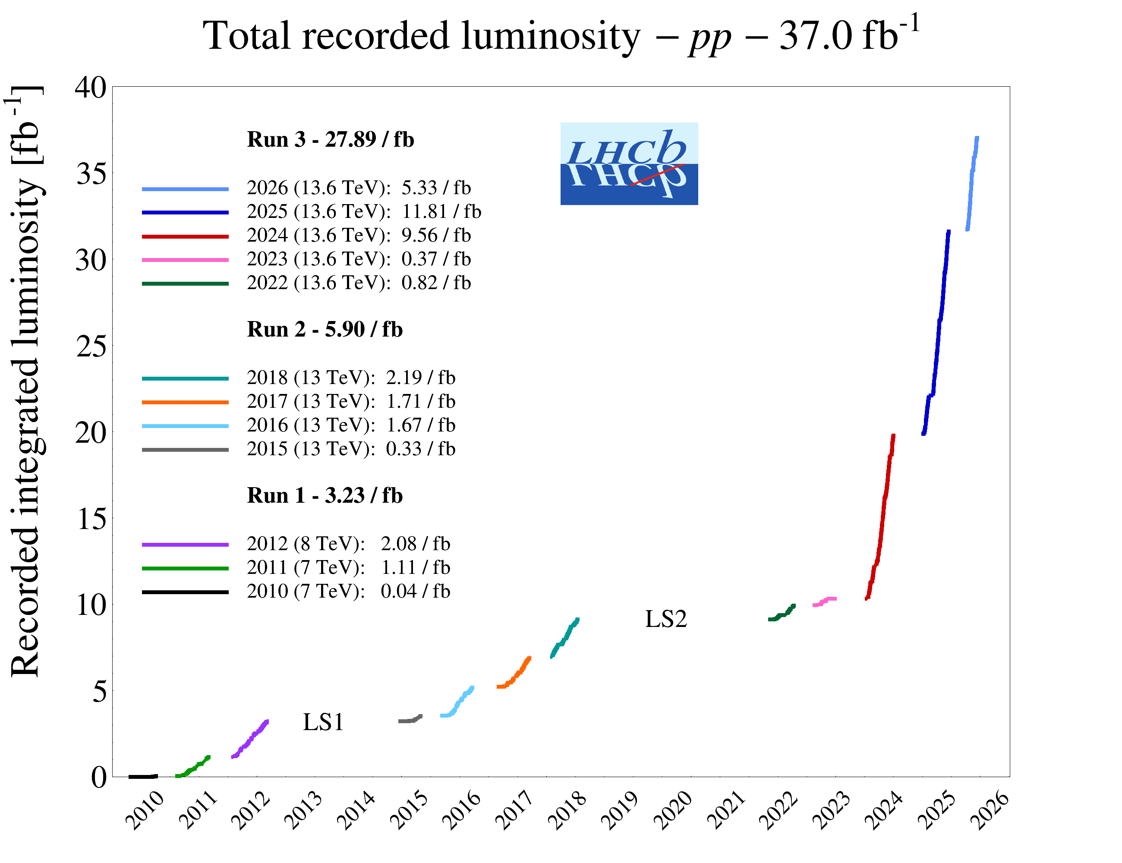
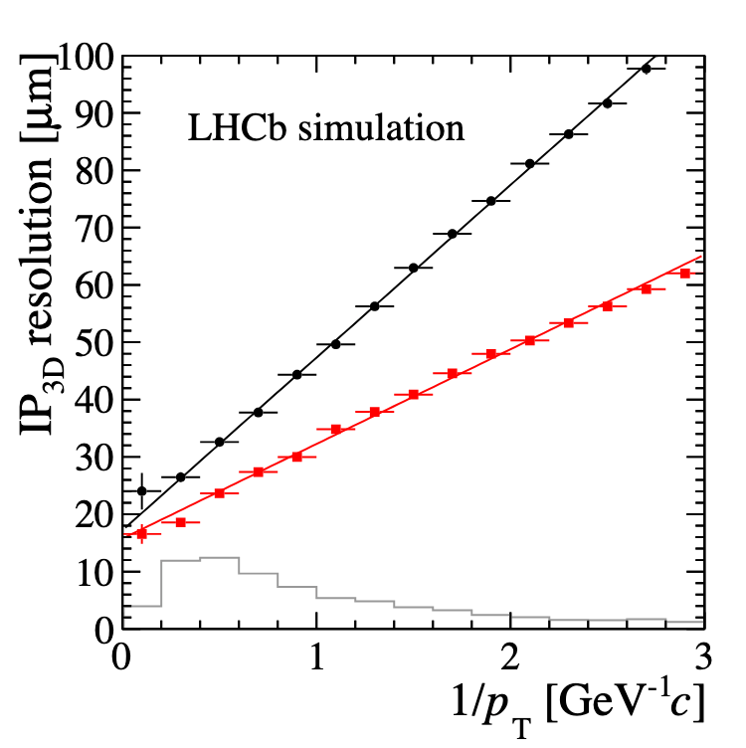
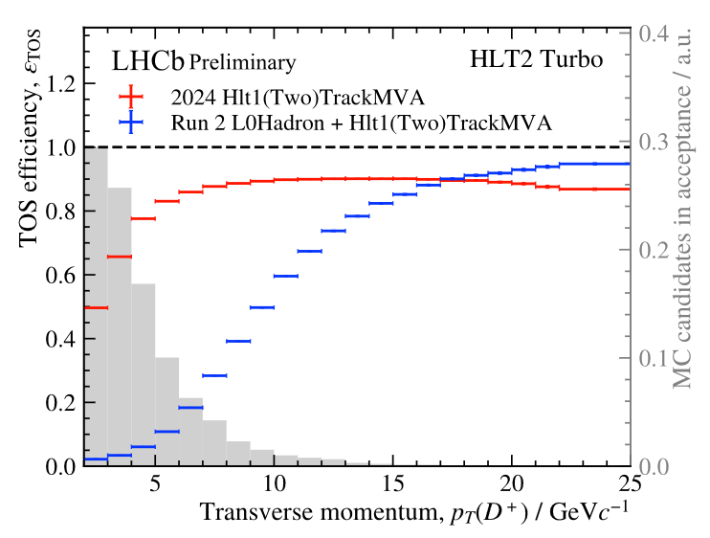
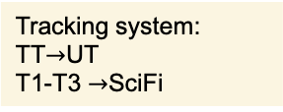
LHCb upgrade I detector
New Vertex Locator
Tracking system:
TT$→$UT
T1-T3 $→$SciFi
LHCb detector upgraded to handle the increased instantaneous luminosity in Run 3
  Higher integrated luminosity
  More precise vertex resolution
  Software-based trigger: higher efficiency
[JINST 19 (2024) P05065]
Red: Run 3
Black: Run 2
[LHCB-TDR-013]
[LHCb-FIGURE-2024-030]

Slide 6
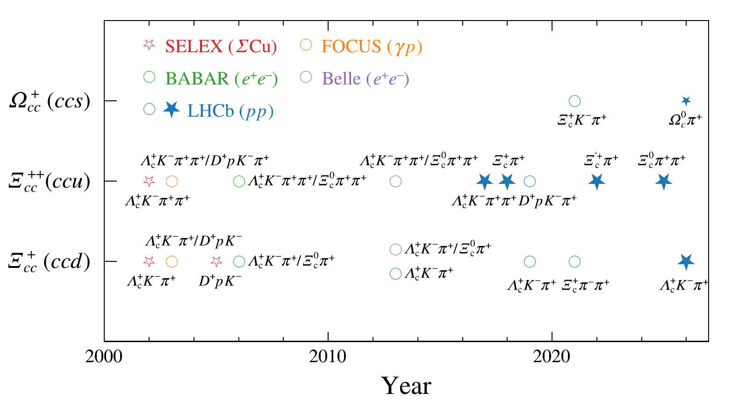


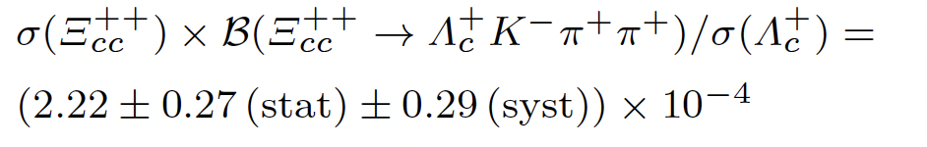

Study of doubly charmed baryons at LHCb
Observed decay modes of $Ξ_{cc}^{++}$:
  $Ξ_{cc}^{++}→$ $Λ_{c}^{+}K^{−}π^{+}π^{+}$ [PRL 119 (2017) 112001]
  $Ξ_{cc}^{++}→$ $Ξ_{c}^{(′)+}π^{+}$ [PRL 121 (2018) 162002] [JHEP 05 (2022) 038]
Upper limit set:
  $Ξ_{cc}^{++}→$ $D^{+}{pK}^{−}π^{+}$ [JHEP 10 (2019) 124]
Precision mass measurement: [JHEP 02 (2020) 049]
Lifetime measurement: [PRL 121 (2018) 052002]
Production in 13TeV pp: [CPC 44 (2020) 022001]
$Ξ_{cc}^{+}$ and $Ω_{cc}^{+}$ not observed in Run 1/2 data [SCPMA 63 (2020) 221062] [JHEP 12 (2021) 107] [SCPMA 64 (2021) 101062]

Slide 7

Observation of the decay
$$Ξ_{cc}^{++}→Ξ_{c}^{0}π^{+}π^{+}$$
[JHEP 10 (2025) 136]

Slide 8
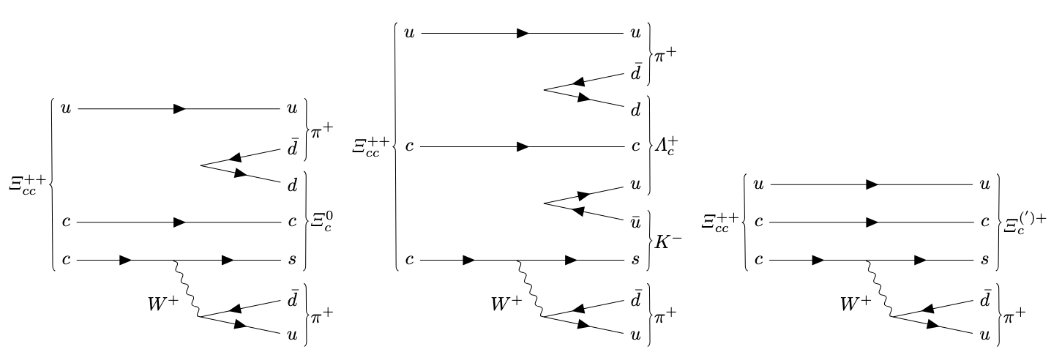
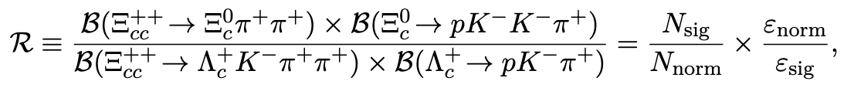

$Ξ_{cc}^{++}→Ξ_{c}^{0}π^{+}π^{+}$ Decay
Same $c→s$ weak transition as $Ξ_{cc}^{++}→$ $Λ_{c}^{+}K^{−}π^{+}π^{+}$ and $Ξ_{cc}^{++}→$ $Ξ_{c}^{(′)+}π^{+}$
  Comparable branching fraction
$Ξ_{cc}^{++}→$ $Λ_{c}^{+}K^{−}π^{+}π^{+}$ as the normalisation channel in branching fraction measurement
  $σ(Ξ_{cc}^{++})$ factored out
  Same final-state particles: systematic uncertainty reduced

Slide 9
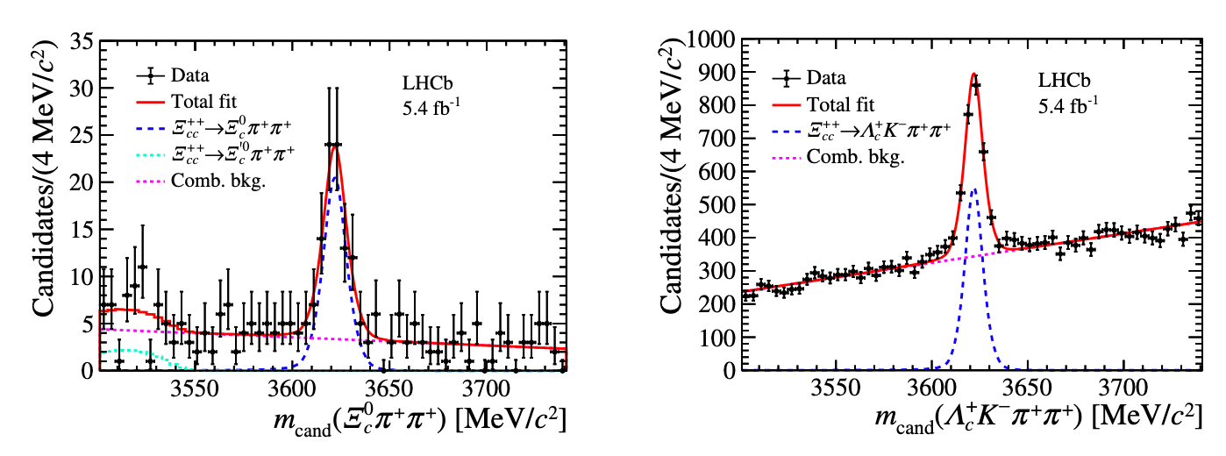
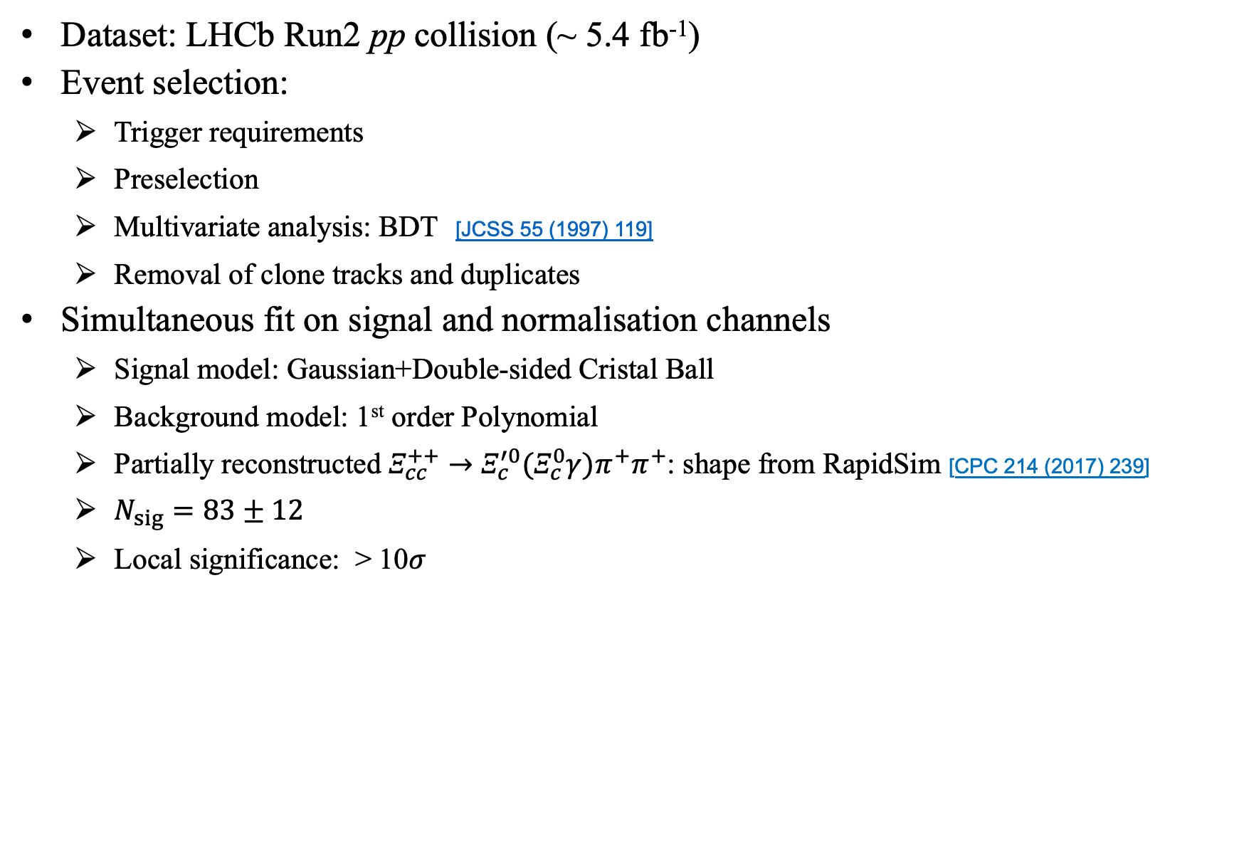
Observation of $Ξ_{cc}^{++}→Ξ_{c}^{0}π^{+}π^{+}$
[JHEP 10 (2025) 136]
Dataset: LHCb Run2 pp collision (~ 5.4 fb⁻¹)
Event selection:
  Trigger requirements
  Preselection
  Multivariate analysis: BDT [JCSS 55 (1997) 119]
  Removal of clone tracks and duplicates
Simultaneous fit on signal and normalisation channels
  Signal model: Gaussian+Double-sided Cristal Ball
  Background model: 1st order Polynomial
  Partially reconstructed $Ξ_{cc}^{++}→Ξ_{c}^{′0}(Ξ_{c}^{0}γ)π^{+}π^{+}$: shape from RapidSim [CPC 214 (2017) 239]
  $N_{sig}=83±12$
  Local significance: > 10$σ$
First Observation!

Slide 10
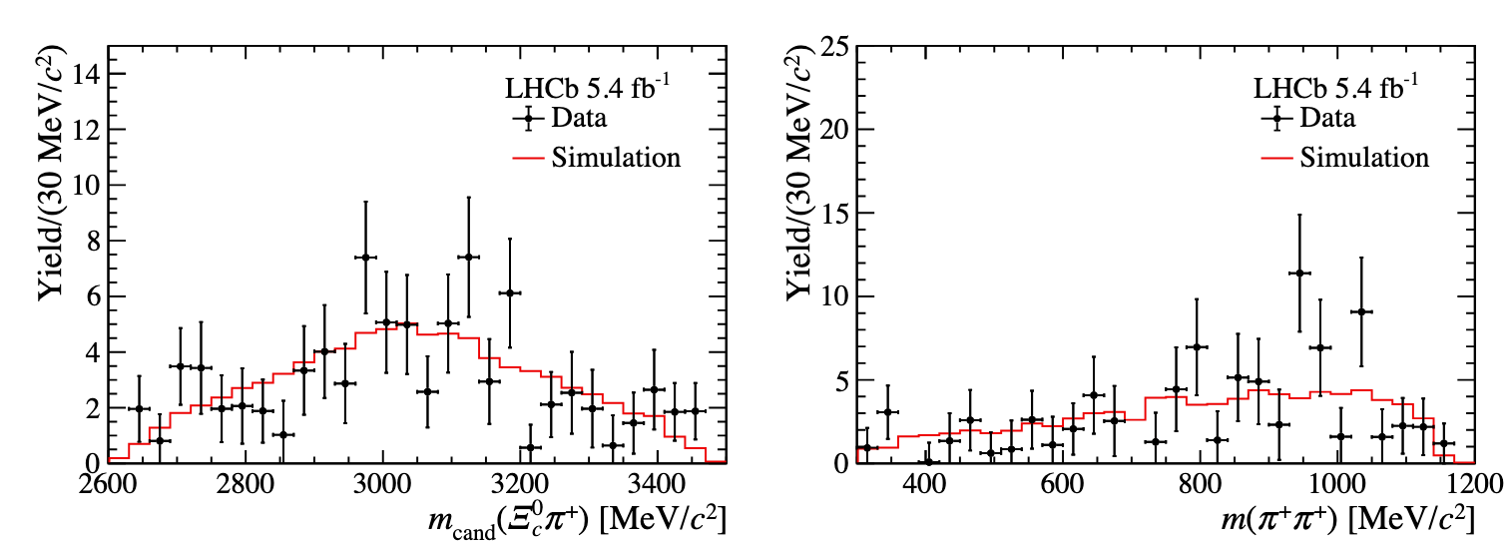

Decay Structure of $Ξ_{cc}^{++}→Ξ_{c}^{0}π^{+}π^{+}$
[JHEP 10 (2025) 136]
Distributions of $m(Ξ_{c}^{0}π^{+})$ and $m(π^{+}π^{+})$ in background-subtracted data
No significant resonant structure observed
Dominated by three-body flat phase-space decay

Slide 11
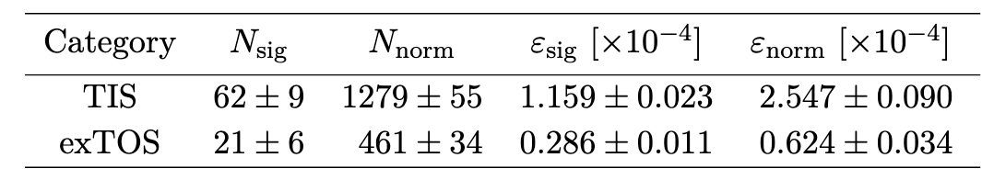
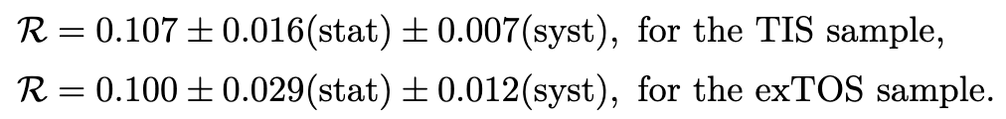
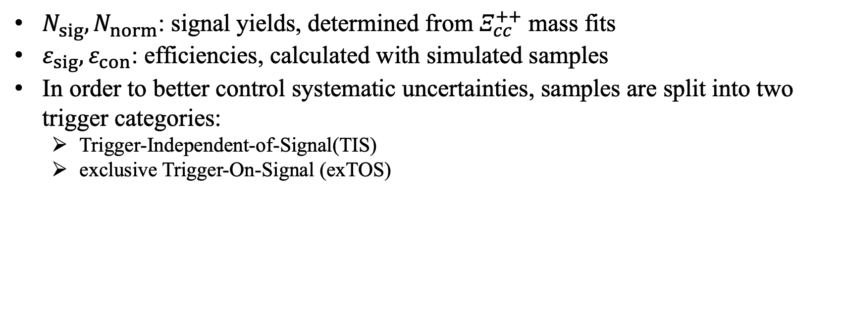
Branching fraction measurement
[JHEP 10 (2025) 136]
$N_{sig},N_{norm}$: signal yields, determined from $Ξ_{cc}^{++}$ mass fits
${ε_{sig},ε}_{con}$: efficiencies, calculated with simulated samples
In order to better control systematic uncertainties, samples are split into two trigger categories:
  Trigger-Independent-of-Signal(TIS)
  exclusive Trigger-On-Signal (exTOS)

Slide 12

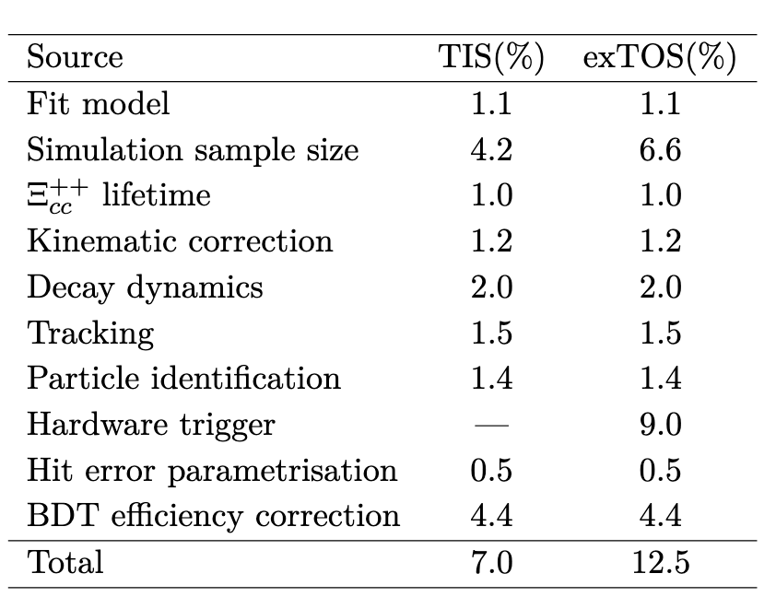
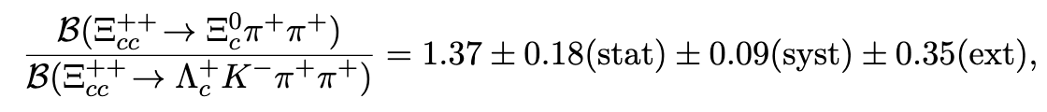
Branching fraction measurement
[JHEP 10 (2025) 136]
Combined results:
Further theoretical and phenomenological work required to calculate absolute multi‑body branching fractions
These results are critical for constraining theoretical models of weak decay dynamics
Systematic uncertainties
[EPJC 78 (2018) 56] [EPJP 136 (2021) 772]

Slide 13

Observation of the $Ξ_{cc}^{+}$baryon
with the LHCb Run 3 detector

Slide 14
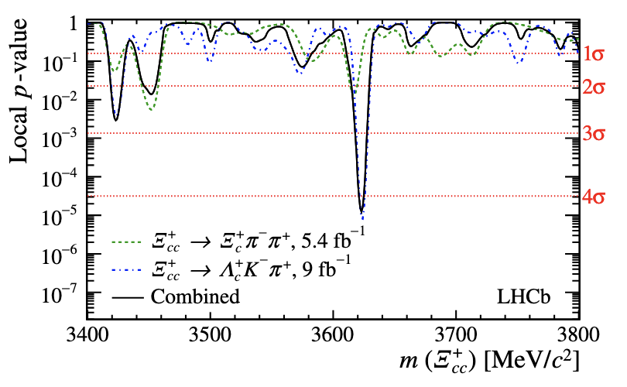
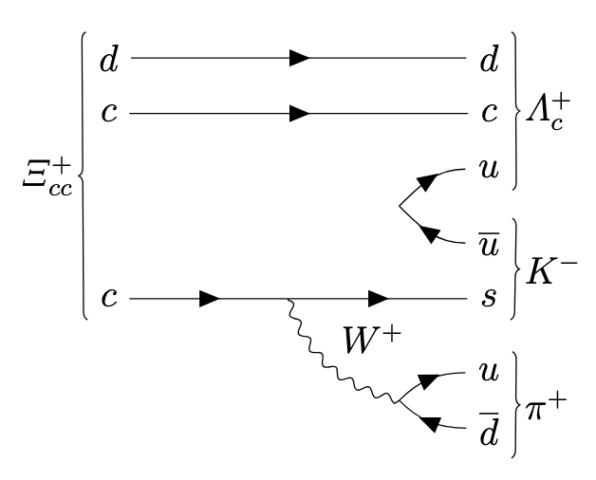
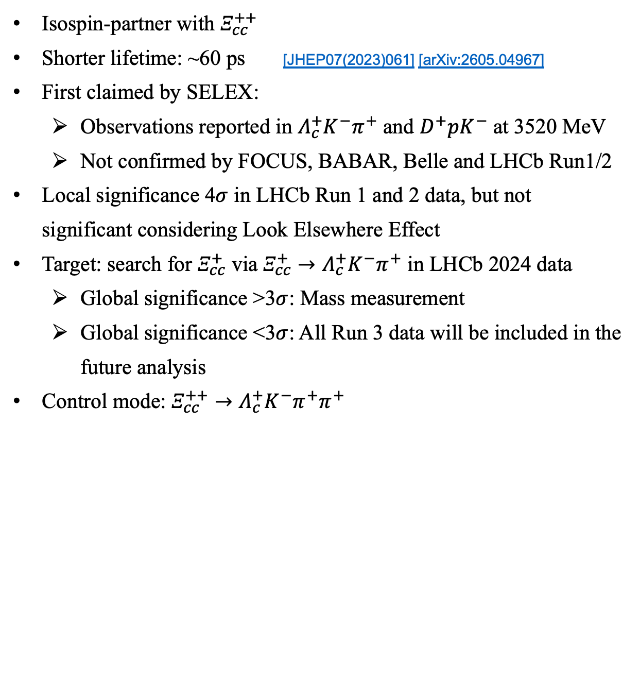
Doubly charmed baryon $Ξ_{cc}^{+}$
Isospin-partner with $Ξ_{cc}^{++}$
Shorter lifetime: ~60 ps [JHEP07(2023)061] [arXiv:2605.04967]
First claimed by SELEX:
  Observations reported in $Λ_{c}^{+}K^{−}π^{+}$ and $D^{+}pK^{−}$ at 3520 MeV
  Not confirmed by FOCUS, BABAR, Belle and LHCb Run1/2
Local significance 4$σ$ in LHCb Run 1 and 2 data, but not significant considering Look Elsewhere Effect
Target: search for $Ξ_{cc}^{+}$ via $Ξ_{cc}^{+}→Λ_{c}^{+}K^{−}π^{+}$ in LHCb 2024 data
  Global significance >3$σ$: Mass measurement
  Global significance <3$σ$: All Run 3 data will be included in the future analysis
Control mode: $Ξ_{cc}^{++}→Λ_{c}^{+}K^{−}π^{+}π^{+}$
[JHEP 12 (2021) 107]

Slide 15
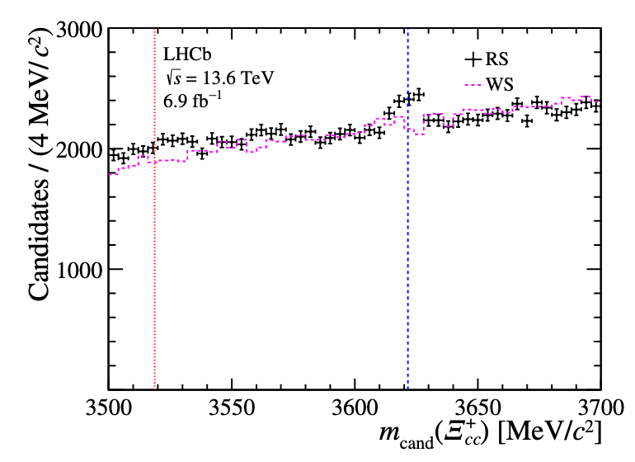
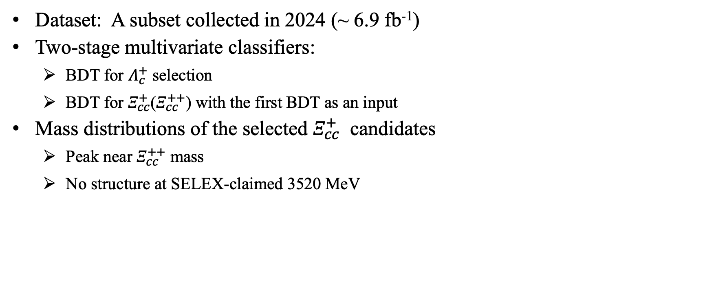

Observation of $Ξ_{cc}^{+}$ via $Ξ_{cc}^{+}→Λ_{c}^{+}K^{−}π^{+}$
[arXiv:2603.28456]
Dataset: A subset collected in 2024 (~ 6.9 fb⁻¹)
Two-stage multivariate classifiers:
  BDT for $Λ_{c}^{+}$ selection
  BDT for $Ξ_{cc}^{+}$($Ξ_{cc}^{++}$) with the first BDT as an input
Mass distributions of the selected $Ξ_{cc}^{+}$ candidates
  Peak near $Ξ_{cc}^{++}$ mass
  No structure at SELEX-claimed 3520 MeV
SELEX
$$Ξ_{cc}^{++}$$

Slide 16
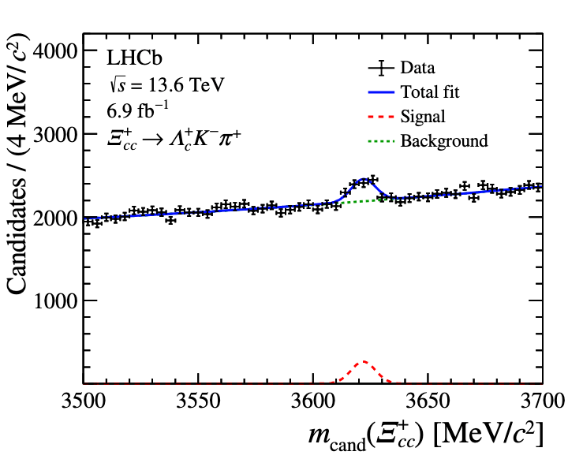
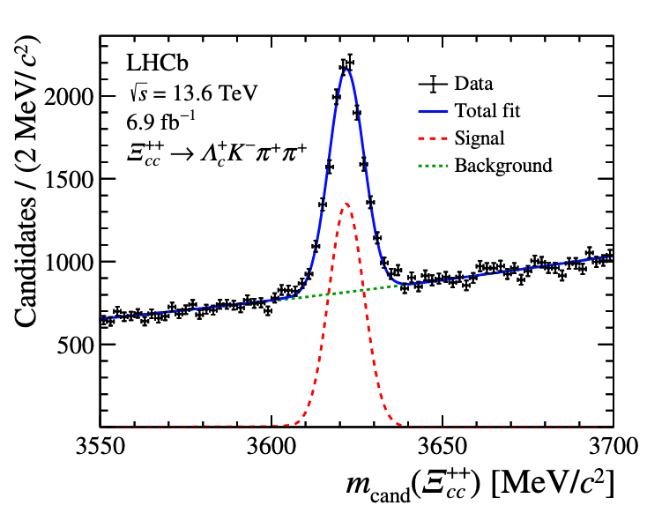
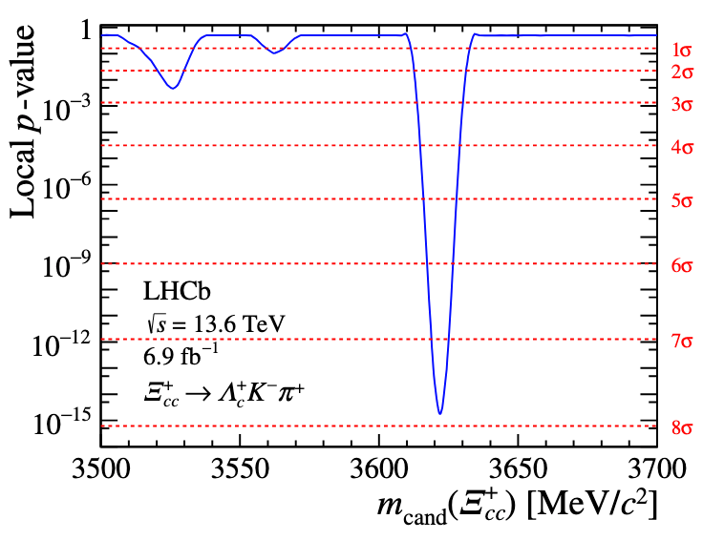

Significance determination
[arXiv:2603.28456]
An unbinned extended maximum-likelihood fit
  Signal model: Crystal Ball function
  Background model: 2st order Polynomial
  $N_{sig}=915±120$
  Local significance: > 7$σ$
First Observation!

Slide 17
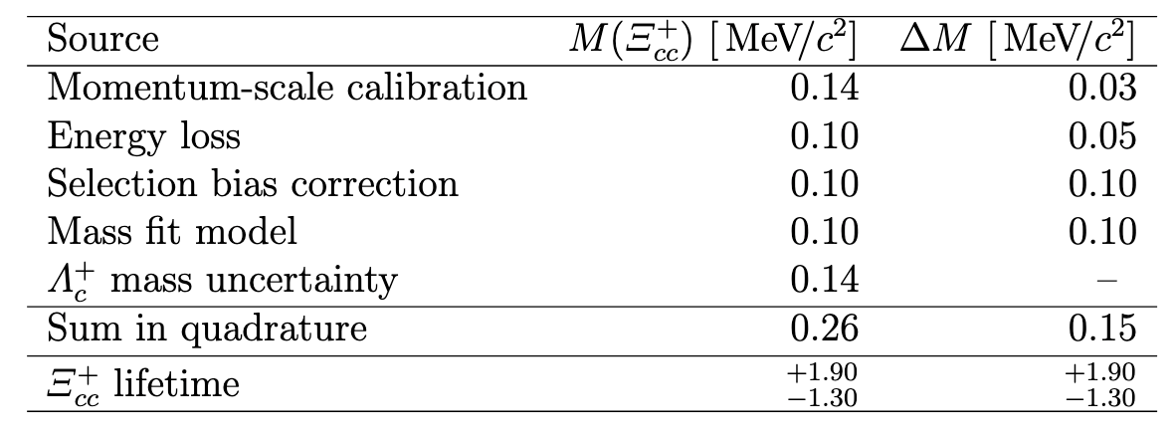
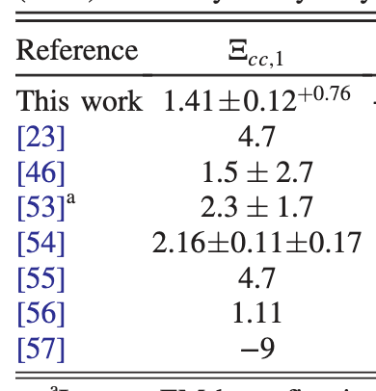
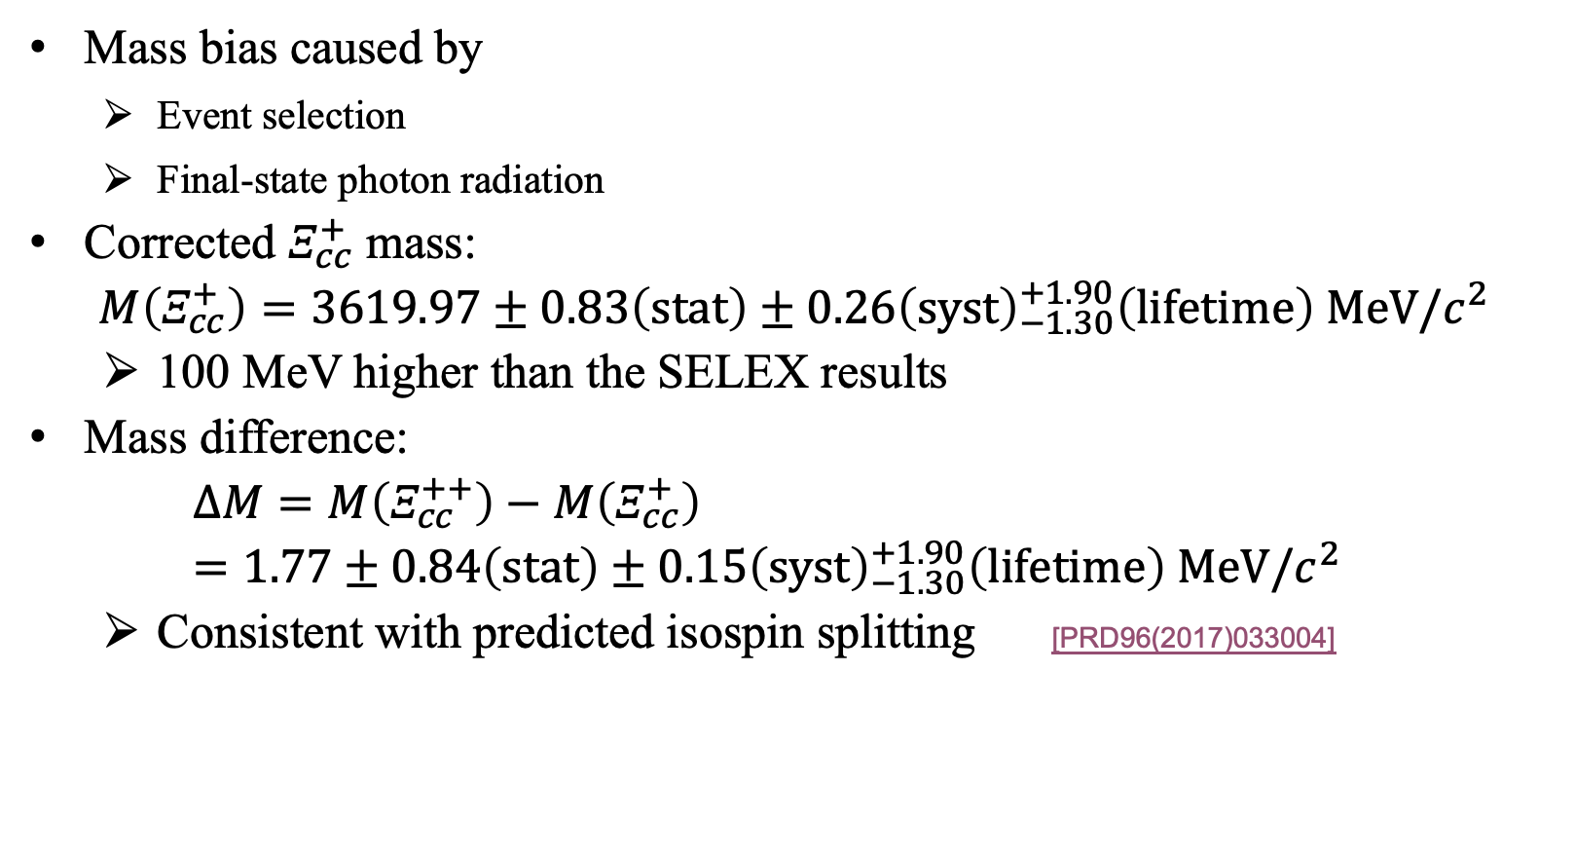
Mass measurement
[arXiv:2603.28456]
Mass bias caused by
  Event selection
  Final-state photon radiation
Corrected $Ξ_{cc}^{+}$ mass:
$$M\left(Ξ_{cc}^{+}\right)=3619.97±0.83\left(stat\right)±{0.26\left(syst\right)}_{−1.30}^{+1.90}\left(lifetime\right) MeV/c^{2}$$
  100 MeV higher than the SELEX results
Mass difference:
$ΔM=M\left(Ξ_{cc}^{++}\right)−M\left(Ξ_{cc}^{+}\right)=1.77±0.84\left(stat\right)±{0.15\left(syst\right)}_{−1.30}^{+1.90}\left(lifetime\right) MeV/c^{2}$
  Consistent with predicted isospin splitting [PRD96(2017)033004]

Slide 18
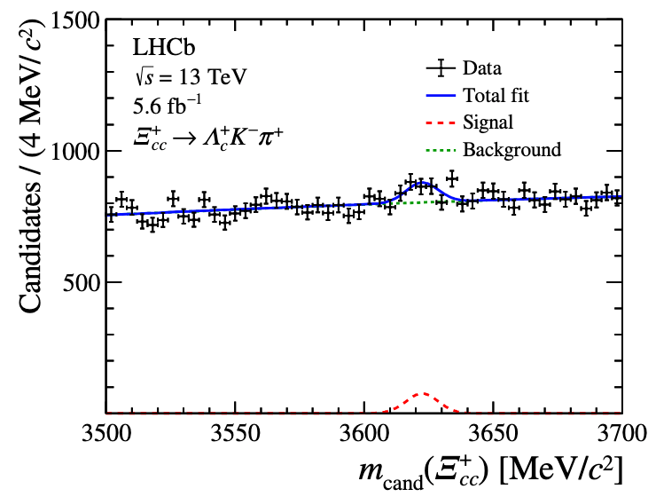
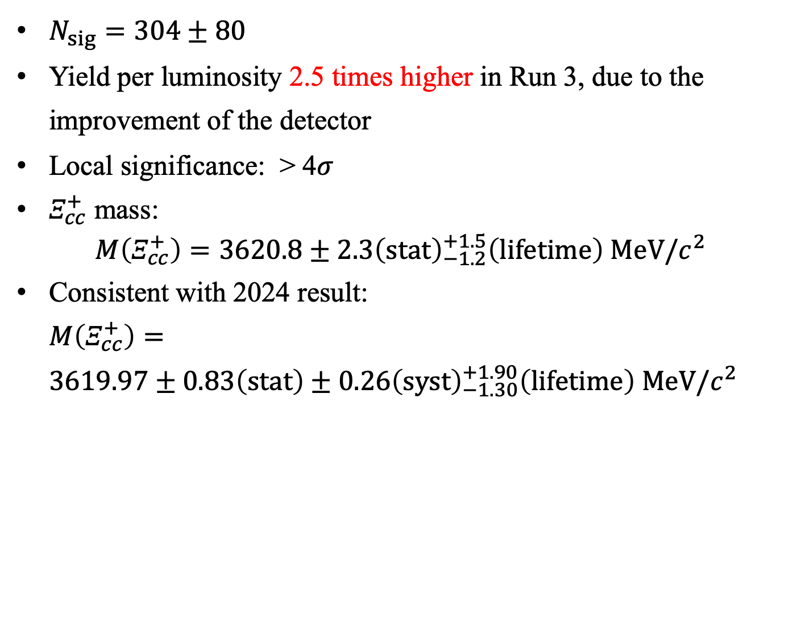
Crosscheck with Run 2 data
[arXiv:2603.28456]
$N_{sig}=304±80$
Yield per luminosity 2.5 times higher in Run 3, due to the improvement of the detector
Local significance: > 4$σ$
$Ξ_{cc}^{+}$ mass:
$$M\left(Ξ_{cc}^{+}\right)=3620.8±2.3{\left(stat\right)}_{−1.2}^{+1.5}\left(lifetime\right) MeV/c^{2}$$
Consistent with 2024 result:
$M\left(Ξ_{cc}^{+}\right)=$
$3619.97±0.83\left(stat\right)±{0.26\left(syst\right)}_{−1.30}^{+1.90}\left(lifetime\right) MeV/c^{2}$
2024
Run 2

Slide 19

Observation of the $Ω_{cc}^{+}$ baryon
with the LHCb Run 3 detector

Slide 20
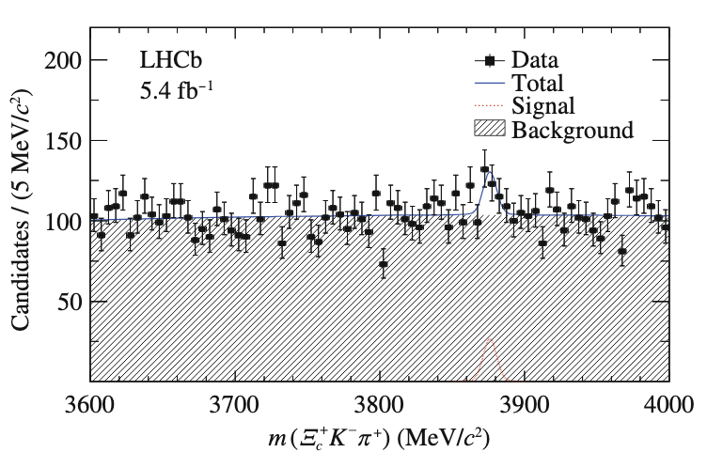
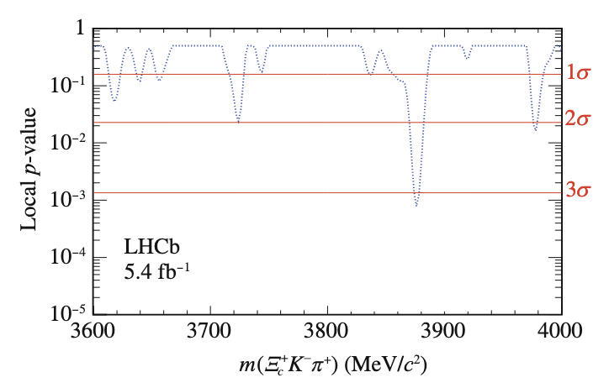
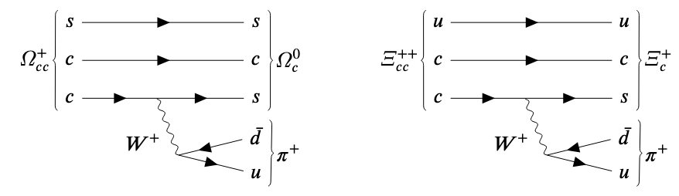

Doubly charmed baryon $Ω_{cc}^{+}$
Isospin-singlet
Lifetime: ~160 ps [JHEP07(2023)061]
Predicted fragmentation fraction $\frac{σ\left(Ω_{cc}^{+}\right)}{σ\left(Ξ_{cc}^{ }\right)}\sim \frac{1}{3}$
Global significance <3$σ$ in LHCb Run 2 data [SCPMA64(2021)101062]
Target: search for $Ω_{cc}^{+}$ via $Ω_{cc}^{+}→Ω_{c}^{0}π^{+}$ in LHCb 2024 data
  Global significance >3$σ$: Mass measurement
  Global significance <3$σ$: Upper limit on relative production rate
Control mode: $Ξ_{cc}^{++}→{Ξ_{c}^{+}π}^{+}$

Slide 21
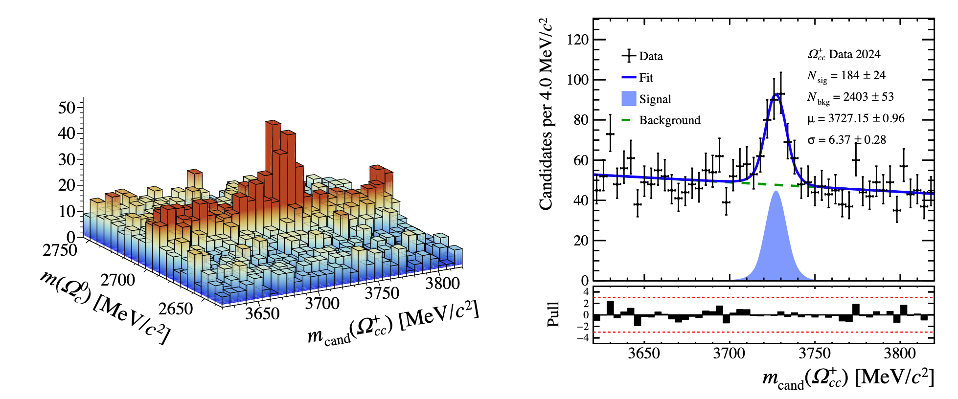
Observation of $Ω_{cc}^{+}$ via $Ω_{cc}^{+}→Ω_{c}^{0}π^{+}$
Dataset: A subset collected in 2024 (~ 6.9 fb⁻¹)
Global significance 8.7σ with 180 signals
The final part of the ground-state spin-1/2 baryon in SU(4) quark model

Slide 22
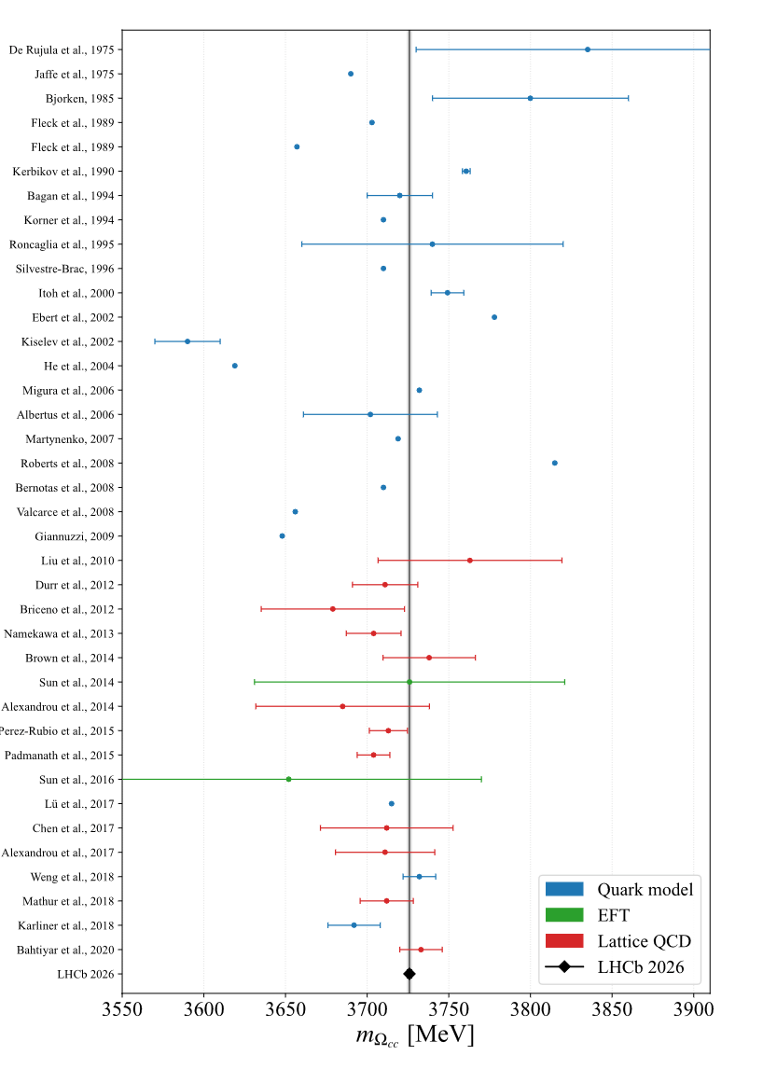
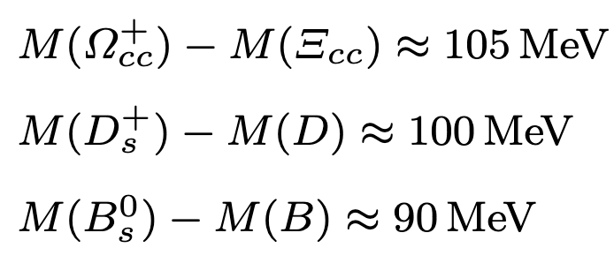

Mass measurement
Mass difference:
$ΔM=M\left(Ω_{cc}^{+}\right)−M\left(Ξ_{cc}^{++}\right)=$
$104.3±1.0\left(stat\right)±0.2\left(syst\right)±0.4\left(lifetime\right)±0.5(ext)MeV/c^{2}$
$Ω_{cc}^{+}$ mass:
$$M\left(Ω_{cc}^{+}\right)=ΔM+M_{PDG}\left(Ξ_{cc}^{++}\right)= \\ 3725.9±1.0\left(stat\right)±0.2\left(syst\right)±0.4\left(lifetime\right)±0.6(ext) MeV/c^{2}$$
The measured mass is in general compatible with theoretical predictions
Light-quark-heavy-diquark picture

Slide 23




Consistency and cross-checks
Mass-peak position is stable with data-taking time
An additional requirement of t > 170 fs, corresponding to 3$σ(τ_{Ω_{cc}^{+}})$, is applied to the signal candidates
  Confirms the weakly-decaying nature of the observed signal

Slide 24


Summary and outlook
Recent results about doubly charmed baryon searches at LHCb
All ground-state spin-1/2 baryons are found.
Future opportunities:
  Lifetime and production measurement of $Ξ_{cc}^{+}$ and $Ω_{cc}^{+}$
  More decay modes of doubly charmed baryons
  Excited states of doubly charmed baryons
  …
[PRD 61 (2000) 057502]

Slide 25
Thank you!

Slide 26
Backup

Slide 27


Slide 28


