Slide 1
Spectroscopy studies with b-hadron decaying into final states with two charmed hadrons
钱文斌
中国科学院大学
2026/08/13
第11届手征有效场论研讨会，兰州，甘肃
2026/08/13
UCAS, Wenbin Qian
1

Slide 2
Outline of the talk
Introduction
Review of published results
Fresh results on spectroscopy studies
Conclusion
Disclaimer: results are selected based on personal taste
2026/08/13
UCAS, Wenbin Qian

Slide 3
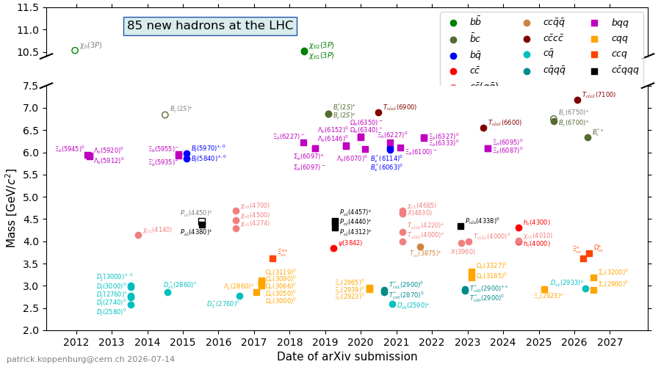
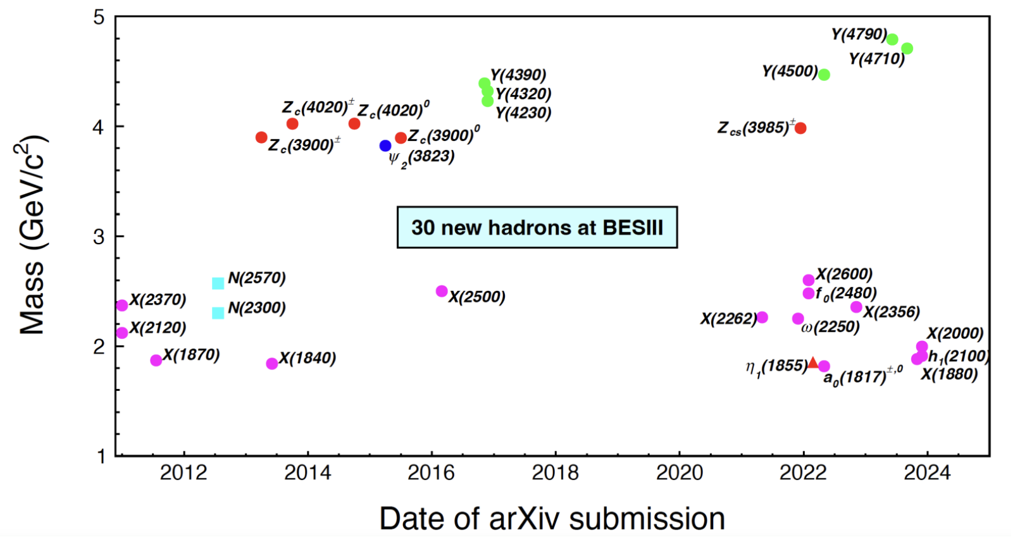
Particle zoo 2.0
Many new hadrons discovered since the discovery of $χ_{c1}(3872)$ in 2003: renaissance and revolution?
85 new hadrons
30 new hadrons
LHC (mainly LHCb)
BESIII
+ 17 new hadrons from Belle (>35 from its start)
> 20 new hadrons since 2022 (only selected ones are shown)
Many can not be explained by conventional quark model
More than 140 new hadrons
2026/08/13
国科大 钱文斌
3

Slide 4
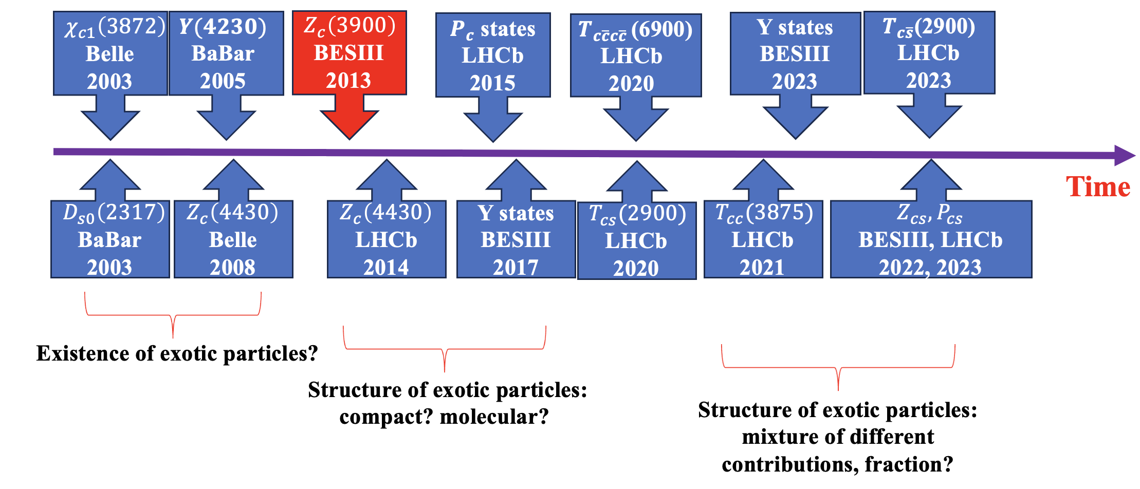


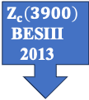






A history of understanding
$$Z_{c}\left(3900\right)$$
BESIII
2013
$c\overline{c}(X)$+ $c\overline{s} (X)$
More states
Better understanding
Unified model for all hadrons?
$$c\overline{c}g$$
$$c\overline{c}$$
+
$$c\overline{c}qq$$
+
+
$$c\overline{c}$$
$$qq$$
+ …
Particle X =
$$cq$$
$$\overline{c}q$$
2026/08/13
国科大 钱文斌
4

Slide 5
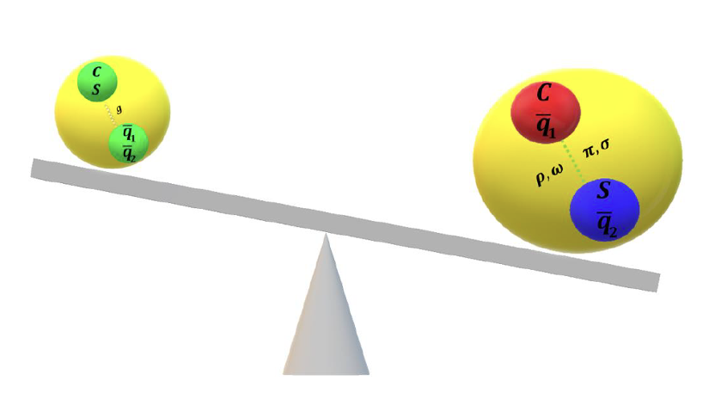
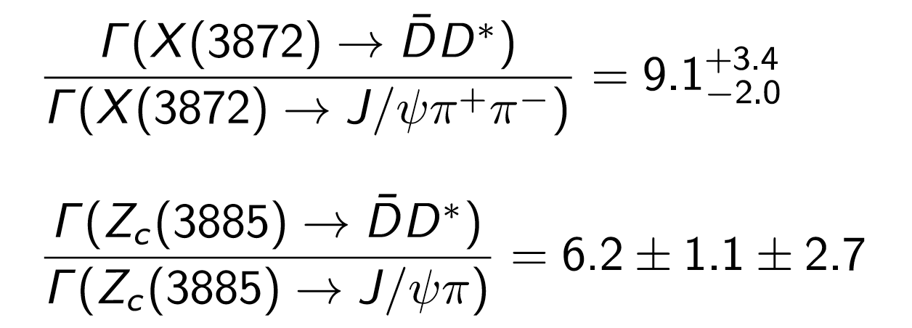



Experimental inputs
$$c\overline{c}g$$
$$c\overline{c}$$
+
$$c\overline{c}qq$$
+
+
$$c\overline{c}$$
$$qq$$
+ …
Particle X =
$$cq$$
$$\overline{c}q$$
Charm + charm + X
charmonium + X
Experimental tasks:
Discover more and understand them through production and decays
However, studies with $B→DDX$decays rather limited at LHCb
2026/08/13
国科大 钱文斌
5

Slide 6
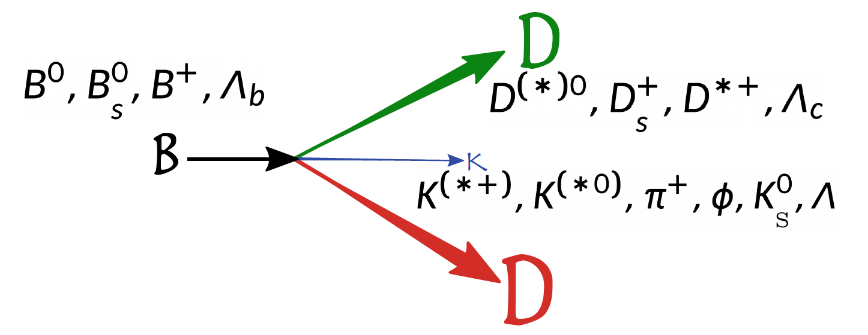
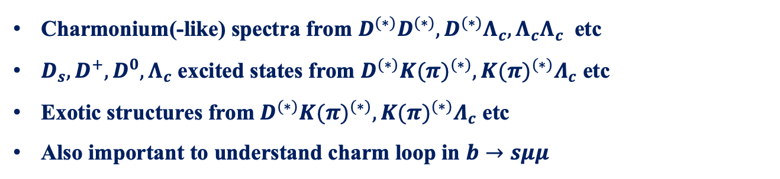
Decays of interest
Charmonium(-like) spectra from $D^{(∗)}D^{(∗)}, D^{(∗)}Λ_{c}, Λ_{c}Λ_{c}$ etc
$D_{s}, D^{+}, D^{0}, Λ_{c}$ excited states from $D^{(∗)}{K(π)}^{(∗)}, {K(π)}^{(∗)}Λ_{c}$ etc
Exotic structures from $D^{(∗)}{K(π)}^{(∗)}, {K(π)}^{(∗)}Λ_{c}$ etc
Also important to understand charm loop in $b→sμμ$
2026/08/13
UCAS Wenbin Qian
6

Slide 7
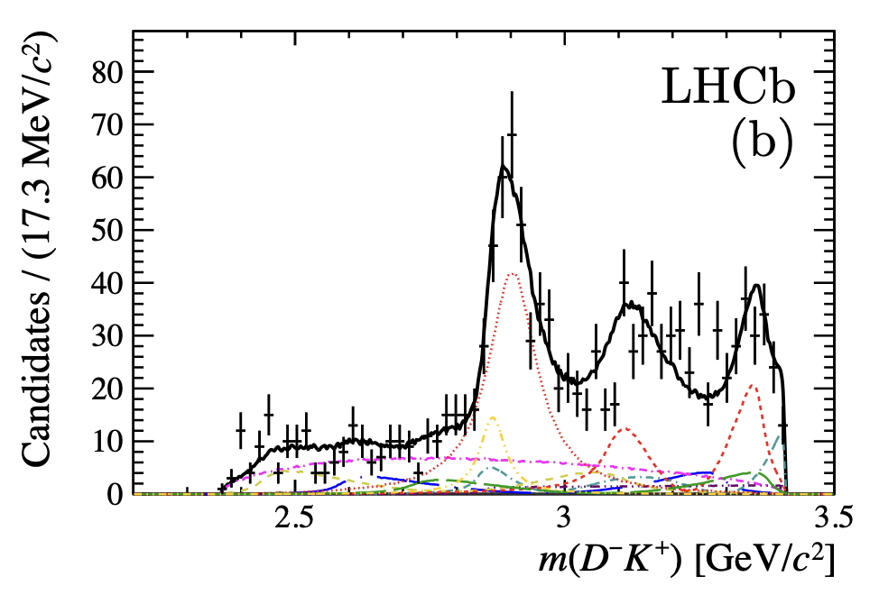
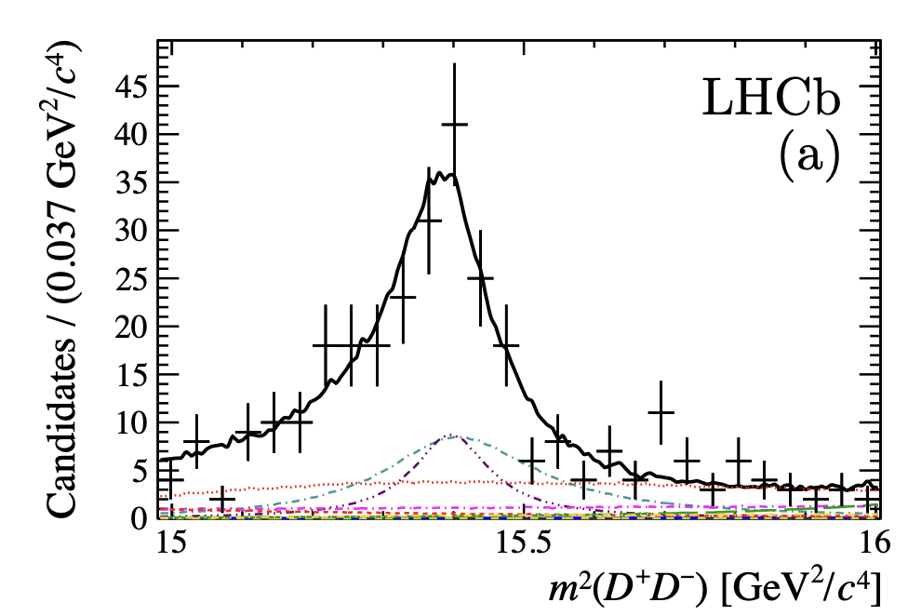
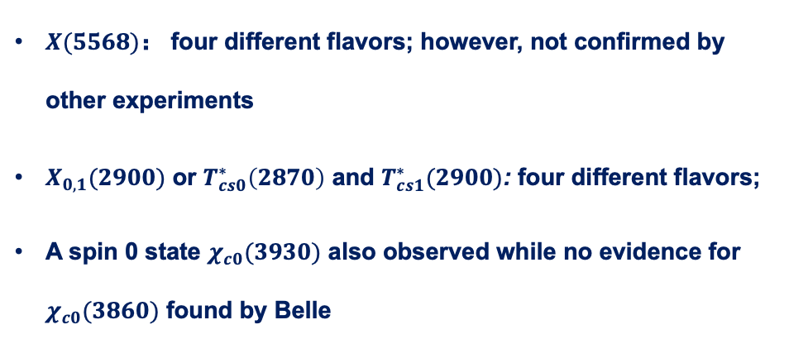
First open-charmed exotics
UK+US
PRL 125 (2020) 242001
Amplitude analysis of $B^{+}→D^{+}D^{−}K^{+}$
$X(5568)$： four different flavors; however, not confirmed by other experiments
$X_{0,1}(2900)$ or $T_{cs0}^{∗}\left(2870\right)$ and $T_{cs1}^{∗}(2900)$: four different flavors;
A spin 0 state $χ_{c0}(3930)$ also observed while no evidence for $χ_{c0}(3860)$ found by Belle
2026/08/13
国科大 钱文斌
7

Slide 8
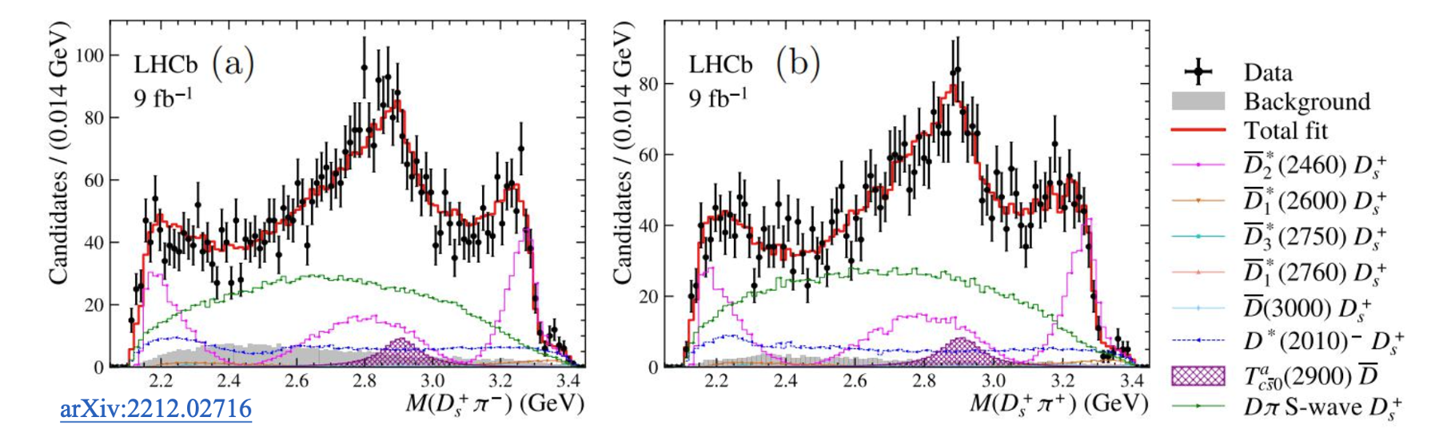
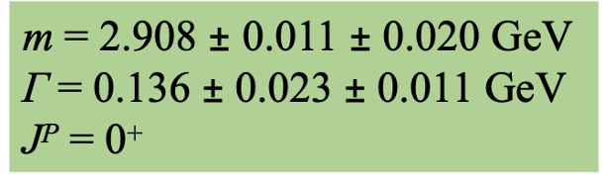
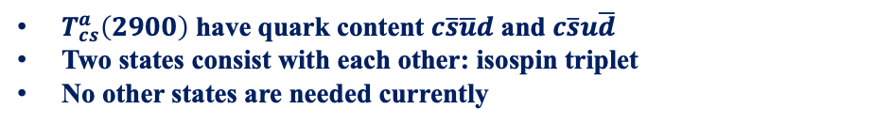






Doubly charged tetraquark and its Isospin partner
Around 4K signal events
UCAS+ Tsinghua
PRL 131 (2023) 041902
$$B^{0}→\overline{D^{0}}D_{s}^{+}π^{−}$$
$$B^{+}→D^{−}D_{s}^{+}π^{+}$$
$$T_{c\overline{s}}^{a}{\left(2900\right)}^{0}$$
$$T_{c\overline{s}}^{a}{\left(2900\right)}^{++}$$
$$FF:\left(4.8±1.1±1.4\right)\%$$
$$FF:\left(1.96±0.87±0.88\right)\%$$
$T_{cs}^{a}\left(2900\right) \text{have} \text{quark} \text{content} c\overline{s}\overline{u}d \text{and} c\overline{s}u\overline{d}$
Two states consist with each other: isospin triplet
No other states are needed currently
2026/08/13
国科大 钱文斌
8

Slide 9
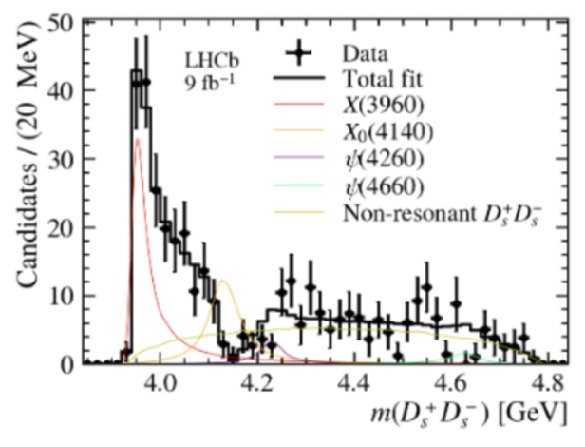
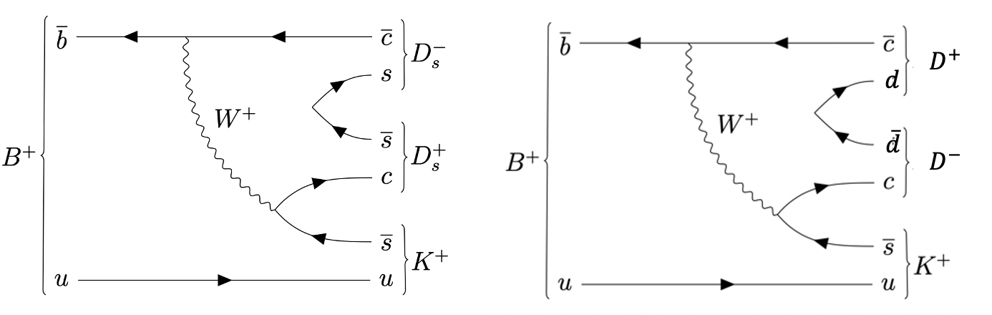
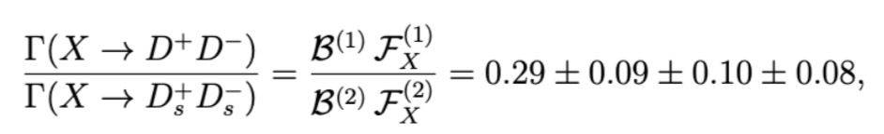

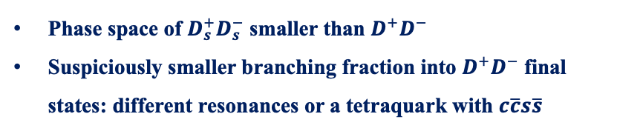

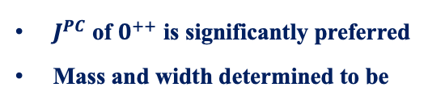
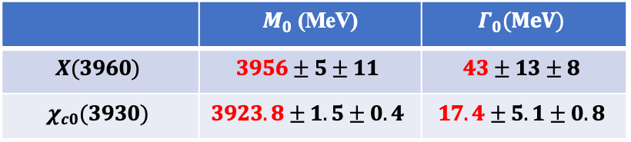


Possible exotic with $c\overline{c}s\overline{s}$
Tsinghua+UCAS
PRL 131 (2023) 071901
Threshold enhancement seen in $B^{+}→D_{s}^{+}D_{s}^{−}K^{+}$ decays
$J^{PC}$ of $0^{++}$ is significantly preferred
Mass and width determined to be
 | $M_{0}$ (MeV) | $$Γ_{0}(MeV)$$
$$X(3960)$$ | $$3956±5±11$$ | $$43±13±8$$
$$χ_{c0}(3930)$$ | $$3923.8±1.5±0.4$$ | $$17.4±5.1±0.8$$
$D_{s}^{+}D_{s}^{−}$ threshold: ~3938 MeV
Phase space of $D_{s}^{+}D_{s}^{−}$ smaller than $D^{+}D^{−}$
Suspiciously smaller branching fraction into $D^{+}D^{−}$ final states: different resonances or a tetraquark with $c\overline{c}s\overline{s}$
$$X(3960)$$
$$χ_{c0}(3930)$$
2026/08/13
国科大 钱文斌
9

Slide 10
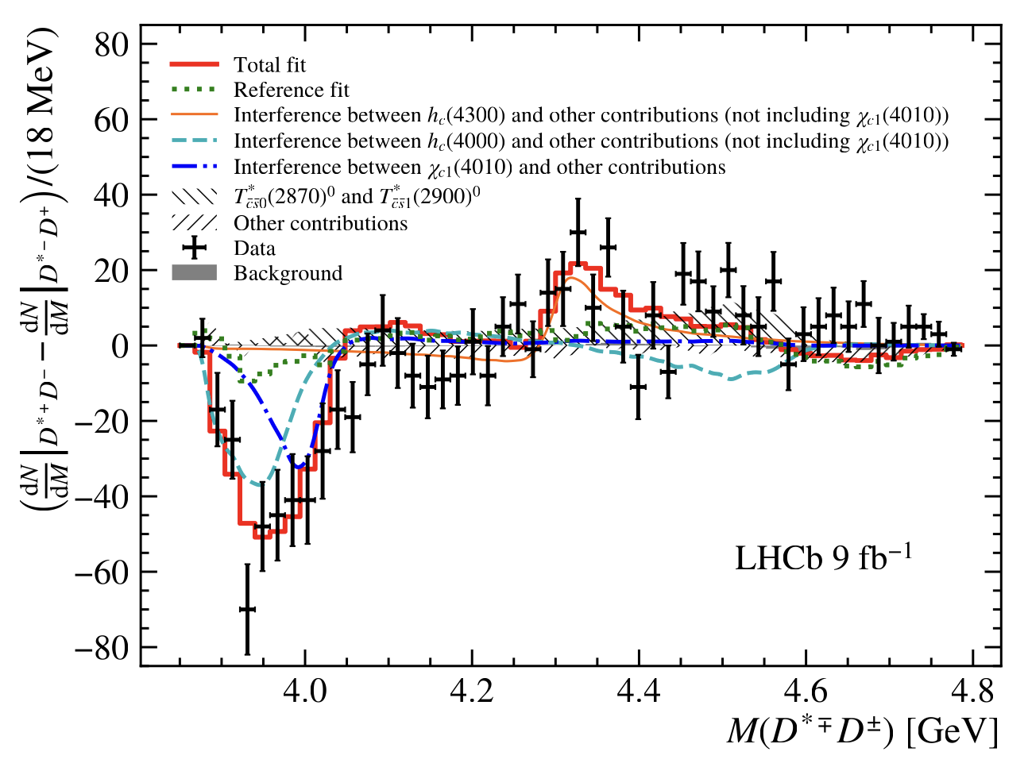
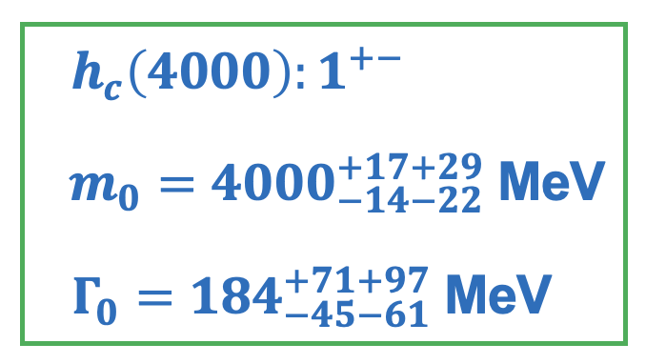
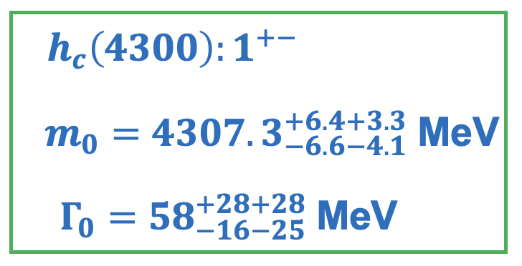
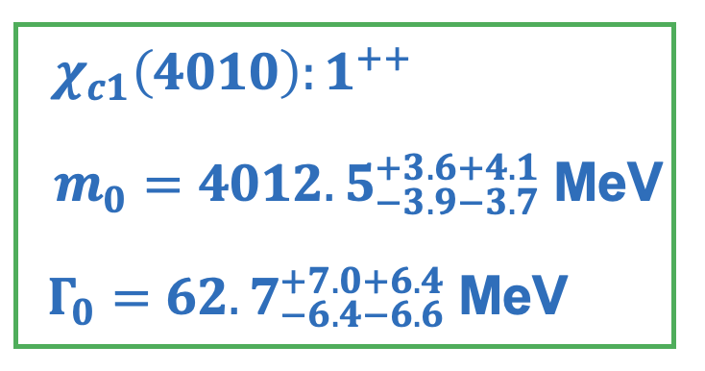
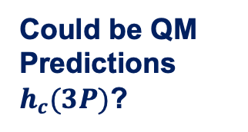
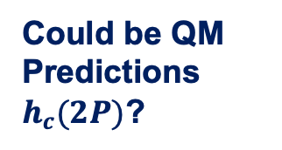



Three new states
UCAS+Tsinghua
PRL 133 (2024) 131902
Could be QM Predictions $h_{c}(2P)$?
$$h_{c}(4300)$$
Could be QM Predictions $h_{c}(3P)$?
$$χ_{c1}(4010)$$
$$h_{c}(4000)$$
Nature still under debate
Only interference with same J^{P} but different C party remains
2026/08/13
国科大 钱文斌
10

Slide 11
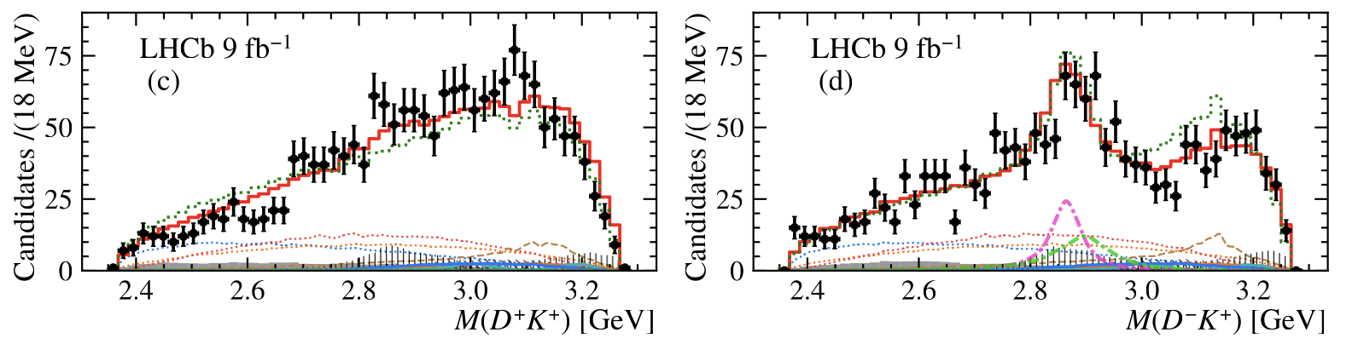

$$T_{cs}→DK$$
UCAS+Tsinghua
PRL 133 (2024) 131902
Negative in search $T_{c\overline{s}0}{\left(2900\right)}^{++}$
$FF\left(B^{+}→T_{c\overline{s}0}{\left(2900\right)}^{++}D^{∗−},T_{c\overline{s}0}{\left(2900\right)}^{++}→D^{+}K^{+}\right)<3.3\% @ 95\%$ C.L.
Confirming $T_{\overline{c}\overline{s}0}^{∗}{\left(2870\right)}^{0}$ and $T_{\overline{c}\overline{s}1}^{∗}{\left(2900\right)}^{0}$ in a new decay channel $B^{+}→D^{∗+}T_{\overline{c}\overline{s}}^{∗}$
This work
Previous work
Large difference on branching fraction ratio, further hints on structures?
2026/08/13
国科大 钱文斌
11

Slide 12
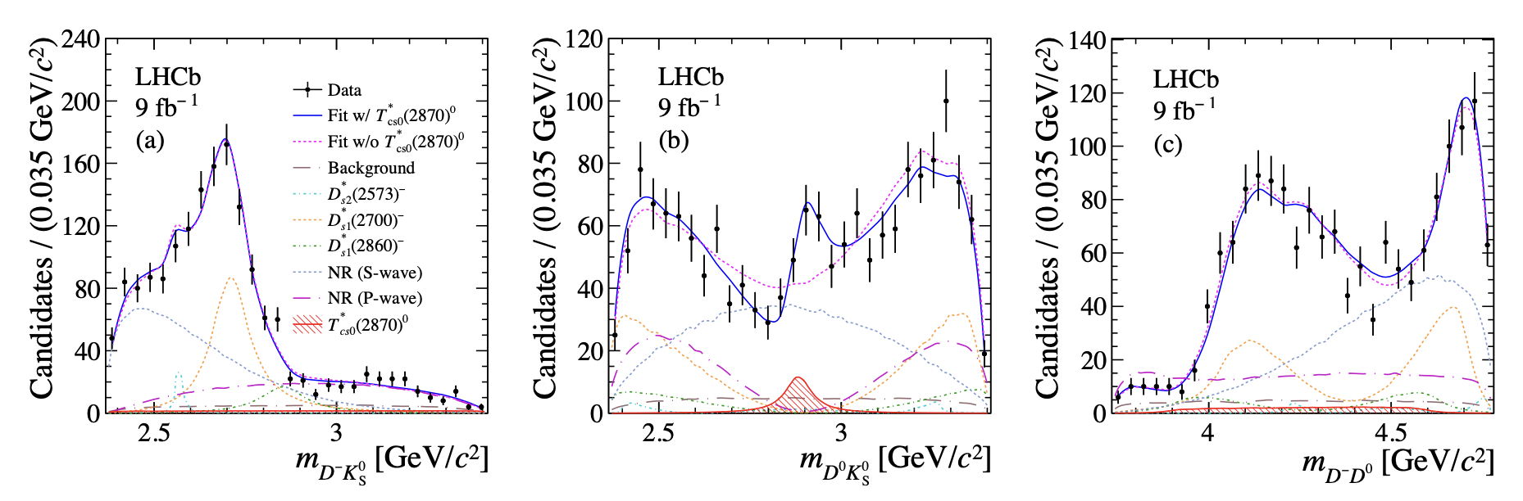


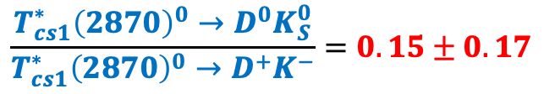
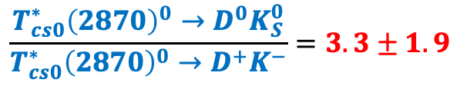
$$T_{cs}→DK_{S}^{0}$$
PKU
PRL 134 (2025) 101901
Amplitude analysis of $B^{+}→D^{−}D^{0}K_{S}^{0}$ finding $T_{\overline{c}\overline{s}0}^{∗}{\left(2870\right)}^{0}$, but not $T_{\overline{c}\overline{s}1}^{∗}{\left(2900\right)}^{0}$ to $D^{0}K_{S}^{0}$
$$\frac{T_{cs0}^{∗}{\left(2870\right)}^{0}→D^{0}K_{S}^{0}}{T_{cs0}^{∗}{\left(2870\right)}^{0}→D^{+}K^{−}}=3.3±1.9$$
$$\frac{T_{cs1}^{∗}{\left(2870\right)}^{0}→D^{0}K_{S}^{0}}{T_{cs1}^{∗}{\left(2870\right)}^{0}→D^{+}K^{−}}=0.15±0.17$$
Similar as $B→D^{∗}T_{cs}$, more spin 0 contributions than spin 1
While 1 from Isospin symmetry?
2026/08/13
国科大 钱文斌
12

Slide 13
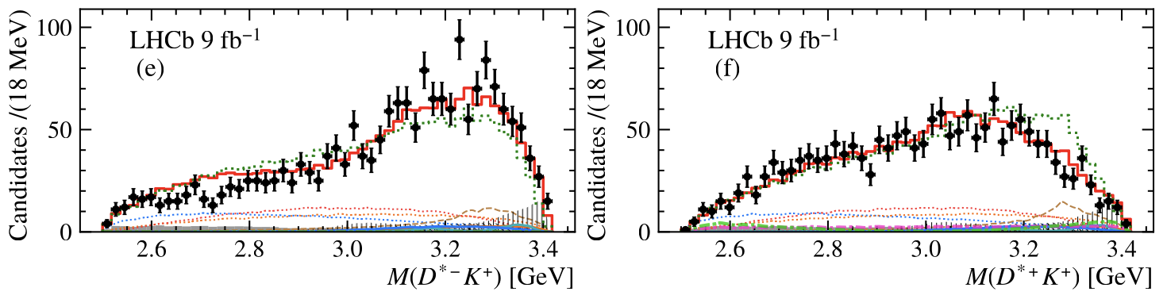

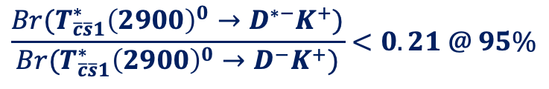
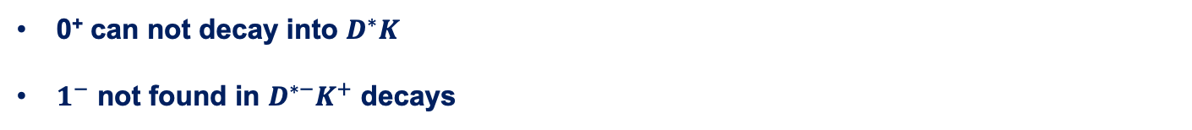
$$T_{cs}→D^{∗}K$$
UCAS+Tsinghua
PRL 133 (2024) 131902
0⁺ can not decay into $D^{∗}K$
$1^{−}$ not found in $D^{∗−}K^{+}$ decays
$FF\left(B^{+}→T_{\overline{c}\overline{s}1}^{∗}{\left(2900\right)}^{0}D^{+},T_{\overline{c}\overline{s}1}^{∗}{\left(2900\right)}^{0}→D^{∗−}K^{+}\right)<1.5\% @ 95\%$ C.L.
$$\frac{Br(T_{\overline{c}\overline{s}1}^{∗}{\left(2900\right)}^{0}→D^{∗−}K^{+})}{Br(T_{\overline{c}\overline{s}1}^{∗}{\left(2900\right)}^{0}→D^{−}K^{+})}<0.21 @ 95\%$$
2026/08/13
国科大 钱文斌
13

Slide 14
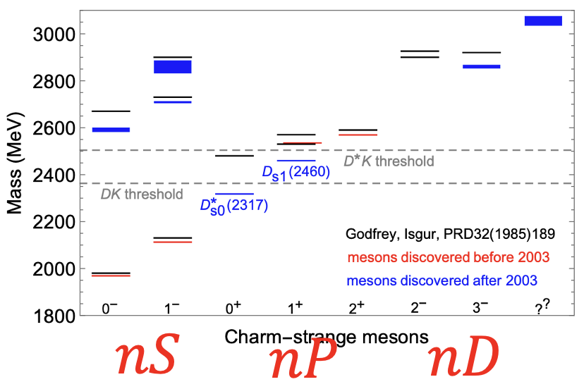
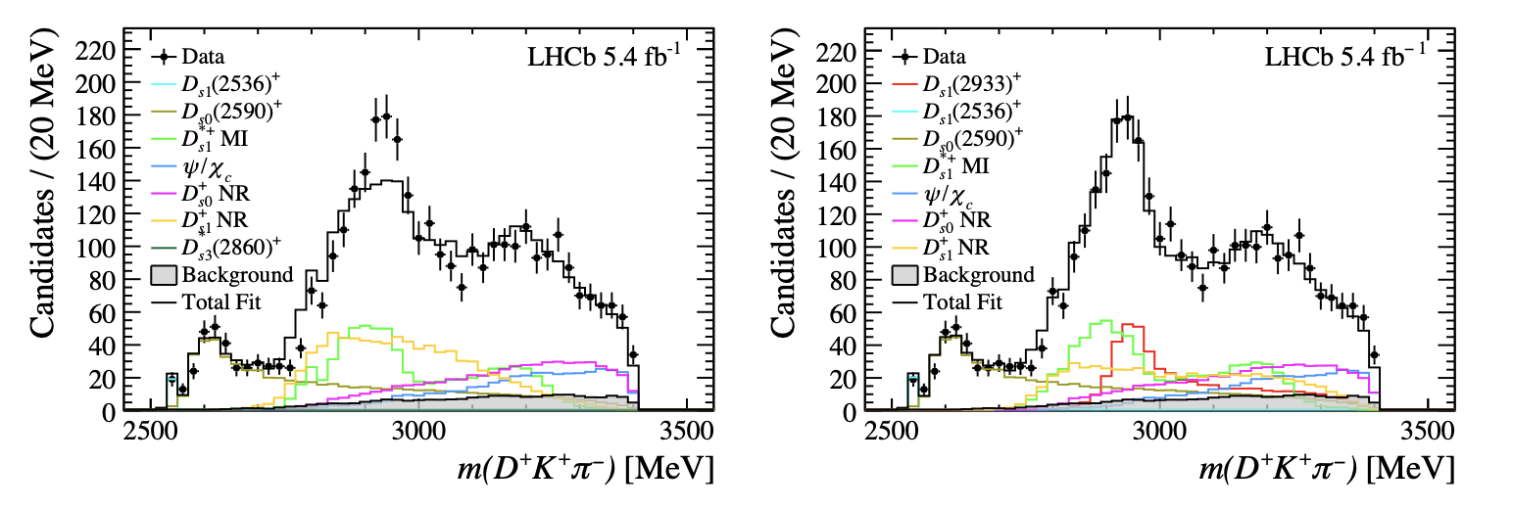
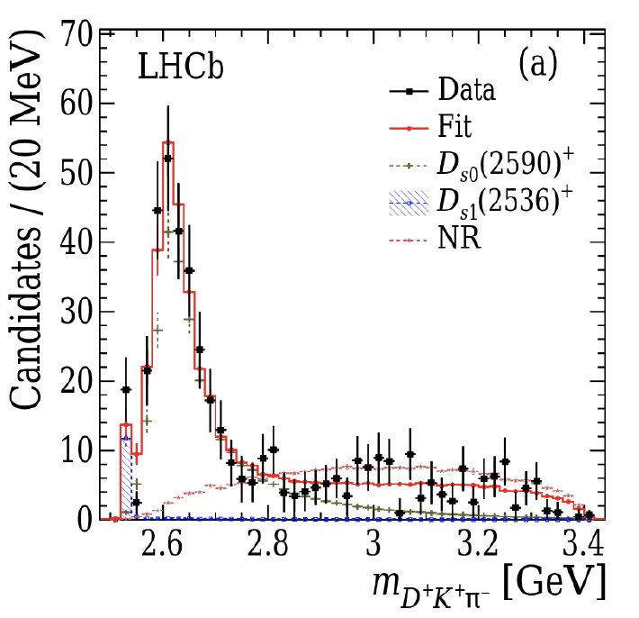

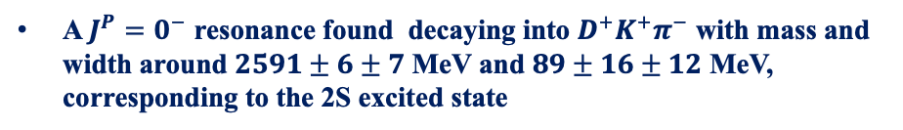

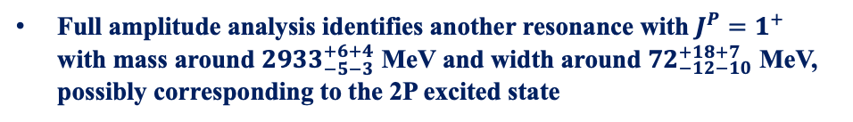
Two $D_{s}^{∗}$ states
Tsinghua
PRL 126 (2021) 122002
LHCb-PAPER-2025-073
An amplitude analysis first performed in the region of $m\left(Kπ\right)<0.75$ GeV
A $J^{P}=0^{−}$ resonance found decaying into $D^{+}K^{+}π^{−}$ with mass and width around $2591±6±7$ MeV and $89±16±12$ MeV, corresponding to the 2S excited state
Full amplitude analysis identifies another resonance with $J^{P}=1^{+}$ with mass around $2933_{−5−3}^{+6+4}$ MeV and width around $72_{−12−10}^{+18+7}$ MeV, possibly corresponding to the 2P excited state
2026/08/13
国科大 钱文斌
14

Slide 15
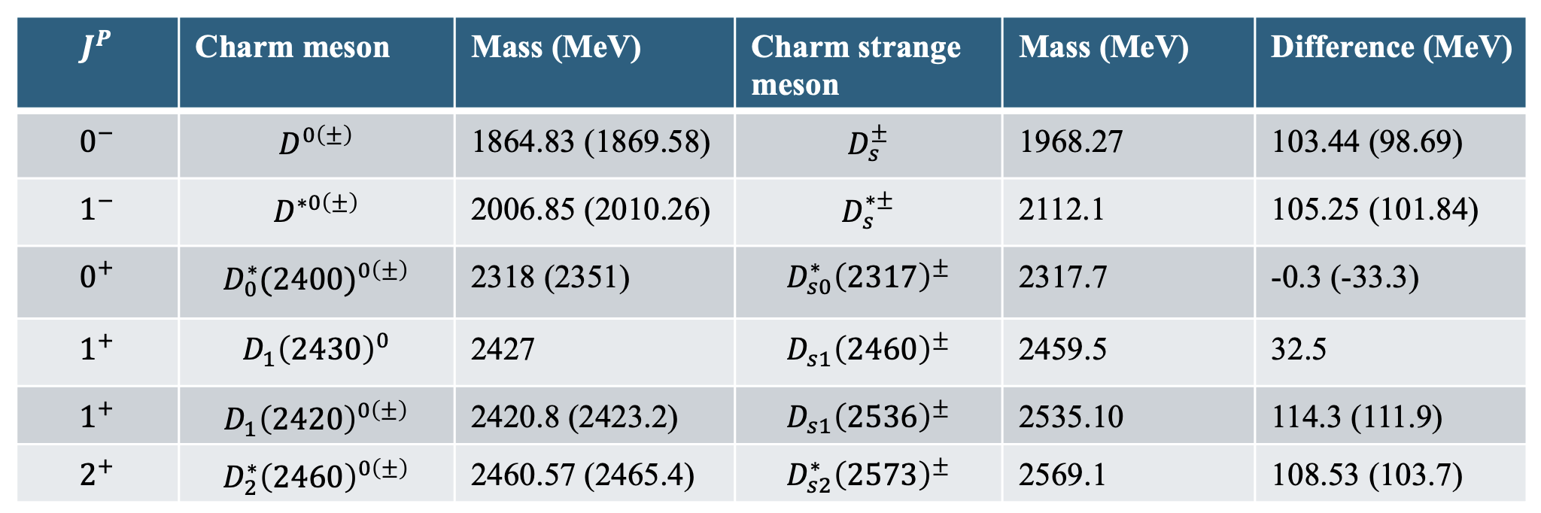





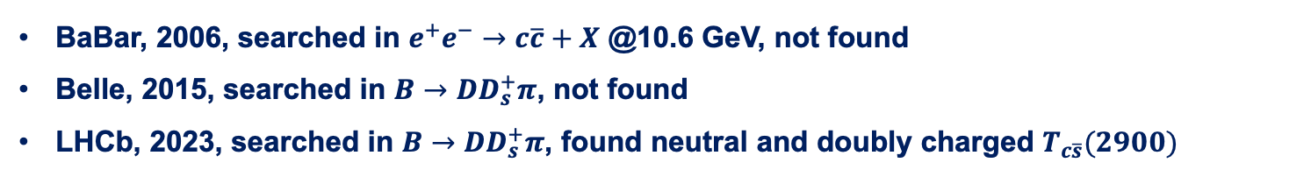
Nature of $D_{s}^{+}(2317)$ and its isospin partner
Discovered more than 20 years ago, however, its structure remains puzzling
$$\vec{s_{l}}$$
$$1/2$$
$$1/2$$
$$3/2$$
BaBar, 2006, searched in $e^{+}e^{−}→c\overline{c}+X$ @10.6 GeV, not found
Belle, 2015, searched in $B→DD_{s}^{+}π$, not found
LHCb, 2023, searched in $B→DD_{s}^{+}π$, found neutral and doubly charged $T_{c\overline{s}}(2900)$
2026/08/13
国科大 钱文斌
15

Slide 16
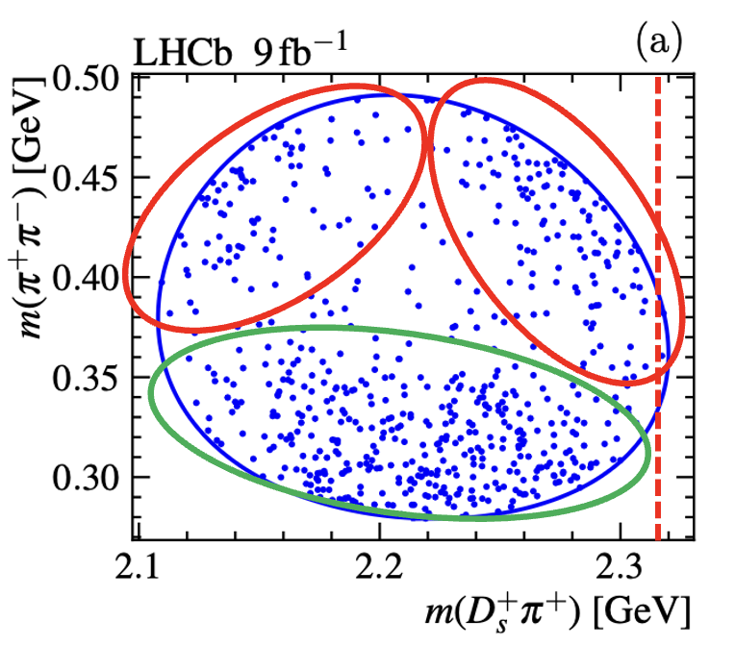
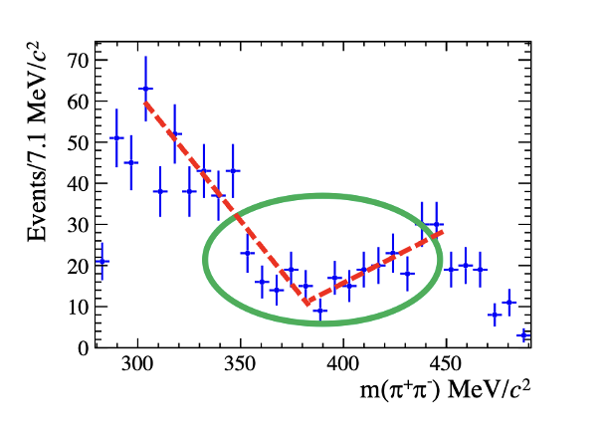
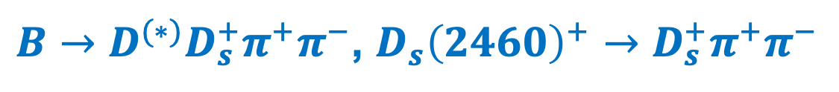
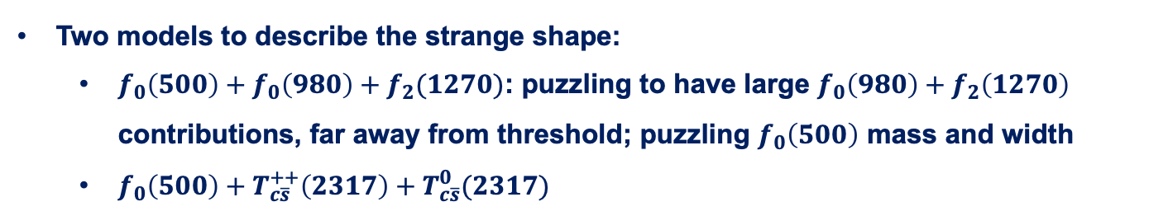
$B→D^{(∗)}D_{s}^{+}π^{+}π^{−}$, $D_{s}{\left(2460\right)}^{+}→D_{s}^{+}π^{+}π^{−}$
UCAS+Tsinghua
Science Bulletin 70 (2025) 1432
Interesting structures seen on Dalitz plot and projections
Very puzzling structures, rarely seen before
Two models to describe the strange shape:
  $f_{0}\left(500\right)+f_{0}\left(980\right)+f_{2}(1270)$: puzzling to have large $f_{0}\left(980\right)+f_{2}\left(1270\right)$ contributions, far away from threshold; puzzling $f_{0}\left(500\right)$ mass and width
  $f_{0}\left(500\right)+T_{c\overline{s}}^{++}\left(2317\right)+T_{c\overline{s}}^{0}(2317)$
2026/08/13
国科大 钱文斌
16

Slide 17
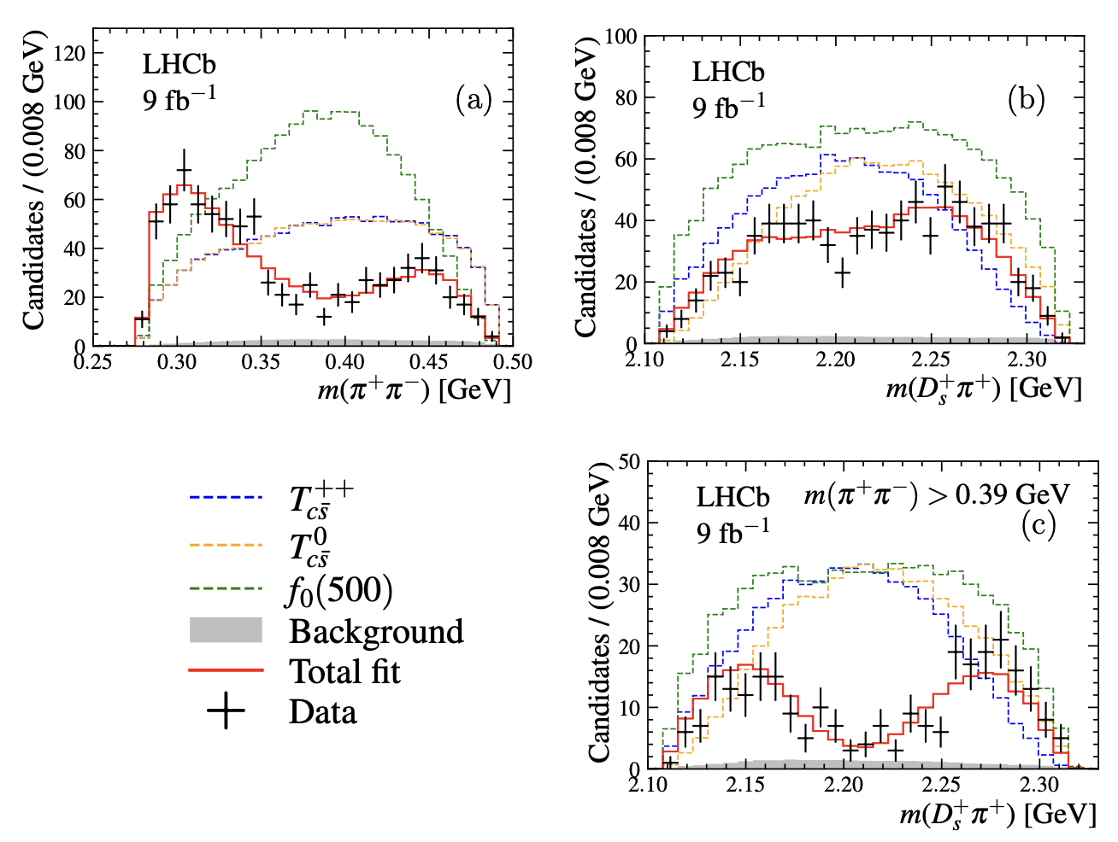
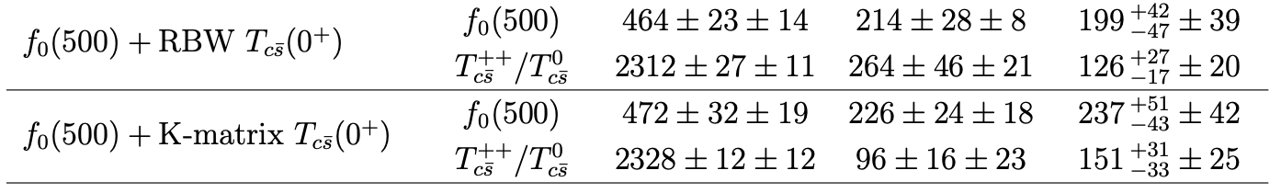

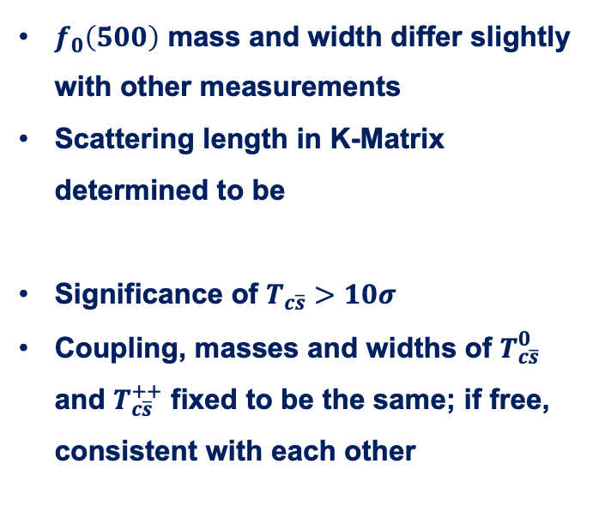

Fit results for models with $T_{c\overline{s}}$
$m\left(π^{+}π^{−}\right)∈\left[279.2, 491.2\right]$ MeV
$f_{0}\left(500\right)$ mass and width differ slightly with other measurements
Scattering length in K-Matrix determined to be
Significance of $T_{c\overline{s}}>10σ$
Coupling, masses and widths of $T_{c\overline{s}}^{0}$ and $T_{c\overline{s}}^{++}$ fixed to be the same; if free, consistent with each other
2026/08/13
国科大 钱文斌
17

Slide 18
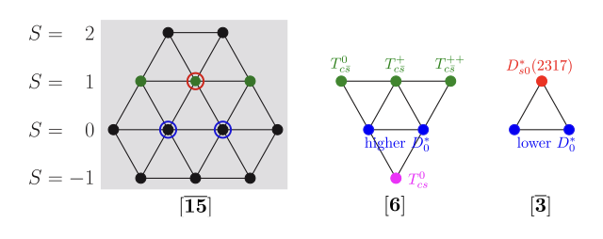
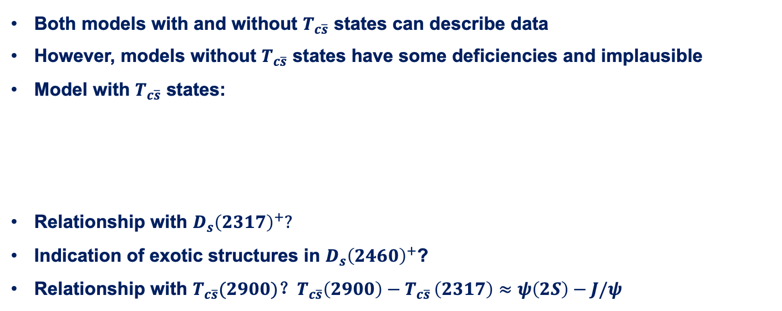
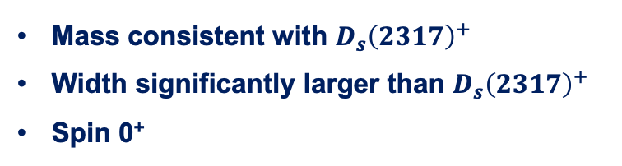
Discussion
Both models with and without $T_{c\overline{s}}$ states can describe data
However, models without $T_{c\overline{s}}$ states have some deficiencies and implausible
Model with $T_{c\overline{s}}$ states:
Relationship with $D_{s}{\left(2317\right)}^{+}?$
Indication of exotic structures in $D_{s}{\left(2460\right)}^{+}$?
Relationship with $T_{c\overline{s}}(2900)$？$T_{c\overline{s}}\left(2900\right)−T_{c\overline{s} }\left(2317\right)≈ψ\left(2S\right)−J/ψ$
Mass consistent with $D_{s}{\left(2317\right)}^{+}$
Width significantly larger than $D_{s}{\left(2317\right)}^{+}$
Spin 0⁺
2026/08/13
国科大 钱文斌
18

Slide 19




How is it with $D_{s1}{\left(2536\right)}^{+}$
LHCb-PAPER-2026-019
France + Russia
Muon tagged samples:
$D_{s1}{\left(2460\right)}^{+}$ enhanced: mainly double charmed final states ($D→μX$)：~1360 signals (large background) vs ~790 in fully reconstructed (negligible background + info. for $D_{s1}{\left(2460\right)}^{+}$ helicity)
$D_{s1}{\left(2536\right)}^{+}$ enhanced: mainly from single charmed final states ($B→DμX$):~980 signals
2026/08/13
国科大 钱文斌
19

Slide 20



Dalitz plot comparison
LHCb-PAPER-2026-019
France + Russia
$$D_{s1}{\left(2460\right)}^{+}$$
$$D_{s1}{\left(2536\right)}^{+}$$
Same as fully reconstructed
Very different pattern than $D_{s1}{\left(2460\right)}^{+}$
2026/08/13
国科大 钱文斌
20

Slide 21



Results with $π^{+}π^{−}$ resonances
LHCb-PAPER-2026-019
France + Russia
Similarly, only $π^{+}π^{−}$ resonances can describe data, but even more strange: very different $f_{0}(500)$, $f_{0}(980)$ and $f_{2}\left(1270\right)$ fraction ($f_{0}(980)$ and $f_{2}(1270)$ significant larger in $D_{s1}{\left(2536\right)}^{+}$ with smaller phase space);
2026/08/13
国科大 钱文斌
21

Slide 22




Results with $T_{c\overline{s}}$
LHCb-PAPER-2026-019
France + Russia
Model with Breit-Wigner has large interference, with mass larger than 2600 MeV and width not well constrained
Model with Triangle diagrams does not give reasonable $f_{0}(500)$ parameters
Model with K-matrix gives similar results as in fully reconstructed analysis
Not sensitive to spin-parity (fixed to the one from fully reconstructed)
Contributions of $T_{c\overline{s}}$ in $D_{s1}{\left(2536\right)}^{+}$ significantly smaller (~4$σ$)
2026/08/13
国科大 钱文斌
22

Slide 23




Correspondence of $D_{s0}{\left(2317\right)}^{+}$ in $B_{s}$ states
PKU
LHCb-PAPER-2026-021
By looking at the Isospin-violating decay $B_{s}^{0}+π^{0}$, a resonant with mass $M=5698.9±1.5±0.6±0.1$ MeV and width $Γ<9.8 (11.8)$ MeV @ 90 (95)% CL found
Assuming L = 0, the $J^{P}=0^{+}$ which gives the beauty counterpart of $D_{s0}^{∗}{\left(2317\right)}^{+}$
Could also be $B_{s1}^{0}→B_{s}^{∗0}\left(→B_{s}^{0}γ\right)π^{0}$ where $γ$ is missing, then the mass would be $5745±1.5±0.6±1.5$ MeV
Or a superposition of $B_{s1}^{0}$ and $B_{s0}^{∗}$
$M−M\left(B_{s}^{0}\right)=332.0±1.5±0.6$ MeV
2026/08/13
国科大 钱文斌
23

Slide 24

TF-PWA
A general and user-friendly partial wave analysis framework
Hao Cai¹, Chen Chen⁵, Shuangshi Fang⁴, Haojie Jing², Yi Jiang², Pei-Rong Li³, Beijiang Liu⁴, Yin-Rui Liu², Xiao-Rui Lyu²,
Runqiu Ma⁴, Rong-Gang Ping⁴, Wenbin Qian², Rongsheng Shi³, Mengzhen Wang⁵, Shi Wang⁴, Zi-Yi Wang²,
Jiajun Wu², Shuming Wu², Liming Zhang⁵,Yang-Heng Zheng²
¹WHU, ²UCAS, ³LZU, ⁴IHEP, ⁵THU
Joint efforts + experience on previous analyses + very good students
Cross-checks performed with several independent fitters developed previously for dedicated analyses: e.g. Z(4430)⁺ and pentaquark search, $B^{0}→\overline{D^{0}}π^{+}π^{−}$ analysis etc.
2026/08/13
国科大 钱文斌
24

Slide 25
Features
Fast
General
Easy to use
GPU based
Vectorized calculation
Automatic differentiation
https://gitlab.com/jiangyi15/tf-pwa
Custom model available
Open access and well supported
Simple configuration file
Automatics process
All necessary functions implemented
2026/08/13
国科大 钱文斌
25

Slide 26

Conclusion
Understanding QCD at low energy important for almost all aspects of high energy physics
Hadron structures provide a unique environment
Less studied $B→DDX$ system offers complementary information to other studies
Stay tuned for more interesting results
Thank you for your attention!
2026/08/13
国科大 钱文斌
26

Slide 27
Thank you for your attention!
2026/08/13
国科大 钱文斌
27

Slide 28
Next LHCb detector from 2030
2026/08/13
UCAS, Wenbin Qian

Slide 29



A new LHCb detector
With our new LHCb detector, already collected more data than Run1+2
More importantly, full software trigger ➜ better performance on hadronic final states
New pixel Velo
New UT
New SciFi
Removed M1 and new readout
Similar PID performance
Twice trigger efficiencies (hadronic)
Removed PS/SPD and new readout
New RICH optics and PMS
2026/08/13
国科大 钱文斌
29

Slide 30


The LHCb detector (Run 1+2)
2008 JINST 3 S08005
Designed for CP violation and heavy flavor studies
2026/08/13
国科大 钱文斌
30

Slide 31

The LHCb status
Run 1:
  2011 (7 TeV): 1 fb⁻¹
  2012 (8 TeV): 2 fb⁻¹
Run 2:
  2015-2018 (13 TeV): 6 fb⁻¹
Run 3:
  2024 (13.6 TeV): 9.56 fb⁻¹
  2025 (13.6 TeV): 11.81 fb⁻¹
  2026 (13.6 TeV): 5.33/fb⁻¹
Operates at $×5$ higher instantaneous luminosity
1 year @ Run 3 > Run 1+2; + increase in efficiencies
2026/08/13
UCAS, Wenbin Qian
31

