Slide 1

Effective Range Expansion with the Left-Hand Cut:
Higher Order Improvements
Wen-Jia Wang（王文佳）
University of Electronic Science and Technology of China, Chengdu（电子科技大学，成都）
In collaboration with Bing Wu, Meng-Lin Du, Feng-Kun Guo
Based on Phys. Rev. D. 114 (2026) 1, 014003 ，Phys. Rev. L. 135 (2025) 011903
2026/08/13

Slide 2


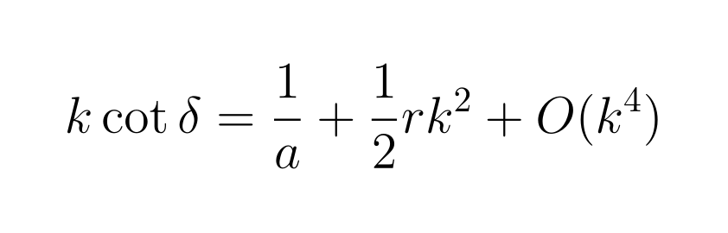
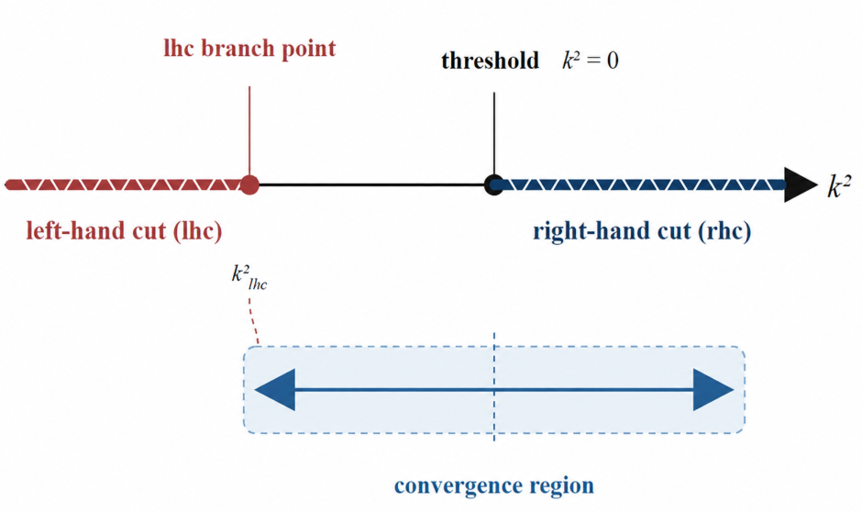
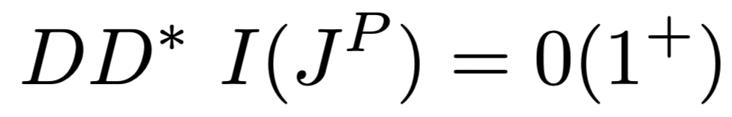
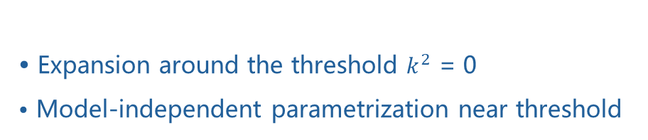

第十一届手征有效场论研讨会
The traditional effective-range expansion (ERE) and its limitations
phase shift scattering length effective range
Expansion around the threshold $k^{2}$ = 0
Model-independent parametrization near threshold
Ignoring the OPE-induced lhc may lead to unreliable near-threshold pole extractions from lattice data.
${ T}_{cc}$
M.-L. Du et al., PRL 131, 131903 (2023)
A nearby lhc restricts the convergence region of the traditional ERE.
Aug.13 2026
Wen-Jia Wang | Effective Range Expansion with the Left-Hand Cut: Higher Order Improvements |
2/13

Slide 3
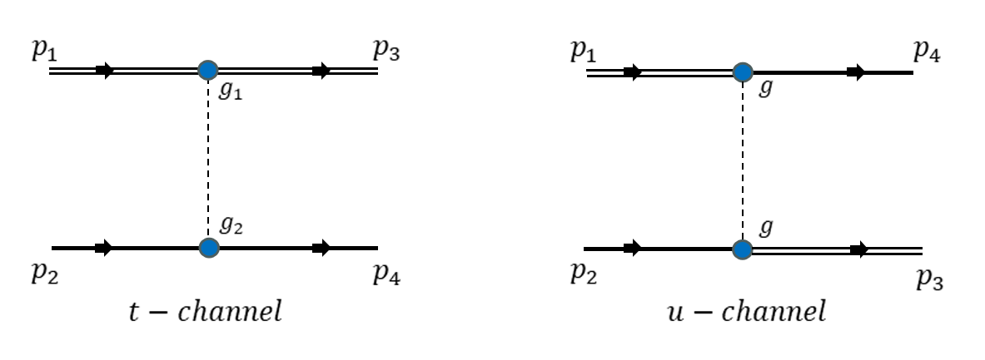
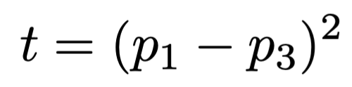
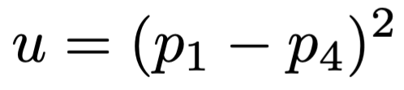
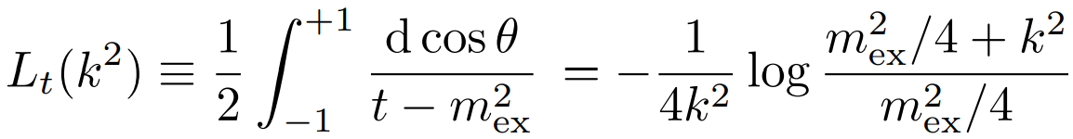
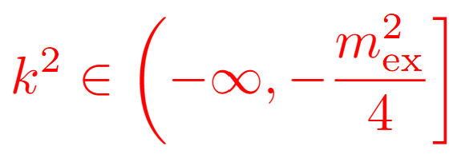
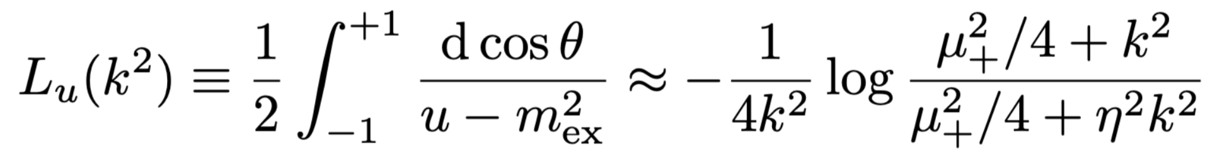
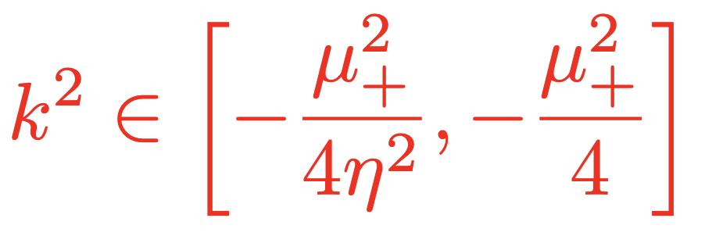
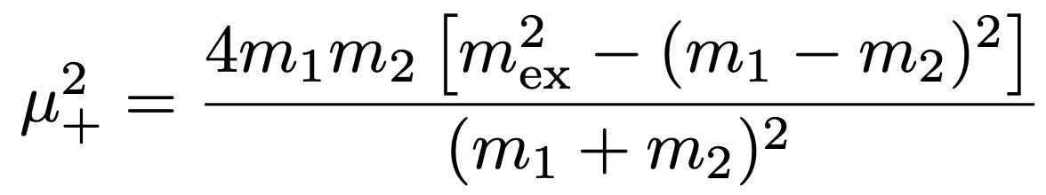
第十一届手征有效场论研讨会
The lhc generated by one-particle exchange
S-wave projection
The lhc branch points are determined by the particle masses.
Aug.13 2026
Wen-Jia Wang | Effective Range Expansion with the Left-Hand Cut: Higher Order Improvements |
3/13

Slide 4
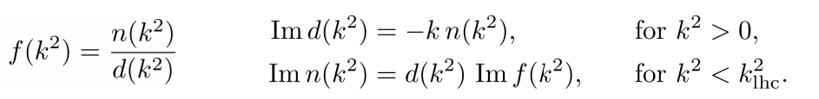
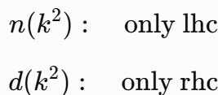
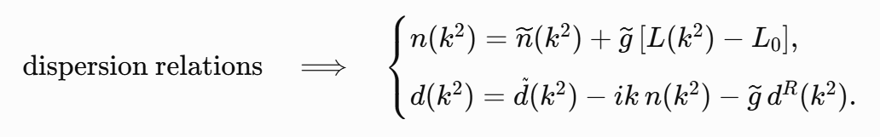
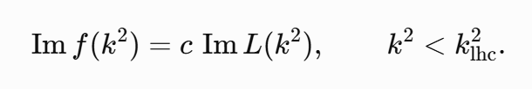
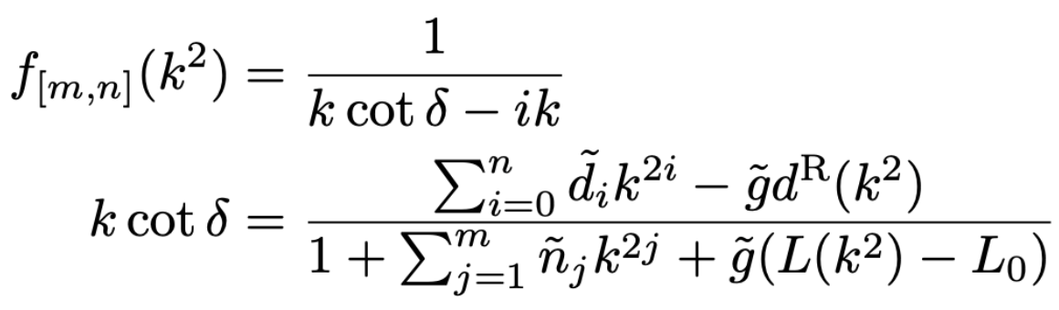



第十一届手征有效场论研讨会
The generalized ERE with the lhc
N/D separation:
• : the one-particle-exchange lhc
• : remove the lhc from the denominator
• : short-range dynamics
M.-L. Du et al., PRL 135 (2025) 011903
Aug.13 2026
Wen-Jia Wang | Effective Range Expansion with the Left-Hand Cut: Higher Order Improvements |
4/13

Slide 5

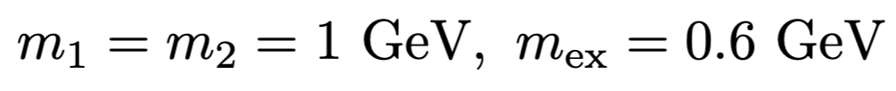
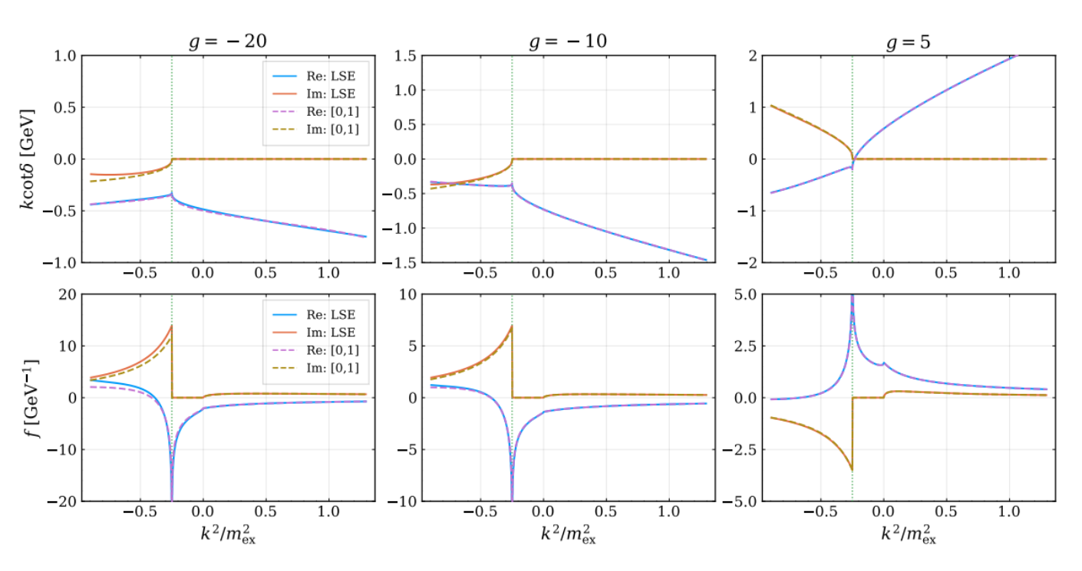
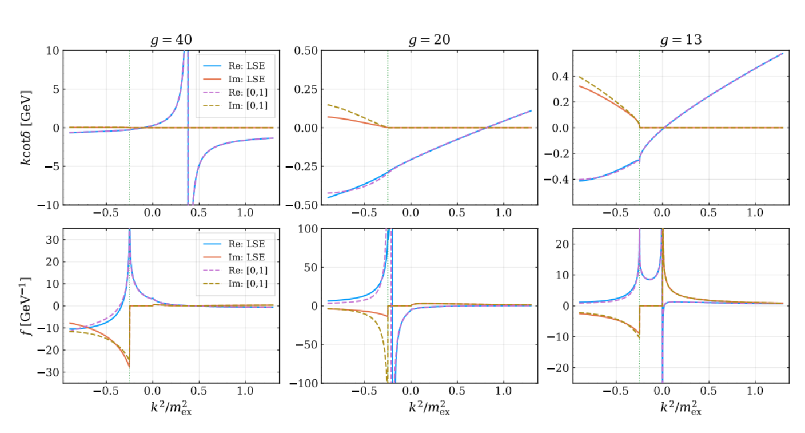
第十一届手征有效场论研讨会
Numerical validation: t-channel Yukawa potential
g = −20, −10
repulsive · no pole
g = 5
Virtual state
g = 40
deep bound state
g = 13,20
Shallow bound state
1GeV
0.1 MeV
71 MeV
Binding energy
Aug.13 2026
Wen-Jia Wang | Effective Range Expansion with the Left-Hand Cut: Higher Order Improvements |
5/13

Slide 6
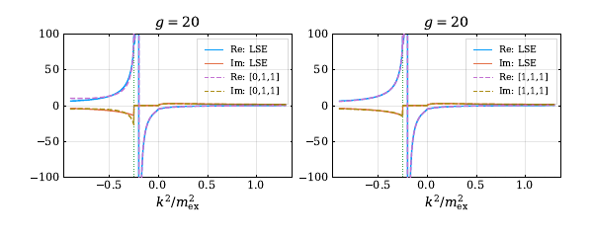

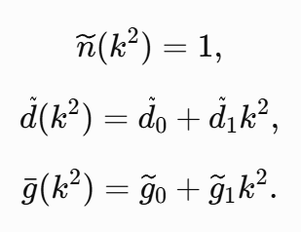

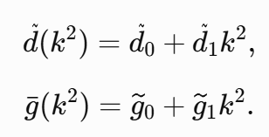
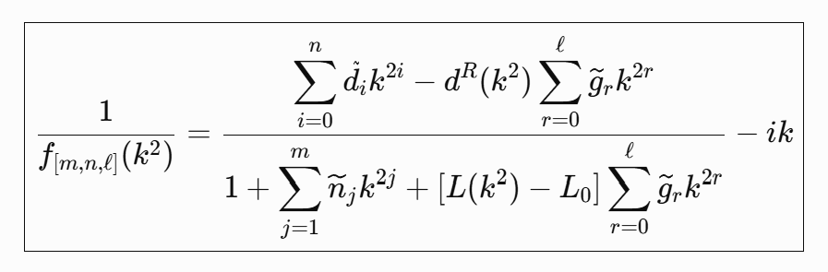
第十一届手征有效场论研讨会
Improved parameterization for the special case
binding energy = 71 MeV
[0,1,1] and [1,1,1]
Aug.13 2026
Wen-Jia Wang | Effective Range Expansion with the Left-Hand Cut: Higher Order Improvements |
6/13

Slide 7
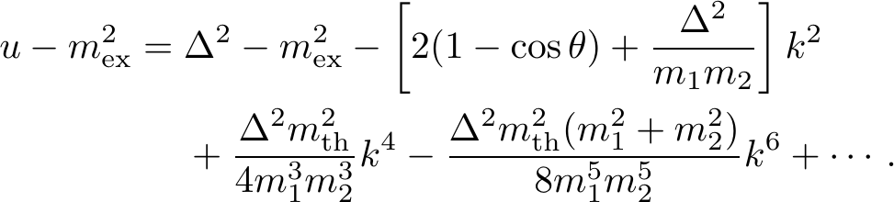

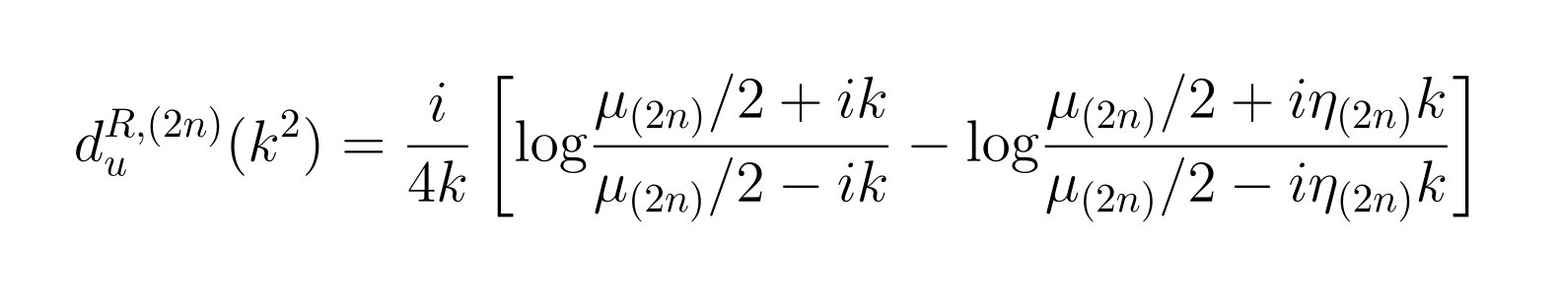
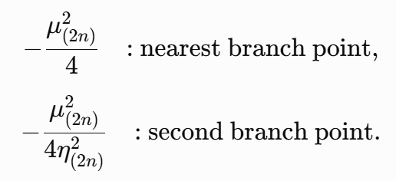
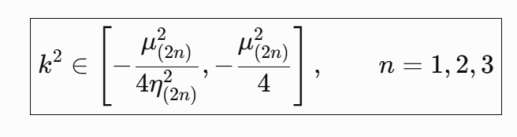

第十一届手征有效场论研讨会
Higher-order expansion of the u-channel lhc
Improved branch-point positions
Higher-order branch cuts
Aug.13 2026
Wen-Jia Wang | Effective Range Expansion with the Left-Hand Cut: Higher Order Improvements |
7/13

Slide 8
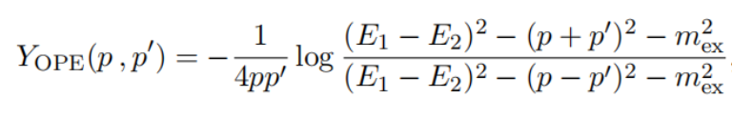




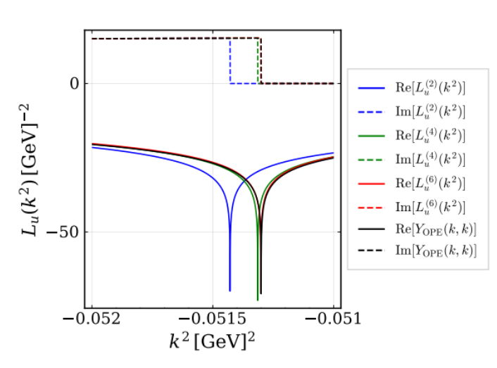



第十一届手征有效场论研讨会
Higher-order branch cuts: O(k²), O(k⁴), O(k⁶)
Systematic convergence of the branch-point position without fitting parameters
Aug.13 2026
Wen-Jia Wang | Effective Range Expansion with the Left-Hand Cut: Higher Order Improvements |
8/13

Slide 9
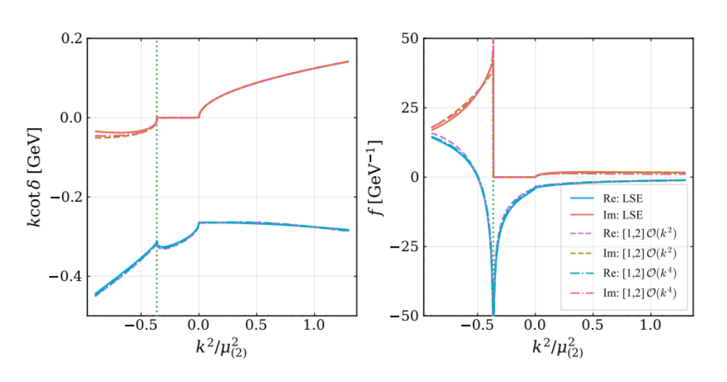
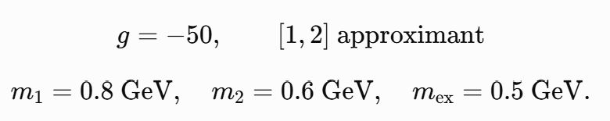

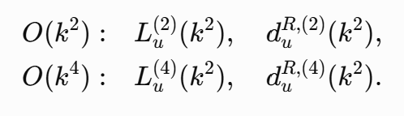
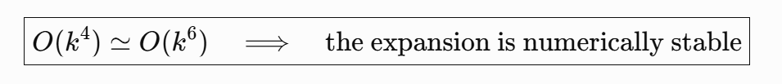
第十一届手征有效场论研讨会
Higher-order u-channel cuts improve accuracy without new parameters
phase shift and scattering amplitude
The improvement comes from a more accurate analytic structure, not from more fit parameters.
Aug.13 2026
Wen-Jia Wang | Effective Range Expansion with the Left-Hand Cut: Higher Order Improvements |
9/13

Slide 10
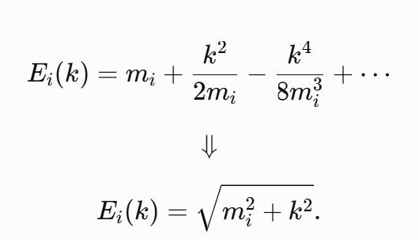
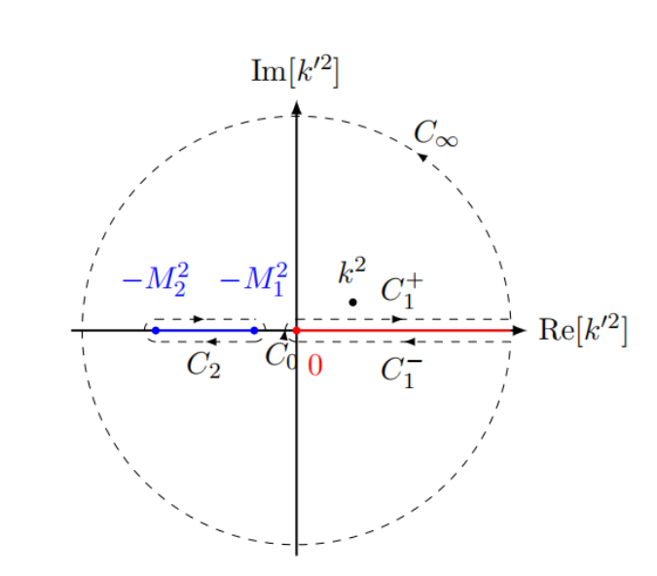
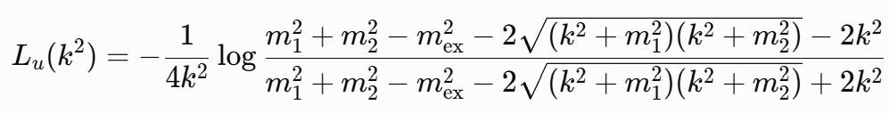
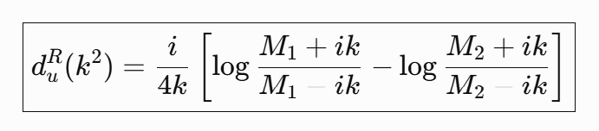







第十一届手征有效场论研讨会
A kinematically relativistic version of ERE with the lhc
Aug.13 2026
Wen-Jia Wang | Effective Range Expansion with the Left-Hand Cut: Higher Order Improvements |
10/13

Slide 11

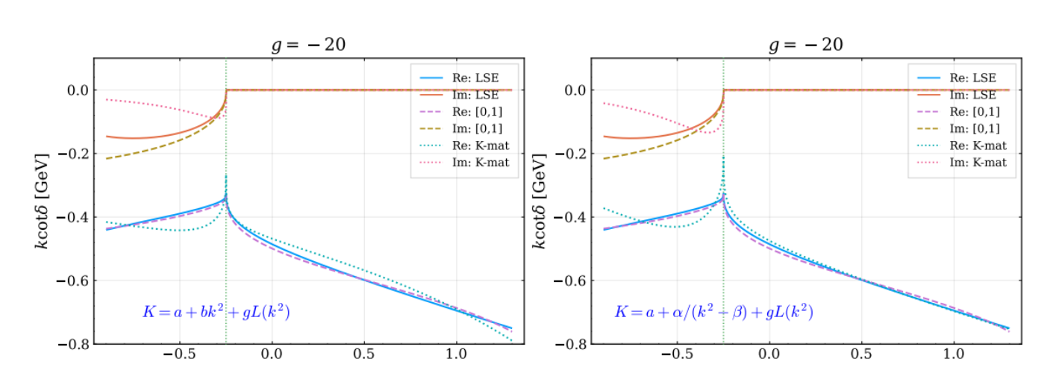
第十一届手征有效场论研讨会
Comparison with the K-matrix parametrization
Aug.13 2026
Wen-Jia Wang | Effective Range Expansion with the Left-Hand Cut: Higher Order Improvements |
11/13

Slide 12
第十一届手征有效场论研讨会
Summary and outlook
1
Systematically improvable generalized ERE
2
Numerical reliability and order-by-order convergence
3
Kinematically relativistic version
Further development: coupled-channel extension
Matrix amplitudes · channel-dependent thresholds · off-diagonal transitions
Bing Wu et al., work in preparation
Aug.13 2026
Wen-Jia Wang | Effective Range Expansion with the Left-Hand Cut: Higher Order Improvements |
12/13

Slide 13
第十一届手征有效场论研讨会
Thank you for your attention!
Aug.13 2026
Wen-Jia Wang | Effective Range Expansion with the Left-Hand Cut: Higher Order Improvements |
13/13

