Slide 1


Neutrinoless double beta decay: connecting xEFT with Nuclear many-body calculations
第十一届手征有效场论研讨会 兰州
Dong-Liang Fang (IMP,CAS)
Collaborators:
Tai-xing Liu, Ri-guang huang, You-cai chen
2026.08.13

Slide 2


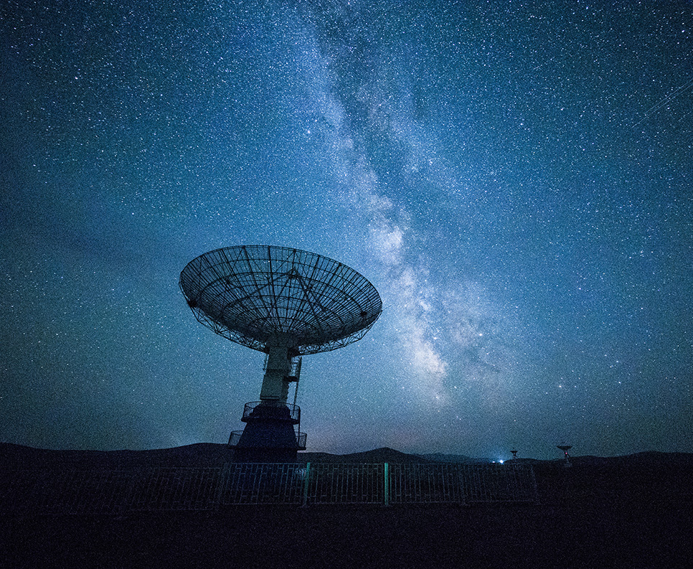
Outline
Background
Case studies
Conclusion and Outlook

Slide 3
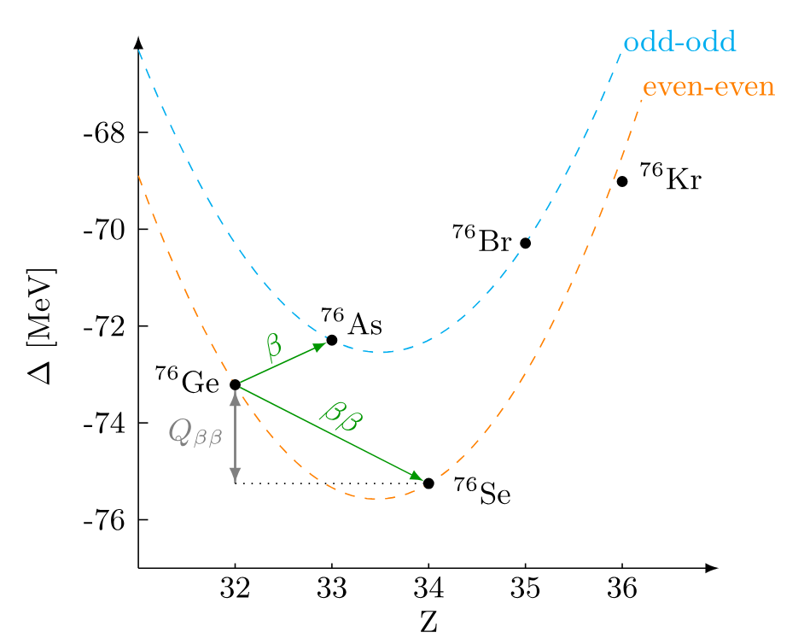
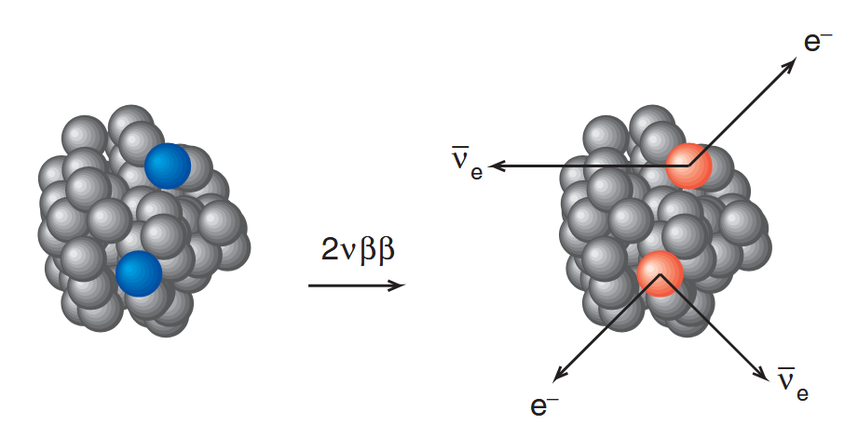
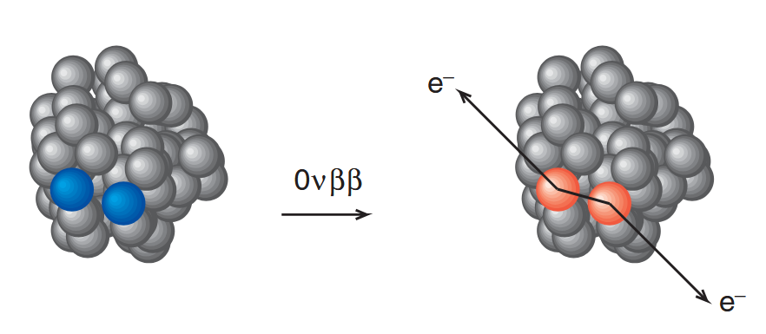
Background
Double beta decay originates from strong nuclear pairing
If neutrino is majorana particle, then a process called neutrinoless double beta decay can be observed

Slide 4
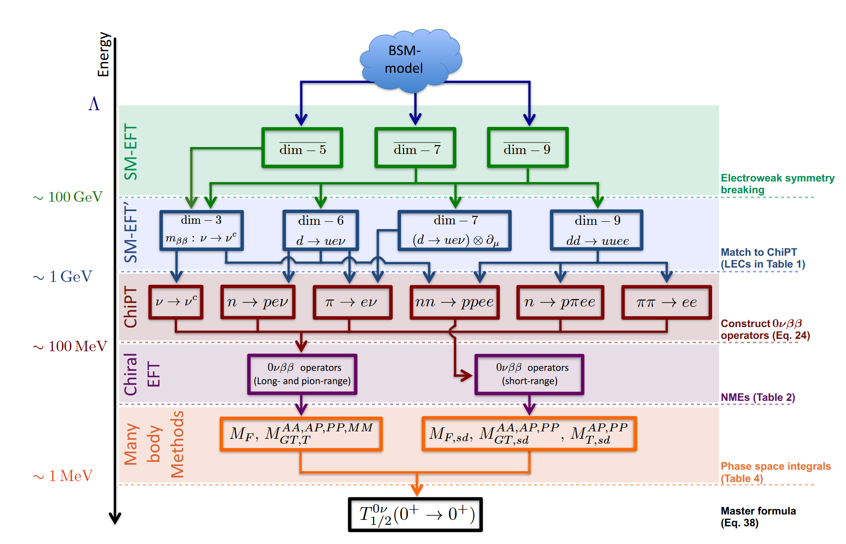
Background
Cirigliano et al. JHEP12,097(2018)
New physics search starting from SMEFT offers model independent predictions
At different energy scales, different d.o.f’s are included
Relevant tools are adopted

Slide 5
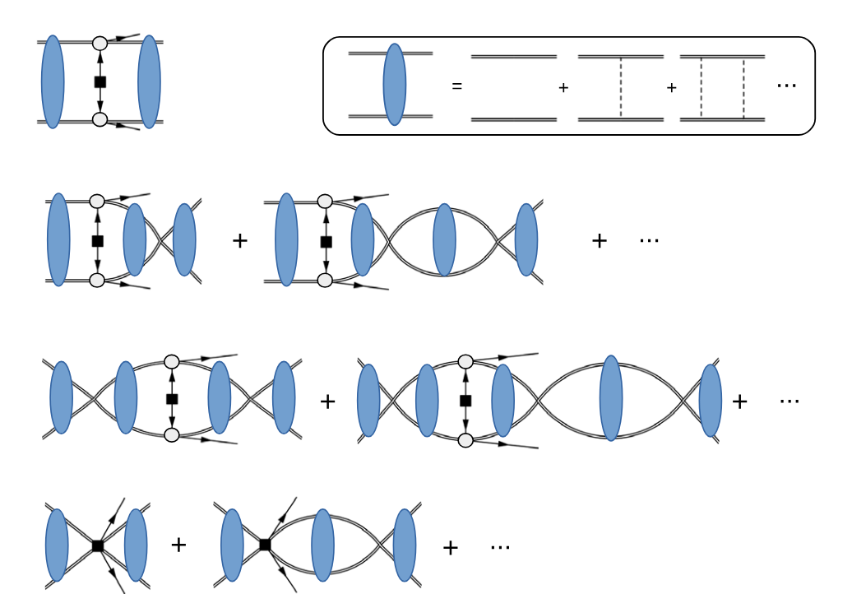
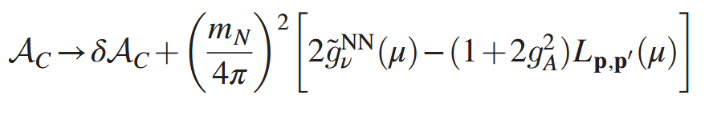
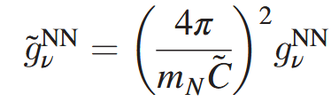

CasE 1
Cirigliano et al. PRL120,202001(2018)
A new LO contact term is needed to cancel the divergence in the nn→ppee amplitude
By deriving this, Fierz transformation is used and gA is a bare one

Slide 6
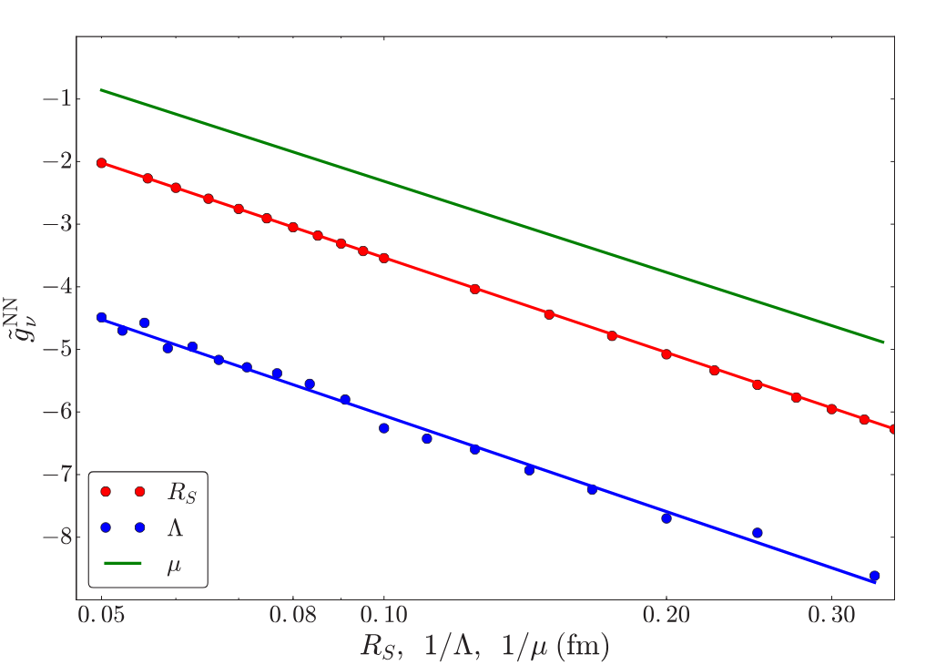
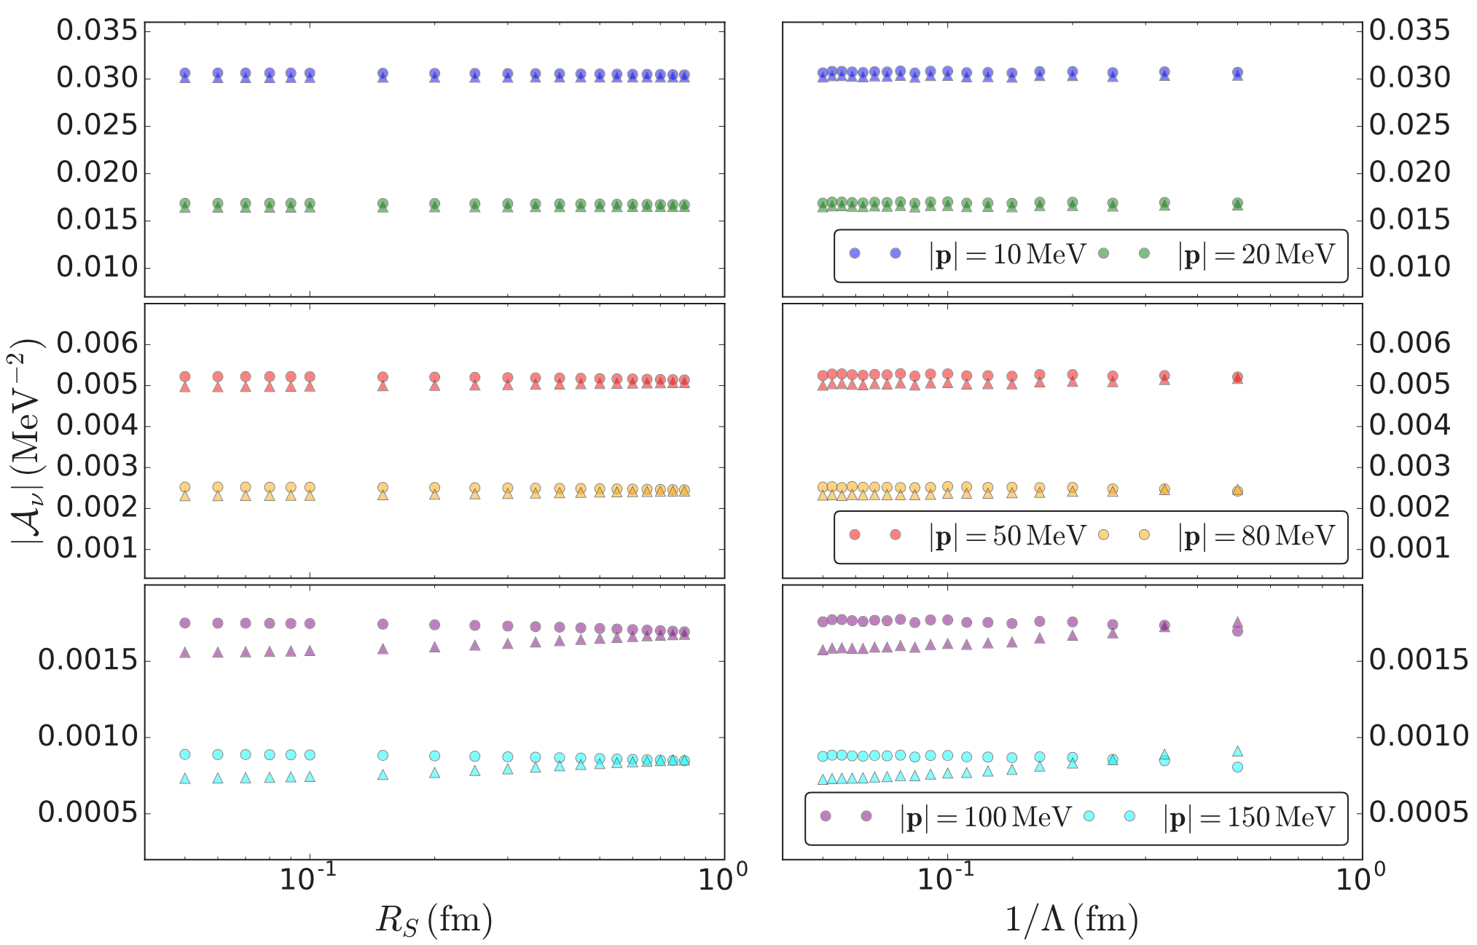
Case 1
Cirigliano et al. PRC110, 055504(2019)
Later the LEC was determined using the Cottingham approach

Slide 7
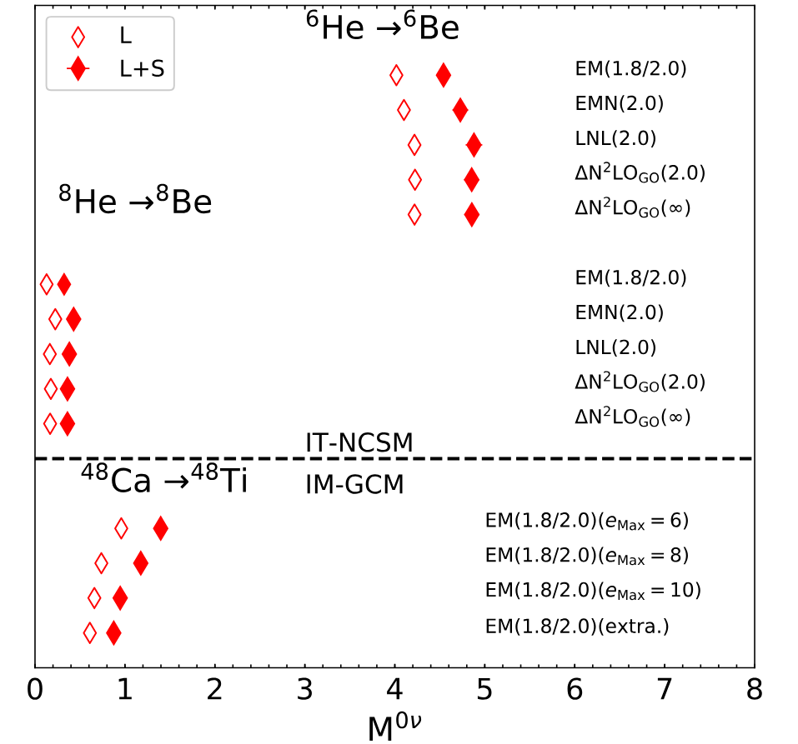
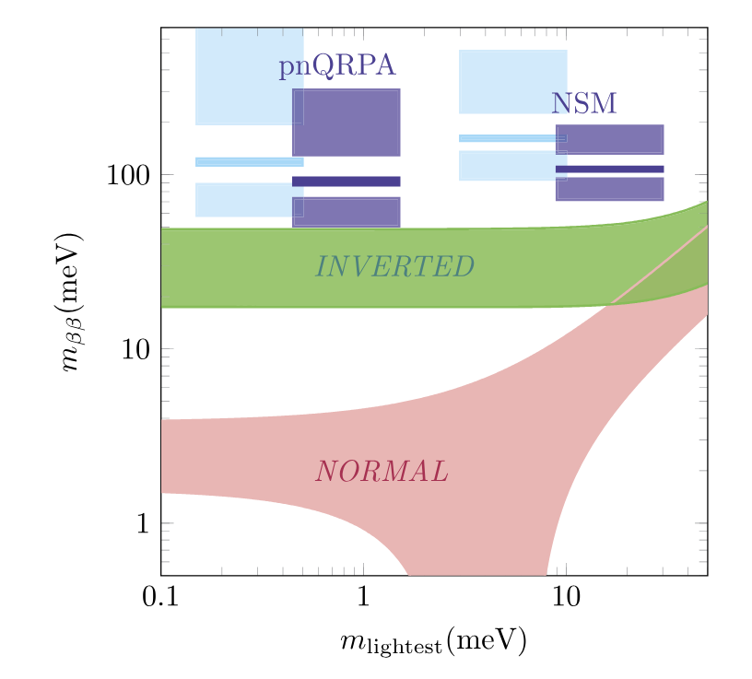
Many-body calculations
Wirth et al. PRL127,242502(2021)
Jokiniemi et al. PLB823,136720(2021)
Ab initio Calculations suggest large changes, so does phenomenological one

Slide 8
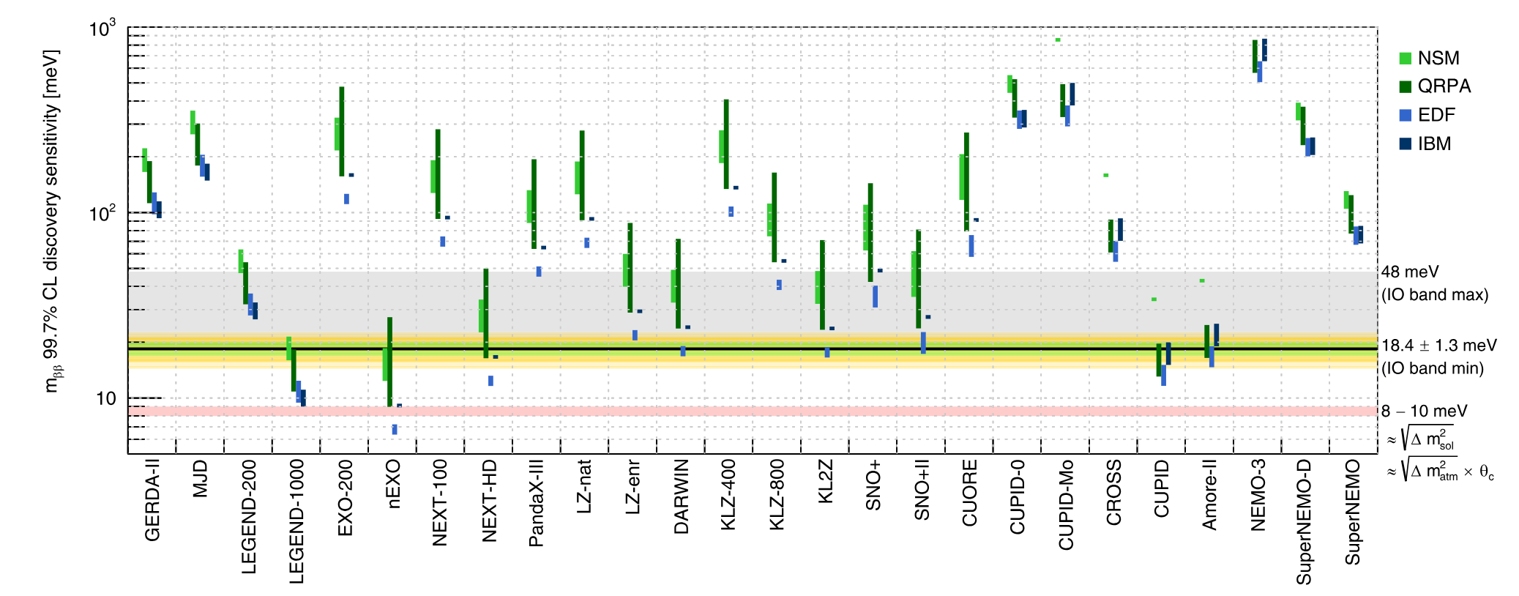
Many-body calculations
Agostini et al. RMP95, 025002(2023)
And the contact term contributions were automatically used for estimating the neutrino mass limit

Slide 9
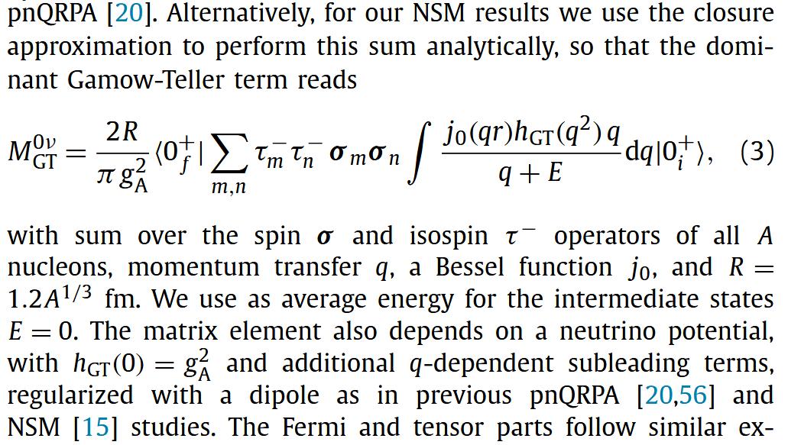
FNS effects
Jokiniemi et al. PLB823,136720(2021)
Minor issues:
  Violation of Fierz identity
  gA quenching
All these calculation treat the form factor originate from finite size of nucleon as a NLO contribution
Assuming it will not affect the UV behavior of neutrino potential
Is this correct?

Slide 10
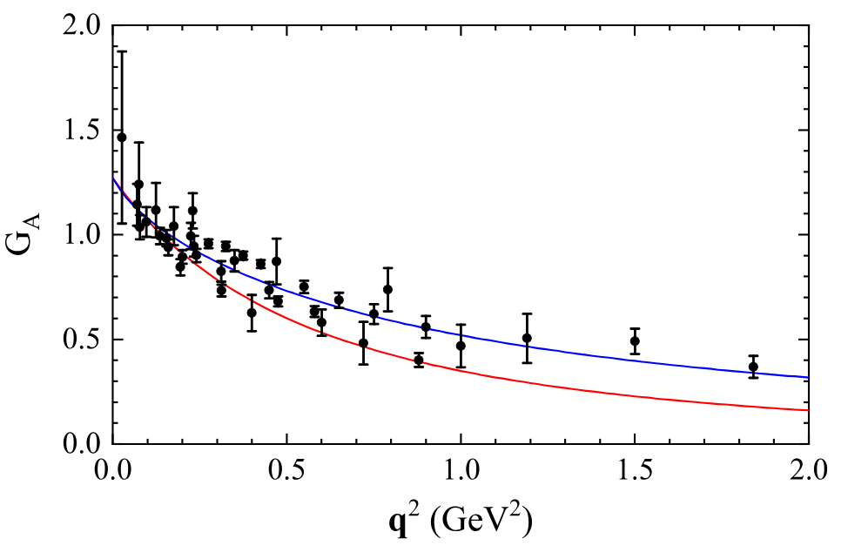
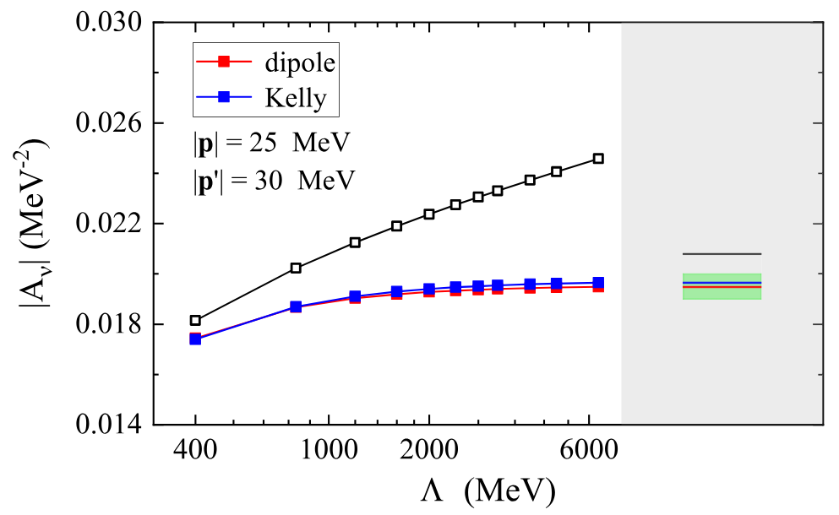
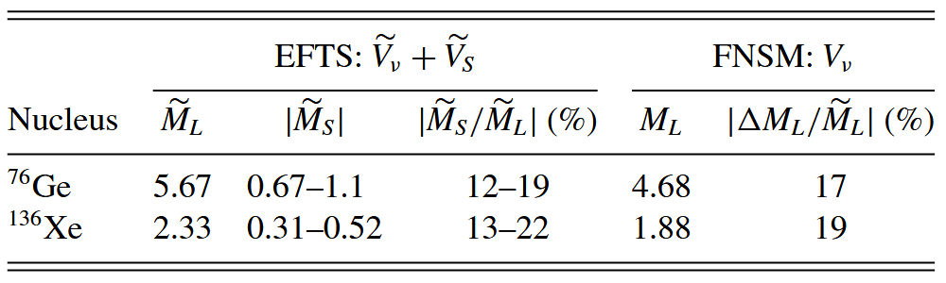
FNS effect
We perform EFT analysis for the renormalizability of theory with FNS
Our calculations suggest no more leading order terms are needed if FNS is considered
Careful treatments are needed for many-body calculations
Liu et al. PRC112, 055501(2025)

Slide 11
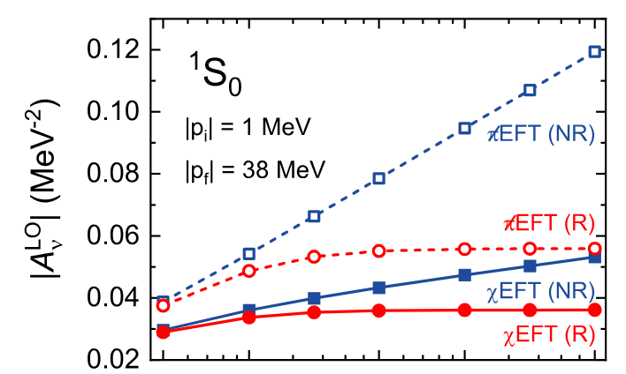
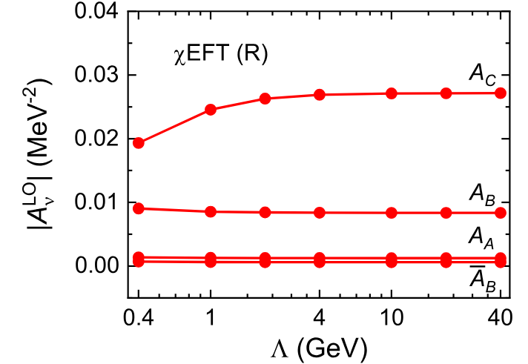
Other calculations
Yang et al. PLB855,138782(2024)
A relativistic nucleon propagator also leads to the convergence of the amplitude

Slide 12
Lessons we Learn
For traditional nuclear many-body calculations, previous calculations are complete at LO, no more contact terms are needed
For ab initio calculations, at LO, a bare gA or gV should be used instead of a non-perturbative form factors at LO
However, the latter is more nature since we have no idea the on shell form factor still valid in virtual process
Perhaps future LQCD could tell us more
Applications of EFT operator to many-body calculations are non-trivial

Slide 13
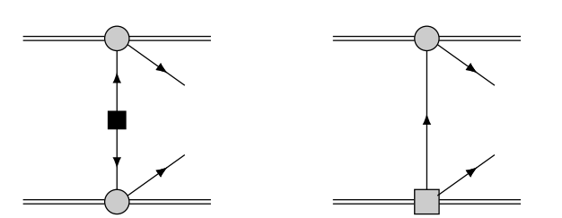



Case 2
Chen et al. CPC50, 034105(2026)
Two important vertices from LR symmetric model and EFT matchings

Slide 14
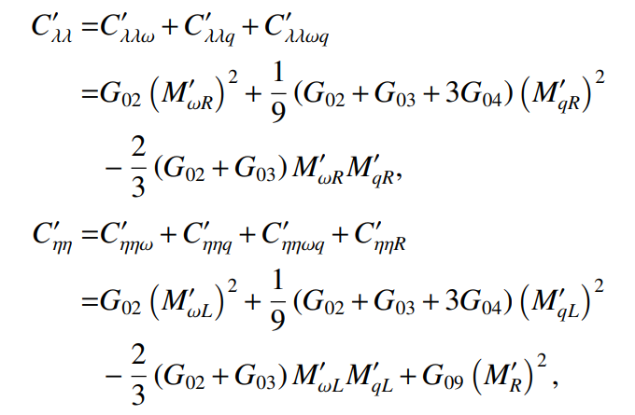
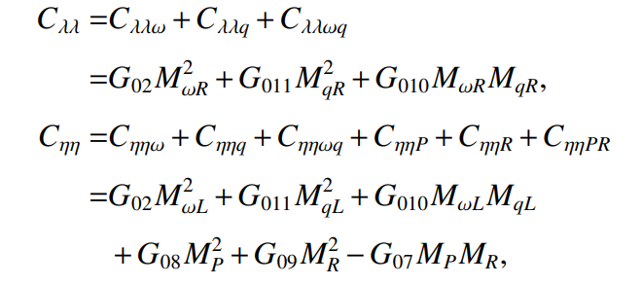

LRSM
Cirigliano et al. JHEP12,097(2018)
Chen et al. CPC50, 034105(2026)
To avoid actual calculation of p-wave electrons, the Dirac equation for free electron is used, $γ⋅p$ to $m_{e}$ , in the so-called master formula
this will bring quite different behavior for NME

Slide 15
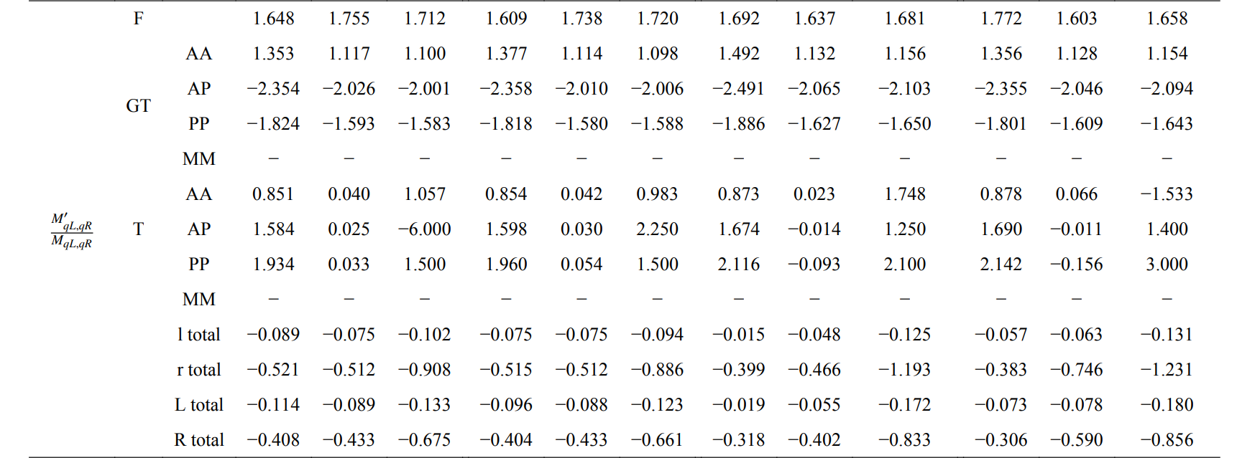
LRSM
Chen et al. CPC50, 034105(2026)
A comparison between the exact S-matrix calculation and that of the so-called Master formula

Slide 16
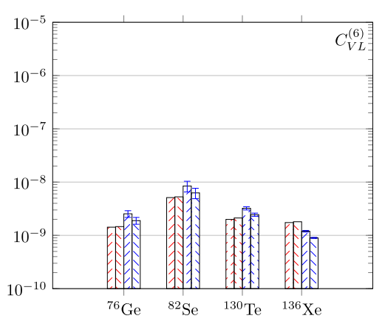
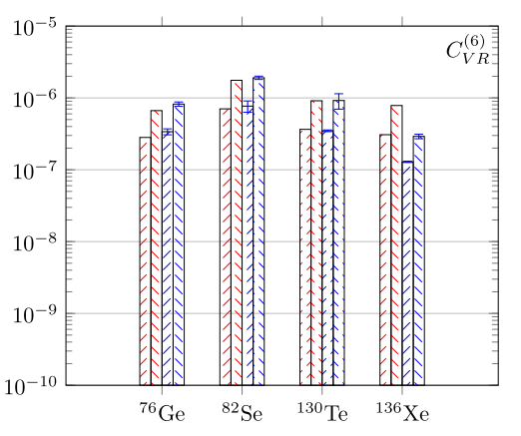
LRSM
Chen et al. CPC50, 034105(2026)
As a consequence, the constraints on Wilson coefficient can be differed by more than 2 times

Slide 17
Conclusion and outlook
It is important to translate the underlying mechanism to actual decay width
A lot of attempts are devoted to EFT studies of double beta decay as well as the nuclear matrix element calculations
However, careful treatments are needed when we go from EFT operators to that of nuclear many-body calculations
This is as important as pining down uncertainties in nuclear many-body calculations
They are vital for future determination of underlying mechanism in double beta decay

Slide 18
谢谢！

