Slide 1



第十一届手征有效场论研讨会
2026年8月11日 – 16日 · 中国兰州
$π^{+}p$ 关联函数中的量子干涉效应
刘志伟
深圳大学 · 中国核能与安全高等研究院
2026年8月13日
合作者：耿立升，陆俊旭，葛多伦

Slide 2
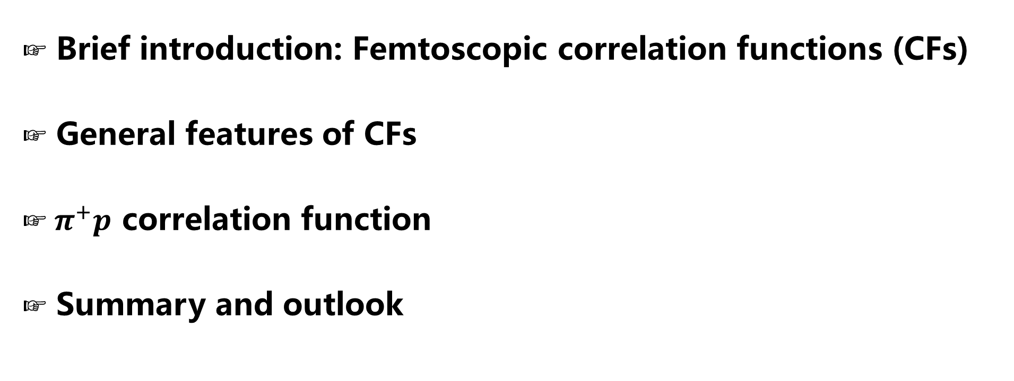
Contents
Brief introduction: Femtoscopic correlation functions (CFs)
General features of CFs
$π^{+}p$ correlation function
Summary and outlook

Slide 3

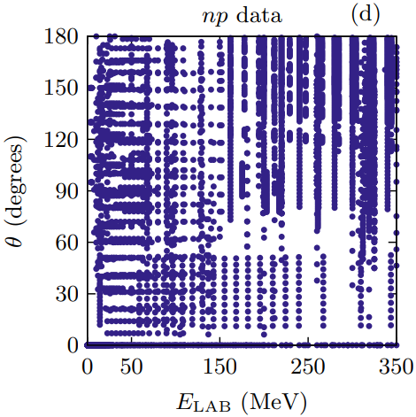
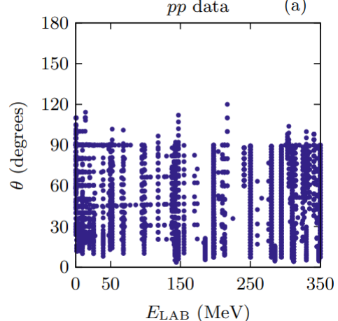
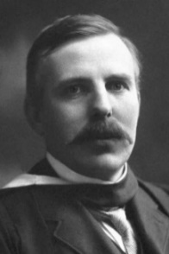
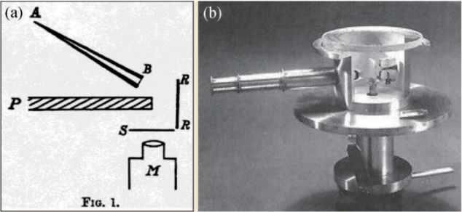
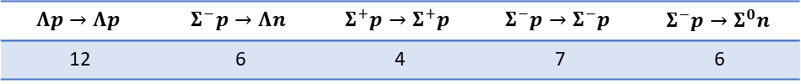
立项依据—传统散射实验
Traditional probe—scattering data
For stable hadrons, scattering experiments are extremely valuable in extracting their interactions
NN scattering，8125 data
Foundation of high-precision nuclear force
Ernest
Rutherford
Rutherford Scattering Experiment
For unstable particles, direct scattering experiments are impossible!
  Difficult to get large quantity of beam particles
  No fixed targets available
$$Λp→Λp$$ | $$Σ^{−}p→Λn$$ | $$Σ^{+}p→Σ^{+}p$$ | $$Σ^{−}p→Σ^{−}p$$ | $$Σ^{−}p→Σ^{0}n$$
12 | 6 | 4 | 7 | 6
Hyperon-nucleon low energy scattering, 35 data
Hindering hyper-nuclear physics and neutron star studies

Slide 4




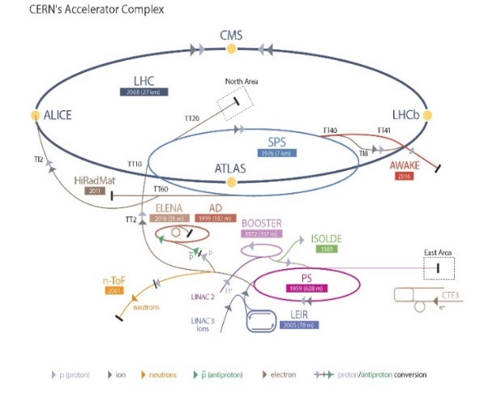
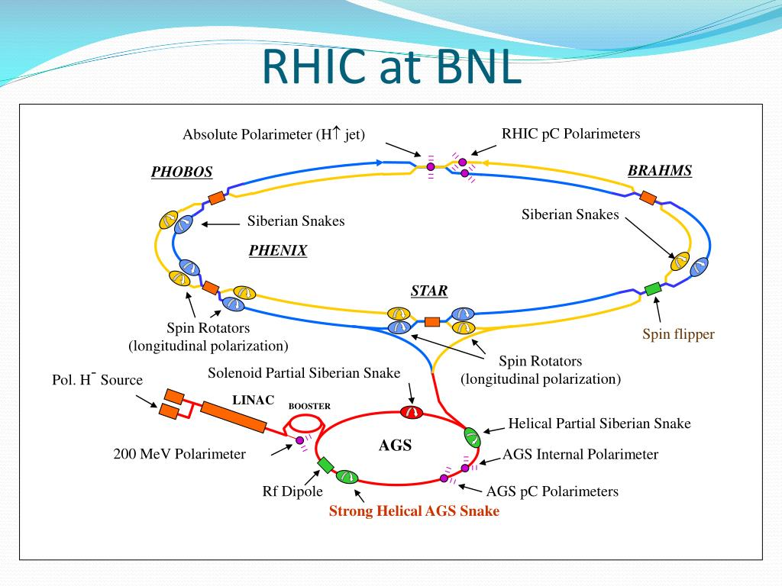
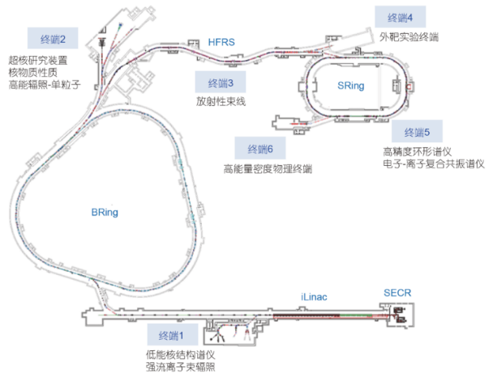
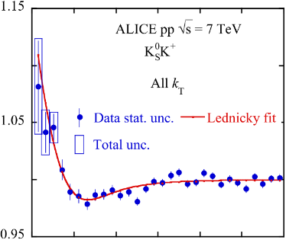
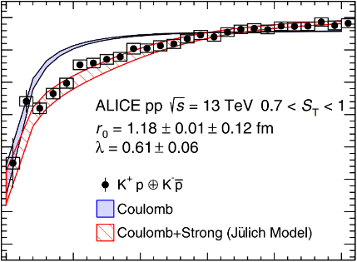
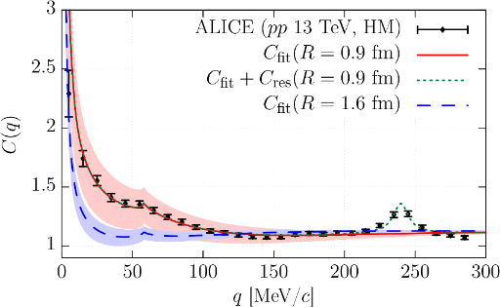
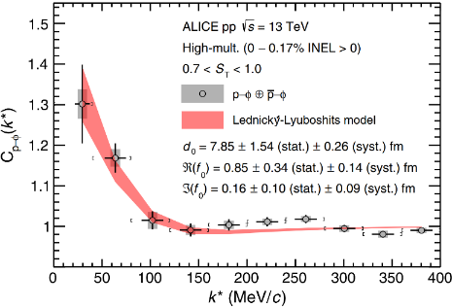
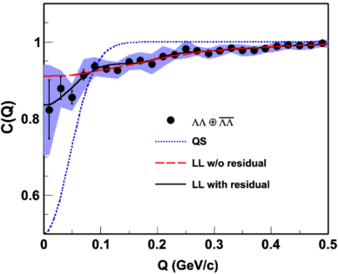
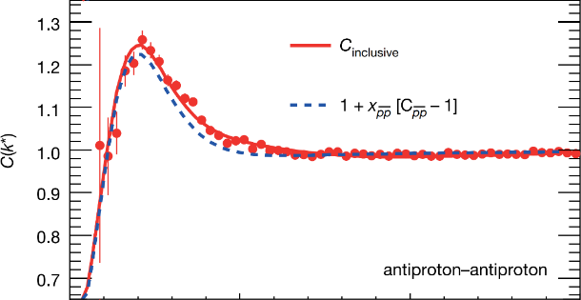
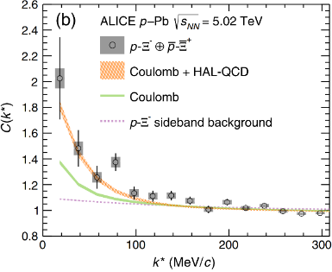
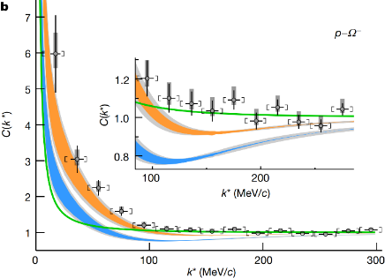









New probe—femtoscopic correlation functions
$$K_{S}^{0}K^{±}$$
$$K^{±}p$$
$$K^{−}p$$
$$ϕp$$
$$\overline{p}\overline{p}$$
$\text{Λ} \text{Λ}$
$${\text{X}}^{−}p$$
$$^{−}p$$
PLB 2019
PRL 2020
PRL 2020
PRL 2021
Nature 2015
PRL 2015
PRL 2019
Nature 2020

Slide 5
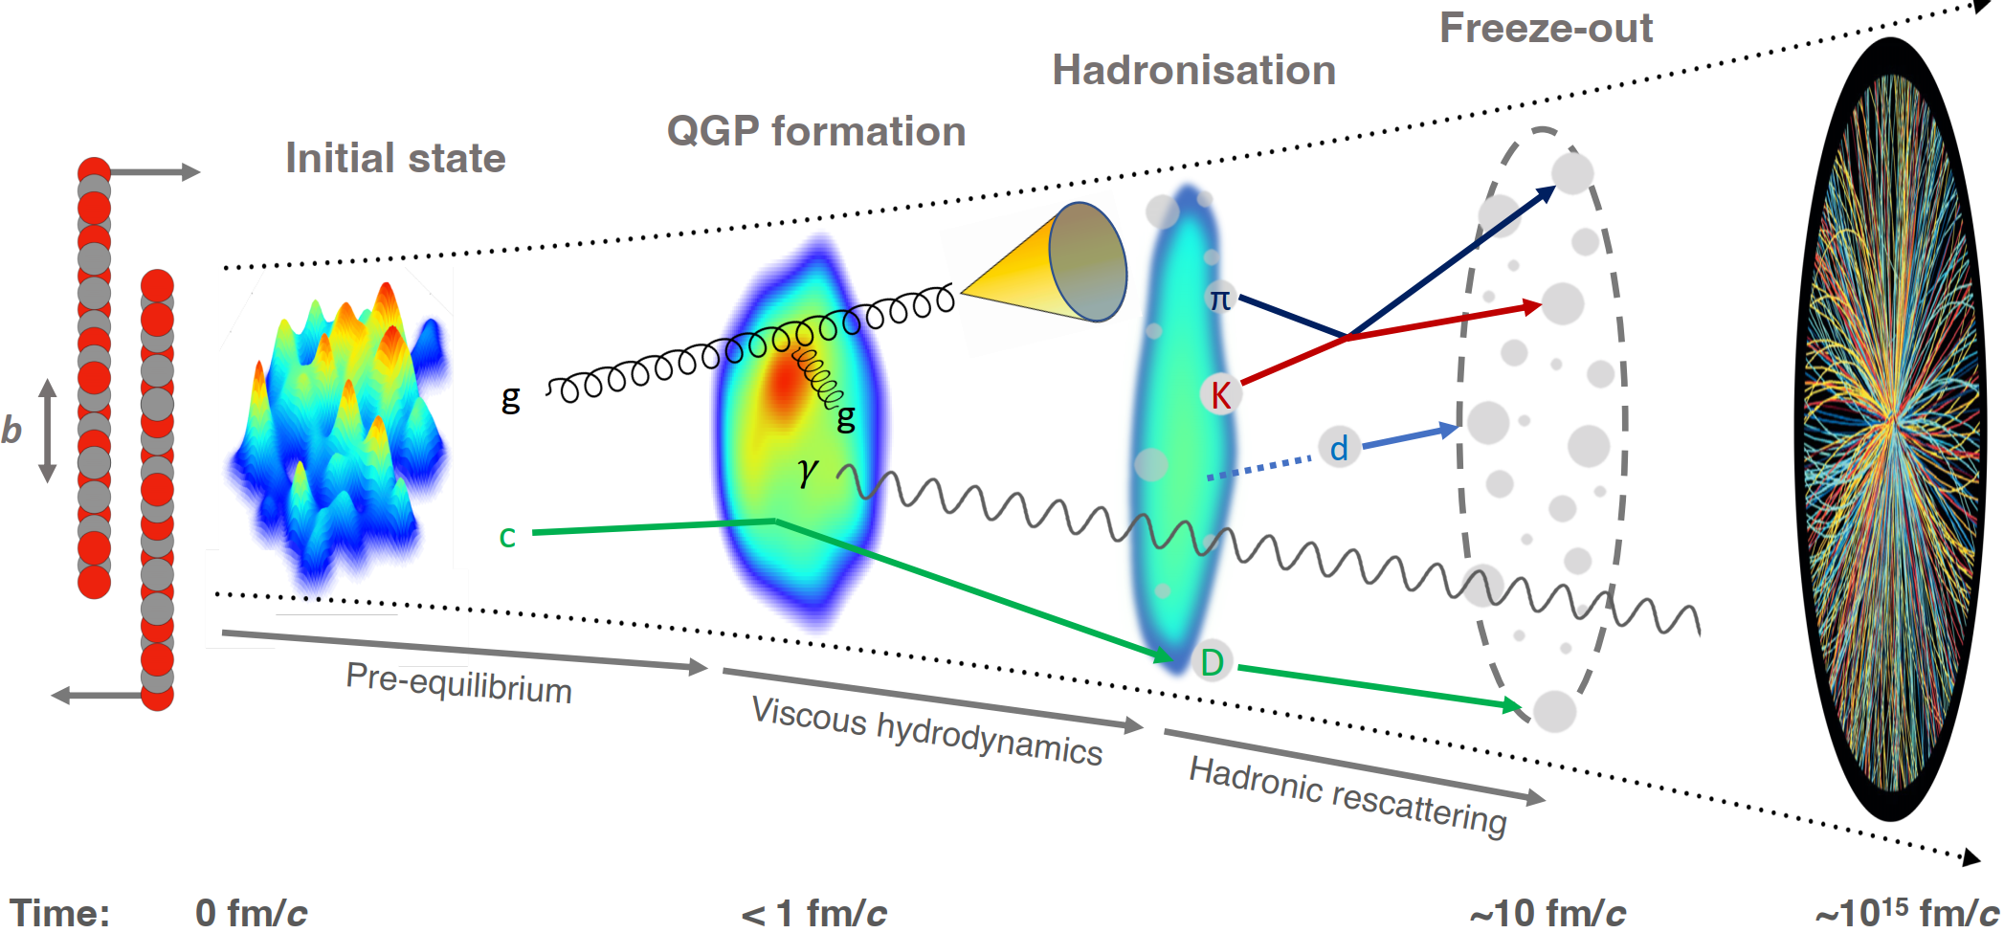
Abundant particles produced in AA, pA, and pp collisions
Final-State Interaction

Slide 6
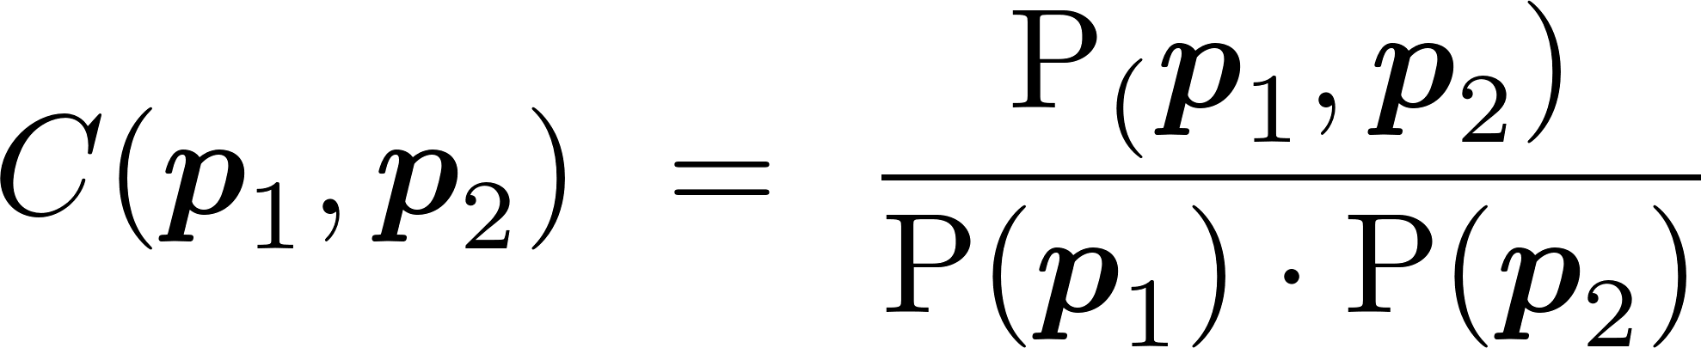
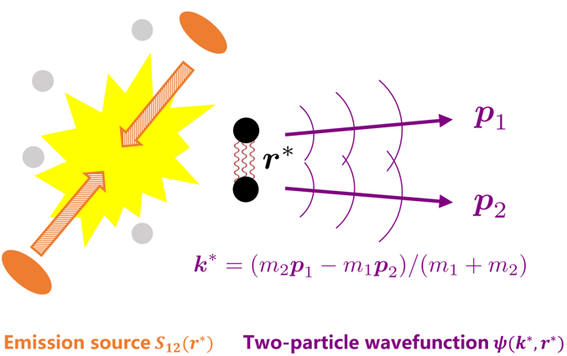
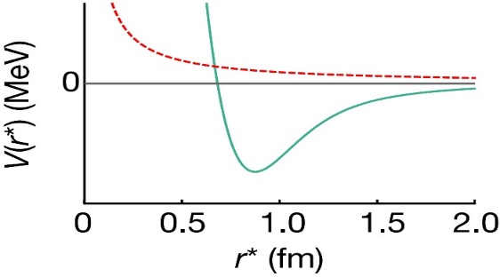
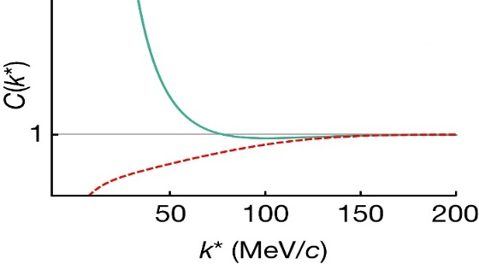
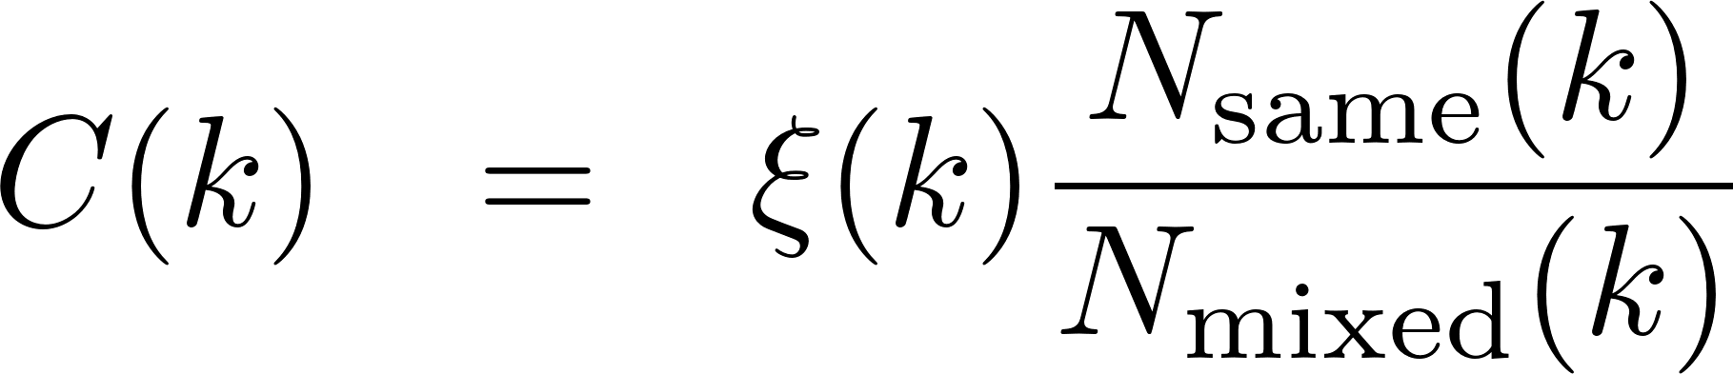
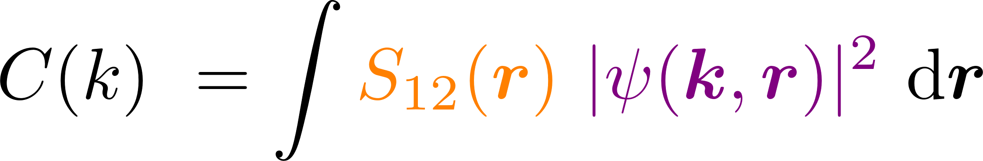
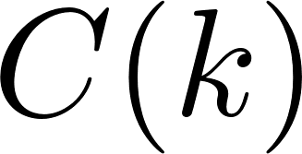

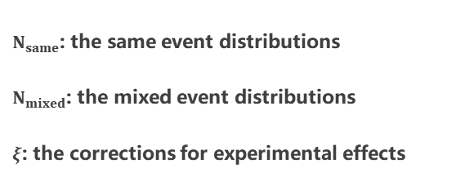
Femtoscopic correlation functions (CFs)
Interacting potential
Correlation function
repulsive
attractive
attractive
repulsive
Schrödinger equation
Two-particle wavefunction$ψ(k^{∗}, r^{∗})$
Exp. measurement
mixed-event technique
Theo. description
Koonin–Pratt formula
Basic Properties
>1 if the interaction is attractive
=1 if there is no interaction
<1 if the interaction is repulsive
$N_{same}$: the same event distributions
$N_{mixed}$: the mixed event distributions
$ξ$: the corrections for experimental effects
final-state interactions
quantum statistics effects
coupled-channel effects
spacial structure

Slide 7
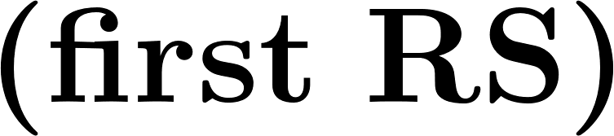

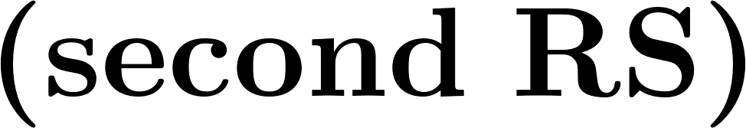

Classification of hadron-hadron interactions
repulsive
attractive
nonexistent
weaker attraction
resonant
state
stronger attraction
weak attraction
deeply bound state
shallow bound state
virtual
state

Slide 8
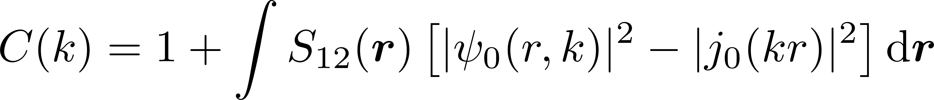
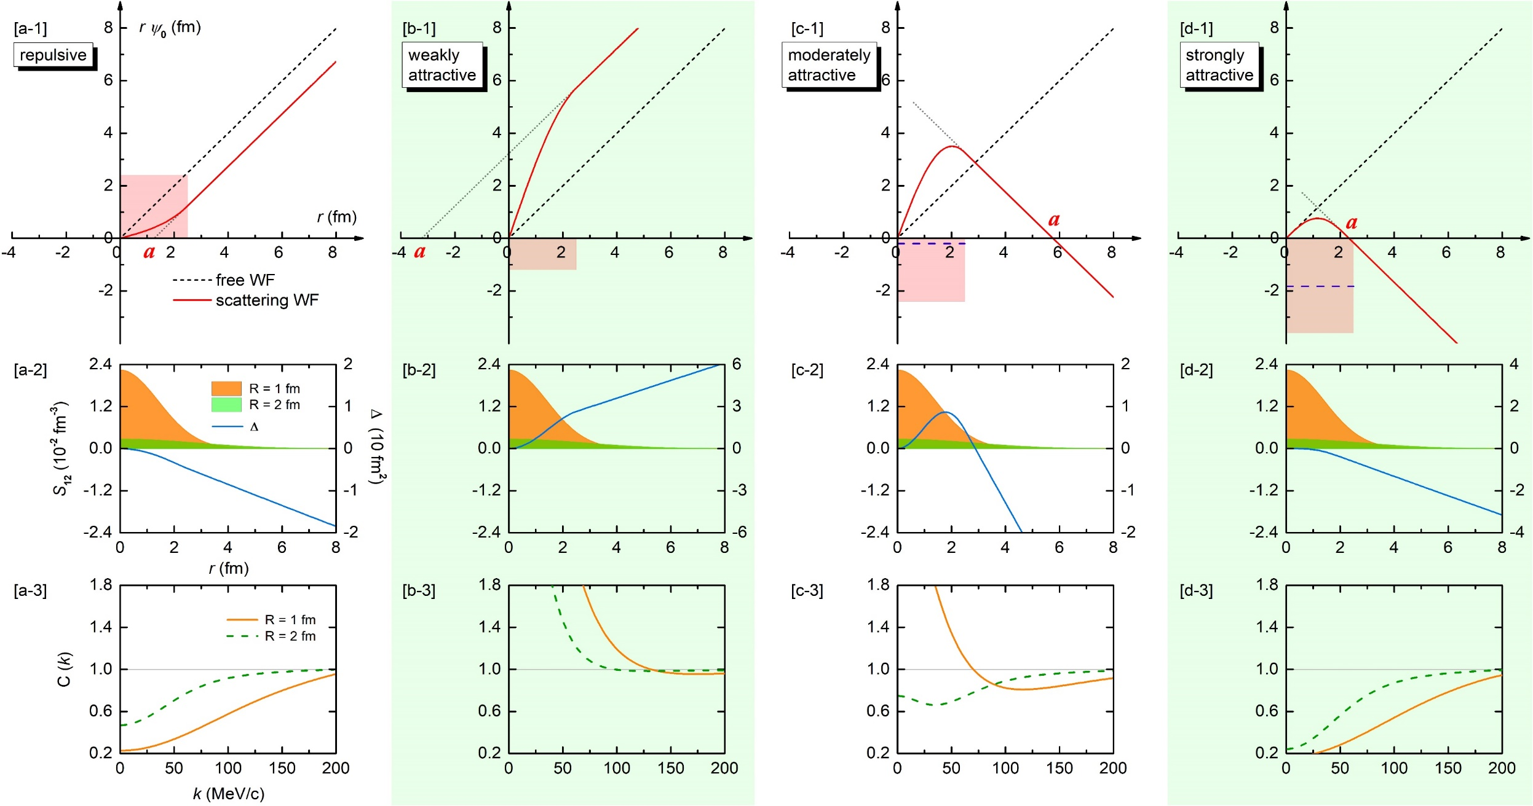
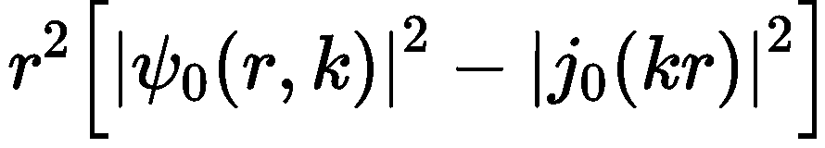
ZWL, Jun-Xu Lu and Li-Sheng Geng*,
PRD 107, 074019 (2023)
CFs in the presence of bound states

Slide 9
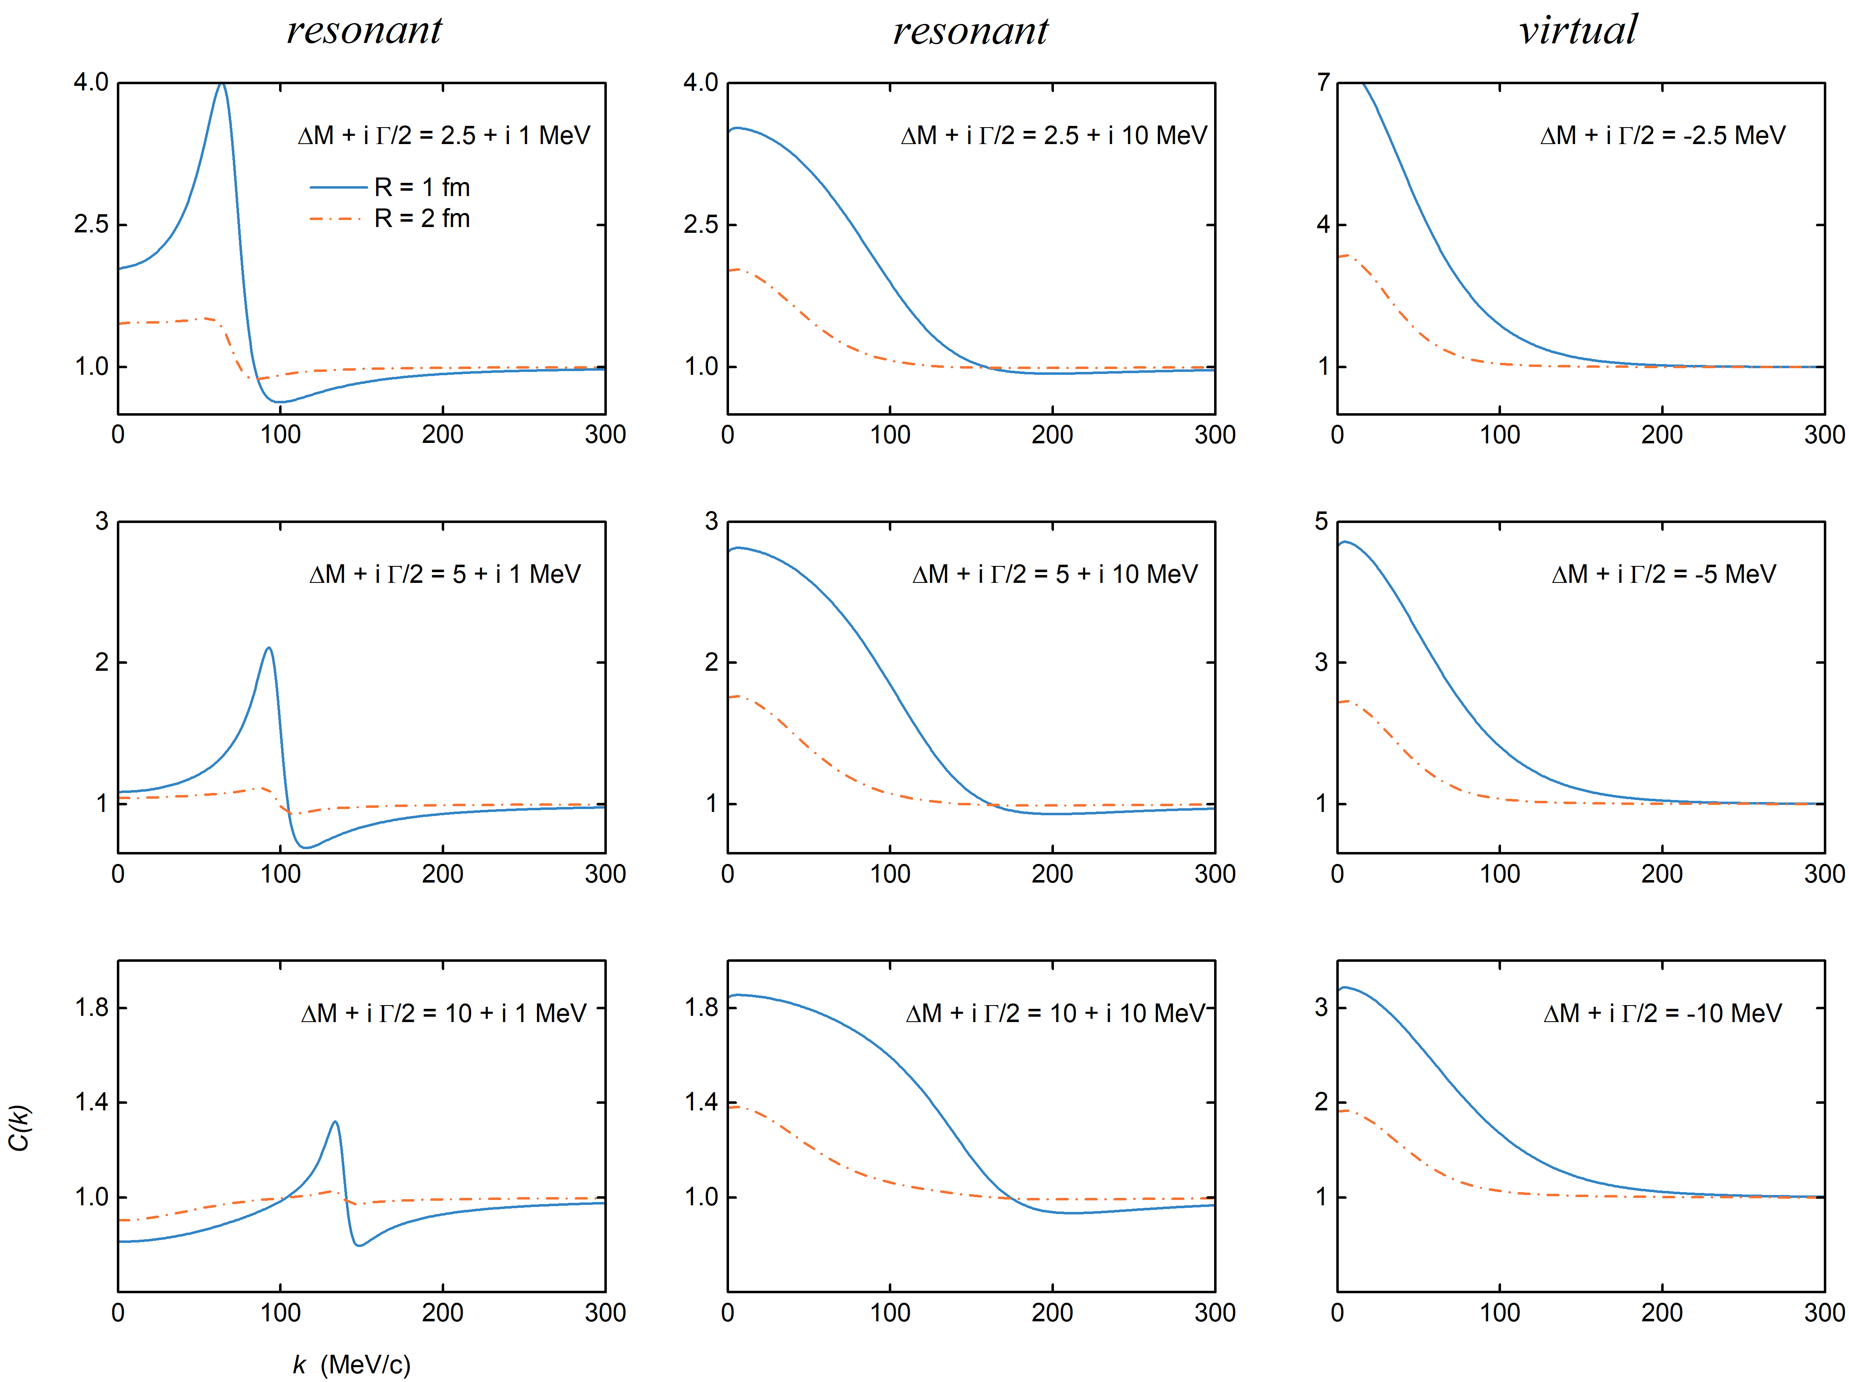

CFs in the presence of resonant and virtual states
ZWL, Jun-Xu Lu*, Ming-Zhu Liu and Li-Sheng Geng*, Sci. Bull. 70, 3515 (2025)
narrow
broad

Slide 10
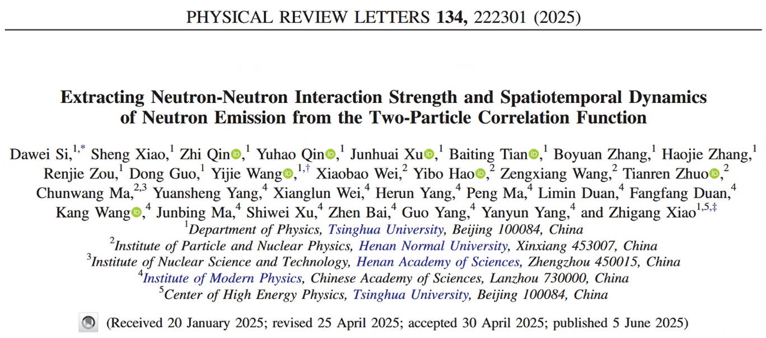
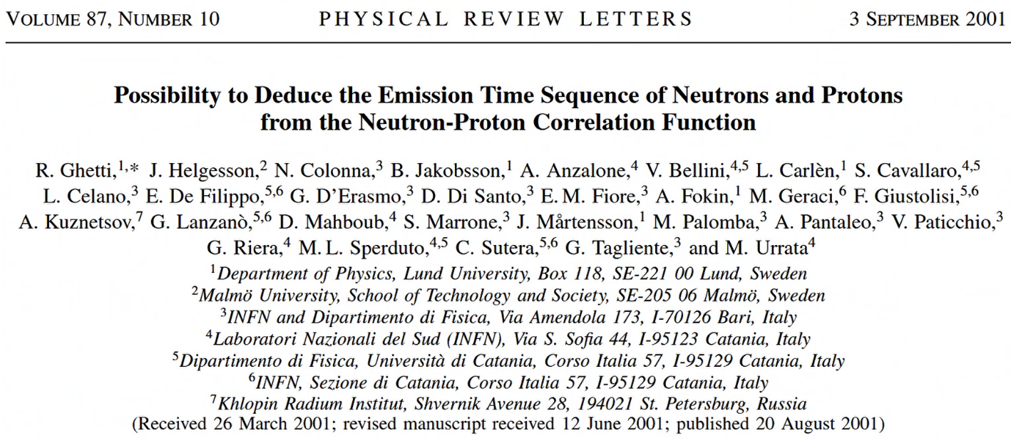
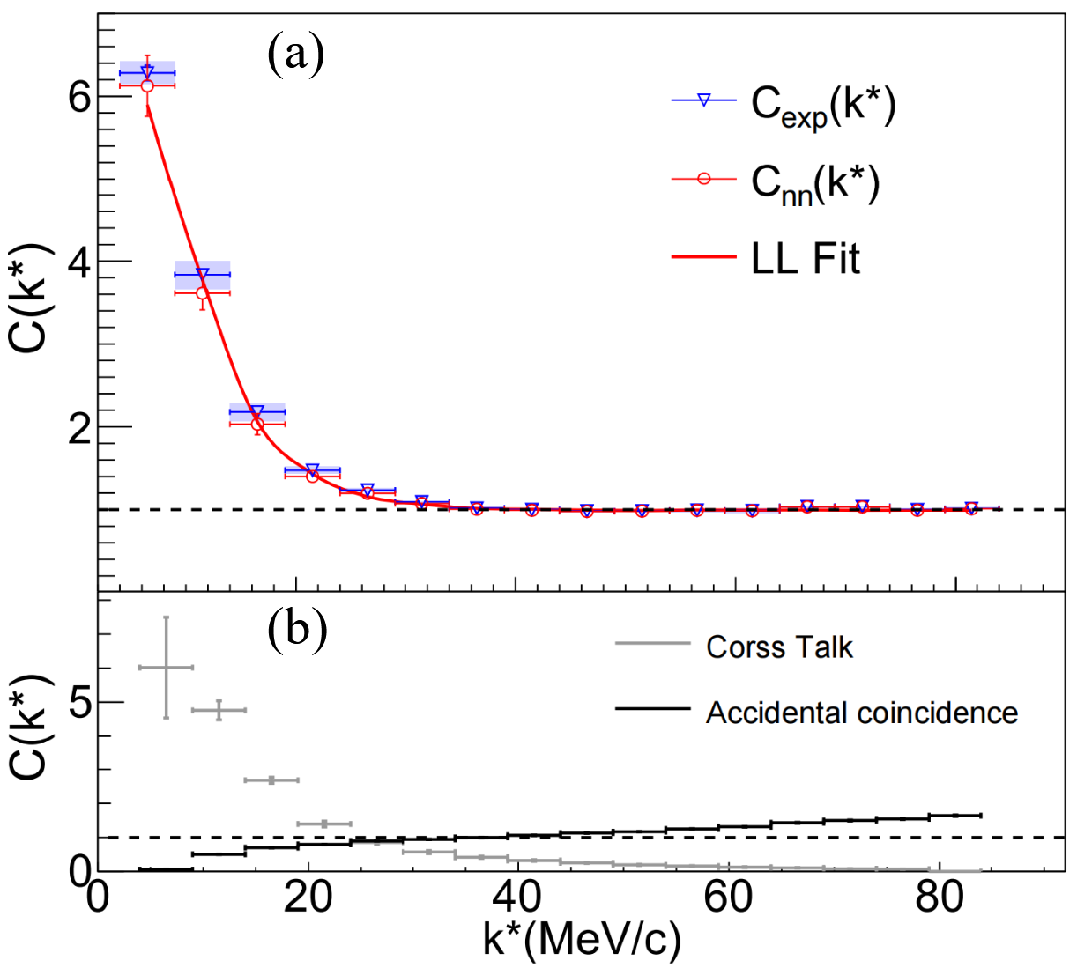
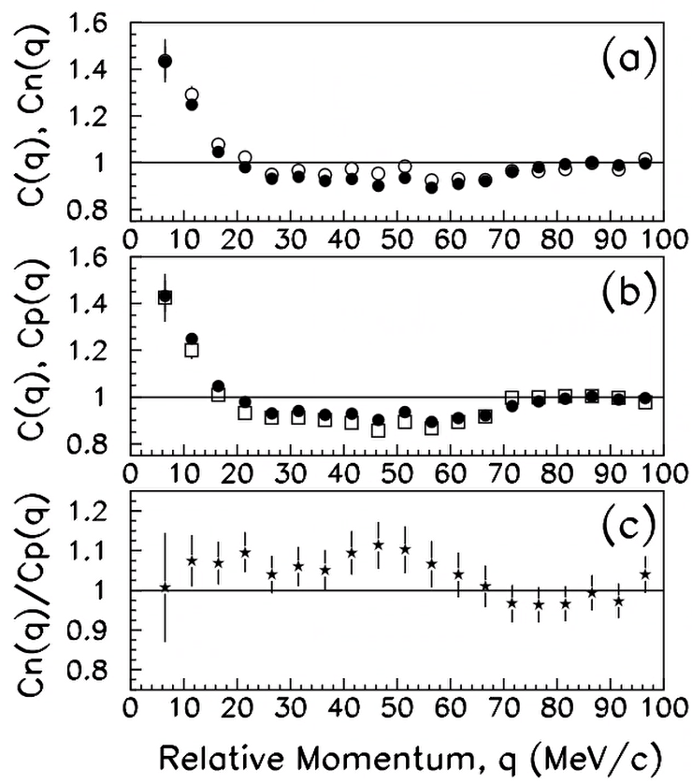
Experimental supports

Slide 11
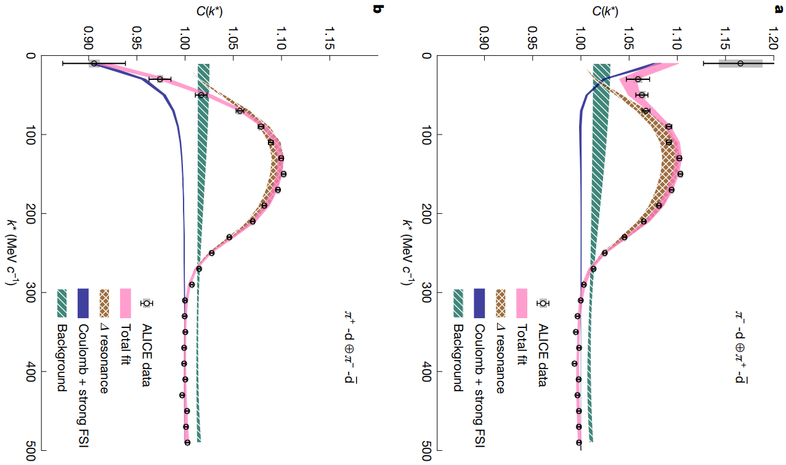
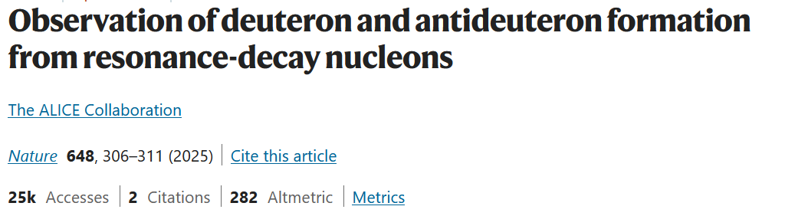
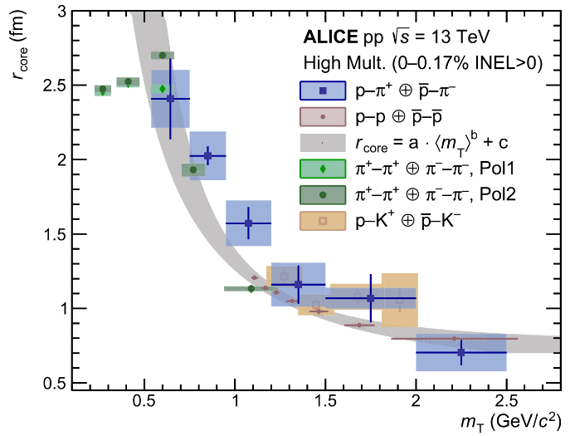

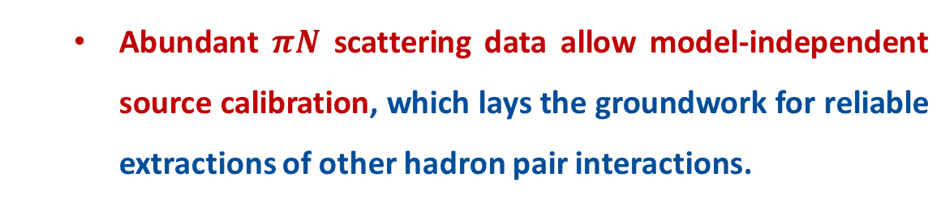
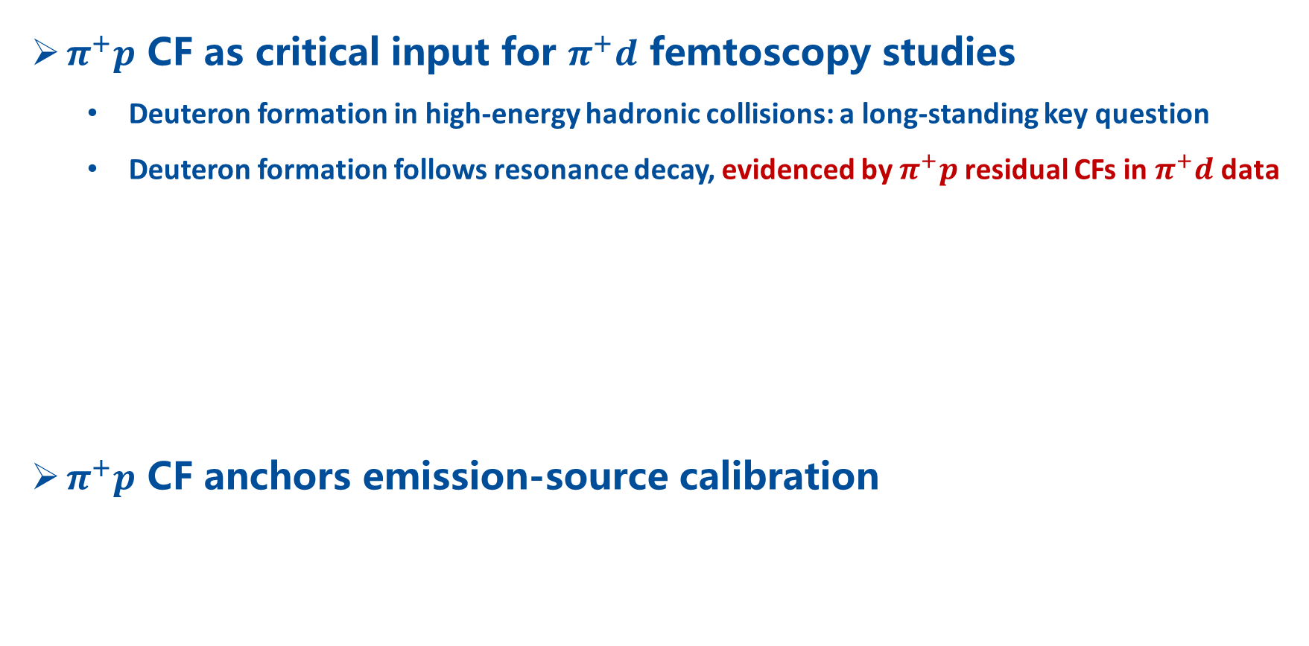
Why Study the $π^{+}p$ Correlation?
$π^{+}p$ CF as critical input for $π^{+}d$ femtoscopy studies
  Deuteron formation in high-energy hadronic collisions: a long-standing key question
  Deuteron formation follows resonance decay, evidenced by $π^{+}p$ residual CFs in $π^{+}d$ data
$π^{+}p$ CF anchors emission-source calibration
  Abundant $πN$ scattering data allow model-independent source calibration, which lays the groundwork for reliable extractions of other hadron pair interactions.

Slide 12
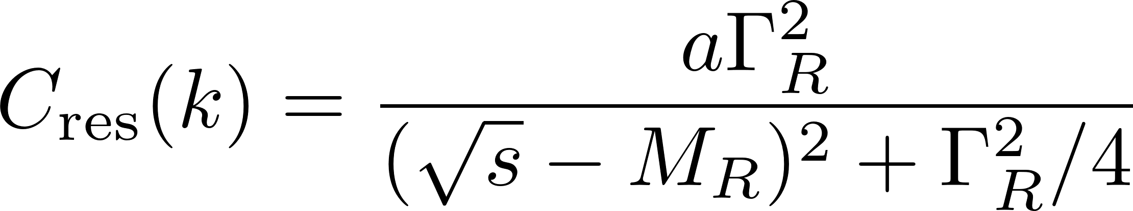
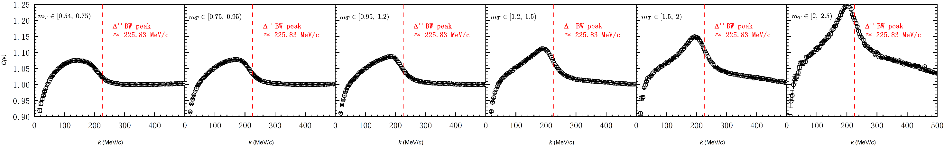
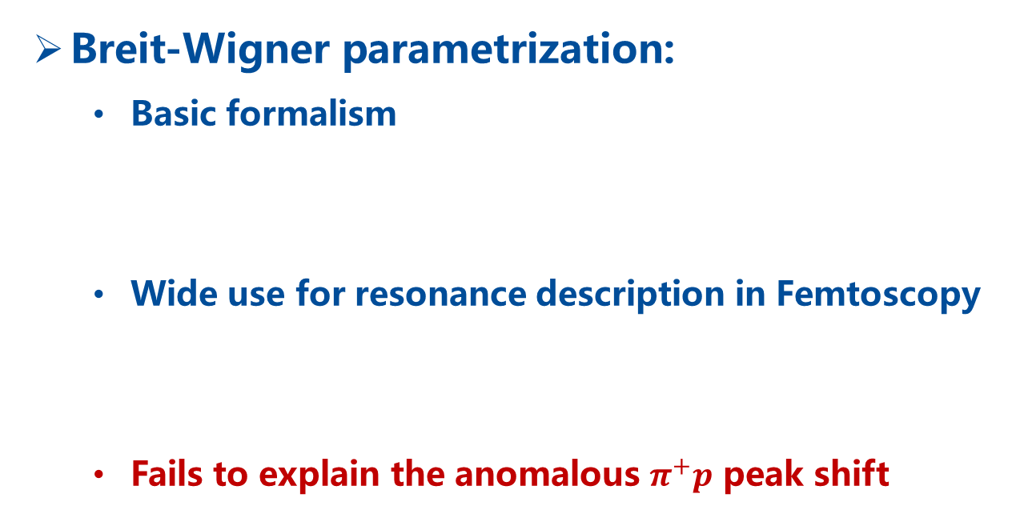

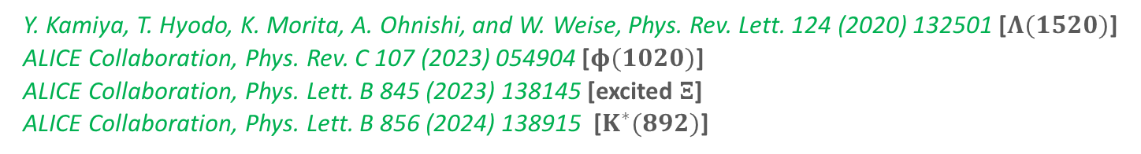
Theoretical Challenges
Breit-Wigner parametrization:
  Basic formalism
  Wide use for resonance description in Femtoscopy
  Fails to explain the anomalous $π^{+}p$ peak shift
$M_{R}$: Breit-Wigner mass; $Γ_{R}$: Breit-Wigner width
Y. Kamiya, T. Hyodo, K. Morita, A. Ohnishi, and W. Weise, Phys. Rev. Lett. 124 (2020) 132501 [$Λ(1520)$]
ALICE Collaboration, Phys. Rev. C 107 (2023) 054904 [$φ(1020)$]
ALICE Collaboration, Phys. Lett. B 845 (2023) 138145 [excited $Ξ$]
ALICE Collaboration, Phys. Lett. B 856 (2024) 138915 [$K^{∗}(892)$]

Slide 13
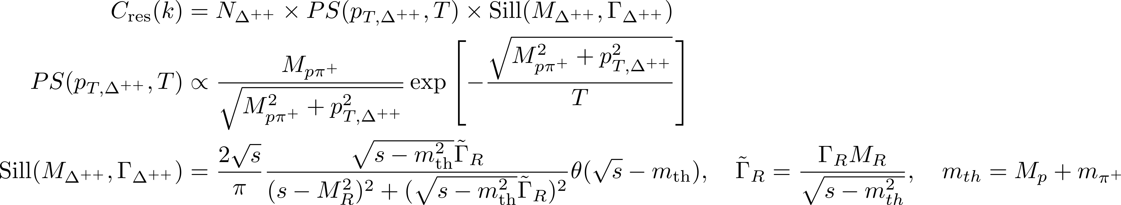
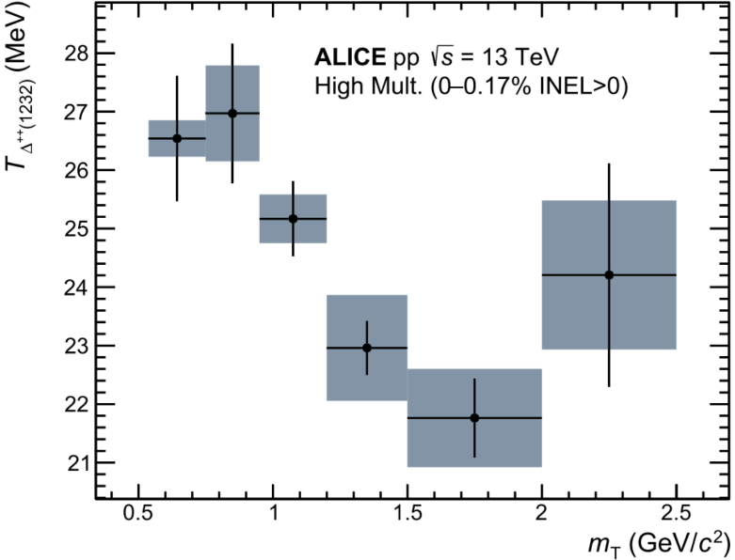
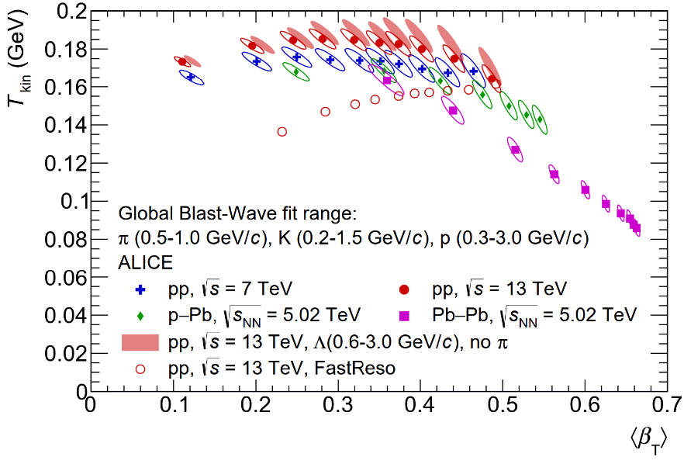


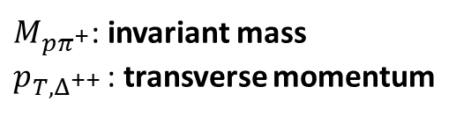
Theoretical Challenges
Temperature-dependent spectral function:
  Basic formalism
  Extracted temperature contradicts blast-wave freeze-out
ALICE Collaboration, Eur. Phys. J. A 61 (2025) 194
$N_{Δ^{++} }$: overall normalization
$M_{pπ^{+}}$: invariant mass
$p_{T,Δ^{++} }$: transverse momentum
ALICE Collaboration, Eur. Phys. J. C 80 (2020) 693

Slide 14
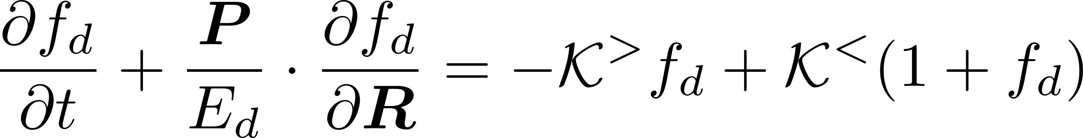






Theoretical Challenges
Relativistic kinetic equations:
  Basic formalism
  Freeze-out require a ≈70 MeV/c² mass reduction of the $Δ(1232)$ resonance
L.-Y. Zhang, C. M. Ko, Y.-G. Ma, Q.-Y. Shou, K.-J. Sun, R. Wang, and S. Zhang, 2511.10298
$f_{d}$: phase space distribution
$K^{>} (K^{<})$: dissociation and regeneration rates
$Ψ_{k}(r)$: Bethe-Salpeter amplitude

Slide 15


Theoretical Challenges
Friedrichs-Lee model T-matrix:
  Basic formalism
  underestimates strength, predicts dip absent
L. Zhang, T. Shao, S. Zhang, K.-J. Sun, and Y.-G. Ma, (2026), arXiv:2606.08230

Slide 16



Strong interaction T-matrix
control off-shell behavior

Slide 17
Coulomb interaction T-matrix
Fourier‑transforming the r‑space Coulomb potential into p-space
Partial Wave Projection
Relativistic correction (relativistic propagator & relativistic normalization convention)
where

Slide 18




CF from the $π^{+}p$ scattering
Outgoing wave function
where
Correlation function from the $π^{+}p$ scattering process
strong + coulomb
coulomb only
where

Slide 19





CF from the $Δ^{++}→π^{+}p$decay
Correlation function from the $Δ^{++}→π^{+}p$decay process
radius 0.84 fm
where $S_{12}^{R=0.42}$ denotes the Gaussian source with $R=0.42$ fm.
pion
proton
① without incident wave $j_{L}$
② without weight factor $ω_{LJ}$
③ smaller source size
Experimental corrections
$P$: separable fraction of $Δ$ decay; $λ$: misidentification and feed-down effects;
$(a+bk^{2})$: Correlation with mini-jet background;

Slide 20



Comparison with experimental data
ZWL, Jun-Xu Lu, Duo-Lun Ge, Li-Sheng Geng*, 2607.04351
The theory matches data and reproduces the peak shift from broad low‑$k$ to narrow high‑$k$ with increasing transverse-mass $m_{T}$.
The observed peak is a weighted sum of the scattering and $Δ$‑decay parts; their relative weights $P$drive the $m_{T}$‑dependent shift.

Slide 21




Physical picture of the peak shift
ZWL, Jun-Xu Lu, Duo-Lun Ge, Li-Sheng Geng*, 2607.04351
At low $m_{T}$​, $Δ$ decays inside source, mixing with direct pairs; at high $m_{T}$​, escapes before $Δ$decay. Increasing $m_{T}$​ raises $P$ (escape fraction) supporting the picture.

Slide 22


Why scattering and decay peaks differ
ZWL, Jun-Xu Lu, Duo-Lun Ge, Li-Sheng Geng*, 2607.04351
The scattering peak near 140 MeV/c originates from the P3/2 partial wave, while the decay peak near 220 MeV/c resembles the conventional Breit‑Wigner form.
The shift arises because scattering includes the incident wave $j_{1}$ in the outgoing wave function, while the decay does not.

Slide 23

Influence of strong interaction
ZWL, Jun-Xu Lu, Duo-Lun Ge, Li-Sheng Geng*, 2607.04351
Comparison of partial-wave correlations with / without strong interaction shows strong suppression of S1/2, negligible effect on P1/2, and distortion of P3/2 with a peak at 140 and dip at 230 MeV/c.

Slide 24

Interference-induced peak shift
ZWL, Jun-Xu Lu, Duo-Lun Ge, Li-Sheng Geng*, 2607.04351
Comparison of $|j_{1}+R_{P3/2}|$and $|R_{P3/2}|$in phase space shows that interference shifts amplitude to low $k$.

Slide 25


Interference from broad vs narrow resonances
Jia-Ming Xie, ZWL*, Jun-Xu Lu*,
Hao-Zhao Liang*, LSG*, 2607.04351
Large $Δ(1232)$ width enhances $π^{+}p$ interference, while narrow $Λ(1520)$ width causes negligible $K^{−}p$ peak shift (only 2 MeV/c shift).

Slide 26


Summary and outlook
  This work presents a comprehensive analysis of the $π^{+}p$ femtoscopic correlation in pp collisions:
  the $m_{T}$-dependent superposition of scattering (140 MeV/c) and decay (220 MeV/c) components reproduces the observed shift.
  the 140‑MeV/c peak is identified as quantum interference between incident and scattered waves—a novel effect in femtoscopy.
  The same mechanism may be responsible for $Δ(1232)$ peak shifts in $π$–deuteron femtoscopic CFs, currently under study.
Thanks a lot for your attention!

