Slide 1

Resonance Femtoscopy Beyond the On-Shell Approximation
arXiv:2606.08230 [nucl-th]
Liang Zhang (张良)
Fudan university

Slide 2

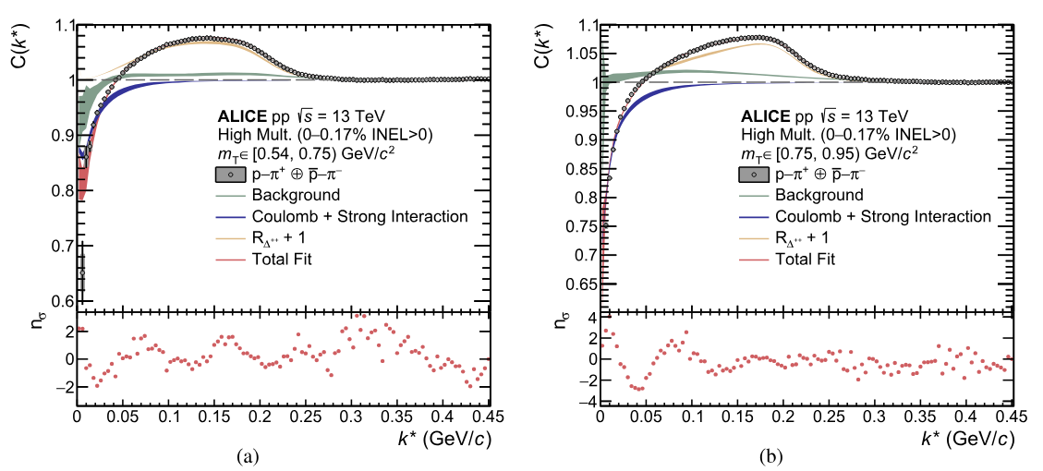

Motivation
Delta peak original position ~ 227 MeV/c
Why there is a shift?
[1] S. Acharya et al., Eur. Phys. J. A 61, 194 (2025).

Slide 3
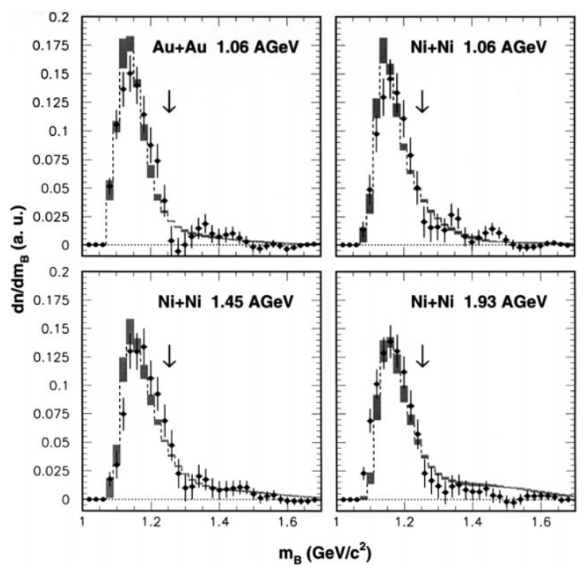
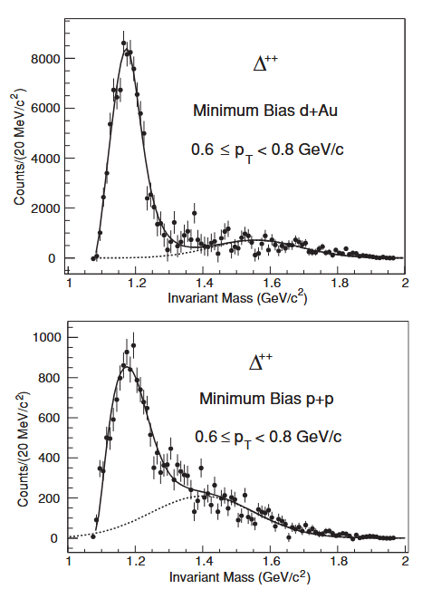
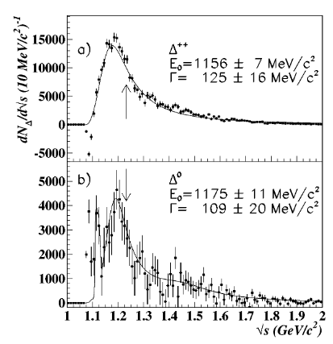
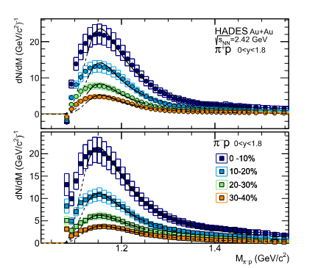
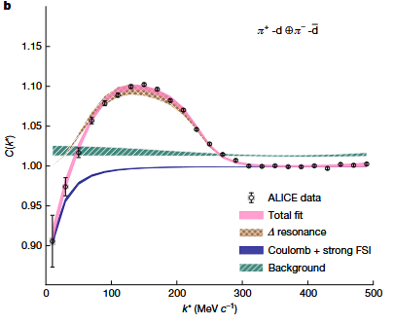
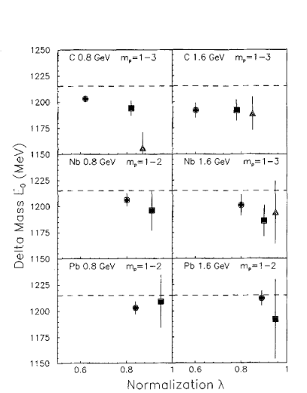
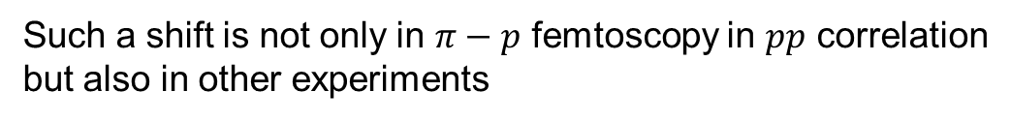


Motivation
Star Collaboration et al., Phys. Rev. C 78, 44906 (2008).
M. Trzaska et al., Z. Phys. A 340, 325 (1991).
proton-nucleus collisions
⁵⁸Ni+Cu @ E = 1.97AGeV
$\sqrt{s_{NN}}=200$ GeV
$\sqrt{s_{NN}}=200$ GeV
J. Adamczewski-Musch et al., Phys. Lett. B 819, 136421 (2021).
Alice Collaboration, Nature 648, 306 (2025).
M. Eskef et al., Eur. Phys. J. A 3, 335 (1998).
E. L. Hjort et al., Phys. Rev. Lett. 79, 4345 (1997).
Such a shift is not only in $π−p$ femtoscopy in $pp$ correlation
but also in other experiments

Slide 4

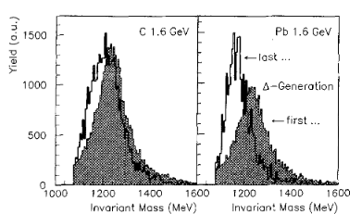
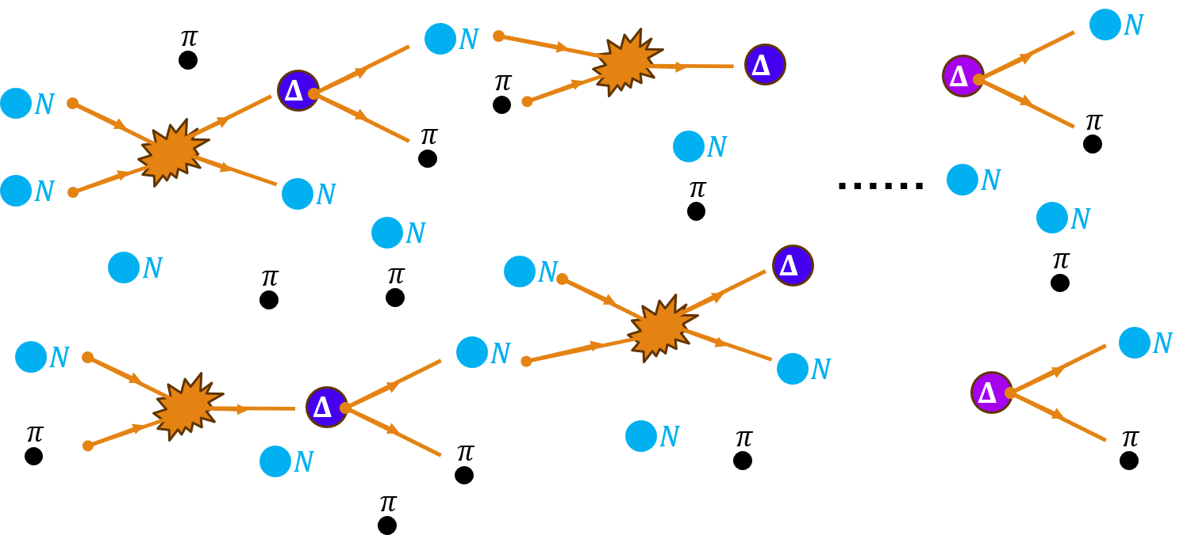
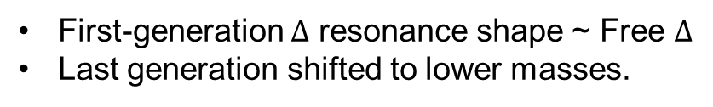
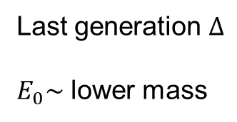
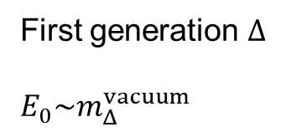
Intranuclear-cascade model (INC)
First generation $Δ$
$E_{0}\sim m_{Δ}^{vacuum}$
Last generation $Δ$
$E_{0}\sim$ lower mass
First-generation $Δ$ resonance shape ~ Free $Δ$
Last generation shifted to lower masses.
[1] J. Cugnon and M.-C. Lemaire, Nucl. Phys. A 489, 781 (1988).
[2] J. Cugnon, A. Lejeune, and P. Grangé, Phys. Rev. C 35, 861 (1987).
[3] M. Trzaska et al., Z. Phys. A 340, 325 (1991).

Slide 5
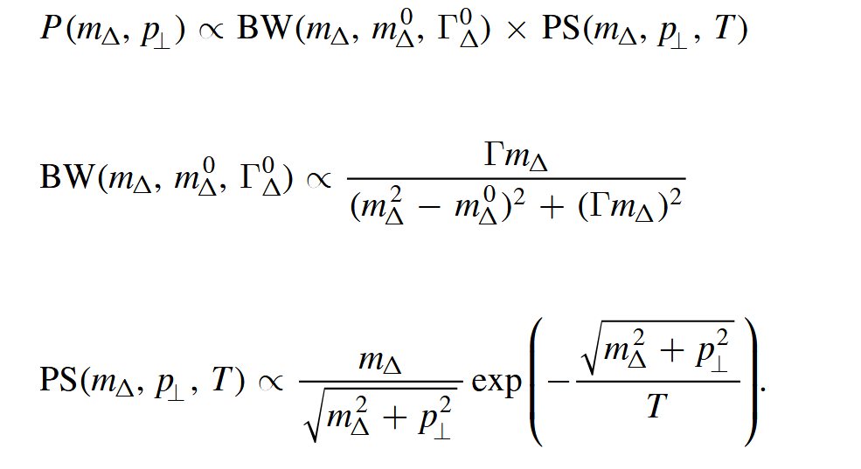
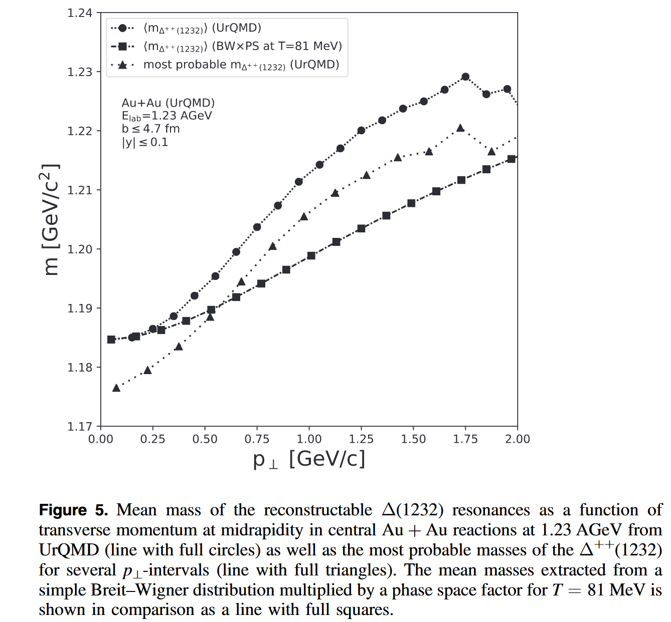
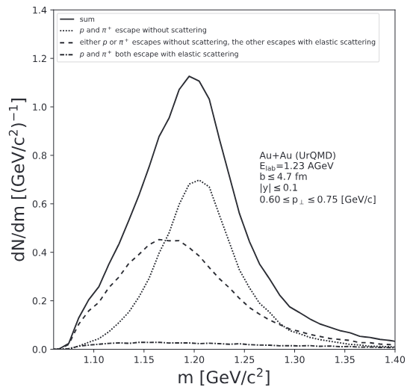
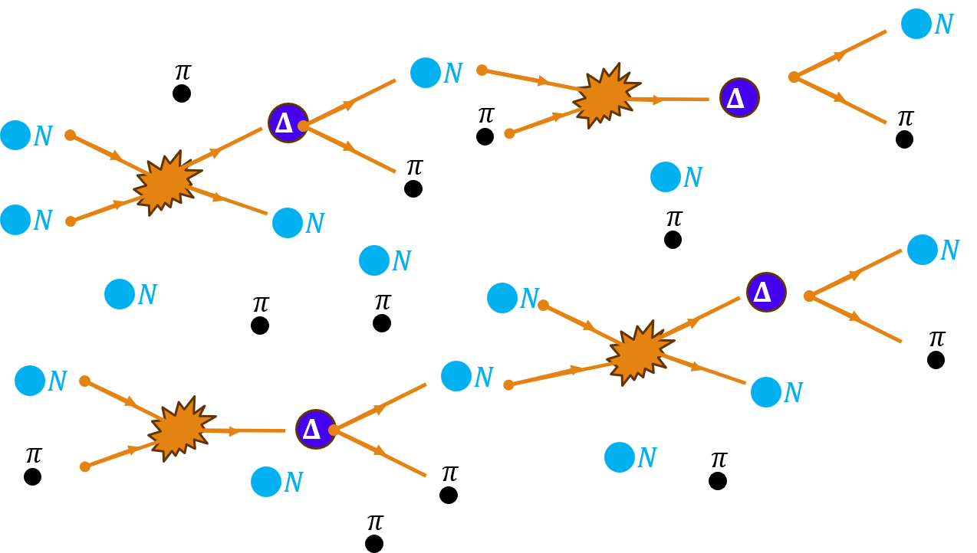
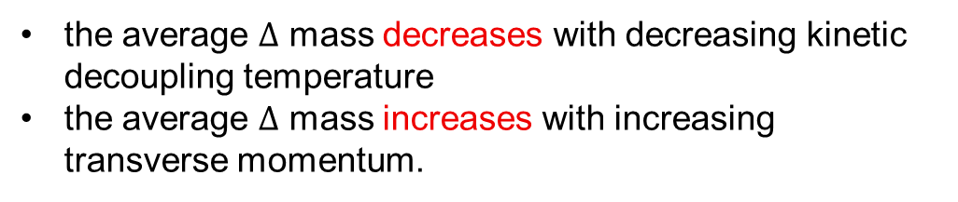
Thermometer of kinetic decoupling
[1] T. Reichert et al., J. Phys. G 46, 105107 (2019).
the average $Δ$ mass decreases with decreasing kinetic decoupling temperature
the average $Δ$ mass increases with increasing transverse momentum.

Slide 6
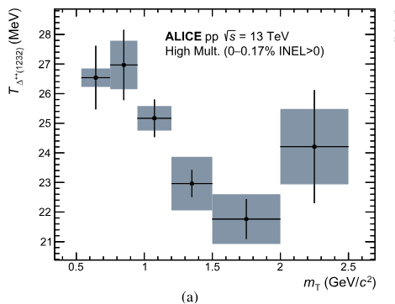
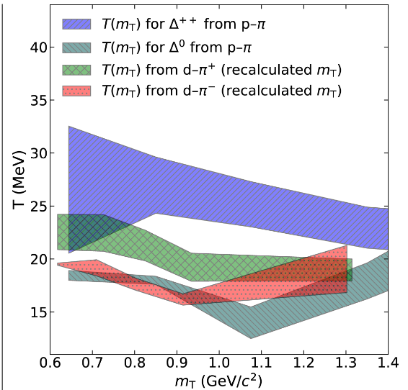
Thermometer of kinetic decoupling
[1] T. Reichert et al., J. Phys. G 46, 105107 (2019).
[2] Alice Collaboration, Nature 648, 306 (2025).
[3] Alice Collaboration, Eur. Phys. J. A 61, 194 (2025).
Why the temperature is so low
the average $Δ$ mass decreases with decreasing kinetic decoupling temperature
the average $Δ$ mass increases with increasing transverse momentum.

Slide 7
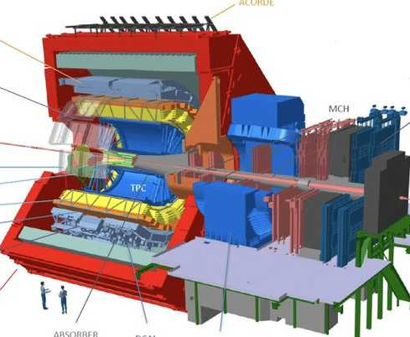
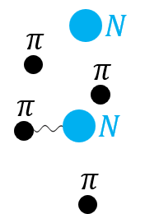
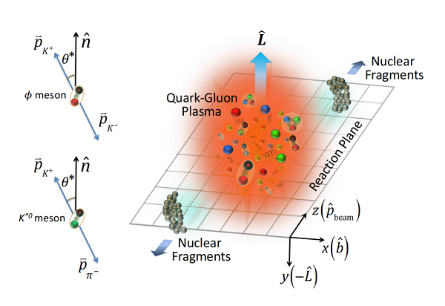
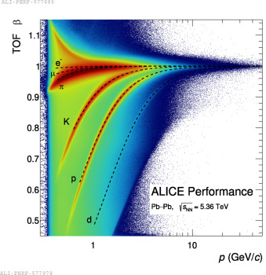
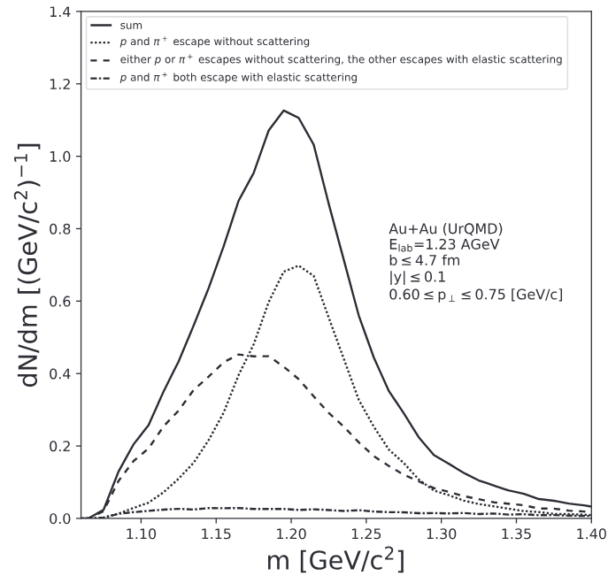




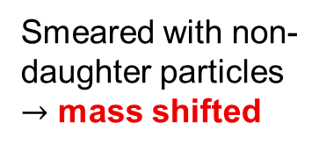



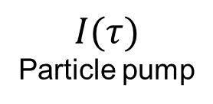
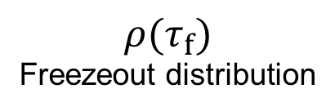
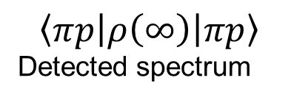
From semiclassical to quantum
Transport description (semiclassical)
Quantum description
$$\left|π\right\rangle \left|N\right\rangle$$
$$\left|ψ_{πN}\right\rangle$$
$$π$$
$$Δ$$
$$\left|Δ\right\rangle$$
$$I(τ)$$
Particle pump
Smeared with non-daughter particles
$→$ mass shifted
$$ρ(τ_{f})$$
Freezeout distribution
$$\left\langle πp\left|ρ\left(∞\right)\right|πp\right\rangle$$
Detected spectrum
[1]T. Reichert et al., J. Phys. G 46, 105107 (2019).

Slide 8

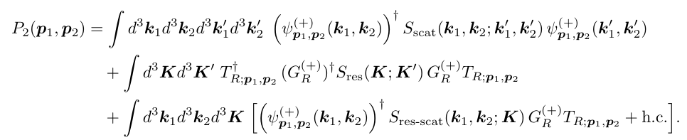
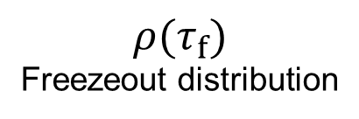
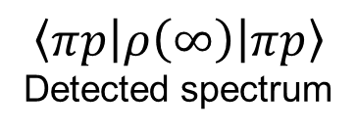







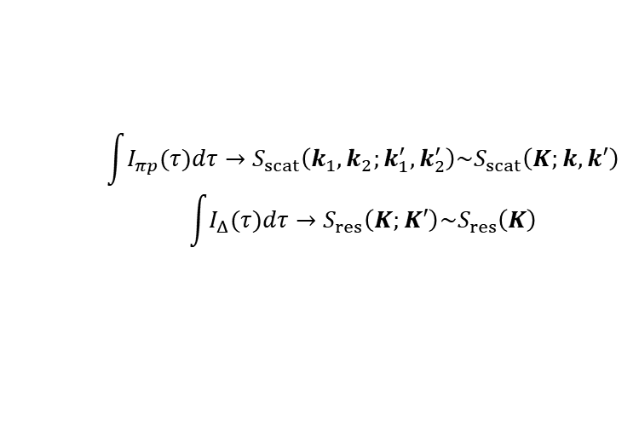

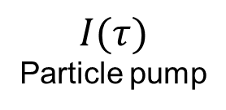

Liouville equation
$$\int{I_{πp}(τ)dτ}→S_{scat}\left(k_{1},k_{2};k_{1}^{′},k_{2}^{′}\right)\sim S_{scat}\left(K;k,k^{′}\right)$$
$$\int{I_{Δ}(τ)dτ}→S_{res}\left(K;K′\right)\sim S_{res}\left(K\right)$$
$πp$ pair source
$Δ$ production
$$\left|π\right\rangle \left|N\right\rangle$$
$$\left|ψ_{πN}\right\rangle$$
$$P_{2}\left(p_{1},p_{2}\right)=\left\langle πp\left|ρ\left(∞\right)\right|πp\right\rangle$$
$$π$$
$$Δ$$
$$\left|Δ\right\rangle$$
$$I(τ)$$
Particle pump
$$ρ(τ_{f})$$
Freezeout distribution
$$\left\langle πp\left|ρ\left(∞\right)\right|πp\right\rangle$$
Detected spectrum
Koonin-Pratt formula
Femtoscopy
$$C\left(p_{1},p_{2}\right)=\frac{P_{2}(p_{1},p_{2})}{P_{1}(p_{1})P_{1}(p_{2})}$$
[1] U. A. Wiedemann and U. Heinz, Phys. Rep. 319, 145 (1999).
[2] LZ, T. Shao, S. Zhang and et al., arXiv:2606.08230 (2026).

Slide 9

Liouville equation
$$\int{I_{πp}(τ)dτ}→S_{scat}\left(k_{1},k_{2};k_{1}^{′},k_{2}^{′}\right)\sim S_{scat}\left(K;k,k^{′}\right)$$
$$\int{I_{Δ}(τ)dτ}→S_{res}\left(K;K′\right)\sim S_{res}\left(K\right)$$
$πp$ pair source
$Δ$ production
$$\left|π\right\rangle \left|N\right\rangle$$
Background $\sim P_{1}(p_{1})P_{1}(p_{2})$
$$\left|ψ_{πN}\right\rangle$$
$$P_{2}\left(p_{1},p_{2}\right)=\left\langle πp\left|ρ\left(∞\right)\right|πp\right\rangle$$
$$π$$
$$Δ$$
$$\left|Δ\right\rangle$$
$$I(τ)$$
Particle pump
$$ρ(τ_{f})$$
Freezeout distribution
$$\left\langle πp\left|ρ\left(∞\right)\right|πp\right\rangle$$
Detected spectrum
Ignored due to decoherence
Koonin-Pratt formula
Femtoscopy
$$C\left(p_{1},p_{2}\right)=\frac{P_{2}(p_{1},p_{2})}{P_{1}(p_{1})P_{1}(p_{2})}$$
[1] U. A. Wiedemann and U. Heinz, Phys. Rep. 319, 145 (1999).
[2] LZ, T. Shao, S. Zhang and et al., arXiv:2606.08230 (2026).

Slide 10
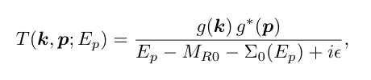
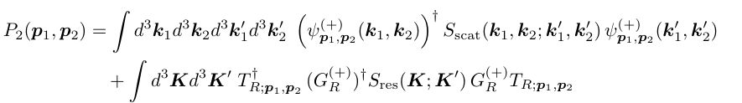
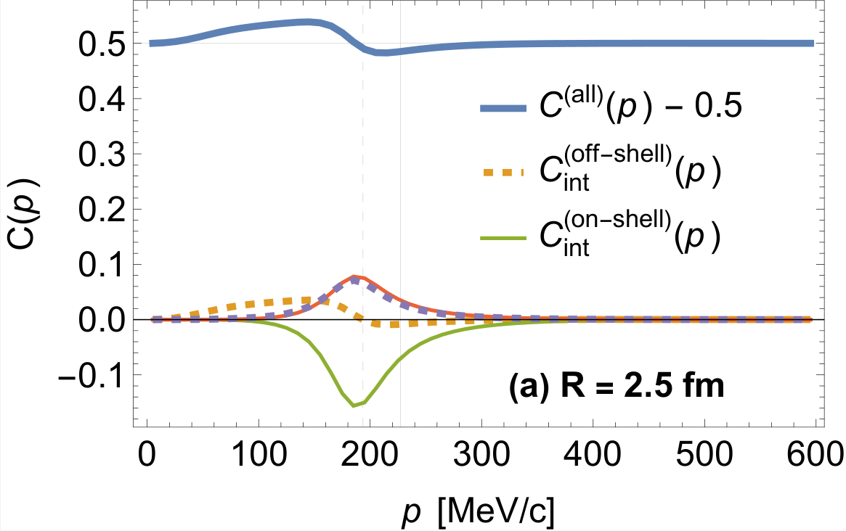

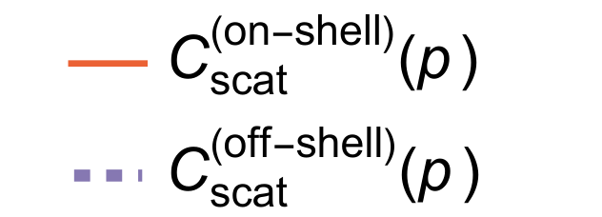


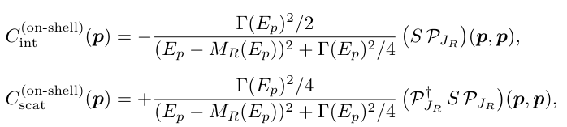
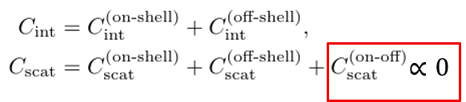
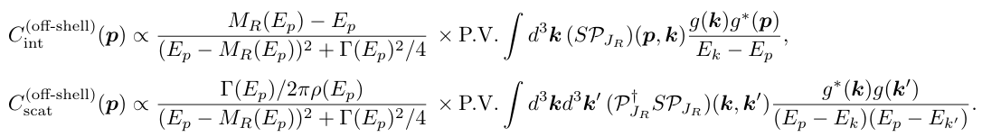
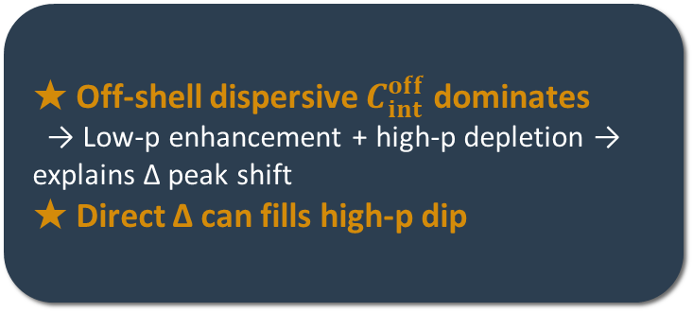
Femtoscopic correlations
separable T-matrix for a single resonance
Lippmann-Schwinger equation
off-shell
on-shell
Sokhotski-Plemelj
theorem
★ Off-shell dispersive $C_{int}^{off}$dominates
→ Low-p enhancement + high-p depletion → explains Δ peak shift
★ Direct Δ can fills high-p dip
[1] LZ, T. Shao, S. Zhang and et al., arXiv:2606.08230 (2026).

Slide 11
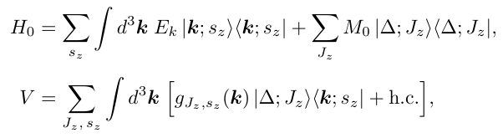

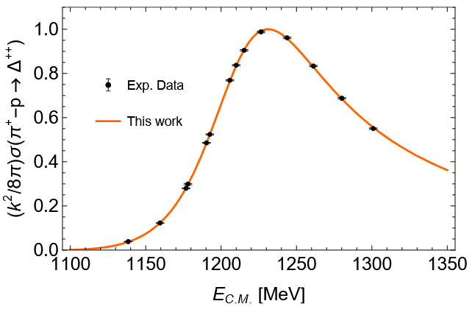


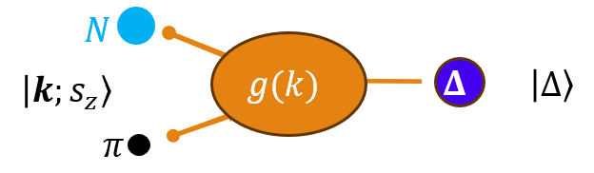
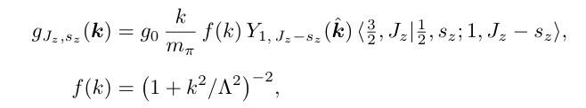
Friedrichs-Lee model
Fit cross section to fix the model parameters
Solve Lippmann-Schwinger equation
[1] T. D. Lee, Phys. Rev. 95, 1329 (1954).
[2] K. O. Friedrichs, Commun. Pure Appl. Math. 1, 361 (1948).
[3] LZ, T. Shao, S. Zhang and et al., arXiv:2606.08230 (2026).
[4] A. A. Carter et al., Nucl. Phys. B 26, 445 (1971).

Slide 12

Friedrichs-Lee model
Fit cross section to fix the model parameters
The model reproduce the $Δ$ pole well
Solve Lippmann-Schwinger equation
[1] T. D. Lee, Phys. Rev. 95, 1329 (1954).
[2] K. O. Friedrichs, Commun. Pure Appl. Math. 1, 361 (1948).
[3] LZ, T. Shao, S. Zhang and et al., arXiv:2606.08230 (2026).
[4] A. A. Carter et al., Nucl. Phys. B 26, 445 (1971).

Slide 13
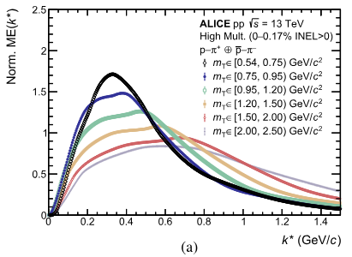
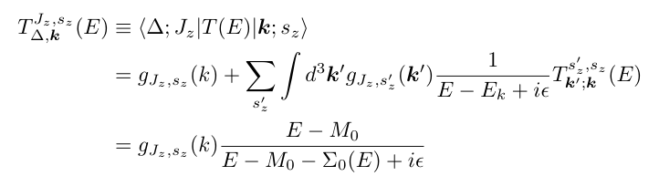


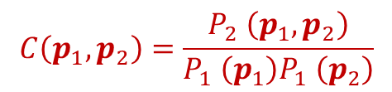



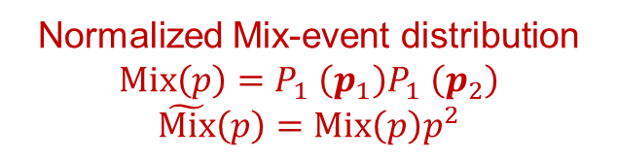

Direct $Δ$ contribution
$$C\left(p_{1},p_{2}\right)=\frac{P_{2} \left(p_{1},p_{2}\right)}{P_{1} \left(p_{1}\right)P_{1} \left(p_{2}\right)}$$
Alice Collaboration, Eur. Phys. J. A 61, 194 (2025).
$$C_{Δ}=$$
$$P_{1} \left(p_{1}\right)P_{1} \left(p_{2}\right)$$
From Friedrichs-Lee model
$S_{res}\left(K;K^{′}\right)→S_{res}\left(K\right)$ the $Δ$ production
Normalized Mix-event distribution
$$Mix\left(p\right)=P_{1} \left(p_{1}\right)P_{1} \left(p_{2}\right)$$
$$\tilde{Mix}\left(p\right)=Mix\left(p\right)p^{2}$$
$$P_{Δ}=N_{Δ}/N_{πp}^{background}$$

Slide 14




Reproduce ALICE femtoscopy
Consider Coulomb and $πp$ background interaction
[1] LZ, T. Shao, S. Zhang and et al., arXiv:2606.08230 (2026).

Slide 15

Difference between semiclassical and quantum
Transport description (semiclassical)
Quantum description
Smeared with non-daughter particles
$→$ mass shifted
Dispersive structure from off-shell contribution in the interference term

Slide 16


Summary
Experiments
  In nucleus collisions, the $Δ$ peak of $πp$ spectrum shift to lower energy
  Different from $πp$ scattering experiments
Semiclassical description
  Rescattering of $πp$
  Smeared the $Δ$ peak to lower energy
This work
  Liouville equation $→$ origin of $πp$ and $Δ$ contribution
  Lippmann-Schwinger $→$
  Sokhotski-Plemelj therom $→$ on-/off-shell decomposition
  Numerical reproduce: Friedrichs-Lee model
  Not only reproducing, but also, physical origin

Slide 17
Backup

Slide 18





































Intranuclear-cascade model (INC)
$$π$$
$$N$$
$$N$$
$$π$$
$$Δ$$
$$Δ$$
$$N$$
$$Δ$$
$$π$$
$$π$$
$$N$$
……
$$N$$
$$N$$
$$π$$
$$N$$
$$N$$
$$N$$
$$N$$
$$π$$
$$π$$
$$N$$
$$Δ$$
$$π$$
$$N$$
$$N$$
$$N$$
$$N$$
$$Δ$$
$$Δ$$
$$π$$
$$N$$
$$π$$
$$π$$
$$N$$
$$π$$
$$π$$
First-generation $Δ$ resonance shape ~ Free $Δ$
Last generation shifted to lower masses.
[1] J. Cugnon and M.-C. Lemaire, Nucl. Phys. A 489, 781 (1988).
[2] J. Cugnon, A. Lejeune, and P. Grangé, Phys. Rev. C 35, 861 (1987).
[3] J. Cugnon, Nucl. Phys. A 462, 751 (1987).
[4] J. Cugnon, D. Kinet, and J. Vandermeulen, Nucl. Phys. A 379, 553 (1982).

Slide 19




In-medium effect
[1] G. Aarts et al., Phys. Rev. D 99, 74503 (2019).
[2] G. Aarts et al., J. High Energy Phys. 2017, 34 (2017).
[3] H. van Hees and R. Rapp, Phys. Lett. B 606, 59 (2005).
H. van Hees and R. Rapp, Phys. Lett. B 606, 59 (2005)
In a hot-dense matter
The $Δ$ mass can be larger than vacuum
Due to the high-temperature
and the restore of chiral symmetry
$$Δ$$
A probe of QGP
$$Δ$$

Slide 20






















Resonance Femtoscopy Beyond the On-Shell Approximation
$$π$$
$$π$$
$$π$$
$$p$$
$$∂_{t} ρ\left(τ\right) + i[H,ρ(τ)] = I(τ).$$
$$Δ$$
$$Δ$$
$$π$$
$$p$$
measure
$$P_{2}\left(p_{1}, p_{2}\right)=⟨p_{1}, p_{2}|ρ\left(∞\right)|p_{1}, p_{2}⟩$$
$$π$$
$$p$$
$$π$$
$$π$$
Femtoscopy
$$C\left(p_{1},p_{2}\right)=\frac{P_{2}(p_{1},p_{2})}{P_{1}(p_{1})P_{1}(p_{2})}$$
$$I_{πp}|πp⟩⟨πp| ⊕ I_{Δ}|Δ⟩⟨Δ|$$
Projection onto 2-channel subspace
At freeze-out time $τ_{freezeout}$
Chaotic Source $I\left(τ\right)$
$$τ<τ_{freezeout}$$
Mix event $πp$ distribution
$$\int{I_{πp}(τ)dτ}→S_{scat}\left(k_{1},k_{2};k_{1}^{′},k_{2}^{′}\right)\sim S_{scat}\left(K;k,k^{′}\right)$$
$$\int{I_{Δ}(τ)dτ}→S_{res}\left(K;K′\right)\sim S_{res}\left(K\right)$$
$πp$ pair source
$Δ$ production

Slide 21




Resonance Femtoscopy Beyond the On-Shell Approximation
Lippmann-Schwinger equation
Sokhotski-Plemelj
theorem
$$∝0$$
$$C_{exp}\left(p\right)=1+λ \left(1−P_{Δ}\right)C\left(p\right)+λ P_{Δ}C_{Δ}(p)$$
★ Off-shell dispersive $C_{int}^{off}$dominates
→ Low-p enhancement + high-p depletion → explains Δ peak shift
★ Direct Δ fills high-p dip → good agreement with ALICE data

Slide 22



Back to $Δ$ mass shift in nucleus collisions
Fit mix event distribution with a multi-Gaussian function
Fit the same event
Well reproduce

