Slide 1
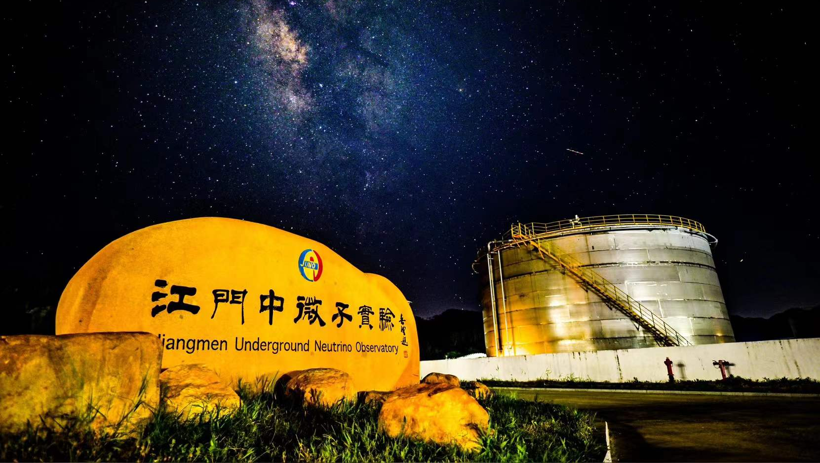
Recent Progress from JUNO
Yi Jia, IHEP
(on behalf of JUNO Collaboration)
2026-8-14
NOPP 2026, IHEP

Slide 2
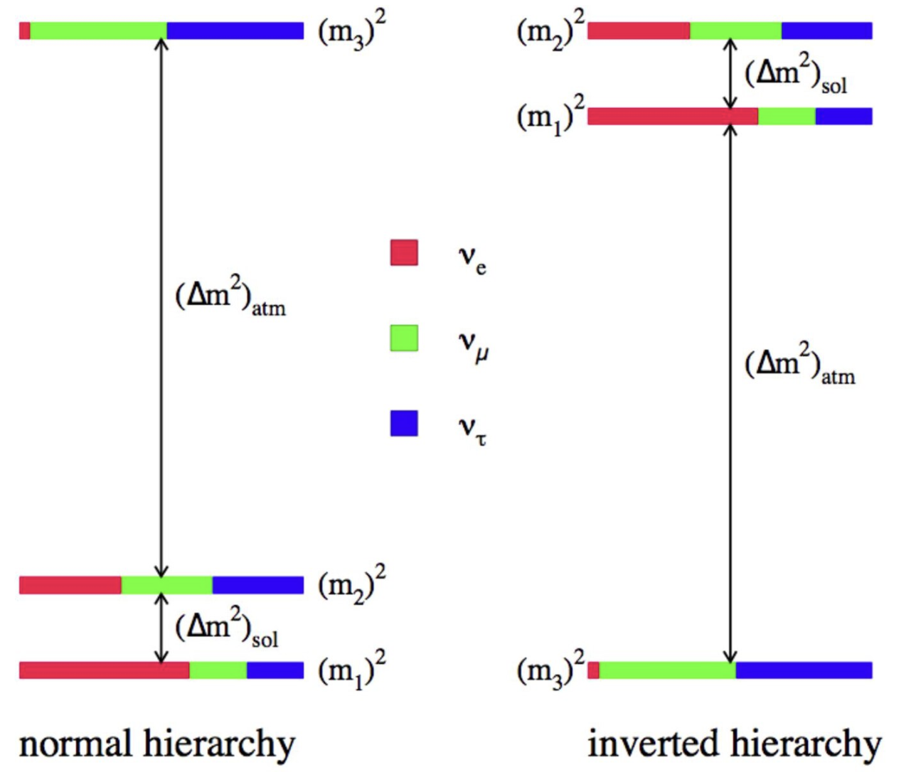
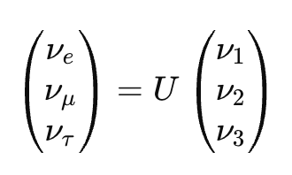
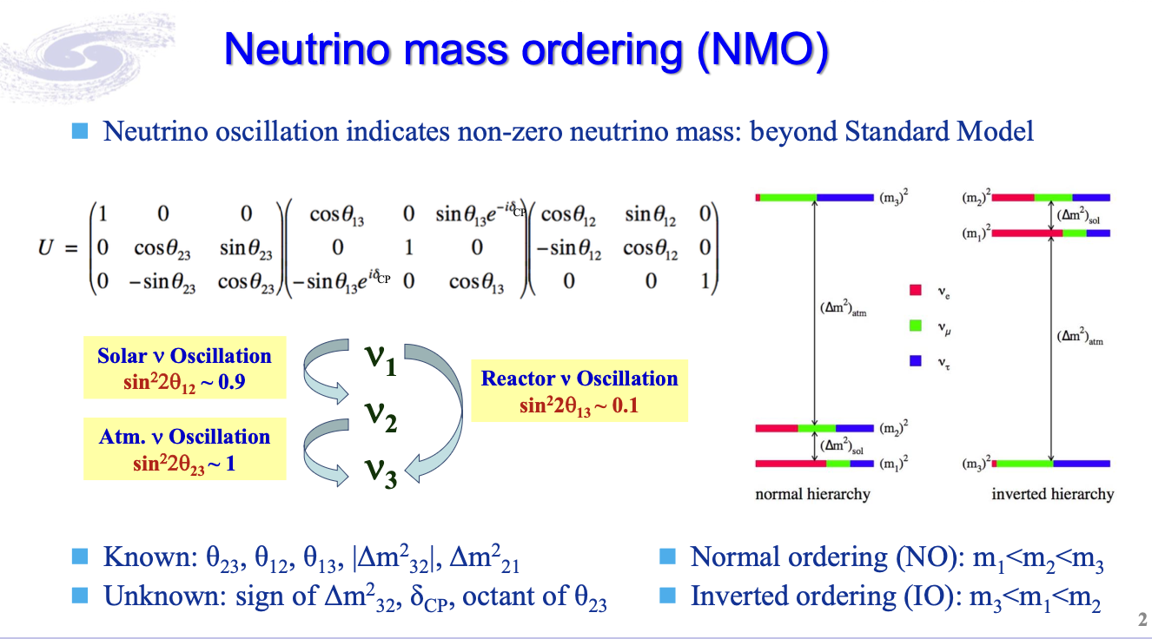
Parameters in the 3-flavor Neutrino Paradigm
Neutrino oscillation indicates non-zero neutrino mass
Neutrino flavor states and mass states are connected by a unitary matrix U:
2
Notes:
In the three-flavor paradigm, neutrino flavor states are mixtures of mass states. The mixing is described by the PMNS matrix.
This matrix contains three mixing angles, θ12, θ13, and θ23, and one CP-violating phase δCP. Oscillation experiments also measure two independent mass-squared differences.
Most of these parameters are already measured, but not all with the same precision.
In particular, the sign of Δm²31, or equivalently the neutrino mass ordering, is still unknown. The ordering can be normal, where m3 is heavier, or inverted, where m3 is lighter.
JUNO is sensitive to the mass ordering through a very precise measurement of the reactor antineutrino energy spectrum.
Different neutrino sources probe different parts of this oscillation picture.

Slide 3
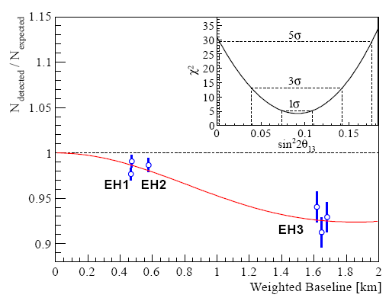
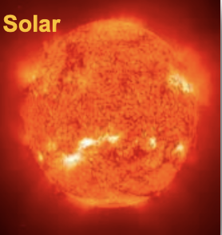
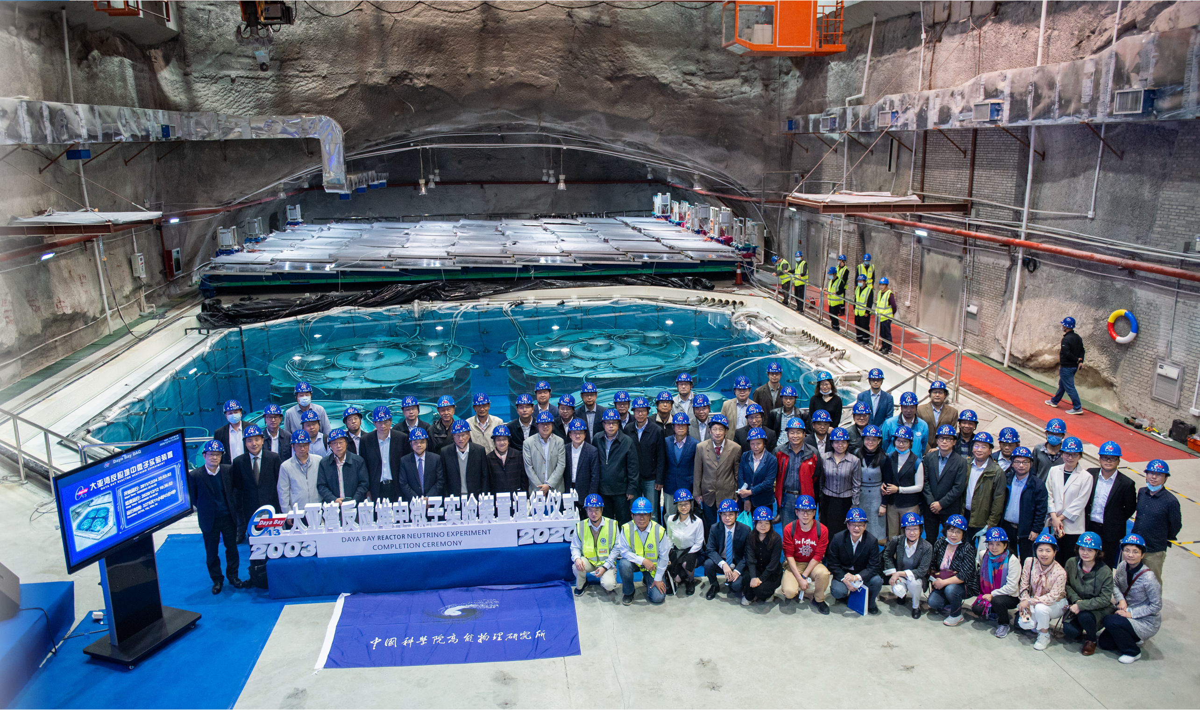

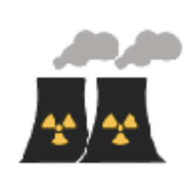
Oscillations from Different Neutrino Sources
Daya Bay
Discovered the third neutrino oscillation mode in 2012
Confirmed by RENO one month later
ν₁
ν₂
ν₃
~6%
sin²2θ₁₂ ~ 0.9
sin²2θ₁₃ ~ 0.09
sin²2θ₂₃ ~ 1
Completed data taking in 2020
3
Notes:
This slide shows that different neutrino sources are sensitive to different oscillation parameters.
Solar neutrinos mainly probe θ12 and Δm²21. Atmospheric and accelerator neutrinos are sensitive to θ23 and Δm²31. Reactor neutrinos have played a very important role, especially in measuring θ13.
Daya Bay discovered the third neutrino oscillation mode in 2012, with θ13 non-zero. This was a key result, because it opened the door for CP violation searches in accelerator experiments.
JUNO follows this reactor neutrino tradition, but at a different baseline and with a different goal: precision measurement of θ12 and Δm²21, and sensitivity to the mass ordering.
Let me now explain how reactor antineutrinos are detected.

Slide 4
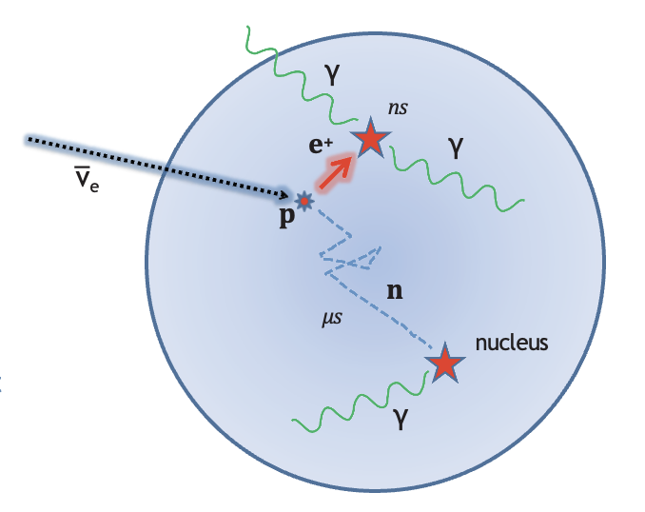
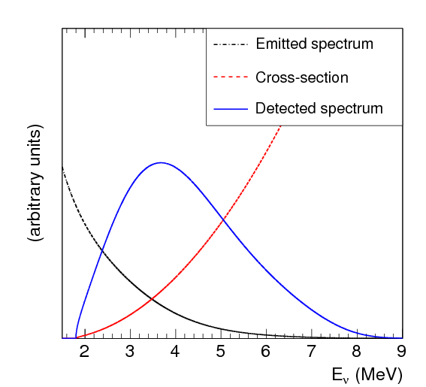

Reactor Antineutrino Detection
Primary detection channel:
Inverse Beta Decay (IBD)
ν¯ + p → e + n
Prompt signal: e⁺ kinetic energy loss + annihilation
Delayed signal: capture on Hydrogen (nH) or Gadolinium (nGd) and subsequent gamma-ray emission
Coincidence between prompt positron and delayed neutron signals allows for powerful background rejection.
Energy of positron preserves information about energy of incoming ${\overline{ν}}_{e}$: $E_{{\overline{ν}}_{e}}$ ≈ $E_{e^{+}}$ + 0.78 MeV
Notes:
Reactor antineutrinos are detected mainly through inverse beta decay, or IBD:
anti-electron-neutrino plus proton gives positron plus neutron.
This reaction has a very useful delayed-coincidence signature. The positron gives a prompt signal through energy loss and annihilation. The neutron is captured later, producing delayed gamma rays.
The coincidence in energy, time, and space gives powerful background rejection.
Another important feature is that the positron energy preserves the information of the incoming antineutrino energy. Approximately, the antineutrino energy is the positron energy plus 0.78 MeV.
So by measuring the prompt energy spectrum, we can reconstruct the reactor antineutrino spectrum and study oscillations.
The next question is: what can reactor antineutrino oscillations tell us?

Slide 5
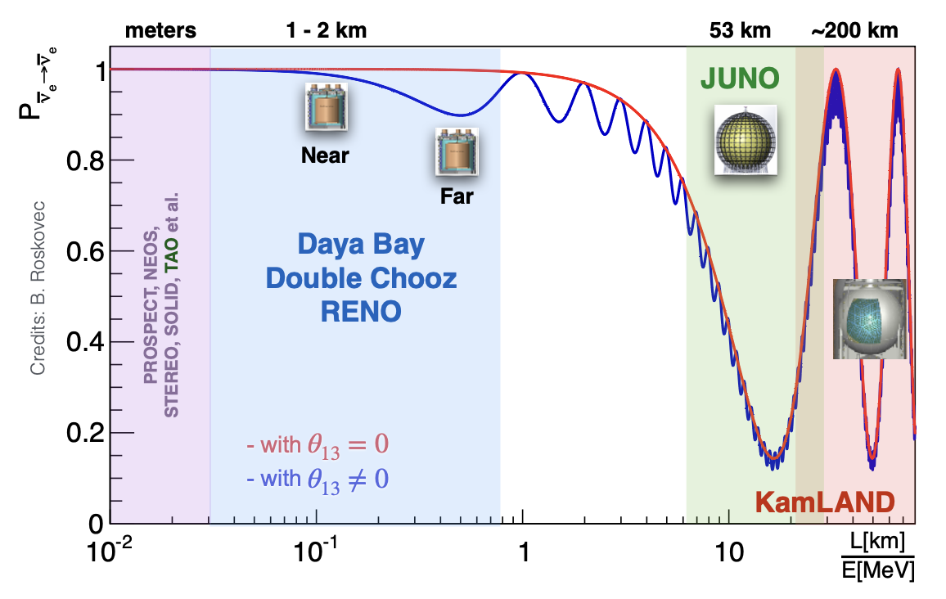

Reactor Antineutrino Oscillations
Reactor neutrinos provide a clean tool to make precision measurements of neutrino oscillations
Measure how ${\overline{ν}}_{e}$ oscillate into other flavors
Access to $θ_{12}$ , $θ_{13}$, $Δm_{21}^{2}$, $Δm_{31}^{2}$ and the mass ordering
No dependence on $θ_{23}$ and $δ_{CP}$
Baseline is set by physics goals
5
Notes:
“这一页展示 reactor neutrino oscillation 的基本思想。
反应堆中微子是研究振荡非常干净的工具。
因为 reactor 只产生电子反中微子，所以系统相对简单。
振荡概率主要取决于：
mixing angle；
mass splitting；
基线长度 L；
中微子能量 E。
左边这张图展示了不同 baseline 对应的不同物理目标。
比如：
几百米到一公里左右，对 θ13\theta_{13}θ13​ 最敏感；
大约 50 km，则对 mass ordering 最敏感；
更长距离，比如 KamLAND，则主要测量 solar oscillation parameters。
JUNO 选择 53 km baseline，其实是一个非常精心优化的结果。
因为在这个距离上：
太阳振荡和大气振荡会产生干涉。
而这种干涉结构正好包含 mass ordering 信息。
另外 reactor neutrino 还有一个重要优点：
它不依赖：
θ23\theta_{23}θ23​
δCP\delta_{CP}δCP​
因此 reactor experiment 能够提供非常 clean 的 oscillation measurement。”

Slide 6
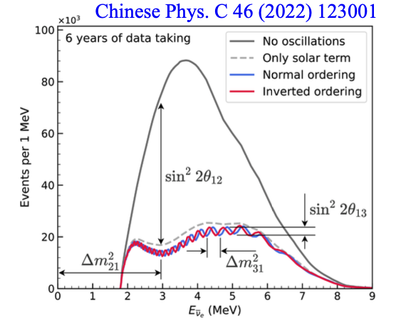
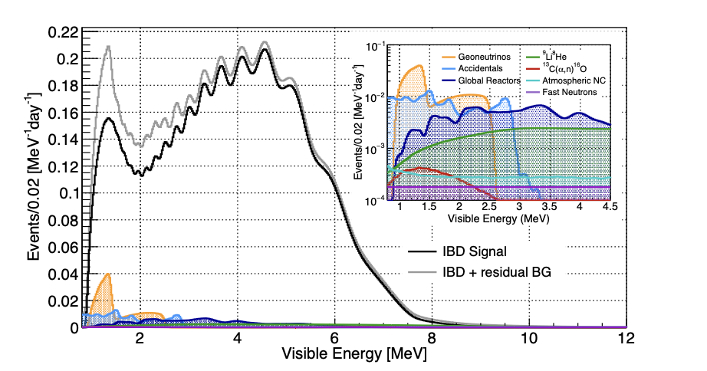
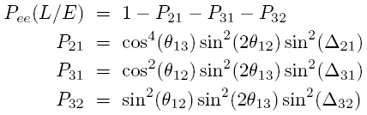
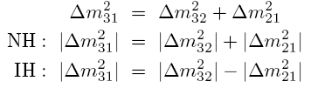
Mass Ordering by Reactor Neutrinos
JUNO
Δm²₂₁
|Δm²₃₂|
~ 3%
Require high statistics, excellent energy resolution and low backgrounds.
6
Notes:
The mass ordering effect in reactor neutrinos is encoded in the fine structure of the energy spectrum.
The difference between normal and inverted ordering is small, because Δm²21 is only about 3 percent of Δm²31.
So experimentally, this is very challenging.
To resolve the fine oscillation pattern, JUNO needs three things: high statistics, excellent energy resolution, and low backgrounds.
This requirement drives the design of the JUNO detector: a very large liquid scintillator detector with unprecedented energy resolution.

Slide 7
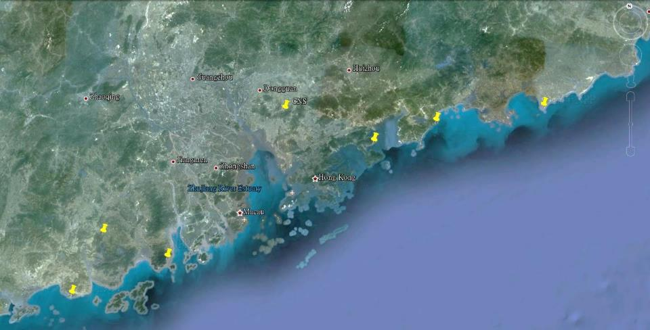
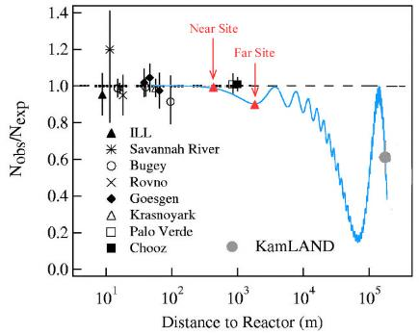

Jiangmen Underground Neutrino Observatory
Use reactor neutrinos to determine the mass ordering
Equal distance to two reactor power plants for doubling the neutrino flux
Daya Bay
JUNO
Previous site candidate
Guang Zhou
2.5 h drive
Lufeng
NPP
Shen Zhen
Huizhou
NPP
Daya Bay NPP
Zhu Hai
Hong Kong
53 km
Macau
53 km
Taishan NPP 18.4 GW
Talk by Y.F. Wang at ICFA seminar 2008, Neutel 2011;
Paper by L. Zhan, Y.F. Wang, J. Cao, L.J. Wen, PRD78:111103,2008; PRD79:073007,2009
Yangjiang NPP 17.4 GW
7
Notes:
“这一页介绍 JUNO 的选址。
JUNO 位于广东江门。
实验的核心思想是：
同时接收来自阳江和台山核电站的反应堆中微子。
两个核电站的总热功率大约：
35 GW 以上。
而且更重要的是：
JUNO 到两个核电站的距离几乎完全相等，大约都是 53 km。
这样设计有两个关键优势。
第一，可以获得更高的中微子通量。
因为两个核电站同时贡献 signal。
第二，也是更重要的一点：
如果两个 reactor baseline 差别太大，不同 reactor 的 oscillation pattern 会互相 smearing。
而等基线设计能够最大程度保留 oscillation 细结构。
因此：
53 km + 等基线，
实际上是 reactor mass ordering 最优方案。
这一方案最早大约在 2008 年左右提出。
后来逐渐发展成今天的 JUNO。”

Slide 8
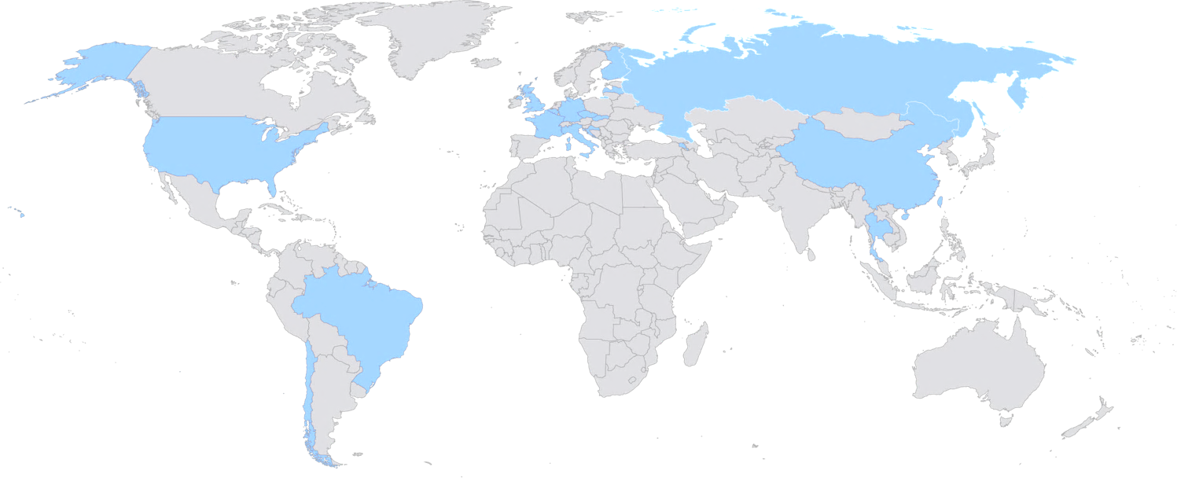
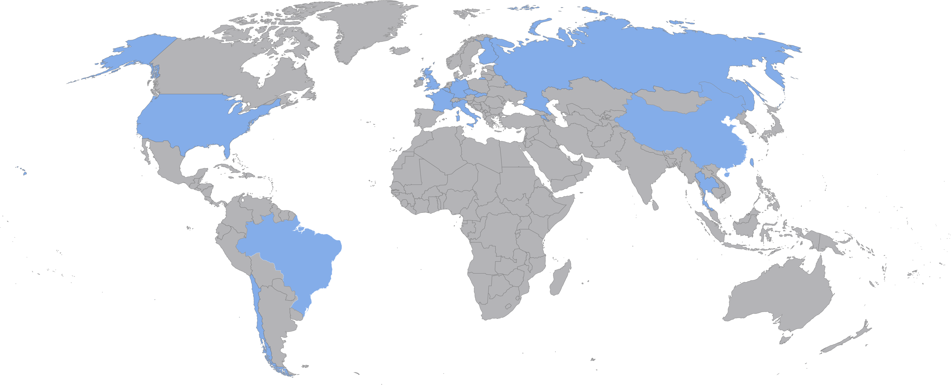
JUNO Project and the Collaboration
firstly approved in China in 2013 and later in other countries. Civil construction started in 2015
Collaboration established in 2014, now >700 collaborators from 70 institutions in 16 countries/regions
Country | Institute | Country | Institute | Country | Institute
Armenia | YerPhI | China | SDU | Italy | INFN-CT
Belgium | ULB | China | SJTU | Italy | INFN-FE
Chile | SAPHIR | China | SUSTech | Italy | INFN-LNF
Chile | UNAB | China | SYSU | Italy | INFN-MI
China | BISEE | China | THU | Italy | INFN-MIB
China | CDUT | China | UCAS | Italy | INFN-PD
China | CNPRI | China | WHU | Italy | INFN-PG
China | CUGB | China | WuYiU | Italy | INFN-Roma3
China | DGUT | China | XJTU | Pakistan | PINSTECH (PAEC)
China | ECUT | China | XMU | Russia | JINR
China | GXU | China | ZZU | Slovakia | FMFI-UK
China | HIT | Czech | Charles U. | Taiwan-China | NCTU
China | HunanU | Finland | JyU | Taiwan-China | NKNU
China | IGGCAS | France | CPPM | Taiwan-China | NTU
China | IHEG-CAGS | France | IJCLab | Taiwan-China | NTUT
China | IHEP | France | IPHC | Thailand | CHULA
China | IMP | France | LP2iB | Thailand | NARIT
China | JNU | France | Subatech | Thailand | SUT
China | JXNU | Germany | EKUT | U.K. | U. Liverpool
China | KNRC | Germany | GSI | U.K. | U. Warwick
China | Nankai U. | Germany | U. Hamburg | USA | UC-Irvine
China | NCEPU | Germany | JGUMainz | USA | UMD-G
China | NJU | Germany | RWTH-AC
China | RNCG | Germany | TUM
+Observers: USTC, Peking Uni., Jilin Uni., Beijing Normal Uni., CIAE (China), PUC, UEL (Brazil)
Notes:
JUNO 项目 2013 年在中国首先获批，2014 年成立国际合作组，2015 年开始土建。现在合作组规模已经超过 700 人，来自 70 个机构和 16 个国家或地区。北大也是 JUNO 相关的观察成员之一，所以今天在北大介绍这些结果也很有意义。

Slide 9
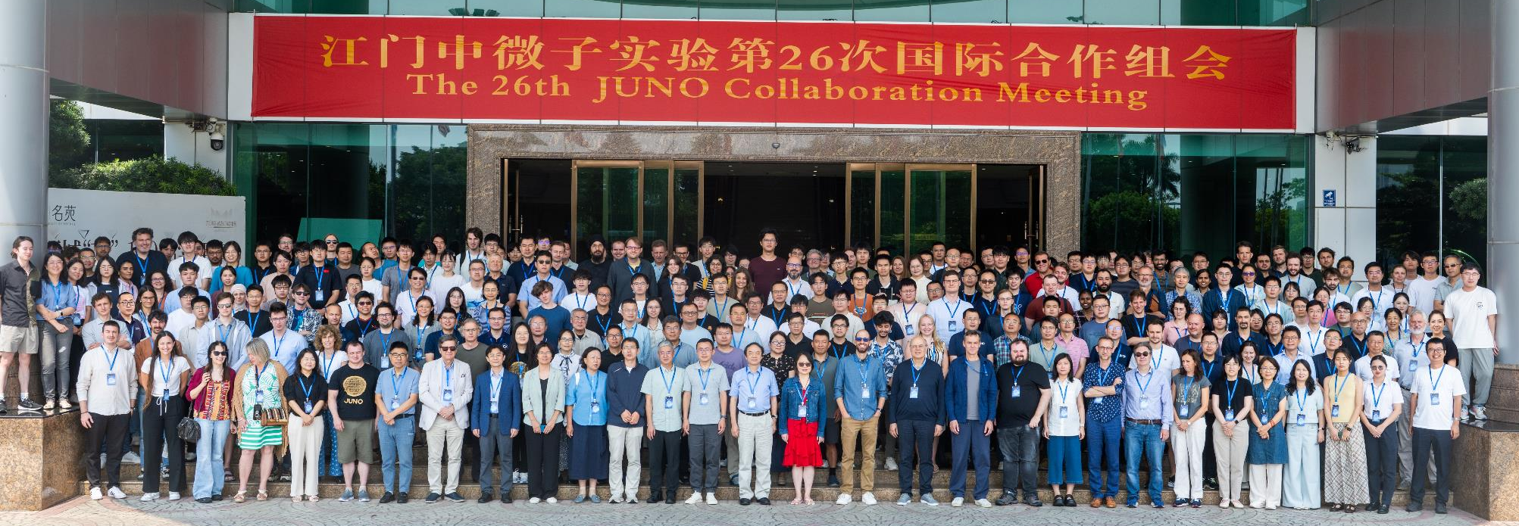
JUNO Project and the Collaboration
firstly approved in China in 2013 and later in other countries. Civil construction started in 2015
Collaboration established in 2014, now >700 collaborators from 70 institutions in 16 countries/regions
Country | Institute | Country | Institute | Country | Institute
Armenia | YerPhI | China | SDU | Italy | INFN-CT
Belgium | ULB | China | SJTU | Italy | INFN-FE
Chile | SAPHIR | China | SUSTech | Italy | INFN-LNF
Chile | UNAB | China | SYSU | Italy | INFN-MI
China | BISEE | China | THU | Italy | INFN-MIB
China | CDUT | China | UCAS | Italy | INFN-PD
China | CNPRI | China | WHU | Italy | INFN-PG
China | CUGB | China | WuYiU | Italy | INFN-Roma3
China | DGUT | China | XJTU | Pakistan | PINSTECH (PAEC)
China | ECUT | China | XMU | Russia | JINR
China | GXU | China | ZZU | Slovakia | FMFI-UK
China | HIT | Czech | Charles U. | Taiwan-China | NCTU
China | HunanU | Finland | JyU | Taiwan-China | NKNU
China | IGGCAS | France | CPPM | Taiwan-China | NTU
China | IHEG-CAGS | France | IJCLab | Taiwan-China | NTUT
China | IHEP | France | IPHC | Thailand | CHULA
China | IMP | France | LP2iB | Thailand | NARIT
China | JNU | France | Subatech | Thailand | SUT
China | JXNU | Germany | EKUT | U.K. | U. Liverpool
China | KNRC | Germany | GSI | U.K. | U. Warwick
China | Nankai U. | Germany | U. Hamburg | USA | UC-Irvine
China | NCEPU | Germany | JGUMainz | USA | UMD-G
China | NJU | Germany | RWTH-AC
China | RNCG | Germany | TUM
+Observers: USTC, Peking Uni., Jilin Uni., Beijing Normal Uni., CIAE (China), PUC, UEL (Brazil)
Notes:
这一页还是合作组和项目概况，我会快速带过。想强调的是 JUNO 不是单一的反应堆实验，而是一个大型低能中微子观测平台。它的探测器性能和数据样本会支撑后面很多物理方向，包括超新星、地球中微子、太阳中微子和新物理搜索。

Slide 10
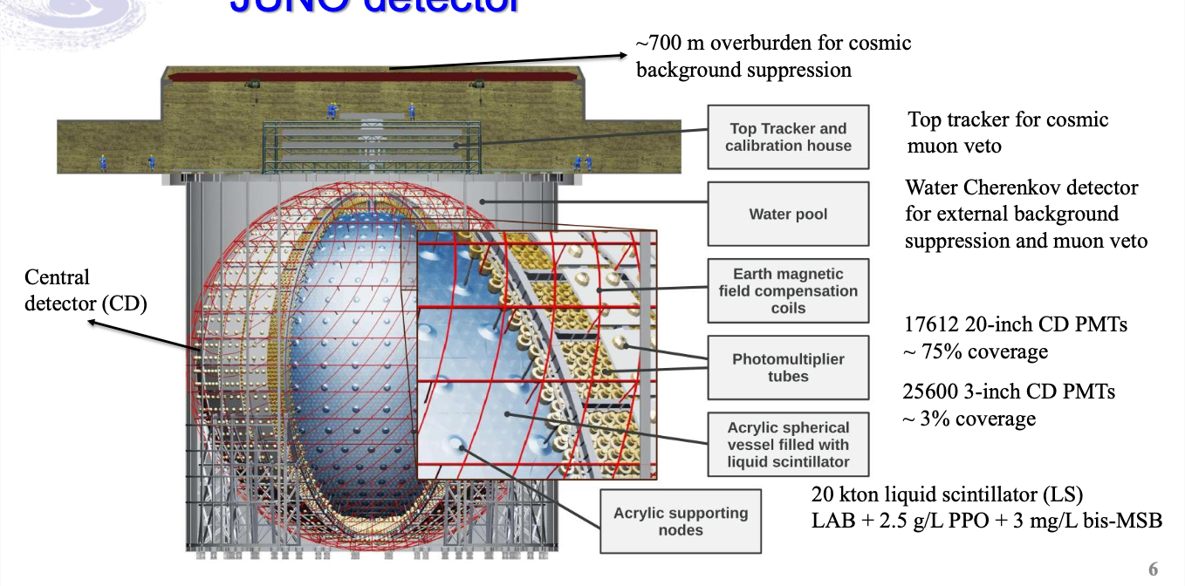
JUNO Detector
10

Slide 11
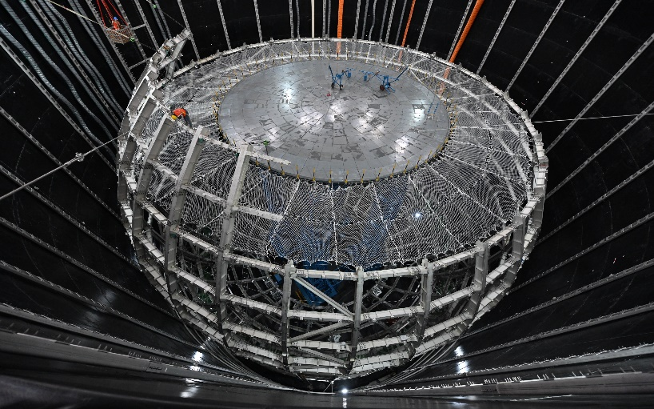
Steel Structure and the Installation Platform

Slide 12
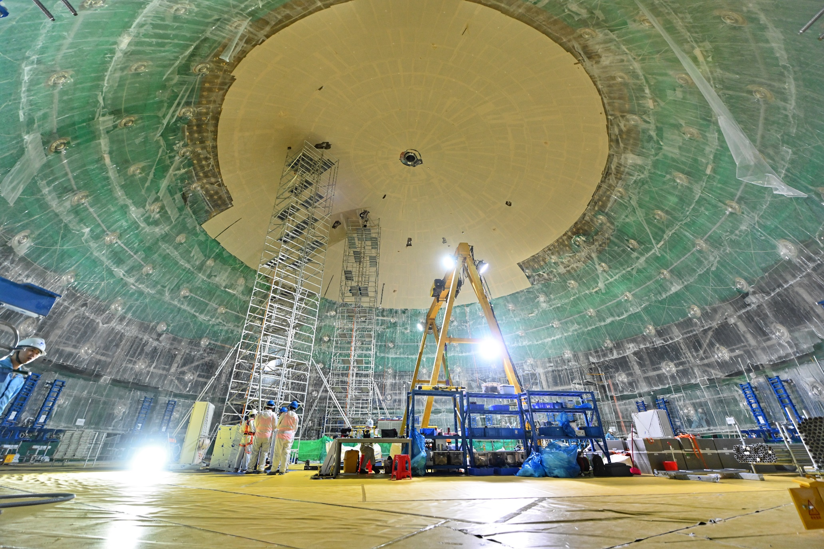
Working for Acrylic on the Platform

Slide 13
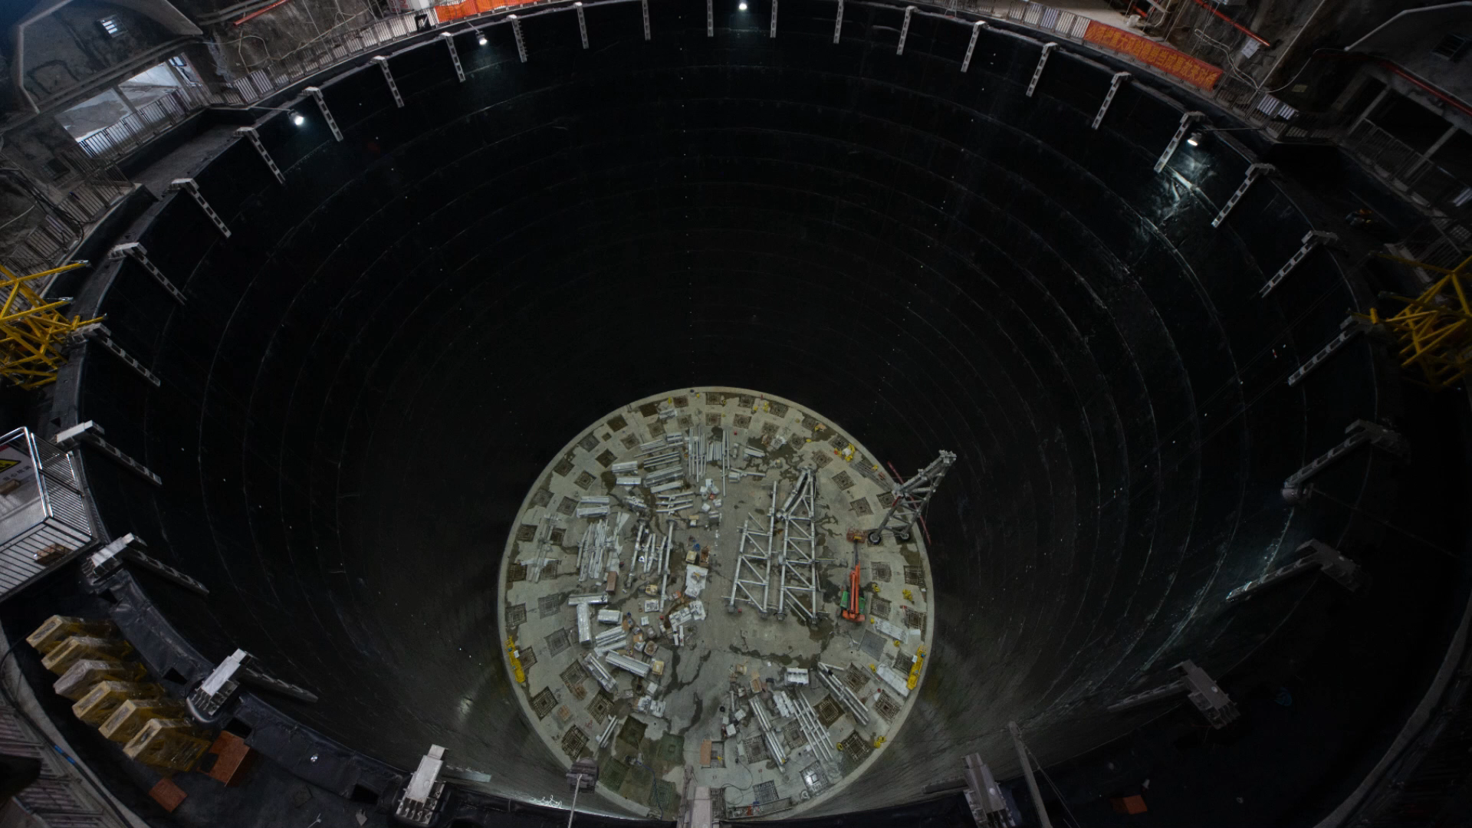

Slide 14
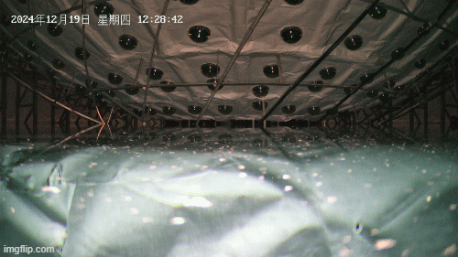
Water filling began on December 18, 2024.

Slide 15
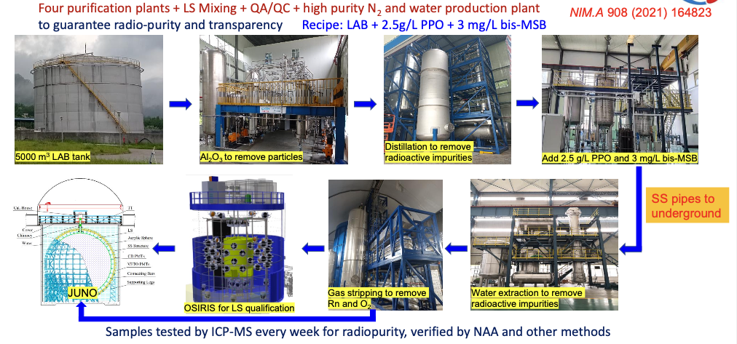
Liquid-scintillator filling began on February 8, 2025
Fluors
Base solvent
Notes:
下面我介绍一下 JUNO 的液体闪烁体系统。
JUNO 使用了大约 2 万吨液体闪烁体，是目前世界上最大的液体闪烁体探测器之一。对于这样大体积的探测器来说，最关键的要求有两个：一个是超高放射性纯度，另一个是足够好的光学透明度。
为了实现这一目标，JUNO 建立了一整套非常完整的液闪纯化与质量控制系统。
首先，液闪的基础溶剂是 LAB，也就是 Linear Alkyl Benzene。左上角这张图展示的是 5000 立方米的 LAB 储罐。
随后，液闪会经过多级纯化流程。首先通过氧化铝吸附去除颗粒杂质；之后进行蒸馏，用于去除放射性杂质和化学污染物。
在完成基础纯化之后，会向液闪中加入荧光材料。目前 JUNO 使用的配方是：
2.5 g/L 的 PPO
3 mg/L 的 bis-MSB
这个配方在光产额、透明度以及长期稳定性之间取得了比较好的平衡。
接下来，液闪还会经过水萃取和气体剥离等步骤。
其中，水萃取主要用于进一步去除放射性杂质；而气体剥离则主要去除氡气以及氧气。因为氧气会影响闪烁光产生，而氡则会带来额外本底，因此这一步非常重要。
之后，液闪会通过不锈钢管道输送到地下实验大厅，并最终注入 JUNO 探测器。
在正式注入之前，我们还使用了一个叫 OSIRIS 的原型系统，对液闪进行在线质量验证和放射性评估，确保最终进入探测器的液闪满足设计要求。
此外，JUNO 还建立了持续性的质量监控体系。我们每周都会取样，并通过 ICP-MS 等高灵敏度方法测量放射性纯度，同时还会使用中子活化分析（NAA）等方法进行交叉验证。
总体来说，这一整套复杂的纯化与质量控制流程，使 JUNO 能够实现极低本底和高透明度，这对于反应堆中微子、太阳中微子、超新星中微子以及其他低能稀有事例探测都至关重要。

Slide 16
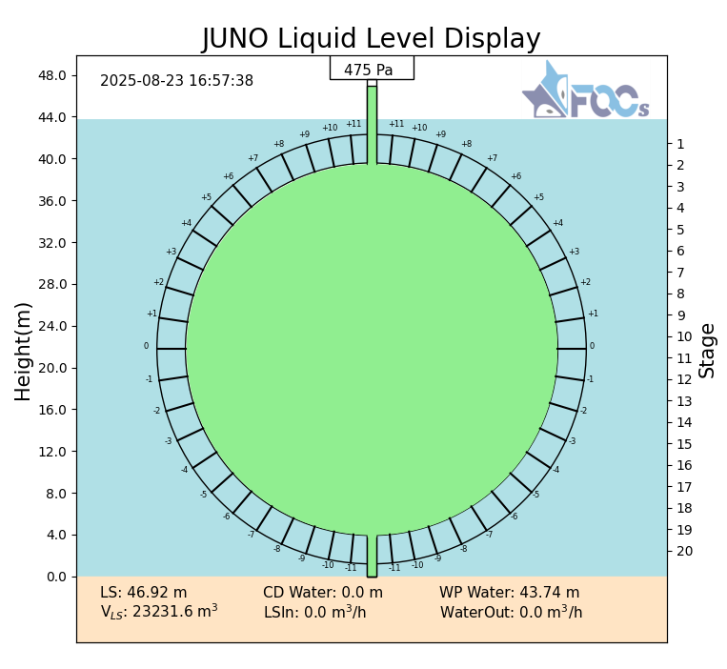
Physics data taking began on August 26, 2025
On August 22,2025 at ~22:12, water in Acrylic tank was fully replaced by Liquid Scintillator
Calibration started at 14:00 of Aug. 23
Data taking for physics started on Aug. 26 at 5:30 am (Beijing time)
Total LS in CD: 23231.6 m³
Total water in pool: 41225.1 m³
16
Notes:
JUNO 已经进入稳定取数阶段。2025 年 8 月 22 日，丙烯酸球内的水完全替换为液闪；8 月 23 日开始校准；8 月 26 日开始物理取数。中心探测器液闪体积约 23231.6 立方米，水池中有约 4 万吨超纯水。这标志着 JUNO 从建设阶段进入数据阶段。

Slide 17
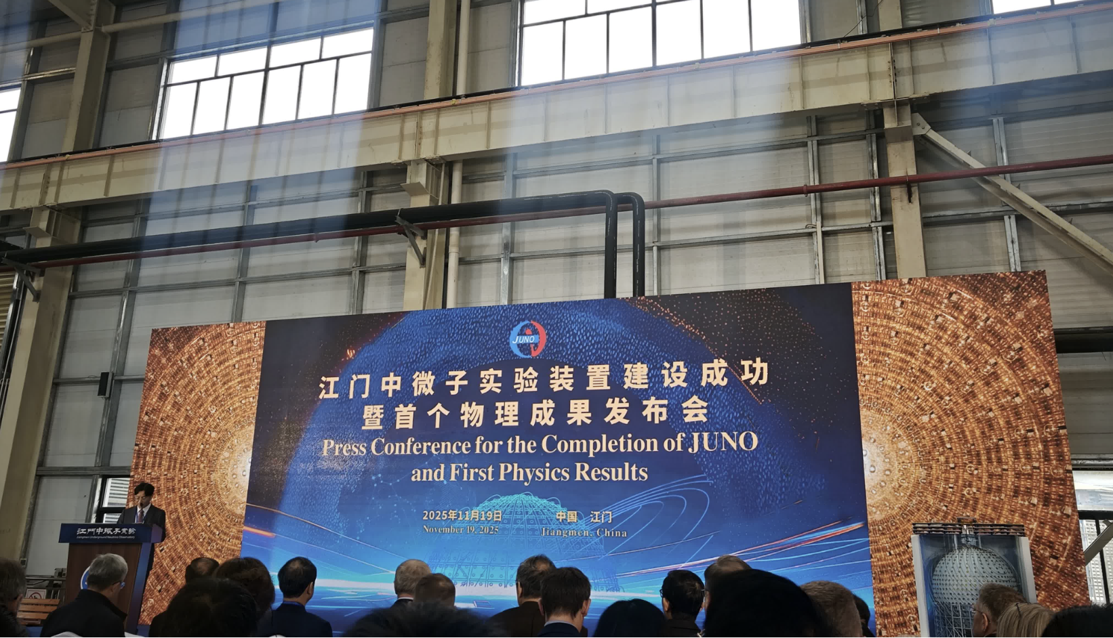
First Results from JUNO
Released on Nov. 19, 2025. “First measurement of reactor neutrino oscillations at JUNO”, arXiv:2511.14593
Press Conference in Jiangmen
Notes:
第一批结果使用约 59 天数据，最初以预印本形式发布，后来正式发表在 Nature。这个结果的意义不仅是观测到 JUNO 的反应堆振荡谱，更重要的是验证了整个分析链：选事例、本底估计、能量响应、反应堆源项和振荡拟合。给学生强调：第一篇结果不是终点，而是证明 JUNO 可以在短时间内看到清楚振荡谱，并把 detector performance 转化成物理测量。

Slide 18
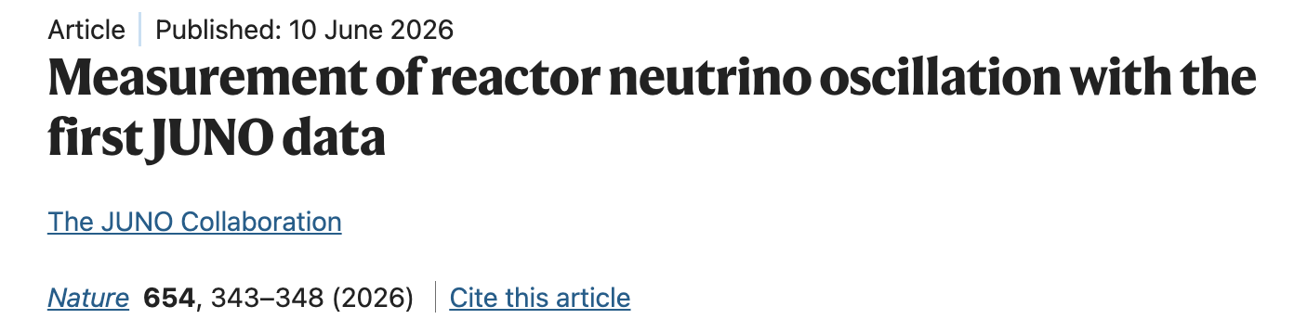
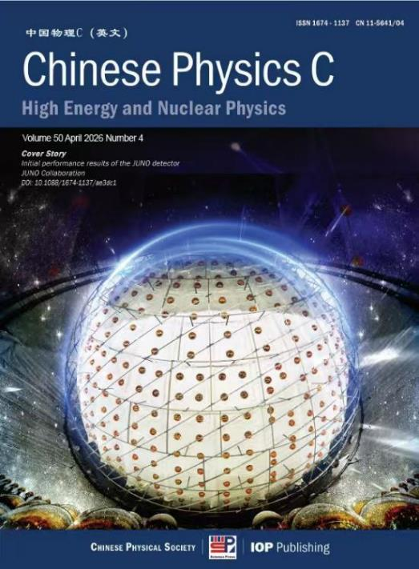
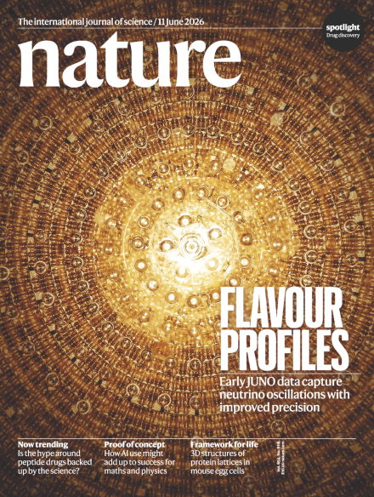
First Results from JUNO
“Initial Performance of the Detector” Chinese Phys. C 50, 043001 (2026)
First results using 59 days of data recently published
Notes:
这页强调 59 天 Nature 结果。虽然统计量还不大，但已经能够看到清楚的振荡结构，并给出 theta12 和 Delta m21 平方的高精度测量。后面的 207 天新结果就是在这个基础上扩大统计量、优化选择和进一步压低本底。

Slide 19
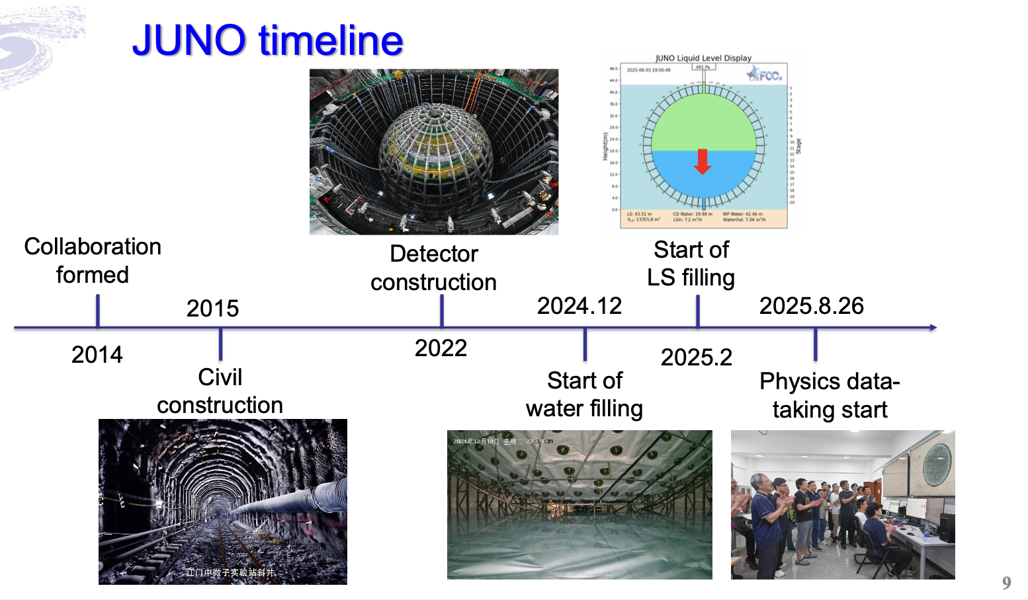
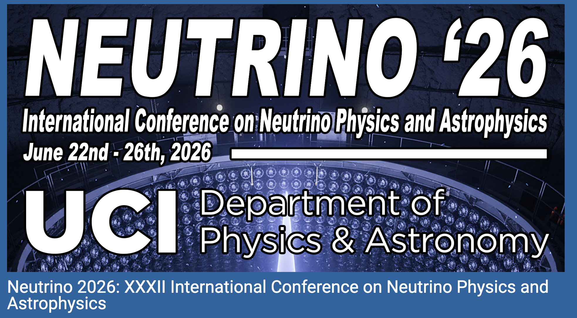
JUNO Timeline
Start of detector installation
First Results
announced
2026.6
2025.11
First Results
published in Nature
New Results released in Neutrino 2026!
Notes:
这里是 JUNO 第一批结果的时间线。2025 年 11 月 19 日，JUNO 公布了首个反应堆中微子振荡结果。对一个新建成的大型探测器来说，能在几十天数据内给出物理结果，本身也是对探测器性能的强检验。

Slide 20
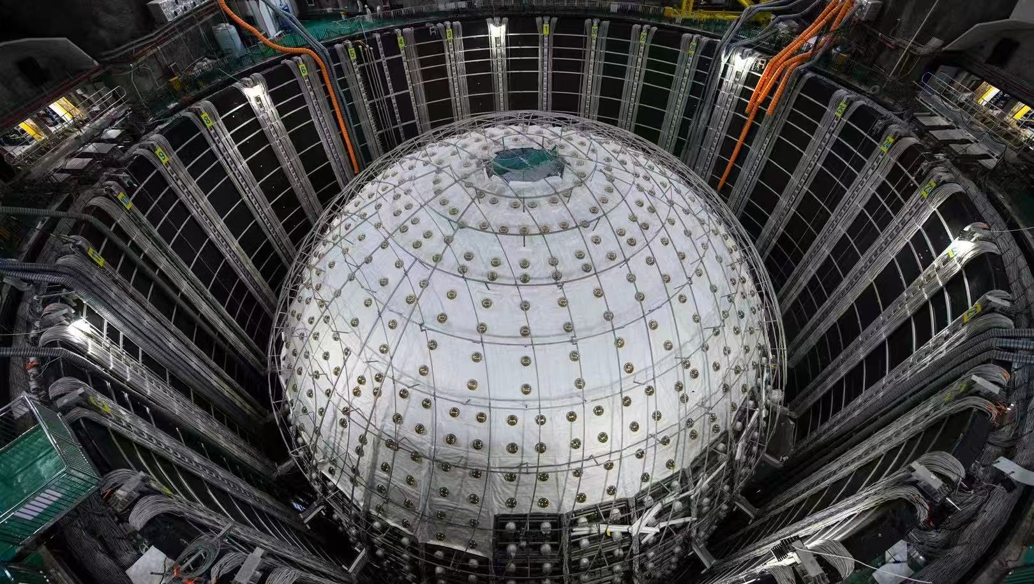
Performance of the Detector

Slide 21
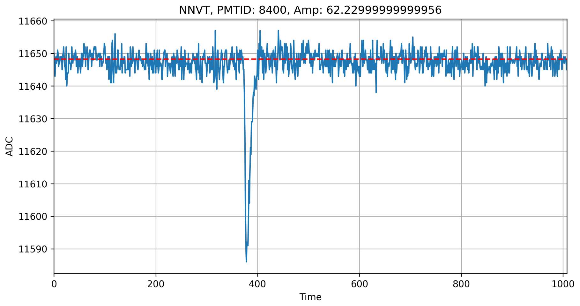
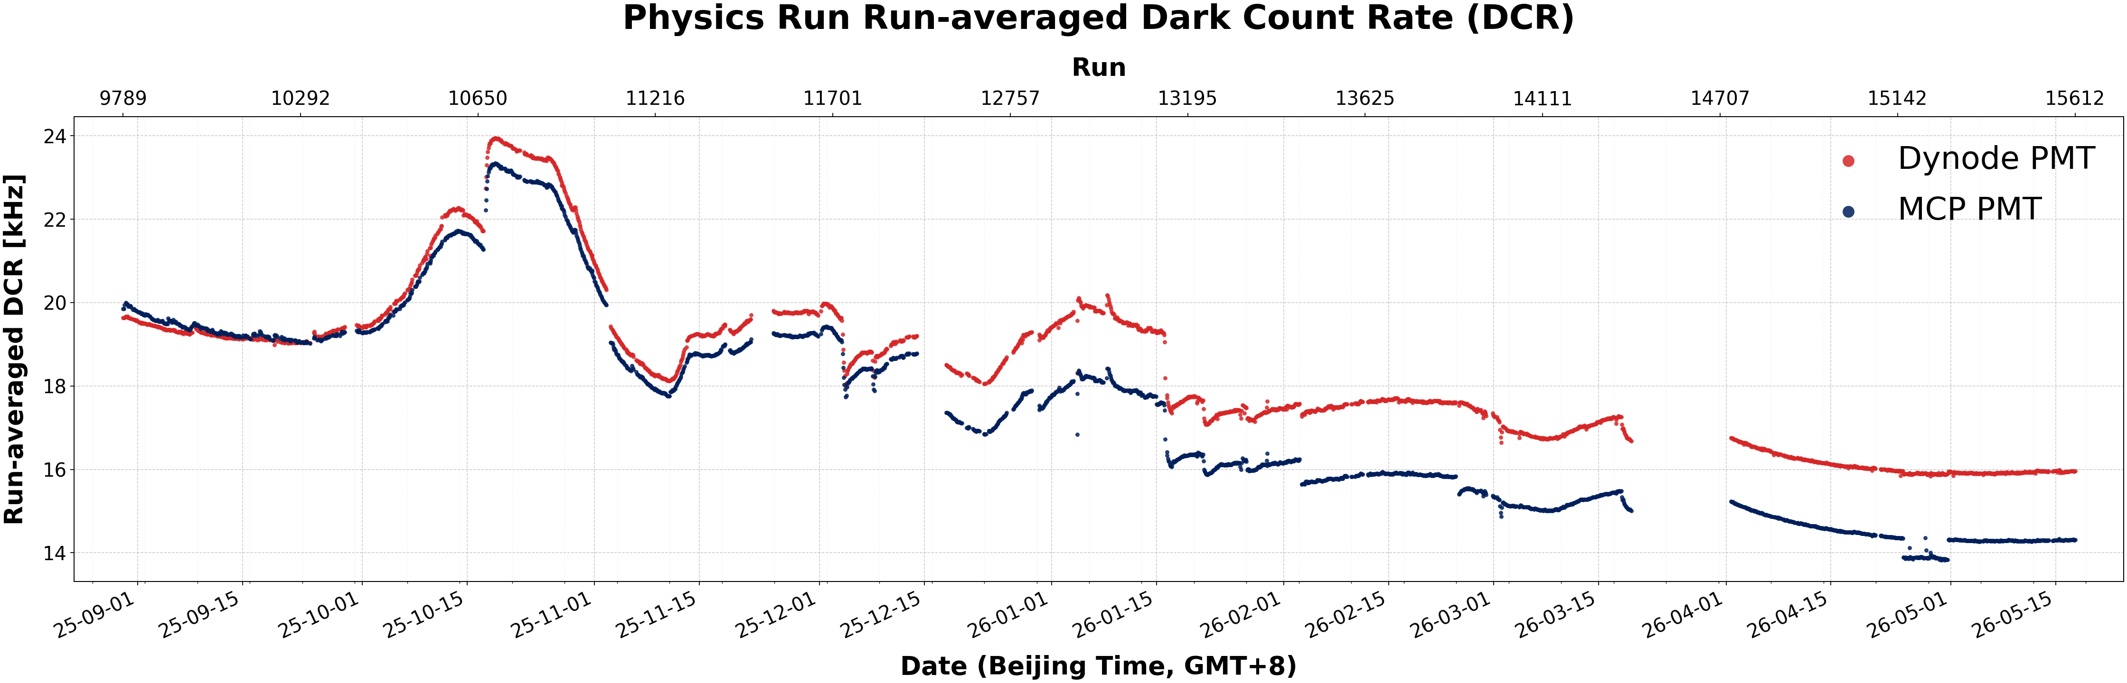
Low-Level Detector Performance
Waveform of a typical PMT
Large PMTs work fine
  17612-16 LPMTs installed for CD, 2400-1 LPMTs installed for VETO
  ~26 dead PMTs, ~600 flashing PMTs
  Gains of MCP (Dynode) PMTs are reduced from 7.4×10⁶ to 4.0×10⁶ (6.5×10⁶ to 5.5×10⁶), efficiencies not affected
Great performance of electronics:
  Good grounding and low noise:
    RMS ~2.8 ADC ch. ➔ ~0.055 PE
  PMT threshold: 0.2-0.3 PE/ch.
Trigger and DAQ work fine
  Trigger threshold: ~200 keV
Dark Count Rate continuously decreasing
  Variations due to HV changes and water temperature
17 kHz
15 kHz
Preliminary
Notes:
底层硬件运行情况总体很好。大 PMT、电子学、触发和 DAQ 都稳定工作，噪声水平低，触发阈值可以做到约 200 keV。这里不展开工程细节，只强调一点：稳定、低噪声的读出是后面低能物理和能量重建的基础。可以

Slide 22
Clean Detector
  Ultra-low natural radioactivity, fulfill reactor neutrino oscillation measurement
Central Detector | Specification | Measure
Singles Rate (Hz) | < 7.2 Hz | < 7 Hz
²³⁸U/²³²Th (×10⁻¹⁵ g/g) | < 1 | < 0.1
²¹⁰Po (×10⁴ cpd/kt) | < 8 | < 5
Muon Veto Detector | Specification | Measure
²²²Rn (mBq/m³) | < 10 | <10
²²⁶Ra (mBq/m³) | < 1 | < 0.01
U/Th (×10⁻¹⁵ g/g) | <10 | <0.4
  20,000 tons of liquid scintillator with dust levels on the order of 10 milligrams.

Slide 23
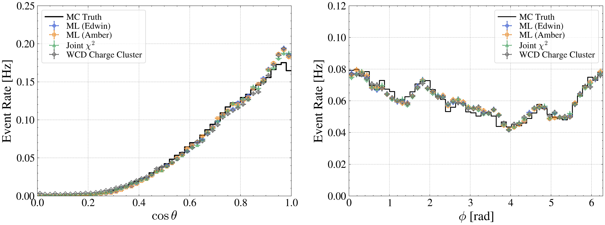
Measurement of Cosmic Muons
  Muon trigger rate in CD ~5 Hz, in Water Pool ~4 Hz
  Muon detection efficiency of CD through-going muons > 99.5%
  Reconstructed angular distributions in good agreement with Monte Carlo simulation
Work in progress
Work in progress
Muon’s flux and energy spectrum, mountain’s profile and density are well understood.
Notes:
宇宙线 muon 是地下实验的重要本底来源。JUNO 位于约 700 米岩石覆盖下，仍然有 muon 穿过。中心探测器和水池可以高效率标记 muon，测到的角分布也和山体模拟一致。这说明我们对 overburden 和 muon-induced backgrounds 的建模是可靠的。重点句：JUNO 不只是要看到 muon，还要知道它从哪里来、轨迹如何、之后多长时间和多大空间范围需要 veto。

Slide 24
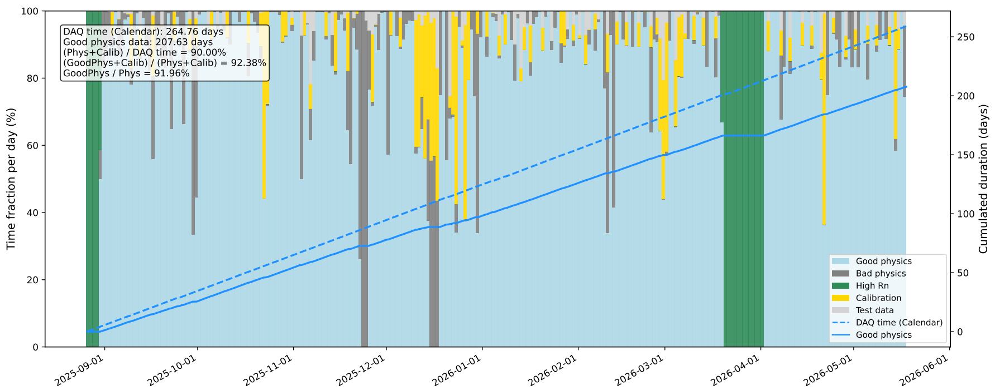
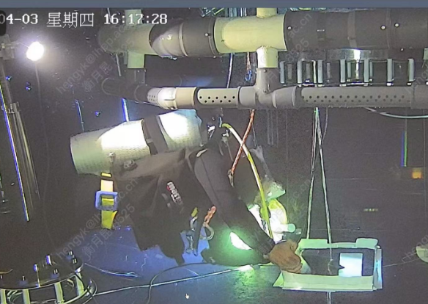
Data Taking
Smooth data-taking, gaps mainly due to weather-related power outage
Main structure is safe, stress within expectations
  Two leaks occurred in Mar 2025 (fixed in 1 week) and Mar 2026 (fixed in 2 days)

Slide 25
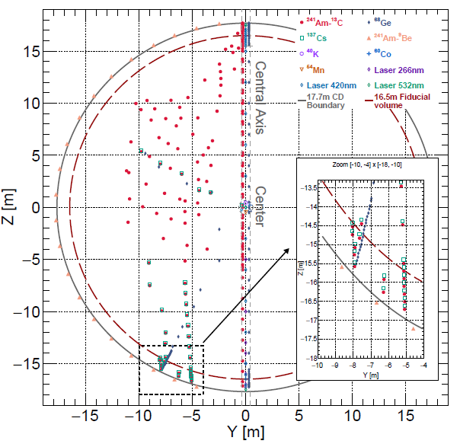
Calibration
1D (central axis): ¹³⁷Cs, ⁵⁴Mn, ⁴⁰K, ⁶⁸Ge, ⁶⁰Co, Am-C, Am-Be, sensors, laser
2D (cable loop): Am-C, ⁶⁸Ge, ¹³⁷Cs
3D using cosmogenic backgrounds:
  Bi-Po214 from Rn decays, spallation neutrons, other cosmogenic isotopes
Positions at which source calibration performed
No ²²²Rn leakage or other contaminations introduced during calibration

Slide 26
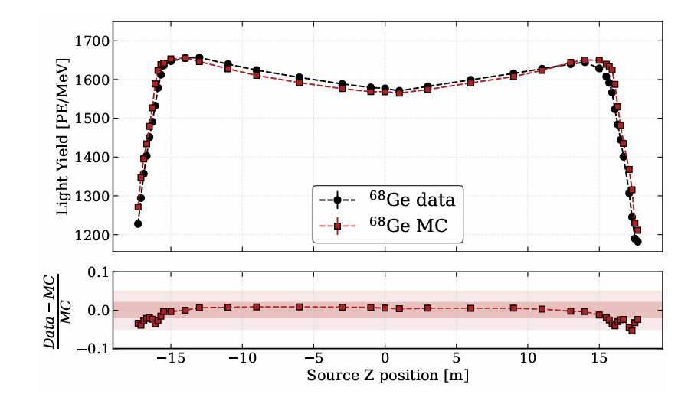
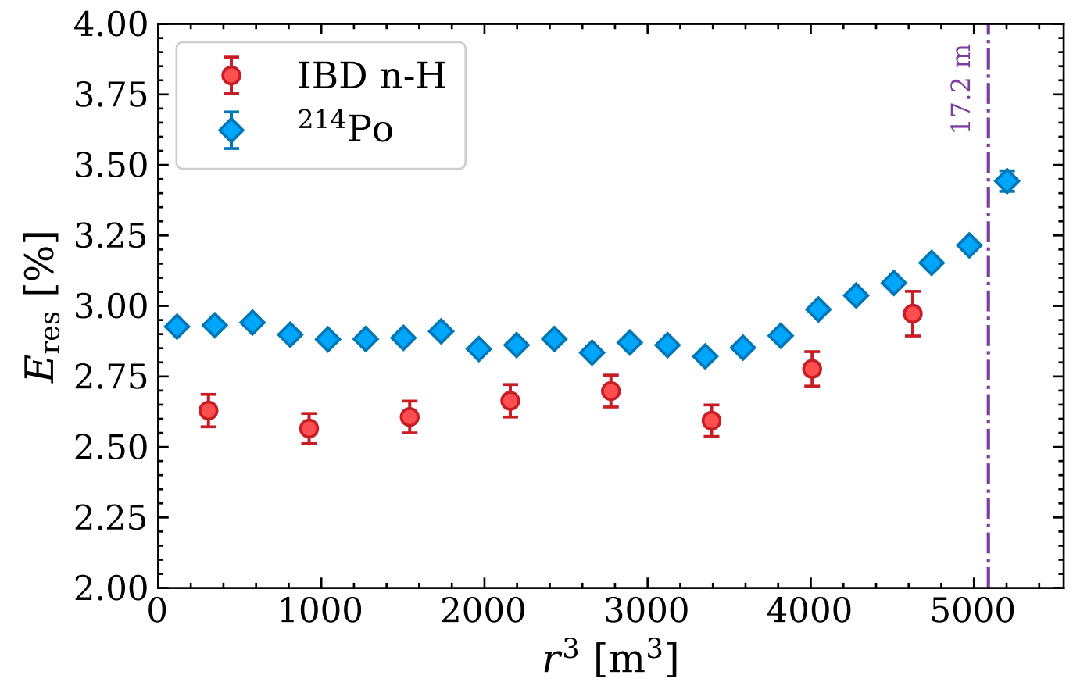
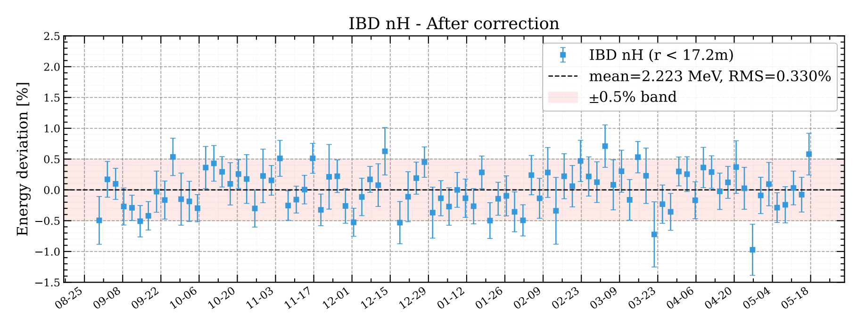
Reconstruction and Energy Correction
Light yield at the detector center is ~1600 PE/MeV for ⁶⁸Ge and ~1785 PE/MeV for neutrons, in good agreement with MC
Energy resolution for ⁶⁸Ge is ~3.5% @ 2× 0.511 MeV at the center
Energy resolution for alpha from ²¹⁴Po is ~2.9% @0.93MeV
Energy scale anchored at neutron capture on hydrogen (n-H) from ⁹Li+IBD
Time dependent variations corrected by ²¹⁴Po in the whole volume, check by n-H from IBD
Light yield of ⁶⁸Ge
Preliminary
Energy resolution vs r³
Preliminary
IBD n-H after correction
Preliminary
RMS = 0.3%

Slide 27
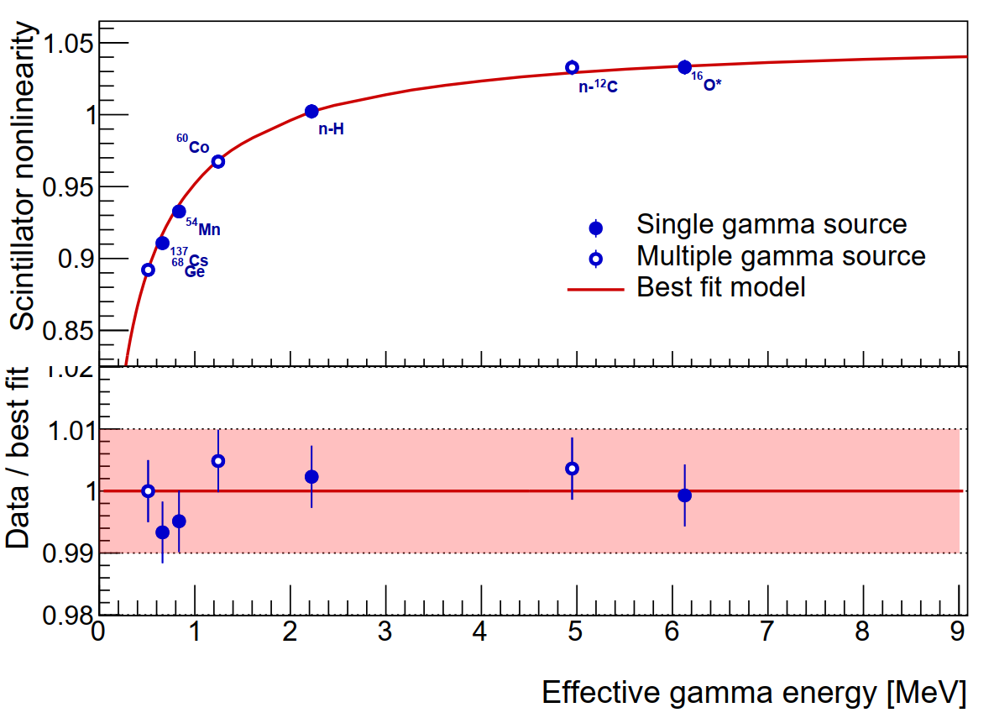
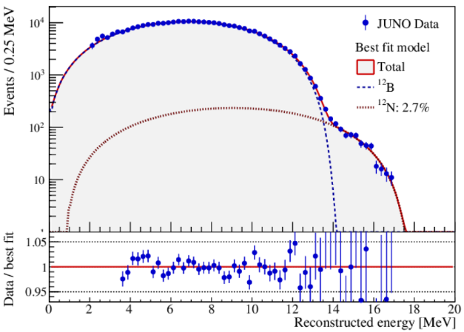
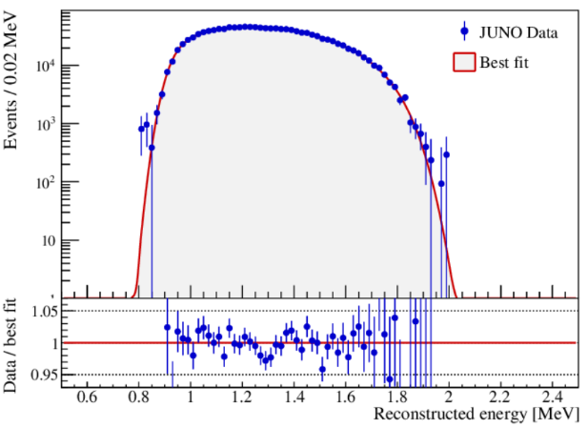
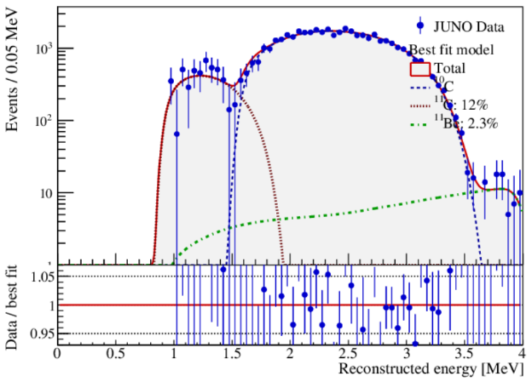
Energy Non-linearity
Preliminary
Non-linearities of LS and electronics are determined by calibration sources at the center: ⁶⁸Ge, ¹³⁷Cs, ⁵⁴Mn, ⁴⁰K, ⁶⁰Co, Am-C, and Am-Be
The non-linearity model for e⁺ is based on Geant4 and γ-sources
The model is constrained by cosmogenic isotopes, ¹¹C(e⁺), ¹⁰C(e⁺), ¹²B(e⁻), ⁸Li (e⁻), ⁸B(e⁺), ⁶He(e⁻), etc. in the whole volume
Using sPMTs to correct and constrain LPMT instrumental non-linearity
Uncertainty < 1%
γ @Detector center
Cosmogenic ¹²B
Cosmogenic ¹¹C
Cosmogenic ¹⁰C
27

Slide 28
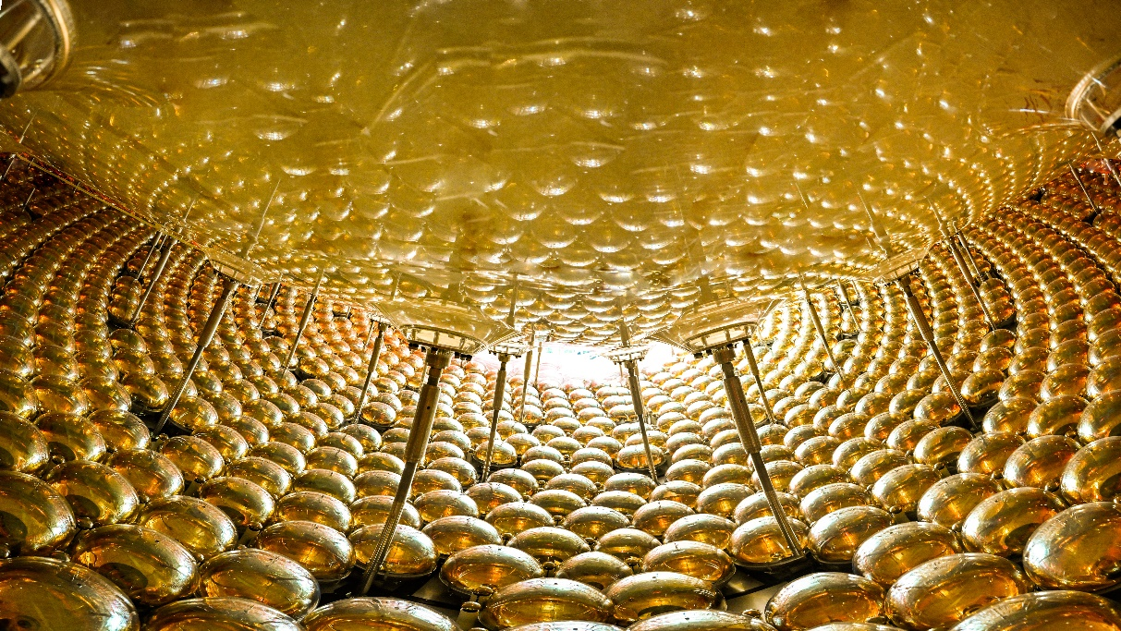
New Results released using 207 days of data
Notes:
接下来进入 Neutrino 2026 上公布的新结果：使用 207 天数据。相比 59 天结果，这次统计量显著增加，同时分析选择也做了优化，因此能够给出更精确的太阳振荡参数，并第一次给出 JUNO 自身对 Delta m31 平方和质量排序的约束。

Slide 29

Reactor Neutrino Selection
Prompt and delayed coincidence in time, space with energy features
energy
Similar to our “Nature” paper
time
What is new in this analysis:
  ~10% more fiducial volume (R=16.5m➔17.2m)
  ~60% reduction of ⁹Li bkg.
  a factor of 50 reduction of accidental bkg. using likelihood cut
  model independent estimate of the ²¹⁴Bi bkg.
space

Slide 30

Reactor Neutrino Event Rate versus Time
Measured reactor neutrino event rate consistent with expectation
Total live time is 207.2 days
χ²/n.d.f. = 40.1/37

Slide 31


Measured Reactor Neutrino Spectrum
Fitting constrained by the near detector spectra from TAO and Daya Bay
Consistent results from three independent analyses

Slide 32



New Results of Solar Oscillation Parameters
Even though the statistical uncertainty is dominant, systematic errors become important:
  ²¹⁴Bi bkg. and detection eff. can be improved
Δm²₂₁ | 7.388±0.078 (1.60% →1.06%)
sin²θ₁₂ | 0.3036±0.0064 (2.8%→2.1%)

Slide 33


First Result of Δm²₃₁
Due to statistical fluctuations, JUNO only profiles of Δm²₃₁ have multiple minima
The final minimum for each mass ordering is obtained by using the Δm²₃₁ constraint from the Daya Bay result (PRL 130 16, 161802)
Feldman-Cousins (FC) method is used to determine the 1σ range of Δm²₃₁：~1% precision achieved
[-1.05%，+1.00%]
[-1.00%，+1.08%]

Slide 34

Adding Constraint from NuFit-LBL
Δm²₃₁ from reactor and accelerator neutrinos should align at the right mass ordering[1]
Adopt the NuFit-LBL results from [2]: normal mass ordering is favored at Δχ² = 4.86
[1] H. Nunokawa, S. Parke and R.Z. Funchal, Phys. Rev. D 72 (2005) 013009; Y. F. Li et al., Phys. Rev. D 88, 013008 (2013)
[2] NuFIT 6.0 (JHEP 12 (2024) 216 [arXiv:2410.05380]), www.nu-fit.org and M. Maltoni private communication

Slide 35


Neutrino Mass Ordering Significance
Frequentist approach using pseudo exp. to convert Δχ² to significance
Influence of δ_{CP} considered (scanned)
Normal Ordering is favored at 2.3σ
Bayesian approach using Markov Chain Monte Carlo(MCMC) method
Normal Ordering is favored with a Bayes factor of 10.18 ➔ 2ln κ= 4.64
  Consistent with the frequentist Δχ²

Slide 36

Consistent Results from Independent Analyses
Our 3 independent analyses got consistent results (0.2σ)
  different event reconstruction code, fiducial volume, selection cuts, efficiency, background estimation, energy response models and oscillation fitters

Slide 37
Comparison of Results on Oscillation Parameters
sin²2θ₁₂
Δm²₃₁
Δm²₂₁
Results from JUNO have smallest uncertainties

Slide 38
Rich Physics beyond Reactor Neutrino
JUNO
U. Katz and C. Spiering, Prog. Part. Nucl. Phys. 67, 651 (2012)
Notes:
JUNO is sensitive to neutrinos over a broad energy range.
The detector can study not only reactor antineutrinos, but also solar neutrinos, geoneutrinos, atmospheric neutrinos, supernova neutrinos, and diffuse supernova neutrino background.
This makes JUNO a multi-purpose neutrino observatory.
The large target mass, low background, and good energy resolution are useful for many different physics topics.
The next slide summarizes these physics opportunities.

Slide 39






Physics at JUNO
Supernova Neutrinos
Cosmic evolution, star formation, supernova explosion mechanism
Diffuse Supernova Neutrino Background
Potential to discover DSNB
Atmospheric Neutrinos
Complementary to reactor neutrinos to improve the sensitivity to mass ordering
Solar Neutrinos
Examine the dynamics of stellar evolution
700 m
Geoneutrinos
Examine the Earth's geophysical model
Reactor Neutrinos
Determine neutrino mass ordering
Measure oscillation parameters
New physics searches
e.g., proton decay and sterile neutrinos
J. Phys. G 43 (2016) 030401
Prog. Part. Nucl. Phys. 123(2022), 103927
Notes:
This slide summarizes the physics program of JUNO.
For reactor neutrinos, JUNO will determine the mass ordering and precisely measure oscillation parameters.
For geoneutrinos, JUNO can probe the Earth’s radiogenic heat and test geophysical models.
For solar neutrinos, JUNO can study stellar evolution and solar neutrino oscillations.
For supernova neutrinos, JUNO can detect a large number of events from a galactic supernova and provide valuable information about the explosion mechanism.
JUNO is also sensitive to the diffuse supernova neutrino background, and can search for new physics such as proton decay and sterile neutrinos.
Let me give one example: supernova neutrinos.

Slide 40



New Results on Geo-neutrinos
Fits are performed without constraint on geo-neutrino flux, but with 3.4±10% U/Th ratio
  Constraining the geo-nu flux doesn’t change oscillation results
Clear geo-nu signals at 1-3 MeV, giving a flux of 73 ± 11 TNU
  Largest geo-neutrino samples so far, and most precise measurement
JUNO result is higher than expectation from existing models, but not statistically significant
Need more JUNO data and more refined geological model predictions
geo-ν

Slide 41

Diffuse Supernova Neutrino Background
DSNB: The accumulated neutrino signal from all core-collapse supernovae throughout cosmic history
19 DSNB candidate events were observed in 12–30 MeV
  Consistent with the predicted background of 21.3 ± 10.5 events
  A competitive upper limit on the DSNB flux was obtained
A preliminary pulse-shape-discrimination (PSD) study suggests that most of these candidate events likely originate from atmospheric neutrino interactions

Slide 42



Summary
JUNO has begun stable physics data-taking. Preliminary study shows that the detector works well as designed.
With 59 days of data, world-leading precision was achieved in the measurements of $\sin^{2}θ_{12}$ and $∆m_{21}^{2}$. The 207-day dataset has further improved the measurement precision by a factor of 1.3–1.5.
First measurement on $∆m_{31}^{2}$ achieved a precision of ~1%
With external constraint, Normal Mass Ordering is favored at ~2.3σ
First geo-neutrino results yield a flux of 73 ± 11 TNU
Stay tuned for what will come next!
Notes:
大气中微子在 JUNO 中一方面是物理信号，可以补充反应堆质量排序；另一方面在 DSNB、暗物质和核子衰变搜索中又是重要本底。这里特别需要中微子-核相互作用模型和核退激发模型，这也是与核物理理论联系很强的地方。这也是为什么中微子-核相互作用建模重要，尤其在碳、氧、氩等核上，不同探测器的核靶不同。

Slide 43
Back up
Notes:
最后总结。JUNO 已经开始稳定取数，探测器性能达到设计目标。59 天 Nature 结果验证了反应堆振荡测量能力，207 天新结果进一步给出世界领先的 theta12 和 Delta m21 平方精度，并开始约束 Delta m31 平方和质量排序。更广泛地说，JUNO 是一个低能中微子平台，未来在地球中微子、太阳中微子、超新星、DSNB 以及中微子-核相互作用相关研究中都会发挥重要作用。最后可以说：未来几年，统计量增长和系统误差改善会同时推进，JUNO 的结果会越来越有分量。

Slide 44

Data Taking
Posters: 338, 48,
354, 343, 254, 359
Data taking period for this analysis: 2025.08.30-2026.05.18
Golden data are selected for physics analysis
Water leak to LS
Power outage due to weather is one of the main causes of interruptions

Slide 45



Cracks on the Acrylic Tank
Main structure is safe, stress within expectations
However, a LS leak to water happened on March 21, 2025:
  Abnormal trigger rate observed and confirmed by under water robot
  Leak was stopped within 1 week using epoxy and tape by divers
  Further repair by epoxy and acrylic plate to reduce the stress (pulling open the crack) by 50%
Another leak of water to LS happened on March 19, 2026:
  Experienced divers were called to stop the leak within 2 days
  Further repair in the following two days
  A total of ~1Bq ²²²Rn went into LS, 13 days of data excluded
  No other increase of radioactive backgrounds in LS
epoxy

Slide 46




PMT Testing and Installation
Container test stations
Scanning station
Cables in corrugated pipes
 | LPMT (20-inch) |  | SPMT (3-inch)
 | Hamamatsu | NNVT | HZC
Quantity | 5000 | 15012 | 25600
Charge Collection | Dynode | MCP | Dynode
Photon Detection Efficiency | 28.5% | 30.1% | 25%
Dynamic range for [0-10] MeV | [0, 100] PEs |  | [0, 2] PEs
Coverage | 75% |  | 3%
Reference | Eur.Phys.J.C 82 (2022) 12, 1168 |  | NIM.A 1005 (2021) 165347
Notes:
备份页：如有相关问题再展开说明。

Slide 47



Neutrinos from Sun (Be7, pep and CNO)
Angel Abusleme et al JCAP10(2023)022
Notes:
备份页：如有相关问题再展开说明。

Slide 48


Supernova Relic Neutrinos
Background Reduction Techniques: Muon Veto, Fiducial Volume Cut, Pulse Shape Discrimination, Triple Coincidence cuts, …
Fiducial Volume 1
Before background reduction
Prompt-like: nuclear de-excitation and recoil
Delayed-like: neutron capture
After background reduction
JUNO Collaboration, JCAP 10 (2022) 033
The dominant background for DSNB detection comes from atmospheric neutrinos interacting via neutral-current (NC) processes with ¹²C nuclei in JUNO's liquid scintillator.
Notes:
DSNB 是所有历史核心坍缩超新星中微子的累积背景。JUNO 通过 IBD 搜索 DSNB，但最危险的本底来自大气中微子在碳 12 上的 neutral-current 相互作用。代表性过程可以写成 nu_atm 加 12C 到出射中微子、激发残余核和一个中子。残余核退激发和反冲产生 prompt-like 信号，中子俘获产生 delayed-like 信号，因此会模仿 IBD。需要用 PSD、fiducial volume、muon veto 和 triple-coincidence 方法来压低或约束。代表性公式可以写成 nu_atm + 12C -> nu + A* + n。出射中微子不可见，A* 退激发和核反冲形成 prompt-like，n 俘获形成 delayed-like。如果现场有核物理老师，可以

Slide 49



Supernova Relic Neutrinos
Average energy of SN neutrinos
Black hole
Fraction
Key information:
Supernova (SN) rate R_{SN}
Reference model
5$σ$
3$σ$
JUNO Collaboration, JCAP 10 (2022) 033
With the reference model: 3𝝈 (3 yrs) and >5𝝈 (10 yrs)
Notes:
DSNB 的物理收益包括平均超新星中微子能量、黑洞形成比例和宇宙超新星率。不同模型给出的 DSNB 通量差别较大，因此首次观测本身就很重要。JUNO 的灵敏度显示，参考模型下几年尺度有望达到 3 sigma，长期运行可接近或超过 5 sigma。因此它对平均超新星中微子谱、黑洞形成比例和恒星形成历史敏感。JUNO 的挑战是把很少的 DSNB IBD 事例从大气 NC 和其他本底中提取出来。

Slide 50

New results released in Neutrino 2026
Notes:
Neutrino 2026 还发布了一些非反应堆方向的新进展。这里我只选几个和低能中微子物理相关的例子快速介绍。重点仍然是：同一个干净、低阈值、精确校准的大液闪探测器，可以服务非常多的物理目标。

Slide 51

JUNO-0$νββ$ Upgrade
JUNO offers a unique opportunity to search for 0νββ
20 kton LS → 100-ton scale isotope loading (e.g., Tellurium)
Low background
Energy resolution < 3% @ 1 MeV
Critical R&D
Isotope loading technology
Background control
Te-LS
Concept of the experiment
Notes:
JUNO also offers a possible future opportunity to search for neutrinoless double beta decay.The basic idea is to load a large amount of isotope, such as tellurium, into the liquid scintillator.Because JUNO has 20 kilotons of liquid scintillator, even a modest loading fraction could correspond to a very large isotope mass, potentially at the 100-ton scale.The key challenges are isotope loading technology and background control.This is not part of the first physics result, but it shows the long-term potential of the JUNO detector.Let me now summarize.

Slide 52

History of Reactor Neutrino Experiments
我们正进入反应堆中微子实验的新时代
New results released!
Presented by J. Pedro Ochoa-Ricoux
Physics of the Two Infinities Conference, 2025

Slide 53


Energy Resolution Model
能量分辨率取决于粒子种类、能量和空间位置
基于 Geant4 模拟以及 α, γ 标定源数据，建立了随径向位置 R 变化的正电子（e⁺）能量分辨率解析模型
在 5% 的事例中加入 ¹⁴C 堆积效应，并利用能量响应矩阵拟合正电子能谱
Preliminary
Preliminary

Slide 54

Light Yield and Energy Resolution
在探测器中心，⁶⁸Ge 的光产额约为 1600 PE/MeV，中子的光产额约为 1785 PE/MeV ，与蒙特卡洛模拟结果符合良好
在探测器中心，⁶⁸Ge 在 2× 0.511 MeV 处的能量分辨率约为 3.5%，略差于预期的 3.1%
  需要进一步改进切伦科夫过程、光学边界和 δ 电子等过程的模拟
  可能的改进包括：利用机器学习方法去除 ¹⁴C 本底、增加标定数据，以及改进事例重建和拟合方法等
²¹⁴Po的 α 粒子在 0.93MeV 可见能量处的能量分辨率约为 2.9%
⁶⁸Ge
Light yield of ⁶⁸Ge
Energy resolution vs r³
Preliminary
Preliminary

