Slide 1
Some thoughts on AI in HEP
Hua Xing Zhu
Peking University
International Workshop on New Opportunities for Particle Physics (NOPP) 2026

Slide 2
Motivation
The unprecedented scale of AI investment demands careful evaluation of its scientific impact
  ~$1 trillion/year (~1% of global GDP) is now directed toward AI development
  In contrast: NSF Mathematical Sciences budget ≈ $200M/year
Scientists should help to define and clarify what AI can do for science:
guide responsible AI development
assess genuine scientific contributions
adapt research and education for the AI era

Slide 3
what area can AI already accelrated HEP?
AI is already accelerating many aspects of HEP research
Focus here:
  Complex multi-step workflows: requiring chains of tools, simulations, analysis codes, and validation steps
  Large-scale collaboration: coordinating multiple specialized agents or human–AI teams seamlessly
  Massive resource utilization: exploiting large-scale computing, data, and automated exploration
a chatbox on your browser, or even a cli app (codex/claude code) might not be enough
(see talks by David Shih and Huilin Qu for broad examples)

Slide 4
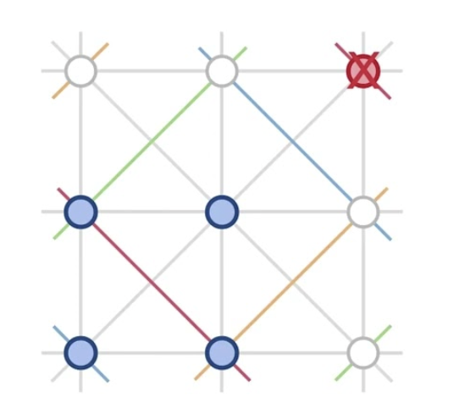

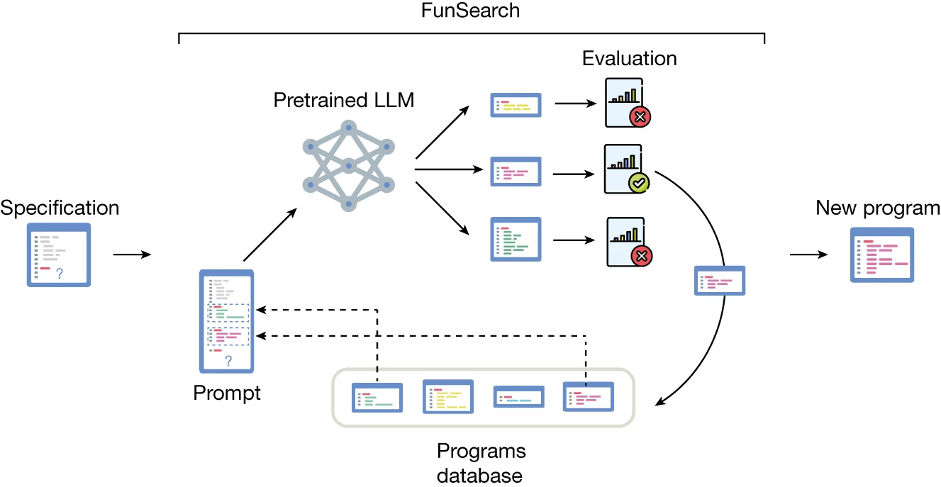
FunSearch
Genetic algorithm + LLM + Evaluator
Search for programs to optimize a combinatoric problem
Search in infinite space, but with prior knowledge
Can FunSearch helpful in high energy physics
  explainable, not just a blackbox application
achieve SOTA result on cap set problem
see also AlphaEvolve

Slide 5
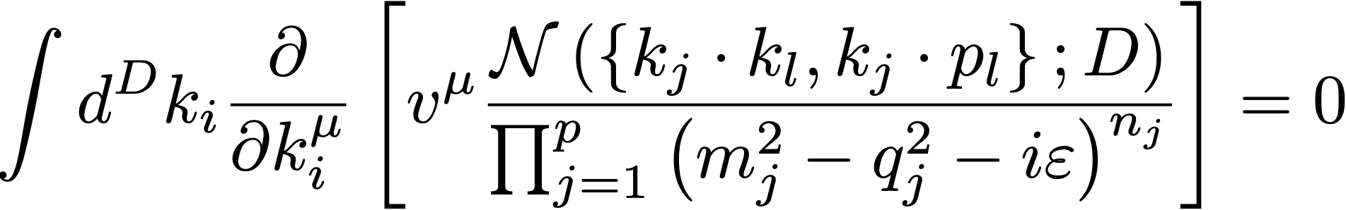


The Integration-by-parts (IBP) identities
KG Chetyrkin, FV Tkachov, NPB, 1981
polynomial in lorentz invariants
Vanishing of boundary term in dimensional regularization
Linear relations for integrals with different {nj}
Integrals with given topology related to a set of master integrals
The number of master integral finite
Each topology defines a finite dimensional vector space

Slide 6
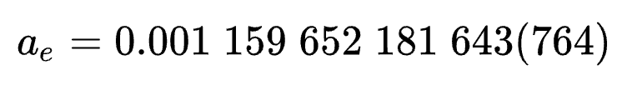

Feynman diagram in QFT
Electron Anomalous Magnetic Moment
A calculation which established the foundation of Quantum Electrodynamics
40 years of efforts!
Schwinger, Phys. Rev. 73, 416
Aoyama, Hayakawa, Kinoshita, Nio, PRL109, 11807
Hannake, Hoogerheide, Gabrielse, PRA83, 052122

Slide 7
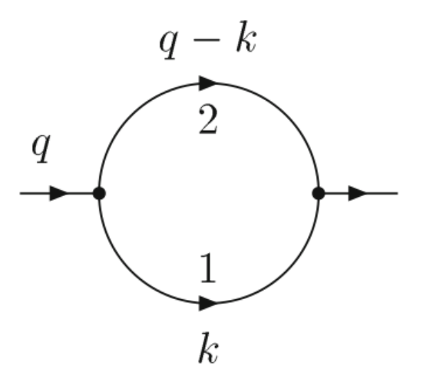

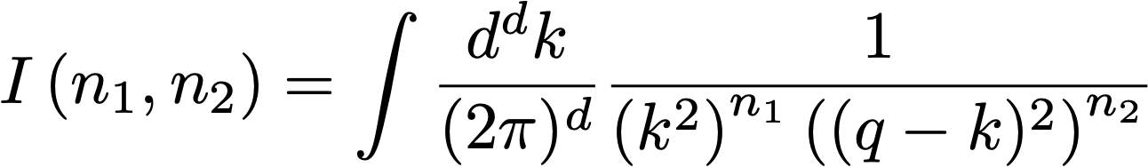

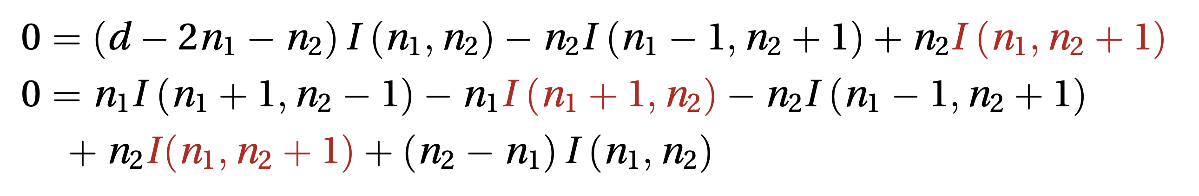
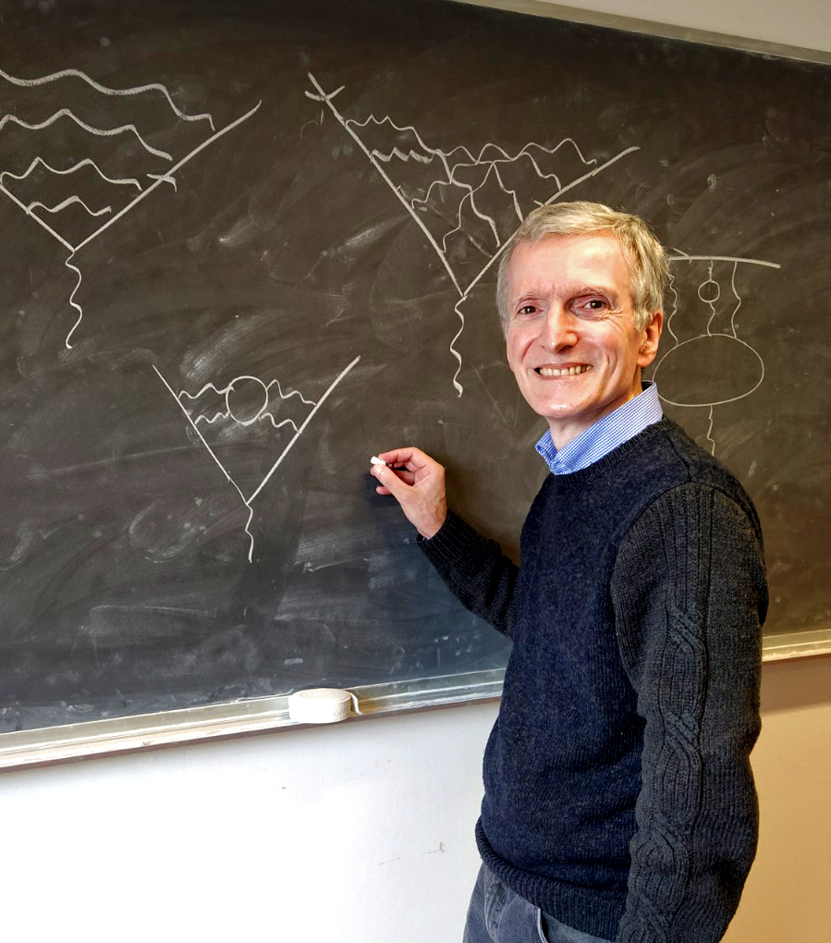
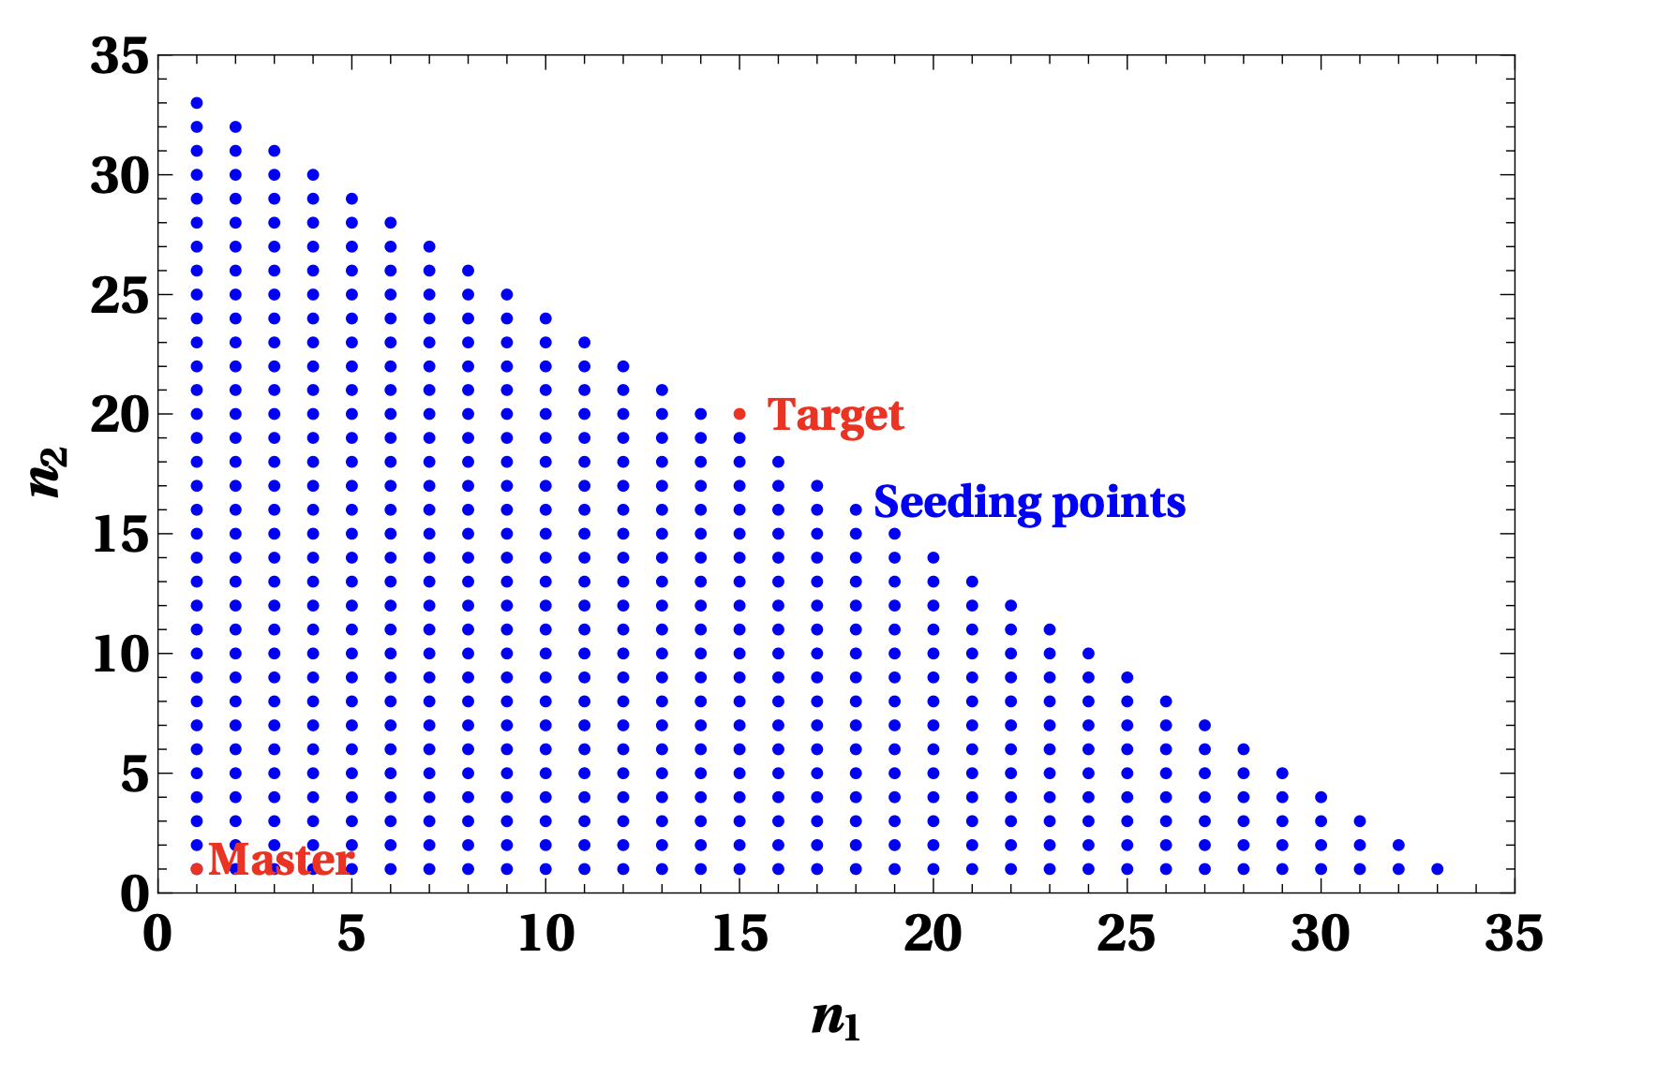
The Laporta algorithm
Example IBP for one-loop bubble integrals:
Infinite number of ways of producing identities
Need to find a finite number of seeds integrals as target
Laporta algorithm

Slide 8
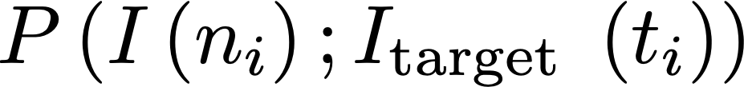
The priority function approach
Take a start seeding set and its subsets, find an optimized
Find an optimized set that is enough for target integral
2^{N} subsets, too many for brute force search
Priority function:
Ordering the sets by their priority score
Search for optimized set by binary search
Laporta gives over complete set of seeding integrals
Z.Y. Song, T.Z. Yang, Q.H. Cao, M.X. Luo, HXZ, 2502.09544

Slide 9
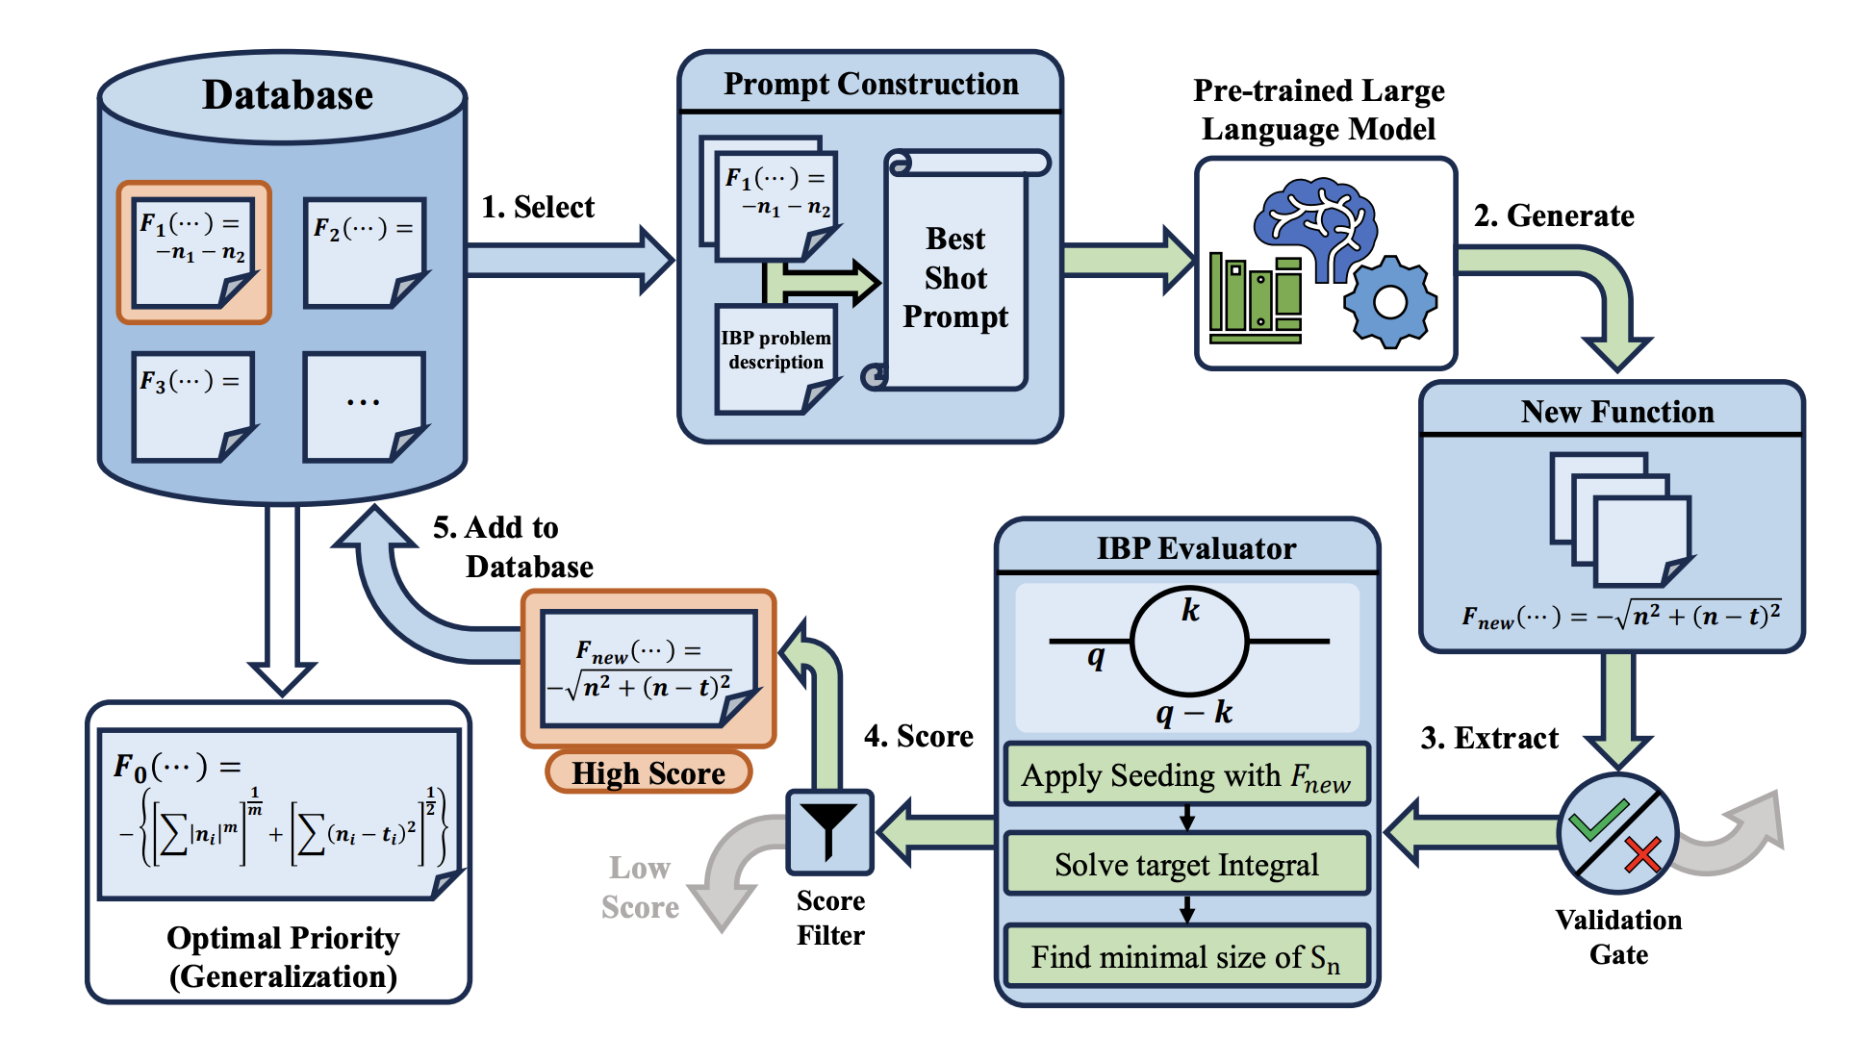
Agent workflow for Priority function

Slide 10
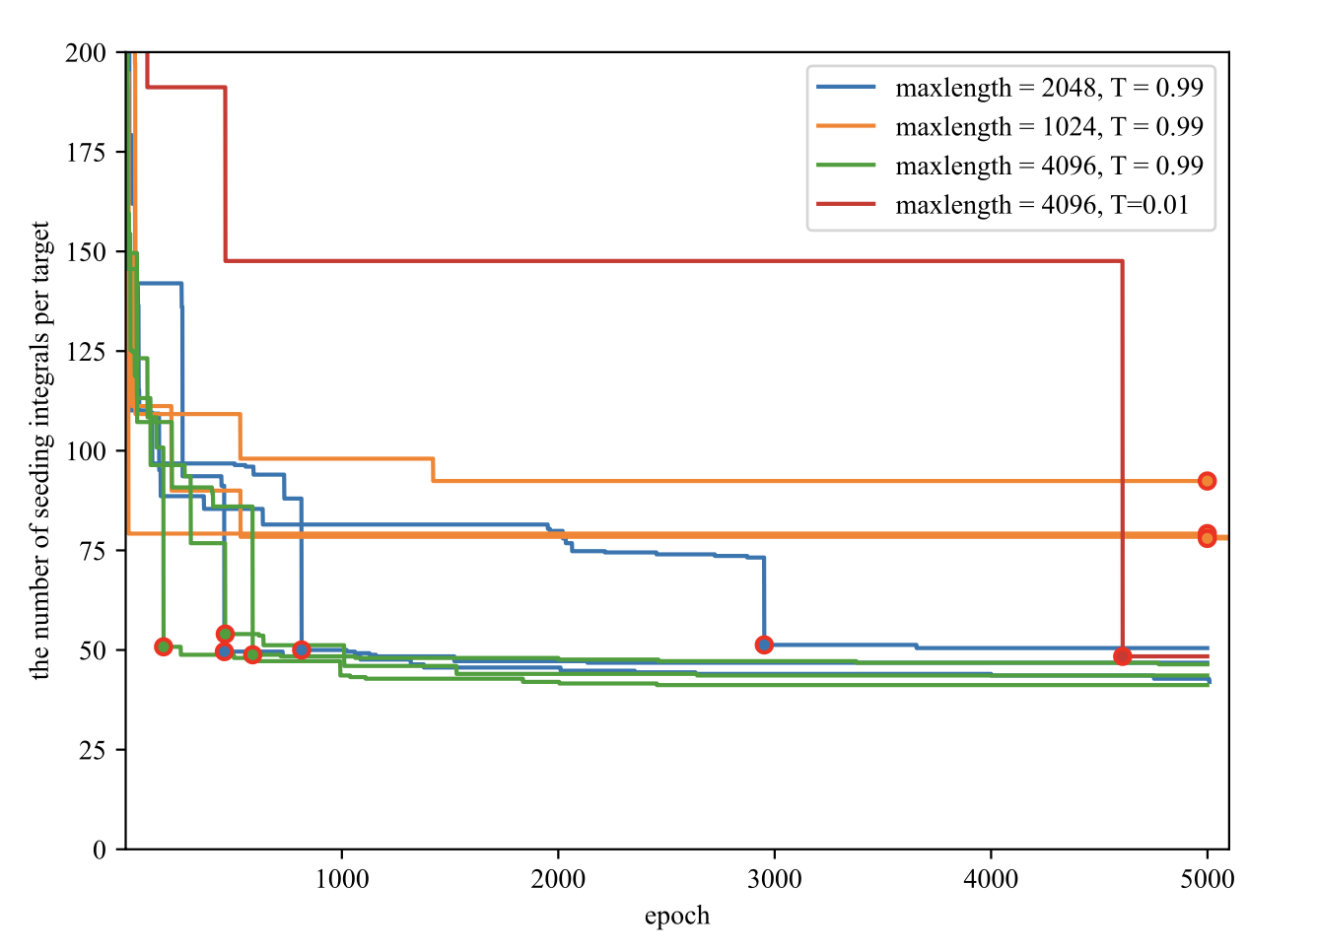
Evolution of optimized Priority function
Evolution setup:
Use one-loop bubble integral with arbitrary (n1,n2) as target
Local open-source LLM: CPM-2B, Qwen2.5-14B
Initial seeding: all points in a big enough box
# of needed seeding integrals after 5000 epoch for different hyperparameter

Slide 11


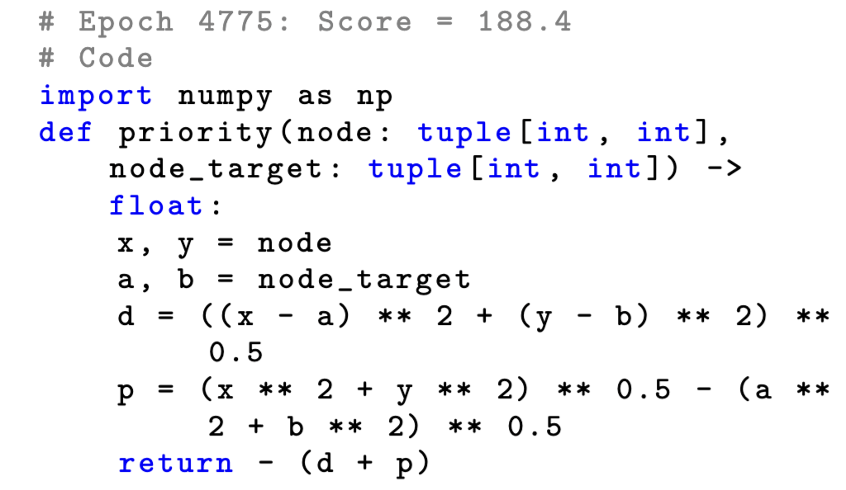
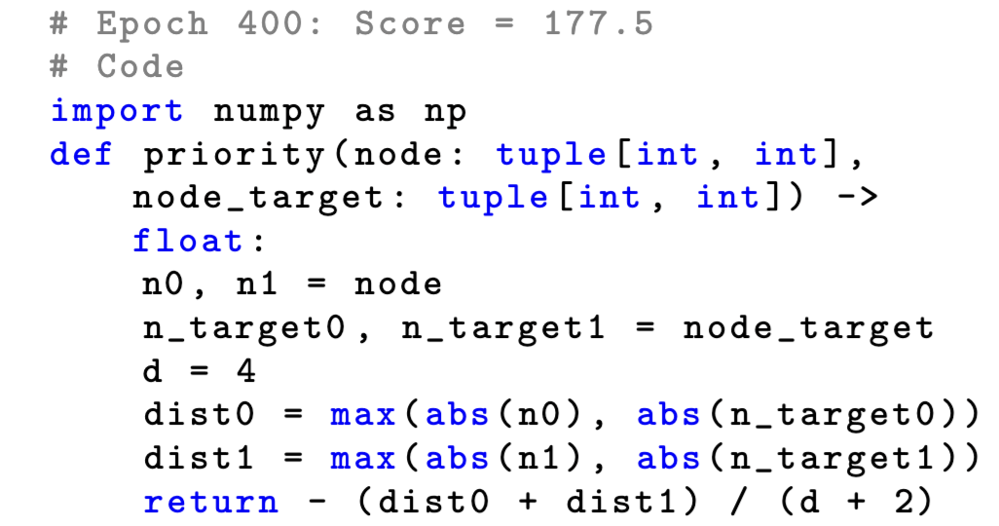

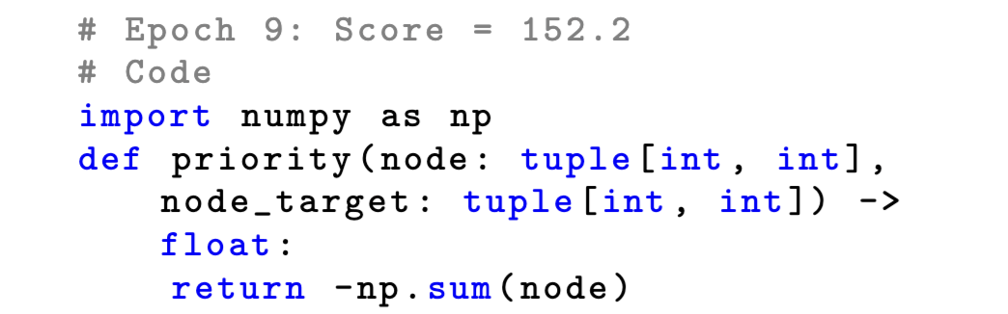
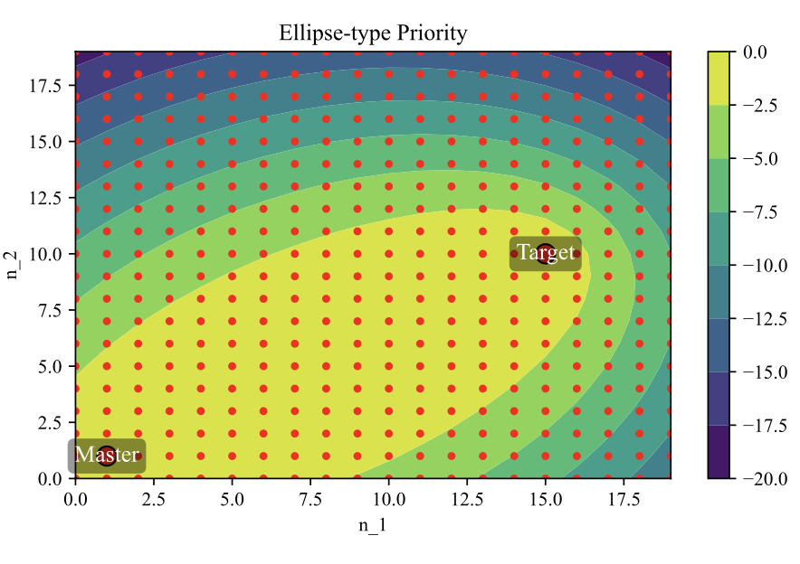
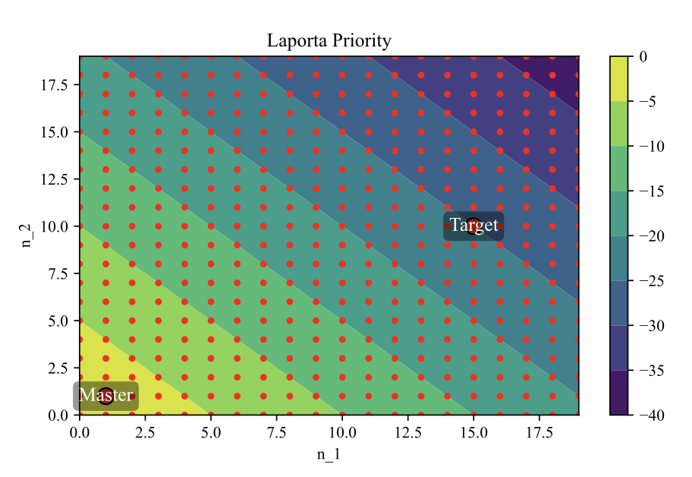
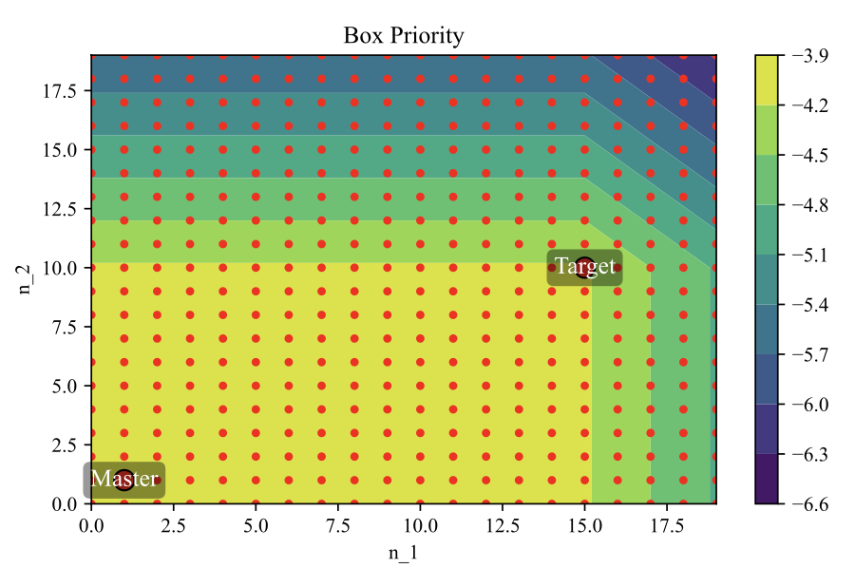
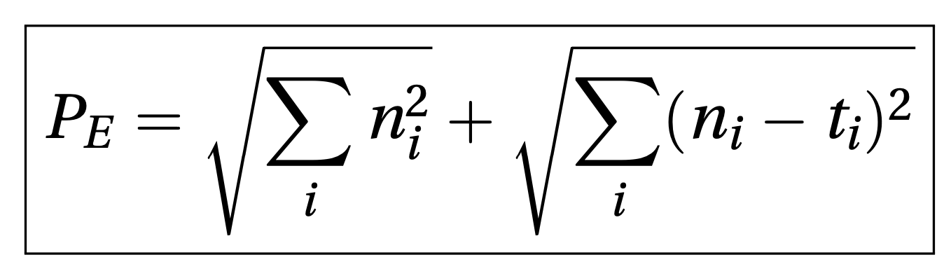
Laporta seeding was re-discovered on epoch 9.
Best seeding found on Epoch 4775, which is nothing but an ellipse with master and target integrals as foci.
The geometry structure allows easy generalization to higher loops
Generalization for higher loops

Slide 12
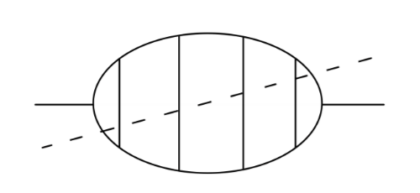
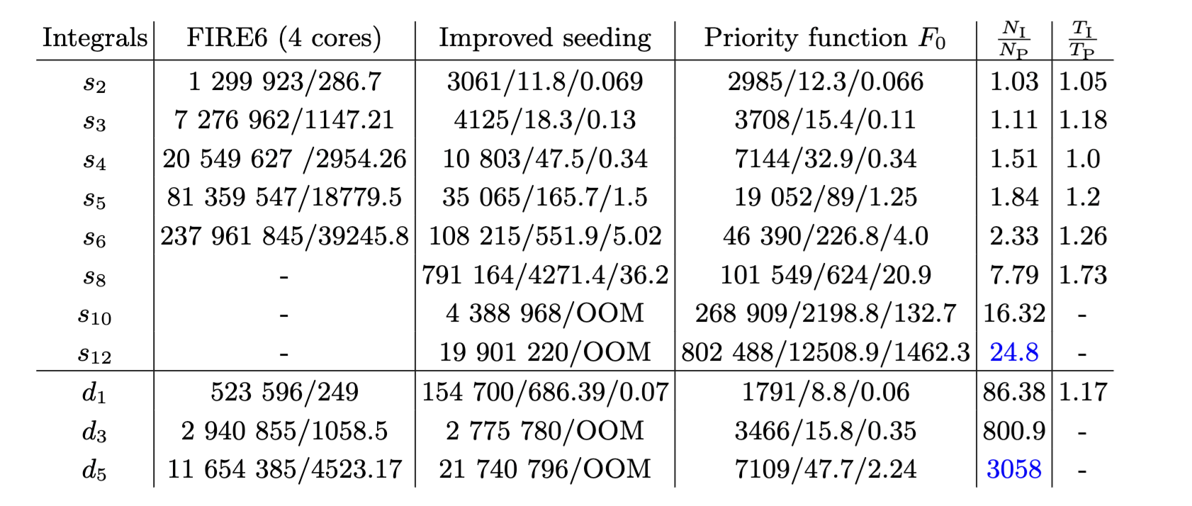



Application to a 6-loop integral
Laporta
seeding
improved
seeding
AI assisted
seeding (ours)
A cutting-edge example, which cannot be solved with existing methods
Ratio of seeded integrals needed
see also:
von Hippel, Wilhelm, 2502.05121, Berman et al., 2606.10698
Number of seeding integrals from different method

Slide 13

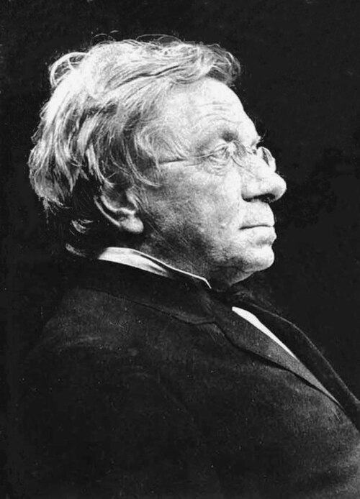
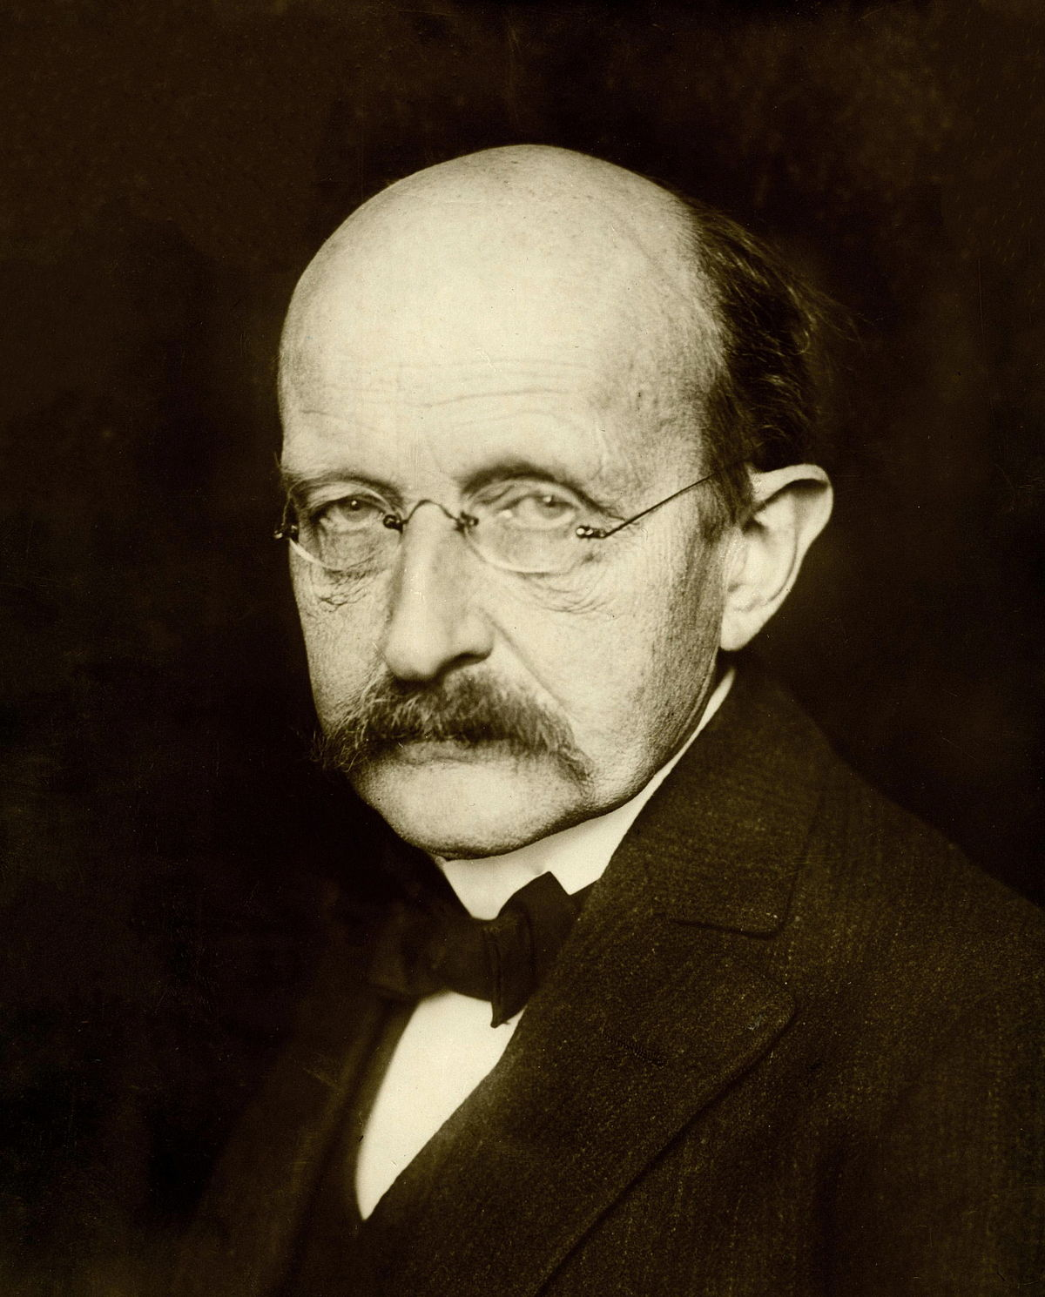
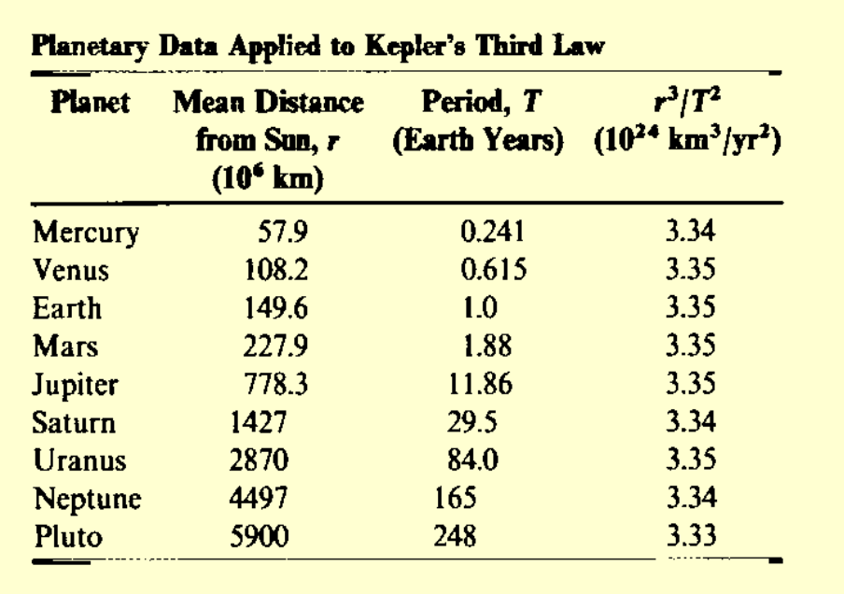
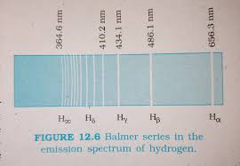
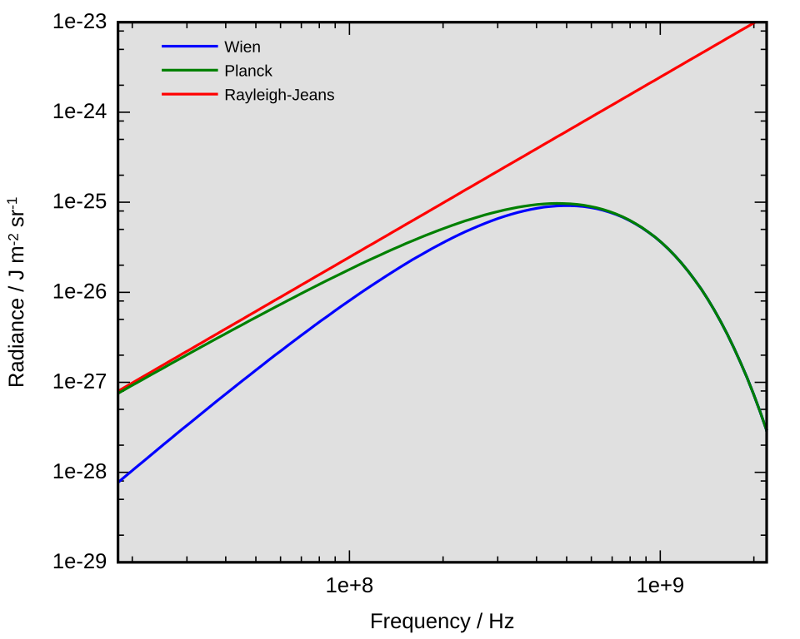
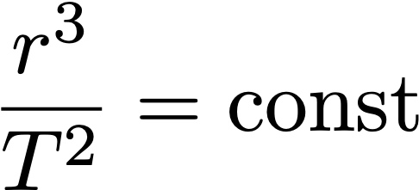
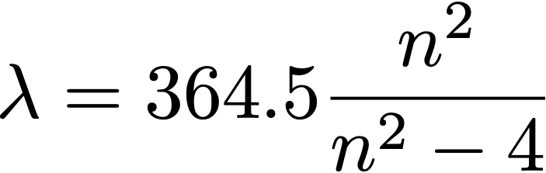

Symbolic Regression in Physics
Johannes Kepler
Johann Balmer
Max Planck
Rayleigh-Jeans
Planck
Wien

Slide 14
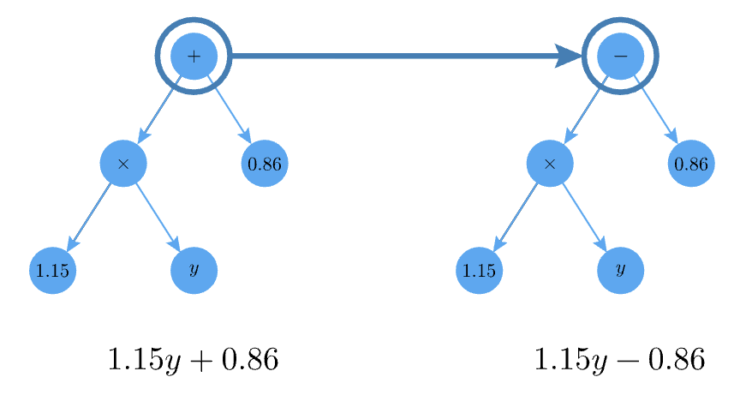
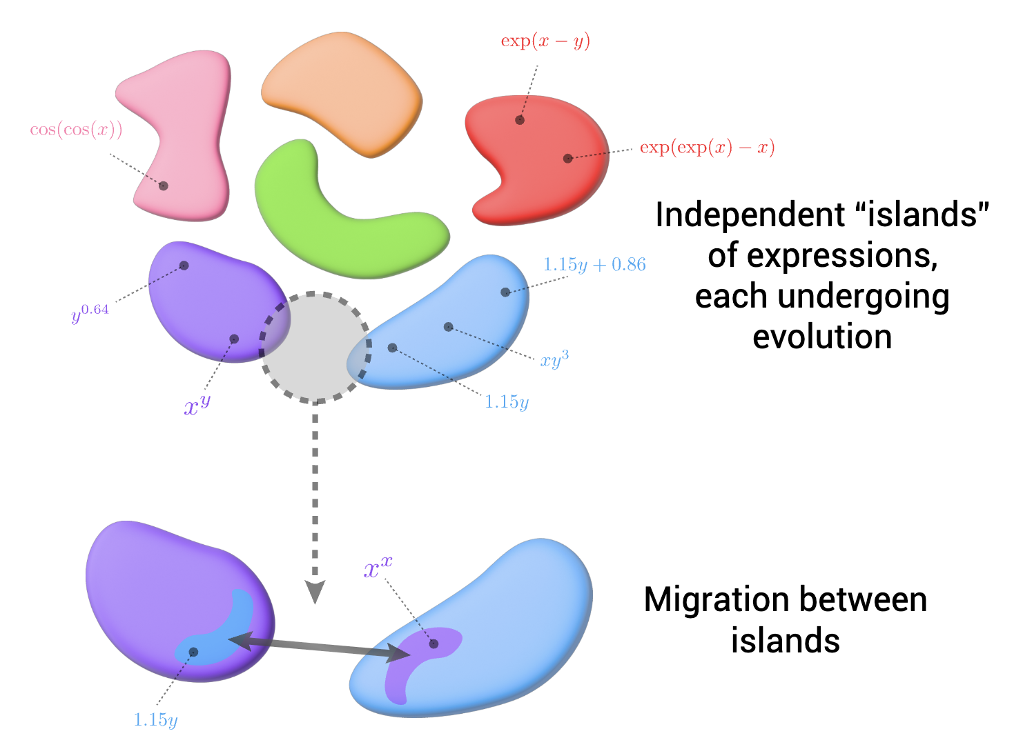
Modern Symbolic Regression
SR for automatic scientific discovery, 1970s-now
State-of-the-art: pySR, Cranmer, 2305.01582
Genetic Programing (state) + Mutation operator (detailed design)
Directionless exploration (sufficient exploration)
Exploration in infinite space of synatic
Mutation
&
crossover
Islands
&
migration

Slide 15
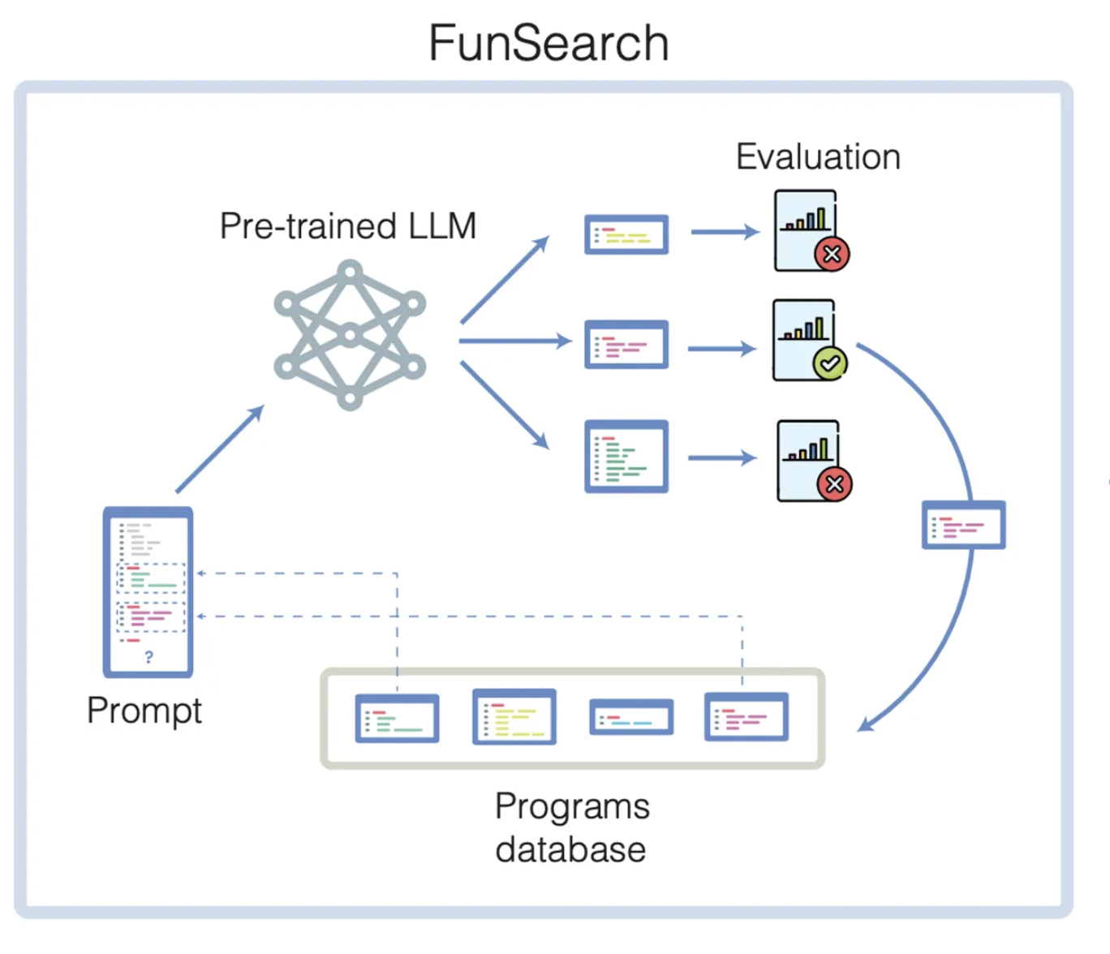
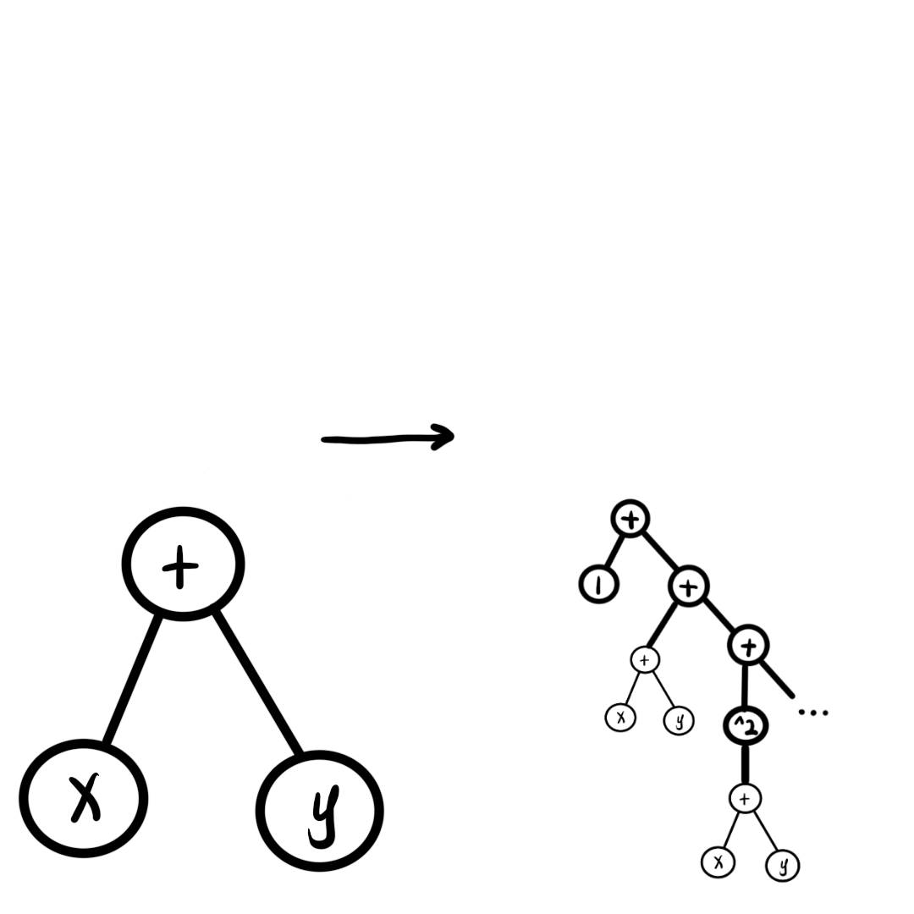
LLM-Driven Symbolic Regression
DeepMind, Nature, 2024
LLM prompt and response:
An example is that: [x+y], now I need to find out a better expression to fit the data: I think a good attempt is that `exp(x+y)`, but I find there is no `exp` operator, so I expand the expression to the NNLO and thus my result is \n
[1+(x+y)+(x+y)**2/2]
mutation
islands
$$1+(x+y)+\frac{(x+y)^{2}}{2!}+⋯$$
$$x+y$$
Combine genetic programming and LLM mutation
Explore with state + conceptual space
Directional exploration within an finite space of logic
related works: 2404.18400, 2503.07994, 2505.07956, 2510.08317, 2604.14133

Slide 16

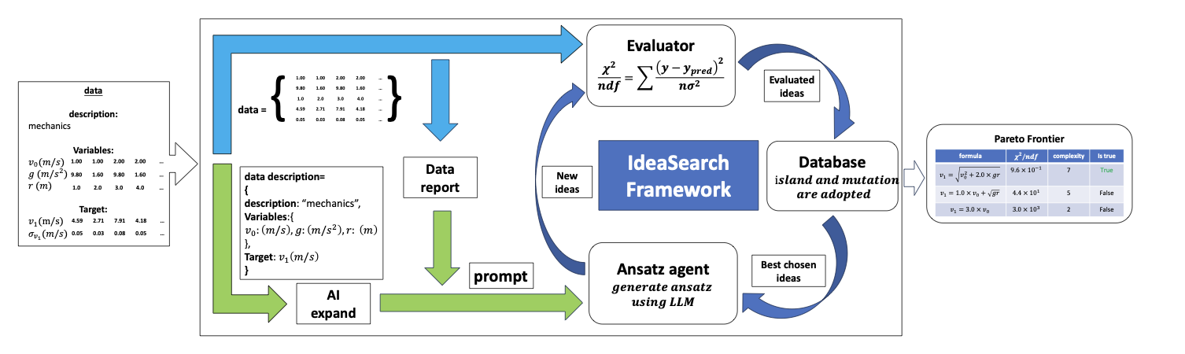
IdeaSearch.Fitter
https://www.ideasearch.cn/
2510.08317
Workflow for Symbolic Regression

Slide 17
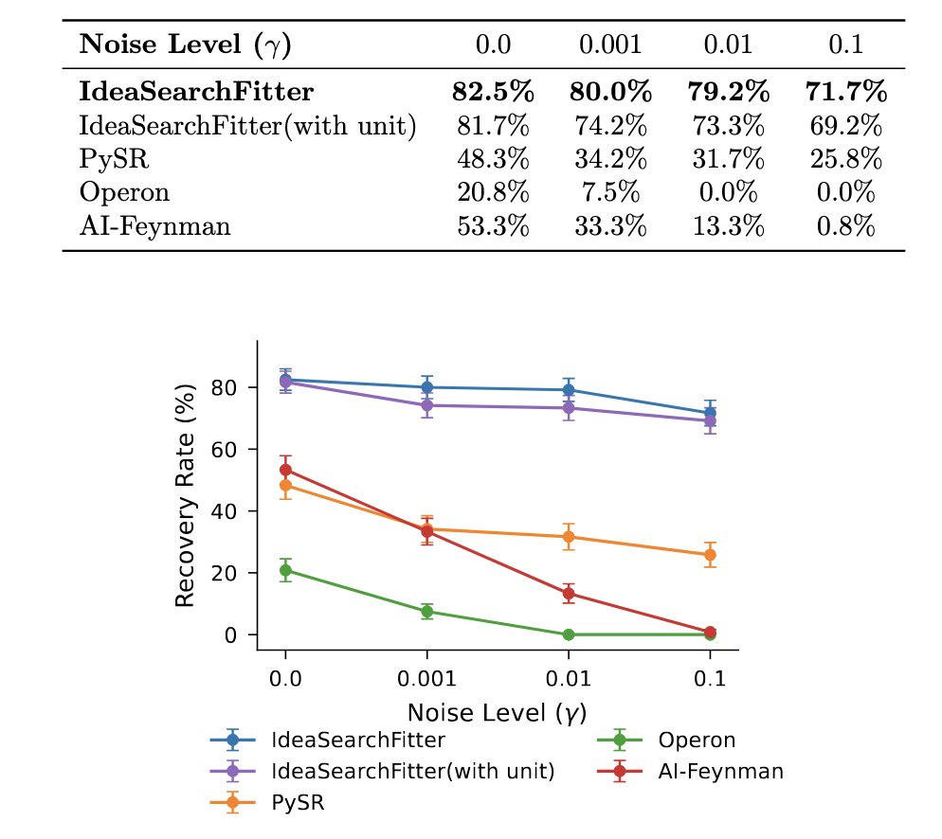
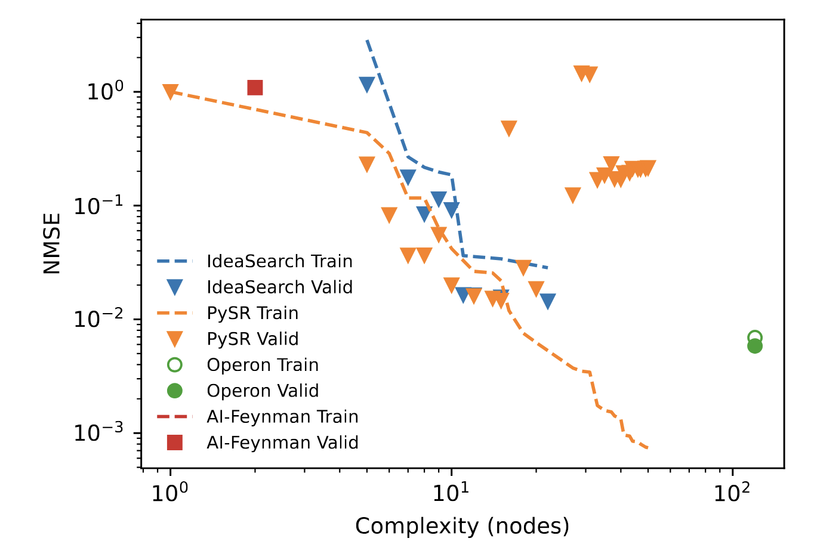
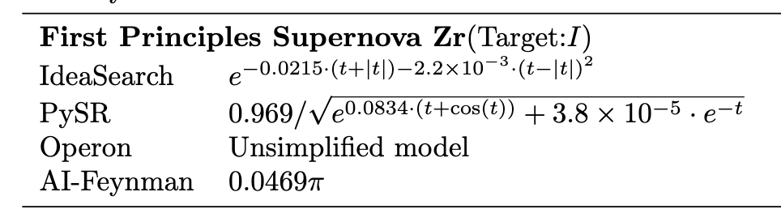
https://www.ideasearch.cn/
2510.08317
State-of-the-art with high noise resistance
Interpretability

Slide 18
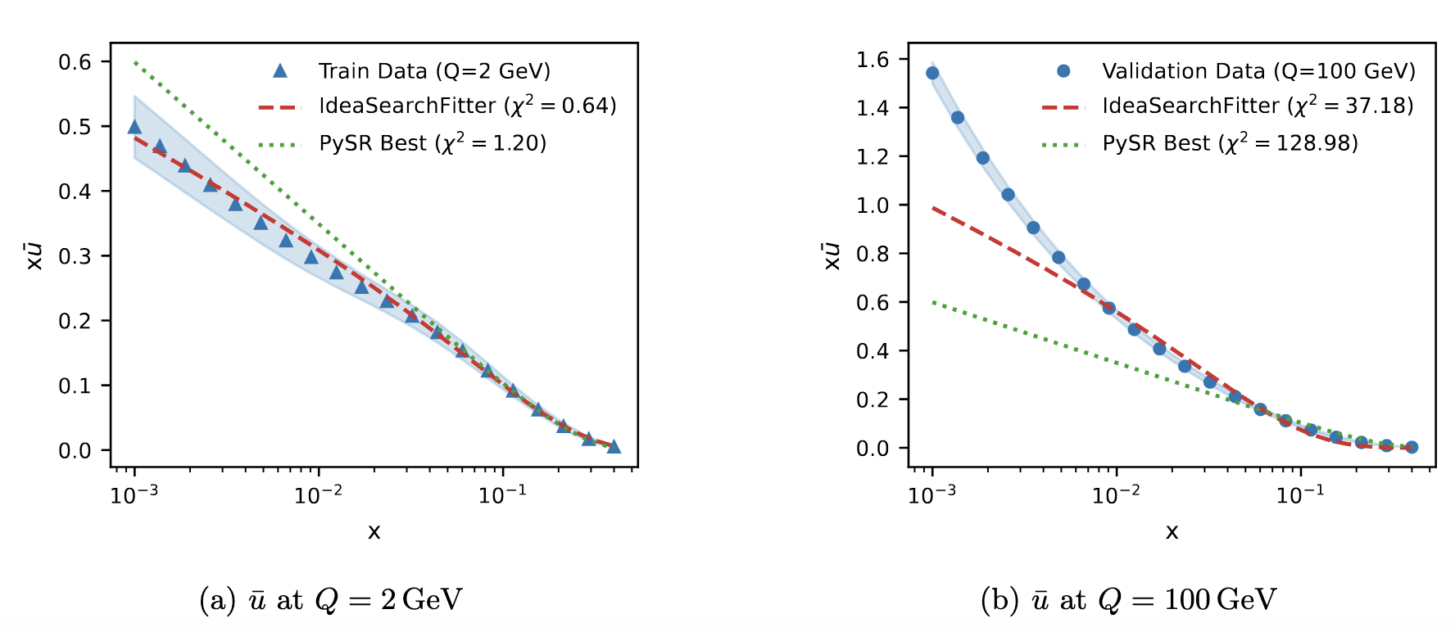
Application on PDF fitting
https://www.ideasearch.cn/
2510.08317

Slide 19
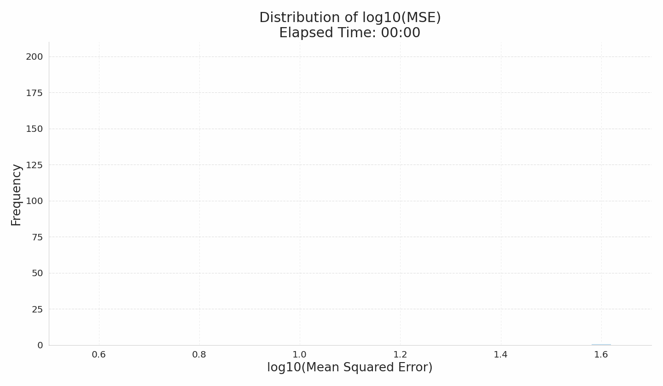
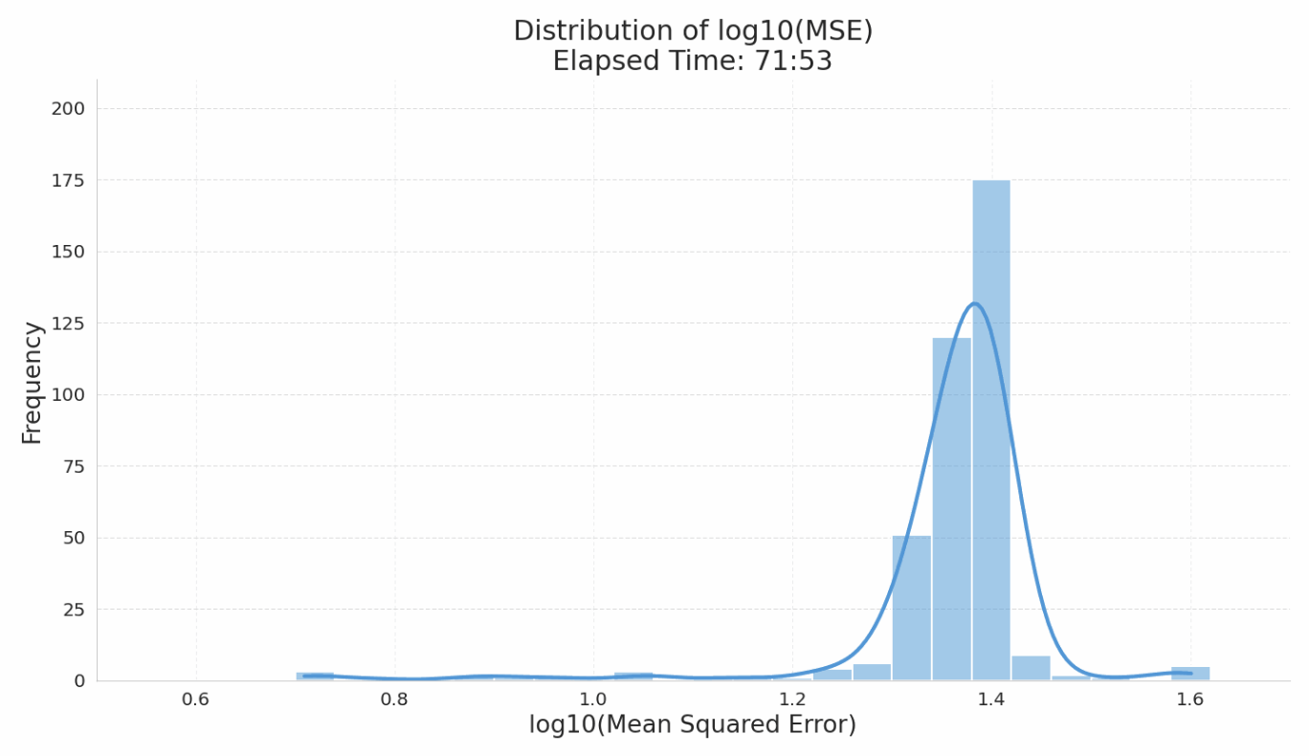
  Problem of limited exploration
LLMs-agent explore in conceptual space
However, LLMs exploration is directional; insufficient exploration
Example: in Symbolic Regression, we observe repetitive sampling within the training set
We need to develop a theory for how LLM explore its conceptual space
Most generation
are repeat
High score but low potential

Slide 20
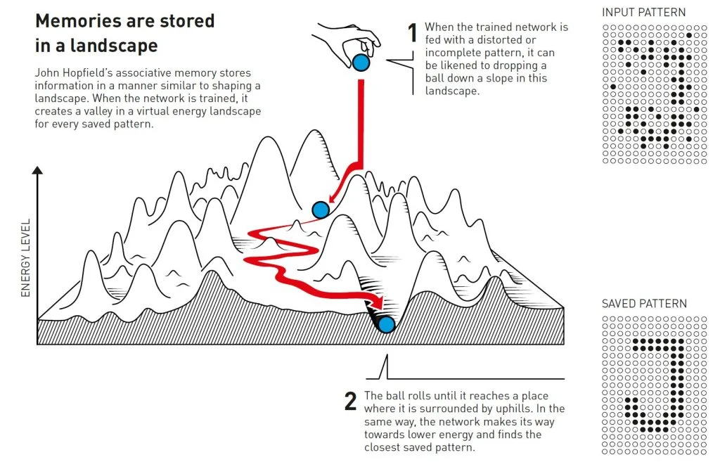
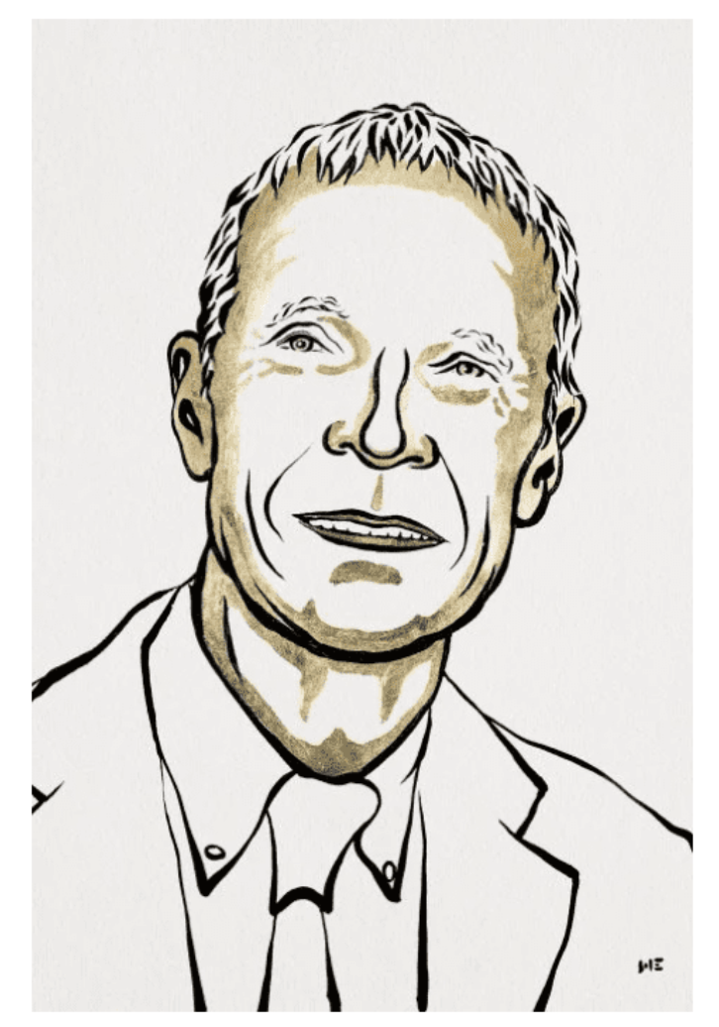
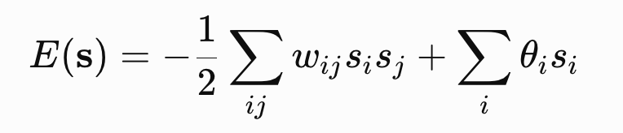
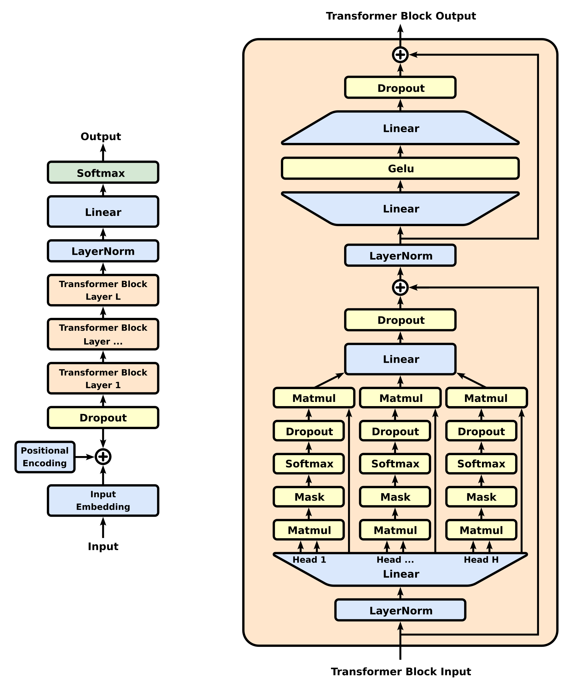
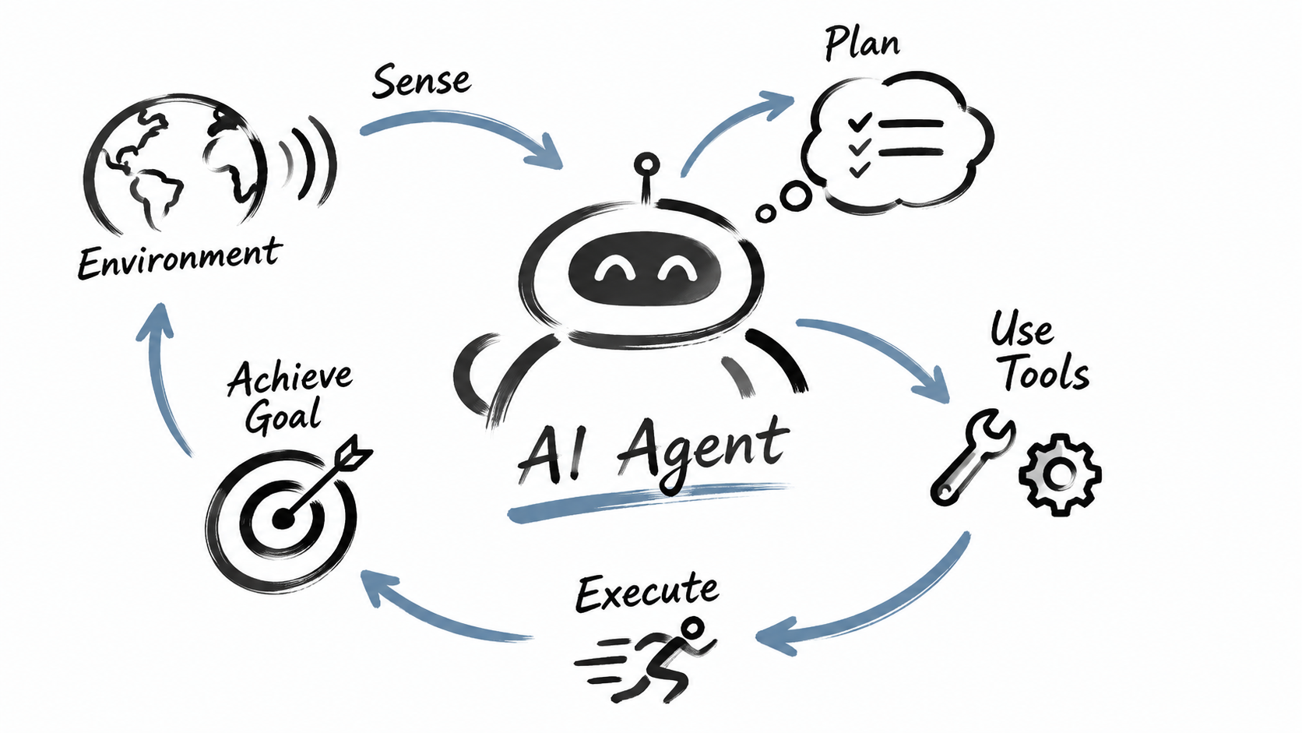
John Hopfield
https://www.nobelprize.org/prizes/physics/2024/popular-information/
Does agent generation possess an energy landscape?

Slide 21
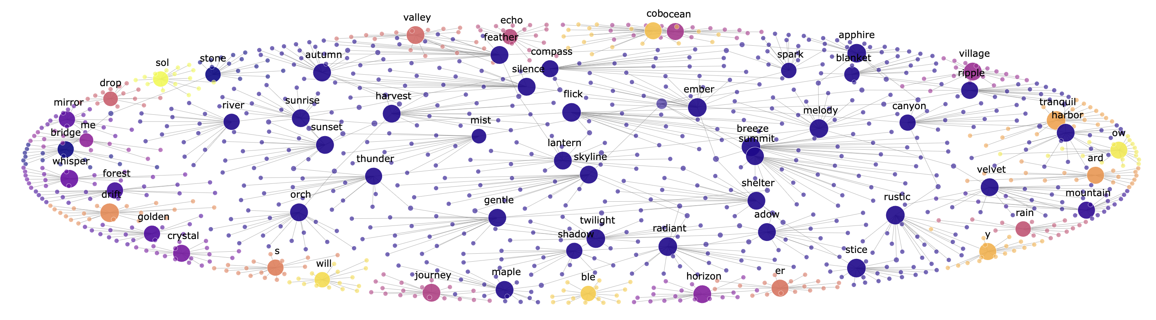
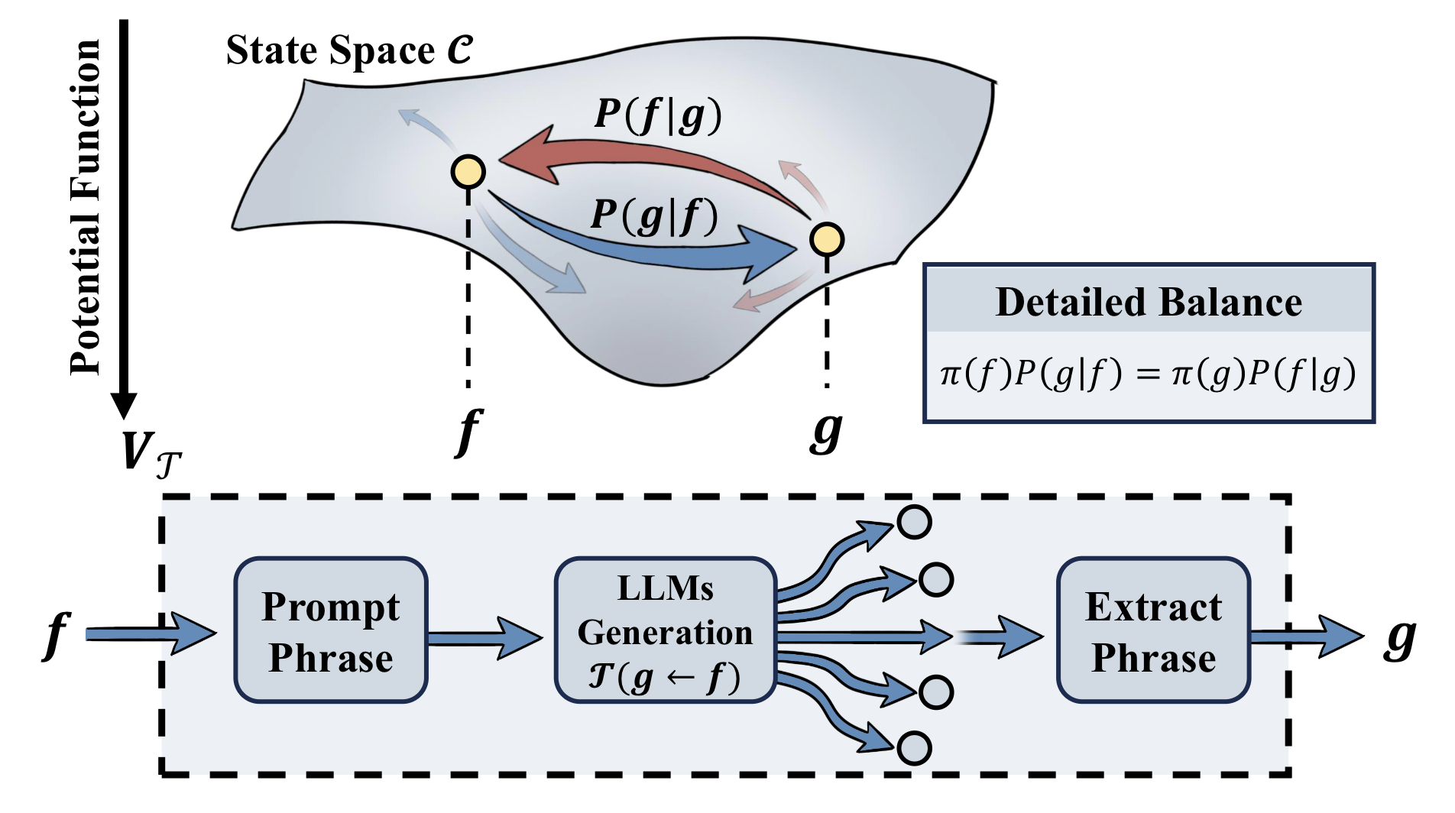
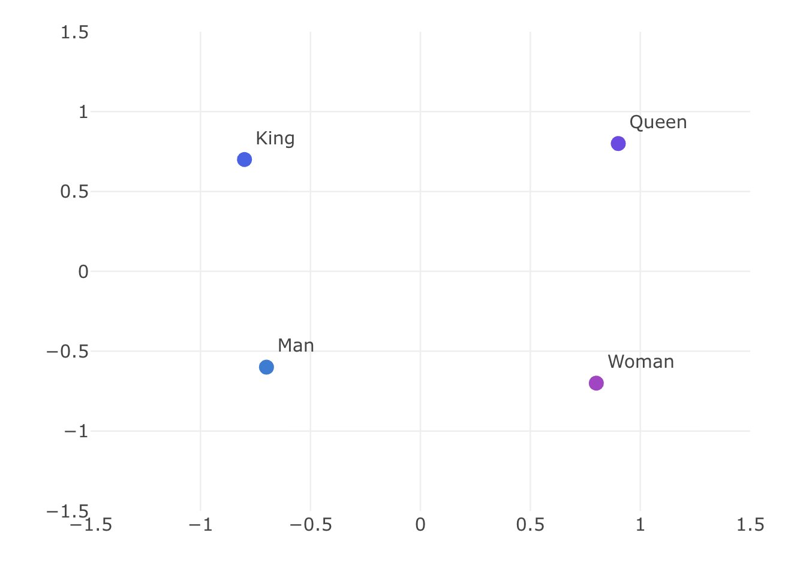
Space of exploration: from token to state
a possible energy landscape of generation?
Source: Huggingface
king - man + woman $≈$ queen
token
state
Sun, Haghighat, 2501.16241

Slide 22
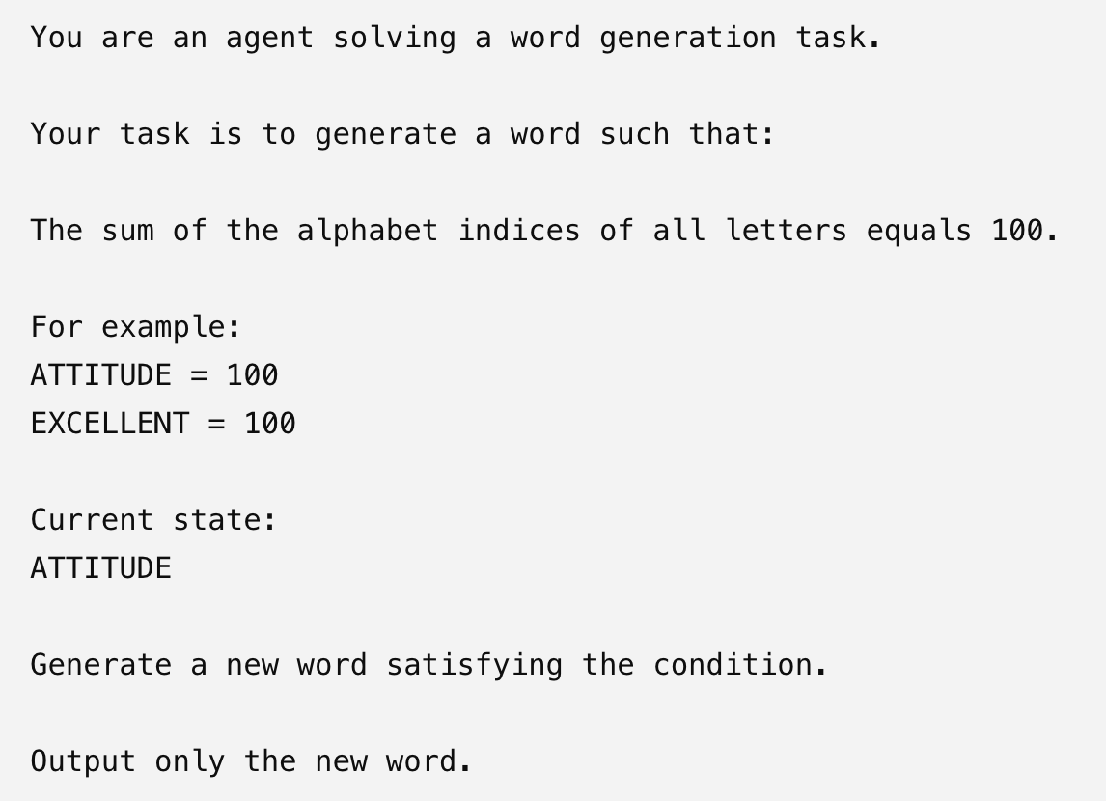
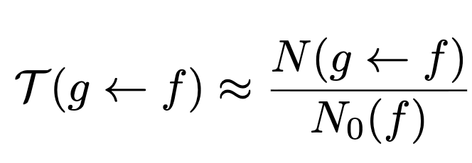
A simple example: conditioned word generation
state f:
ATTITUDE
conditioned word generation agent
agent
state g:
PERSONAL
Transition probability can be measured
N0: total # of sample
N(g<-f): # of g generated
Zhuo-Yang Song, Q.H. Cao, M.X. Luo, HXZ, 2512.10047

Slide 23
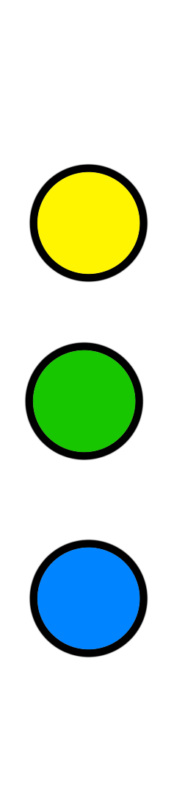








The least action principle and potential
A potential function for state space can be measured
$$V_{T}$$
action principle

Slide 24




Are LLM-agent near equilibrium system?
We discover there exist a scaling low in LLM exploration
Suggest approximate detailed balance in agent generation
Can we apply more tools from equilibrium physics to study LLM agent?

Slide 25


Slide 26


Detailed balance in function fitting agent

Slide 27

The potential landscape for function fitting
Potential extracted from a function fitting agent
9769 transitions with T > 0.05
6795 (69%) exhibits pontential decrease
2523 (26%) exhibits pontential increase
This indicates that the potential function partially captures the intrinsic directionality in agent generative dynamics
good
bad

Slide 28
Summary
Two examples of explainable application of AI to physics
  IBP reduction
  Symbolic regression
Need to understand the exploration space of LLM agent
Evidence of approximate energy landscape/detailed balance in generation
Can it be used to improve physics application?
Thank you very much!

