Slide 1

Probe EWSB with vector bosons
Yusheng Wu
University of Science and Technology of China
NOPP @ IHEP, August 14-16, 2026

Slide 2
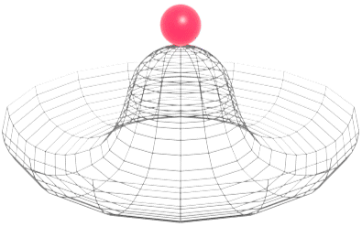
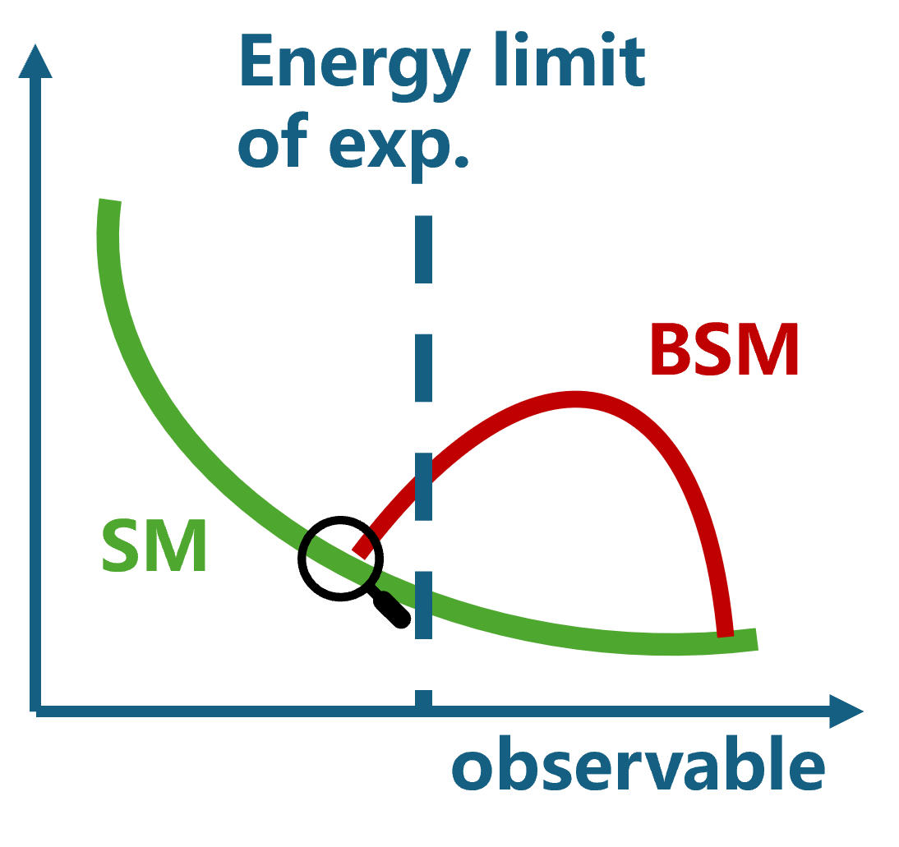
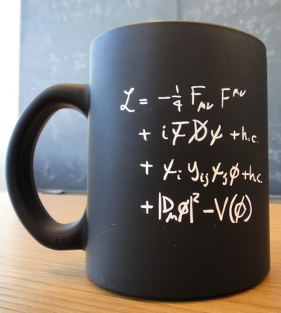
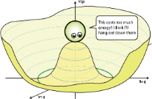


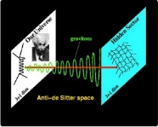

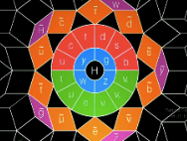

Physics with Vector Bosons at High-energy Frontier
EWSB, Goldstone
Effective Field Approaches
New Physics
Electroweak Structure

Slide 3
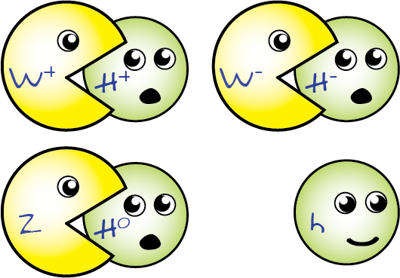
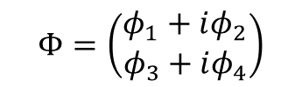
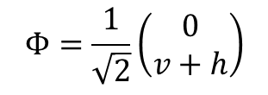
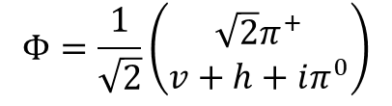
SM EWSB with Vector Bosons
Unbroken
Electroweak Symmetry Breaking via Higgs mechanism is core/mysterious in SM:
symmetric nature to physical spectrum
origin of elementary particle mass
multidisciplinary connection/analogy (cosmology, condensed matter, etc.)
naturalness problem …
$$Φ=\left(\begin{matrix}φ_{1}+iφ_{2} \\ φ_{3}+iφ_{4}\end{matrix}\right)$$
Broken, R_{ξ}​ Gauge
$$Φ=\frac{1}{\sqrt{2}}\left(\begin{matrix}\sqrt{2}π^{+} \\ v+h+iπ^{0}\end{matrix}\right)$$
Broken, Unitary Gauge
$$Φ=\frac{1}{\sqrt{2}}\left(\begin{matrix}0 \\ v+h\end{matrix}\right)$$
Goldstone bosons as direction d.o.f. of Higgs vector,
are eaten by the massive vector bosons (W, Z),
appear as longitudinal components of W and Z

Slide 4
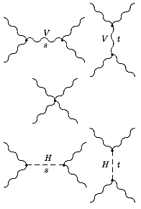
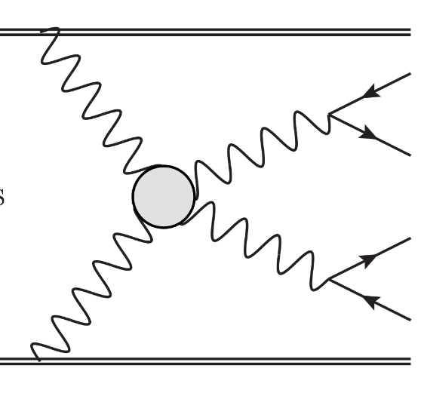



Vector Bosons for EWSB
* at small E, V_{L} not exact as true GSB due to mass effect
Goldstone Boson Equivalence Theorem (Cornwall–Levin–Tiktopoulos and Vayonakis)
scattering amplitude for a longitudinally polarized massive gauge boson is equal to that for the corresponding goldstone boson at high-energy limit* (E >> m)
Studying high-energy V_{L} directly probe
→ goldstone boson interactions
→ dynamics of EWSB, e.g., linear vs non-linear
* Unique against direct Higgs measurement
→ Need golden practice, e.g., unitarity restoration of W_{L}W_{L} scattering at TeV
$$ℳ\sim O(E^{2})$$
$$ℳ\sim O(1)$$
$$ℳ\sim O({−E}^{2})$$

Slide 5
Experimental Steps
Precision EW fit:
oblique parameters S,T,U
indirect constraint
LHC:
In addition, offer
precision multiboson probe
access vector boson scattering
access boson polarisation in multiboson production
→ direct probe of EWSB dynamics via vector bosons
LEP:
e+e- → WW
aTGC searches
W/Z helicities
Tevatron:
Opened more diboson channels
Enhanced aTGC searches
W/Z helicities
W helicity from top quark decay

Slide 6
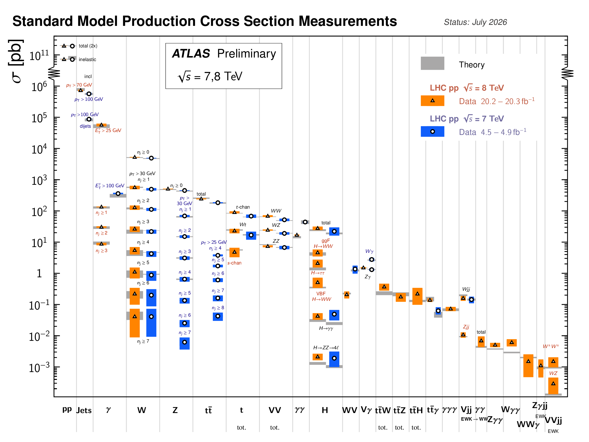
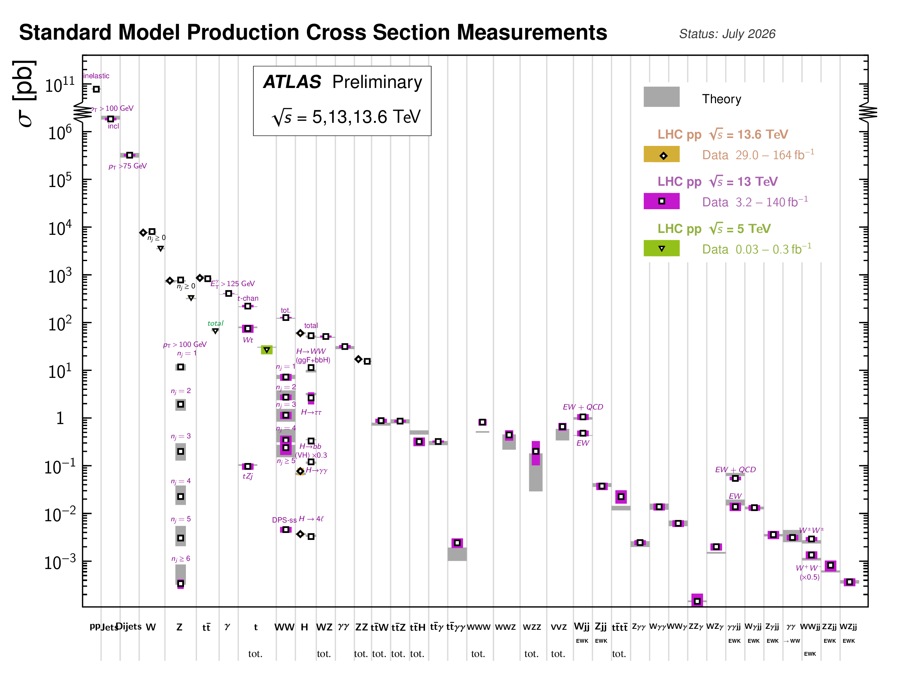
Experimental Precision in a Nutshell
LHC Run-1
LHC Run-2 +3
Critical improvement multiboson precision

Slide 7
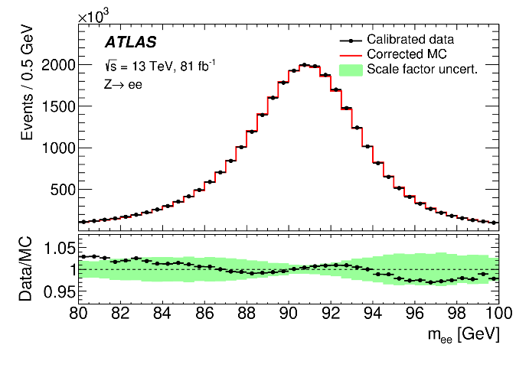
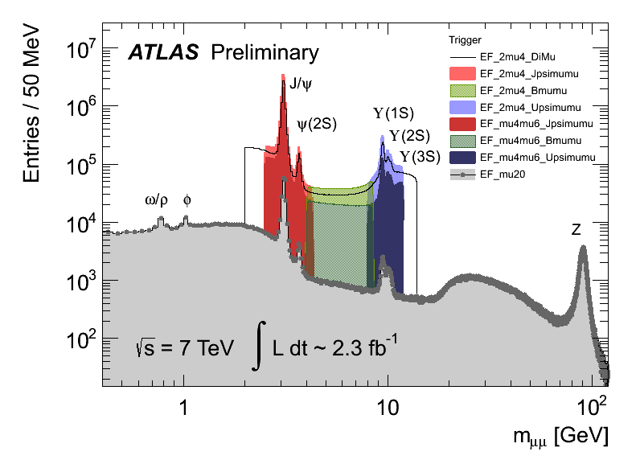
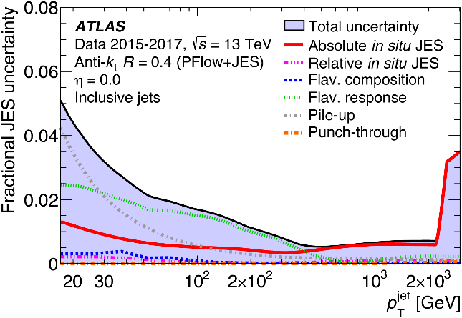
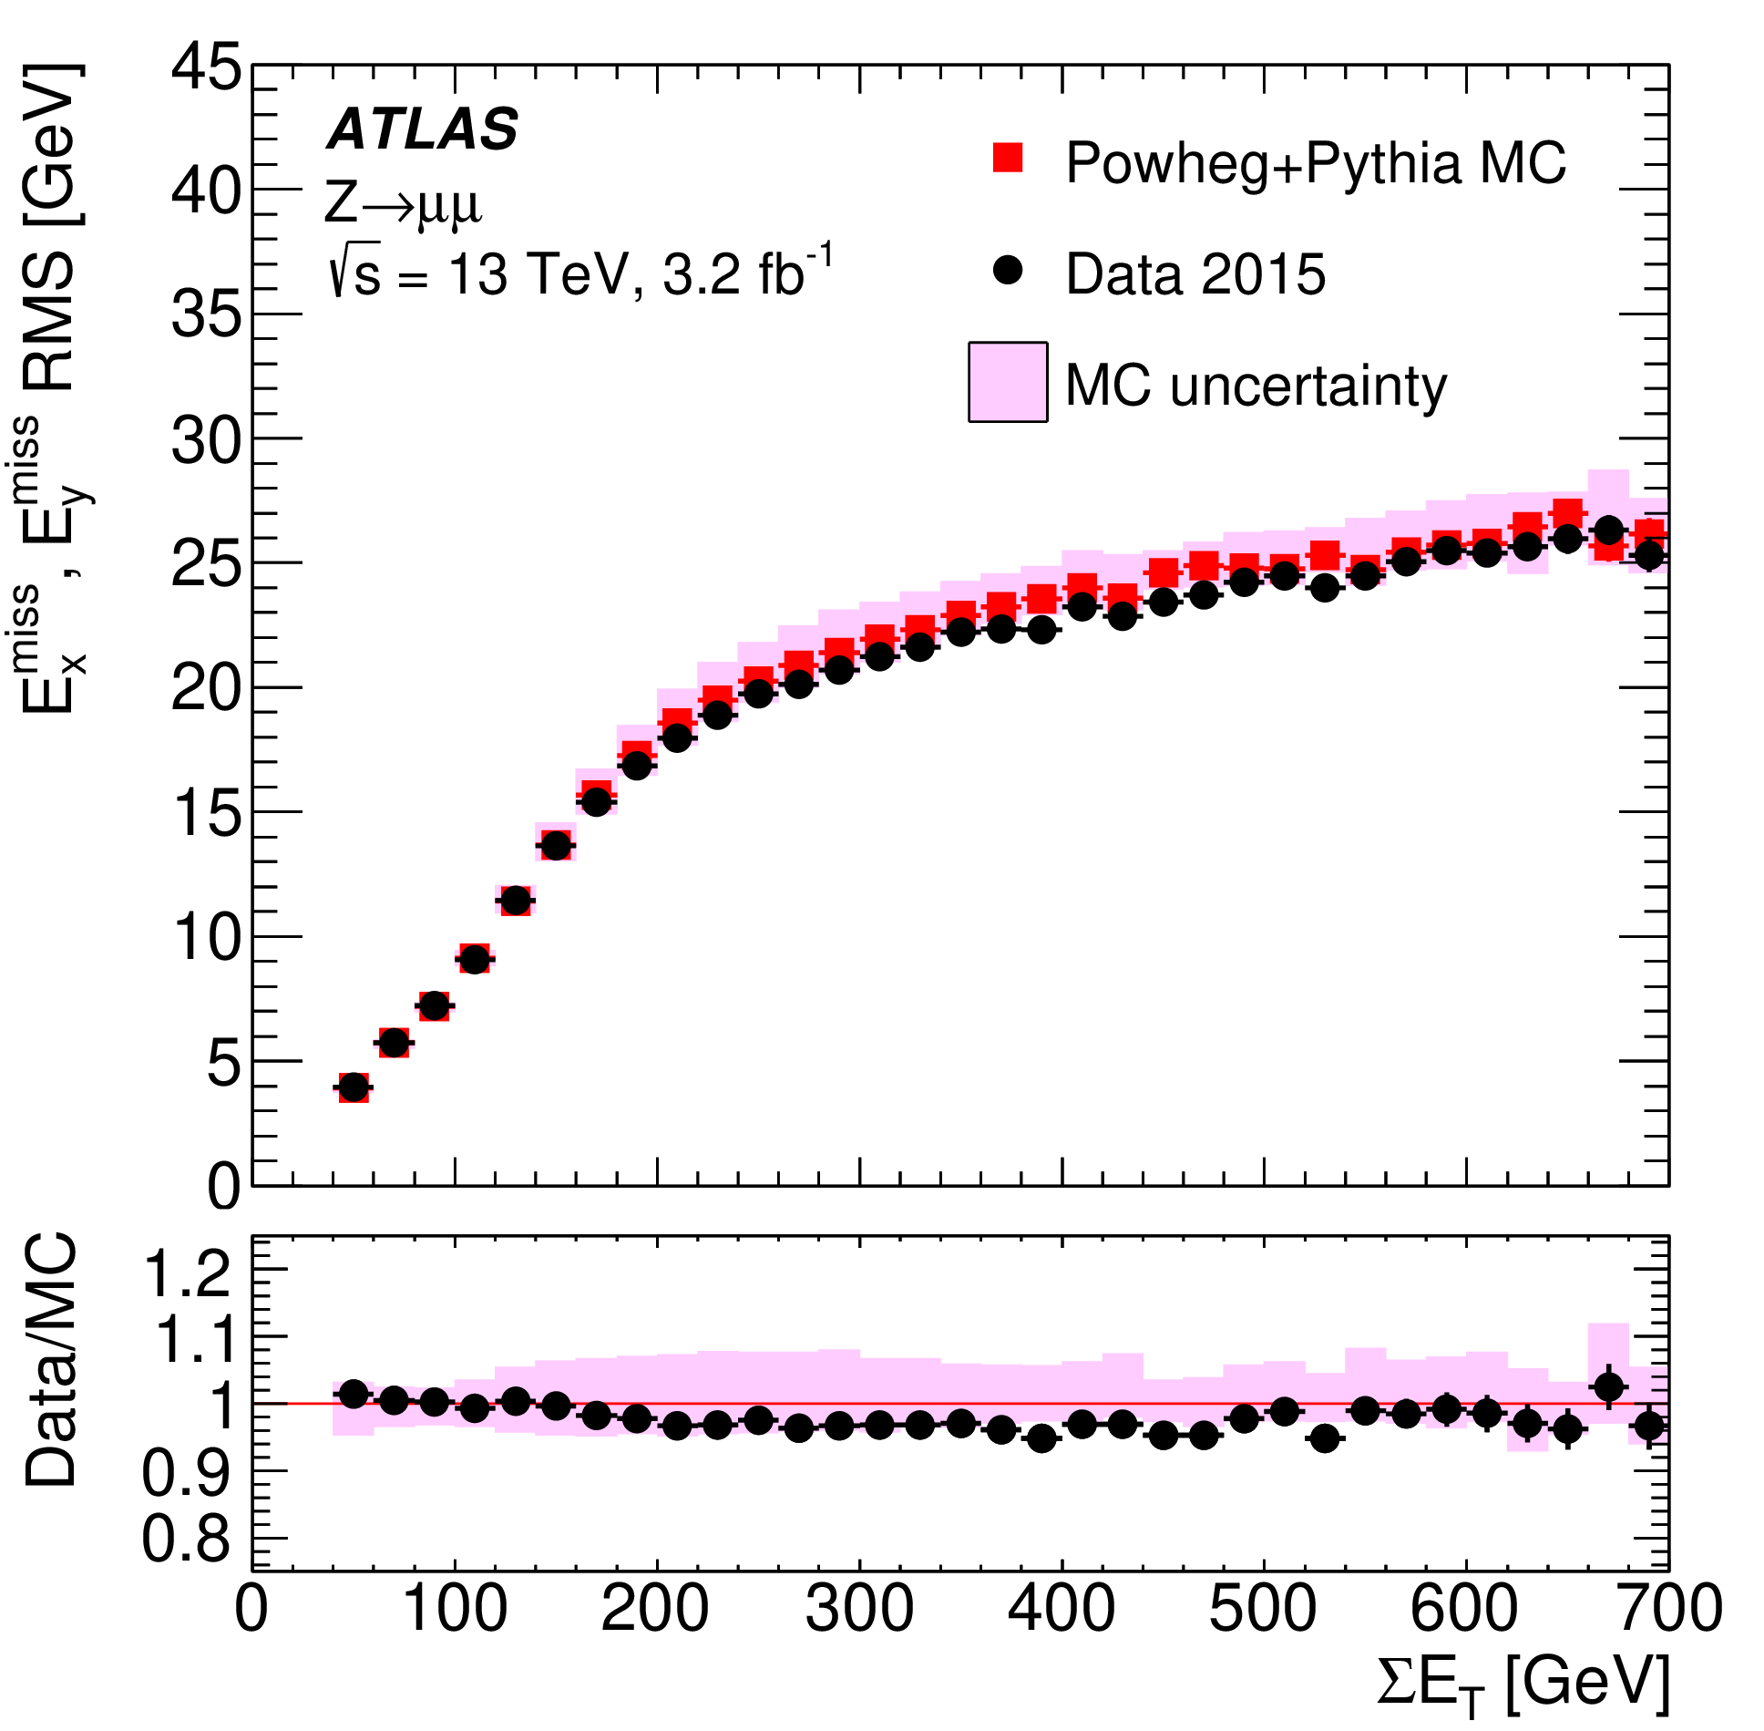
Experimental Precision in a Nutshell
Per-mil to percentage precision needed for measurements
Need
all-around knowledge
Continuous innovation
demanded
Z(ee)
scale
dimuon mass
JINST 14 (2019) P12006
Jet energy scale
Missing E_{T} resolution
EPJC 78 (2018) 903
EPJC 81 (2021) 689

Slide 8
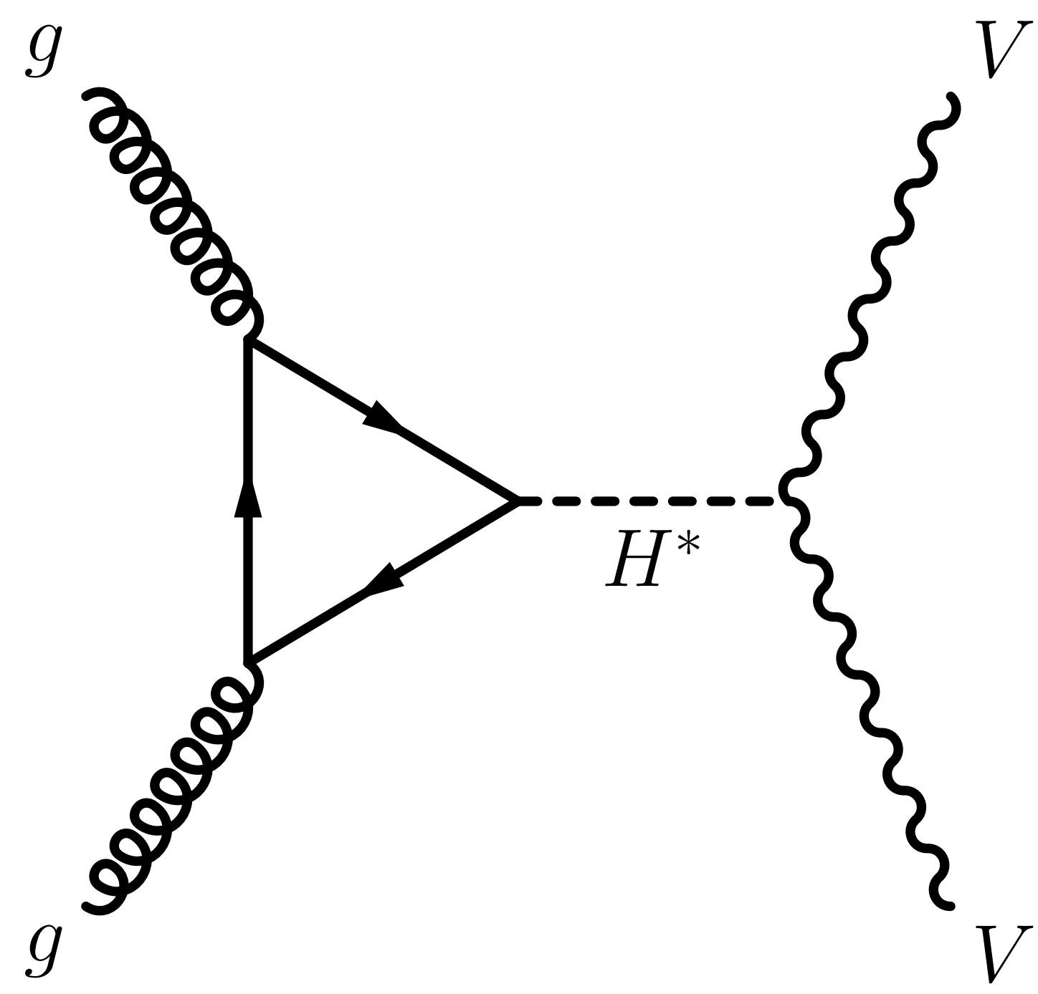
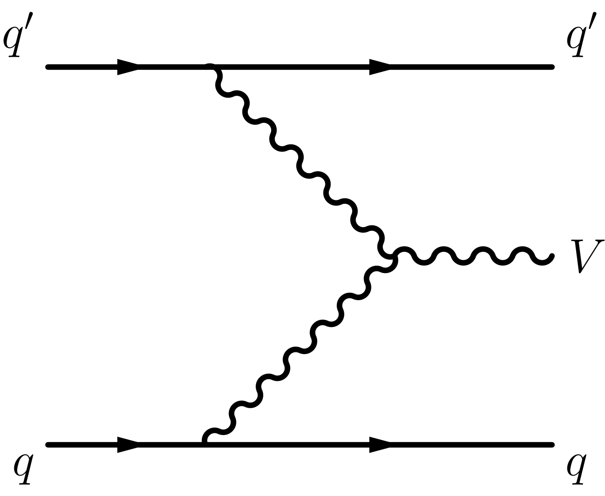
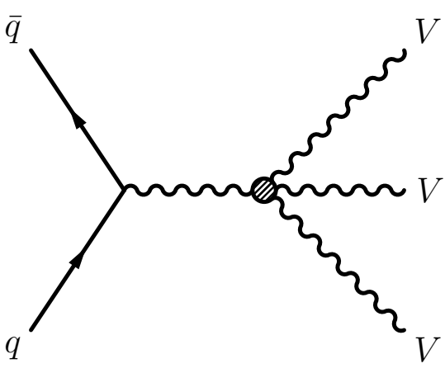
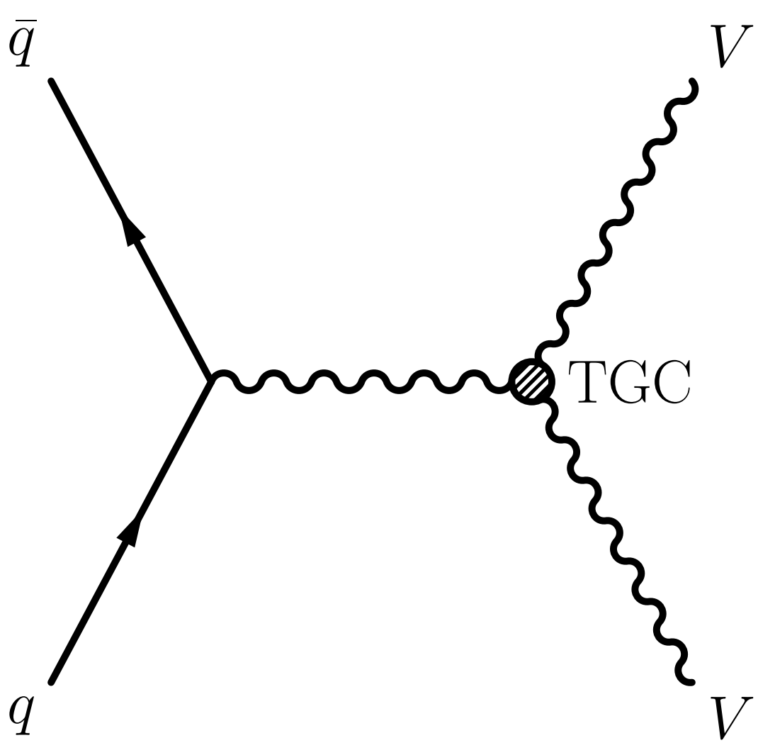
LHC Experimental Reach in a Nutshell
nb
pb
fb
Cross-section orders at the LHC and example diagrams
Vector Boson Scattering (VBS)
Diboson
Vector Boson Fusion
Triboson
inclusive precision down to 3%
access of high energy behavior enhance TGC accuracy
observing double longitudinal polarizations
access to differential measurements
observation
observation
look into polarisation and energy dependence
Selected, biased highlights later

Slide 9
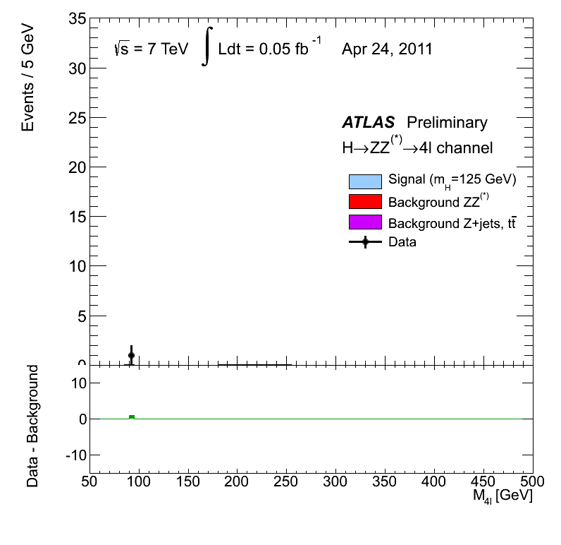
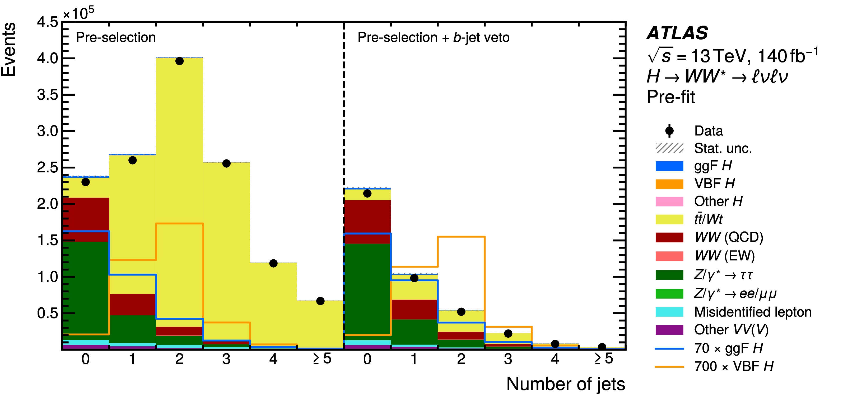
VV and H→VV
Modelling of VV crucial for Higgs property program
EPJC 85 (2025) 1403
Golden channels for Higgs discovery and measurement
Leading background for Higgs physics channels (e.g., WW for H→WW study)

Slide 10
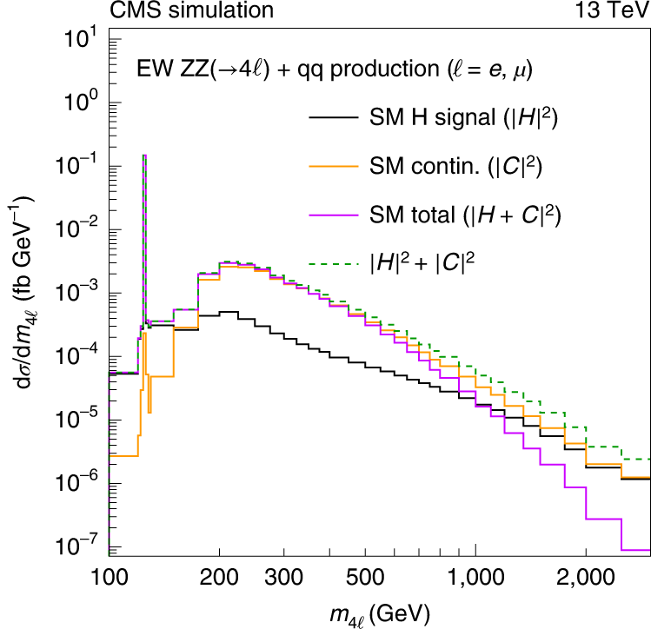
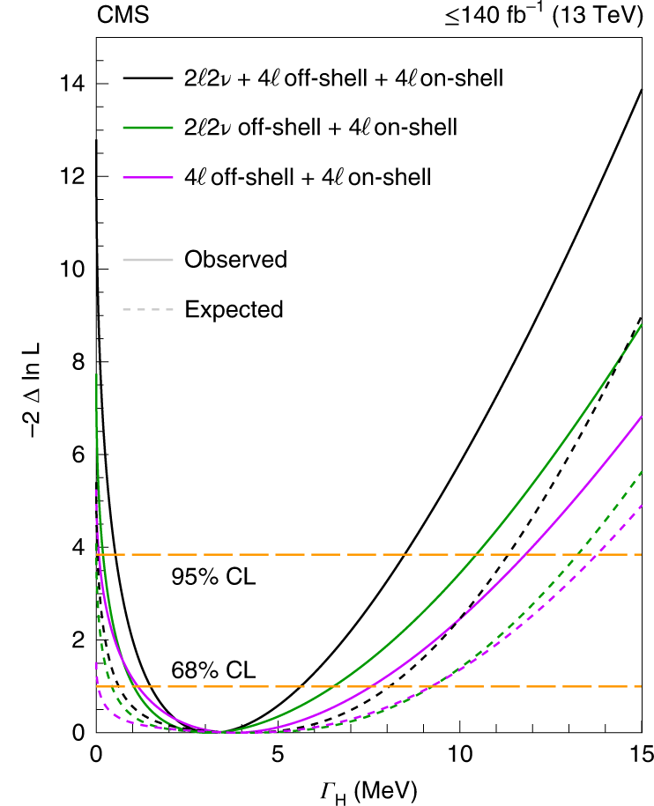
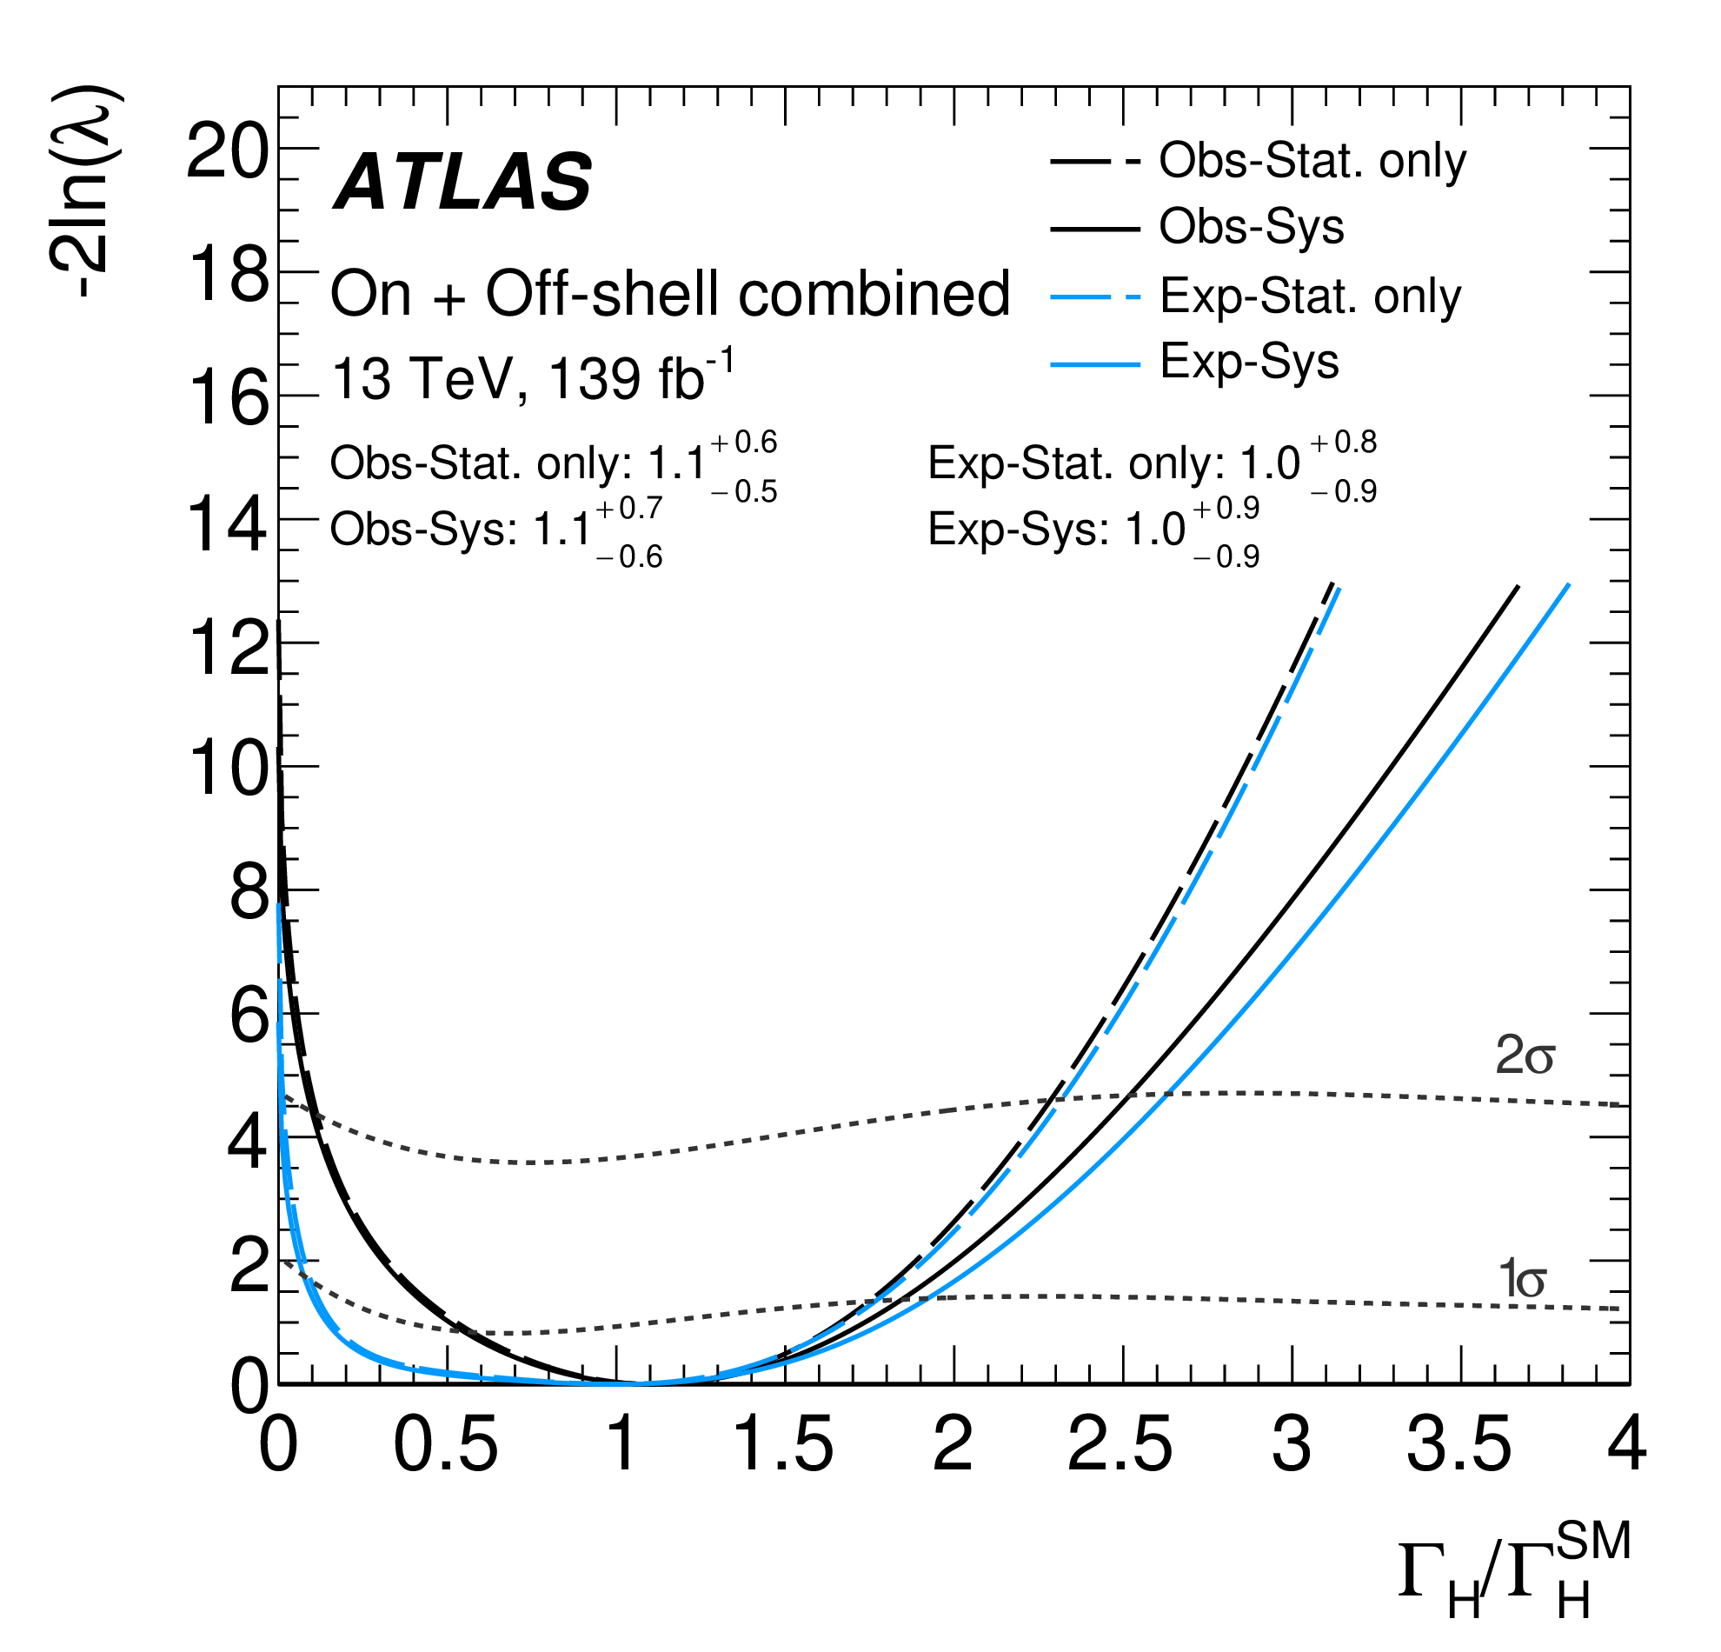
VV and offshell Higgs
Nature Physics 18 (2022) 1329–1334
PLB 846 (2023) 138223
High precision ZZ and delicate interference
→ evidence of off-shell Higgs
Constrain total H width down to 10 MeV

Slide 11
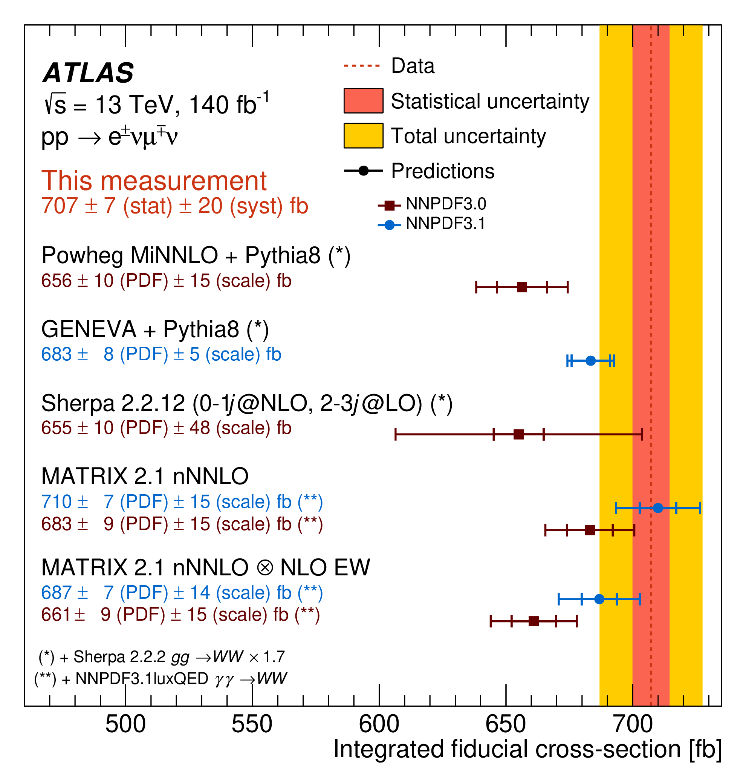
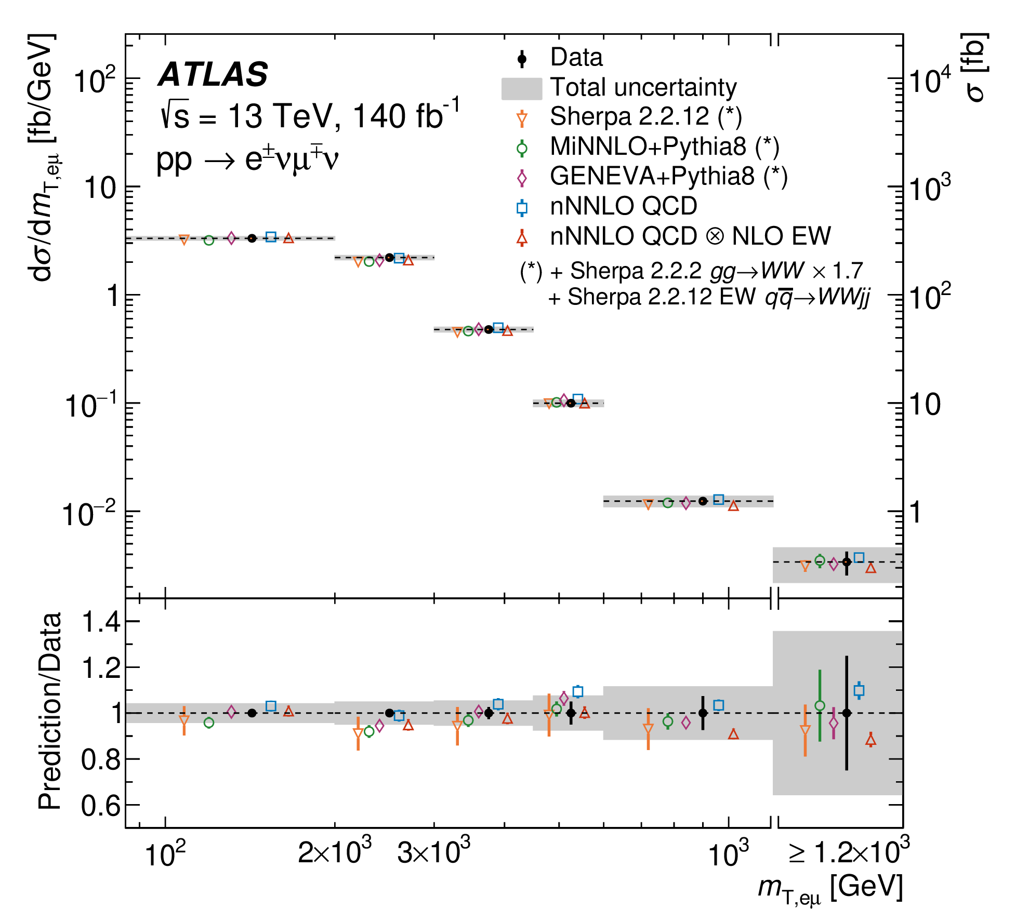
VV precision
JHEP 08 (2025) 142
NLO+PS → NLO+PS x NLO EW
→ NLO multileg + PS x NLO EW or NNLO+PS x NLO EW …
Exploration into previously inaccessible high-energy regions
<3% fiducial σ precision
Significantly improved precision test capacity in EW sector

Slide 12
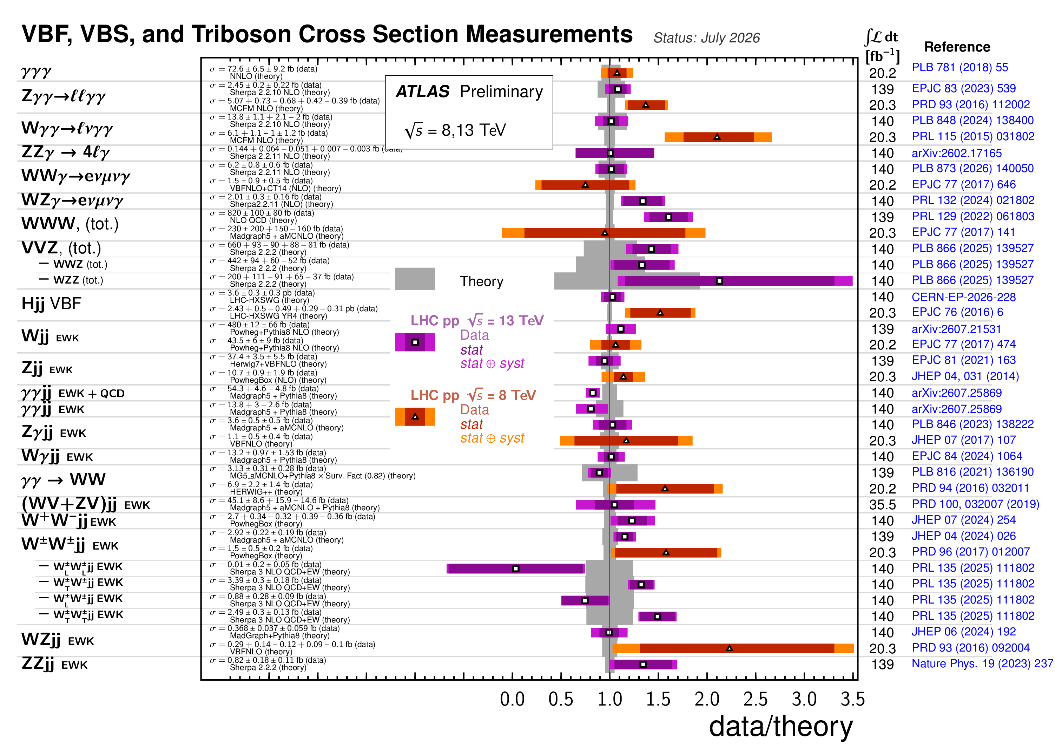
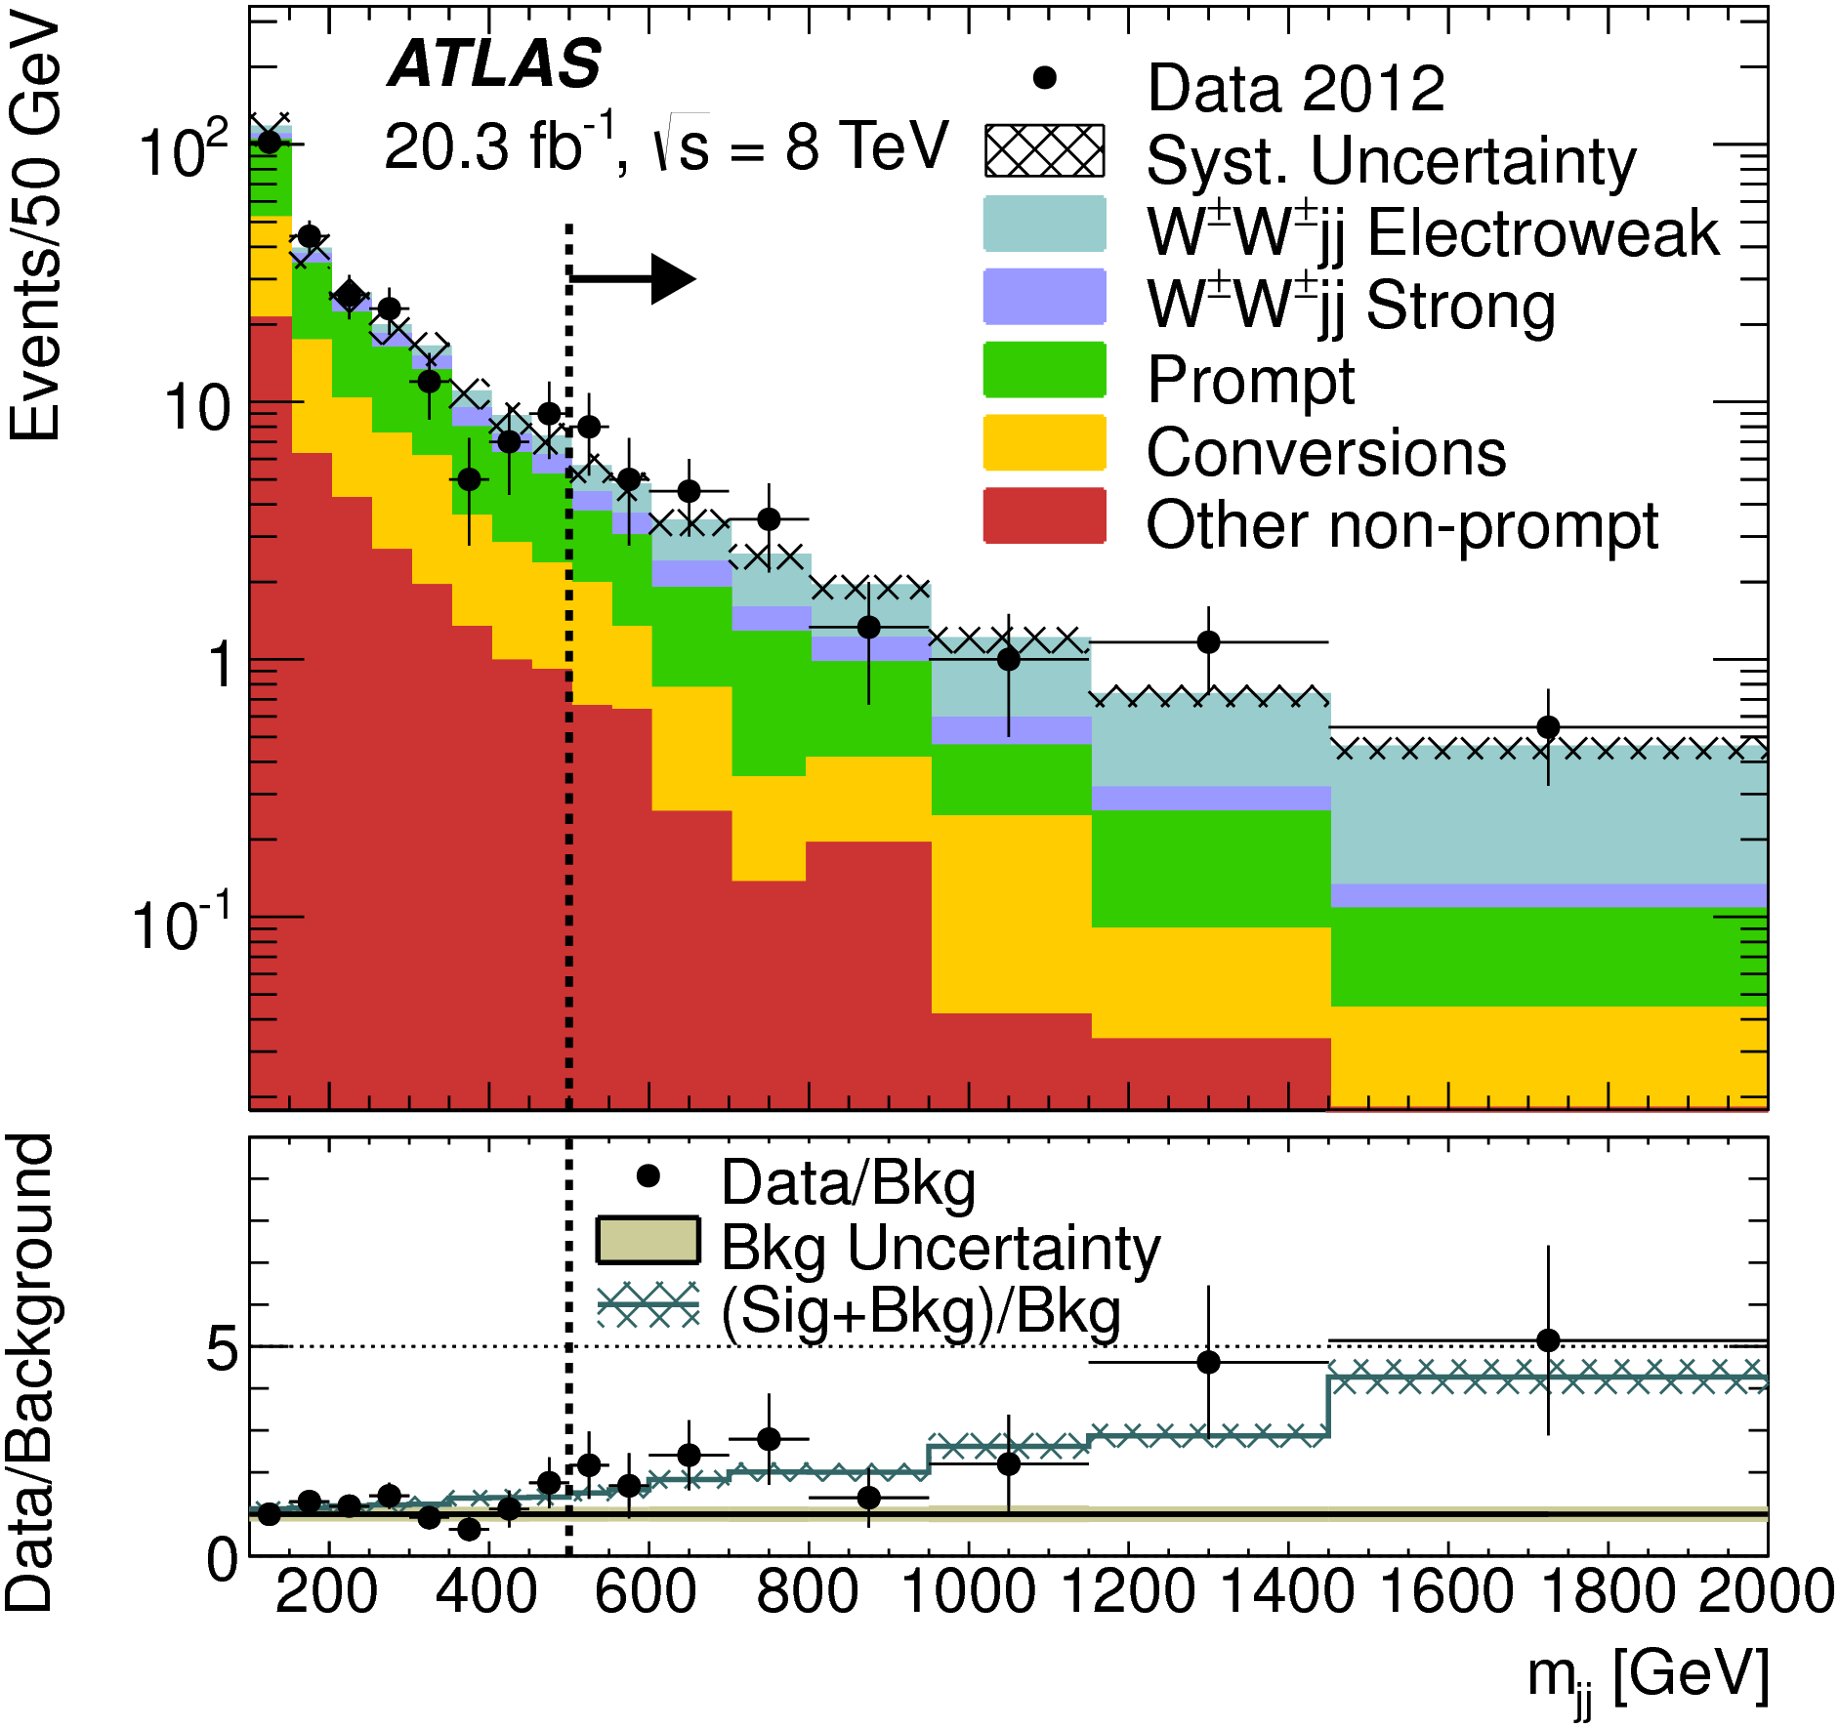
Vector Boson Scattering
PRL 113 (2014) 141803
Started 10 years ago with same-sign WW pairs + two jets with a handful of signal events
All EW VVjj modes have been observed
First-stage validation of EWSB predictions
Start to investigate more …

Slide 13
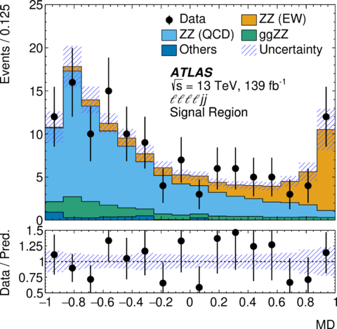
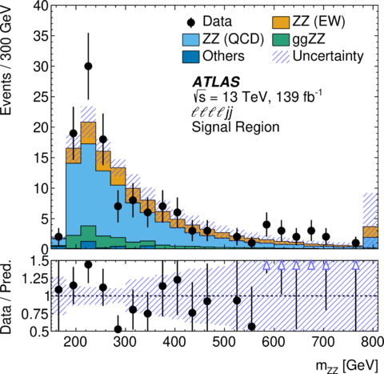
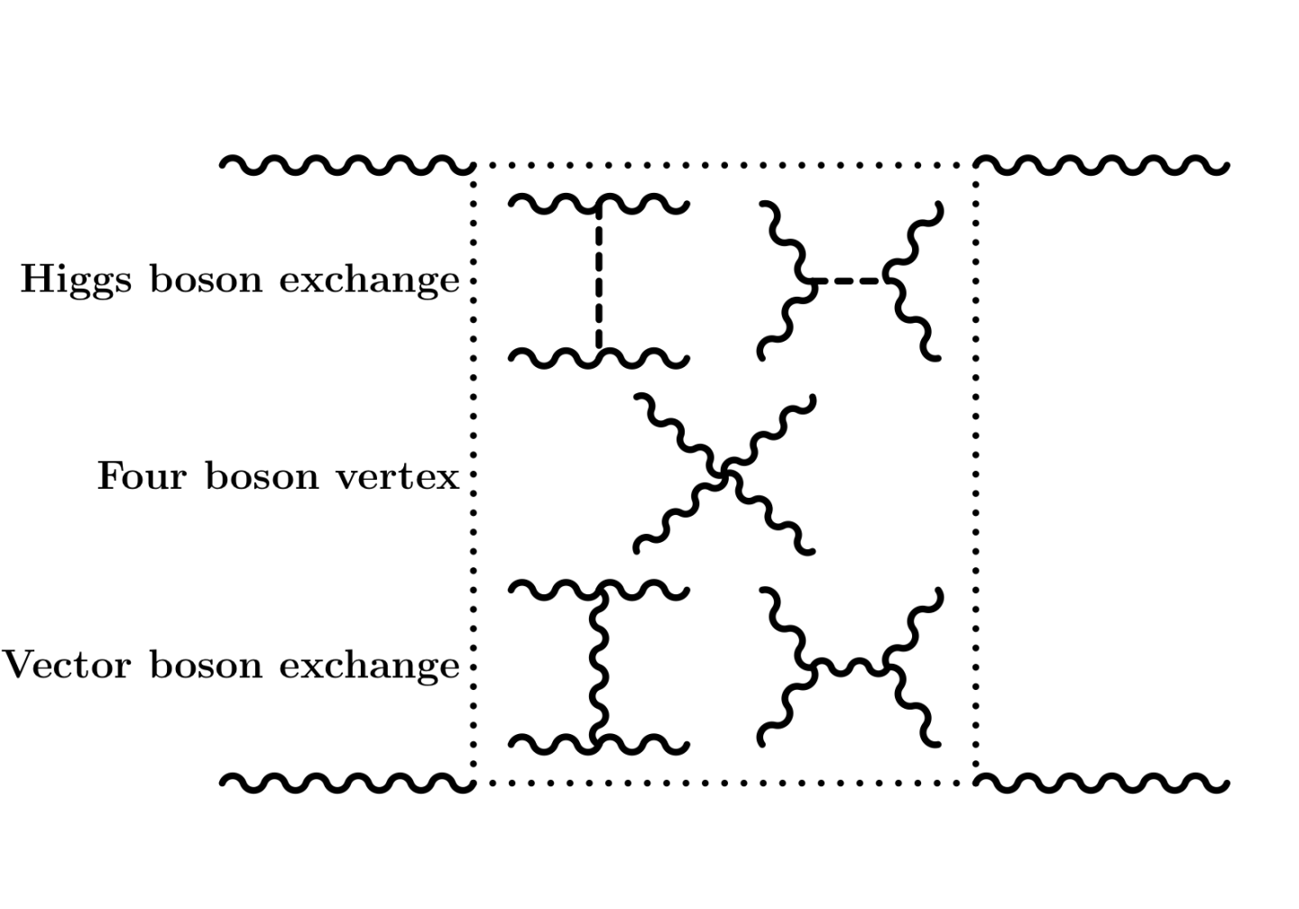
Vector Boson Scattering: Rarest VBS ZZ
Nature Physics 19 (2023) 237–253
arXiv:2606.20558
Fiducial σ as small as 0.1 fb, but rich in physics
First observation with ML enhancement
Peek into high mass behaviors with fully reconstructable states

Slide 14
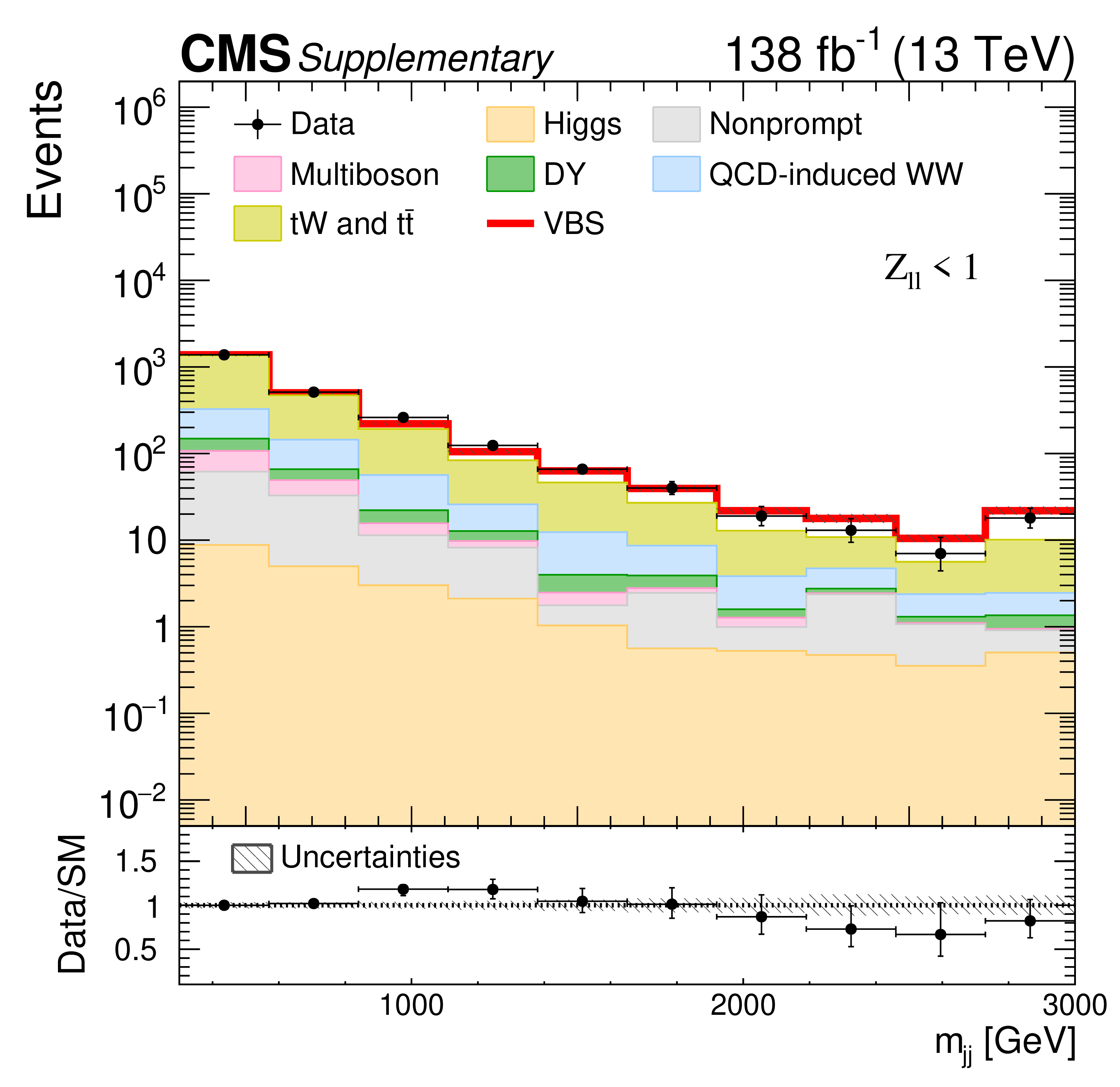
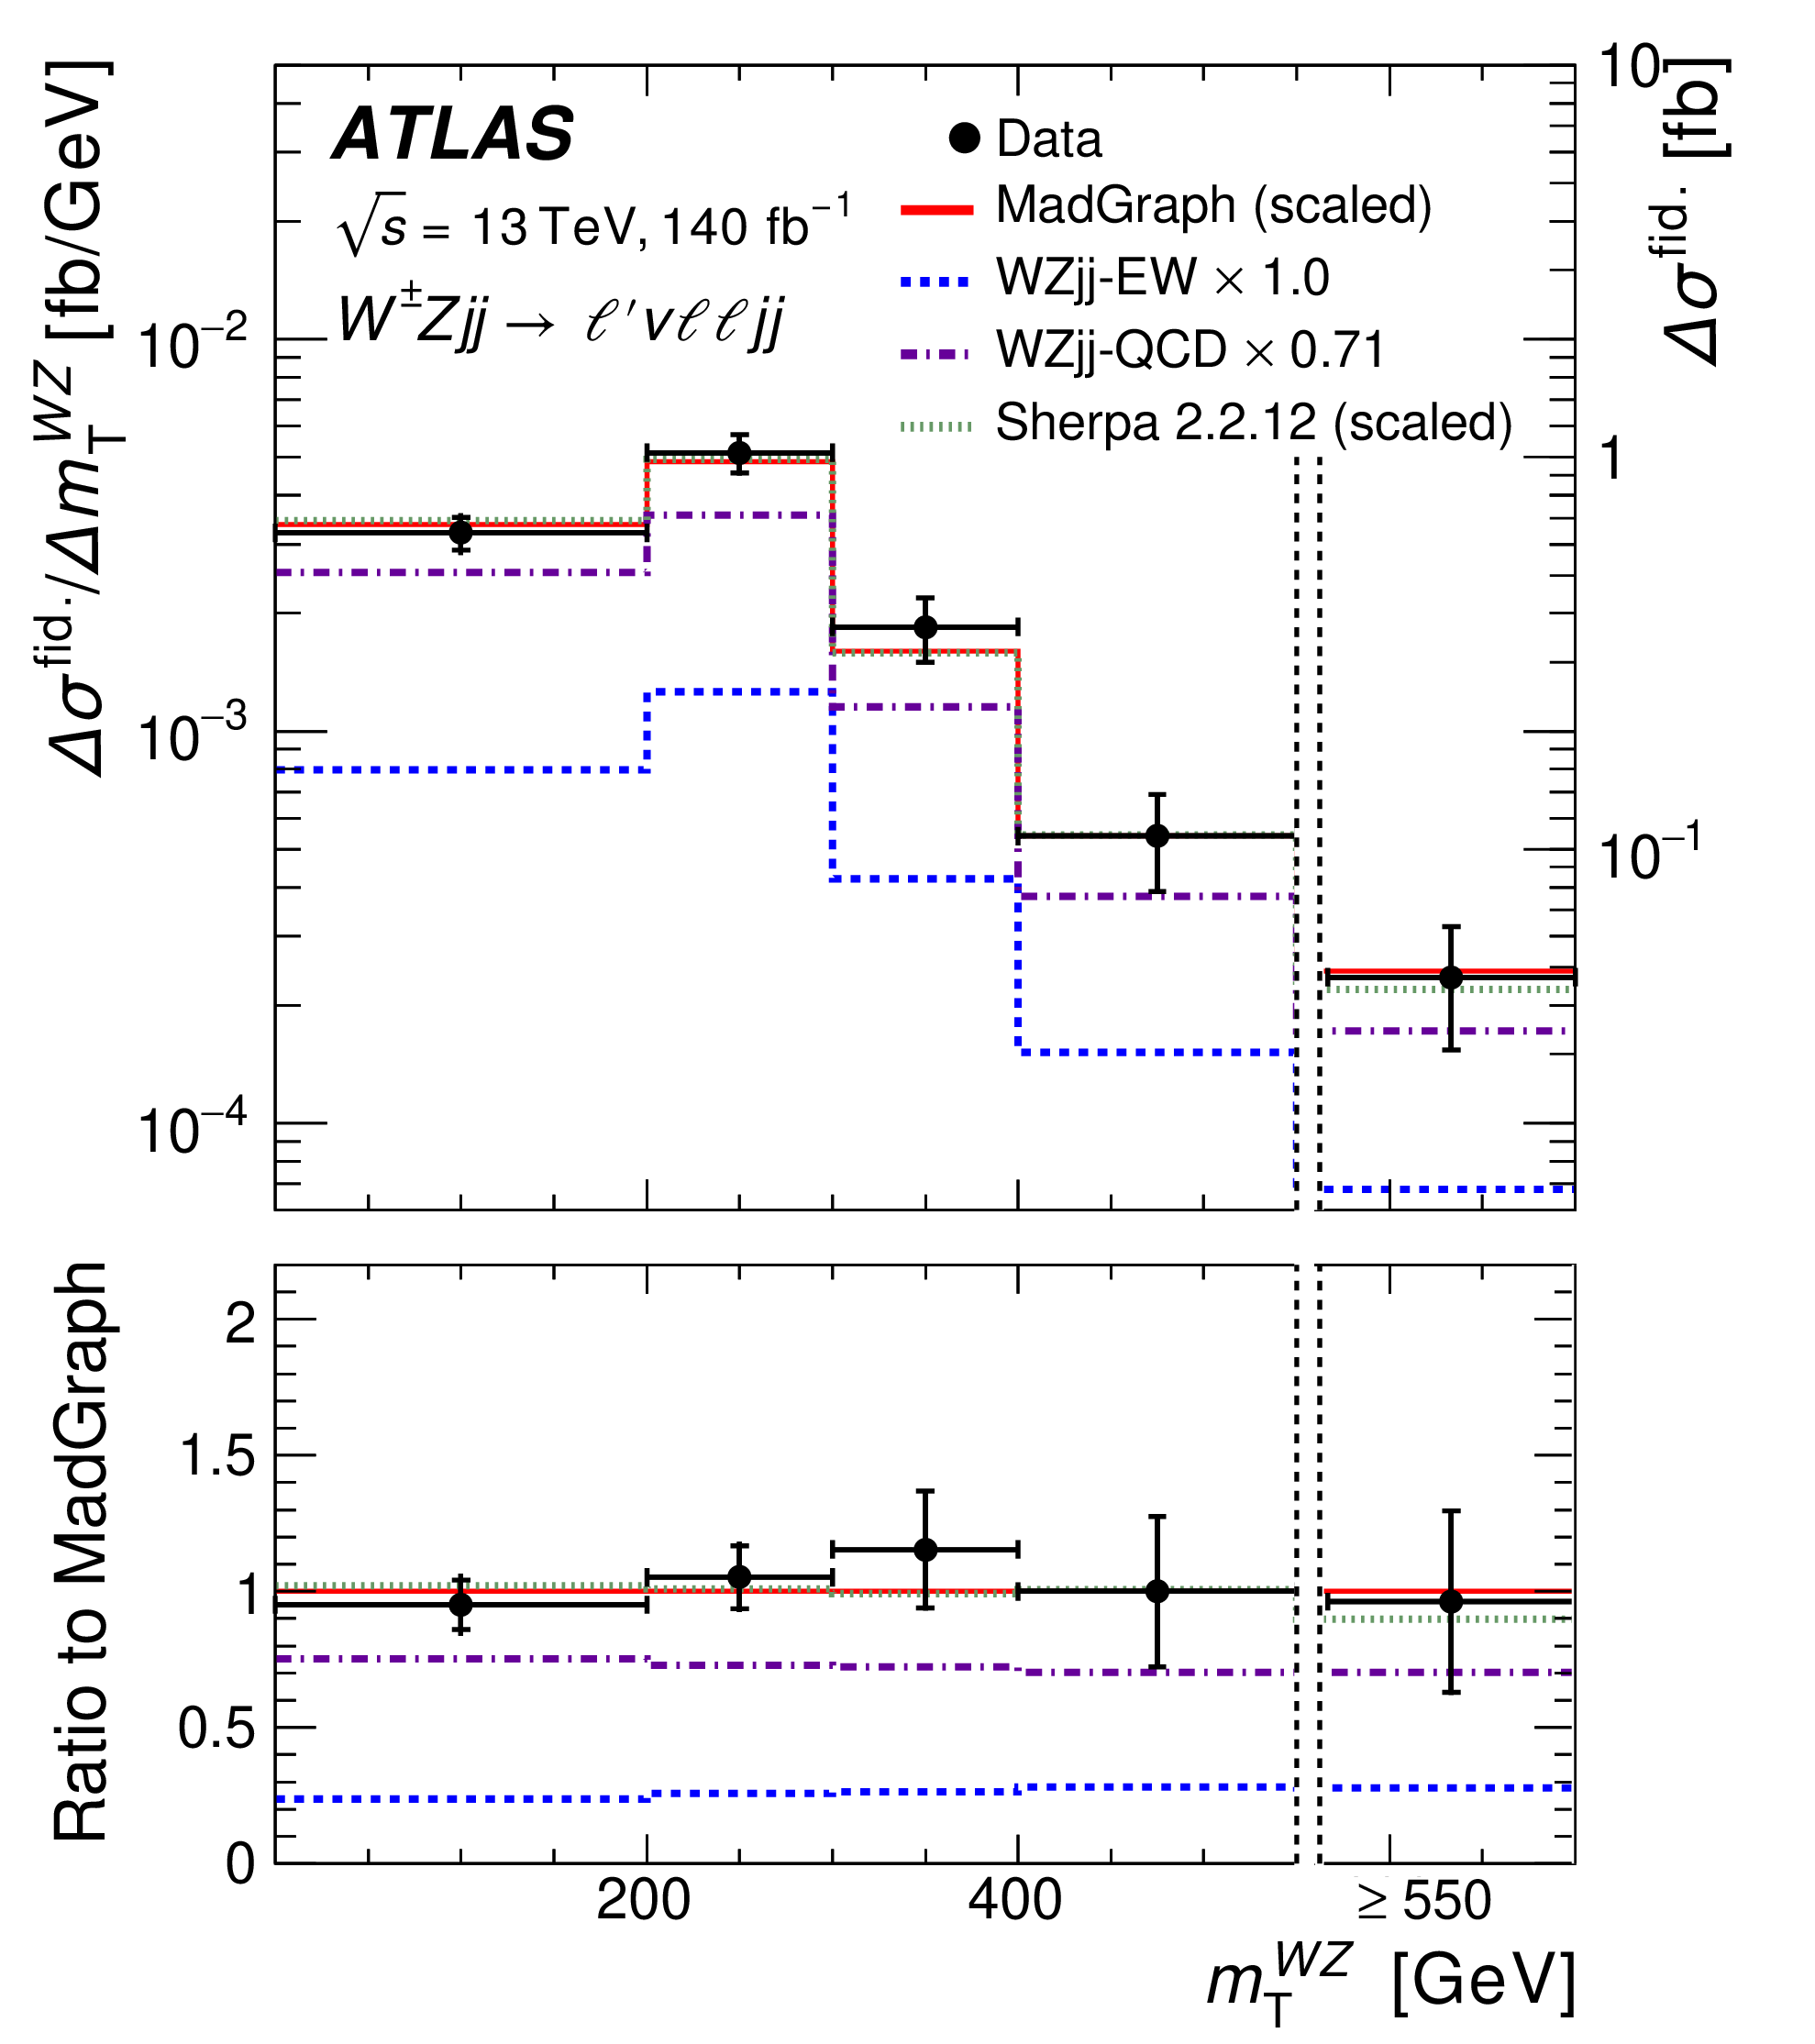
Vector Boson Scattering: VBS ssWW and WZ
PLB 841 (2023) 137495
JHEP 06 (2024) 192
Examine high-energy behavior with differential measurements

Slide 15
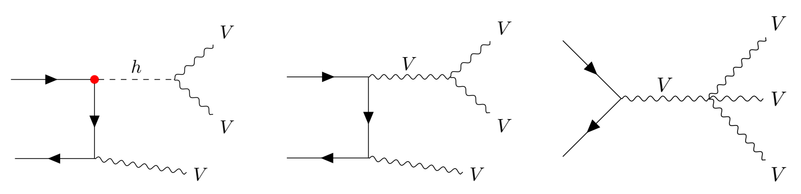
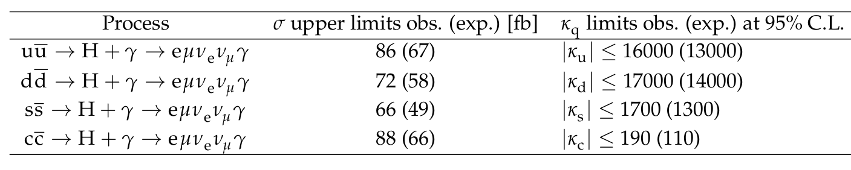
Triboson and Yukawa
JHEP 04 (2021) 023
Off-shell Higgs diagram important to unitarize high-energy behavior of VVV production → sensitivity to light quark Yukawa, O(100) upper limit (?) on κ_{f} for HL-LHC
PRL 132 (2024) 121901 (CMS)
WWγ also contains γH production with sensitivity to Yukawa

Slide 16
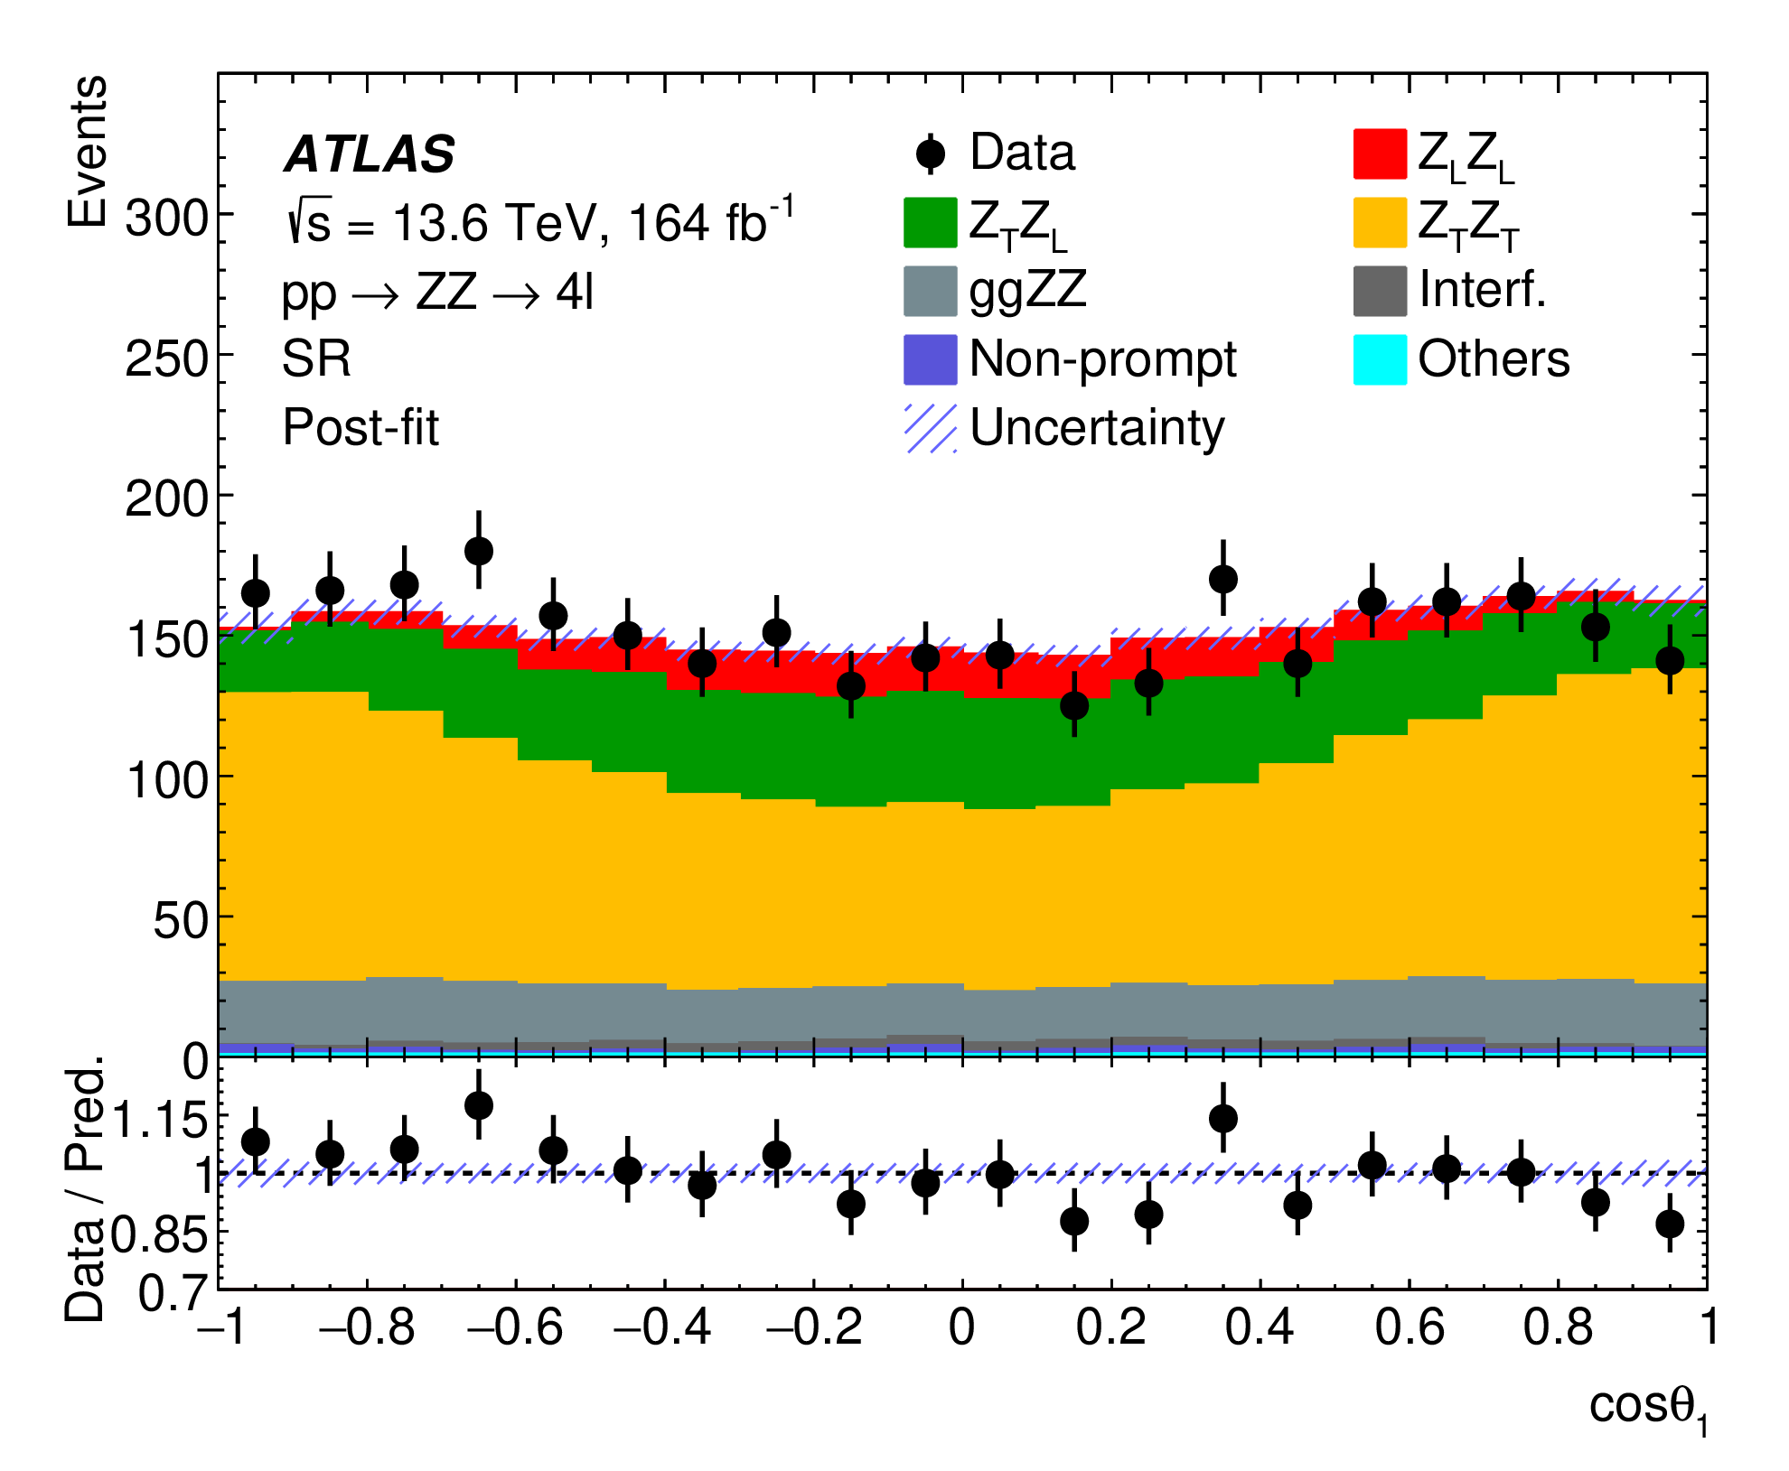
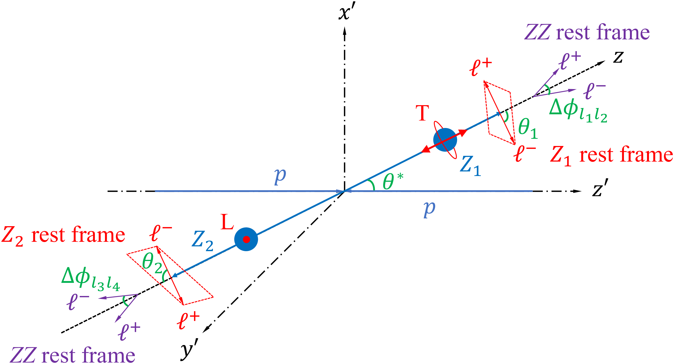
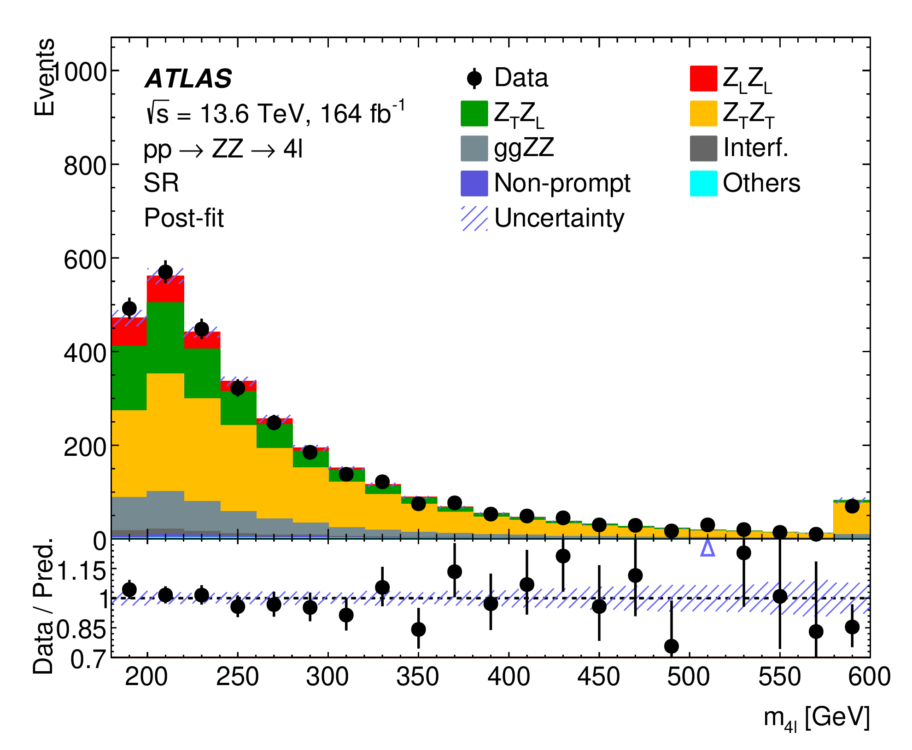
Diboson Polarisation (ZZ)
arXiv:2607.12879 (submitted to PRL)
V_{L}V_{L} typically < 10% in inclusive phase space
Experimental challenging to separate it out
Template modelling important (NLO+PS essential)
- decay angles
- energy dependence

Slide 17
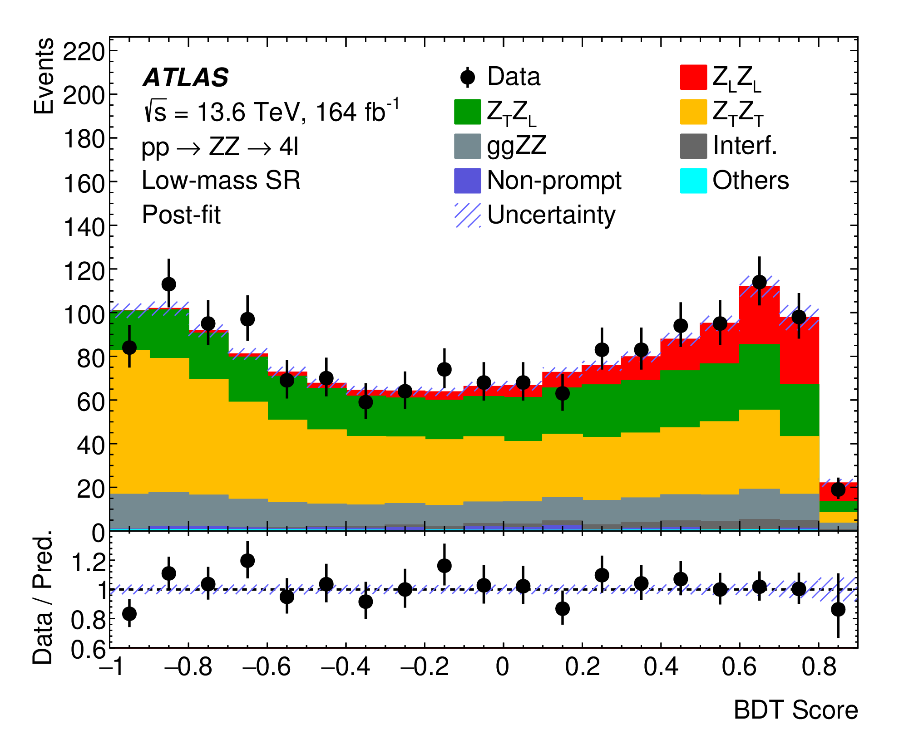
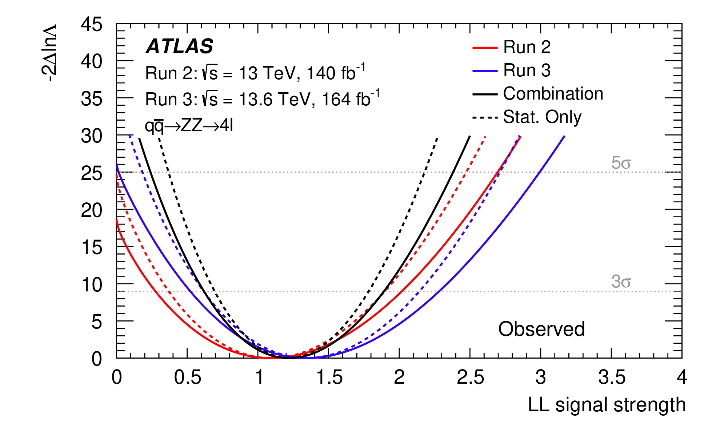
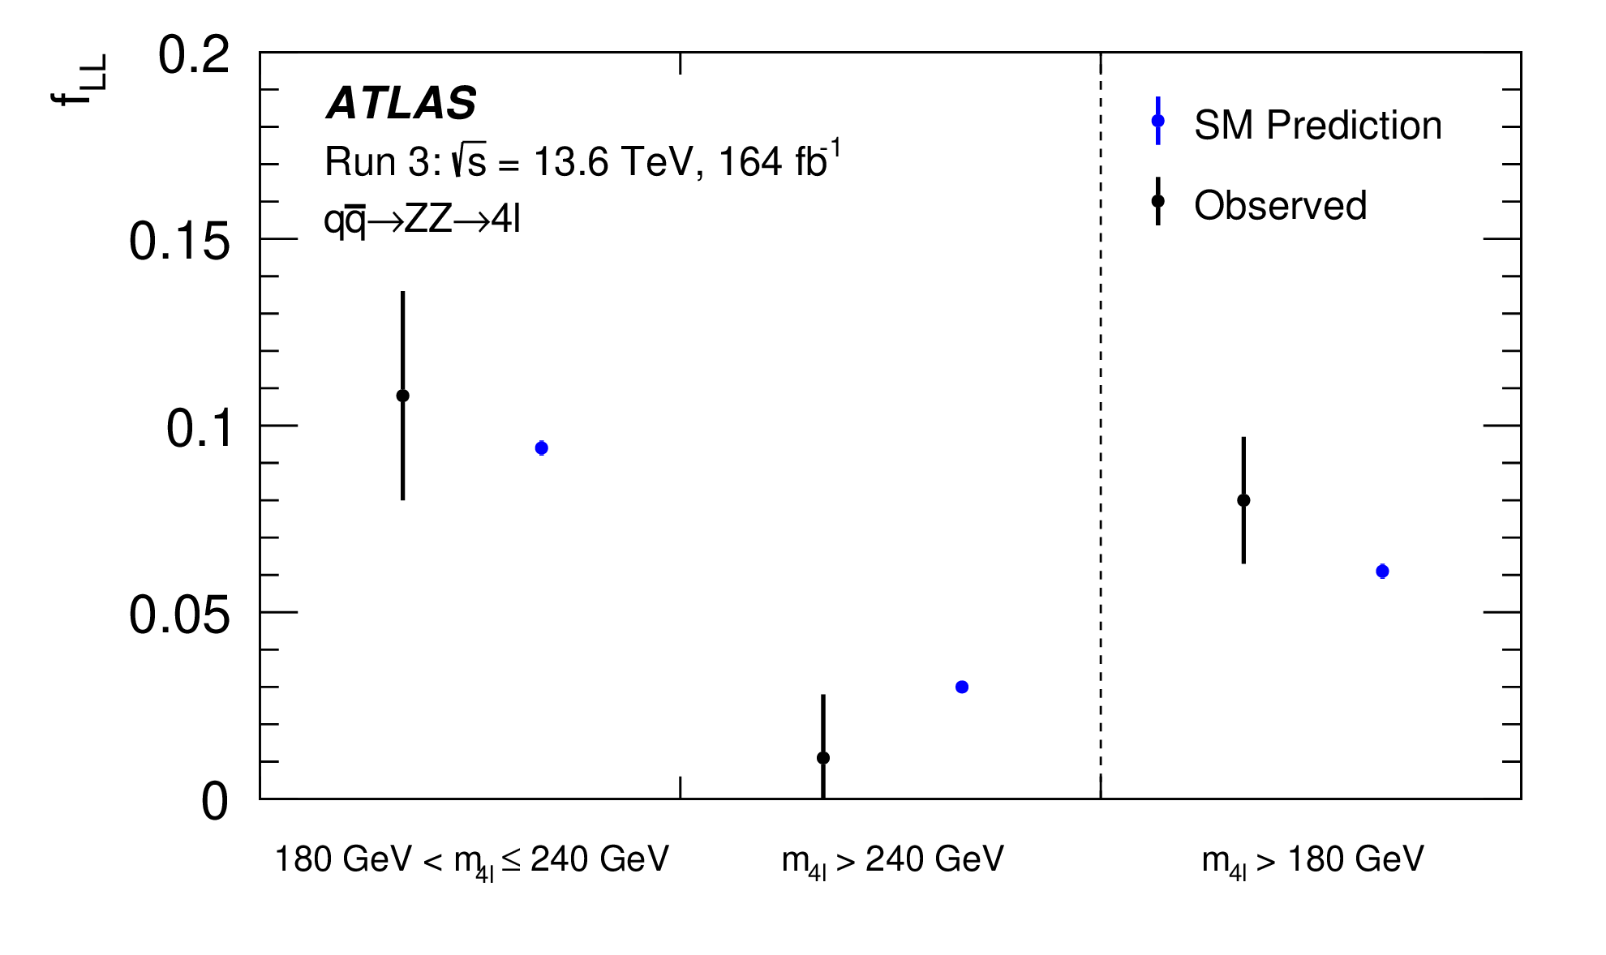
Diboson Polarisation (ZZ)
arXiv:2607.12879 (submitted to PRL)
Combing partial Run 3 + Run 2 →
First observation of Z_{L}Z_{L} production
Attempt to study the energy dependence
ML enhancement of Z_{L}Z_{L} detection

Slide 18
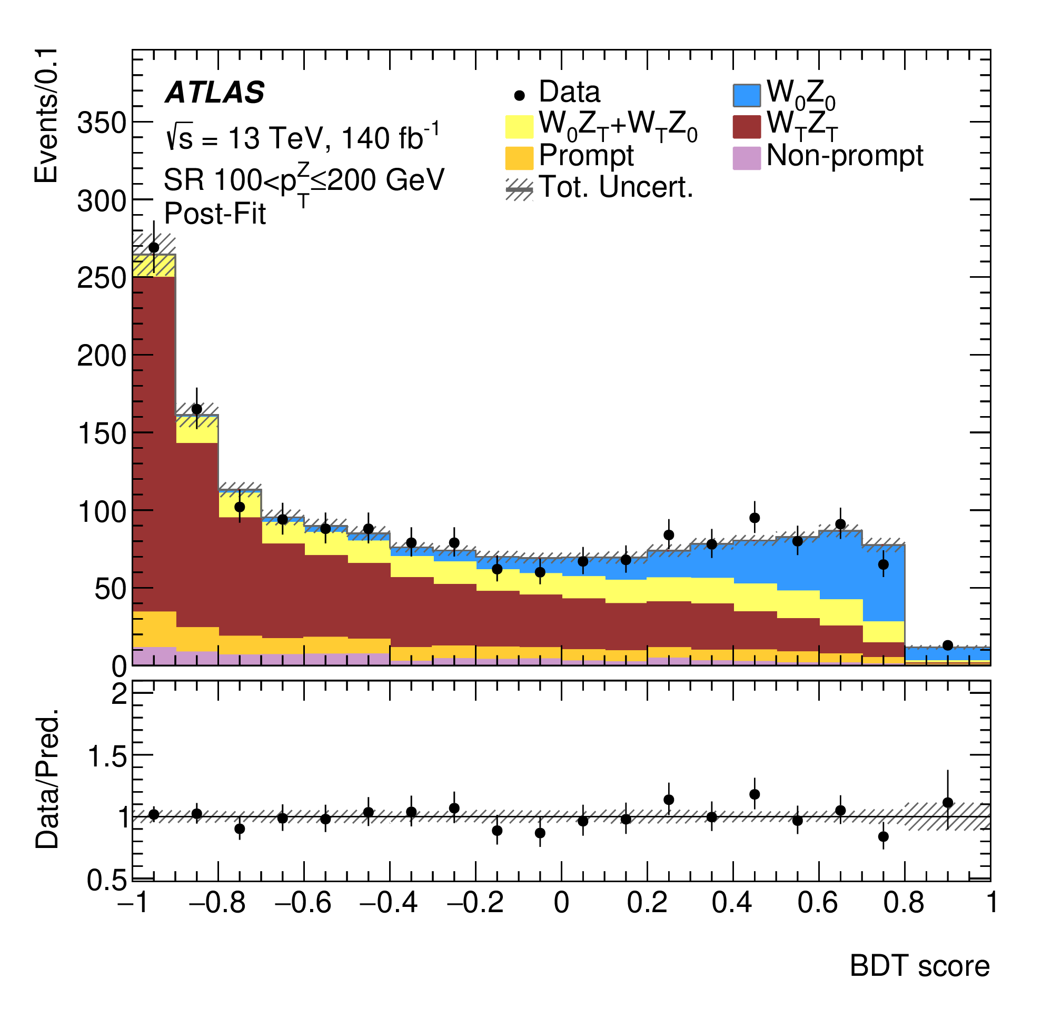
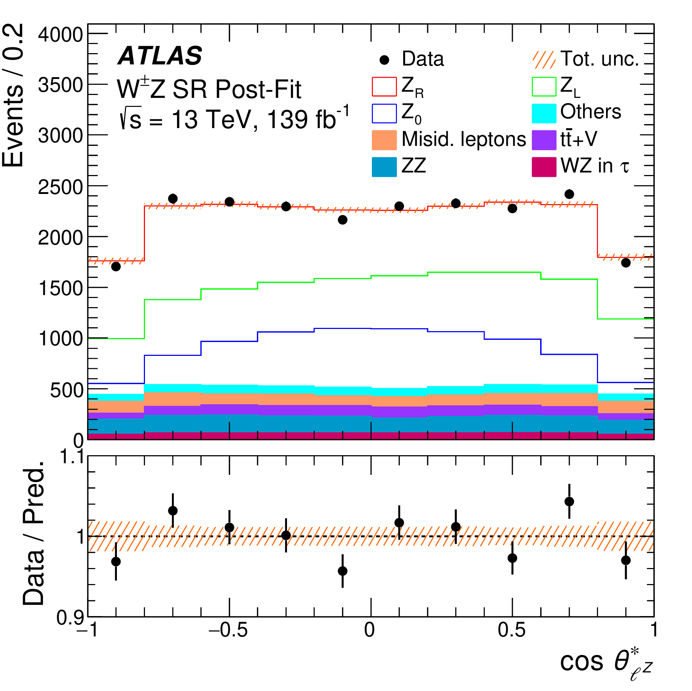
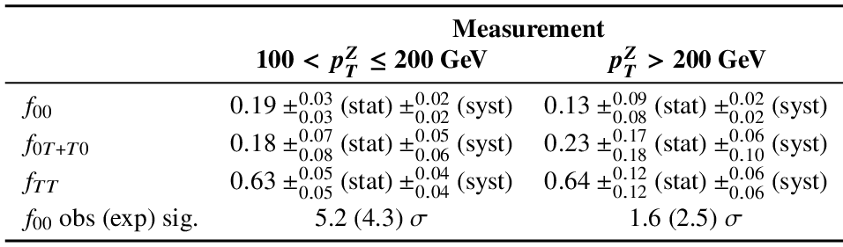
Diboson Polarisation (WZ)
PRL 133 (2024) 101802
PLB 843 (2023) 137895
Attempt to probe higher-energy behavior of W_{L}Z_{L}
→ Observation of W_{L}Z_{L} with pT>100 GeV
First V_{L}V_{L} observation

Slide 19
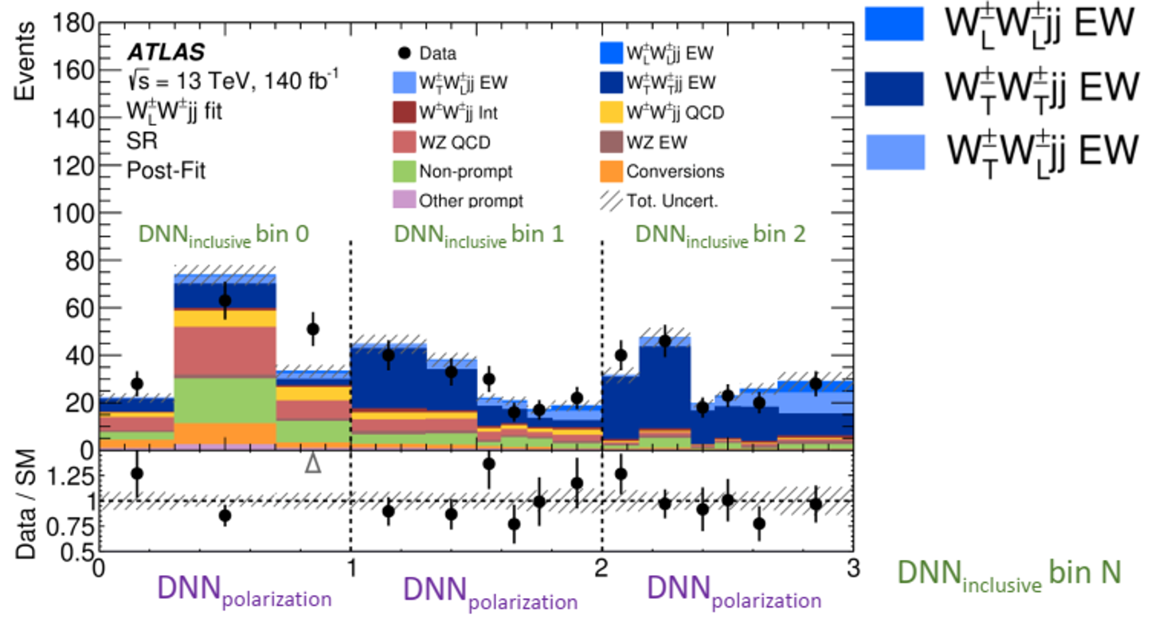
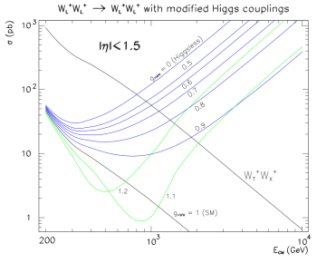
Boson Polarisation in VBS (WW)
PRL 135 (2025) 111802
Accumulated experience and ML enhancement lead to the milestone
arXiv:1412.8367
First evidence on W_{L}W_{X} polarized production in same-sign WW VBS process
Larger datasets to probe the EWSB

Slide 20
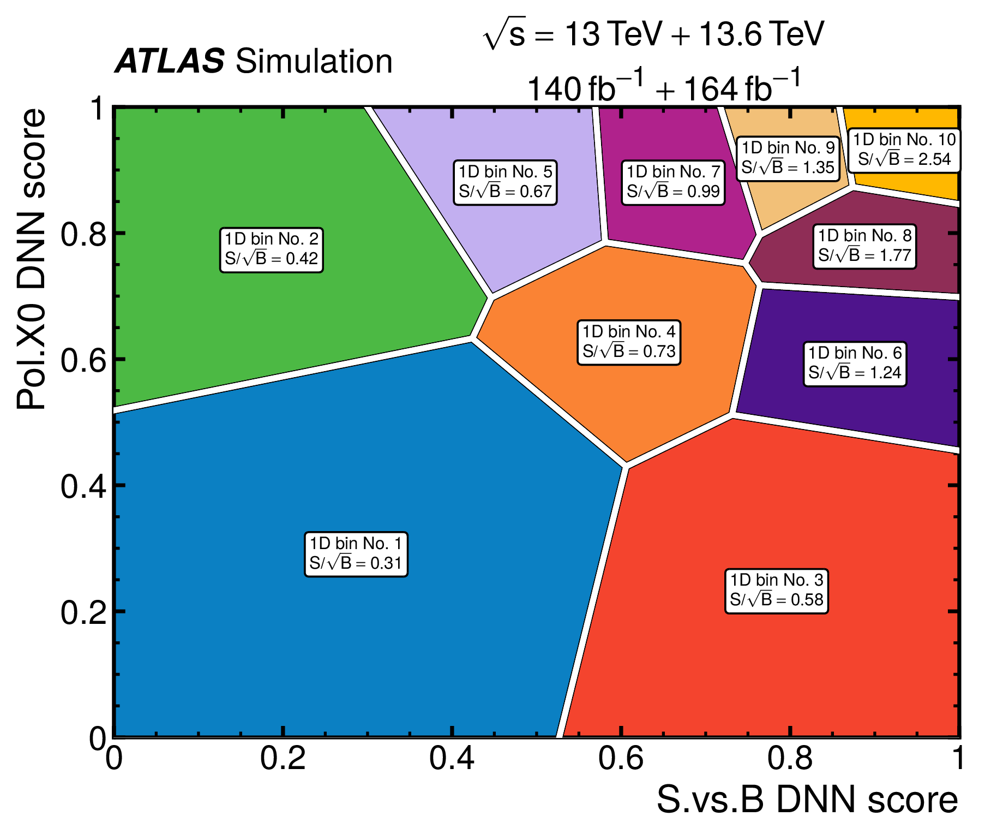


Boson Polarisation in VBS (WZ)
arXiv:2607.20246
Evidence for Z_{L} in VBS WZ events, while statistical deficit seen for W_{L}
Dynamic binning based on ML and signal significance
Sensitivity to VBS W_{L}Z_{L} < 1 σ so far

Slide 21

Future: Joint Measurement
arXiv:2605.08433
Electroweak restoration test via VV/VH ratio measurements
Large dataset at HL-LHC desired

Slide 22


Future: Hadronically Decaying Bosons
Larger BR for high-energy behavior study
specific tagger needed for background separation
From ATLAS Public Results
Efforts to take advantage of decaying angles information with ML, to separate longitudinal component out
- and to improve large R jet and its substructure reconstruction

Slide 23
Summary
High-energy behavior of longitudinal vector boson ~ goldstone boson → Understanding the EWSB dynamics
* Unique and complementary to direct Higgs measurement
Accessible only at the LHC
* precision diboson measurements
* opening of VBS channels
* diboson polarisation measurements
* thanks to fast development start-of-art theory calculations and
innovation of experiment technics
With full Run-3 and future HL-LHC data, hope to turn the qualitative exploration into quantitative measurement
* new approaches to differentiate different EWSB models
* improving exp. technicalities with increasing data size

Slide 24



Where is it?
New Physics
Very successful
Still expecting new physics due to dark matter, …
A long-term program for
High-energy V_{L} and EWSB dynamics
THANKS!
SM

Slide 25
Backup

