Slide 1
Some studies on cosmological phase transitions — subcritical or aspherical bubbles
Jin Min Yang
Center for Theoretical Physics, Henan Normal University;
Institute of Theoretical Physics, Chinese Academy of Sciences
International Workshop on New Opportunities for Particle Physics
2026.8.14-16

Slide 2
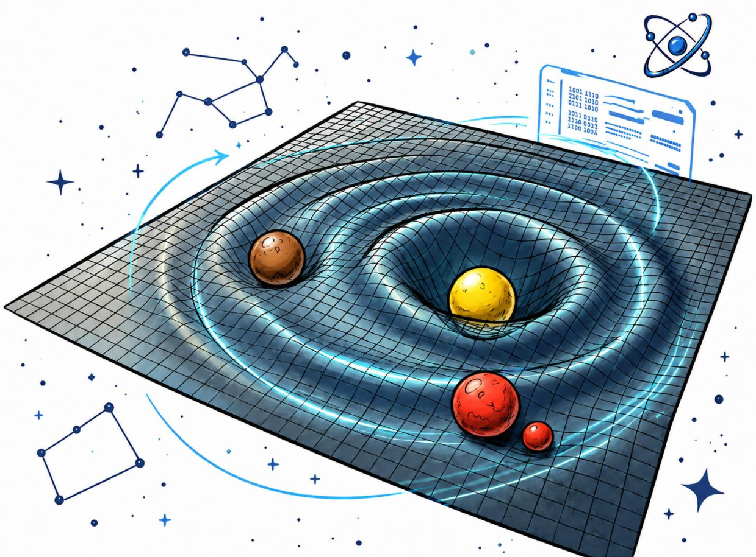
based on:
Subcritical bubble prehistory in weak first-order phase transition,
G. Chen, Y. Xiao, JMY, Y. Zhang, 2605.24891
Gravitational wave signature of aspherical bubbles driven by thermal fluctuation,
L. Bian, G. Chen, S. Li, H. Wang, Y. Xiao, JMY, Y. Zhang, 2601.15933
All graphics in this talk are from the talks of Yang Xiao (肖洋) and Hongxin Wang (王宏昕), given in Xinxiang this summer

Slide 3
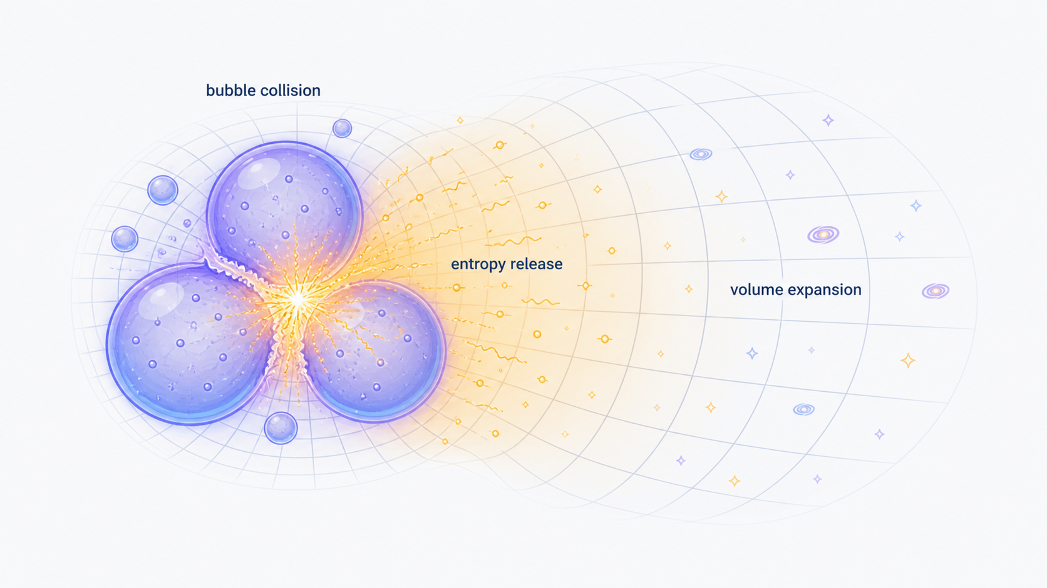
Outline
1 Introduction
2 Subcritical bubbles
3 Aspherical bubbles
4 Summary

Slide 4
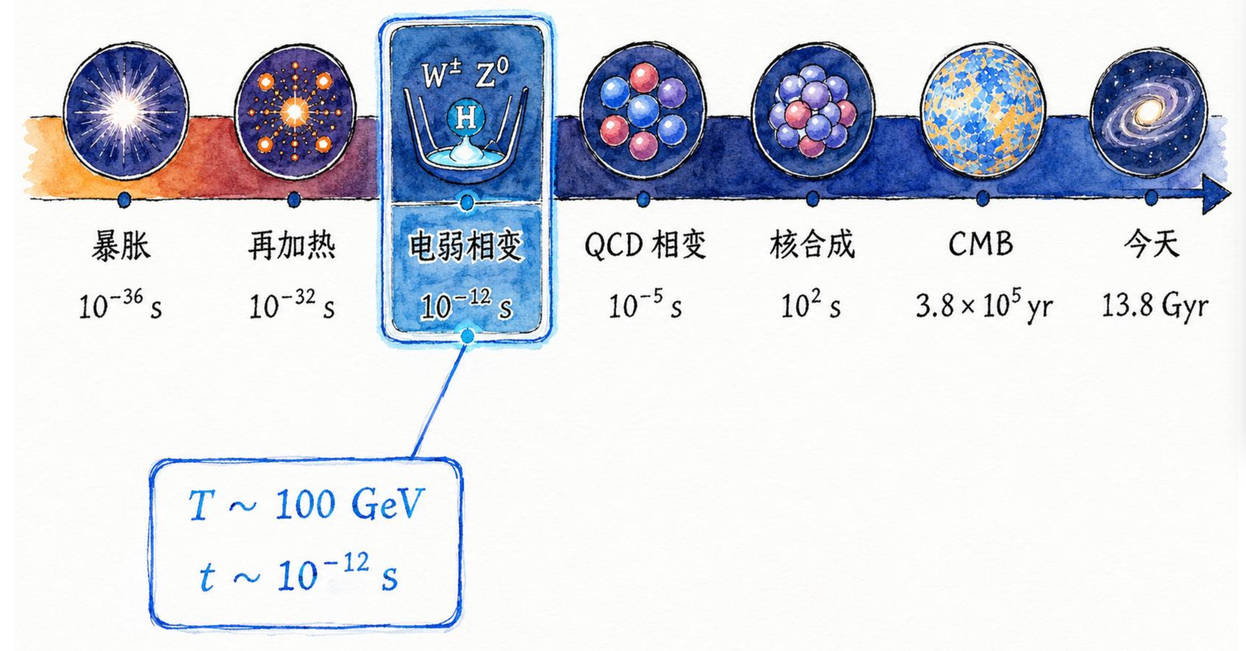
1 Introduction
Electroweak phase transition (EWPT) plays a key role in birth and evolution of our Universe.
The study of birth and evolution of our Universe is called cosmology.

Slide 5
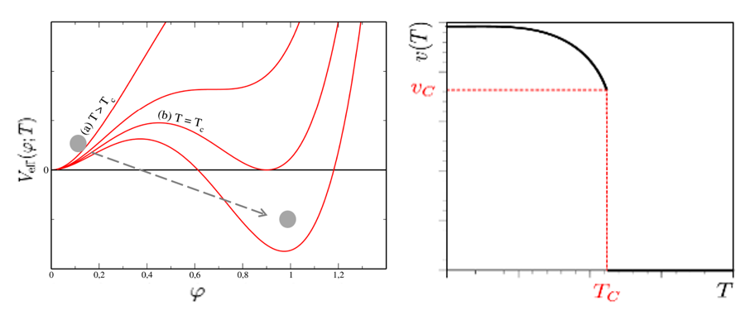
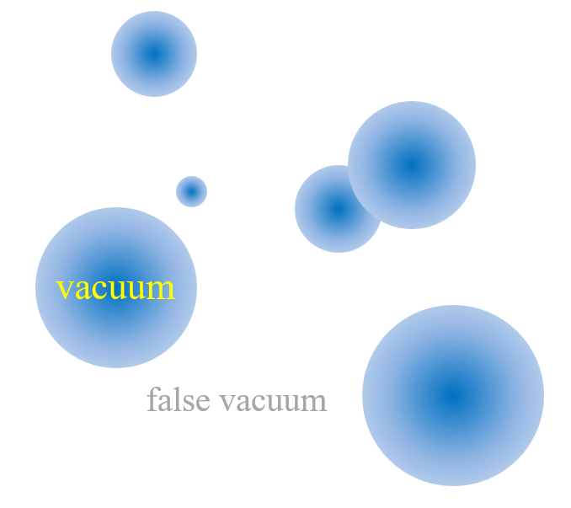
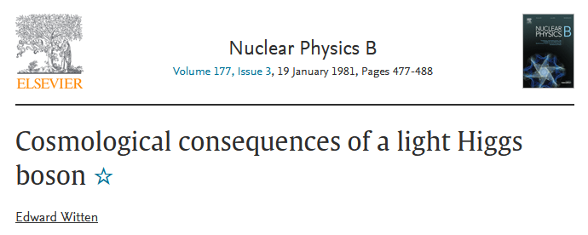
Why particle physicists study EWPT ?
first-order EWPT
In SM, due to 125 GeV Higgs (too heavy), EW transition is a smooth crossover: no bubbles, no departure from equilibrium.

Slide 6
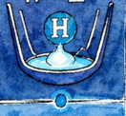
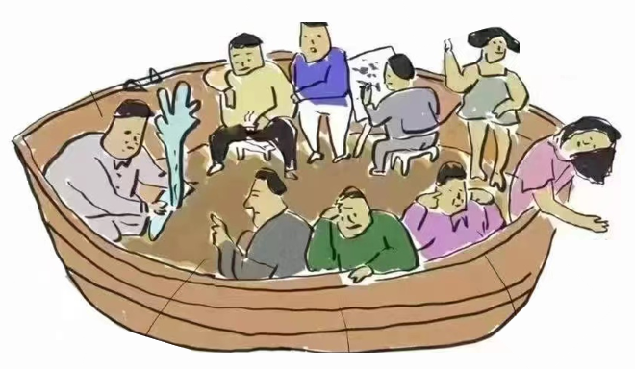
Why particle physicists study EWPT ?
first-order EWPT
implies new physics beyond SM (at least Higgs sector need to be extended)
SM Higgs
new scalars

Slide 7
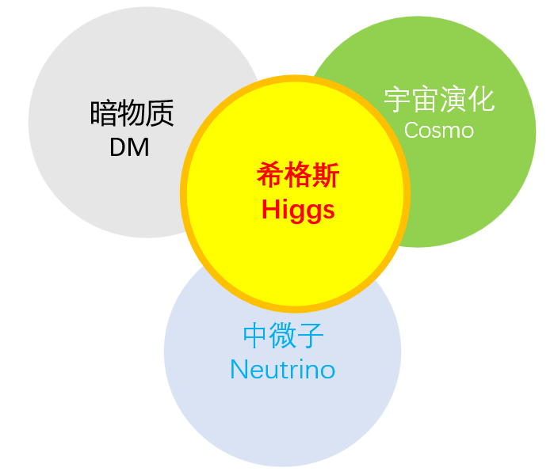
Why particle physicists study EWPT ?
first-order EWPT

Slide 8
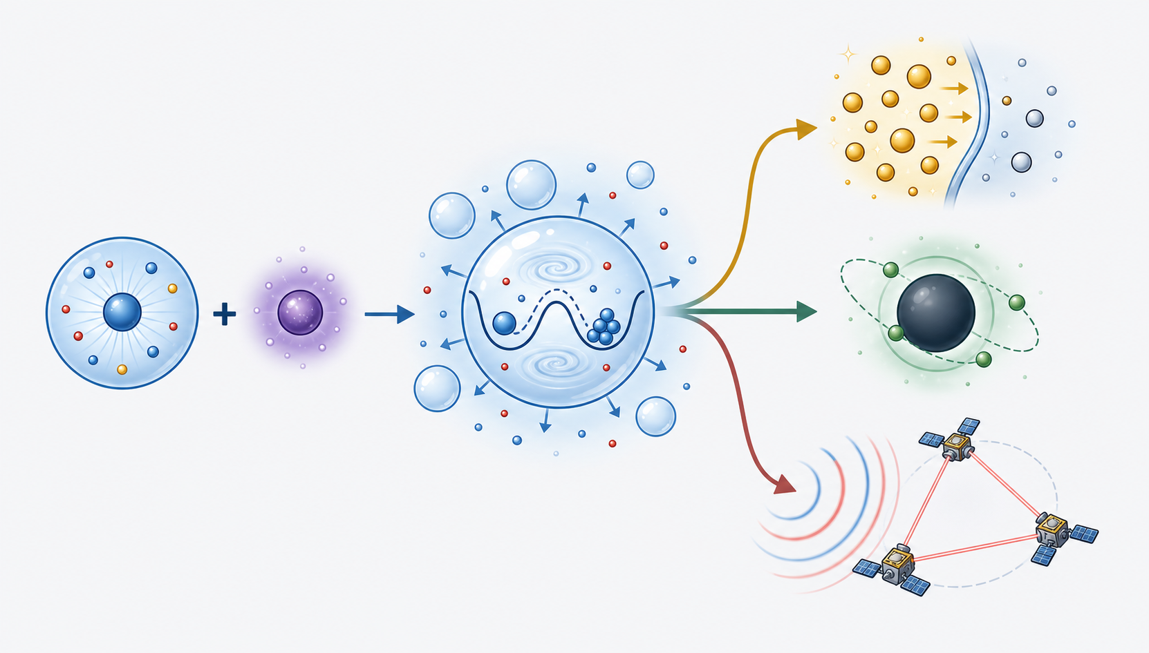
Talk big
EWPT links micro-physics to cosmoscopic-physics
EWPT
Baryogenesis
BSM
DM
GW

Slide 9
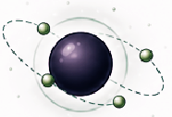
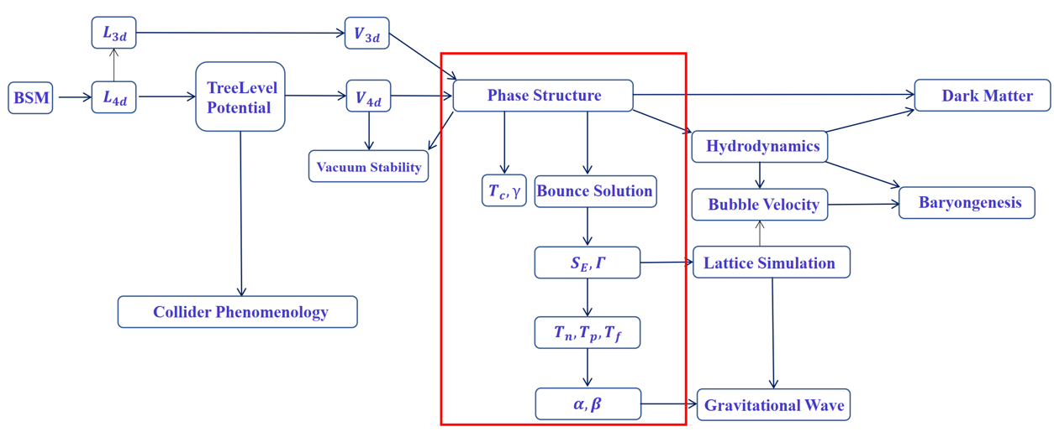
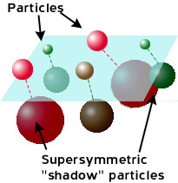
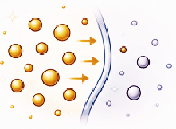
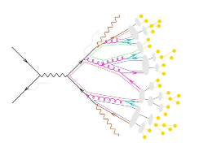
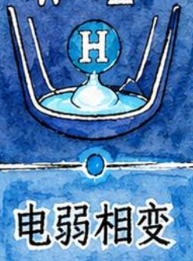
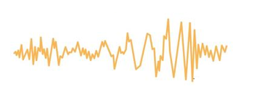
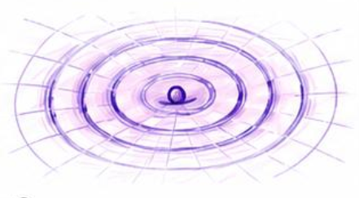
Talk big
in some details
EWPT links micro-physics to cosmoscopic-physics
EWPT

Slide 10
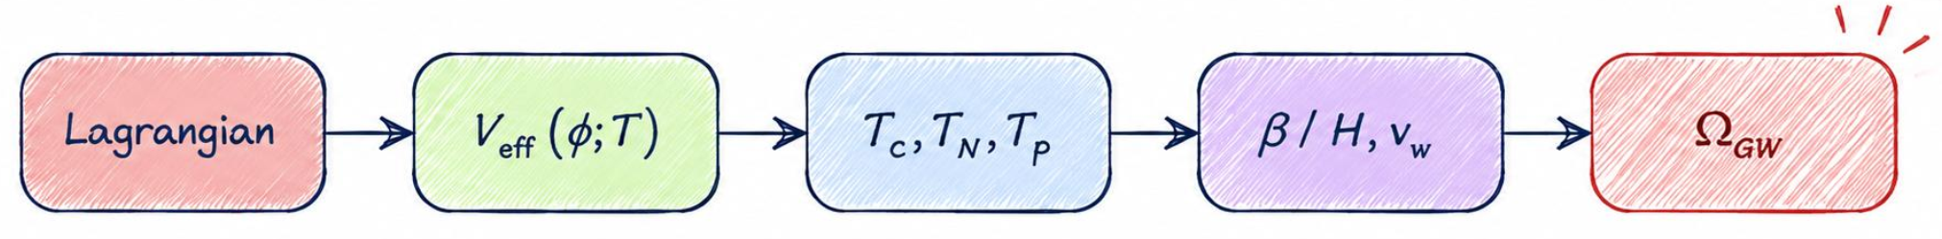
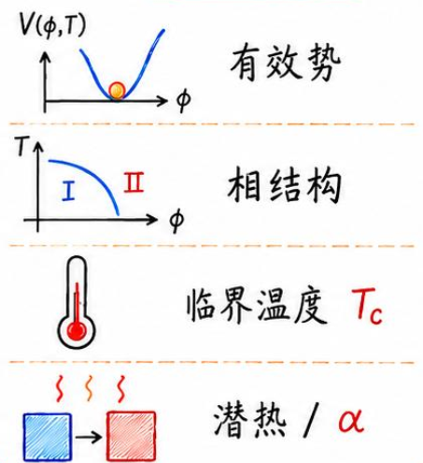
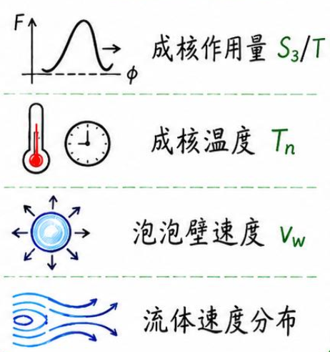
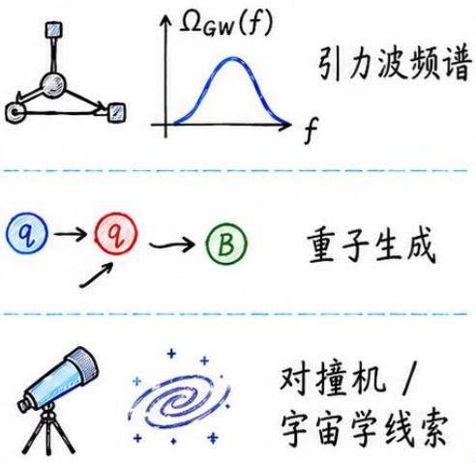
About calculation of PT:
complex just like particle pheno
EWPT: calculation is tedious

Slide 11
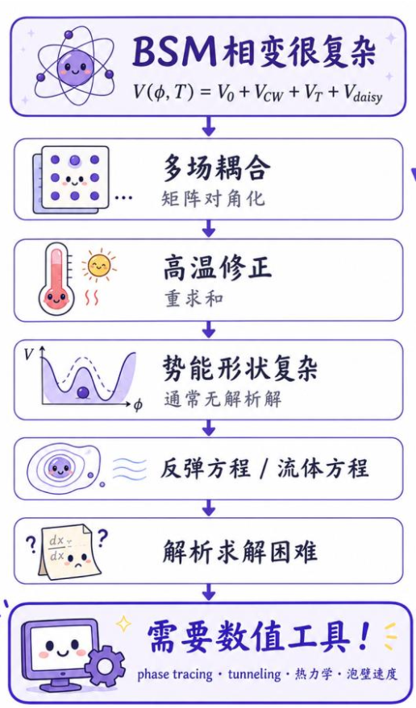

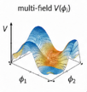
About calculation of PT:
complex just like particle pheno
EWPT: calculation needs tools
multi-field couplings
matrix diagonalization
correction at finite-T
need resummation
complicated potential shape
usually no analytic solution
bounce equation
fluid equation
no analytic solution
need numerical tools

Slide 12
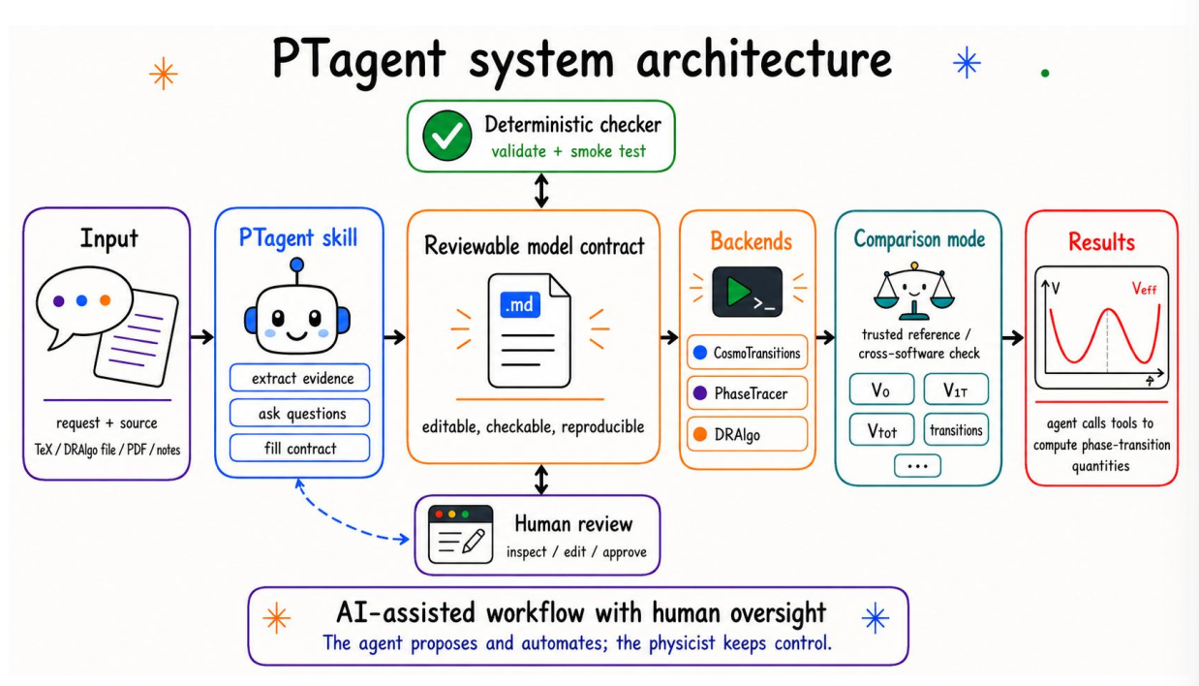
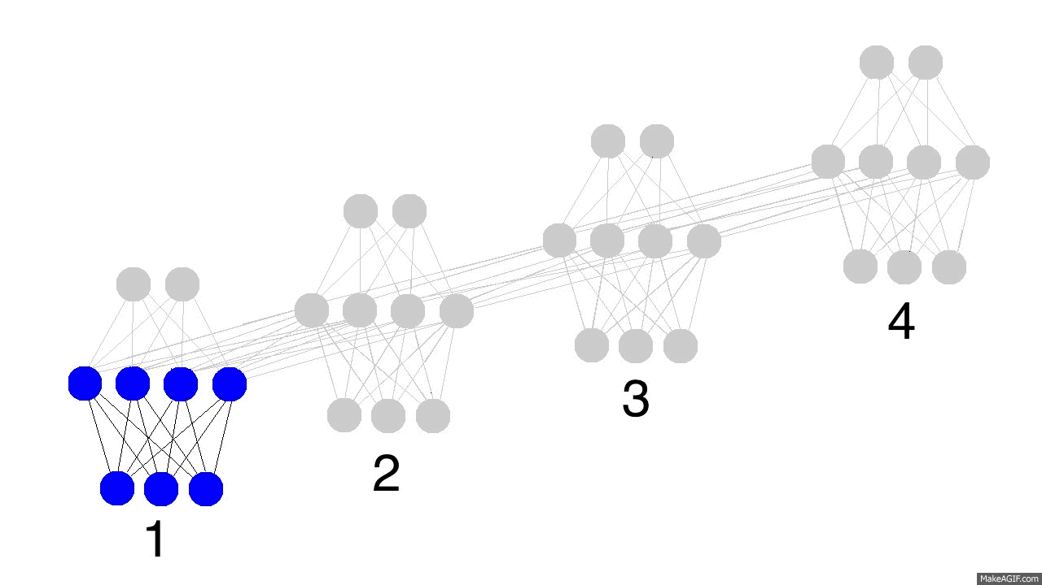
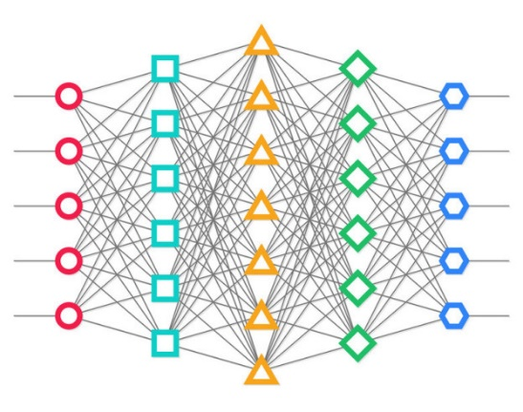
About calculation of PT:
complex just like particle pheno
EWPT: AI can be of assistance
Machine learning
AIagent + LLM
Enhancing Phase Transition Calculations with fitting and Neural Network
L. Bian, H. Wang, Y. Xiao, J. Yang, JMY, Y. Zhang, 2510.10667
PTagent: Constructing Effective Potential for Cosmological Phase Transition
L. Wu, Y. Xiao, JMY, Y. Zhang, 2608.????

Slide 13

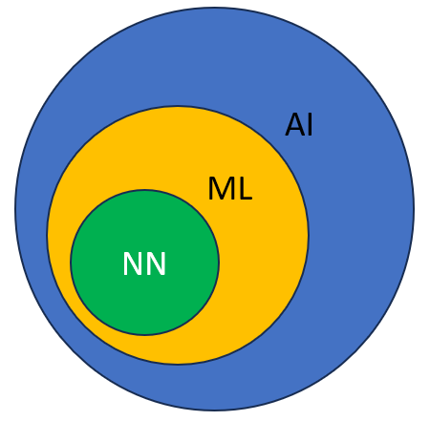
About calculation of PT:
complex just like particle pheno
EWPT: AI can be of assistance
AI is good at doing complex calculations.
AI is not able to discover new physics.

Slide 14
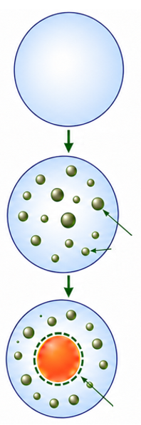
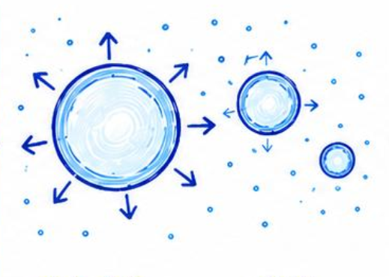

In my talk I will skip the dirty calculation details and focus on bubble physics
subcritical
bubbles
critical
bubbles
spherical bubble
thermal ripples
aspherical bubble

Slide 15
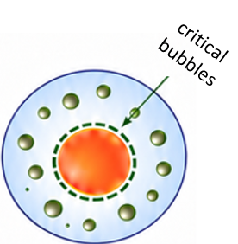
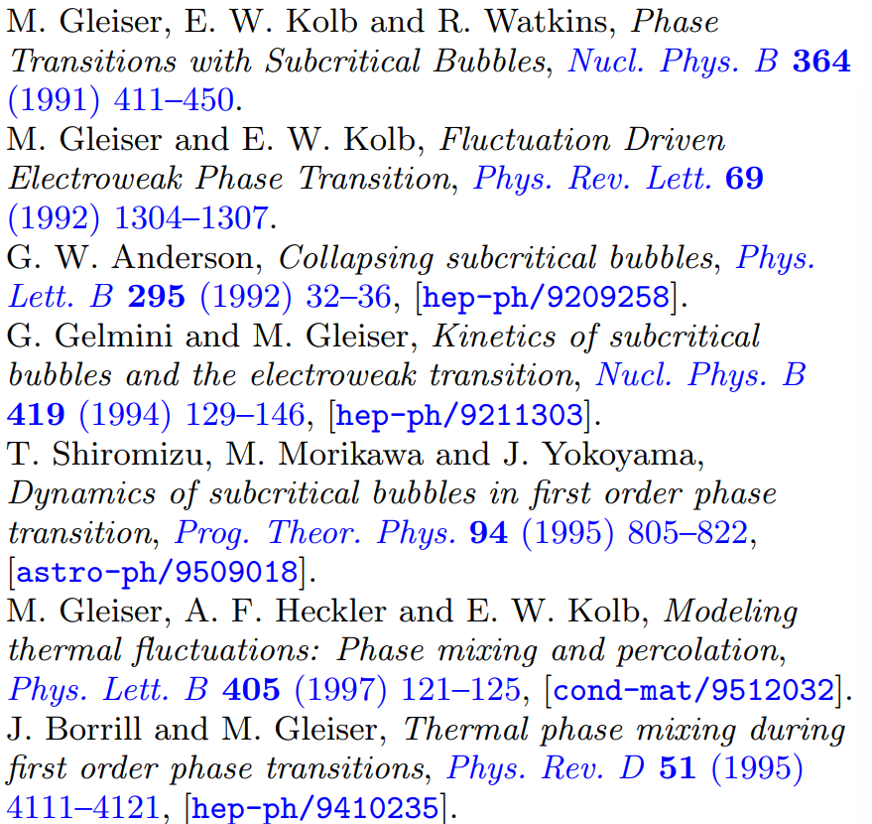
2 Subcritical bubbles
Subcritical bubble prehistory in weak first-order phase transition,
G. Chen, Y. Xiao, JMY, Y. Zhang, 2605.24891
subcritical bubbles
Subcritical bubbles were studied 30 years ago. For a weak first order EWPT, these subcritical bubbles may have nonnegligible effects on the formation and evolution of critical bubbles.
In our work we revisited this issue in depth. We obtained some new insights.

Slide 16
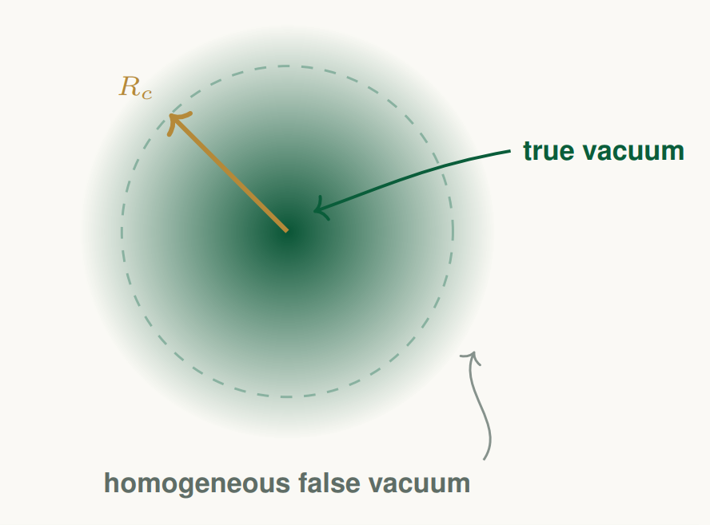
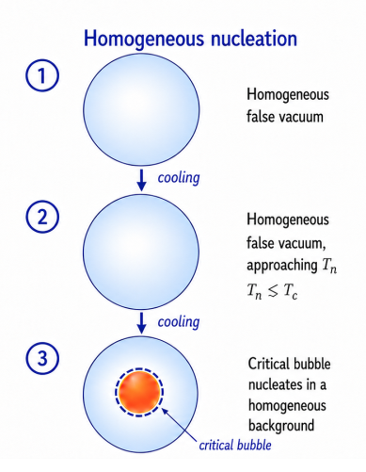


critical bubbles:
Standard description of a first-order EWPT begins with nucleation and expansion of critical bubbles.
A critical bubble is computed on a homogeneous symmetric vacuum background.
$${\left\langle φ\right\rangle =φ}_{b}≠0$$
$${\left\langle φ\right\rangle =φ}_{s}=0$$

Slide 17
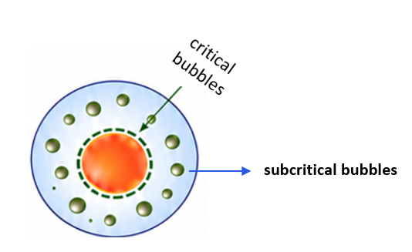
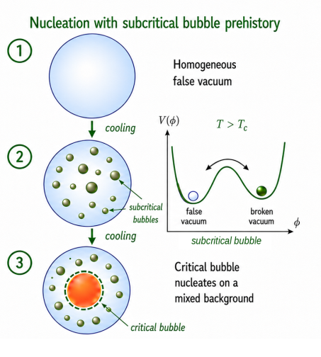
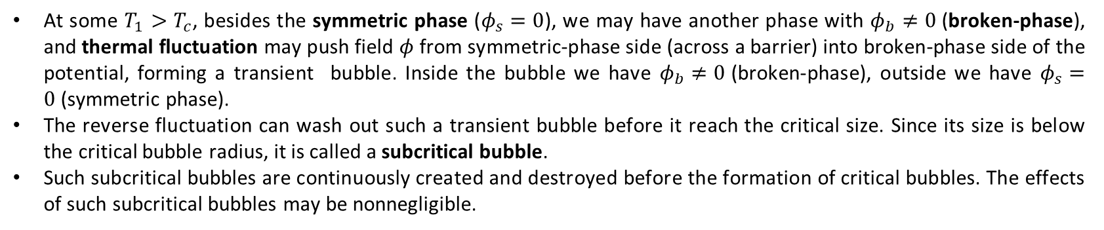
subcritical bubbles:
At some $T_{1}>T_{c}$, besides the symmetric phase ($φ_{s}=0$), we may have another phase with $φ_{b}≠0$(broken-phase), and thermal fluctuation may push field $φ$from symmetric-phase side (across a barrier) into broken-phase side of the potential, forming a transient bubble. Inside the bubble we have $φ_{b}≠0$(broken-phase), outside we have $φ_{s}=0$(symmetric phase).
The reverse fluctuation can wash out such a transient bubble before it reach the critical size. Since its size is below the critical bubble radius, it is called a subcritical bubble.
Such subcritical bubbles are continuously created and destroyed before the formation of critical bubbles. The effects of such subcritical bubbles may be nonnegligible.
17/33

Slide 18
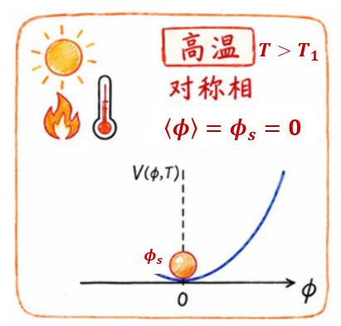
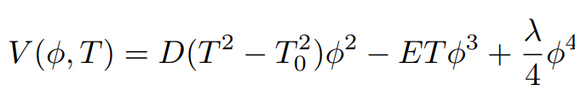
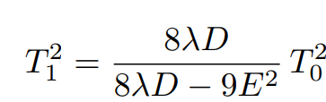
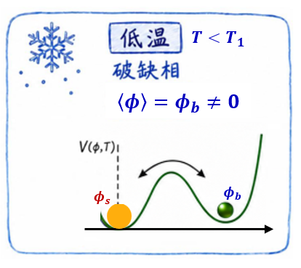
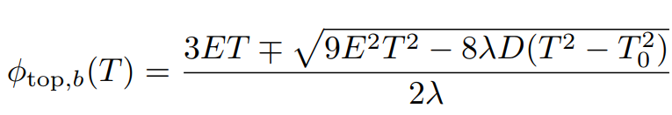

subcritical bubbles:
As an example we consider the finite-T potential of a single real scalar field
There exist a temperature $T_{1}$
At high temperature $T>T_{1}$, only have a symmetric phase with vev (${\left\langle φ\right\rangle =φ}_{s}=0$)
At low temperature $T<T_{1}$, have another phase with vev (${\left\langle φ\right\rangle =φ}_{b}≠0$) called broken phase; the symmetric phase and broken phase are separated by a barrier with peak value $φ_{top}$

Slide 19
subcritical bubbles:
to see more clearly
bubble
burst
subcritical
bubble
barrier
19/33

Slide 20
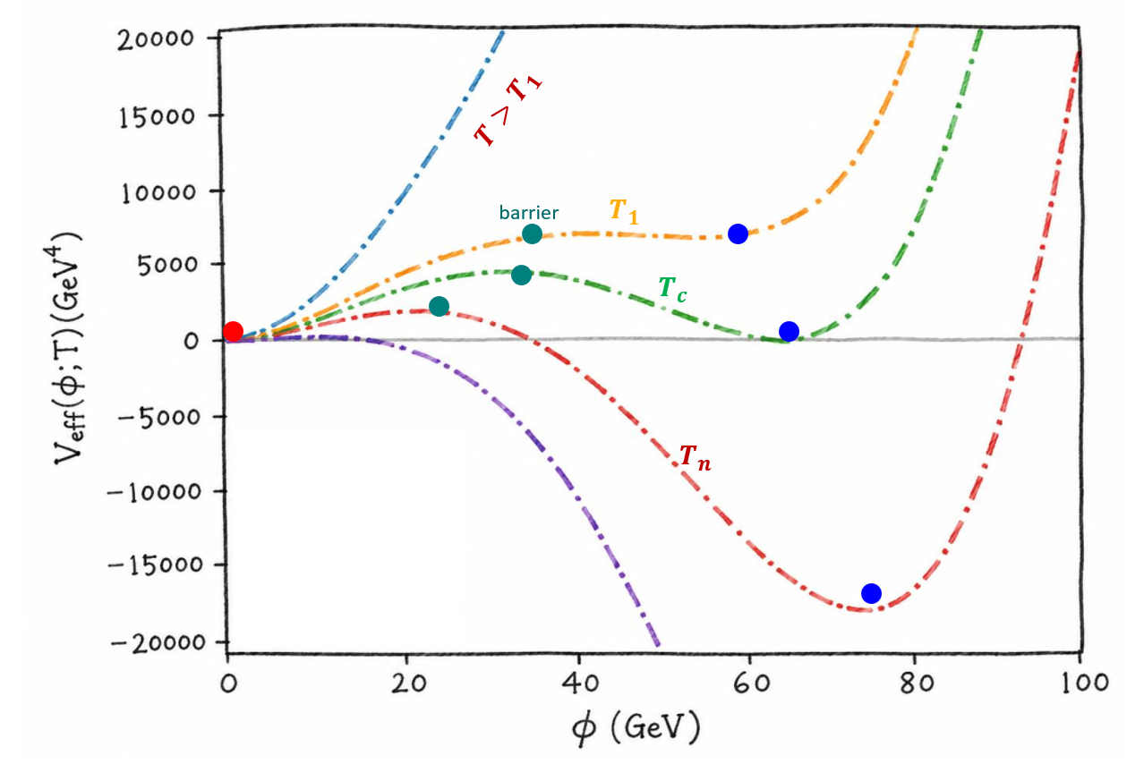
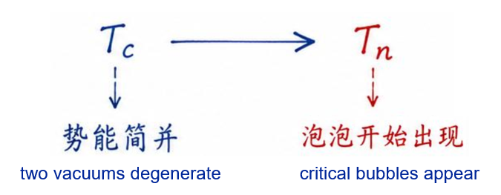
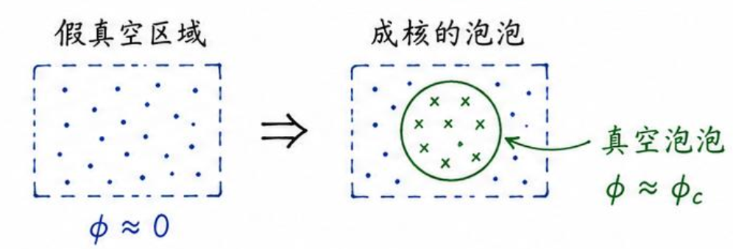
subcritical bubbles:
thermal history is like this
Subcritical bubbles appear before critical bubbles.
So it is called subcritical bubble prehistory
20/33

Slide 21
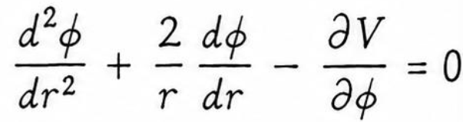
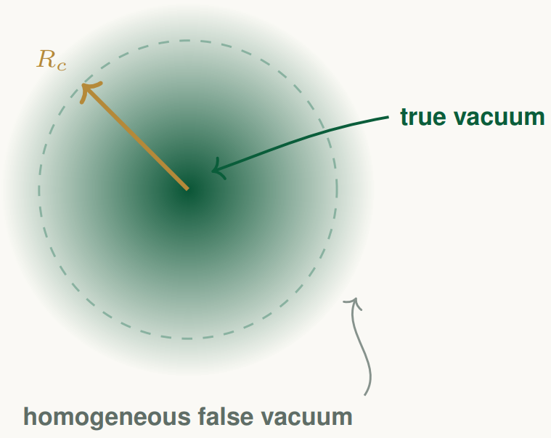
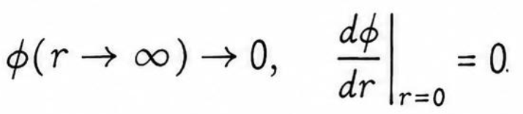
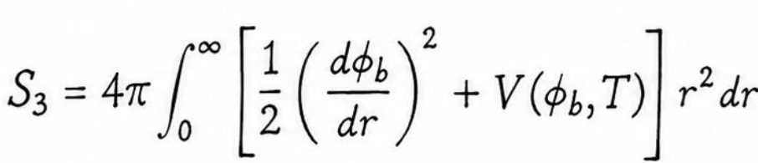


critical bubble calculation：
Given a finite-T potential, the critical bubble is obtained from the finite-T O(3) bounce equation
( $r$ is the radial coordinate of the bubble)
the corresponding three dimensional Euclidean action
the nucleation rate of a critical bubble
($A_{c}$is the fluctuation prefactor, estimated as $A_{c} ≃T^{4}$)
$$⋯⋯⋯$$
21/33
( Here, twenty formulas are omitted)

Slide 22
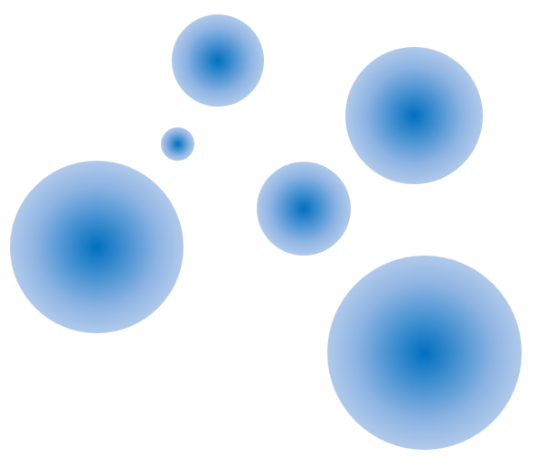



subcritical bubble calculation：
n(R, t) : number density of subcritical bubbles with fixed radius R at time t
dilution caused by
cosmic expansion
reverse subcritical
nucleation
erasure by thermal noise
$V_{tot}$ : total physical volume
$V_{s}$ : symmetric vacuum volume
$V_{b}^{(R)}$ : broken vacuum volume of subcritical bubbles
shrinking in radius space
thermal production in the remaining symmetric volume
$$⋯⋯⋯$$
( Here, twenty formulas are omitted)
To determine when subcritical prehistory can modify the standard nucleation description, we perform a parameter scan

Slide 23





The pre-transition history for three different benchmark points
$p_{b}^{sub}:$ subcritical bubble volume fraction
$p_{crit }^{ }:$ critical bubble probability
$α_{n} ≡ α\left(T_{n}\right):$ transition strength at nucleation T
$p_{b}^{sub}:$ per milli
$p_{b}^{sub}:$ percent
$p_{b}^{sub}:$ 10 percent
(subcritical bubbles can be safely ignored)
(cannot be ignored)
( very relevant )
23/33

Slide 24










$p_{b}^{sub}:$ subcritical bubble volume fraction
$α_{n} ≡ α\left(T_{n}\right):$ transition strength at nucleation T
free energy splitting between two phases:
barrier height above false vacuum:
field value in broken-phase at nucleation:
(c) shows that large subcritical bubble volume
fraction correspond to small $φ_{n}/T_{n}$, the
broken phase is close to the symmetric point
at $T_{n}$
(d) shows that large subcritical bubble volume
fraction correspond to small barrier height
(which weakens Boltzmann suppression in
the formation rate).
(a) shows that large subcritical bubble
volume fraction arise when the two
phases remain nearly degenerate at $T_{n}$
(b) shows the corresponding cooling
history, where large subcritical
bubble volume fraction is near $T_{n}/T_{c} ≃ 1$
24/33

Slide 25



3 Aspherical bubbles
Gravitational wave signature of aspherical bubbles driven by thermal fluctuation,
L. Bian, G. Chen, S. Li, H. Wang, Y. Xiao, JMY, Y. Zhang, 2601.15933
A widely used starting point for modeling first-order phase transitions (FOPTs) dynamics is the spherical bubble. The critical bubble profile is described by an exactly O(4)-symmetric solution at zero temperature, or O(3)-symmetric one at finite temperature. This assumption gives the standard picture of bubble nucleation, growth, collision, and consequently GW predictions.
This long-standing assumption may not be robust. Real-time simulation incorporating thermal fluctuation showed that the bubbles formed in a hot plasma are generically non-spherical bubbles, often seeded by oscillons and exhibiting pronounced asphericity during their early growth
25/33

Slide 26

Our work:
We perform (3+1)-dimensional lattice simulations to deeply study the impact of thermal fluctuation on post-nucleation bubble evolution.
We find that thermal fluctuation can lead to the loss of spherical symmetry during bubble expansion.
We also calculate the GW spectrum for both a single aspherical bubble and multi-bubbles, providing numerical and semi-analytic quantification of the influence of thermal fluctuation.
Quantum fluctuations around an expanding bubble can generate nontrivial multipole moments and thus generate GW emission even from a single bubble (K. Blum and M. Mirbabayi, 2403.20164 )
26/33

Slide 27










Our simulations:
We approximate the background as Minkowski spacetime and consider a simplified real-scalar potential
we fix $γ$= 1.11, α = 1.41, λ = 0.5, $T_{0}$ = 30 GeV,
so that the potential has two local minimums: a symmetric vacuum $φ_{s}$ = 0; a broken-symmetry vacuum $φ_{b}≠0$
$φ_{bounce}$ is the spherically symmetric bounce profile
$δφ$ is the correction induced by thermal fluctuation
The scalar field evolves according to
with initial condition
The post-nucleation bubble is embedded in a fluctuating background rather than being perfectly spherically symmetric
We adopt the following thermal spectrum for thermal fluctuation
We solve the real-time dynamics using a leapfrog integrator, and the GW spectrum is evaluated using the CosmoLattice procedure.
We perform lattice simulations with spatial spacing $d\overline{x}$ = 0.22, and time step$d\overline{t}$ =$d\overline{x}$ / 5.
We simulate single bubble dynamics on ${256}^{3}$ lattice, while GW spectra are computed using ${256}^{3}$ and ${512}^{3}$ lattice to ensure adequate infrared resolution.
27/33

Slide 28





Our results for a single bubble :
We begin by initializing a single bubble at the center of ${256}^{3}$ lattice to examine how thermal fluctuation affect its post-nucleation evolution.
This figure shows the slices of ϕ along the z-direction at selected times for the fluctuation-free case (left) and the case with thermal fluctuation at T = 50 GeV (right). The bubble is initialized on a ${256}^{3}$ lattice at t = 0.
uneven and scarred
28/33

Slide 29





Our results for a single bubble :
The emergence of bubble asphericity generates a nonzero quadrupole moment and thus induces gravitational radiation. The normalized GW spectrum for a single bubble in presence of fluctuation at T = 50 GeV:
This figure shows the results obtained on a $512^{3}$ lattice. The GW spectra are computed a$t \overline{t} = 30$ for a single bubble with thermal fluctuations at T = 50 GeV. The blue curve shows the result from evolving the full scalar field, the red curve corresponds to the evolution of fluctuations alone, and the orange curve denotes their difference, which can be interpreted as the contribution from the evolution of a nonspherical bubble.

Slide 30



Our results for multi-bubbles:
Solid curves are GW spectra computed on a ${512}^{3}$lattice for multi-bubble evolution, evaluated at $\overline{t}=4R_{sep}M$, for T = 50 GeV, 55 GeV, 60 GeV (blue, green, orange). Dashed lines denote the corresponding spectra without thermal fluctuations. The vertical dash–dot lines mark the characteristic scales $kR_{sep} = 2πR_{sep}T$
$R_{sep}$ is the mean bubble separation
30/33

Slide 31




Our results for multi-bubbles:
GW spectra extrapolated from our simulations performed at T = 60 GeV and$\overline{t}=4R_{sep}M$.
The solid curves correspond to $HR_{sep}=0.003$, The dashed curves denote $HR_{sep} = 0.0001$.
The sensitivity curves for GW experiments are for 1 year observation time, with signal-to-noise ratio = 1
To determine the frequency range and the amplitude of the signal, we need to specify the dimensionless parameters HRsep and Ωvac (Ωvac is 0.2% in our toy model). The physical frequency is given by
31/33

Slide 32


4 Summary
For subcritical bubbles:
thermal fluctuation trigger subcritical bubbles before the standard nucleation;
subcritical bubbles may have a sizable volume fraction during the phase transition process.
For aspherical bubbles:
thermal fluctuation distort spherical vacuum bubbles and reshape the resulting GW spectrum,
which may be within the reach of future GW observatories

Slide 33

Thanks
for your attention

