Slide 1
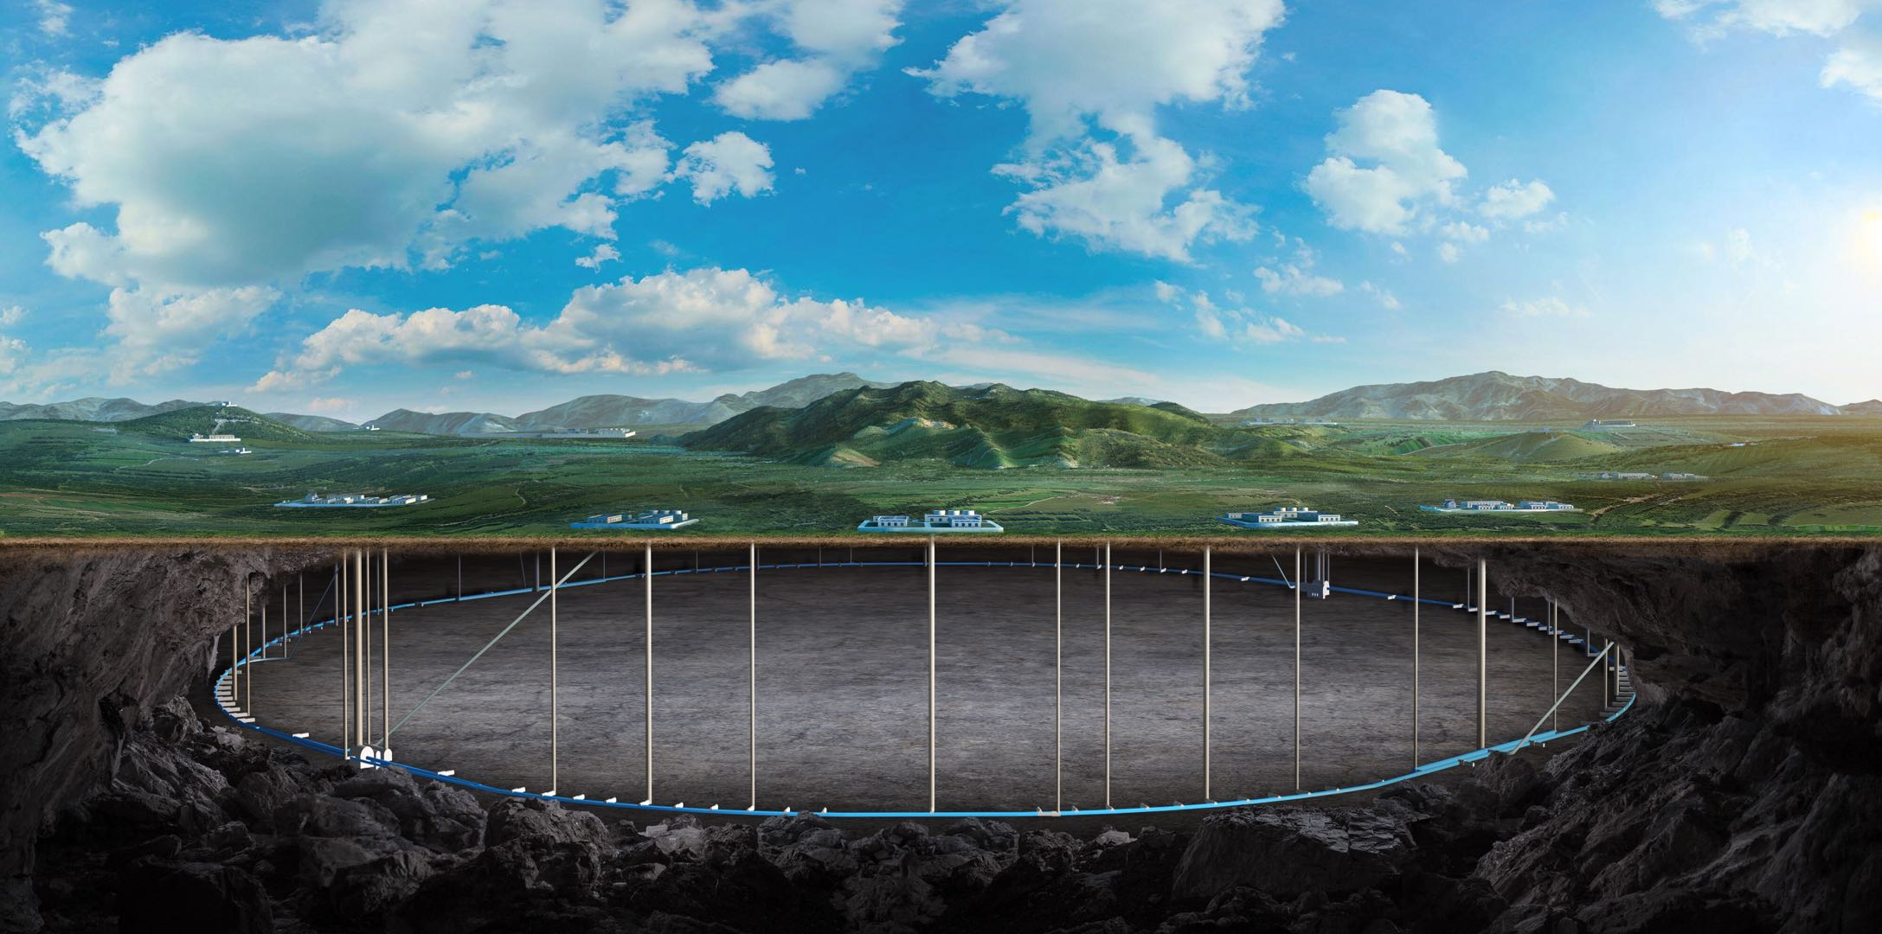


CEPC collider ring error analysis with detector dipole and anti-solenoid effects
Bin Wang
(on the behalf of the CEPC error correction team)
CEPC Day 2026.03.02

Slide 2
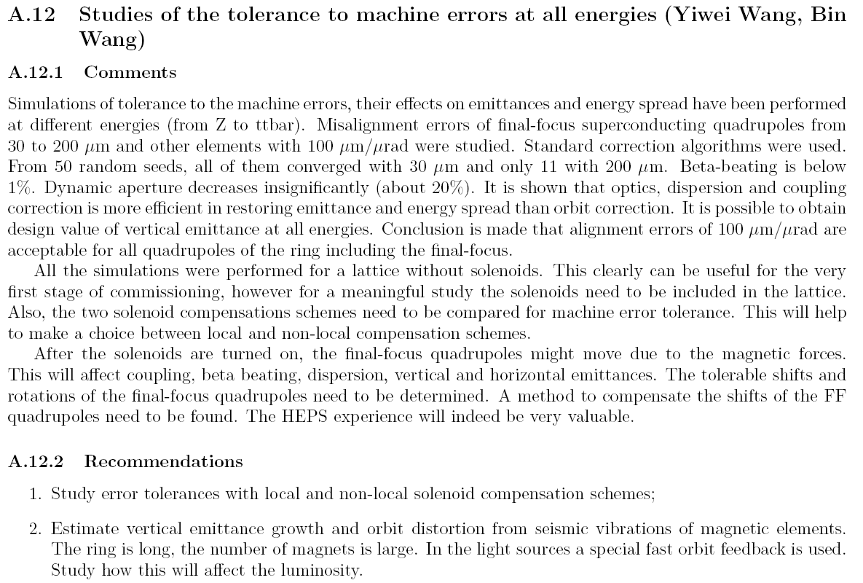
Responses to the 2025 IARC EDR review report

Slide 3
Responses to the 2025 IARC EDR review report
1. Study error tolerances with local and non-local solenoid compensation schemes;
[Reply] This study is currently underway. We will analyze the correction and its performance of a lattice with solenoids by systematically scanning across different magnet error scenarios.
2. Estimate vertical emittance growth and orbit distortion from seismic vibrations of magnetic elements. The ring is long, the number of magnets is large. In the light sources a special fast orbit feedback is used. Study how this will affect the luminosity.
[Reply] The vertical orbit distortion is mainly affected by two factors: the ground vibrations at the Interaction Points (IPs) and the ground motions in the arc region. With an estimated contribution of 4 nanometers from the ground vibrations at the IPs, based on the CERN vibration levels at the IP when situated 100 meters underground, and an additional 25 nanometers from the ground in the arc region—due to its length and the inevitable presence of mind-out areas even at a depth of 100 meters—the luminosity is expected to experience a reduction of approximately two percent. This is a roughly estimation. A multi-particle tracking initiative, including FOFB research, is set to commence.

Slide 4
Content
Introduction of the lattice with solenoid field compensation
Status of the error correction team
Progress of the correction to the Higgs lattice with solenoid
Summary and to do list

Slide 5
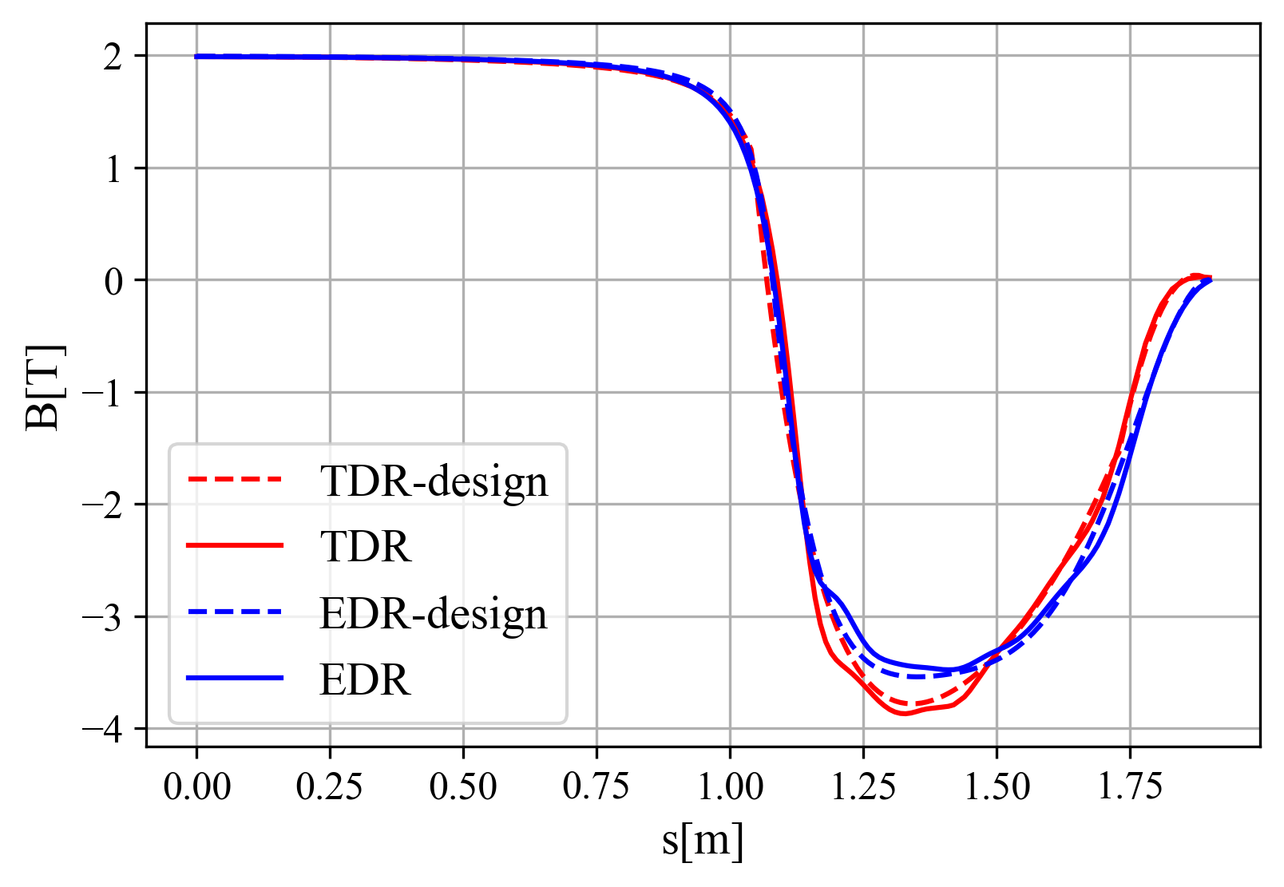
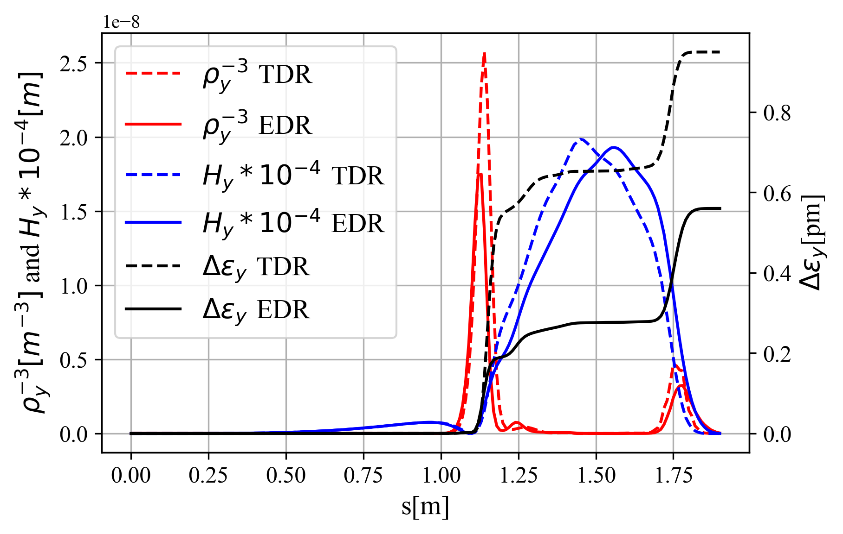
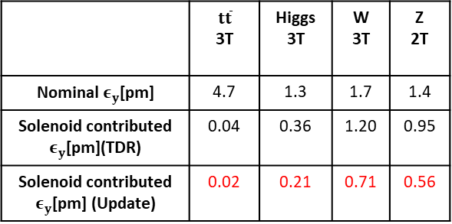
Solenoid field compensation in CEPC TDR and update
Ande MA, Yiwei Wang, Yingshun Zhu et al
Detector solenoid field @ W/Higgs/ttbar
(Scaled to 2T at IP @ Z)
1.9m
The detector solenoid are compensated locally with anti-solenoids
From IP to the entrance of Q1A (0 to 1.9m):
∫Bzdz cancled between the IP and the entrance of final quadrupole with strong anti-solenoid field in 1.1m to 1.9m.
Field configuration optimized to get emittance minimum and iterate with anti-solenoid technical constraints
From the entrance of Q1A to Q3(1.9m to 10.55m)
Bz keep fully cancellation along this region
From the Q3 to the last bend (farer than 10.55m)
∫Bzdz from detector only < 0.5 T*m.
Along beam line (not z), fully cancelation in Q3 and pre-cancelation in some extension region (with length of 1m) for the long tail of the detector solenoid field
Combined field @ Z
Data from Feipeng Ning
Z scaled to 2T
Emittance contribution from the from IP to the entrance of Q1A
 | $$t\overline{t}$$ 3T | Higgs 3T | W 3T | Z 2T
Nominal $ε_{y}$[pm] | 4.7 | 1.3 | 1.7 | 1.4
Solenoid contributed $ε_{y}$[pm](TDR) | 0.04 | 0.36 | 1.20 | 0.95
Solenoid contributed $ε_{y}$[pm] (Update) | 0.02 | 0.21 | 0.71 | 0.56

Slide 6
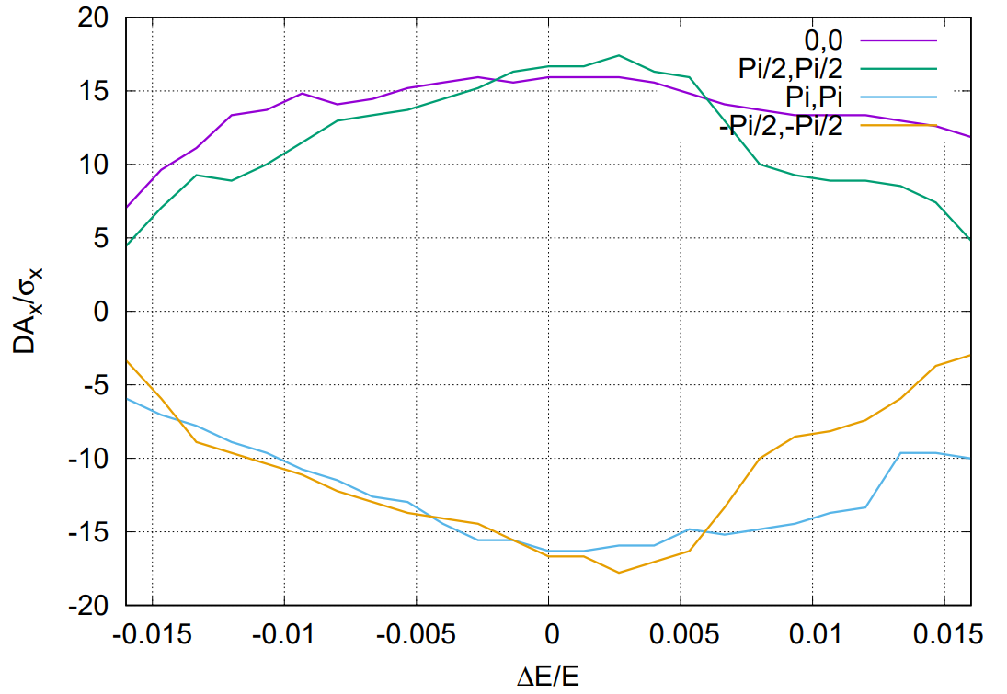
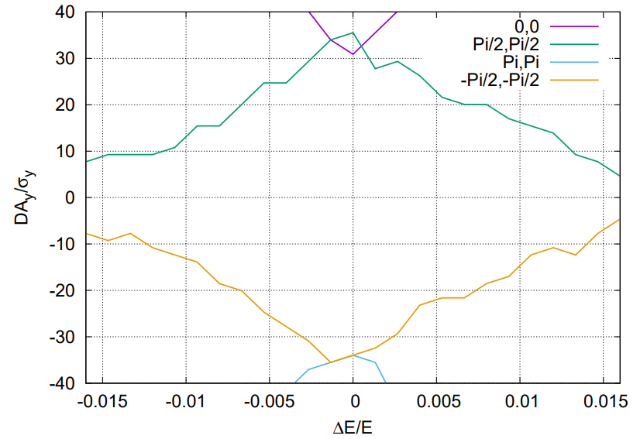
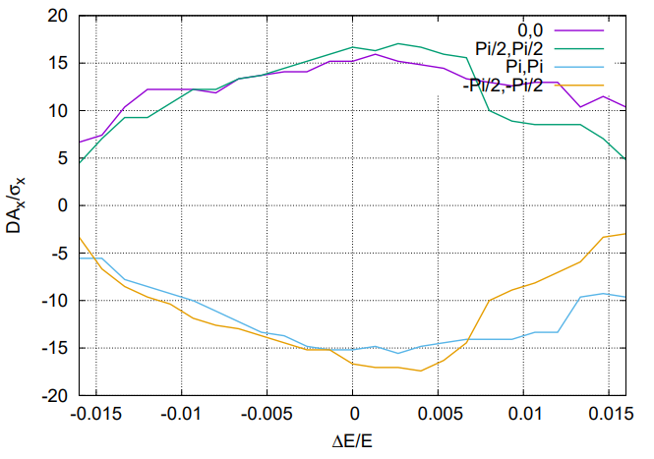
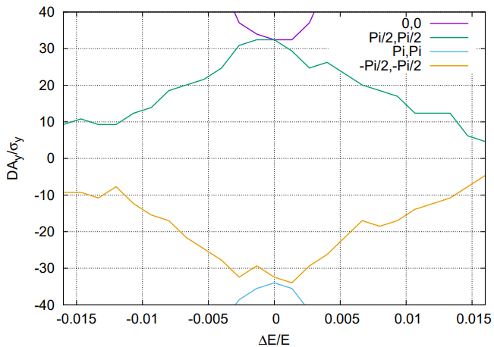
Solenoid effect on dynamic aperture
The anti-solenoid cancel the ∫Bzdz between the IP and the faces of the final quadrupole.
The Twiss function distortion due to solenoid field was corrected with final quadrupoles.
The solenoid effect on the dynamic aperture is small.
Effects included in tracking
Synchrotron motion
Radiation loss in all magnets
Tapering
Crab waist sextupole
Maxwellian fringes
Kinematic terms
Finite length of sextupole
Solenoid
Higgs without solenoid
Higgs with
solenoid

Slide 7
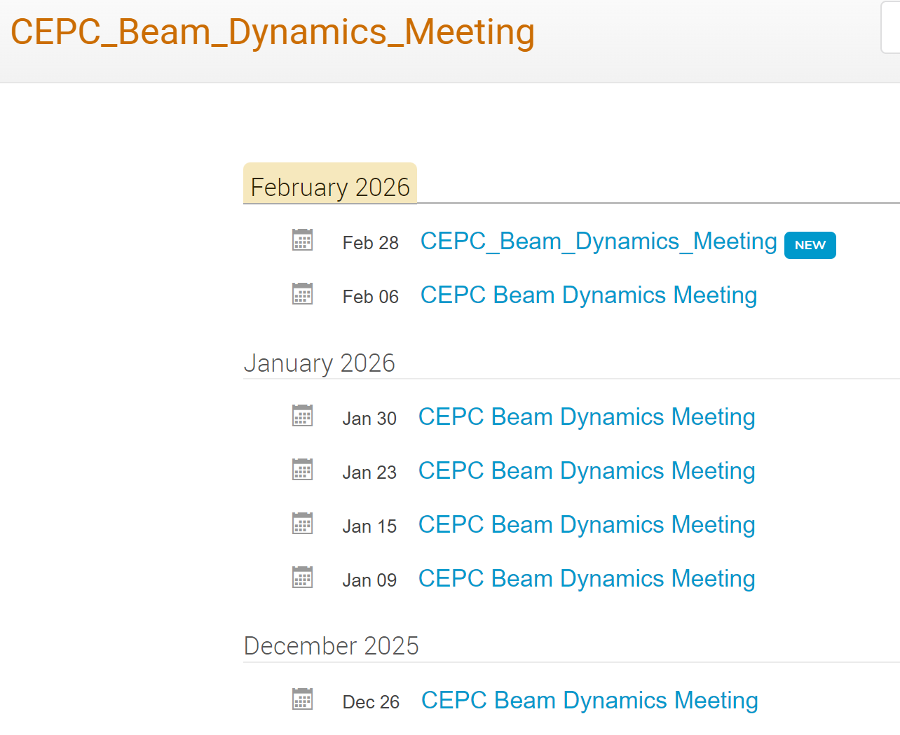
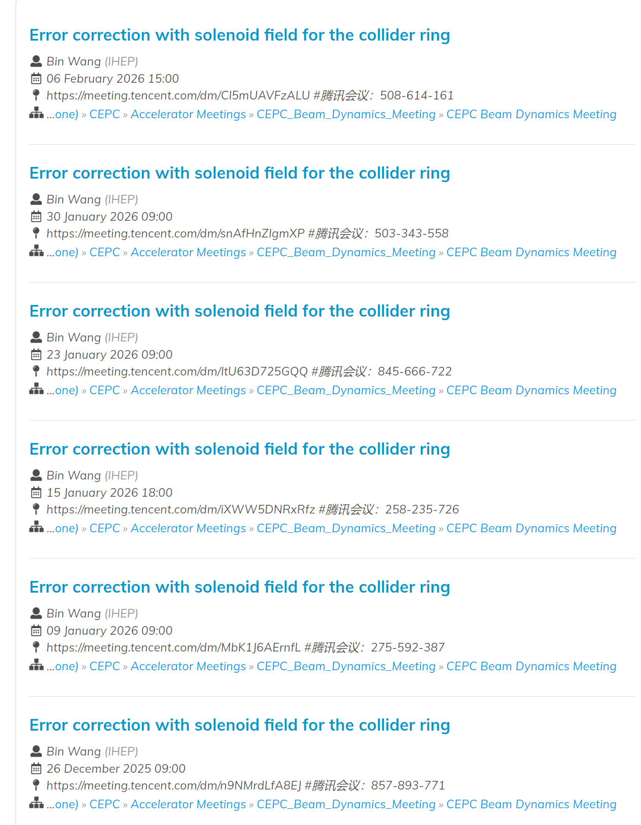
Status of the error correction team
From the end of December, the "CEPC Beam Dynamics Meeting" was formed to hold weekly discussions on error correction with solenoid.
The weekly meeting also included discussions on the other optimization of the collider ring lattice, including IP tuning (Wei Yuanyuan), vibration influence (Yan Fang), lattice optimization (Wang Yiwei), etc.

Slide 8
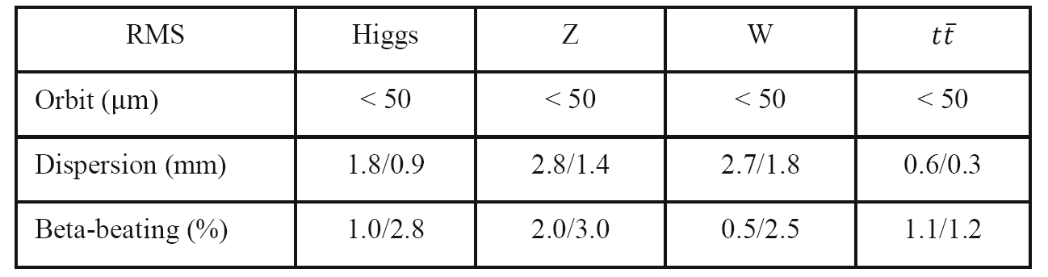
Error Correction to the Higgs lattice
Software: SAD and Matlab-based accelerator toolbox (AT)
Closed-orbit distortion (COD) correction was performed with sextupoles off, then the sextupoles were turned on and the COD correction repeated.
The dispersion correction (DISP) and beta-beating correction are also used for optics correction.
The coupling and vertical dispersion correction are used to decrease the vertical emittance.
The above correction scheme is iterated until the emittance and tracking dynamic aperture satisfy the design requirements.
The correction target is 50 μm for COD correction, 2mm for DISP correction and 3% for beta beating correction. ‌Taking the Higgs mode correction as an example‌.
Correction performance for lattices without solenoid.
Misalignment and field error requirements.
Component | Δx (mm) | Δy (mm) | Δθ_{z} (mrad) | Field error
Dipole | 0.10 | 0.10 | 0.10 | 0.01%
Quadrupole | 0.10 | 0.10 | 0.10 | 0.02%
Sextupole | 0.10 | 0.10 | 0.10 | 0.02%

Slide 9
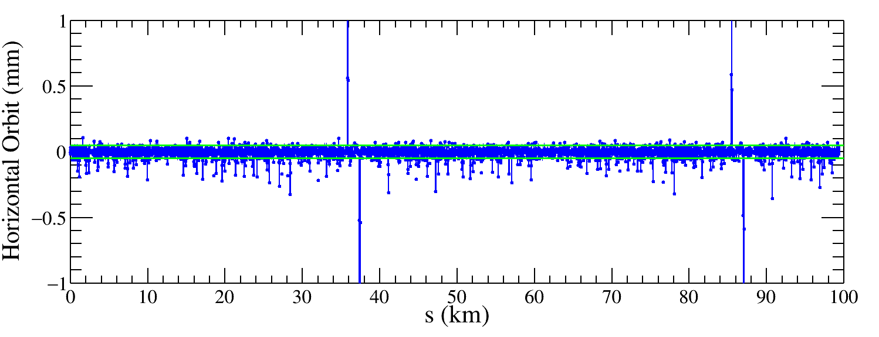
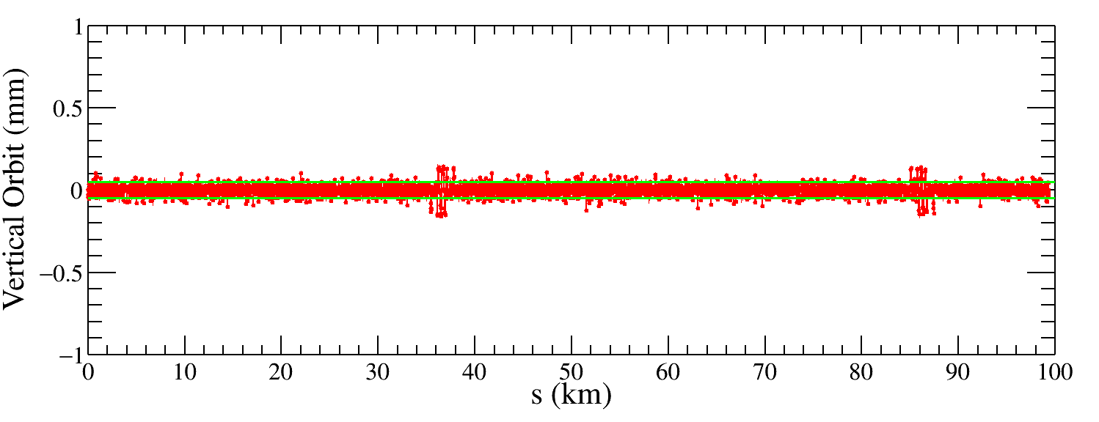
Closed-orbit distortion correction (Higgs mode)
The Lattice starts at the injection point.
100 random Higgs lattice seeds are generated, there are 85 lattice seeds have convergent solutions.
Correction target: The green line is marked with the correction target (50 μm), corresponding to the correction performance without solenoid.
Correction result (one seed): Most horizontal and vertical orbits are within 50 μm, while some points near IP are significantly larger, exceeding 200 μm.
One seed
IP
IP
One seed
IP
IP

Slide 10
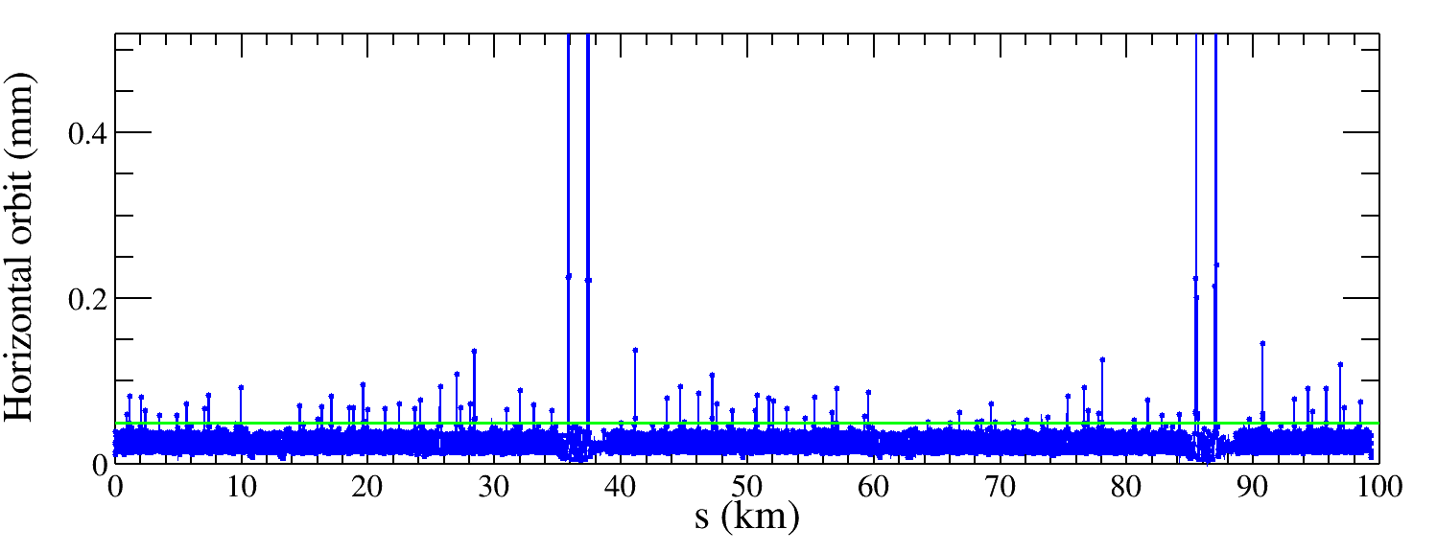
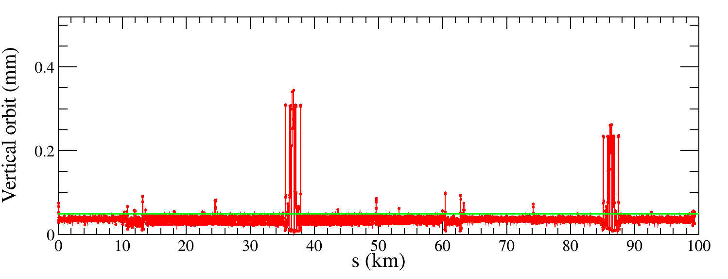
Closed-orbit distortion correction (Higgs mode)
85 seeds
The Lattice starts at the injection point.
100 random Higgs lattice seeds are generated, there are 85 lattice seeds have convergent solutions.
Correction target: The green line is marked with the correction target (50 μm), corresponding to the correction performance without solenoid.
Correction result (85 seeds): Most of the RMS values for horizontal and vertical orbits are within 50 μm, while some orbits near the IP are significantly larger, exceeding 200 μm.
Conclusion: Move to the next dispersion correction, which also include the orbit adjustment.
85 seeds

Slide 11
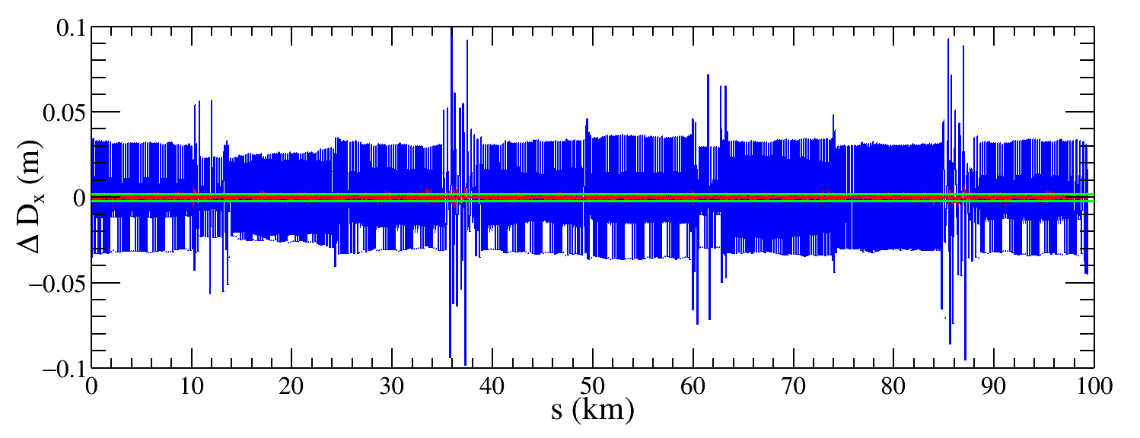
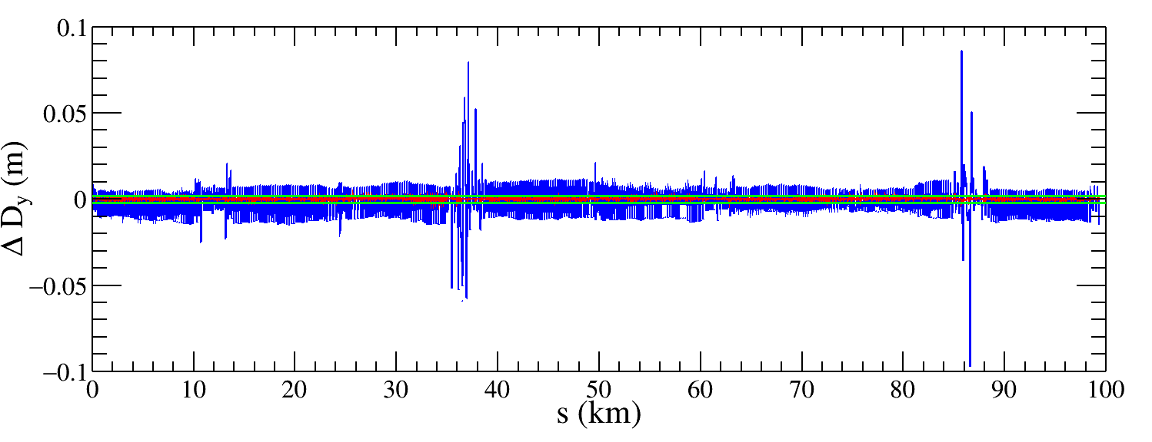
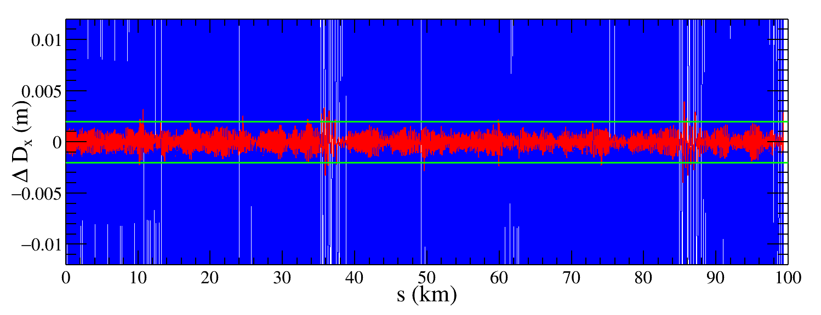
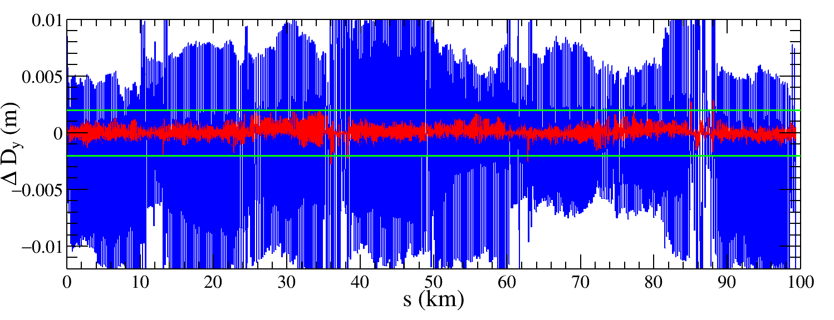
Dispersion correction (Higgs mode)
85 Higgs lattice seeds with COD correction are used to do the dispersion correction.
Correction target: The green line is marked with the correction target (2 mm), corresponding to the correction performance without solenoid.
Correction result: Both horizontal and vertical dispersion deviation after correction are lower than the correction target, 2mm. The application of the DISP correction resolved the large fluctuations in the vertical dispersion near the IP.
One seed
Blue: before DISP correction
Red: After DISP correction

Slide 12
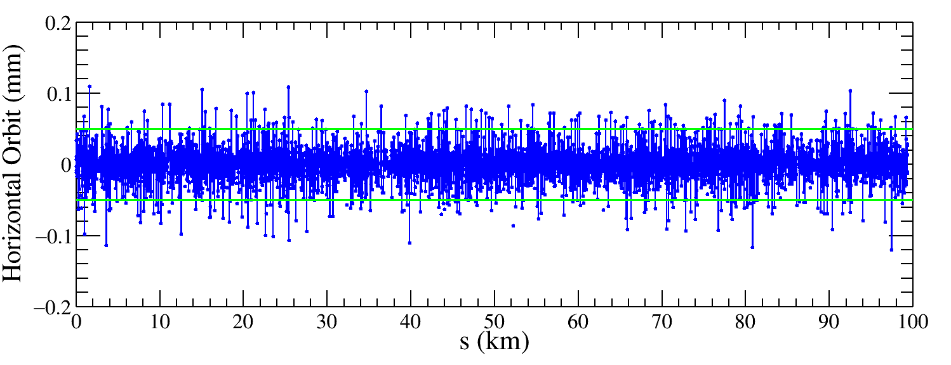
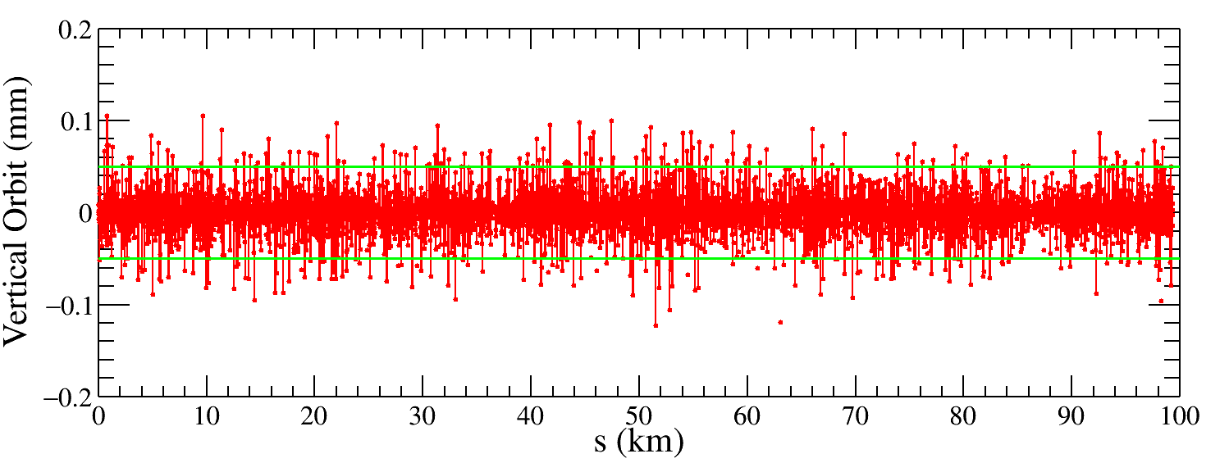
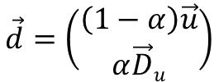
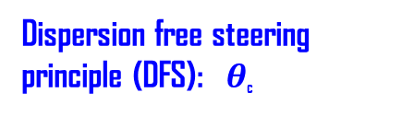



Closed orbit after dispersion correction (Higgs mode)
Correction result: The large fluctuation of closed orbit is also corrected.
Explanation: During the DISP/DFS correction, the closed orbit deviations are used as weighting factors in the response matrix inversion to prioritize correcting dispersion errors where the orbit is most distorted.
Dispersion free steering principle (DFS):$θ$_{c}
$$\vec{d}=\left(\begin{aligned}\left(1−α\right)\vec{u} \\ α\vec{D}u\end{aligned}\right)$$
M$=\left(\begin{aligned}\left(1−α\right)A \\ αB\end{aligned}\right)$
$\vec{u}$: Orbit vector
$\vec{D}u$: Dispersion vector
$\vec{θ}$: Corrector strengths vector
$α$: Weight factor
$A$: Orbit response matrix
$B$: Dispersion response matrix
$$\vec{d}+M\vec{θ}=0$$
One seed
Before DISP correction
After DISP correction

Slide 13
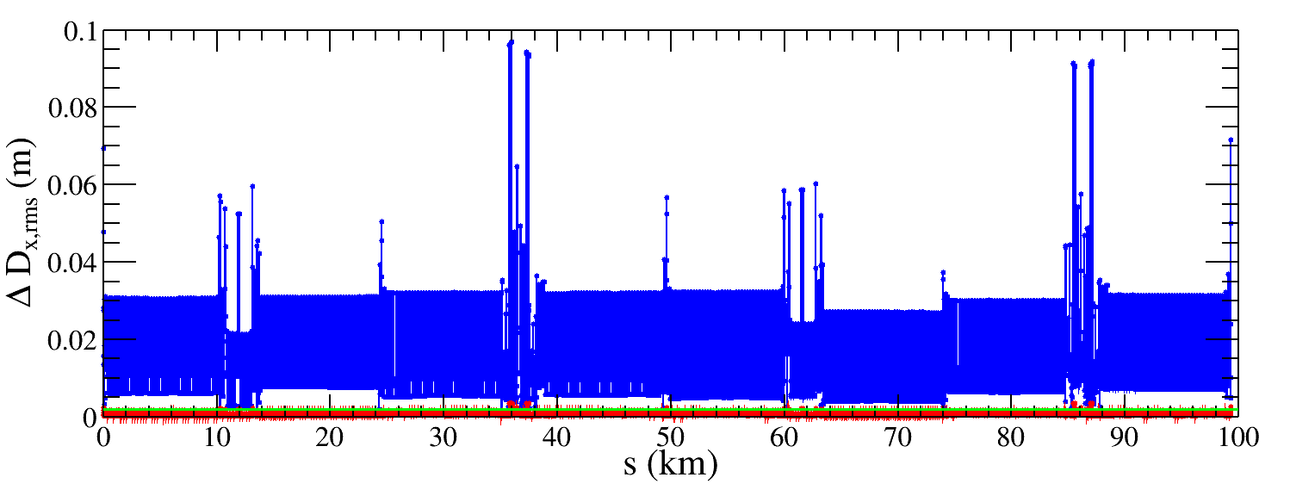
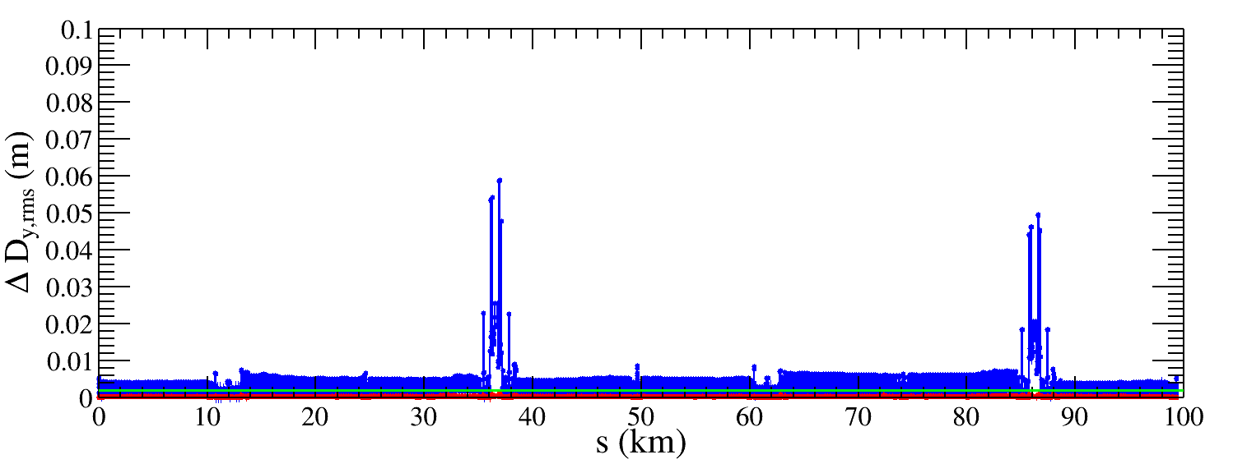
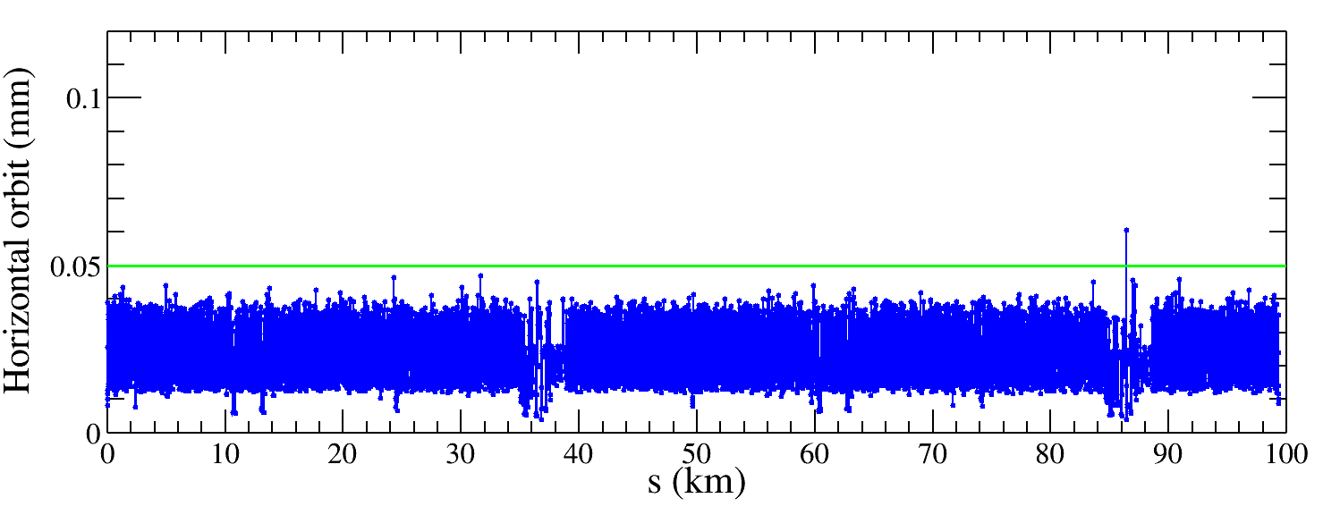
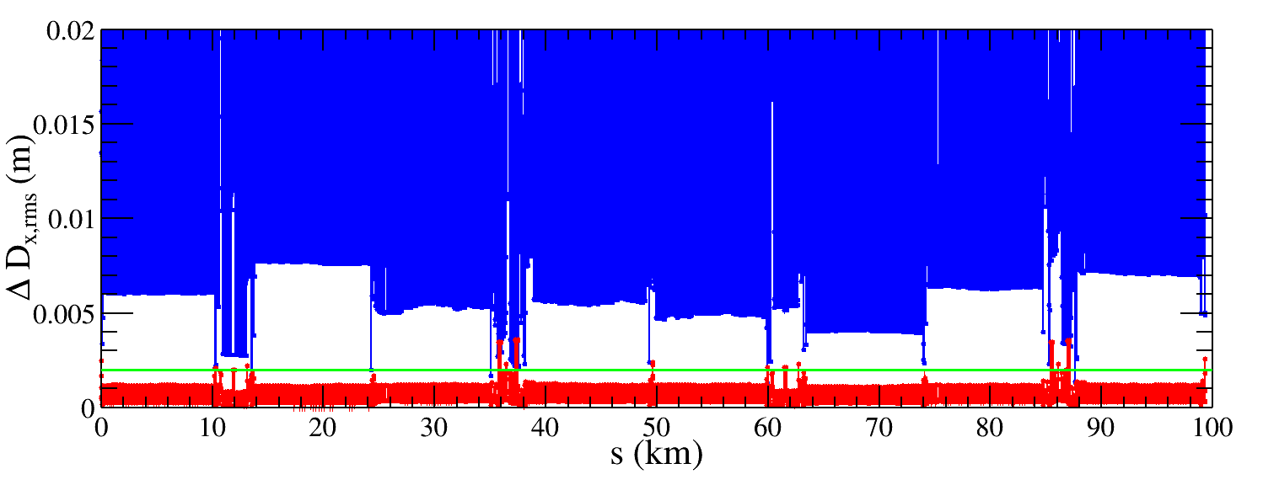
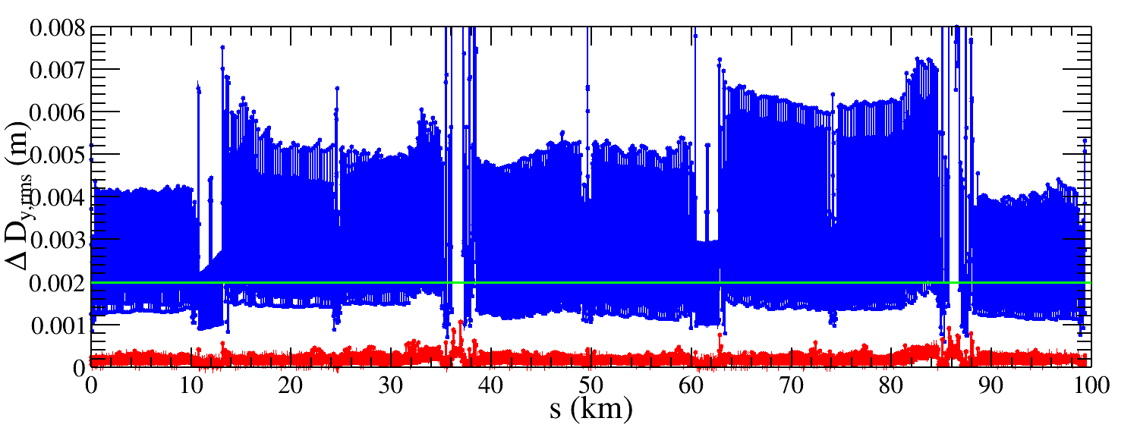
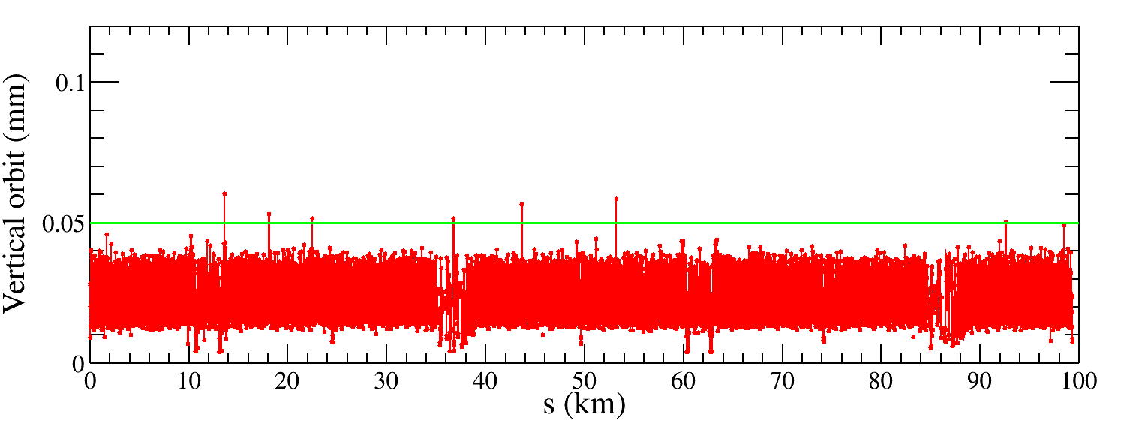
Dispersion correction (85 seeds)
85 seeds
Correction result: All 85 seeds are converged, the horizontal dispersion RMS value is reduced from 15.6 mm to 0.6 mm, and the vertical dispersion RMS value is reduced from 3.5 mm to 0.2 mm. The RMS horizontal and vertical orbits are lower than 50 μm.
Conclusion: After DISP correction, closed orbit and dispersion deviation are lower than those correction targets, respectively. We move to the next beta beating correction.
Blue: before DISP correction
Red: After DISP correction
Closed orbit
Notes:
*

Slide 14
Beta-beating correction (on going)
Correct the beta functions with sextupoles on.
Based on AT LOCO: model based correction
Establish lattice model Mmod, multi-parameter fit to the orbit response matrix Mmeas to obtain calibrated model:
Parameters fitted: K, KS …
Use calibrated model to perform correction and apply to machine.
Fit the dispersion at the same time.
Application to correct beta-beating, dispersion and coupled response matrix.
We are working on the lattice debug based on the MATLAB softer ware.

Slide 15
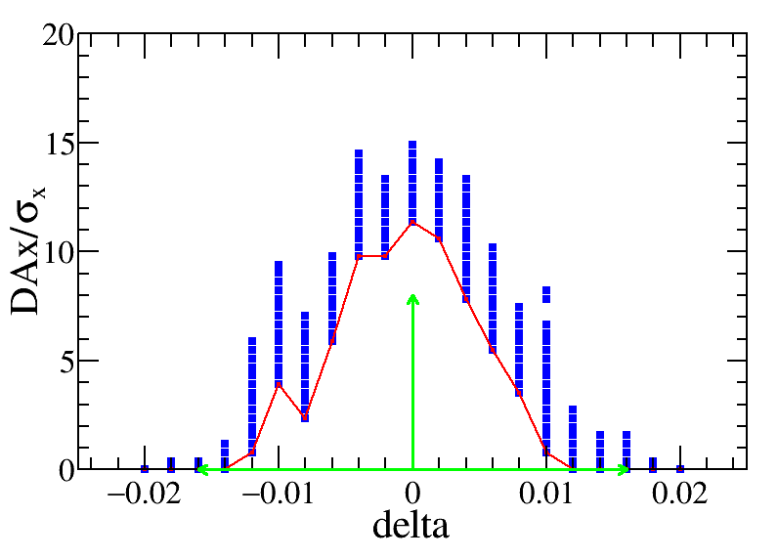
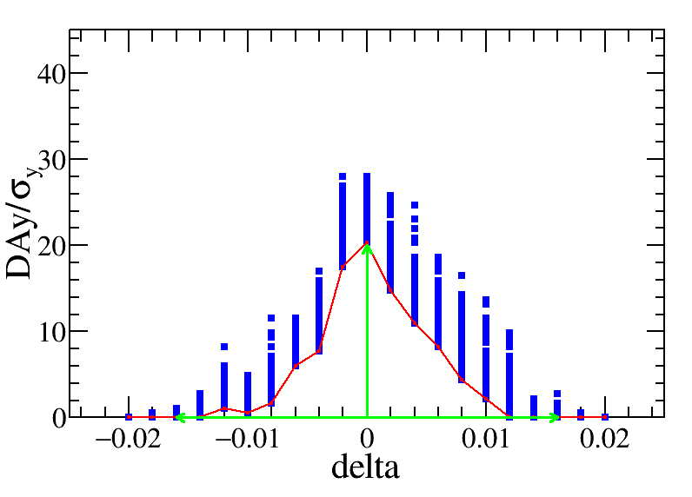
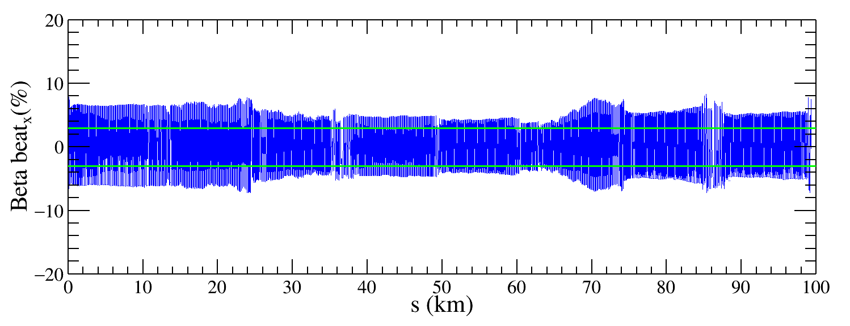
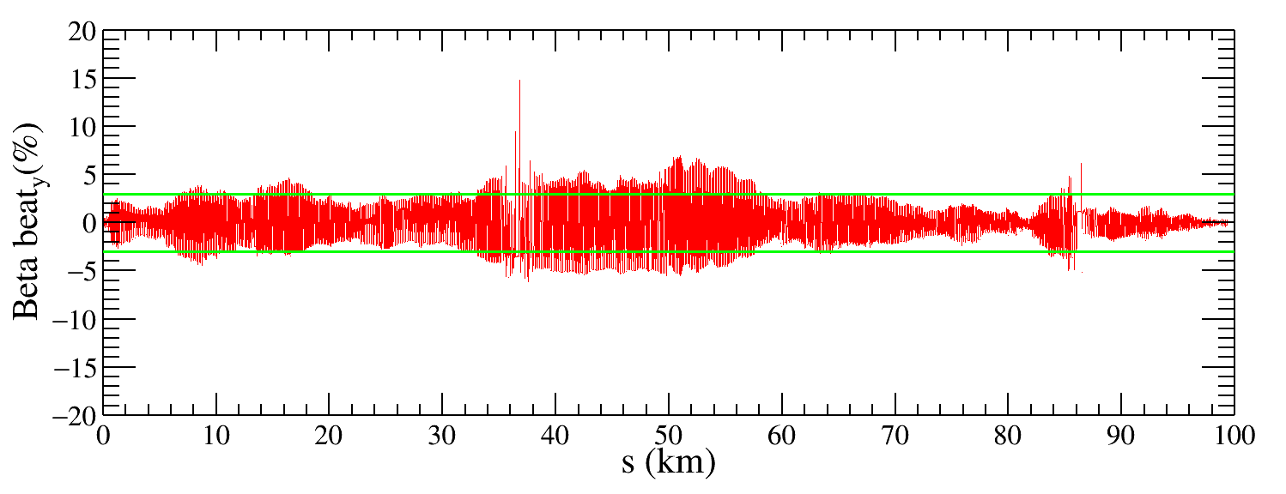
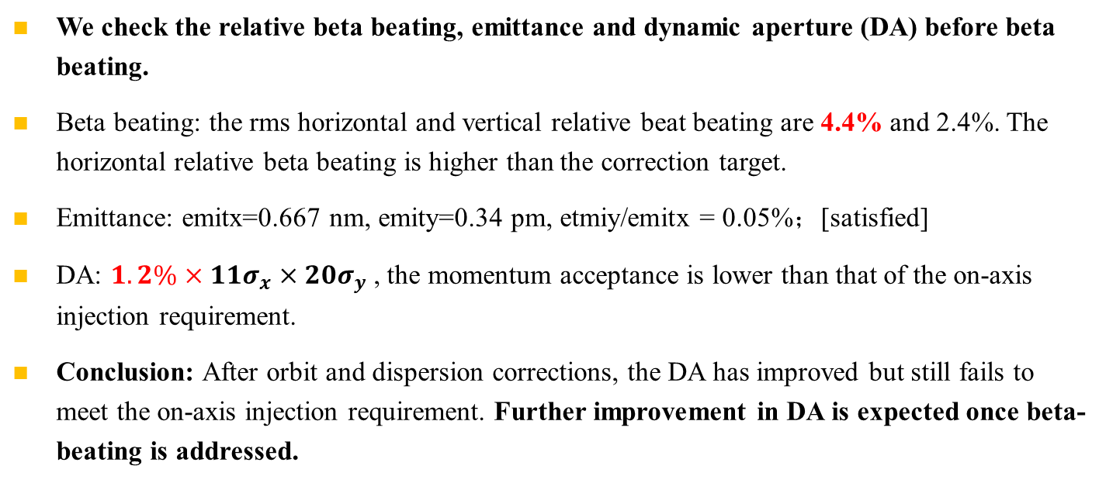
Beat beating and DA after dispersion correction
One seed
We check the relative beta beating, emittance and dynamic aperture (DA) before beta beating.
Beta beating: the rms horizontal and vertical relative beat beating are 4.4% and 2.4%. The horizontal relative beta beating is higher than the correction target.
Emittance: emitx=0.667 nm, emity=0.34 pm, etmiy/emitx = 0.05%；[satisfied]
DA: $1.2\%×11σ_{x}×20σ_{y}$, the momentum acceptance is lower than that of the on-axis injection requirement.
Conclusion: After orbit and dispersion corrections, the DA has improved but still fails to meet​ the on-axis injection requirement. Further improvement in DA is expected once beta-beating is addressed.
The green arrow indicates the Dynamic Aperture requirement for on-axis injection.

Slide 16
Summary and to do list
Error correction with solenoid is mainly promoted.
After weekly discussions and updates, the closed orbit correction and dispersion correction are carried out effectively, and the correction performance is comparable to that of the correction without solenoid.
The beta beating correction is currently ongoing.

Slide 17
Thank you for your attention!

Slide 18
backup

Slide 19
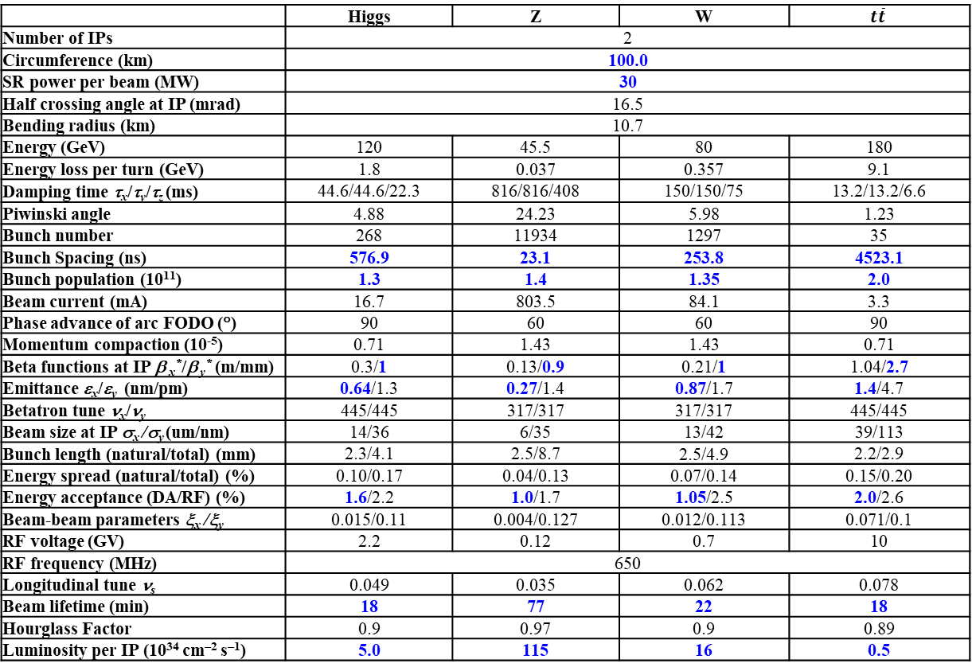
CEPC Design Parameters
𝛽y∗ and emittance chosen for luminosity
adequate bunch population Ne for the luminosity and the achievable energy acceptance for lattice design
Number of bunches Nb is adjusted to keep the beam current
Updated bunch spacing for the requirement from detector (D. Wang, Aug 2024, CEPC day)
 | Higgs | Z | W | $$t\overline{t}$$
Number of IPs | 2
Circumference (km) | 100.0
SR power per beam (MW) | 30
Half crossing angle at IP (mrad) | 16.5
Bending radius (km) | 10.7
Energy (GeV) | 120 | 45.5 | 80 | 180
Energy loss per turn (GeV) | 1.8 | 0.037 | 0.357 | 9.1
Damping time τ_{x}/τ_{y}/τ_{z} (ms) | 44.6/44.6/22.3 | 816/816/408 | 150/150/75 | 13.2/13.2/6.6
Piwinski angle | 4.88 | 24.23 | 5.98 | 1.23
Bunch number | 268 | 11934 | 1297 | 35
Bunch Spacing (ns) | 576.9 | 23.1 | 253.8 | 4523.1
Bunch population (10¹¹) | 1.3 | 1.4 | 1.35 | 2.0
Beam current (mA) | 16.7 | 803.5 | 84.1 | 3.3
Phase advance of arc FODO (°) | 90 | 60 | 60 | 90
Momentum compaction (10⁻⁵) | 0.71 | 1.43 | 1.43 | 0.71
Beta functions at IP β _{x}*/β _{y}* (m/mm) | 0.3/1 | 0.13/0.9 | 0.21/1 | 1.04/2.7
Emittance ε_{x}/ε_{y} (nm/pm) | 0.64/1.3 | 0.27/1.4 | 0.87/1.7 | 1.4/4.7
Betatron tune ν_{x}/ν_{y} | 445/445 | 317/317 | 317/317 | 445/445
Beam size at IP σ_{x} /σ_{y} (um/nm) | 14/36 | 6/35 | 13/42 | 39/113
Bunch length (natural/total) (mm) | 2.3/4.1 | 2.5/8.7 | 2.5/4.9 | 2.2/2.9
Energy spread (natural/total) (%) | 0.10/0.17 | 0.04/0.13 | 0.07/0.14 | 0.15/0.20
Energy acceptance (DA/RF) (%) | 1.6/2.2 | 1.0/1.7 | 1.05/2.5 | 2.0/2.6
Beam-beam parameters ξ_{x} /ξ_{y} | 0.015/0.11 | 0.004/0.127 | 0.012/0.113 | 0.071/0.1
RF voltage (GV) | 2.2 | 0.12 | 0.7 | 10
RF frequency (MHz) | 650
Longitudinal tune ν_{s} | 0.049 | 0.035 | 0.062 | 0.078
Beam lifetime (min) | 18 | 77 | 22 | 18
Hourglass Factor | 0.9 | 0.97 | 0.9 | 0.89
Luminosity per IP (10³⁴ cm^{–2} s^{–1}) | 5.0 | 115 | 16 | 0.5
Ref: CEPC TDR; Radiation Detection Technology and Methods (2024) 8:1–1105, https://doi.org/10.1007/s41605-024-00463-y;

Slide 20
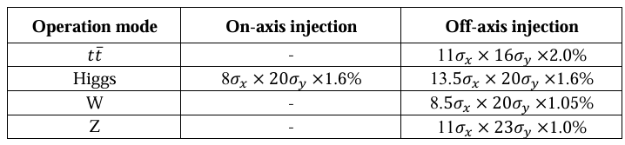
Dynamic aperture requirement
From Yiwei Wang
The dynamic aperture requirement comes from the injection parameters, beam lifetime for the top-up injection.
Considering: 3 sigma injection beam from booster (nominal booster emittance x and energy spread, 1% coupling for emittance x), 4 sigma circulated beam in collider, beam jitter due to kicker strength jitter are usually limit at the order of 10% sigma for circular accelerators.
All the particles from injection will survival w/ error, w/ jitter, w/o beam-beam as the particles located within the dynamic aperture.
E (GeV) | emitx_b (nm) | emitx_c (nm) | emity_b (pm) | emity_c (pm)
45.5 | 0.19 | 0.27 | 1.9 | 1.4
80 | 0.56 | 0.87 | 5.6 | 1.7
120 | 1.26 | 0.64 | 12.6 | 1.3
180 | 2.83 | 1.4 | 28.3 | 4.7

Slide 21

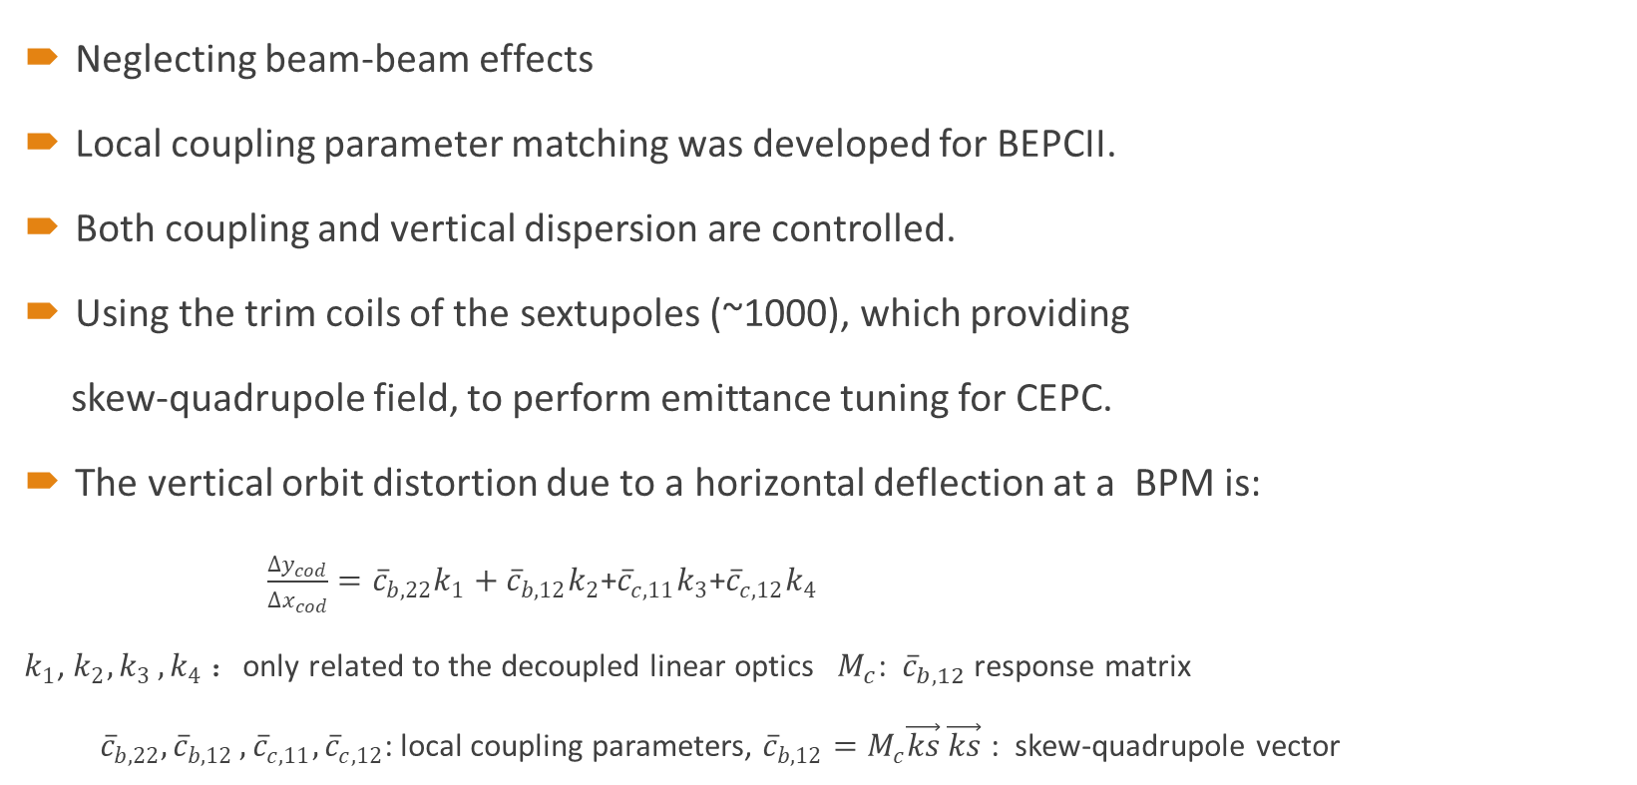
Coupling correction
Neglecting beam-beam effects
Local coupling parameter matching was developed for BEPCII.
Both coupling and vertical dispersion are controlled.
Using the trim coils of the sextupoles (~1000), which providing
skew-quadrupole field, to perform emittance tuning for CEPC.
The vertical orbit distortion due to a horizontal deflection at a BPM is:
$\frac{∆y_{cod}}{∆x_{cod}}={\overline{c}}_{b,22}k_{1}+{\overline{c}}_{b,12}k_{2}$+${\overline{c}}_{c,11}k_{3}$+${\overline{c}}_{c,12}k_{4}$
$k_{1}$, $k_{2}{,k}_{3},k_{4}$ ：only related to the decoupled linear optics $M_{c}$: ${\overline{c}}_{b,12}$ response matrix
${\overline{c}}_{b,22}{,\overline{c}}_{b,12},{\overline{c}}_{c,11},{\overline{c}}_{c,12}$: local coupling parameters, ${\overline{c}}_{b,12}=M_{c}\vec{ks}$ $\vec{ks}$ : skew-quadrupole vector
$ε_{y}$= $ε_{y0}+κε_{x}+γE^{2}{(D_{y}^{rms})}^{2}$

Slide 22
Error assumptions and correction schemes
Software: SAD and Matlab-based accelerator toolbox (AT)
Closed-orbit distortion (COD) correction is performed with sextupoles off, then the sextupoles were turned on and the COD correction repeated.
The dispersion correction using dispersion free steering principle (DFS).
beta-beating correction (LOCO), coupling and vertical dispersion correction
The vertical emittance is calculated in each step of correction, and ‌only auto-corrected seeds were included in the performance evaluation‌.
‌Taking the Higgs mode correction as an example‌.
Component | Δx (mm) | Δy (mm) | Δθ_{z} (mrad) | Field error
Dipole | 0.10 | 0.10 | 0.10 | 0.01%
Quadrupole | 0.10 | 0.10 | 0.10 | 0.02%
Sextupole | 0.10* | 0.10* | 0.10 | 0.02%

