Slide 1
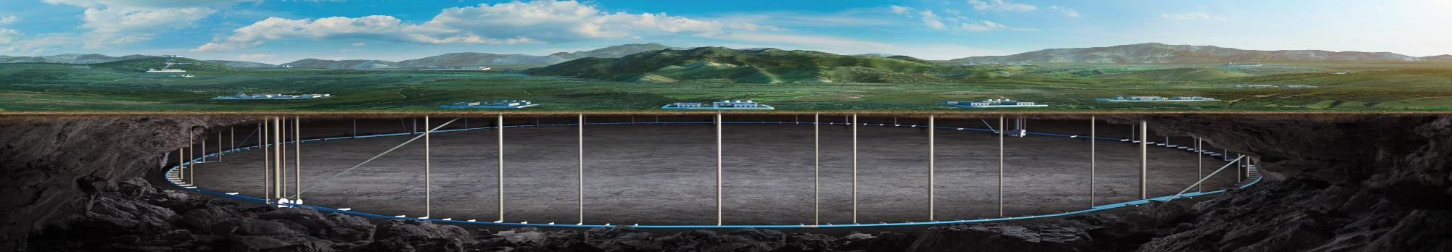


CEPC survey and mechanical system
Haijing Wang
CEPC DAY
2026.3.2

Slide 2
Content
IARC recommendations and replies
CEPC EDR survey and layout
MDI mechanics progress
Tunnel mockup progress
Vibration test scheme
Summary

Slide 3
IARC recommendations and replies
A.8.1 Comments
The committee is pleased to see that the accelerator design has largely been completed, with extensive work carried out in areas such as determining the machine’s scale, establishing the coordinate system, prototyping various types of equipment, conducting quantity surveys, and developing the overall accelerator layout. A digital twin system, under design, will significantly improve efficiency and reduce errors during the integration process. A naming convention for equipment and structures has been defined, and a 60-meter tunnel model (mockup) incorporating typical curved sections and an RF model have been designed. An automatic support adjustment mechanism has been developed, and the prototype design of the MDI has been completed, including static mechanical and vibration analyses, leading to subsequent optimization. The committee looks forward to the smooth progress of the next phase and the achievement of the expected outcomes.

Slide 4
IARC recommendations and replies
A.8.2 Recommendations
1. Prepare and integrate geodetic reference frames and transformations between reference systems to the survey layout and CAD systems;
A: Thank you for the recommendation. Now we are designing the layout in a virtual coordinate system. During the alignment engineering, the key points of the facility will be determined, and the coordinate transformation will be performed.

Slide 5
IARC recommendations and replies
A.8.2 Recommendations
2. Optimize the MDI mechanics and supports with all the involved stakeholders, in a collaborative approach, to finalize the designs and Finite Element Analysis, and launch the fabrication of a dedicated mock-up;
A: Thank you for the recommendation. We will do the further optimization with the involved colleagues, negotiate with the different requirements and make a balance. Then we will finalize the design and FEA with all the involved components. Meanwhile, we will launch the fabrication of the mockup.
3. Confirm the (vertical and lateral) stability requirements in the MDI and tunnel, and perform the Experimental Modal Analysis and transfer functions analyses on the designed solutions.
A: Thank you for the recommendation. We will confirm the stability requirements from the accelerator physics colleagues. The vibration test will include the ground motion test close to the real site and the modal test of magnet-support assembly.

Slide 6
EDR goal, scope and plans
Items | 2024 | 2025 | 2026 | 2027
CEPC equipment layout | Determine layout software and method Version 1 in arc section | Version 1 in other sections | Refinement and updating | Wrap up the unfinished work. Prepare the EDR report.
CEPC tunnel mockup | Finish the design, development and installation
High accuracy automatic adjusting and alignment system | Finish the design, development and the tests to fulfill the main requirements |  | Optimize the alignment method and support structure
Vibration test | Finish the design Follow the geological exploration to do the tests
MDI layout | More detailed layout, identify the MDI interface dimensions The locations for additional BPMs
Cryostat support design | More detailed support structure and FEA Design of auxiliary support |  | Vibration decreasing methods, eg. damping material
RVC design | Mechanical design Prototype development and leak rate experiment |  | Structure optimization Finish the leak rate experiment
Majority finished
Design finished
Design finished
Design finished
Finished
Optimize →mini review
Design finished

Slide 7
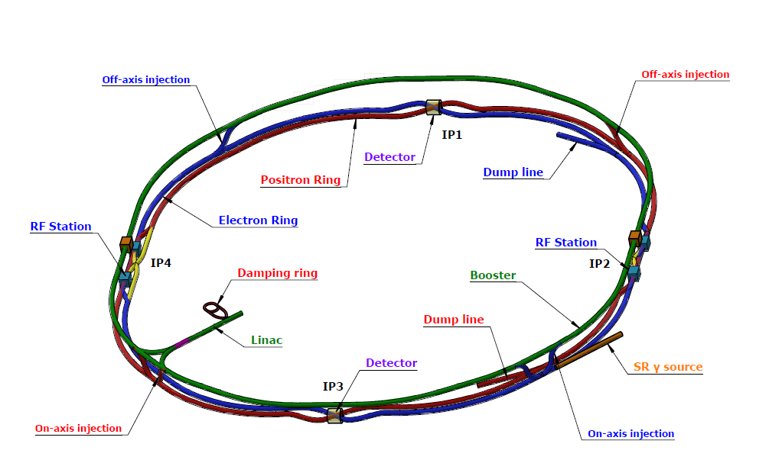
CEPC EDR layout progress
CEPC layout is one of the key tasks for CEPC in EDR stage
It makes the geometry of the accelerator physics to engineering layouts.
It serves as a bridge for communication and discussion between the mechanical system, accelerator physics system and multiple hardware systems, brings CEPC towards a more systematic and optimized direction.
Survey design
(the coordinates of each elements)
Hardware model design
Layout design
(place hardware on drawing according to survey)

Slide 8
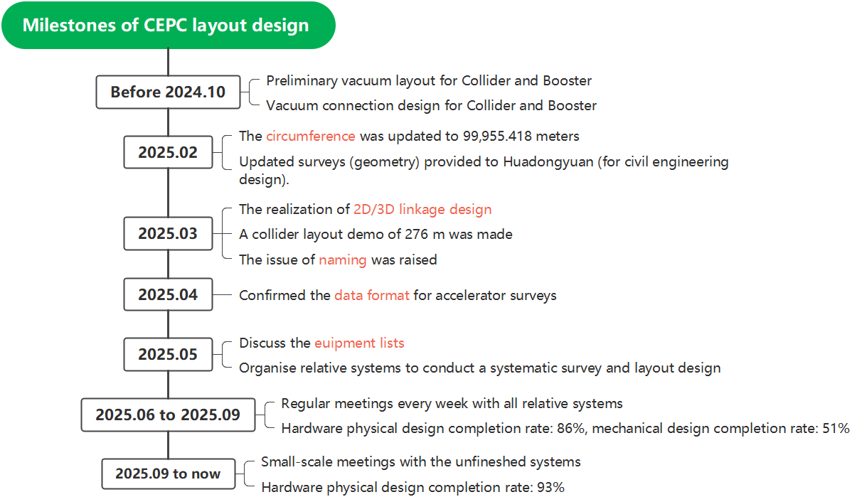
CEPC EDR layout progress

Slide 9
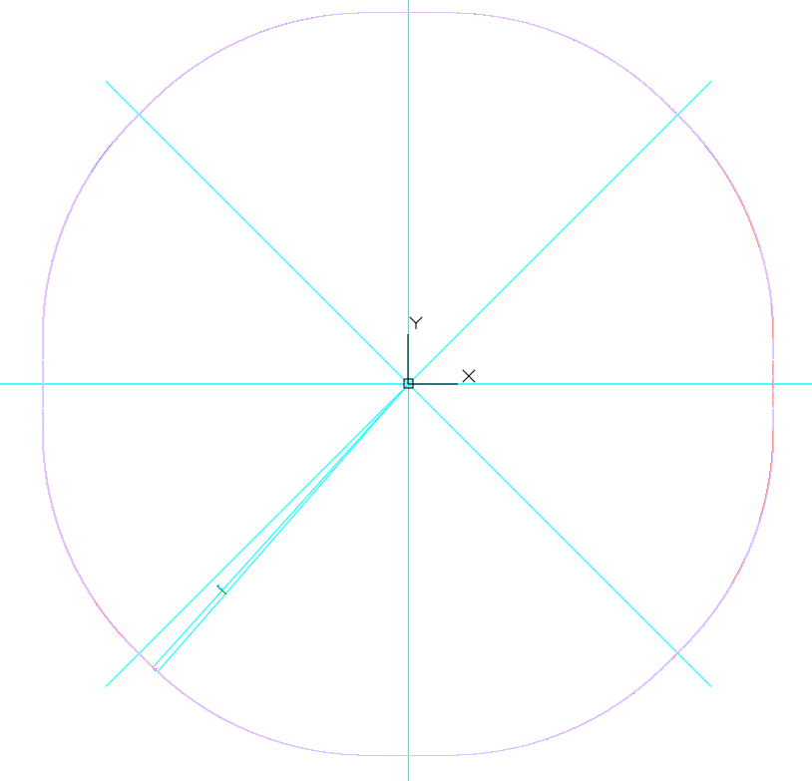
CEPC EDR layout progress-overall
The coordinate origins of all the accelerator has been unified. The (0,0) point is at the symmetric center of the Collider.
The survey position accuracy reaches the micrometer level.
Accelerator | Have EDR survey data? | Finish EDR survey design? | Have layout demo? | Complete survey naming?
Collider | √ | × note 1 | √ | ×
Booster | √ | √ | √ | ×
Linac | √ | √ | √ | √
Damping Ring | √ | √ | √ | ×
Transport lines | √ | × note 2 | × | ×
(0,0)
note 1&2: Due to the iterative discussions and optimizations of some complex issues (P14-P17), the overall progress is currently slower than planned.
We have a working group and regular meetings to propose the design and solve the issues we confront when working on the layout. The overall work is evolving toward detailed engineering discussions and design.

Slide 10
CEPC EDR layout progress-hardware
Accelerator | Hardware types * note1 | Hardware quantities | Progress (completed hardware types and completion rate)
 |  |  | Have survey design | Have 3D physics design | Have 3D mechanical design
Collider | 53 (66) | 51756 | 46, 87% | 56, 85% | 31, 47%
Booster | 22 (30) | 40466 | 22, 100% | 29, 97% | 24, 80%
Linac | 66 (69) | 9690 | 66, 100% | 65, 94% | 18, 26%
Damping Ring | 10 (15) | 498 | 10, 100% | 15, 100% | 5, 33%
Transport lines | 25(44) | 2758 | 42, 95% | 23, 92% | 14, 56%
INJ & EXT | 27(50) | 186 | 40, 80% | 27, 100% | 27, 100%
note 1, No1. (No.2), the item numbers need survey (the total item types along beamline). The vacuum chambers are not included, because the detailed vacuum chambers design must be after the vacuum segmentation and layout definition.
When are mainly focusing on some complex issue discussions recently. The types of hardware almost remain the same as Nov. 2025
Physics design progress from May to November, 2025

Slide 11
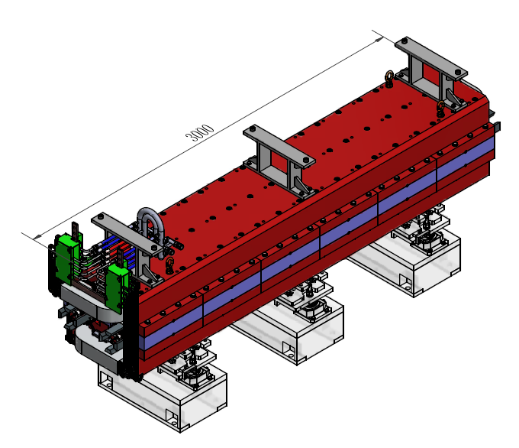
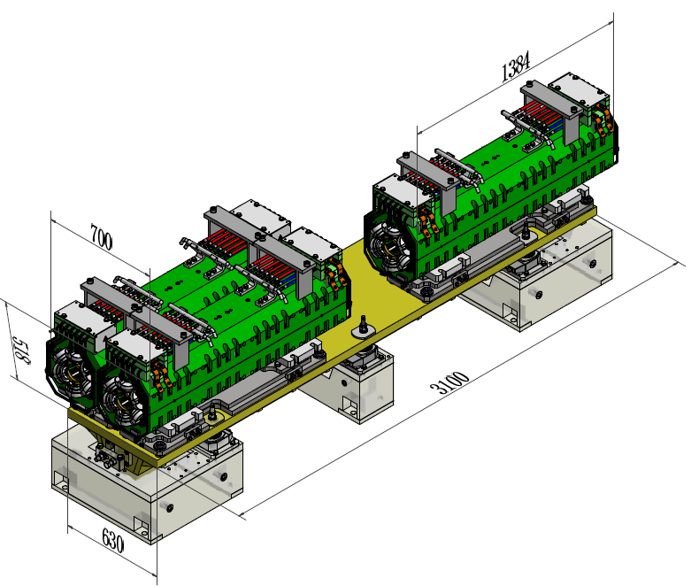
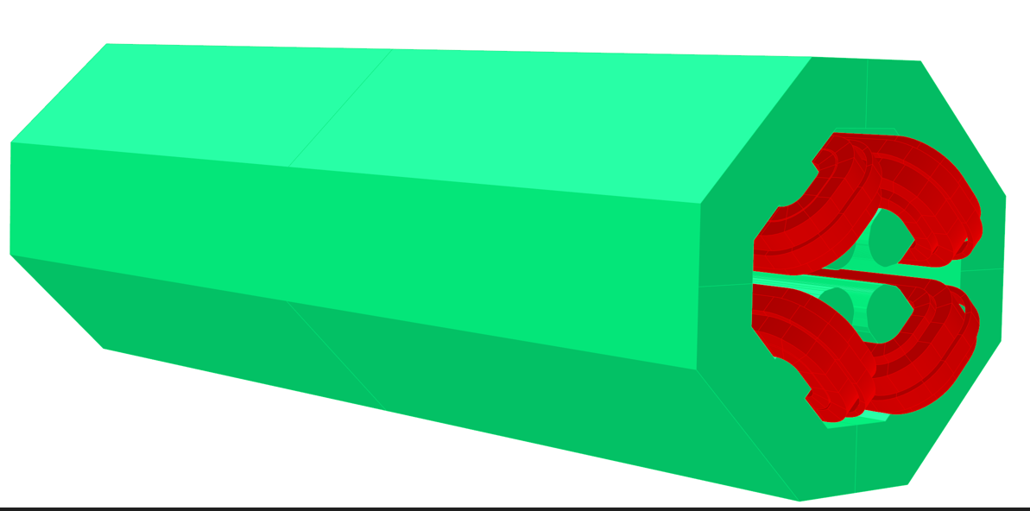
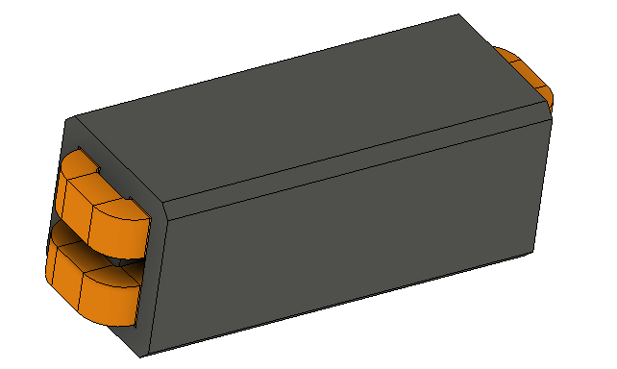
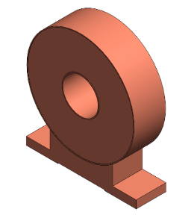
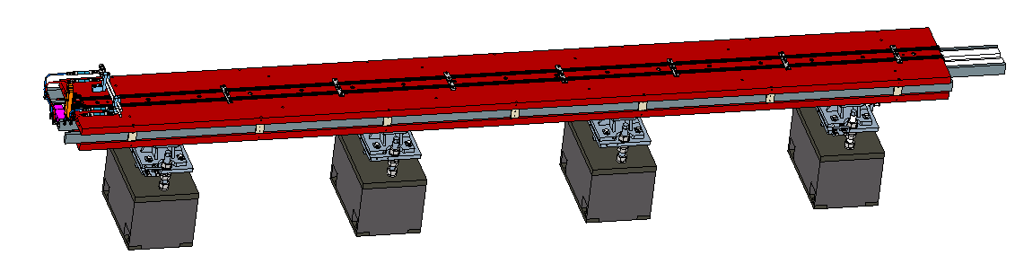
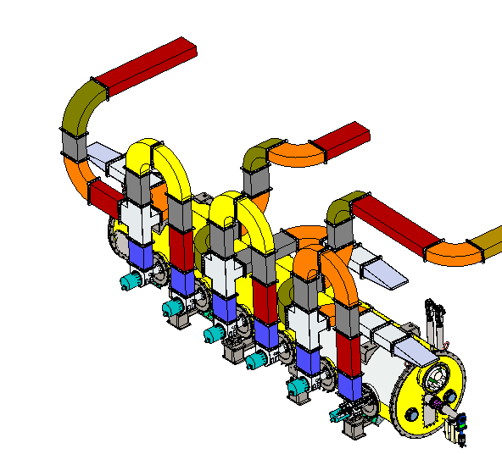
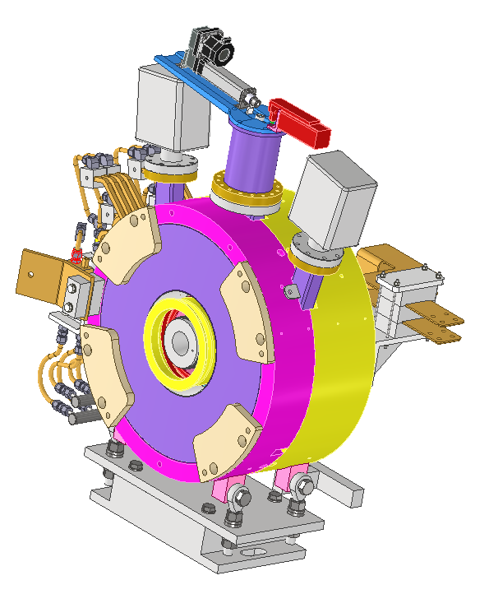
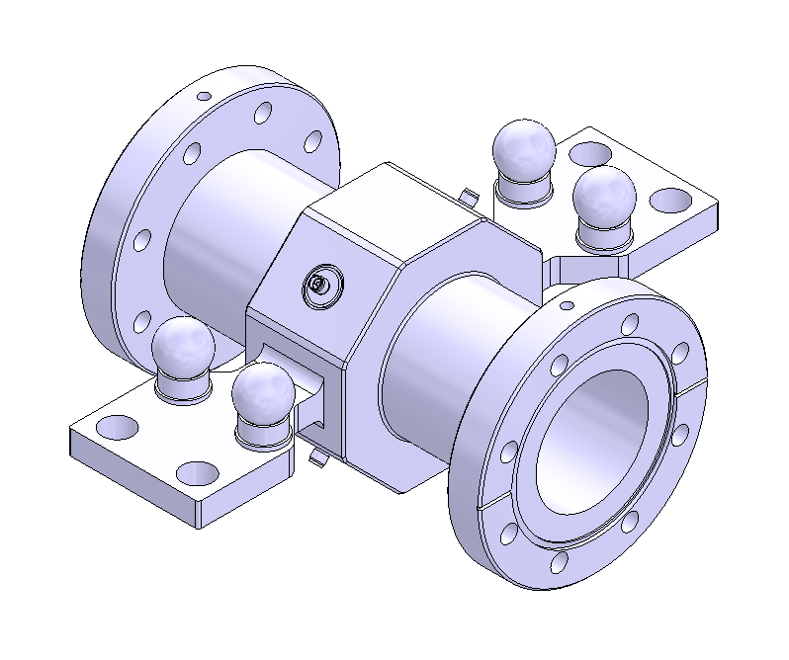
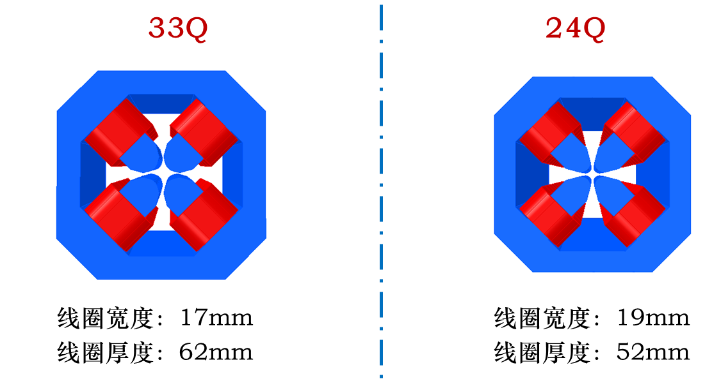
CEPC EDR layout progress-hardware
We are mainly focusing on hardware physics design at this stage, and when resources permit or necessity arises, we also undertake some mechanical design.
Physics design for some magnets
Mechanical design for some equipment

Slide 12
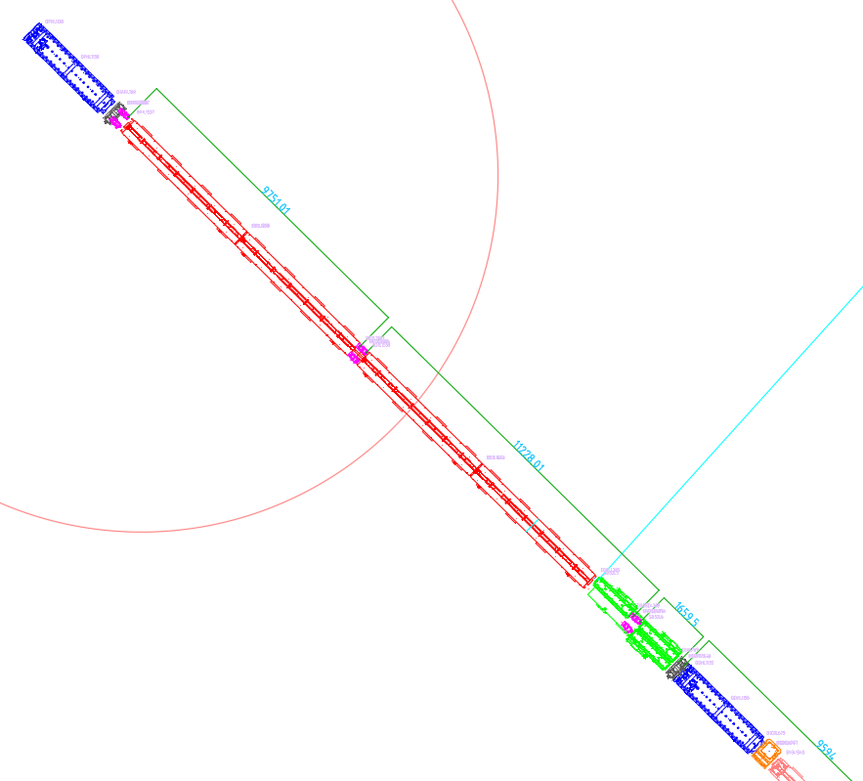
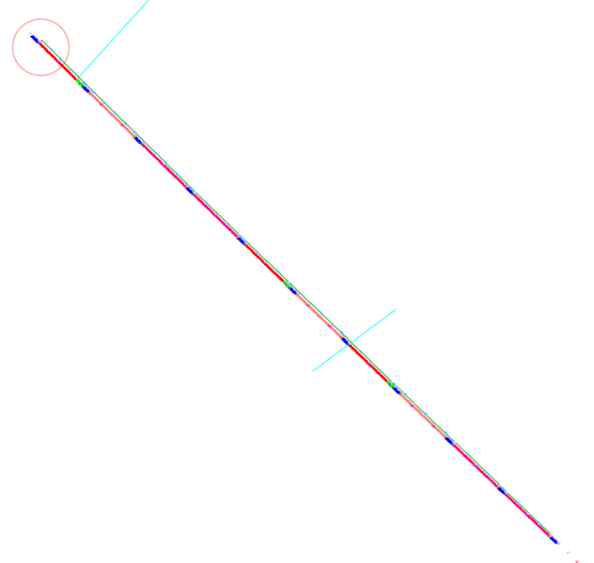
CEPC EDR layout progress-Collider demo
Collider layout demo (2D, arc section, 276 m)
Q
BPM
B01
Tunnel inside
Vacuum connection
Vacuum connection
Vacuum connection
Tunnel outside
BPM
S
Q
CH&CV

Slide 13
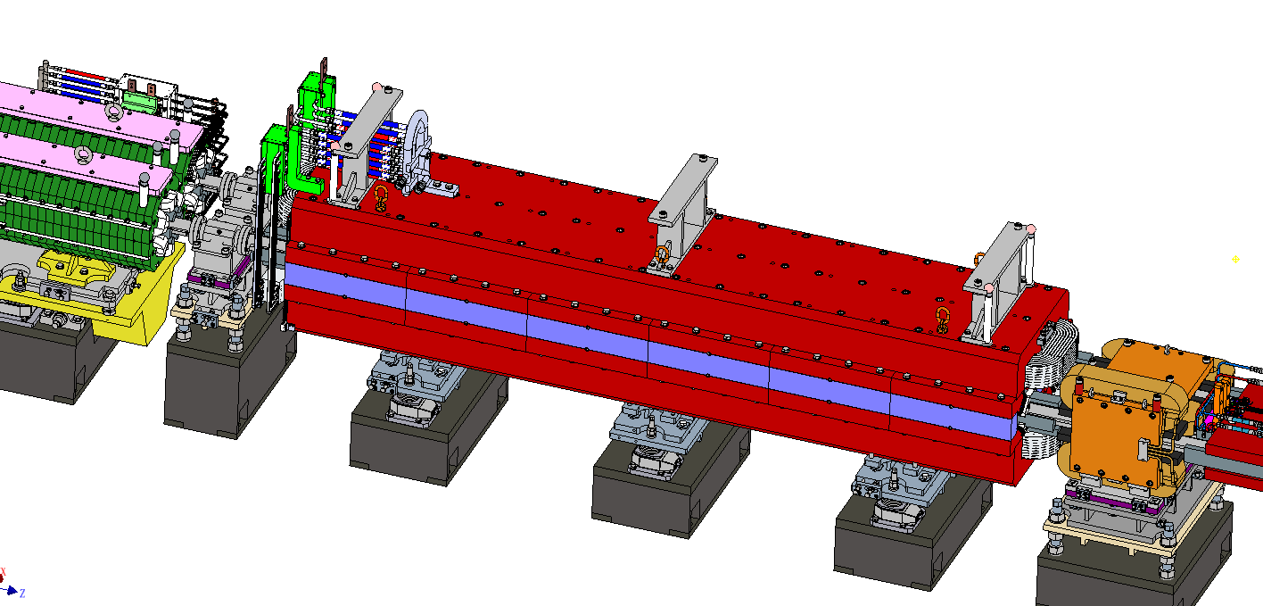
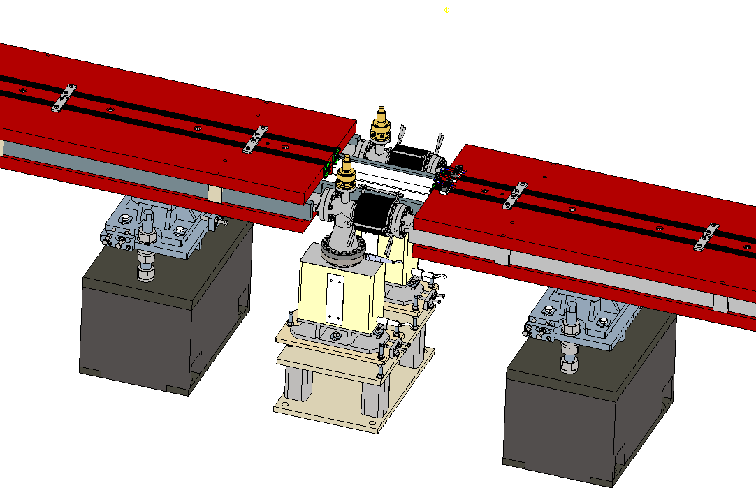
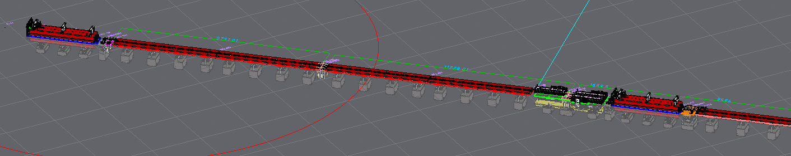
CEPC EDR layout progress-Collider demo
Collider layout demo (3D, arc section, 276 m)

Slide 14
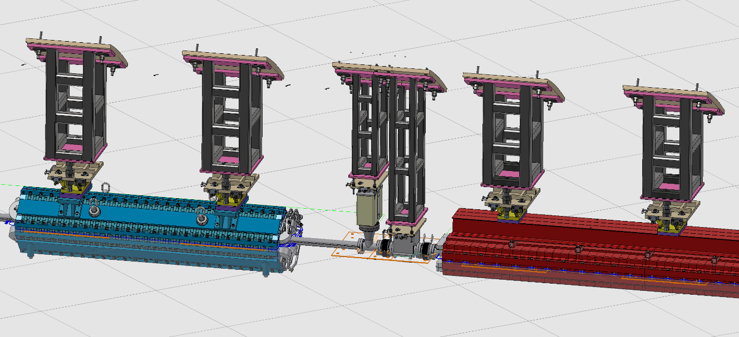
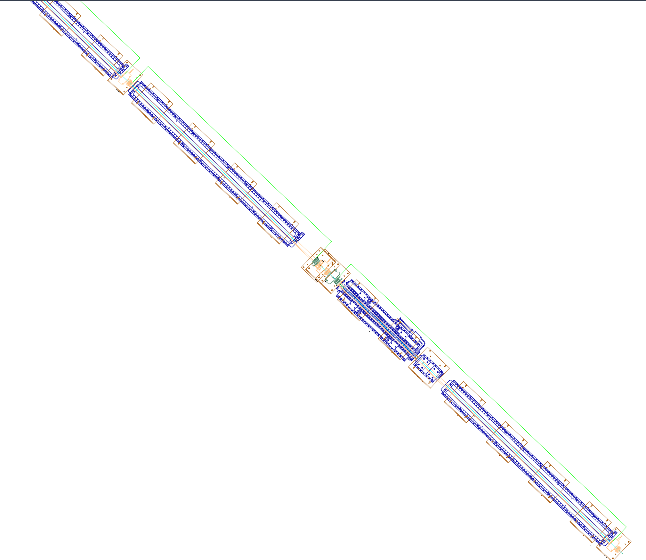
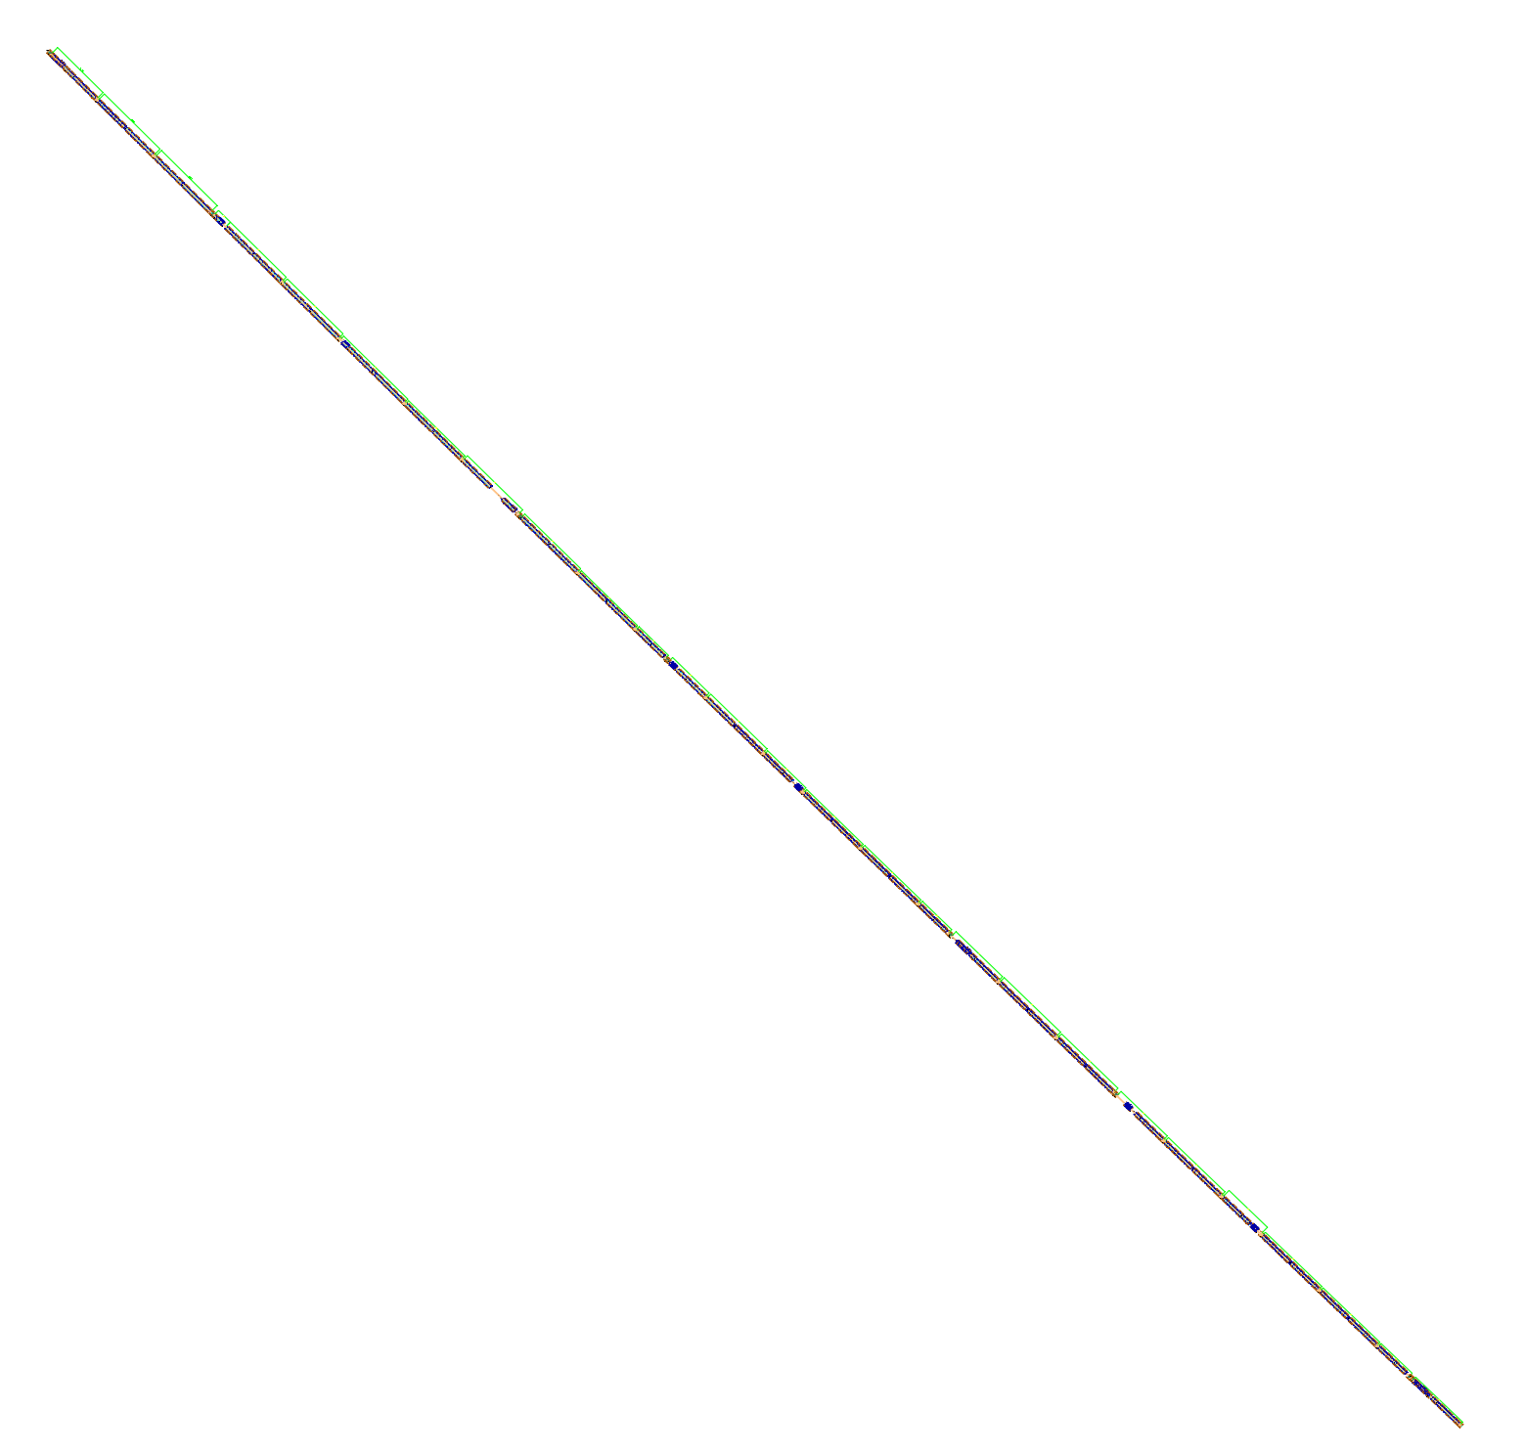
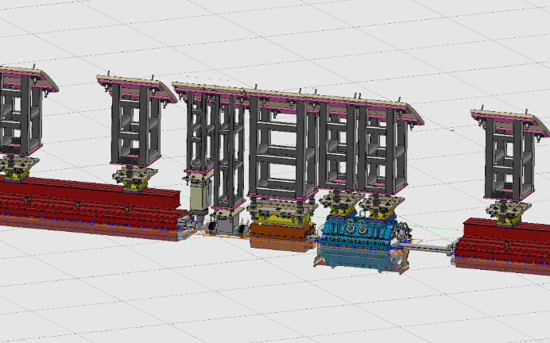
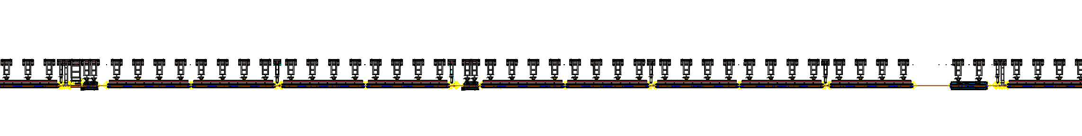
CEPC EDR layout progress-Booster demo
Booster layout demo (2D/3D, arc section, 230 m)
B01
Tunnel inside
Vacuum connection
Q
Vacuum connection
Vacuum connection
Tunnel outside
CH

Slide 15
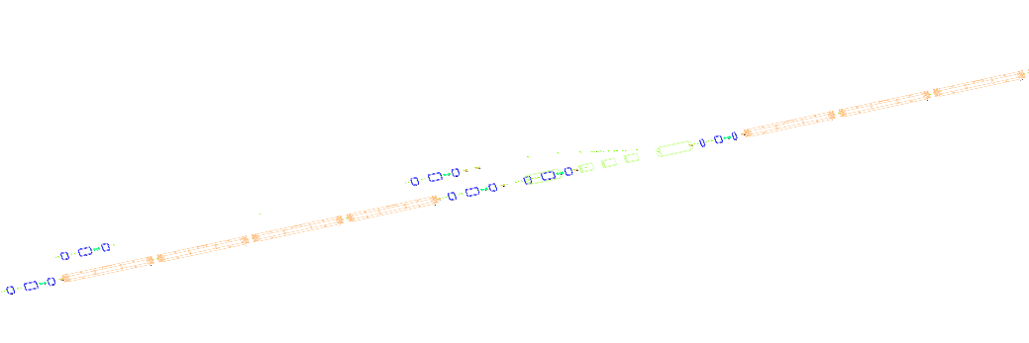
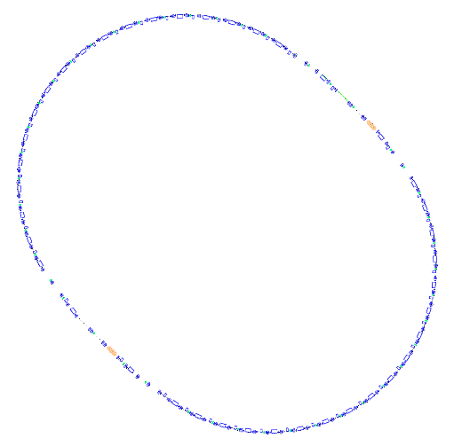
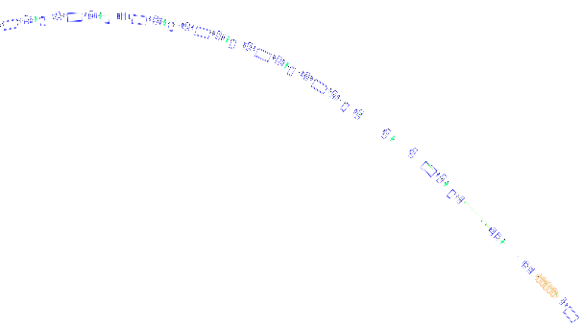
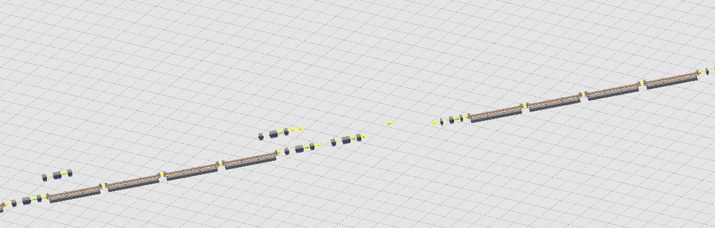
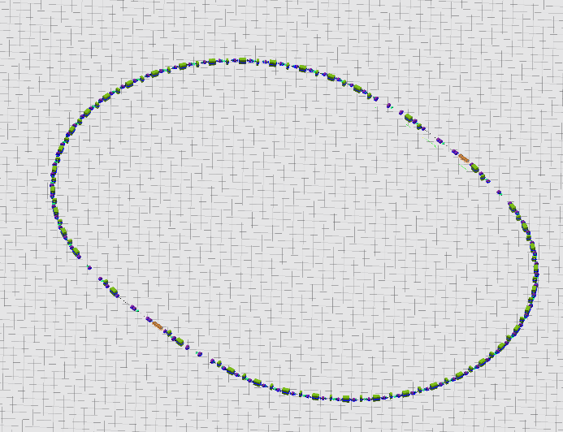
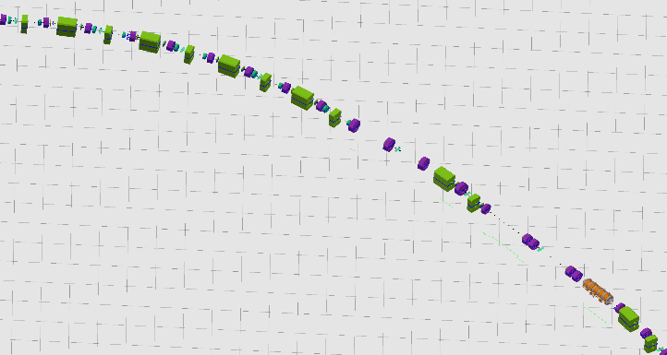

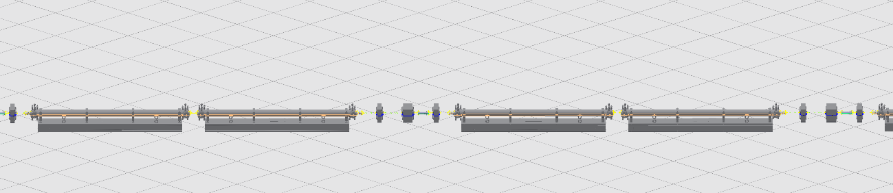
CEPC EDR layout progress-Linac and DR demos
Linac layout demo
Damping ring layout demo
EBTL (Electron bypass transport line)
Up: 2D layout; Down: 3D layout
2D layout
FAS (first accelerator section)
Up: 2D layout; Down: 3D layout
3D layout

Slide 16
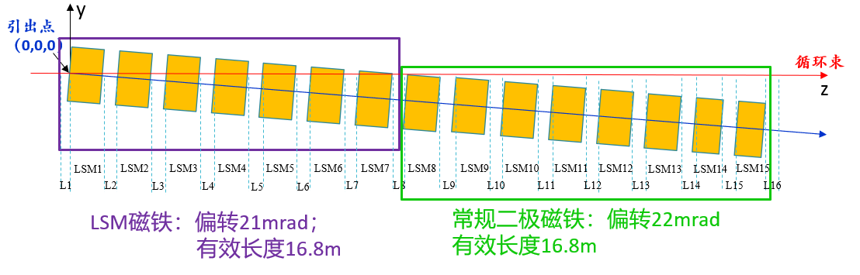
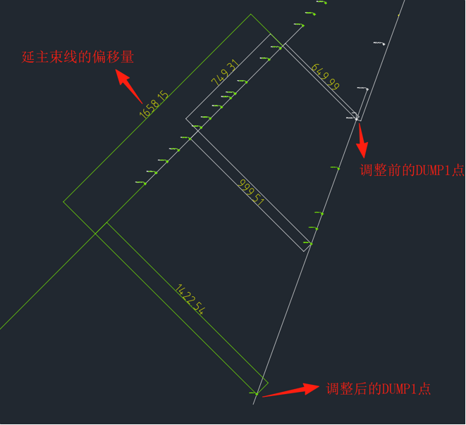
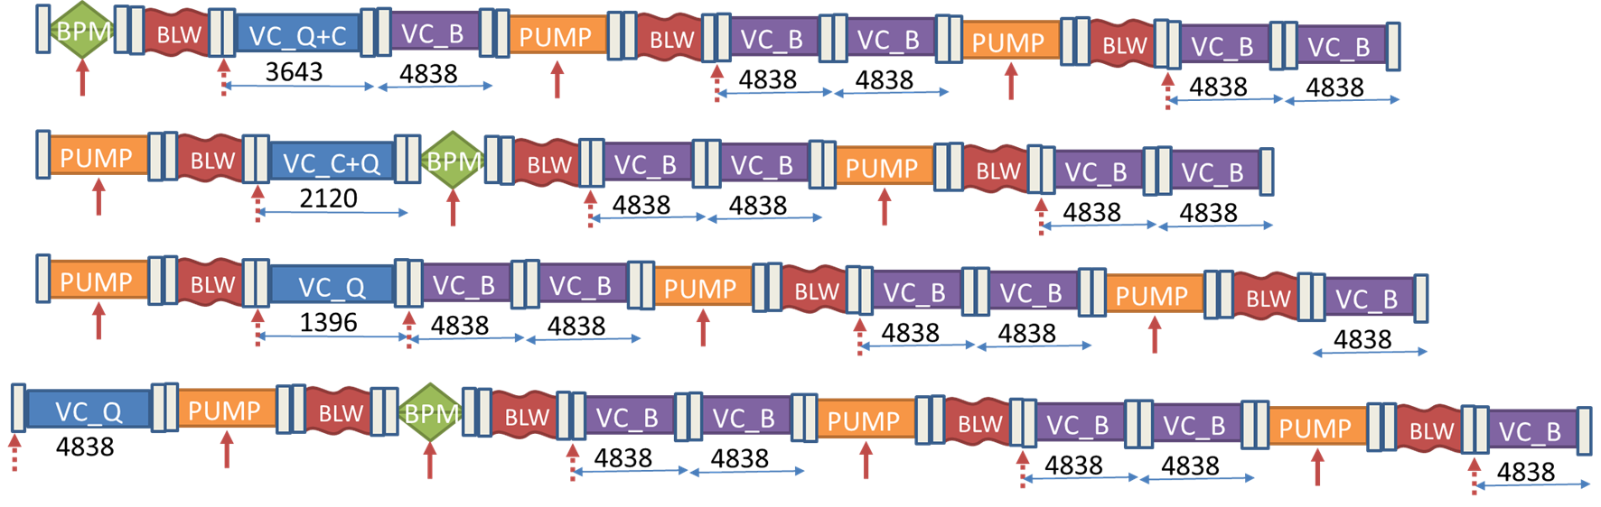
CEPC EDR layout progress-Main issues
1: LSM or dipole?
Changed part of LSMs to regular dipoles
2: DUMP space interference in Linac→ solved
3: Different vacuum layout considering installation requirements
Three vacuum layout for Collider
3 vacuum layout for Booster, optimizing the installation method
Haijing Wang, CEPC DAY, 25.5.23, https://indico.ihep.ac.cn/event/25992/
Addressed or solution identified

Slide 17
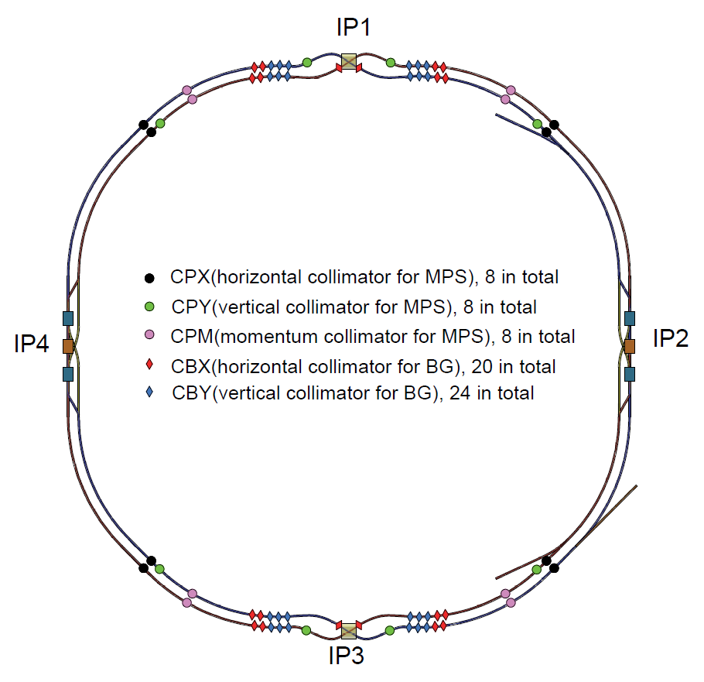
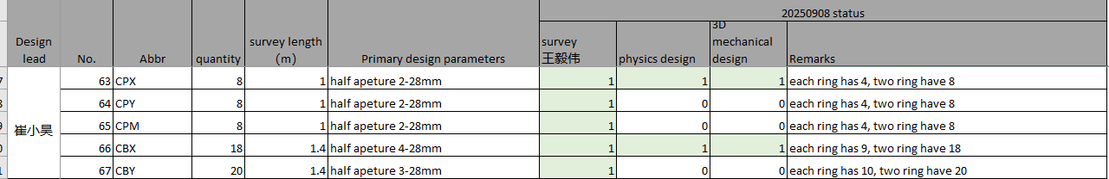
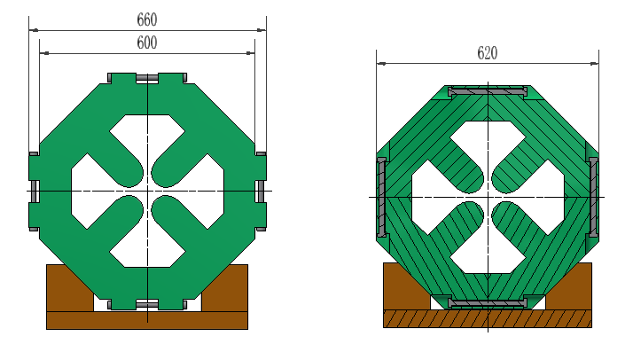
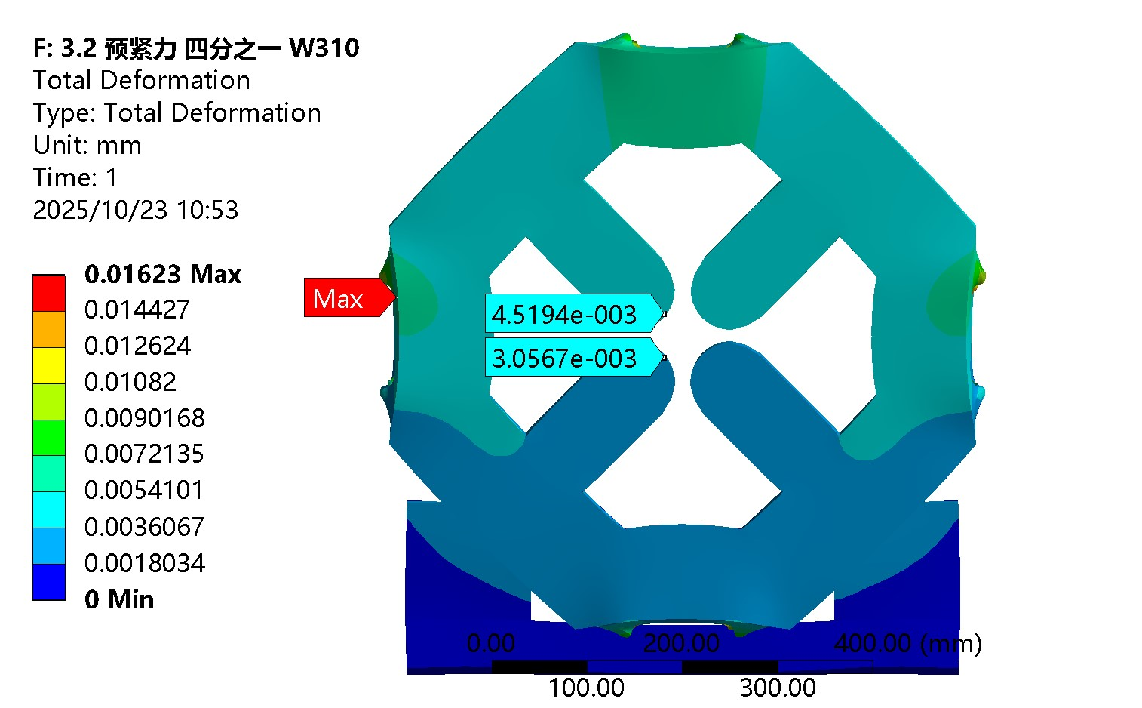
CEPC EDR layout progress-Main issues
4. Collimators
Optimize design according to new lattice, update data formats
All collimators are located beside sextupoles (1.4 m available)
5. Quadrupole cross section optimization based on limited space.
Comparison on the deformation of magnet pole tip.
Collimator layout parameters and status
Collimators distribution
Addressed or solution identified
Quadrupole cross section optimization

Slide 18
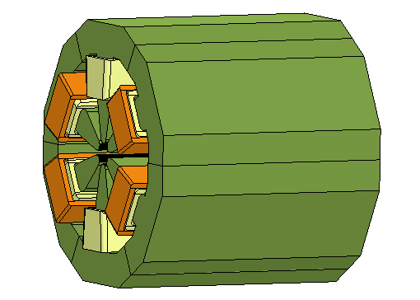
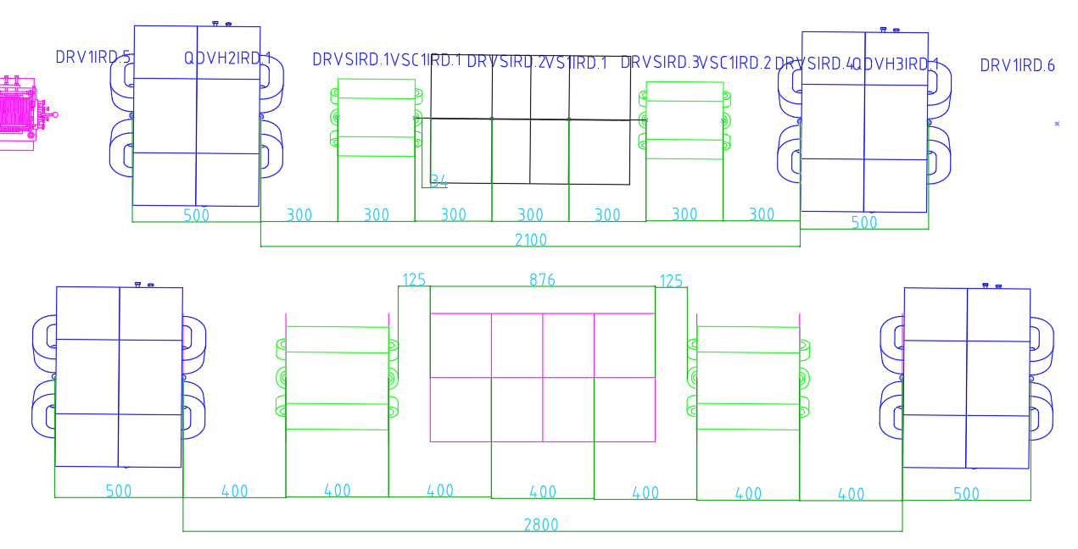
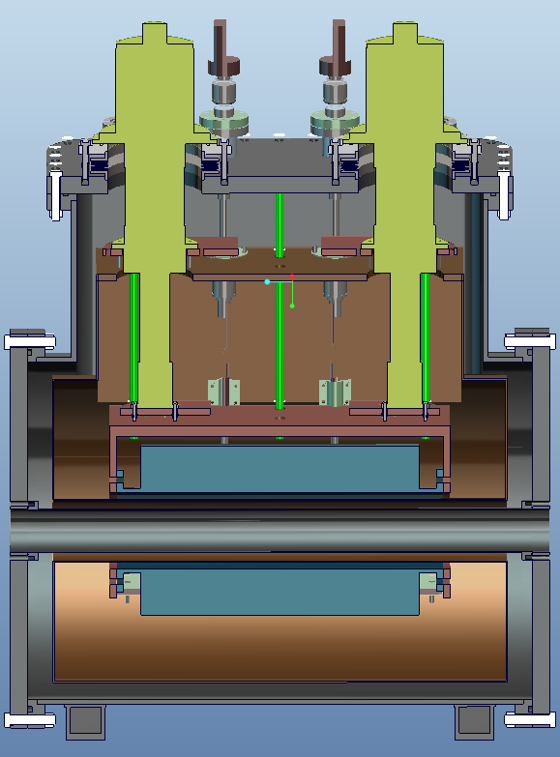
CEPC EDR layout progress-Main issues
6: IP multi-magnets
Three kinds of sextupole-quadrupole combined magnets.
Through many negotiations on the space, magnet parameters and materials, a consensus has been reached out and the physics design has been finished.
7: IP sextupoles
Two kinds of sextupoles are changed to SC magnets, from TDR to EDR, with a quantity of 32.
Preliminary longitudinal layout and cryostat design has been identified.
Addressed or solution identified
SA1 sextupole-quadrupole combined magnet
Preliminary longitudinal layout optimization
Preliminary cryostat design of IP SC sextupoles

Slide 19
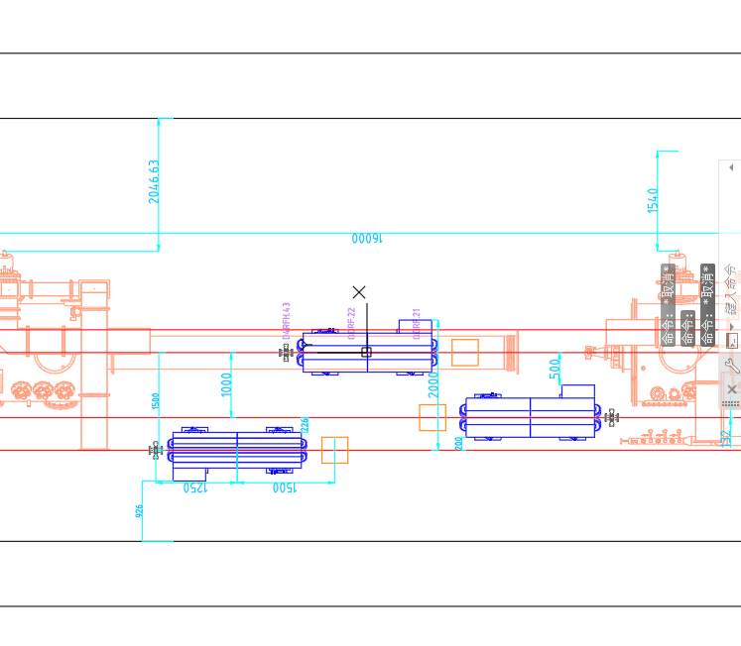
CEPC EDR layout progress-Main issues
8: Space arrangement at RF section, 3 beam lines.
Through many negotiations on the RF update strategies, space, magnet parameters, the 1st version of survey for RF beamline and bypass survey has been finished. The magnet design and layout is on going.
The bypass design of the Booster has been discussed recently and added to our work list.
Under negotiation

Slide 20
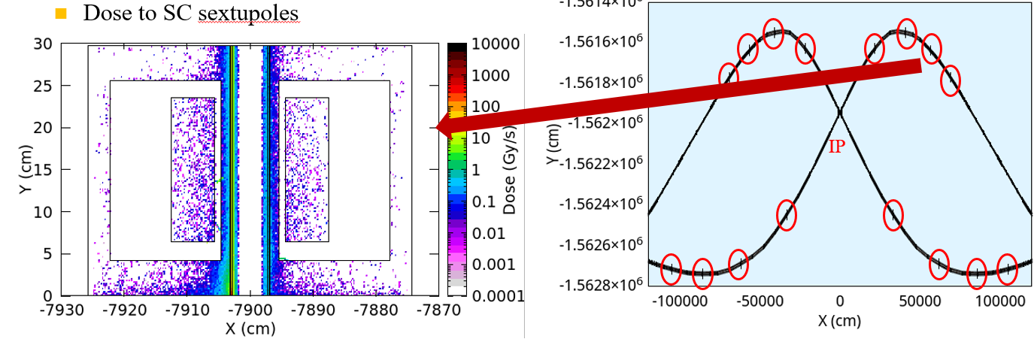
CEPC EDR layout progress-Main issues
9: Spatial interference issues within 1.5 km of IP
Spatial interference resolution has been carried out with optimizations of magnet dimensions, accelerator physics, and magnet parameters.
Several iterations have been conducted, but a finalized issue-free version hasn’t yet been achieved.
10: Radiation simulation and shielding design
About 2.5 cm Lead within magnet coils at arc section.
Radiation should also be considered near IP. Be added to the IP layout design recently. The key focuses are the superconducting sextupoles and the final focus magnets.
Simulation includes the dose and the energy deposition, especially the deposition to the cryostats.
Preliminary calculations for the SC sextupoles, the values are not yes available for reference.
Under negotiation

Slide 21
CEPC EDR layout progress-Integration method
2D and 3D layouts of CEPC are being built synchronized.
Less workloads
The 2D and 3D layouts are interconnected, reducing the possibility of inconsistencies between them.
After numerous iterations of collider layout demo, we have essentially get the design process.
Computer lag reduces work efficiency, as the layout is too big for such a huge project!
Discuss with Autodesk and Huadongyuan. Some suggestions like BIM (Building Information Modeling), Navisworks, and external interfaces are considered as candidate methods.
Better workstations.
Sub-layouts
Preliminary survey and magnet design
Preliminary 2D layout and vacuum segmentation
Detailed survey design
Detailed 3D magnet design
Detailed 2D layout design
Publish resource library
Automatic
Automatic
Manual
Detailed 3D layout
Manual
Survey design change
Model design change

Slide 22
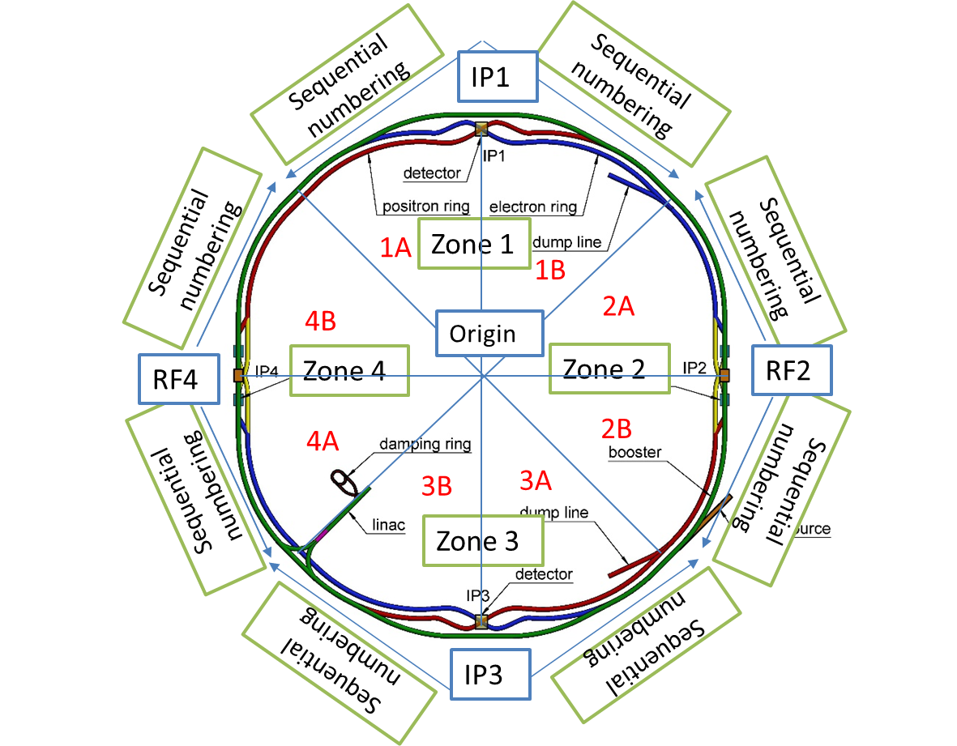
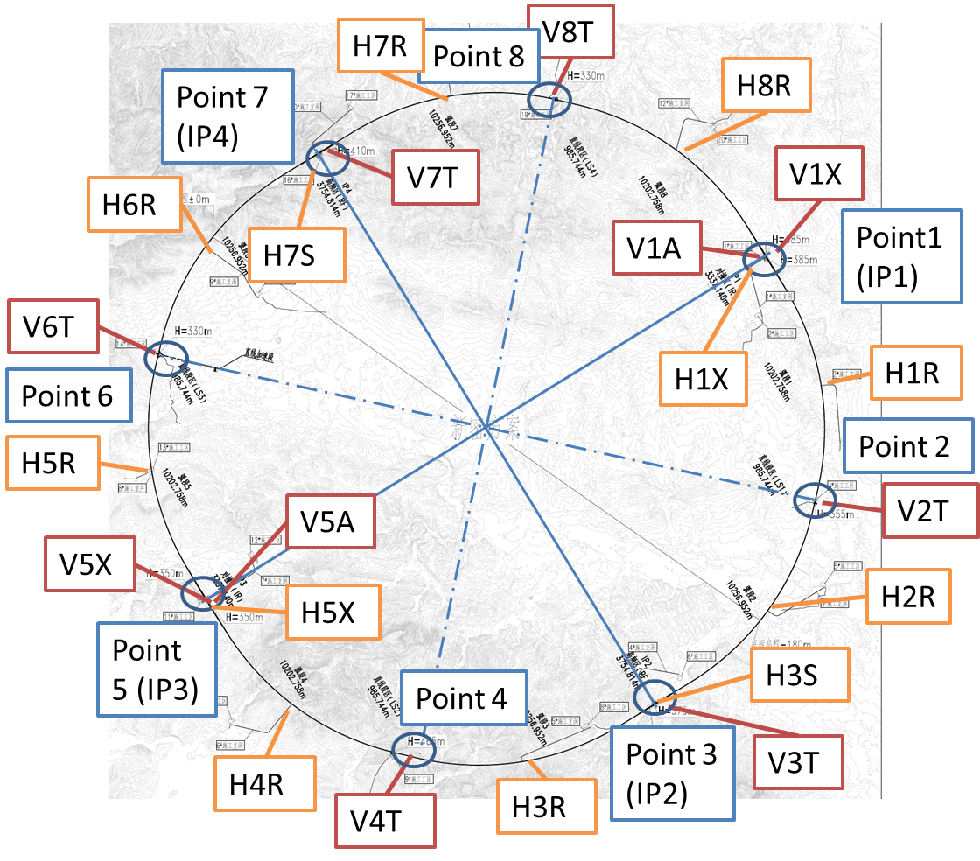
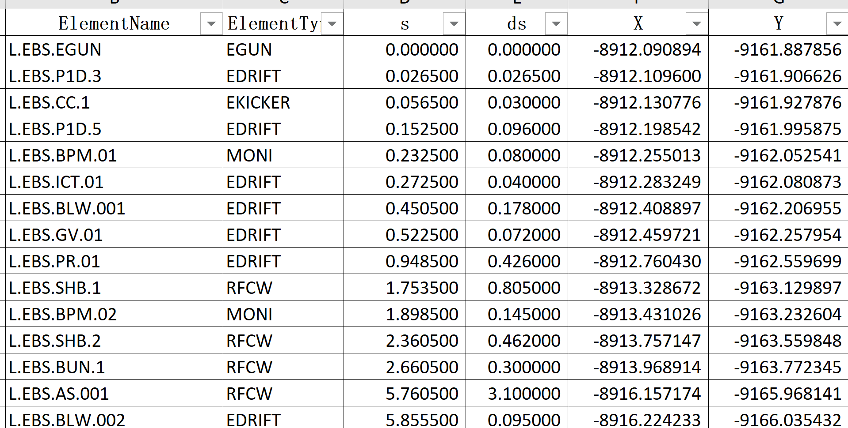
CEPC EDR layout progress-Hardware naming
When working on the layout, we realized the naming should be expedited.
We have formulated preliminary opinions on equipment along the beam and the shafts.
The naming has been applied in Linac survey, that on other accelerators are on-going
Zoning for collider and booster
Shafts naming

Slide 23
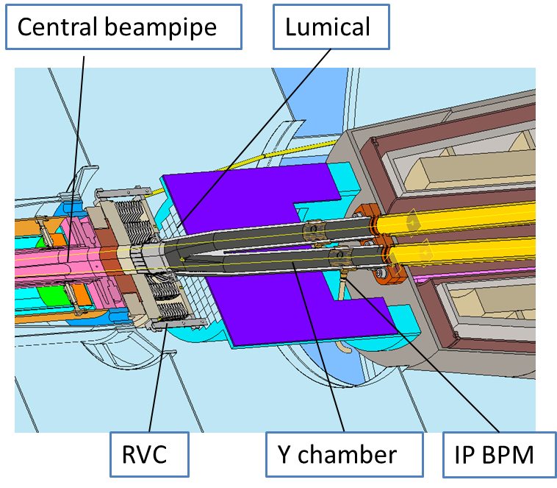
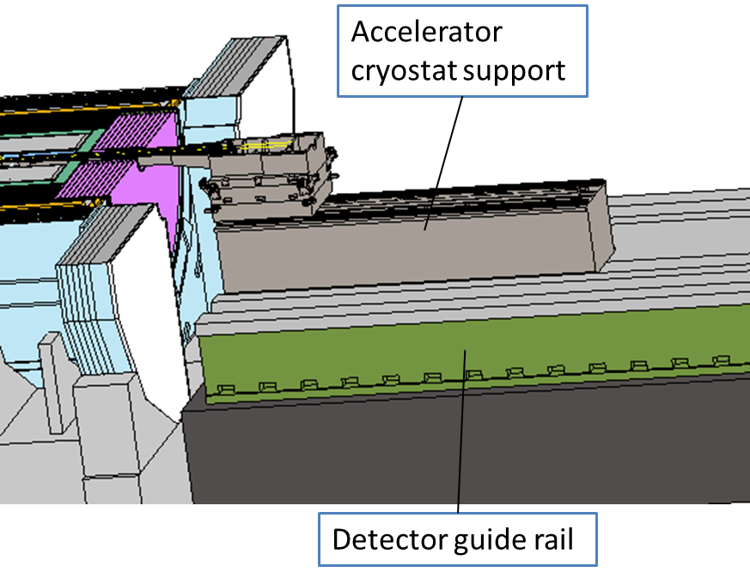
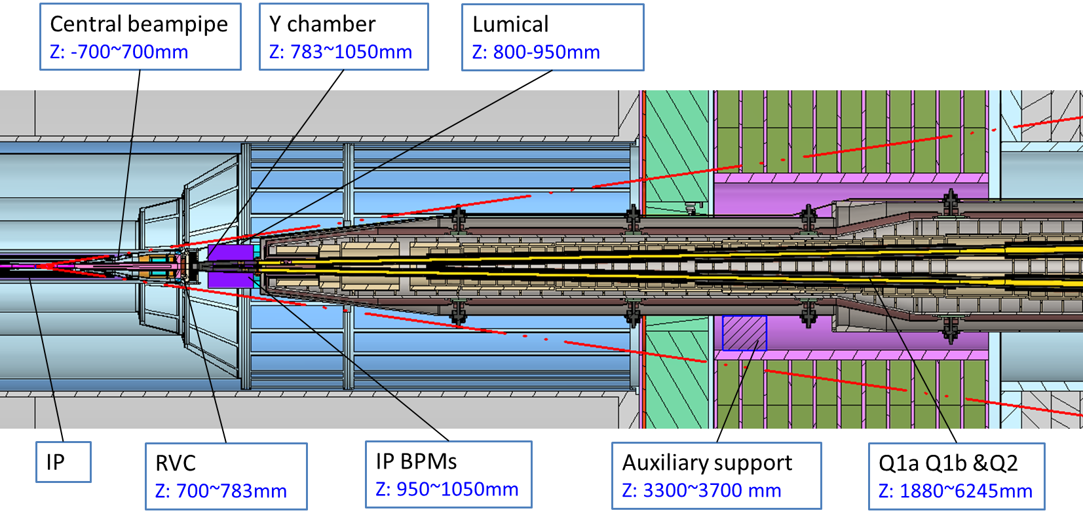
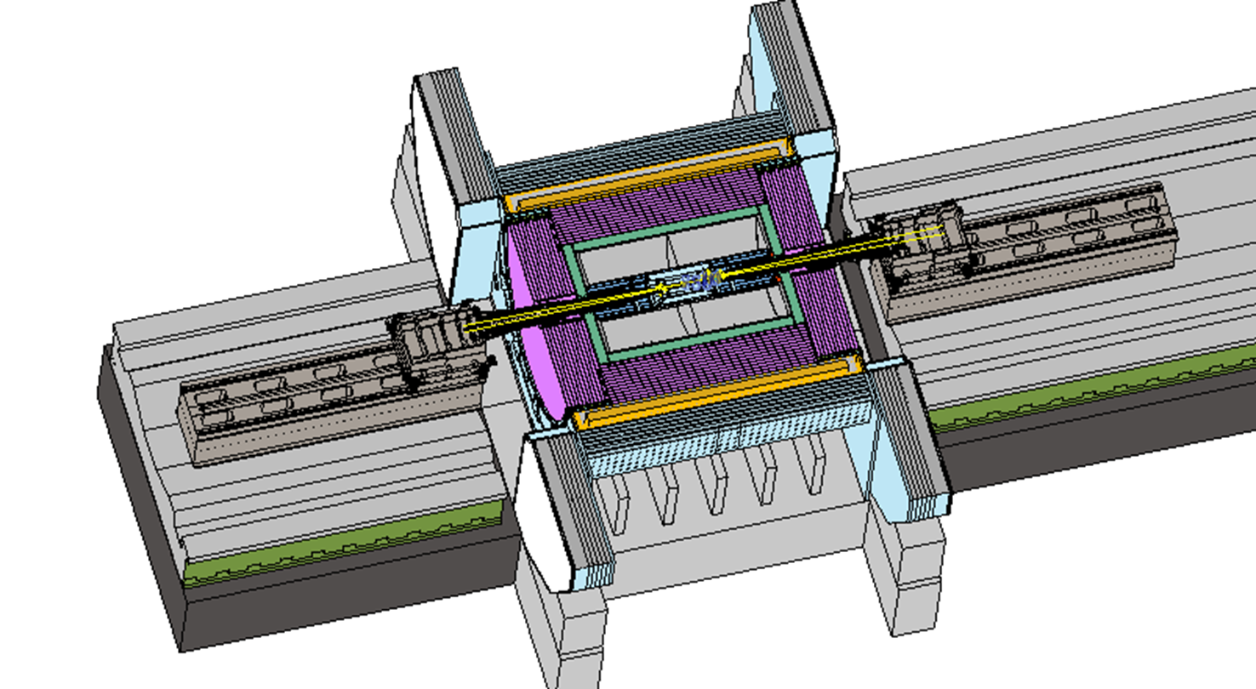
MDI mechanics progress-layout
MDI layout
Detective angle: acos0.99
IP chamber：±700mm
Yoke length：11950mm
Distance to detective angle
IP chamber flange: 5.3mm
RVC: 14.9mm
Mechanical interface between accelerator and detector
MDI layout

Slide 24


MDI mechanics progress-mechanical analyses
Mechanics and vibration analyses
Static structure: max. deformation and displacement change with/wo Lorentz force
Vibration analyses: natural frequency & harmonic response
Structure optimization
 | Related requirements | Response now*
Position accuracy (X/Y) of SC quadrupoles ≤100μm | Adjusting resolution≤5μm Adjusting accuracy≤30μm | ≤5μm ≤30μm from HEPS experience
 | Max. def. and disp. change, ＜ 50μm | FEA，＜40μm
Small vibration, 1-100Hz RMS ≤4nm | High natural frequency | FEA, ~50Hz and 1 (same level to HEPS, and arc section of CEPC)
 | Low amplification factor
Designed model
Analyses model
* The response now only considers the mechanics aspect.

Slide 25
MDI mechanics progress-mechanical analyses
We made detailed analyses and presented on the MDI mini-review in June 2025.
Iron-free quadrupole and optimized skeleton has benefits (Max. disp. of SC quadrupoles/cryostat decreased)
Material optimization，no obvious effect
Auxiliary support，significant effect (max. disp. change from 2 mm to 84 um, max. def. smaller than 15 um, natural frequency from 17.7Hz to 49.2 Hz)
Thicker vacuum vessel: significant effect (max. disp. change from 84 um to 33 um)→can be considered comprehensively with radiation.
Support rods: significant effect→ can be optimized further
It seems there is no sudden positional jitter caused by the disappearance of the Lorentz force. Either for the Von mises stress. We are checking on it.
Works to be done
Further optimization with collaboration with other colleagues: compromise solution with other aspects of optimization such as cryogenic.
After above analyses converged, we will taking into account all the relative components and make a whole FEA.

Slide 26






MDI mechanics progress-mechanical analyses
Simulation results, with Lorentz force and gravity
Z disp. of SC quadrupoles, 4.2 K
SC quadrupole displacement
Y disp. of vacuum vessel, 4.2 K
1st order of mode, 4.2 K
Displacement of SC quadrupoles when quenching
Harmonic response, 1-100Hz

Slide 27




MDI mechanics progress-RVC
RVC
Leak rate requirement: 2.7 ×10–11 Pa·m3/s
Leak rate: $Q=C∙∆P$
Decrease $∆P$ (experience from CSNS)
Single-layer → double layer, leak rate can be improved from 1e-6 Pa.m3/s to 8.5e-10 Pa.m3/s.
Decrease C
We are engaging on it
We are applying for “所创新基金”，and also considering the engineering application on BEPCII CW if it is needed.
Inflatable seal
$$\left.C=34A^{2}（L/w）exp{[}−3F/(LwR)\right]$$
More details of MDI in: Haijing Wang, CEPC Interaction Region engineering design status, this workshop

Slide 28

Tunnel mockup progress
A 60-meter tunnel with typical arc section and RF section
Arc section：one FODO cell in both Collider and Booster（including dipole, quadrupole, sextupole, corrector and BPM）
RF section：one RF module in both Collider and Booster
Technical verification of installation and alignment for the above-mentioned equipment.
Development progress
Design review: 24.8.16
Now: waiting for bidding for the displaying models, under machining for the supports.

Slide 29



Tunnel mockup progress-dimension optimization
Optimizing dimensions to fulfill the space arrangement of TDR tunnel design.
The water and electricity connections for quadrupole and sextupoles have relocated to the upper side.
Cryomodule design update: bottom support→ top suspension
Collider quadrupole and sextupole optimization
Miaofu Xu, CEPC SRF Cryogenic System EDR Design Peer Review, May, 2025

Slide 30







Tunnel mockup progress-developing
The site construction design of the tunnel mockup is under-going.
The devices of the mockup is under developing.
The deformation has been analyzed for the real magnet in Booster, the max. deformation by gravity is 20µm, which is small enough for lifting and operating.
Wen Kang, Zhihui Mu, Design and production tolerance analysis of the CEPC Booster dipole-sextuple combined magnets. Mini-Review for CEPC Booster Combined Magnets. May, 2025

Slide 31




Tunnel mockup progress-automatic adjusting mechanism
The amount of CEPC equipment is huge. Therefore, improving alignment and adjusting efficiency while ensuring accuracy is one of the important aspects in EDR stage.
The high accuracy automatic adjusting and alignment system of CEPC
High-accuracy measurement field (alignment): multi-camera photogrammetry, multi-point synchronous monitoring, high efficiency
Automatic adjusting mechanism (adjustment): movable drive, unified quick plug-and-play interface
The prototypes are designed and waiting developing
Output shafts at the aisle side
Dipole and its support
Adjusting mechanism for dipole (screw)
Adjusting mechanism for quadrupole (wedge)
Quadrupole and its support

Slide 32


Vibration test scheme
 | Ground motion requirements, RMS, 1-100 Hz displacement integral
MDI | ≤4 nm
Arc and straight section, and RF section in Collider | ≤24 nm
Linac | ≤50 nm
Mechanical dynamic stability (vibration)
Ground vibration:
Magnet-support assembly: natural frequency? Amplification factor?
Damping devices: damping material? active vibration technology?
Enhancing the natural frequency is an effective method to decrease vibration.
HEPS site

Slide 33





Vibration test scheme
Test scheme
The test sites has been identified.
The vibration sensors have been tested and identified.
Test contents |  | Site requirements
Ground motion test | Amplitude of ground vibration | Close to a real tunnel site
 | Wave velocity and vertical attenuation.
Modal test on magnet & support assembly | Collider magnet & support | Good vibration performance, to validate the rationality of the design
 | Booster magnet & support
Ground motion test sites
Modal test sites, at JUNO
Sensor testing at PAPS and HEPS

Slide 34
Summary
We are dedicated to the detailed layout design during the EDR phase while simultaneously advancing the progress of various hardware equipment. By now, most of survey and hardware physics design have been completed. The 2D and 3D layouts of CEPC are being built synchronized. The naming of hardware along beam and shafts have been made as well.
The cryostat and its supports at MDI have been analyzed detailly, after optimization, it has little effect on alignment, and no re-alignment is needed after having Lorentz force. The RVC has been designed and waiting for developing.
The design of tunnel mockup has been completed, during which we have optimized some hardware design. Part of the mockup (supports) are under developing.
The vibration test scheme has been identified, and the test sites are determined.

Slide 35
Thanks for your attention!
Thanks to the contributors!
Haijing Wang, Siyu Chen, Minxian Li, Lei Wu, Zihao Wang, Jianli Wang, Jie Gao, Yiwei Wang, Dou Wang, Cai Meng, Xiaohao Cui, Wen Kang, Mei Yang, Yafeng Wu, Xianjing Sun, Qing Li, Yingshun Zhu, Jinhui Chen, Lihua Huo, Lei Wang, Bin Chen, Yongsheng Ma, Qi Yang, Yanfeng Sui, Jingru Zhang, Jiyuan Zhai, Guangyi Tang, Zusheng Zhou, Miaofu Xu, Ruixiong Han, Sha Bai, Haoyu Shi, Huamin Qu, Min Zhou, Dapeng Jin, Guoping Lin

