Slide 1
Performance study of SiPM for CEPC HCAL
Yuguang Xie
On behalf of HCAL group
2026.02.11

Slide 2
Content
SiPM for GS-HCAL
SiPM providers and commercial candidates
SiPM performance
Outlook

Slide 3
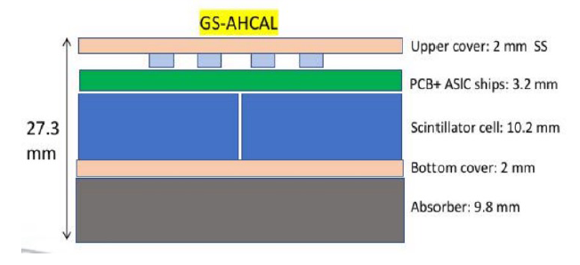
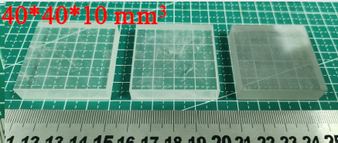
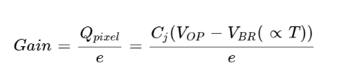
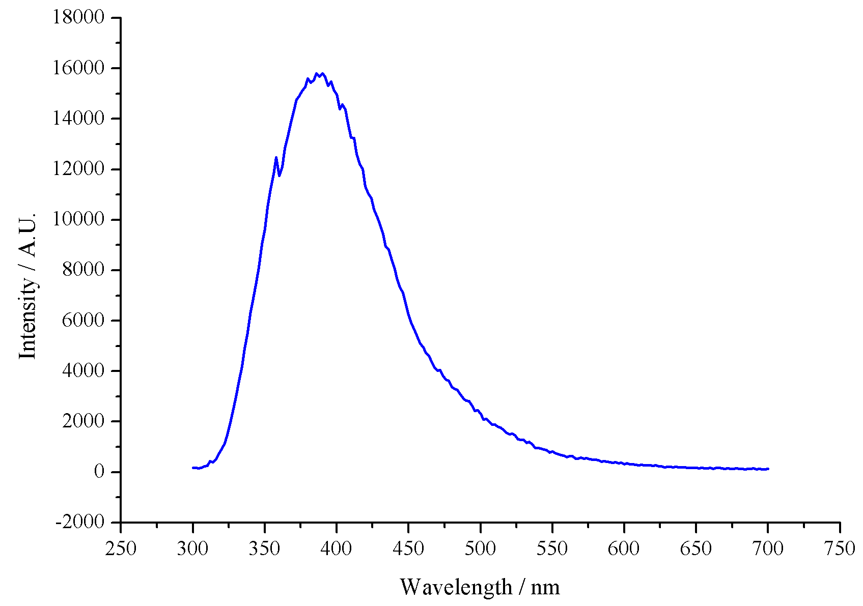


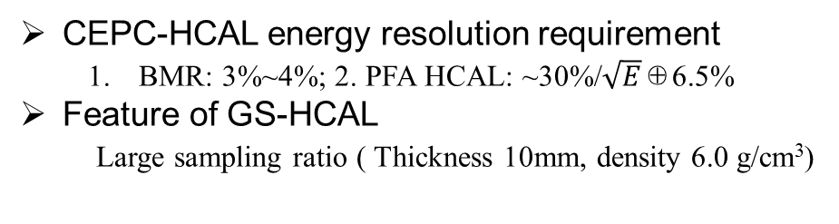
SiPM for GS-HCAL
GS characteristics
CEPC-HCAL energy resolution requirement
  BMR: 3%~4%; 2. PFA HCAL: ~30%/$\sqrt{E}$⊕6.5%
Feature of GS-HCAL
Large sampling ratio ( Thickness 10mm, density 6.0 g/cm³)
Parameters | Unit | BGO | PS | GS（GFO）
Density | g/cm³ | 7.13 | 1.03 | 6.0
Melting point | ℃ | 1050 | ~200 | 1250
Radiation Length, X₀ | cm | 1.12 |  | 1.59
Molière radius | cm | 2.23 |  | 2.49
Nuclear interaction length | cm | 22.7 | ~59.5 | 24.2
Z_{eff} | -- | 71.5 | ~5.7 | 56.6
dE/dX | MeV/cm | 8.99 | 2 | 8.0
Emission peak | nm | 480 | 425 | 400
Refractive Index | -- | 2.15 | 1.58 | 1.74
Light yield, LY | ph/MeV | 7500 | 10000 | 1500
Energy resolution, ER | %662keV | 9.5 |  | 23
Decay time | ns | 60, 300 | 0.9, 2.1 | 60, 500
Attenuation length | cm | 1.12 | 210 | >4.0
GS-HCAL unit structure
GS unit size: 40×40×10mm(H)
Layer thickness: 28mm,Total layers: 48
SiPM requirements
GS emission spectrum
Peak：400 nm
40×40×10mm results
High PDE@400nm(>=45%);
High gain(>= 5e5)
Low noise (<=150kHz/mm^2)
Low cost(<=10 RMB/pcs)
MIP response: ~8 MeV/cm
One 3×3 mm^2 SiPM
at surface center, 60~100 p.e/MIP

Slide 4

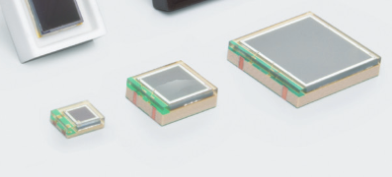
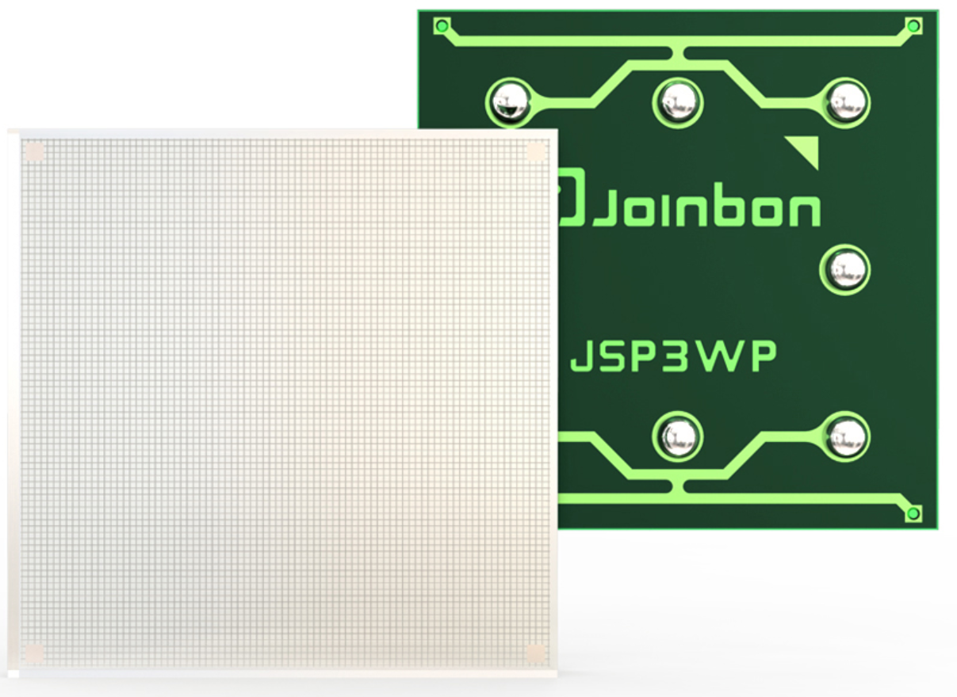
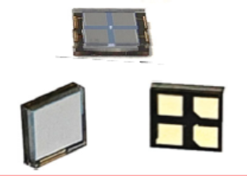
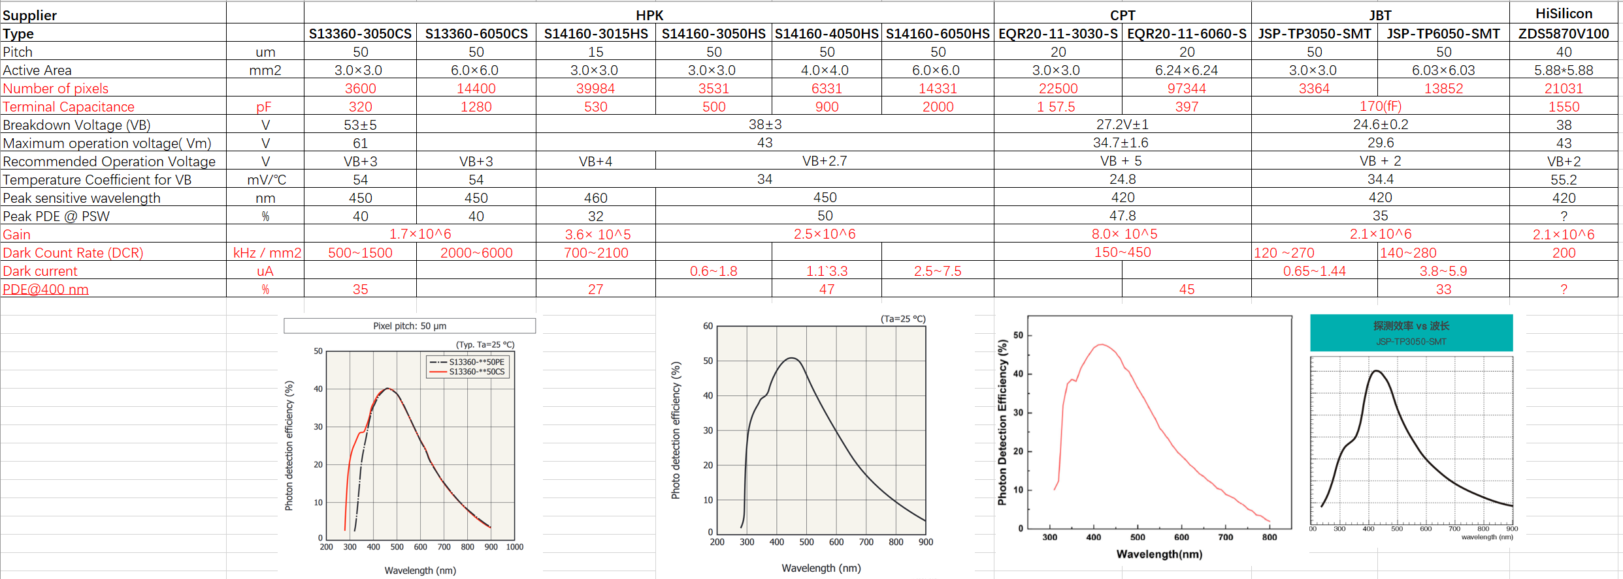
SiPM providers and commercial candidates
SiPM suppliers
HPK-S13360
HPK-S14160
JBT-JSP-TP3050-SMT
Hamamatsu(HPK,滨淞, for HEP)
Fondazione Bruno Kessler (FBK, for HEP)
ON Semiconductor Corp(OSM,安森美, acquisite Sensl, for HEP）
First Sensor (for HEP)
Capital Photonics Technology (Tianjin) Co., Ltd (CPT,中京光电,北师大, for HEP）
Joinbon Technology Co., Ltd.(Hubei) (JBT,湖北锐光科技有限公司, for HEP)
HiSilicon(HuaWei, 华为海思，for LiDAR)
Xilight Technology (XLT,芯辉科技, for LiDAR)
ADAPS photonics(adaps, 灵明光子， for LiDAR)
CPT-EQR20
SiPMs candidates for GS-HCAL
HPK S14160-3050HS/3015PS
CPT EQR20-3030
。。。

Slide 5
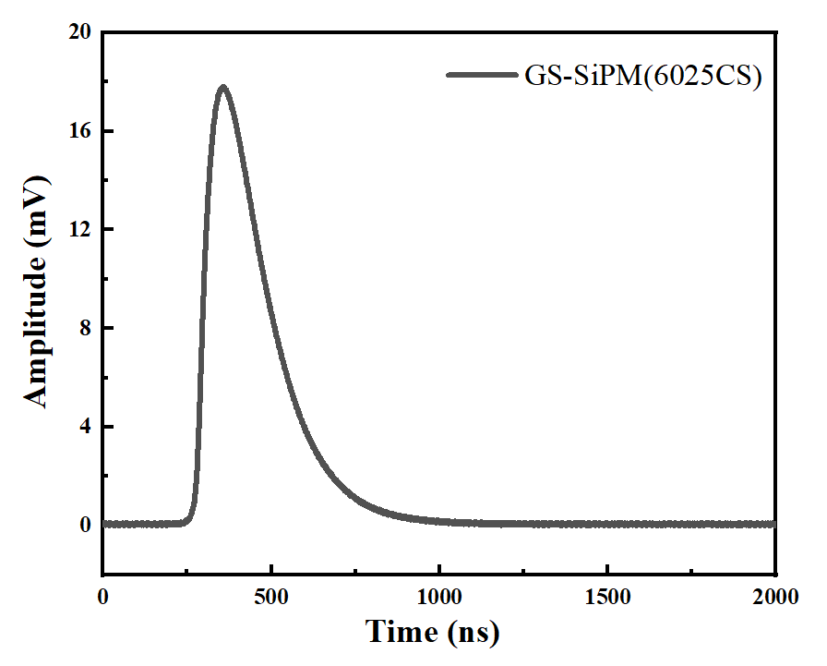
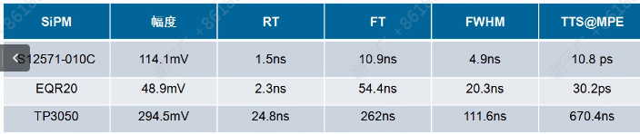
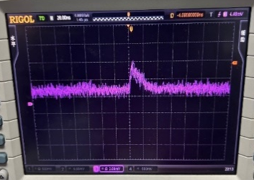
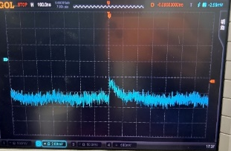
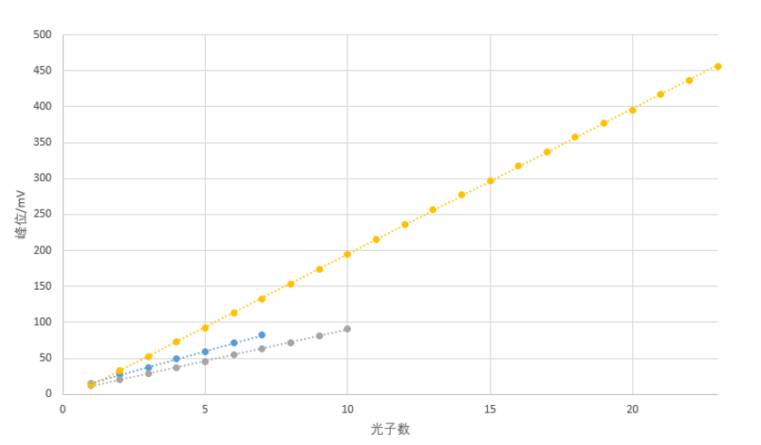
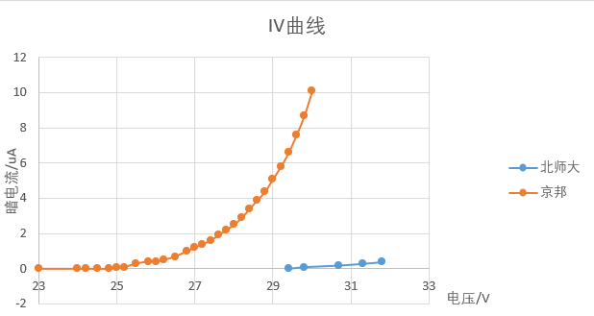
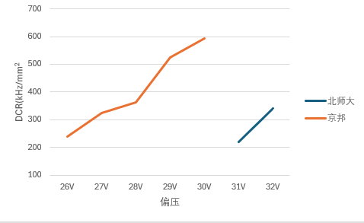
SiPM performance
Some test results earlier
SiPM signal comparison(IHEP)
GS+HPK S13360-6025CS（IHEP)
CPT
JBT
SiPM performance comparison (JiFeng Han, SCU)
Single photon linearity
DCR
IV curve
Yellow: JBT
Blue: CPT
Yellow: JBT
Blue: CPT
Yellow: HPK (40.7V)
Blue: JBT(27V)
Gray: CPT(32V)

Slide 6
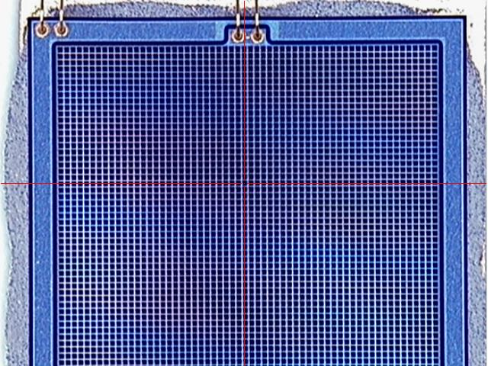
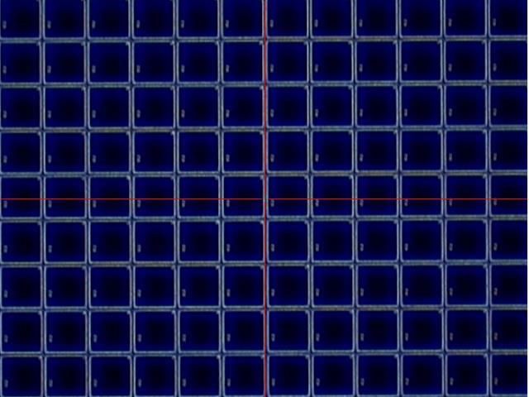
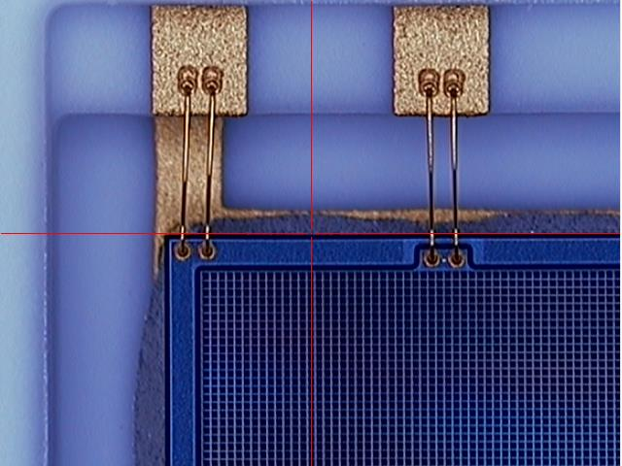
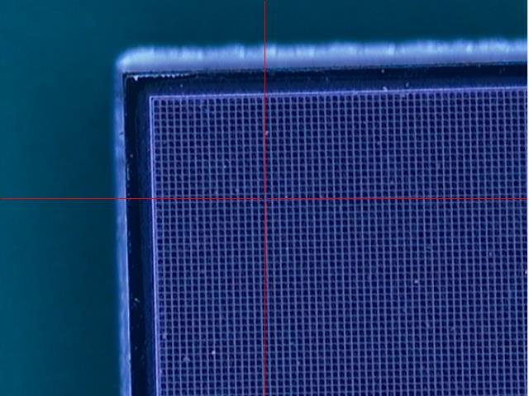
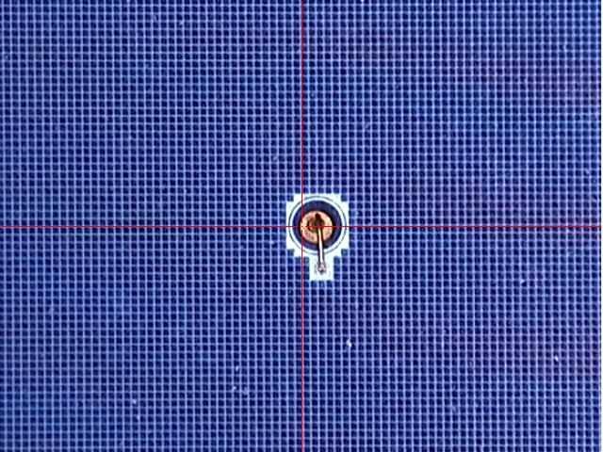
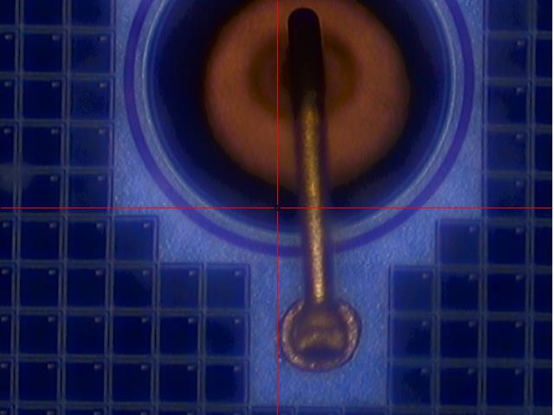
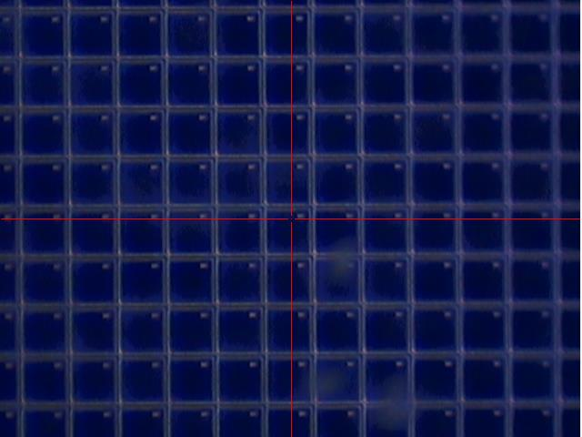
SiPM sensitivity area comparison
HPK33
HPK66

Slide 7
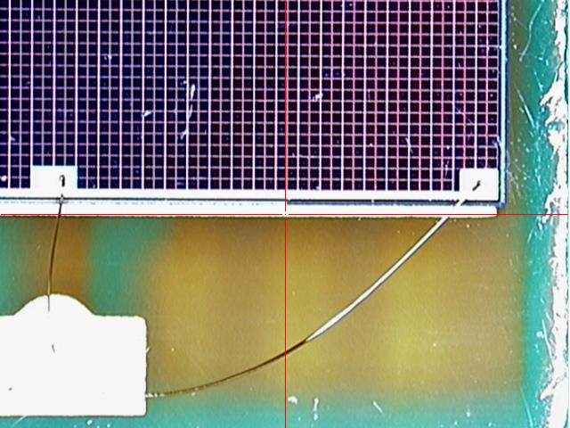
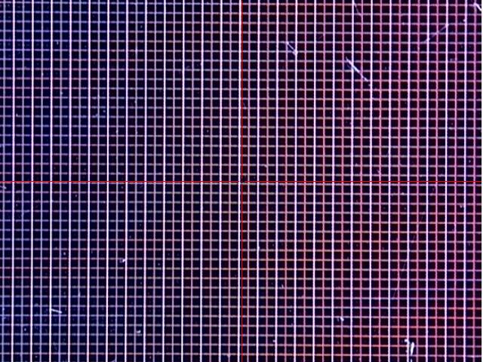
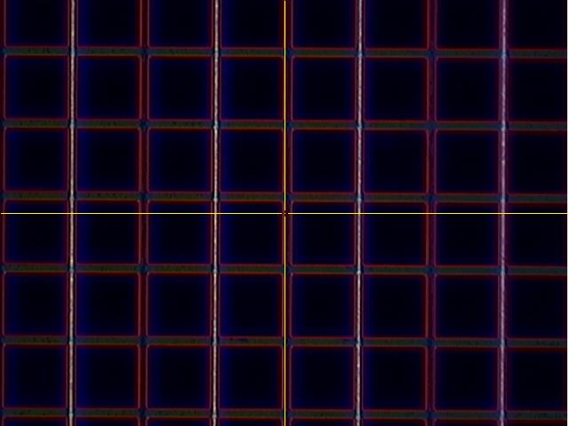
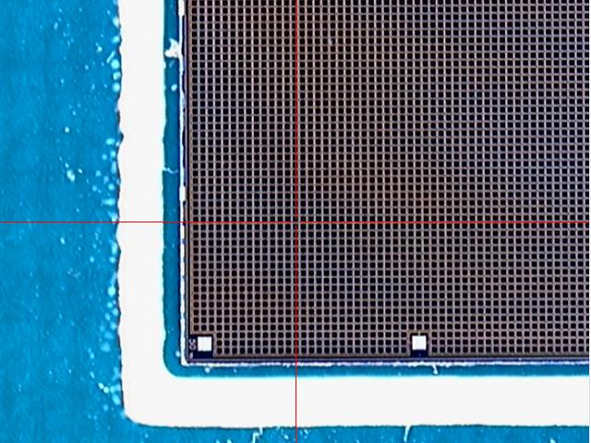
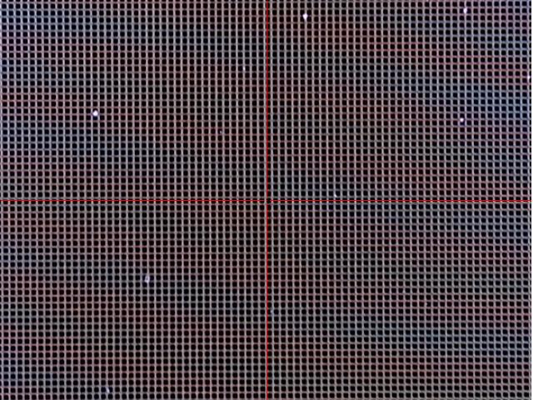
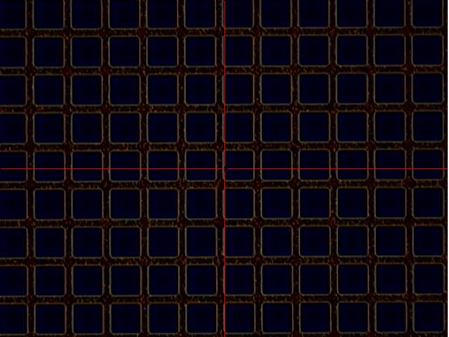
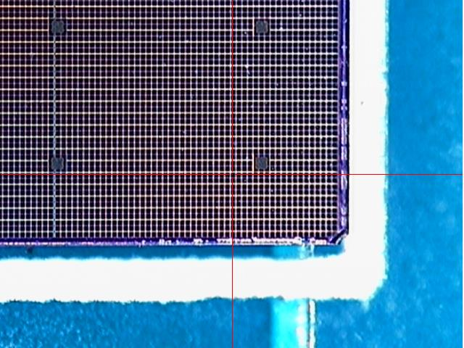
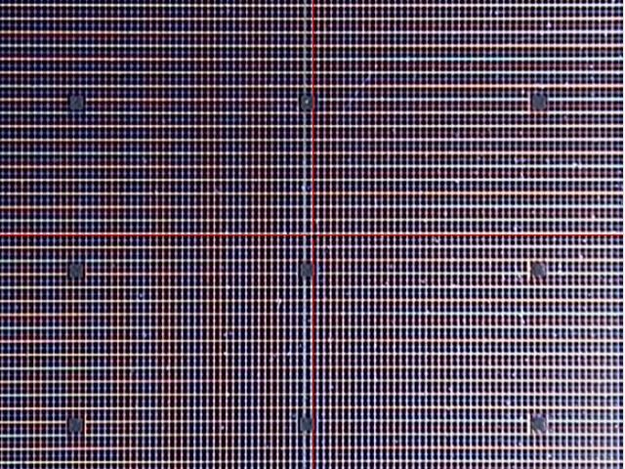
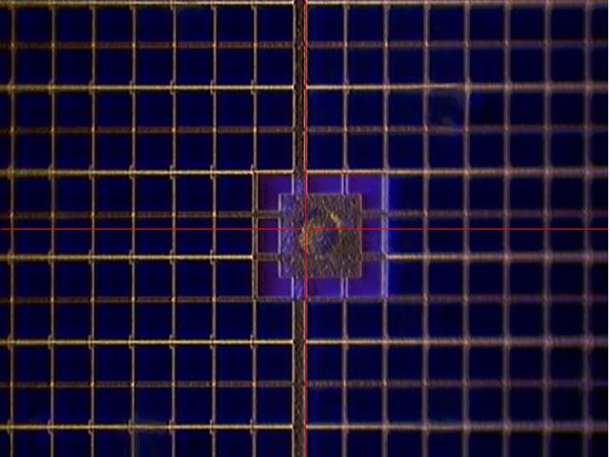
FBK66
Sensl33
Sensl66

Slide 8
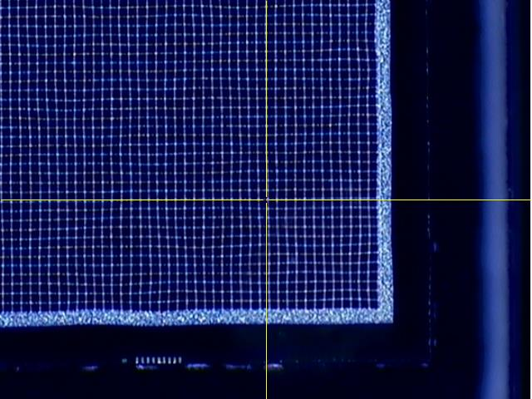
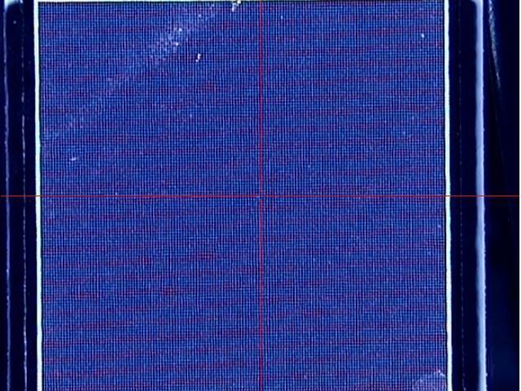
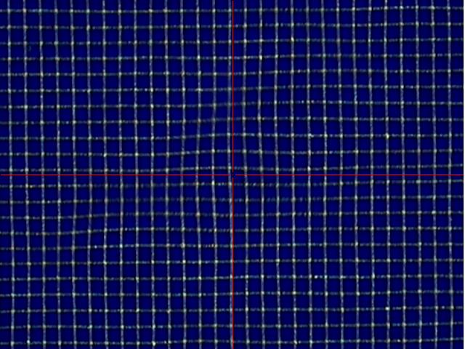
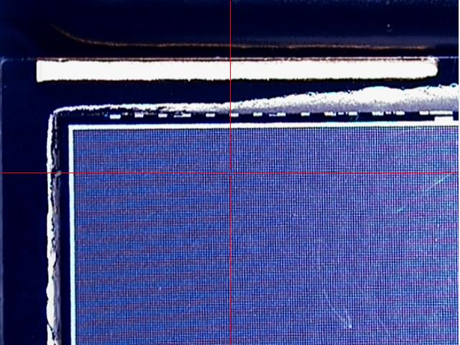
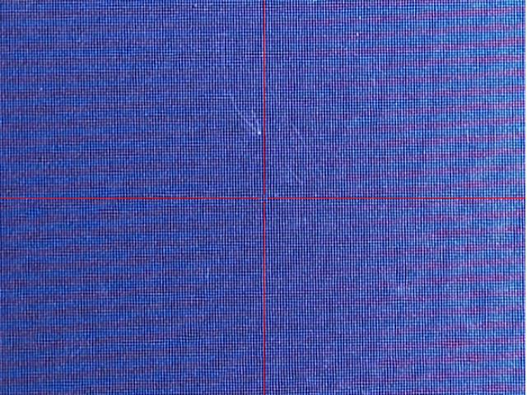
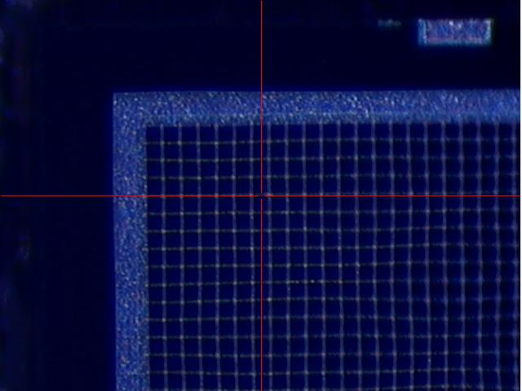
1. Difference among factories, also different cost.
2. Imported SiPMs have better precision and uniformity. It is helpful to reduce noise and improve gain uniformity.
NDL33
NDL66

Slide 9
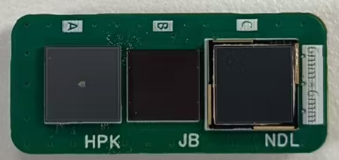
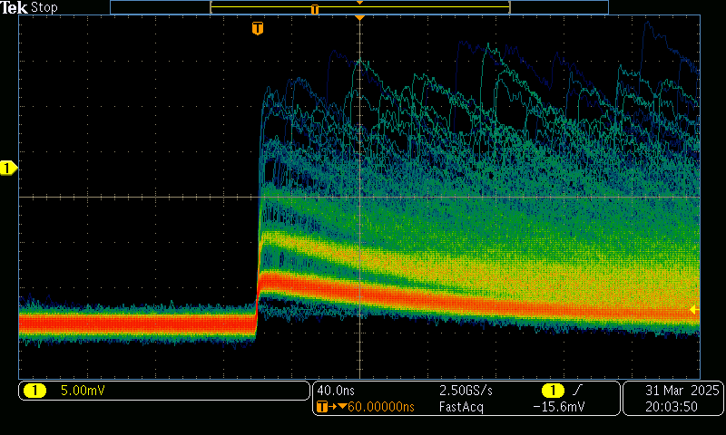
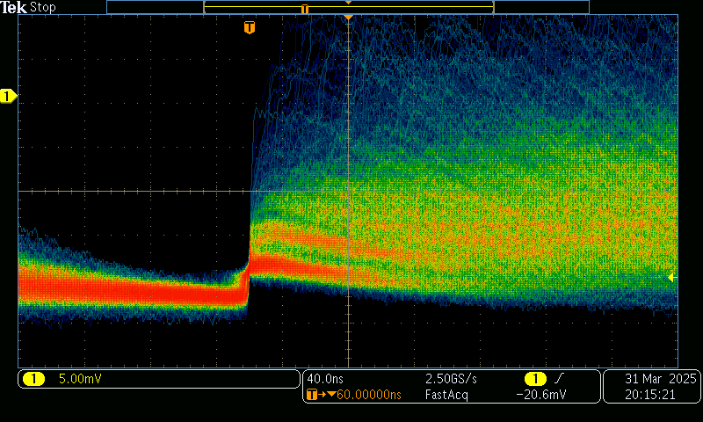
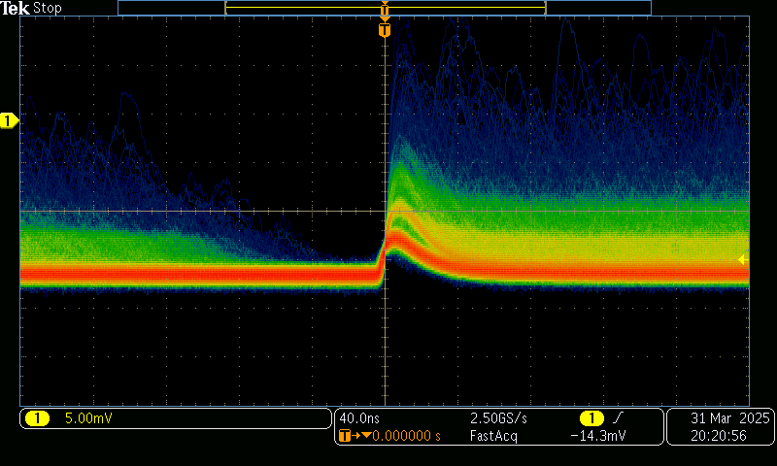
Some test results with customized single channel PreAmplifier
SiPM Signal（6mm×6mm）
S14160-6050（HPK）
JSP-TP6050-SMT (JBT)
EQR20-11-6060

Slide 10
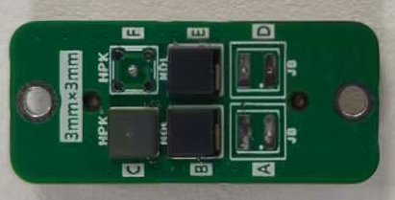
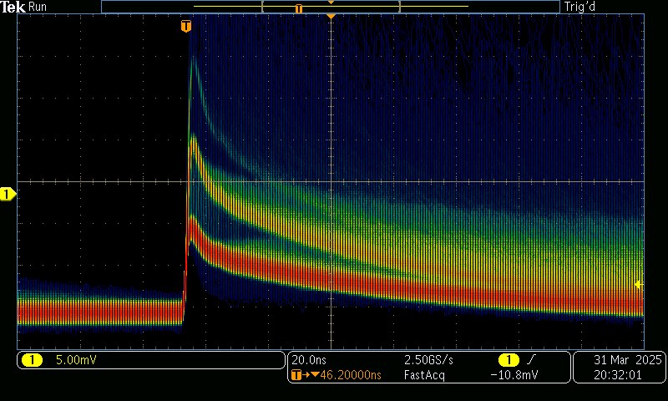
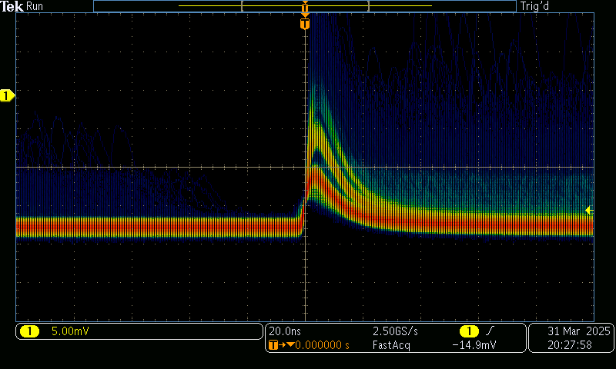
SiPM Signal（3mm×3mm）
S14160-3050 (HPK)
EQR20-11-3030 （NDL）

Slide 11
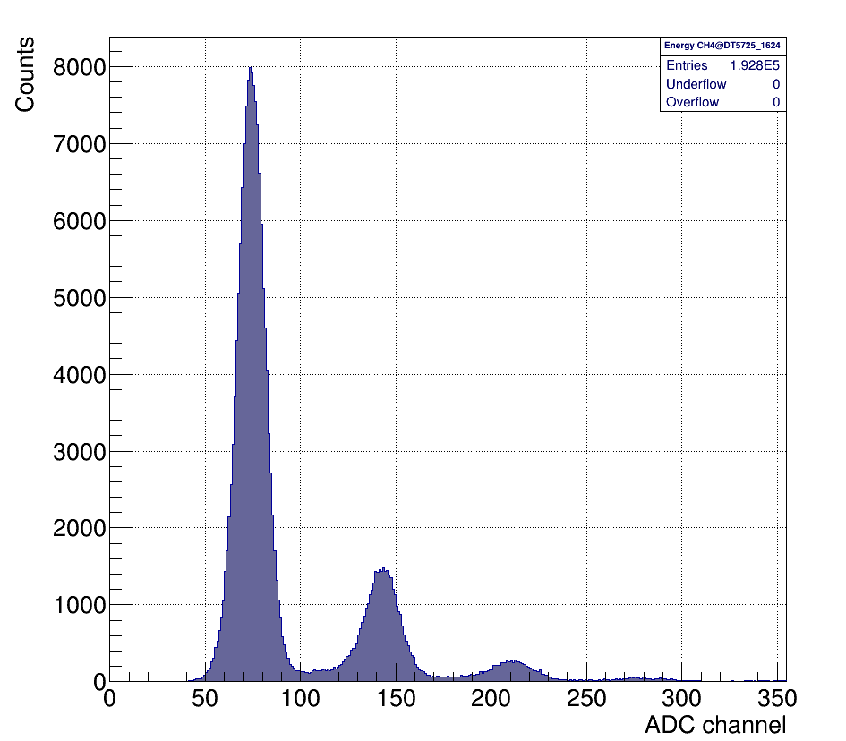
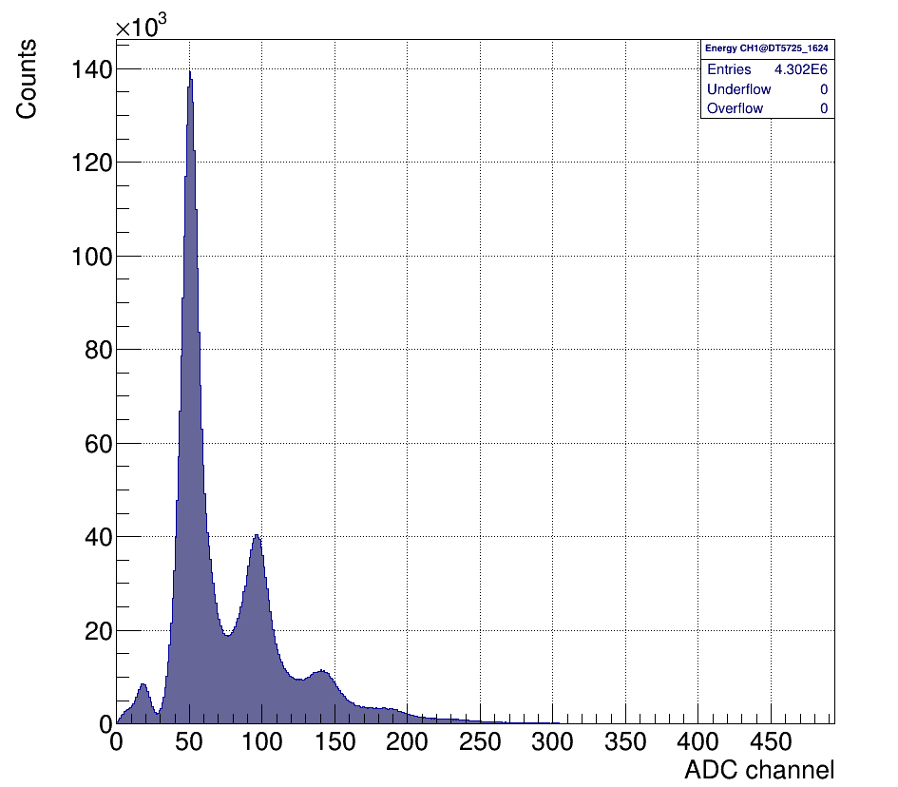
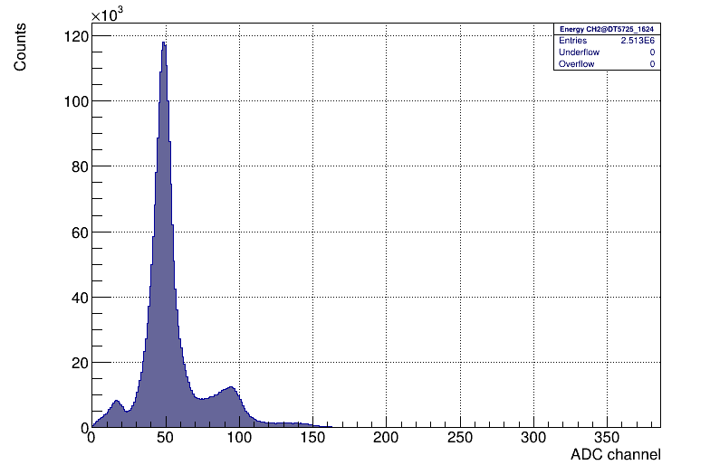
Spectrum of dark noise
EQR20-11-3030
EQR20-11-6060
S14160-6050

Slide 12
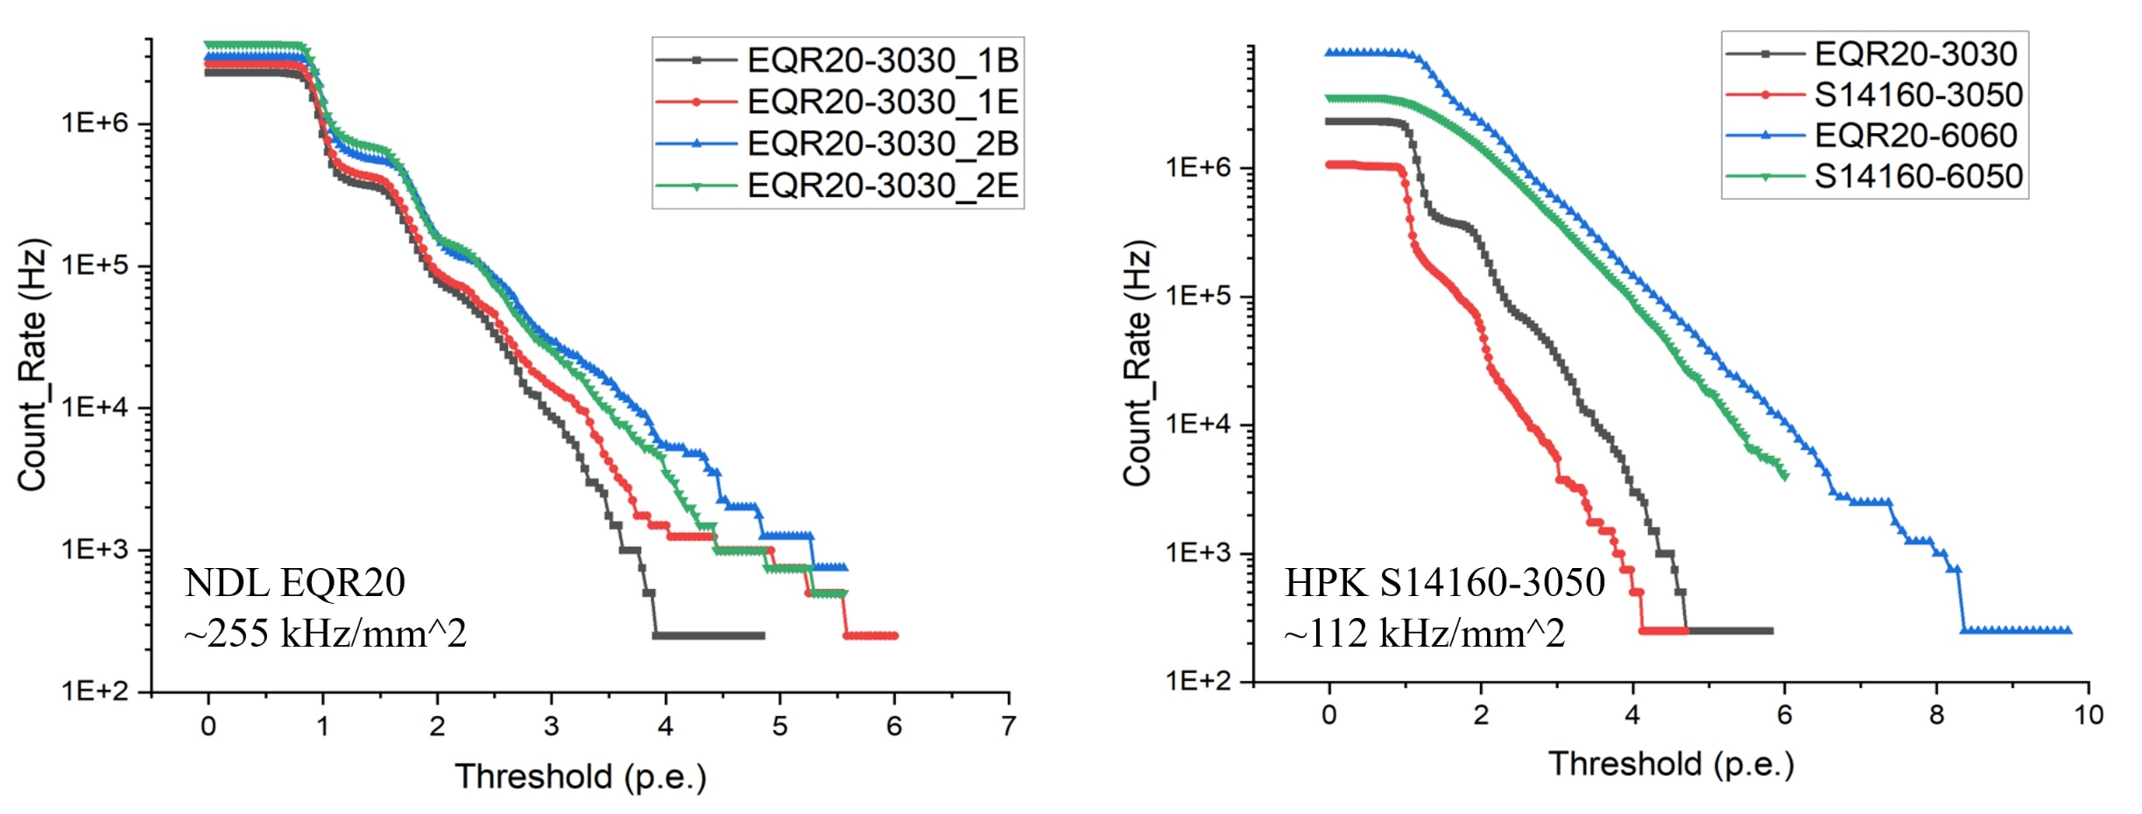
DCR

Slide 13
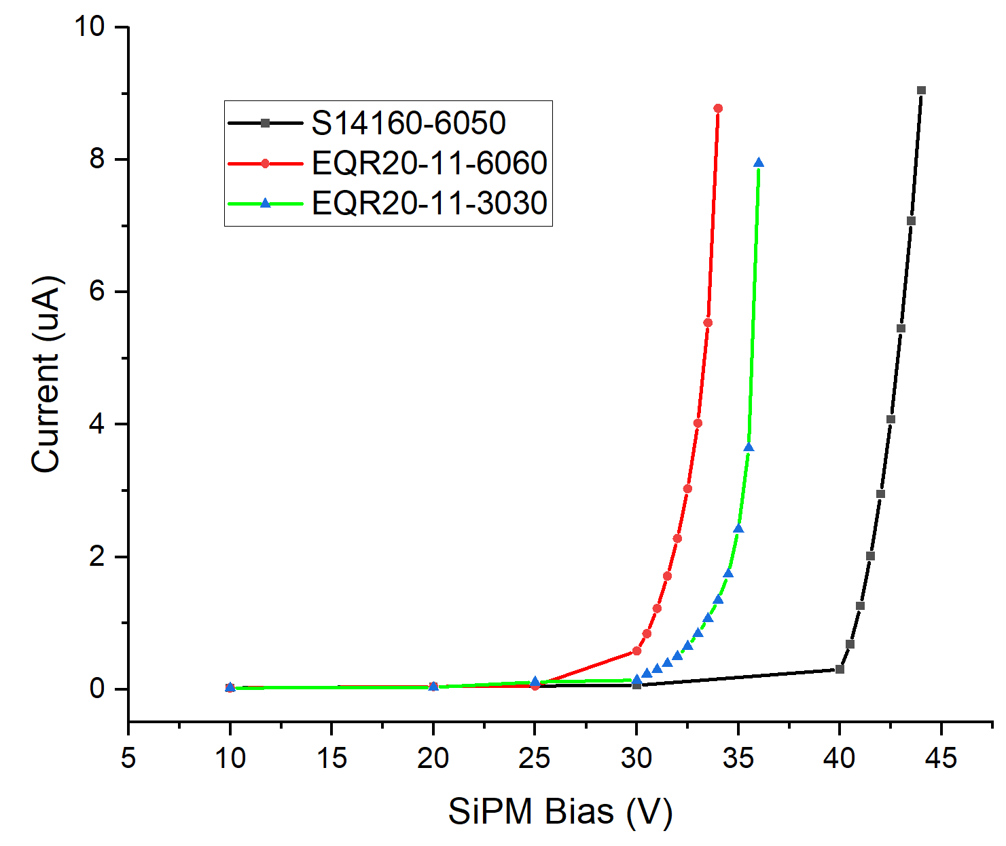

I-V

Slide 14

SiPM radiation resistance
 | NDL EQR20- 3030D-S | HPK S14160-3050HS | HPK S14160-6050HS | NDL EQR20- 6060D-S | JB JSP-TP6050
Active Area / mm² | 3.00 * 3.00 | 3.00 * 3.00 | 6.00 * 6.00 | 6.24 * 6.24 | 6.00 * 6.00
Pixel Pitch /um | 20 | 50 | 50 | 20 | 50
Microcells | 22500 | 3531 | 14331 | 97344 | 13852
Typical Breakdown Voltage / V | 27.2 | 38 | 38 | 27.2 | 24.6
PDE @ Typical Operate Voltage | 47.8% @ 420nm | 50% @ 450nm | 50% @ 450nm | 47.8% @ 420nm | 35% @ 420nm
Gain | 8.0E5 | 2.5E6 | 2.5E6 | 8.0E5 | 2.1E6
Temperature Coefficient /mV/℃ | 24.8 | 34 | 34 | 24.8 | 34.4
Terminal Capacitance /pF | 57.5 | 500 | 2000 | 397 | 2355
Dark Current/μA | 1.5 | 1.1 | 5.5 | 10.2 | 12.5

Slide 15


 | ΔDCR/DCR | ΔI_{d}/I_{d}
NDL EQR20-3030D-S | 1.49 | 0.39
HPK S14160-3050HS | 2.89 | 1.15
@ After 116 Gy
DCR_after-DCR_before/DCR_before; I_after-I_before/I_before;

Slide 16


Slide 17




KEK electron beam(5GeV) test
5GeV, 1.6 kHz
About 150 p.e/MIP
5 GeV e response at different thickness GS unit
Single 3*3mm^2 SiPM+GS unit
ECAL
GS Test
Beam
10*40*3 mm³ PS trigger
GS+SiPM
40*40*3 mm³ PS trigger

Slide 18
GS | Reflector | MIP Response (p.e./MIP)
 |  | HPK 3050HS | HPK 6050HS | NDL 3030 | NDL 6060 | NDL 3030 with new FEE
BGRI-146 | Teflon | 127.0±0.9 | 408.6±2.7 | 163.4±3.2 | 385.3±5.0 | 104.1±1.0
 | Tyvek | 88.4±1.2 | 426.7±2.9 | 120.3±1.1 | 418.8±8.9 | 95.0±0.6
BGRI-147 | TiO₂ | 84.5±0.4 | 417.0±4.6 | 167.4±2.3 | 361.6±9.2 | 106.8±1.6
BGRI-E6 | Teflon | 14.7±1.0 | 153.1±1.4 | 17.2±0.3 | 151.4±1.8 | /
The MIP response of GFO glass coupled with 3*3 mm² SiPM is around 84.5~127(HPK) and 120~167(NDL) p.e./MIP.
Teflon, Tyvek, and TiO₂ coatings are close within 33.4%(HPK3*3), 28.14%(NDL3*3), 4.24%(HPK6*6), 13.66%(NDL6*6)
TiO₂ coating can be applied as a reflective layer for the glass in GSHCAL.

Slide 19











HCAL miniPrototype CERN SPS hadron beamtest
Tow 7-Layer modules, 3*3 GS+SiPM units per layer.
Pi, Mu @ 180 GeV, scan 5/20//50/100/120/150/180 GeV, change +16° and -11° angle.
~110 p.e./MIP for Pi.
Both HPK and CPT SiPMs worked well.
Normal incidence μ
Oblique incidence π
π response at different thickness GS unit
Mu deposited energy

Slide 20
Outlook
For the future, two development directions:
Low cost high performance SiPM; Self-develop or cooperate with suppliers
Low noise high gain front-end electronics development (high channel density, low power consumption ASIC).
Item | Requirement/Goal | Remark(Ref)
Size (mm) | 3*3/6*6 | 4*4 also optional
Encapsulation | SMD
Pixel (um) | 25 ?40? (>20um) | Must to balance DCR
PDE@400nm （%） | >= 50% (60%@420nm?) | now 45%
Gain | >= 5e5 | now 8e5
Dynamic range: | 10~10000 P.E | Depends on pixel size
Dark counting rate(DCR, kHz/mm^2） | <100 | now 150
Terminal capacitance(pF） | <=100 | now 57.5
Temperature coefficient(mV/℃) | <25 | now 24.8
Cost for mass production(RMB/pcs) | <=10 | Now ~20

Slide 21
Technical consideration
Pixel (um) | 20/25/30um, DR: 10~10000 P.E, (22500 for 20um) ,
PDE@400nm （%） | Increasing depletion layer?
Dark counting rate(DCR） | Add guarding ring like HPK?
Optimize encapsulation | Small rim acceptable(<=1mm per side), reduce cost
Version update | Modification and update based on current product , if have
New design | Aiming at CEPC HCAL requirement, maybe expensive and long lead time

