Slide 1

Radiation hard SiPM development for CEPC calorimeter
Zhijun Liang
IHEP,CAS
Notes:
重点报告内容：（1）未来5年拟开展的研究工作，包括主要研究方向、关键科学问题与研究内容；（2）研究方案，包括骨干成员之间的分工及合作方式、学科交叉融合研究计划、年度工作计划与目标等；（3）五年预期目标和可能取得的重大突破等。

Slide 2
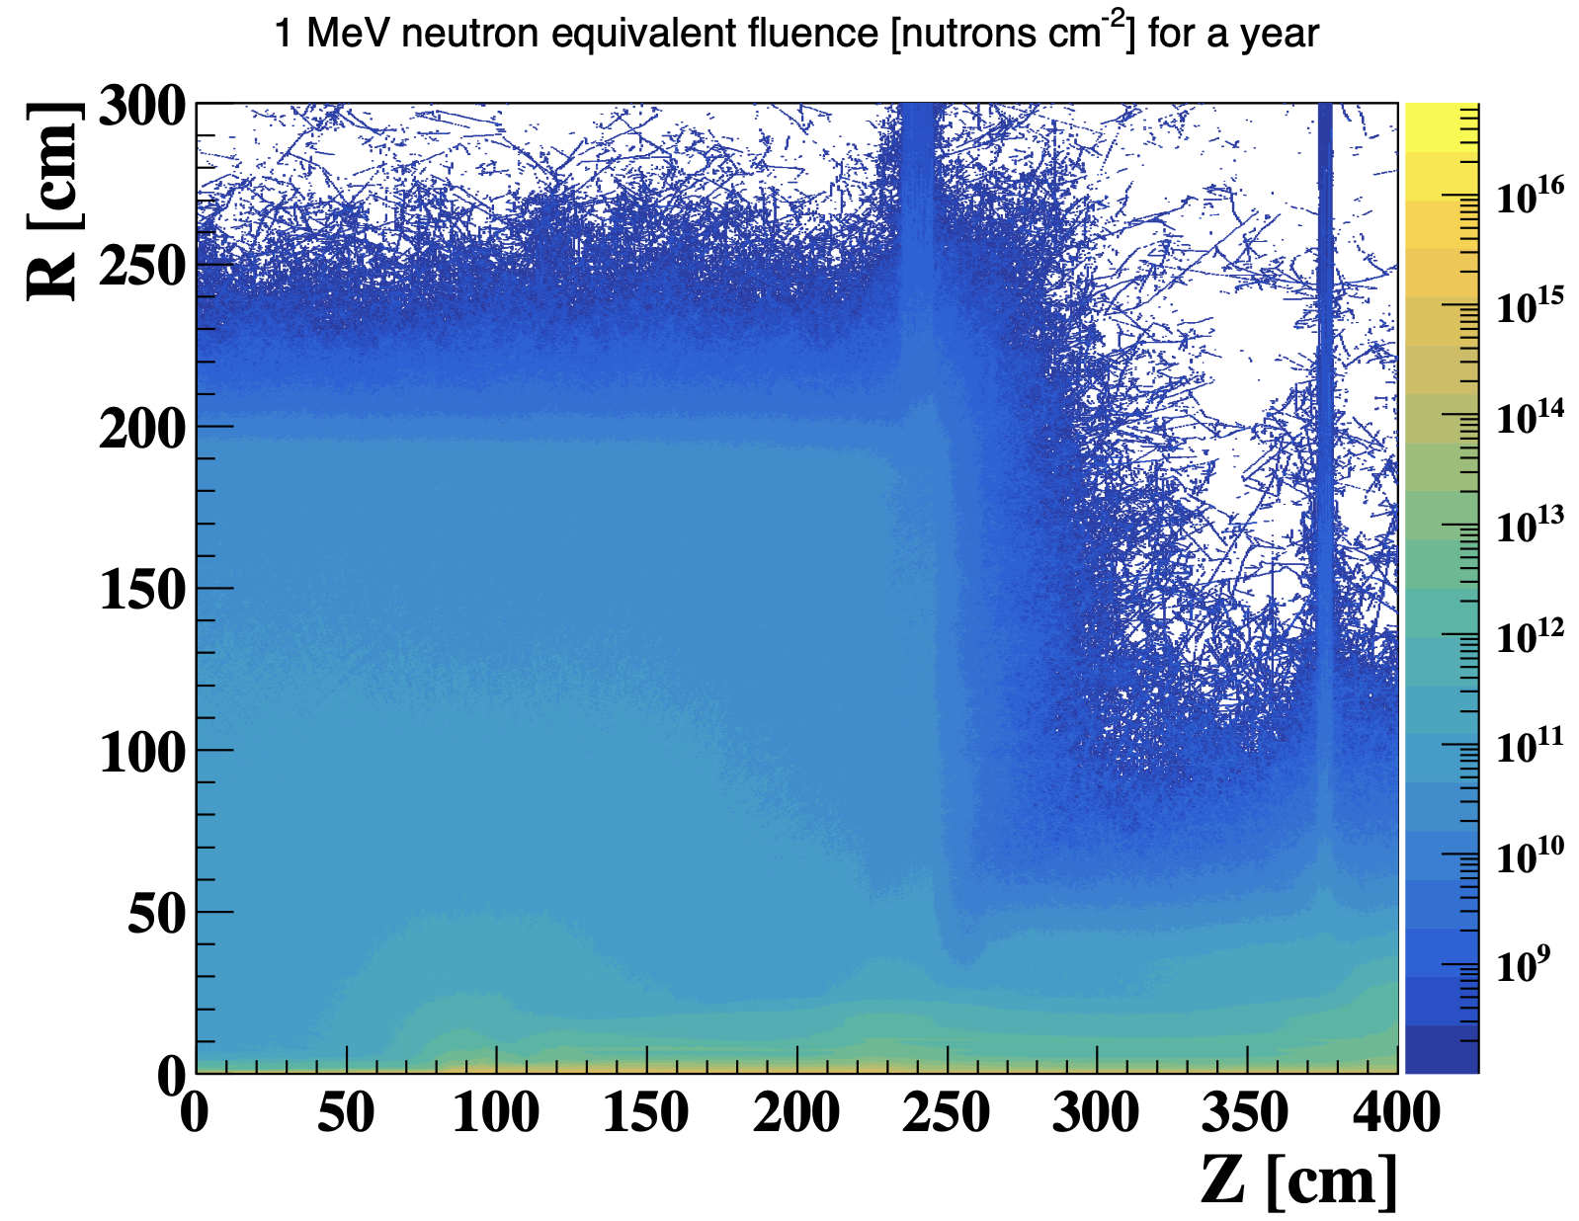
SiPM radiation hardness challenge
CEPC fluence : 100krad and 10¹¹ n_{eq}/cm² per year for calorimeter endcap
  From Haoyu: Higgs runs result without Synchrotron radiation
Fluence in ZH run（240GeV）
 | Space station application | CEPC requirement ZH run 10 years operation
TID does | 100 krad | >1 Mrad
Fluence | ~10¹⁰ n_{eq}/cm² | >10¹² n_{eq}/cm² (Endcap @ ZH runs )

Slide 3
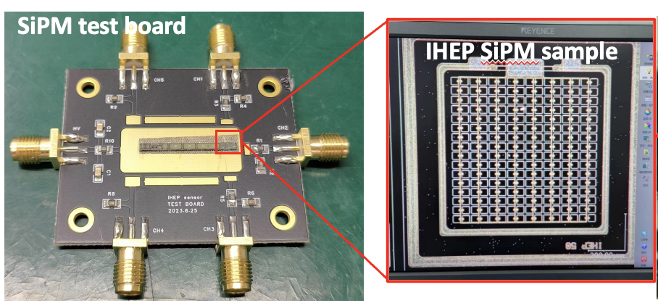
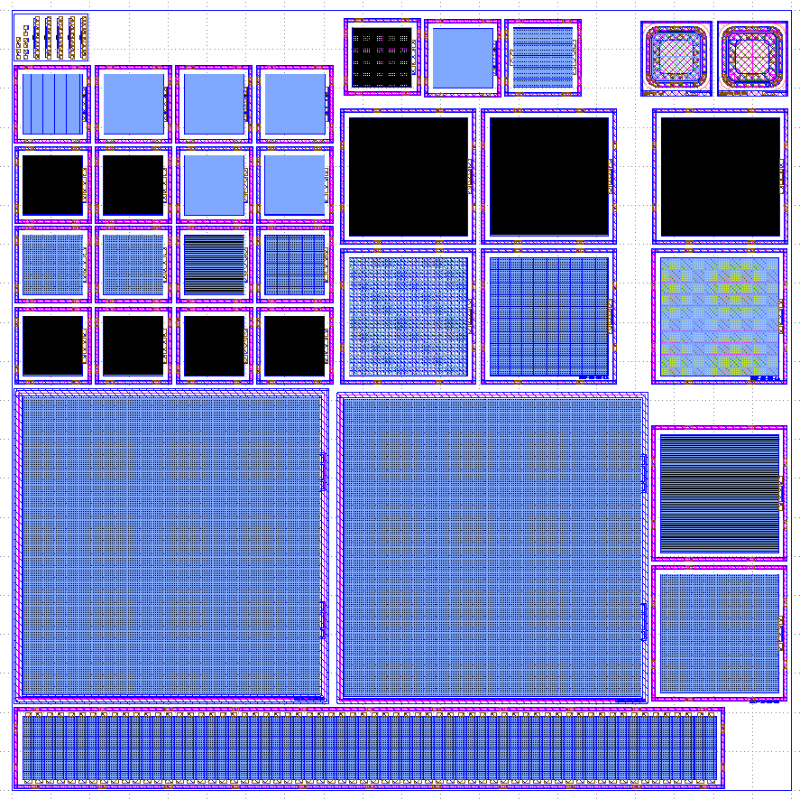
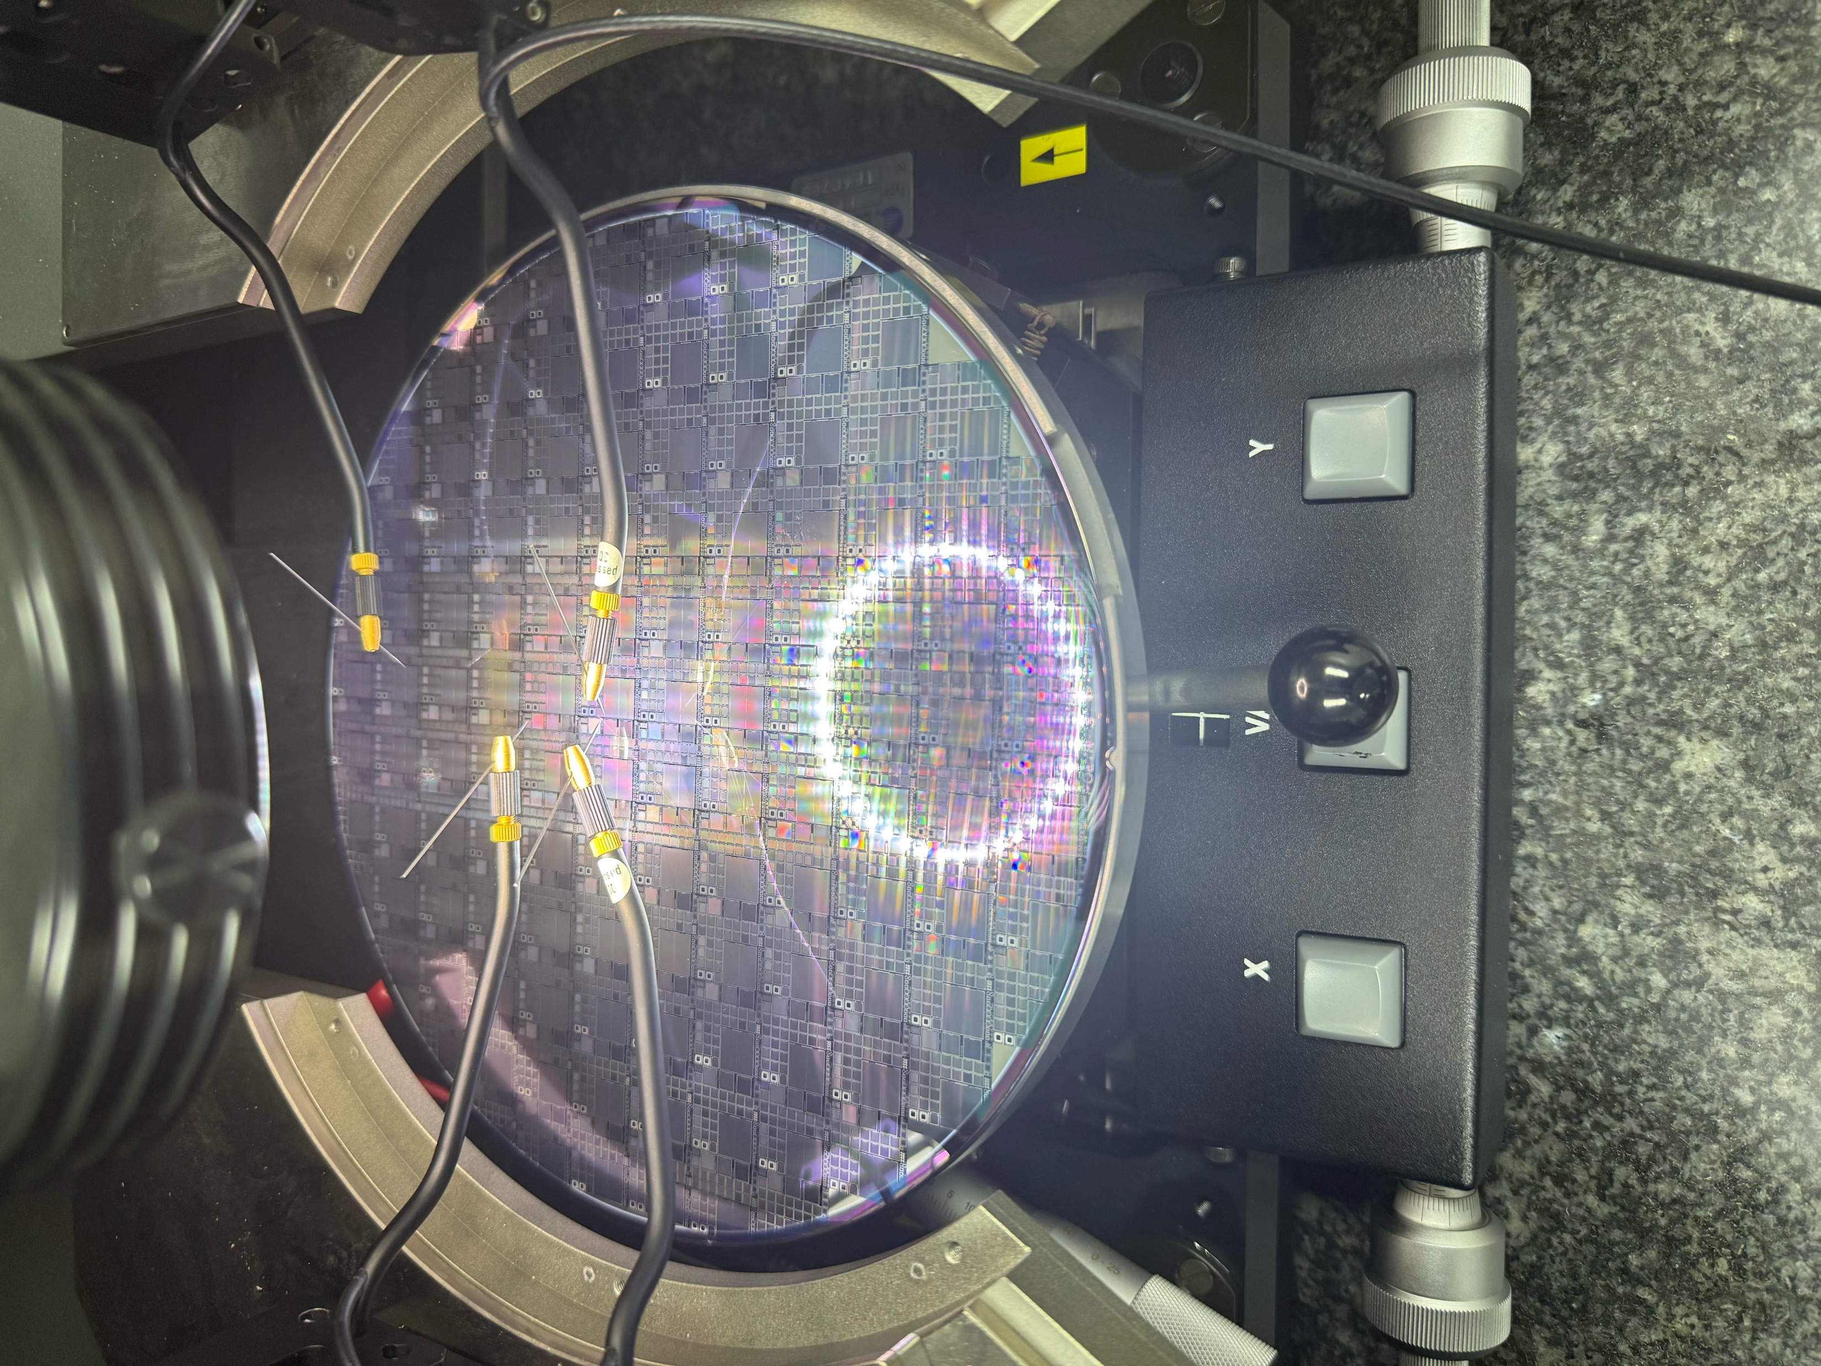
Recap of radiation hard SiPM development
Two prototypes of radiation hard SiPM developed by IHEP team.
2nd prototype with engineering run, trial run 2025, to be done in middle 2026
  Various SiPM size: 1*1mm, 3*3mm, 5*5mm
  Various Pixel size: 10um ,20um, 50um
2nd prototype, trial run
1st MPW prototype
Designer: MengZhao Li, Mei Zhao

Slide 4
Recap from last CEPC days
Summary last CEPC days discussion
  Support the design development for radiation hard SiPM
    Make sure SiPM to survive for fluence 10¹³ n_{eq}/cm²，aim for 10¹⁵ n_{eq}/cm²
    Cross talk for ECAL should aim for smaller than 3%
    Aim for low cost (~10 RMB/piece) in production

Slide 5
CEPC ECAL and HCAL: SiPM requirement
  ECAL : Small pixel size (6um*6um), large dynamic range, small cross-talk (< 3%)
  HCAL: High PDE Sipm (PDE>60-70%), need to have small pixel （20μm）?
  Cherenkov: high PDE，good to be sensitive for UV light (300-400nm) ?
 | SiPM for ECAL | SiPM for HCAL/muon | SiPM for Cherenkov
Wavelength | 350 – 600 nm | 350 – 600 nm | 100 nm – 600 nm
Size | 3 mm× 3mm | 3 mm× 3mm | 3 mm× 3mm (position sensitive) Or 1mm× 3mm (conventional)
Pixel size | 6 μm × 6 μm | 50 μm × 50 μm Or 20μm × 20 μm ? | 50 μm × 50 μm ?
Cross talk | < 3%
PDE | >= 30% (at 420-480nm) | >= 60% (at ~400nm) | 50% at 420nm Sensitive for 300-400nm?
Number of SiPM | ~1 Million | ~5 Million | ~0.2 Million

Slide 6
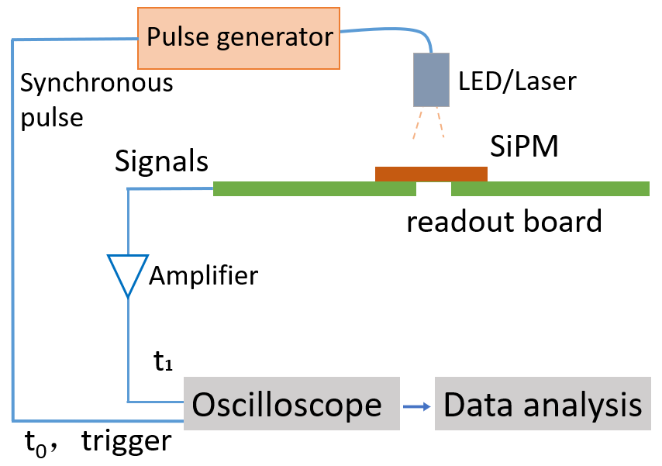
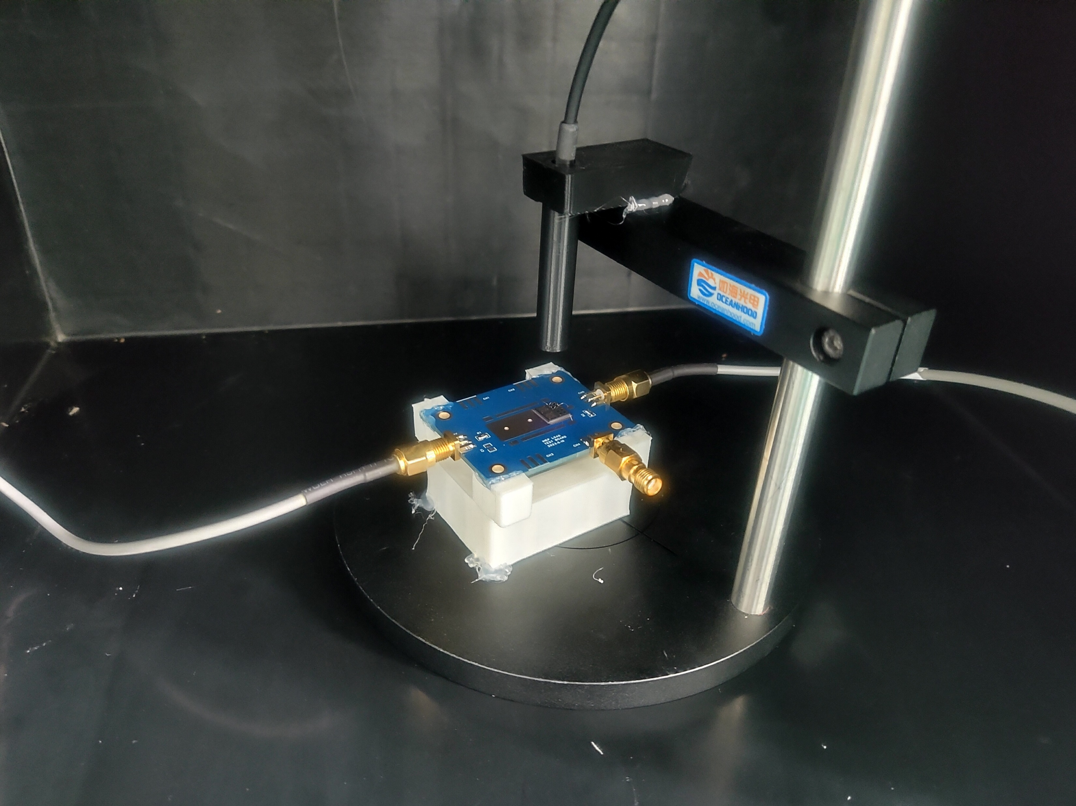
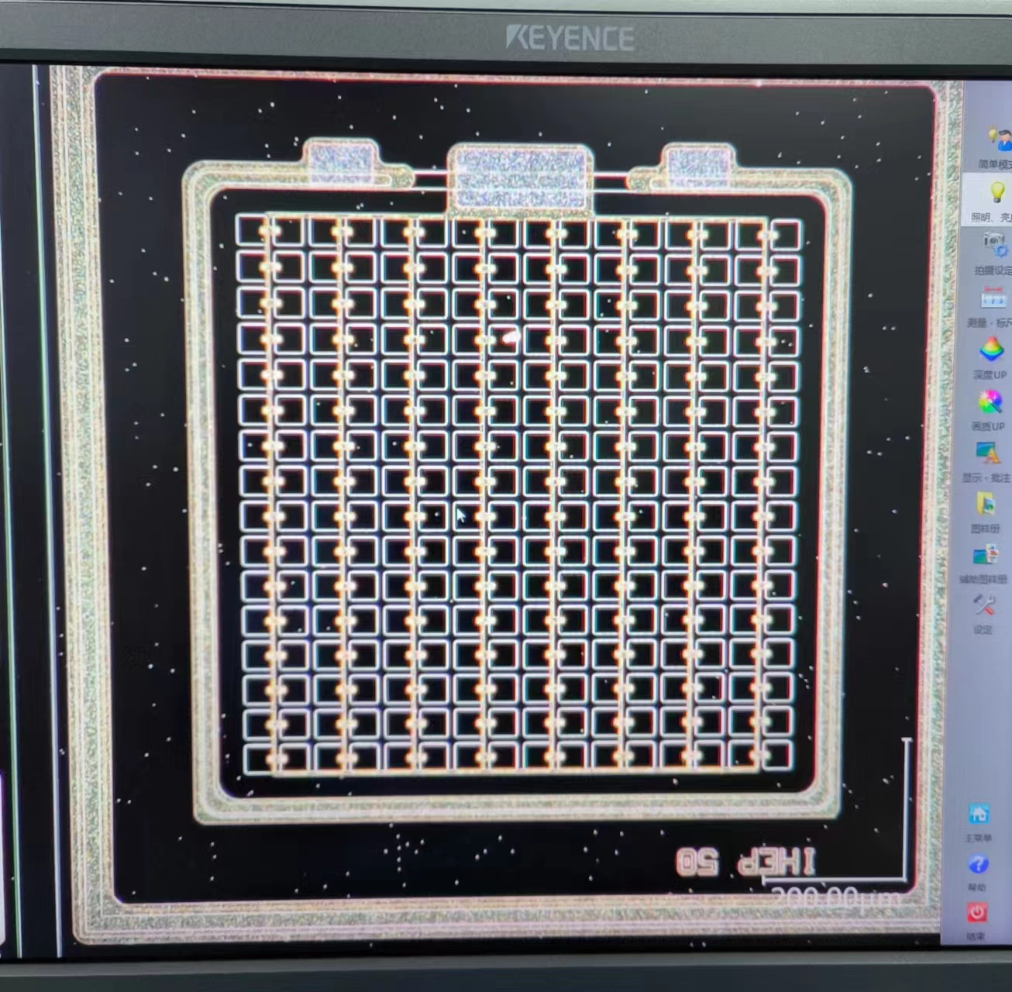
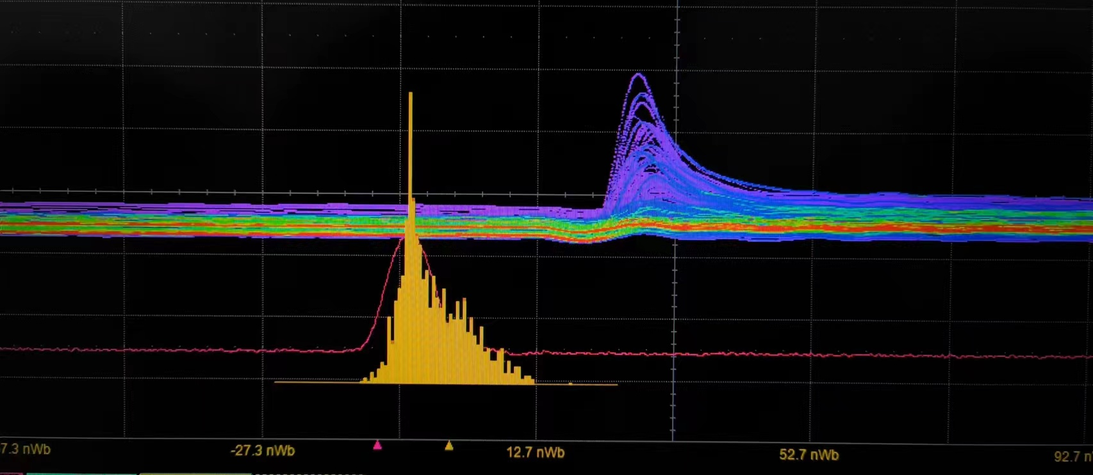
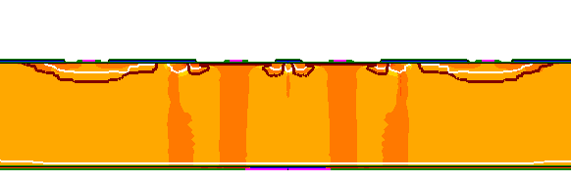
      Plan for 1st engineering run: Guard ring optimization
SiPM test system
Typical SiPM signal
Found a bug in design
SiPM读出板
SiPM Leakage current is a bit high in 1st trial run
Pstop and GR design has some issue
Optimized the design for engineering runs
SiPM layout and process has been validated

Slide 7
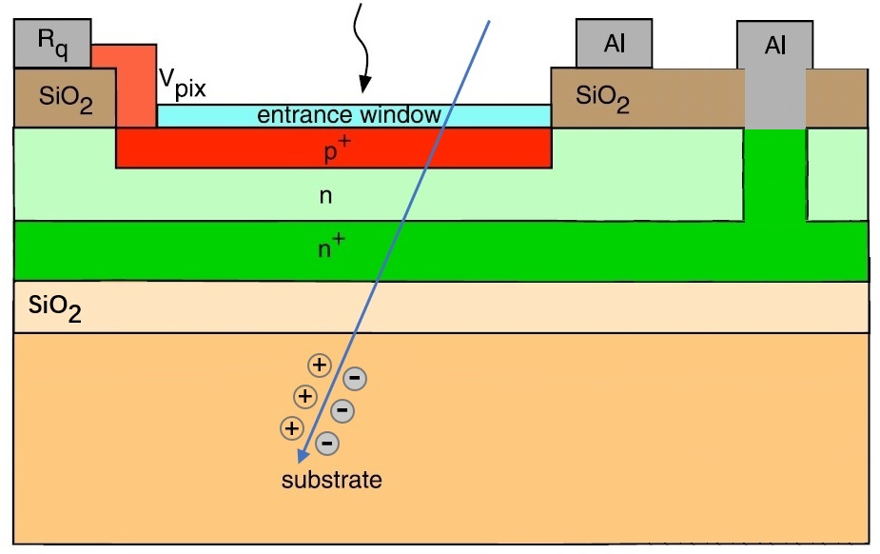
Plan for 1st run: SiPM dark count after irradiation
Bulk damage after irradiation → dark count increased
Potential Solution:
  Design a special wafer to isolate the dark current from bulk damage
  Isolate the bulk damage from the device
Special wafer

Slide 8
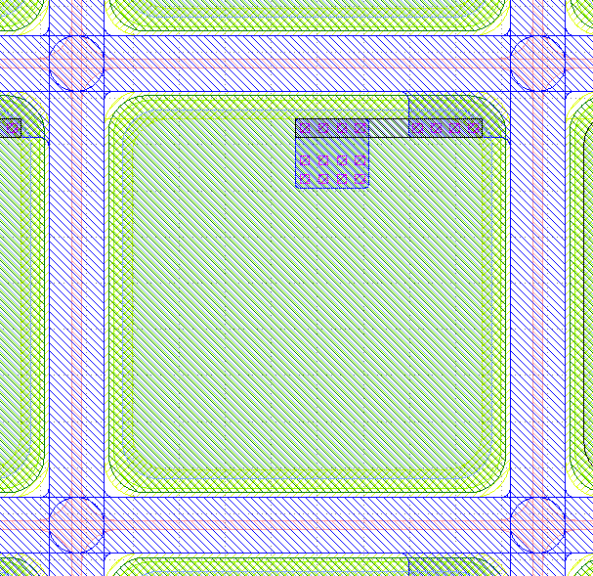
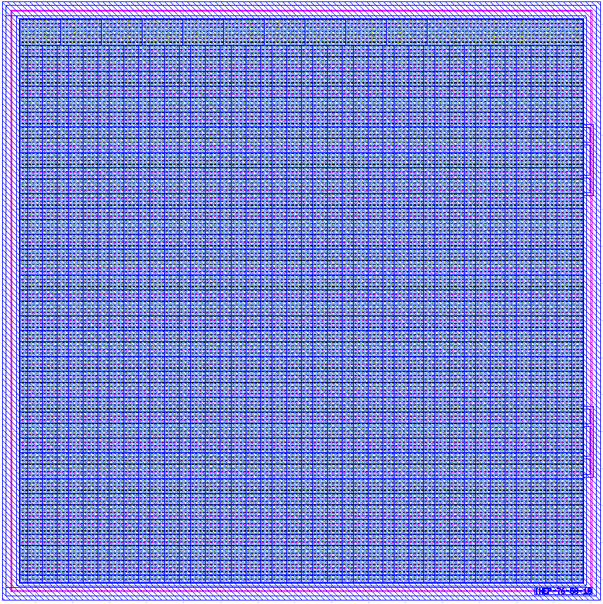
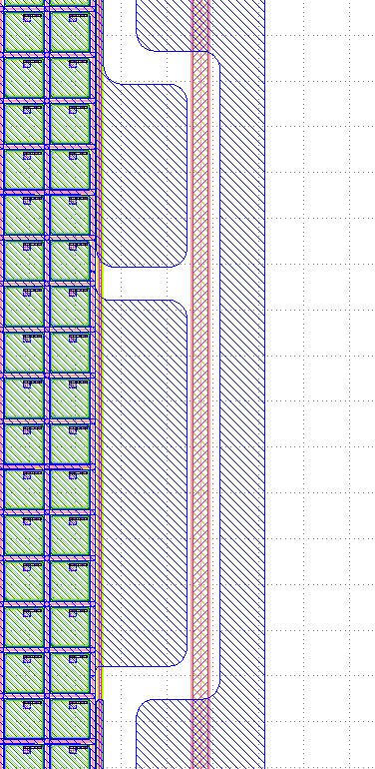
Plan for 2nd engineering run
Try to increase dynamic range for ECAL
  Try Small pixel size (6μm) for EM calorimeter
  Try different isolation and packaging to improve cross talk
Try to improve PDE for HCAL
  different quenching resistance design or bulk resistor
Pixel size 50um
Quenching resistance 200KΩ
anode
GR
IHEP SiPM layout
cathode
SiPM for LACT：
7.6 mm X 7.6 mm
152 x 152 pixels
Pixel size： 50um
Fill factor 64%
Designer for 1st engineering run:
MengZhao Li, Mei Zhao

Slide 9
Time line SiPM development
2026 :SiPM irradiation hard design engineering run
  1st full engineering run ready in June:
    Two type of radiation hard Sipm
      Normal wafers and Special wafers with bulk damage isolation.
2027: 2nd engineering run
  More dedicated optimization for CEPC
  Try small pixel size (6μm) for EM calorimeter
  Try to improve PDE for HCAL
2028: 3rd engineering run
  Improve the yield, uniformity, improve packaging
  Exercise the QA/QC

Slide 10
Backup

Slide 11
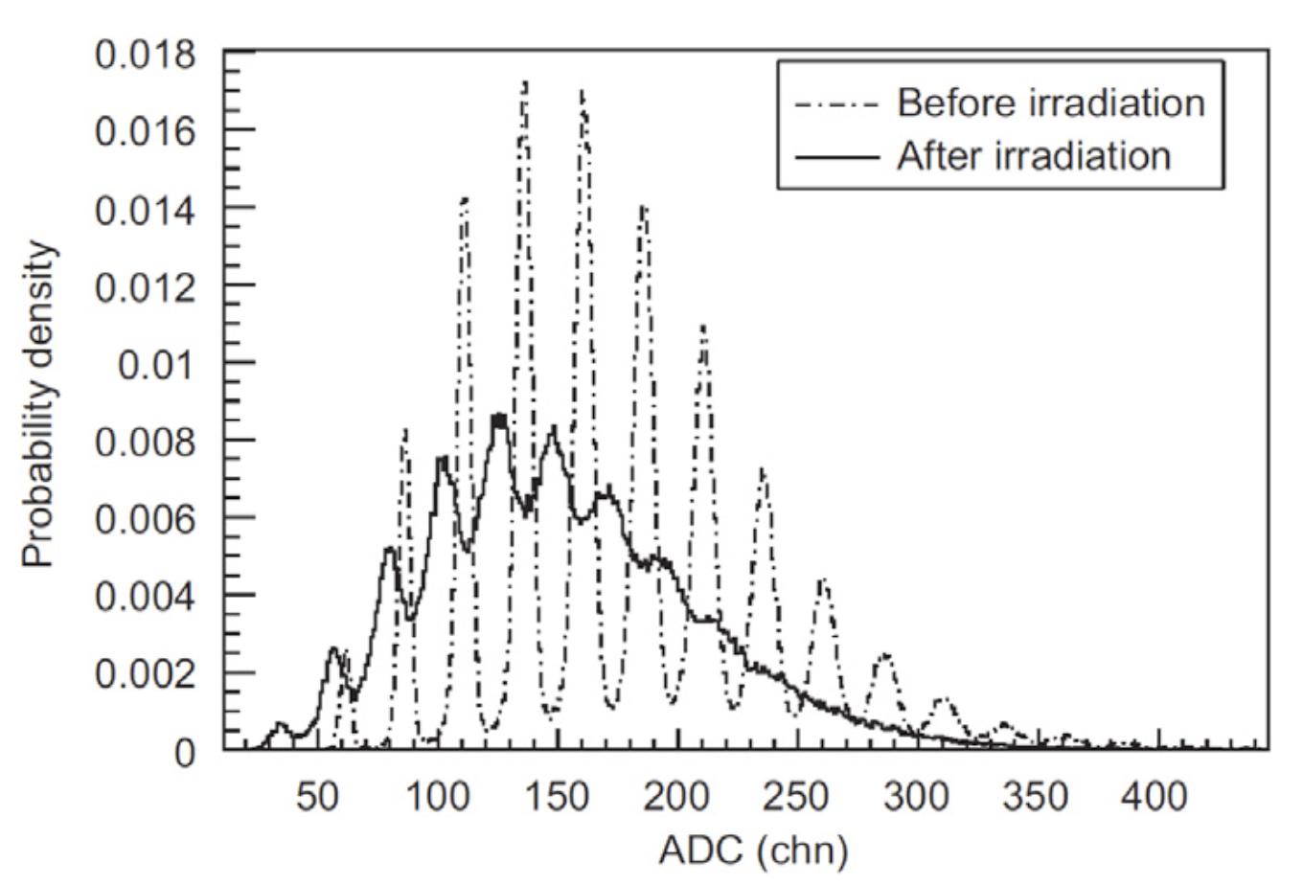
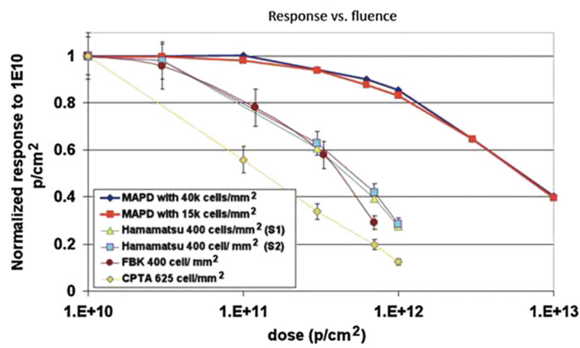
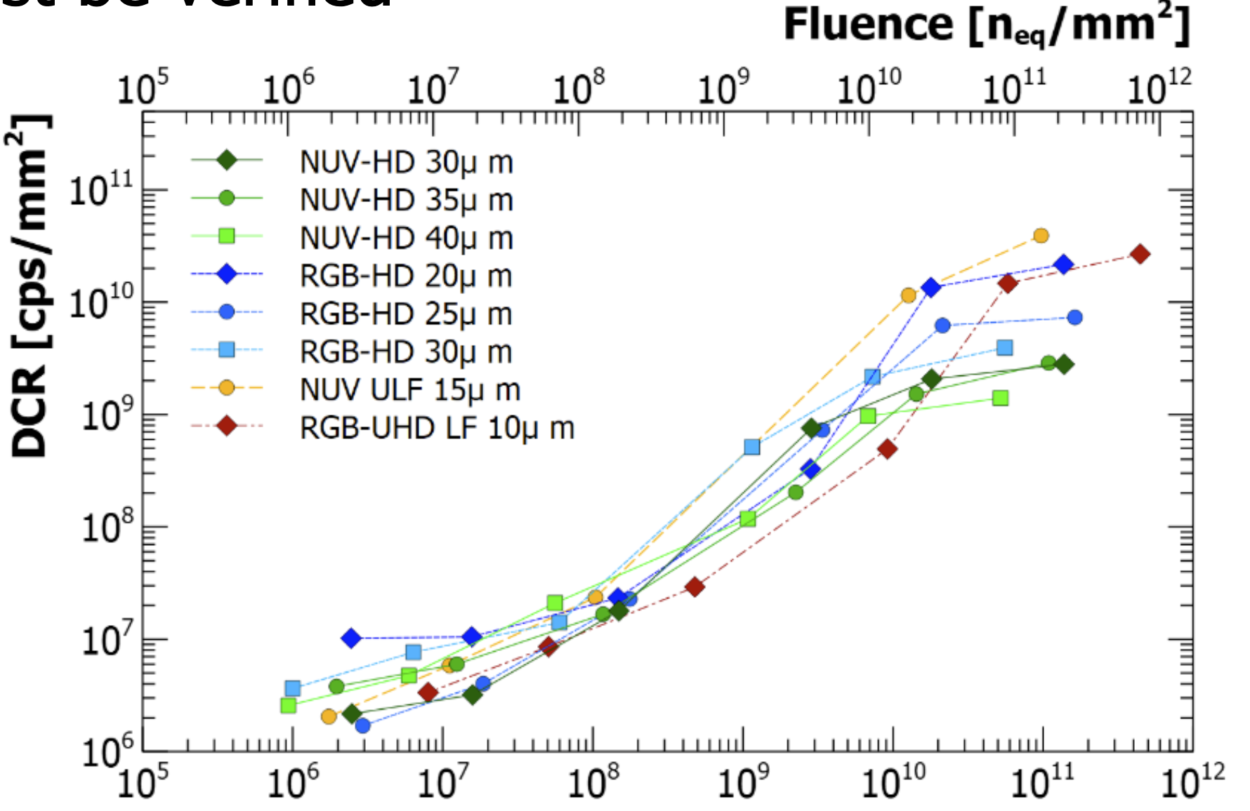
SiPM Radiation hardness
Energy resolution
before/after irradiation
After 10¹⁰ n_{eq}/cm² or 10Krad dose
  Signal gain decrease
  Energy resolution decrease
  Dark count increase
SiPM gain VS Dose
SiPM dark count VS Fluence

Slide 12
Dedicated SiPM engineering run
Dedicated radiation hard SiPM run will be submitted next month
  Various SiPM size: 1*1mm, 3*3mm, 5*5mm
  Various Pixel size: 10um ,20um, 50um
SiPM designed for LACT
Pixel size 50um
Quenching resistance 200KΩ
anode
GR
IHEP SiPM layout
cathode
SiPM for LACT：
7.6 mm X 7.6 mm
152 x 152 pixels
Pixel size： 50um
Fill factor 64%
Designer: MengZhao Li, Mei Zhao

Slide 13
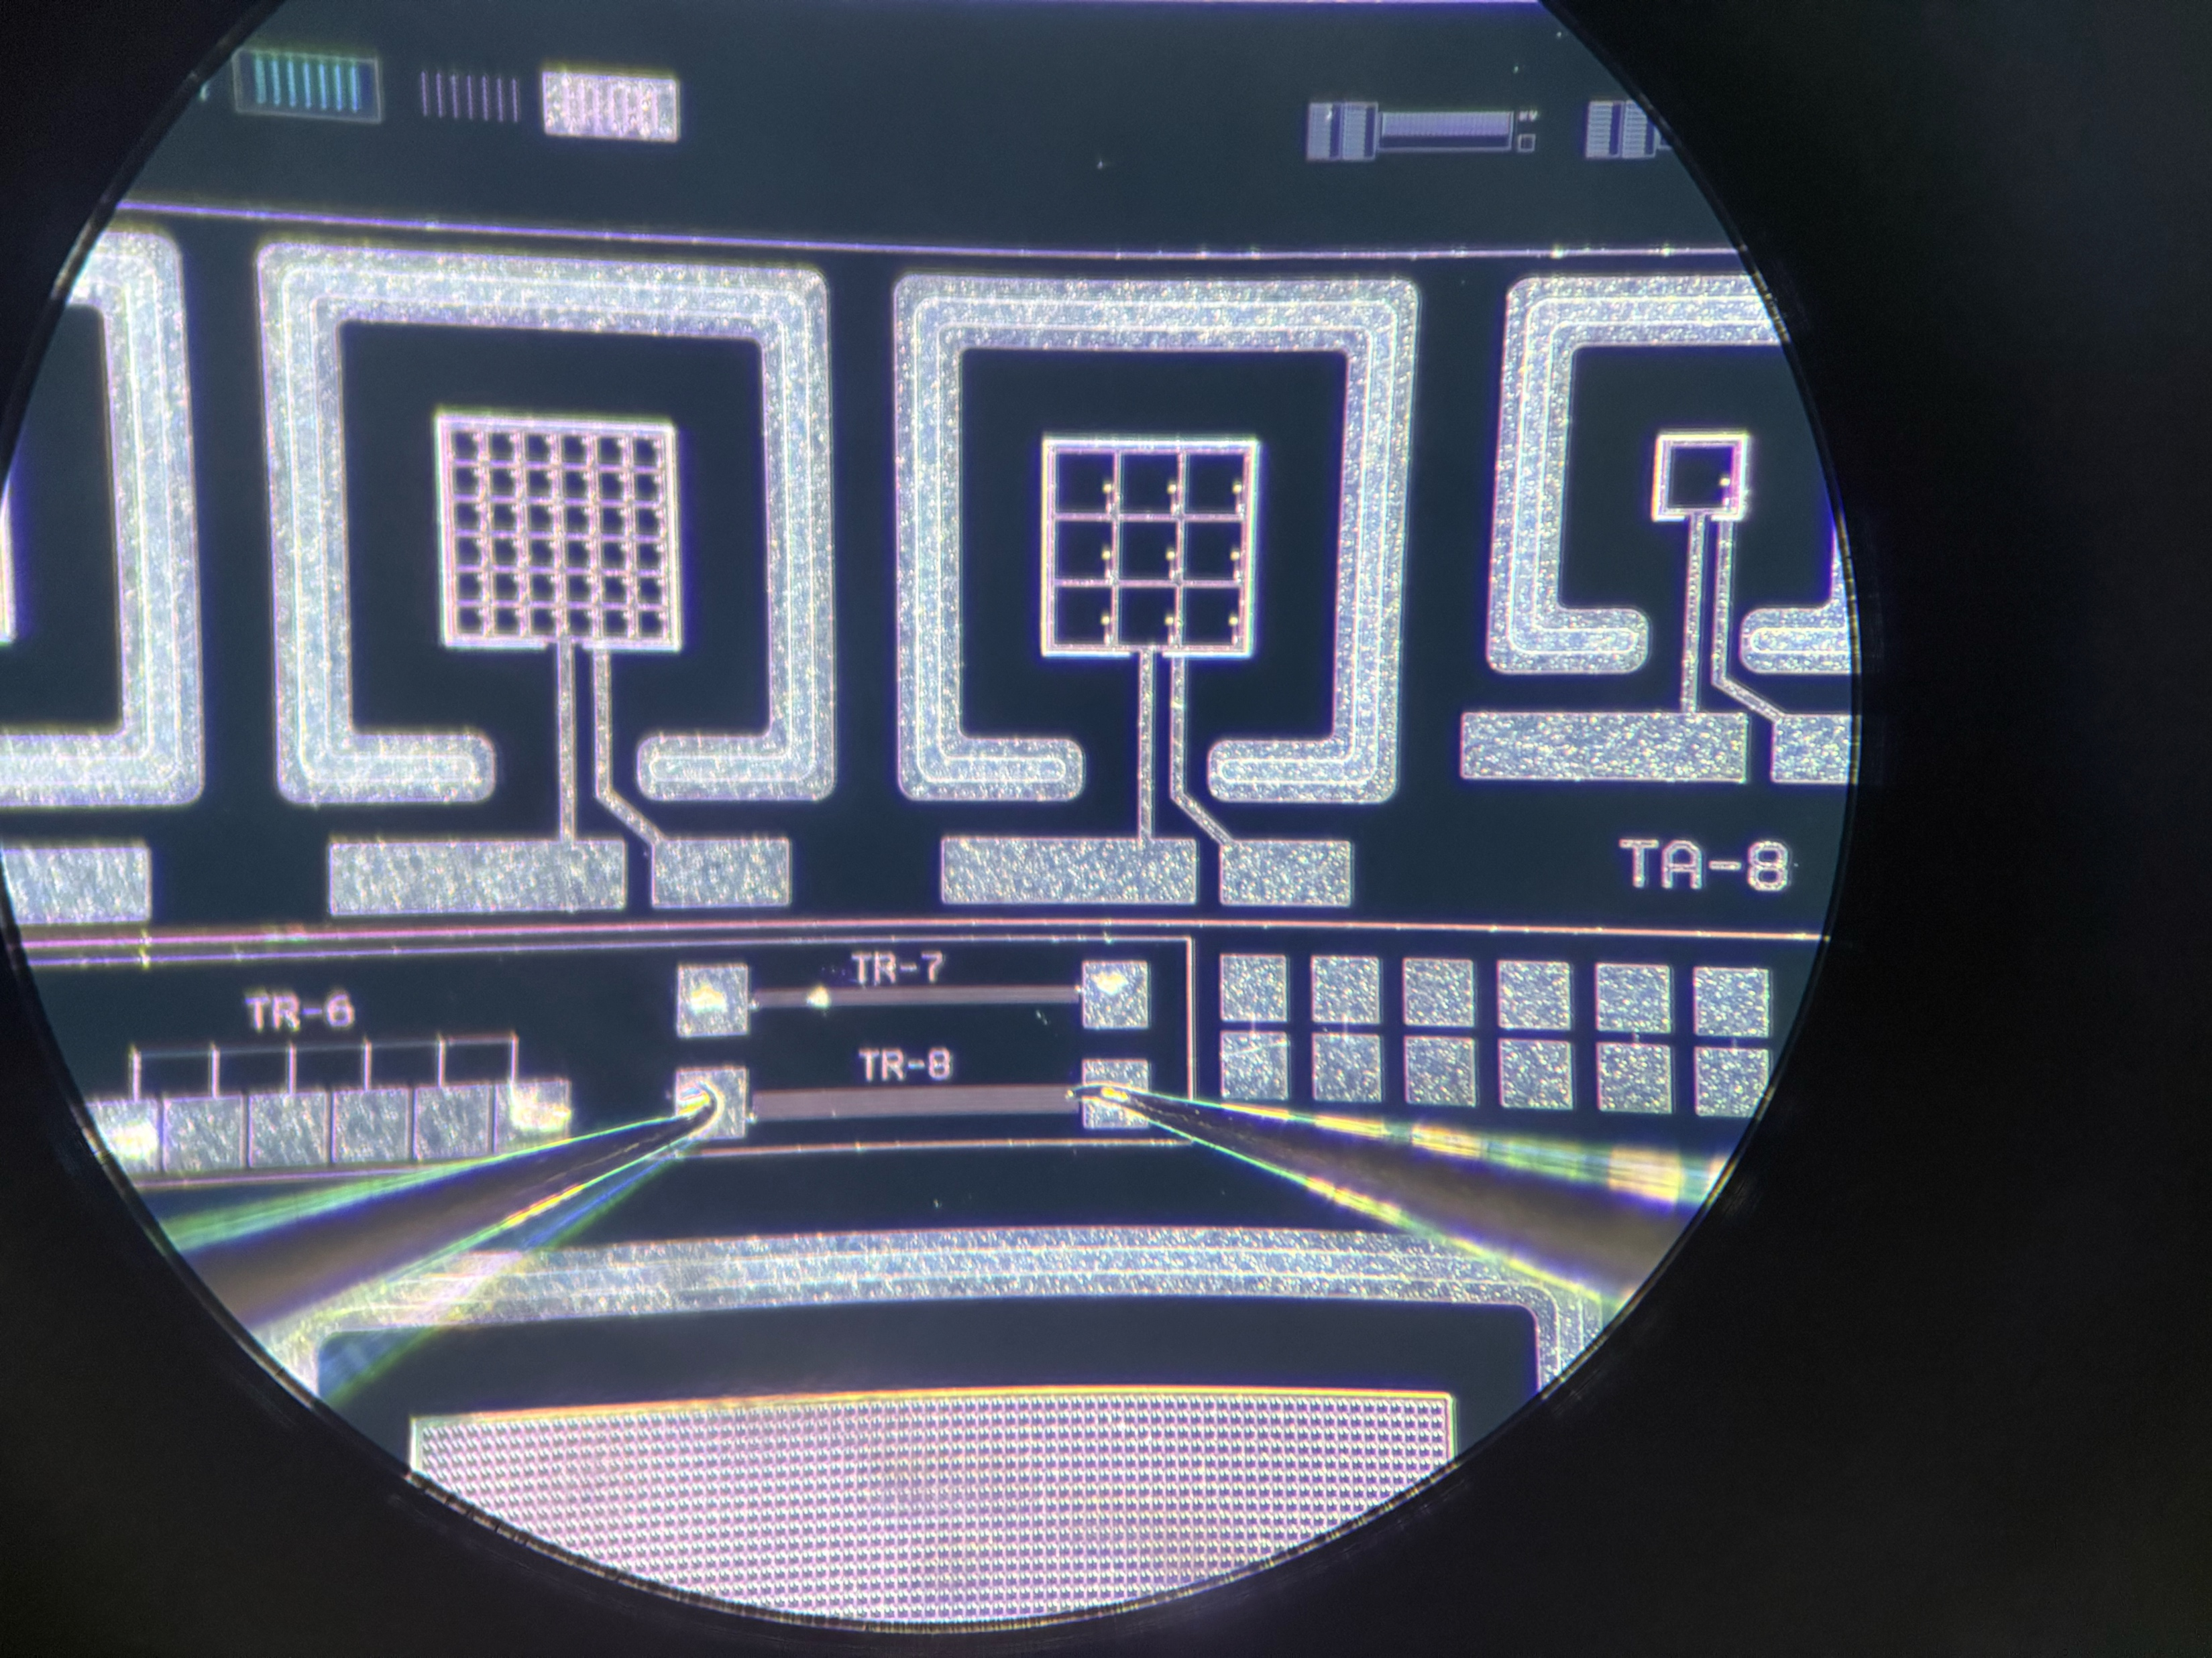
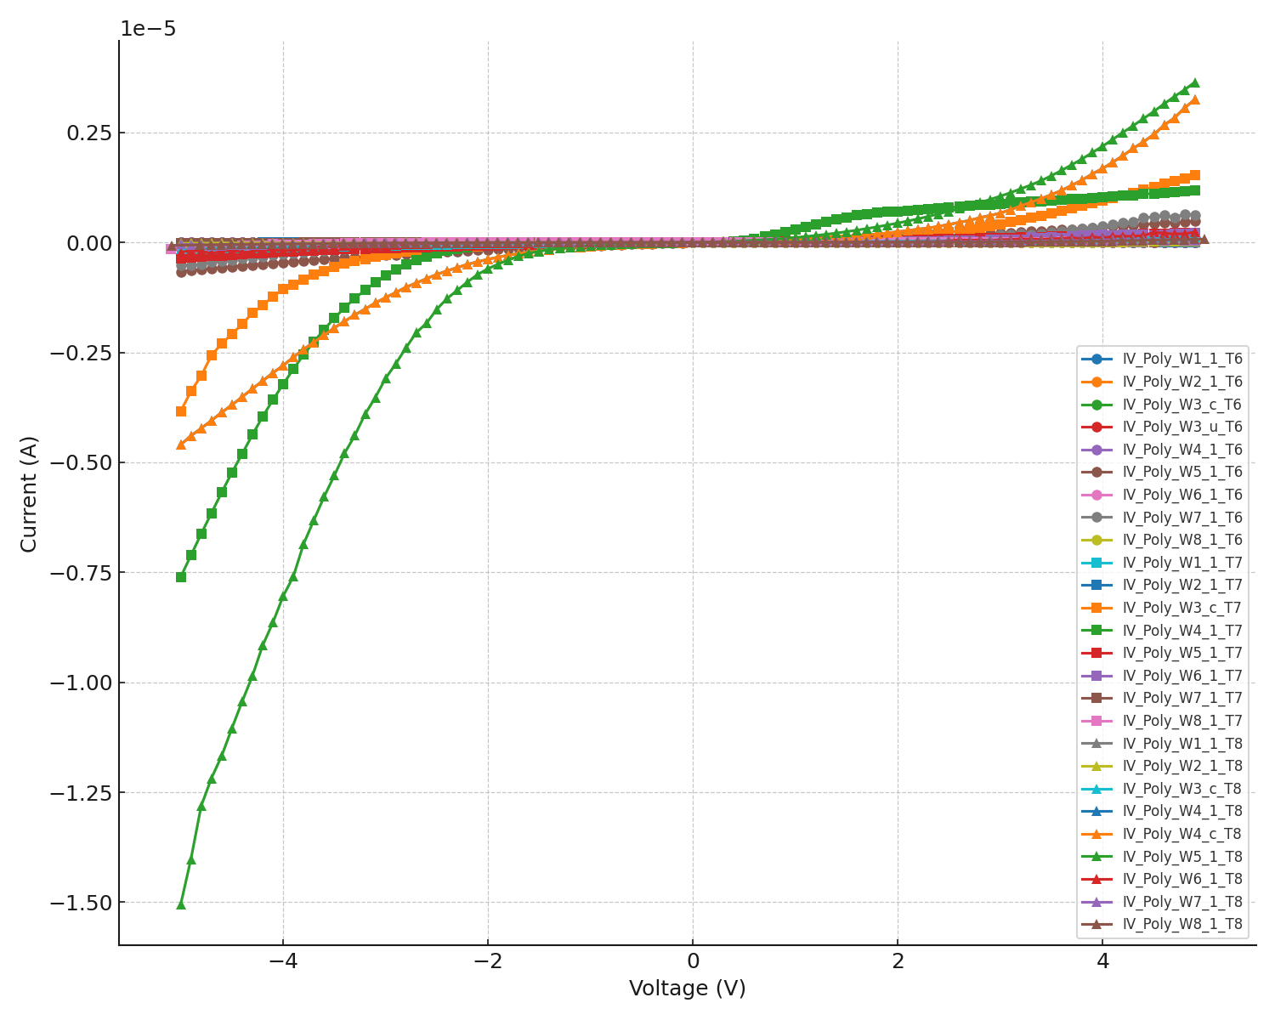
Dedicated SiPM engineering run
First trial run wafers received at the end of 2025.
  Validate the doping for poly-silicon quenching resistors
  Validate the mask design
Validating quenching resistors: I-V curve
Engineering run wafers
By Weiyi Sun

Slide 14
Summary
Development for radiation hard SiPM
  Aim for CEPC and Astrophysics application
Key technology has been validated in ATLAS HGTD detector
  Radiation hard LGAD sensor developed by IHEP team
Status of Radiation SiPM R & D project
  1st MPW small prototype was fabricated and tested.
    Showed good potential to be radiation hard in the tests
  Full engineering run designed
    Received trial run wafers at the end of 2025.
    Expect to get full wafers by middle of 2026.
  Plan to integrate into ECAL and HCAL prototyping in the coming years.

Slide 15
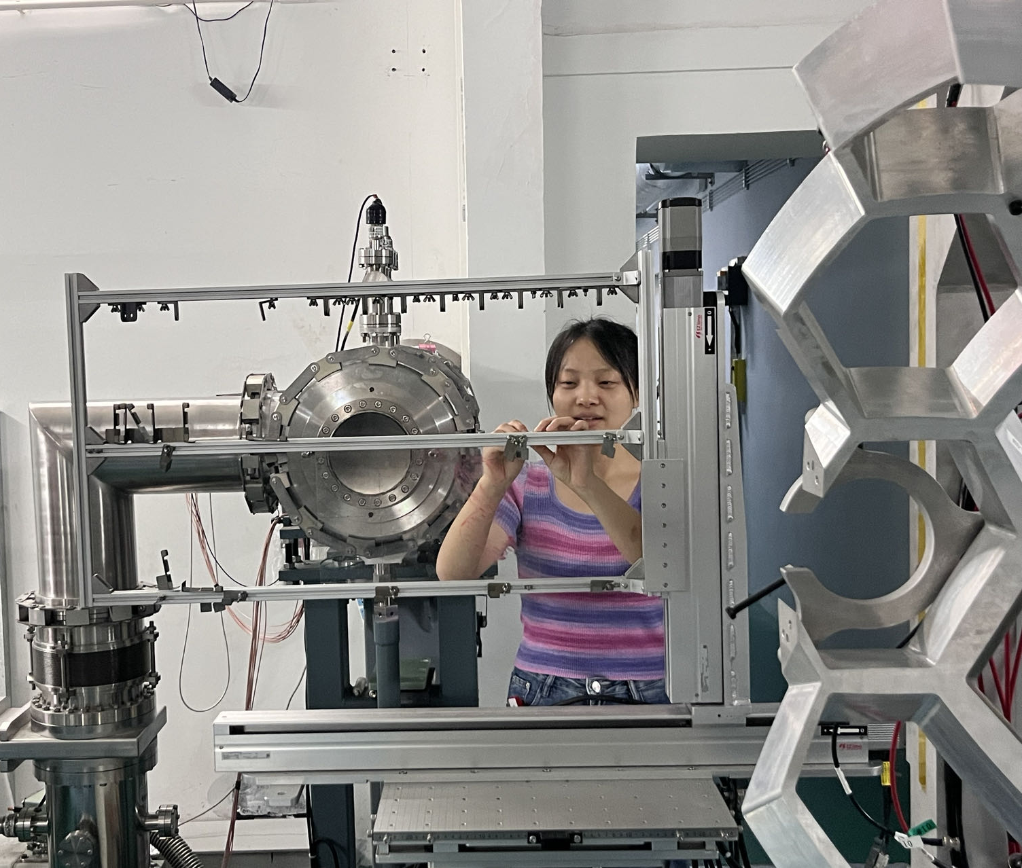
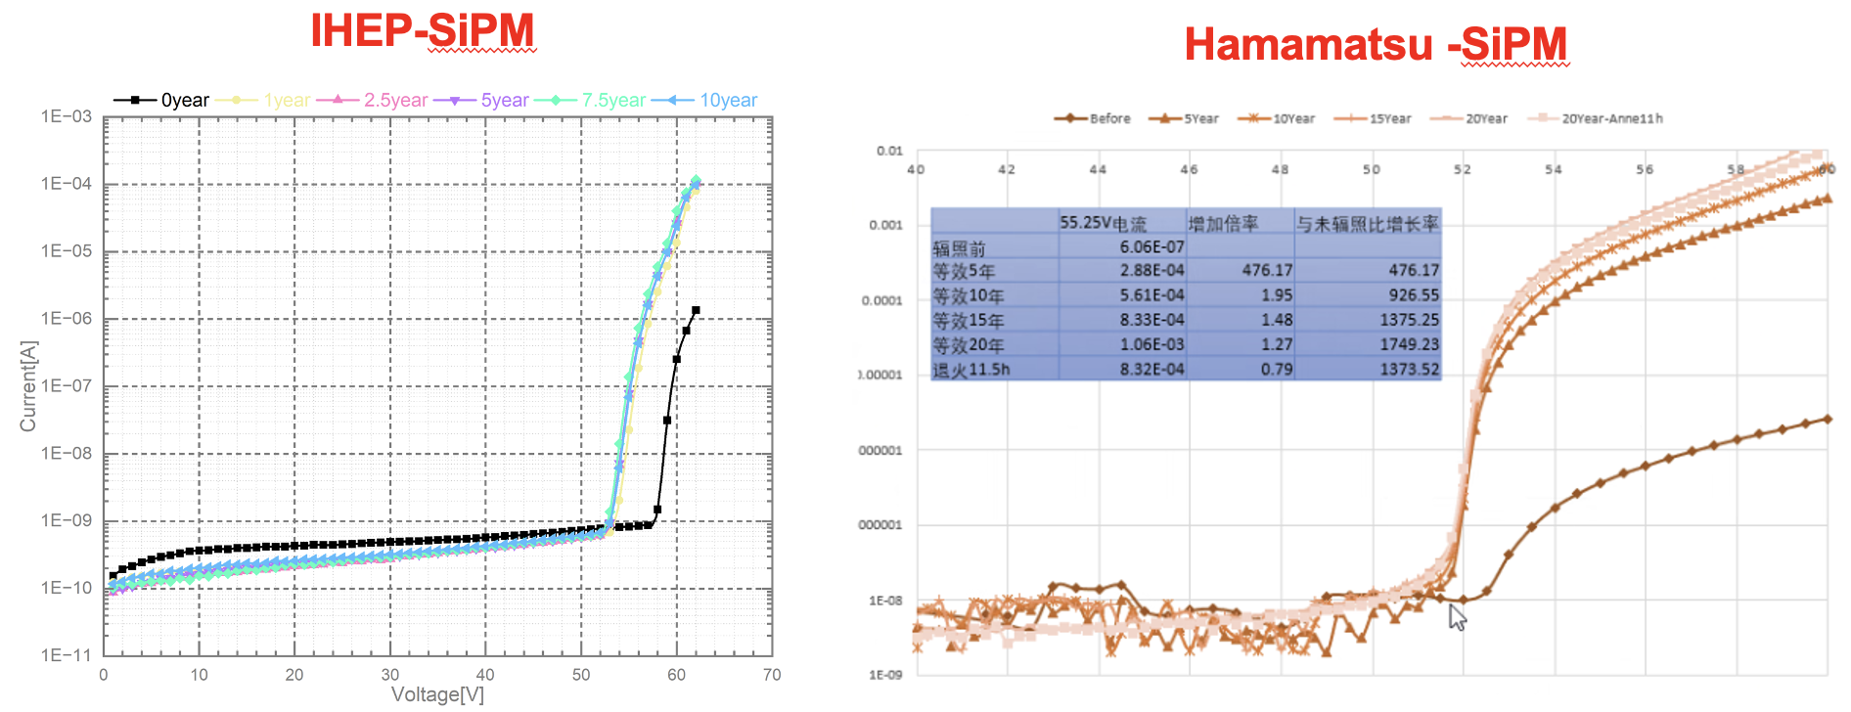
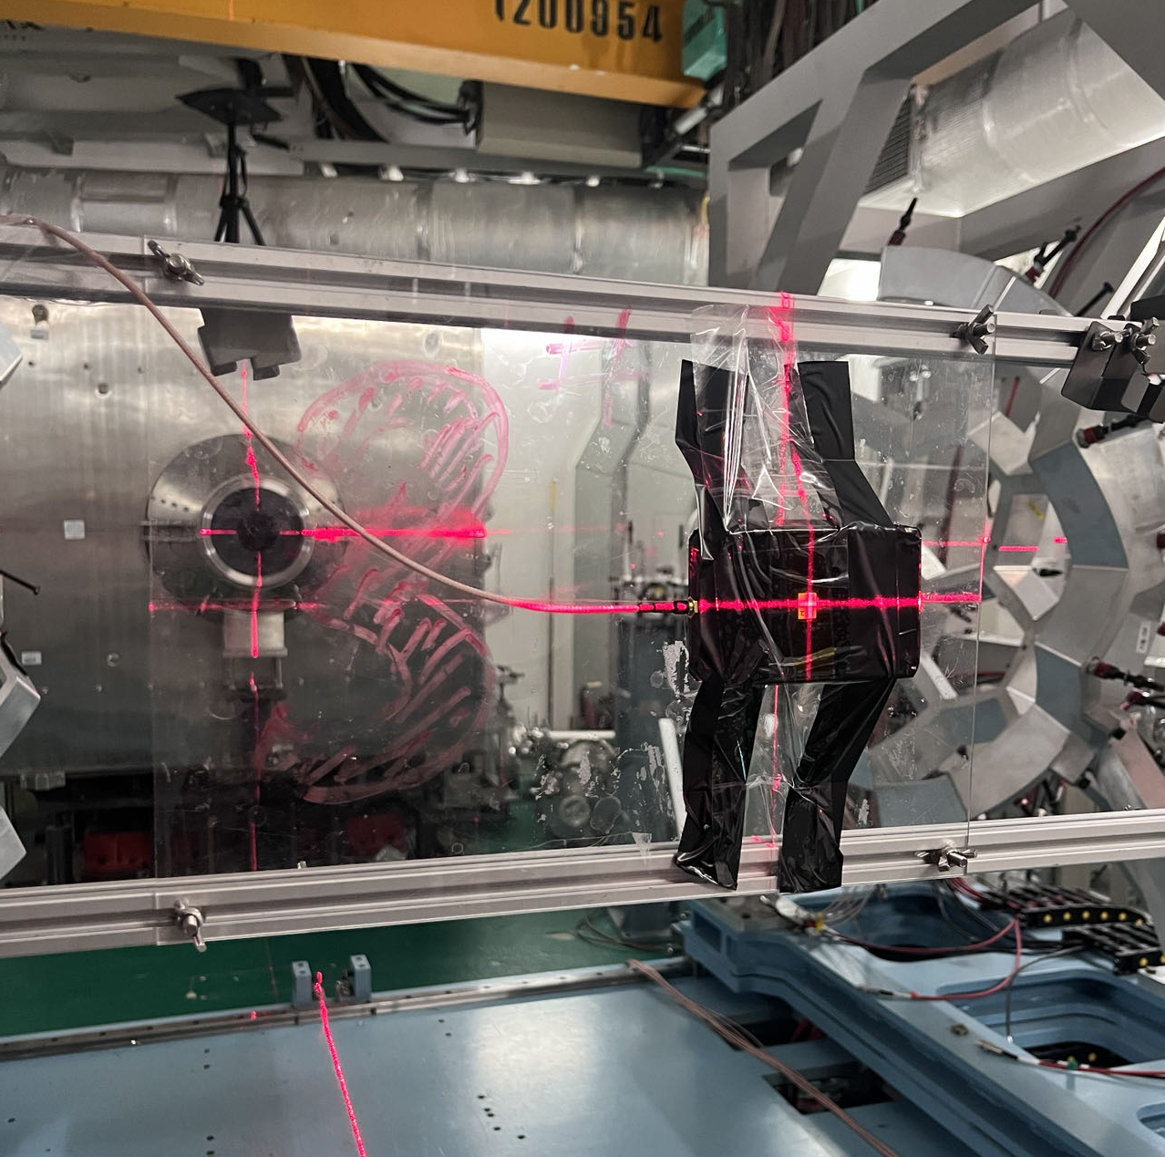
Leakage current of Sipm after irradiation
First trial of this special wafer idea in LGAD development
Indication that IHEP Sipm has potential to be irradiation hard
  After 2E10 n_{eq}/cm2, IHEP SiPM leakage current increased by ~10
  After 2E10 n_{eq}/cm2, HKP sipm increase by 2-3 order of magnitude
by Tianyuan Zhang.
Tested together with HERD team in CSNS.
1E10 n_{eq}/cm2 is the fluence received by HERD in 10 years operation

Slide 16
Some thought about the Cost
One 8 inch cost in production : 16k RMB
Number of 3*3mm SiPM in one wafer (assuming 90% yield): ~3000
Raw Cost of SiPM: ~5 RMB
Assuming packaging of SiPM will double the price
Final cost per Sipm ~10 RMB

Slide 17
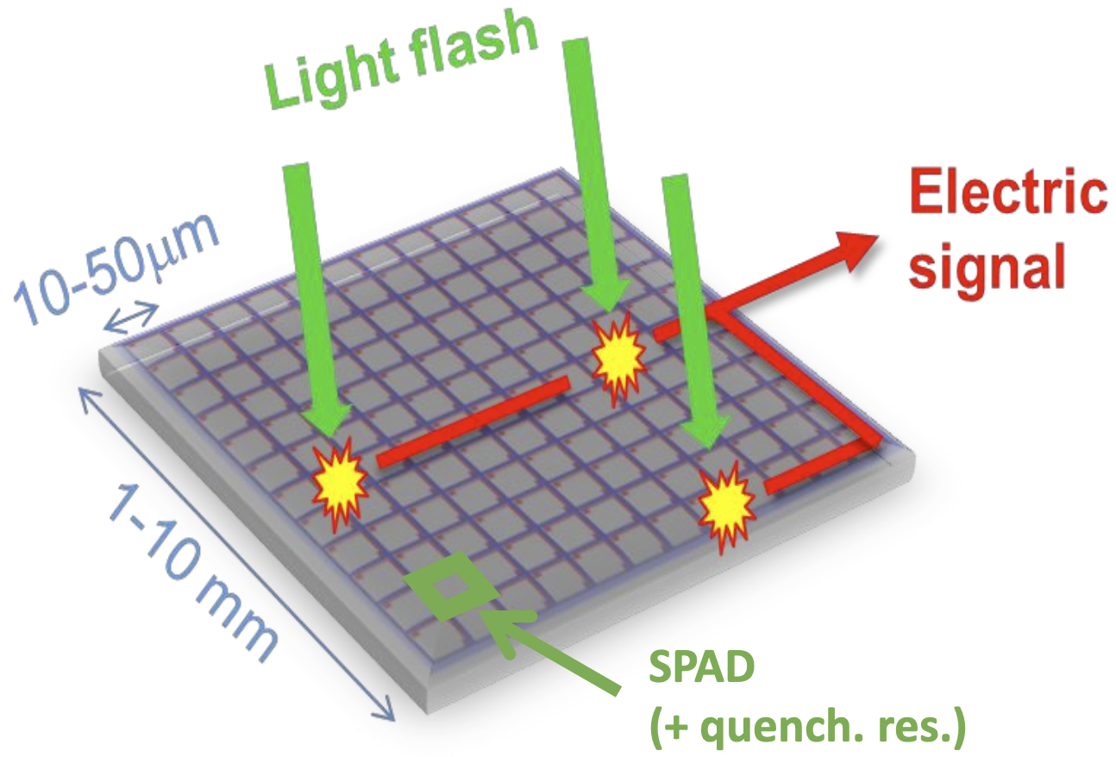
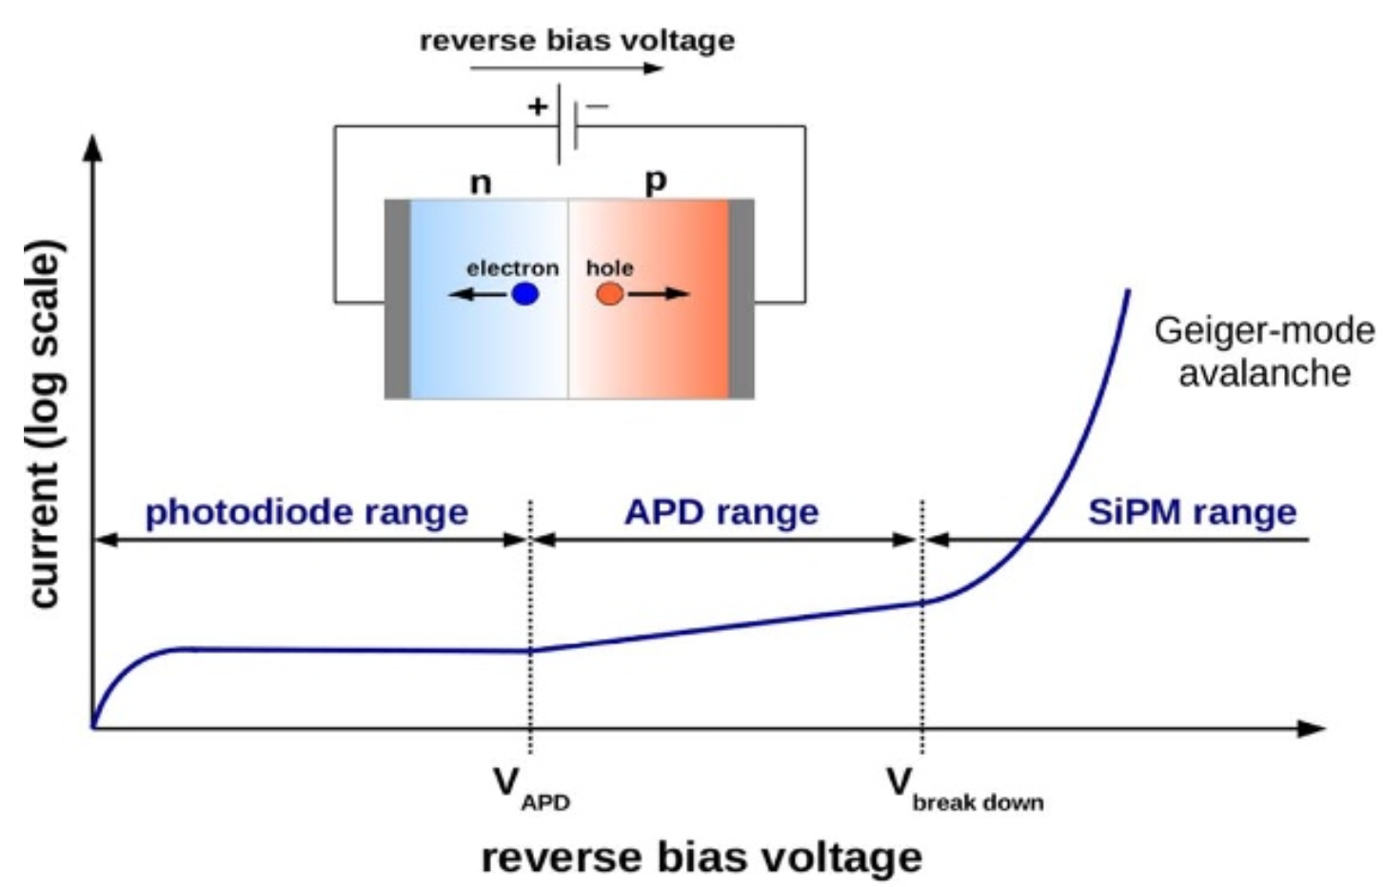
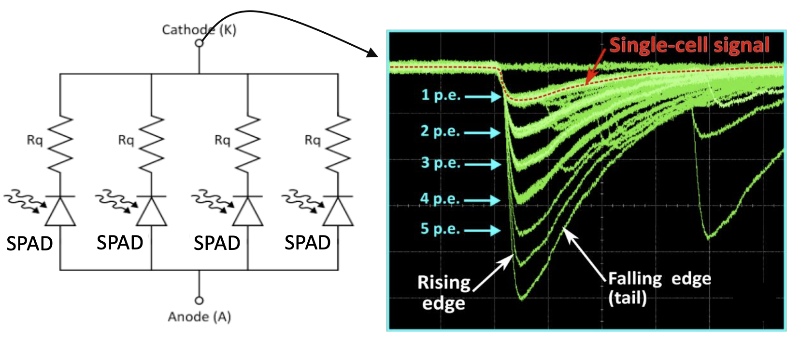
SiPM introduction
SiPM--silicon photomultiplier: advantage:
  High resolution
  Single photon counting
The goal is to develop Radiation hard SiPM

Slide 18
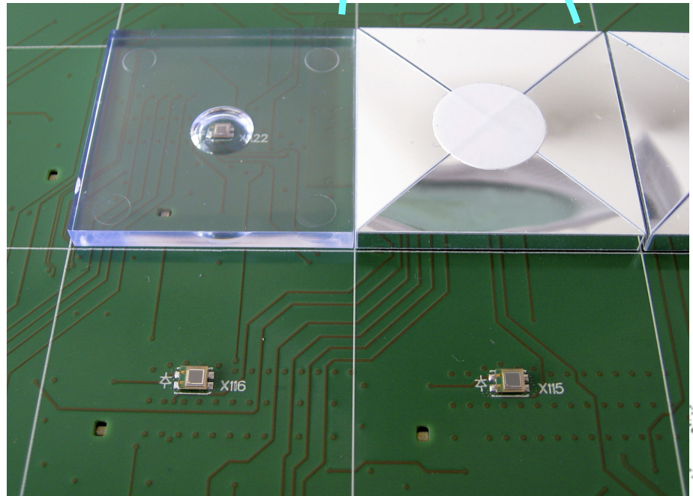
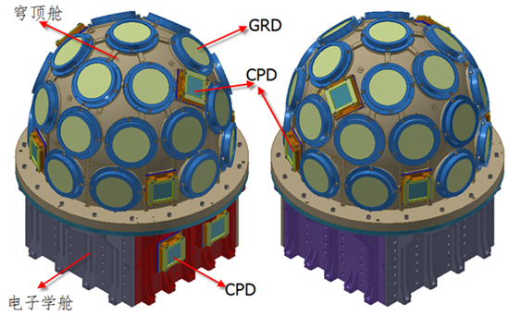
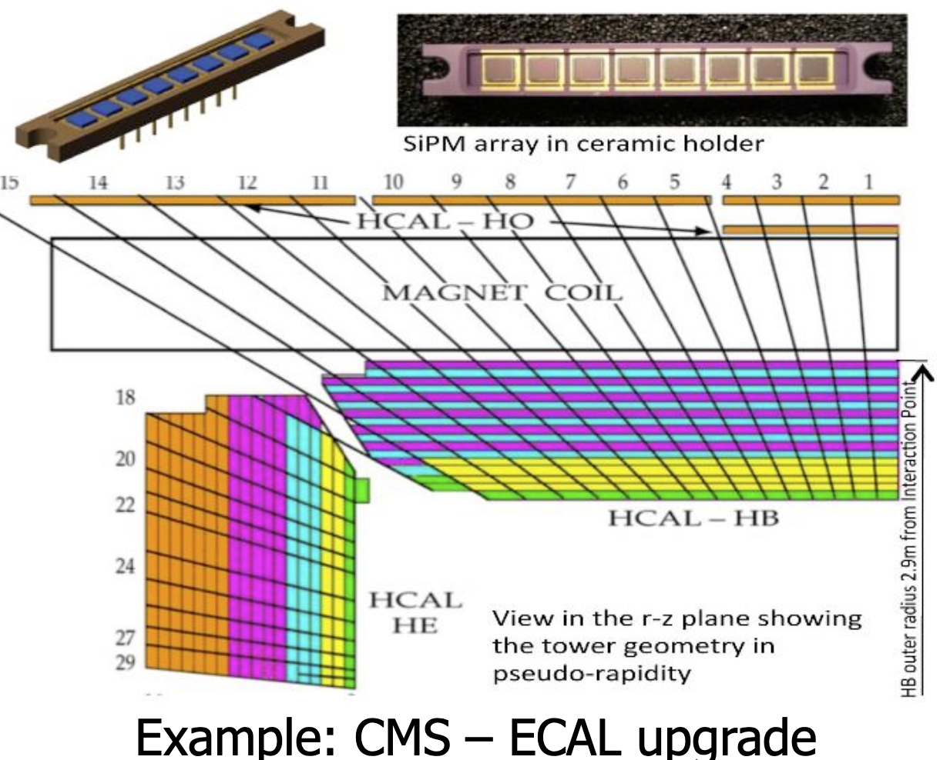
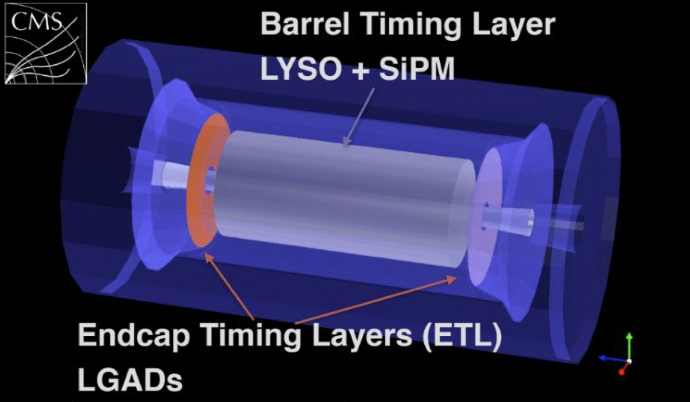
Radiation SiPM application
Astrophysics: Space station scientific experiment (Herd …)
Collider physics: calorimeter application
  CMS timing layer, calorimeter
  CEPC calorimeter and time of flight detector
GECAM
CEPC PFA
calorimeter
prototype
CMS MIP timing detector
CMS Calorimeter

