Slide 1
Study on B-tagging and SUSY in ATLAS Experiment
Yu Bai (IHEP), Nicolas Bousson(CPPM), Shan Jin(IHEP), Emmanuel Monnier(CPPM), Huan Ren(IHEP), Lianyou Shan(IHEP), Laurent Vacavant(CPPM) ,Da Xu(IHEP), Xuai Zhuang(IHEP)
6 thFCPPL, Nanjing, 2013. 3. 27

Slide 2
Outline
Part 1 : B-tagging
Optimization
Commissioning
Part 2 : SUSY study
Strong production
Weak production
Summary and prospects

Slide 3
Part1: Flavor Tagging - Introduction
Important to varies of physics analysis : (V/tt)Higgs->bb , top physics, super symmetry
Principle based on two properties of b-quark
long life time (SV tagger, IP tagger)
Heavy (kinematic information)
Challenging : complexity
understanding performance of detector
understanding performance of varies object reconstruction algorithms ( track/vertex)
affected by experiment situation(pile-up events e.g.)
ATLAS B-tagging time table:
SV0
JetProb/ IP3D+SV1
JetFittCombNN, MV1/MV2
2010
2011
2012

Slide 4
Flavor Tagging Optimization and Commissioning
Performance Optimization
To get higher performance of the taggers
Aiming realistic situation
More and more pile-up events
Imperfect performance of the detector
Applied to simple taggers, but advanced tagger can also benefit from these studies
Results adopted by ATLAS b-tagging group
Commissioning
To understand the performance
Based on data 2011, first time to commissioning on advance tagger(IP3D+SV1, JetFitter)
CONF NOTE: ATLAS-CONF-2011-102
Commissioning continued in 2012 for more advanced tagger

Slide 5
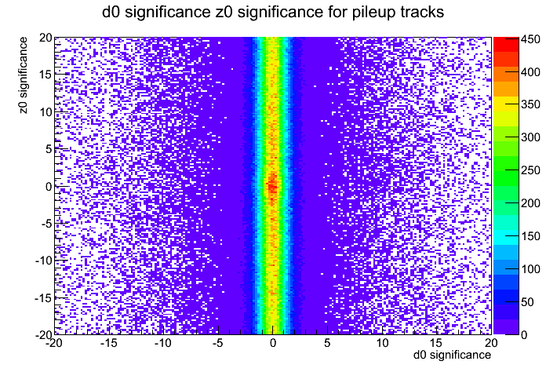
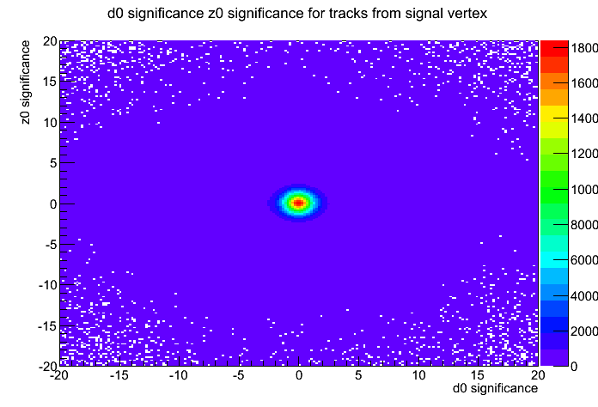
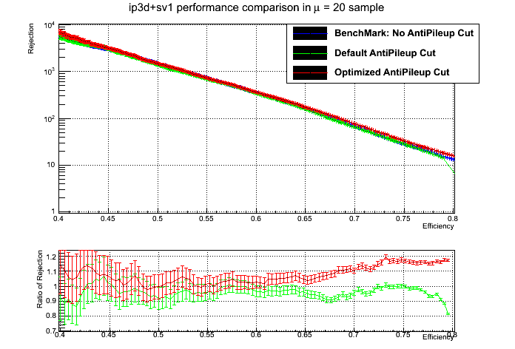
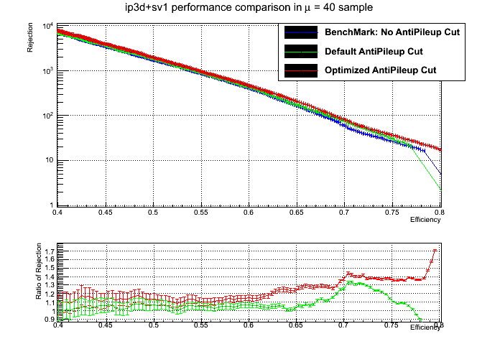
B-tagging Optimization : Pile-up events rejection
Pile-up can have negative effect to b-tagging
Based on track impact parameter information(inspirited from IBL study)
The cut can be optimized to get higher performance
d0-z0 distribution
In pile-up vertices
In signal primary vertices
Improved performance of IP3D+SV1 tagger

Slide 6
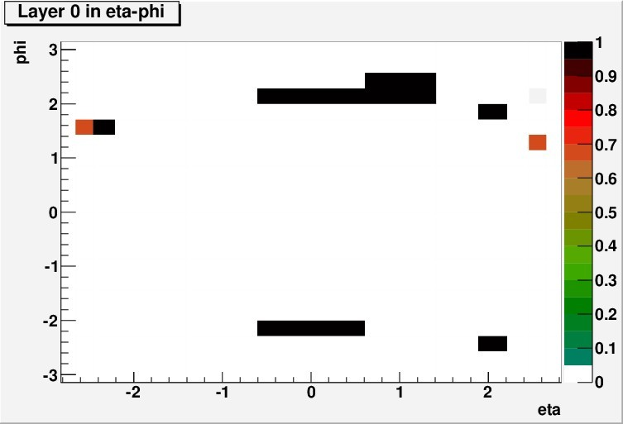
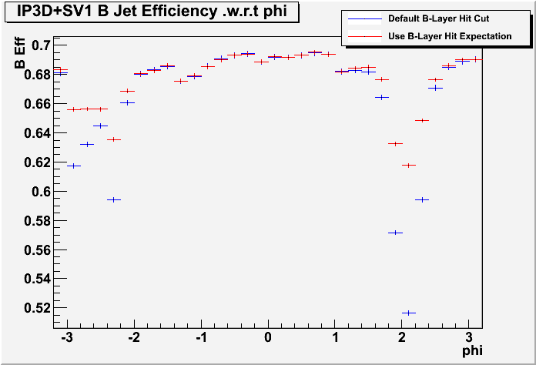
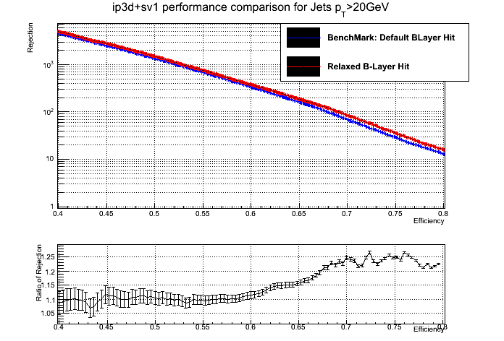
Flavor Tagging Optimization : Dead pixel module effect
Pixel is crucial for b-tagging
Dead modules in pixel, decrease the efficiency
Loosen the cuts on track if it pass dead module
Dead module distribution in one run
Increased performance in dead module concentrate region
Improved performance

Slide 7
Flavor tagging Commissioning
Importance: to understand the deviation of simulation to the data. Can reduce the systematic
Method: compare the distribution in Monte Carlo and Data(tagging weight, tagging rate and so on)
Difficulty :
Various source of deviation:
Events generation(.e.g flavor components), detector simulation, triggers

Slide 8
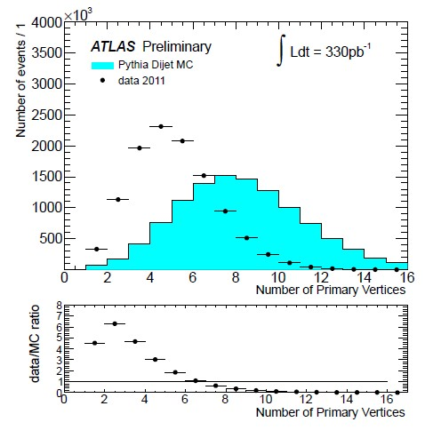
Reweighting technics: Pileup Reweighting
Reweighting techniques:
To remove the significant known discrepancy between MC and Data
Pileup reweighting(reweighting on primary vertex number)
Jet P_{T} reweighting(reweighting the P_{T} for leading jets, next leading jets, next next leading jets, and the result)
Before reweighting
After reweighting

Slide 9
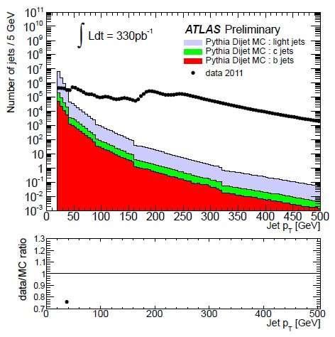
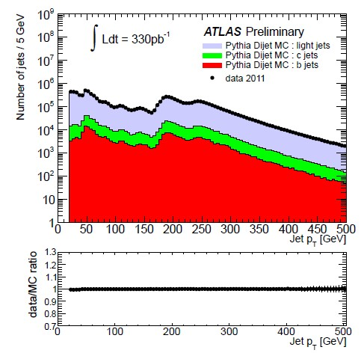
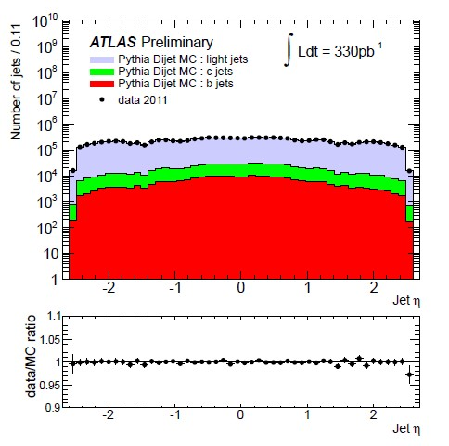
Jet Pt and eta reweighting
Before reweighting: Huge discrepancy (caused by trigger presale in data)
After reweighting: discrepancy removed

Slide 10
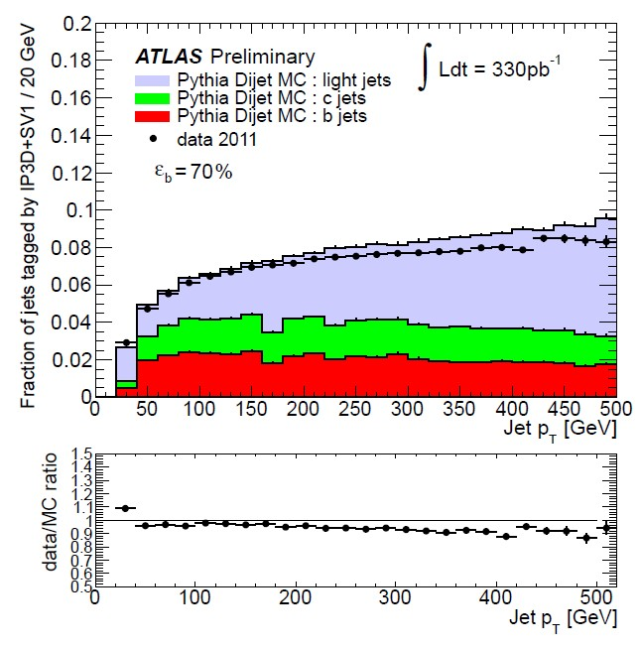
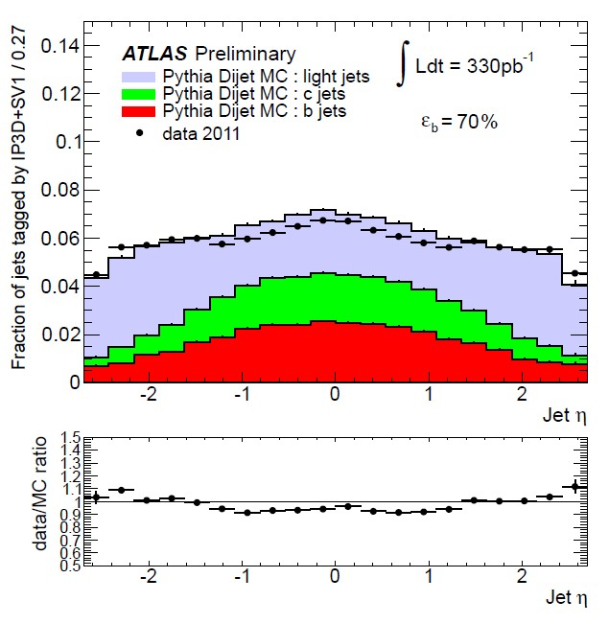
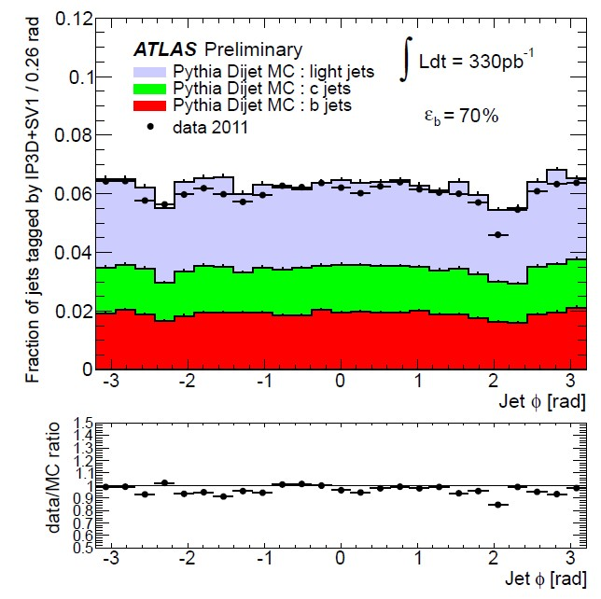
Data/MC comparison of tagging rate
With respect to jet pt
With respect to jet eta
With respect to jet phi
Reasonable agreement: within 20%

Slide 11
Part 2 : Super symmetry
Strong production
Gluino pair production
4-top 1L(Feng) :gluinos ->stop pair-> ttbar+LSPs(on progress)
On going with 8 TeV data
Weak production
direct gaugino production: tautau+MET :
First study of direct gaugino or stau pair production through the final states with at least two taus, complementary of emu final states
Higgs into di-photon rate can be enhanced via staus without changing the Higgs to WW/ZZ rates, so light stau with large mixing may help
CONF NOTE : ATLAS-CONF-2013-028

Slide 12
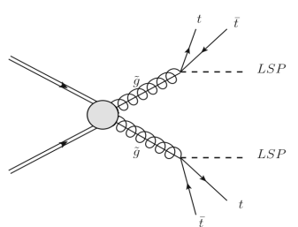
Strong production : gluino pair production, analysis on 7 TeV Data
g~g~->t~tt~t->4top+MET->4b+4W+MET->1l+4b+6j+MET
Analysis Strategry:
1lepton(e/muon)+4bjets+4non bjets+MET(h1lh8j)
SM background: dominantly tops
Gluino mass between 700 and 900 GeV studied
1 lepton(either electron H1lh8j Selection (Signal region)
1 lepton(e or muon), trgger match
at least 8 jets, leading jets with pt > 120 GeV
MET > 140 GeV, MT>100 GeV
Sumpt4 > 350 GeV
Control Region (for Data/MC Comparison):
Same as Signal region(h1h8j), except that :
80 GeV<MET<120 GeV
40 GeV<MT<80 GeV

Slide 13
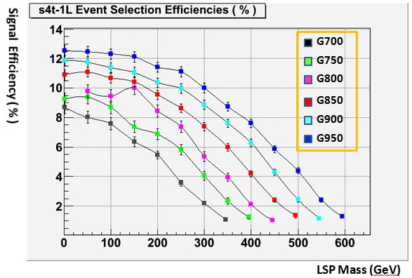
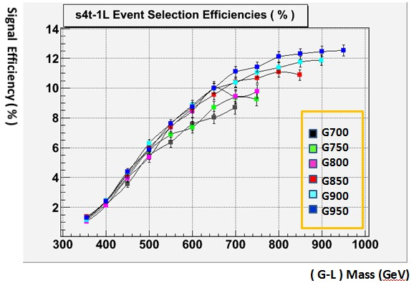
Efficiency of signal
Efficiency depend on mass difference between gluino and LSP

Slide 14
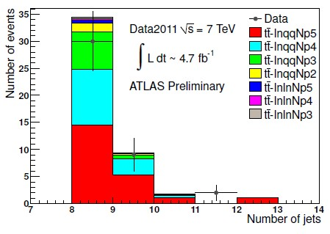
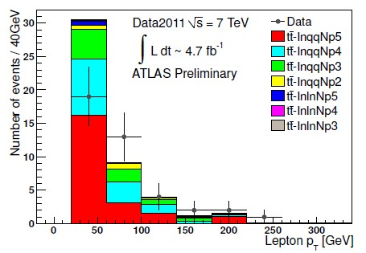
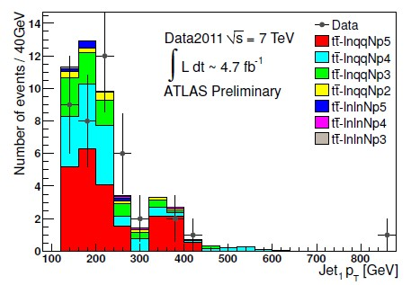
Control Region Distribution
Reasonable agreement
Discrepancy needs further study

Slide 15
Towarding 8 TeV data
Data/MC comparison went on
Tried to improve sensitivity
Require at least 1 bjet seems promising to increase sensitivity
Optimization for the cuts: trigger, MET, MT2 .etc(can directly aim 14 TeV run)

Slide 16
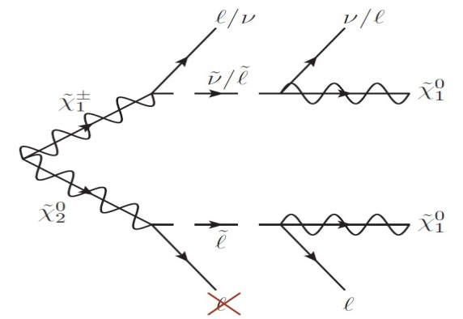
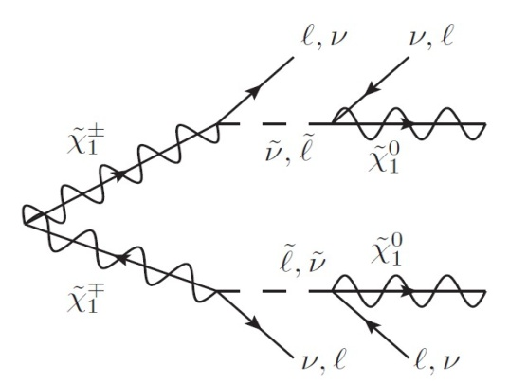
Super Symmetry Weak Production : Signal grids
Direct Gaugino Decay
pMSSM Signal Grid:
Heavy Squarks and Gluonios
tan β = 50
M₁ = 50 GeV
M₂ and μ ranging from 100 to 500 GeV
Mass of stau fixed at 95 GeV, other sleptons are heavy
Mode A (chargino-neutralino decay):
Mode C (chargino-chargino decay):

Slide 17
SR definition
Two SRs have been defined
require at least 1 OS tau pair
one SR is after jet veto
another SR is only applying bjet veto
Suppress Z+jets BG through Z-veto
MET>40 GeV to suppress fake tau background
Apply large m_{T2} cut to enhance SUSY sensitivity
m_{T2} cut has been optimized

Slide 18
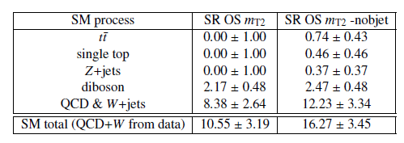
Background components in SRs
Two classes of backgrounds: fake tau (qcd+W, ~75-80%) and real tau background (top, Z+jets, diboson)
Fake tau background: estimated with data-driven approach (ABCD method）
Real tau background: use MC simulation

Slide 19
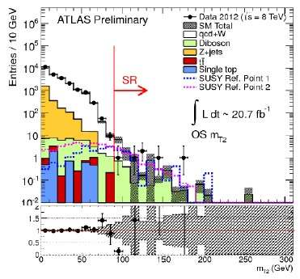
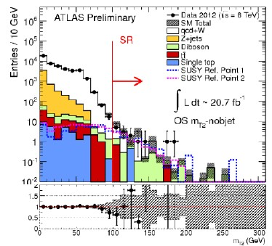
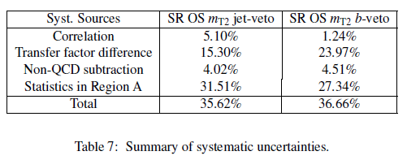
Results of background estimation
m_{T2} jet veto
m_{T2} b-veto
QCD+W Results:
In m_{T2 -}jet veto region :
8.38+/-2.98
In m_{T2} b-veto region :
12.23+/-4.48
Good Data/MC Agreement in non-signal region (mT2 < 90 GeV)

Slide 20
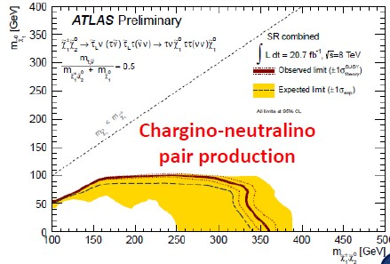
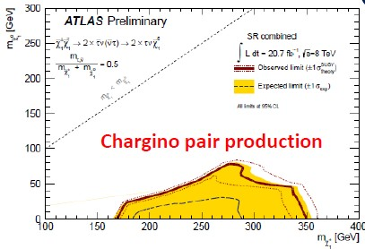
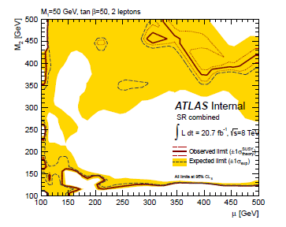
Results : Exclusion Limits
Mode A : exclude chargino 1, neutralino 2 mass up to 350 GeV
Mode C: exlculde chargino mass from 200-300 GeV, neutralino mass below 50 GeV
pMSSM: large region in parameter space excluded

Slide 21
Summary and Prospects
B-tagging performance improved with optimization
Commissioning of b-tagging provide reasonable agreement between data and MC, one CONF published
Gluino production with multiple jets and 1 lepton in final states is interesting. Preliminary study has performed, on
cut criterion, data/MC comparison, .e.g
Exclusion limit on gaugino mass set for weak production scenario and Moriond CONF note published
With higher beam energy and luminosity, hopefully something new show up ☺, but before that
Facing much tougher experiment situation than before: more pile-up, more challenging for detector
B-tagging performance need to be re-studied
Continue the study in 7TeV or 8TeV collision

Slide 22
Bakup: SR Optimization - mode A
5fb-1 data used
mT2 jet veto
Mt2>80GeV: 3
Mt2>90GeV: 2
Mt2>100GeV: 1
mT2 b-veto
Mt2>80GeV: 20
Mt2>90GeV: 4
Mt2>100GeV: 2
m_{T2} > 80 GeV
m_{T2} > 90 GeV
m_{T2} > 100 GeV
m_{T2} jet veto
m_{T2} b-veto
m_{T2} jet-veto: pick m_{T2} >90 GeV (similar performance)
m_{T2} b-veto: m_{T2} >100 GeV (best performance)
Other models are checked, consistent with mode A

Slide 23
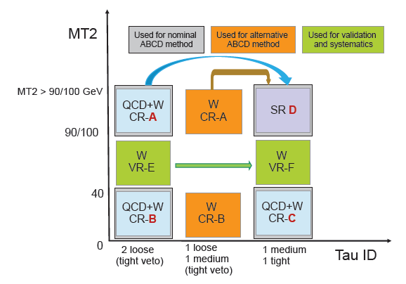
Bakup: The ABCD method
Variables:
m_{T2 ,} tauid
Base line control region
A high m_{T2}, loose tauid
B low m_{T2,}, loose tauid
C low m_{T2}, tight+medium tauid
extrapolation from A to D through a TF (C/B)
Alternative ABCD method checked (W CR-AB)
Use transfer factor (TF) from QCD events (low m_{T2} region from data) and take the TF difference between QCD and W+jets as systematics

Slide 24
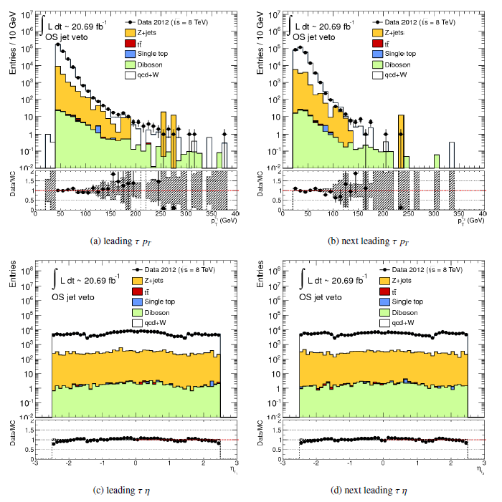
Bakup: Kinematic distributions
Good data/MC agreement for leading and next leading tau pt and eta distributions
The ABCD method works well

