Slide 1
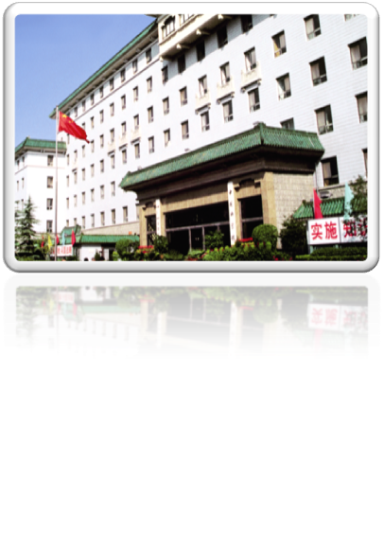
An Overview of
Chinese Academy of Sciences and its International Cooperation
Xiaofeng Lu
Bureau of International Cooperation, CAS
xflu@cashq.ac.cn
28 March, 2012

Slide 3
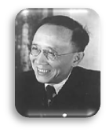
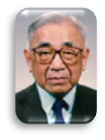
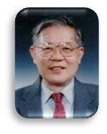
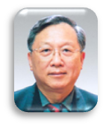
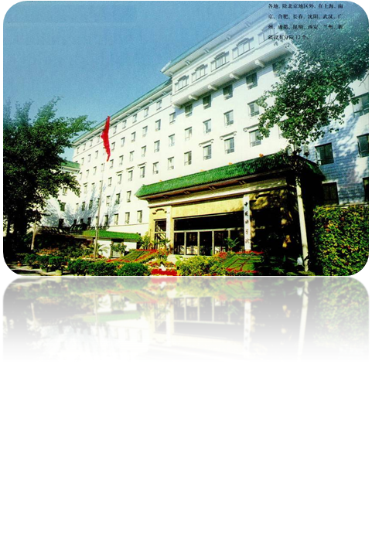
HISTORY & POSITION
1949－1978
Guo Moruo
1979－1981
Fang Yi
1981－1987
Lu Jiaxi
1987－1997
Zhou Guangzhao
1997－2011
Lu Yongxiang
2011-
Bai Chunli
Founded in Nov. 1949
Research: Largest & most comprehensive research center in S&T
Fundamental research and innovation Tech transfer & dissemination
Consultation: A supreme advisory body on S&T
Representing highest academic accomplishments
Higher education: A big school
Research talent and skilled professionals
（Enrollment of graduate students reaches 16,851 in 2011, with 6,363 Ph. D candidates.）

Slide 4
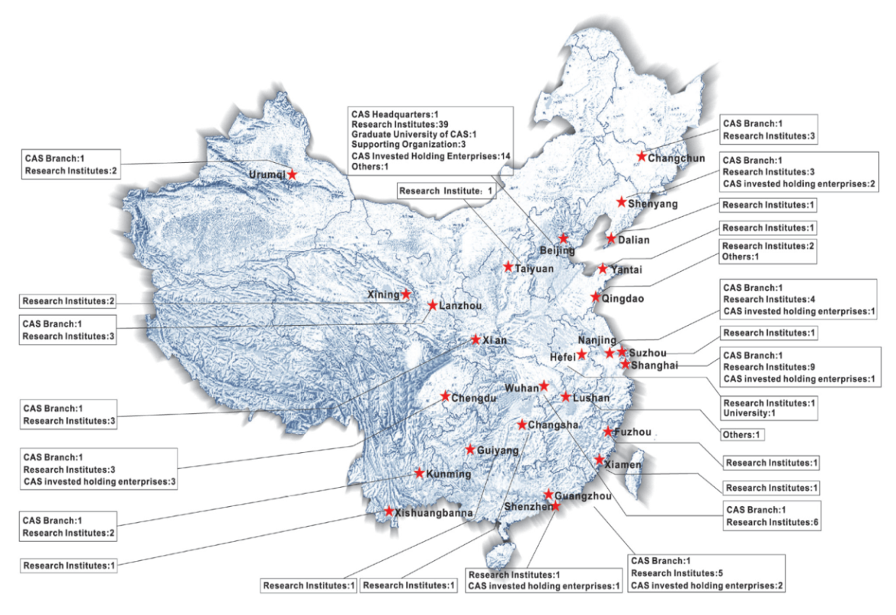
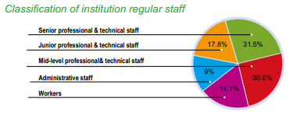
FACTS & FIGURES
11 Branches, 104 Institutes, 2 Universities in 23 provinces
90% of big science facilities in China
13 Botanic gardens, 26 Herbariums
42 field stations (The Chinese Ecosystem Research Network)
22 CAS invested holding enterprises
Total staff : 60,683，Members of CAS: 727，
Graduate students: 48,971

Slide 5
FINANCIAL ALLOCATION
TOTAL BUDGET : RMB 42.2 billion (5 billion euro) (2012)
Institutional funding VS Competitive funding (1:1)
Institutional funding
Budgetary funding
for institutes
Regulatory funding
in CAS headquarters
Competitive funding
Project-based: MOST, NSFC, etc.
Contract-based: industry, local governments

Slide 6
Innovation 2020
A ten-year program aims at providing solutions to national needs
through great science and innovation
4 Projects approved:
Advanced Nuclear Fission Energy
Climate Change: Carbon Budget and Relevant Issues
Space Science
Stem Cell and Regenerative Medicine
CAS Strategic Priority Research Program
3 under review: Study of new information technology for sensing china
Key technology and demonstration for clean, efficient and cascade utilization of low-rank coal
Demonstration for research, development and application of deep resource exploration technology
To provide scientific solutions to various major challenges facing the country
To further strengthen the fundamental basis of various scientific disciplines
To significantly improve its innovation capacity
To nurture and train a large number of high-calibre talents
To improve its technology transfer capability
To provide sound science-based consultations on national decision-makings
Notes:
战略性先导科技专项:
正式立项４个Ａ类先导专项: 未来先进核裂变能、空间科学、干细胞与再生医学研究、应对气候变化的碳收支认证及相关问题
预启动３个Ａ类先导专项： 面向感知中国的新一代信息技术研究、低阶煤清洁高效梯级利用关键技术与示范、深部资源探测核心技术研发与应用示范。
6

Slide 7
“CAS Innovation 2020”
The overall idea is to promote innovation capacity-building and sustainable development, key emphasis includes:
Scientific frontiers that are likely to lead to technology breakthroughs and industrial development
Scientific challenges that will improve people’s welfare and livelihood and address the constrains in resources and eco-environment
High tech challenges that will improve our international competitiveness and national security
To provide scientific support to the realization of China’s overall well-being and modernization including promoting emerging industries

Slide 8
General Introduction
International Cooperation

Slide 9
CAS’ International Cooperation
China’s scientific progress in the past has been closely correlated with international cooperation. This has been particularly true for CAS progress and capacity-building
CAS international cooperation has gone through a few stages of development in the past three decades:
Simply learning from the West in the initial stage
Mutually beneficial cooperation in selected areas
An extensive international linkages and partnerships in a wide range of disciplines

Slide 10
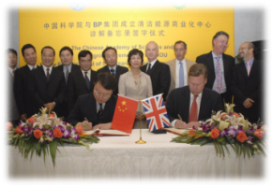
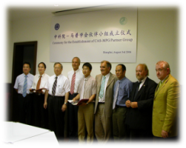
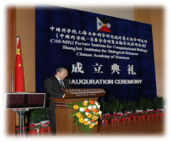
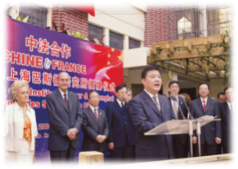
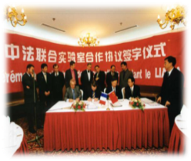
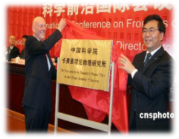
International exchanges
An annual 13,000 person/times overseas visits by CAS scientists, 20,000 person/times international visits to CAS
With national research institutions
Developing long-term, strategic partnership with world-class research institutions to conduct substantial collaboration of mutual benefits
With international-known universities
Combining cooperation with assistance
Integrating research collaboration with talent exchange and training
With multi-national companies
Establishing long-term, stable relationship to promote exchange and cooperation
Notes:
233/1000 gouvernement Always attaches much importance and takes it an inseparable part of R&D
Forged various types of partnerships and cooperation
Basic strategies:
To partnership with major S&T institutions all over the world, particularly those in the developed economies
To cooperate with scientists and experts world over
To join in int’l mega-science programs selectively
To set up joint research units when needed & possible
To partnership with scientists in less developed countries
10

Slide 11
Statistics of visitors hosted by CAS
French Visitors hosted by CAS: 959 person/times, No.5

Slide 12
Statistics of CAS staff sent overseas
CAS staff sent to France: 718 person/times, No.4

Slide 13
CAS’ International Cooperation
Different forms in a wide range of scientific disciplines
Symposia series
High-level strategic symposia
Frontier interdisciplinary symposia
Collaborative research projects
Co-funding projects
Netherlands, Australia, UK, Finland, Switzerland, Japan …
Joint partnership groups/ labs/centers/institutes
Germany, France, Australia, Japan, UK…
CAS
Talent training
Various international fellowships
Joint Training Program for PhD Students
Summer school
With multi-national companies
Support collaborative projects, awards, workshop, joint unit
BP, P&G, Boeing, Unilever ,Bayer, Novo Nordisk, GE…

Slide 14
CAS’ International Cooperation
Multilateral international programs
Centering on global common challenges, either initiated and participating in different kind of international programs
Double Stars
Asian Monsoon
Third Pole
ITER
Climate Change
Meridian Project
Tropical Western
Pacific Storms
More actively involved in international initiatives and programs

Slide 15
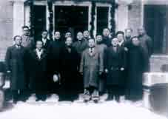
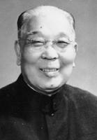
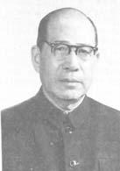
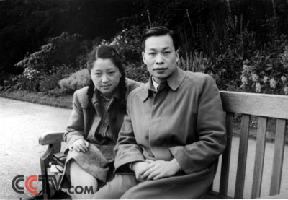
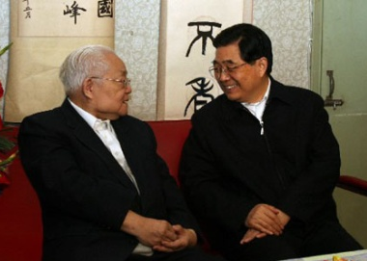
History of scientific cooperation between China and France
15th century, new scientific thoughts and technogies were brought to China from France by freindly personalities
17th century, French Academy tried to establish relationship with China
1928, Academia Sinica was established on the French model
1920s-40s,
Yan Jici, physicist,
Wang Dezhao, acoustician,
Qian Sanqiang and He Zehui, physicists, ……
1978，Government Scientific Cooperation Agreement
1991，PRA (Programme de recherche avancé) Agreement between Chinese Ministry of Science and Technology and French Ministry of Foreign Affairs
Notes:
（严济慈）（汪德昭）（钱三强）（何泽慧）

Slide 16
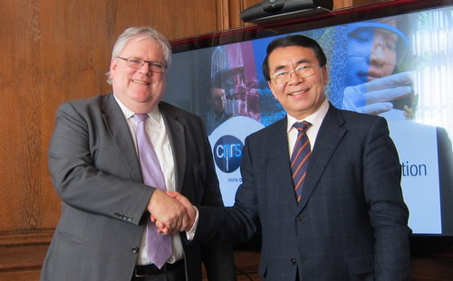
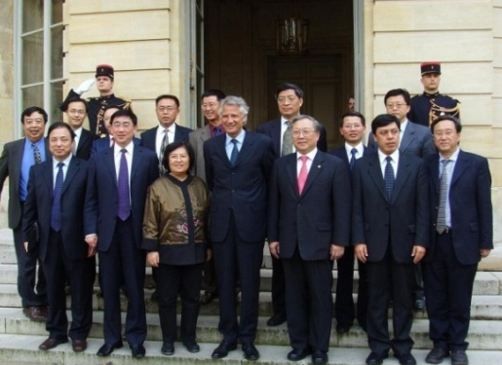
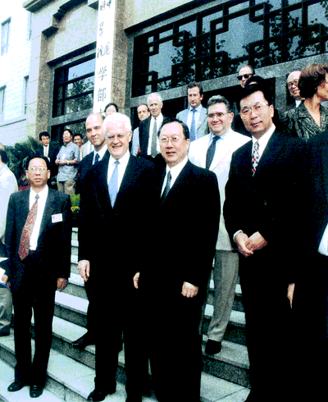
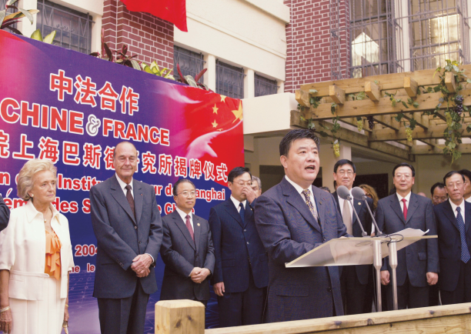
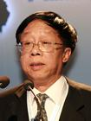
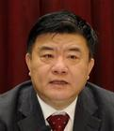
Cooperation agreements with French research organizations
1. National Center for scientific Research (CNRS)，1978
2.Agency for Atomic Energy (CEA)，1979
3. National Institute for health and medical research (Inserm), 1981
4. National Institute for Research in Computer Science and Control (INRIA), 1981
5.Academy of Sciences, 1989
6. Institut Pasteur ，2000
7. National Institute for Agronomic Recherche (INRA)，2001
8. Academy of Technologies, 2007
Notes:
Zhan cnrs

Slide 17
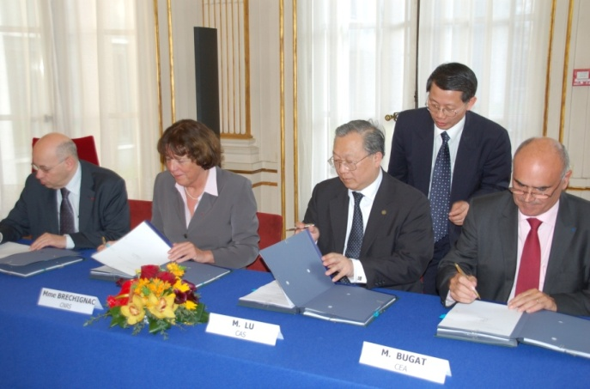
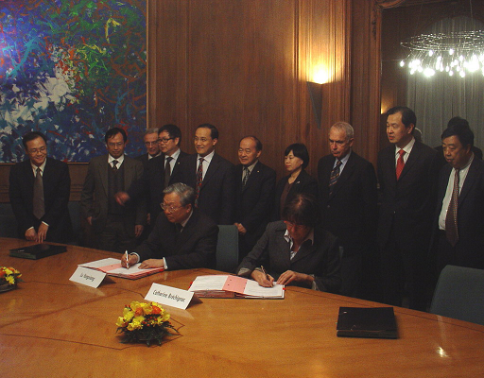
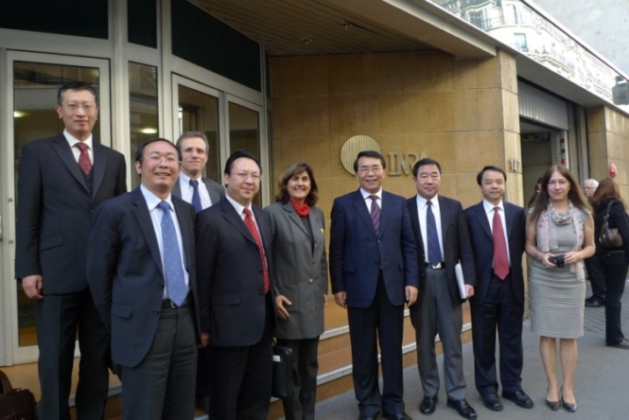
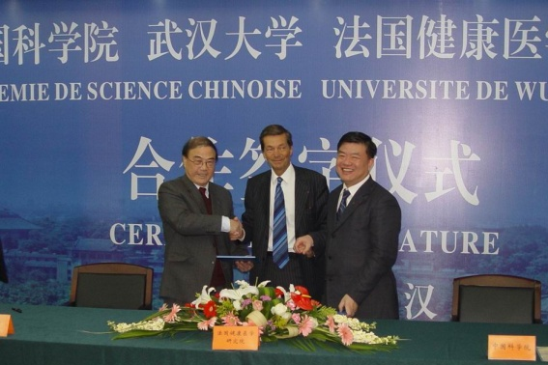
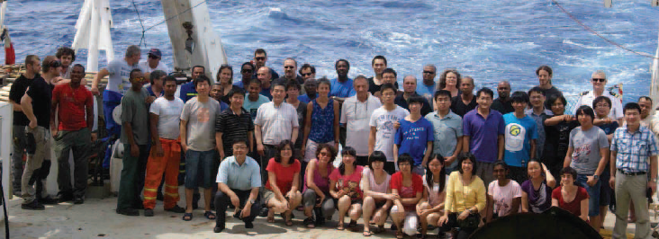
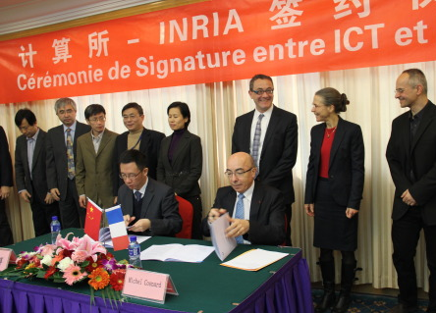
Particle Physics, Clean Energy, Astronomy,
Computer science, Ocean, Stem cell, Atmosphere…….

Slide 18
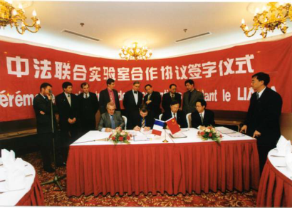
financial model of joint lab.
1997 : The Sino-French Laboratory for computer science, automation and applied mathematics
2009: LIAMA Consortium
MOST,
NSFC…
2009-2013
CASIA: Institute of Automation, Chinese Academy of Sciences
1997—1999
CNRS: National Center for Scientific Research
Ecoles Centrales
2000—2003
INRIA: The French National Institute for Research in Computer Science and Control
NPWU: Northwestern Polytechnical University
2004－2008
Tsinghua University
Vrije Universiteit Brussel
Notes:
对等的原则下，中法双方又各增加近50%的投入,附件是我们的2008年签署的中法英文协议，目前这个协议正在讨论修改过程中，关于经费的部分就是考虑到汇率的变化。因为2008年汇率是10的时候，法方的FundingMember给LIAMA Office 1万欧元，中方单位是10万人民币，目前汇率变为8了，法方还给我们1万欧元。Liama现在有7个Funding Member。LIAMA Office的经费主要用于支付LIAMA Office雇佣人员的工资，房租，日常办公，来访，学术会议交流，LIAMA的理事会和学术委员会会议，新研发项目的支持等。
2008年LIAMA被科技部和国家外国专家局评为“国家级国际联合研究中心”，科技部分别于2008年和2009年以项目的形式给予LIAMA运行经费支持。
目前科技部和基金委都有国际合作的项目申请，但是均没有基地和实验室运行经费方面的支持。我们希望能得到持续稳定的支持，确保实体性的国际合作实验室运行和发展。
ARTICLE 7 FINANCIAL MANAGEMENT
7.1 Budget
The Consortium budget consists of the resources and expenses of both the LIAMA Office and the Projects of mutual interest of the Consortium.
All resources made available for the Consortium shall be valued in accordance with the usual accounting and management principles and practices of the respective Members.
The budget is divided into the Budget of the LIAMA Office, and the Budget of each Project of mutual interest.
At the beginning of each civil year, Members undertake to set up yearly their contribution, whether human, financial or material, to the LIAMA consortium and their allocation.
On this basis, the Directorate sets up an annual provisional budget, specifying the allocation of resources and expenses for the different activities of the Consortium.
This annual provisional budget is then submitted for approval to the Steering Committee, which decides on the final allocations, respecting the budget allocation of the Members to the respective Projects.
At the end of each civil year, the Directorate establishes an annual financial report, which is submitted for approval to the Steering Committee
7.2 Accountability
All accounting acts in connection with the budget of the Consortium shall be made by the Host member, in accordance with the relevant rules applicable to it.
The Host member shall promptly provide the Members all required justifications upon the release of the Consortium funds.
The accounting of the Consortium is made by CASIA for the LIAMA office, and the Projects of mutual interest in which CASIA is involved.

Slide 19
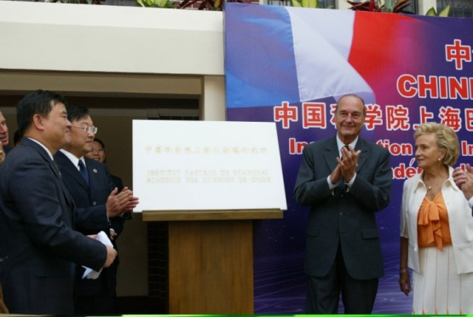
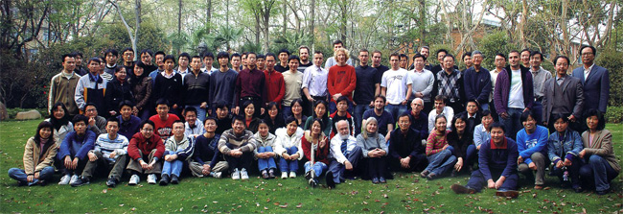
financial models of joint institutes
CAS-MPG Partner Institute
For Computational Biology
First stage（2006-2008）
First stage (2004-2009)
CAS (50 M rmb)
Pasteur Institute (12,5 M+ donation) Shanghai Municipality (50 M rmb )
CAS (1 M euro/year)
Max Planck Society (0.5 M euro/year)
(2004-2012 Ministry of Education and Research, Germany)
International grants: over 55 Million RMB
Notes:
一期协议中马普学会资助为50万欧元，合5百万人民币（来自联邦教研部，2012年终止），我院按2:1支持1千万人民币。二期协议中马普学会将资助额度提高为1百万欧元（此外，联邦教研部资助50万欧元仍会持续到2012年），我院将按比例支持伙伴研究所2千万人民币。

Slide 20
Research Funds In China
Ministry of Science and Technology
Framework Programs, EU
http://www.most.gov.cn
http://www.istcp.org.cn
http://www.cistc.gov.cn
International Cooperation Base for S&T
National Natural Science Foundation of China
http://www.nsfc.gov.cn/Portal0/default166.htm
Ministry of Education and Chinese scholarship Council
http://www.moe.gov.cn/publicfiles/business/htmlfiles/moe/moe_2792/index.html
The State Administration of Foreign Experts Affairs
“Recruitment Program of Foreign Experts”
http://1000plan.safea.gov.cn/
Notes:
The “Recruitment Program of Foreign Experts” aims to introduce in five hundred to a thousand high-level foreign experts over a ten-year period, or fifty to a hundred a year, to cope with the demand for high-level expertise in the key sectors of China’s socio-economic development.

Slide 21
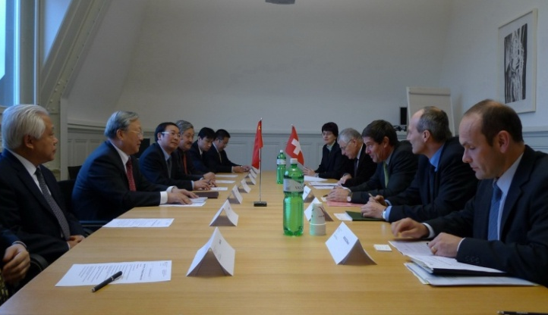
CO-funding Program and International Key Projects of CAS
State Secretariat for Education and Research, Switzerland (SER)
Royal Netherlands Academy of Arts and Sciences
Research Council of Norway
Academy of Finland, Finland
Engineering and Physical Sciences Research Council, UK
Helmholtz Association, Germany
Identify
Priority
Areas
Receive
Application
Joint
Funding
Joint Call
for Proposal
Peer
Review
Joint
Evaluation
Year | Priority Areas with Germany
2009 | Integrated Water Management
2010 | Biomass Conversion
2011 | Medical Devices in an Aging Society
2012 | Agriculture & Food: How to Feed the World?
Notes:
课题经费的开支范围一般包括设备费、材料费、测试化验加工及计算分析费、燃料动力费、差旅费、会议费、国际合作与交流费、出版/文献/信息传播/知识产权事务费、劳务费、专家咨询费、管理费等。
国际合作与交流费：是指在课题研究开发过程中课题研究人员出国及外国专家来华工作的费用。国际合作与交流费应当严格执行国家外事经费管理的有关规定。
项目经费是指在项目组织实施过程中与研究开发活动直接相关的、需由项目经费支付的各项费用。项目经费一般由课题经费和综合集成与调控经费组成。

Slide 22
Talent Program
Einstein Professorship
Supporting world-class scientists to lecture in China
Fellowship for Senior International Scientists
Supporting well-established researchers to work at CAS
Fellowship for Young International Scientists
Supporting young researchers
to work at CAS
International Partnership Program for Creative Research Teams
Supporting partner groups to implement joint research
Talent Program for Big Science Facilities
Jointly launched by CAS and SAFEA
Award for International Scientific Cooperation
Award foreign experts with outstanding contribution in their cooperation with CAS
International Cooperation Award for
Young Scientists
Award young scientists and their collaborators for academia and cooperation
http://english.bic.cas.cn/ Bureau of International cooperation, CAS

Slide 23
Einstein Professorship Program
awarded each year to 20 distinguished international scientists actively working at the frontiers of science and technology, for conducting lecture-tours to China. The cost of accommodation and transportation in China
Duration: 1-2 weeks
Fellowship for International Senior Scientists
For senior scientists holding a PhD degree, with academic standing as a Professor, Associate Professor or equivalent.
Duration: 2-12 months with extension possible
The fellowship:
500,000RMB per year
400,000RMB per year
A round-trip international airfare
765 recipients, 2009 - 2012
Fellowship for
International Young Scientists
For young researchers with a PhD degree, under the age of 40, and over five years of research experience
For Post-doctoral applicants under the age of 35.
Duration: 12 months with 12 months extension via evaluation
The fellowship:
250,000RMB per year
150,000RMB per year
A round-trip international airfare
295 recipients, 2009 - 2012
Notes:
CAS key int’l/ cooperation programs
Provides seed support to well-designed concrete cooperation projects
Einstein Professorship
Supports 20 or so world-class scientists to lecture in China every year. It requires awardee’s assistance in receiving our scholars
CAS Fellowship for Senior International Scientists
Supports well-established int’l scientists at associate professor and professor level with related and focused research associated with the host collaborator
From a few months to a year and beyond if needed
CAS Fellowship for Young International Scientists
Supports int’l young scientists with PhD and a few years of research experience; with related and focused research associated with the host collaborator
Usually a year and extension possible if meeting requirements

Slide 24
Statistics of the fellowships for international scientists
(2009 and 2010)
International Young Scientists
International Senior Scientists
Notes:
4,5，基本和总体交流量排位相当。人数在欧盟范围内不及德国和英国。提醒我们需要提高合作的质量。
外国专家特聘研究员和外籍青年科学家计划实施一年多来，在国内外引起了广泛的影响，得到了国务院领导的充分肯定。
财政部为我院设立外国科学家专项，为我院长期国际合作交流人才工作实施奠定良好基础。
刘延东国务委员在出席我院外国专家交流会时指出
中科院率先实施“外国专家特聘研究员计划”和“外籍青年科学家计划”，探索了科技创新与人才培养结合的新模式。
希望不断总结经验，完善机制，扎实推进，使之成为具有示范意义和国际影响的科技合作与交流计划。
外国专家们就我院持续推进国际科技合作，促进中外科学家开展长期合作提出了很好的建议：邀请和招收更多的交叉学科的优秀科研人员，结合科学院学科领域多、覆盖地域广的特点，做出世界一流的科研工作。在华工作时间能够相对长一些，如延长至两年，甚至到３至５年，以利于能有充分的时间完成一些高水平的合作研究项目，提供后续支持……

Slide 25
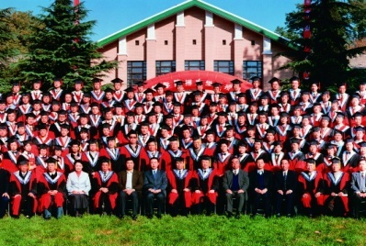
The China-Europe Joint Doctoral Fellowship Program
European Countries (non-English speaking countries)
Scholarship for 12 moths & international airfare
Cost for learning local language
Nations | Organizations | 2006 | 2007 | 2008 | 2009 | 2010 | 2011 | Total | %
Germany | Max Planck Society | 35 | 32 | 25 | 18 | 35 | 40 | 185 | 82%
 | DAAD |  | 17 | 10 | 10 | 11 | 10 | 58
 | Fraunhofer-Gesellschaft |  |  | 11 | 7 | 10 | 10 | 38
France | CNRS |  |  | 6 | 15 | 17 | 15 | 53 | 18%
 | INRIA |  |  |  |  | 5 | 3 | 8
342
Notes:
可以延长
To enhance substantial scientific cooperation in cutting-edge research, it is suggested to set up research program or project based Scientist Group, Joint Center, Laboratory, or Partner Institute etc.
Deutscher Akademischer Austausch Dienst, DAAD
2005年 路院长提出向欧洲非英语国家派遣博士生。
2006年 我院出台管理办法。路院长与德国马普学会签署合作协议。批准35人。
2007年 德国 49人 （马普学会32人，德意志学术交流署17人）
与德国弗朗恩霍夫学会签署合作协议
与法国科研中心商签合作备忘录
2008年 德国 46人 （马普学会 25人，德意志学术交流署 10人，弗朗恩霍夫学会11人）
法国 6人 法国国家科研中心
与法国自动化研究院签备忘录
2009年 德国 35人（德国马普学会18人、学术交流署10人，弗朗恩霍夫学会7人）
法国 15人 法国国家科研中心
商议与瑞士苏黎世高工等高校开展培养计划

Slide 26
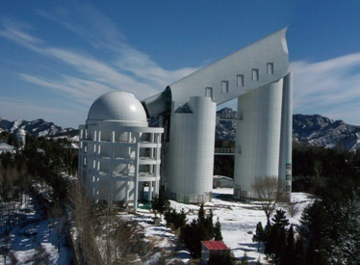
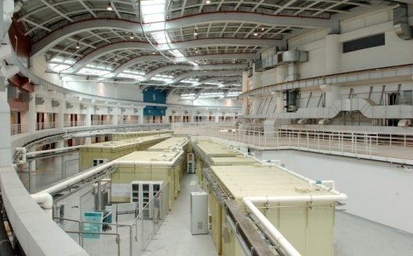
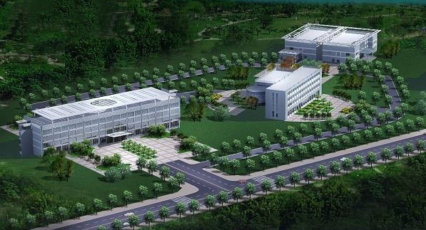
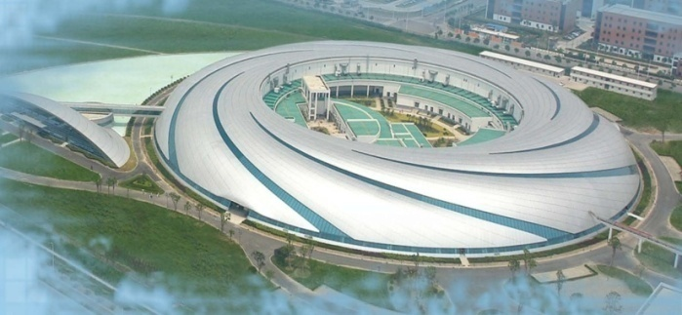
Thank you!
Notes:
Just intend to give you a quick tour of CAS. It is a non-traditional national Academy with solid strong R&D, education functions and plus. Though a huge mixture of many things, it has been doing well in China’s setting. Looking ahead, though facing lots of challenges, it is expected to continue to do well and very likely better due to its legacy and tradition.
International cooperation has been one of the recipes of CAS success in the past. We will continue to enhance for mutual benefits and mutual progress.

