Slide 1
POSITRON SOURCES FOR LINEAR COLLIDERS
Robert CHEHAB
IPNL/IN2P3/CNRS AND UNIVERSITE LYON 1
On behalf of ILC_IHEP_IPNL_POSITRON_SOURCE Group*
* Associated with Peter Sievers (CERN)

Slide 2
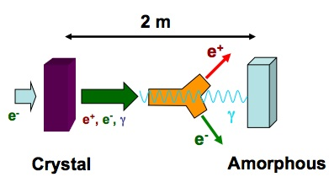
POSITRON SOURCES FOR LINEAR COLLIDERS
THE PROJECT
The principle: the project is based on a new kind of positron source using the intense and relatively soft (some MeV to tens of MeV) photons generated in an axially oriented crystal by channeled multi-GeV electrons.
An amorphous converter is associated to this radiator in order to convert the photons into e+e- pairs. Placed at some distance (2-3 meters) from the crystal, it allows to decrease significantly the energy deposition density and, hence, its peak value (PEDD). The latter being very harmful as observed for the SLC target.

Slide 3
POSITRON SOURCES FOR LINEAR COLLIDERS
THE MAIN ADVANTAGES
The very high intensity needed for the e+ in the LC, requires very intense incident electron beams. Two main ways are chosen to address this challenge;
- multi-target systems to alleviate the incident power on each target,
- the transformation of long nominal incident e- pulses into a succession of
short ones to withstand the high power/pulse value.
ADVANTAGES OF THE HYBRID SOURCE
1- Lowering the PEDD allows avoiding of multi-target systems =>> choice of CLIC
The hybrid e+ source is chosen as the baseline for CLIC
2- The separation of the two functions (radiation and pair creation) allows appropriate choices for the converter material. In our case, we have developed the idea of using granular amorphous converters, which make easier the power dissipation.

Slide 4
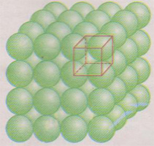
POSITRON SOURCES FOR LINEAR COLLIDERS
GRANULAR AMORPHOUS CONVERTERS
As already pointed out (see P.Pugnat, P.Sievers) [J.Phys.G.Nucl.Part.Phys.29 (2003)1797-1800]
a granular converter made of small
spheres of ~ mm radius offers the
advantages of presenting a relatively
high [surface/volume] ratio which is
interesting for the power dissipation.
Staggered rows of spheres have been
considered, which leads to an effective
density of about 72 % of pure W.
The densest possible packing would be
85 % with special arrangement.
A comparison has been carried out
between the granular and the compact
targets concerning the yield an deposited
energy.

Slide 5
POSITRON SOURCES FOR LINEAR COLLIDERS
WORKS MADE IN 2012
As the hybrid positron source has been selected by CLIC as the baseline (with compact W converter) a particular effort was put on its application for ILC. In particular, the very high intensity with ms pulses led to the following steps:
1- Modification of the beam pulse structure
transforming the nominal 1 ms pulse into
minitrains of 100 bunches generated at a
frequency of 300 Hz. There are 13
minitrains in a macropulse. The scheme is
based on Omori’s suggestion.
2- Choice of a granular W converter made
of small spheres (~mm) in order to have a
better heat dissipation (~ 1/R; R being the
sphere radius).
3- Use of a multi-target system on a rotating
device.

Slide 6
POSITRON SOURCES FOR LINEAR COLLIDERS
WORKS DONE IN 2012 (continued)
The capture and transport of the e+ has been studied and optimized with the following the steps:
* Comparison of different capture systems :
# Axial magnetic fields:
=>> Quarter Wavelength Transformer (QWT)
=>> Adiabatic Matching Device (AMD)
# Azimuthal magnetic field : Lithium lens.
Their performances in terms of the e+ beam qualities were investigated.
The optimization concerning the targets and the capture and transport was the subject of the PhD thesis of Chenghai XU from IHEP. This thesis was carried out under a co-direction (Beijing &Orsay) and with a co-tutelle between U-Psud and Graduate University of CAS.

Slide 7
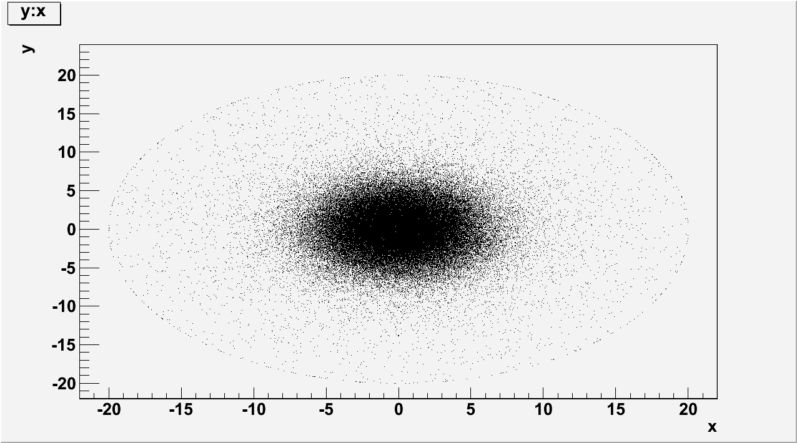
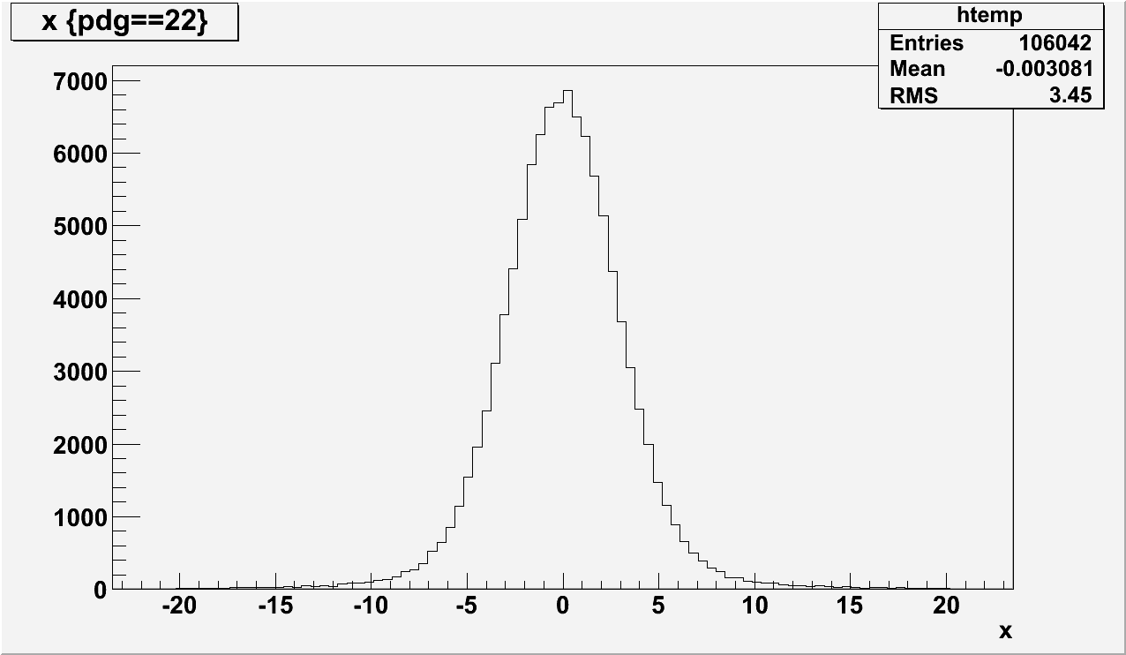
POSITRON SOURCES FOR LINEAR COLLIDERS
SOME RESULTS:
THE HYPOTHESIS
The following results are obtained with an hybrid source using a W crystal, 1 mm thick on which a 10 GeV e- beam is impinging; rms transverse radius of e- beam is 2.5 mm. An illustration of the γ beam is given:
X-Y image of the photon beam
Transverse photon distribution

Slide 8
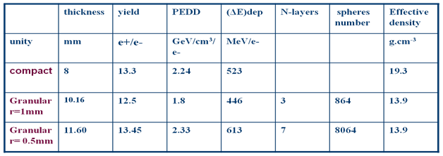
POSITRON SOURCES FOR LINEAR COLLIDERS
SIMULATIONS ON COMPACT AND GRANULAR CONVERTERS
A comparison has been carried out using an electron incident beam of 10 GeV.

Slide 9
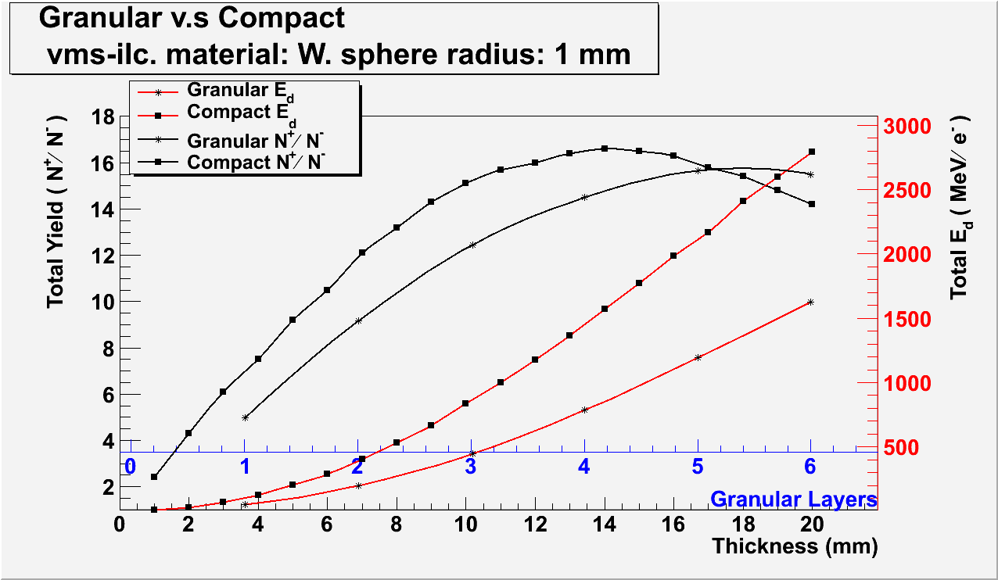
POSITRON SOURCES FOR LINEAR COLLIDERS

Slide 10
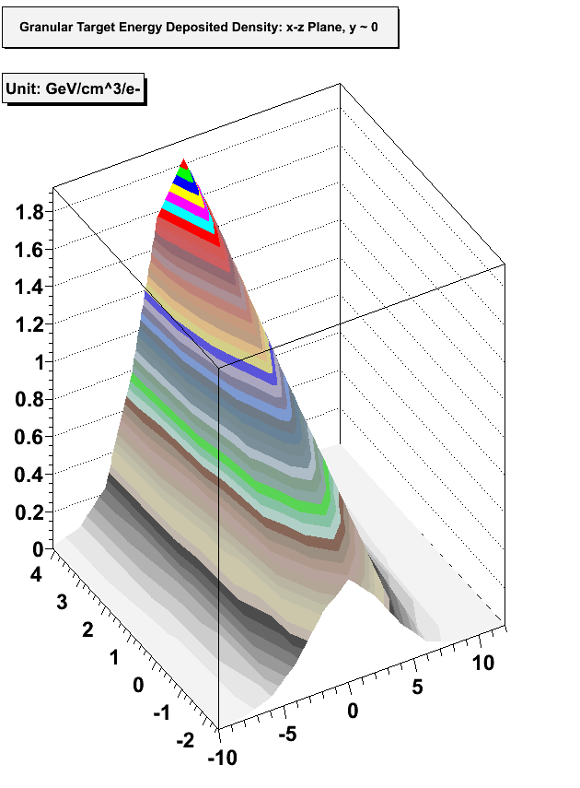
POSITRON SOURCES FOR LINEAR COLLIDERS
PEDD
The PEDD has been also simulated in the amorphous compact/granular converter. The results of the simulations are given. We can notice the interest of the granular converter w.r.t. the compact one (20% less for the PEDD).
We have chosen to modify the beam
time structure, following the
proposition of Omori et al, to reach
a reasonable amount of energy
deposition density in the converter.
The granular converter is made of 3 layers
=>> Energy deposition: 446 MeV/e-
=>> PEDD; 1.8 GeV/cm3/e-

Slide 11
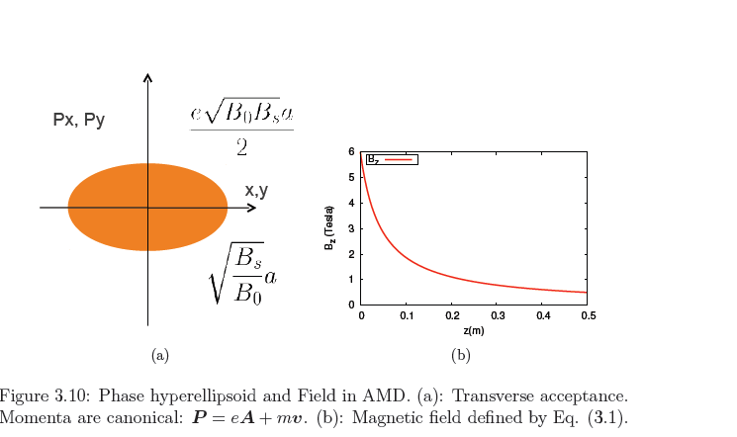
POSITRON SOURCES FOR LINEAR COLLIDERS
CAPTURE OF THE POSITRONS AFTER THE GRANULAR CONVERTER: AMD
The Adiabatic Matching Device is the most proposed for e+ focusing; great momentum acceptance =>> high yield
Bo and Bs are the maximum and minimum values of the magnetic field; a, is the accelerator radius.

Slide 12
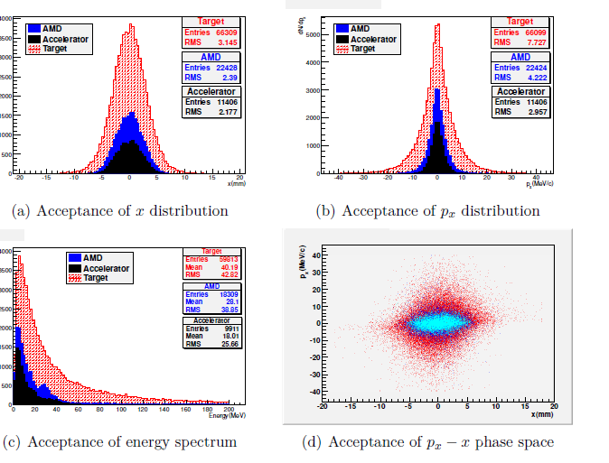
POSITRON SOURCES FOR LINEAR COLLIDERS
POSITRON BEAM FROM TARGET TO ACCELERATION =>> AMD FOCUSING
POSITRON ACCEPTANCE
The positrons are accelerated on 1 meter after the AMD

Slide 13
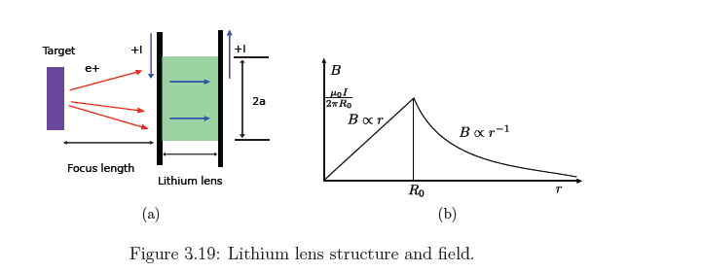
POSITRON SOURCES FOR LINEAR COLLIDERS
POSITRON FOCUSING WITH LITHIUM LENS
The Lithium lens provides an azimuthal magnetic field: it focuses one kind of particle and defocuses its anti-particle=>> interesting to capture positrons only. The ejected electrons are dispersed=>> need of a collimation to avoid energy deposition.

Slide 14
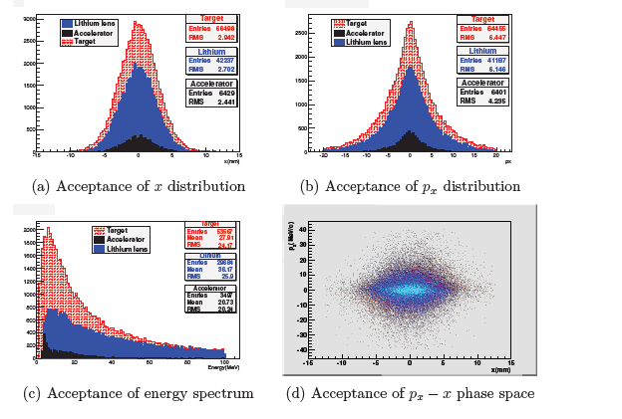
POSITRON SOURCES FOR LINEAR COLLIDERS
POSITRON BEAM FROM TARGET TO ACCELERATION =>> LITHIUM LENS
POSITRON ACCEPTANCE
The positrons are accelerated on 1 meter after the Li lens

Slide 15
POSITRON SOURCES FOR LINEAR COLLIDERS
ADVANTAGES OF THE GRANULAR TARGETS
If we consider the convective cooling in a pulsed
temperature regime, the decay time is given by:
τ = C.m/α.S
Where C is the specific heat, m, the sphere mass,
α, the convection cooling coefficient, and S, the
sphere surface. This expression may be written:
τ= C.ρ.R/3.α
With ρ, the density and R the radius of the sphere;
As for a sphere, S/V is 3/R τ 2τ 3τ
it shows clearly that a fast cooling requires small R value. So, using small spheres present a real interest to ensure rapid cooling. However, some practical limit to small radii is leading to the choice of R~ 1 mm, at least.

Slide 16
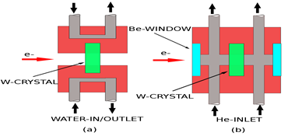
POSITRON SOURCES FOR LINEAR COLLIDERS
APPLICATION TO ILC: HEATING AND COOLING FOR THE HYBRID SOURCE
THE CRYSTAL;
The crystal must be cooled in order
to preserve its qualities. A stationary
crystal, which receives 5 pulses/second,
leads to important increases
of temperature: 275 °C (water cooled)
and 406 °C, He cooled. So, we consider
an array of 5 crystals with a transverse
displacement of 5 cm/s. In that case,
a crystal is receiving 1 pulse/second and
the temperature rise is of 178 °C (water)
and 365 °C (He).

Slide 17
POSITRON SOURCES FOR LINEAR COLLIDERS
CONVERTER COOLING
Considering the high positron intensity, a stationary target would be irrealistic. A moving target is needed. Moreover, the granular nature of the target makes the cooling by a gas flow (He) particularly appropriate.
We considered 2 solutions:
* use of a pendulum
* use a rotating wheel

Slide 18
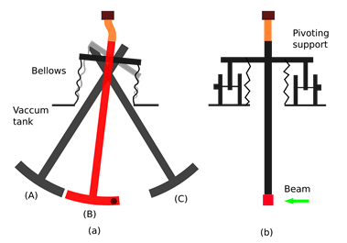
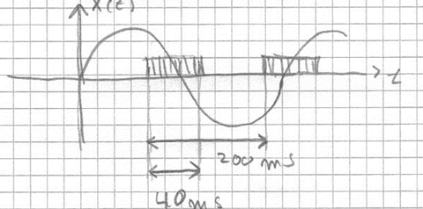
POSITRON SOURCES FOR LINEAR COLLIDERS
PENDULUM;
The moving system for the granular
Coverter uses a pendulum. To place the µpulses besides each other, the speed is 1cm/3.3 ms =>> 3m/s. The time sharing
between beam on and beam off is given below.
The arc length is 13 cm and the frequency, 2.5 Hz.

Slide 19
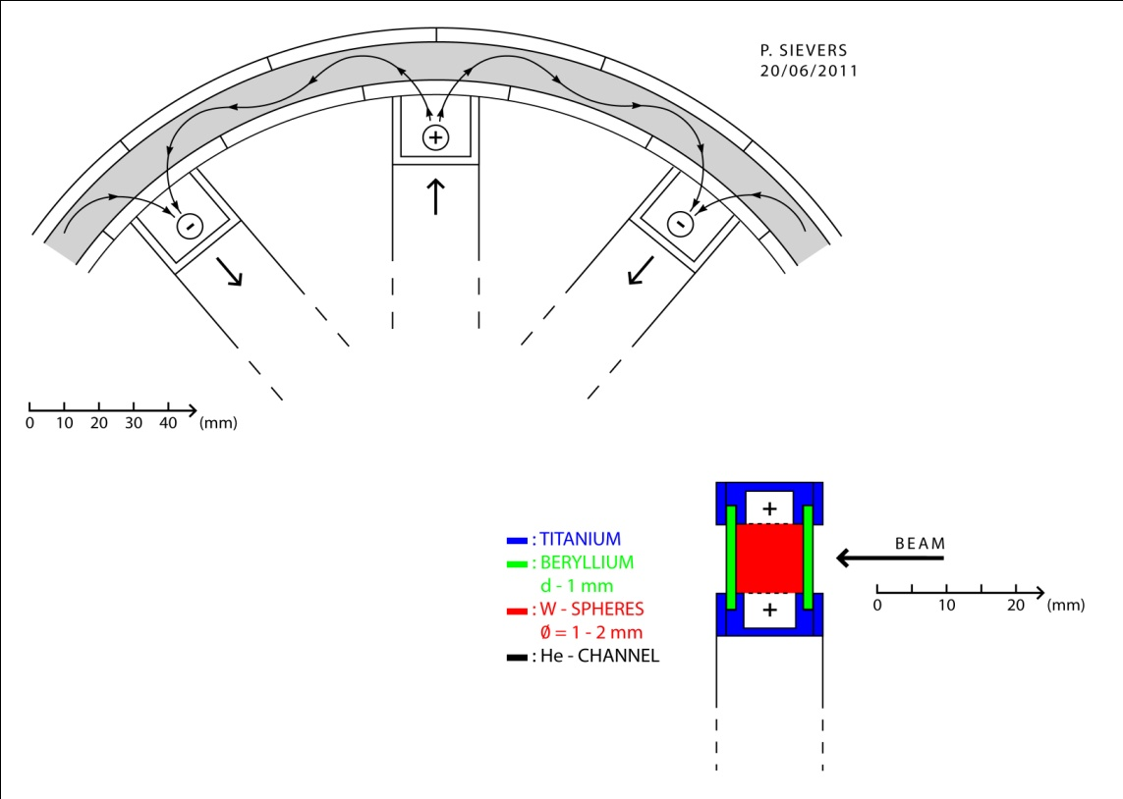
POSITRON SOURCES FOR LINEAR COLLIDERS
THE ROTATING WHEEL:
The wheel diameter is 58 cm ; there
are 182 places for the µpulses. The
rotation is: 100 rpm. A He flow is
circulating to cool the spheres. Be
windows are at upstream and
downstream faces of the target.

Slide 20
POSITRON SOURCES FOR LINEAR COLLIDERS
SUMMARY AND CONCLUSIONS
The hybrid positron source using a high photon yield from channeling radiation in a crystal which generates an intense positron beam in an amorphous converter appears as a promising solution for future linear colliders. It has already been selected as the baseline for CLIC. Moreover, using a granular converter allows improvement of the heat dissipation and also of the PEDD. That allows to consider it for a very intense positron source as that of ILC. Simulations based on a transformation of the ILC beam structure before the target , which is then given back after the Damping Ring, led to an almost complete description of an unpolarized positron source for ILC. Some results of these simulations have been presented; technical particularities concerning the cooling of the crystal-radiator and the granular converter were also provided.
This work was a basis for the PhD of XU Chenghai worked out in a co-direction framework between France and China and defended in May 2012 at IHEP.
It is important that further simulations concerning the optimization of the heating problems continue.

Slide 21
POSITRON SOURCES FOR LINEAR COLLIDERS
THE EXCHANGES FRANCE-CHINA
The PhD student (Chenghai XU) defended his PhD (in co-direction between France and China) in May 2012 at IHEP. Two european colleagues took part in the jury:
* Robert Chehab (IPNL/IN2P3); responsible of the research activity
of Chenghai ,
* Peter Sievers (CERN) ; followed a part of Chenghai research ( on
granular converters)

Slide 22
POSITRON SOURCES FOR LINEAR COLLIDERS
PUBLICATIONS
Articles
Xu Chenghai, Robert Chehab, Peter Sievers, Xavier Artru, Michel Chevallier, Olivier Dadoun, PEI Guoxi, Vladimir Strakhovenko, Alessandro Variola “A positron source using an axially oriented crystal associated to a granular amorphous converter” in Chinese Physics C, Vol.36, No 9 , (Sep.2012) 871-878
Report (PhD)
PhD thesis Report of Chenhai XU: “Intense source of positron using channeling effect in crystals” defended on May 17th, 2012 in Beijing.
Workshops
POSIPOL, September 2012 (Zeuthen, Germany)
“Granular vs compact positron converters: advantages and applications to hybrid sources” by X.Artru (IPNL), R.Chehab (IPNL), M.Chevallier (IPNL), O.Dadoun (LAL), L.Rinolfi (CERN), P.Sievers(CERN), V.M.Strakhovenko (BINP), A.Variola (LAL), C.Xu (IHEP).,
(Presented by P.Sievers)

Slide 23
POSITRON SOURCES FOR LINEAR COLLIDERS
Other publications in 2012
Workshop RREPS-2011 (Royal Holloway, University of London, 12-16 Sept. 2011)
O. Dadoun, G. Le Meur, F. Touze, A. Variola, X. Artru, R. Chehab, M. Chevallier, V. Strakhovenko,
An event generator for crystal source. Application of the CLIC positron baseline.
IX Int. Symp. On Radiation from Relativistic Electrons in Periodic Structures (RREPS-2011), Journal of physics: Confernce Series 357 (2012) 012024.

Slide 24
POSITRON SOURCES FOR LINEAR COLLIDERS
PERSPECTIVES
In the close future the research activity will focus on:
* The complete transport of the positon beam to the Damping Ring
* The study of the radiation damages in the crystal
* Simulations on the distribution of the deposited energy and
optimization of the parameters (converter structure, distance
between radiator and converter,..) to lower the PEDD
* Complete determination of the heat load in the targets
Concerning the two last points, the collaboration of Dr. Song JIN (IHEP) , with a visit in France, is expected. Such activity is linked with the test of an hybrid positron source, with a granular converter, at KEK which nearest date would be in january 2014.

