Slide 1
DIRAC Distributed Computing Services
A. Tsaregorodtsev,
CPPM-IN2P3-CNRS FCPPL Meeting, 29 March 2013, Nanjing

Slide 2
Plan
DIRAC Project
Resources available to DIRAC users
DIRAC in the FCPPL Collaboration
Conclusions
Notes:
Qui a besoin de plus qu’un seul ordinateurs pour le travail ?

Slide 3
DIRAC Project
DIRAC is developed originally for the LHCb experiment with the goals:
Integrate all the heterogeneous computing resources available to the community
Provide a complete solution for all the tasks - both WMS and DMS tasks
The experience collected with a production grid system of a large HEP experiment turned out to be very valuable
Several new experiments expressed interest in using this software relying on its proven in practice utility
In 2009 the core DIRAC development team decided to generalize the software to make it suitable for any user community.
Separate LHCb specific functionality into a set of extensions to the generic core services
Now DIRAC is used by multiple projects
HEP: LHCb, ILC/CLIC, Belle II, BES III, ( SuperB )
Astrophysics: CTA, Glast, Fermi-LAT, LSST
Other communities: biomed, earth sciences, etc

Slide 4
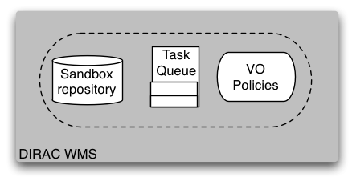
Physicist
User
Production
Manager
Matcher
Service
EGI/WLCG
Grid
NDG
Grid
GISELA
Grid
CREAM
CE
EGEE
Pilot
Director
NDG
Pilot
Director
EELA
Pilot
Director
CREAM
Pilot
Director

Slide 5
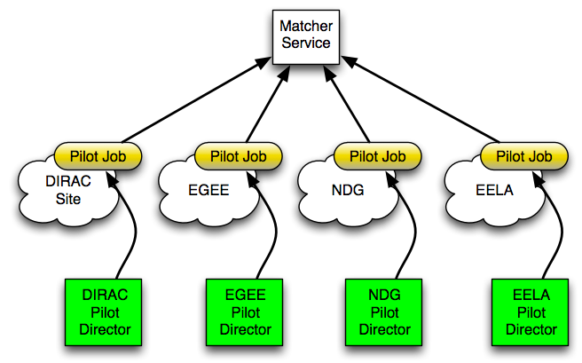
WMS: using heterogeneous resources
Including resources in different grids and standalone clusters is simple with Pilot Jobs
Needs a specialized Pilot Director per resource type
Users just see new sites appearing in the job monitoring

Slide 6
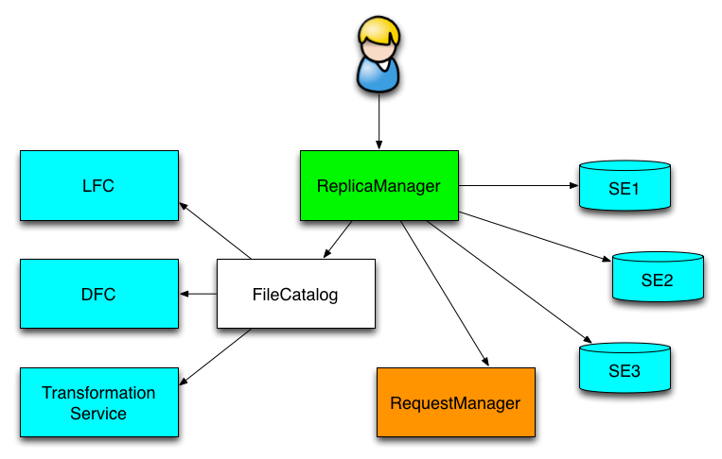
Data Management components
Various Storage and Catalog service are hidden behind a uniform abstract interface
For DIRAC users the use of any Storage Element or File Catalog is transparent
Users see depending on the DIRAC Configuration
Logical Storage Elements
Logical File Catalog

Slide 7
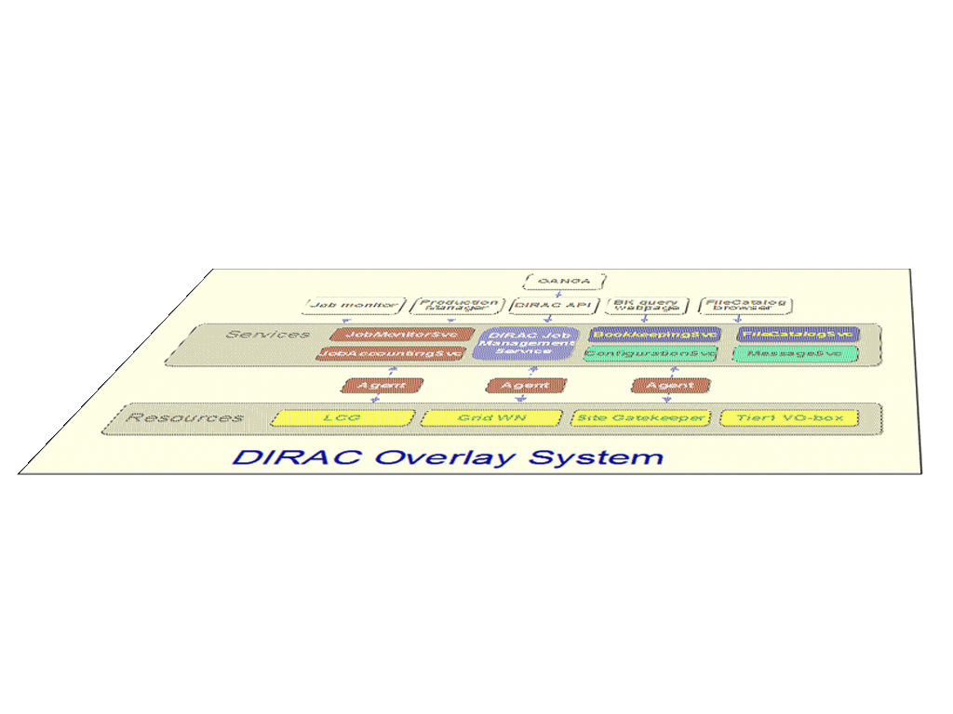
Interware
DIRAC has all the necessary components to build ad-hoc grid infrastructures interconnecting computing resources of different types. This allows to speak about the DIRAC interware.
User Community
Grid A
Grid B

Slide 8
DIRAC as a resource manager

Slide 9
Computing resources
It fully supports several grid infrastructures
gLite: EGI, GISELA, OSG, …
ARC: NorduGrid
Other types of grids can be supported if there will be customers
Conventional computing centers with different batch systems not involved in any grid infrastructure
LSF, BQS, SGE, PBS/Torque, Condor
More to come: OAR, SLURM, LoadLeveler. Etc
Clouds are a new emerging paradigm for distributed computing
DIRAC is supporting multiple cloud managers:
OpenStack, OpenNebula, CloudStack, Amazon EC2

Slide 10
DIRAC in FCPPL

Slide 11
Enhancing basic tools
Explore the possible use of distributed “NoSQL” databases for the DIRAC services
Accounting, Monitoring, etc
This has a potential to create distributed systems of a new scale
Adding more computing resources available to DIRAC users
Cloud storage resources based on the Amazon S3 standard
Desktop volunteer virtualized grids

Slide 12
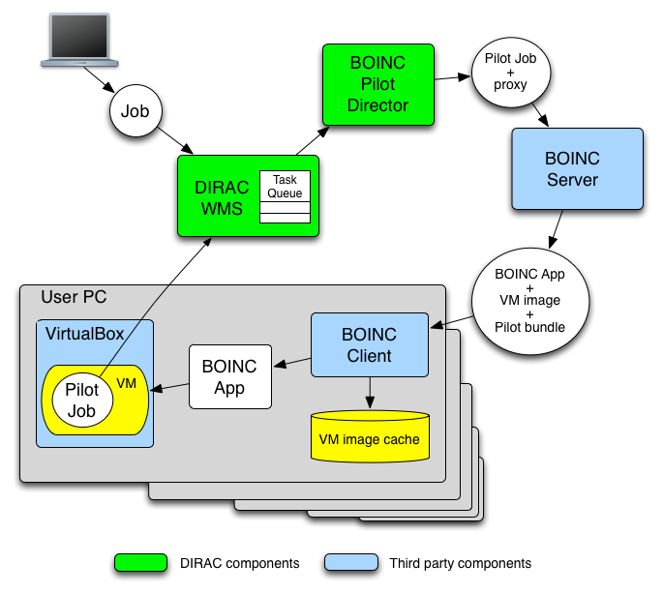
BOINC Desktop Grids
Work done by Jie Wu and followed now by Wenxiao Kan at CPPM
PhD students
On the client PC the third party components are installed:
VirtualBox hypervisor
Standard BOINC client
A special BOINC application
Starts a requested Virtual Machine
Executes Pilot Job in the VM
Prototype system is functioning in the DIRAC installation in CC/Lyon

Slide 13
Experiment support
Building the distributed computing system for the BES III experiment
Continue the support of the already deployed system
Add more functionality as needed
E.g. Condor sites support
Data management operations
Data Catalogs
Setting up the MC production system for the TREND experiment
Perform the case study
Setup available computing resources with the DIRAC service at IHEP
Create the MC production workflow

Slide 14
DIRAC as a Service

Slide 15
DIRAC as a service
DIRAC client is easy to install
Part of a usual tutorial
DIRAC services are easy to install but
Needs dedicated hardware for hosting
Configuration, maintenance needs expert manpower
Monitoring computing resources
Small user communities can not afford maintaining dedicated DIRAC services
Still need easy grid access
Large grid infrastructures can provide DIRAC services for their users
Distributed computing resources should be available to the users as easily as Google search engine, for example

Slide 16
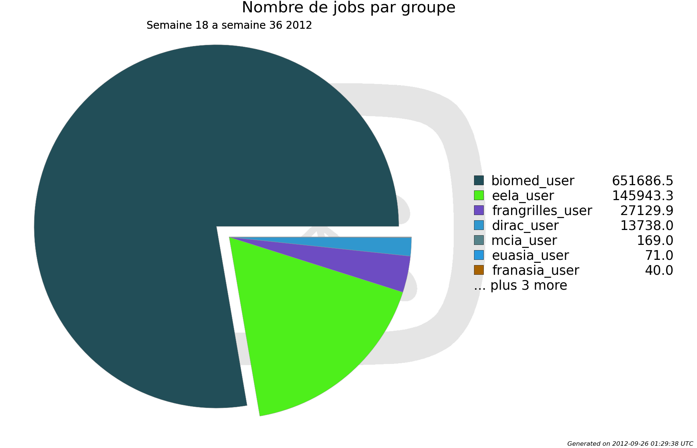
France-Grilles DIRAC service
Started as a support for user grid tutorials
The FG-DIRAC joint project
Hosted by the CC/IN2P3, Lyon, T1 center
Distributed team of service administrators
5 participating universities
France-Grilles users
15 Virtual Organizations, 88 users registered
astro, biomed, esr, euasia, vo.france-asia.org, etc
More VO’s and users can be added as necessary
In production since May 2012
First ~3 millions jobs went through the system
Mostly biomed applications

Slide 17
“CAS-DIRAC” service
Proposal to build similar service at IHEP
Leverage the FG-DIRAC project experience and experience of the DIRAC usage at IHEP
Computing resources
Conventional grids
France-Asia grid sites
CNGrid
CC/IHEP(Beijing), National Supercomputing Centre (Shenzhen)
IHEP campus desktop grid based on the BOINC technology
Computing clouds ( e.g. OpenStack )
Storage resources
Conventional, e.g. gLite/SRM SE, DIRAC SE
S3 Cloud storage
iRods storage

Slide 18
“CAS-DIRAC” service (cont’d)
Target user communities
Collaborations with involvement of users from China
Users from the Asia Pacific region
Use the service to provide assistance to the actual and potential users of the system
Tutorials
Assistance in porting applications to the grid

Slide 19
Conclusions
DIRAC is a versatile tool to build distributed computing systems used in multiple user communities in different scientific domains
Within the FCPPL Collaboration DIRAC will be further enhanced to use novel technologies and computing resources
Setting up the DIRAC general purpose service in IHEP will allow to share the HEP experience in distributed computing with other user communities

