Slide 1
IHEP-INFN collaboration
Yifang Wang
Institute of High Energy Physics

Slide 2
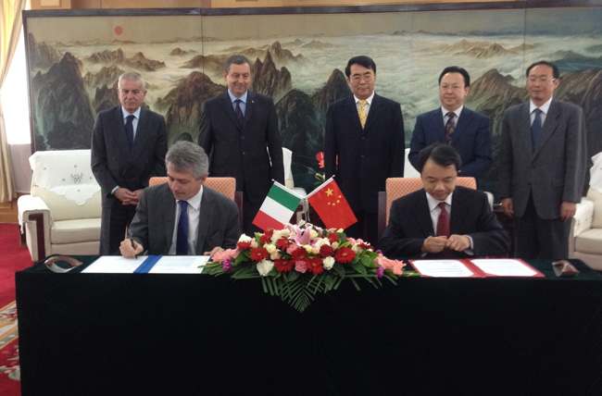
Short history
CAS-INFN collaboration agreement, 2006
IHEP-INFN collaboration agreement, 2011
IHEP-INFN annual meeting:
Pre-meeting at Beijing in 2011
First meeting at Rome in 2012
Second meeting at Beijing: this June
IHEP-INFN joint virtual lab
MOU signed in 2012
Call for Proposal in 2012
Will be awarded this year

Slide 3
Activities
ARGO: since 2000
BESIII: since 2005
Physics & Technologies
Under discussion:
Daya Bay II
LHAASO
HERD
A workshop on cosmic-ray physics in Sep. at Gran Sasso

