Slide 1


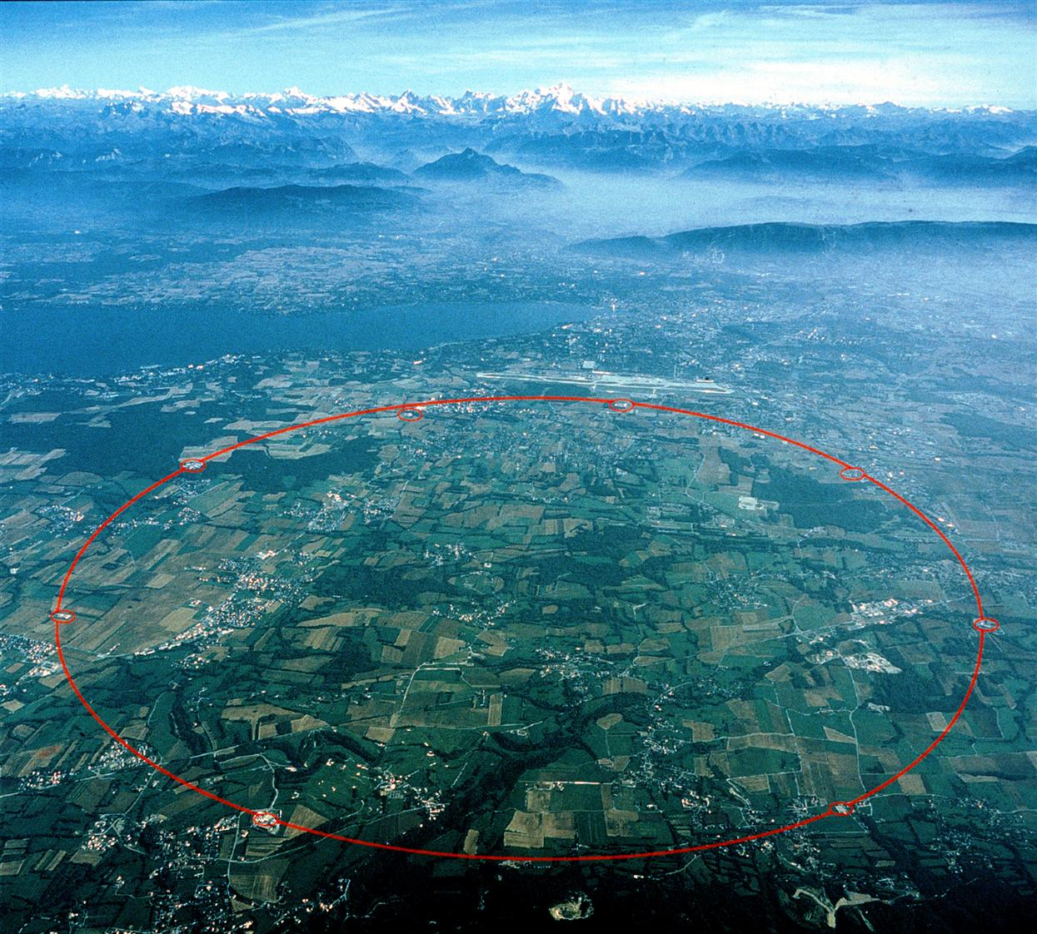
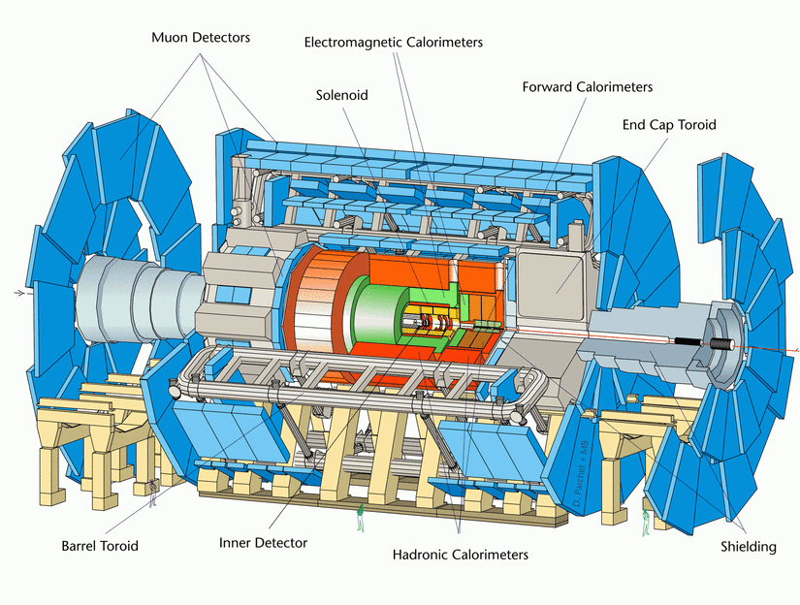
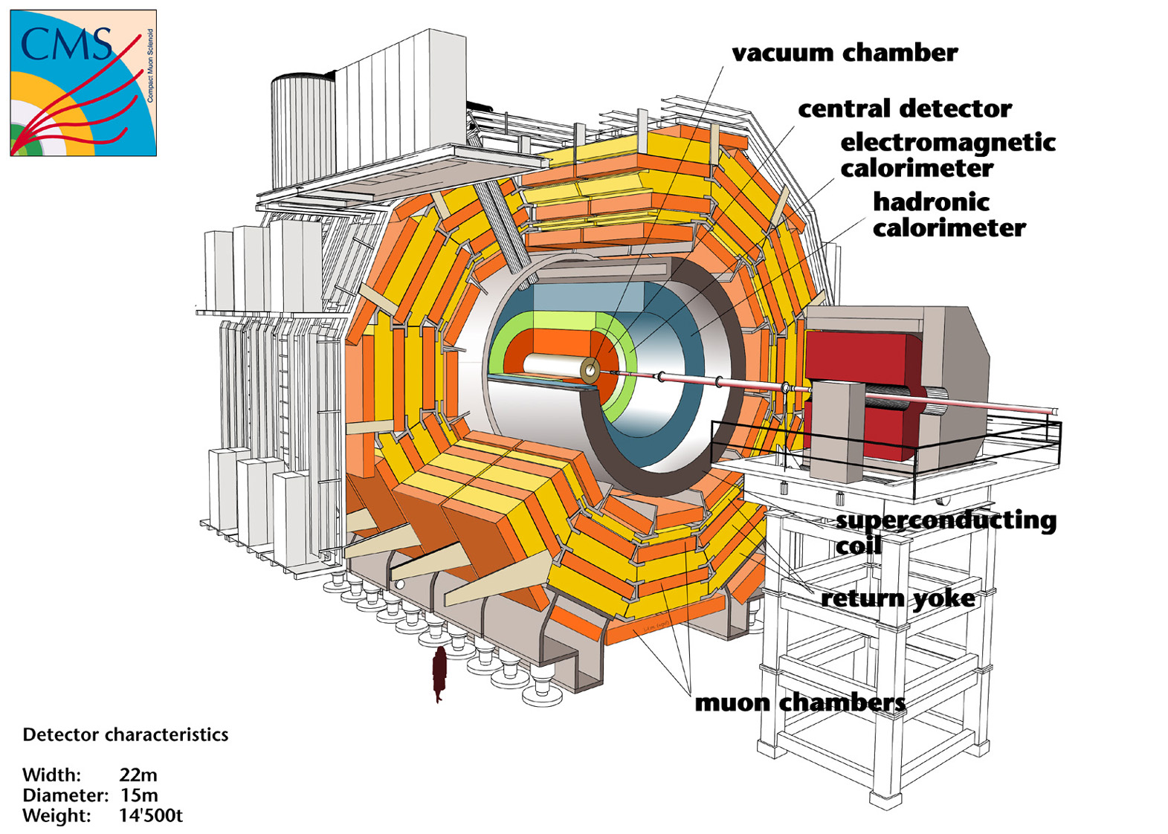
Top-quark Physics at LHC
Huaqiao ZHANG (Michigan State University)
2005－2008： IHEP/CPPM co-tutor Ph.D: ttH
  superviosr: E. Monnier and S. Jin
  First graduated Ph.D within FCPPL framework
2008－2010： CPPM, Calorimeter related calibration
Recent work on Wt, b* (editorship of 3 papers)
Will join IHEP CMS group in June 2013 (CAS 100-talent plan)
26th, Mar. 2013; Nanjing, China

Slide 2
Outline
Introduction of top quark physics
Top quark physics at LHC
  Measurements with top pair
  Measurements with single top
  New physics with top signature
Summary

Slide 3
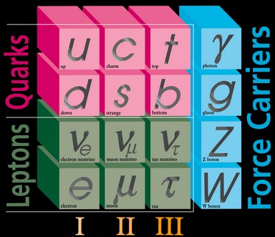
Why Top Quark
Higgs => Mass
Mass: ~173 GeV
  The known heaviest element
Large Yukawa Couplings
  With Higgs: Yt=√2Mt/vev ~1
Life time: ~4*10⁻²⁵
  Decay before hadronization
Produced with strong or electroweak interaction
Precision test of SM
  α_{s}(Mt) ~ 0.1
  pQCD calculation accurate

Slide 4

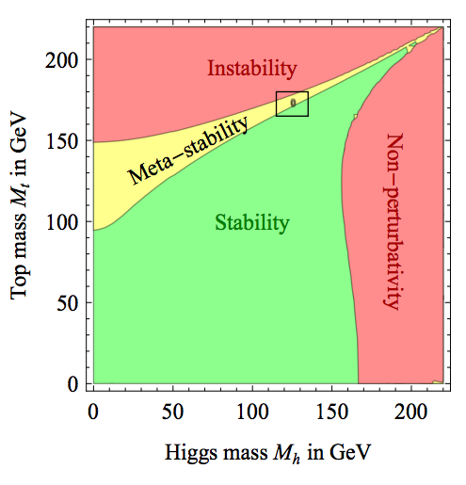
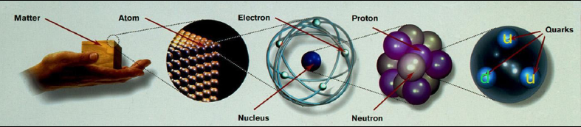
Top Mass
Metastable Universe?
Substructure of top quark?
Main uncertainties from Top-quark Mass

Slide 5
Top quark Yukawa Couplings
How to confirm the new observed boson is higgs?
  Spin/Parity
  Couplings to boson
  Couplings to fermions =>Yukawa coupling
Top quark Yukawa Coupling
  With Higgs: Yt=√2Mt/vev ~1
  The only Yukawa coupling that could be measure @ LHC
Large Yt suggest special role of top in the electroweak symmetry breaking (EWSB)
New physics concerning to EWSB preferably couple to top quark

Slide 6
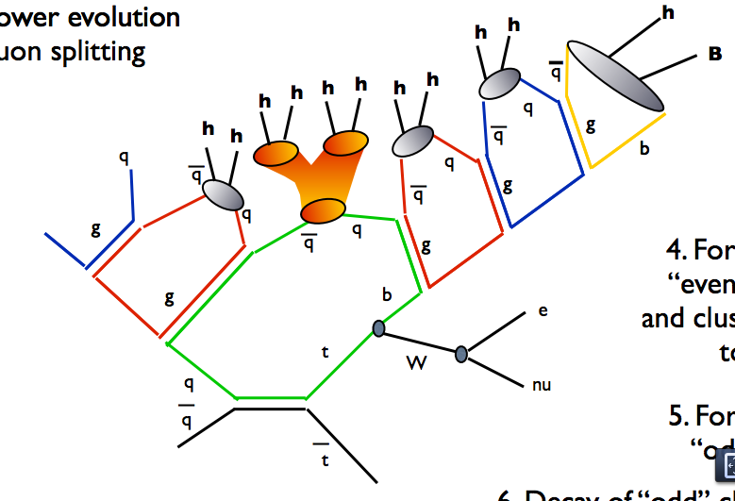

Top quark lifetime
Lifetime: ~4*10⁻²⁵ Sec
  Typical hadronization time ~3*10⁻²⁴ Sec
  Decay before hadronizatio4
Only place to study a “bare” quark properties
  Mass
  Spin
  Polarization
  Vtb
  Charge
Top quark is a laboratory to precise test SM

Slide 7
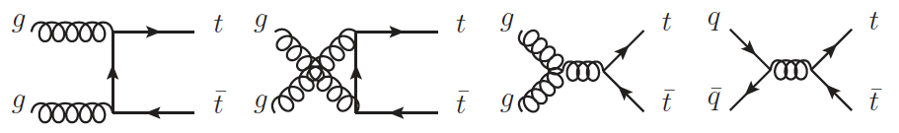
top quark pair production
Predicted by SM, production via strong interaction
Possible ttbar resonance?
90%
10%
164⁺¹³₋₁₀ pb @ 7TeV
Comput. Phys. Commun. 182 (2011) 1034
238⁺²²₋₂₄ pb @ 8TeV
First time observed at Tevatron in 1995

Slide 8
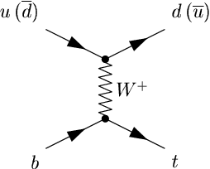
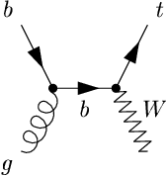
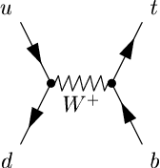
Single top-quark production
Predicted by SM, production via electroweak interaction
t-channel
Wt
s-channel
64.6^{+2.7}_{-2.0} pb @ 7TeV
15.7±1.1 pb @ 7TeV
4.6±0.2 pb @ 7TeV
87.8^{+3.4}_{-1.9} pb @ 8TeV
22.4±1.5 pb @ 8TeV
5.6±0.2 pb @ 8TeV
Calculated at NNLO approx.
N. Kidonakis, Phys. Rev. D 83 (2011) 091503
Calculated at NNLO approx.
N. Kidonakis, Phys. Rev. D 82 (2010) 054018
Calculated at NNLO approx.
N. Kidonakis, Phys. Rev. D 81 (2010) 054028
t-channel already observed at both Tevatron (2009) and LHC (2011)

Slide 9
Top quark physics (1)
Predicted by SM, production via electroweak interaction
t-channel
Wt
s-channel
Involve |V_{tb}| in the production vertices: Direct measurement of |V_{tb}|.
Production cross section proportional to |V_{tb}|²: Very sensitive to modifications of |V_{tb}|.

Slide 10
Top quark physics (2)
Predicted by SM, production via electroweak interaction
t-channel
Wt
s-channel
FCNC Zg…
b*…
W’,π⁺, π⁰…
Could involve beyond SM particles in the production: Direct search of new physics through EW interactions.
  Complementary/Leading sensitivity to new physics searches
Entangle the new physics once see different modification of single top-quark production cross section of these 3 channels

Slide 11
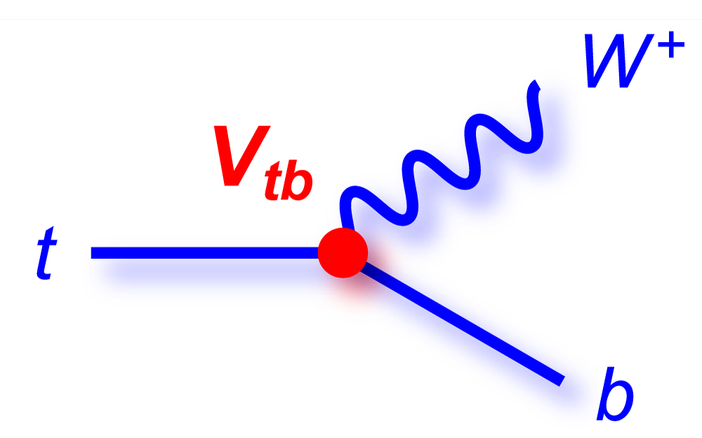
Top quark physics (3)
S
d
S
d
Check top decay products properties
  Top polarization/W helicity
  Charge Higgs searches
Check extra radiations
With Top pair
  Spin Correlations
H

Slide 12
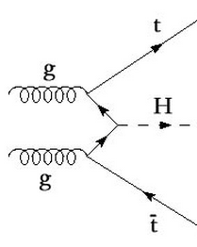
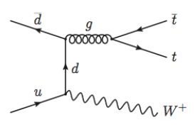
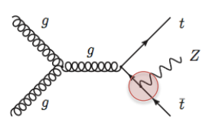
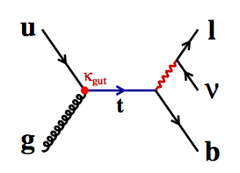
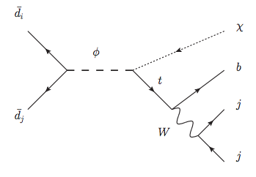
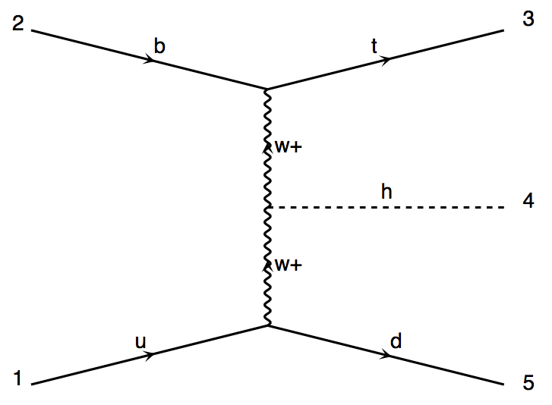
Other interesting top process
ttH
ttW
ttZ
FCNC
tX (RPV)
tHj
b
t
W
H
W
u
d
Phys. Rev. D 63 014018 (2000)
Phys. Rev. D 86 034008 (2012)

Slide 13
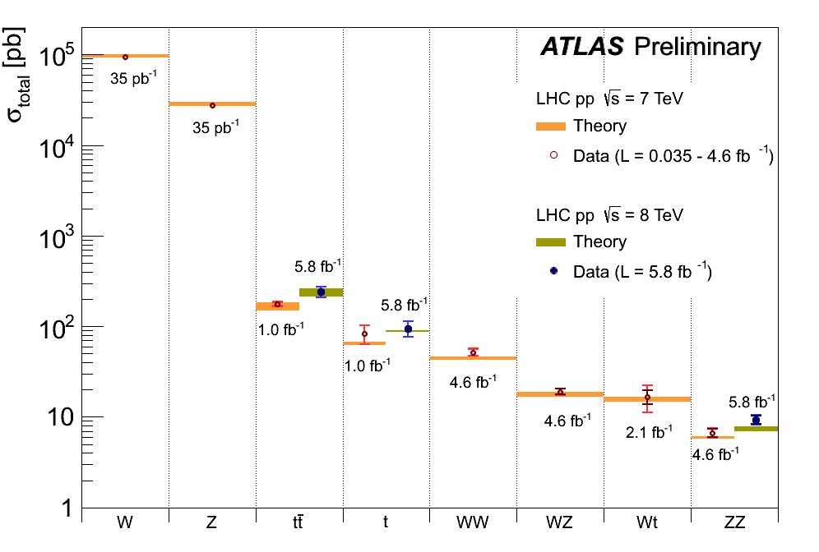
top-quark @ LHC
LHC is a top factory: 240k top events/fb @ 7TeV
LHC Delivered per experiment: 5.7 M top pair, 2.7 M single top
  5fb-1 @ 7TeV, 20 fb-1 @ 8 TeV data

Slide 14
Top pair

Slide 15
top pair measurement @ LHC
Will cover:
  Top mass; W helicity
  Top pair production cross section/differential/extra jet
Will not covered:
  Top anti-top mass differences
  Top pair associate with heavy flavor production
  ttW/ttZ/ttgamma production measurement
  Bottom quark content in top decay
  Charge/FCNC/….

Slide 16
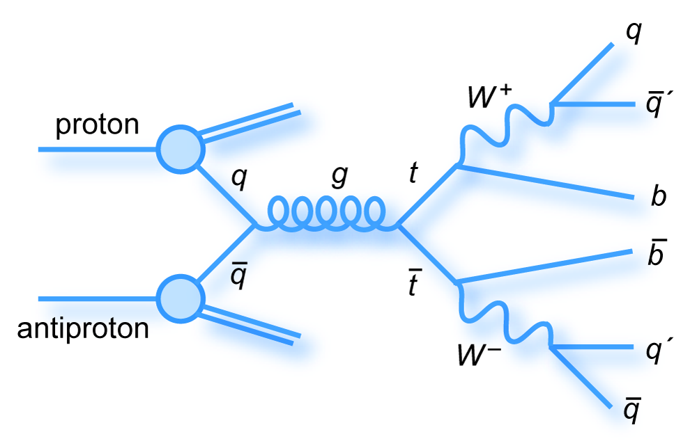
Top quark pair @ LHC
Final state used with dedicated selection and background modeling
  Lepton + jets channel
  Dileptonic channel
  Full hardronic channel
  Tau final state channel

Slide 17
Top pair event selection
Common to ATLAS and CMS, sel. according to event topology
Lepton + jets channel
  One high Pt lepton (e/mu), typical Pt>25 GeV
  At least 4 high Pt jets, typical Pt>25 GeV
  B-jets multiplicity requires, typically =2
Dilepton channel
  Two high Pt lepton (e/mu), typical Pt>25GeV
  At least 2 jets, typical Pt>25 GeV
  B-jets multiplicity requires, typically =2
Full hadronic channel
  At least 6 high Pt jets, of which 2 are b jets
Channel involve tau lepton
  Hadronic tau ID (tau equal e/mu in other topology)

Slide 18
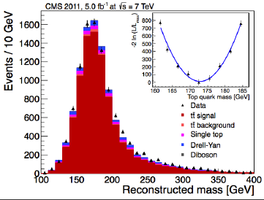
Top Mass Measurement
Top mass limit our knowledge to the stability of vacuum
Performed in lepton+jets, dilepton, full hadronic final states @ both ATLAS and CMS
  Fully reconstruct in lepton+jets and full hadronic FS
  Special weighting procedure in dilepton FS
Combination of different experiments => best meas.
  ATLAS+CMS
  Tevatron
Systematics
  Detector effects
  Signal modeling
dilepton

Slide 19
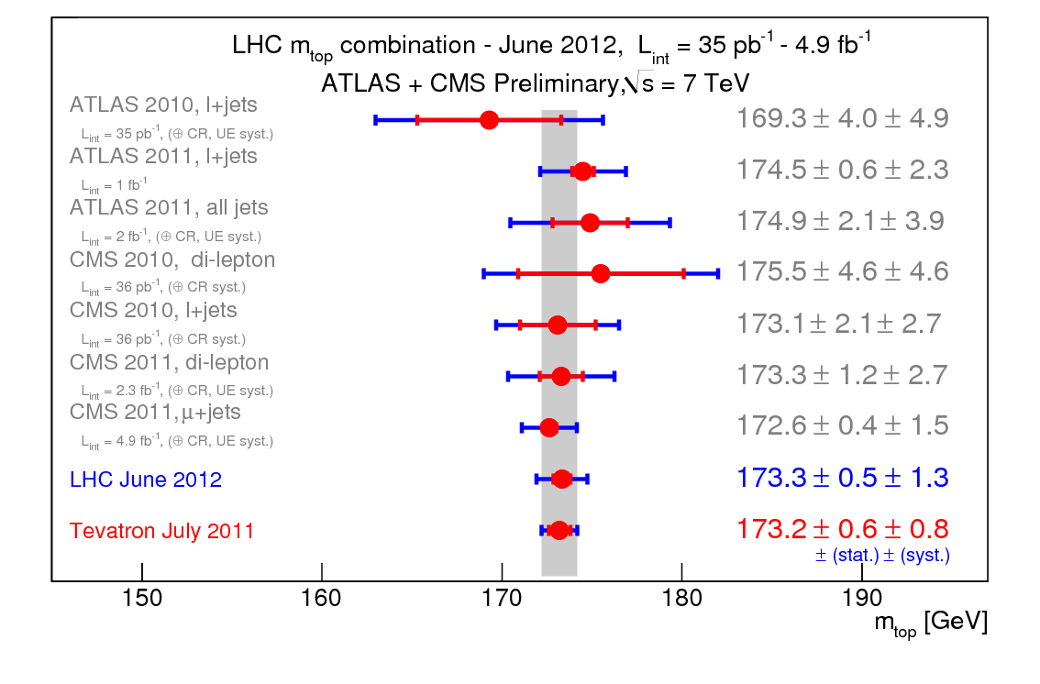
Top Mass measurement
ATLAS-CONF-2012-095
CMS-PAS-TOP-12-001
Combination with BLUE (Best Linear Unbiased Estimator)
  challenge: correlation of uncertainties especially different theory treatment

Slide 20
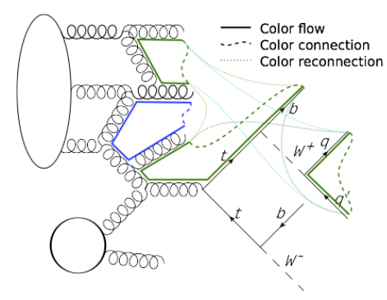
Challenge in Mass meas.
Top decay before Hadronization
  Need extra antiquarks be added later
  M_{top}^{exp} != M_{top}^{pole}
  Mtop dependent on how event evovled
    Event dependent mass
LHC main uncertainties
  Jet calibration
  Signal modeling
  Underlying event tune
Lasted individual result
with event dependent mass
https://indico.cern.ch/getFile.py/access?contribId=3&resId=0&materialId=slides&confId=189617
CMS-PAS-TOP-12-029

Slide 21
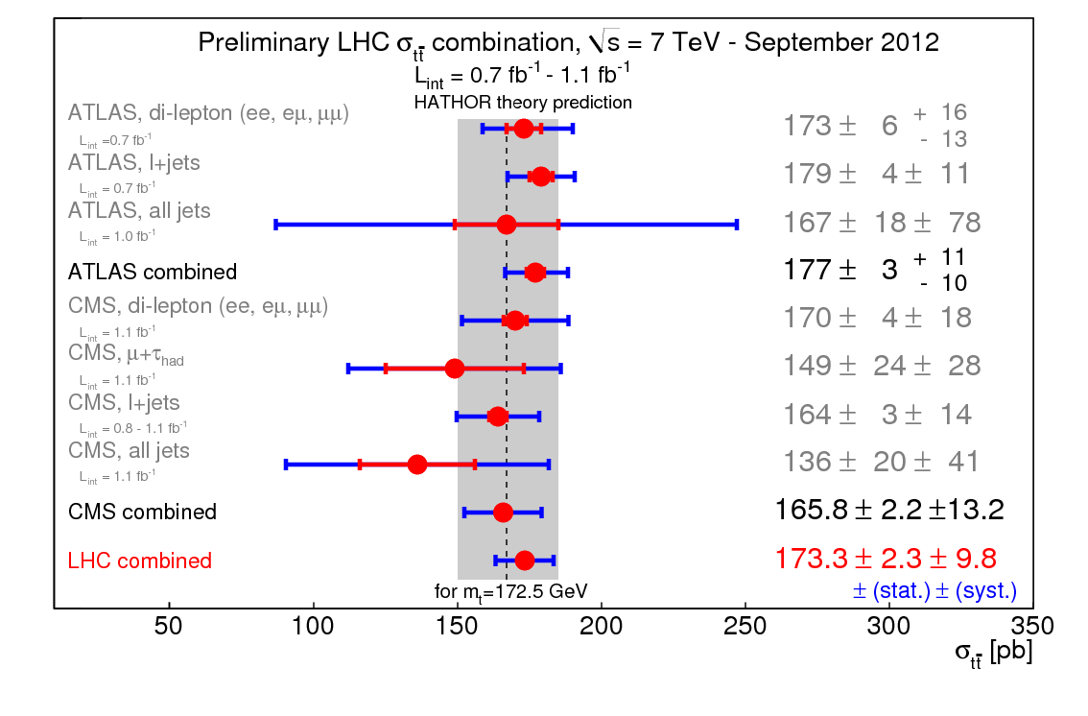
Top pair cross section meas.
ATLAS-CONF-2012-134
CMS-PAS-TOP-12-003
Measurement performed with dilepton, lepton+jets, full hadronic channel at both ATLAS and CMS
First LHC combination with BLUE (Best Linear Unbiased Estimator)
Dominate uncertainties: Luminosity, Detector modeling

Slide 22
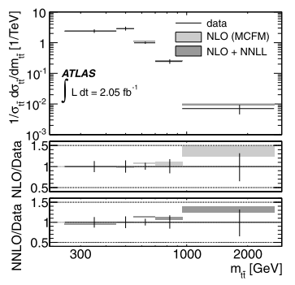
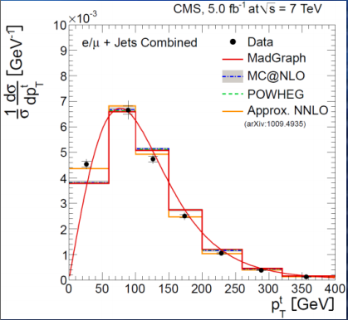

Top pair differential cross section
EPJC(2013)73:2261/arXiv:1211.2220
Precise test of pQCD
Unfolding experimental observables back to theory interested quality => compare to theory
Good agreement between data and app. NNLO prediction

Slide 23
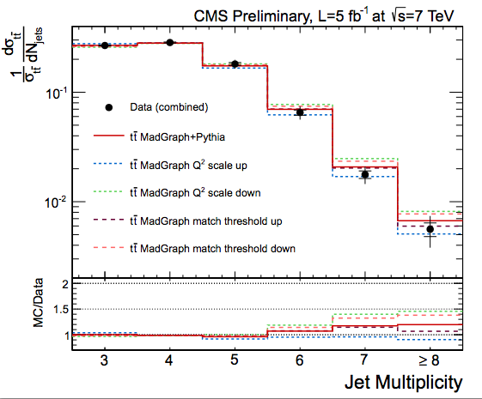
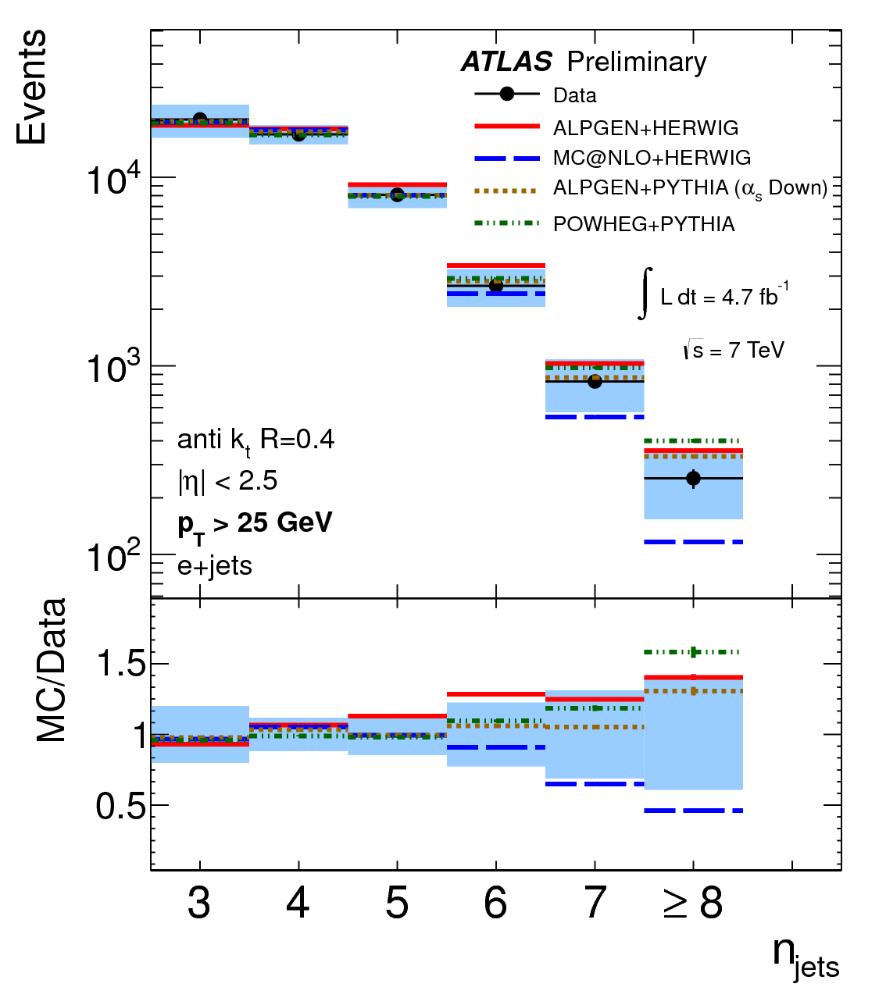
Extra jets activity (1)
Test Radiation from Initial/final state
Unfold Njet dist. Compare with several MC model
Systematics dominated by Jet/EtMiss reco.
ATLAS-CONF-2012-155
CMS-PAS-TOP-12-018
Prefer MadGraph/Powheg
Prefer Alpgen/Powheg

Slide 24
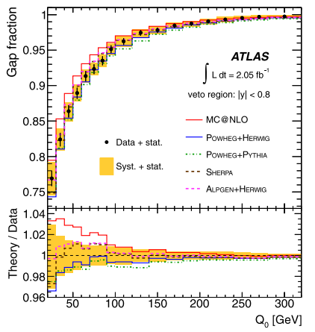
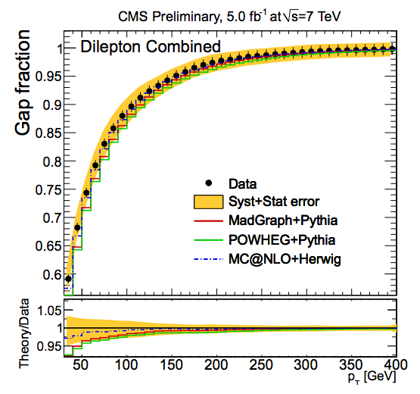
Extra jets activity (2)
EPJC 72 (2012) 2043
CMS-PAS-TOP-12-023
Exclusively select dilepton final states with 2 b-jets
  Any extra light jets should come from ISR/FSR
Tuning Simulation to have proper ISR/FSR radiation

Slide 25
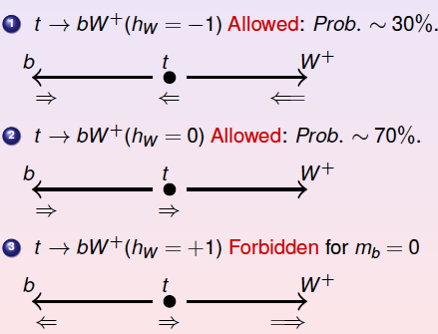
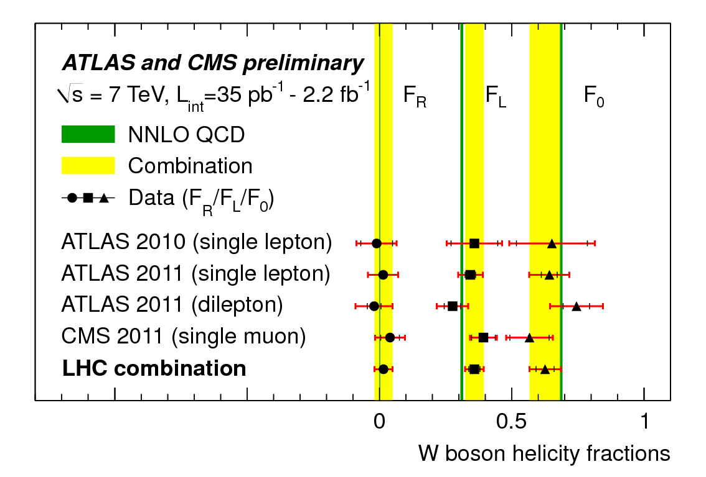
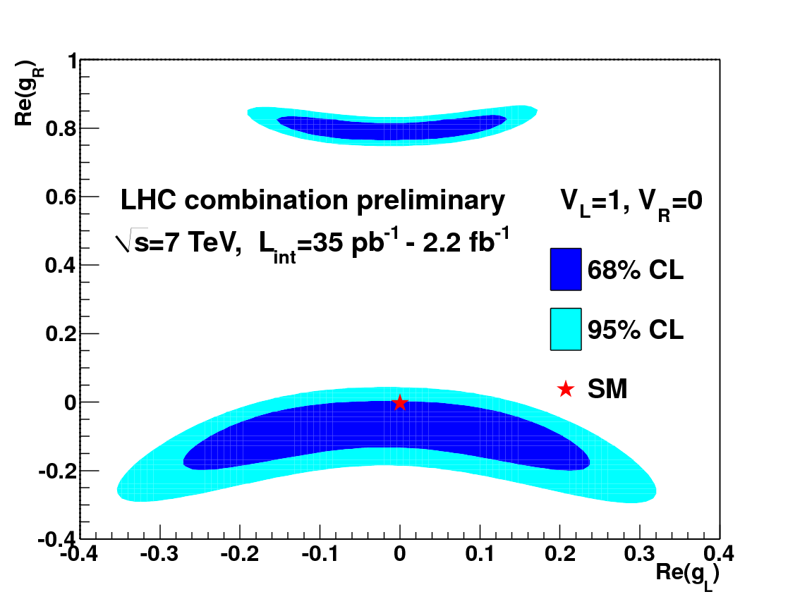

W boson helicity
ATLAS-CONF-2013-033
CMS-PAS-TOP-12-025
Anomalous Coupling

Slide 26
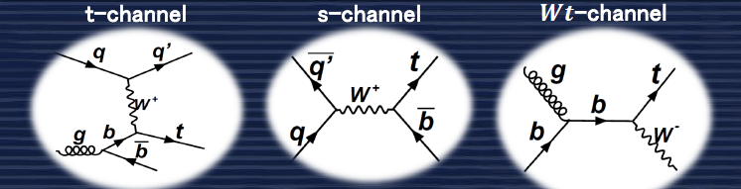
Single top

Slide 27
SM single top-quark analysis
t-channel single top-quark measurement
  Precision measurement at 8 TeV
Wt channel single top-quark Evidence
  Only accessible at LHC
  Evidence with 7 TeV data (This talk)
  Expect observation/measurement with 8 TeV data
s-channel single top-quark searches
  First limit setting (This talk)
  Still a long way to an observation

Slide 28
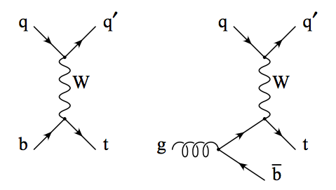
t-channel single top
Interaction of light quark and b-quark by exchange a W boson
  Single top-quark + recoil light quark
More than 1/3 of top-pair cross section
Searches with top quark leptonic decay
  Select events with one lepton + 2 jets, during one is b jet
  Single top-quark system could be reconstructed
Observed both at Tevatron and LHC

Slide 29
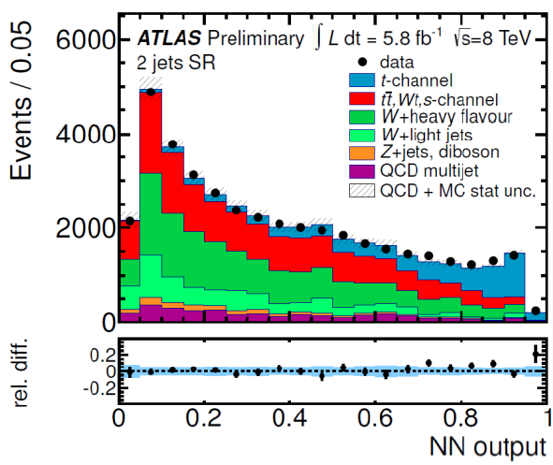
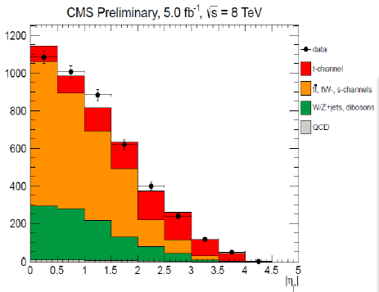
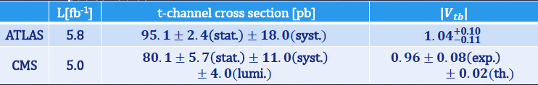
t-channel: meas. @ 8 TeV
ATLAS-CONF-2012-132/CMS-PAS-TOP-12-011
Use Neural Network to combine several variables
Fit the NN output to extract signal
Fit the recoil light jet |eta| to extract signal
Direct measurement of |Vtb|
Dominate uncertainties both ATLAS/CMS: JES/b-tag/modeling

Slide 30
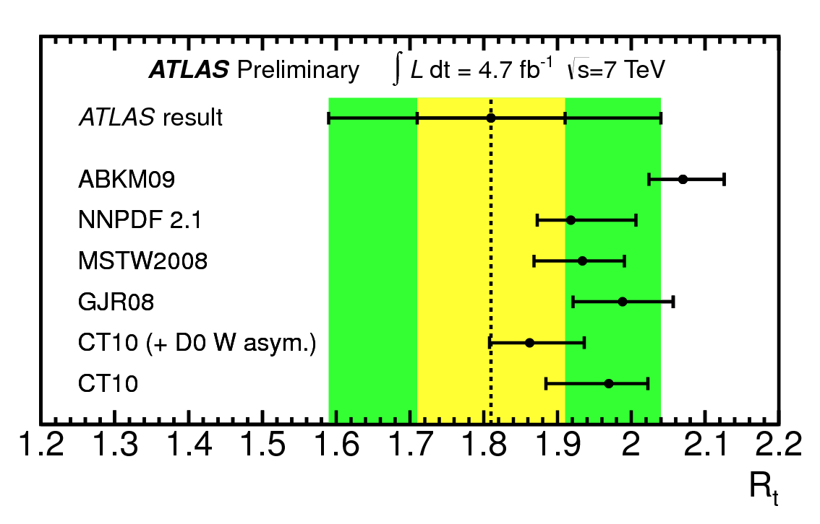
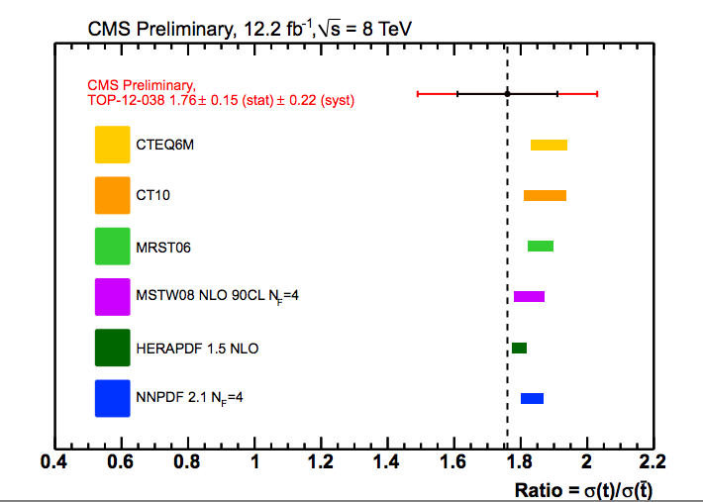

t-channel: Charge asymmetry
Same strategy as t-channel analysis, charge separated
Initial u/d quark determines the final state lepton charge
Ratio of t-channel lepton charge => light quark PDF info.
Dominate uncertainties: JES/background modeling
Agreement with SM predictions
ATLAS-CONF-2012-056
CMS-PAS-TOP-12-038

Slide 31
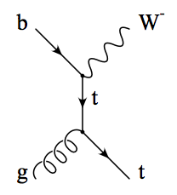
Wt-channel single top
Single top quark associate production with a W Boson
1/10 of ttbar cross section
  Abundant signal
Difficulty: Separation against top-pair events
Searches both at the tow W all leptonic decay channel (Dilepton) signal region:
  Two leptons+jet+MET
  CMS require the extra jet is b-jet
First evidence seen by ATLAS with 2 fb⁻¹ data and confirmed by CMS with 5 fb⁻¹ data
Observation expected with 8 TeV data

Slide 32
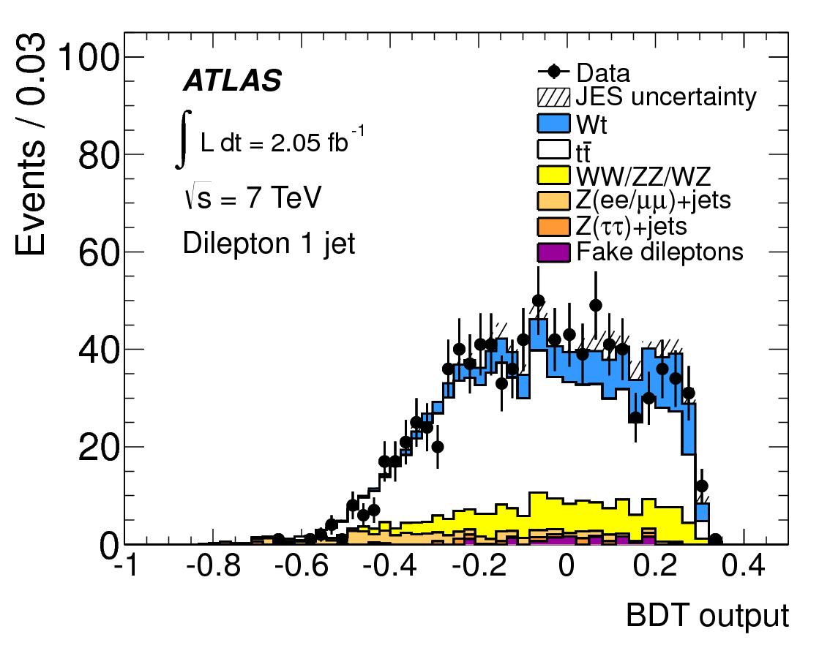
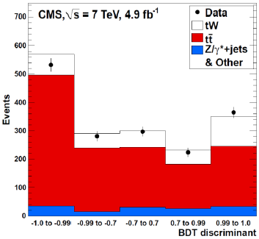

Wt channel: strategy
BDT analysis with 22 var.
BDT analysis with 4 var.
  Cross check with cut based
Maximum likelihood fit to BDT output Includs extra jet bin to control top pair
Simultaneous determination of signal and background rates
Interpreted to |Vtb| by assume Wt mainly produced from |Vtb|, without any assumption on top decay

Slide 33
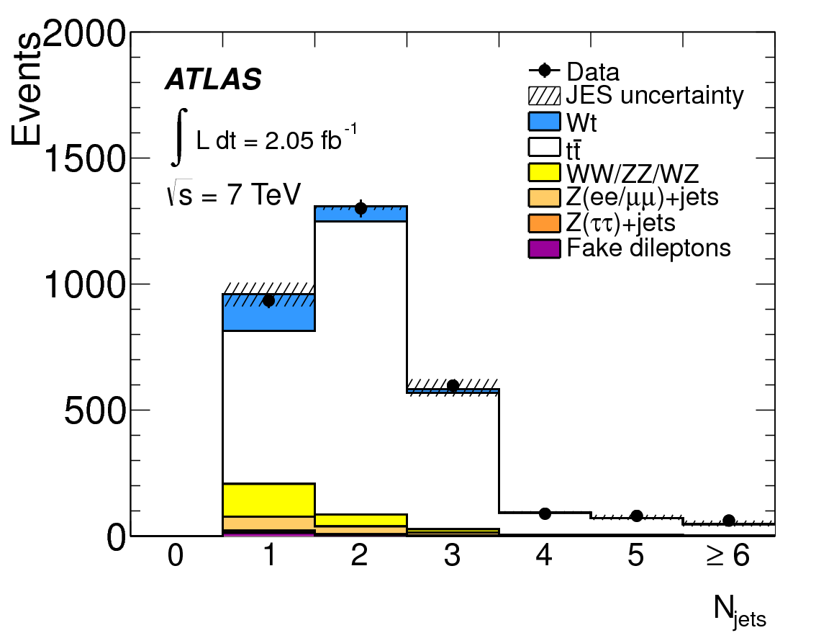
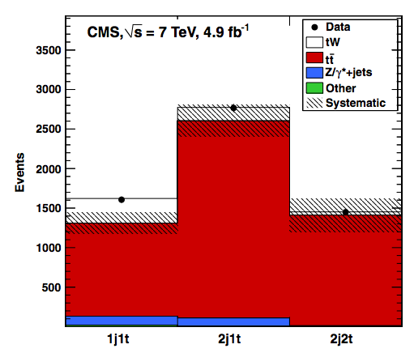

Wt channel: results
Total uncertainties: 34% (ATLAS) vs 31%(CMS)
Dominate uncertainties: Modeling/JES/Statistics
PLB 716 (2012) 142-159
PRL 110, 2013 022003
First evidence

Slide 34
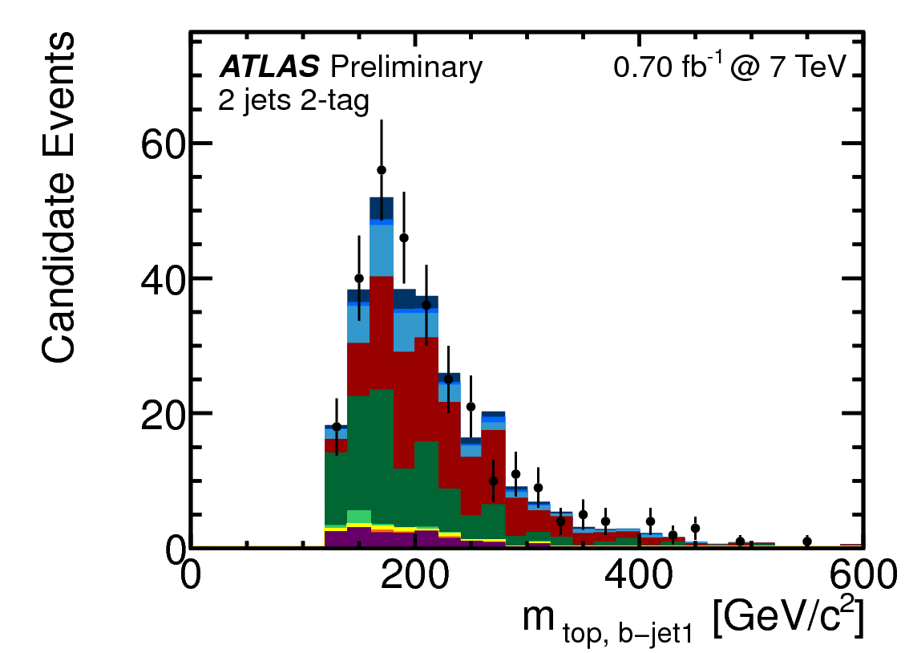

s-channel single top
Production through an off-shell W boson
  Single top-quark + central b-quark
Less than 1/30 cross section of top pair events
  Difficulty: Suffers from large background and small signal cross section
Searches with leptonic top decays
  Single top-quark system reco.
Main uncertainties from:
  Data statistics 100%
  Others from 20-60%
First preliminary limit at ATLAS

Slide 35
New physics with top signature searches

Slide 36
New physics with top signature searches @ LHC
Only Cover
  ttbar resonance
  tb resonance (W’) searches
  Wt resonance (b*) searches
Will not cover
  Many other new physics with top signature

Slide 37
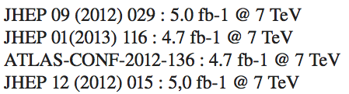
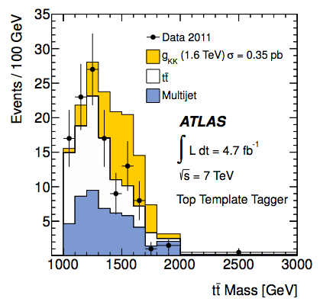
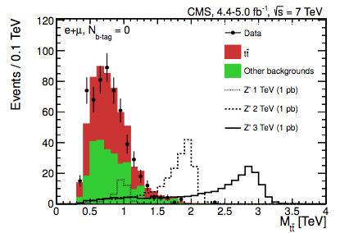
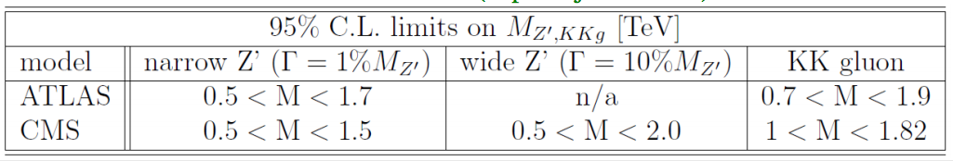
ttbar resonance searches
Reconstruct the invariant mass of top pair in the lepton+jets/full hadronic final states
  boosted top alg. in full had. analysis

Slide 38




tb resonance searches: W’
Right handed W’_{R} model with SM like couplings (PRD 66, 075011 2002)
  CMS extend to set limit at the left/right mix plate
Use the invariant mass of final state t+b as discriminant
  CMS has additional BDT analysis
Combined both 1 and 2 b-tagged events
No excess found, Set limits on W’ masses
PRL 109 (2012) 081801
PLB 718 (2013) p1229-1251
Extra gauge boson?
M_{W’}>1.13TeV (ATLAS 1.04fb⁻¹)

Slide 39


Wt resonance searches: b* (1)
Excite quark/lepton could reveal the substructure of SM fundamental particles
Composite 3rd generation quark model allows FCNC/SM coupling
Search excited bottom quark in the signature of W boson plus single top-quark
  Both dileptonic and semileptonic final states are analyzed
Same selection and background modeling as SM Wt analysis
  Look at W+t without extra jets
ArXiv:1301.1583, 4.7 fb⁻¹
Dileptonic discriminate: HT

Slide 40




Wt resonance searches: b* (2)
Lepton + jets discriminate: b* mass
No excess found, set limit to b* mass
  Bayesian limit set at 95% C. L.
Translate b* mass limit into 2D coupling plate
Set Limits for left-, right- handed and vector like quarks separately
Left handed b* quark: > 870 GeV @ 95% C.L.
Vector Like b* quark: > 1030 GeV @ 95% C.L.
ArXiv:1301.1583, 4.7 fb⁻¹
Left handed b*
Vector like b*

Slide 41
Summary
Standard Model is tested precisely with top quark physics at LHC
  Both at the pQCD and electroweak sector
So far, no deviation from SM is observed
  Cross section and property measurement agrees with SM predictions
  No sign of new physics with top quark signature
    But we believe they were hidden somewhere
Requires more precise knowledge of top mass
    A TLEP/Higgs factory of ~350 GeV Ecm needed?
More results will come with 8 TeV data
  Stay tuned
Lastes details:
https://twiki.cern.ch/twiki/bin/view/AtlasPublic/TopPublicResults
https://twiki.cern.ch/twiki/bin/view/CMSPublic/PhysicsResultsTOP

Slide 42
THANK YOU

