Slide 1


The IHEP-IPNL Collaboration: Photon studies and the search for H→γγ in CMS
A new boson is discovered
Guoming Chen (1), Suzanne Gascon-Shotkin (2)
(1) IHEP/Chinese Academy of Sciences
(2) Institut de Physique Nucléaire de Lyon/
Université Claude Bernard Lyon 1
IN2P3-CNRS
6th France-China Particle Physics Workshop
Nanjing University, Nanjing
March 27-29, 2012

Slide 2
Outline
I – A brief history of our collaboration
II – July 4 2012, 9h30…..the end of one road, the beginning of another
III – Electromagnetic Cluster and Photon Commissioning
IV – Photon Validation and Energy Scale Extraction
V – γγ + X Differential Cross-section Measurements
VI – H→ γγ: Impact of higher-order calculations on kinematical observables in 2γ processes
VII – H→ γγ: γ/π0 discrimination and photon identification
VIII – Proposal for 2013
IX – Summary and Conclusion
X – Acknowledgements
Note/Apology: CMS rules require that only formally approved results can be shown.

Slide 3

The CMS groups of IHEP and of IPN Lyon: A brief history of our collaboration
IHEP Beijing ➔ IPN Lyon:
TAO Junquan (Doctoral Student)—January-May 2007 (IN2P3)
ZHANG Zhen (Doctoral Student)— November 2007-May 2008 (FCPPL)
TAO Junquan (Postdoc)—March-August 2009 (PICS 4162)
XIAO Hong (Doctoral Student)—January-July 2010 (PICS 4162)
FAN Jiawei (Doctoral Student)---April-October 2011 (PICS 4162)
XIAO Hong (Doctoral Student)---June-July 2011 (FCPPL proposal)
FAN Jiawei (Doctoral Student)—August-September 2012) (FCPPL )
SHEN Yuqiao (Doctoral Student)—May-September 2013 (FCPPL proposal)
IPN Lyon ➔ IHEP Beijing:
Nicolas CHANON (Doctoral Student)—March-May 2009 (FCPPL)
Hugues BRUN (Doctoral Student)—October-December 2010 (FCPPL)
Olivier BONDU (Doctoral Student)– April-May 2011 (FCPPL)
Louis SGANDURRA (Doctoral Student)-October-December 2012)
+ participation to the
Organising committees of the founding
Workshop at IHEP in 2006 and of the
1st, 2nd, 3d and 4th FCPPL workshops
(IPNL co-chaired the 3d workshop)
Congratulations to FAN Jiawei, first
IHEP-IPNL Co-Ph.D student, winner of a
CSC scholarship !!

Slide 4
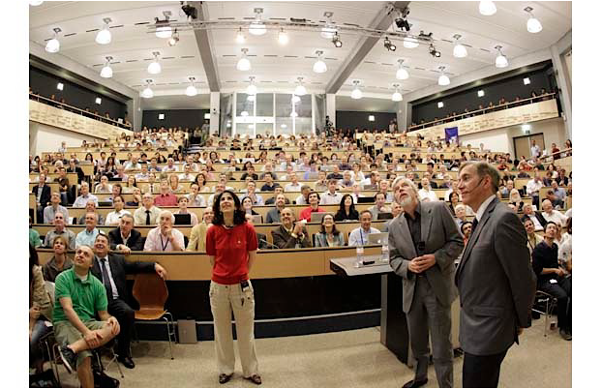
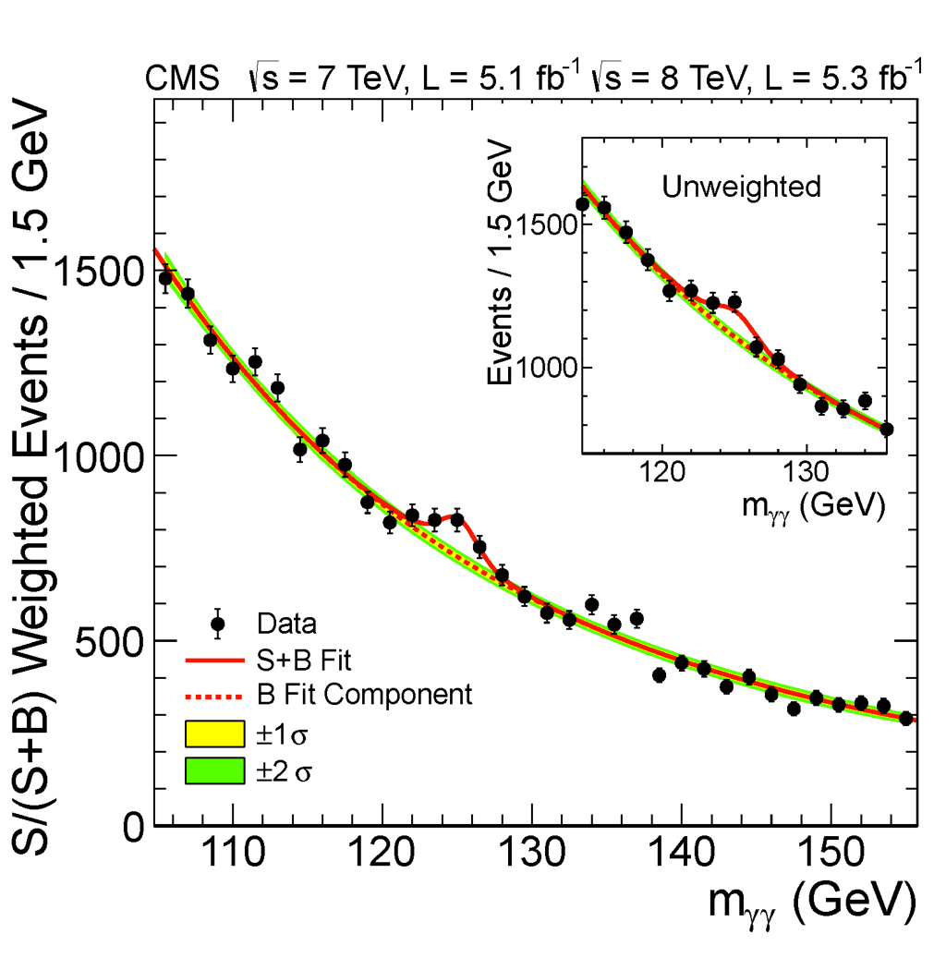
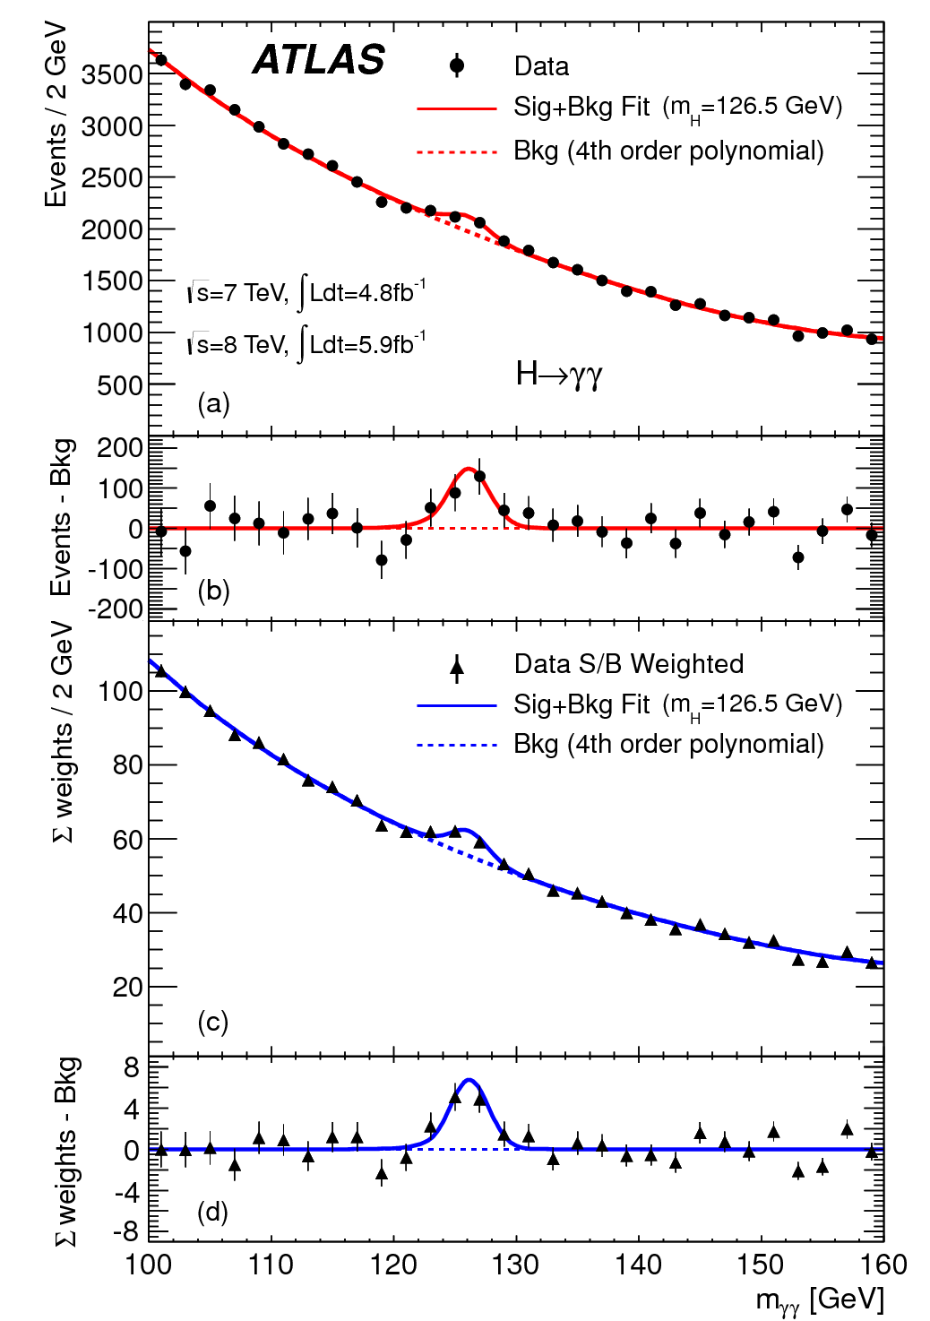
July 4th 2012, 9h30…..
“This result constitutes evidence for the existence of a new massive state that decays into two photons.”
“Clear evidence for the production of a neutral boson …is presented.”
Thanks largely to FCPPL support, the CMS groups of IHEP and IPNL, working together since 2007, were able to contribute significantly to the discovery of a Higgs-like boson through analysis of the gamma–gamma channel. But this reward came only after years of painstaking work in many areas of study of photons….
S. GASCON-SHOTKIN FCPPL13 Nanjing March 27, 2013

Slide 5
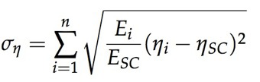
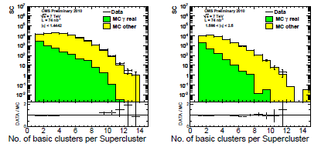
Electromagnetic cluster and Photon Commissioning
(2008-..): (O. BONDU, H. BRUN, A. FALKIEWICZ, M. LETHUILLIER, S. GASCON, J. FAN, J. TAO, H. XIAO, Z. ZHANG)
Check understanding of key observables for photon reconstruction ( starting with ~80nb-1 in 2010) :
  - Cluster constituent multiplicites
- Cluster shapes used to assign energy determination method, to derive energy corrections and photon identification
- Isolation energies used for photon identification
- Determine and address problem of goodness of GEANT4 simulation of EM shower
- Public results for ICHEP2010 (EGM-10-001 and EGM-10-005)
Loose Photon Id
N_{cluster}
σ_{ϕ}/σ_{η}
Notes:
Idea for picking categories: fit the 3 physical parts
Z=➔mumugamma:
Resultats recents (photon workshop)
Appariement PS/ME (Clement/auteurs ALPGEN, plots Bruxelles)
H-→4l: Brem recuperation (Pres N. Chanon groupe Higgs)
H-→2gamma:
CSA07 Skim testing/size estimates
Skim 3 monitoring e/gamma
Travail LH analyse NLO et de nouvelles observables
(plots LH Grazzini, DIPHOX cones saturation, boite Schmidt..) these en co-tutelle
ANR Theorique corrections Klasen/Aldo
ANR SUSY-HIGGS PF
Higgs non-standard H-→AA→4photons

Slide 6
Photon Commissioning
Loose Photon Id
E_{3x3}/E_{γ}
E_{Tγ}
Tracker
Isolation E
Notes:
Idea for picking categories: fit the 3 physical parts
Z=➔mumugamma:
Resultats recents (photon workshop)
Appariement PS/ME (Clement/auteurs ALPGEN, plots Bruxelles)
H-→4l: Brem recuperation (Pres N. Chanon groupe Higgs)
H-→2gamma:
CSA07 Skim testing/size estimates
Skim 3 monitoring e/gamma
Travail LH analyse NLO et de nouvelles observables
(plots LH Grazzini, DIPHOX cones saturation, boite Schmidt..) these en co-tutelle
ANR Theorique corrections Klasen/Aldo
ANR SUSY-HIGGS PF
Higgs non-standard H-→AA→4photons

Slide 7
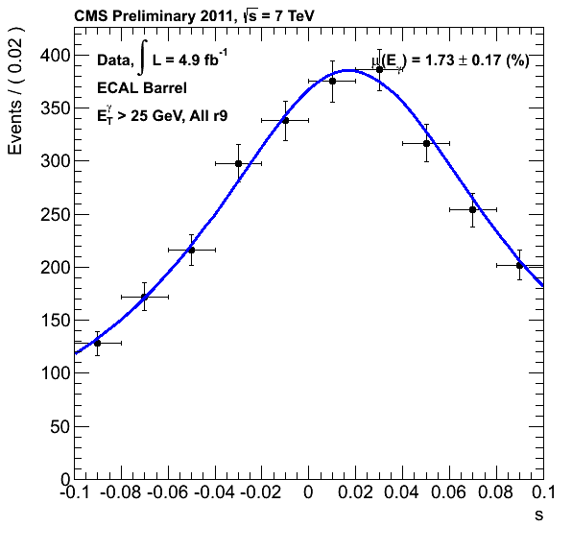
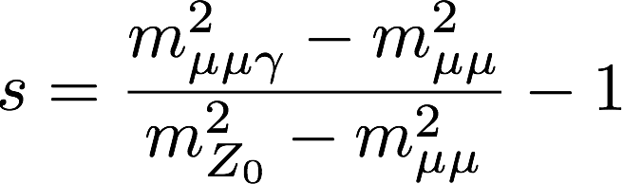
Photon Validation and Energy Scale Extraction
« Certified » photons from Z→μμγ FSR (2007-..): (C. BATY, O. BONDU, H. BRUN, M. LETHUILLIER, S. GASCON, L. SGANDURRA, J. FAN, Y. SHEN, J. TAO, H. XIAO, Z. ZHANG)
- Isotropic source of relatively high-pT γ enabling extraction of
- Photon energy scale : One of two CMS-approved methods (see CMS-DP-2011/008 http://cds.cern.ch/record/1373389?ln=en and CMS-DP-12-024: http://cds.cern.ch/record/1490641?ln=en)
- Photon energy correction parametrisation
- Photon trigger efficiency
- Photon id efficiency
Selection: Minimum photon Pt, Veto non-radiative Z, far muon Pt and isolation.
Result used to estimate systematic error on photon energy scale for first Measurement of the Wγ and Zγ inclusive cross-sections with 2010 dataset (Phys. Lett. B701, 535-555 (2011))
Used to validate understanding of H→γγ input variables (CMS-HIG-13-001)
Ready to furnish energy corrections for photons for 7 and 8 TeV analyses

Slide 8
Photon Energy Scale Measurement
input to Wγ, Zγ cross-section Measurements
Phys. Lett. B701, 535-555 (2011))
See dedicated talk by FAN Jiawei

Slide 9
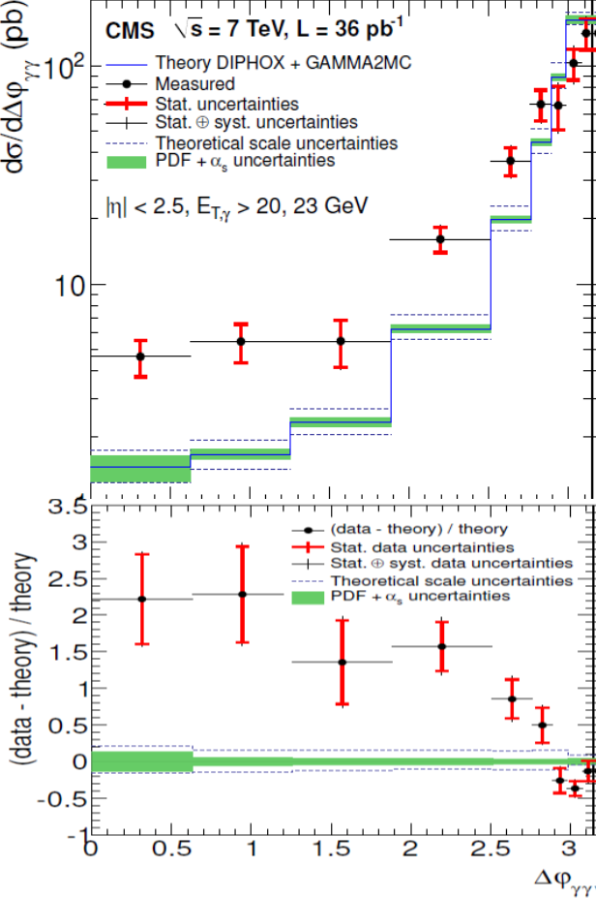
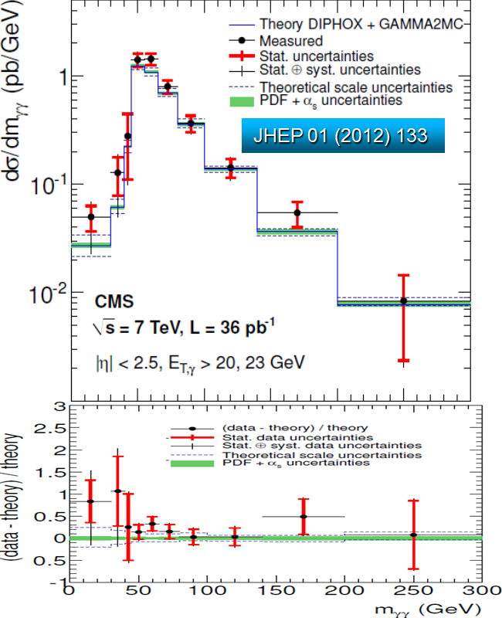
γγ + X Differential σ Measurements
γγ + X differential cross-section measurements (2010-…): (H. BRUN, N. CHANON, G. CHEN, M. LETHUILLIER, S. GASCON, J. TAO, H. XIAO, J. FAN, Y. SHEN)
For measurement of SM backgrounds to H→γγ : γγ + X and γ + X; Can probe gluon PDF at unprecedented Et and reduce gluon NLO PDF error by ~20%
Use data-driven EM isolation templates
2011 results forthcoming
Comparison to pQCD predictions (see next page), determination of efficiencies

Slide 10
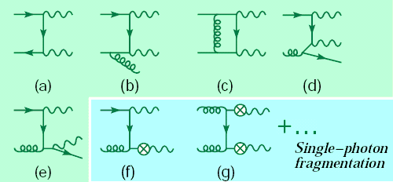
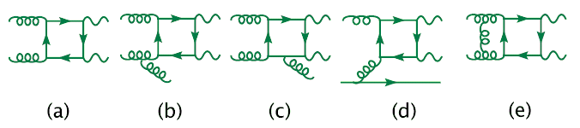
Generators/calculators of SM γγ+X processes
DIPHOX
Binoth, Guillet, Pilon, Werlen, hep-ph/9911340, 2000
RESBOS
Balazs, Berger, Mrenna, Yuan, hep-ph/9712471, 1997
gamma2MC, NLO
Bern, Dixon, Schmidt, hep-ph/0211216, 2002
2gammaNNLO
Catani et al,
hep-ph/11102375, 2011
qT SUB : NNLO
FIXED ORDER : NLO
FIXED ORDER : NLO
NLO with NNLL Resummation
BORN + FRAG (and NLO corrections)‏
BOX (and NLO corrections)‏
Resbos only
BORN (up to NNLO corrections)
1-frag :
- LO, effectively in Resbos
- NLO in Diphox
2-frag :
DIPHOX only (NLO)‏

Slide 11
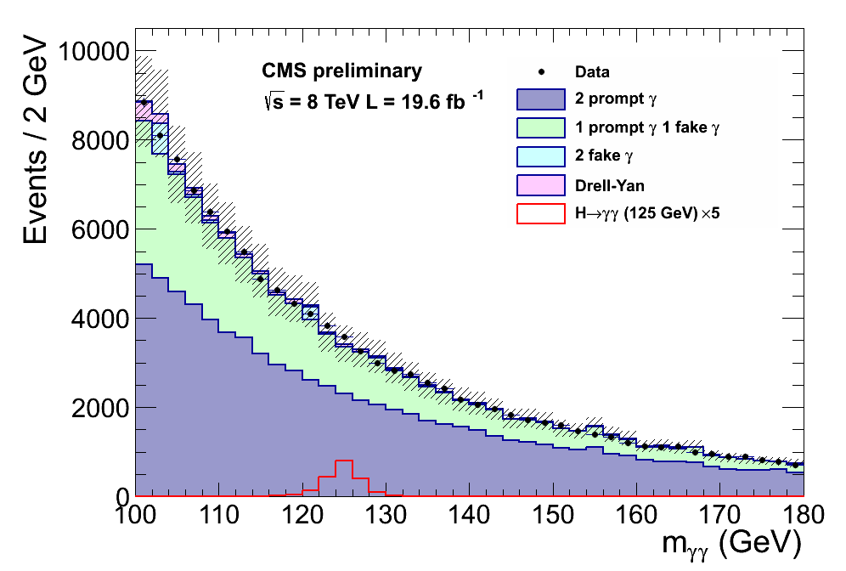
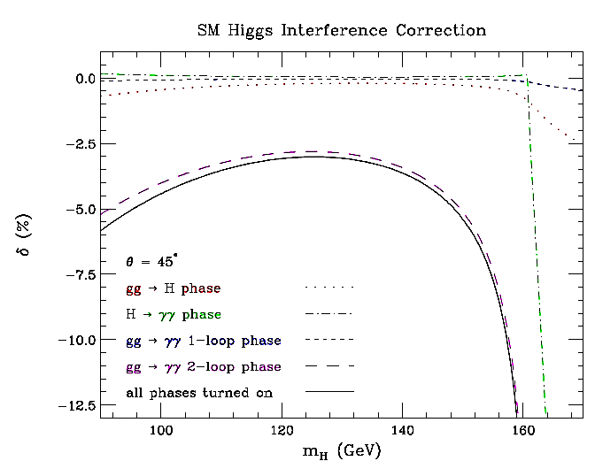
H→γγ analysis: Impact of higher-order calculations
on kinematical observables in 2γ processes
(2007-…): (O. BONDU, N. CHANON, M. LETHUILLIER, S. GASCON, J. TAO)
- Incorporate kinematic implications of >LO calculations on analysis observables (pt_2γ, Δφ_2γ , m_2γ, cos θ*...). Collaboration with LAPTH/IPNL/INFN and American theoreticians.
- Implemented doubly-differential reweighting scheme with dynamical k-factors for H→γγ signal and diphoton background, significant contribution to LHC Higgs XS WG ‘Yellow Report 2: Handbook of Cross sections: Differential Distributions (CERN-2012-002, arXiv:1201.3084), furnished integrated k-factors for the analysis
- Evaluated effect of destructive signal-background interference δ from digluon-induced processes
L. Dixon and S. Siu, hep-ph/0302233
See dedicated talk by TAO Junquan

Slide 12
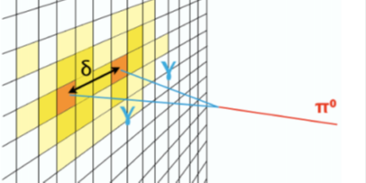
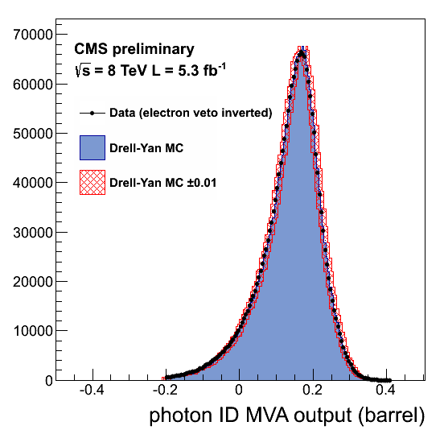
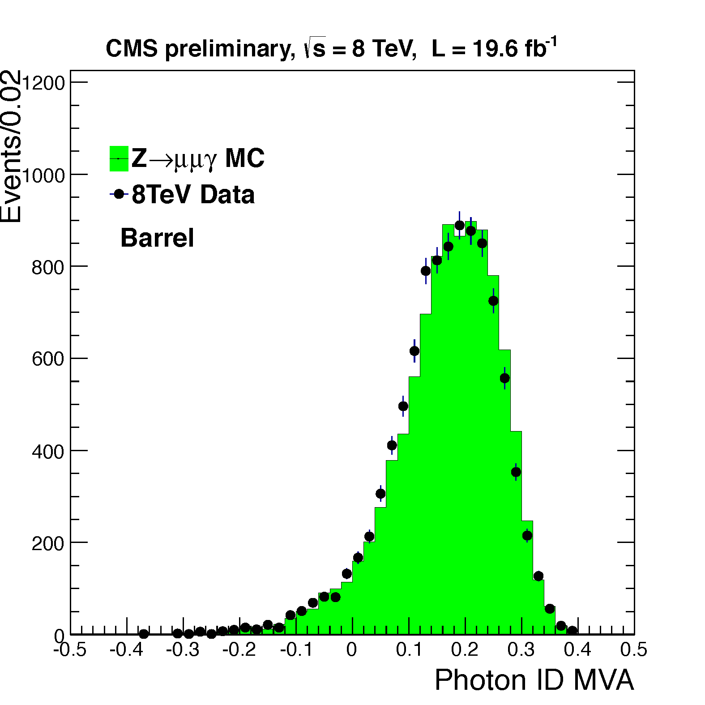
H→γγ analysis: γ/π⁰ discrmination and photon identification
γ/π⁰ discrmination (2008-…): (H. BRUN, N. CHANON, G. CHEN, M. LETHUILLIER, S. GASCON, J. FAN, J. TAO, Z. ZHANG) for both converted and non-converted photons
Exploit particular cluster and shower shape observables proper to our crystal calorimeter in a photon id boosted decision tree.
Direct input to the overall MVA analysis for the H→γγ search but possibly also useful in other analyses using photons.
  Fight reducible background, mostly from π⁰ (~30% after preselection)
See dedicated talk by TAO Junquan
Validation on Z→ee and Z→μμγ events

Slide 13


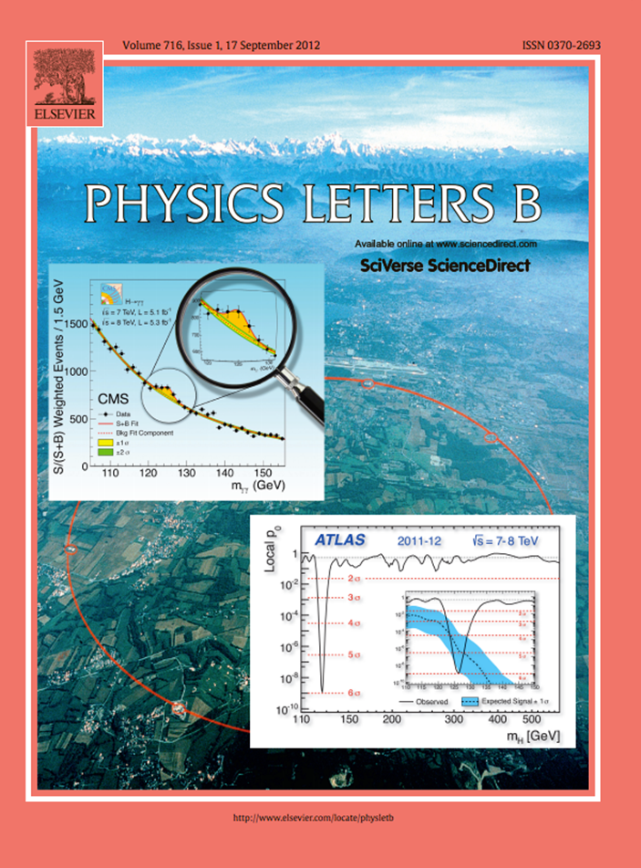
IHEP-IPNL FCPPL Proposal for 2013
CMS and ATLAS have seen an excess of events, consistent between the 7 and 8 TeV datasets, at a mass of ~125 GeV for CMS and ~126 GeV for ATLAS, where the expected limit on σ/σ_{SM} was well below 1.
The result is evidence for the existence of a new boson; of which the decay into two photons excludes the S=1 hypothesis,
compatible within experimental uncertainties with the SM Higgs boson hypothesis
For 2013 the IHEP and IPNL CMS groups will continue to work on improvements to the H→gg analyses for the ‘legacy’ results, as well as further probing the data for any evidence of a second resonance.
We ask for support for a stay of 5 months at IPNL for SHEN Yuquiao to reinforce these immediate efforts

Slide 14
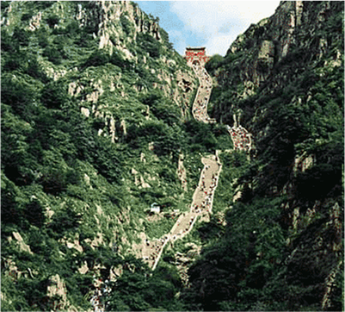


Acknowledgements
Thanks to all for having accompanied us on this long but very productive road:
To the IN2P3/CNRS, the IHEP-CAS, and the CSC
To the FCPPL directorate and steering committee
To the local organising committee of this workshop here in Nanjing for the wonderful hospitality and working environment

Slide 15
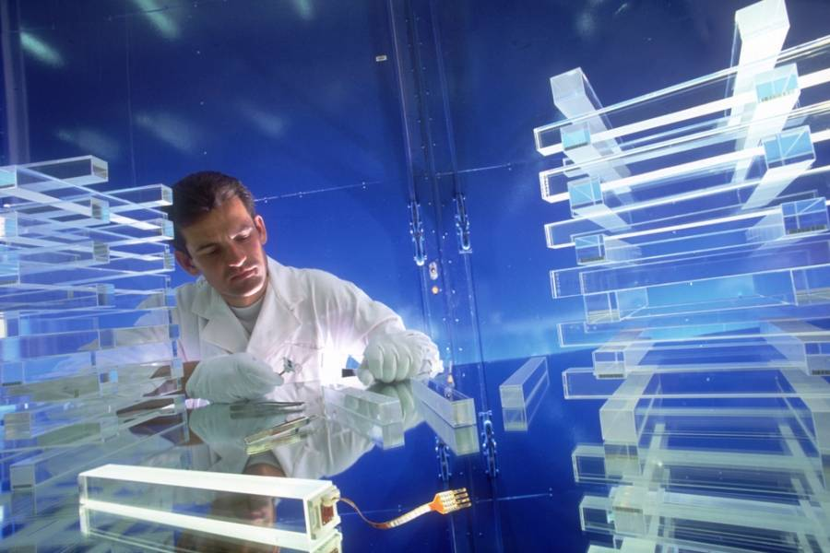
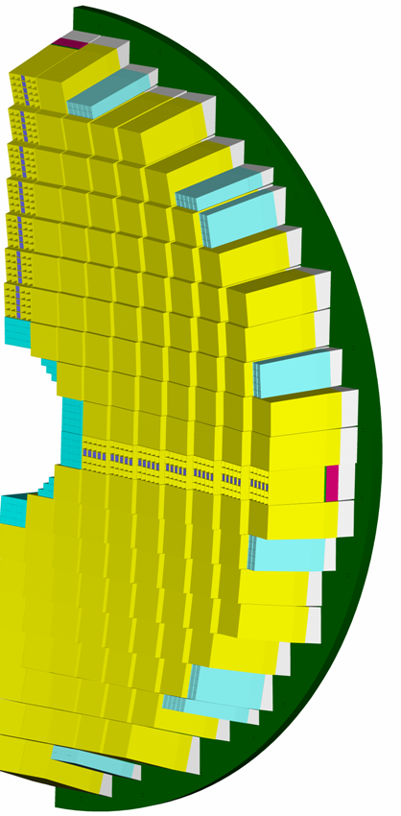
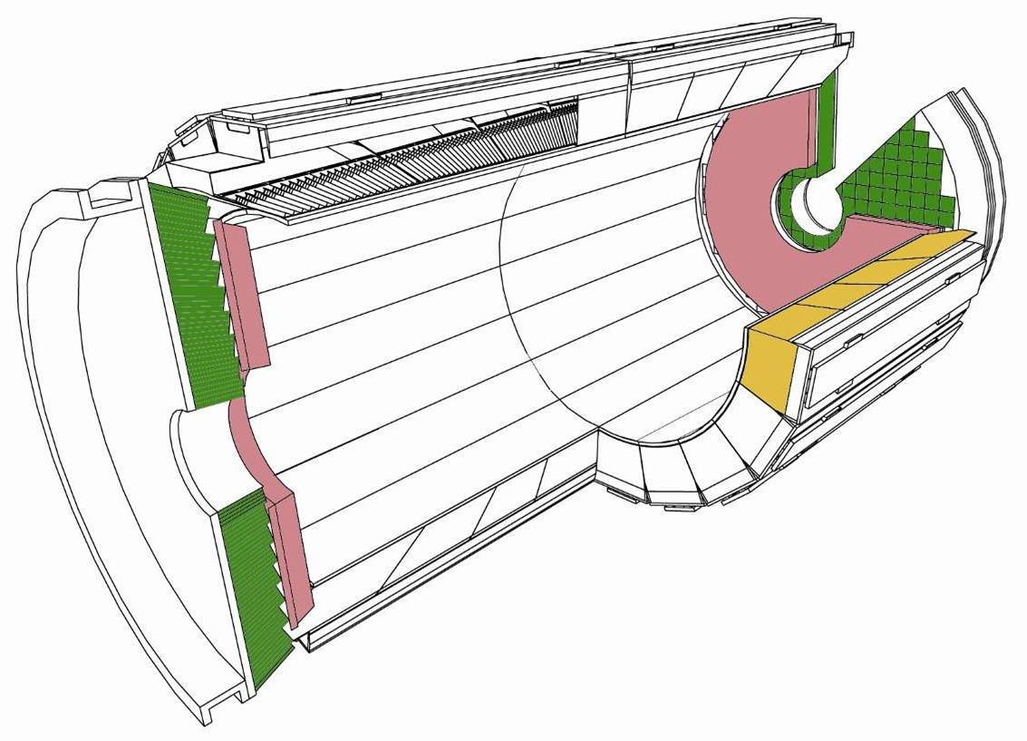
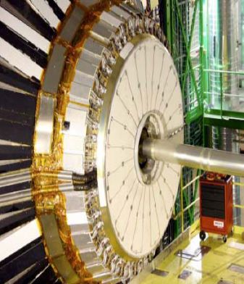
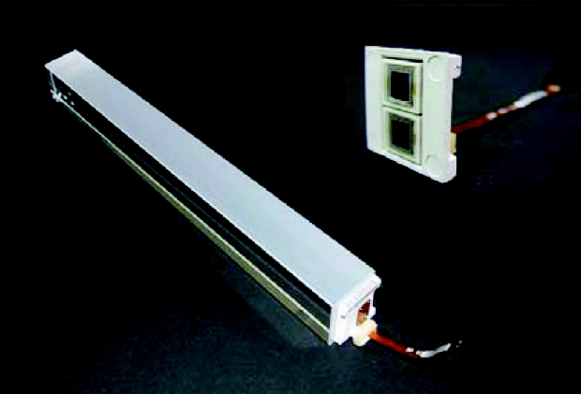
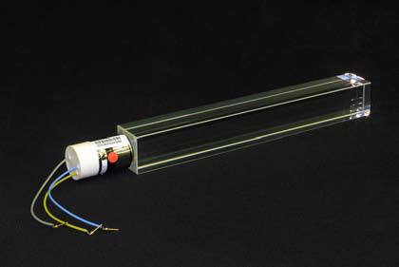
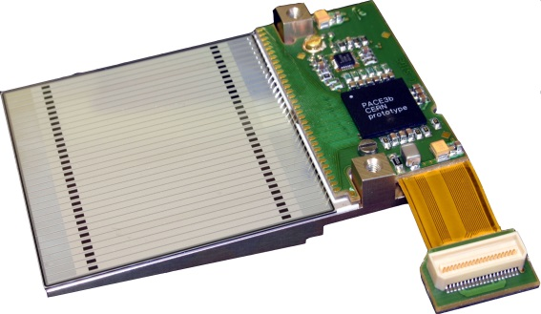
The Electromagnetic Calorimeter (ECAL) of the
CMS Experiment
Homogeneous,
Scintillating PbWO₄
Crystals
∼10 m³, 90 tons
1 Endcap 5x5
Super-Crystal xtals
Barrel (EB):
61200xtals (2.2x2.2x23cm3)
36 Supermodules (SM), each 1700 crystals
|η| < 1.48
Δηx Δϕ= 0.0175 x 0.0175
APD readout
6.4m
Endcap (EE):
14648 crystals
(3x3x22cm3)
4 Dees, SuperCrystals of 5x5 xtals
1.48 < |η| < 3.0
Δηx Δϕ= 0.01752↔0.052
VPT readout
2.6m
Preshower (ES):
Pb(2X)-Si(1X)
4 Dees
4300 Si strips
1.65 < |η| < 2.6
1 Barrel Super- Module (1700 xtals)
1 Dee
(3662 xtals)
Pb-Si Pre-shower
Excellent resolution measured in test beam (σ/E < 0.5% at 100 GeV)
Major issues for realization of this performance in situ:
- Intercalibration
- Showering in tracker material

Slide 16
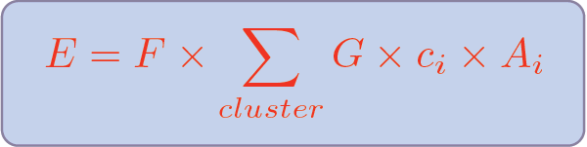
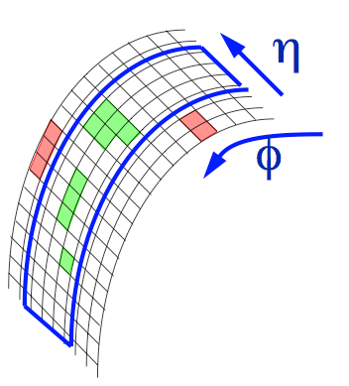
Definition and Components of Calibration, Clusterisation and Energy Scale
Cal. rechit
Energy scale on the
ECAL/physics object
Level (E5x5/SC or
Reco Photon) will be
adjusted with
Algorithmic
Corrections F):
Energy scale definition:
k=E_{true}/E_{reco.}, can be
divided into ‘constant’ (peak position)
and ‘variable’ (‘resolution’) parts. Variable part: k=k(Et, η, ϕ)
5x5 or SC
R₉ =
E_{3x3} /E_{sc}
Reco Photon Energy
from R9₀
R9 >R9₀
R9 > R9₀
E from Supercluster
Energy from 5x5 matrix
Barrel:
Endcaps:
F Corrections:
f(σ[ϕ]/σ[η]),
f(Et, η),
add
Preshower E
F Corrections:
f(η)[barrel only],
Local containment
F Corrections:
f(η), f(σ[ϕ]/σ[η]),
f(Et, η)

