Slide 1
Progress of triangular carbon fiber beam for ITK
Xiaohui Qian, Jian Wang, Yujie Li, Jiajian Zhang, Qi Yan
IHEP.CAS
202603

Slide 2
content
Structure of triangular carbon fiber beam
Manufacturing of 500 mm length beam
Manufacturing of 1000 mm length beam
Static mechanical test of 1000 mm length beam

Slide 3
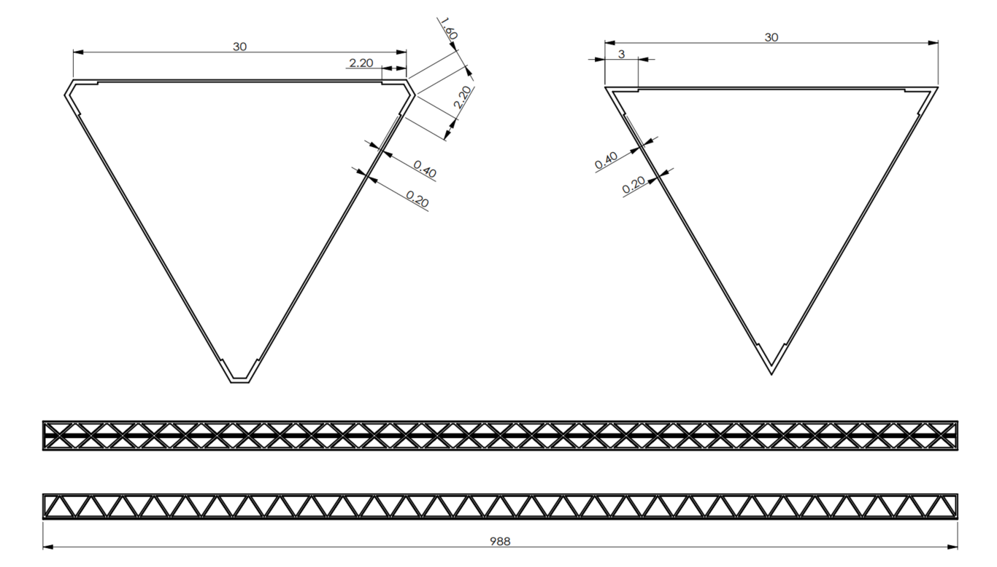
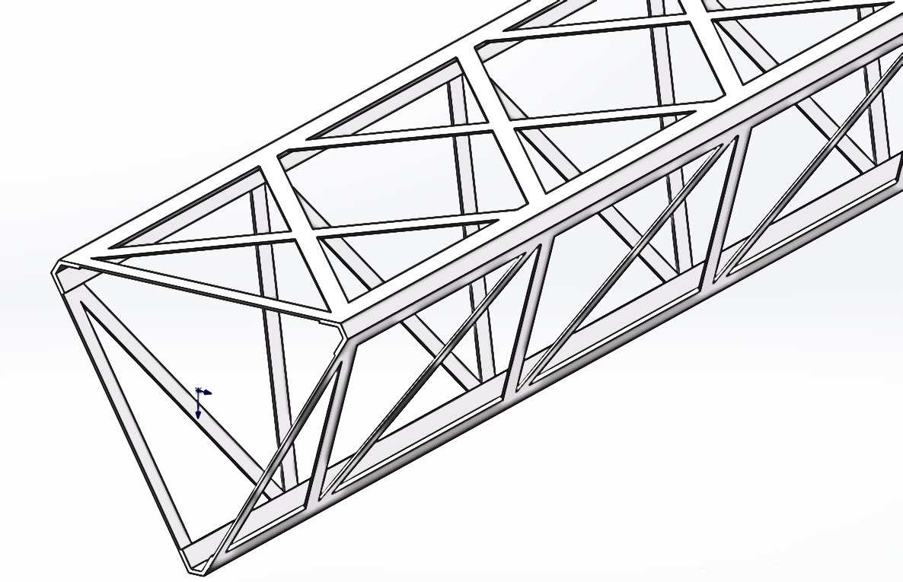
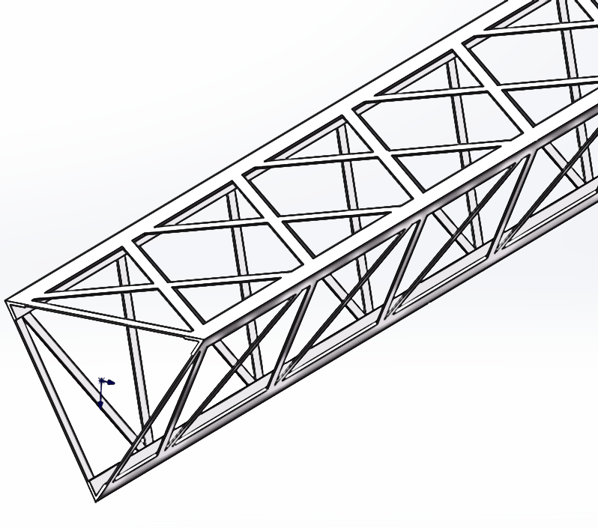
Structure of triangular carbon fiber beam
0.3
Main Beam
0.3
Structure 1：16.31g
Structure 2：15.54g
Main Beam: 0.4mm：0-0-0-90-0-0-0，layer thickness: 0.05mm, M40J
secondary beam: 0.3mm，Carbon fiber filament, T700
Base glue: epoxy
secondary beam
1000

Slide 4
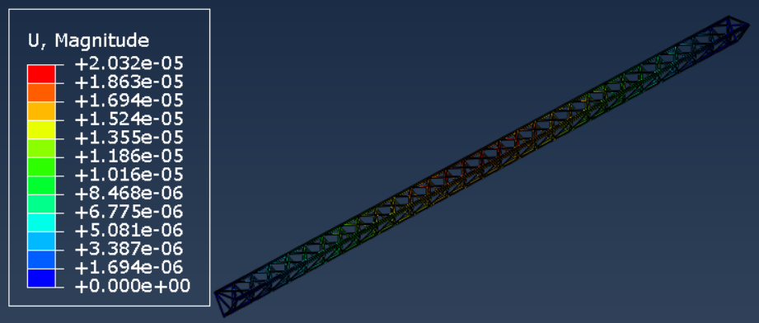
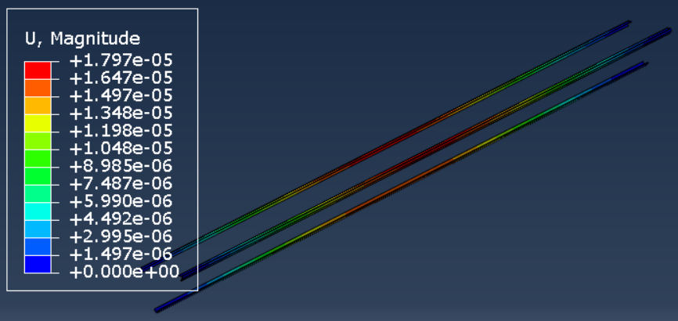
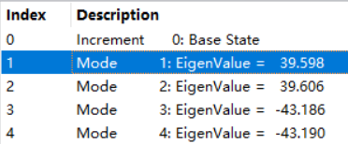
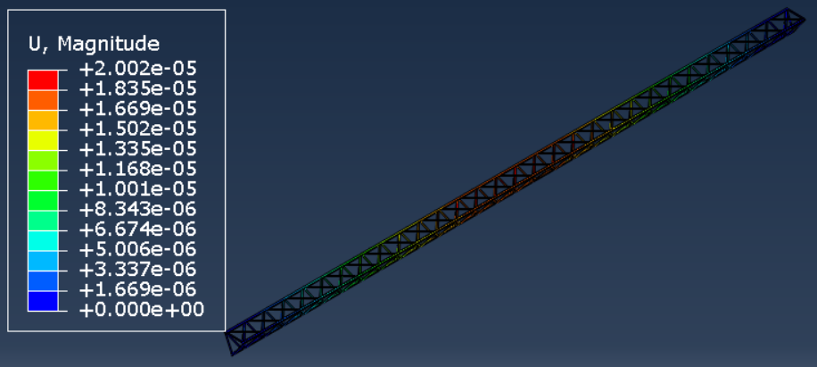
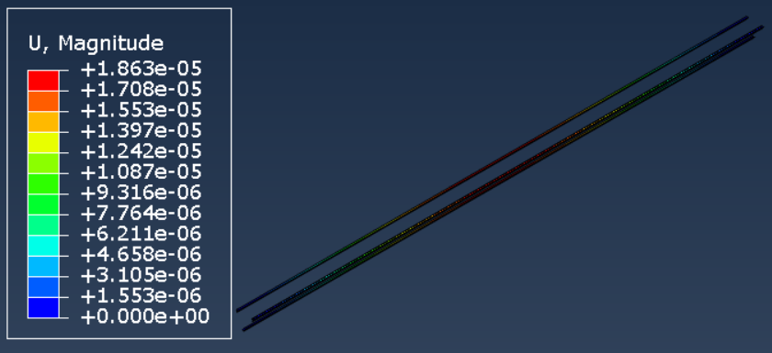
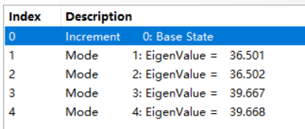
Deformation by FEA
face load on main beam：20Pa (988X41mm), ~80g, not considering cold plate
Gravity ，density 1840kg/m^3
Fixed support both end side
Structure 1:
Total deformation: 20.32um
Main beam deformation: 17.97um
Buckling coefficient: 39.6
Structure 2:
Total deformation: 20.02um
Main beam deformation: 18.63um
Buckling coefficient: 36.5

Slide 5
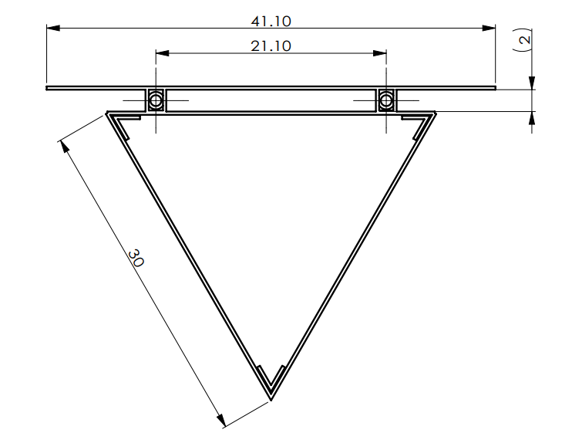
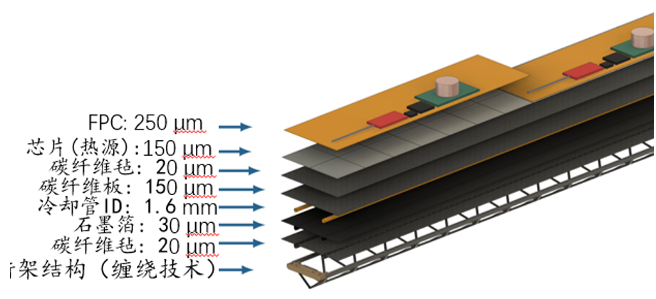
Triangular beam with cold plate
The thickness of each layer film of cold plate is different with the picture.
Sensor(heat source)
Carbon fiber felt
carbon fiber plate
Cold plate
Cooling tube
Graphene film
Carbon fiber felt
Triangular carbon fiber beam

Slide 6
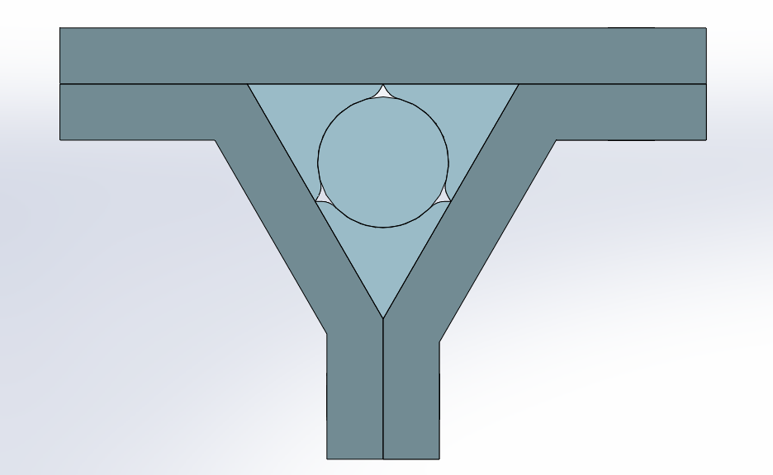
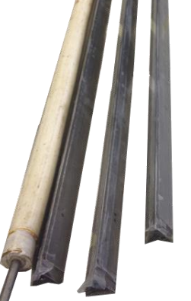
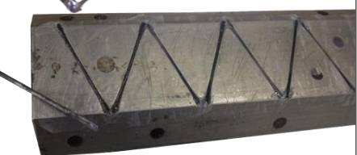
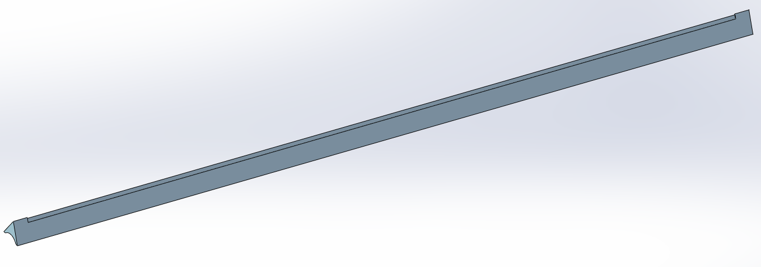
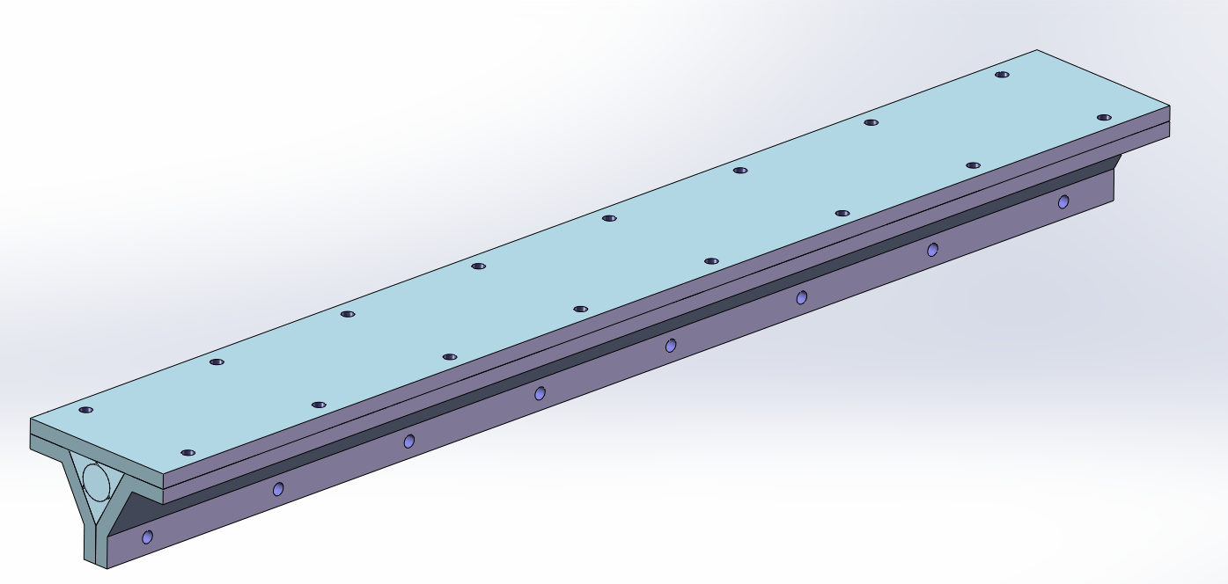
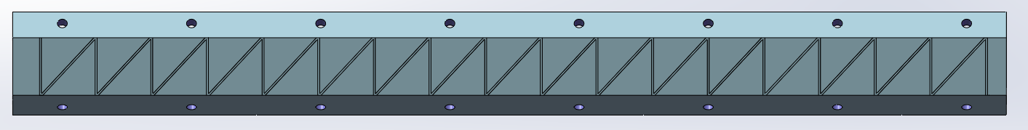
Manufacturing of 500mm length beam
Mold design:
Almost the same structure as ALICE’s tracker mold
Silicone Rubber Rod
PTFE rods
ALICE’s tracker mold
Cross section
PTFE rod
Slotted outer mold

Slide 7
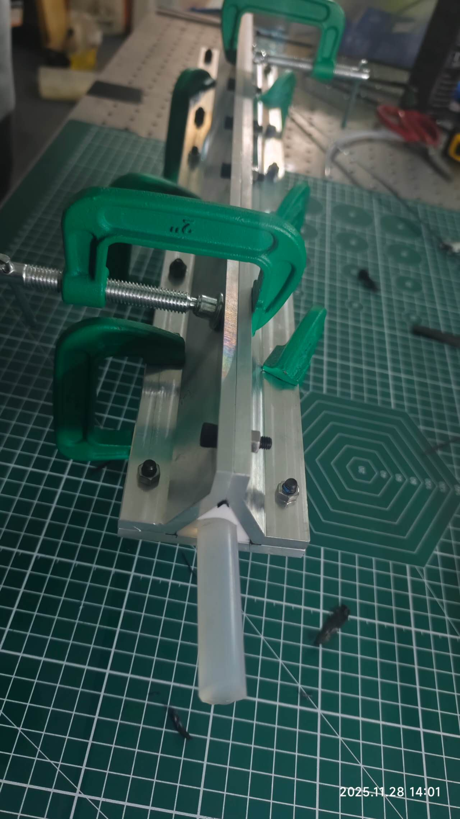
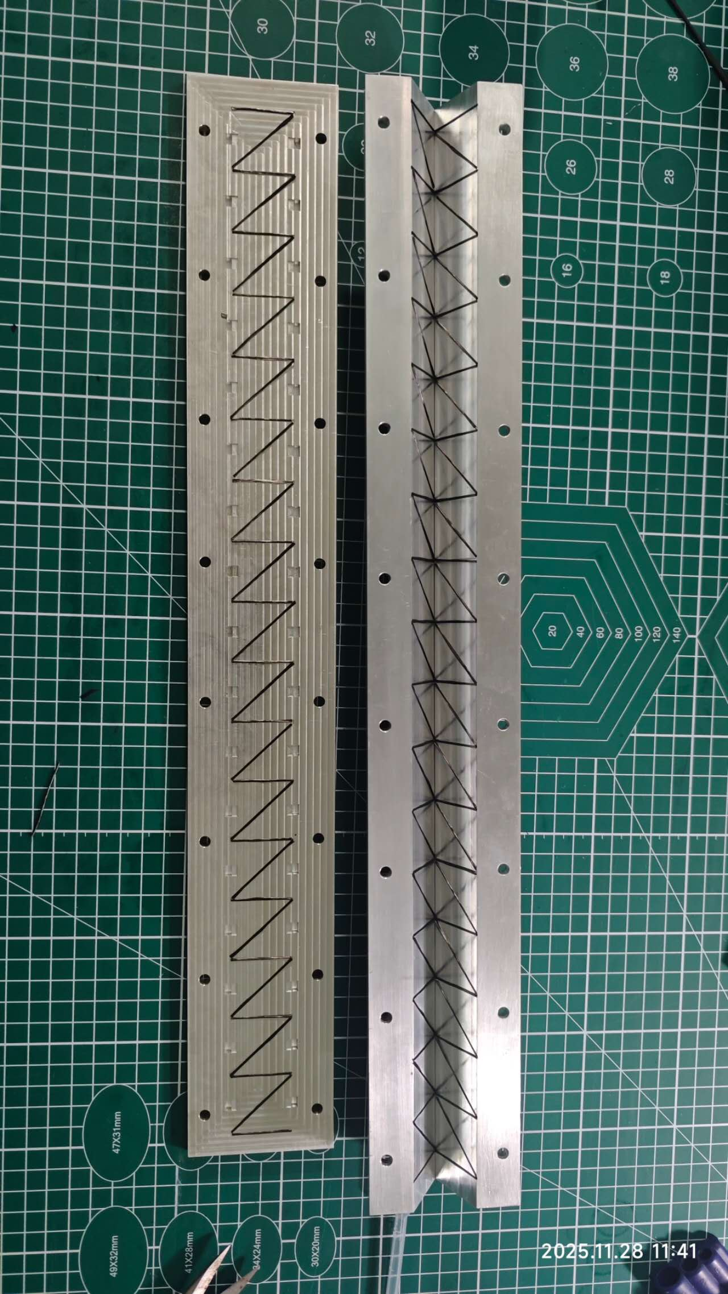
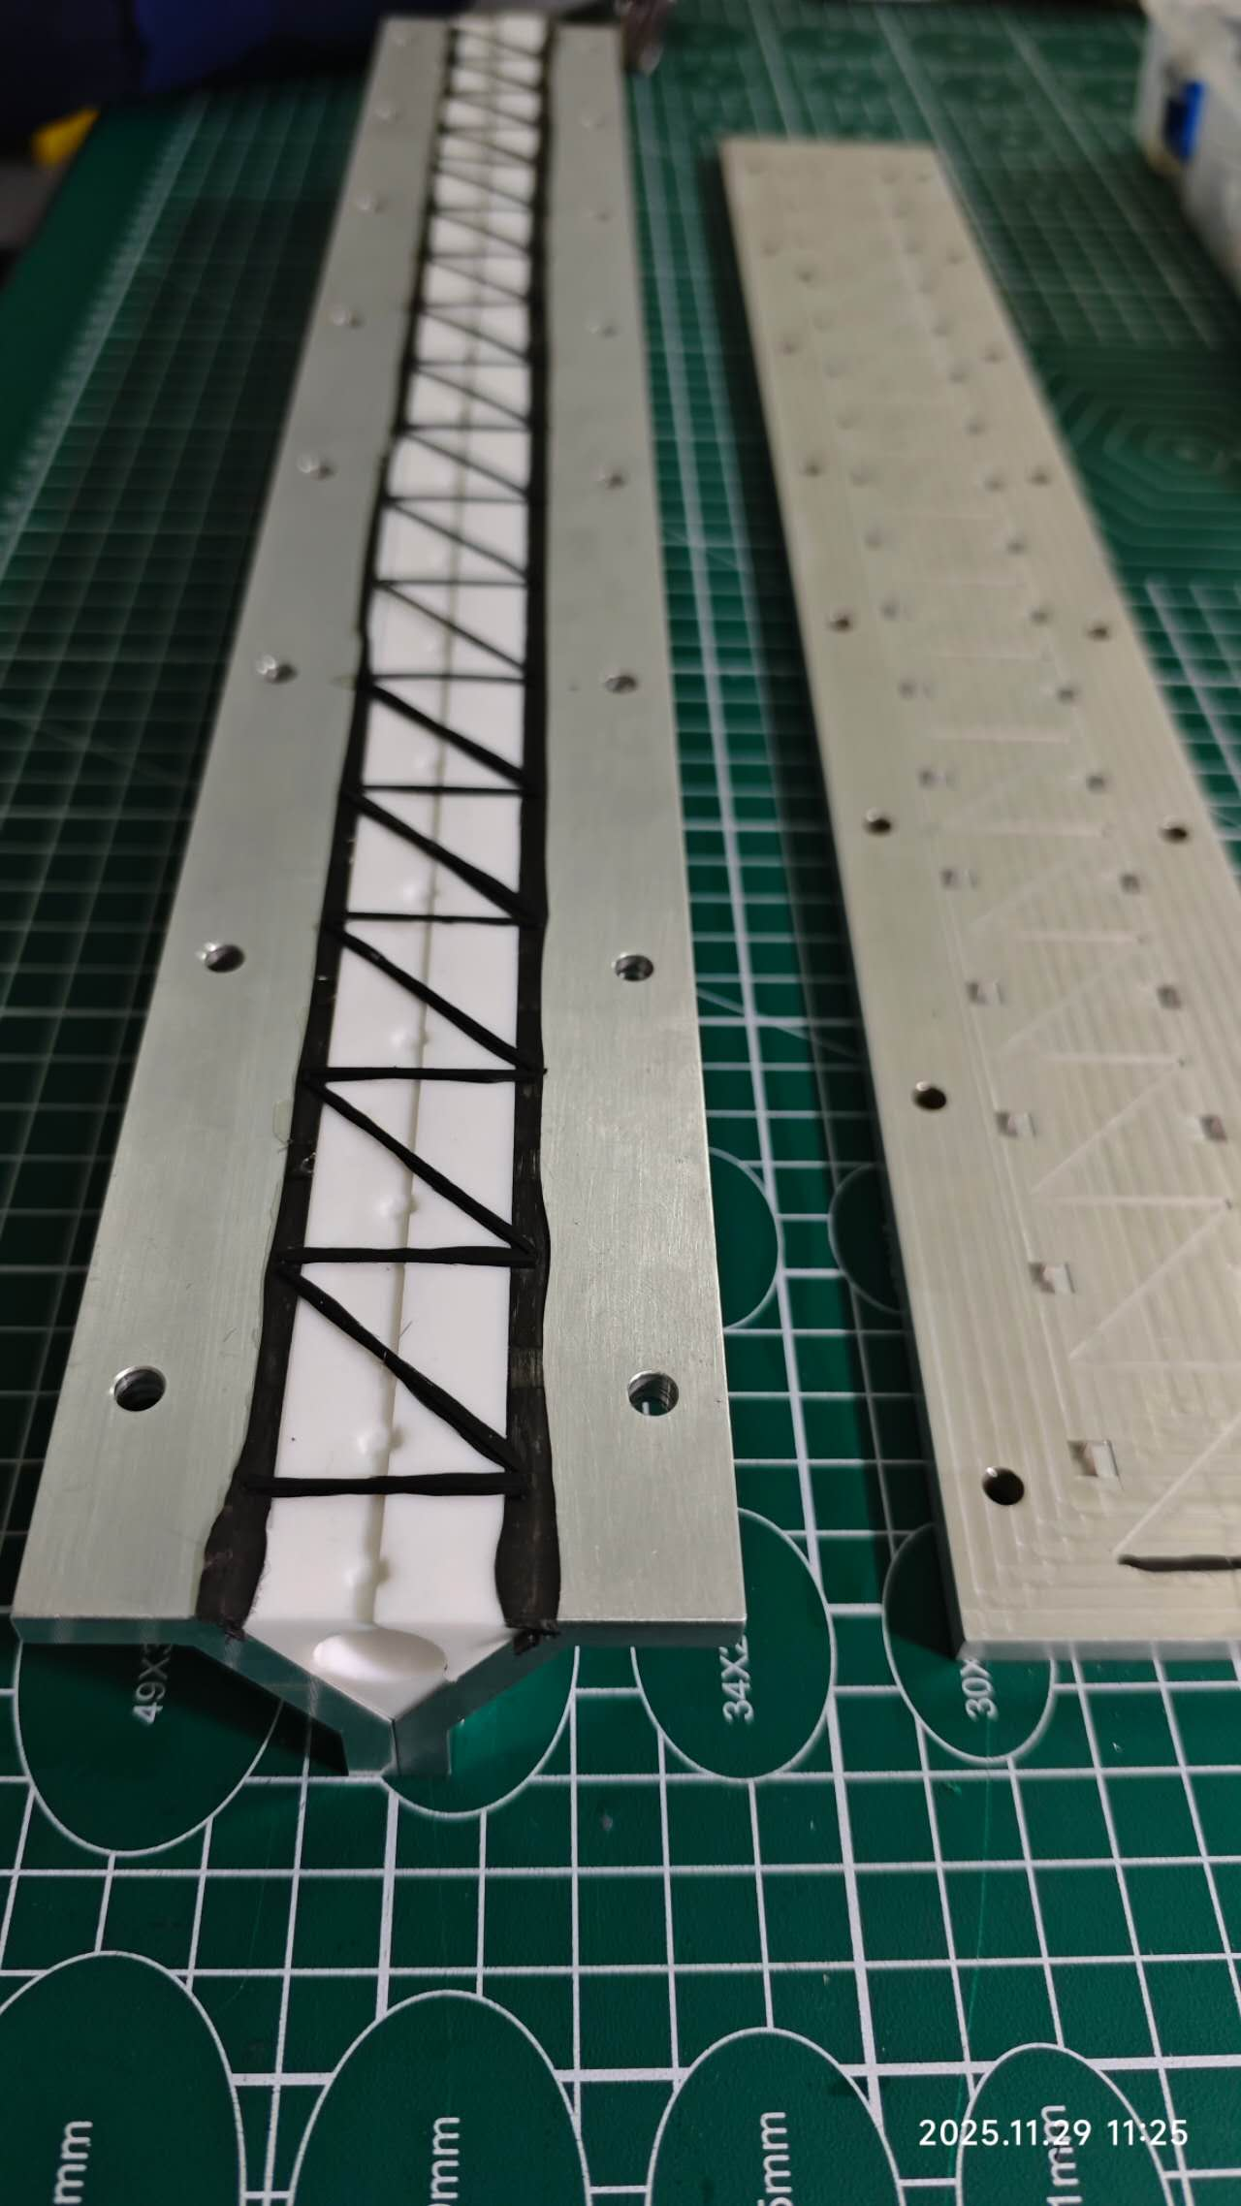
Manufacturing of 500mm length beam
Aluminum Mold
Carbon fiber of Secondary beam can not be continuous——separated into lots of carbon fiber rods

Slide 8
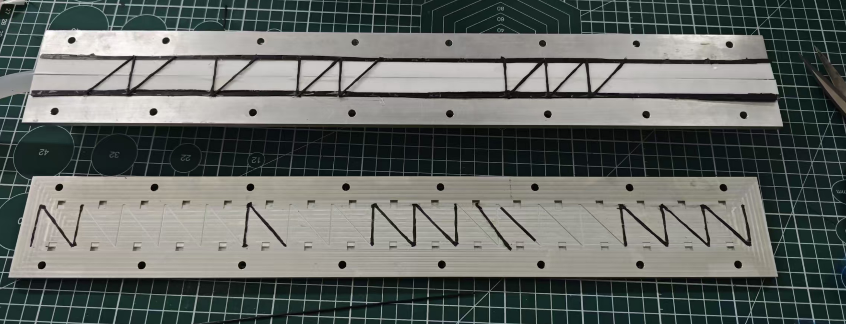
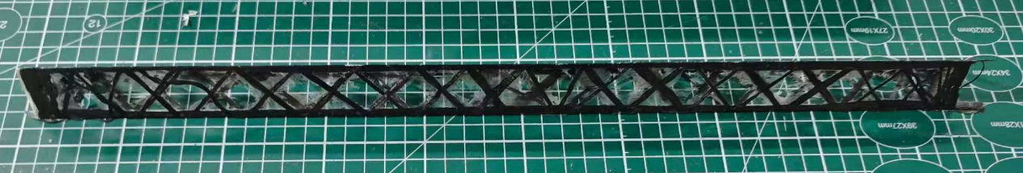
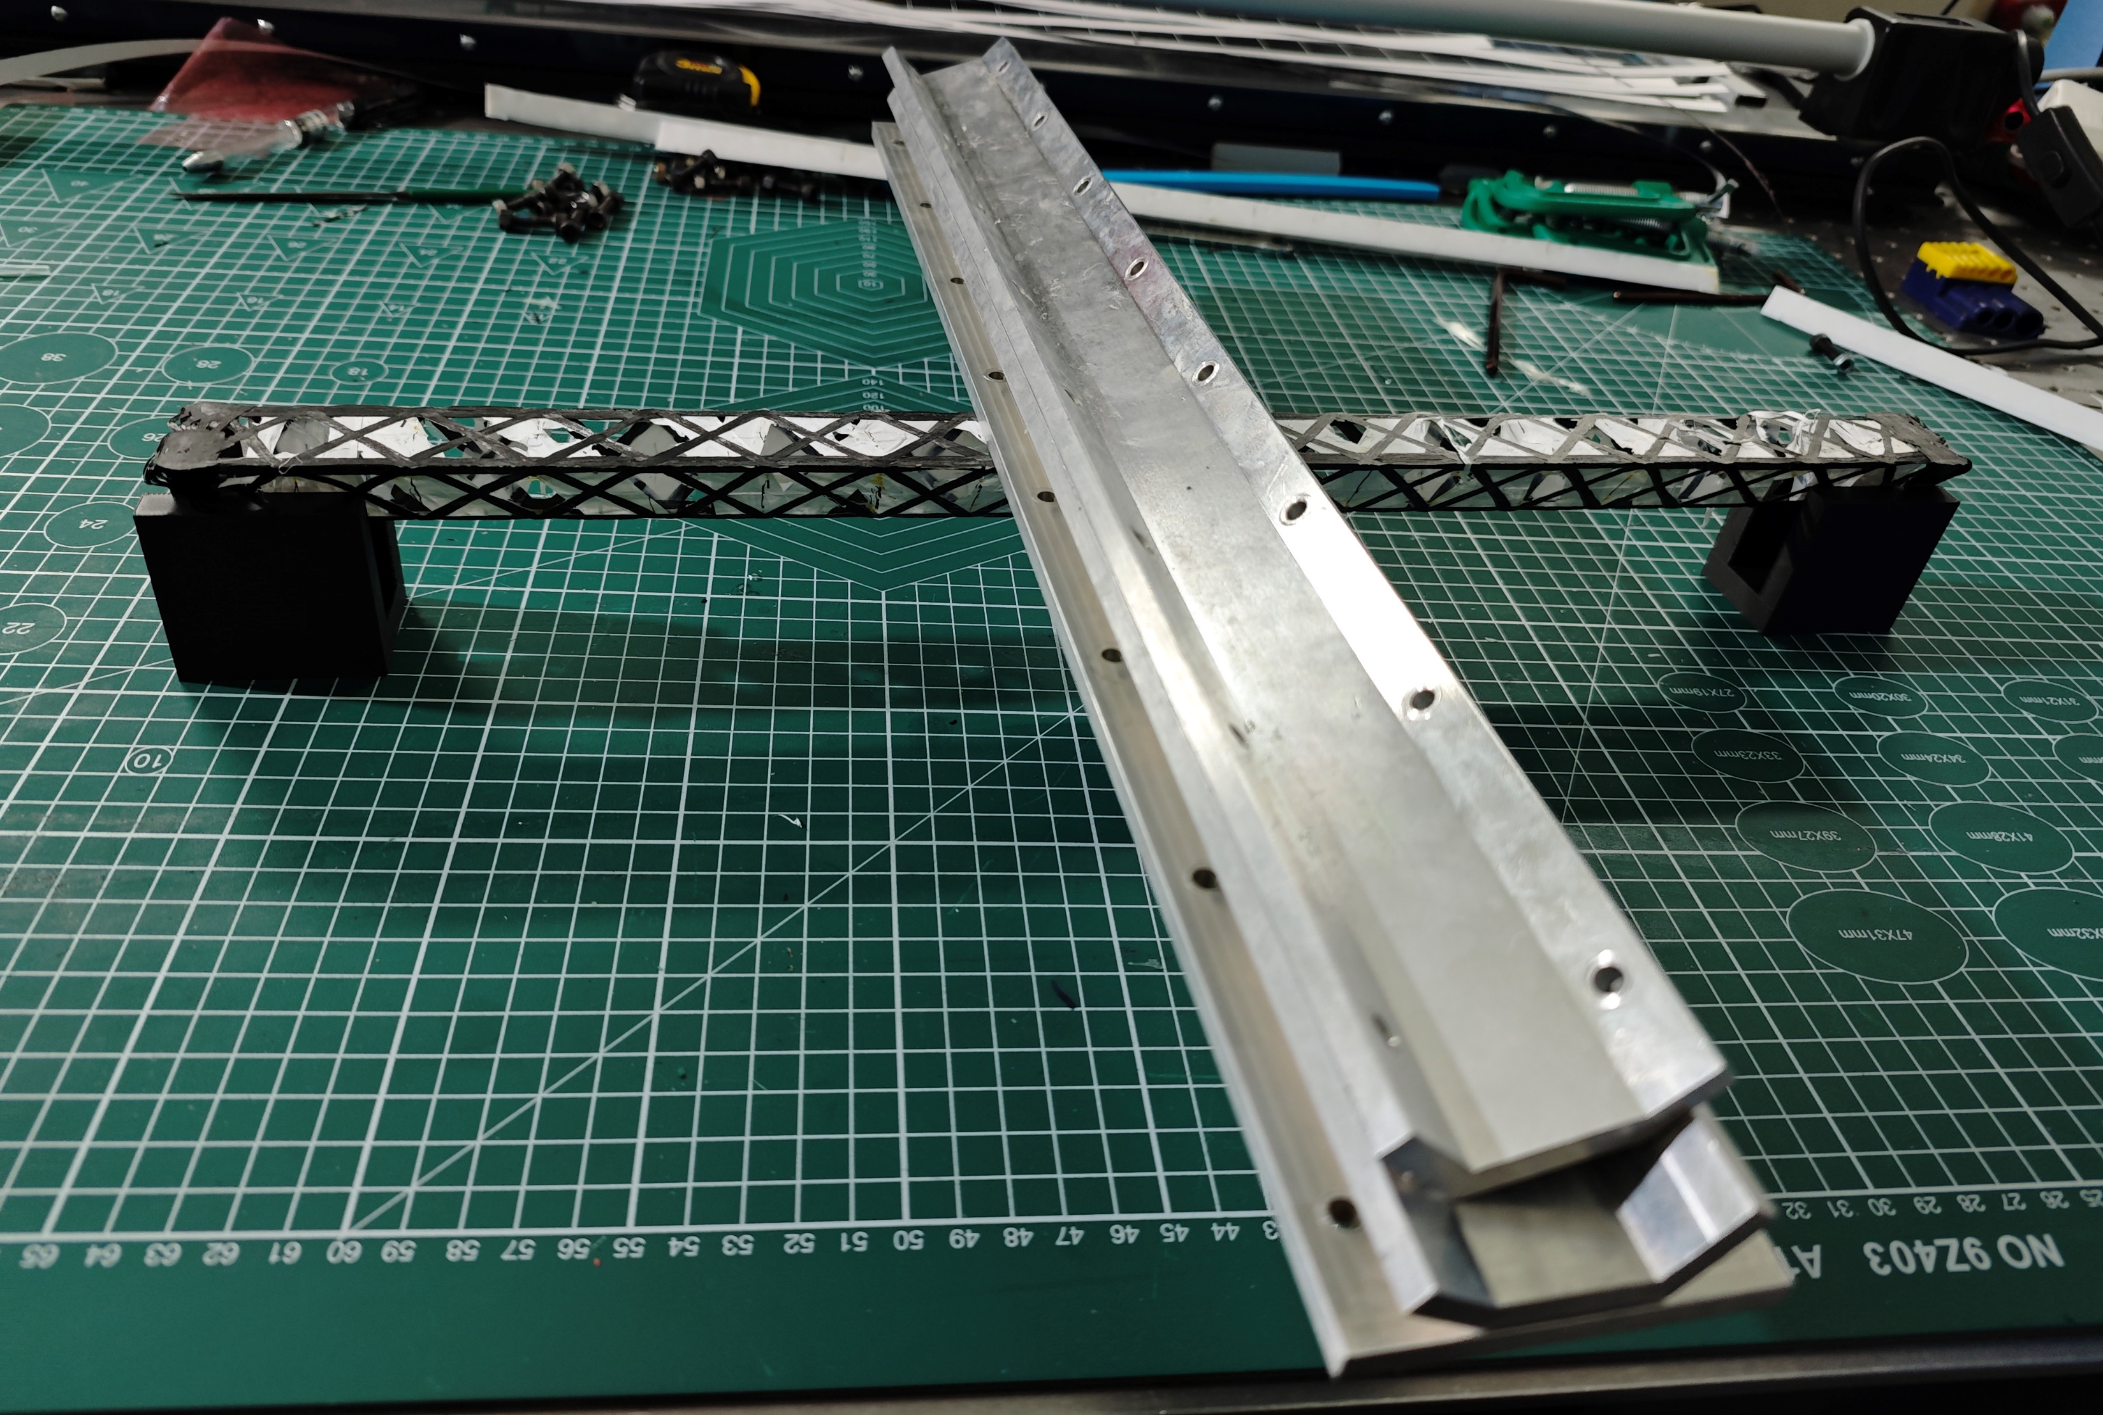
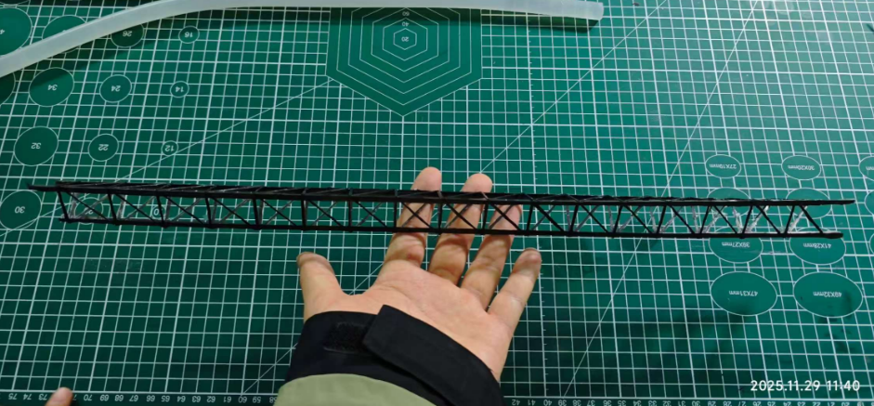
Products of triangular beam
Failure samples (ALICE method)
Not continuous of CF makes the bonding strength between secondary beam and main beam very weak (<2 mm bonding length)
Main beams and secondary beams hard to be their position
Success samples:
Changing the process of secondary——not in the slots of outer mold——continuous fiber

Slide 9
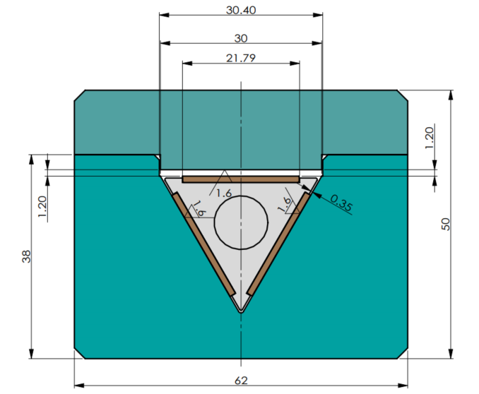
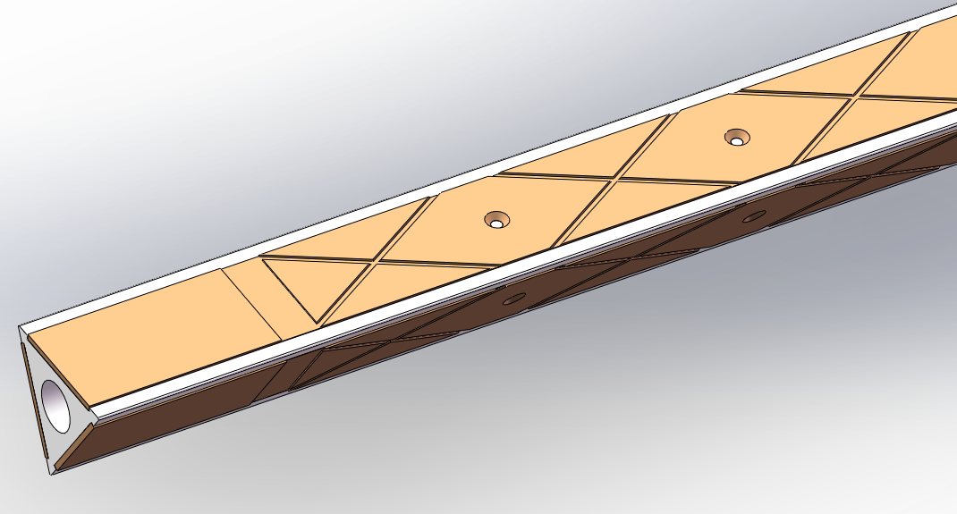
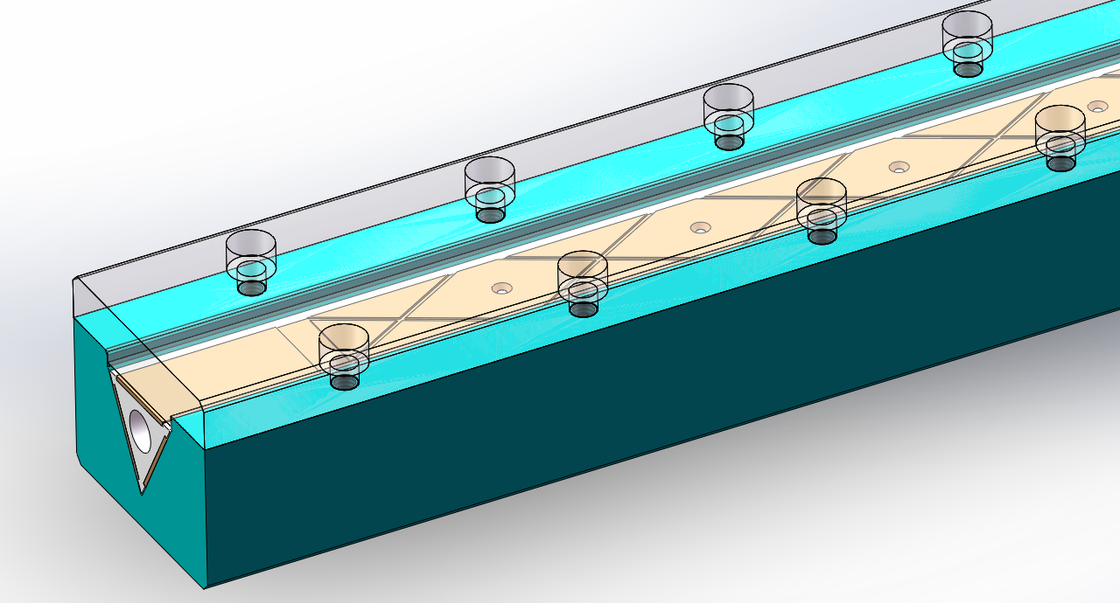
Manufacturing of 1000mm length beam
Mold design of Beam:
Main difference: the slots in the mandrel
Length of Beam:1000 mm
Secondary beam length: ~7m
Slotted stainless steel plate
PTFE mandrel
mandrel
Mandrel and Stainless Steel Outer Mold

Slide 10
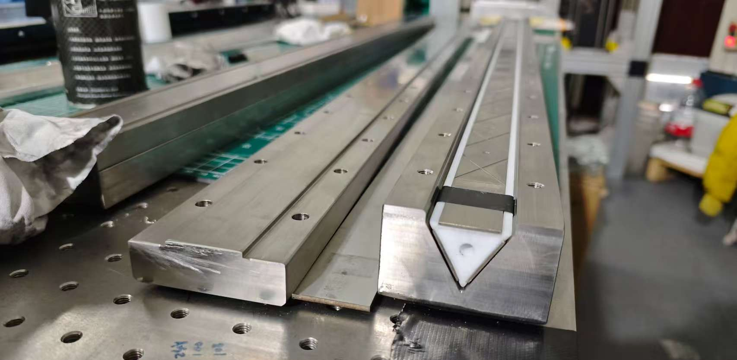
Mold
Cold plate mold
Triangular beam mold

Slide 11
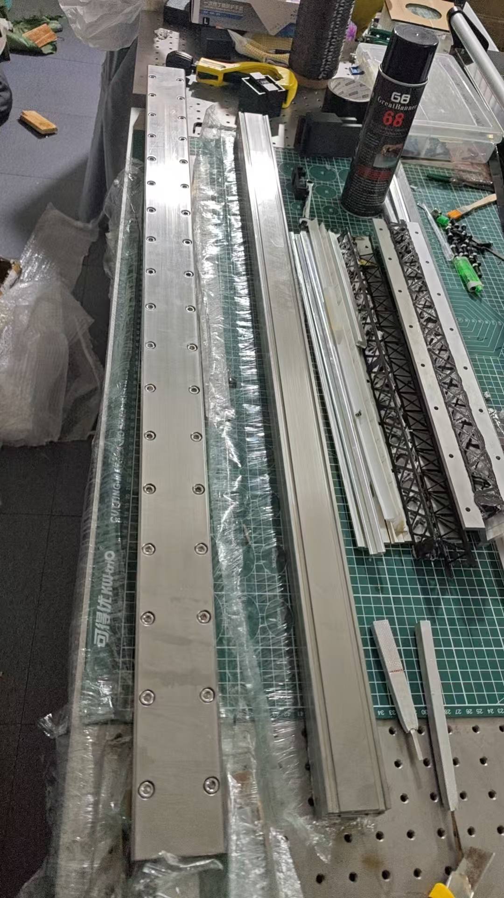
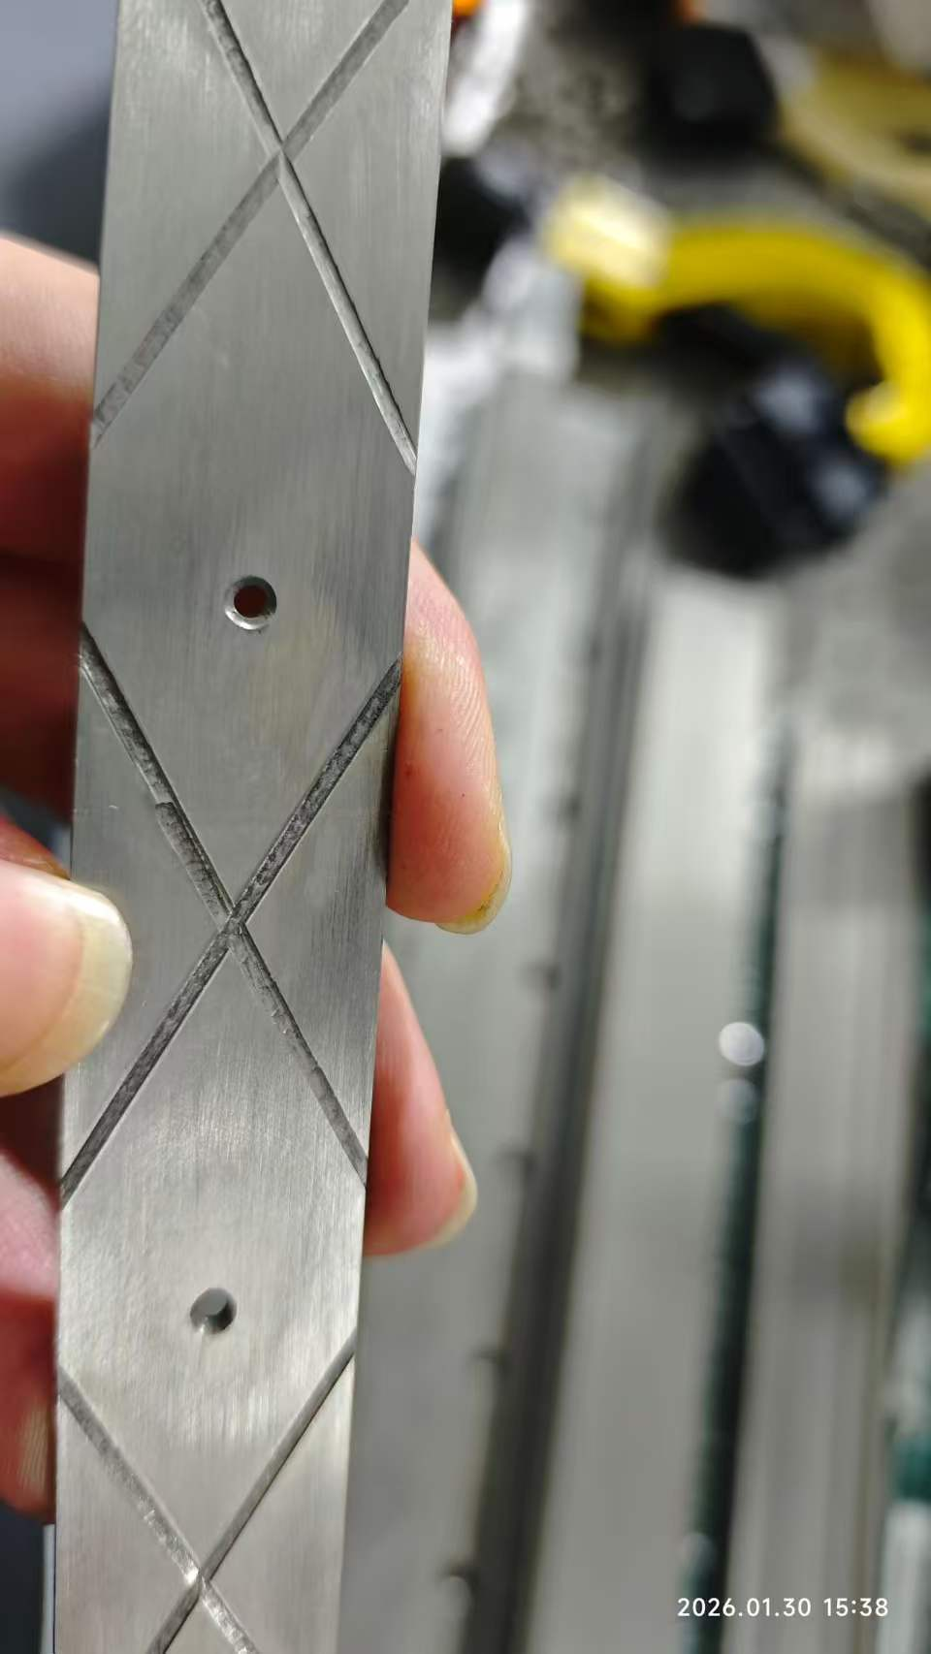
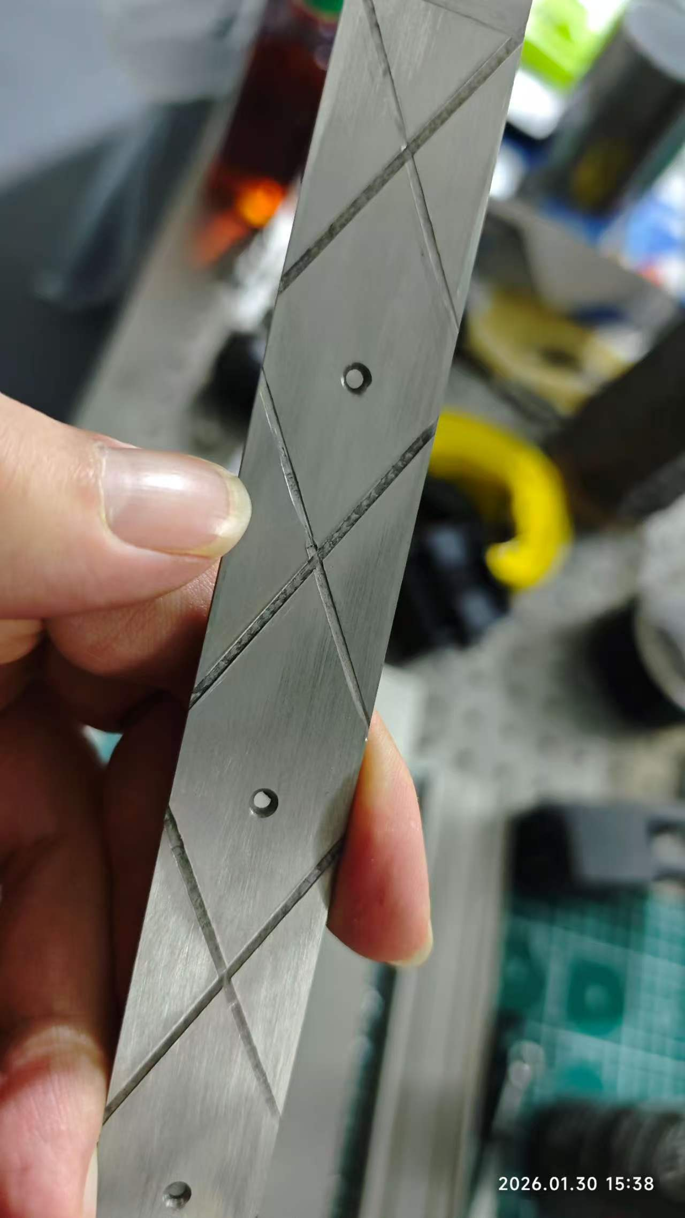
Mold

Slide 12
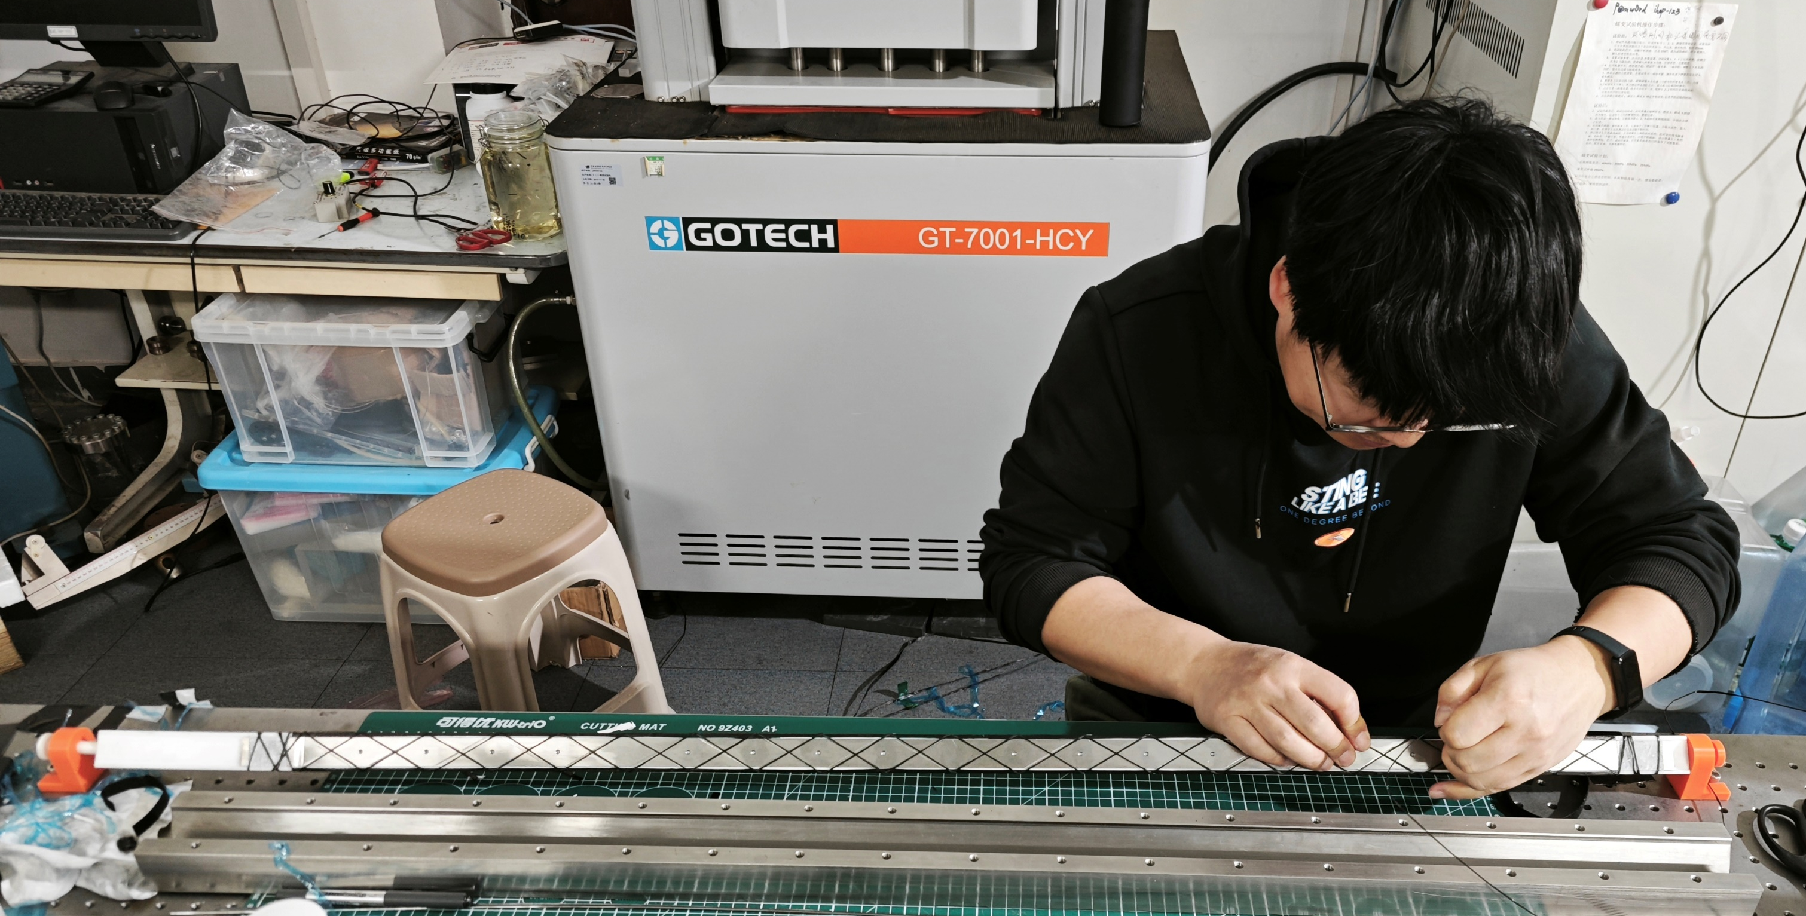
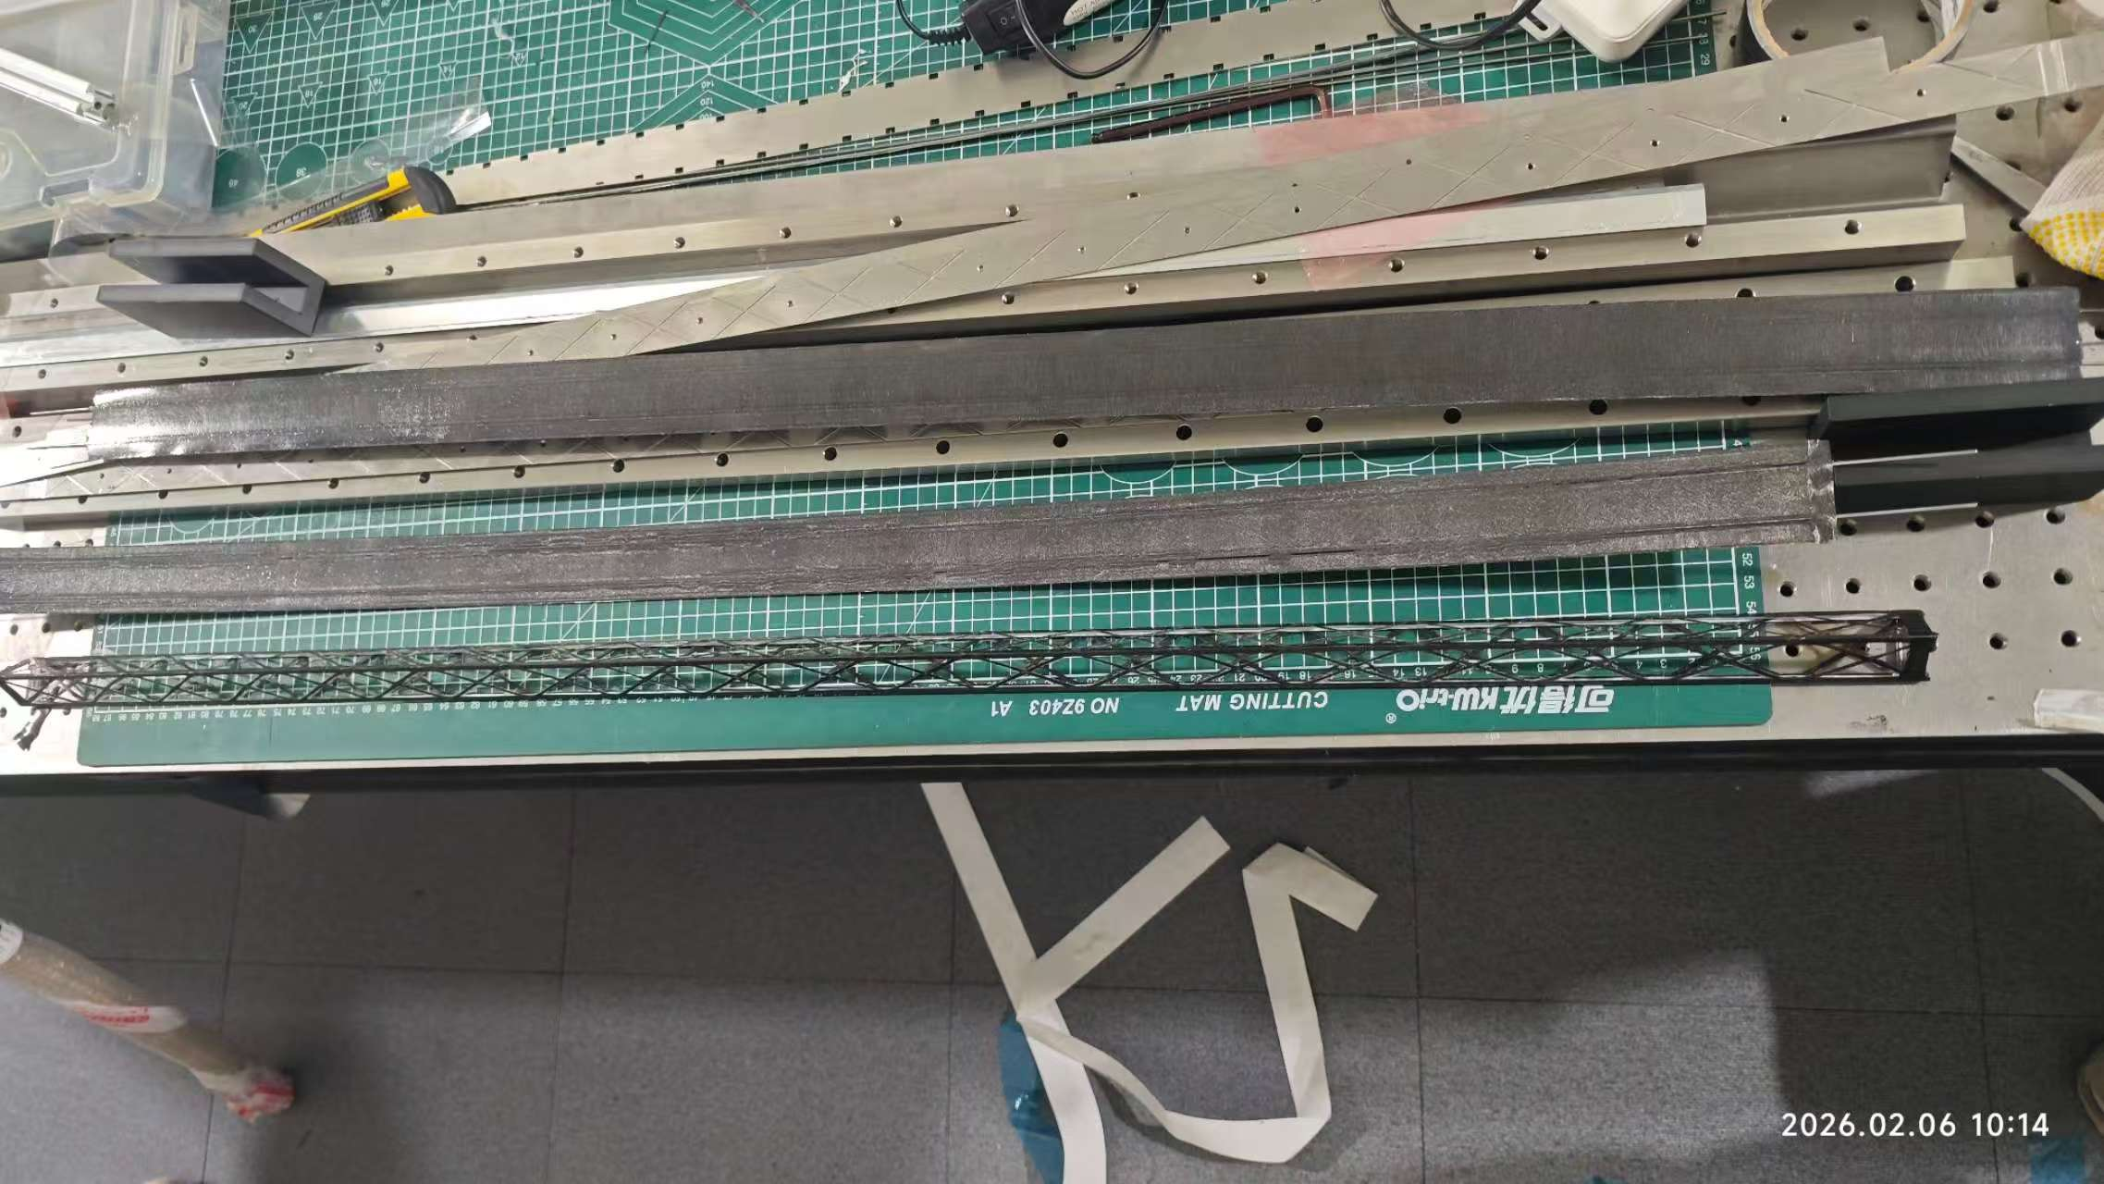
Manufacturing of 1000mm length beam
Main beam：0/0/0/90/0/0/0，M40J
Secondary beam： Unidirectional Carbon Fiber Tows: T700， 12K
First beam weight: 13.9g
The carbon fiber thread is manually wound on the mandrel.
mandrel
First beam

Slide 13
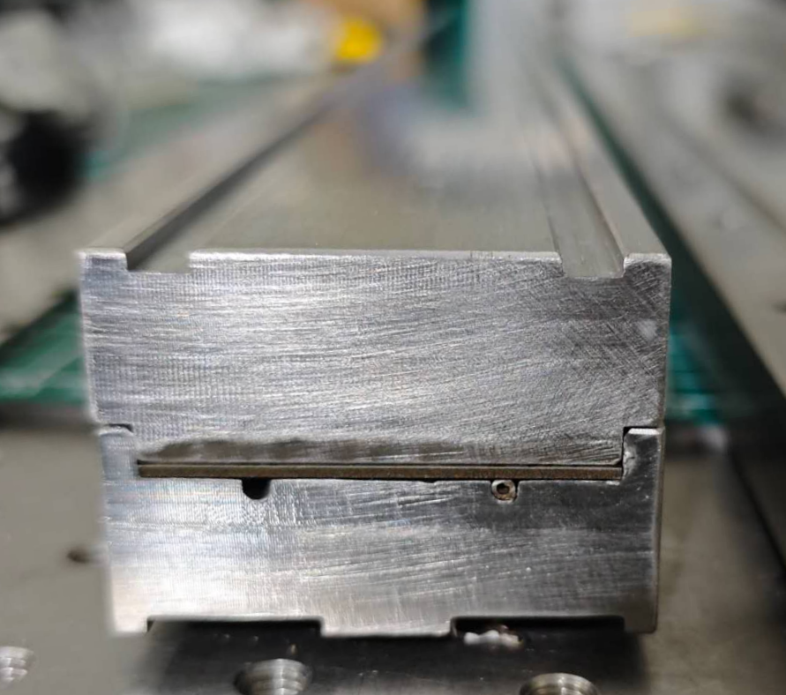
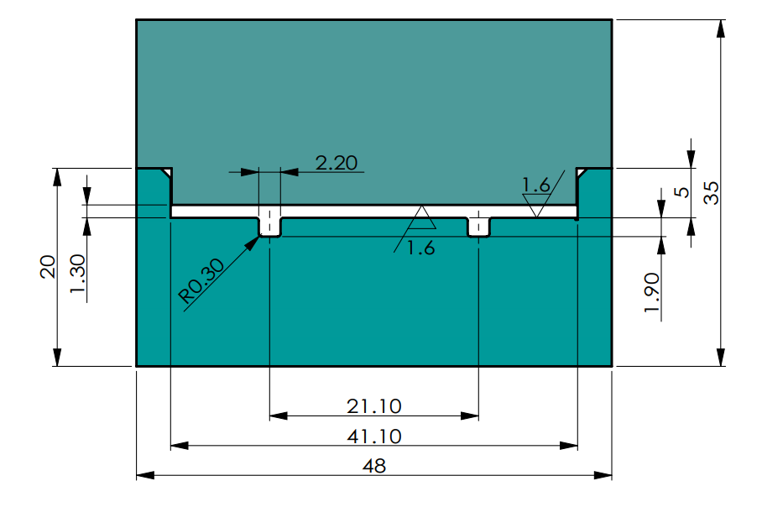
Manufacturing of 1000mm length beam
Mold design of cold plate:
The stainless steel mold features two elongated slots for inserting the cooling tubes
Length of plate:1000 mm
Put the different material film in the mold layer by layer
Slote for the cooling tube: OD1.6mm
cooling tube
Cross section of cold plate mold

Slide 14
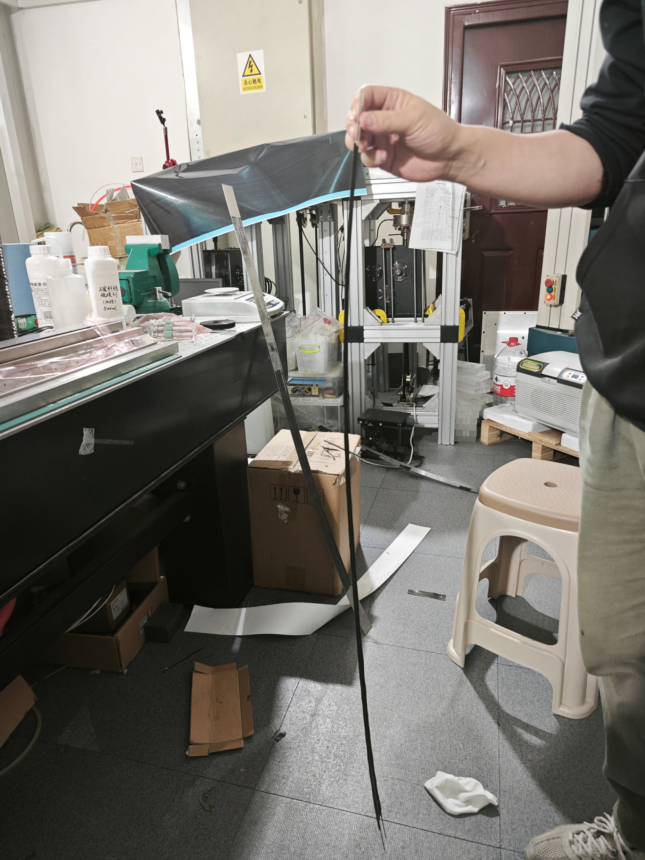
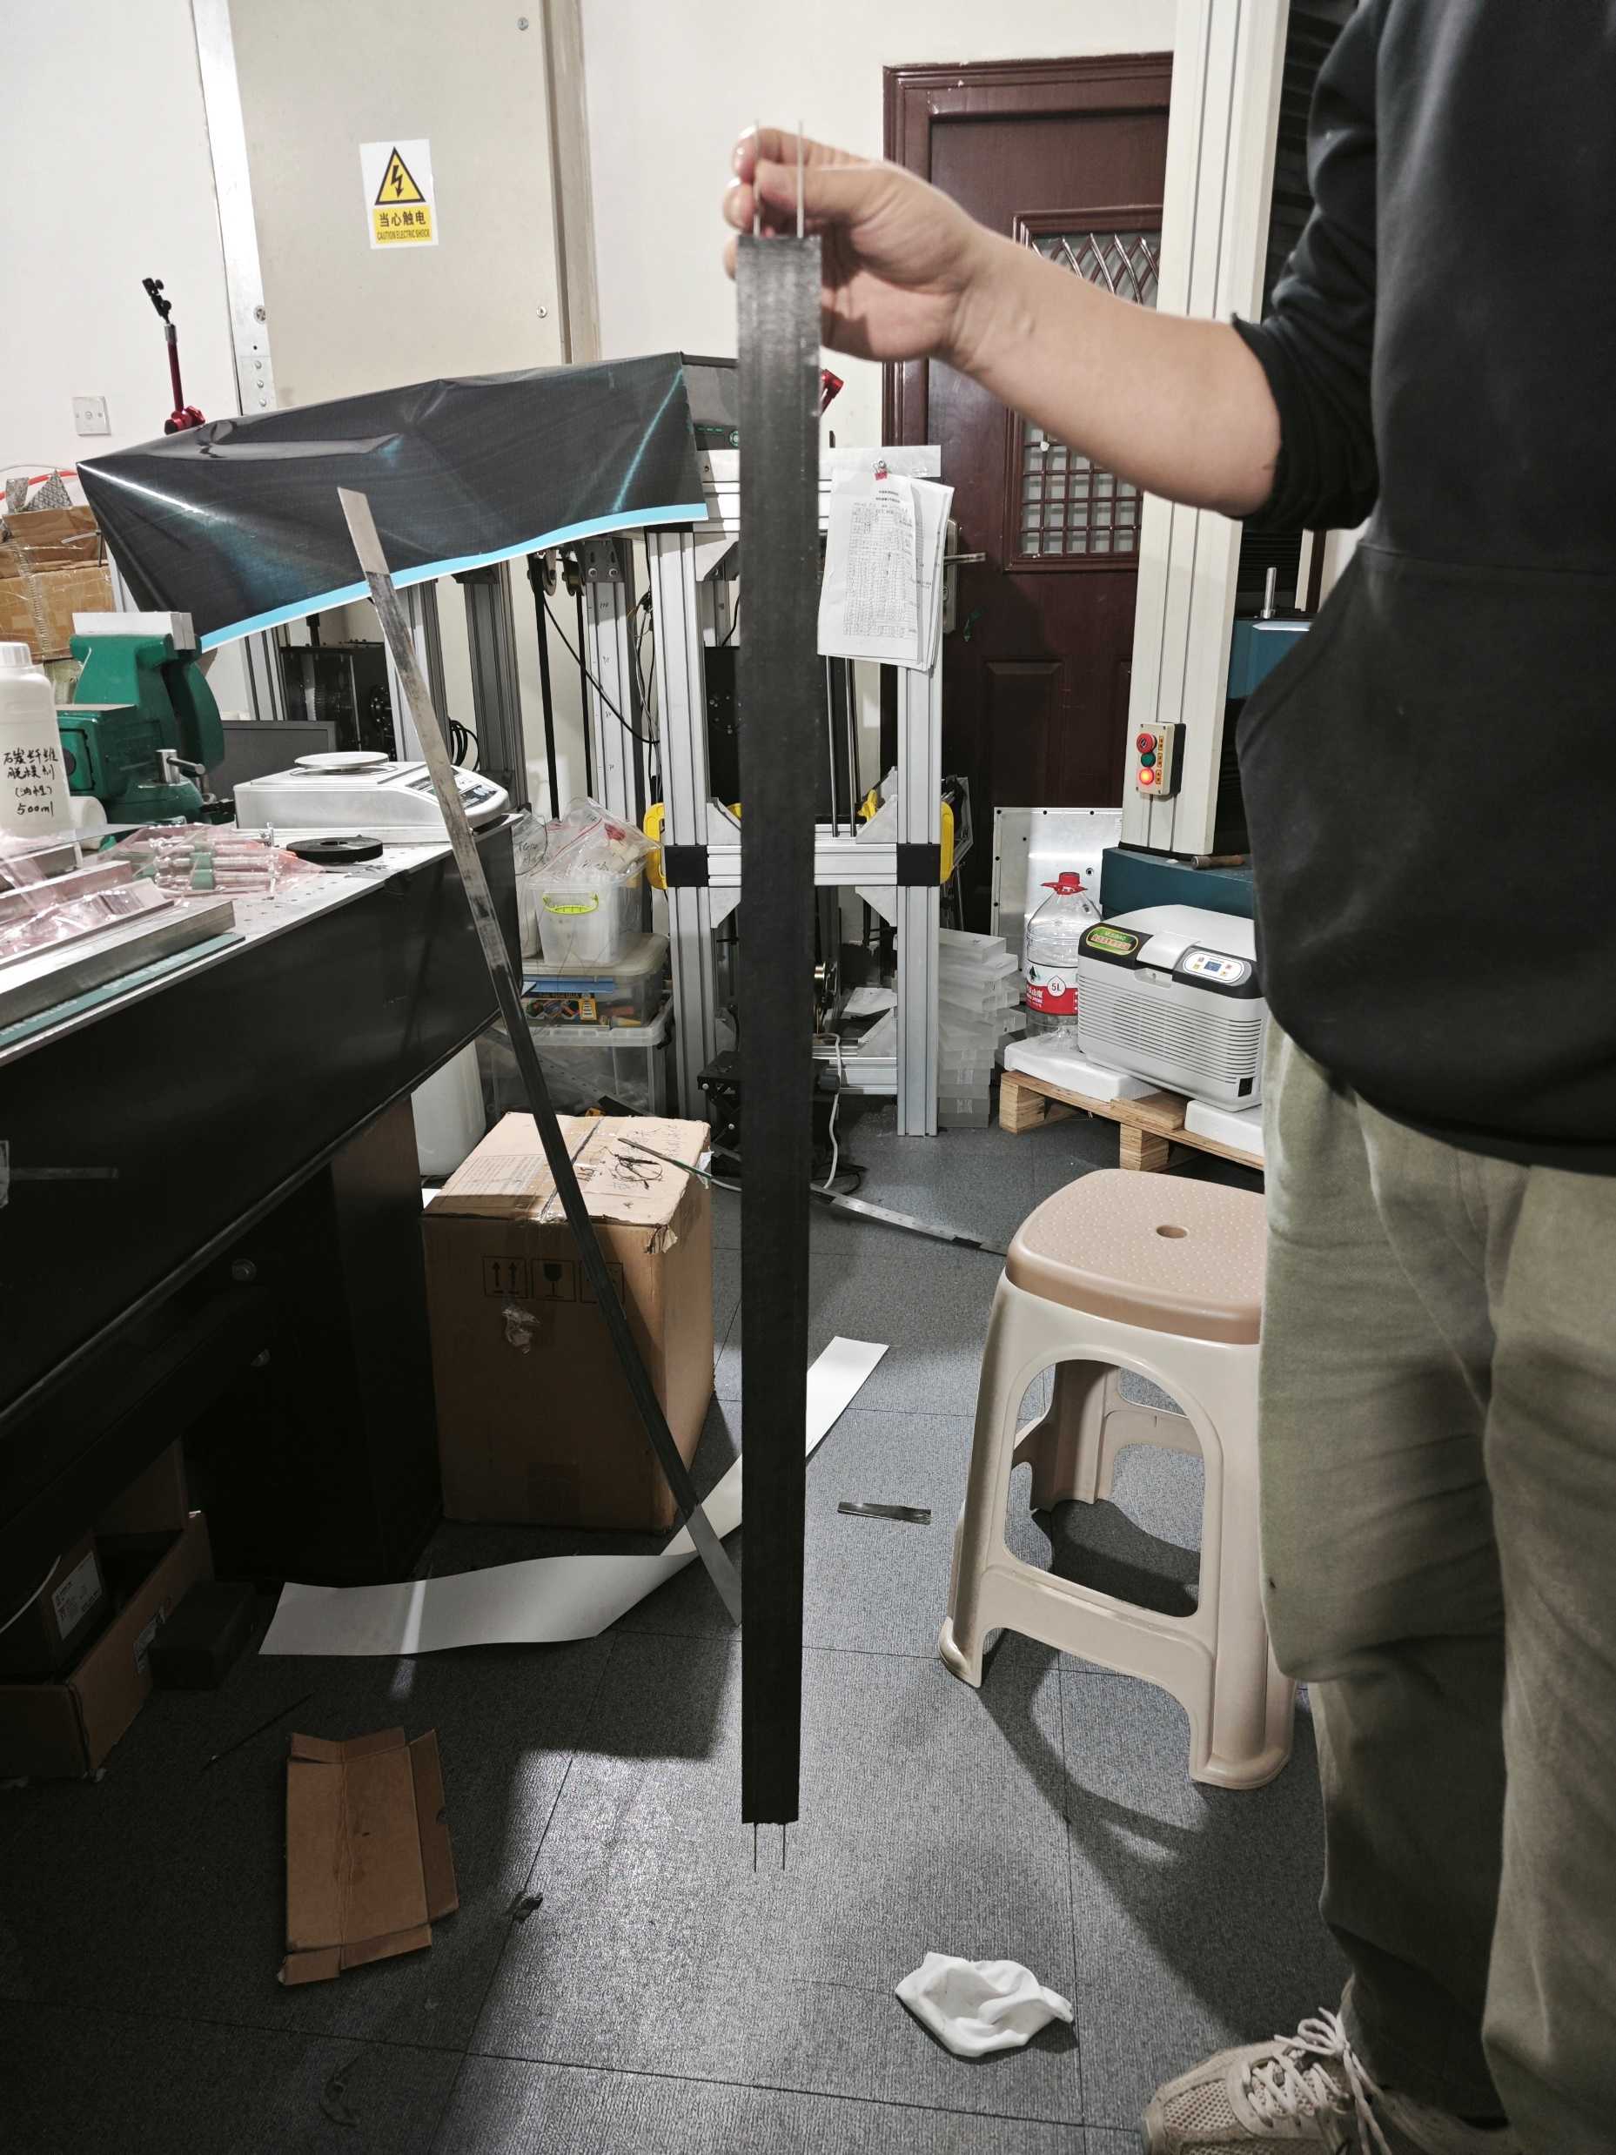
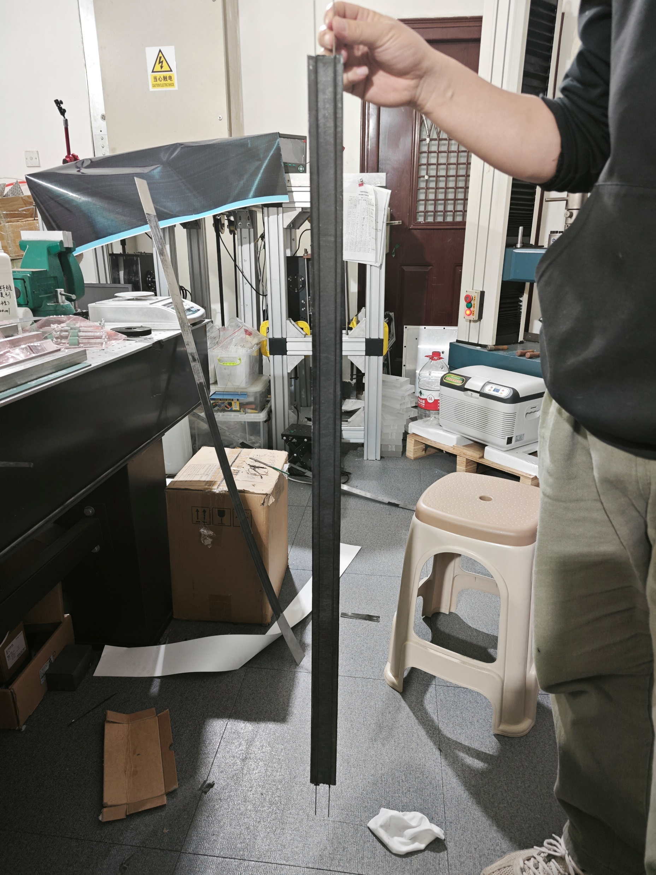
First cold plate
Bended for the thermal coefficient difference between materials

Slide 15
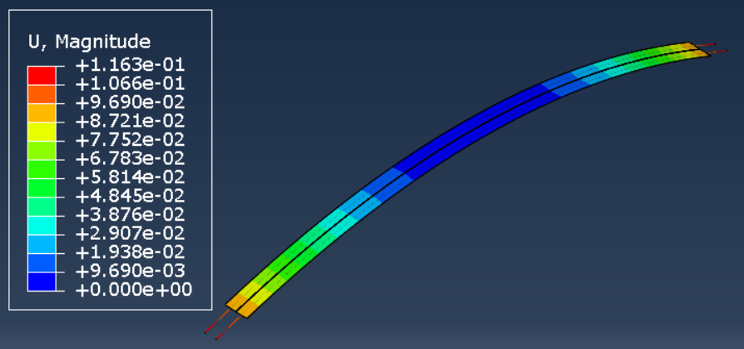
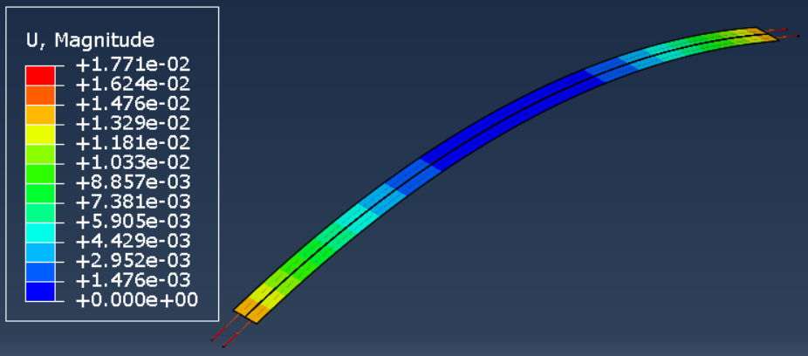
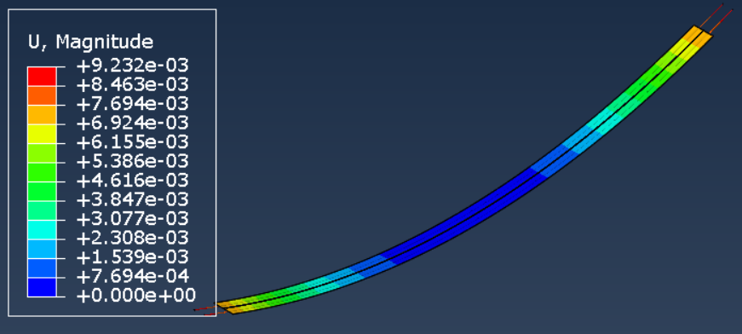
FEA of thermal deformation（load：-100℃）
116mm
17.7mm
Carbon fiber direction: 0/0/90/0，stainless steel tube
Carbon fiber direction: 90/90/90/90， stainless steel tube
-9.2 mm
Carbon fiber direction: 90/90/90/90, Titanium tube

Slide 16
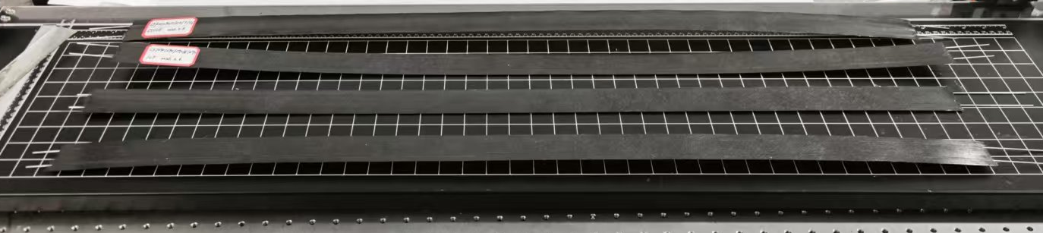
Cold plate manufacturing test of different direction
Optimizing Laying to change the bending of cold Plate
Carbon fiber direction: 0/0/90/0，
Carbon fiber direction: 90/90/90/90，without Graphene film
Carbon fiber direction: 0/90/90/90， without Graphene film
Carbon fiber direction: 90/90/0/90， without Graphene film
Good quality of the thickness consistency: 0.28±0.02mm
Reduce the bending amplitude
1
2
3
4

Slide 17
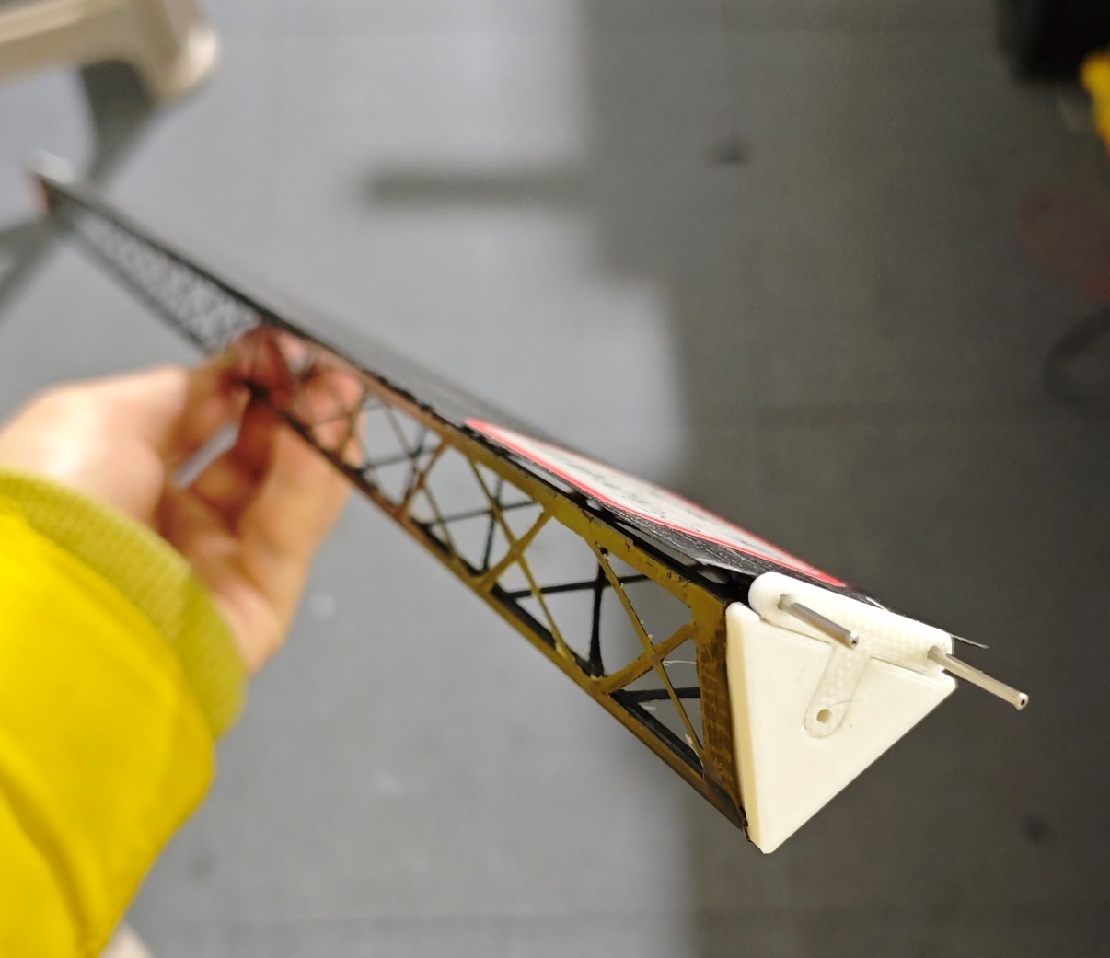
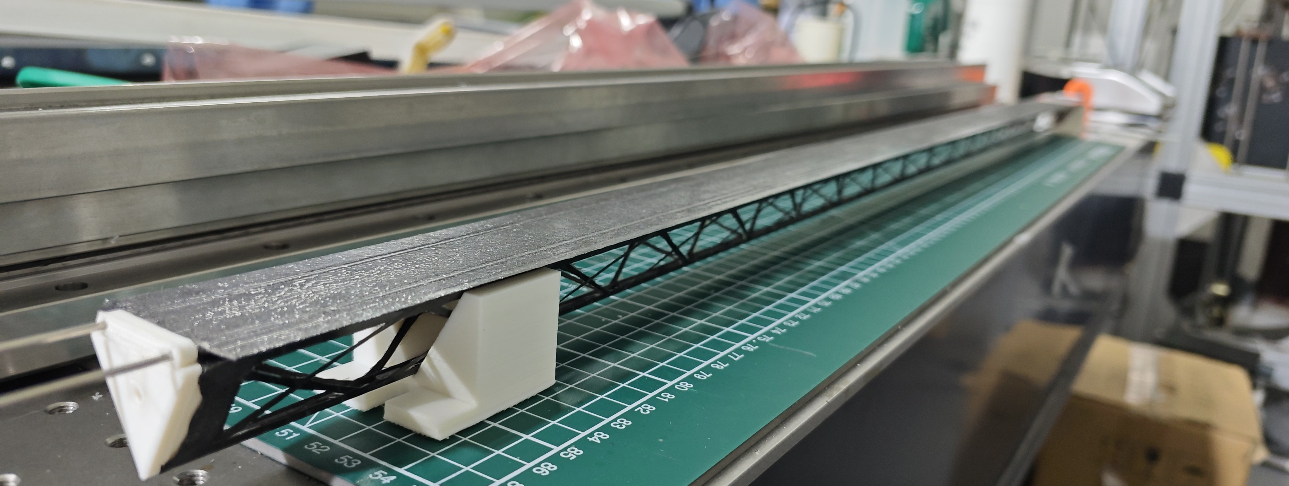
Assembly of cold plate and triangular beam

Slide 18
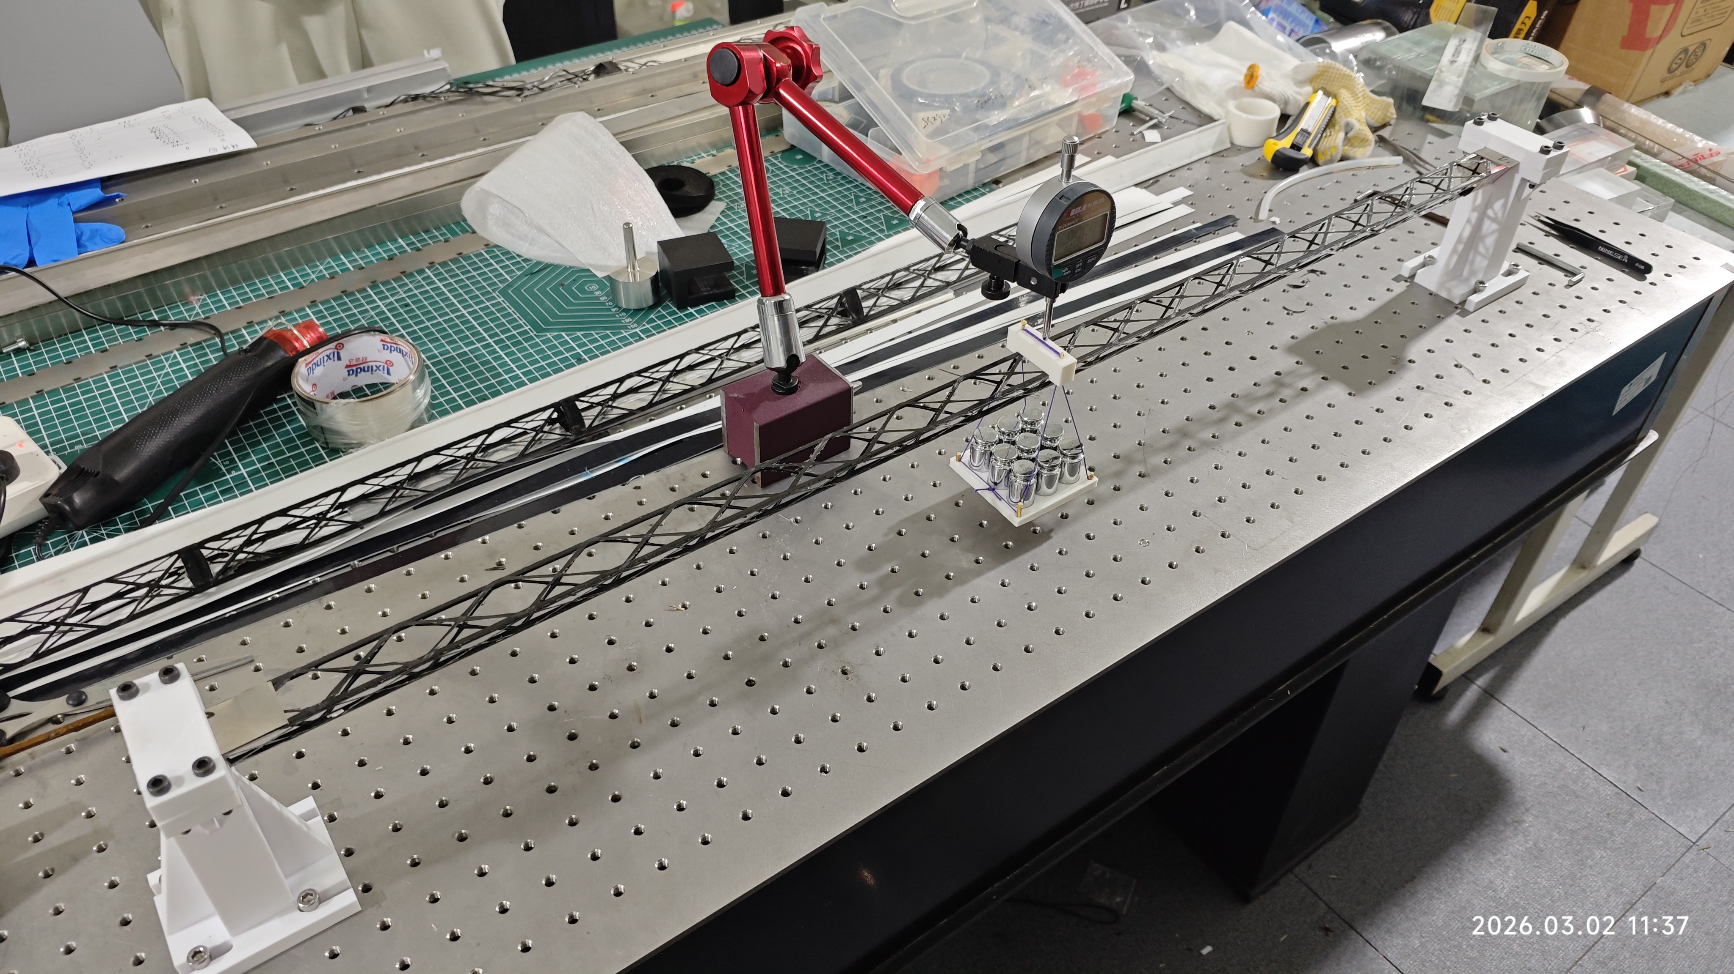
Static mechanical test of triangular beam
Dial gauge
standard weights
Triangular beam
Supporting method: fixed and pinned support
Load: concentrated load with standard weight (50g)
Displacement measuring: Dial gauge, resolution 1um, accuracy ±5um
Two Beams: beam1：13.9 g and beam2：15.1 g
Supporting structure

Slide 19
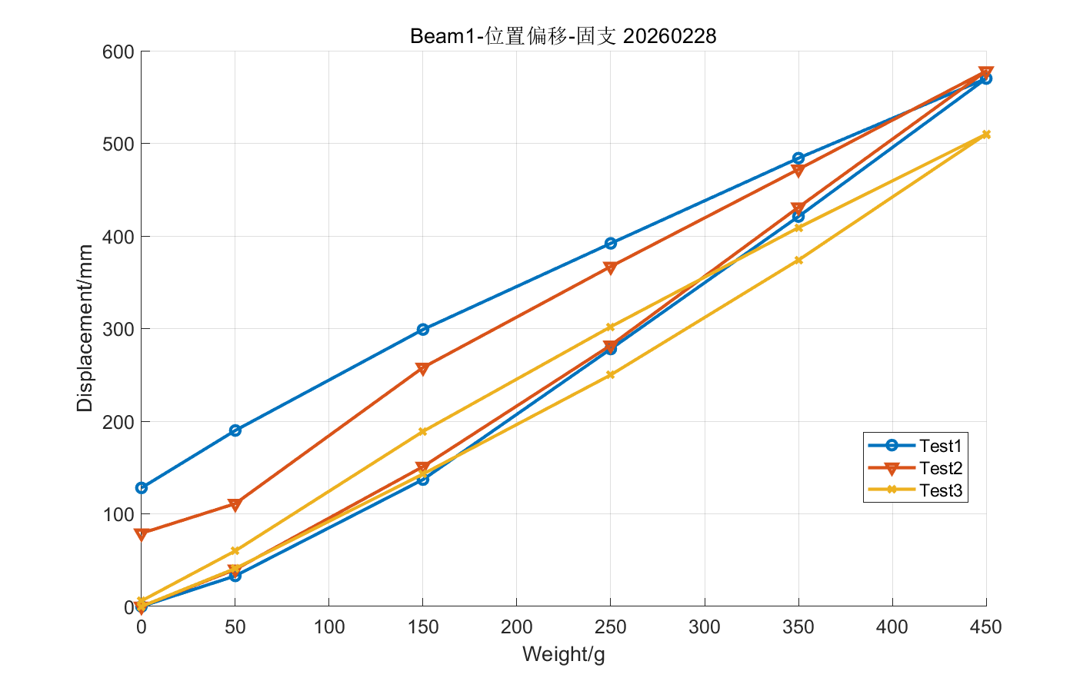
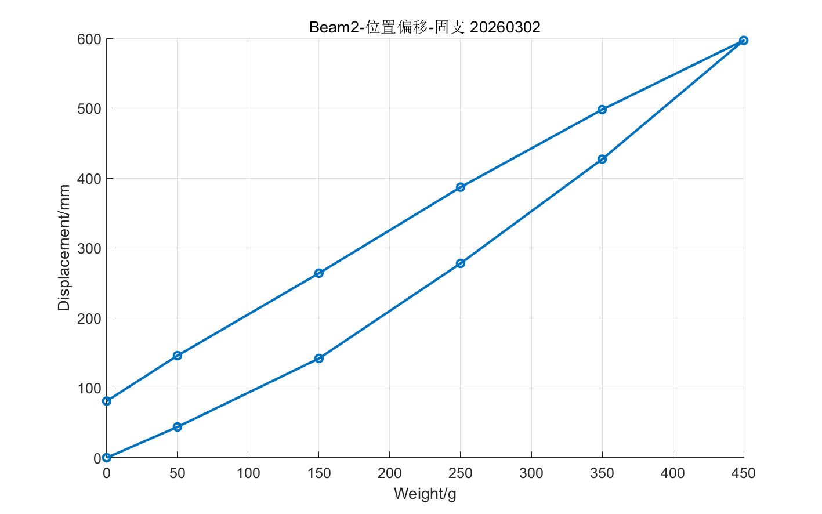
Beam2-fixed supporting
Load: 0~450g
Loading and unloading curves are not matched together
Displacement is not linear as the weight increases
Creeping is obvious under high load
Unloading progress
Loading progress

Slide 20
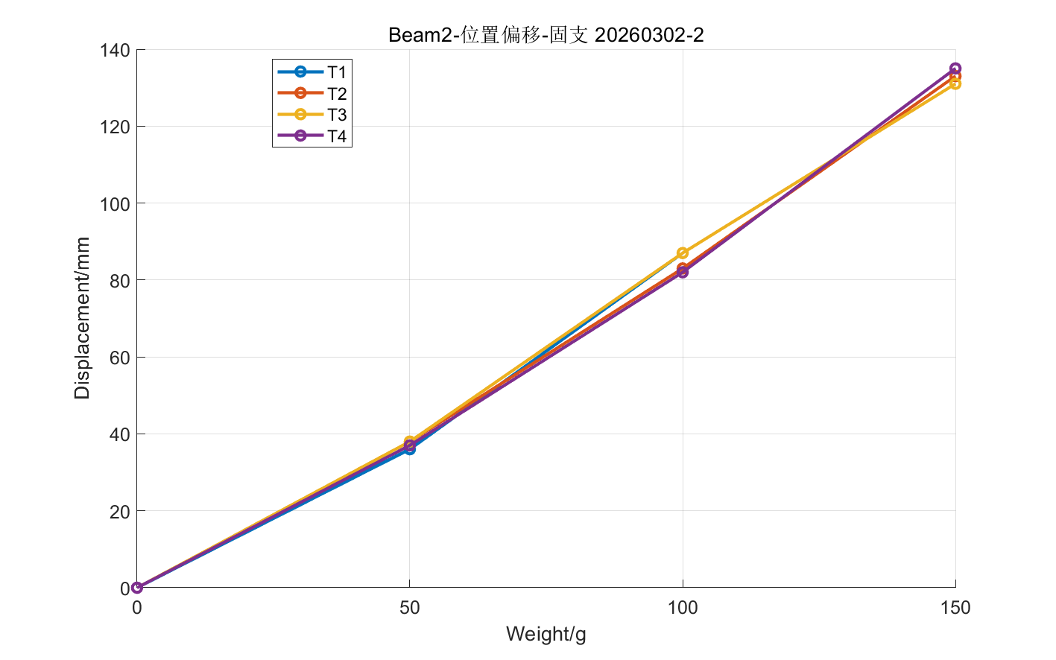
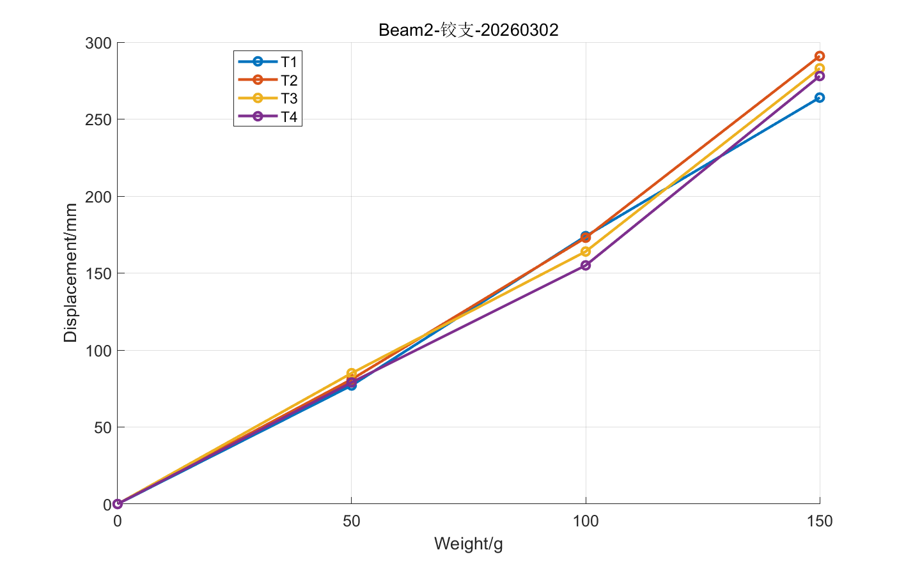
Beam2 test
Low load for creeping: 0~150g
Creeping also exist: curve is not linear
Fixed boundary:
50g: 37.25 ± 0.96 um
100g: 84.75 ± 2.63 um
150g: 132.50 ± 1.91 um
Pinned boundary:
50g: 80.50 ± 3.42 um
100g: 166.50 ± 8.89 um
150g: 279.00 ± 11.34 um

Slide 21
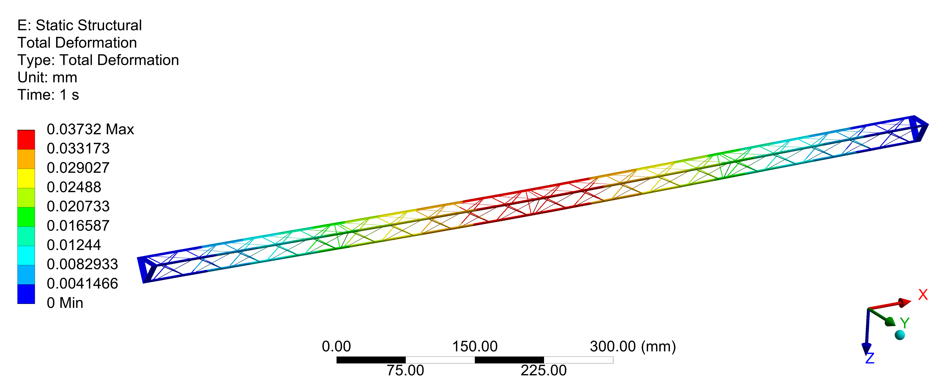

FEA of test beam
Fixed boundary
load：50g—concentrated load
Test data：beam1 34.75±2.22 um
beam2 37.25 ± 0.96 um
FEA result(main beam)：36.3um

Slide 22


FEA of test beam
Fixed boundary
load：50g —concentrated load
Test data：beam1 94.00 ± 3.46 um
beam2 80.50 ± 3.42 um
FEA result(main beam)： 81.49 um

Slide 23


FEA of beam under the exact sensor weight
Fixed boundary
Sensor weight: 80g——uniformly distributed load
Deformation is ~20um better than that of concentrated load of 50g

Slide 24


Compare between FEA of test result
Under 50g load, the result can be matched well between FEA and test results.
The two beams deformation almost the same under the fixed boundary condition
Under pinned boundary condition, Beam1(13.9g) deformation is larger than beam2’(15.1g)
Beam1 and beam2
Beam1
Beam2
FEA
FEA
Comparison under fixed boundary condition
Comparison under pinned boundary condition

Slide 25
Conclusion
Successfully manufactured the 1000mm triangular CF beam
The weight of 1000mm beam is ~15g, and its deformation is about 35um under the 50g concentrated load, 80gjub~20um
FEA result can match well with test results
The beam under high load may be creeping obviously
The mold could be further optimized in future

Slide 26
Back up

Slide 27
Beam1-fixed supporting
Load: 0~450g
Loading and unloading curves are not matched together
Displacement is not linear as the weight increases
Creeping is obvious under high load
Unloading progress
Loading progress

Slide 28


Beam1-固支
荷载：0~150g
线性度一般，最大变形
50g: 34.75±2.22 um
100g: 85.00± 6.32 um
150g: 134.25 ± 1.89 um
50g: 94.00 ± 3.46 um
100g: 224.50 ± 5.74 um
150g: 344.00 ± 14.83 um

Slide 29


固定支撑
载荷：100g

Slide 30


固定支撑
载荷：150g

Slide 31


铰链支撑
载荷：100g

Slide 32


铰链支撑
载荷：150g

Slide 33

主梁使用M40J 单层50μm
铺层：0，0，0，90，0，0，0
腹杆使用T700 单层50μm
单向，6层

