Slide 1
CEPC IP tuning
Wei Yuanyuan, Wang Yiwei, Zhang Yuan,
Wang Bin, Bai Sha

Slide 2
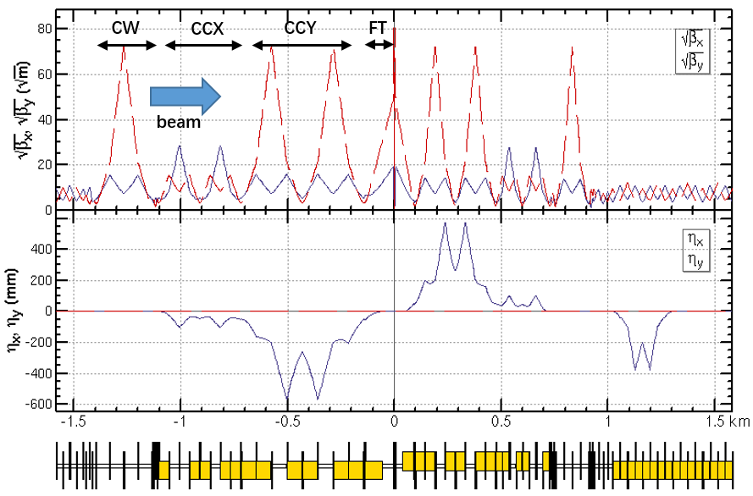
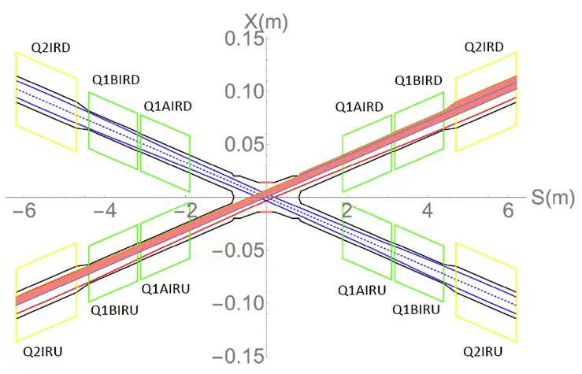
CEPC baseline lattice
CEPC baseline lattice— TDR lattice for Higgs energy w/o solenoid
Layout of IR
Layout of IP

Slide 3
What is “IP tuning”
IP tuning is a process adjusting and optimizing some important optics properties at IP by some knobs
knobs of local orbit, orbit angle_ H&V correctors in IR
β * , waist shift _ Quads in IR
coupling, dispersion _ Skew quads in IR
One knob is to tune specific parameters at IP locally using a set of magnets
The magnets are localized in IR region and the distortion of beam parameters should be closed in this area
Parameters at IP can be tuned linearly by changing the strengths of the sets of magnets
Notes:
明确IP 观测量是什么？

Slide 4
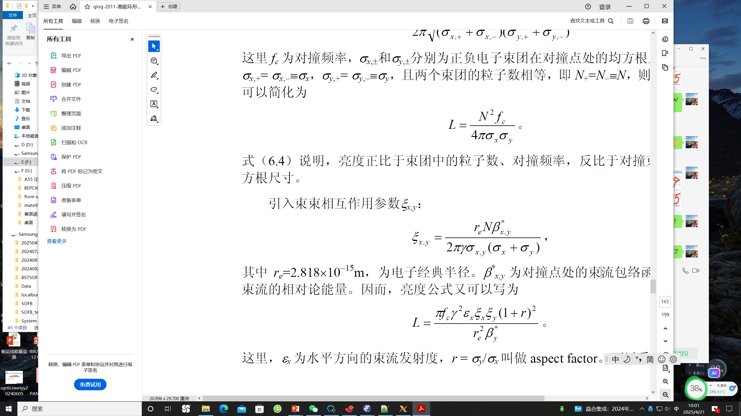
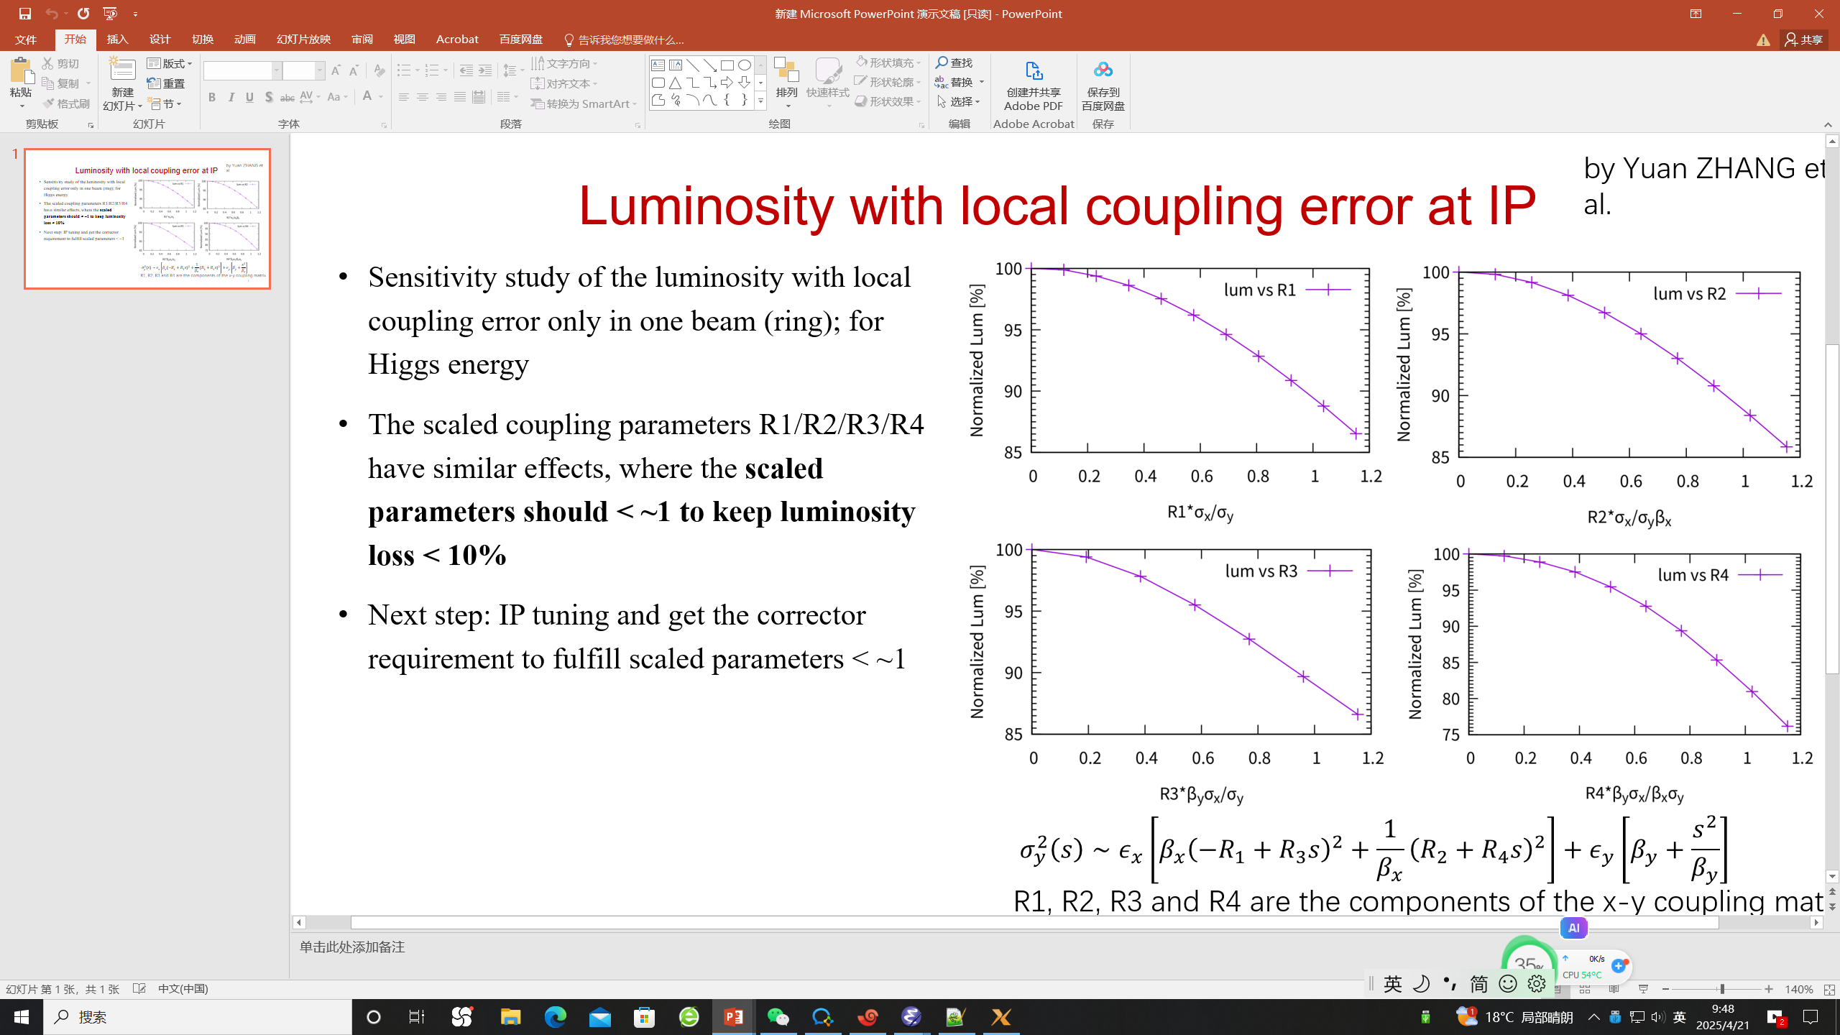
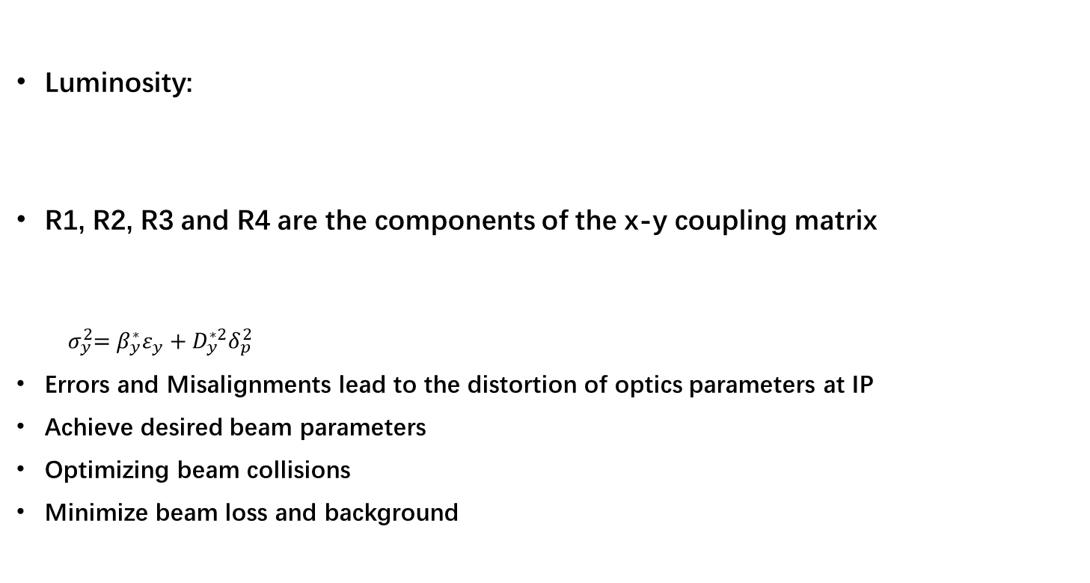
Why is IP tuning important
Luminosity:
R1, R2, R3 and R4 are the components of the x-y coupling matrix
$${ σ}_{y}^{2}=β_{y}^{∗}ε_{y}+D_{y}^{∗2}δ_{p}^{2}$$
Errors and Misalignments lead to the distortion of optics parameters at IP
Achieve desired beam parameters
Optimizing beam collisions
Minimize beam loss and background
Notes:
阐明和亮度相关，明确Ip tuning的目标。了解FCC进展，具体从事工作的人员。

Slide 5
Why is IP tuning important
ϵ_{x}=6.6478e-10 (m*rad)
Β_{x IP}=0.33 (m)
Β_{y IP}=0.001 (m)
Critical value — corresponding to 10% luminosity loss:
R1 * =0.0022 (rad)
R2 * =7.31e⁻⁴ (m)
R3 * =2.22 (m⁻¹)
R4 * =0.61 （rad)
Critical value — comparable to 1σ_{y} and 1σ’_{y} at IP
D_{y} * =1.85e⁻⁵ (m)
D’_{y} * =3.65e⁻⁵ (rad)
Luminosity with local coupling error at IP for Higgs energy from Zhang Yuan’s simulation
Notes:
10%亮度下降具体对应尺寸的变化？

Slide 6
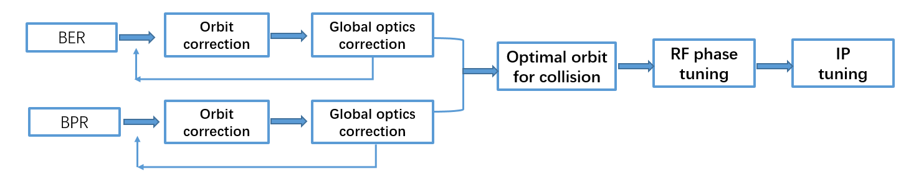
When is IP tuning performed
Whenever optimization of collisions:
During Initial Beam Commissioning
During Routine Operation:
When Beam quality degrades
Maintaining Beam Stability
The typical of beam tuning to achieve a good luminosity:

Slide 7
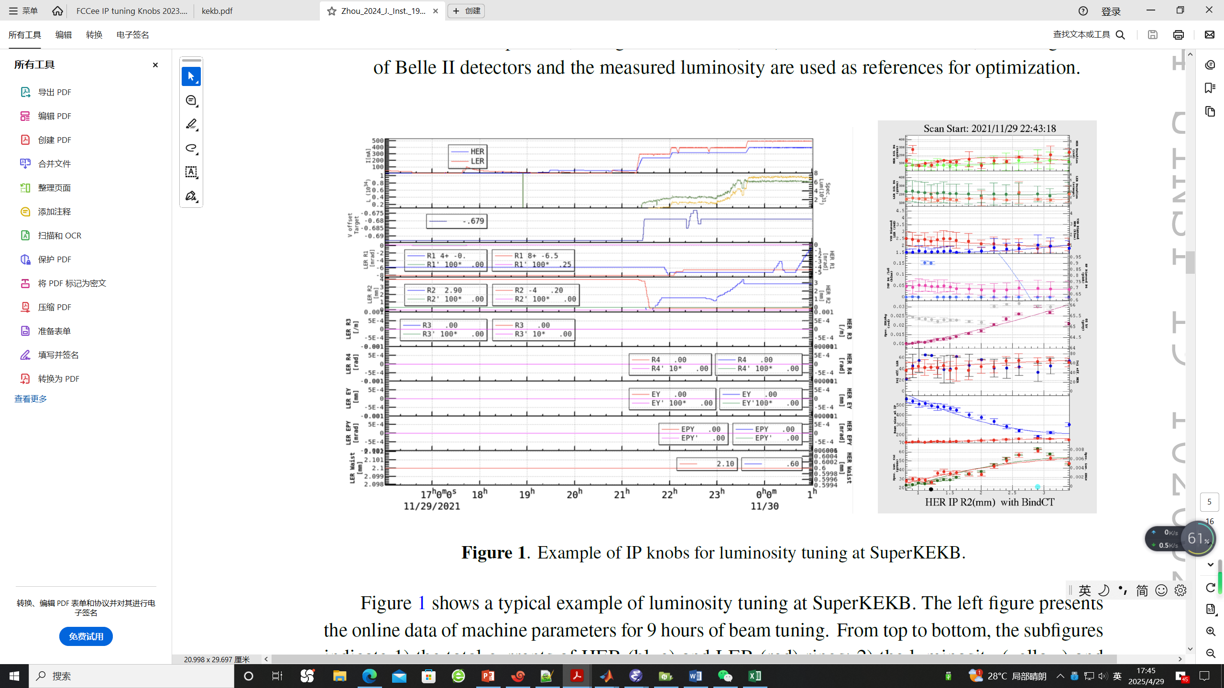
How is IP tuning performed
Determine the knobs according to the simulation
IP orbit knob , waist shift knob, IP coupling knob, IP dispersion knob
During the IP tuning
Input the desired parameters at IP，calculate the strength of knob magnets by fitting using SAD online
Record the luminosity corresponding to the specific parameters
Scan the parameters to maximize the luminosity
Example of IP knobs for luminosity tuning at SuperKEKB
D. Zhou et al 2024 JINST 19 T02002

Slide 8
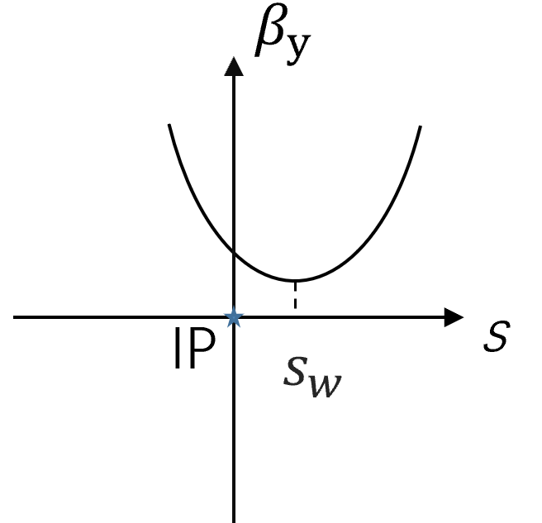
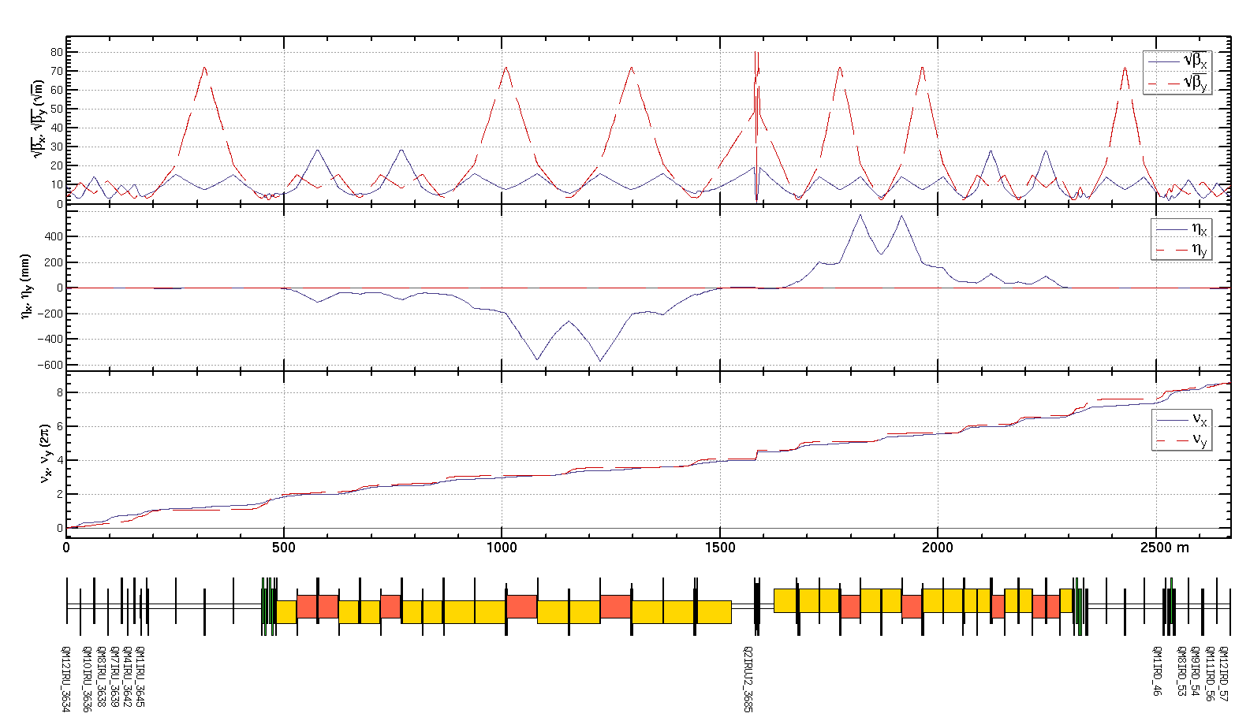

Determine beta and waist knobs
IP beta and waist knobs:
Constrains in fitting:
β*, α*at IP
optics (β, α and tunes not disturbed
outside the IR region)
For one side of IP including:
2 Quadrupoles of FF
dispersion free
6 Quadrupoles in matching section
16 Quadrupoles in total
Dispersion free region
$$α^{∗}=\frac{s_{w}}{β_{w}}$$
$${ β}^{∗}=β_{w}+\frac{s_{w}^{2}}{β_{w}}$$
$$γ^{∗}=\frac{1}{β_{w}}$$
Notes:
本页需要与之前general的介绍进行区分，说明接下来的介绍是针对CEPC的具体case的结果。图上注明哪个lattice、能量，磁铁名字？明确16个磁铁是针对CEPC的具体结果，在图上标注与具体数量相对应的磁铁名称。

Slide 9
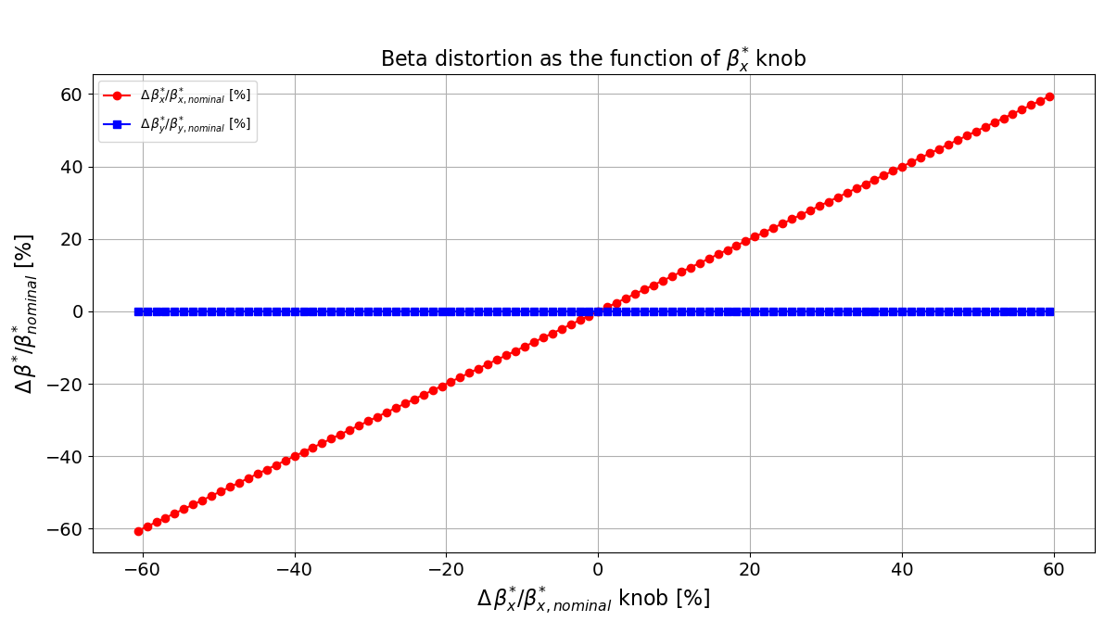
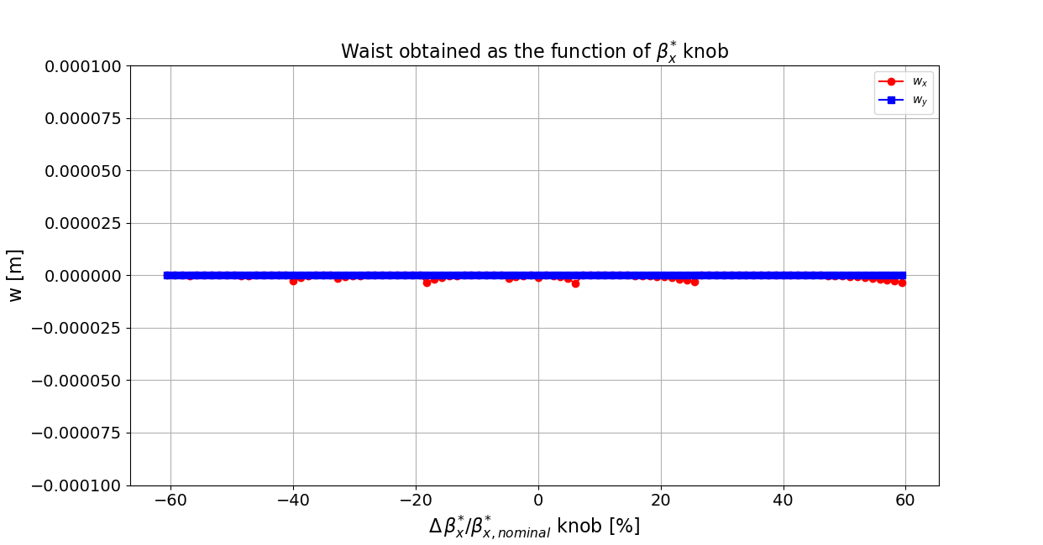
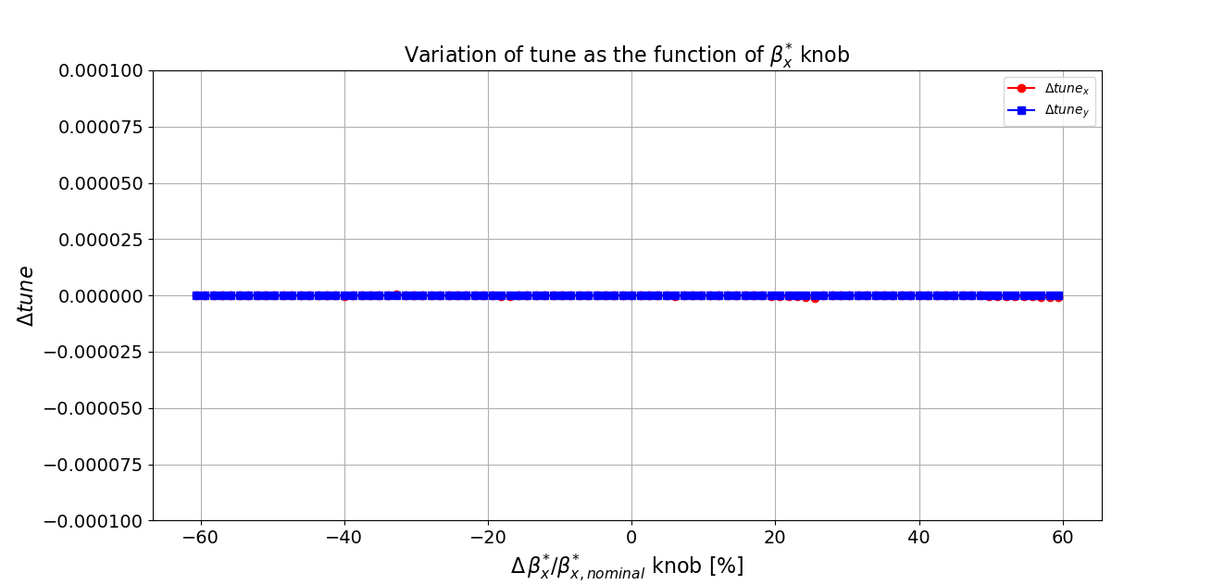
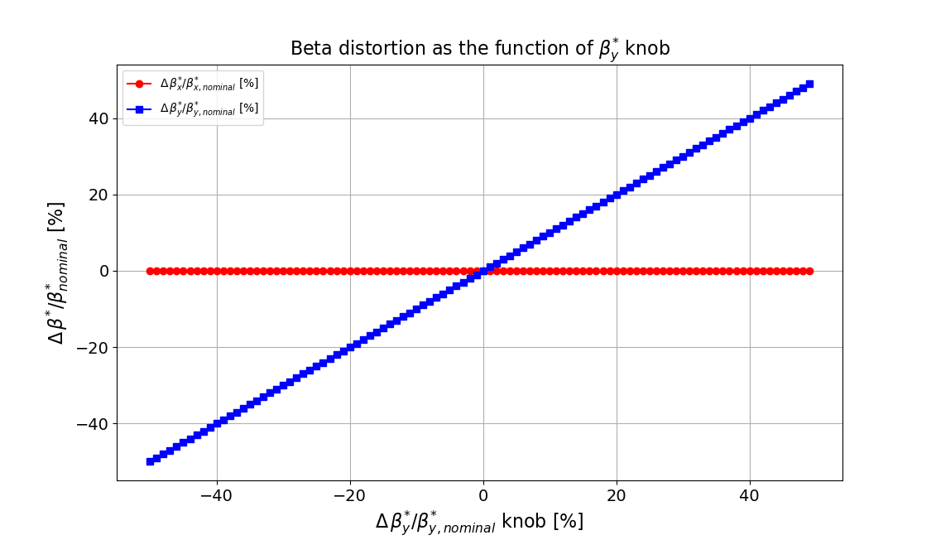
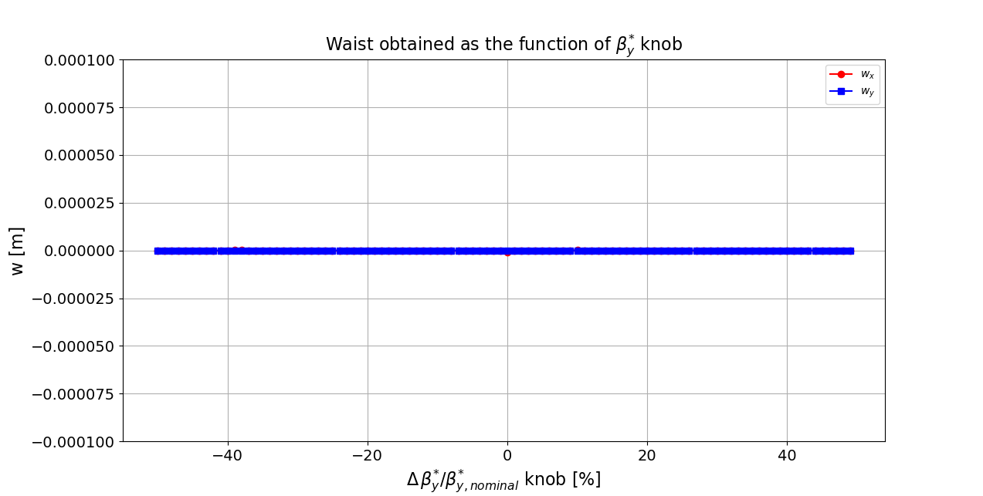
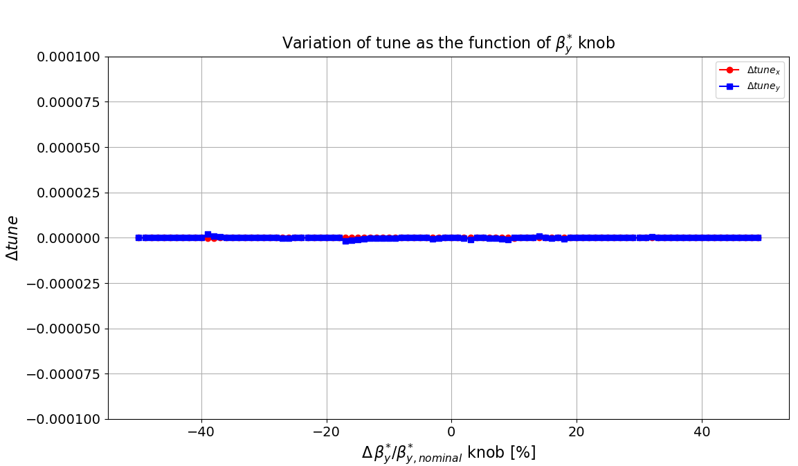
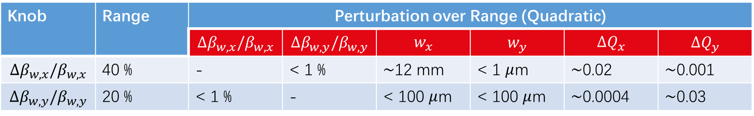
IP beta knobs
Knob | Range | Perturbation over Range (Quadratic)
 |  | $${Δβ}_{w,x}/β_{w,x}$$ | $$Δβ_{w,y}/β_{w,y}$$ | $$w_{x}$$ | $$w_{y}$$ | $$ΔQ_{x}$$ | $${ΔQ}_{y}$$
$${Δβ}_{w,x}/β_{w,x}$$ | 40 % | - | < 1 % | $\sim$12 mm | < 1 $μ$m | $\sim$0.02 | $\sim$0.001
$$Δβ_{w,y}/β_{w,y}$$ | 20 % | < 1 % | - | < 100 $μ$m | < 100 $μ$m | $\sim$0.0004 | $\sim$0.03
Notes:
标注调节变量，明确参数名称。需要文字给出结论：通过16个磁铁的knob，让Ip optics参数独立可调。明确调节范围是如何确定的？说明依据的合理性？线性区域是否足够？

Slide 10
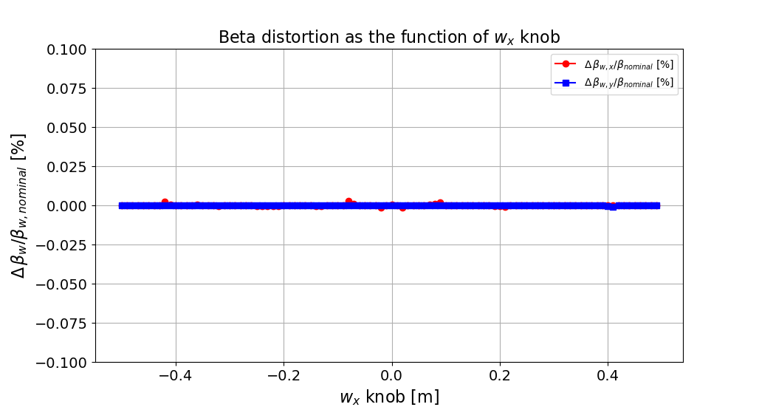
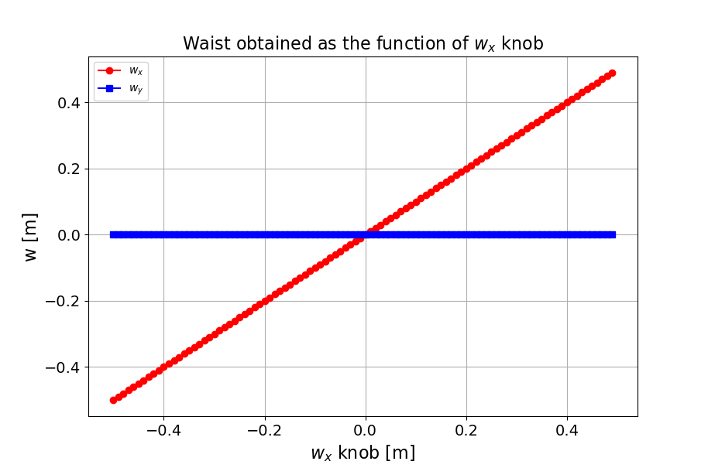
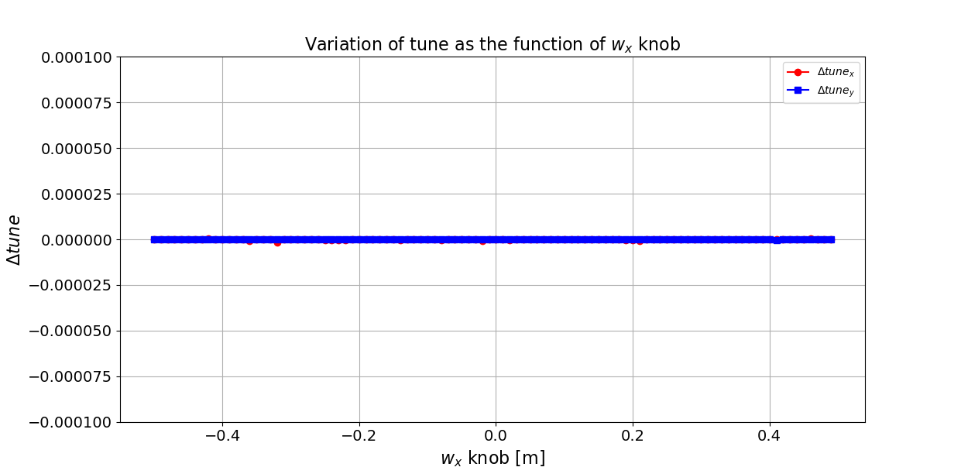
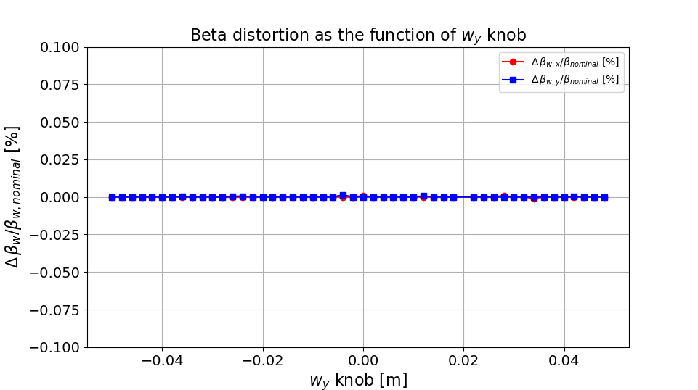
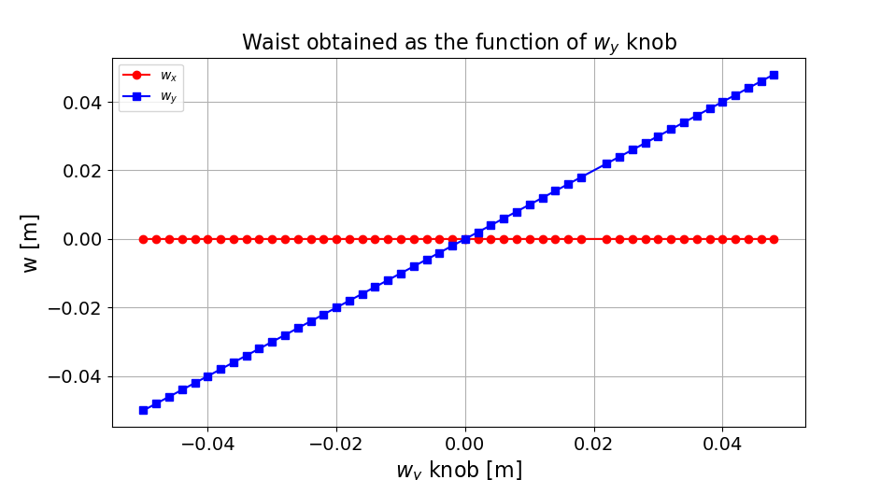
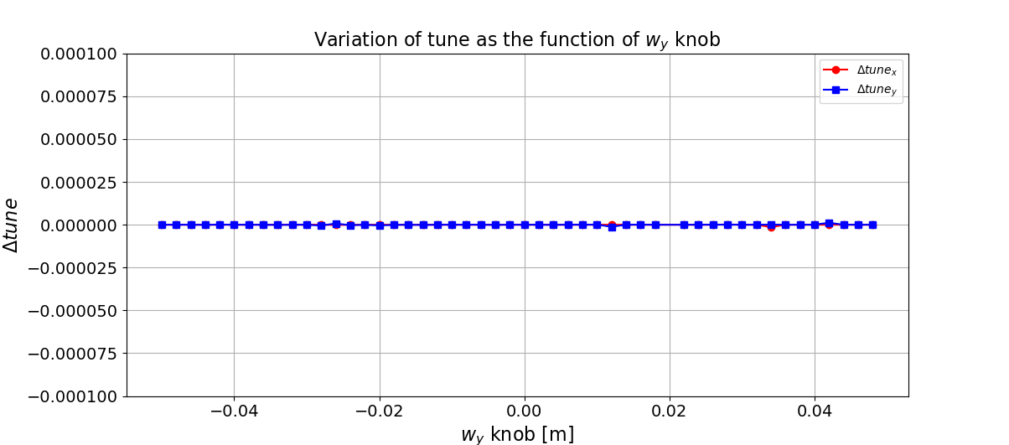
IP waist knobs
Knob | Range | Perturbation over Range (Quadratic)
 |  | $${Δβ}_{w,x}/β_{w,x}$$ | $$Δβ_{w,y}/β_{w,y}$$ | $$w_{x}$$ | $$w_{y}$$ | $$ΔQ_{x}$$ | $${ΔQ}_{y}$$
$${Δβ}_{w,x}/β_{w,x}$$ | 40 % | - | < 1 % | $\sim$12 mm | < 1 $μ$m | $\sim$0.02 | $\sim$0.001
$$Δβ_{w,y}/β_{w,y}$$ | 20 % | < 1 % | - | < 100 $μ$m | < 100 $μ$m | $\sim$0.0004 | $\sim$0.03

Slide 11
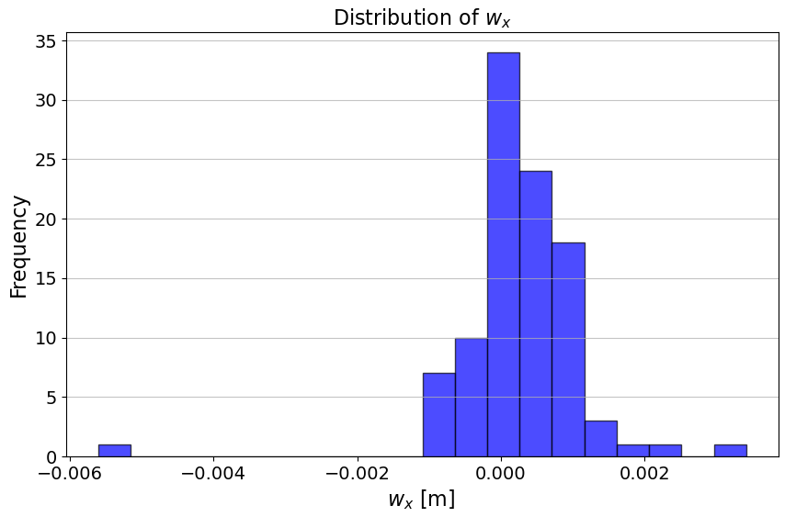
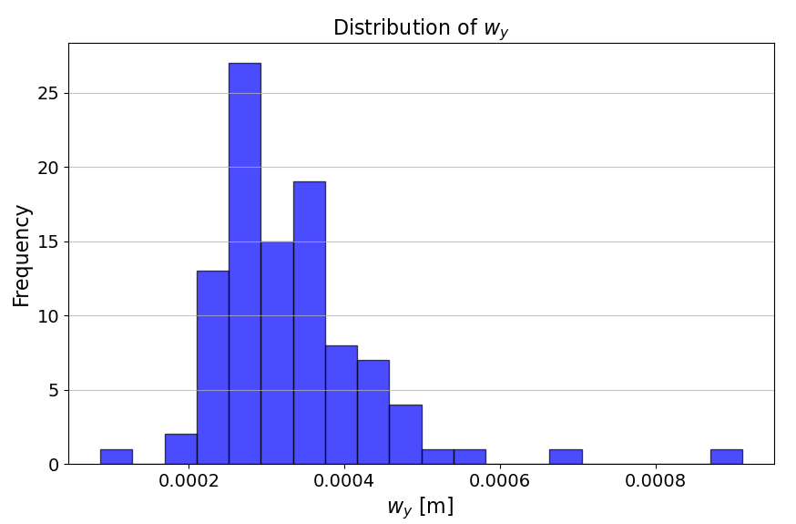
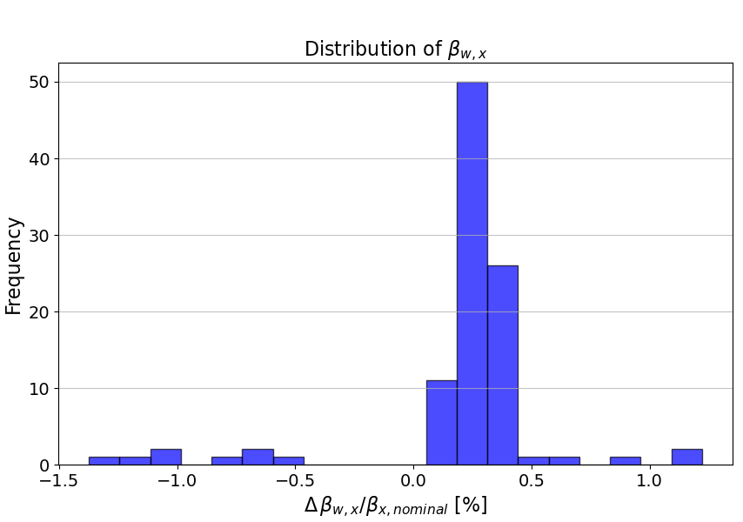
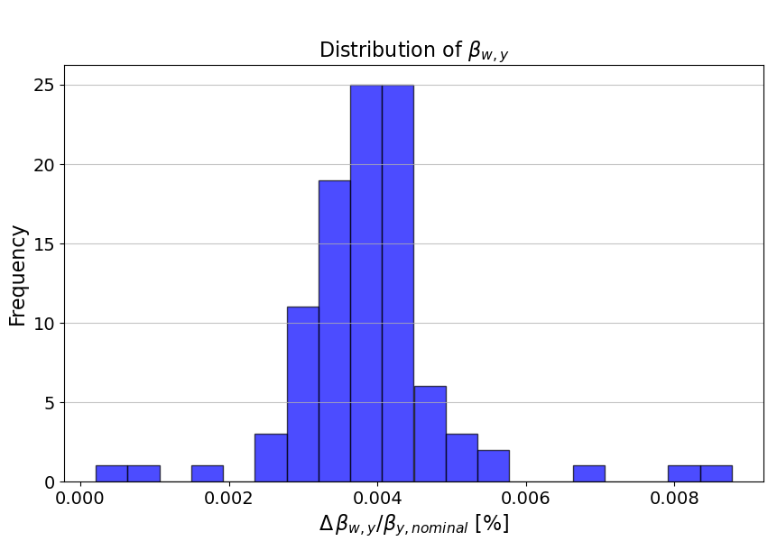
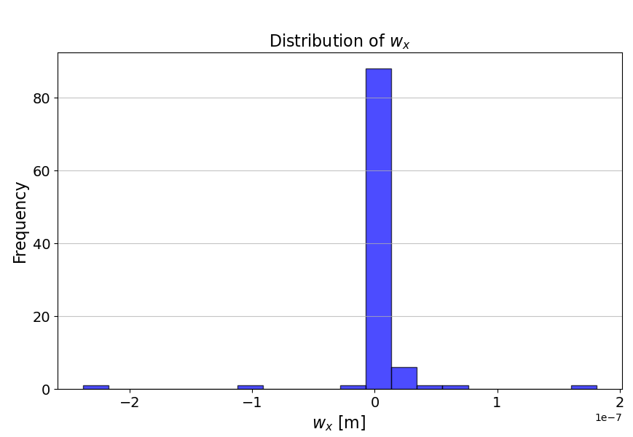
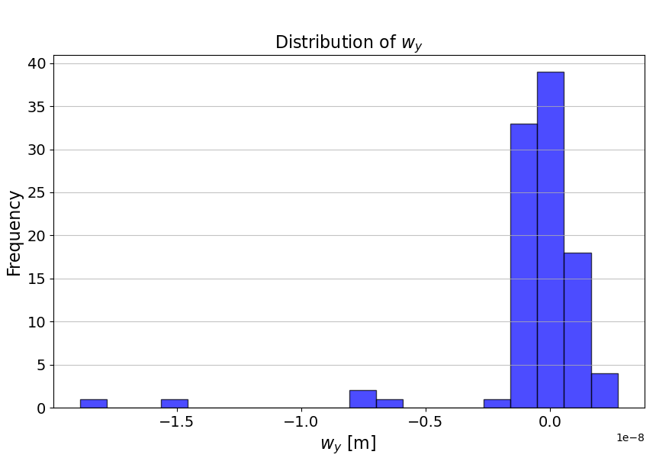
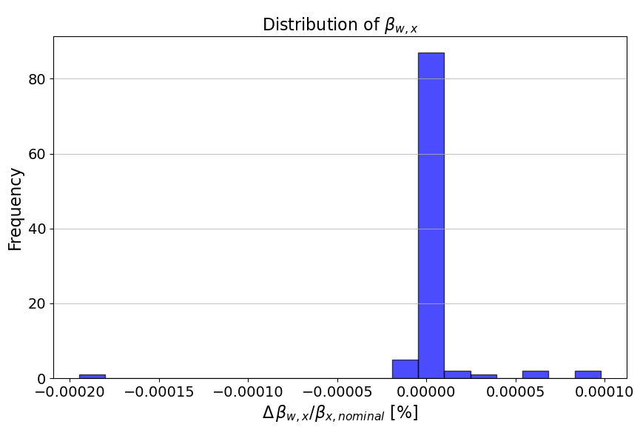
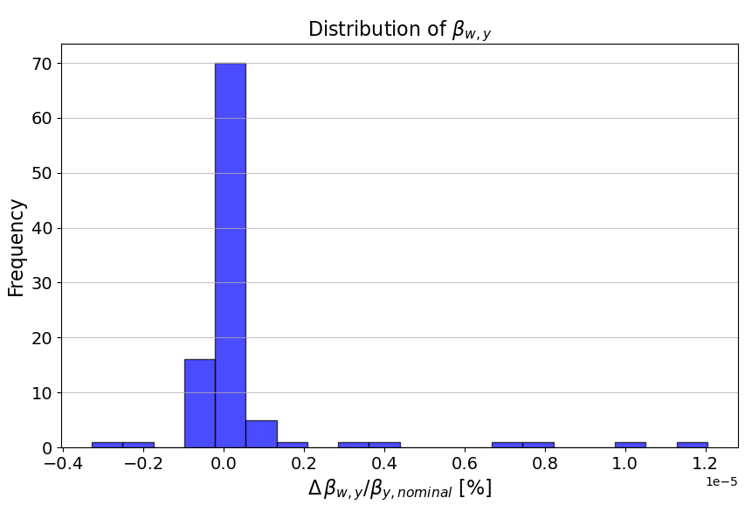
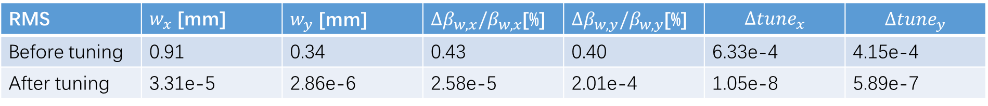
IP beta and waist knobs
Perform IP beta and waist knobs for 100 seeds after global optics correction
RMS | $w_{x}$ [mm] | $w_{y}$ [mm] | ${Δβ}_{w,x}/β_{w,x}$[%] | $Δβ_{w,y}/β_{w,y}$[%] | $$Δ{tune}_{x}$$ | $${Δtune}_{y}$$
Before tuning | 0.91 | 0.34 | 0.43 | 0.40 | 6.33e-4 | 4.15e-4
After tuning | 3.31e-5 | 2.86e-6 | 2.58e-5 | 2.01e-4 | 1.05e-8 | 5.89e-7
Notes:
纵坐标Frequency是否合适？最好给出IP tuning前亮度模拟结果。

Slide 12
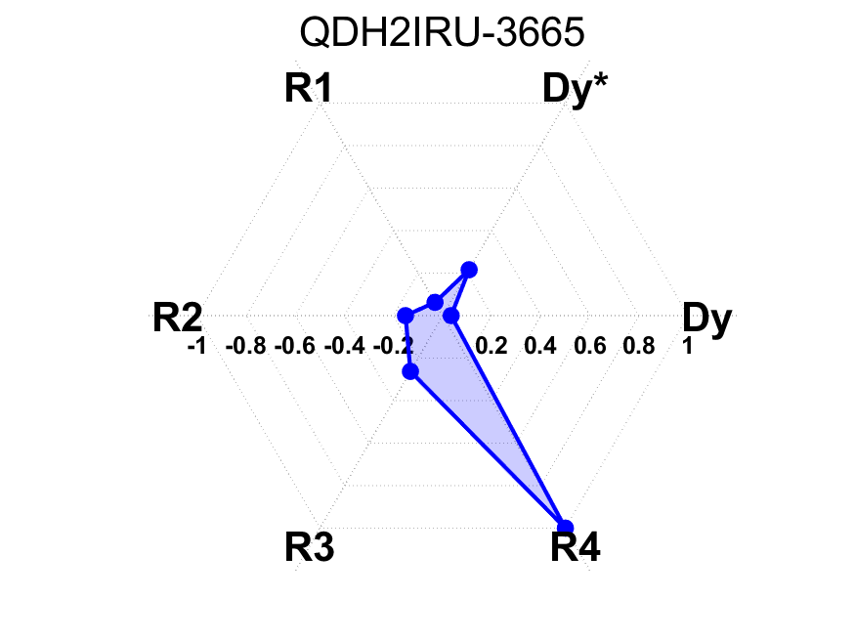
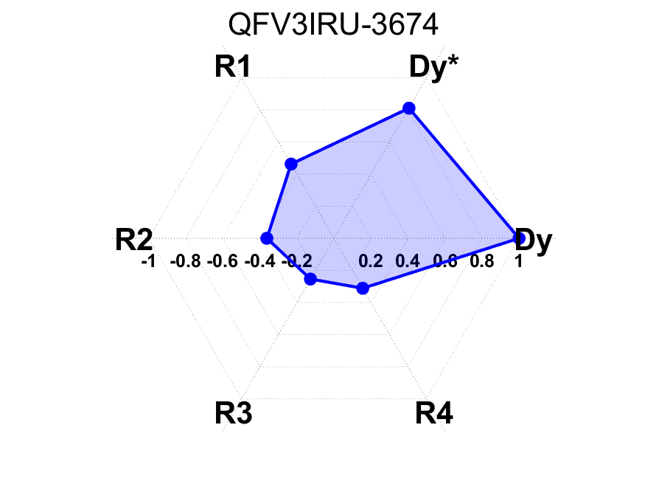

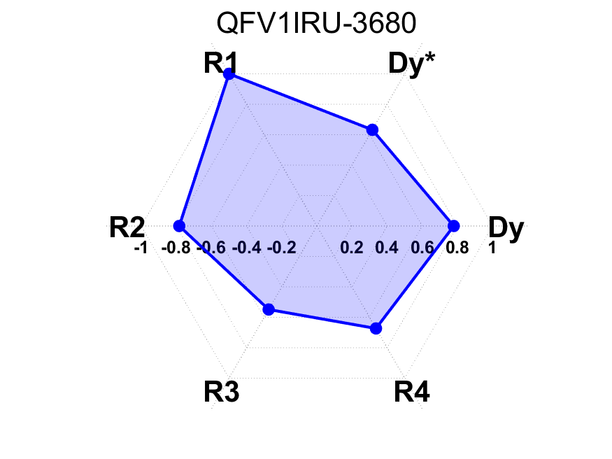
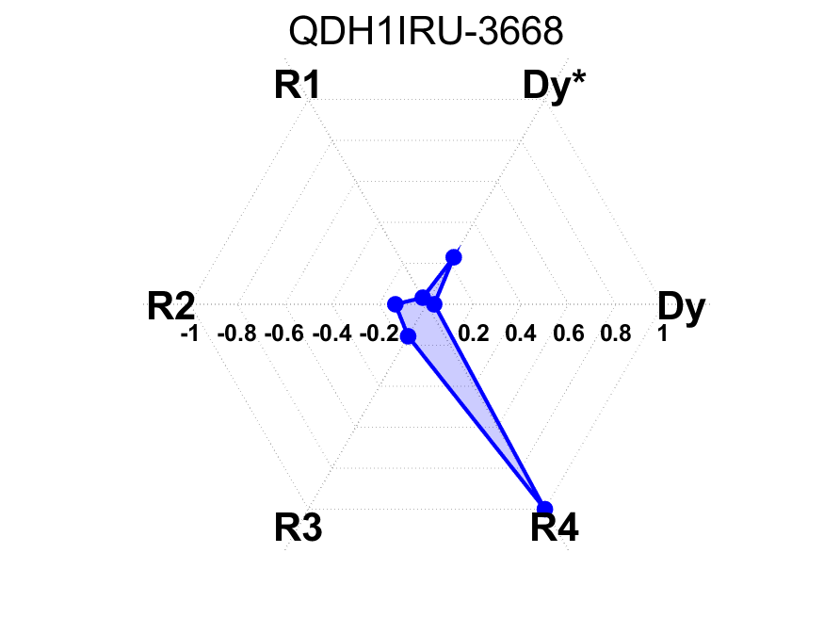
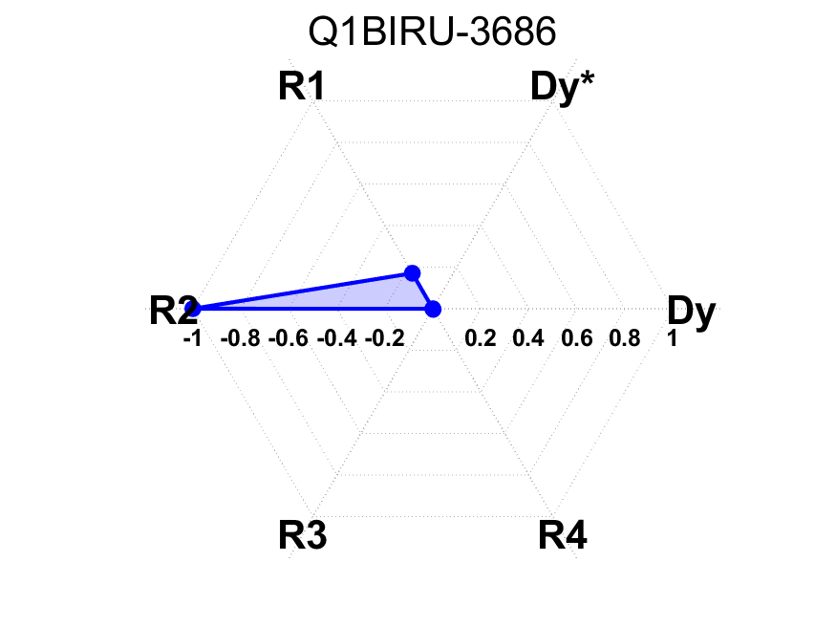
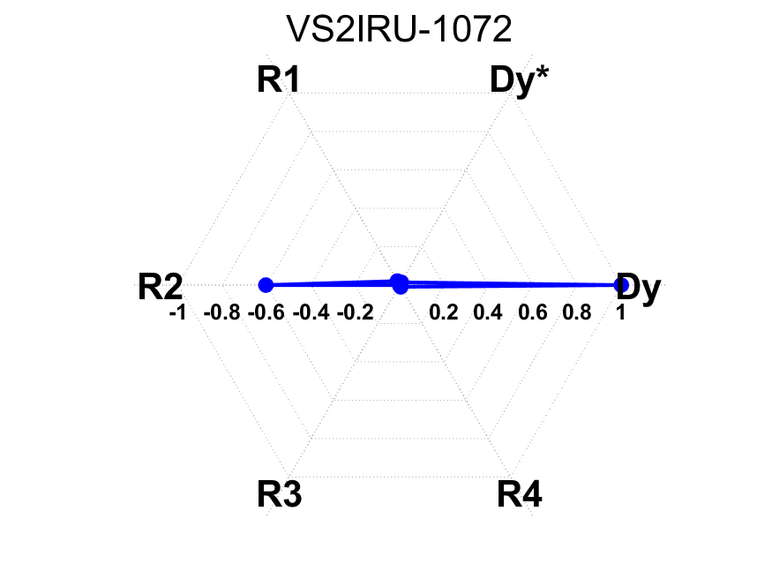
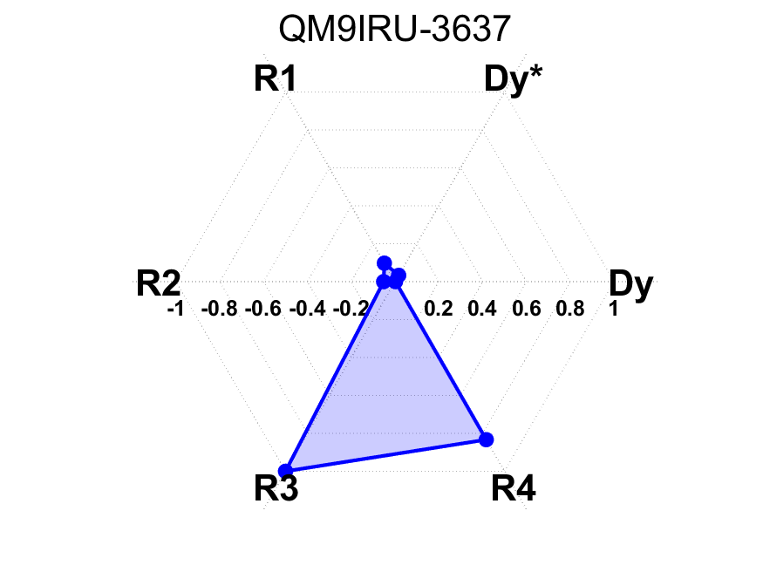
Determine the coupling knobs for CEPC
Suppose skew components at quadrupoles and sextupoles of IR
Calculate the response of { D_{y},D_{y}’,R1, R2, R3, R4} at IP to skew strength variations
Plot the 6 vectors and calculate the area enclosed by the 6 vectors for each magnet
Sort the area and find 6 magnets which are most sensitive to the parameters
Notes:
统一title，明确该内容是针对CEPC case的结果。如何理解图形的含义？需高度概括和总结目标和图形之间的关系。

Slide 13
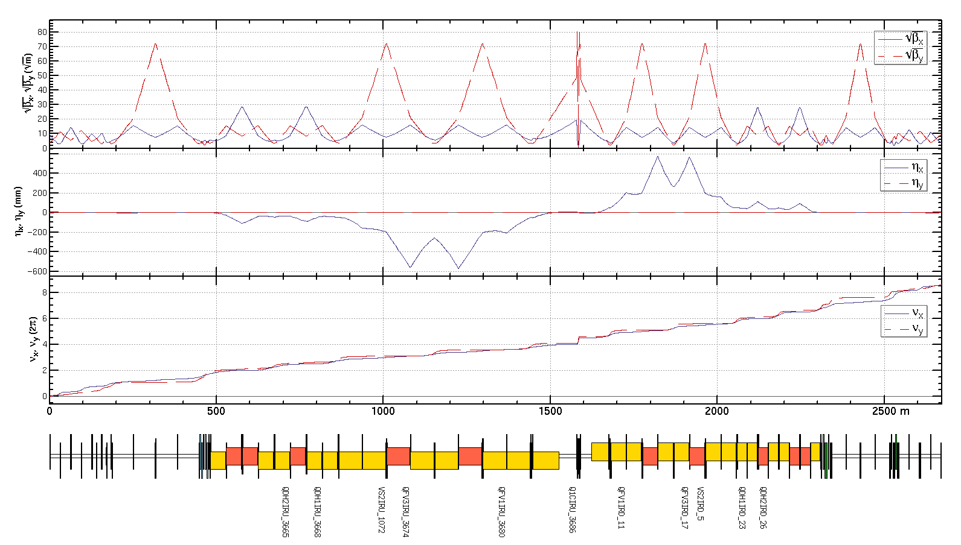
Determine the coupling knobs
Coupling knobs:
For one side of IP including:
1 skew coil on FF quadrupole
dispersion free
1 skew coil on sextuple
4 skew coils on quadrupoles
dispersive region
12 skew components in total
Constrains in fitting:
R1，R2，R3，R4
D_{y}, D’_{y} at IP
optics not disturbed
outside the knob region

Slide 14
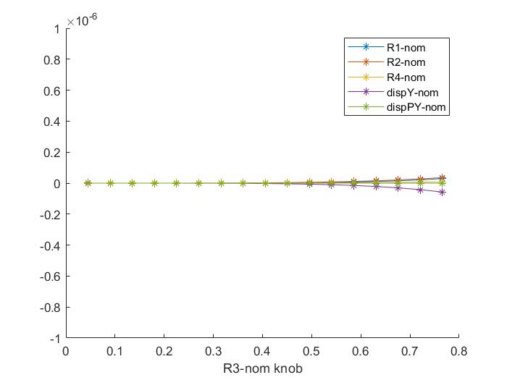
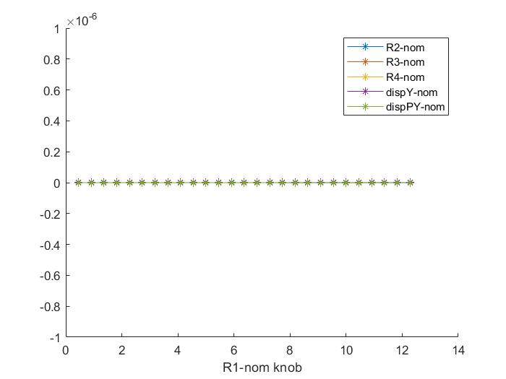
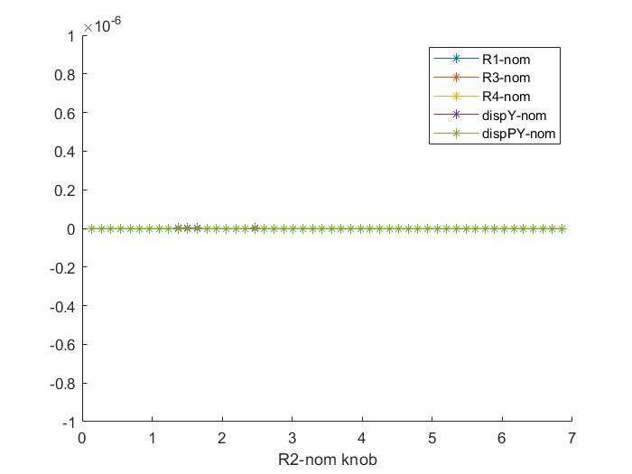
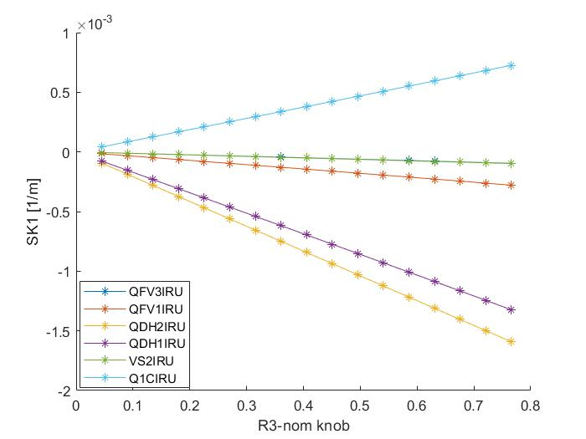
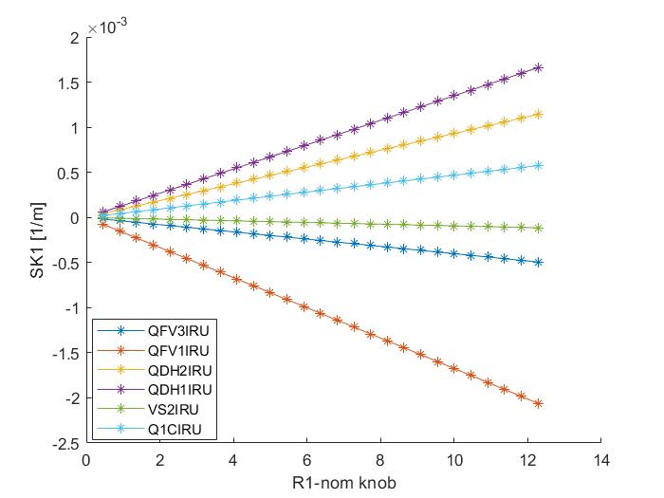
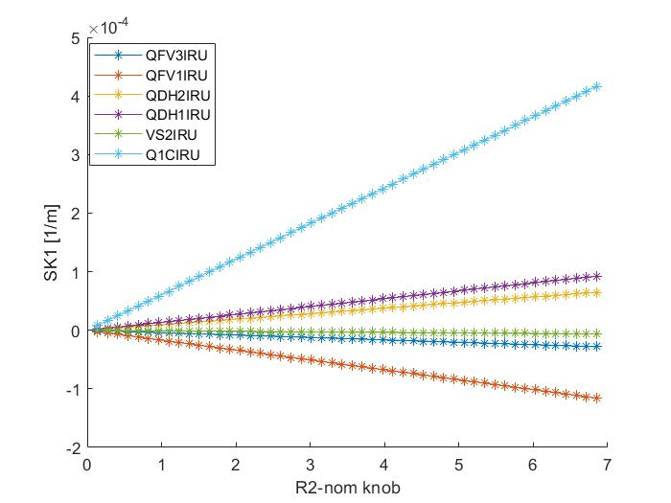
Scans of each knob and the corresponding skew strengths
Coupling parameters are normalized by the values corresponding to 10% luminosity loss (R1* ,R2* ,R3* ,R4*)
D_{y} and D’_{y} are normalized by the values comparable to 1 σ_{y} and 1σ’_{y} at IP (D_{y} * , D’_{y} * )
Scan of R1 knob (normalized by R1*)
Scan of R2 knob (normalized by R2*)
Scan of R3 knob (normalized by R3*)
Notes:
明确R1-R4 参数的定义 ，通过调节12个skew ，达到对6个参数调节的目的，范围是如何确定的？

Slide 15
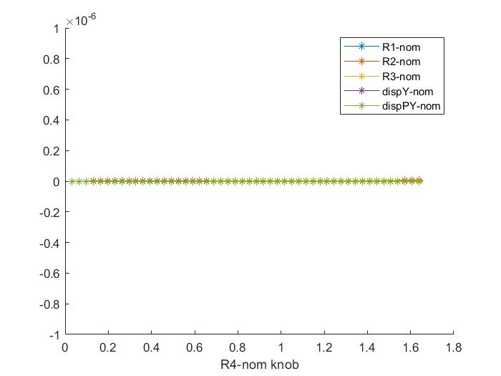
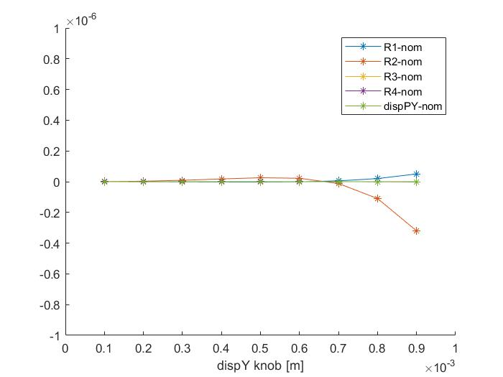
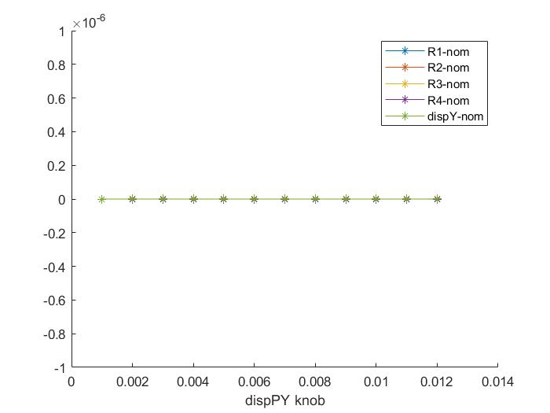
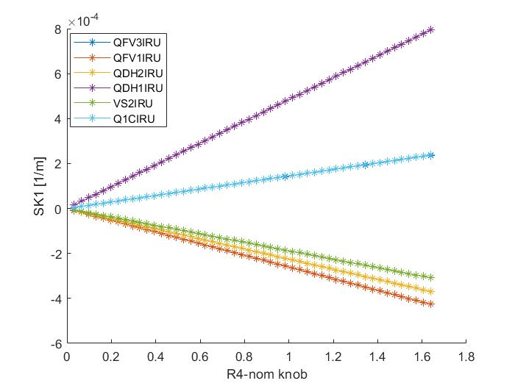


Scans of each knob and the corresponding skew strengths
Coupling parameters are normalized by the value corresponding to 10% luminosity loss (R1* ,R2* ,R3* ,R4*)
D_{y} and D’_{y} are normalized by the value comparable to 1 σ_{y} and 1σ’_{y} at IP (D_{y} * , D’_{y} * )
Scan of R4 knob (normalized by R4*)
Scan of D_{y} knob
Scan of D’_{y} knob
Notes:
结果是否达到要求？清晰表明。

Slide 16


Results of IP coupling tuning
Vertical dispersion knob for D_{y,IP}=0.1（mm）*
Coupling knob for R1_{IP}=0.002 *
Notes:
标注出对撞区区域，具体数值如0.1，0.002的选择依据？

Slide 17
Results of IP coupling tuning
●
Assumed errors (3σ*3)
Perform coupling tuning and calculate the strength of skew quadrupoles
Provide specifications for magnet design
 | R1* | R2*[m] | R3*[m⁻¹] | R4* | Dy*[m] | Dpy*
rms(*10⁻³) | 0.87 | 0.89 | 49.77 | 31.11 | 0.0052 | 0.016
 | Q1BIRU | QFV1IRU | VS2IRU | QFV3IRU | QDH1IRU | QDH2IRU
L(m) | 1.21 | 2.00 | 0.60 | 2.00 | 2.00 | 2.00
SK1(*10⁻³m⁻¹) | 1.13 | 1.00 | 0.20 | 0.25 | 1.00 | 1.00
G（T/m) | 0.37 | 0.20 | 0.14 | 0.05 | 0.20 | 0.20
Notes:
结合目标，清晰地表述结论。

Slide 18






Results of IP coupling tuning
Statistic of strength of skew components (Simulation with assumed errors (3σ*3) )

Slide 19
Summary
Knobs for IP beta、waist and coupling have been determined at CEPC
IP beta and waist tuning are performed for lattices with errors after global optics correction
Parameters D_{y},D_{y}’,R1, R2, R3, R4 at IP can be tuned independently in the range corresponding to
10% luminosity loss
Specification for magnets design have been evaluated by applying a correction for 9 times of
the RMS residual error at IP after global optics correction
To-do list
Perform all the tunings using lattices with errors after global optics
Tuning simulations with APES
Investigate the effects of tuning on other dynamic parameters
Ref: CEPC TDR; Radiation Detection Technology and Methods (2024) 8:1–1105, https://doi.org/10.1007/s41605-024-00463-y;
Notes:
补充BEPCII IP tuning 流程，IP调节的具体范围，以及调节后相关亮度的改善。
所作工作要尽量体现BII的高水平，应该体现自己机器对IP tuning工作的贡献。

Slide 20
Thanks for your attention

Slide 21
Results of IP coupling tuning
●
Errors applied for global optics correction
Component | Δx (µm) | Δy (µm) | Δθ_{z} (µrad)
Dipole | 100 | 100 | 100
Quadrupole | 100 | 100 | 100
Sextupole | 100 | 100 | 100
Component | Field error (RMS)
Dipole | 0.01%
Quadrupole | 0.02%
Sextupole | 0.02%

