Slide 1

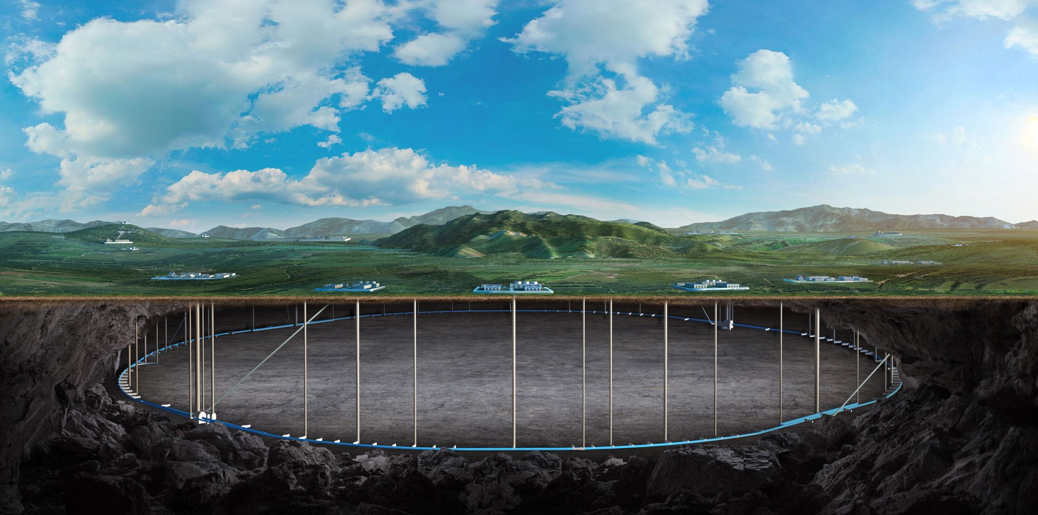

Institute of High Energy Physics, CAS
Developing Status of CEPC Detector Magnet
Feipeng Ning
On behalf of Detector Magnet Team
2026-10-24

Slide 2
Outline
Overview of FCC-ee detector solenoids
Conductors
  Conductors used in FCC-ee detector solenoids
  Progress of Box type conductor
  Progress of HTS conductor
Summary

Slide 3
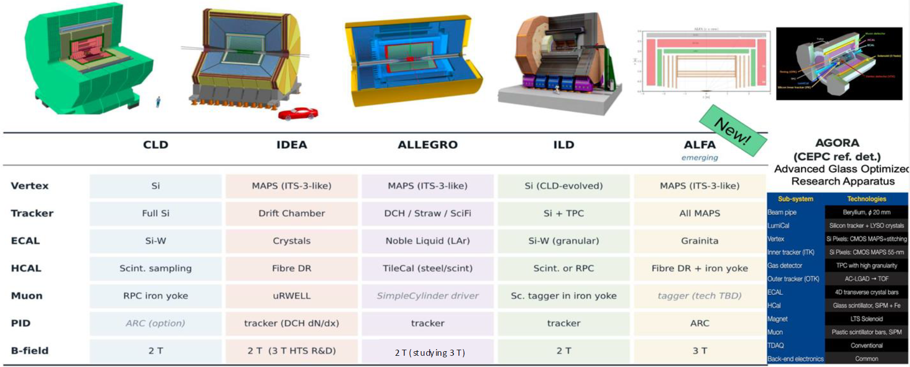
Overview of FCC-ee detector solenoids
The FCC-ee has a total of 6 detector proposals, and the previous 2T superconducting magnets are all moving toward 3T magnet designs.

Slide 4
Overview of FCC-ee detector solenoids
Magnet Parameters
 | CLD | IDEA | ALLEGRO | ILD | ALFA | AGORA
Central field | 2T(study 3T) | 3T | 2T(study 3T) | 3.5T(max 4T) | 3T | 3T
Warm Bore Diameter(m) | 7.438 | 5 | 5.8 | 6.88 | 5.6 | 7.07
Length(m) | 7.41 | 6 | 4.5 | 7.35 | 5.6 | 9.05
Characteristic | Calorimeter inside the magnet | Magnet inside the calorimeter | Magnet sharing the cryostat with ECAL, between ECAL and HCAL | Detector Integrated Dipole | between ECAL and HCAL | Calorimeter inside the magnet
For FCC-ee they are all changed to higher field (3T). These need higher strength superconducting conductors. The current conductor designs cannot meet the requirements.
4

Slide 5
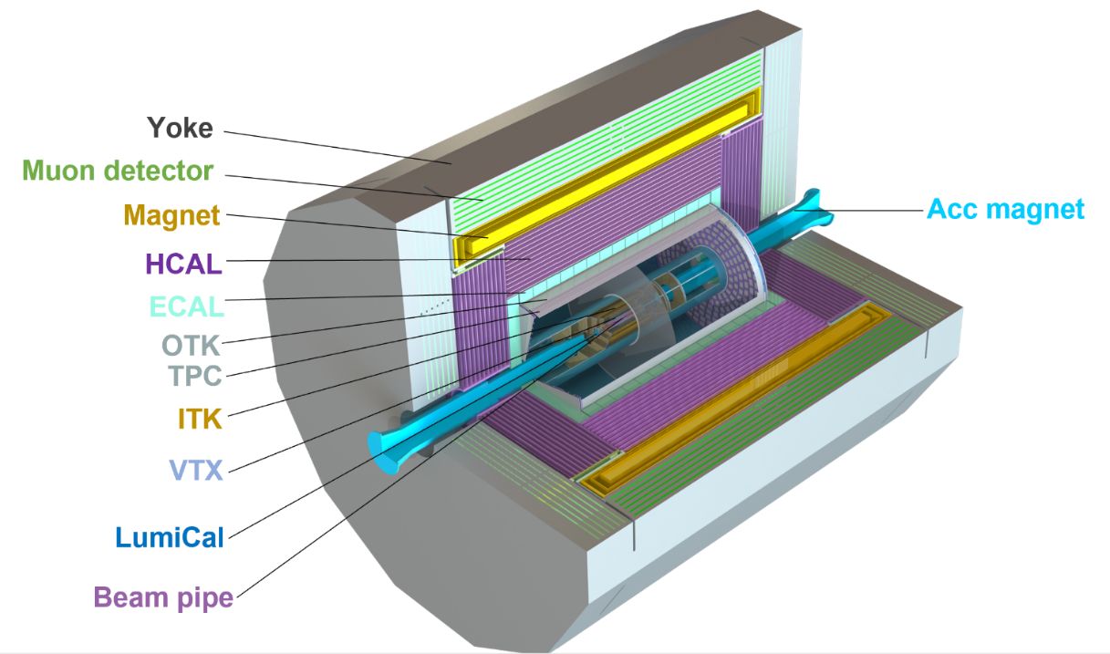
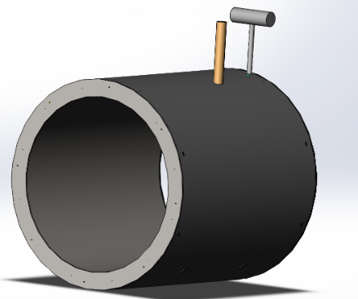
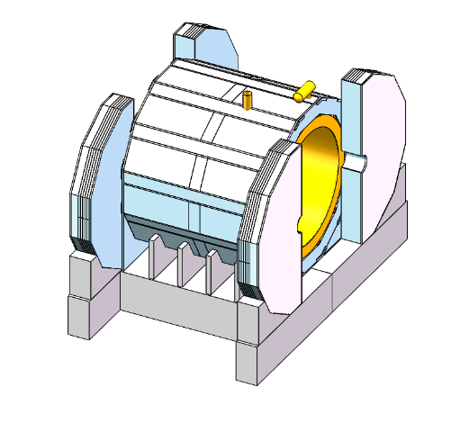
CEPC/AGORA Detector Solenoid
Design Overview
Central magnetic field | 3 T
Inner diameter | 7070 mm
Outer diameter | 8470 mm
Thickness | 700 mm
Length | 9050 mm
Cold mass | 145 t
Yoke weight | 3010 t
Magnet weight | 250 t

Slide 6
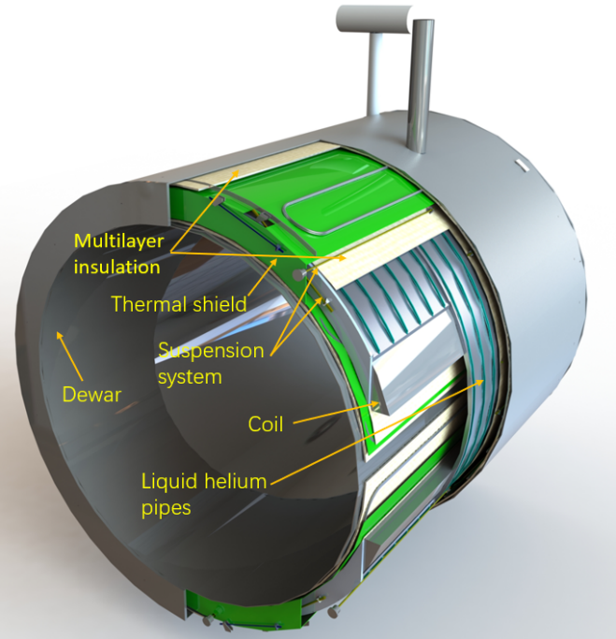
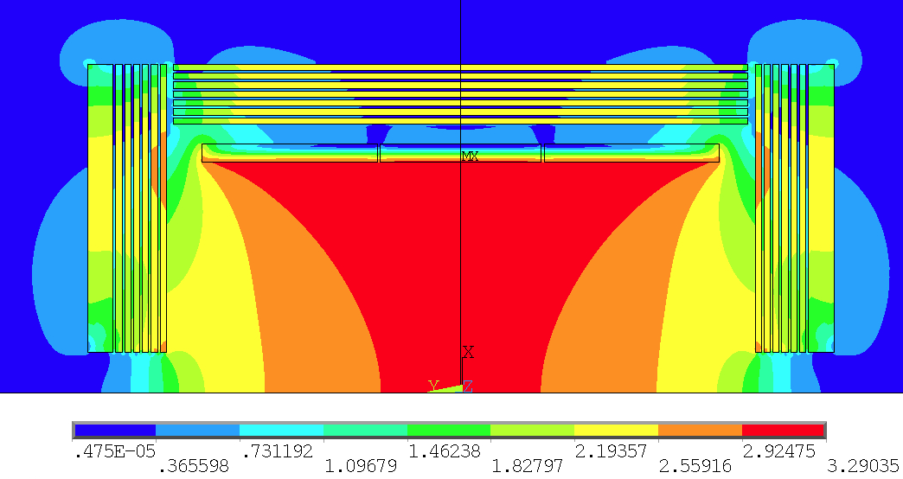
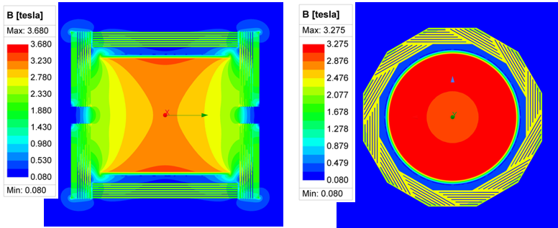
CEPC/AGORA Detector Solenoid
Physical design of the magnet
Coil parameters:
Central magnetic field | 3 T
Inner diameter | 7300 mm
Operating current | 17 kA
Cable length | 33 km
Inductance | 11 H
Stored Energy | 1.54 GJ
2D Magnetic field simulation
3D Magnetic field simulation
6

Slide 7
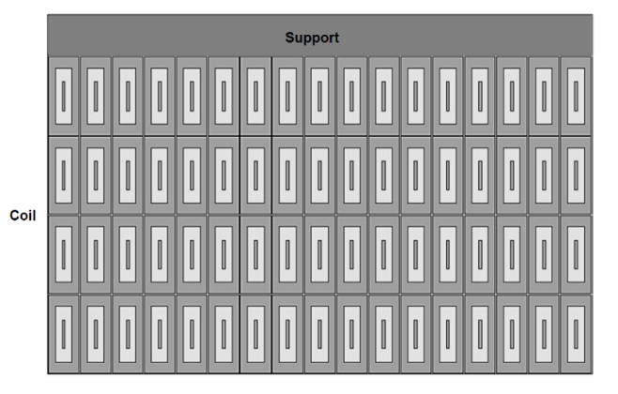
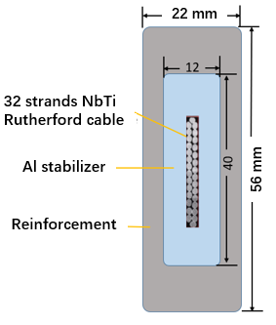
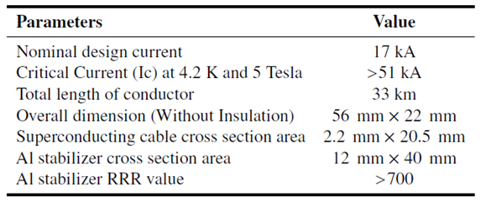
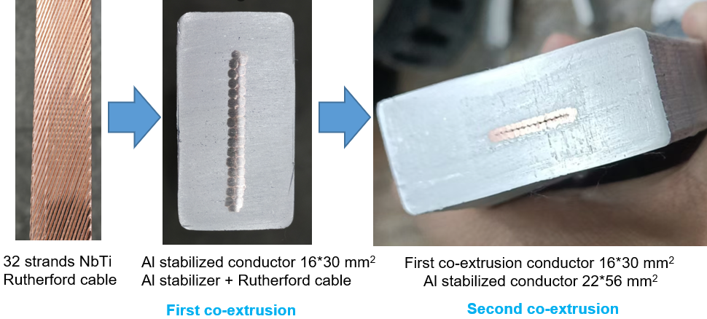
CEPC/AGORA Detector Solenoid
Coil and Box-type conductor structure
Secondary co-extrusion Box-type conductor
Cable parameters
The conductor is a box-structured aluminum-stabilized cable consisting of three components:
NbTi/Cu Rutherford cable
The high purity aluminum stabilizer
The aluminum alloy reinforcement
This structure is manufactured through a double extrusion process.

Slide 8
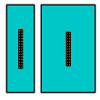
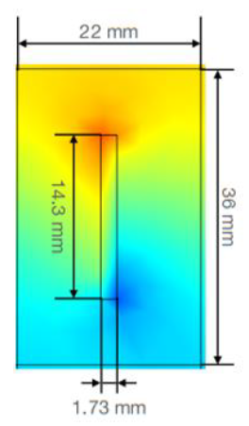
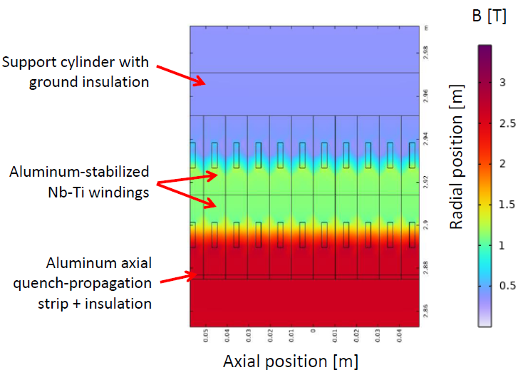
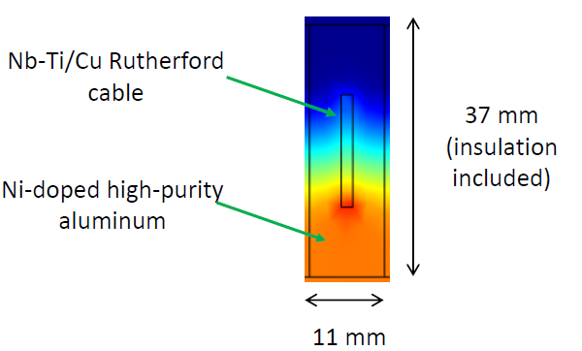
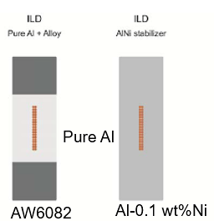
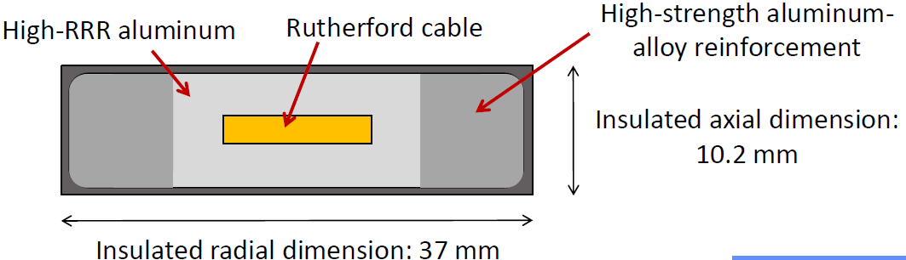
Conductors
LTS Aluminium-stabilized Nb-Ti/Cu Rutherford Cable types
CMS
High Strength Pure Aluminum
IDEA
CLD
ALLEGRO
IDEA
CLD
CLD and IDEA
ILD
AGORA

Slide 9
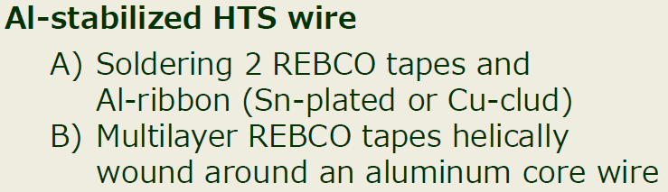
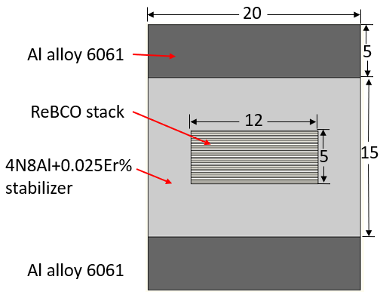
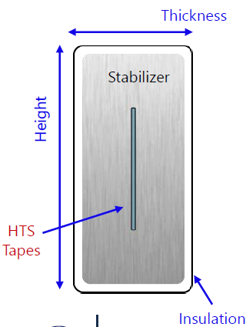
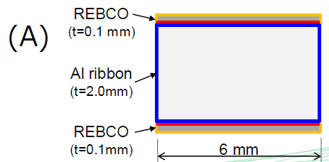
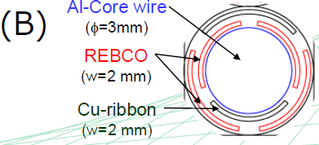
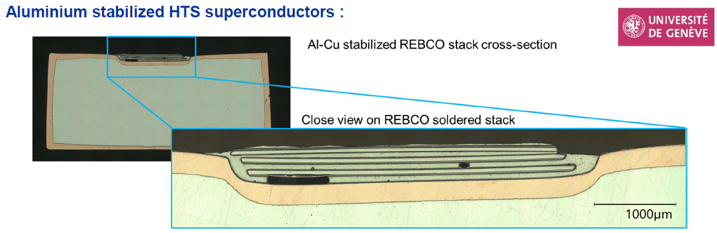
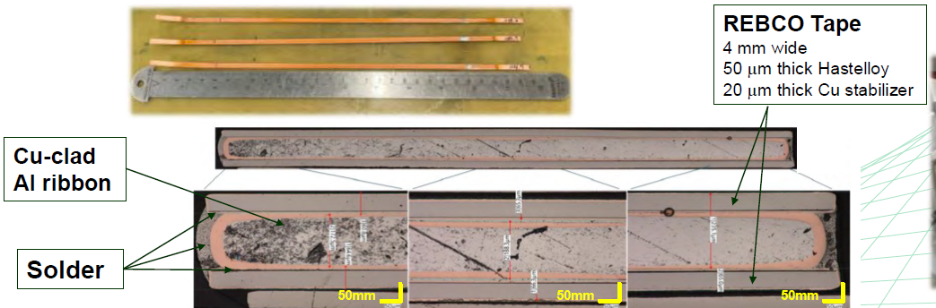
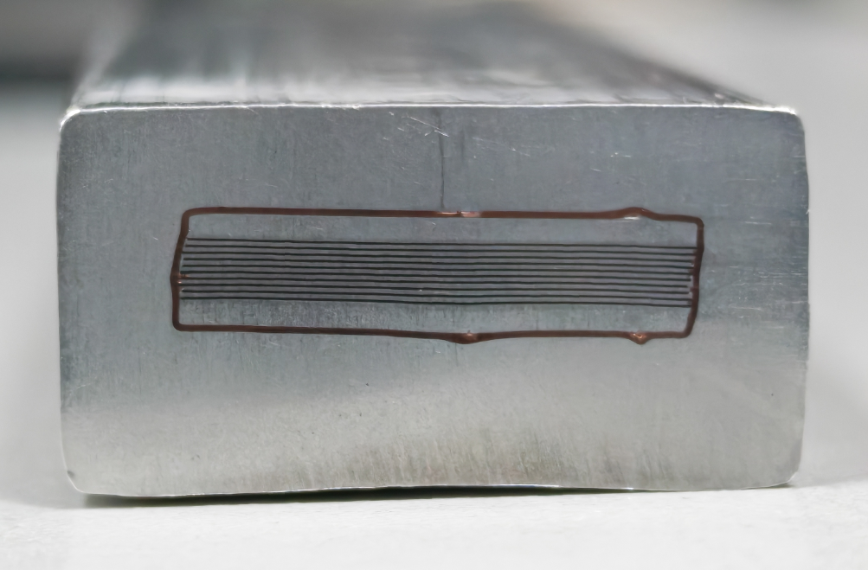
Conductors
HTS（High Temperature Superconductivity）
IDEA is currently mainly promoting HTS solutions.
IDEA proposed
CERN proposed
KEK proposed
IHEP proposed

Slide 10
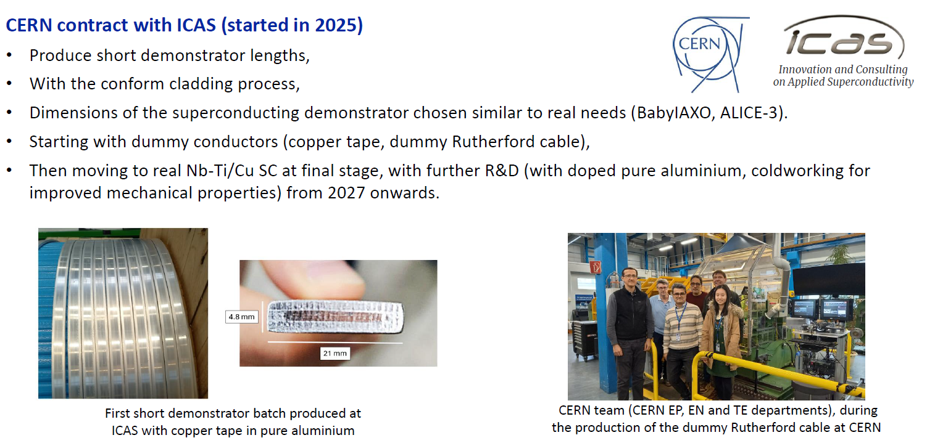
Conductors
Due to the importance of aluminum-stabilized superconducting cables, CERN contracted with ICAS to start the R&D of aluminum-stabilized superconducting cables in 2025.
With support from experts of CERN TE, EN and EP departments, and experts from KEK.

Slide 11
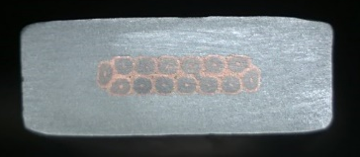
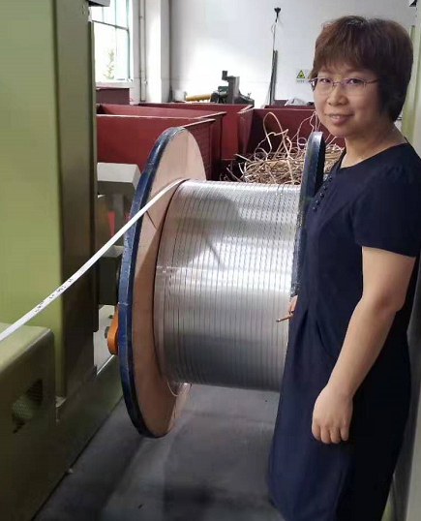
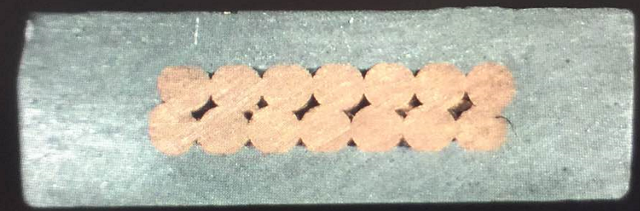
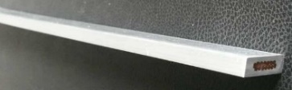
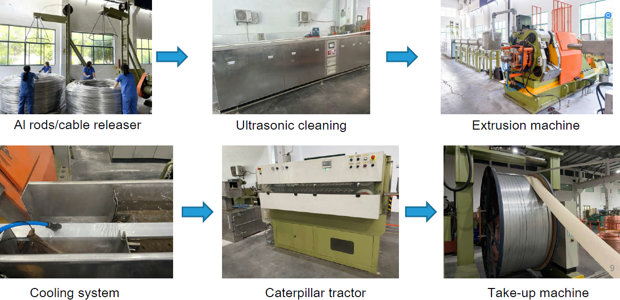
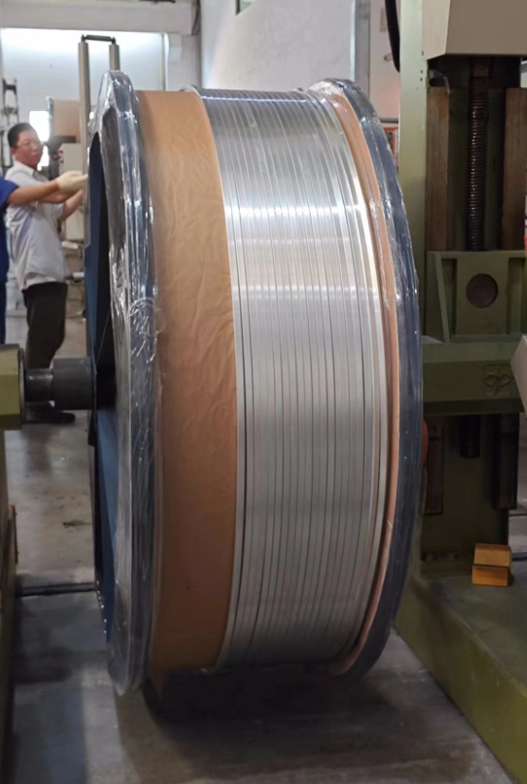
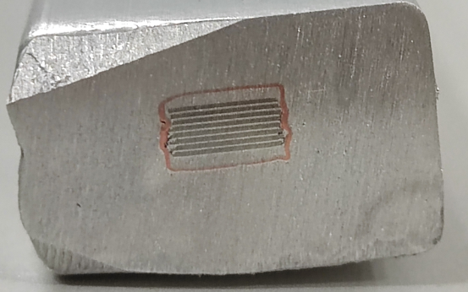
Conductors
Al-stabilized Conductors production line
LTS: Aluminum stabilized NbTi/Cu Rutherford cable
The IHEP and Wuxi Toly company have jointly established an aluminum coated conductor production line in 2015.
1.5 km
HTS: Aluminum stabilized Stacked REBCO Tape Cable
(ASTC)
100 m
11

Slide 12
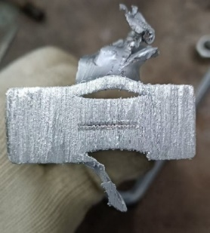
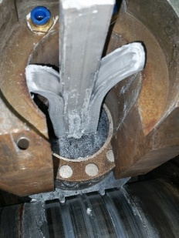
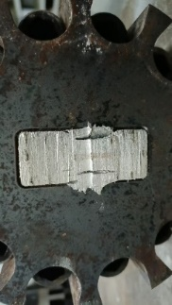
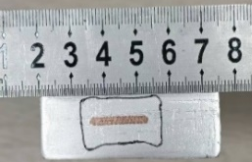
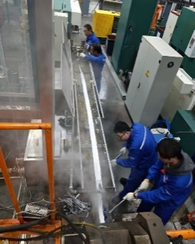
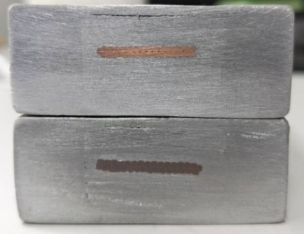
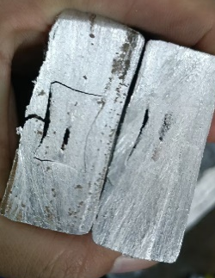
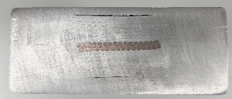
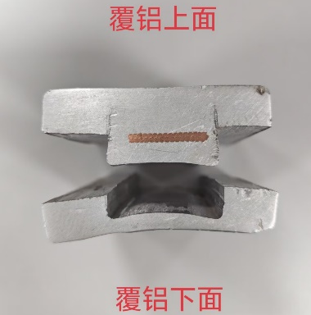
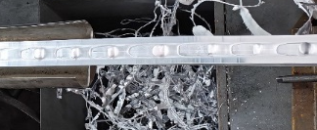
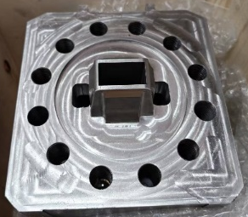
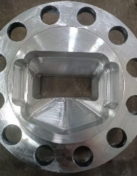
Progress of Box type conductor
2026.1.4
2025.12
Split mold: continuous production, incomplete upper/lower cladding, excessive flash，2025.10
Improvement: Mold gap adjusted → No significant improvement. 2026.01.04
Improvement: Milled insert thickness by 2mm → still incomplete cladding on upper/lower surfaces2025.11
Improvement: Mold modified.
cladding basically complete;
Excessive flash after 1m production；
insert deformation
2025.11
Improvement: Mold modified.
Completed 5m dummy cable;
Obvious gaps still on upper/lower surfaces.
Al-Al bonding strength only 4.5MPa
2025.12
upper surface
lower surface
Improvement: mold
replaced;
Continuous production achievable (6m);
Surface voids occurred.
2026.4
Improvement: Mold design updated.
Upper/lower cladding improved;
Core breakage reoccurred;
2026.3
Improvement: Replaced worn extrusion wheels + adjusted mold gap → No significant improvement.
2026.01.09

Slide 13
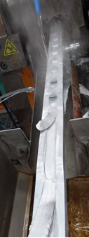

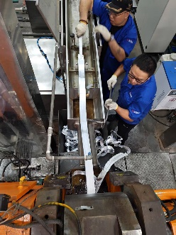
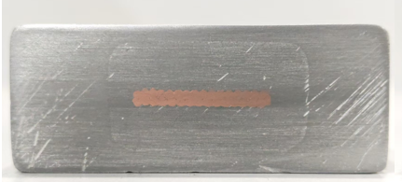
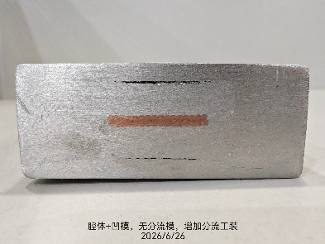








Progress of Box type conductor
Dummy cable
Dummy cable
Dummy cable
upper surface
lower surface
2026.06.26
2026.06.17
Improvement: shimming;
Optimized lower surface;
Upper surface no improvement.
2026.06.05
Used Cu Rutherford cable+ 6061 Alloy, optimized mold, Overflow material stopped the processing (3m)，2026.06.17
Used Cu Rutherford cable+ 6061 Alloy Improvement: Mold gap adjusted → No improvement. 2026.06.26
Full-size Box type Superconducting Cable
Full-size Box type Superconducting Cable
2026.09.10
2026.07.24
Start
End
The cable co-extrusion process proceeded smoothly, the speed was 0.50–0.55 m/min. 4 meters cable was produced.
Surface quality was good, demonstrating the capability for long-length production.
2026.09.10
Improvement: Mold design updated.
No gap and the surface quality is good.
Overflow material stopped the processing (1.5m)
2026.07.24

Slide 14




Progress of HTS conductor
Aluminum stabilized Stacked REBCO Tape Cable (ASTC)
Small size cable: 15*10 mm² , Tape Width: 4 mm, thickness: 80 μm
10 m ASTC prototype cable
2021.09.29

Slide 15





Progress of HTS conductor
Following further process improvements and continuous enhancement of cable performance, the requirements were ultimately met.
Different cross section ASTC cables developed by IHEP.
CICC
(Cable-in-Conduit Conductor)
4 mm wide
HTS tape
15*10 mm²
9*7.5 mm²
Φ9 mm
12 mm wide
HTS tape
Small size prototype cable for CEPC
30 m cable
17.5*9 mm²

Slide 16






Progress of HTS conductor
Critical current performance:
10 layers REBCO tape in the cable.
By continuously optimizing and improving the process, the degradation of critical current is controlled less than 10%.
Ic=830A

Slide 17







Progress of HTS conductor
Mechanical Characteristics of 15*10 mm² ASTC
In-plane bending
Out-of-plane bending
Torsion：
Tensile：
The critical In-plane bending radius is 300mm.
Out-of-plane bending radius is 600mm.
Torsion: the critical torsion angle is 330° for a 300 mm effective length, corresponding to a critical twist pitch of 327 mm, critical torsion angle is about 1.1°/mm
Uniaxial tension: the critical current decreases with increasing principal strain of the REBCO layers. The tensile strain threshold for 95% critical current retention is 0.37%.

Slide 18






Progress of HTS conductor
CEPC HTS prototype coil: φ600 mm No-insulated coil winding by ASTC
Experimental Study of ASTC NI Coil at Different Excitation Rates: 4.41 A/s, 0.87 A/s, and 0.17 A/s

Slide 19
Summary
FCC-ee detector solenoids are moving from 2 T to 3 T; the required conductors exceed current designs.
CEPC/AGORA 3 T solenoid: Ø 7.07 m, 0.7 m thick, 1.54 GJ stored energy, 17 kA, 33 km cable — Ref TDR complete.
LTS: Box-type Al-stabilized NbTi/Cu conductor: short full-size superconducting cable produced (4 m, 0.50–0.55 m/min).
HTS: Al-stabilized Stacked REBCO Tape Cable (ASTC): less than 10% Ic degradation.
CEPC φ600 mm no-insulation ASTC prototype coil wound and tested.
Next: long-length box-type cable, cable performance test and quench detection for the HTS prototype coil.

