Slide 1
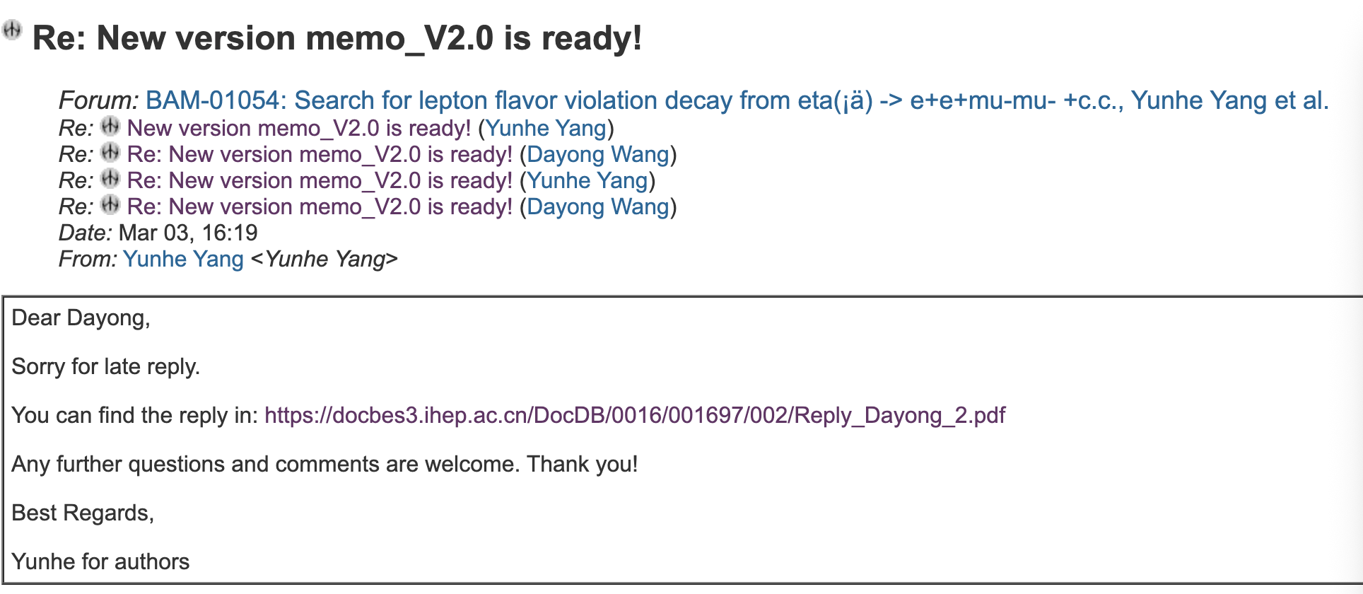
CLFV

Slide 2
CPV
Prepare prof. You’s question.

Slide 3
DC ML tracking
The data cleaning has been completed. Next, start training the GNN model.

