Slide 1
Overview of Generalized Parton Distribution Measurements
叶志鸿
清华大学物理系
第一届强相互作用自旋物理会议, 山东-青岛，07/27~07/30, 2026

Slide 2
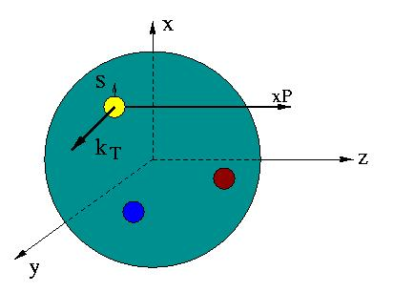
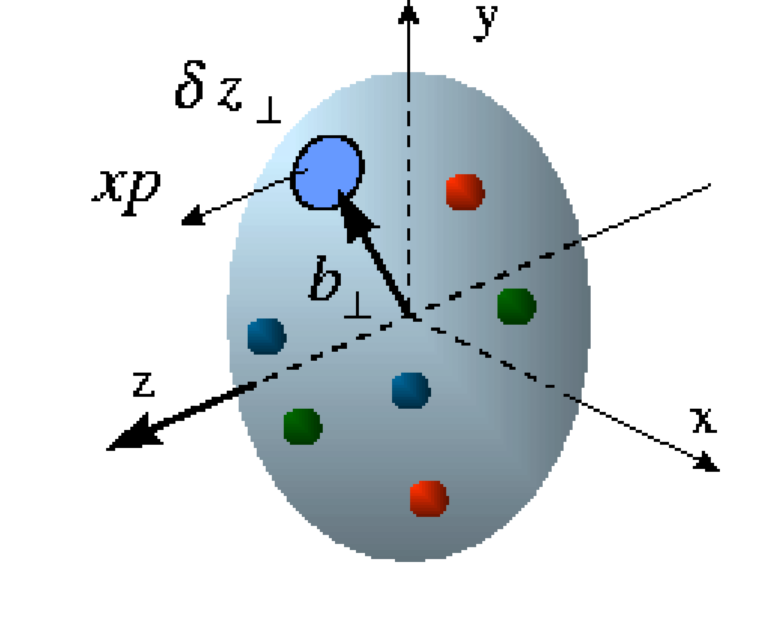
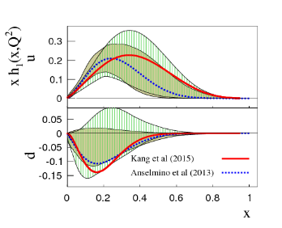
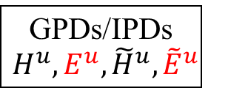
Nucleon’s 3D Structure
W_{p}^{u}(x,k_{T},r_{T} ) Wigner distributions
5D
d²k_{T}
(X. Ji, D. Mueller, A. Radyushkin)
d²r_{T}
TMD
f₁^{u}(x,k_{T}), h₁^{u}(x,k_{T}),…‏
GPDs/IPDs
$$H^{u},E^{u}, {\tilde{H}}^{u},{\tilde{E}}^{u}$$
3D
d²k_{T}
d²r_{T}
dx & Fourier Transfor
Accardi et. al.
Phys. Rev. D 93, 114017 (2016)
Z. Ye, et. al. Phys. Lett. B 777 8-15 (2018)
PDFs
f₁^{u}(x), g₁^{u}(x), h₁^{u}(x)‏,…
Form Factors
G_{E}(Q²),
G_{M}(Q²)‏
1D

Slide 3
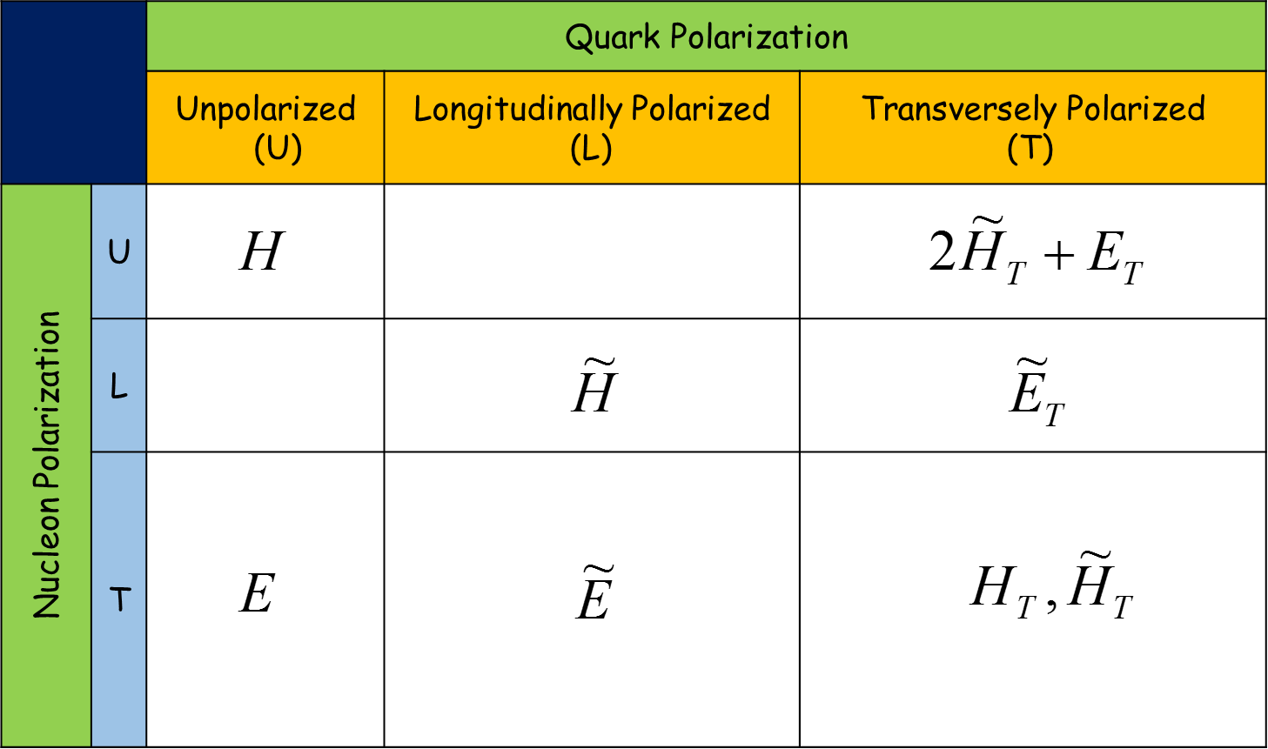
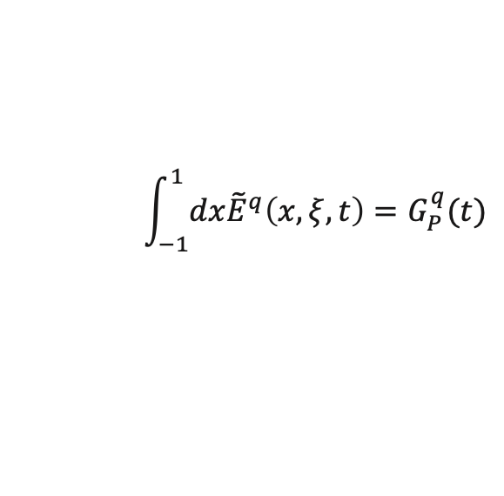
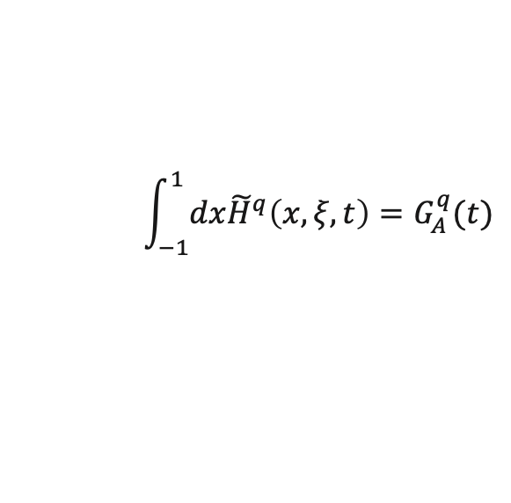


Generalized Parton Distributions
8 Leading-Twist GPDs:
Chiral Even
Chiral Odd
x → Longitudinal quark momentum fraction (not experimental accessible)
ξ → Longitudinal momentum transfer. In Bjorken limit: ξ = x_{B}/(2-x_{B})
t → Total squared momentum transfer to the nucleon: t = (P-P’)²
Connect to FF & PDFs: e.g.
$$\int_{−1}^{1}{dxH^{q}\left(x,ξ,t\right)=F_{1}^{q}(t)}$$
Dirac&Pauli
Form Factors
$$\int_{−1}^{1}{dxE^{q}\left(x,ξ,t\right)=F_{2}^{q}(t)}$$
$$\int_{−1}^{1}{dx{\tilde{H}}^{q}\left(x,ξ,t\right)=G_{A}^{q}(t)}$$
Axial&Pseudoscalar
Form Factors
Access parton distributions in 3D
$$\int_{−1}^{1}{dx{\tilde{E}}^{q}\left(x,ξ,t\right)=G_{P}^{q}(t)}$$
X. Ji, PRL 78, 610 (1997)
M. Diehl, Physics Reports 388 (2003) 41–277,
Belitsky, Radyushkin, Physics Reports 418 (2005) 1–387
PDFs

Slide 4
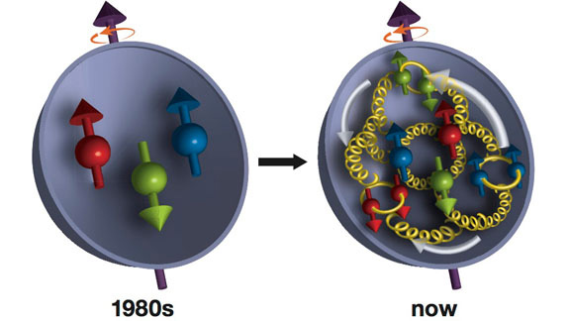
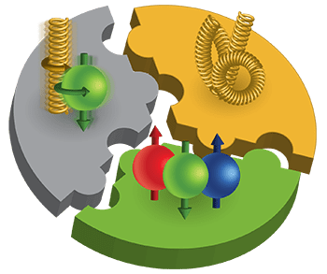
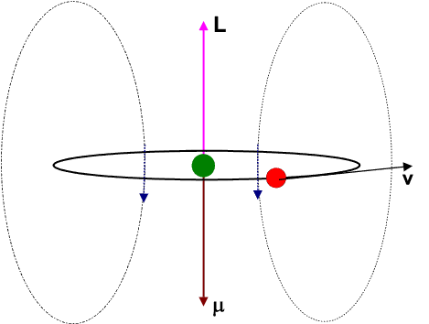
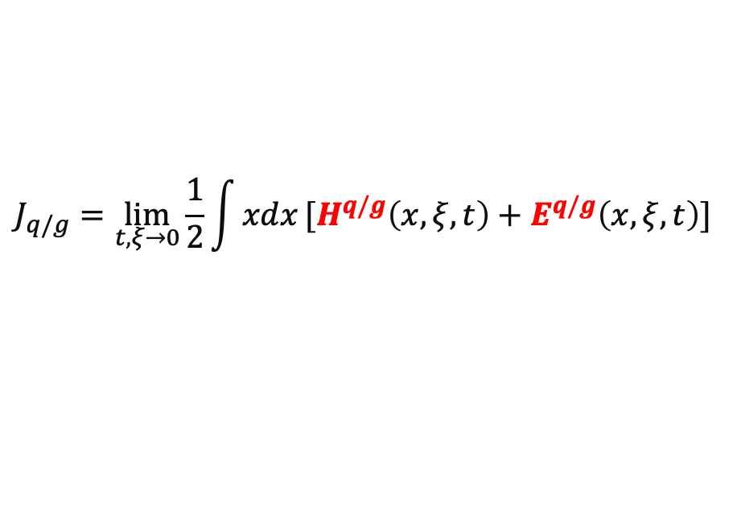
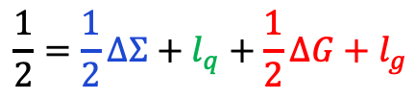
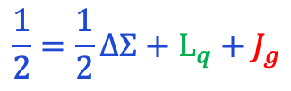
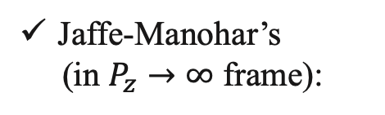
Generalized Parton Distributions
Proton’s Spin Puzzle
X. Ji, F. Yuan, Y. Zhao, Nature Review Physics, 2021
Two ways of spin-decomposition:
Ji’s (frame-independent):
$$\frac{1}{2}=\frac{1}{2}∆Σ+L_{q}+J_{g}$$
DIS
DIS+RHIC
Jaffe-Manohar’s
(in $P_{z}→∞$ frame):
$$\frac{1}{2}=\frac{1}{2}∆Σ+l_{q}+\frac{1}{2}∆G+l_{g}$$
How to access Angular Momenta?
？
Ji’s Sum Rule
(X. Ji, PRL 78, 610 (1997)
？
$$J_{q/g}=\lim_{t,ξ→0}{\frac{1}{2}\int{xdx}[H^{q/g}\left(x,ξ,t\right)+E^{q/g}\left(x,ξ,t\right)]}$$
27%
Generalized Parton Distributions (GPD)

Slide 5
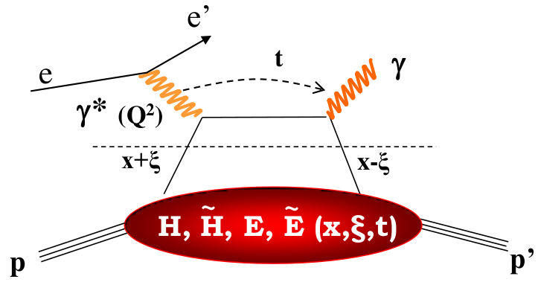
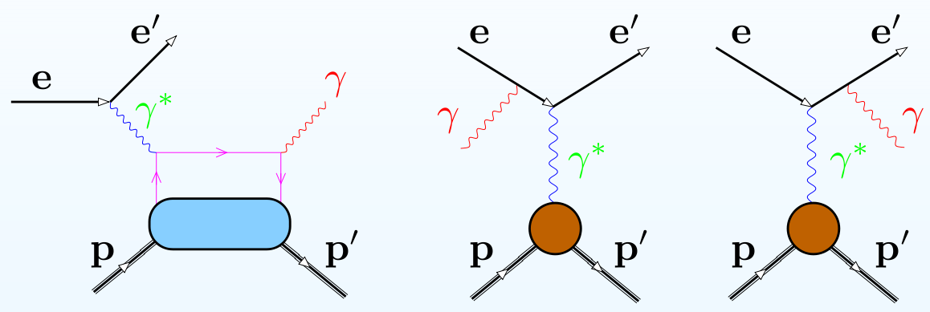
GPD Measurements
Deep Virtual Compton Scattering (DVCS):
Golden channel to study GPD
Contain two processes
Hard
Factorization
Soft
Access GPDs via Interference Terms
DVCS
Bethe-Heitler (BH)
DVCS only measures Compton Form Factors (CFFs):
Large & well-known from Nucleon FF, F₁ & F₂
Re(H) Im(H)

Slide 6
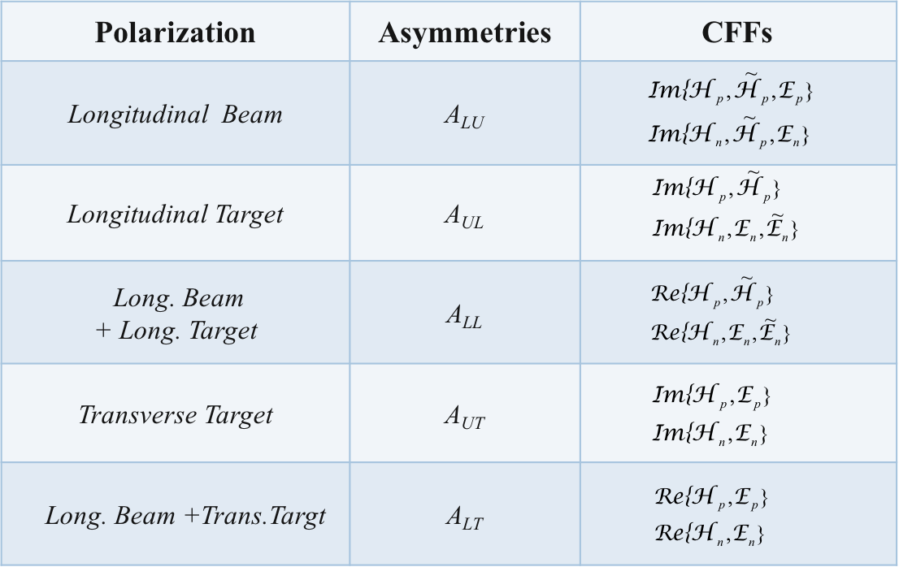




GPD Measurements
Deep Virtual Compton Scattering (DVCS):
With polarization:
$$σ^{BH+I+DVCS}=σ_{UU}^{ }+{{P_{L}σ}_{LU}^{ }+S_{L,T}σ}_{UL,UT}^{ }+{{P_{L}S}_{L,T}σ}_{LL,LT}^{ }$$
unpol
beam pol
target pol
double pol
Asymmetry:
Separate CFFs by angular modulations:
$H$ ony
$$H+\tilde{H}$$
$$H+\tilde{H}+E$$
$$BH$$
Belitsky, Mueller, PRD (2009,2010), NPB (2014)
JLab, Hall-A, Camacho PRL 97 262002

Slide 7
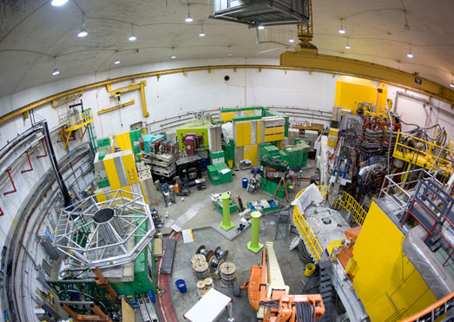
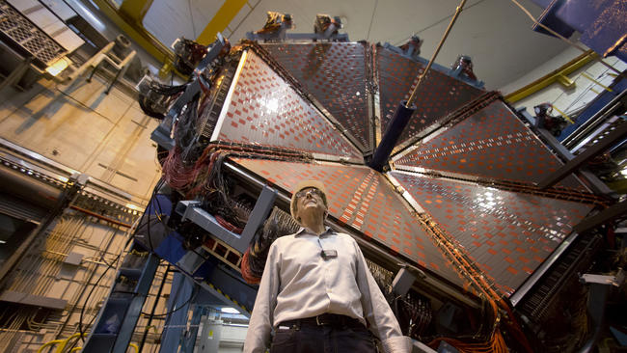
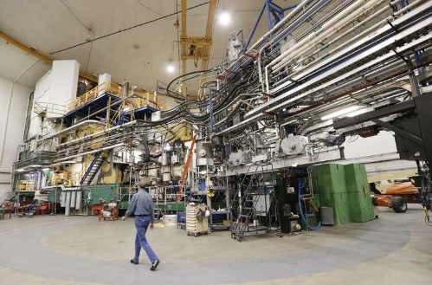
GPD Measurements
Hall-C
Jlab12GeV DVCS Experiments:
Multiple observables needed to decouple 8 CFFs→XS & asym
DVCS not sensitive to flavor → p&n targets needed for u & d
3D → wide kinematic-coverage + high rate
Hall-B
Approved 12GeV DVCS experiments:
E12-16-010B (Hall-B): unpol. proton, XS
E12-12-010 (Hall-B): trans. pol. HDIce, BSA
E12-11-003 (Hall-B): unpol. Deuteron, BSA
E12-06-119 (Hall-B): long-pol proton, BSA, TSA,
E12-06-113 (Hall-B): unpol. Deuteron, BSA
E12-06-114 (Hall-A&C): unpol. proton, XS & BSA, limited coverage
E12-13-010 (Hall-C): unpol. proton, XS , limited coverage
E12-15-001 (Hall-C): proton, XS, limited coverage
LOI: nDVCS w/ TDIS setup (Hall-A), tagged neutron, XS
Hall-A
My group involved
Lack of polarized beam & target data
Lack of neutron data (Deuteron or He3)

Slide 8
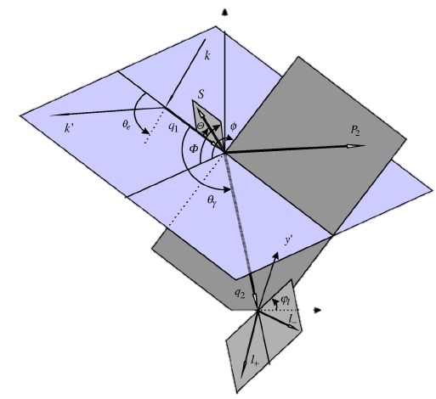
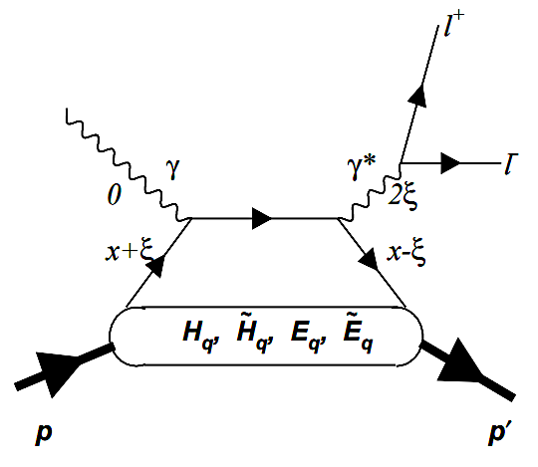

GPD Measurements
Three additional exclusive processes
Timelike Compton Scattering:
Deep Virtual Meson Production
Double-DVCS:
$$e+N→e^{′}+N^{′}+π^{0,±} (K^{0,±},η,ρ,ω, …)$$
Vector mesons → H, E.
Pseudoscalar mesons → $\tilde{H}$ & $\tilde{E}$ .
neutron + pseudoscalar → to $\tilde{E}$
sensitive to chiral-odd GPDs ($H_{T},$ $E_{T},{\tilde{H}}_{T},$ ${\tilde{E}}_{T}$)
Inverse of the space-like DVCS
Extract the real part of CFFs
Complementary to DVCS
Lepton pairs in the final states
Access GPDs beyond the x=ξ limit
NO approved experiments
宋勤涛（周四，大会报告）
唐广（周二下午，分会场二）

Slide 9
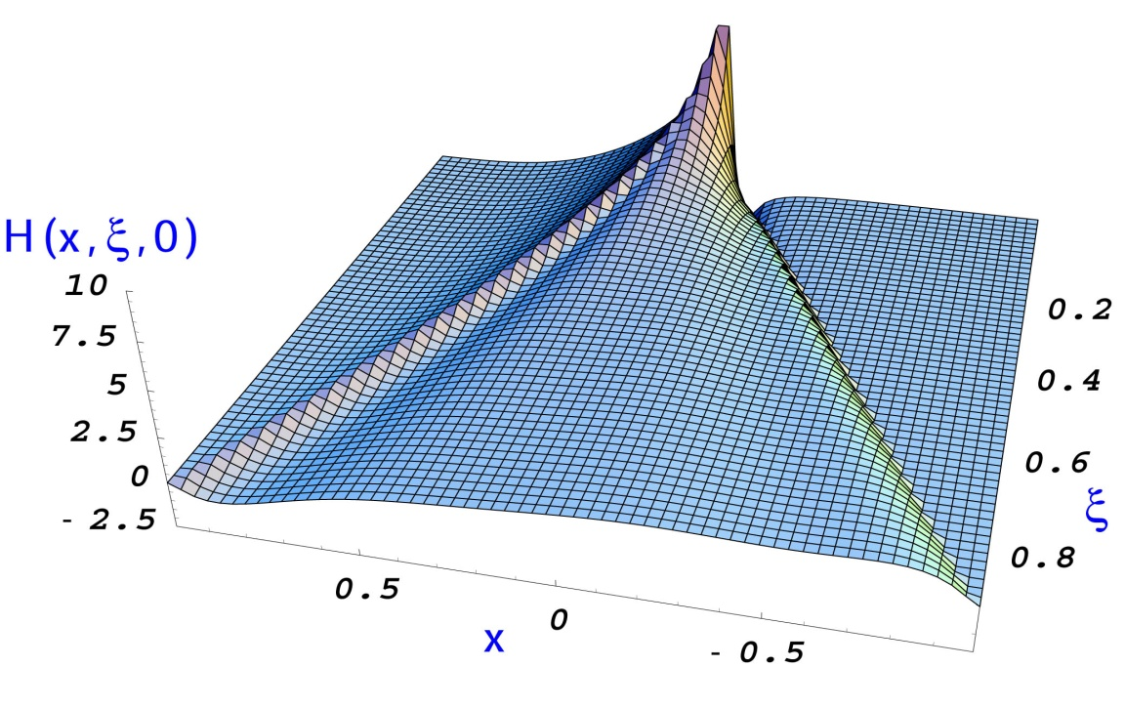
GPD Measurements
Three additional exclusive processes
  All processes together are crucial to fully extract GPDs
(Im, x=ξ)
DVCS: spin asymmetries
TCS with polarized beam
(Re)
DVCS: charge asymmetry
TCS: cross-section, beam asymmetry
DVMP: cross-section, asymmetries
(Im, x ≠ ξ, x < |ξ| )
Double DVCS
(|Im|²+|Re|²)
DVCS: cross section
DVMP: cross-section, asymmetries

Slide 10
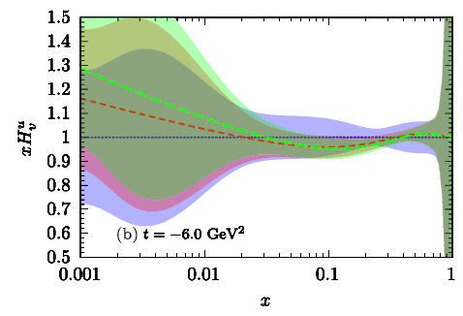
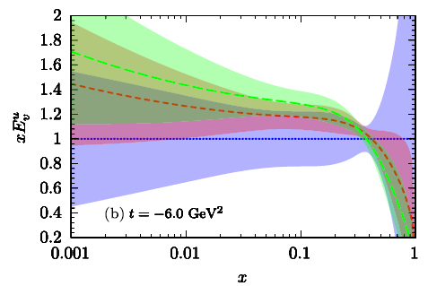
GPD Extraction
Current Status:
Guidal, Moutarde Vanderhaeghen, Rep. Prog. Phys. 76 (2013)
d’ Hose, et. al., Eur. Phys. J. A (2016) 52: 151
X. Ji, National Science Review, 213-223 (2017)
Very limited DVCS data available
  CLAS, Hall-A, COMPASS, HERMES, ZEUS, H1
excluded region
Previous global fits(XSs → CFFs+Models → GPDs)
Blue: fit with model constrained, Moutarde et. al. EPJ (2018)
Gray: unbiased fit by PARTONS Collaboration, EPJ (2019)
excluded region
Recent global analysis
CFF-H
MMGPDs Collaboration, Physical Review D 109, 074042 (2024)
CFF-E

Slide 11
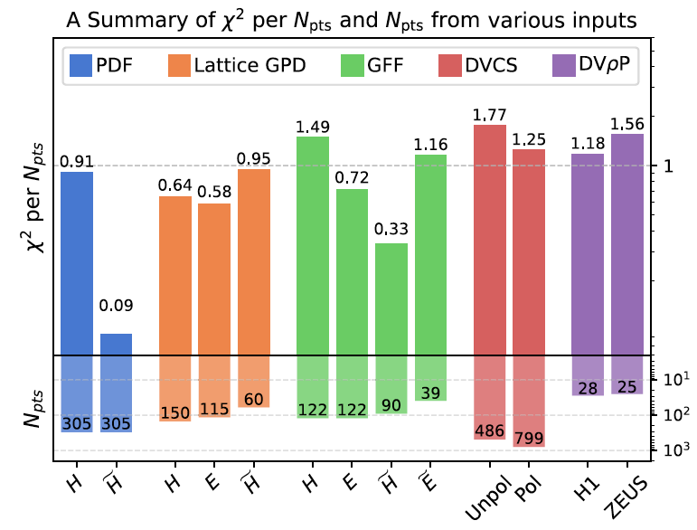
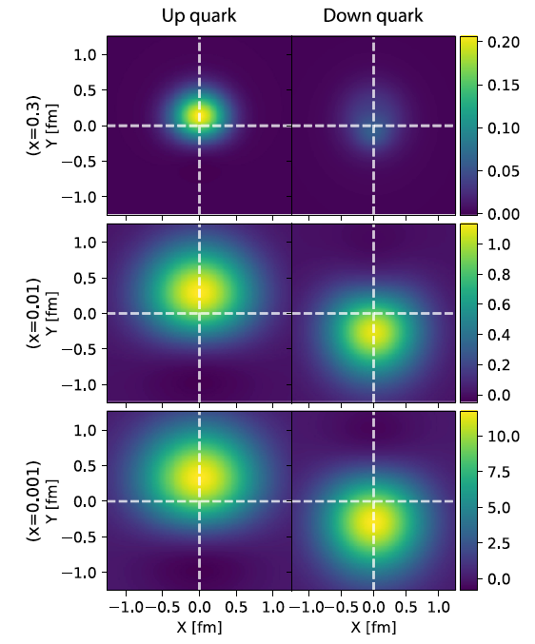
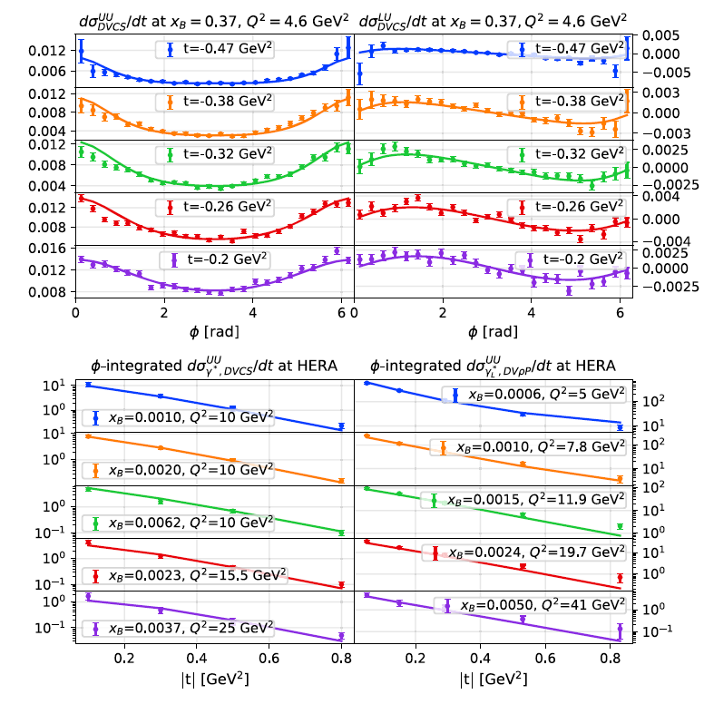
GPD Extraction
Exp. Data + Lattice Results:
GUMP1.0: Y. Guo, F. P. Aslan, X. Ji, M. G. Santiago, Physical Review Letters 135, 261903 (2025)
Lattice data provide essential inputs
Still very limited exclusive data for meaningful GPD extraction

Slide 12
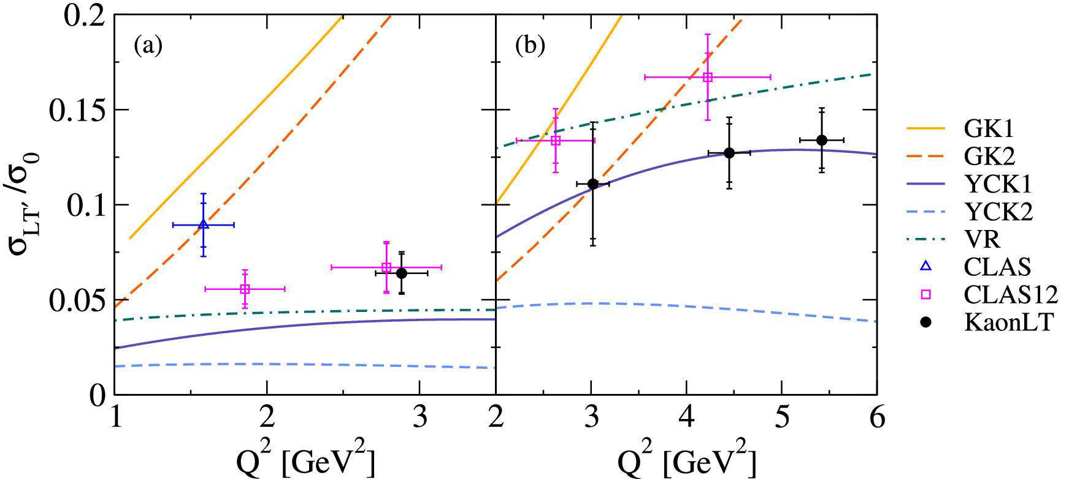

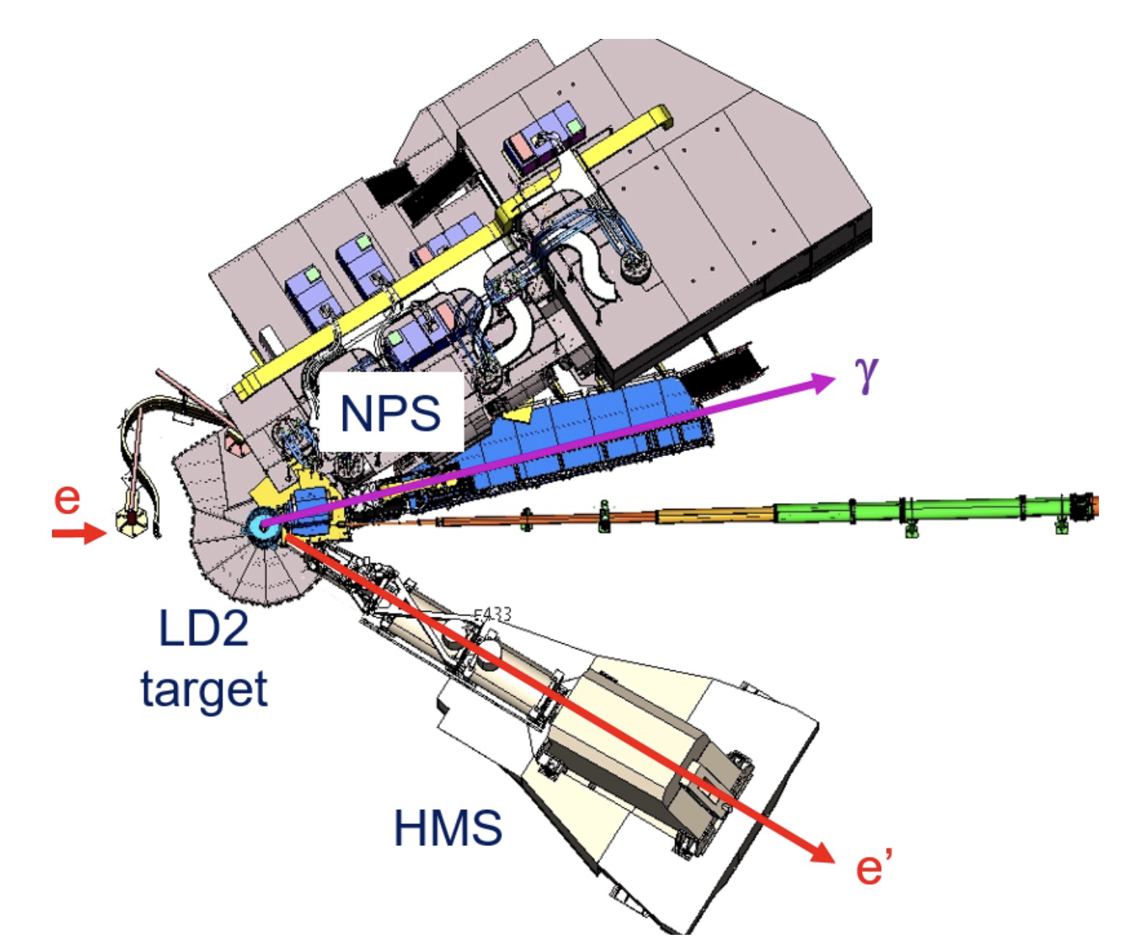
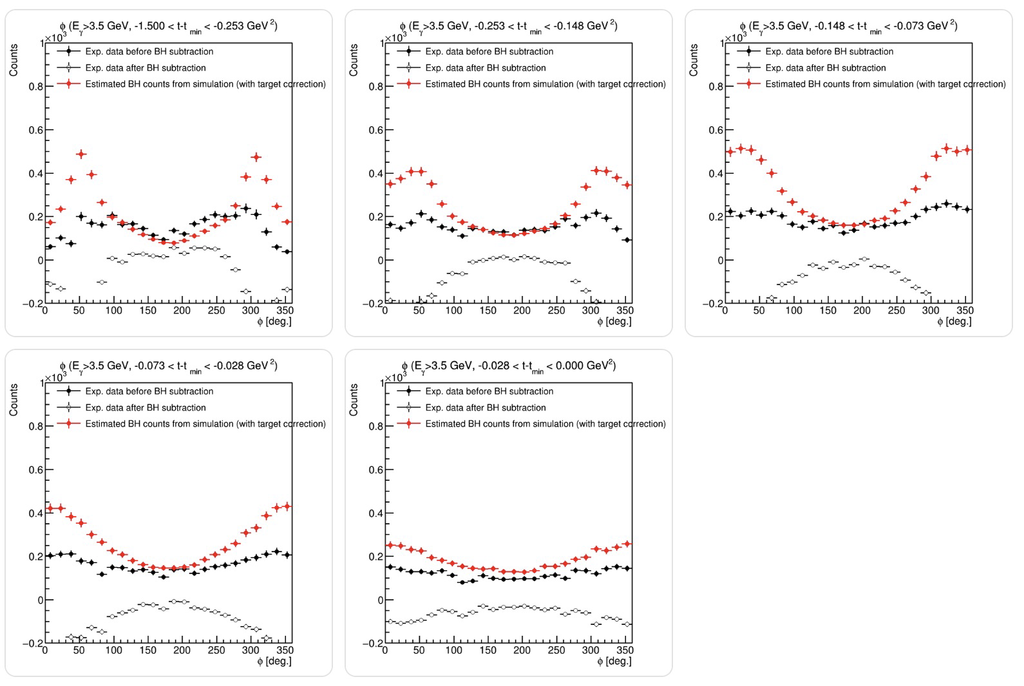
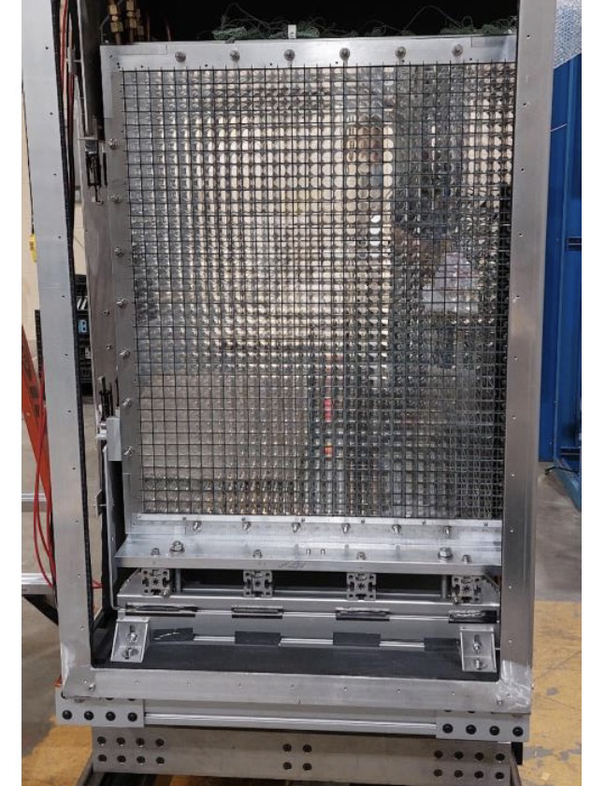
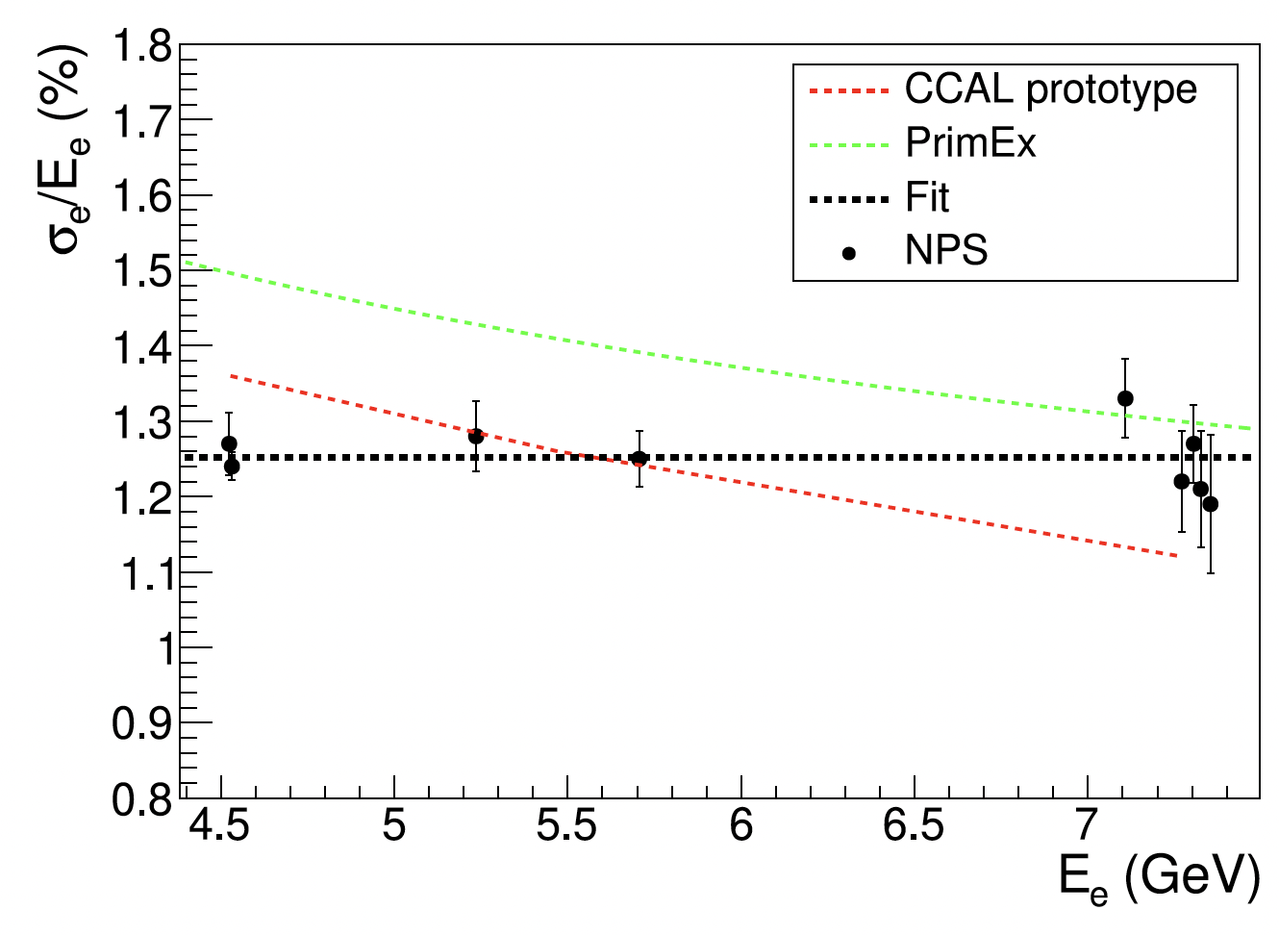
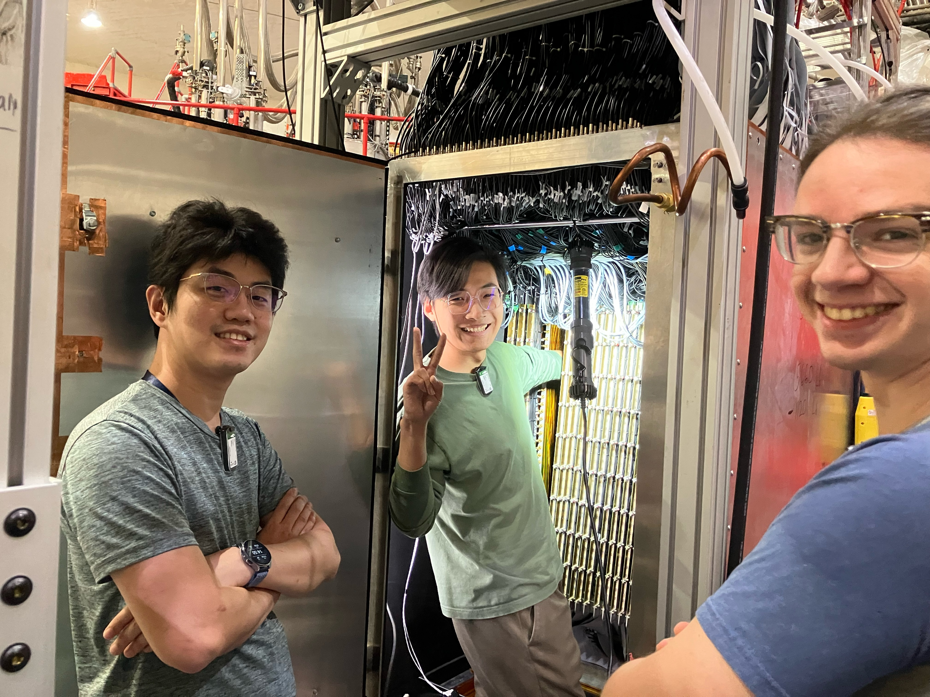
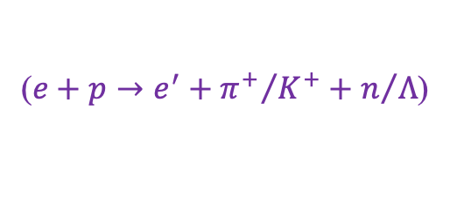
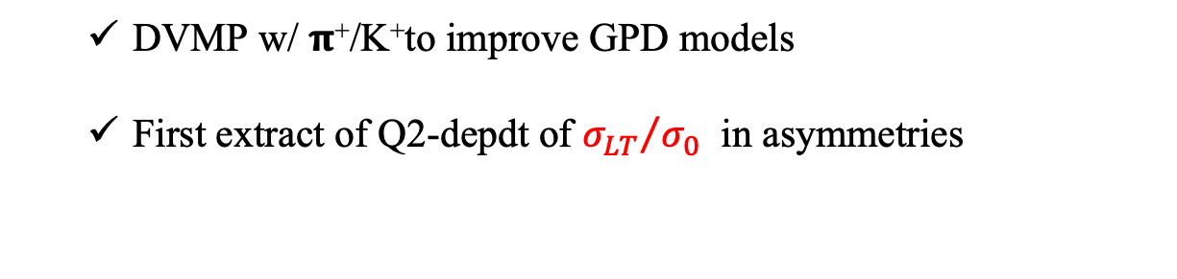
New GPD Experiments in Hall-C
PionLT/KaonLT Experiment in Hall C (completed in 2018):
  DVMP w/ 𝛑⁺/K⁺to improve GPD models
  First extract of Q2-depdt of ${σ_{LT}}/{σ_{0}}$ in asymmetries
($e+p→e^{′}+{π^{+}}/{K^{+}}+n/Λ$)
PLB 872, 140094 (2026)
DVCS&DVMP w/ NPS Experiments (1st part completed in 2024):
NPS Calorimeter
1.3%/sqrt(E)!
DVMP- 𝛑⁰ Preliminary
NIM 1086 (2026) 171323
张耀鹏报告(周三下午，分会场一）

Slide 13
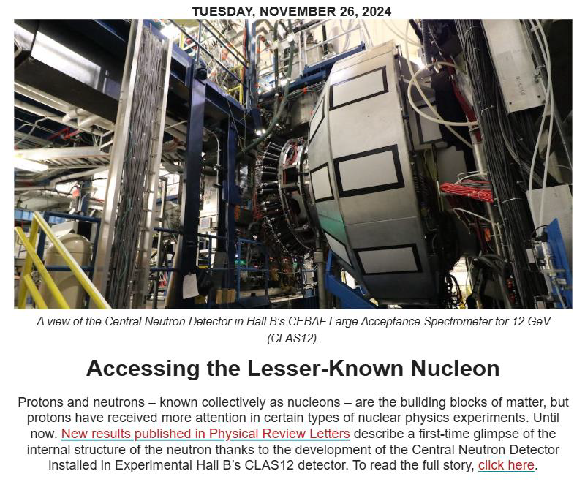
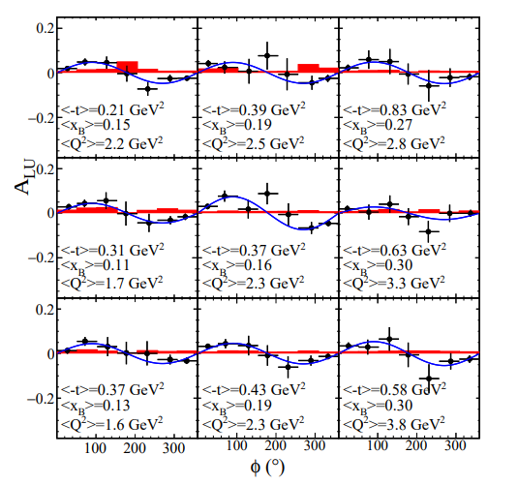
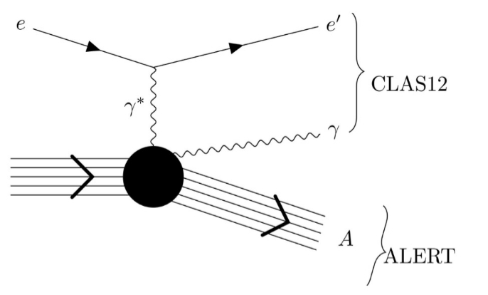
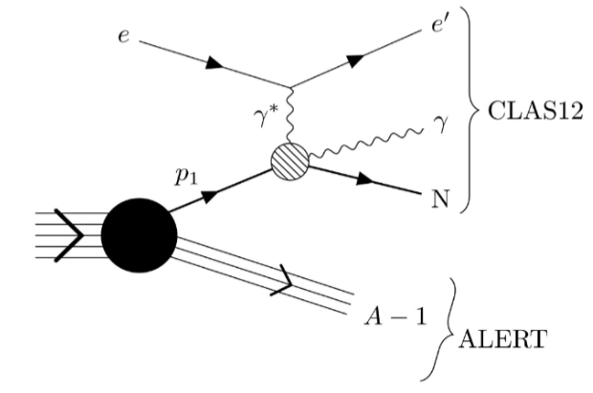
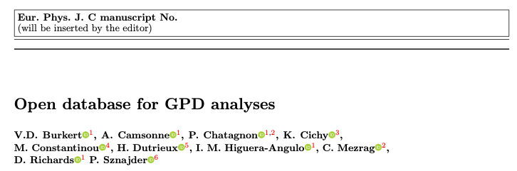
New GPD Experiments w/ CLAS12
First Neutron DVCS with CLAS12 central neutron detector
Phys. Rev. Lett.133, 211903 (Nov. 2024),
ALERT measured DVCS/DVMP in He4
  RG-L (w/ tagged DIS & SRC)
  Completed in 2025, analysis ongoing
  1 GPD in He4 (coherent DVCS)
  Nuclear-GPD in He4 (incoherent)
Global GPD analysis to extract proton properties
arXiv:2503.18152
Coherent-DVCS
Incoherent-DVCS

Slide 14
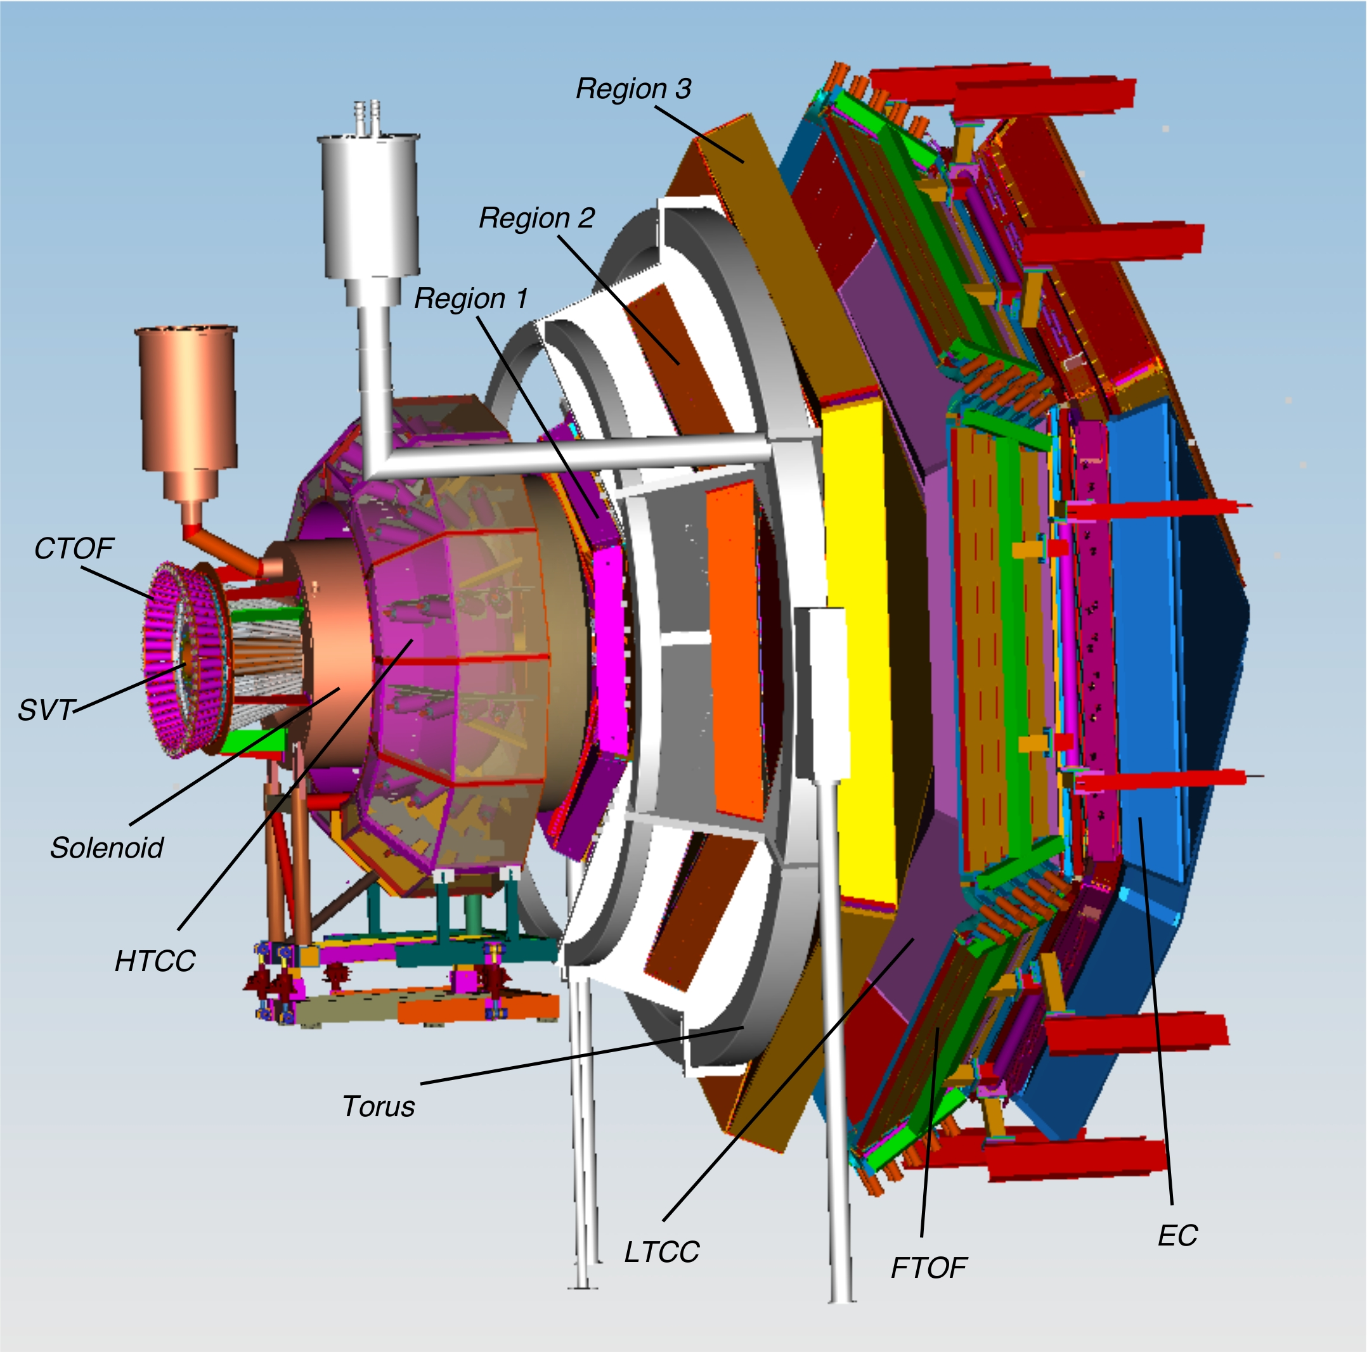
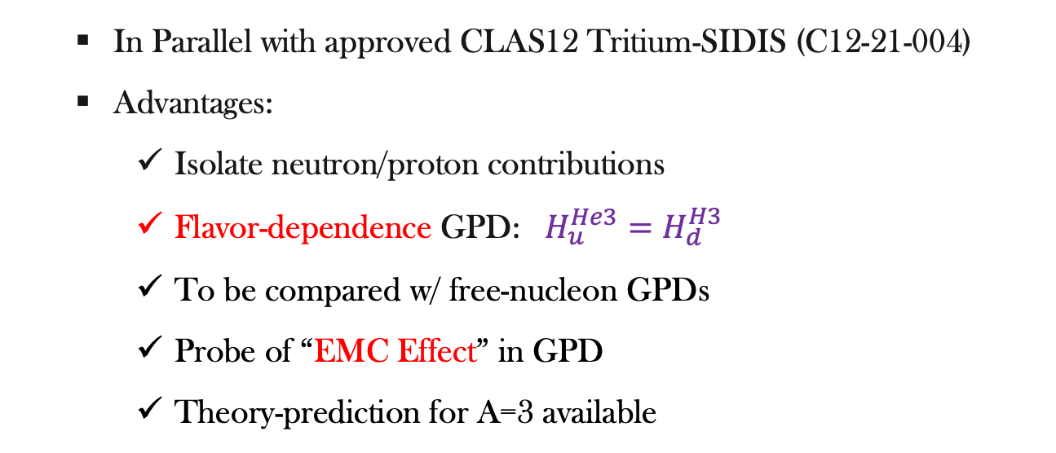
Nuclear GPDs
  DVCS w/ Light Nuclei:
New Experiment: DVCS off He3 and H3 (4 GPD for spin ½):
Coherent
Incoherent
Bound Nucleon-GPD
Nuclear-GPD
p
p
n
n
n
n
  In Parallel with approved CLAS12 Tritium-SIDIS (C12-21-004)
  Advantages:
    Isolate neutron/proton contributions
    Flavor-dependence GPD: $H_{u}^{He3}=H_{d}^{H3}$
    To be compared w/ free-nucleon GPDs
    Probe of “EMC Effect” in GPD
    Theory-prediction for A=3 available
³H & ³He

Slide 15
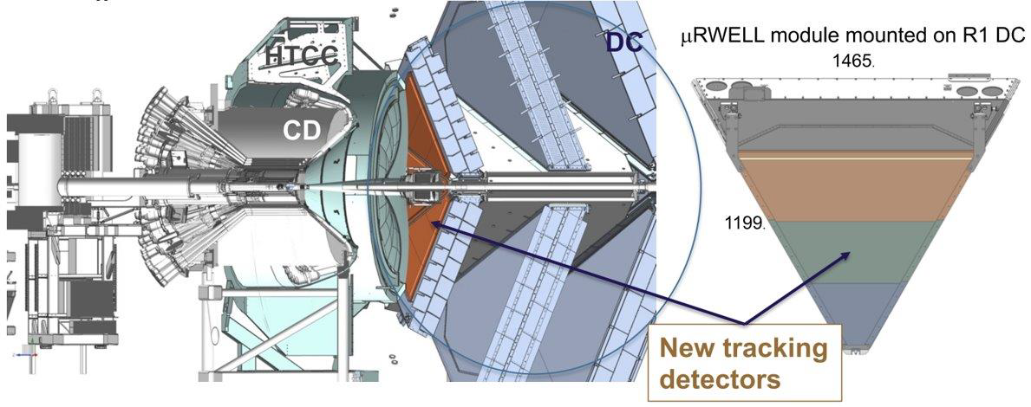
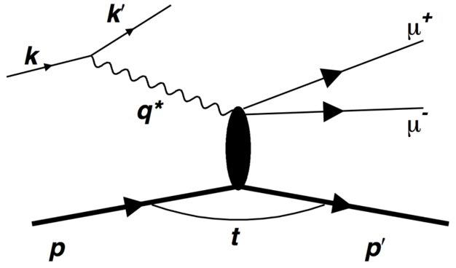
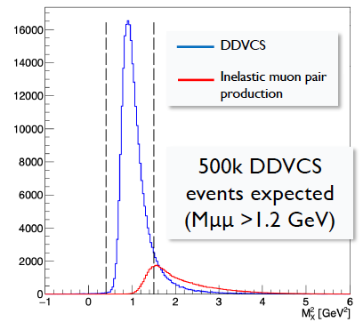
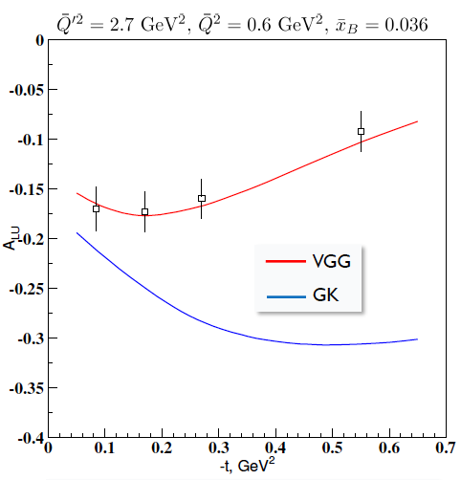
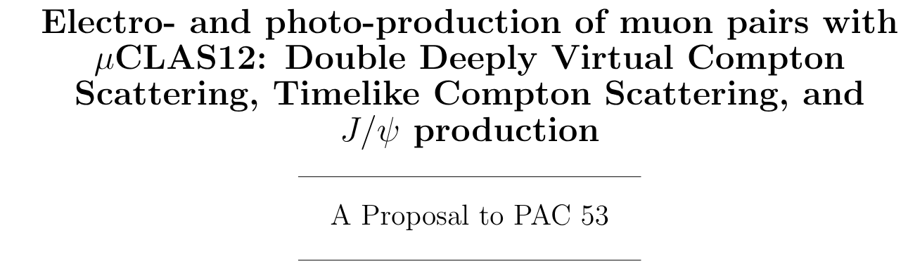
Future Upgrade-𝜇CLAS12
CLAS12 luminosity to be upgraded to 10³⁷ cm⁻²s⁻¹.
  DC to muRWELL trackers
  Add forward trackers
Enable the Double-DVCS measurements
200 days to distinguish models at small-t region

Slide 16
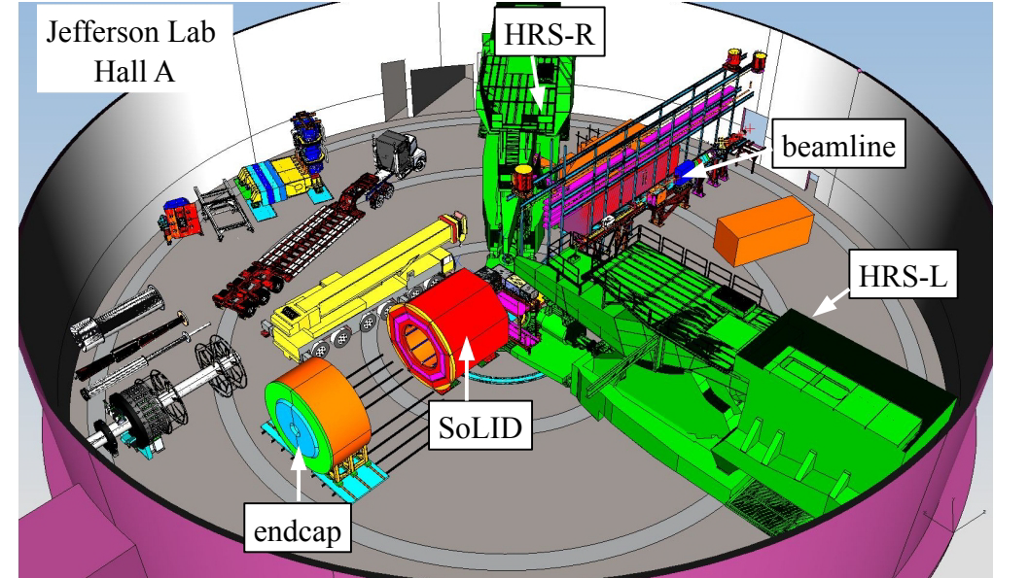




GPD Measurements on SoLID
The Solenoidal Large Intensity Device (SoLID):
  handle 10³⁷-10³⁹ cm⁻² s⁻¹ luminosities
  full 2𝛑 azimuthal acceptance;
  Polarized p&n targets.
Provide 4D/5D mappings of TMD & GPD; PVDIS for d/u & BSM
$$e+N^{↑↓}→e^{′}+N^{′}+π^{±}$$
SIDIS &J/Psi& GPD
SoLID Projection
SoLID Projection

Slide 17


GPD Measurements on SoLID
  Dedicated Setup for New GPD Experiments
SoLID is needed to upgrade to unlock its full power of GPD measurement
Dedicated SoLID-GPD Configuration
Recoil
Detector
DDVCS Projection@SoLID
High Resolution ECal
    DVCS with polarized He3 & SIDIS → better ECal resolution + recoil proton detector
    DDVCS with J/Psi (LOI 12-12-005) → +muon detectors

Slide 18
GPD Experiments on EIC
Unlock the full power of DVMP
Large Q² to go beyond the x=ξ limit
From valence to sea+gluons
Solve spin- puzzle : JLab12 + EicC + EIC+COMPASS + Theories
U.S. EIC Yellow-Report
Gluons
Sea-Quarks
Valence-Quarks

Slide 19





GPD Experiments w/ Hadron Beam
Hard-Exclusive Hadron-scattering in time-like region
H. Kawamura, S. Kumano, Phys. Rev. D 89 (2014) 5, 054007,
D. Muller, et. al., Phys. Rev. D 86 (2012) 031502
CFF from Pion-included exclusive Drell-Yan (COMPASS&AMBER):
S. Goloskokov, P. Kroll, Phys. Lett. B 748 (2015) 323
J.-W. Qiu and Z. Yu PRD 109 (2024) 074023
J-PARC E50 Proposal w/ MARQ Detector
T. Sawada, W. C. Chang, S. Kumano, J. C. Peng, S. Sawada, K. Tanaka,
Phys. Rev. D 93 (2016) 114034

Slide 20





GPD Experiments w/ Hadron Beam
(anti)-Proton-included (J-PARC):
S. Kumano, M. Strikman, K. Sdoh, Phys. Rev. D 80 (2009) 074003
Access to Efremov-Radyushkin-Brodsky-Lepage (ERBL) region (not accessible in lepton scattering)
Factorization in special kinematic regions
Very large XS (ub level)
p&𝝿 must forward & opposite, carrying most of momentum

Slide 21




GPD Experiments w/ Hadron Beam
J-PARC 𝝿20/K10 beamline
𝝿&K separation not ready, dominated by 20GeV protons
Π20/K10
beamline
Workshop on π20 and K10 at J-PARC (Aug5-6) :
https://indico.rcnp.osaka-u.ac.jp/event/2904/
Measure GPD using $p$/$\overline{p}$ secondary beam@𝝿20 w/ MARQ
An early experiment w/ parts of MARQ detector & E16 magnet
Proposal under development: by Natsuki Tomida (Kyoto),
Zhihong Ye (Tsinghua), et. al.

Slide 22






Opportunities at HIAF
Polarized Targets + 4π Detector：
L (s⁻¹) | $$π^{+}$$ | $$π^{−}$$ | $$K^{+}$$ | $$K^{−}$$ | $${μ^{+}}^{ }$$ | $$μ^{−}$$
6cm Be | 4.5x10⁷ | 2.7x10⁷ | 1.8x10⁵ | 0.6x10⁵ | 4.8x10⁶ | 9x10⁷
6cm Pt | 1.3x10⁸ | 8.1x10⁷ | 3.6x10⁶ | 1.2x10⁶ | 1.4x10⁷ | 2.7x10⁸
4𝛑 Detector System
TOF
Liquid Hydrogen Target
Trackers
Trackers
TOF
Aerogel Cherenkov
Veto-Counter
Quadropole
$e^{±}$, $μ^{±}$, $π^{±}$, $K^{±}$, $p$, $\overline{p}$,$Λ$,…
Gas Cherenkov
Veto-Counter
Joined Workshop of Physics w/ J-PARC &HIAF Secondary Beam in late 2026
Beam-Dump
Trackers

Slide 23
Summary
GPDs correlate longitudinal momentum with transverse position
Deep exclusive experiments only constrain CFFs;
Extracting GPDs requires complementary observables and global analysis w/ models & lattice QCD results
Pioneering studies been done at DESY, COMPASS, JLab-6GeV
Precision studies underway at JLab12GeV in valence region
EicC & EIC unlock full kinematic region, extend to sea & gluon GPD
Measurement of GPD w/ hadron beams are about to be explored
Opportunities for GPD experiments w/ polarized targets & 4π detector at HIAF

Slide 24
THANKS!

Slide 25








Generalized Parton Distributions
Proton Pressure & Shear Force
Similar to EM FF, Gravitational Form Factor (GFF)：
Guo,X.Ji&Y.Liu, Phys.Rev.D 103, no.9, 096010 (2021)
A_{g}(t) from J/Psi near threshold production in electron-proton scattering
→Quark kinematic energy in proton → Proton mass
D_{g}(t) from GPD:
Proton Pressure & Shear Force:

Slide 26







Generalized Parton Distributions
Proton Pressure & Shear Force
Define a fitting function on GPD data:
“Obtain” Proton Pressure:
Pressure at Proton “center”: 10³⁵P，x10 than neutron star center

Slide 27


Generalized Parton Distributions
Proton Pressure & Shear Force
“Obtain” Shear Force:
Proton’s shear force changes direction@0.45fm，max@0.55fm
0.55fm is max of color confinement，~650kg gravity on Earth

Slide 28

GPDs on SoLID
Exclusive Measurement based on SIDIS/JPsi Setup
Forward-Angle :
electrons, pion, photons and proton
Large-Angle→electrons, photons and proton

Slide 29




GPD Experiments on SoLID
SoLID-TCS:
H. Moutarde et al. arXiv:1301.3819, 2013
Time-Like Compton Scattering (TCS):
  Re-CFF (Im-CFF) via unpolarized (circularly polarized) photons
  Different angular moments for TCS & BH Interference-terms
TCS
$σ_{INT}^{TCS, unpol}∝cosφRe{\tilde{M}}^{−−}$, $σ_{INT}^{TCS, cir−pol}∝sinφIm{\tilde{M}}^{−−}$
SoLID-TCS: Parallel data taking with J/Psi
  Unpolarized ¹H target
  Indirect photon-production
  Extract $cosφ$ and $sinφ$ modules
SoLID Projection
$$R<cosφ>$$
$$R<cosφ>$$
SoLID Projection

Slide 30




GPD Experiments on SoLID
SoLID-DVMP:
$$e+N^{↑↓}→e^{′}+N^{′}+π^{±}$$
DVMP advantages:
  Probe different hadrons for quark flavor separation
  Vector mesons for H and E; Pseudoscalar mesons for $\tilde{H}$and $\tilde{E}$ Sensitive to transverse GPDs ($H_{T},$ $E_{T},{\tilde{H}}_{T},$ ${\tilde{E}}_{T}$)
β=(φ-φ_{S})
DVMP disadvantages:
  Usually requires Q² >10 GeV² for factorization
  Higher twist contaminations at low Q²
  Long. photons to link to GPD (LT separation)
DVMP w/ asymmetries:
  test onset of factorization at mid Q²；reduce higher-twist effects
Belitsky & Műller PLB 513(2001)349, CIPANP 2003).

Slide 31




GPD Experiments on SoLID
SoLID-DVMP:
$$e+N^{↑↓}→e^{′}+N^{′}+π^{±}$$
Asymmetry (no L/T separation):
helicities: [pion, neutron, photon, proton]
$\tilde{E}$dominated
HERMES Data:
π⁺, 27.6 GeV, trans ¹H, w/o L/T separation
‹x_{B}›=0.13, ‹Q2›~2.4 GeV²,
Consistent with GPD models based on the $\tilde{E}$ dominance
‹Q²›=2.45 GeV², W=3.99 GeV
trans+long γ
Long γ only
S. Goloskokov et. al. PLB 682(2010)345
Eur Phys.J. C65(2010)137

Slide 32

GPD Experiments on SoLID
SoLID-DVMP:
$$e+N^{↑↓}→e^{′}+N^{′}+π^{±}$$
SoLID will provide the first polarized DVMP data before EIC
SoLID Projected Data:
π⁻, 11.0 GeV, trans ³He, w/o L/T separation
Q2>4 GeV², large t coverage
Simultaneous extraction of all angular moments
Precision improved x10+
SoLID Projection
SoLID Projection

Slide 33



GPDs on SoLID
SoLID-TCS: (E12-12-006A, M. Boer, P. Nadel-Turonski, J. Zhang, Z. Zhao)
Proper Q2 and $ξ$ binning
Fit to the angular distribution in each bin
SoLID Projection
$$R<cosφ>$$
$$R<cosφ>$$
SoLID Projection
Projections of two highest bins

