Slide 1

Spin alignment of vector mesons in local equilibrium
by Zubarev’s approach
Shi-Zheng Yang(杨诗正)
Zhejiang Ocean University
SZY, X.-Q. Xie, S. Pu, J.-H. Gao, Q. Wang, Phys. Rev. D 112, 094040 (2025)
第一届强相互作用自旋物理会议，青岛，2026年7月26日至31日

Slide 2
Outline
Introduction
Spin alignment from Zubarev’s approach
Is spin alignment induced by shear tensor dissipative?
Summary

Slide 3
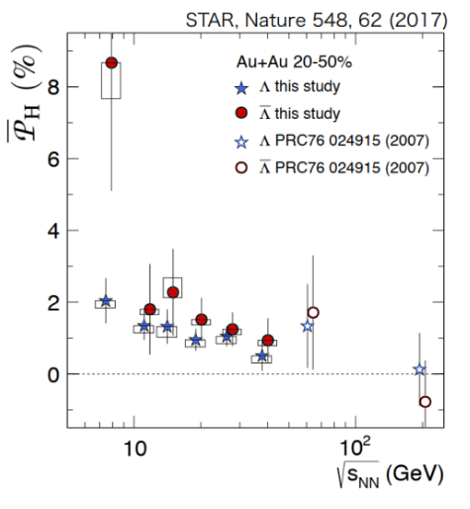
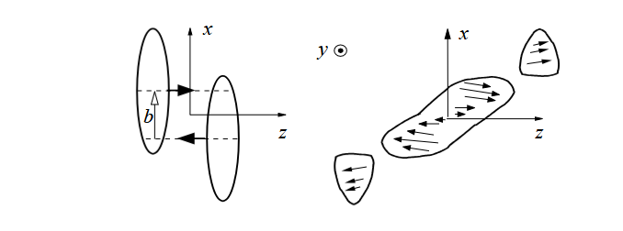
Spin polarization
Huge orbital angular momentum in non-central relativistic heavy-ion collisions
Orbital angular momentum leads to the polarization through spin-orbital coupling
Z.-T. Liang and X.-N. Wang, Phys. Rev. Lett. 94, 102301 (2005)
STAR collaboration, Nature 548, 62 (2017)

Slide 4
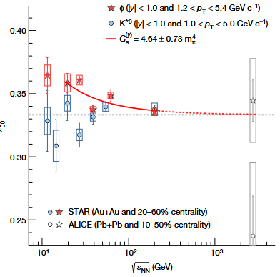
Spin polarization
Spin alignment for vector mesons
Theory：
Z.-T. Liang & X.-N. Wang, PLB 629, 20 (2005)
X.-L. Sheng, L. Oliva, Q. Wang, Phys. Rev. D 101 (2020)
X.-L. Xia, H. Li, X.-G. Huang, H.-Z. Huang, Phys. Lett. B 817, 136325 (2021)
X.-L. Sheng, L. Oliva, Z.-T. Liang, Q. Wang and X.-N. Wang, Phys. Rev. Lett. 131, 042304 (2023)
D. Wagner, N Weickgenannt and E. Speranza, Phys. Rev. Res. 5, 013187 (2023)
X.-L. Sheng, L. Oliva, Z.-T. Liang, Q. Wang and X.-N Wang, Phys. Rev. D 109, 036004 (2024)
Kumar, D.-L. Yang, P. Gubler, Phys. Rev. D 109, 054038 (2024)
J.-H. Chen, Z.-T. Liang, Y.-G. Ma, X.-L. Sheng and Q. Wang, Sci. China Phys. Mech. Astron. 68, 211001 (2025)
……
STAR collaboration, Nature 614, 244 (2023)

Slide 5
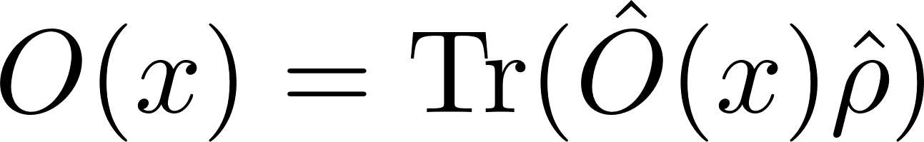
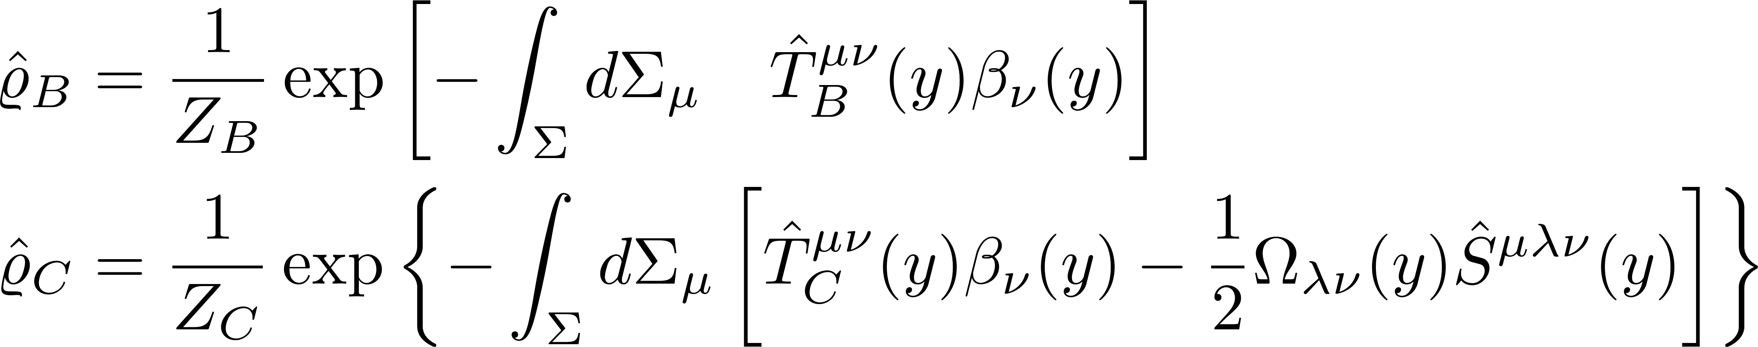

Zubarev’s approach
Mean value at equilibrium
The Belinfante and canonical form of density operator
$u_{μ}/T$ Velocity/Temperature
Spin chemical potential
D. N. Zubarev, A. V. Prozorkevich, and S. A. Smolyanskii, Theor. Math. Phys. 40, 821 (1979)

Slide 6
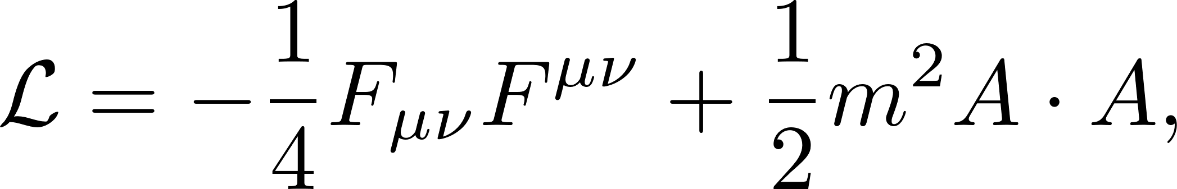
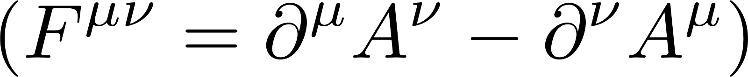
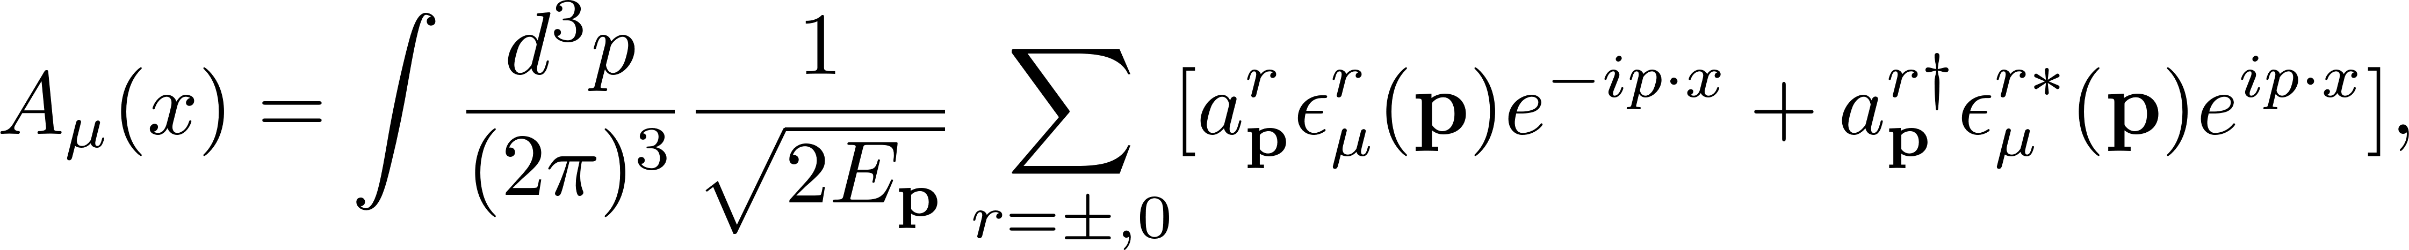
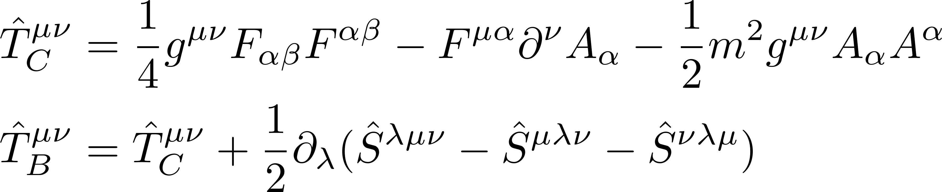
Lagrangian and field operator
The Lagrangian for neutral spin-1 particles
The field operator
The commutation rule
The energy momentum tensor and spin tensor

Slide 7
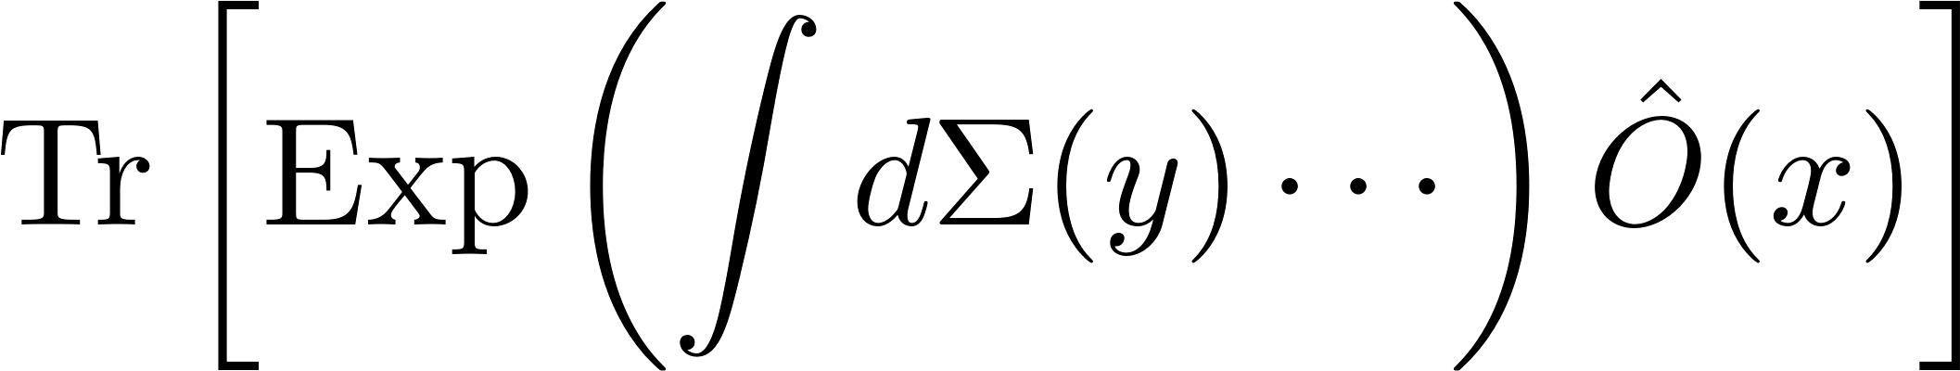
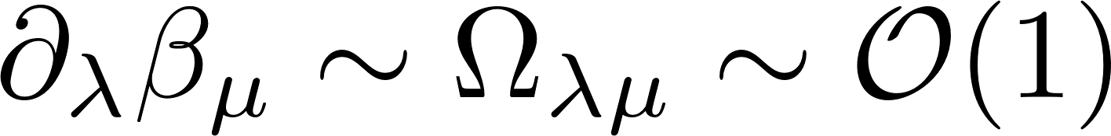
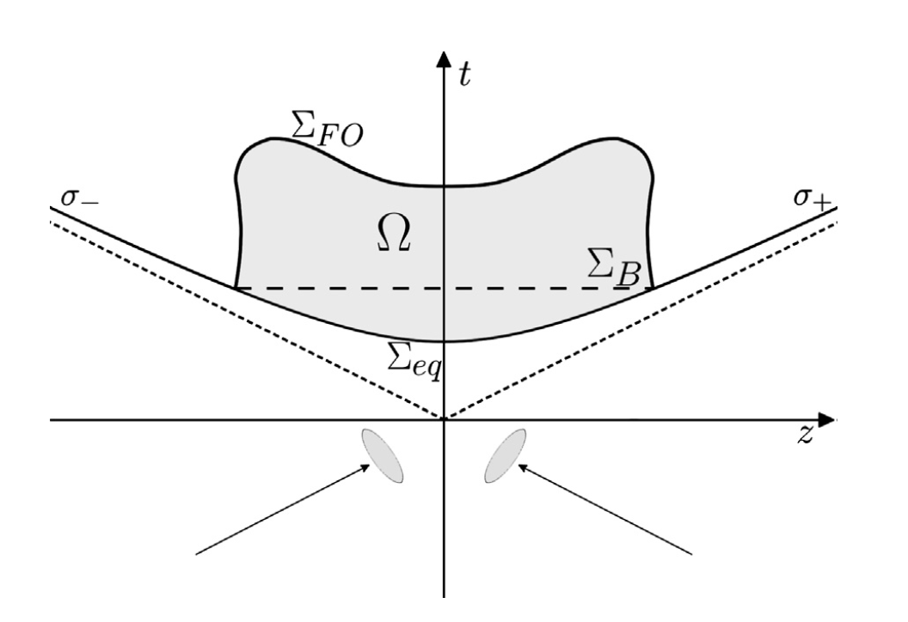
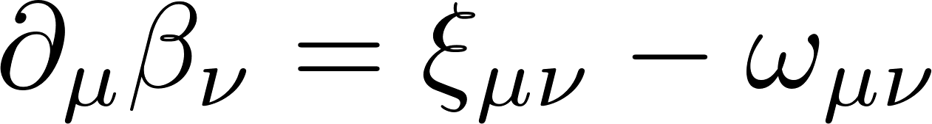
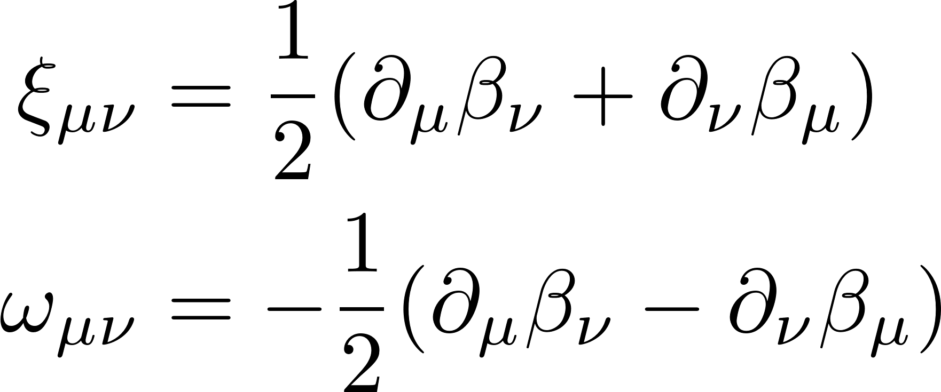

Gradient expansion of the density operator
When $β_{μ}(y)$ varies slowly, it can be expanded in gradient up to first order
The $∂_{μ}β_{ν}$ can be decomposed
y
x
F. Becattini, M. Buzzegoli, G. Inghirami, I. Karpenko, and A. Palermo, Phys. Rev. Lett. 127, 272302 (2021)
Notes:
neglect other possible second-order contributions

Slide 8
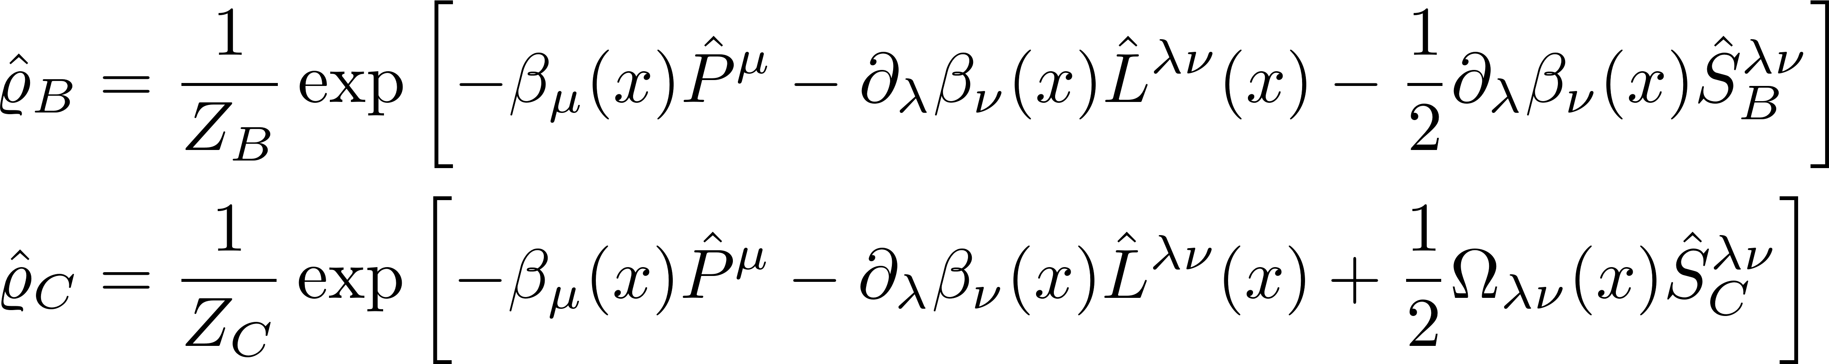
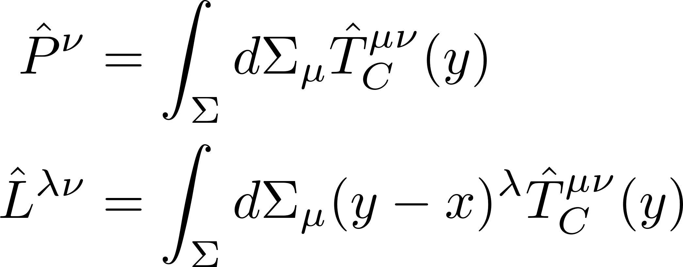
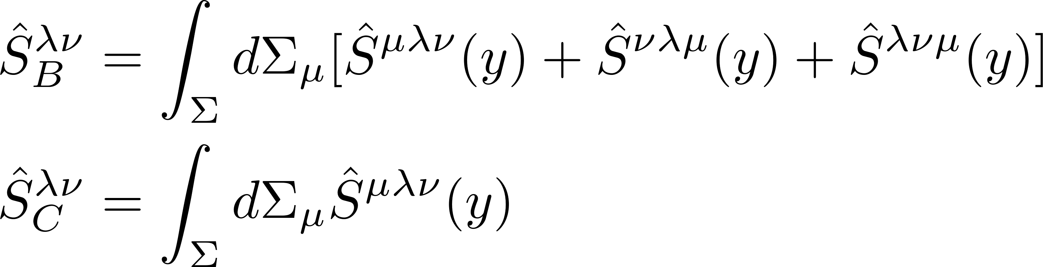
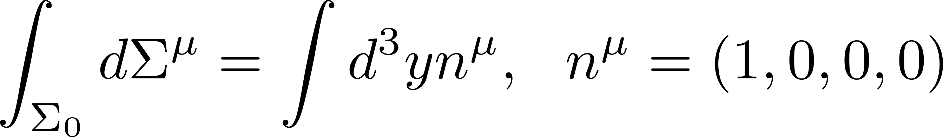

Density operator
The density operator in gradient expansion up to first order
Note that in our work we focus on effects related to $∂_{μ}β_{ν}$ and neglect the contribution of ${∂_{λ}∂}_{μ}β_{ν}$
The momentum, angular-momentum and spin operators are
We adopt the isochronous hypersurface $Σ_{0}$：

Slide 9
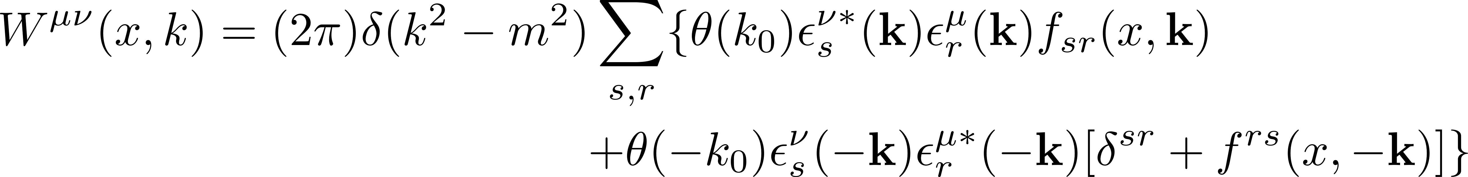

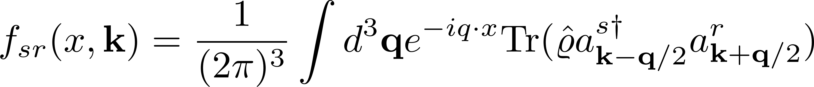
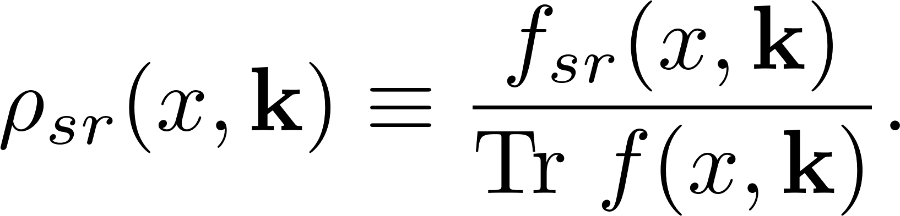

Spin distribution function
The Wigner function for spin-1 particles
At leading order of $ℏ$, the Wigner function can be decomposed as
The are defined as (also be called matrix valued spin dependent distributions, MVSD)
The spin density matrix can be obtained from

Slide 10
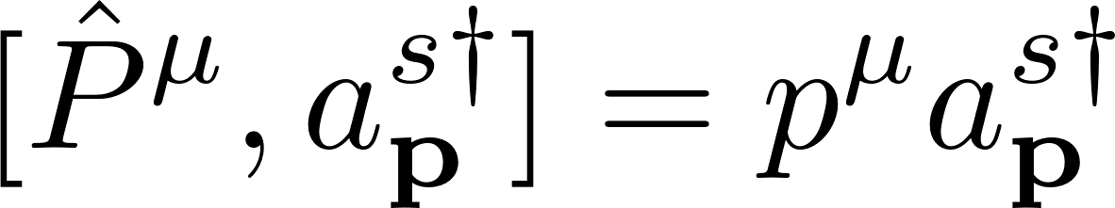
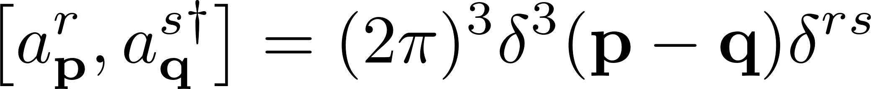
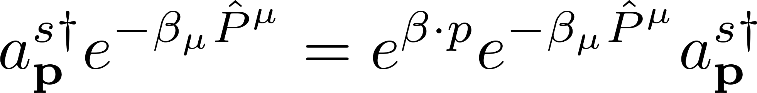
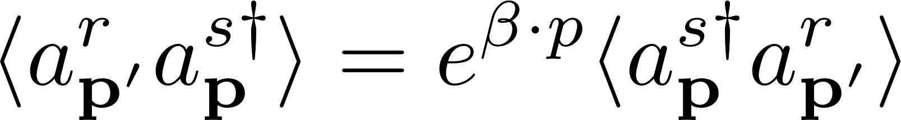
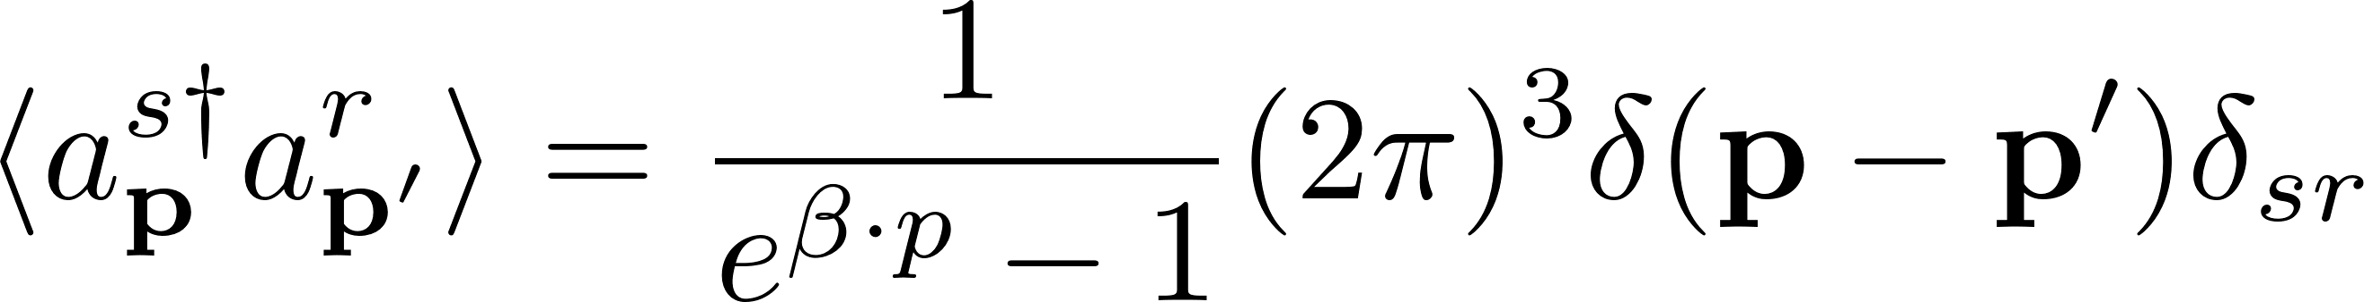
Zeroth-order trace
Using the following commutators
We obtain the Bose-Einstein distribution

Slide 11
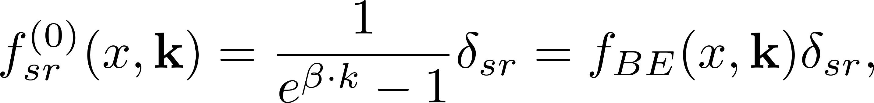
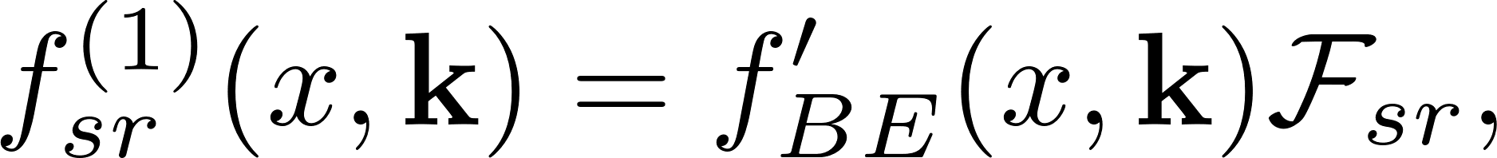

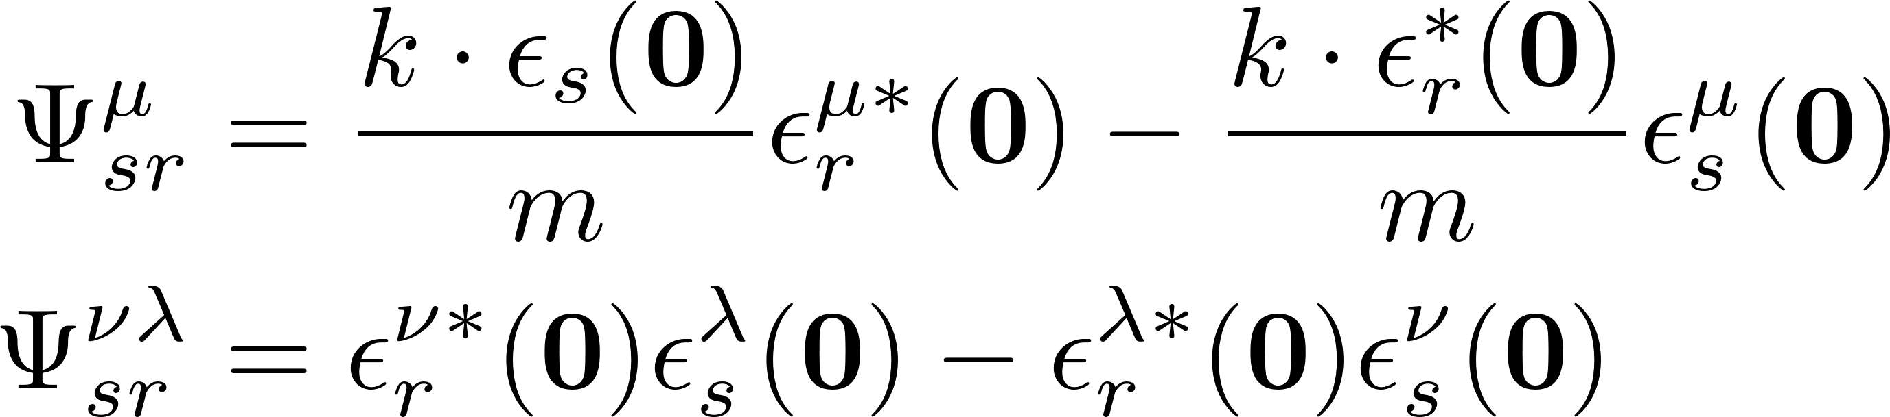
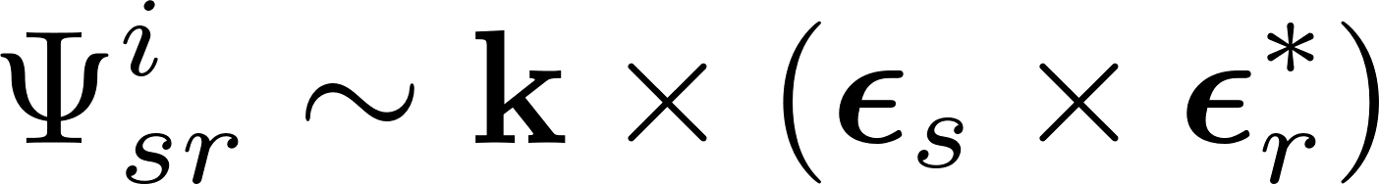
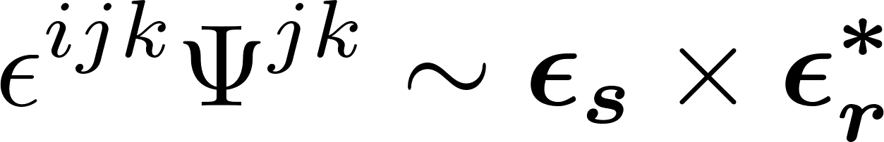
Zeroth- and first-order distribution fucntions
The distribution function
The zeroth-order spin distribution function are
The first-order spin distribution function
where the canonical form are
with

Slide 12
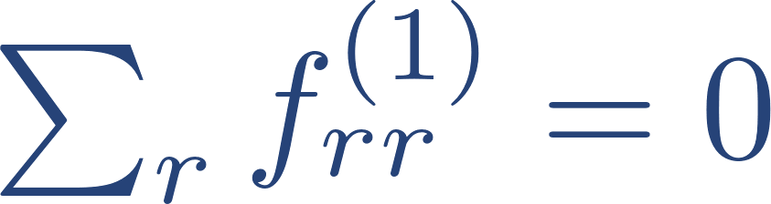
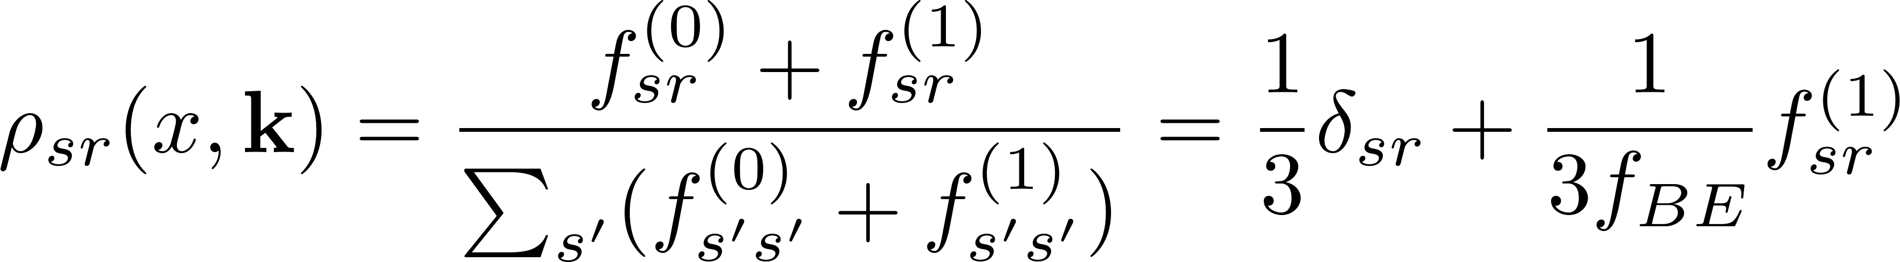
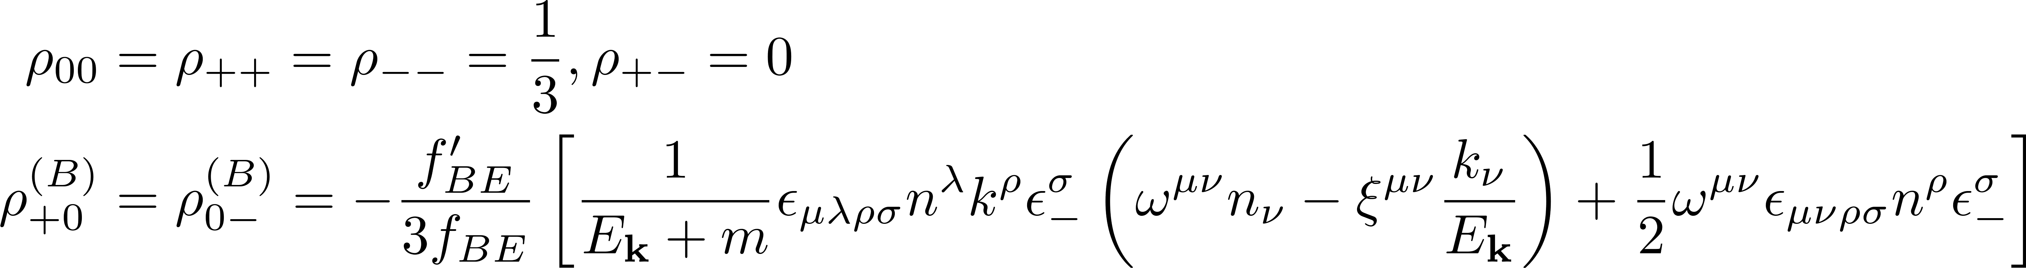
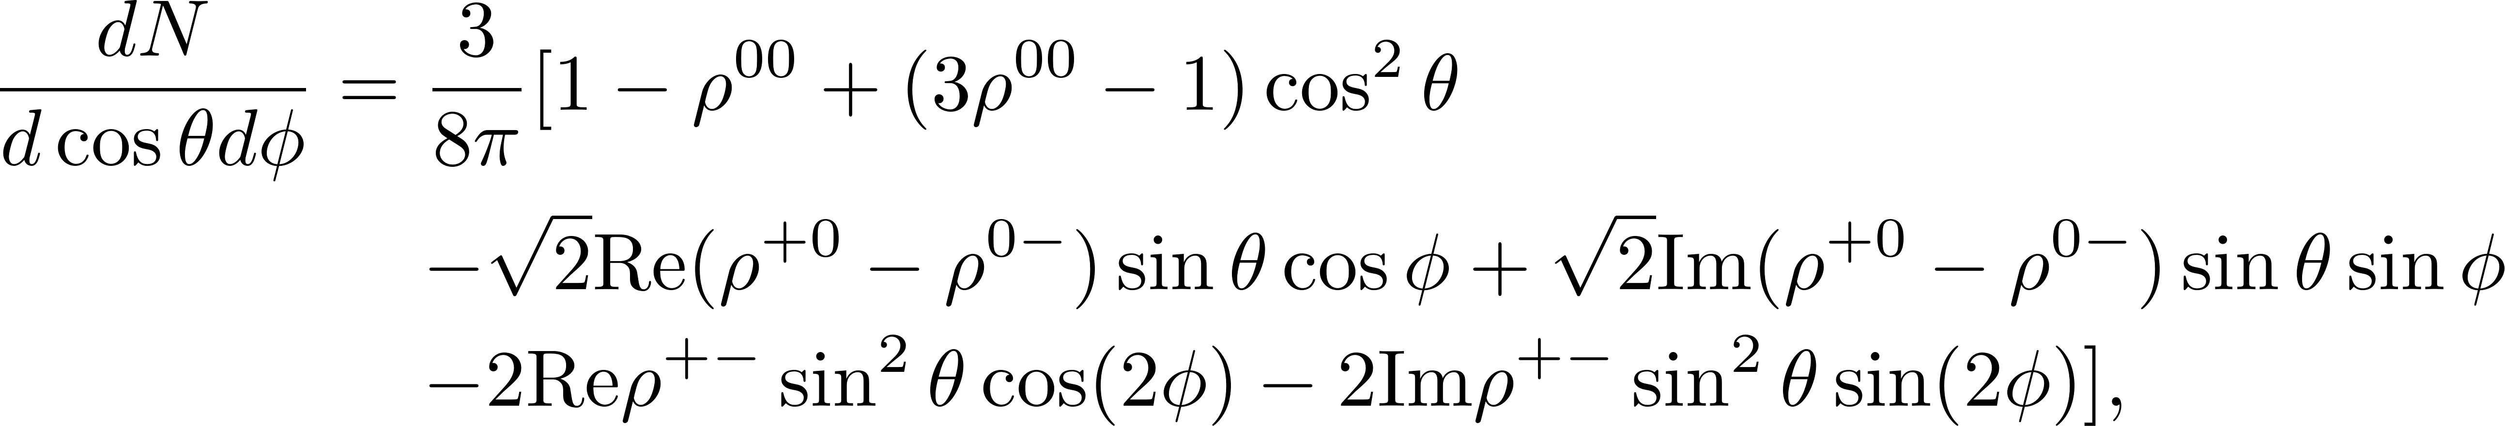
Spin density matrix up to first order
Spin density matrix up to first order, (we used )
the components of spin density matrix are
Cross section for the decay process of a vector meson into two pseudo-scalar mesons
=0

Slide 13
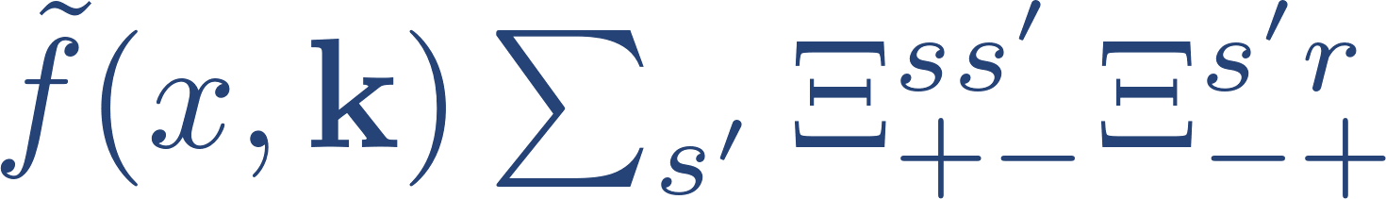
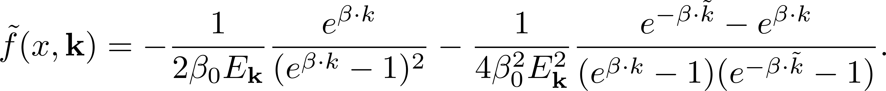
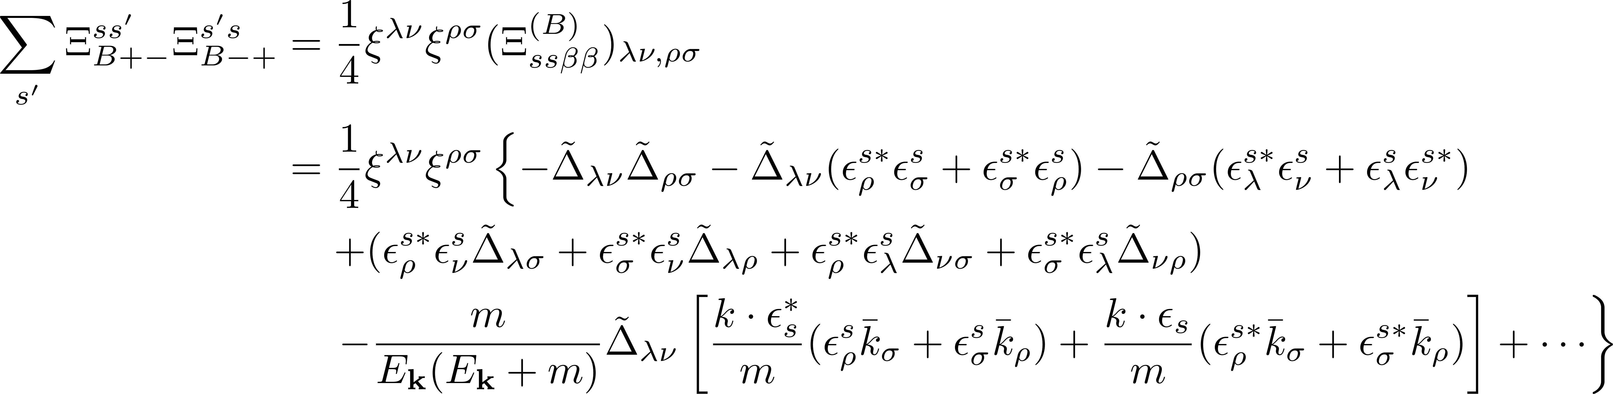

Second-order spin distribution function
The second-order spin distribution function
The $f^{\left(2\right)}(x,k)$ will cancel in $ρ_{00}$ and the third term are

Slide 14
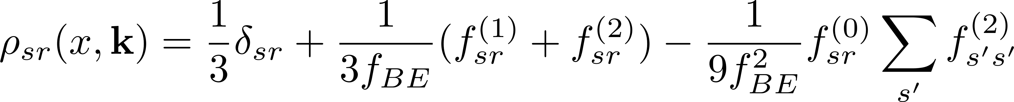
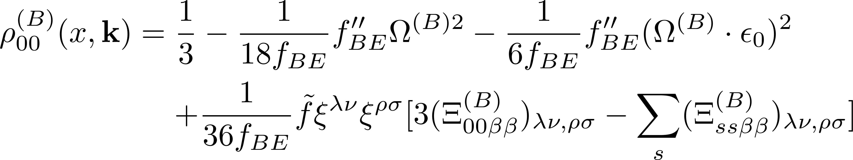

Spin density matrix up to second order
Spin density matrix up to second order, (we used )
The Belinfante form spin alignment up to second order
the $Ω_{σ}^{(B)}$ is

Slide 15
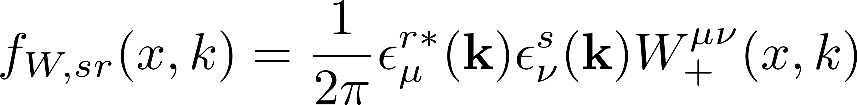
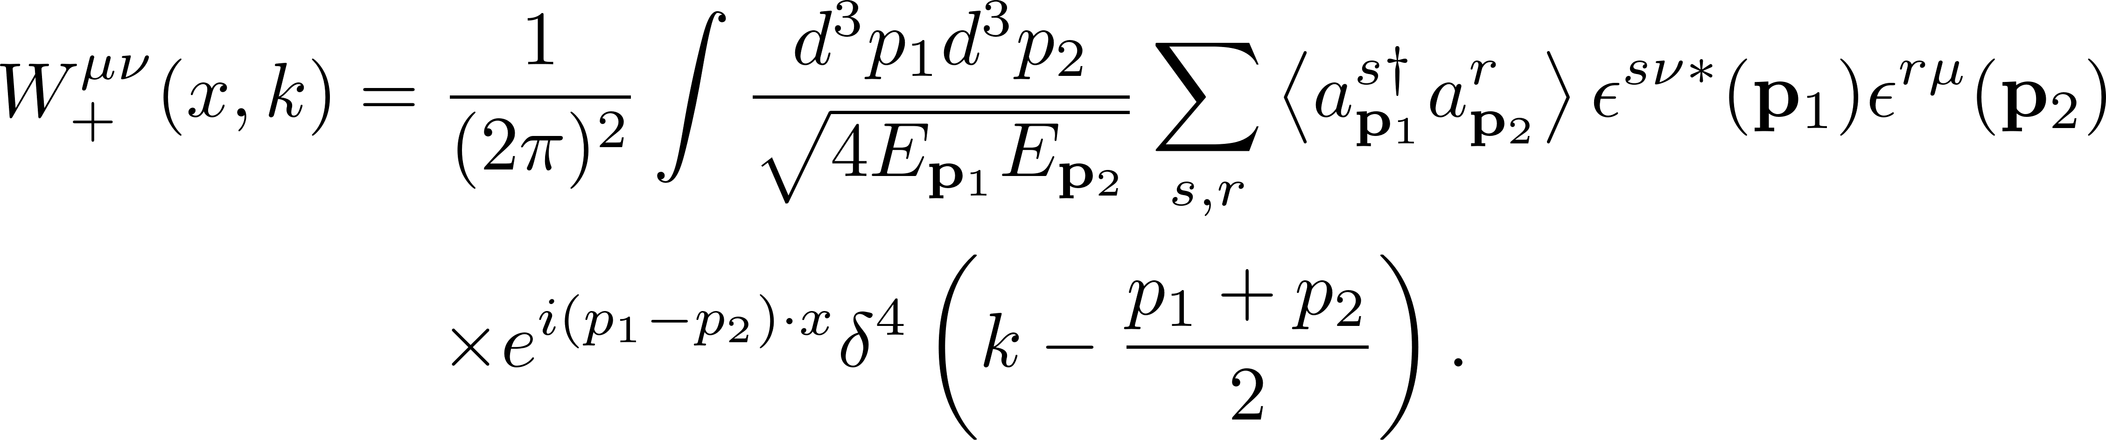
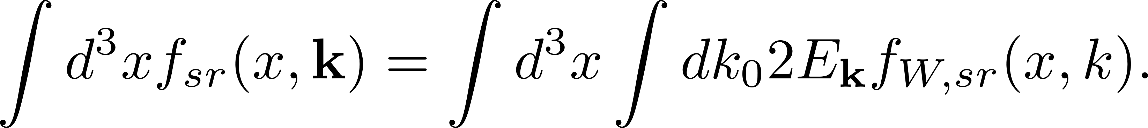
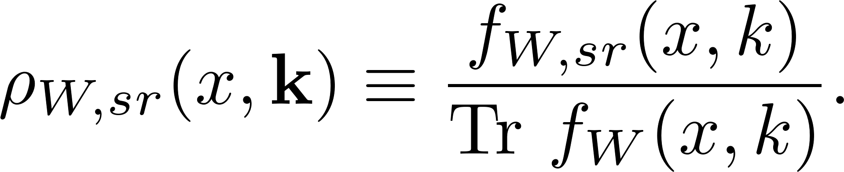

Another choice for MVSD
The alternative definition for MVSD
The $W_{+}^{μν}(x,k)$ is the positive energy part of Wigner function
After integrating over $x^{μ}$, two distribution function have relation
We can still define the spin density matrix as
Z.-H. Zhang, X.-G. Huang, F. Becattini,
X.-L. Sheng, JHEP 07, 224 (2025)

Slide 16



Spin alignment from another definition
The canonical form of spin alignment
the $Ω_{W,σ}^{(C)}$ is
Consistent with the result in Z.-H. Zhang, X.-G. Huang, F. Becattini, X.-L. Sheng, JHEP 07, 224 (2025)

Slide 17

Nonequilibrium density operator
The Nonequilibrium density operator
The entropy production
dissipative
non-dissipative
F. Becattini, M. Buzzegoli and E. Grossi, Particles 2, 197 (2019)

Slide 18


Discussion of dissipative or nondissipative
Under time reversal transformation, the quantities transform as
The spin density matrix can be parameterize as
The Wigner function can be decomposed into thermal shear tensor
From the table, we find that the transport coefficient a is T-odd, and b is T-even for $ρ_{00}$, which implies that the spin alignment induced by shear tensor in the first order of the gradient expansion is dissipative

Slide 19

Summary
1.In the first-order, we find the $ρ_{00}=1/3$ and nonzero off-diagonal components of the spin density matrix which canceled out in the cross section, yielding no observable effects at this order.
2.In the second-order, we find that
i. The $ρ_{00}$ include correction from both thermal vorticity and shear tensors.
ii. The $ρ_{00}$ is dependent on the pseudo-gauge, specifically, $ρ_{00}$ in the Belinfante
and canonical forms differ.
iii. We also compute spin density distribution using an alternative definition.
3. We discuss whether the spin alignment induced by the shear tensor is dissipative. We find that the effective coefficient for spin alignment induced by the thermal shear tensor in the first order is T-odd. It implies that such effect could be dissipative.

