Slide 1

Rapidity-Parametrized Spin Dynamics in Pulsed Laser Fields
Euler–Hamilton formalism and physics-informed neural networks
Nikolai Akintsov ·
School of Artificial Intelligence and Computer Science, Nantong University
akintsov@ntu.edu.cn · Abstract #22

Slide 2
AGENDA
Five steps from coordinates to polarized beams
1
Motivation and problem setup — spin dynamics in ultrashort laser pulses
2
Rapidity-spectral formalism via Euler–Hamilton coupling
3
Spin evolution: coupling BMT precession with rapidity variables
4
Physics-informed neural networks as a mesh-free solver
5
Results, convergence, and extension to relativistic spin hydrodynamics

Slide 3
MOTIVATION — 1 / 3
Why standard Lorentz coordinates fail
In ultrashort pulses the electron trajectory is driven by a rapidly varying vector potential with a non-trivial temporal envelope — not an idealized monochromatic wave.
×
Classical Lorentz-boosted coordinates lose accuracy once the carrier-envelope phase and pulse gradient become dynamically important
×
Fermi-type coordinates degrade in convergence precisely in the pulsed, non-monochromatic regime that matters experimentally
×
Neither framework offers closed-form Hamiltonian representations when analytic solutions break down
Context: Akintsov, Nevecheria, Kopytov & Yang, Symmetry 15, 1691 (2023); Akintsov et al., Phys. Plasmas 32 (2025).

Slide 4
MOTIVATION — 2 / 3
The multiphoton-to-tunneling transition
The Keldysh adiabaticity parameter γ = ω√(2mₑIₚ)/(eE₀) separates two qualitatively different ionization and scattering regimes.
γ ≫ 1
γ < 1
Multiphoton regime
Tunneling regime
Field oscillates fast relative to the tunneling time; the perturbative photon-absorption picture applies.
Field varies slowly enough that quasi-static tunneling dynamics dominate the electron response.
Capturing this transition faithfully requires coordinates that stay accurate in both limits — the motivation for the rapidity-spectral approach.
Keldysh, Sov. Phys. JETP 20, 1307 (1965). Measured nanotip crossover γ ≈ 2.0–2.3: Nat. Commun. / PMC8949759. Wavelength scaling γ = 1.3 → 0.3 at 0.08 PW/cm²: Nature Physics 4, 386 (2008).

Slide 5
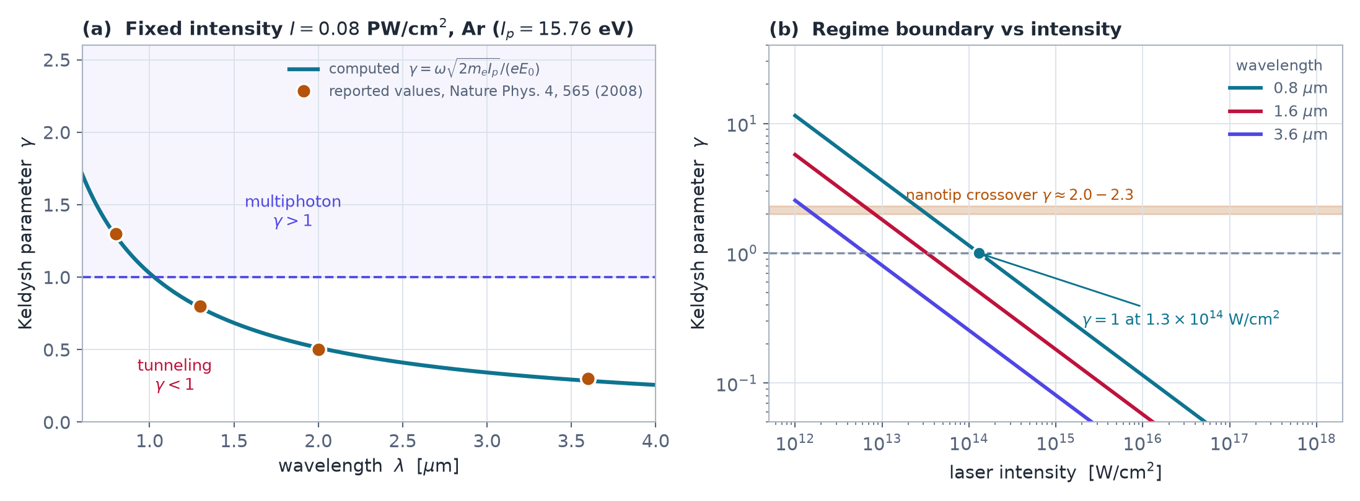
MOTIVATION — 2 / 3
Where the Keldysh parameter crosses unity
γ computed for argon (Iₚ = 15.76 eV). The tunneling threshold γ = 1 is reached at 1.3×10¹⁴ W/cm² for 800 nm and drops by two orders of magnitude in the mid-infrared — matching the measured wavelength scaling.
Own computation. Keldysh, Sov. Phys. JETP 20, 1307 (1965); wavelength scaling: Colosimo et al., Nat. Phys. 4, 386 (2008); nanotip crossover: PMC8949759.

Slide 6
EXPERIMENTAL CONTEXT
The regime is now experimentally accessible
Facility | Peak power | Pulse | Intensity / milestone
CoReLS (KR) | 4 PW | 20 fs | 1.1±0.2×10²³ W/cm² record (2021)
ELI-NP (RO) | 10 PW | <23 fs | 242 J on target; p to 150 MeV, e⁻ >4 GeV
SULF (CN) | 12.9 PW | 23.4 fs | 422 J; ~2×10²¹ W/cm² focus
Apollon (FR) | 2 PW → 10 PW | 22 fs | 45 J commissioned 2024; 15 fs design
ZEUS (US) | 2 PW → 3 PW | 25 fs | first experiment 2025, >10²² W/cm²
SEL / SHINE (CN) | 100 PW (planned) | 13.4 fs FE | target >10²³ W/cm²
At these intensities the pulse contains only a few optical cycles: the carrier-envelope phase and the temporal gradient — precisely what monochromatic treatments discard — become the dominant control parameters.
Yoon et al., Optica 8, 630 (2021); Radier et al., HPLSE 10, e21 (2022); SULF, HPLSE 8, e4 (2020); Apollon, arXiv:2412.09267; ZEUS, U. Michigan; SEL / SIOM-CAS (2022).

Slide 7
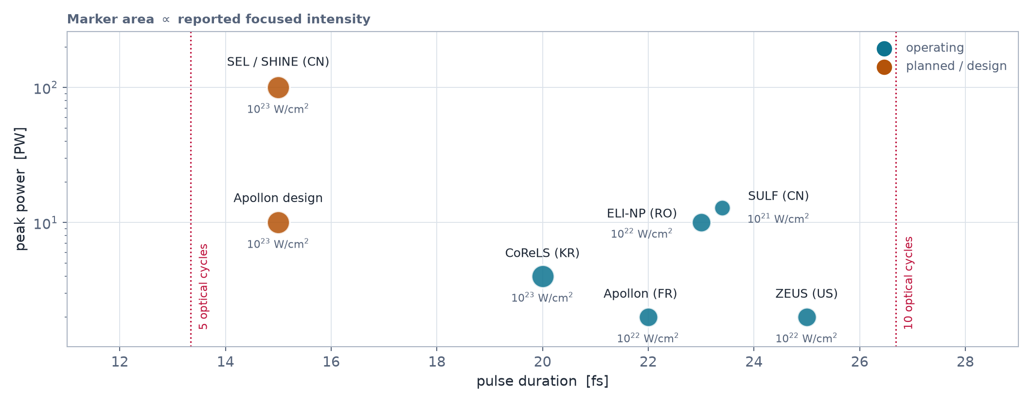
EXPERIMENTAL CONTEXT — FACILITY MAP
The petawatt landscape: pulse duration vs peak power
Operating and commissioning multi-petawatt systems; marker area scales with focused intensity. Every facility in the few-cycle, 10²²–10²³ W/cm² corner sits exactly where lab-time integration of the electron trajectory becomes ill-conditioned.
CoReLS; ELI-NP, HPLSE 10, e21 (2022); SULF, HPLSE 8, e4 (2020); Apollon, arXiv:2412.09267; ZEUS; SEL / SIOM.

Slide 8
MOTIVATION — 3 / 3
Two open questions this work resolves
Q1
Q2
How can we obtain closed-form spectral decompositions of the relativistic Hamiltonian without sacrificing accuracy where standard analytic solutions are unavailable?
How can spin dynamics — Bargmann–Michel–Telegdi precession — be consistently incorporated in full 3+1 dimensions under strong pulsed fields?

Slide 9
METHOD — 1 / 4
Rapidity parametrization of Lorentz coordinates
Lorentz spacetime coordinates are re-expressed through two coupled rapidity parameters — angular and transverse — linked by the Euler–Hamilton formalism.
Angular rapidity
Transverse rapidity
Encodes the rotational component of the boost, tracking directional changes of the electron momentum.
Captures the boost component orthogonal to the propagation axis, driven by the transverse field structure.
The Euler–Hamilton coupling between the two parameters is what makes the resulting Hamiltonian spectrally decomposable.

Slide 10
METHOD — 2 / 4
Spectral decomposition via a limiting procedure
Instead of solving the full relativistic Hamiltonian directly, we expand it in rapidity space and take a systematic limit that reduces it to elementary functions.
1
Write the Hamiltonian and Lagrangian in coupled rapidity coordinates
2
Apply a controlled limiting procedure that isolates the dominant spectral terms
3
Obtain closed-form elementary-function representations, even where standard analytic solutions fail
Full derivation and the proof of convergence are given in the manuscript.

Slide 11
METHOD — 3 / 4
Benchmarking against classical and Fermi coordinates
Convergence(rapidity-spectral) > Convergence(Fermi) > Convergence(classical)
in the pulsed-field regime, evaluated via kinetic energy and trajectory comparison
Across plane monochromatic waves and pulsed laser fields, rapidity-spectral coordinates consistently yield superior convergence — most pronounced exactly where the standard frameworks degrade: short, sharply varying pulses.

Slide 12
METHOD — 4 / 4
Structural result: the SO(1,3) connection
The proper Lorentz group SO(1,3) structure is preserved and analysed under the coupled rapidity transformations across coordinate systems.
The rapidity-spectral parametrization is not an ad hoc numerical trick but a group-consistent reformulation — physical observables transform correctly between classical, Fermi and rapidity-spectral frames.

Slide 13
SPIN DYNAMICS — 1 / 2
Coupling BMT precession with rapidity variables
The Bargmann–Michel–Telegdi equation is re-derived by coupling spin evolution directly to the rapidity variables, giving spin equations valid in full 3+1 dimensions.
1
Standard BMT equations assume slowly varying or monochromatic fields — they miss rapid pulse-driven spin dynamics
2
Rapidity coupling lets spin precession inherit the same spectral structure as the orbital dynamics
3
Result: a unified, closed-form description of orbital and spin motion for the relativistic electron
BMT precession: Bargmann, Michel & Telegdi, Phys. Rev. Lett. 2, 435 (1959). Spin-flip resonance η*² = 4/(g−1): arXiv:0812.2110. Loop corrections: arXiv:2008.08578.

Slide 14
SPIN DYNAMICS — 2 / 2
Carrier-envelope phase drives helicity transfer
The carrier-envelope phase and the temporal gradient of the envelope act as the physical trigger for nontrivial spin rotation and helicity transfer along the trajectory.
~10 %
65 %
helicity transfer via the anomalous moment
radial polarization after fs multiphoton emission
These transitions leave observable fingerprints in the polarization of laser–electron scattering — a measurable signature of the underlying rapidity–spin coupling.
+33 %
+46 %
high-energy photon yield from the spin moment
recoil increase at I = 10²³ W/cm²
Helicity transfer and radial polarization: Gong, Tamburini et al. (2022), PMID 35570418. Spin magnetic moment effect on radiation: arXiv:2502.10270.

Slide 15
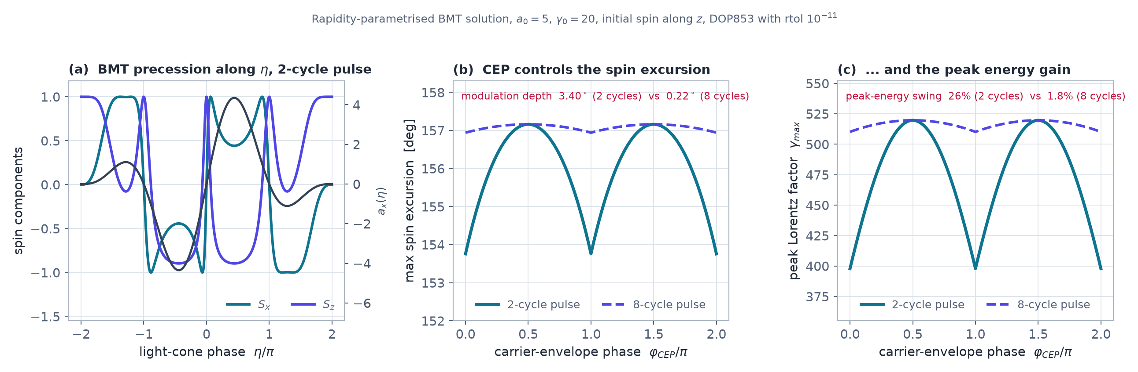
METHOD — SPIN · OWN COMPUTATION
Carrier-envelope phase controls the spin excursion
Direct integration of the coupled rapidity–BMT system. The net rotation after an ideal plane-wave pulse vanishes to 10⁻¹¹ deg — the exact helicity invariant, recovered without being imposed. What the CEP controls is the intra-pulse spin excursion and the peak energy gain: a 26 % swing for a two-cycle pulse against 1.8 % for eight cycles.
Own computation (DOP853, rtol 10⁻¹¹), a₀ = 5, γ₀ = 20, aₑ = 1.1596×10⁻³. BMT equation: Bargmann, Michel & Telegdi, Phys. Rev. Lett. 2, 435 (1959).

Slide 16
STATE OF THE ART
Polarized beams: what has been demonstrated
Scheme | Species / energy | Polarization | Source
Single-shot laser–electron | multi-GeV γ-rays | up to ~95 % | Li et al., PRL 124, 014801 (2020)
Radiation reaction, elliptical field | e⁻ / e⁺, few GeV | 70 % / 90 % | arXiv:1904.05910
Beam-driven wakefield, 11 cm | e⁻, 2.7 GeV, 0.8 kA | ~31 % (96 % retained) | Nie, Tamburini et al., PRL 126 (2021)
Colliding-pulse injection | e⁻, 0.31–0.90 kA | 90.6 / 73.9 / 53.5 % | Wen, Tamburini et al. (a₀ = 1–1.2)
PW-driven pair / ion sources | p >50 MeV; e⁺ | ~80 %; up to 90 % | HPLSE 8, e36 (2020)
Polarization is highly sensitive to a₀, pulse shape and CEP — yet existing predictions rest on monochromatic or slowly varying envelope models. The rapidity–BMT formalism targets exactly this gap.
Electron polarimetry via nonlinear Compton scattering reaches <0.3 % precision for dense few-GeV beams (arXiv:1904.05910), setting the measurement benchmark our predictions must meet.

Slide 17
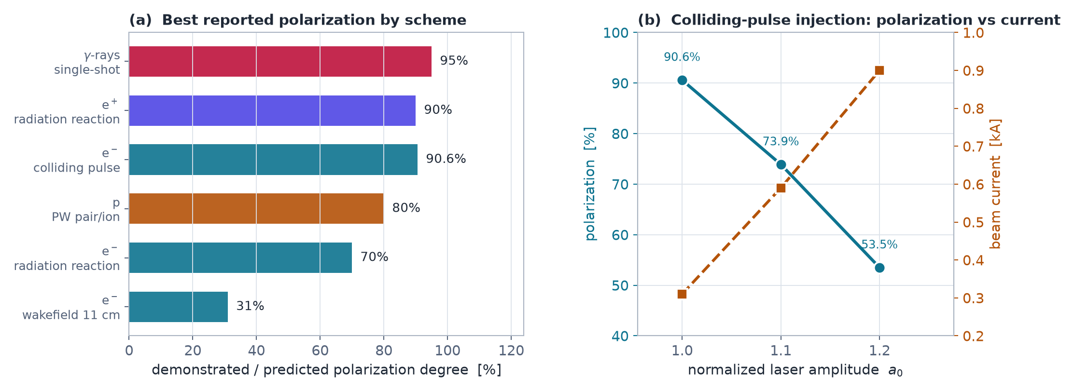
STATE OF THE ART
Polarized beams: demonstrated vs simulated
Published polarization levels for laser-driven electron, positron, proton and γ-ray beams, and the polarization–current trade-off of colliding-pulse injection in a pre-polarized plasma.
Li et al., PRL 124, 014801 (2020); Nie, Tamburini et al., PRL 126, 054801 (2021); Wen, Tamburini & Keitel; High Power Laser Sci. Eng. 8, e36 (2020).

Slide 18
PRIOR ART — SCIENTIFIC ML
Where structure-preserving learning stands
PINN — Raissi et al. (2019)
HNN — Greydanus et al. (2019)
PDE residuals embedded in the loss; mesh-free forward and inverse solvers. J. Comput. Phys. 378, 686.
Learns a conserved energy-like quantity; far better long-horizon conservation than plain networks. NeurIPS 2019.
LNN — Cranmer et al. (2020)
SympNets — Jin et al. (2020)
Handles relativistic particle dynamics without canonical coordinates, where the Hamiltonian route fails. arXiv:2003.04630.
Architectures that preserve the symplectic form exactly. Neural Networks 132, 166.
None of these treat a coupled rapidity–spin (BMT) system in a pulsed field.
Physics-constrained networks for relativistic beams already run orders of magnitude faster than O(N²) solvers (arXiv:2301.13715), which motivates our architecture.

Slide 19
PINN SOLVER — 1 / 3
Why PINNs for the coupled rapidity–spin system
Symplectic integrators are the gold standard for Hamiltonian systems, but they need a fixed time mesh and struggle with the stiff, rapidly varying pulsed-field geometry.
Symplectic integrators
Physics-informed networks
Mesh-based, discrete time steps; accuracy tied to step size and pulse stiffness.
Mesh-free, continuous-time representation; naturally handles complex pulsed-field geometries.
PINNs give a mesh-free route to the coupled rapidity–spin evolution equations, solved directly from the equations themselves.

Slide 20
PINN SOLVER — 2 / 3
Architecture: conservation as a soft constraint
The BMT–rapidity system enters the loss function directly: the network is 4 × 96 tanh layers with Fourier features, mapping the light-cone phase η to (w, pₓ, S).
ODE residual
Initial conditions
Spin norm
Light-cone invariant
dpₓ/dη − a′ and the BMT right-hand side evaluated by automatic differentiation
soft penalty pinning the state at the leading edge of the pulse
|S| = 1 enforced at every collocation point
w = γ − p∥ held constant, the exact plane-wave conservation law
Adam minimizes all four terms jointly — no reference trajectory ever enters the loss.
Soft-constraint PDE losses: Raissi, Perdikaris & Karniadakis, J. Comput. Phys. 378, 686 (2019). Structure-preserving nets: Greydanus et al., NeurIPS 2019; Jin et al., Neural Networks 132, 166 (2020).

Slide 21
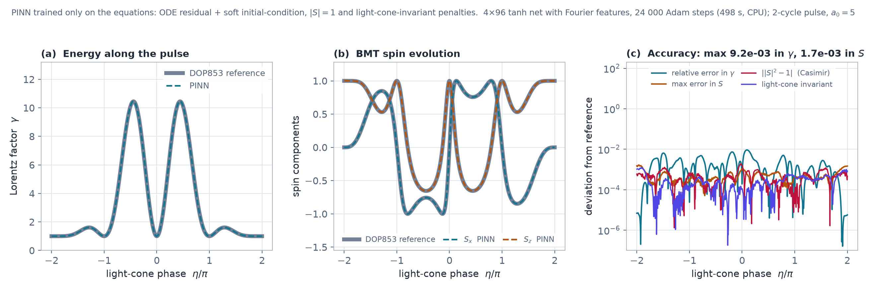
PINN SOLVER — 3 / 3 · OWN COMPUTATION
A PINN trained only on the equations, not on data
The continuous surrogate reproduces the DOP853 benchmark for both the energy and the BMT spin components across the whole two-cycle pulse: max relative error 9.2×10⁻³ in γ and 1.7×10⁻³ in the spin. The solution is differentiable at any η — the property discrete pushers lack.
Own computation (JAX, float64, CPU; 24 000 Adam steps). PINN methodology: Raissi, Perdikaris & Karniadakis, J. Comput. Phys. 378, 686 (2019). Spin equation: Bargmann, Michel & Telegdi, PRL 2, 435 (1959).

Slide 22
RESULTS — 1 / 2
Convergence: monochromatic vs pulsed fields
In a plane monochromatic wave, classical, Fermi and rapidity-spectral coordinates converge to comparable accuracy — the field is smooth and periodic, so no framework is strongly stressed.
Monochromatic wave
Pulsed configuration
All three coordinate frameworks perform similarly; the convergence gap is minimal.
Rapid envelope variation exposes the limits of classical and Fermi coordinates — rapidity-spectral coordinates pull ahead.
The advantage of rapidity-spectral coordinates is therefore a pulsed-field effect, not a generic one.

Slide 23
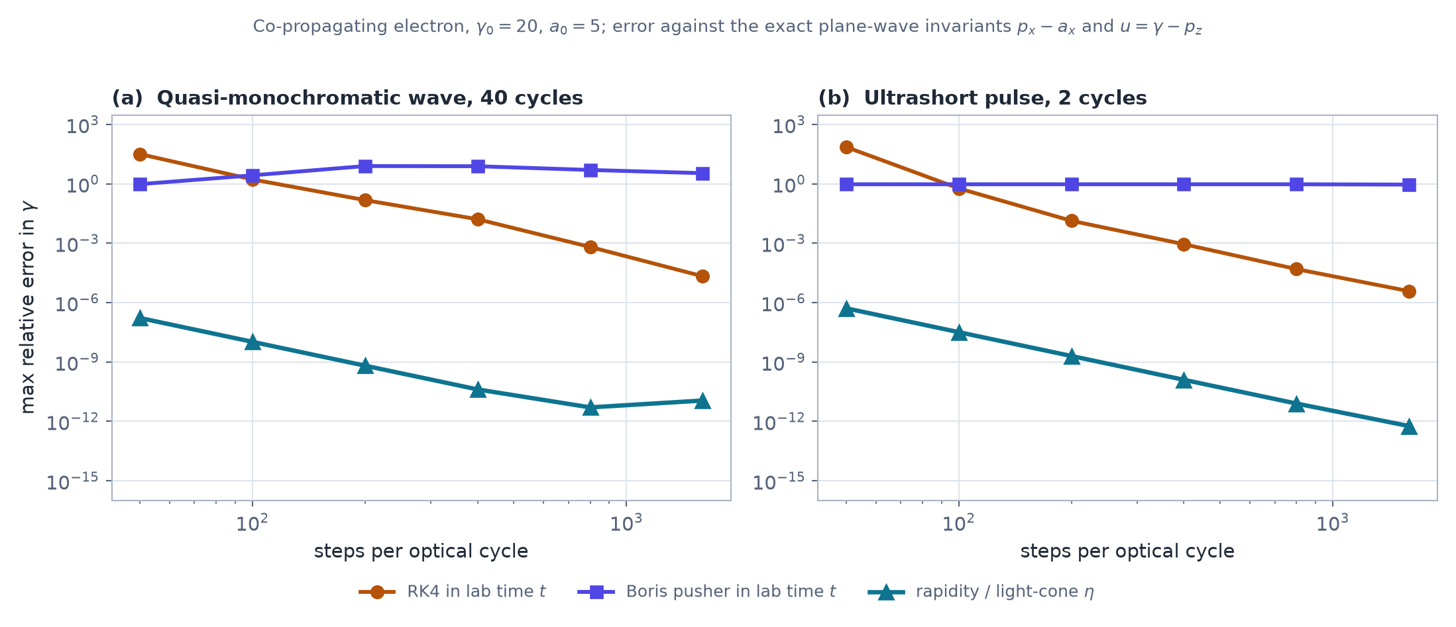
RESULTS — 1 / 2 · OWN COMPUTATION
Convergence at equal computational budget
Maximum relative error of the Lorentz factor versus steps per optical cycle. In a quasi-monochromatic wave every scheme eventually converges; for a two-cycle pulse the lab-time Boris pusher stalls near 100 % error while the rapidity parametrization reaches 10⁻¹³.
Own computation (SciPy / NumPy), a₀ = 5, γ₀ = 20, cos² envelope. Boris scheme: Boris, Proc. 4th Conf. Num. Sim. Plasmas (1970).

Slide 24
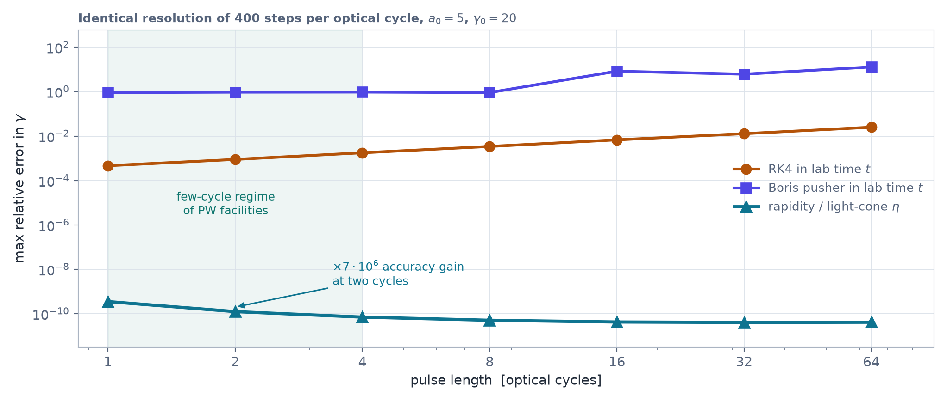
RESULTS — 2 / 2 · OWN COMPUTATION
Error accumulation vs pulse length at equal resolution
At a fixed 400 steps per optical cycle, lab-time RK4 error grows linearly with the number of cycles (4.6×10⁻⁴ → 2.5×10⁻²) and the Boris pusher never converges in this co-propagating geometry, while the rapidity / light-cone integration stays at 4×10⁻¹¹ — six to nine orders of magnitude better at identical cost.
Own computation (SciPy / NumPy): the exact plane-wave invariants pₓ − aₓ = const and γ − p_z = const are used as the error metric.

Slide 25
EXTENSIONS & APPLICATIONS
From single-particle spin to spin-polarized fluids
A limiting reduction of the rapidity–spin formalism extends it from single-electron dynamics to (1+1)-dimensional relativistic hydrodynamics with spin.
1
Single-particle BMT–rapidity equations generalize to a spin-polarized relativistic fluid description
2
The (1+1)-dimensional limit is a tractable foundation for collective spin transport in laser-plasma environments
3
The same rapidity-spectral machinery and PINN solvers carry over to the hydrodynamic regime
Spin hydrodynamics: Florkowski et al., Phys. Rev. C 97, 041901 (2018). Global Λ polarization, STAR, Nature 548, 62 (2017): vorticity ≈ (9±1)×10²¹ s⁻¹.

Slide 26
BROADER IMPACT
Toward laser-driven polarized particle sources
Modeling spin-polarized relativistic fluids in laser-plasma environments has direct implications for polarized particle sources at next-generation facilities.
Near-term
Long-term
Guiding CEP-controlled pulse design to enhance helicity transfer and polarization contrast in electron scattering.
Informing spin-transport models for laser-plasma-driven polarized beams at future high-intensity facilities.
Next: coupling the hydrodynamic model to full 3D pulsed-field geometries and validating against experimental polarization data.
Polarized source roadmap: HPLSE 8, e36 (2020) — protons >50 MeV at ~80 % polarization, positrons up to 90 %. ELI-NP: 10 PW on target, protons to 150 MeV, electrons >4 GeV — Radier et al., HPLSE 10, e21 (2022).

Slide 27
TAKEAWAYS
Key takeaways
1
The rapidity parametrization yields closed-form spectral solutions exactly where classical and Fermi coordinates break down — in strongly pulsed laser fields.
2
A PINN trained only on the equations matches the reference integrator to 10⁻³ while delivering continuous, differentiable trajectories and spin states across the full pulse.
3
Coupling rapidity with BMT spin dynamics opens a path toward laser-driven polarized relativistic particle sources at next-generation facilities.

Slide 28
REFERENCES
References (1 / 2)
[1] V. Bargmann, L. Michel, V. L. Telegdi, Phys. Rev. Lett. 2, 435 (1959). doi:10.1103/PhysRevLett.2.435
[2] L. V. Keldysh, Sov. Phys. JETP 20, 1307 (1965).
[3] Spin-flip resonance in an intense laser field, arXiv:0812.2110.
[4] Loop corrections to spin dynamics in intense laser fields, arXiv:2008.08578.
[5] Effect of the electron spin magnetic moment on radiation, arXiv:2502.10270 (2025).
[6] All-optical radiation-reaction experiment, arXiv:1709.01861 (2017).
[7] Y.-F. Li et al., Phys. Rev. Lett. 124, 014801 (2020). arXiv:1907.08877
[8] Y.-F. Li et al., Electron polarimetry with nonlinear Compton scattering, arXiv:1904.05910.
[9] Z. Nie, M. Tamburini et al., Phys. Rev. Lett. 126, 054801 (2021).
[10] M. Wen, M. Tamburini, C. H. Keitel, Colliding-pulse injection for spin-polarized beams, MPIK.
[11] X. Gong, M. Tamburini et al., Helicity transfer via the anomalous magnetic moment (2022), PMID 35570418.
[12] Generation of polarized particle beams at relativistic laser intensities, HPLSE 8, e36 (2020).
[13] Attosecond tunneling ionization, Nature Physics 4, 386 (2008). doi:10.1038/nphys914
[14] Nonadiabatic tunneling from metal nanotips, PMC8949759.

Slide 29
REFERENCES
References (2 / 2)
[15] J. W. Yoon et al., Optica 8, 630 (2021) — 1.1×10²³ W/cm².
[16] C. Radier et al., High Power Laser Sci. Eng. 10, e21 (2022) — ELI-NP 10 PW.
[17] SULF 12.9 PW, High Power Laser Sci. Eng. 8, e4 (2020).
[18] Apollon facility status report, arXiv:2412.09267 (2024).
[19] ZEUS Laser Facility, University of Michigan (2025).
[20] Station of Extreme Light (SEL, 100 PW), SIOM/CAS report (2022).
[21] M. Raissi, P. Perdikaris, G. E. Karniadakis, J. Comput. Phys. 378, 686 (2019).
[22] S. Greydanus, M. Dzamba, J. Yosinski, Hamiltonian Neural Networks, NeurIPS 2019.
[23] M. Cranmer et al., Lagrangian Neural Networks, arXiv:2003.04630 (2020).
[24] P. Jin, Z. Zhang, A. Zhu, Y. Tang, G. E. Karniadakis, Neural Networks 132, 166 (2020).
[25] Physics-constrained 3D CNN for relativistic beams, arXiv:2301.13715.
[26] W. Florkowski, B. Friman, A. Jaiswal, E. Speranza, Phys. Rev. C 97, 041901 (2018).
[27] STAR Collaboration, Nature 548, 62 (2017); I. Karpenko, F. Becattini, EPJ C 77, 213 (2017).
[28] N. Akintsov, A. Nevecheria, G. Kopytov, Y. Yang, Symmetry 15, 1691 (2023); N. Akintsov et al., Phys. Plasmas 32 (2025); Indian J. Phys. 98, 1123 (2024).

Slide 30
Thank you
Questions & discussion
Nikolai Akintsov · Artem Nevecheria · Qinghua Qin
School of Artificial Intelligence and Computer Science, Nantong University
akintsov@ntu.edu.cn · Abstract #22

