Slide 1

NLO corrections to nucleon
axial-vector form factors
An extension of the Dirac form factors work: Phys.Rev.Lett. 135 (2025) 13, 131903
Hard exclusive nucleon structure at large momentum transfer
Yang Liu – Institute of High Energy Physics, Chinese Academy of Sciences
In collaboration with Feng Feng, Yu Jia, Jichen Pan
Paper in preparation

Slide 2
Outline
Background and motivation
Calculation techniques
Recap of the Dirac results
Two-loop renormalization group evolution
Preliminary axial results
2

Slide 3
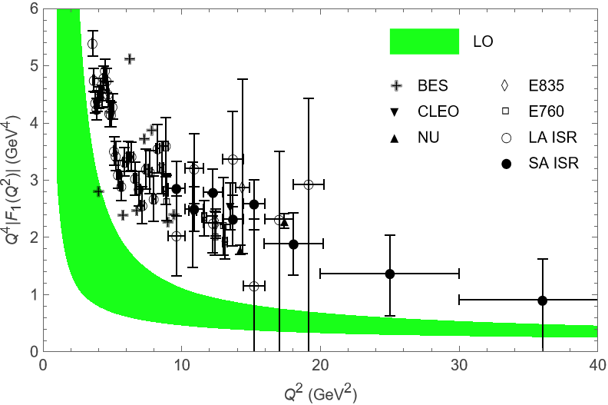
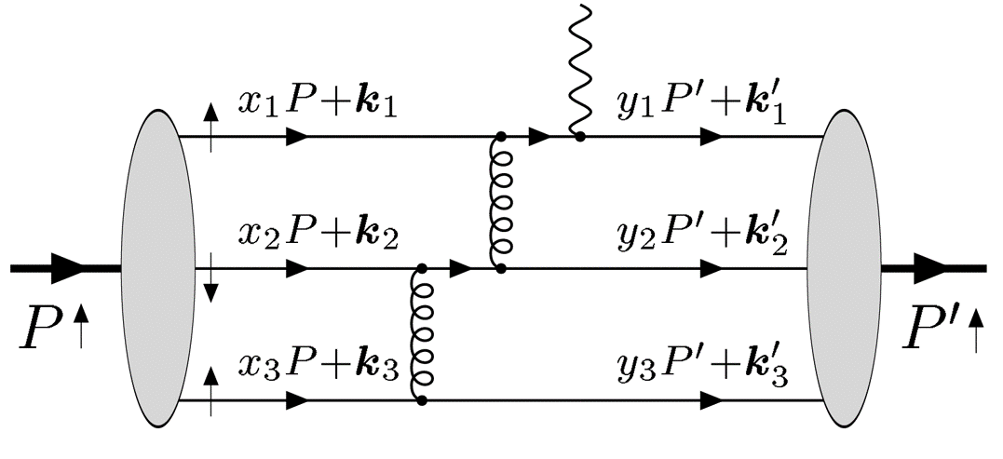
BACKGROUND
N. G. Stefanis and M. Bergmann Phys.Rev.D 47 (1993) R3685-R3689
Why form factors?
Electromagnetic current
Charge and magnetization distributions inside the nucleon.
Axial current
Spin/isovector weak structure, essential for neutrino and β-decay physics.
3

Slide 4
OBSERVABLES
Helicity-conserving form factors are studied most
F₁
helicity conserving
~ 1 / Q⁴ asymptotically
F₂
helicity flipping
~ 1 / Q⁶ asymptotically
G_{A}
G_{P}
4

Slide 5
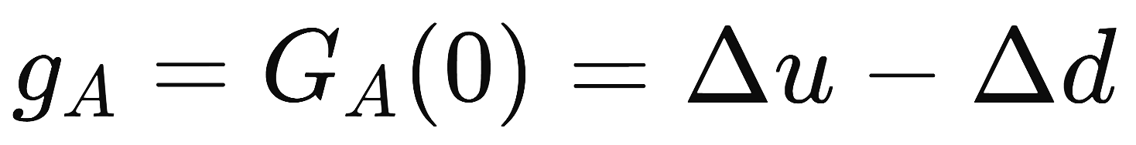
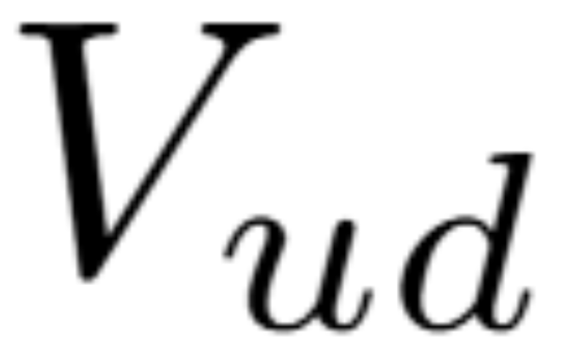
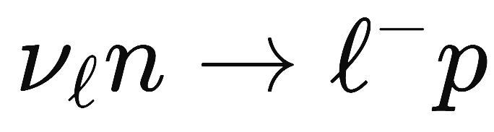
OBSERVABLES
Axial form factors help understand weak force
Connects low-energy weak decay with the spin-flavor structure of the nucleon
Required in analyses of the neutron lifetime
Can be used to test first-row CKM unitarity
One of the dominant free-nucleon uncertainties in
neutrino-energy reconstruction
event classification in oscillation experiments
extraction of neutrino mixing parameters and leptonic CP violation
5

Slide 6
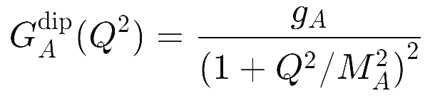

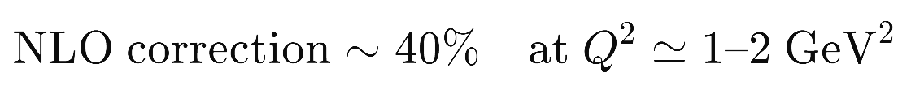
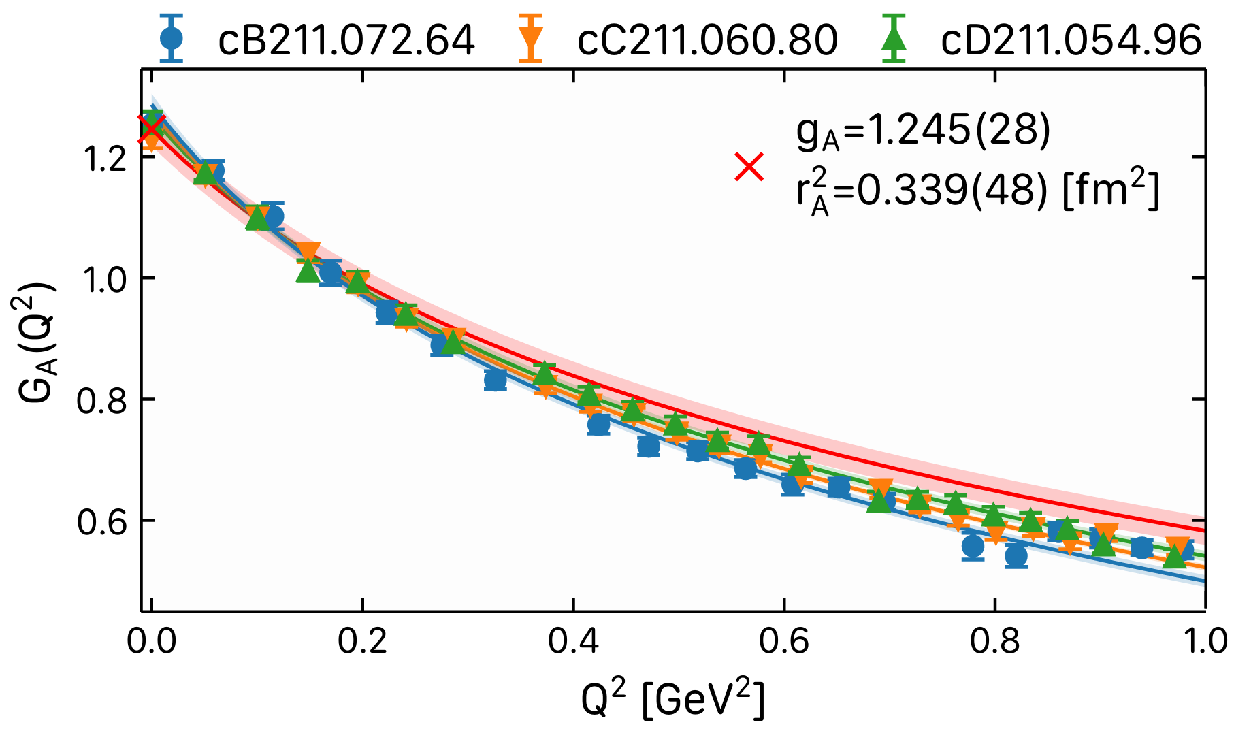
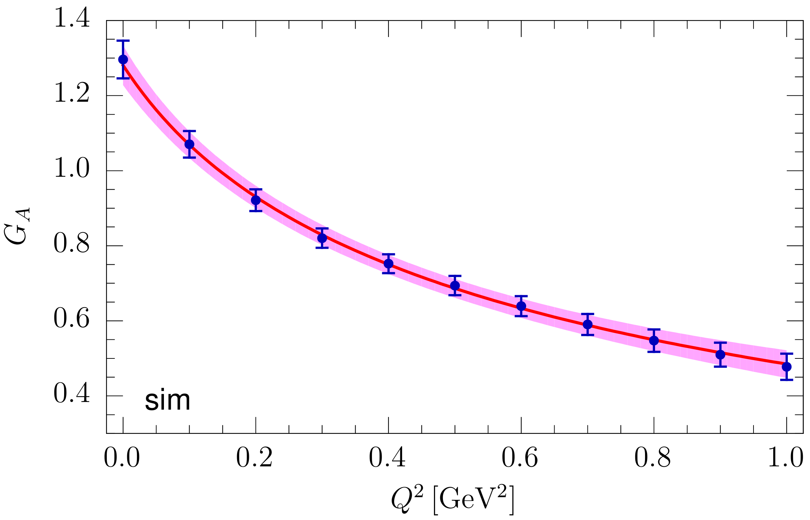
OBSERVABLES
Axial form factors help understand weak force
Phys.Rev.D 110 (2024) 3, 030001
Leading-order calculations
S. J. Brodsky, G. P. Lepage and S. A. A. Zaidi
Phys.Rev.D 23 (1981) 1152
C. E. Carlson and J. L. Poor
Phys.Rev.D 34 (1986) 1478
Further attempts
I. V. Anikin, V. M. Braun and N. Offen
Phys.Rev.D 94 (2016) 3, 034011
X. Y. Liu, A. Limphirat, K. Xu, Z. Zhao, K. Khosonthongkee and Y. Yan
Phys.Rev.D 107 (2023) 7, 074006
C. Chen and C. D. Roberts
Eur.Phys.J.A 58 (2022) 10, 206
Lattice QCD
PoS LATTICE2024 (2025) 346
Phys.Rev.D 109 (2024) 1, 014503
6

Slide 7
HISTORY
A nearly 50-year gap bridged
1977–80
2025
2026
LO scattering kernel
for nucleon F₁
First complete NLO
Dirac hard kernel
First two-loop
nucleon-DA RGE
L. B. Chen, W. Chen, F. Feng, S. Hu and Y. Jia
Phys.Rev.Lett. 135 (2025) 13, 131903
Y. K. Huang, B. X. Shi, Y. M. Wang and X. C. Zhao
Phys.Rev.Lett. 135 (2025) 6, 061901
Y. K. Huang, Y. Ji, B. X. Shi and Y. M. Wang
2512.20471 [hep-ph]
NLO is positive and substantial
But some gaps still exist
Across different DA models and energy scales, the NLO hard contribution is positive and substantial.
With modern lattice DAs, the leading-power hard contribution remains well below the measured data.
7

Slide 8
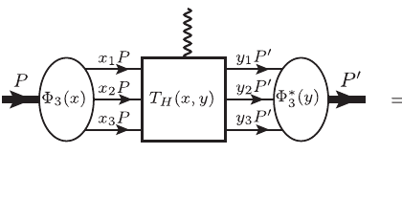
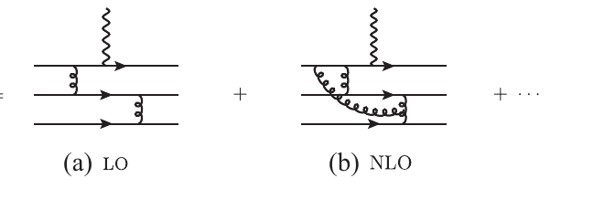
FACTORIZATION
Collinear factorization separates the scales
DA ⊗ hard kernel ⊗ DA
LO: αₛ² | NLO: αₛ³
universal
process specific
universal
Two hard gluons distribute the large momentum among three valence quarks, so the form factor begins at αₛ² / Q⁴.
8

Slide 9
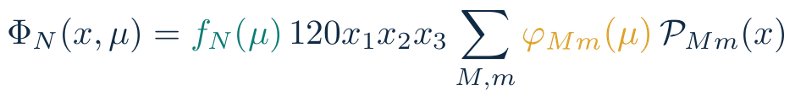



DISTRIBUTION AMPLITUDE
DA expanded in orthogonal polynomials
Normalization
Shape moments
Evolution
Sets the overall hard amplitude; the form factor scales with its square.
Encodes asymmetry and higher conformal waves; DA models diverge here.
Resums collinear logs and evolves the DA to other scales.
9

Slide 10
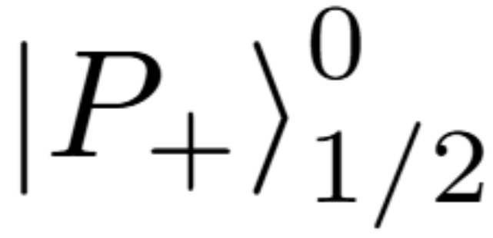
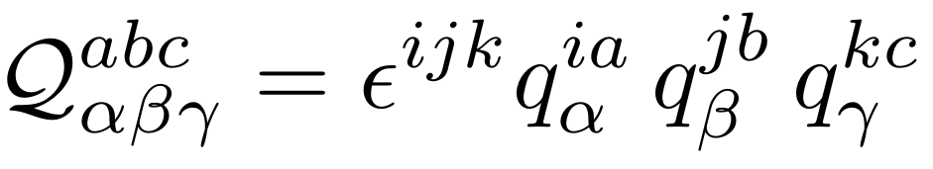
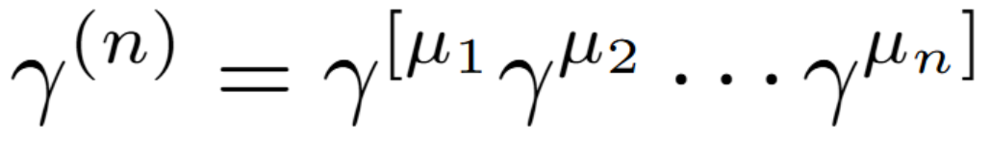
HARD SCATTERING KERNEL
Scattering kernel oblivious of long distances
Substitute the free, collinear three-quark states for the complex nucleon states
Use antisymmetric Dirac basis
10

Slide 11
RENORMALIZATION PROBLEM
Evanescent operators leave finite remnants
M. J. Dugan and B. Grinstein
Phys.Lett.B 256 (1991) 239-244
d = 4 - 2ε
physical + evanescent operators mix
O(ε)
x
1 / ε
=
finite
Four-dimensional Fierz identities cannot be imposed on bare d-dimensional operators.
Evanescent contributions can be removed by finite renormalization.
11

Slide 12

ANOTHER WAY OUT
Kränkl and Manashov’s clever trick
S. Krankl and A. Manashov
Phys.Lett.B 703 (2011) 519-523
1
2
3
Keep spinor
indices open
Renormalize the open-index
operator in d dimensions
Do the Dirac algebra
Evanescent operators vanish in 4d.
Quark flavor structure is irrelevant in determining the renormalization factors.
Renormalized Fierz identities are preserved.
12

Slide 13
CALCULATION
The one-loop factorization checks out
48
2040
~100
2
tree diagrams
one-loop diagrams
master integrals
independent evaluation routes
✓
LO recovered
✓
UV poles removed by renormalization
Tools:
HepLib: Comput.Phys.Commun. 285 (2023) 108631
Apart: Comput.Phys.Commun. 183 (2012) 2158-2164
FIRE: Comput.Phys.Commun. 302 (2024) 109261
PolyLogTools: JHEP 08 (2019) 135
✓
IR poles cancel pointwise by matching
✓
analytic ↔ 100-digit numerical check
Result: a pointwise IR-finite analytical hard kernel
13

Slide 14
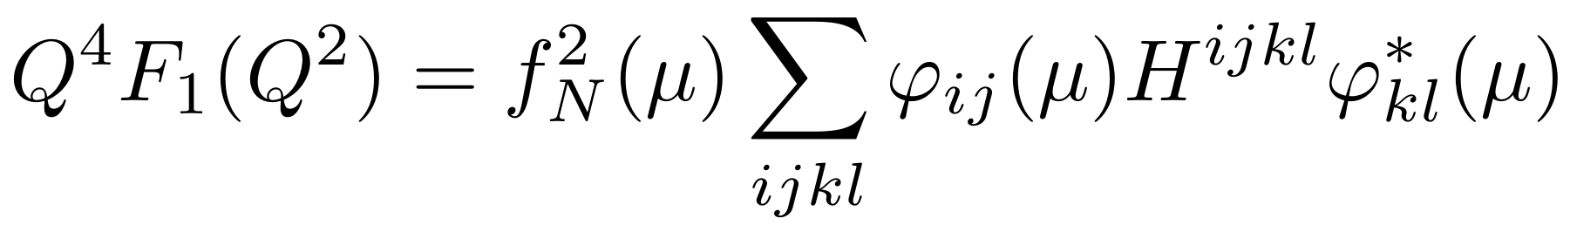

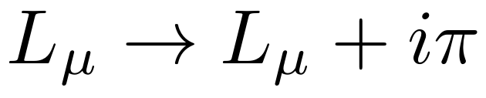
PHENOMENOLOGY
One formula organizes scales and models
neutron
exchange up- and down-quark charges
timelike
14

Slide 15
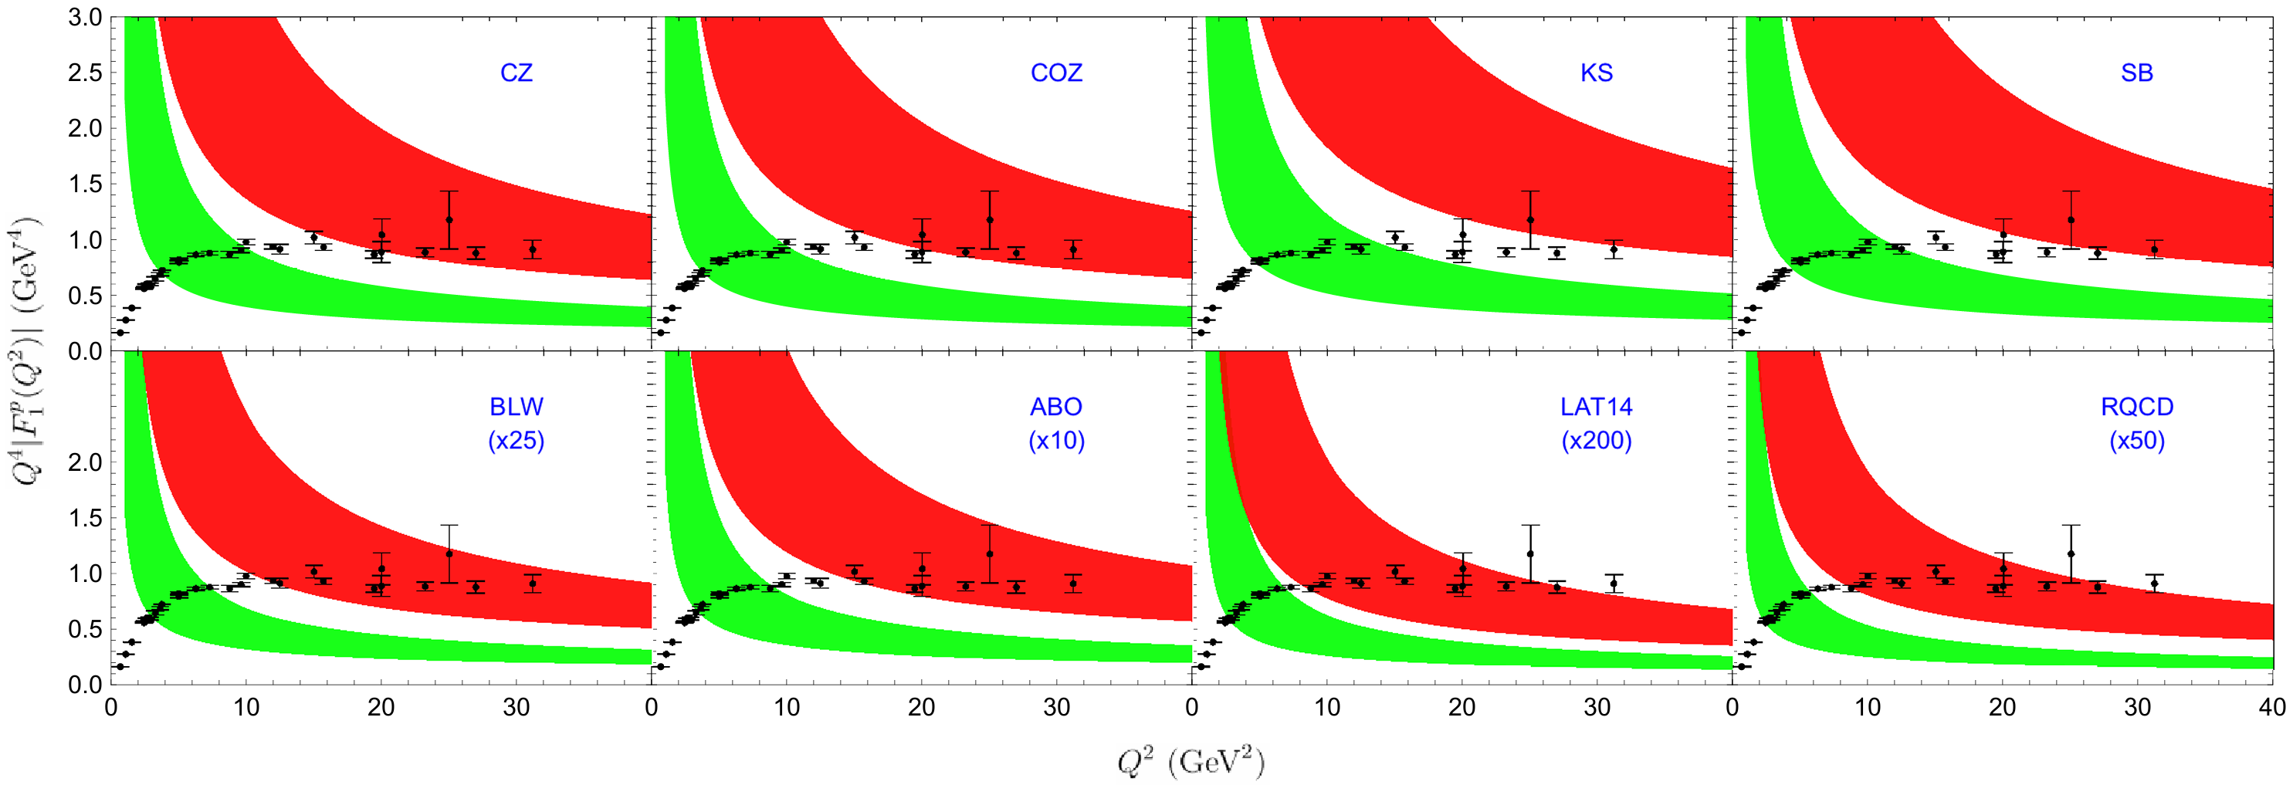
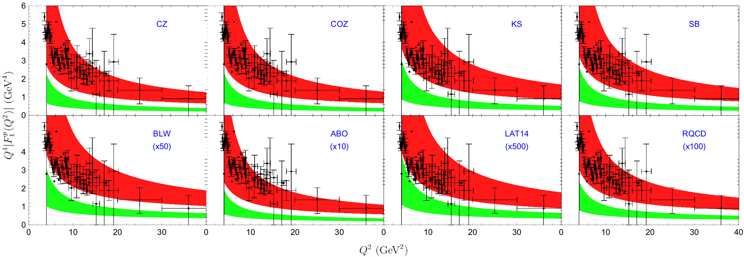
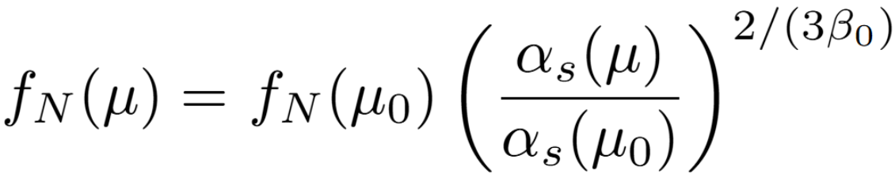
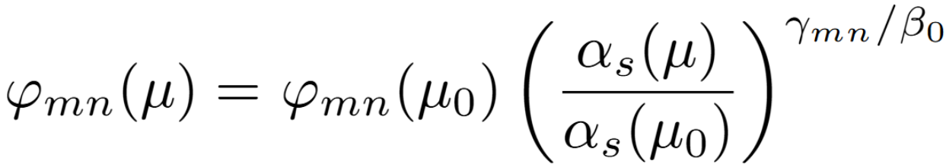
RESULTS
NLO corrections are positive and significant
Proton
Spacelike
Proton
Timelike
15

Slide 16
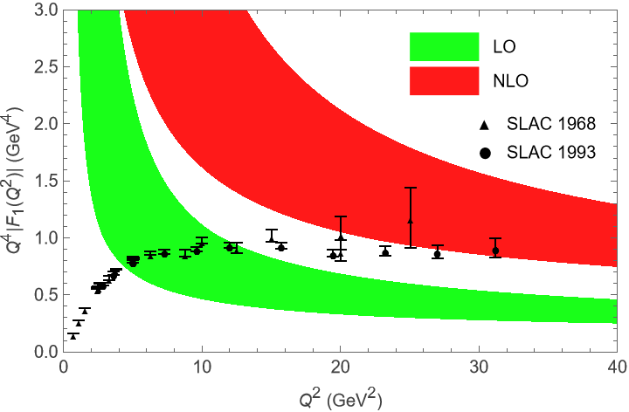
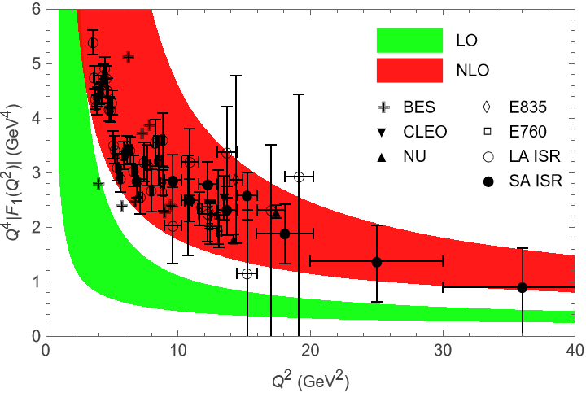
RESULTS
NLO corrections are positive and significant
Proton
Spacelike
Proton
Timelike
16

Slide 17
RESULTS
NLO corrections are positive and significant
Proton
Spacelike
NLO significance
The one-loop hard kernel raises the pQCD prediction and reduces the historical LO underestimation.
Model sensitivity
QCD sum-rule LCDAs can reach the magnitude of large-Q² data, while small-coefficient lattice LCDAs are extremely low.
Proton
Timelike
Important caveat
The predicted Q² trend is decreasing, whereas spacelike proton data show a flatter or rising pattern at large Q².
17

Slide 18
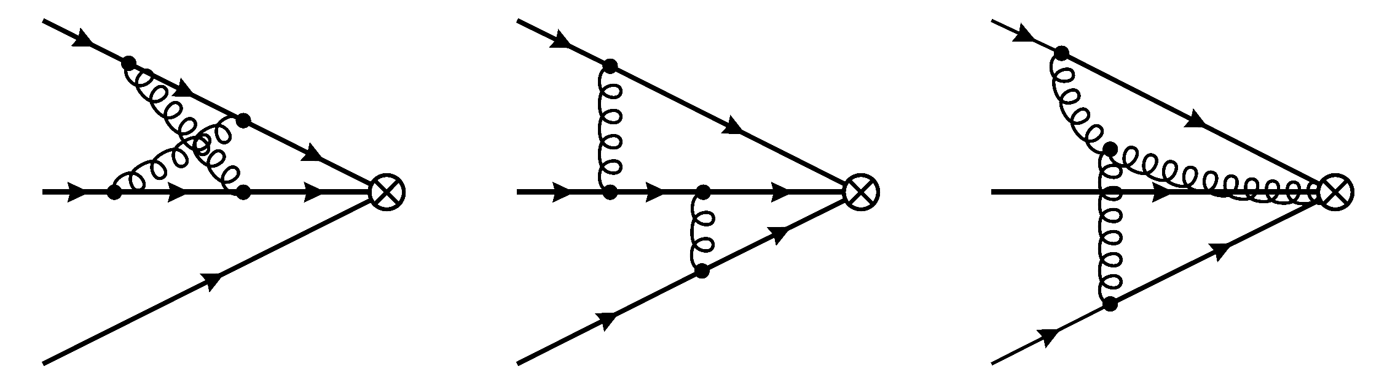
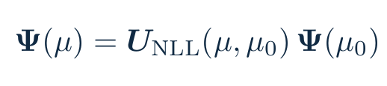
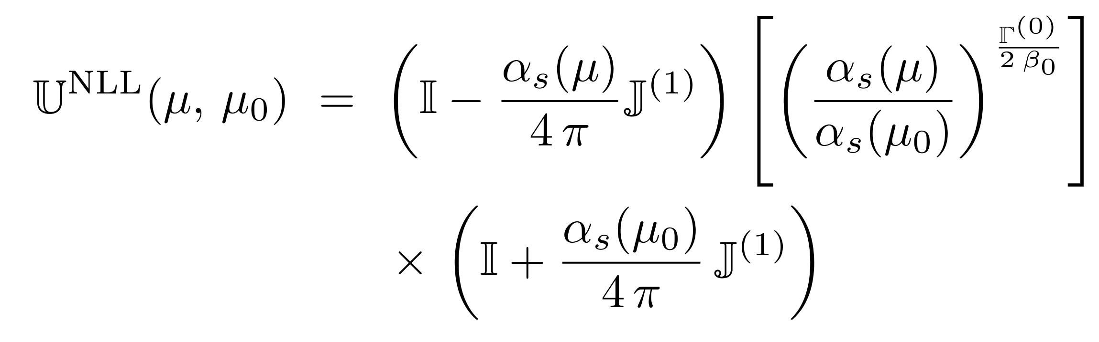
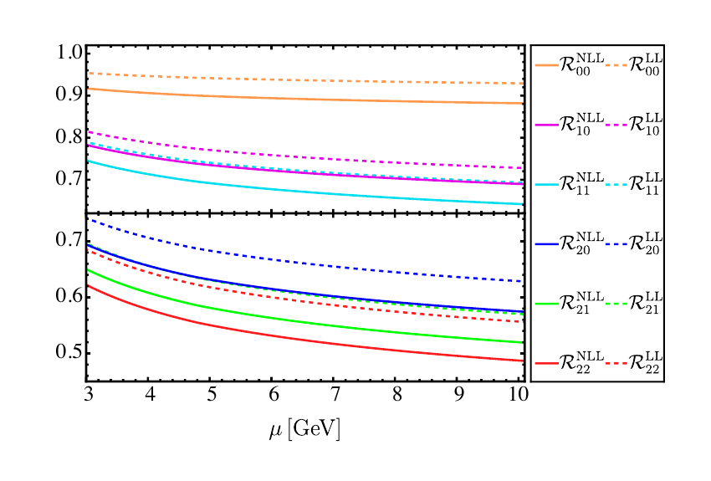
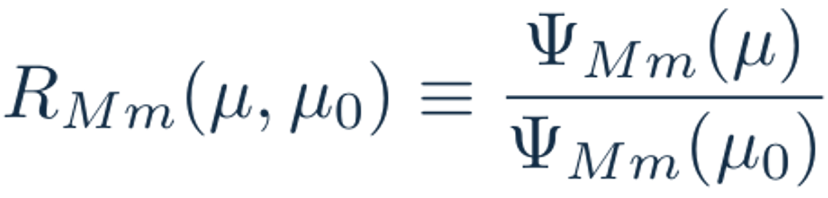
TWO-LOOP EVOLUTION
NLL evolution shifts normalized DA moments
The solid NLL curves differ from dotted LL by up to ~20%; the shift is model-, scale-, and moment-dependent.
Higher-conformal-spin moments receive the larger corrections.
This universal input propagates into leading-twist hard Dirac and axial form factors.
Y. K. Huang, Y. Ji, B. X. Shi and Y. M. Wang
2512.20471 [hep-ph]
Solid: NLL Dotted: LL
18

Slide 19

SCHEME CONSISTENCY
Scheme consistency constrains both DA legs
incoming DA
Finite EO → KM conversion plus NLL evolution
incoming DA
at μ₀ · EO/KM tagged
at μ · selected scheme
outgoing DA
outgoing DA
at μ₀ · EO/KM tagged
apply separately to each external DA leg
at μ · selected scheme
The scattering kernel transforms in the same way
The results are scheme independent when both DAs and the kernel are converted consistently.
19

Slide 20
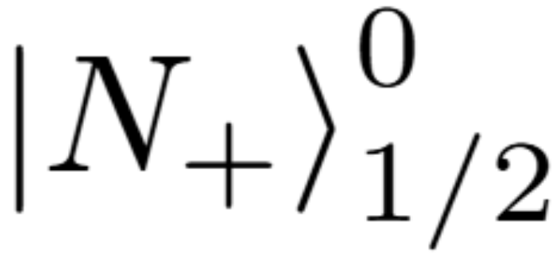
AXIAL FRAMEWORK
The axial channel reuses the precision chain
Inherits from Dirac
twist-3 nucleon LCDA basis
KM renormalization infrastructure
convolution and uncertainty machinery
Complete NLL axial prediction = two-loop DA evolution + NLO axial kernel + consistent EO/KM conversion on both legs + declared flavor current and γ5 scheme.
20

Slide 21
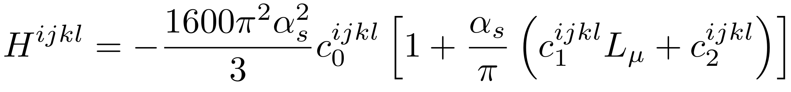
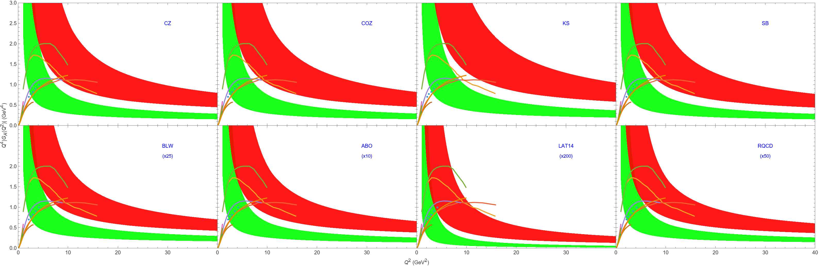
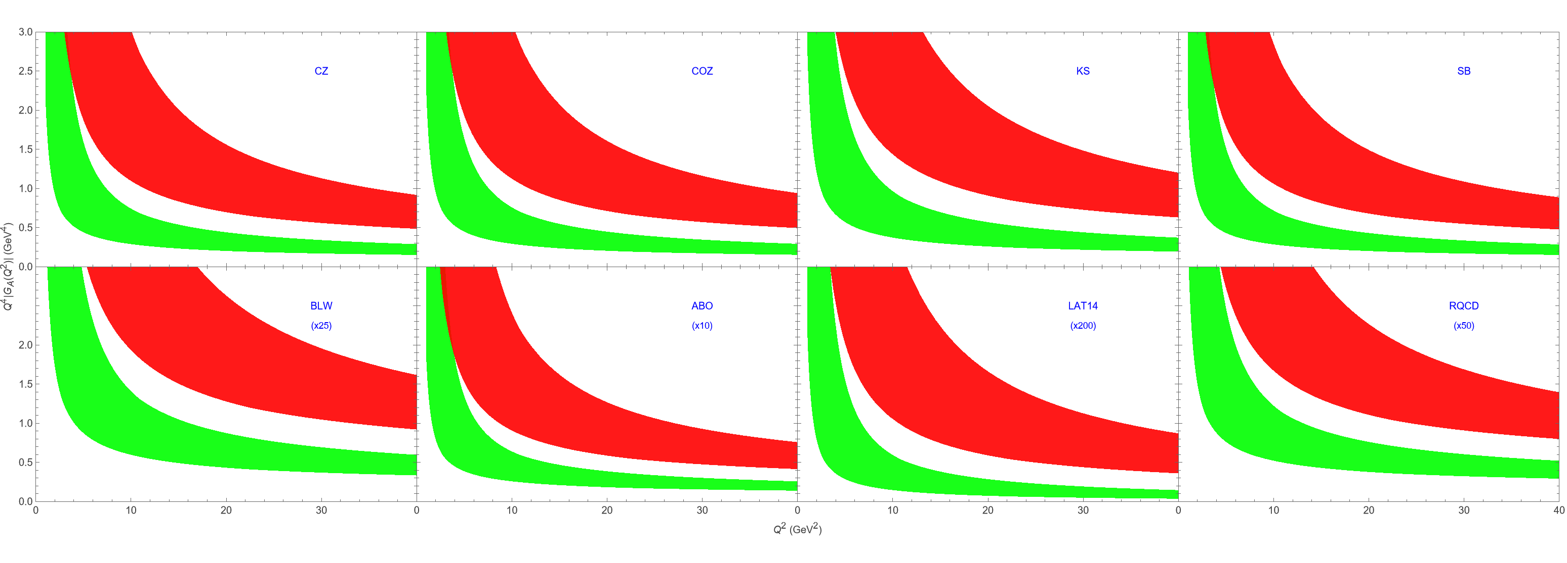
AXIAL RESULTS
Preliminary results are similar
Spacelike
Timelike
21

Slide 22
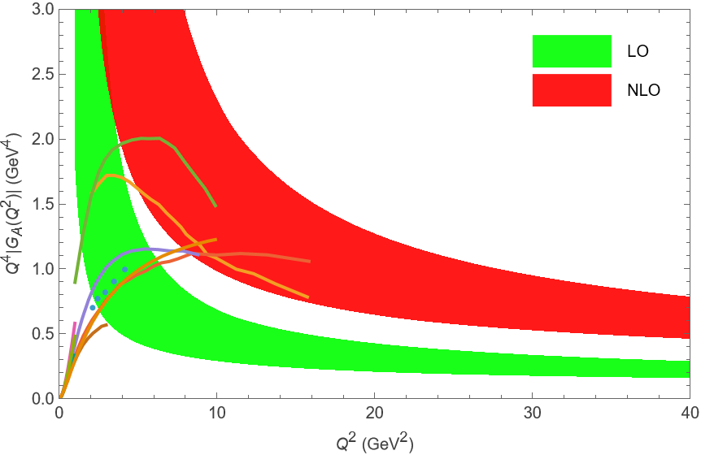
AXIAL RESULTS
Preliminary results are similar
NLO remains essential
Data limitations
Model sensitivity
The positive NLO effect is still visible, and shows some agreement with other models.
Available data are way less extensive than Dirac data, so the phenomenological discrimination is weaker.
Lattice-DA predictions are extremely low in the axial case too.
22

Slide 23

CONCLUSION
The precision picture is clear yet incomplete
1
Following up the first ever results of NLO corrections to the nucleon Dirac form factors in nearly half a century, using the collinear factorization theorem in the KM renormalization scheme.
2
Two-loop evolution completes universal NLL DA running, and axial-vector results are underway.
3
NLO substantially raises the predictions, yet lattice-DA predictions remain far below. Large-momentum effective theory? Failure of factorization?
Longbin Chen, Wen Chen, Feng Feng, Siwei Hu, Yu Jia, Jichen Pan
Thanks!
Questions and comments are welcome.

