Slide 1
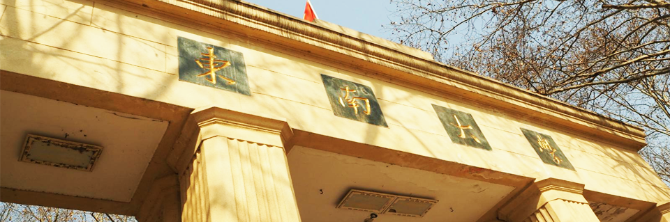




SOUTHEAST UNIVERSITY
Leading-twist gluon transverse momentum dependent distributions from large-momentum effective theory
报告人：谢修鹏 时间：2026年07月29日
第一届强相互作用自旋物理会议

Slide 2

目 录
1
  Background
2
  One-loop gluon TMDPDFs
3
  One-loop gluon quasi-TMDPDFs
4
  Matching relation
5
  Conclusions

Slide 3

PART ONE
Background

Slide 4
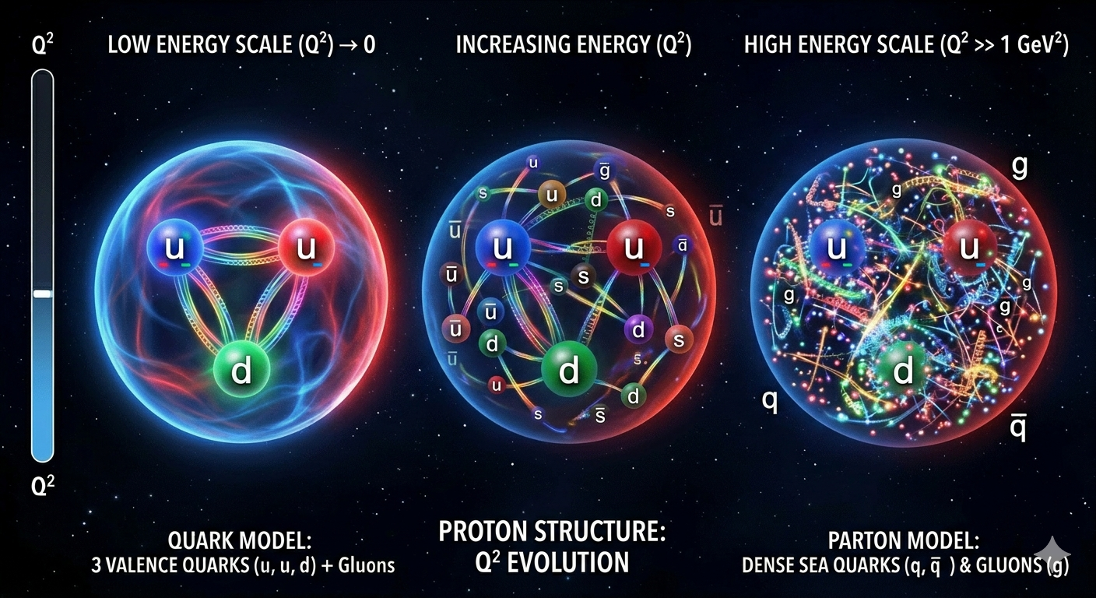



Background
研究背景：从一维到三维核子结构
核子内部的夸克与胶子不能被直接观测，其结构信息需要通过高能散射过程和 QCD 因子化来反演。
传统 PDF：只描述纵向动量
共线 PDF 给出部分子的纵向动量分数$x$，是一维信息；但横向运动和自旋-动量关联被积分掉。
TMDPDF：引入横向动量 $k_{T}$
TMDPDF 同时依赖 $x$与 $k_{T}$，可刻画三维动量结构和自旋相关，是核子三维成像的重要输入。

Slide 5
Background
理论框架：大动量有效理论 (LaMET)
LaMET 为从格点QCD (LQCD) 模拟中提取光锥物理量提供了强大框架，已成功应用于夸克TMDPDFs的研究，是连接格点模拟与实验可观测量的桥梁。
研究空白：胶子自旋相关分布的缺失
目前针对胶子TMDPDFs，尤其是其自旋相关的分布，从第一性原理出发的计算极其匮乏，这是当前格点QCD与强子物理研究中的显著空白。
本研究目标：单圈计算与匹配关系推导
在LaMET框架下，完成全组8个领头扭度胶子TMDPDFs的单圈微扰计算，并推导其与准TMDPDFs的匹配关系，为后续LQCD模拟奠定坚实理论基础。

Slide 6
PART TWO
One-loop gluon TMDPDFs

Slide 7
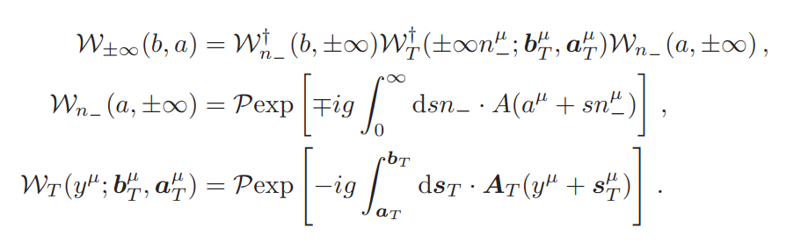
领头扭度的胶子关联函数
The gauge-invariant non-local gluon-gluon correlator is given by
The gauge-link operator $𝒲_{±∞}$ is explicitly given by

Slide 8
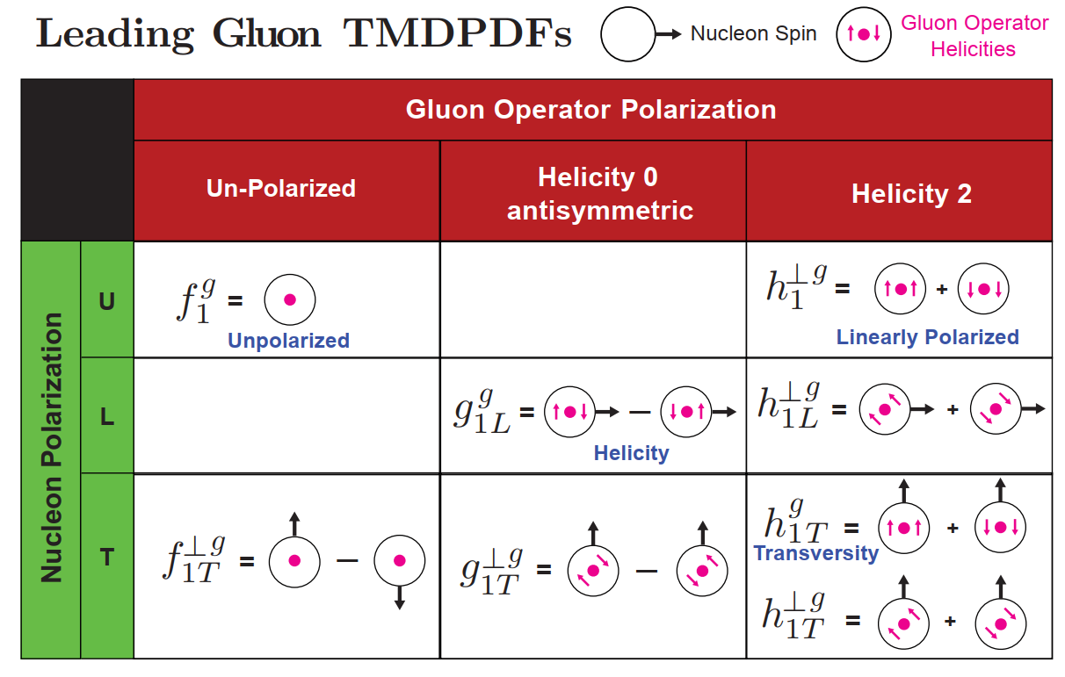
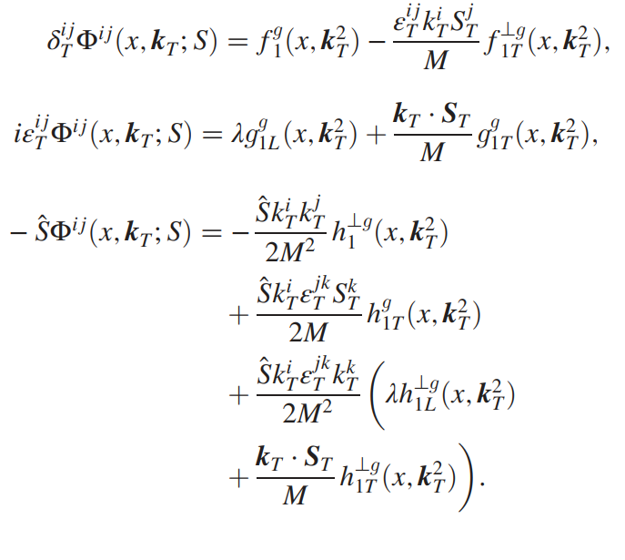
领头扭度的胶子TMDPDFs
R. Zhu, Y. Ji, J. H. Zhang, and S. Zhao, JHEP 02 (2023) 114

Slide 9
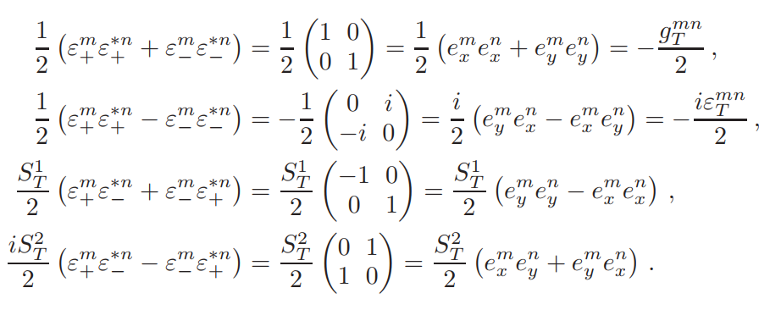
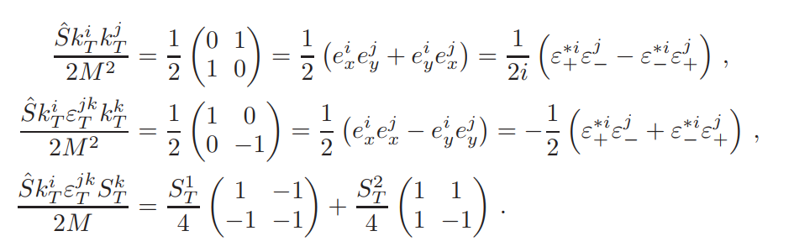
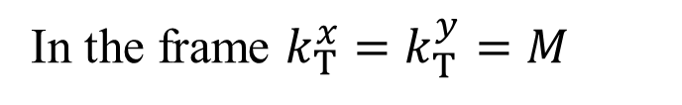
计算框架
In the combined gluon $⨂$ hadron spin space
Projection operators for the matrix elements $Φ_{ΛΛ^{′}}^{ij}$
In the frame $k_{T}^{x}=k_{T}^{y}=M$

Slide 10
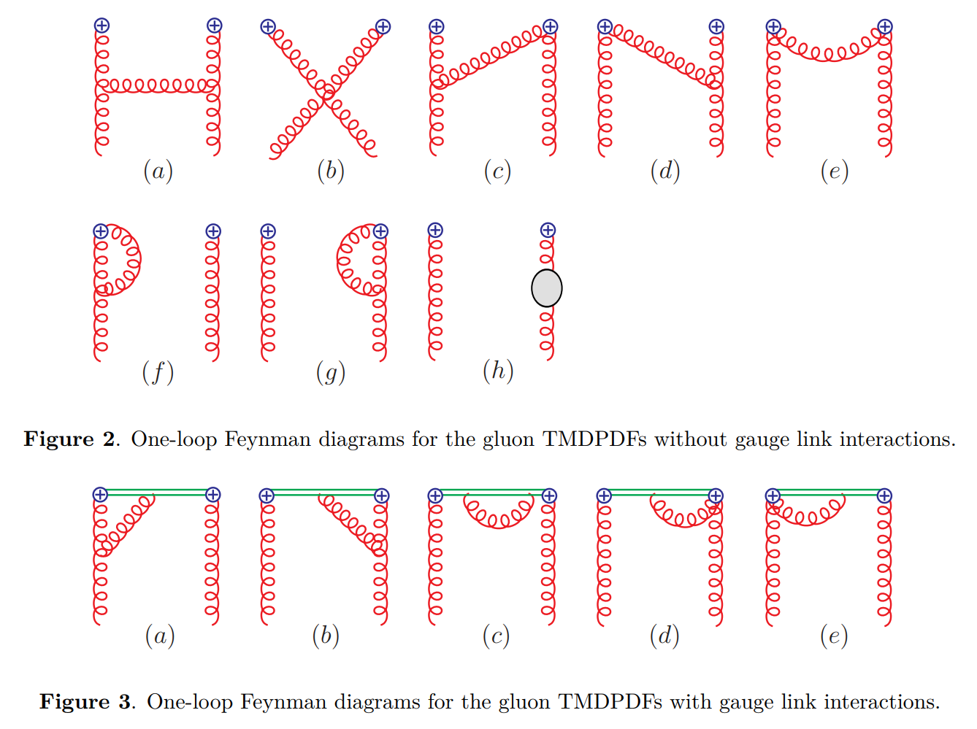

单圈图
$$\frac{i}{k^{±}+i0}→\frac{i}{k^{±}+iδ^{±}}$$
Wilson line propagator:

Slide 11
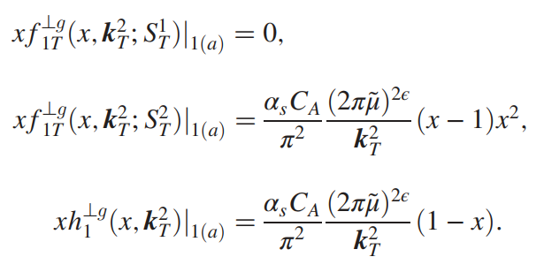
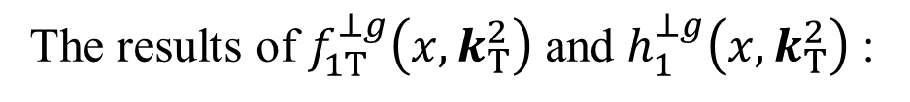

计算结果
A vanishing result
$$xg_{1T}^{g}\left(x, k_{T}^{2}\right)=xh_{1L}^{⊥g}\left(x, k_{T}^{2}\right)=0$$
The results of $f_{1T}^{⊥g}\left(x, k_{T}^{2}\right)$ and $h_{1}^{⊥g}\left(x, k_{T}^{2}\right)$ :

Slide 12
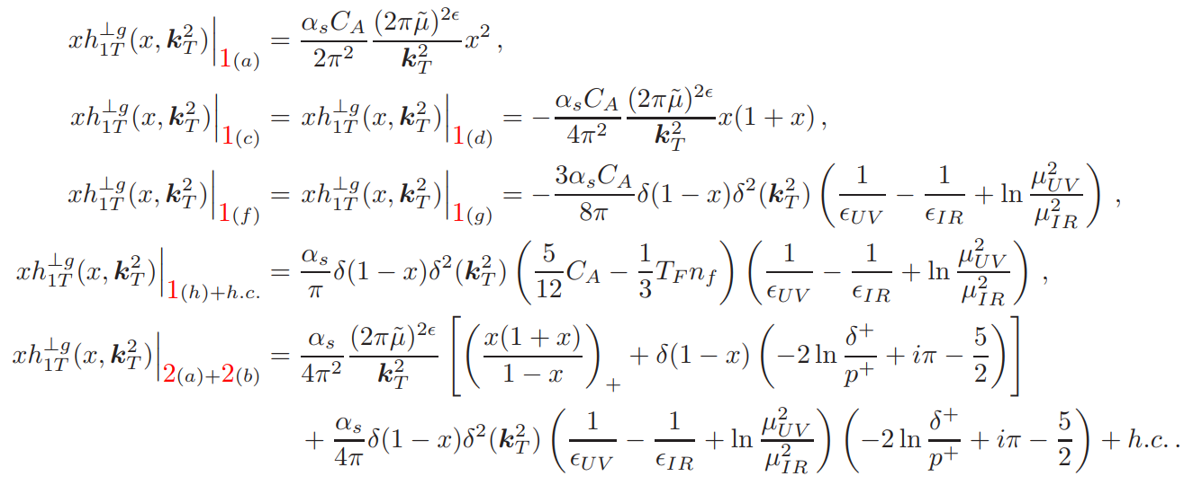
计算结果

Slide 13
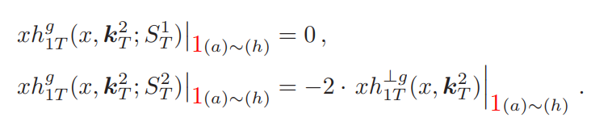
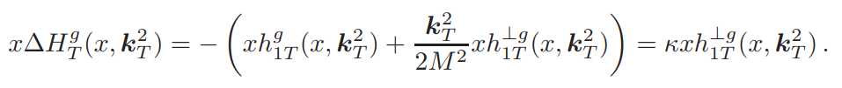
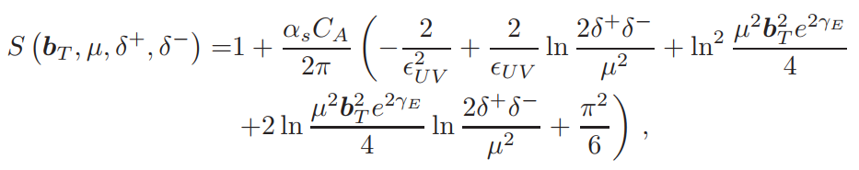
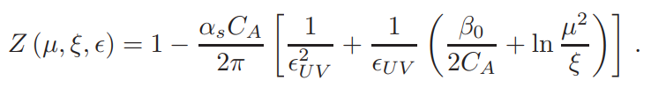

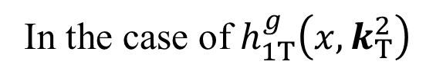
计算结果
In the case of $h_{1T}^{g}\left(x, k_{T}^{2}\right)$
This distinct behavior motivates the introduction of a unified expression:
The soft function
The $\overline{MS}$ UV renormalization factor

Slide 14
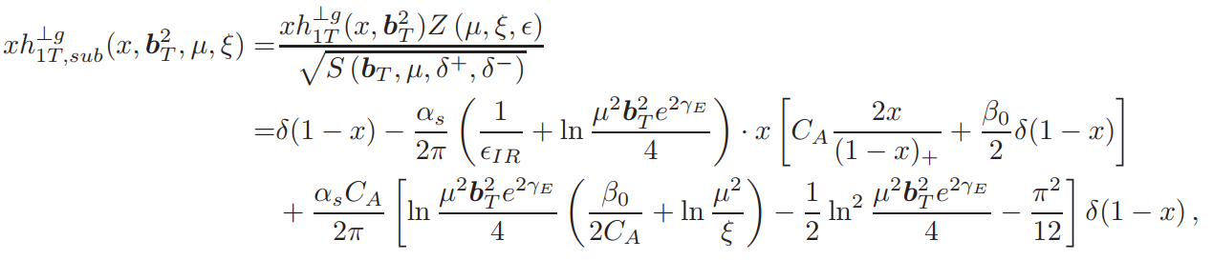
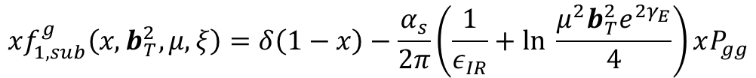
计算结果
$$xf_{1,sub}^{g}\left(x, b_{T}^{2}, μ, ξ\right)=δ\left(1−x\right)−\frac{α_{s}}{2π}\left(\frac{1}{ε_{IR}}+ln \frac{μ^{2}b_{T}^{2}e^{2γ_{E}}}{4}\right)xP_{gg}$$
$$+\frac{α_{s}C_{A}}{2π}\left[ln \frac{μ^{2}b_{T}^{2}e^{2γ_{E}}}{4}\left(\frac{β_{0}}{2C_{A}}+ln \frac{μ^{2}}{ξ}\right)−\frac{1}{2}\ln^{2}\frac{μ^{2}b_{T}^{2}e^{2γ_{E}}}{4}−\frac{π^{2}}{12}\right]δ\left(1−x\right)$$
$$xg_{1L,sub}^{g}\left(x, b_{T}^{2}, μ, ξ\right)=δ\left(1−x\right)−\frac{α_{s}}{2π}\left(\frac{1}{ε_{IR}}+ln \frac{μ^{2}b_{T}^{2}e^{2γ_{E}}}{4}\right)xΔP_{gg}$$
$$+\frac{α_{s}C_{A}}{2π}\left[ln \frac{μ^{2}b_{T}^{2}e^{2γ_{E}}}{4}\left(\frac{β_{0}}{2C_{A}}+ln \frac{μ^{2}}{ξ}\right)−\frac{1}{2}\ln^{2}\frac{μ^{2}b_{T}^{2}e^{2γ_{E}}}{4}−\frac{π^{2}}{12}\right]δ\left(1−x\right)$$

Slide 15
PART THREE
One-loop gluon quasi-TMDPDFs

Slide 16
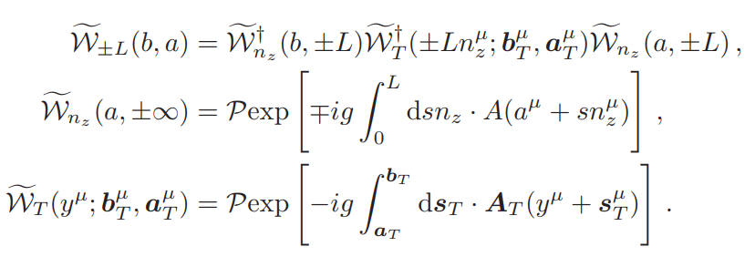
领头扭度的胶子关联函数
The equal-time non-local gluon-gluon correlator is given by
The staple-shaped gauge-link operator $𝒲_{±L}$ is explicitly given by

Slide 17
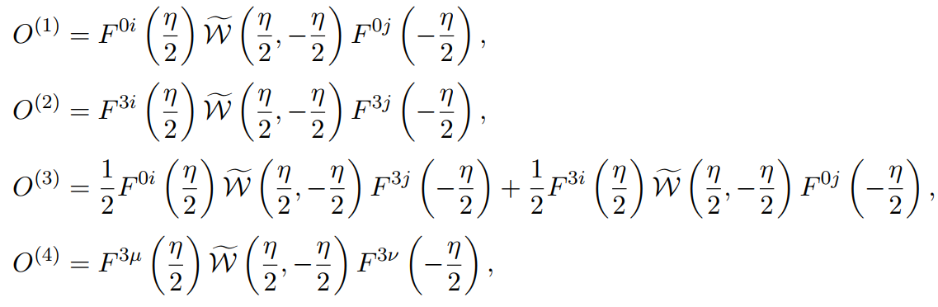
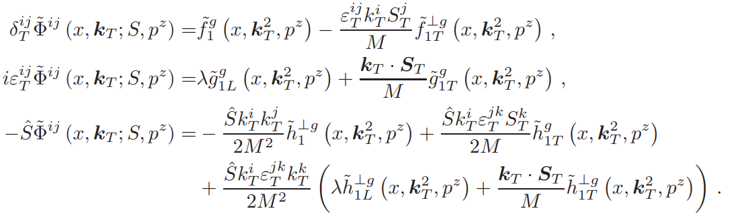

领头扭度的胶子quasi-TMDPDFs
Four gluon quasi-PDF operators
$$N=\frac{v⋅P}{{\left(\overline{v}⋅P\right)}^{2}}=\frac{P^{z}}{{\left(P^{0}\right)}^{2}}\underset{→}{p^{2}=0}\frac{1}{P^{0}}$$
The quasi-TMDPDFs are given by

Slide 18

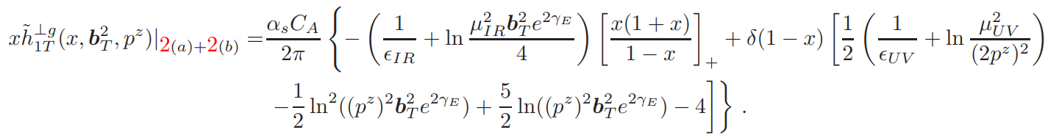
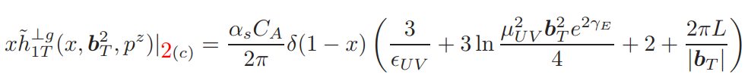
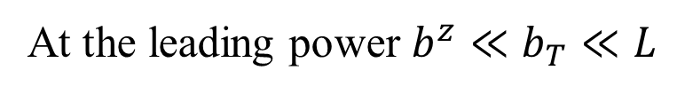
计算结果
At the leading power $b^{z}≪b_{T}≪L$
The sail diagrams (Figs. 2(a) and 2(b)) :
The Wilson line self energy diagram (Figs. 2(c) ) :

Slide 19
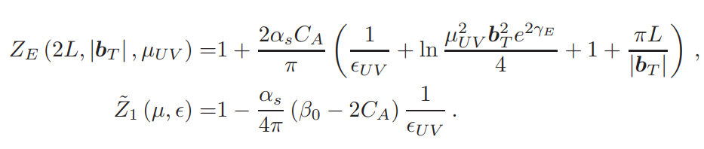
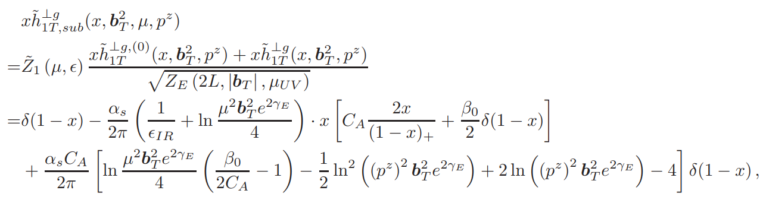
计算结果
Euclidean flat rectangular Wilson loop and the $\overline{MS}$ renormalization factor
The renormalized and subtracted gluon quasi-TMDPDF $x{\tilde{h}}_{1T,sub}^{⊥g}\left(x, b_{T}^{2}, μ, p^{z}\right)$ is

Slide 20
PART FOUR
Matching relation

Slide 21

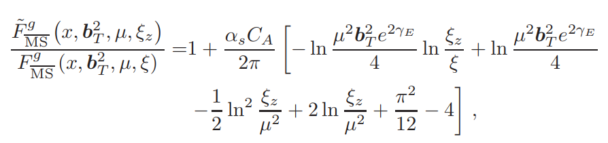
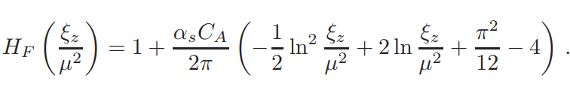
匹配关系
At one-loop order, the ratio for
S. T. Schindler, I. W. Stewart, and Y. Zhao, JHEP 08 (2022) 084
M. A. Ebert, S. T. Schindler, I. W. Stewart, and Y. Zhao, JHEP 04 (2022) 178
The matching relation for the gluon quasi-TMDPDFs is given by
The same matching coefficient at one-loop level

Slide 22
PART FIVE
Conclusions

Slide 23
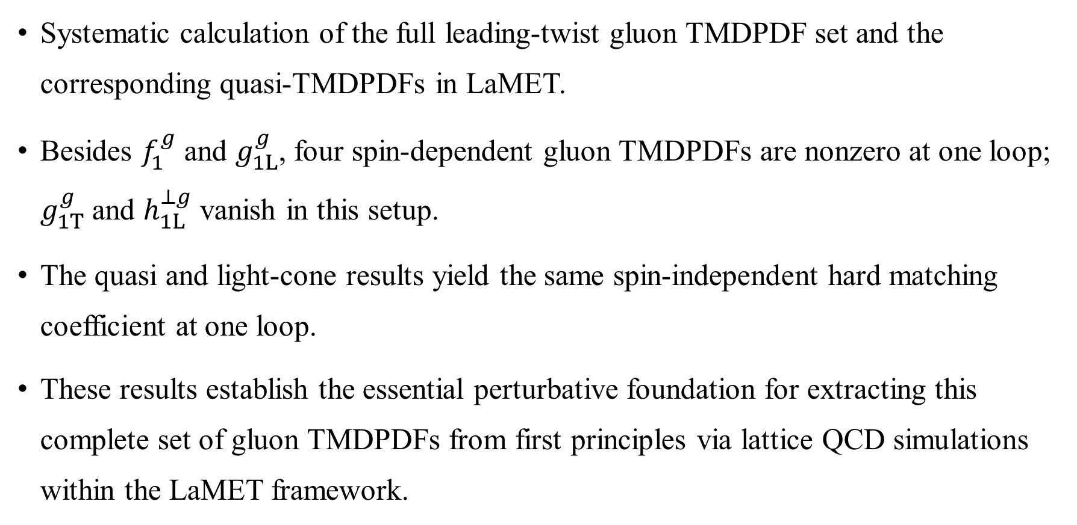
Conclusion
Systematic calculation of the full leading-twist gluon TMDPDF set and the corresponding quasi-TMDPDFs in LaMET.
Besides $f_{1}^{g}$ and $g_{1L}^{g}$, four spin-dependent gluon TMDPDFs are nonzero at one loop; $g_{1T}^{g}$ and $h_{1L}^{⊥g}$ vanish in this setup.
The quasi and light-cone results yield the same spin-independent hard matching coefficient at one loop.
These results establish the essential perturbative foundation for extracting this complete set of gluon TMDPDFs from first principles via lattice QCD simulations within the LaMET framework.

Slide 24
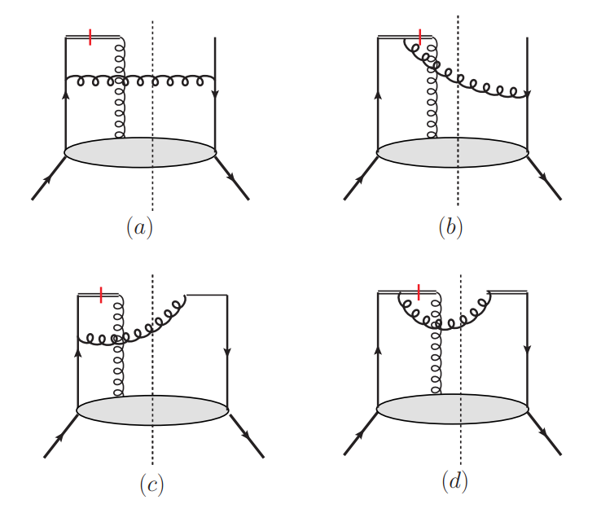
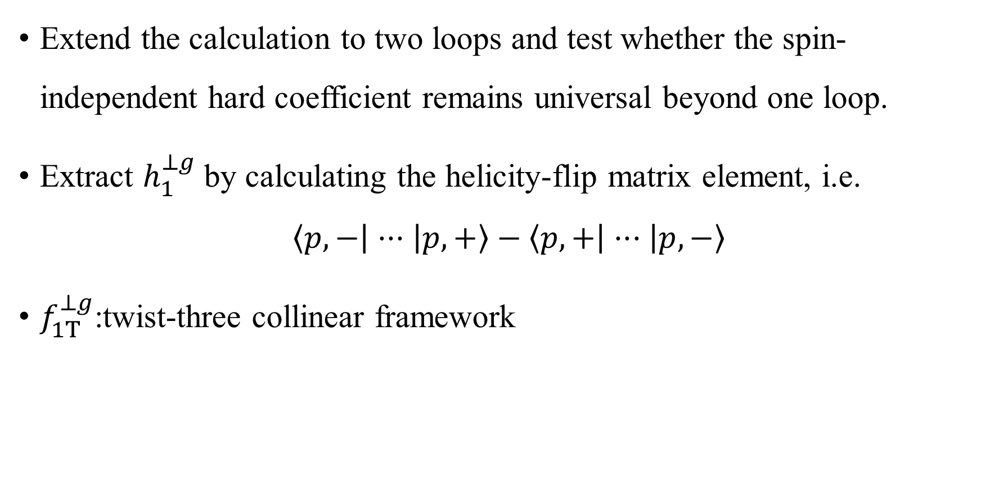
Outlook
Extend the calculation to two loops and test whether the spin-independent hard coefficient remains universal beyond one loop.
Extract $h_{1}^{⊥g}$ by calculating the helicity-flip matrix element, i.e.
$$\left\langle p,− | ··· | p,+\right\rangle −\left\langle p,+ | ··· | p,−\right\rangle$$
$f_{1T}^{⊥g}$:twist-three collinear framework
S. Zhao, Phys. Rev. D 109, 014002 (2024)
X. Ji, Y. Liu, A. Schäfer, and F. Yuan, Phys.Rev.D 103 (2021) 7, 074005

Slide 25

SOUTHEAST UNIVERSITY
欢迎各位老师批评指正！

