Slide 1
Group Meeting
邹世明
2026/03/06

Slide 2
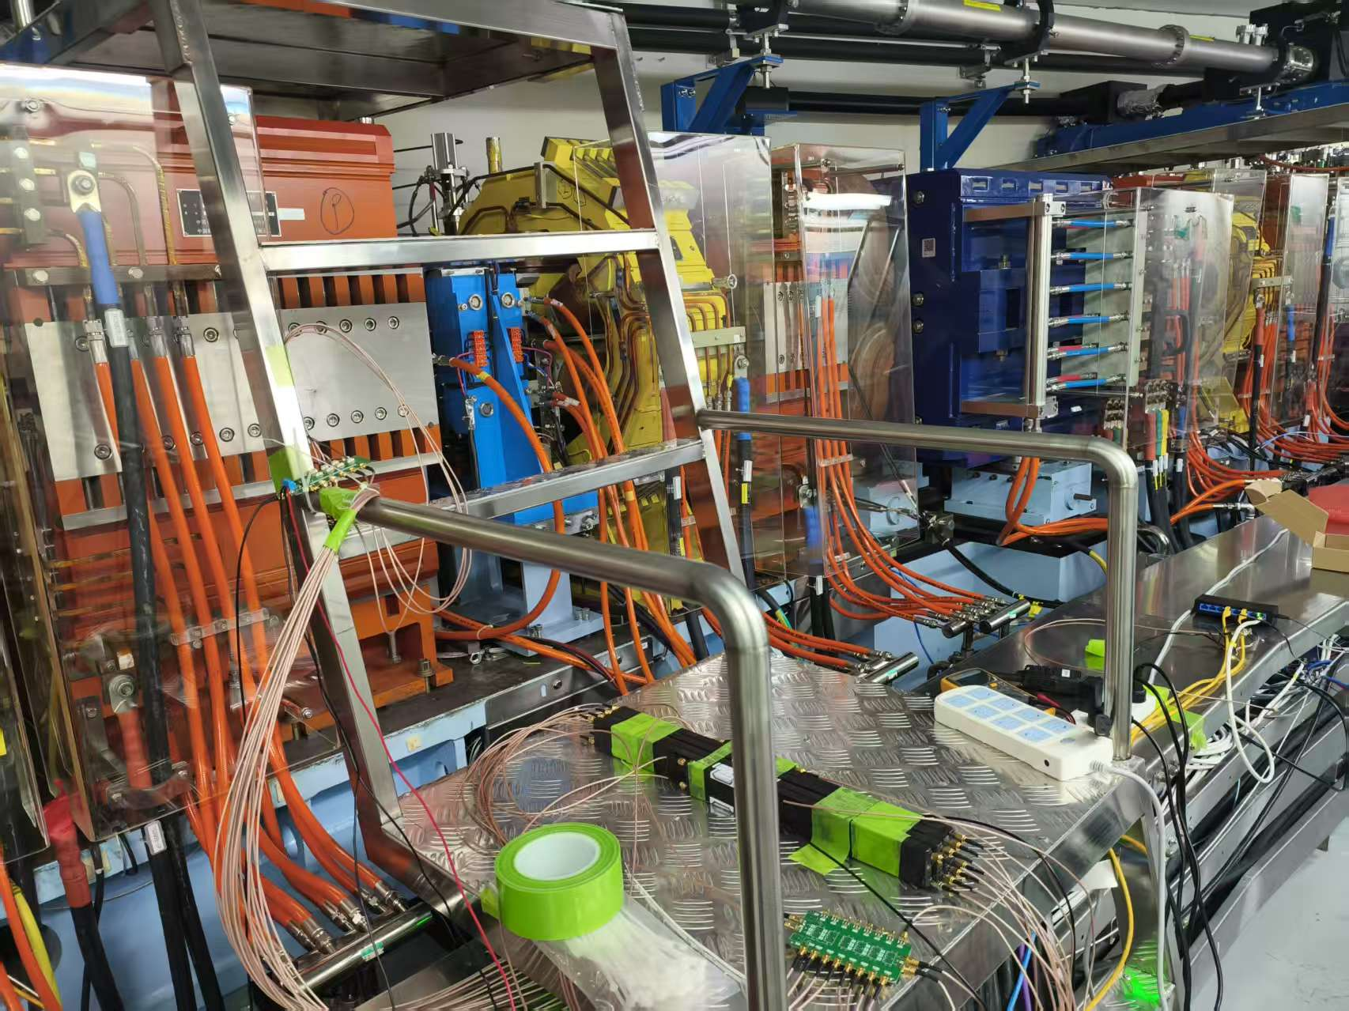
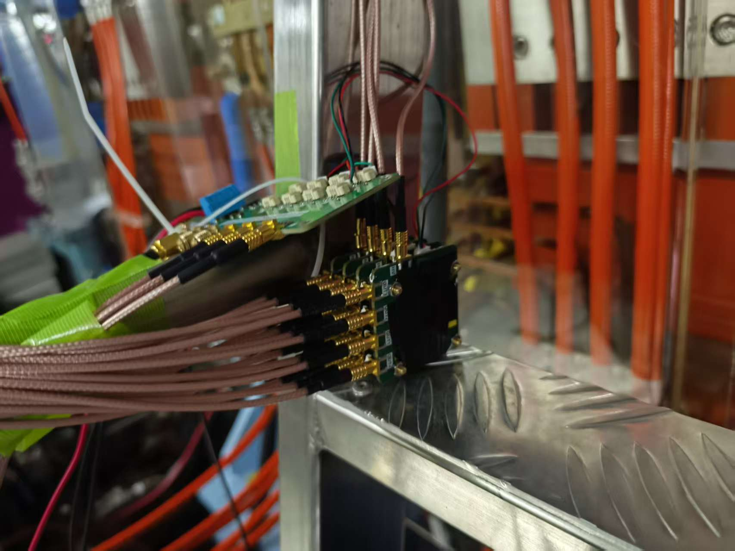
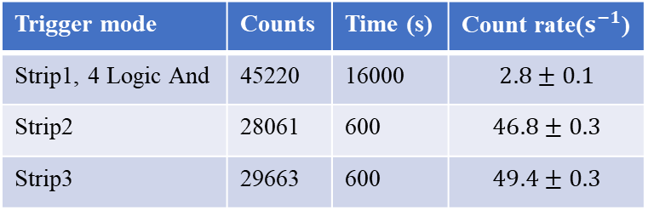
Test in SSRF
Quadrupole magnet
Trigger mode | Counts | Time (s) | Count rate($s^{−1}$)
Strip1, 4 Logic And | 45220 | 16000 | $$2.8±0.1$$
Strip2 | 28061 | 600 | $$46.8±0.3$$
Strip3 | 29663 | 600 | $$49.4±0.3$$
PSS readout boards
Scintillators
Stable beam injection ~ 200 mA

Slide 3
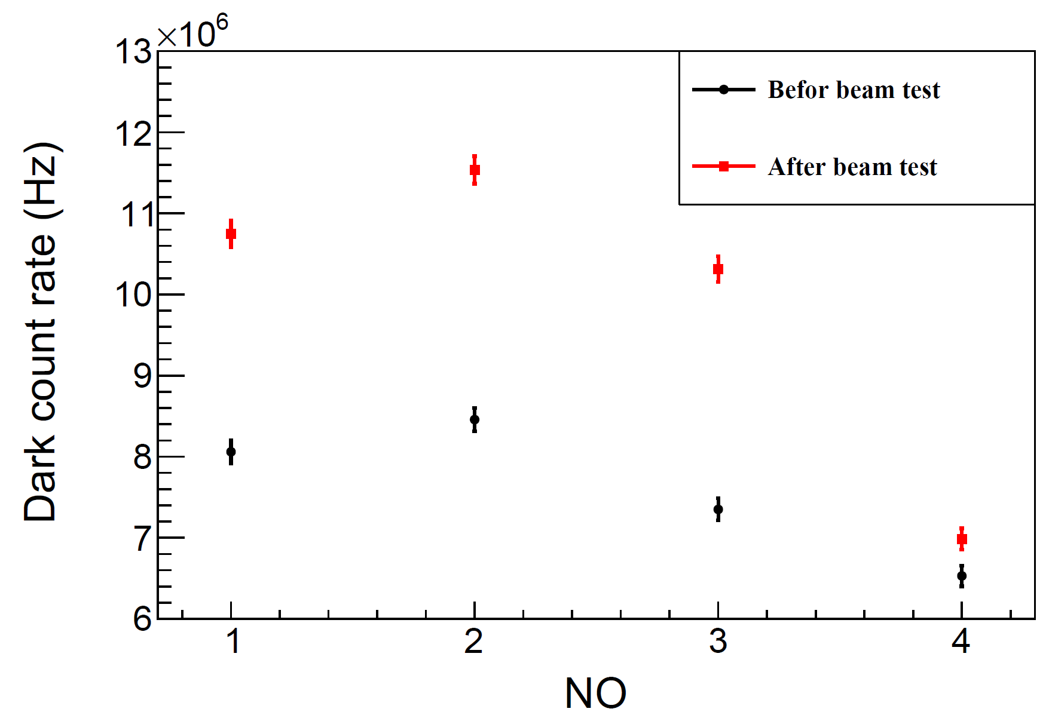
Dark count rate of PSS
After the beam test, the dark count rate increase significantly for NO.1, 2, 3.

Slide 4
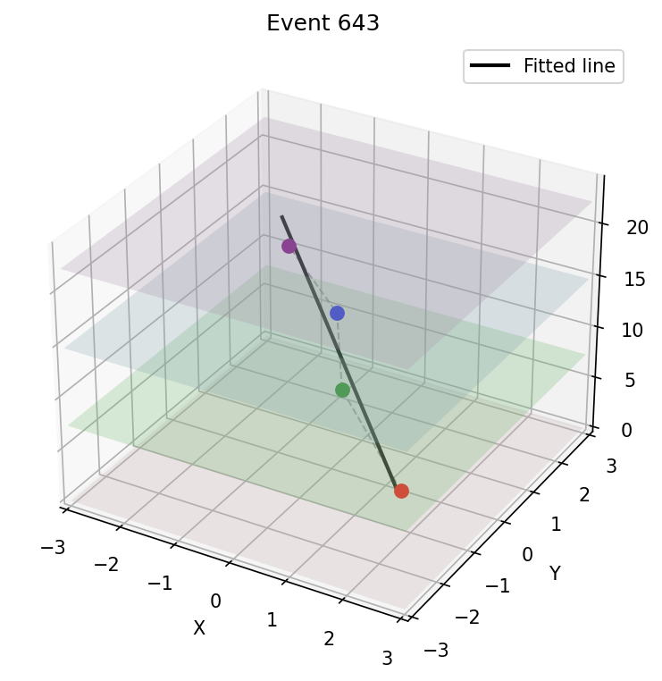
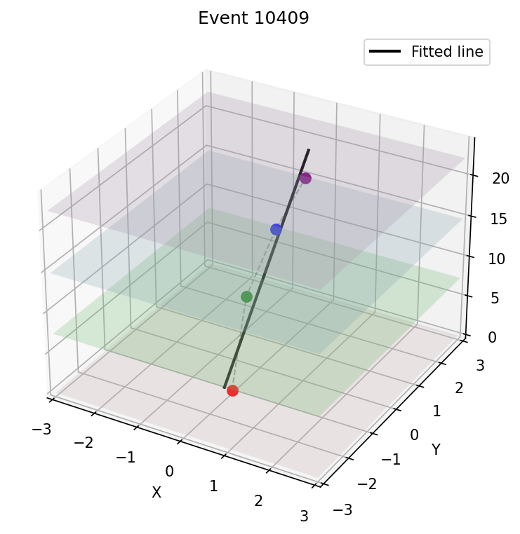
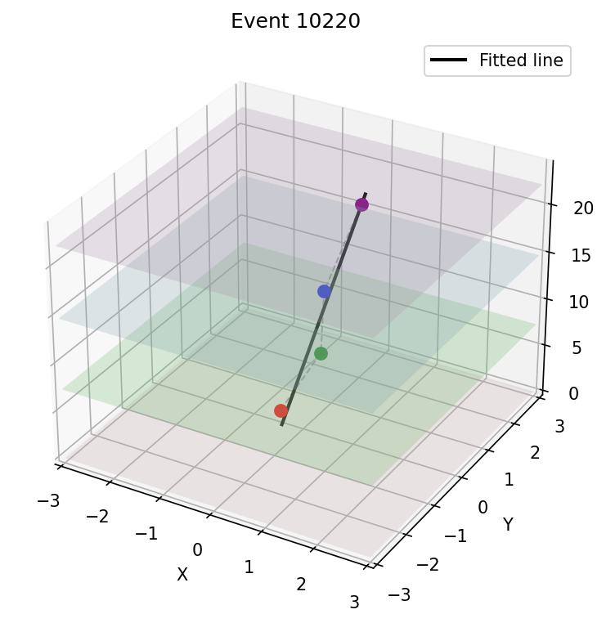
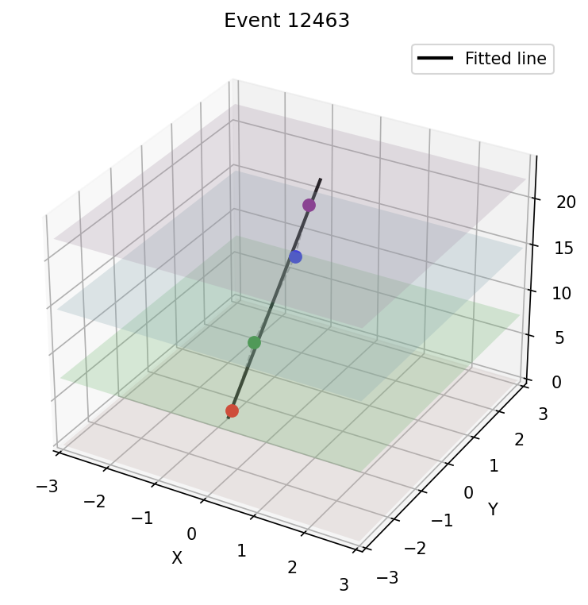
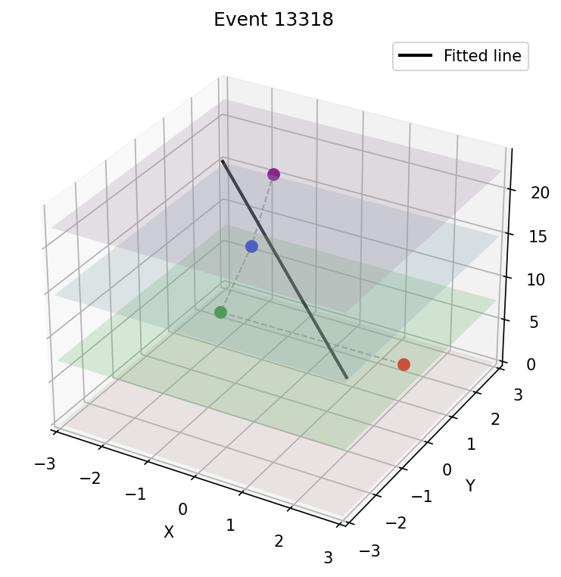
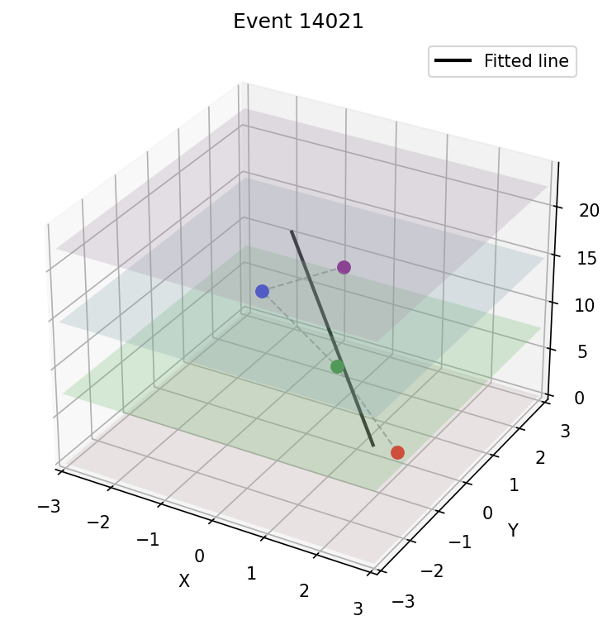
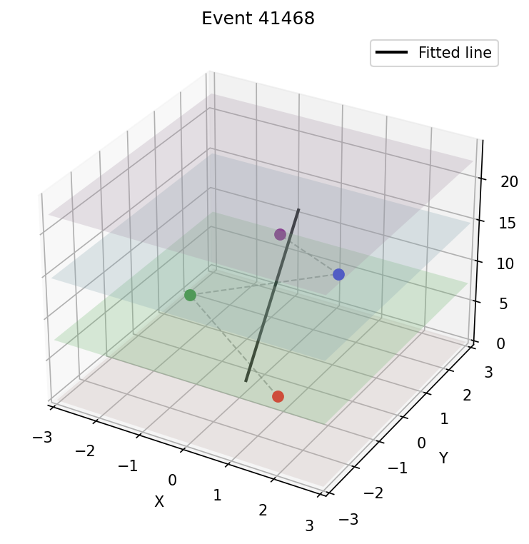
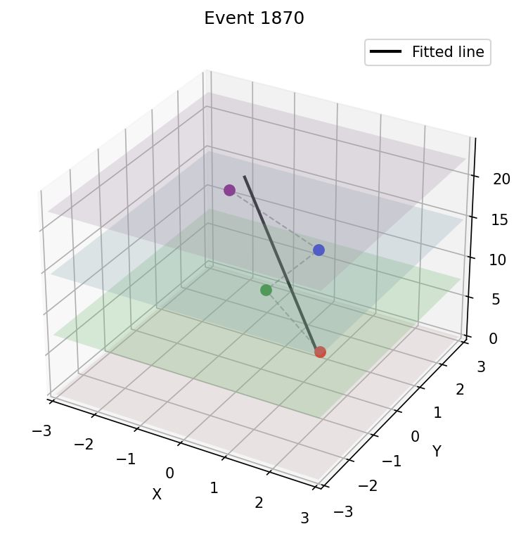
Tracks detected by PSS – Beam test

Slide 5
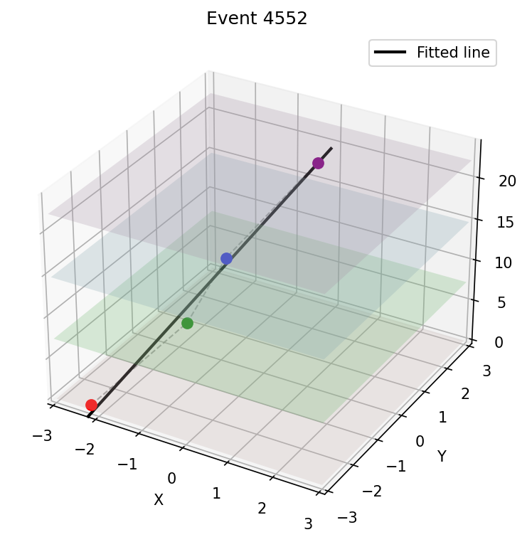
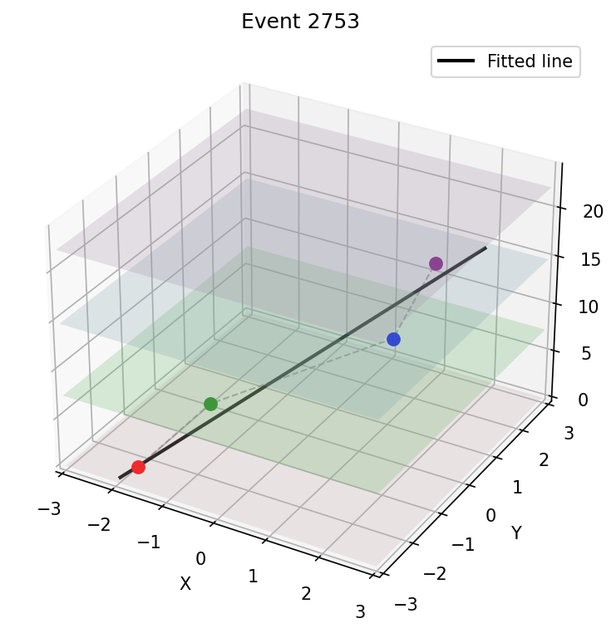
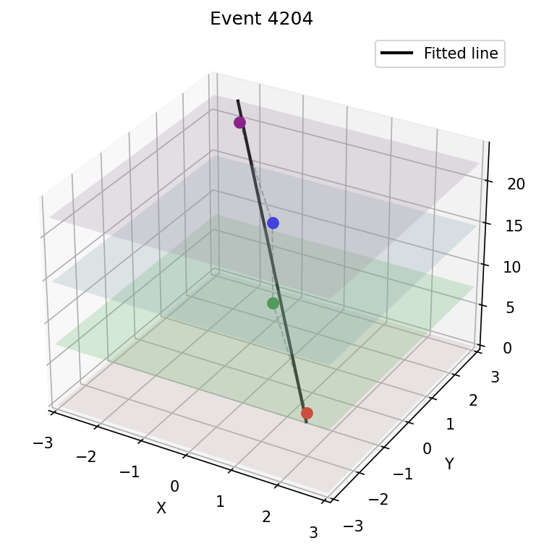
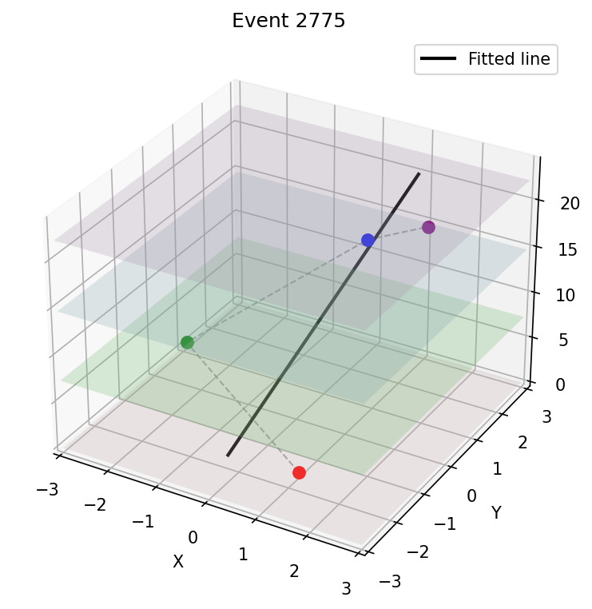
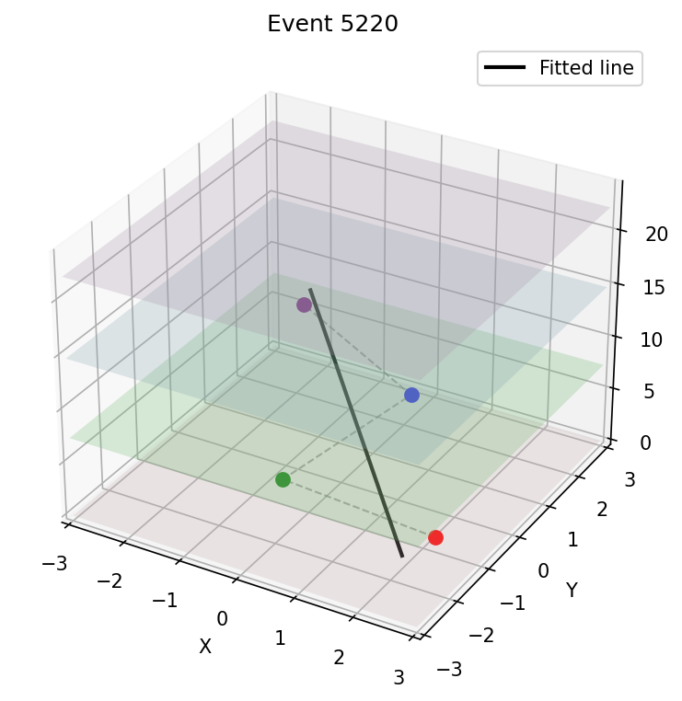
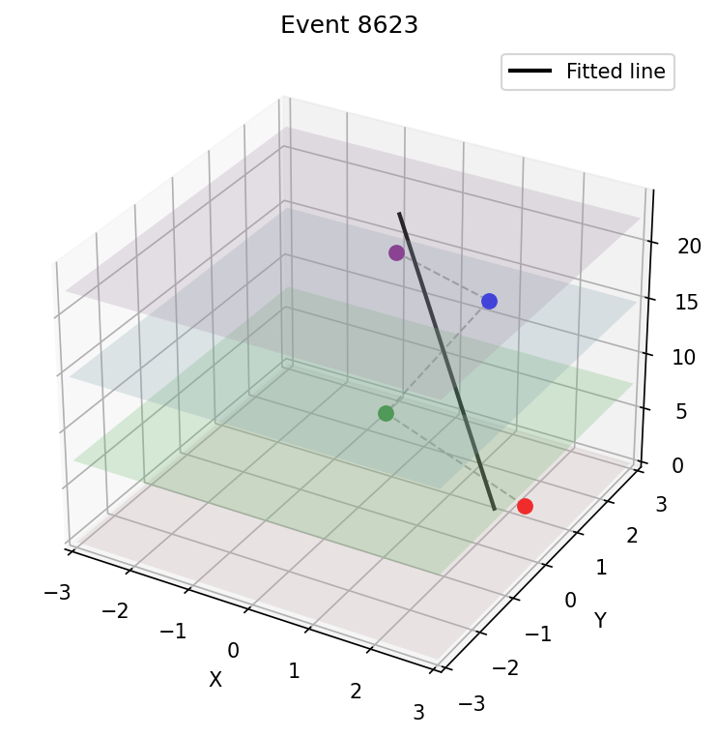
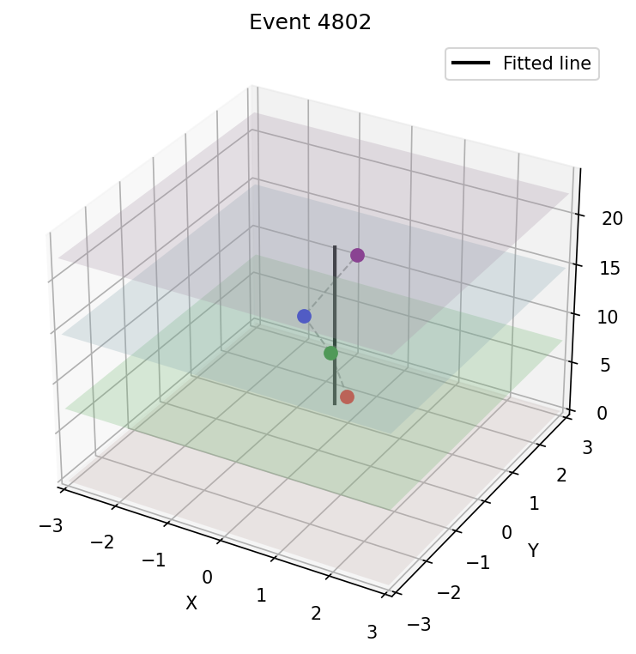
Tracks detected by PSS – Cosmic rat test

Slide 6
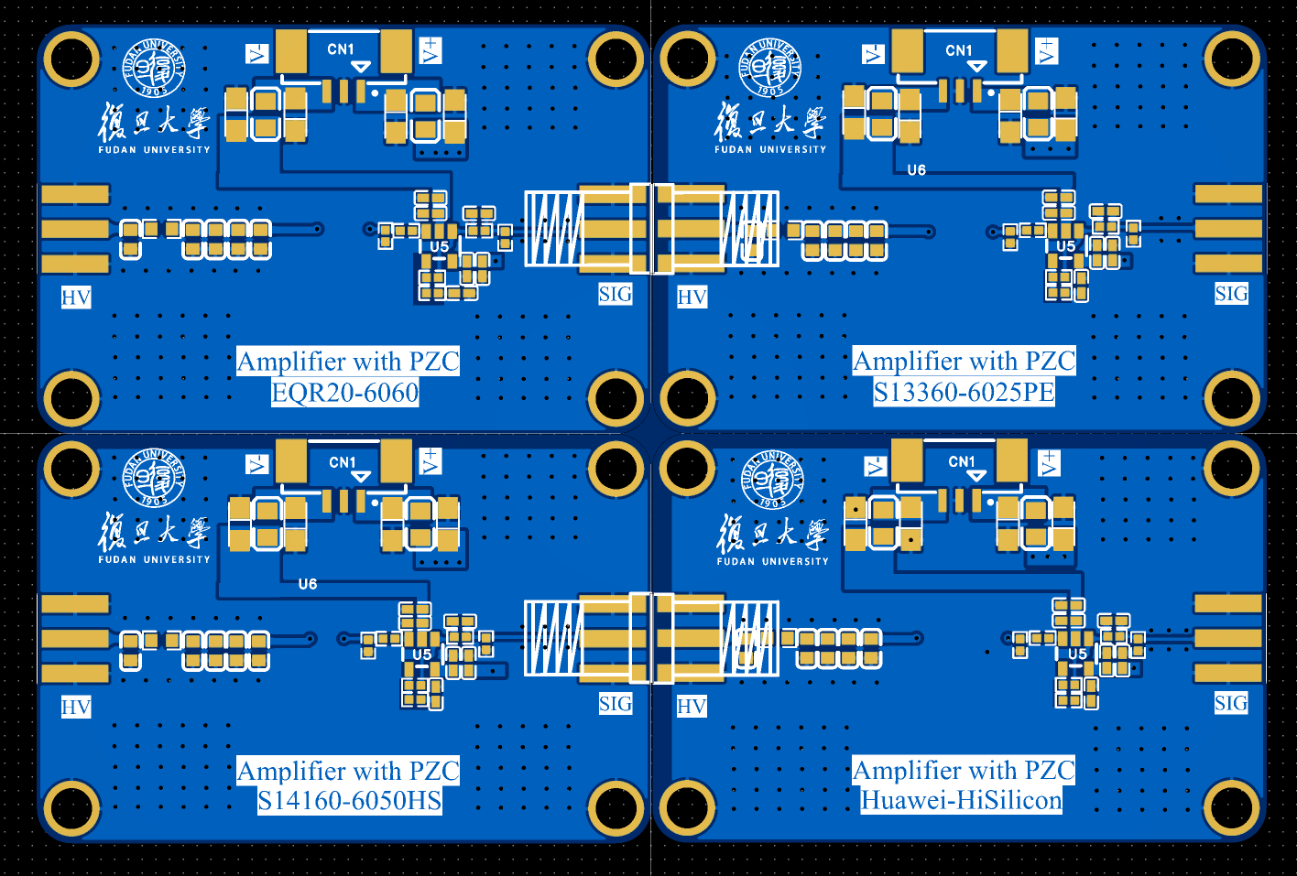
Amplifier with PZC

