Slide 1
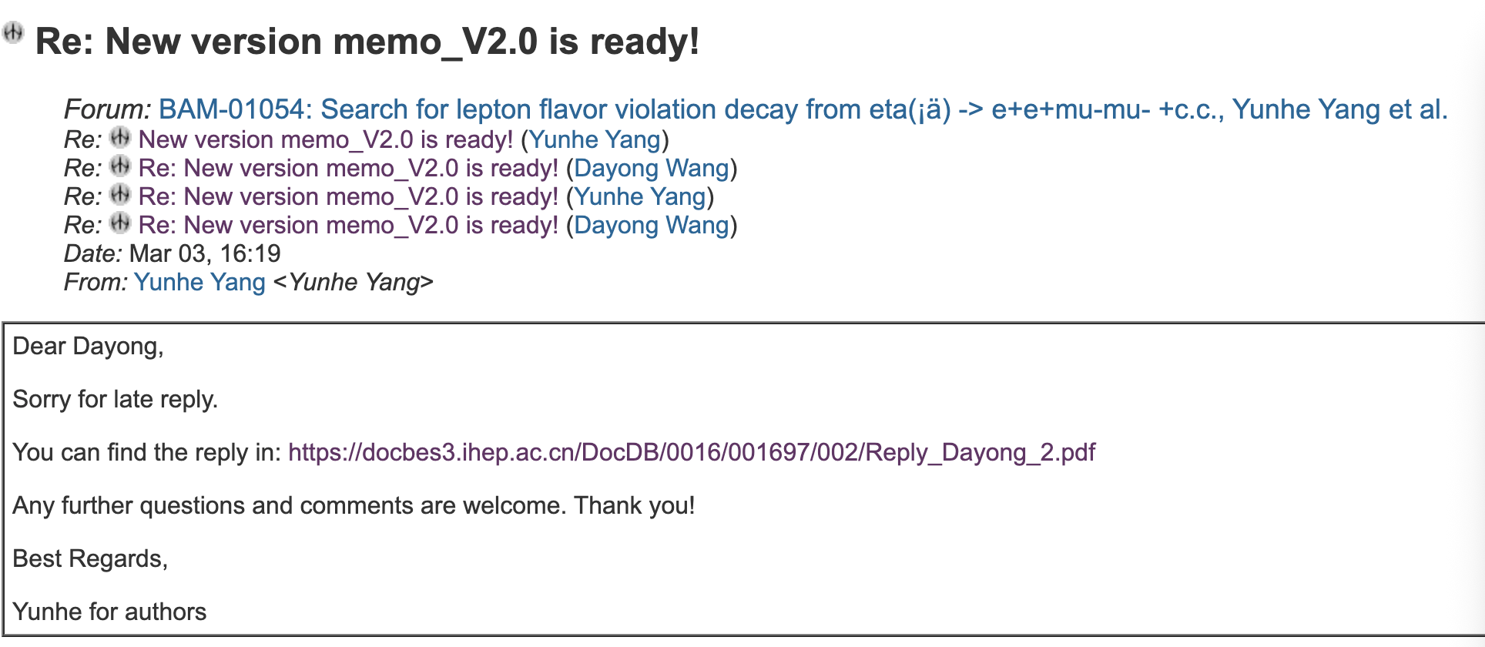
CLFV

Slide 2
CPV
Prepare prof. You’s question.

Slide 3
DC ML tracking
The data cleaning has been completed. Next, start training the GNN model.

Slide 4
2026.3.10
Nankai Group Meeting

Slide 5
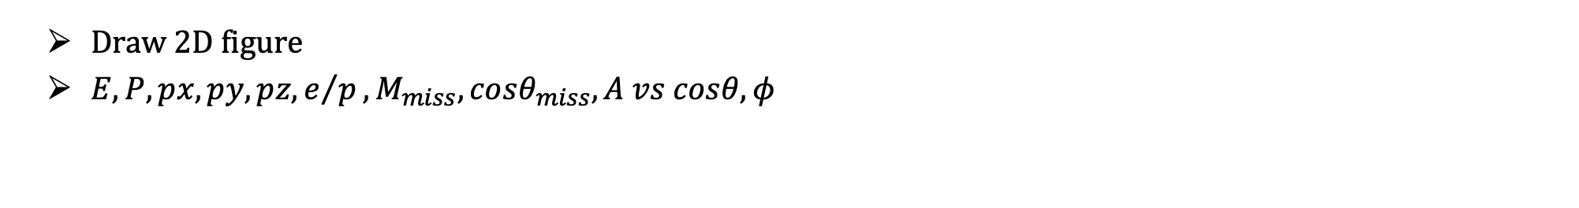
CPV
Draw 2D figure
$E, P, px, py, pz, e/p, M_{miss},cosθ_{miss},A vs cosθ, φ$

Slide 6
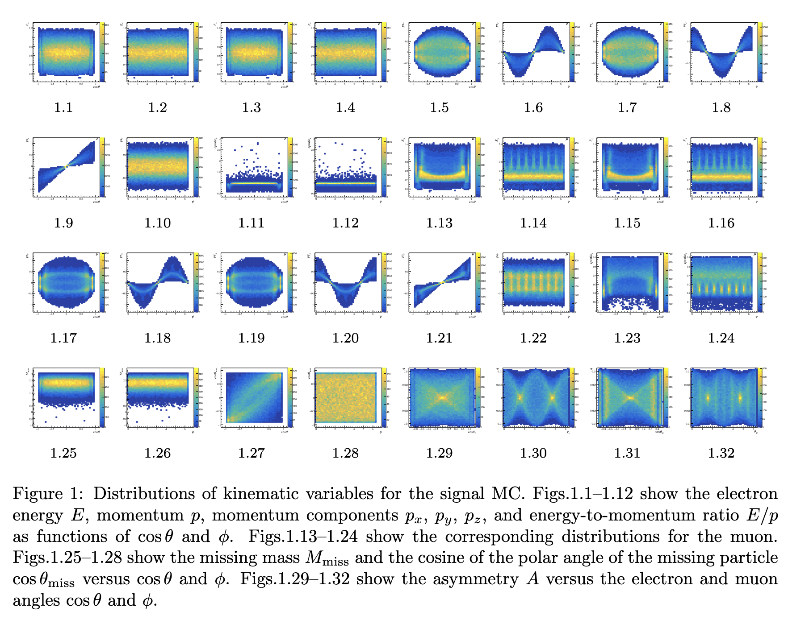

Slide 7
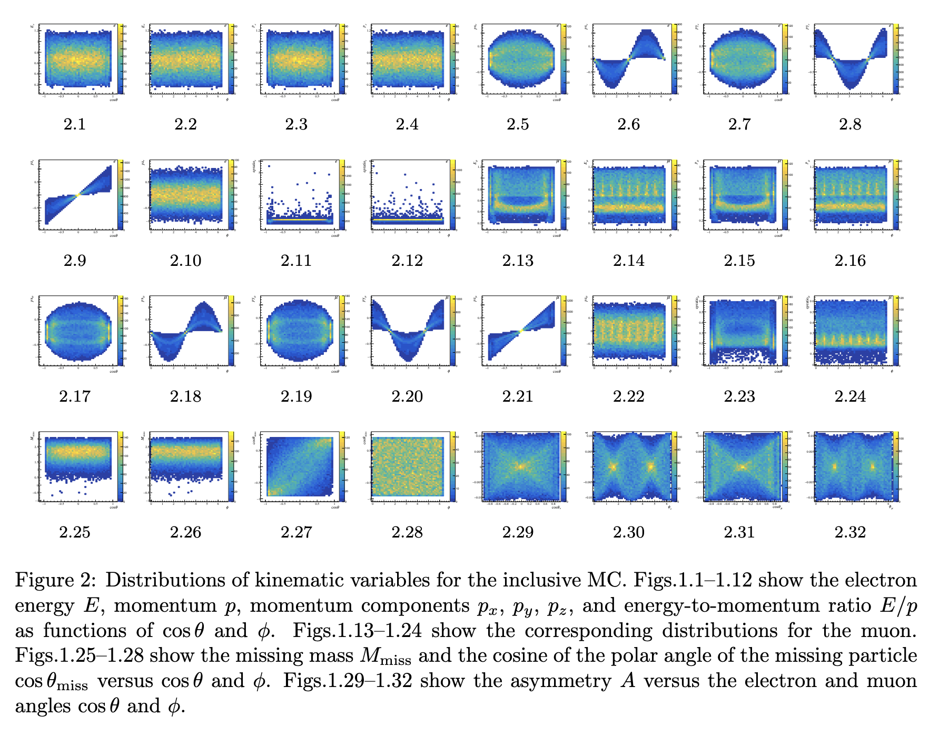

Slide 8
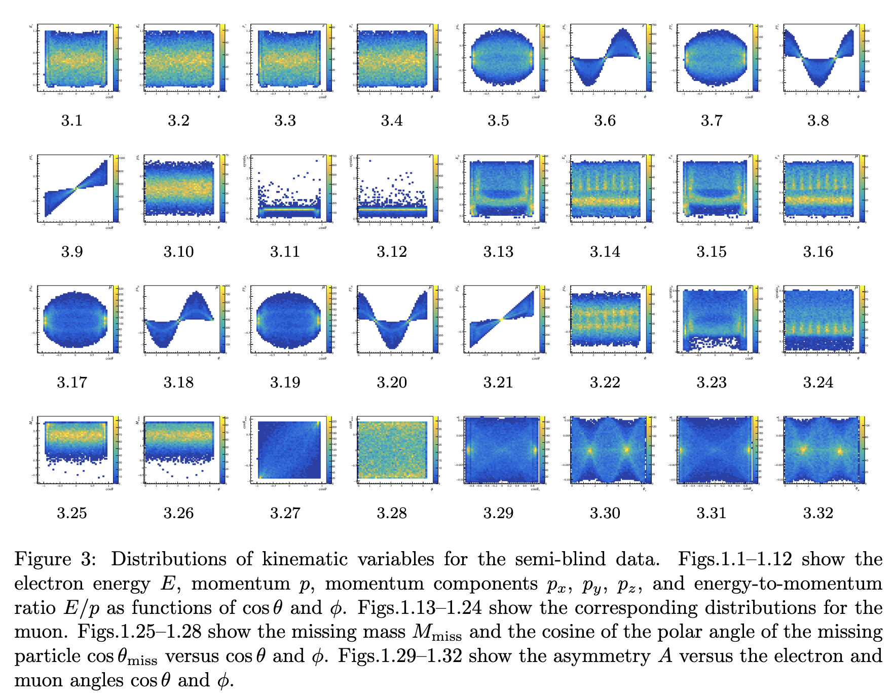

Slide 9
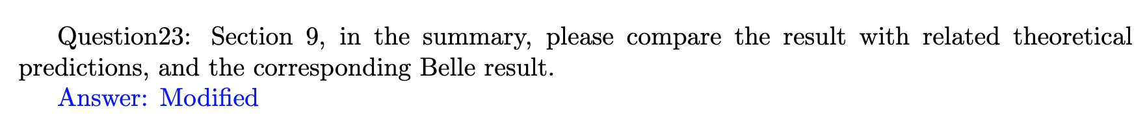
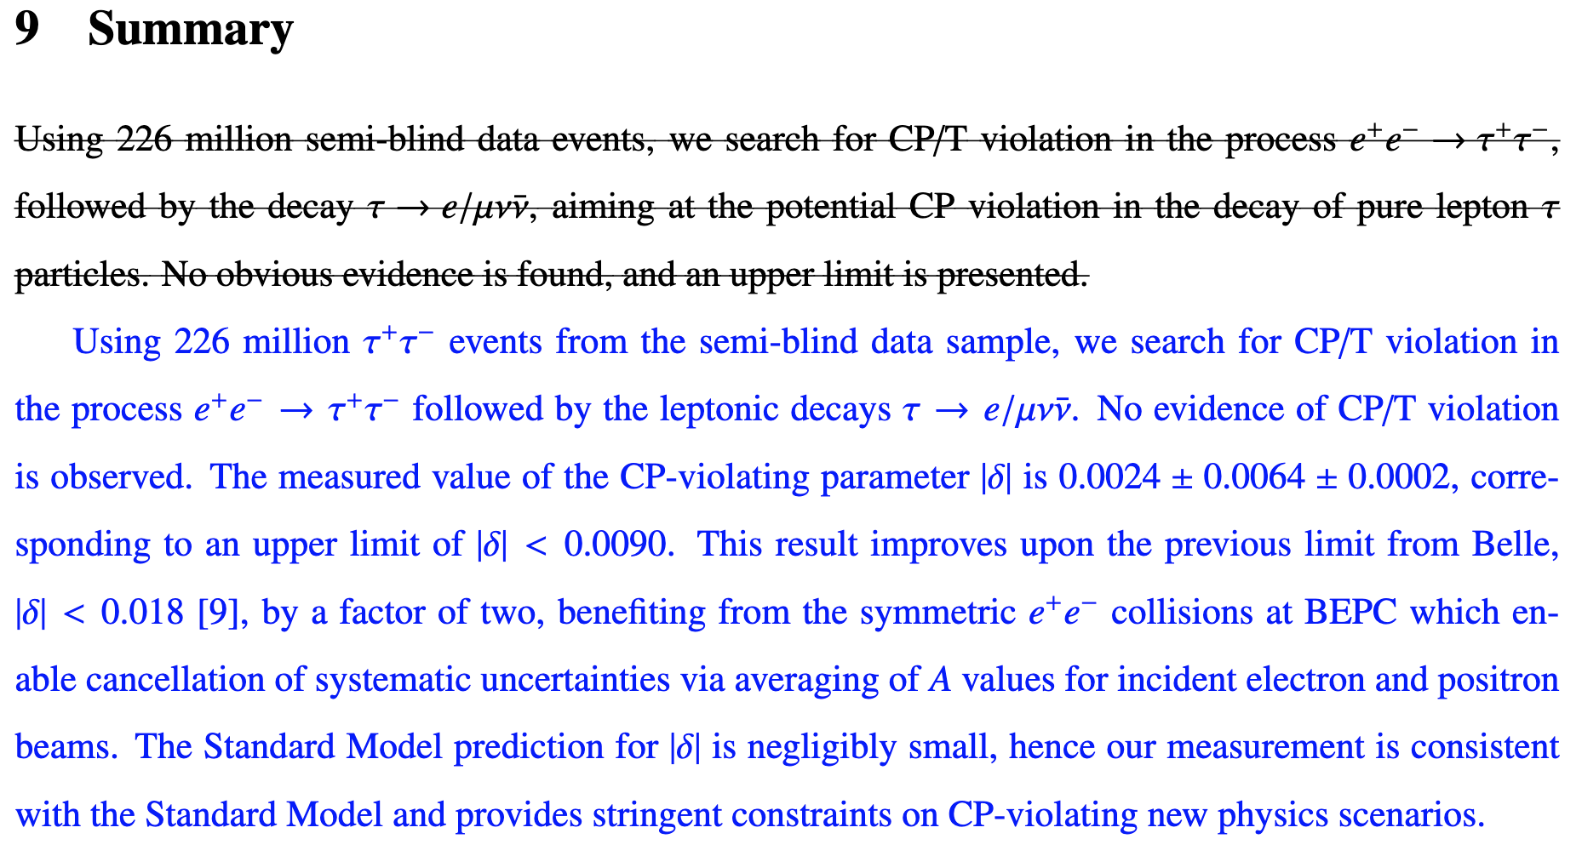
CPV

Slide 10
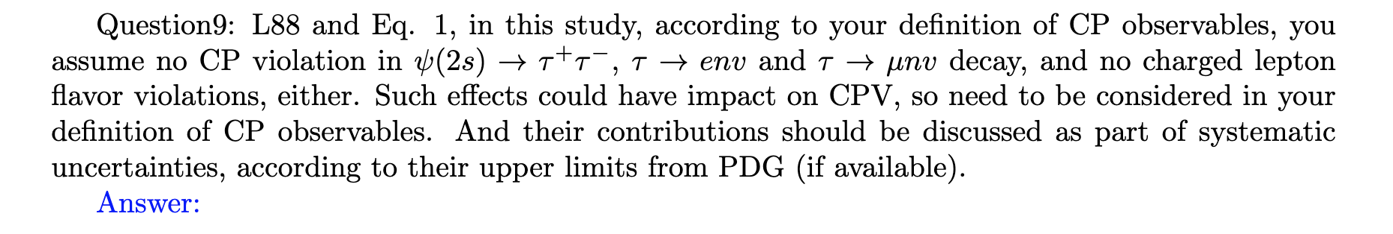
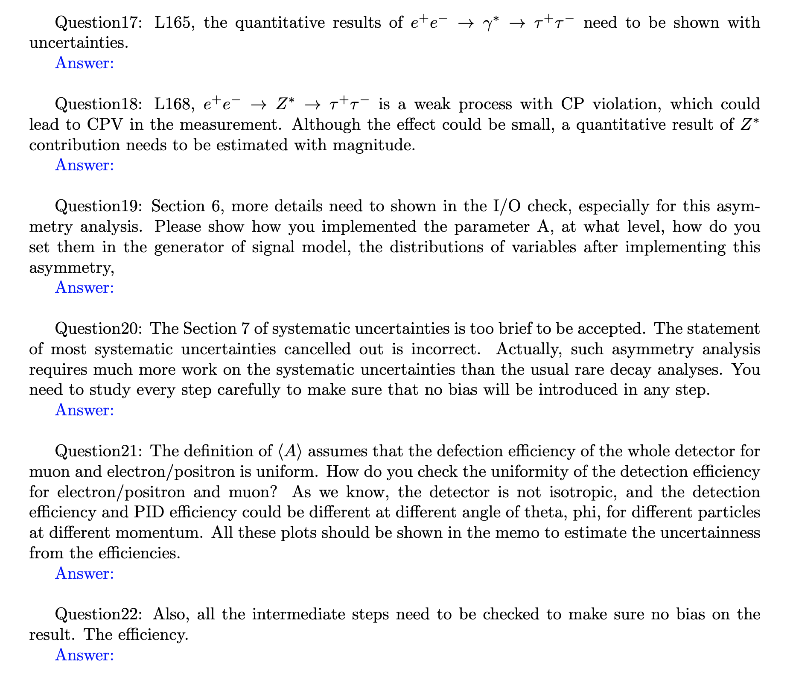
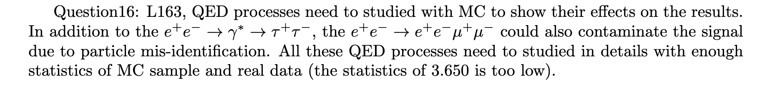
CPV
Next week
There are still 8 questions that we need to respond to.

Slide 11
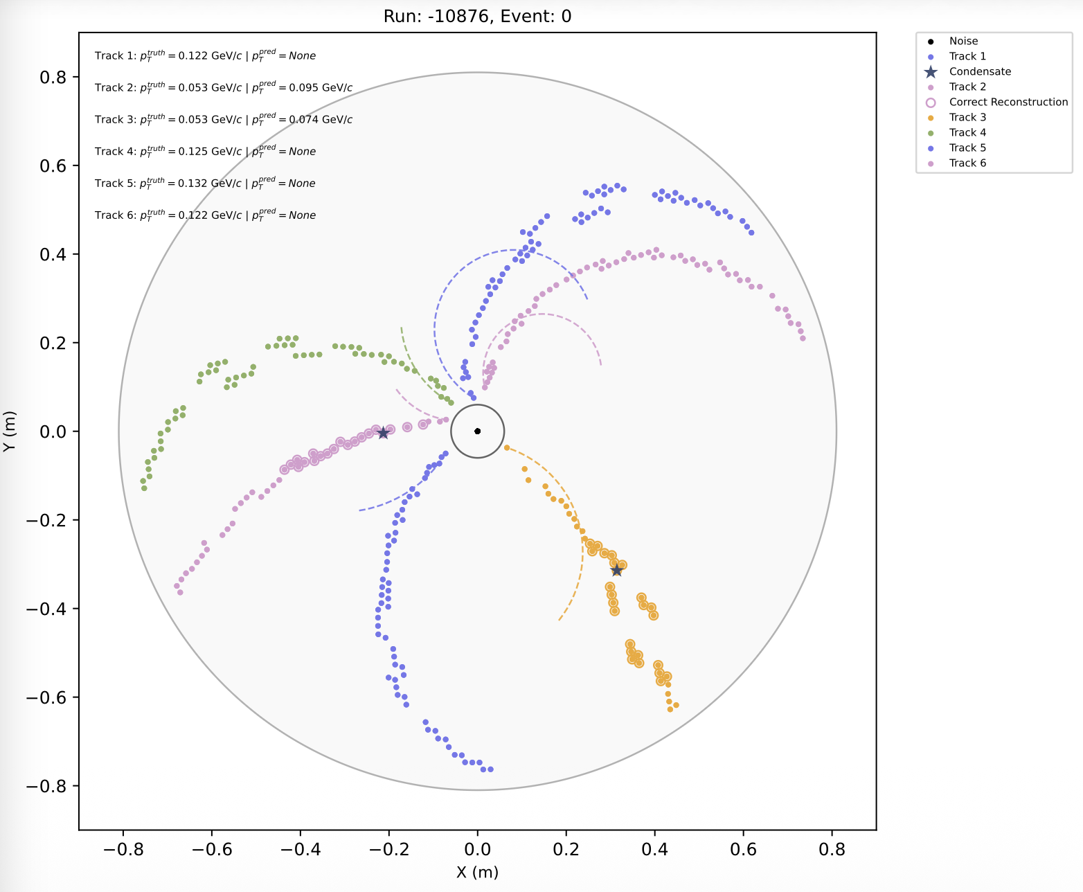
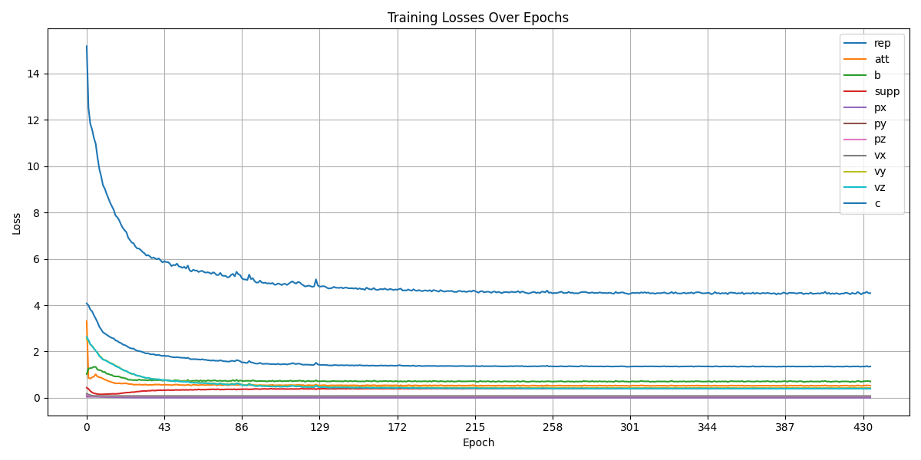
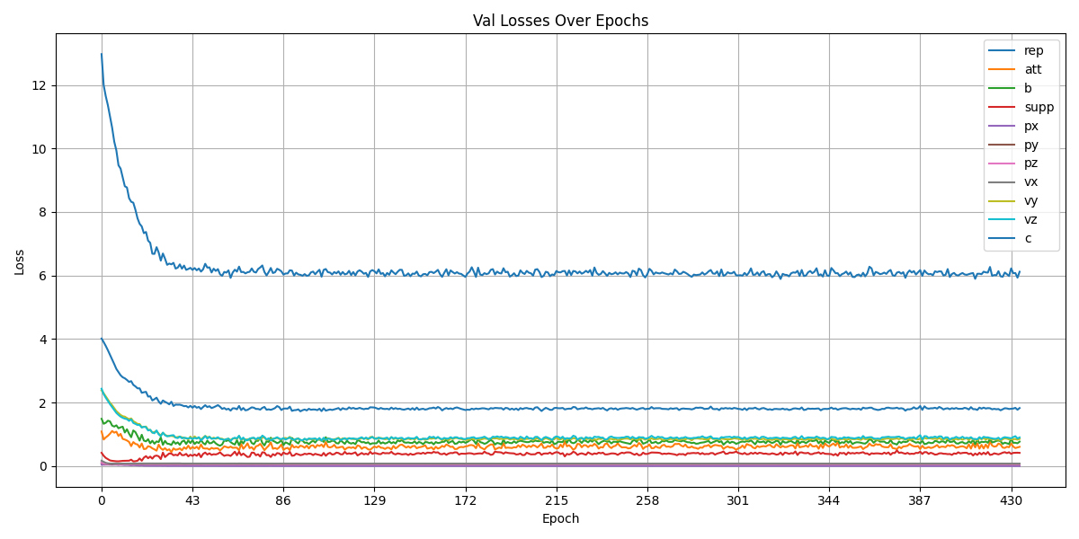
DC ML tracking
Train model: use 9,000 training samples and 1,000 validation samples.
After completing one round of training, the results were not satisfactory.
We believe this is due to the small sample size. The high-momentum training used approximately 200,000 samples for training, while the low-momentum samples were more complex, so more samples should be used.

