Slide 1

Study of $ψ\left(3686\right)→φηη$
Zhuang Xinyu
Nankai University
2025.11.25

Slide 2
Outline
Motivation
Decay chain
Data sets and MC simulation
Initial event selection criteria
Other event selection criteria
Topology analysis
2-body combinations
Next to do

Slide 3
Motivation

Slide 4
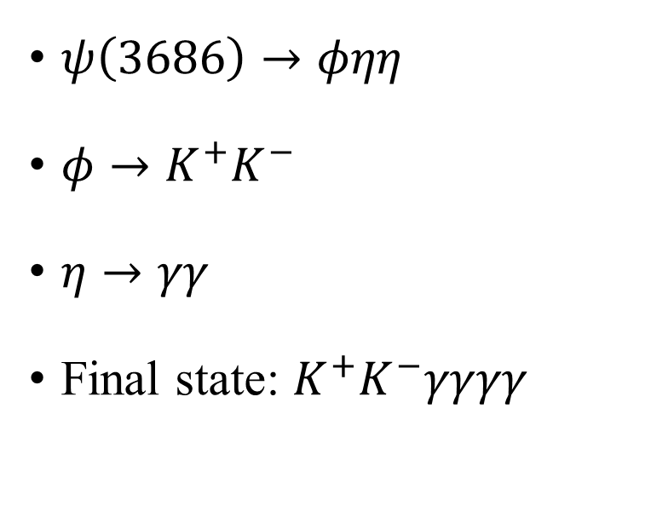
Decay Chain
$ψ\left(3686\right)→φηη$
$φ→K^{+}K^{−}$
$η→γγ$
Final state: $K^{+}K^{−}γγγγ$

Slide 5
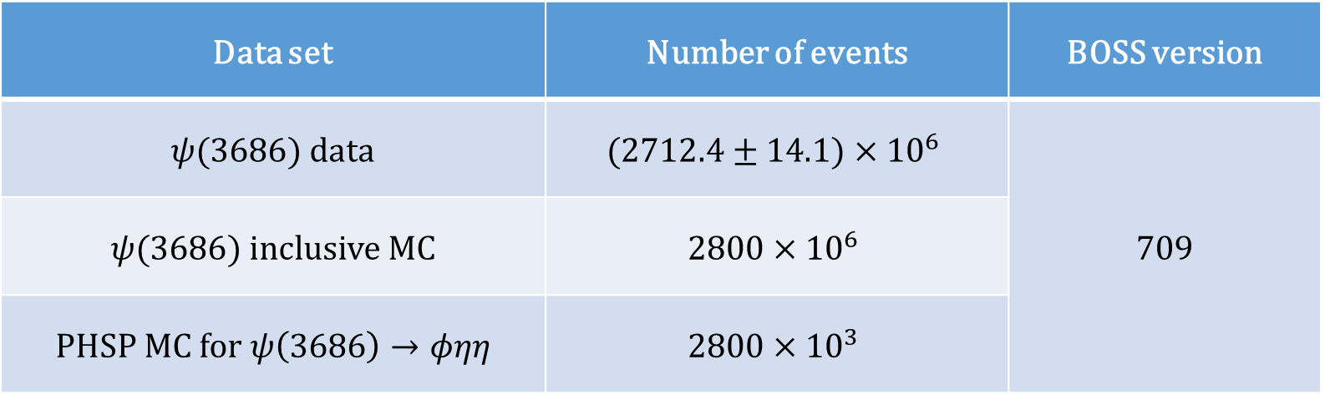
Data Sample and MC Simulation
Data set | Number of events | BOSS version
$ψ(3686)$ data | $$(2712.4±14.1)×{10}^{6}$$ | 709
$ψ(3686)$ inclusive MC | $$2800×{10}^{6}$$
PHSP MC for $ψ\left(3686\right)→φηη$ | $$2800×{10}^{3}$$

Slide 6

Initial Event Selection Criteria
Charged tracks:
  $\left|V_{xy}\right|<1 cm, \left|V_{z}\right|<10 cm$ (not from $\overline{Λ}/Λ$ decay)
  $\left|cosθ\right|≤0.93$
  $N_{good}=2, N_{charge}^{tot}=0$
PID:
  $N_{K^{+}}=1, N_{K^{−}}=1$
  The tracks are assigned to the particle type with the highest confidence level
Good photons:
  $0≤TDC≤14$
  Barrel: $E>25 MeV, \left|cosθ\right|<0.8$
  End cap: $E>50 MeV, 0.86<\left|cosθ\right|<0.92$
  $N_{γ}≥4$
Vertex fit:
  The $K^{+}K^{−}$ pair is fitted to a common vertex
$η$ reconstruction:
  Combining pairs of photons by kinematic fit with $η$ mass constraint
  $χ_{η}^{2}<20, N_{η}≥2$
Kinematic fit:
  4-momentum conservation constraint (4C) + $η$ mass constraint (1C×2) kinematic fit under hypothesis of $ψ\left(3686\right)→φηη$

Slide 7
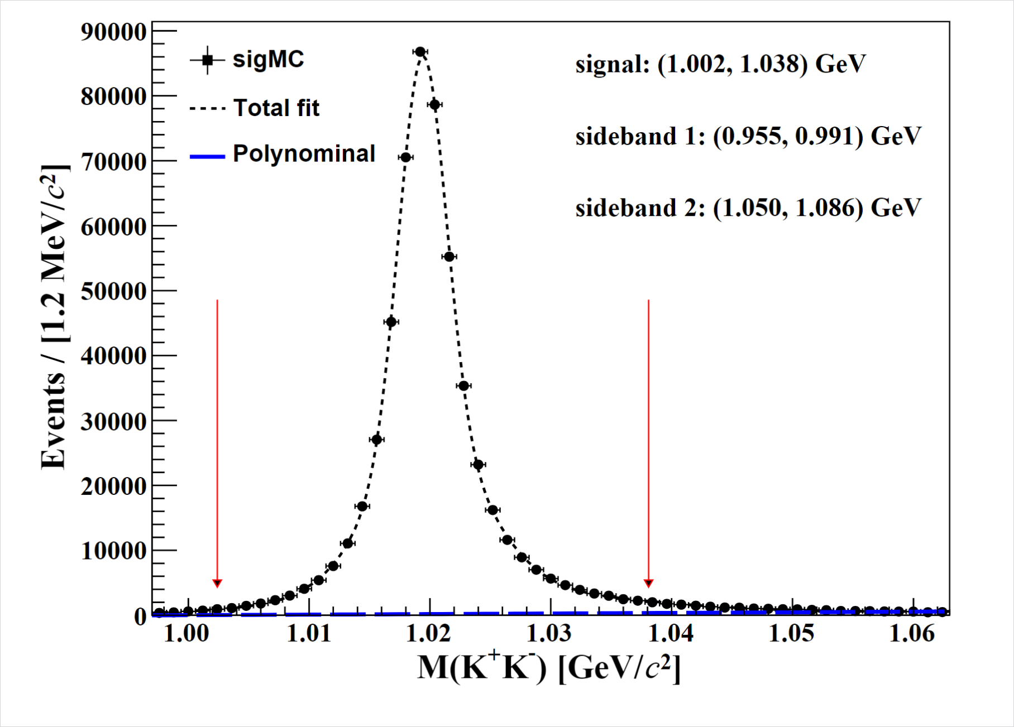
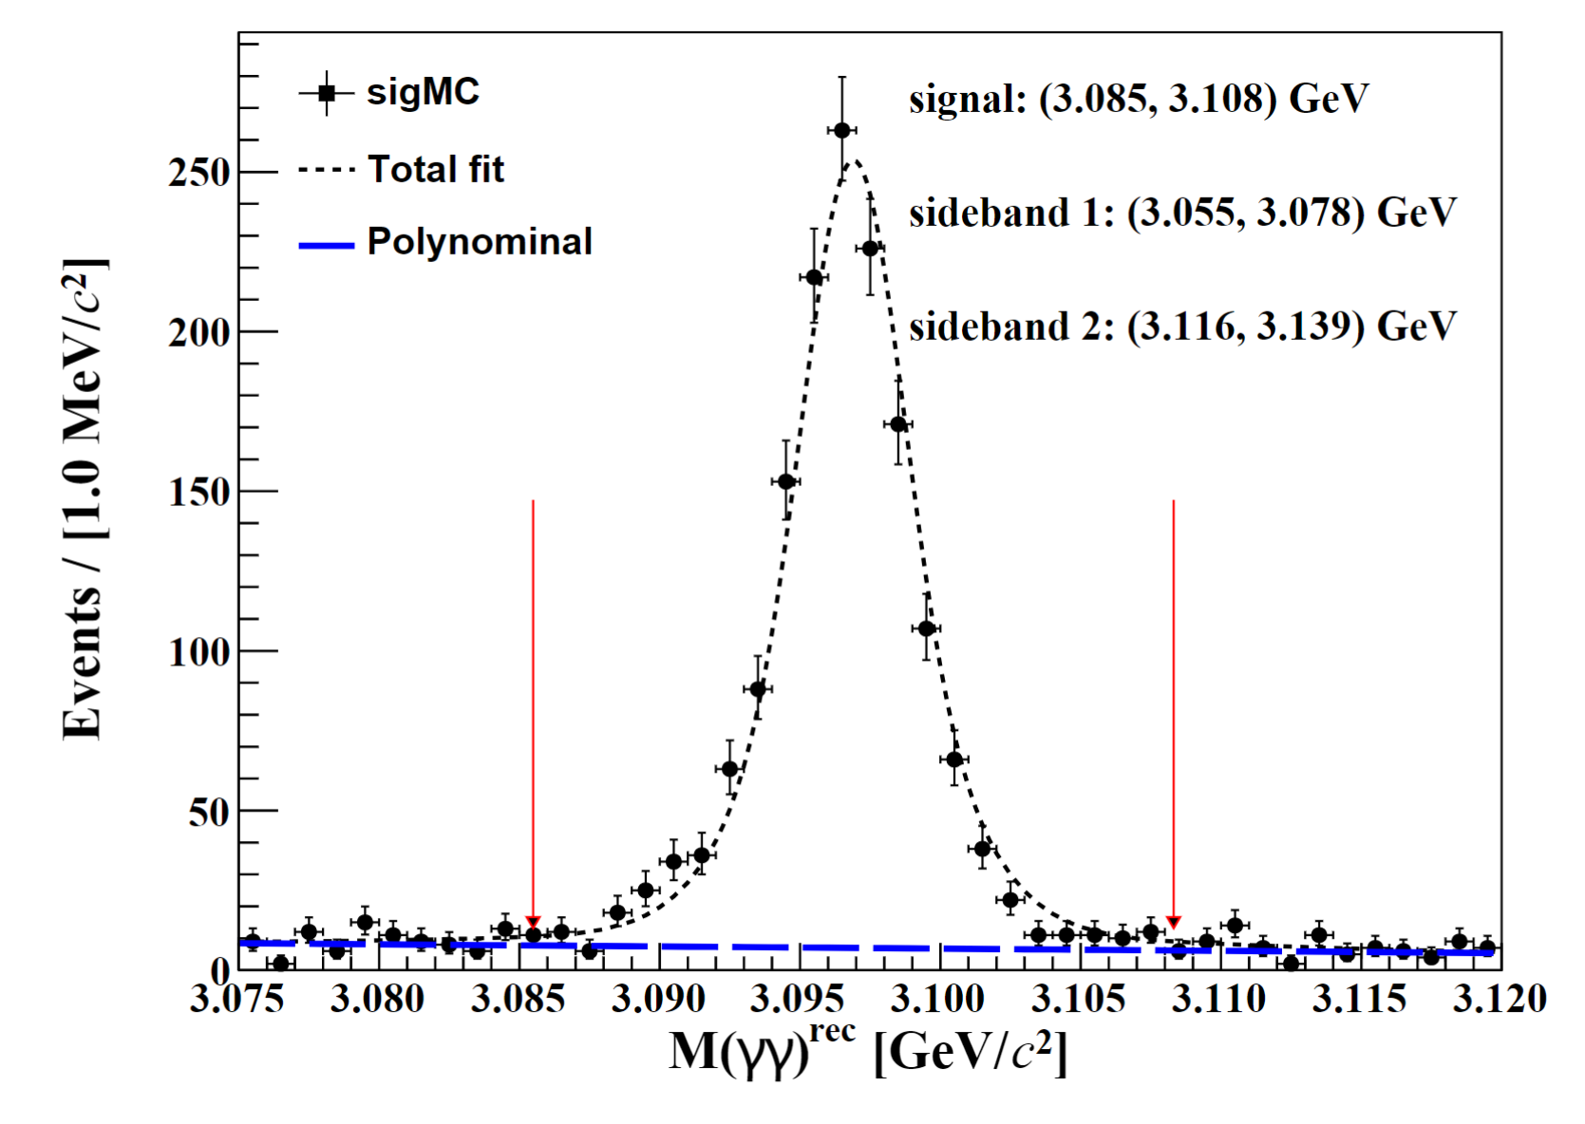

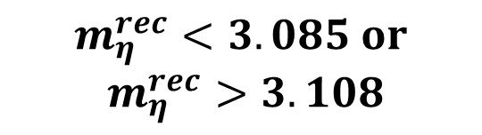
Other Event Selection Criteria
$$m_{η}^{rec}<3.085 or$$
$$m_{η}^{rec}>3.108$$
$$1.002< m_{φ}<1.038 GeV$$

Slide 8
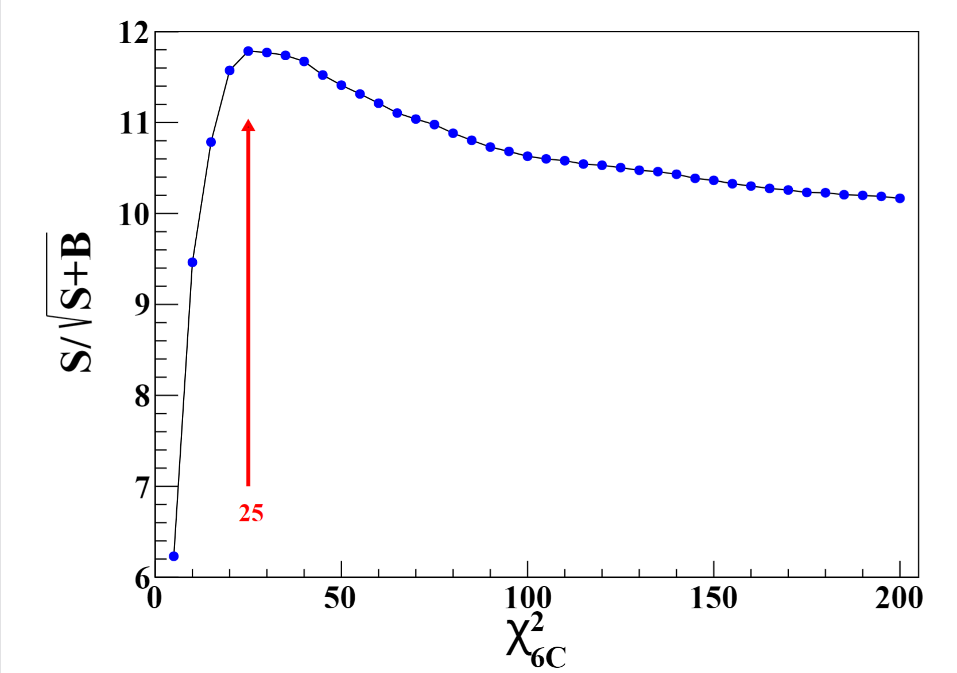
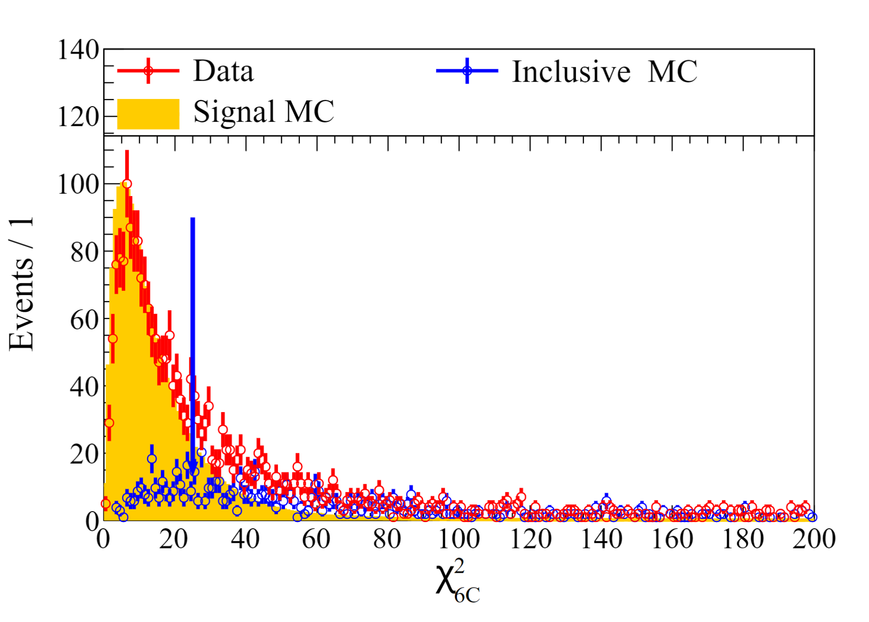


Other Event Selection Criteria
$$FOM=\frac{S}{\sqrt{S+B}}$$
$$χ^{2}<25$$

Slide 9
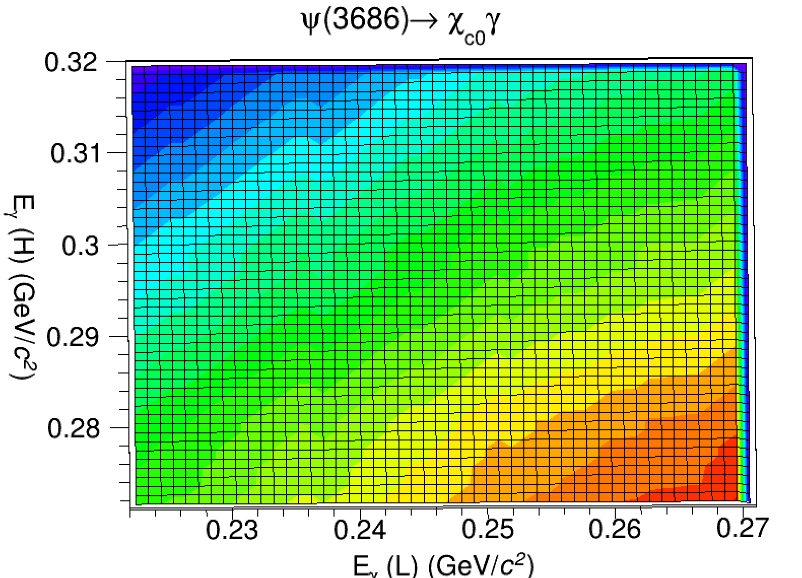
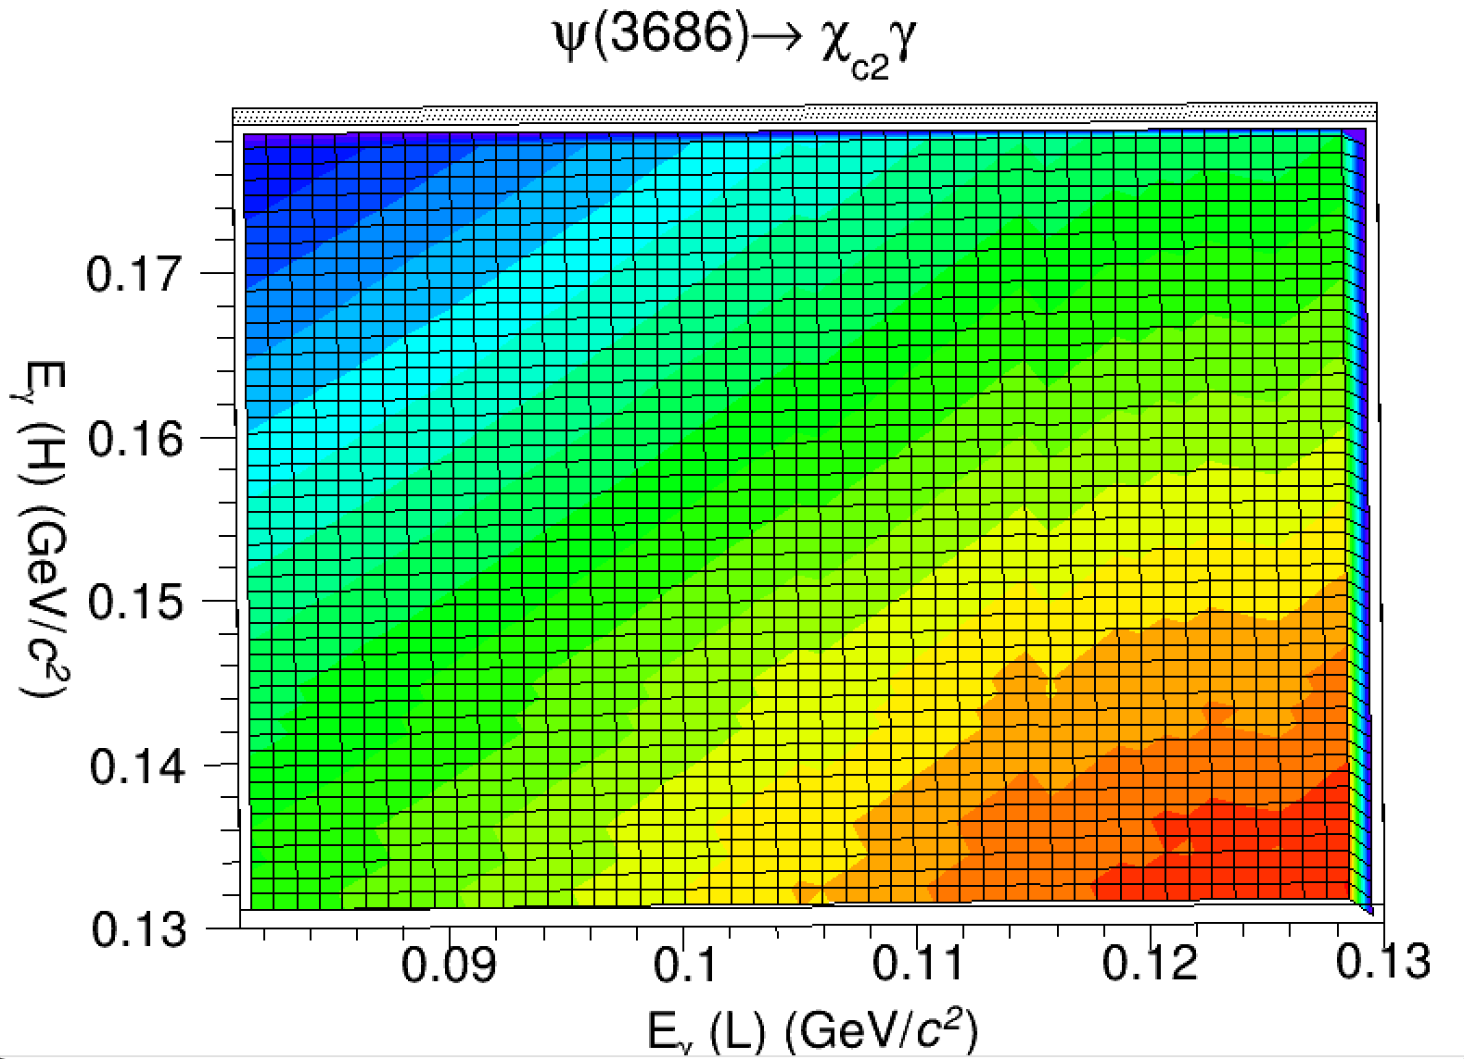

Other Event Selection Criteria

Slide 10
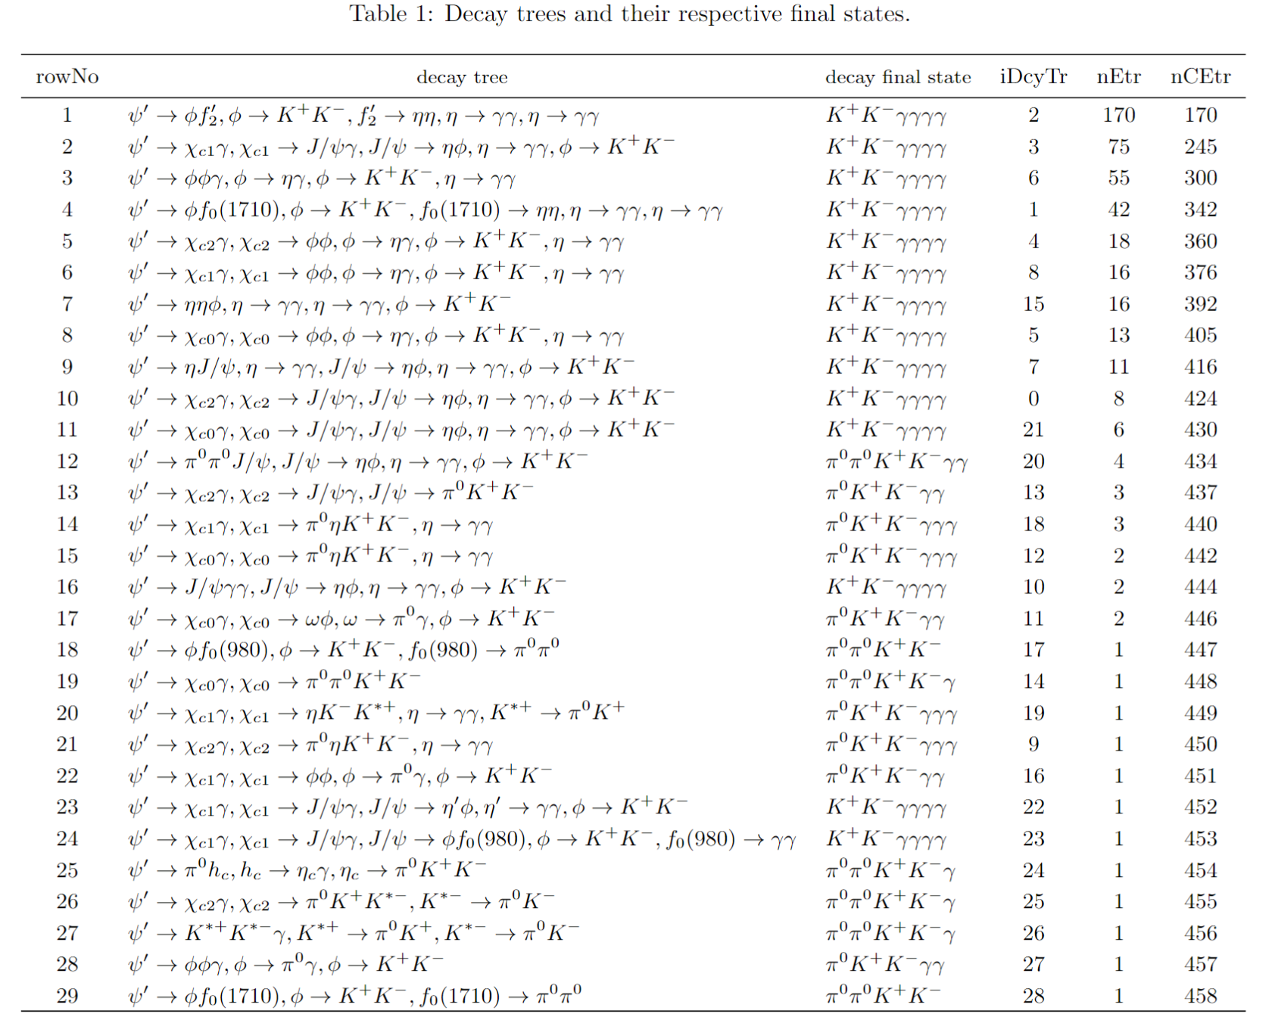
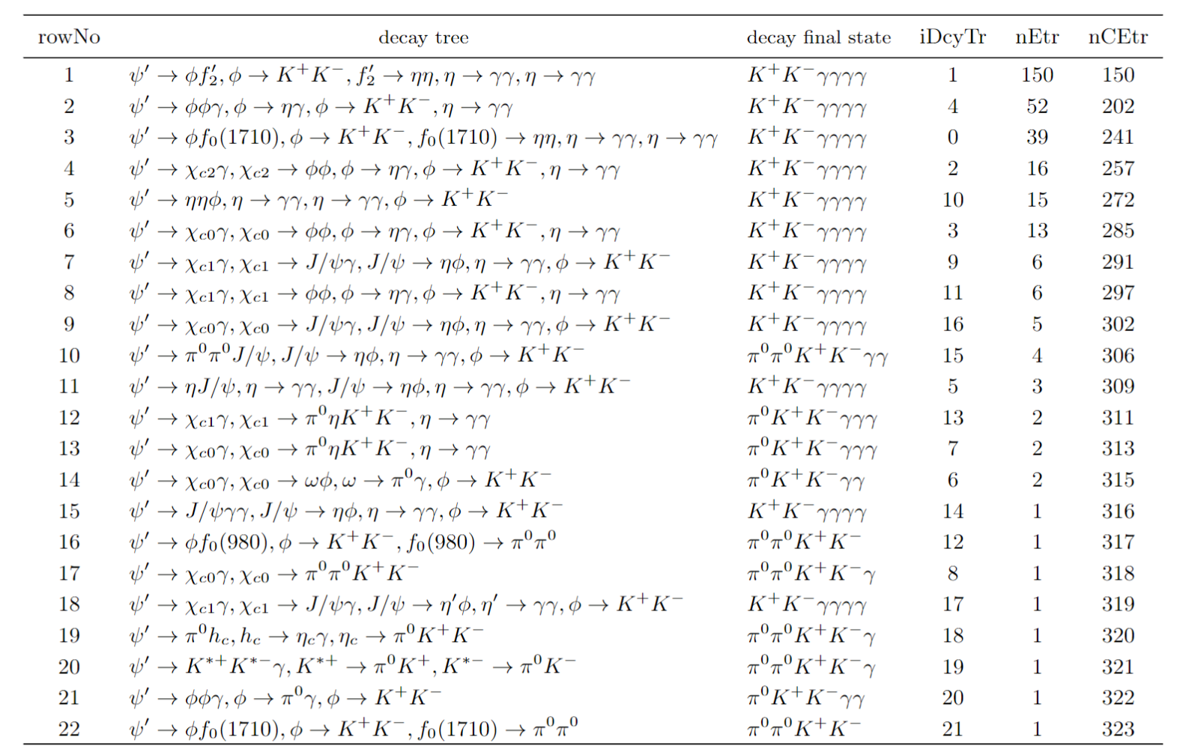
Topology Analysis

Slide 11
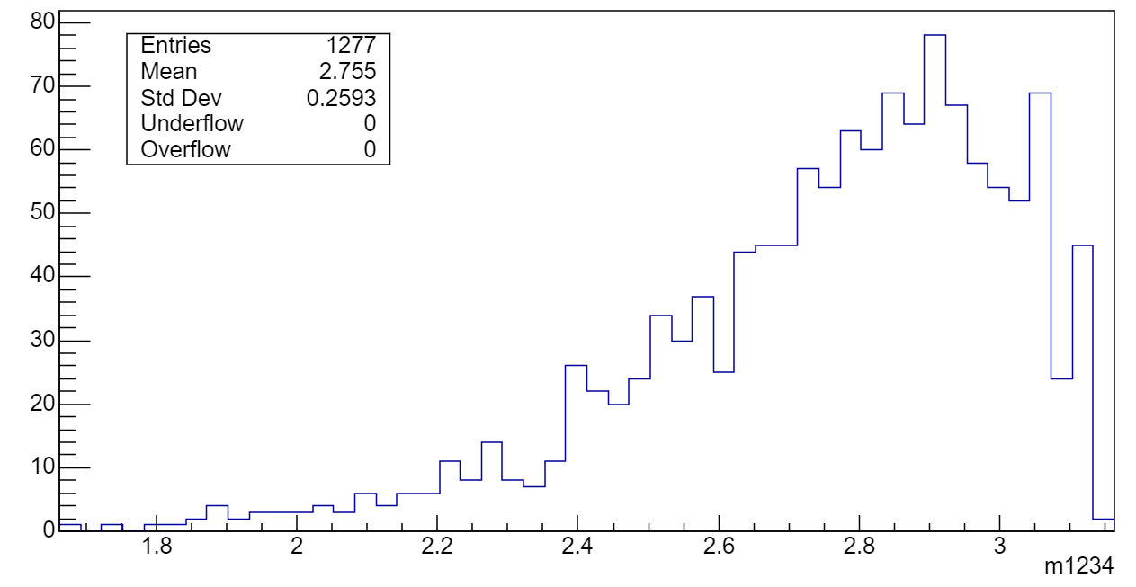
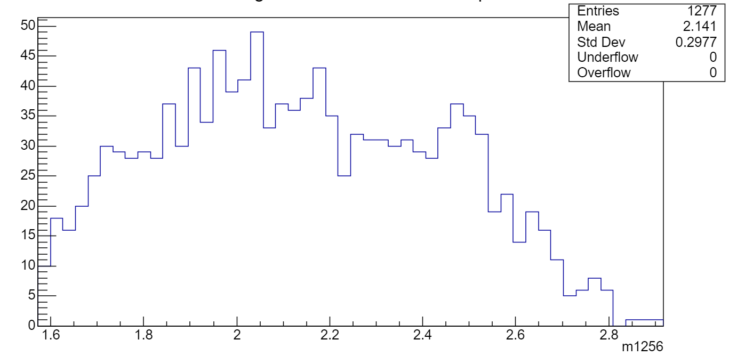
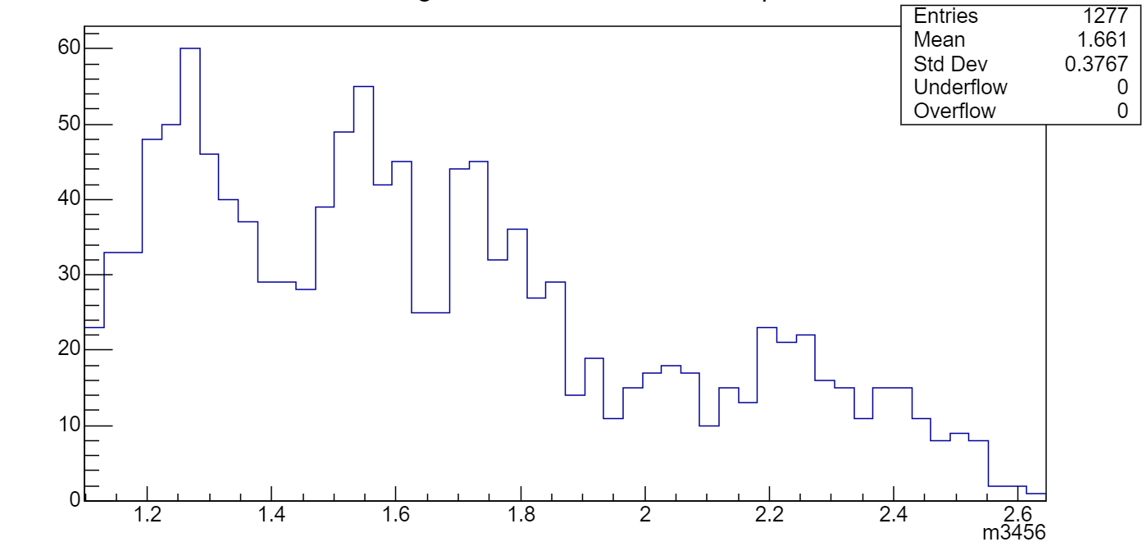



Data Distribution
$$M(φη_{1})$$
$$M(φη_{2})$$
$$M(η_{1}η_{2})$$

Slide 12
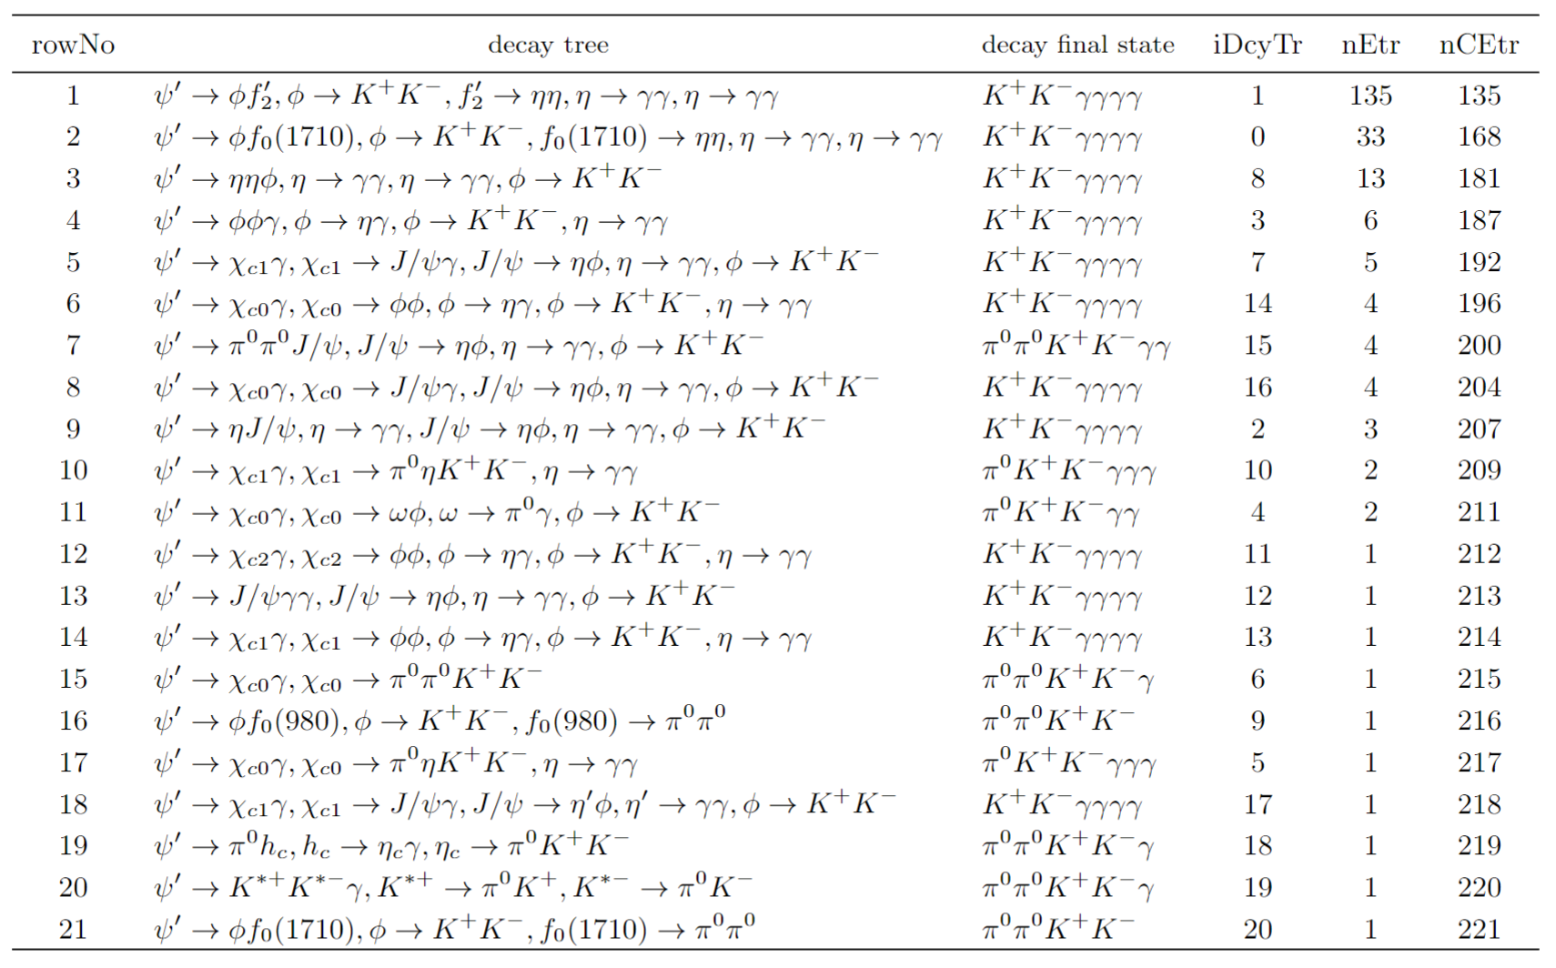
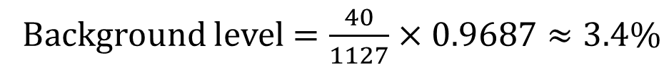
Topology Analysis
Background level $=\frac{40}{1127}×0.9687≈3.4\%$

Slide 13
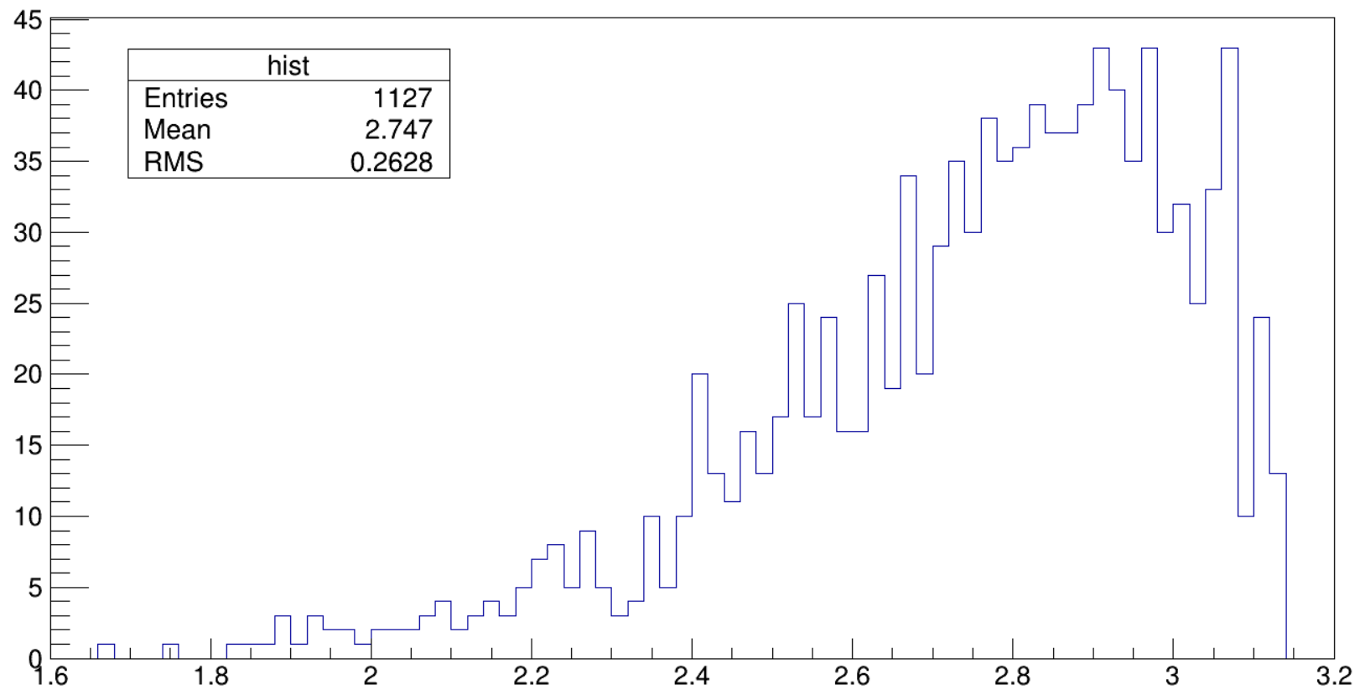
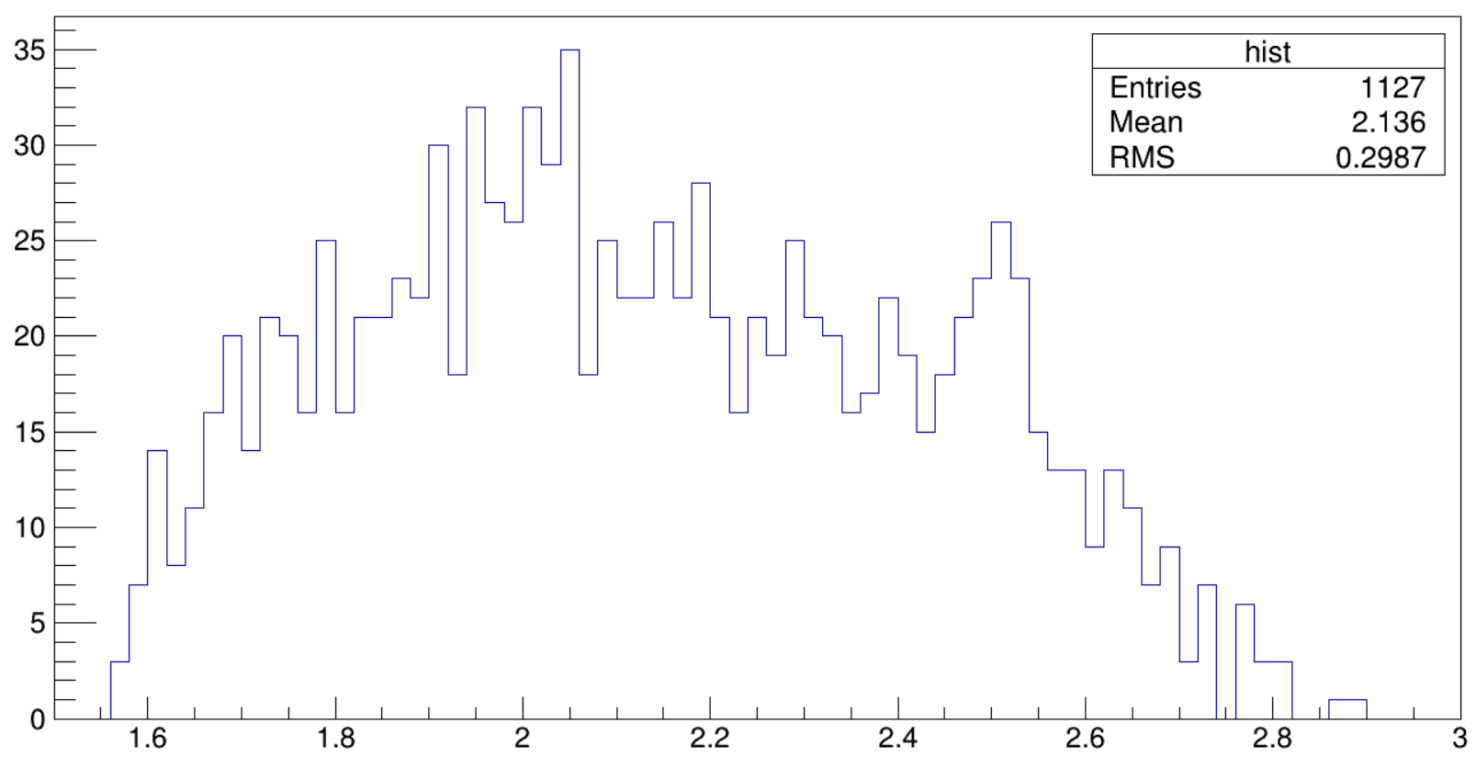
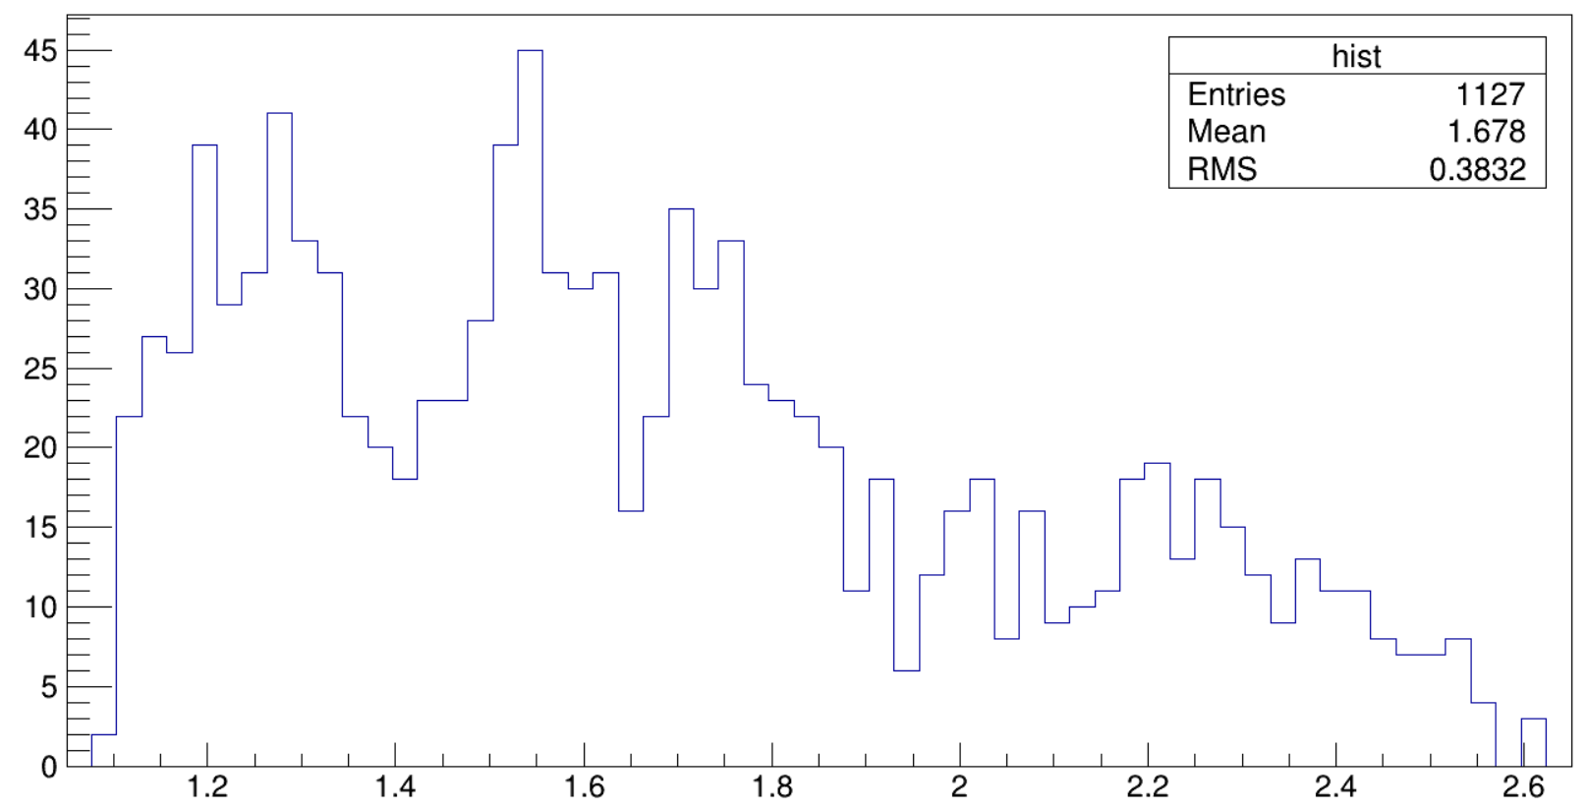


Data Distribution
$$M(φη_{1})$$
$$M(φη_{2})$$
$$M(η_{1}η_{2})$$

Slide 14
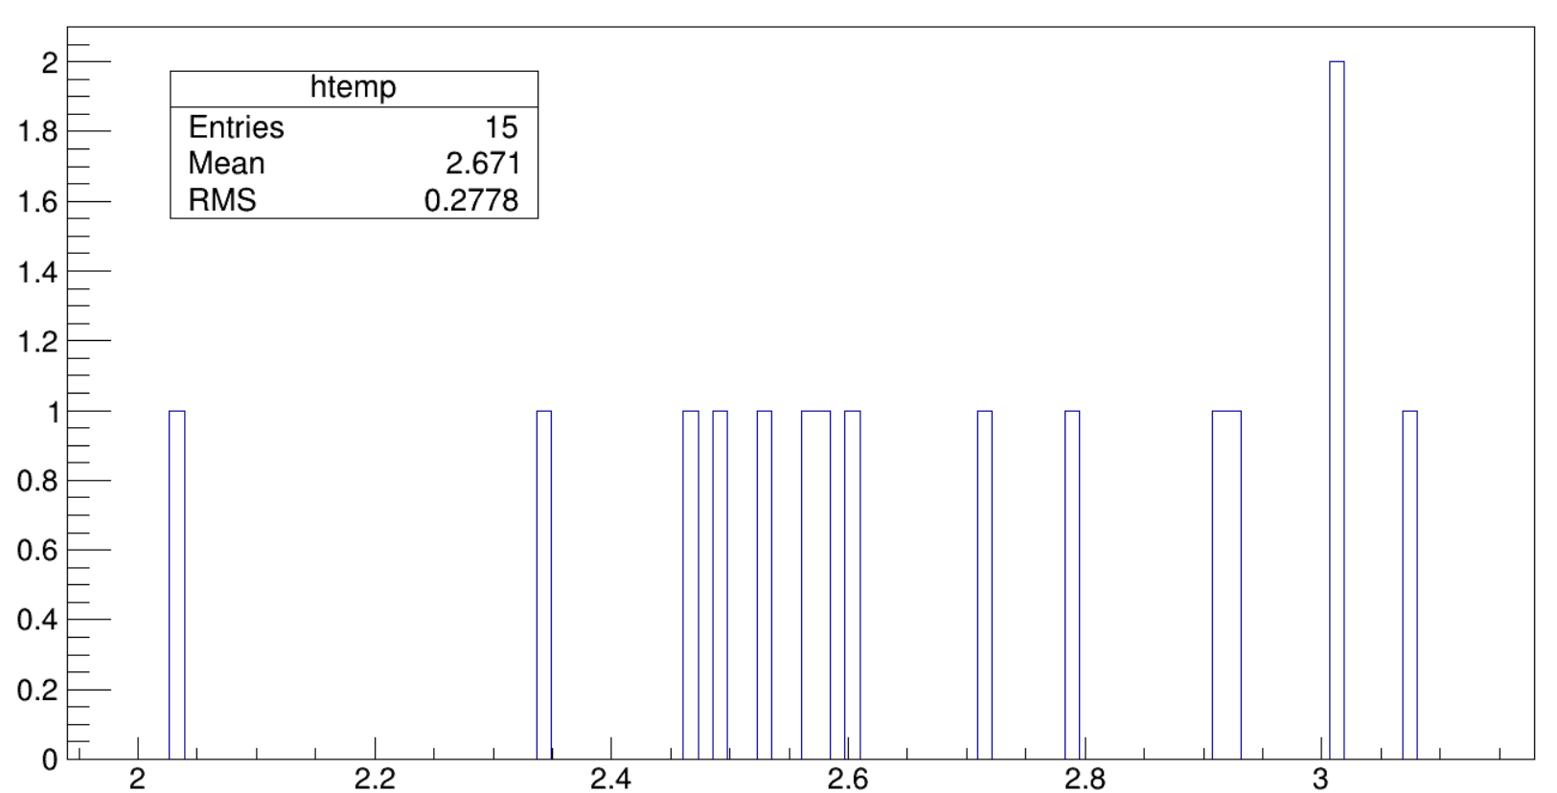
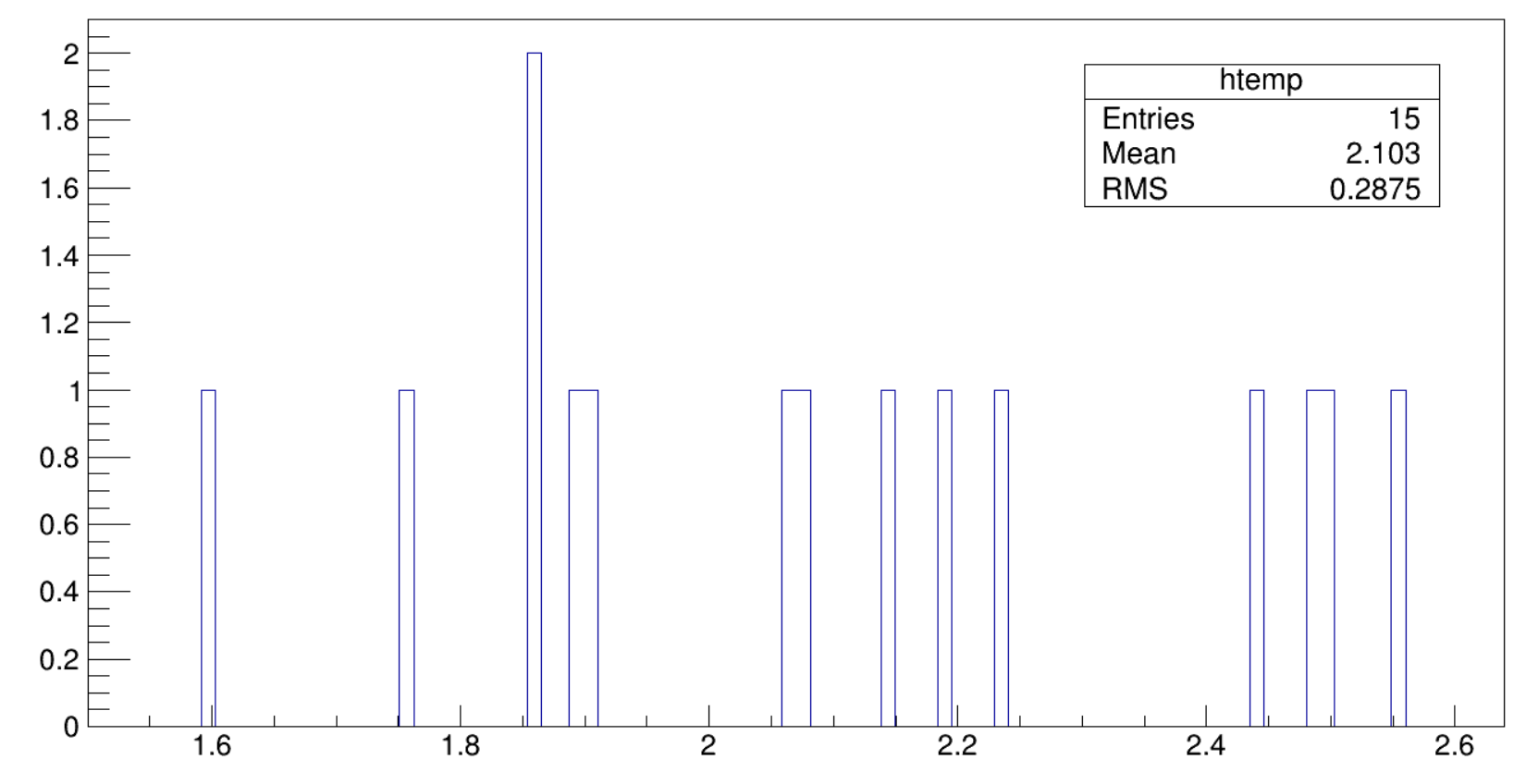
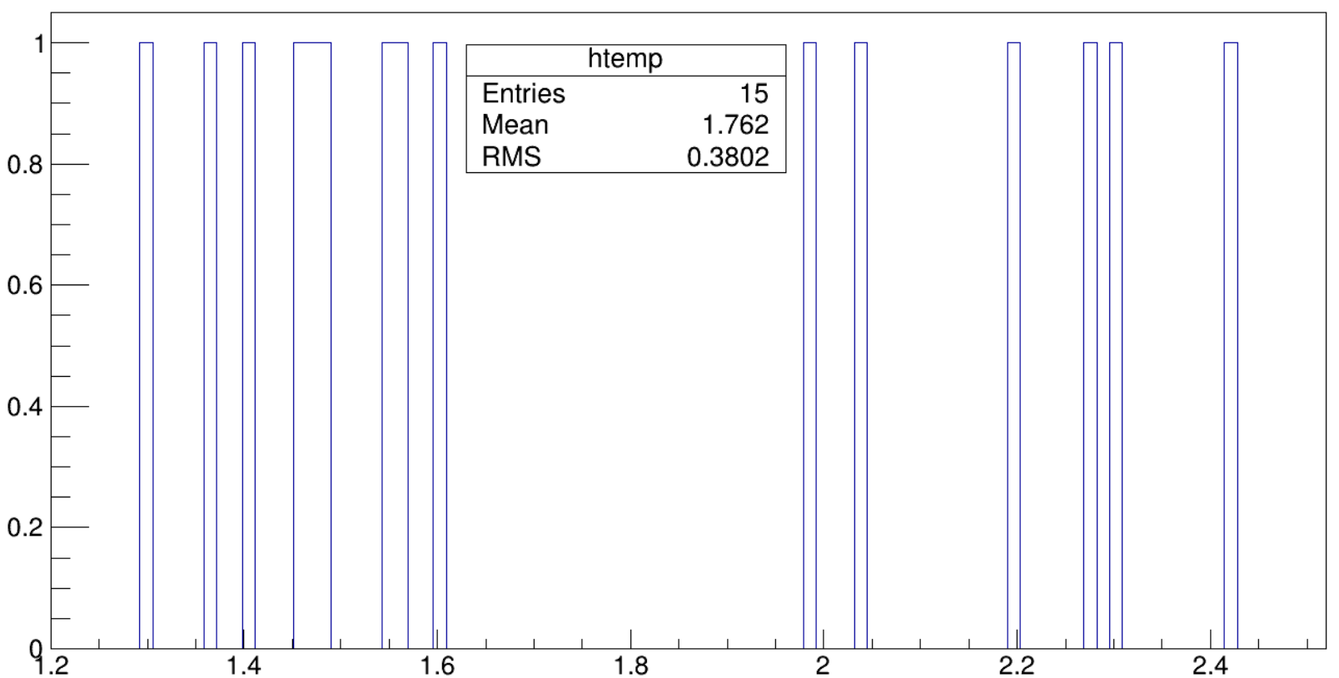



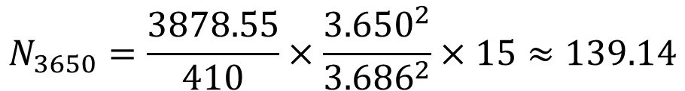
Continuum Background
$$M(φη_{1})$$
$$M(φη_{2})$$
Estimation from 3.650 GeV.
No obvious structure is observed.
$$N_{3650}=\frac{3878.55}{410}×\frac{{3.650}^{2}}{{3.686}^{2}}×15≈139.14$$
$$M(η_{1}η_{2})$$

Slide 15
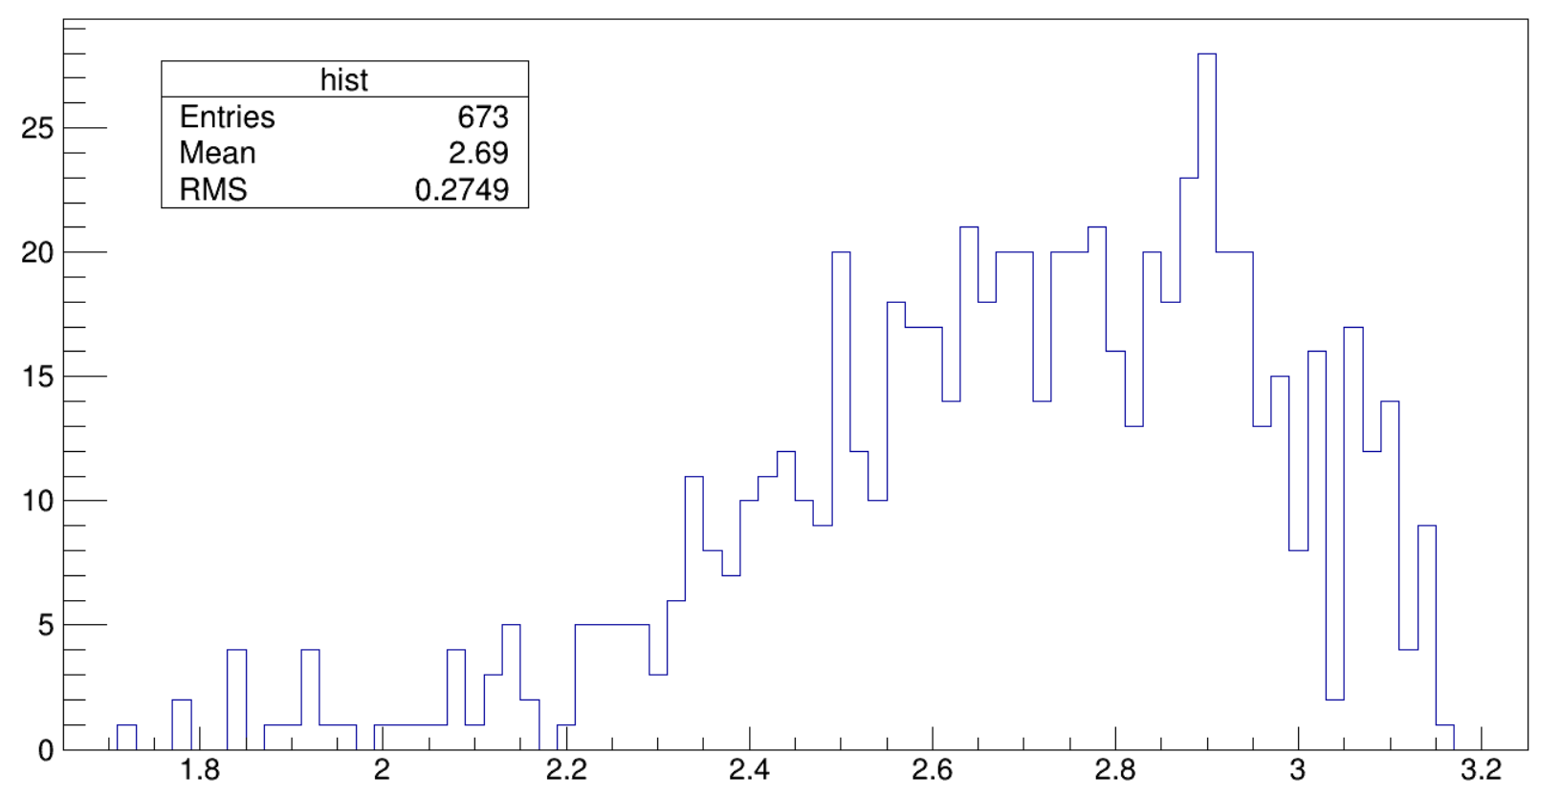
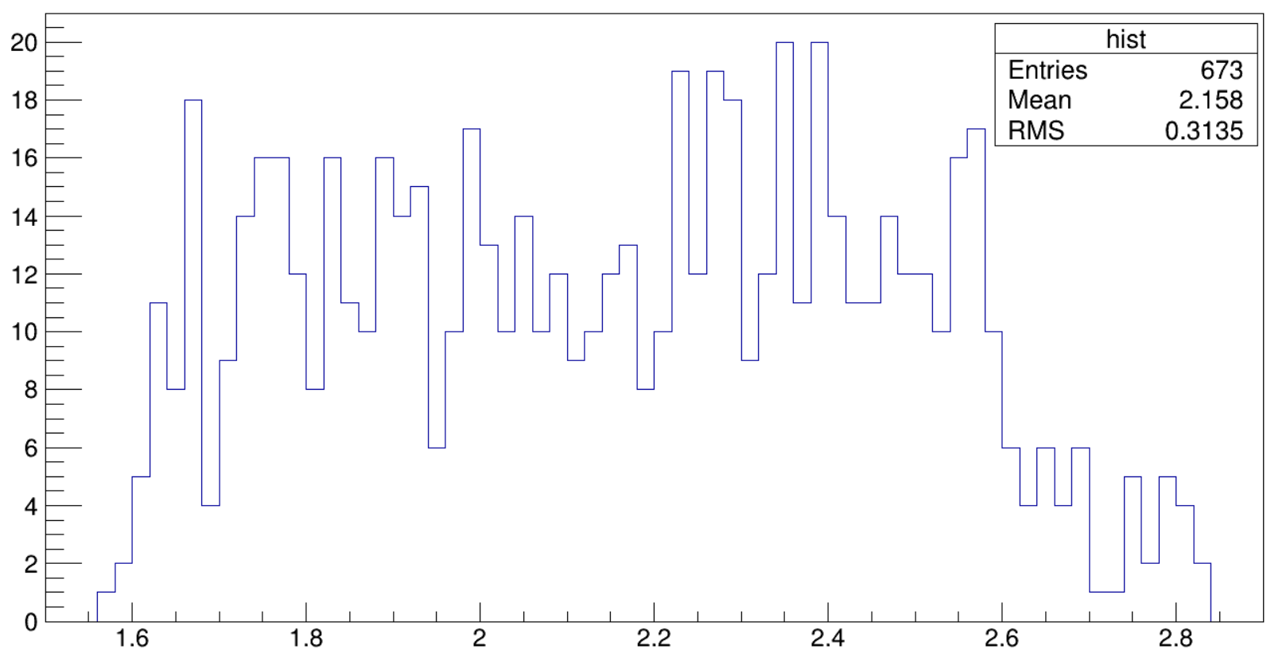
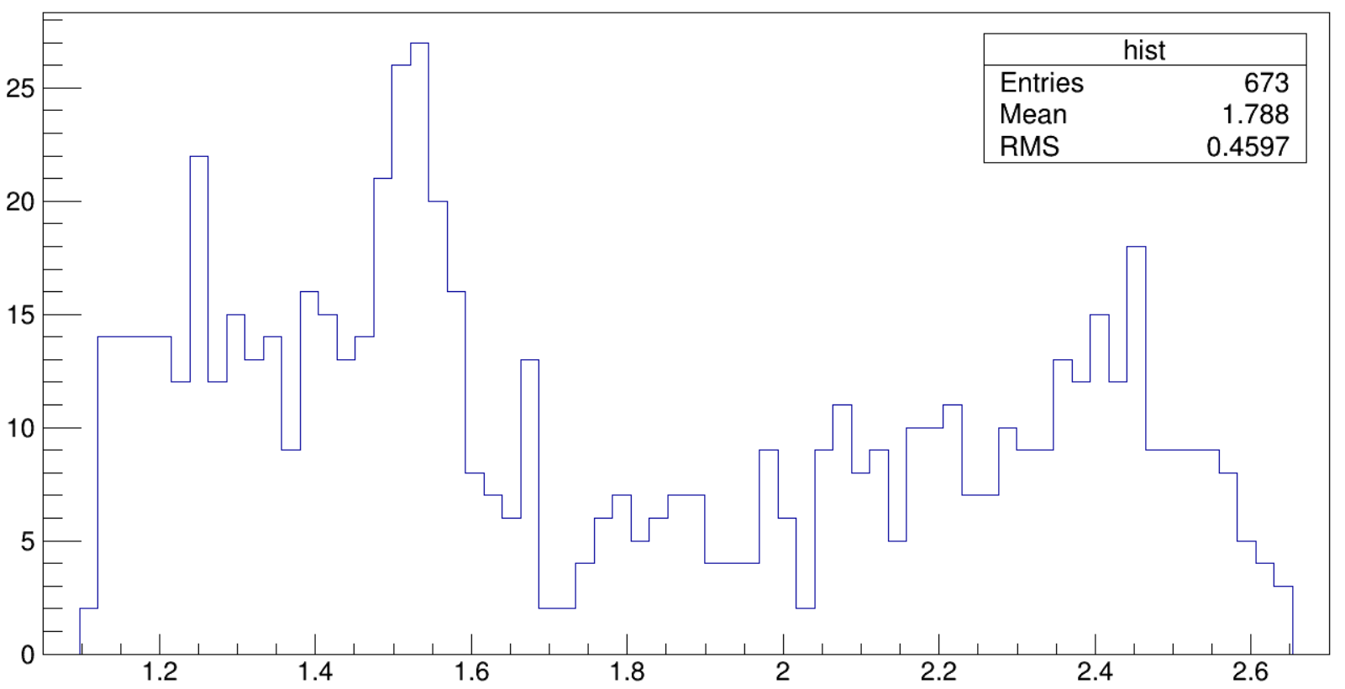
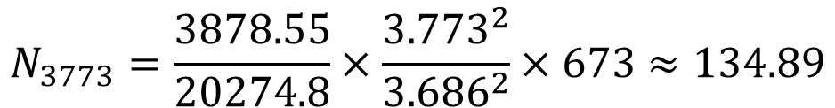
Continuum Background
$$M(φη_{1})$$
$$M(φη_{2})$$
Estimation from 3.773 GeV. Obvious structure is observed.
$$N_{3773}=\frac{3878.55}{20274.8}×\frac{{3.773}^{2}}{{3.686}^{2}}×673≈134.89$$
$$M(η_{1}η_{2})$$

Slide 16
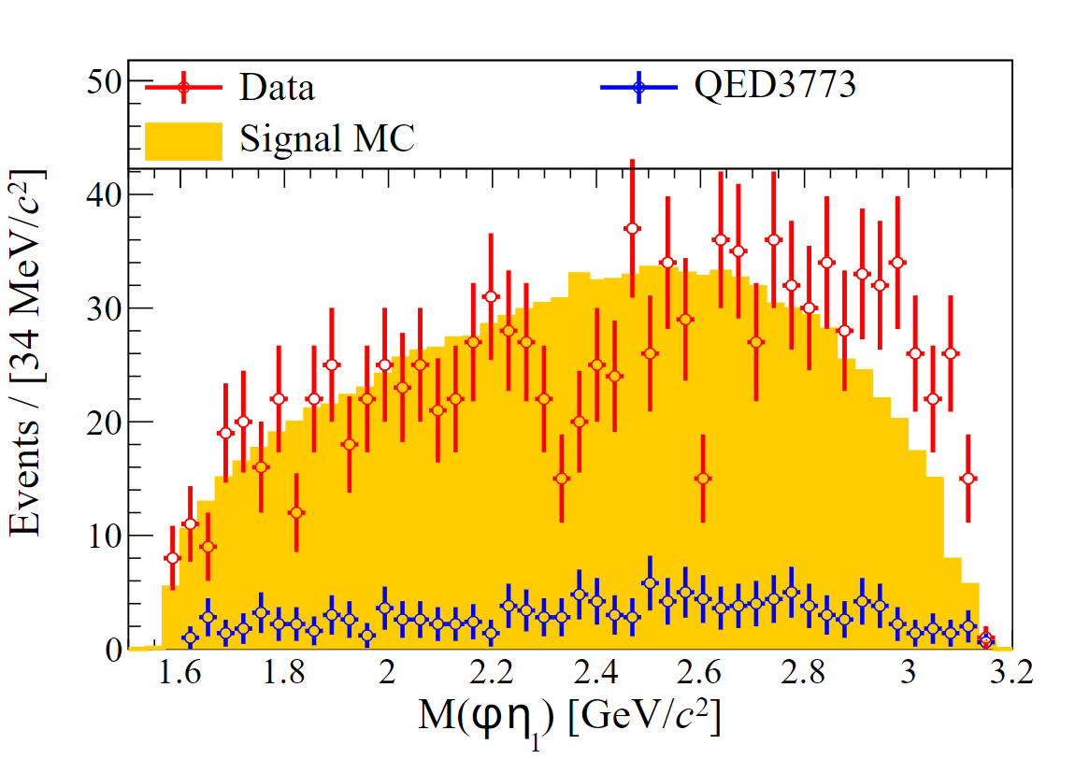
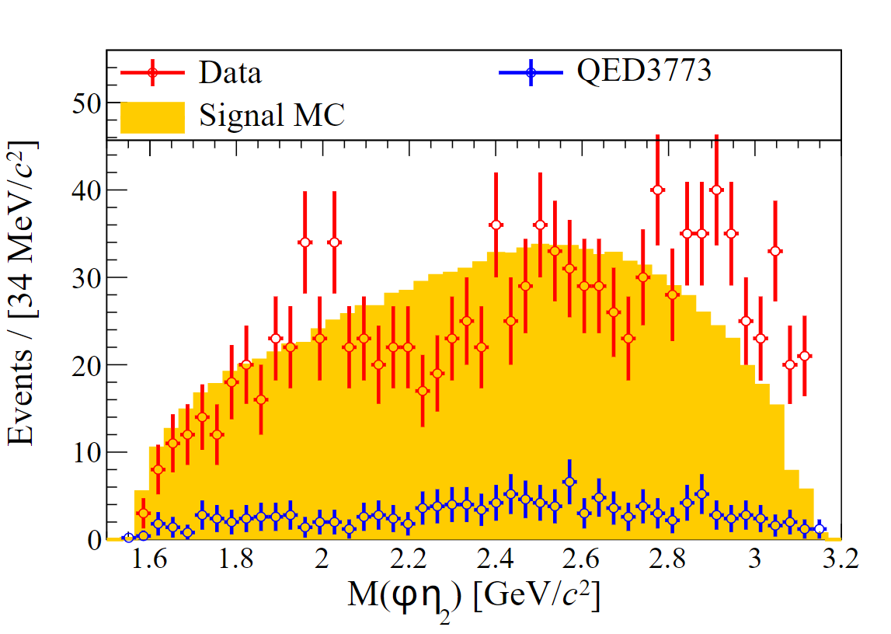
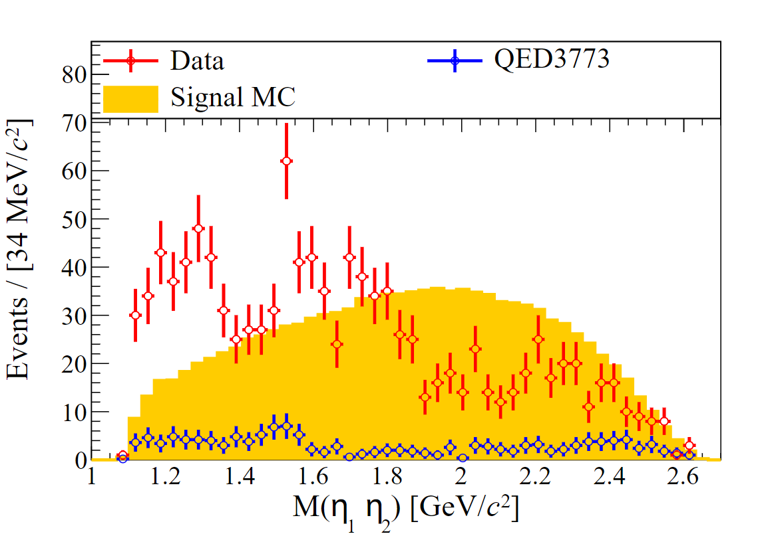
Data Distribution

Slide 17
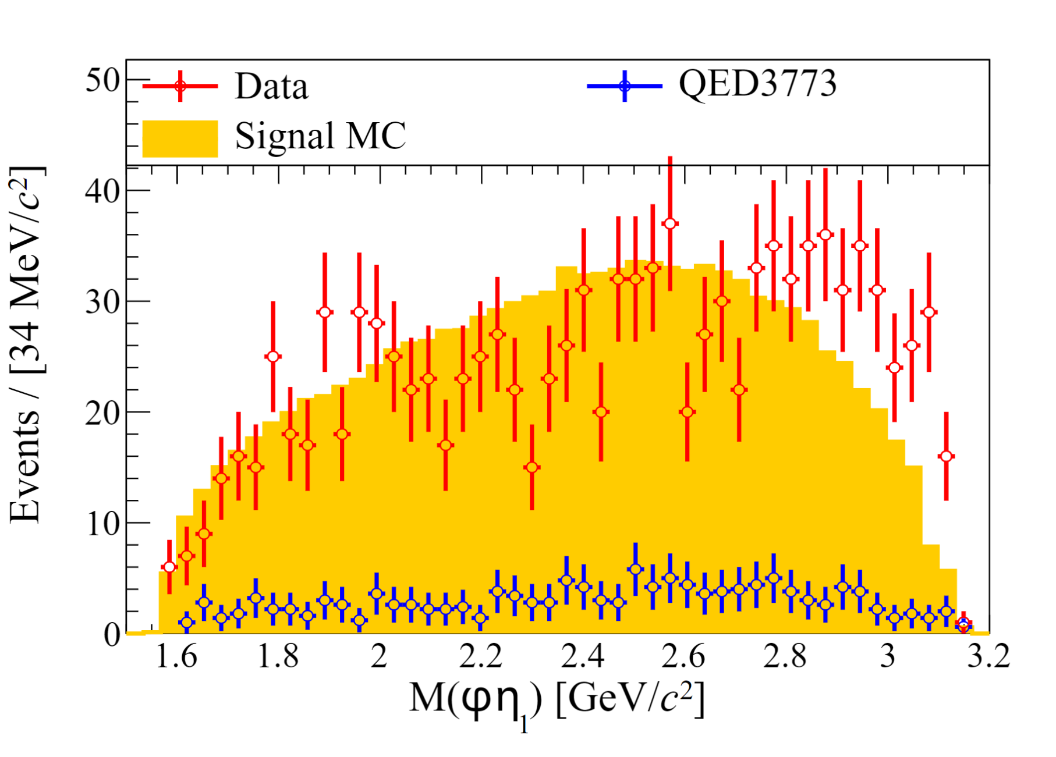
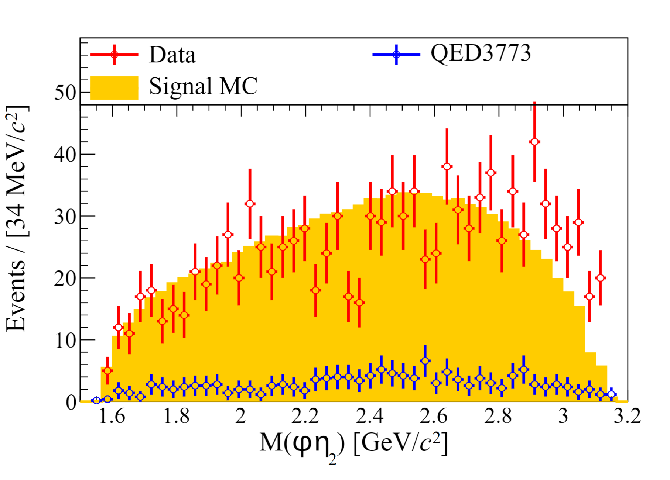
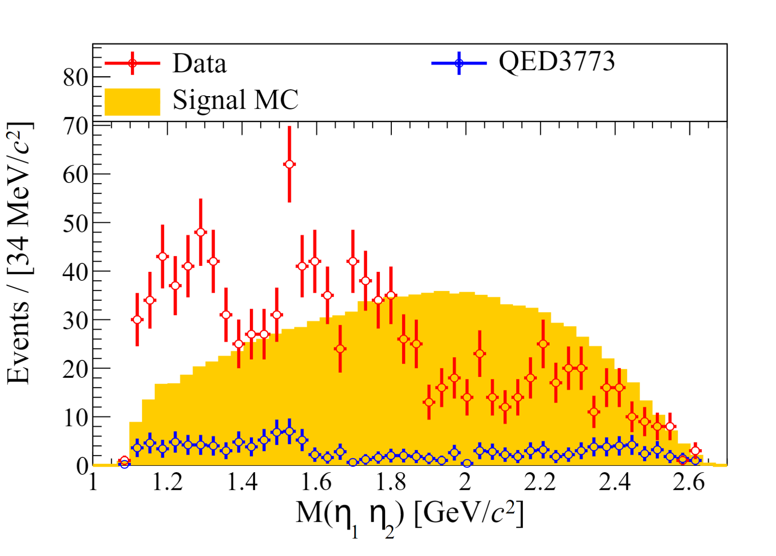
Data Distribution
Iterate 10w times on mixing 4-momentum of $η_{1}$ and $η_{2}$.

Slide 18
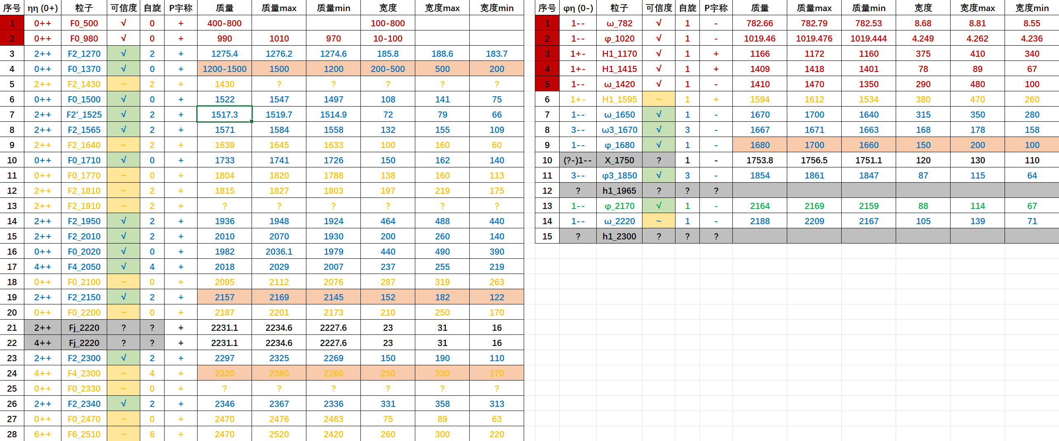
Candidate States

Slide 19
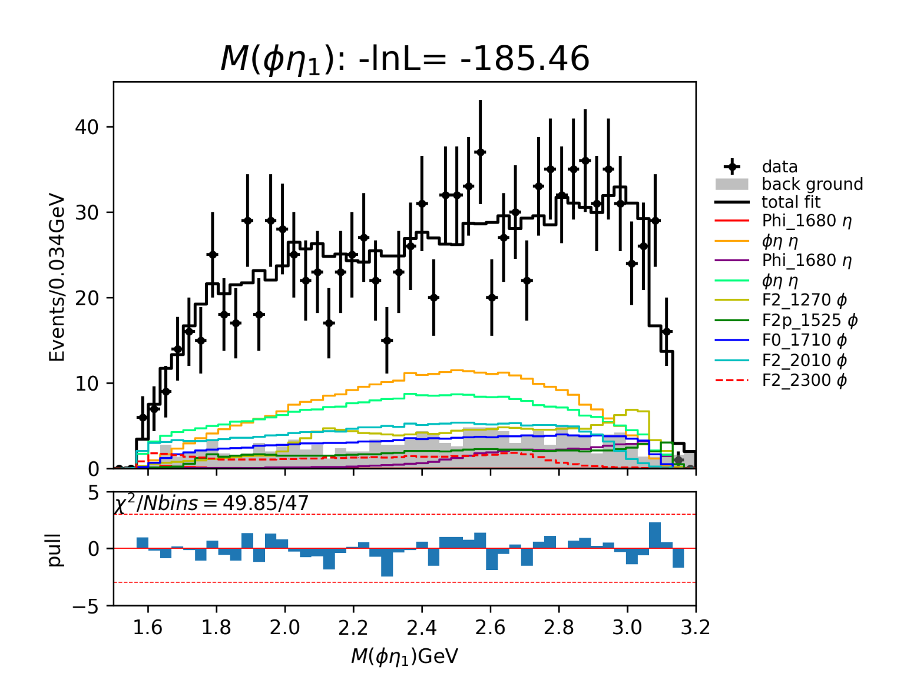
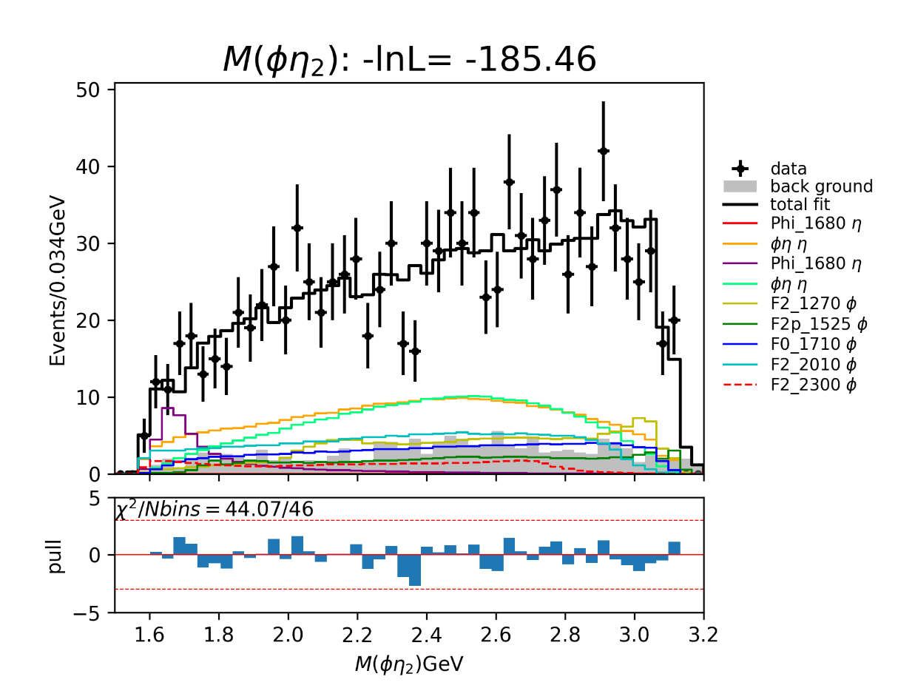
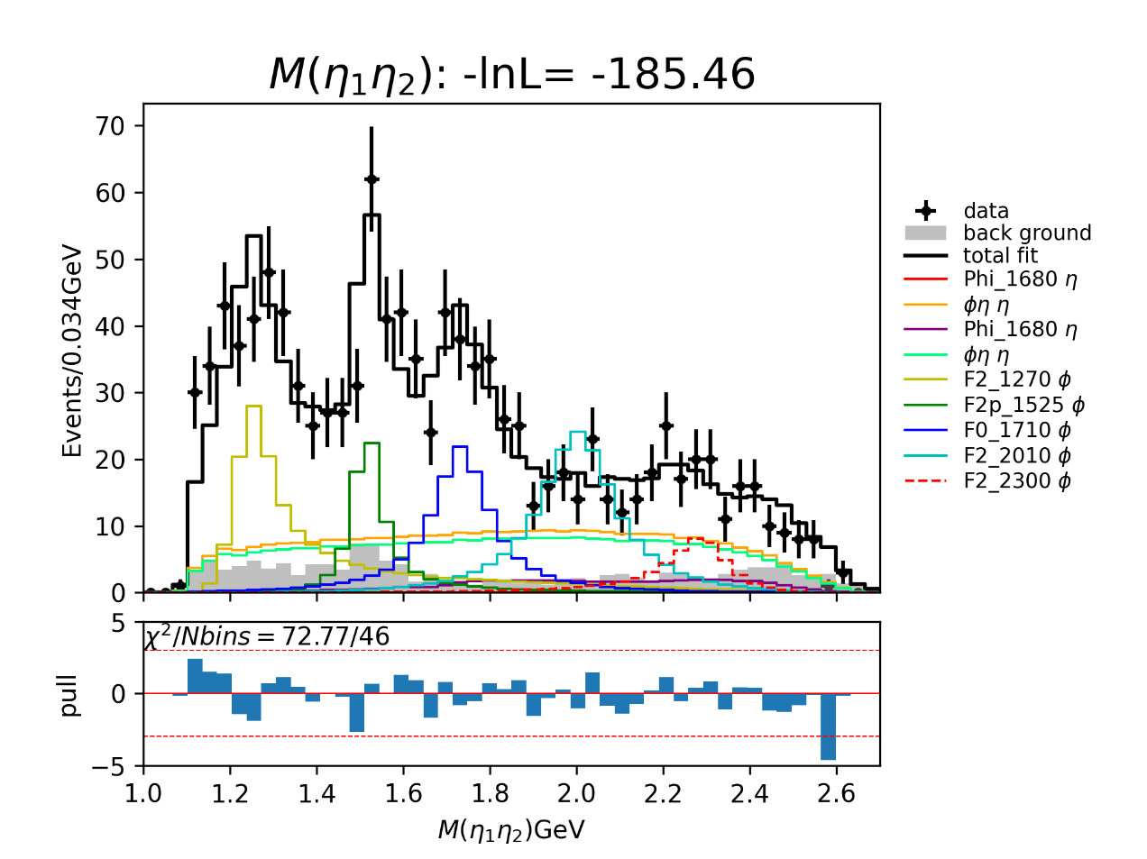
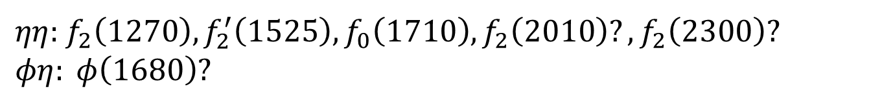
Partial Wave Analysis
Temporary solution.
$ηη$: $f_{2}\left(1270\right), f_{2}^{′}\left(1525\right), f_{0}\left(1710\right), f_{2}\left(2010\right)?, f_{2}\left(2300\right)?$
$φη: φ\left(1680\right)?$

Slide 20
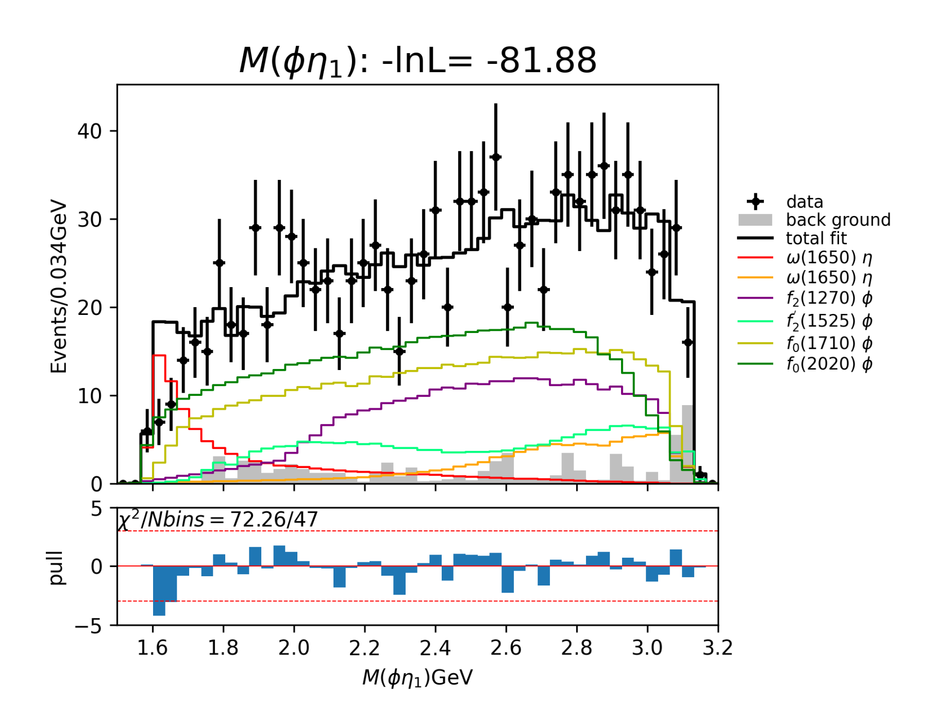
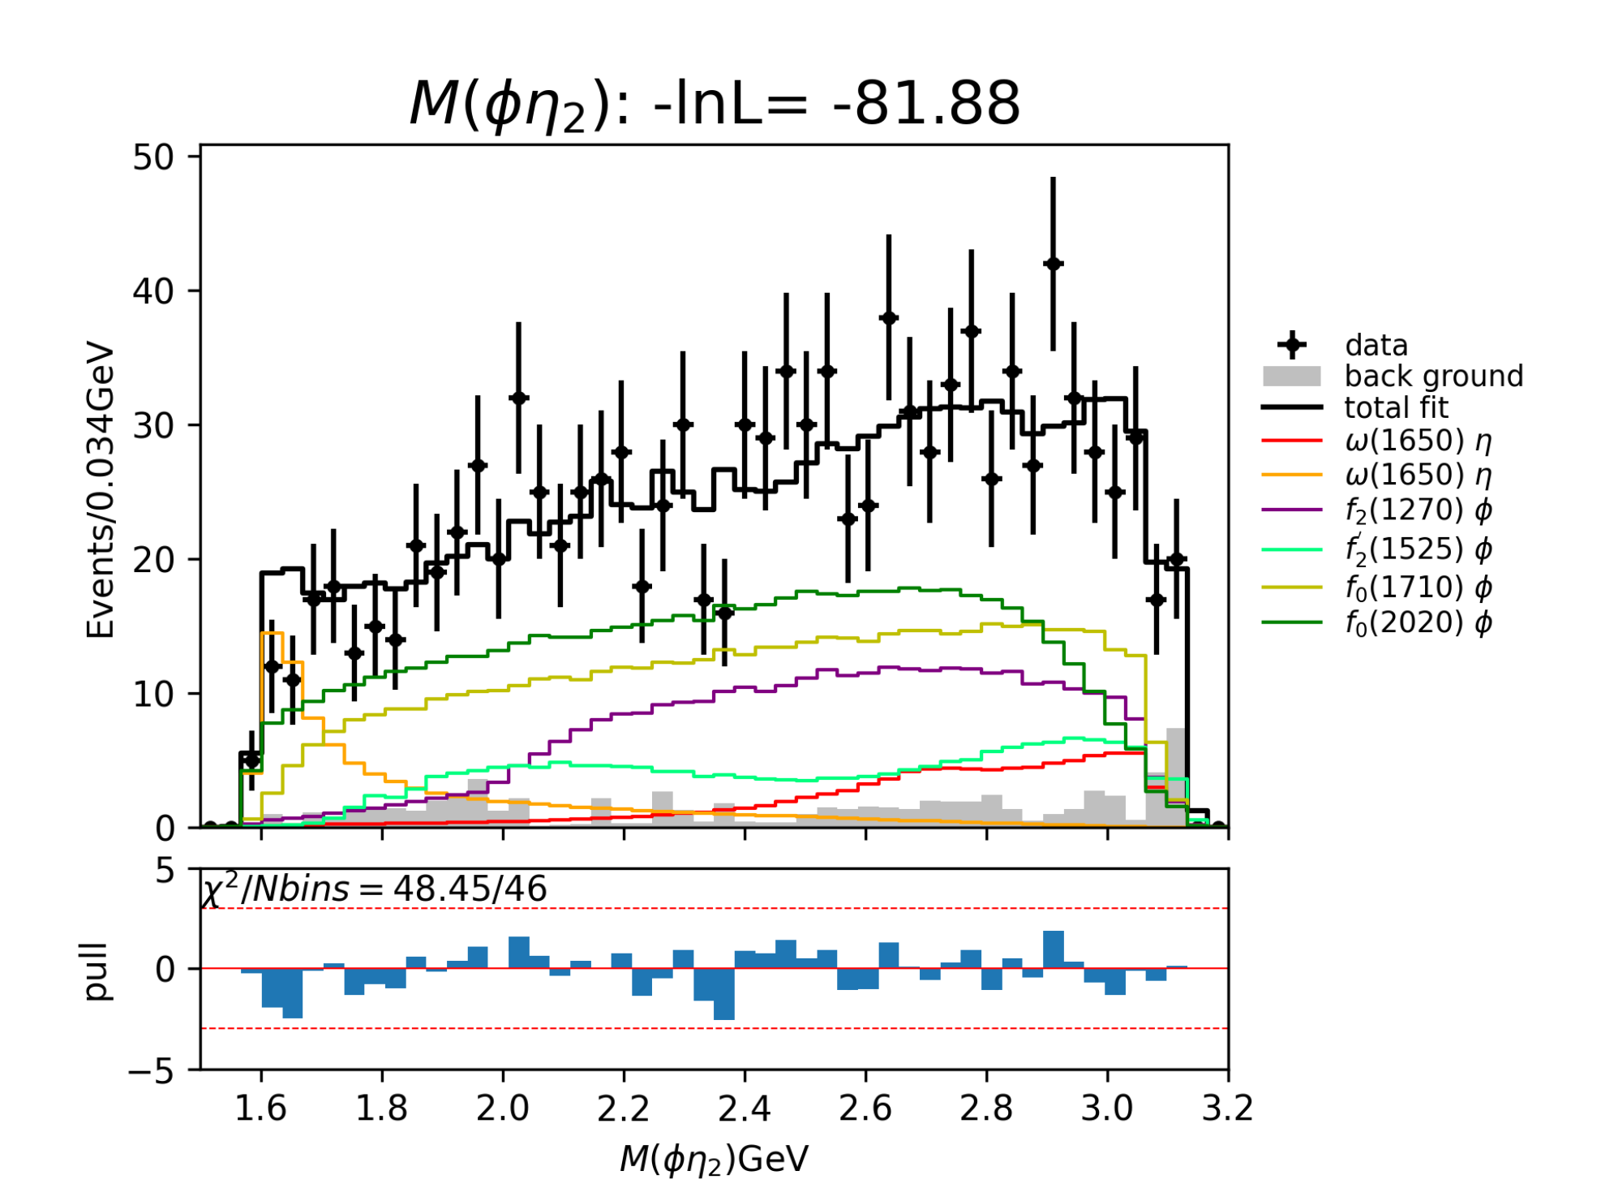
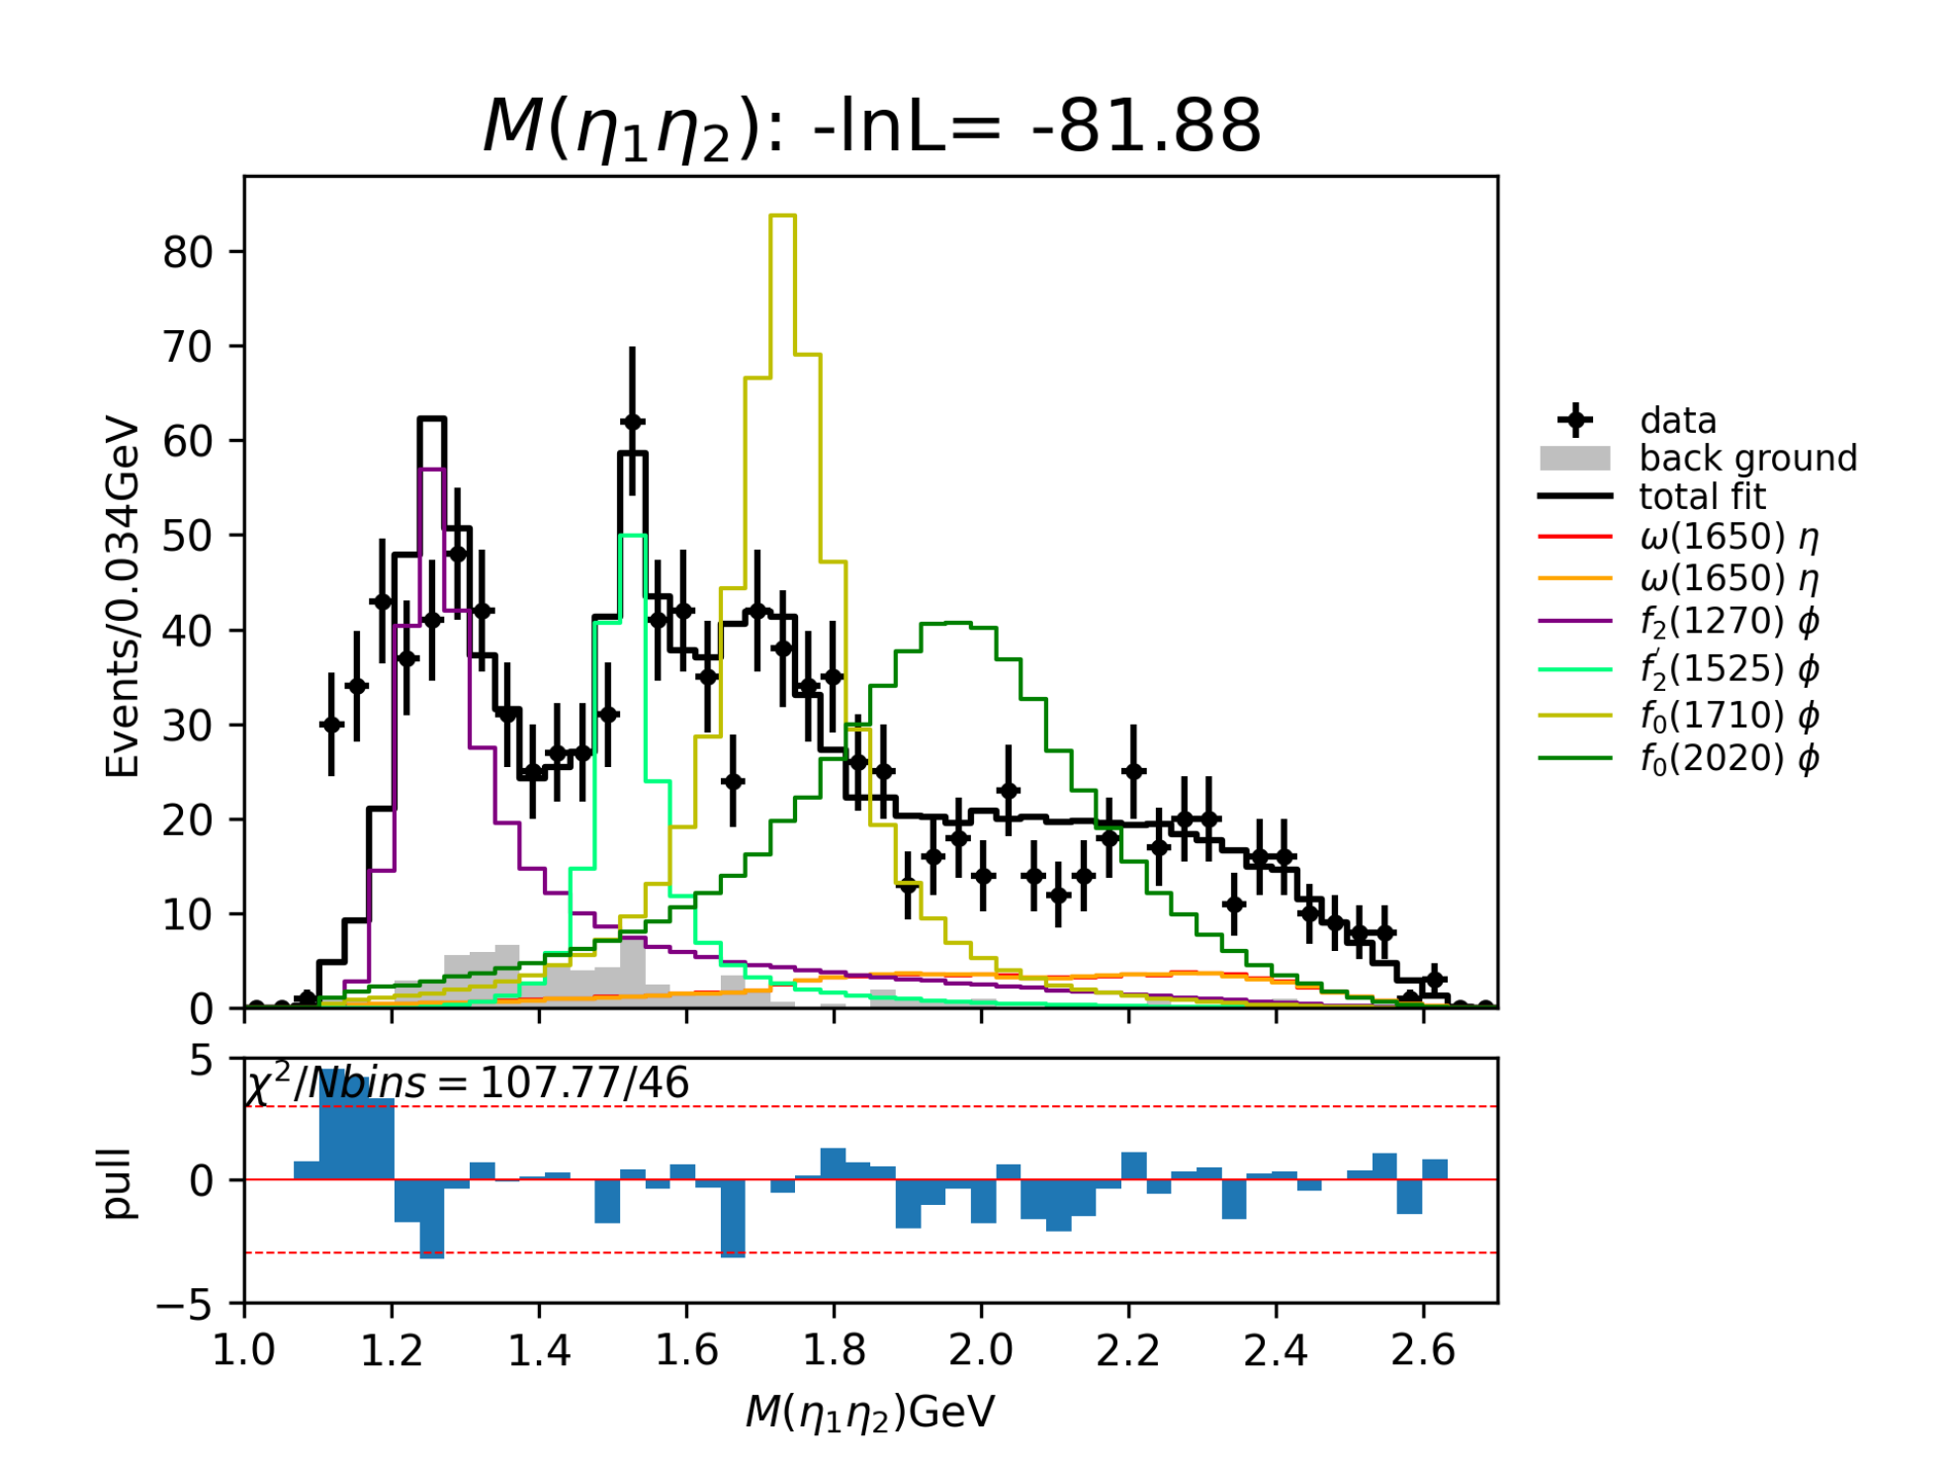
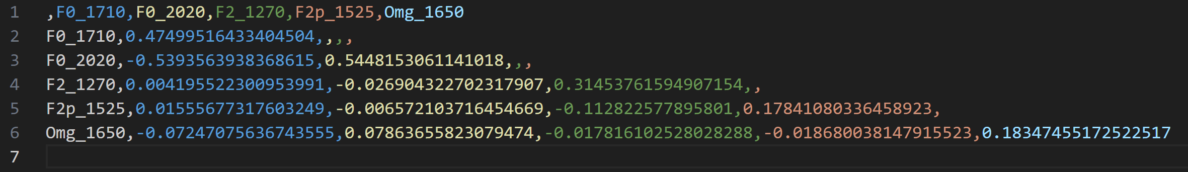
Partial Wave Analysis
Former: Interference between $F_{0}(1710)$ and $F_{0}(2020)$ is very large.

Slide 21
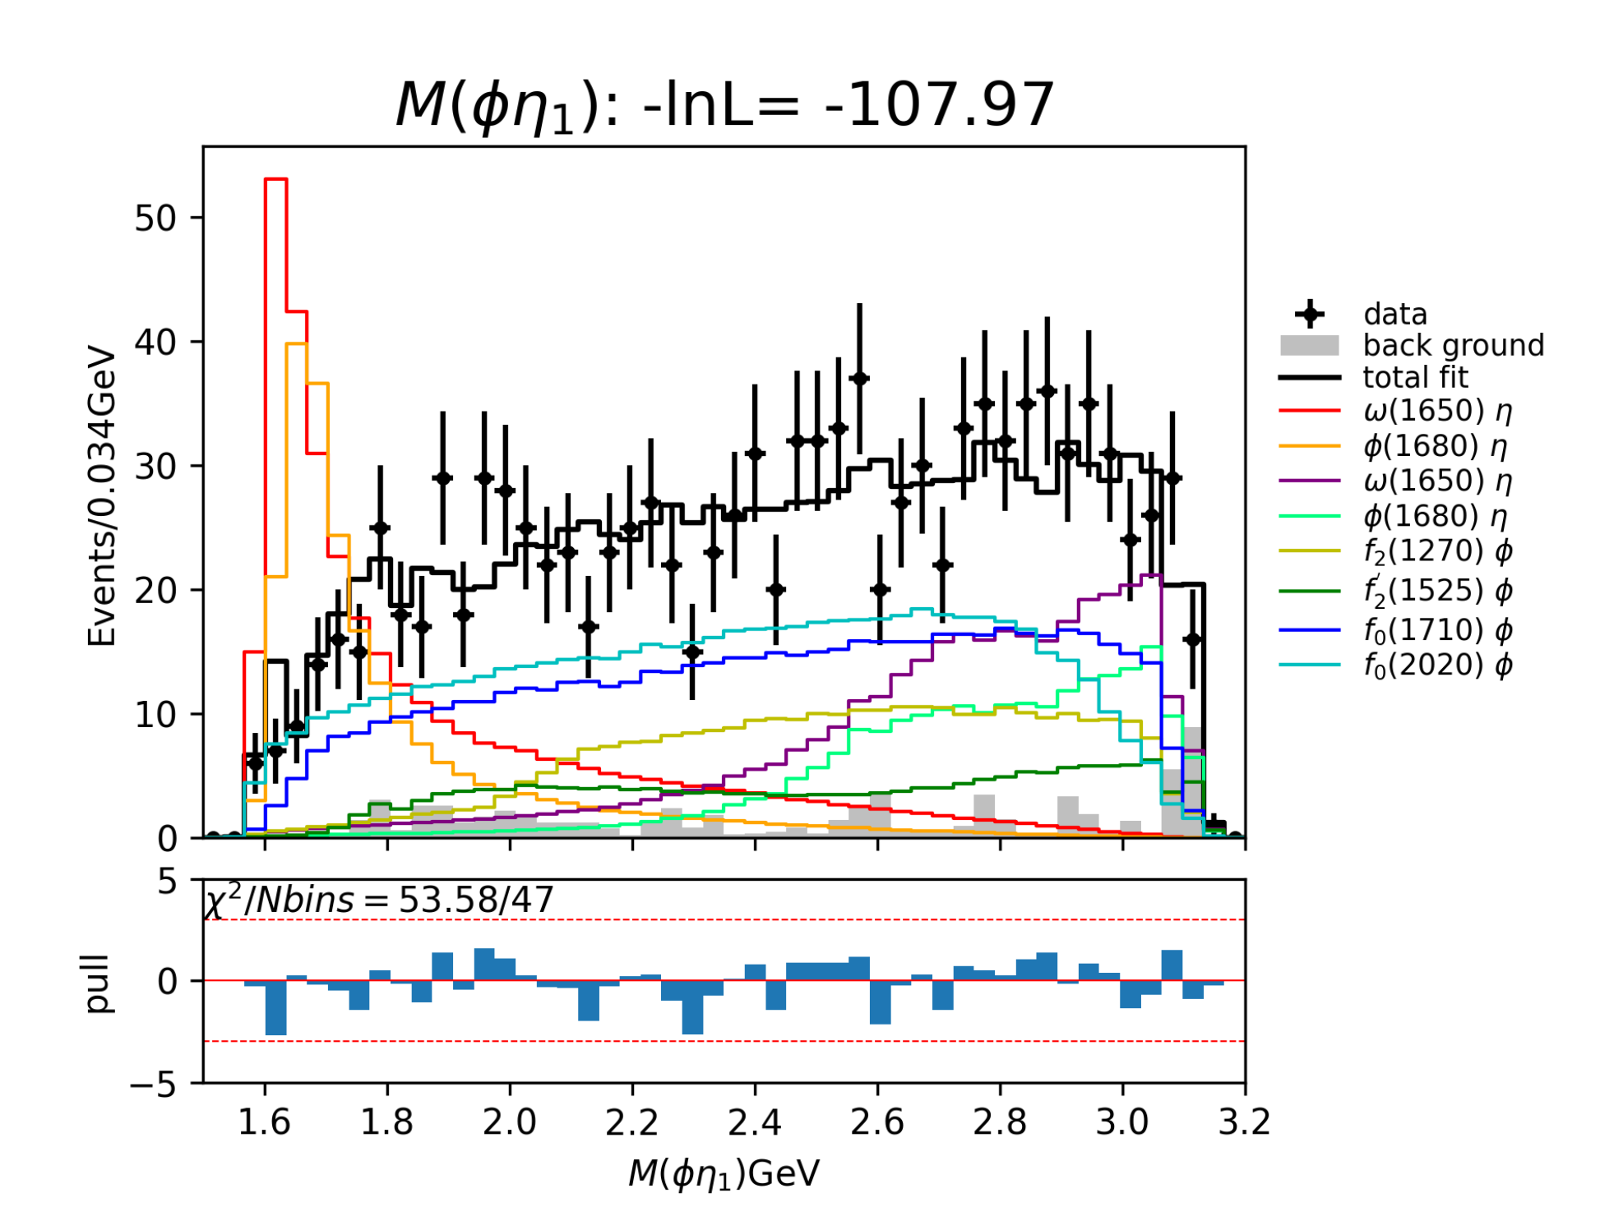
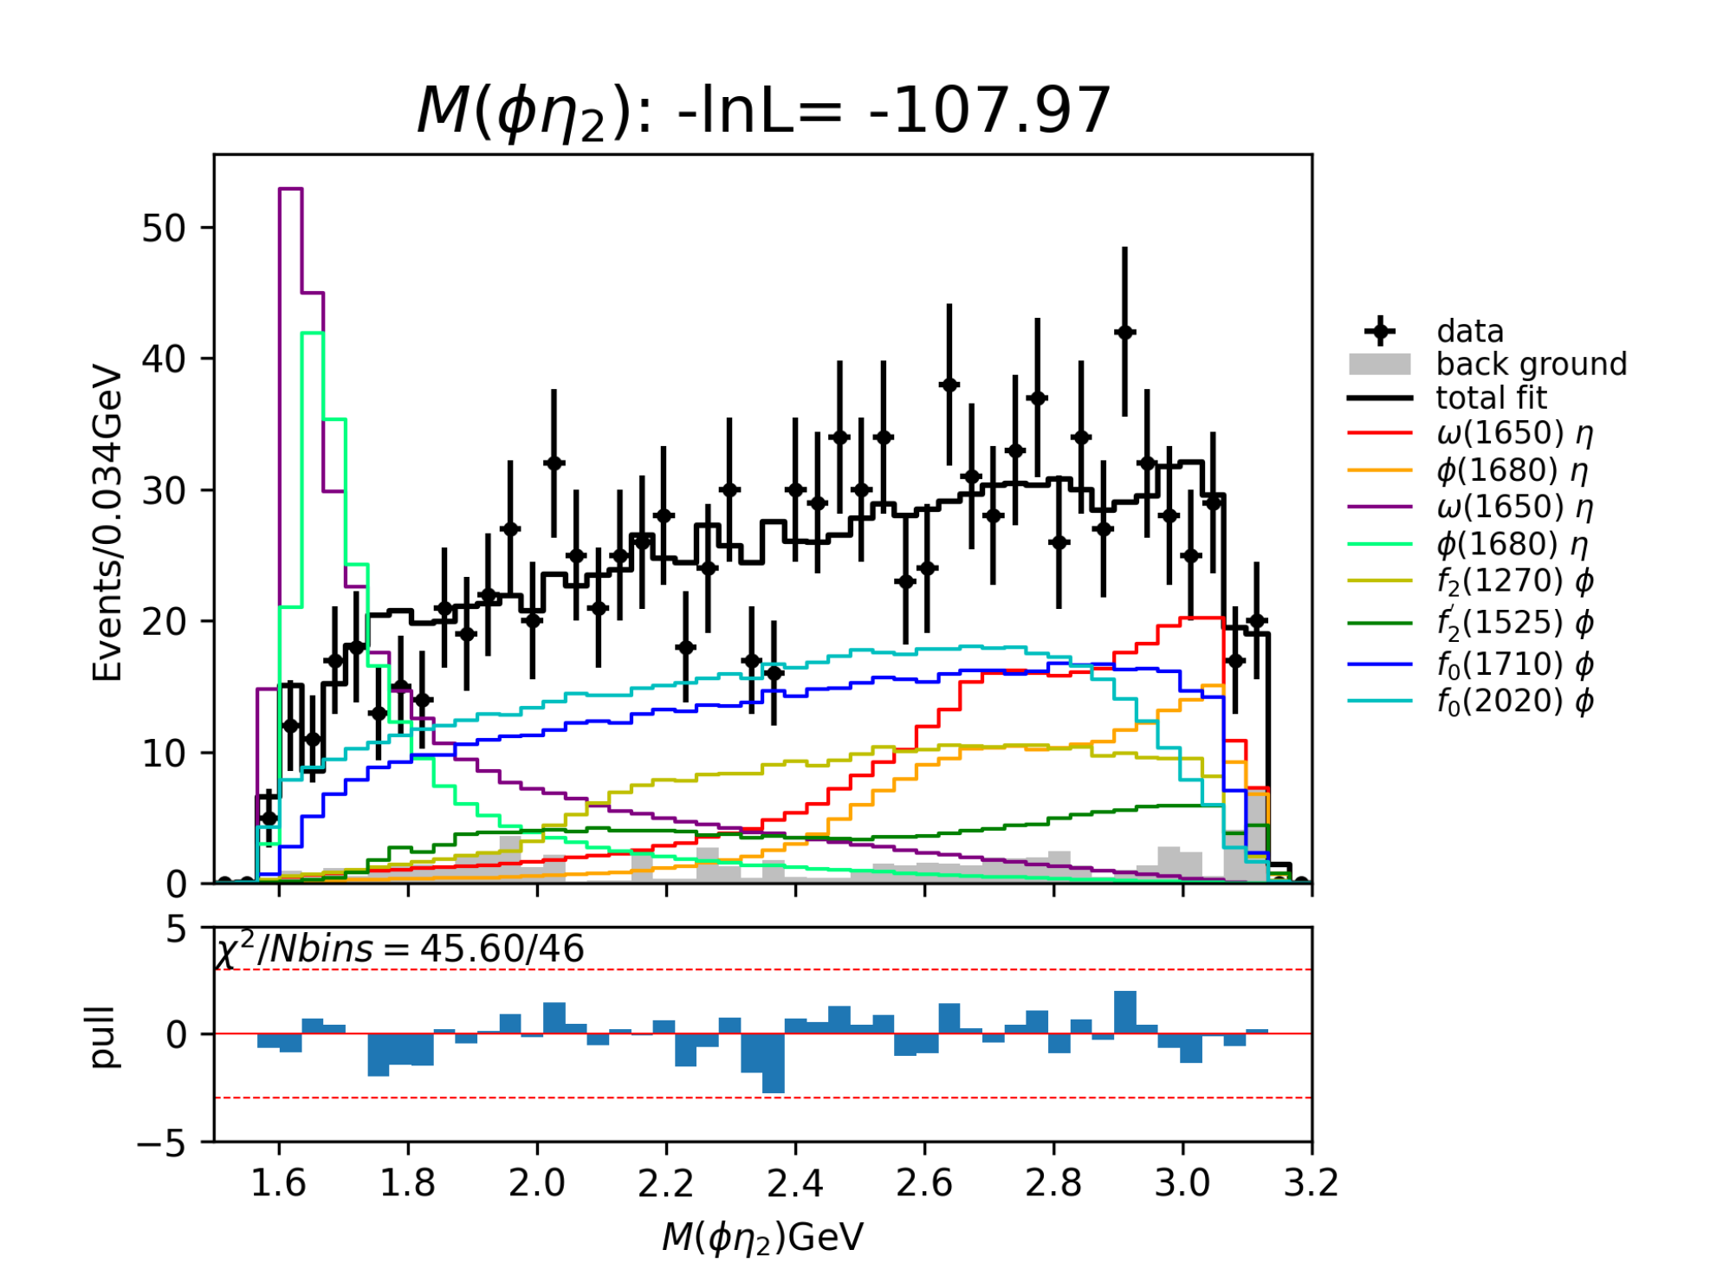
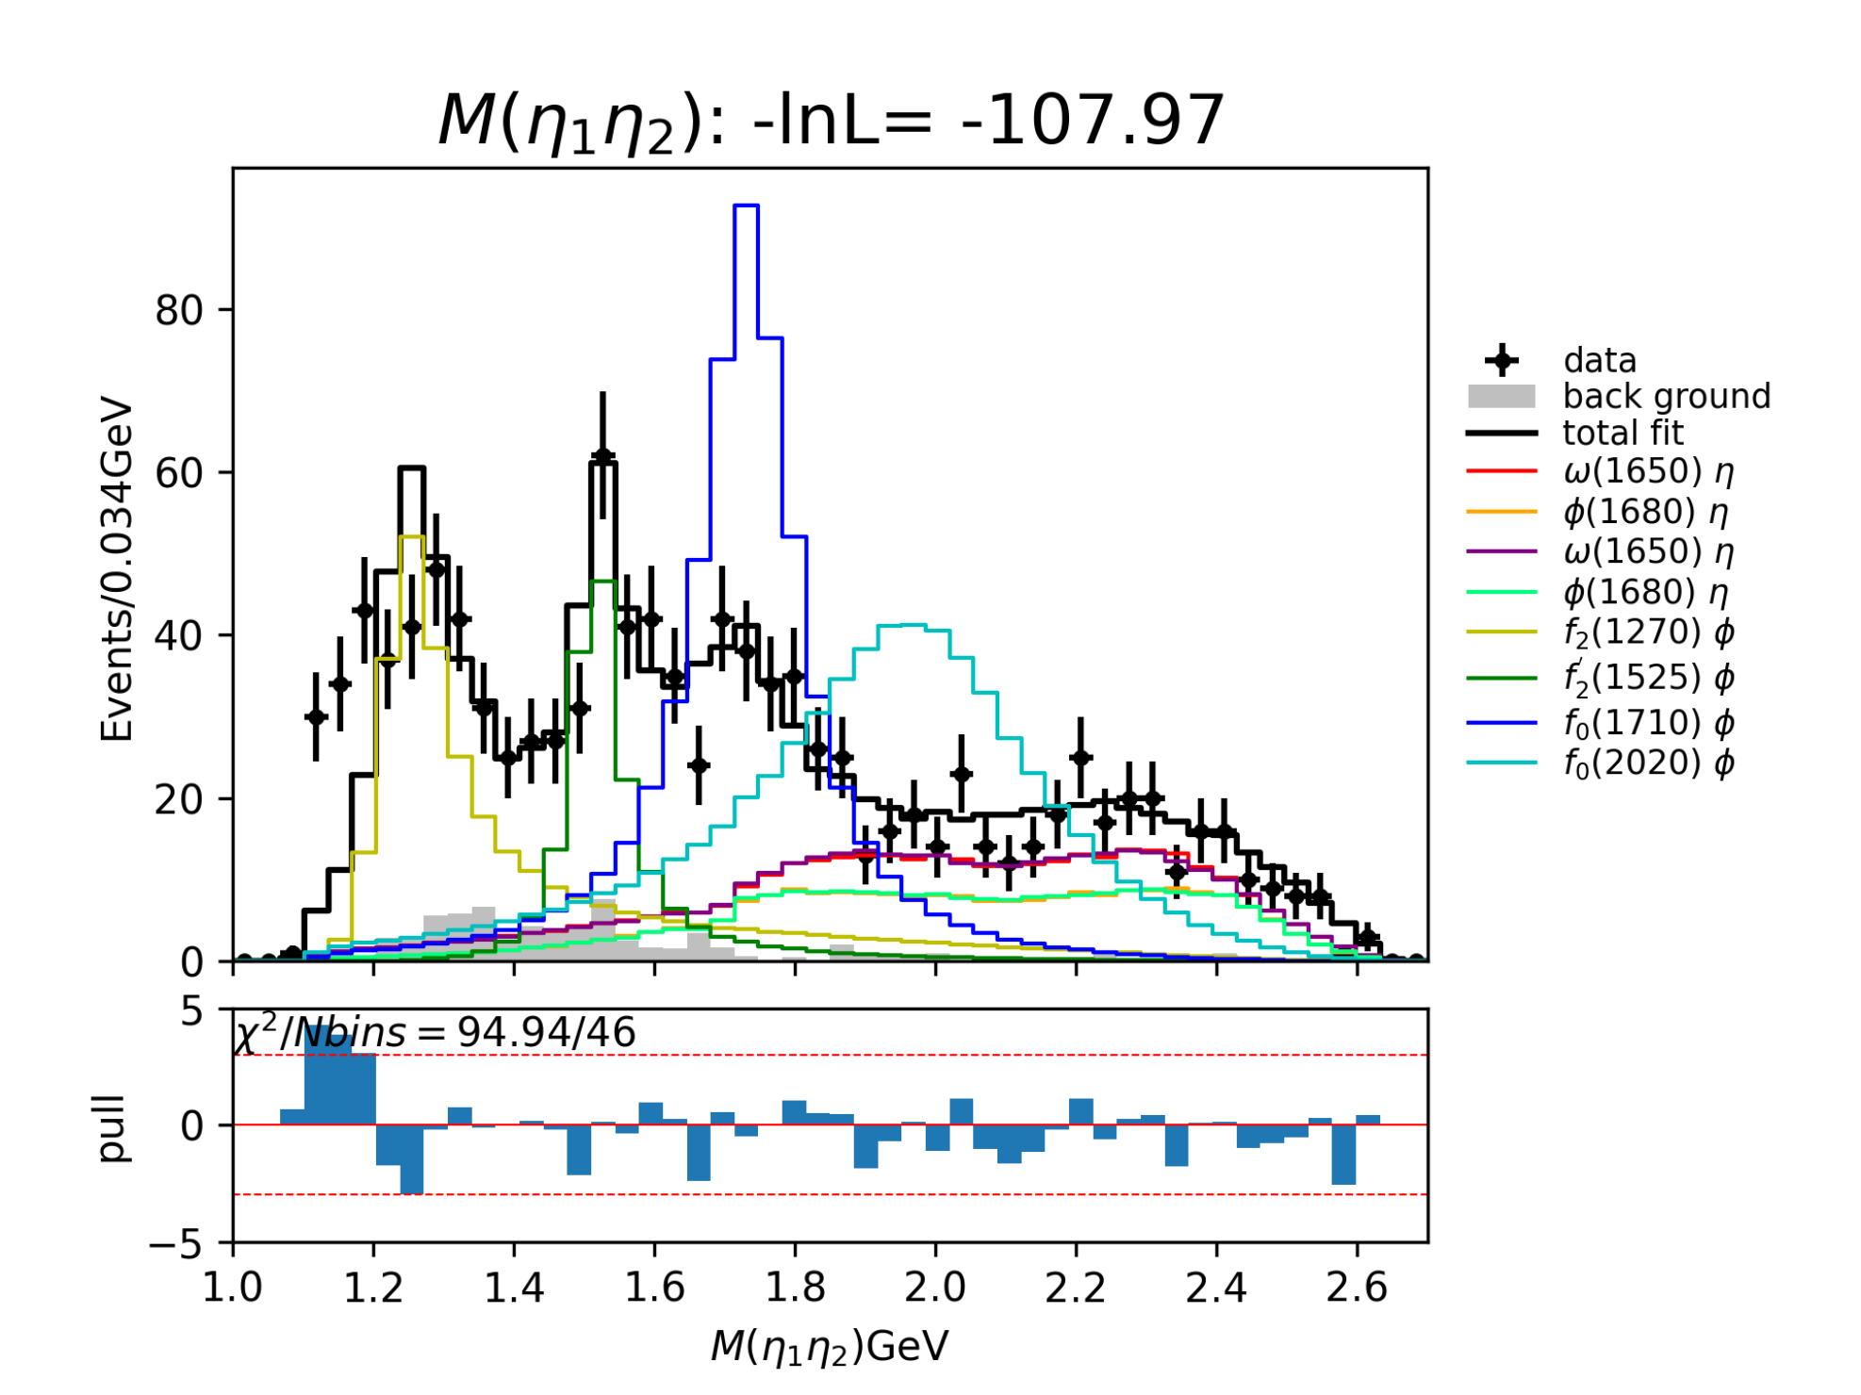
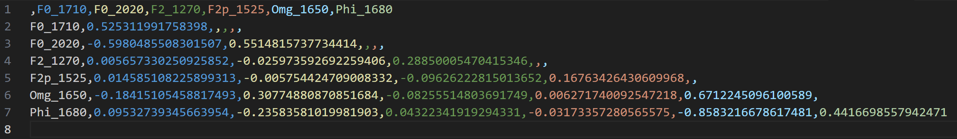
Partial Wave Analysis
Later-1: Interference between $F_{0}(1710)$ and $F_{0}(2020)$, $ω(1650)$ and $φ(1680)$ are very large.

Slide 22
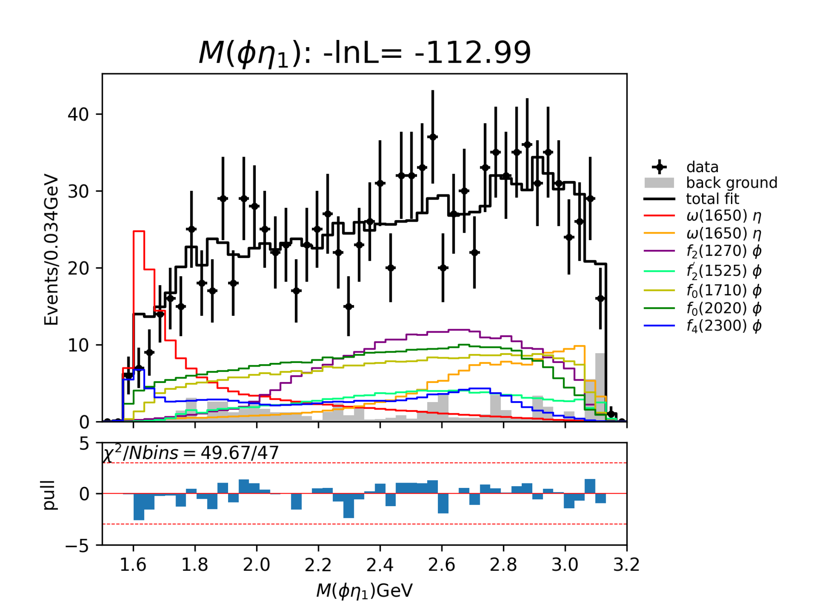
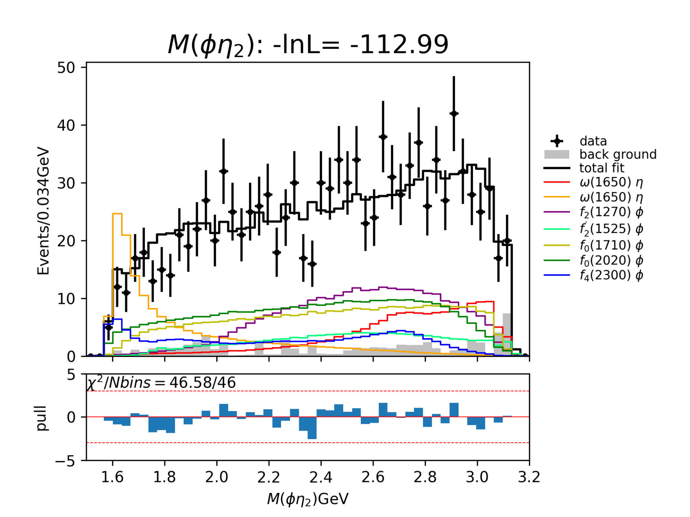
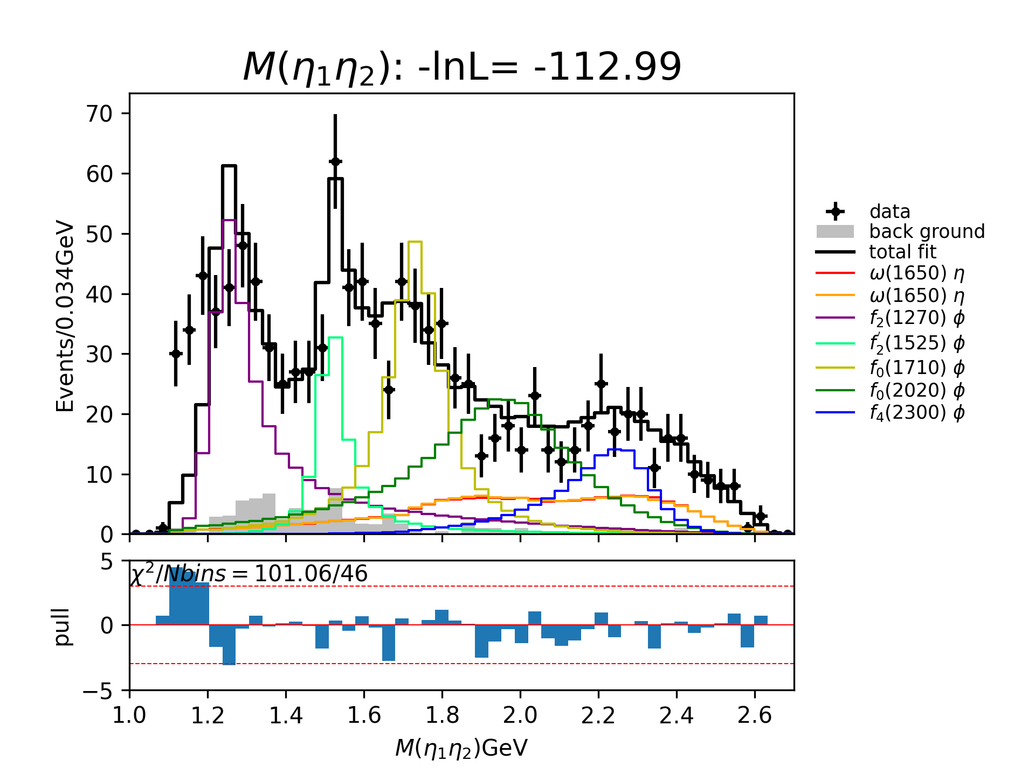


Partial Wave Analysis
Later-2: Interference between $F_{0}(1710)$ and $F_{0}(2020)$ is still relatively large, but less than former.
However, the significance of this state is relatively small than that in “Later-1”.

Slide 23




Partial Wave Analysis

Slide 24



Partial Wave Analysis

Slide 25


Partial Wave Analysis

Slide 26





Partial Wave Analysis
$f_{0}(1370)$ : mass : 1370 MeV width : 350 MeV
$f_{2}\left(1270\right)$ : mass : 1275.4 MeV width : 185.8 MeV

Slide 27

















$$φη(0^{−})$$
$$φη(1^{+})$$
$$φη(1^{−})$$
$$φη(2^{+})$$
$$f_{0}(1370)$$

Slide 28
















$$φη(2^{−})$$
$$ηη(0^{+})$$
$$ηη(2^{+})$$
$$ηη(4^{+})$$
$$f_{0}(1370)$$

Slide 29













$$φη(0^{−})$$
$$φη(1^{+})$$
$$φη(1^{−})$$
$$φη(2^{+})$$
$$f_{2}(1270)$$

Slide 30












$$φη(2^{−})$$
$$ηη(0^{+})$$
$$ηη(2^{+})$$
$$ηη(4^{+})$$
$$f_{2}(1270)$$

Slide 31



Slide 32









Slide 33
boss_dcmltracking algorithm package update status :
( Green : Already done ; Red : Not now ; Yellow : Ongoing )
Generator : (1) BesEventGen , (2) MultiParticleGun(new) , (3) SingleParticleGun .
Reconstruction : (1) GenFitAlg(new) , (2) KalFitAlg , (3) MLTrackingAlg(new) , (4) T0Dummy .
Simulation : (1) BesEventMixer(part new) , (2) BOOST/BesSim , (3) BOOST/MdcSim , (4) BOOST/PrintMcInfo(+cgem) , (5) BOOST/CgemSim(add) .
Mdc : (1) MdcTrackHelper(part new)
Cgem : (1) CgemTrackHelper(new)
FileFilterAlg(new)
Utilities : (1) DumpEventAlg(new) , (2) MLTrackingUtils(new)

Slide 34
DCMLTracking work:
Modify dcmltracking algorithm package and mske it able to use with CGEM √
Fix bugs of the package and release it under BOSS800 √
Generate single particle datasets for further analysis ongoing
……Further analysis

