Slide 1


CEPC:
Top Quark Electroweak Couplings
            Mustapha BIYABI
            on Behal of CEPC ttbar Team

Slide 2
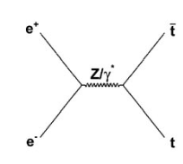
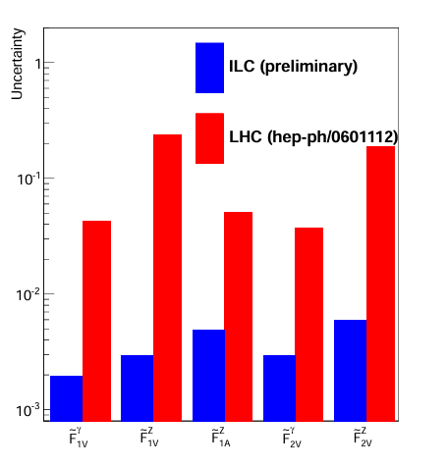
INTRODUCTION
The top quark, the heaviest known elementary particle (mt​∼173 GeV), plays a unique role in EW symmetry breaking and is a prime candidate for BSM effects.
Its electroweak couplings to the γ and Z boson , parameterized by form factors are largely unconstrained and sensitive to new physics.
Lepton colliders (i,e CEPC) offer clean e+e− → ttˉ environments with no QCD background, enabling per-mil level precision on these form factors, far beyond LHC reach!

Slide 3




Sensitive Observables
The EW top-quark couplings can be probed through three complementary observables in e+e− →ttˉeach sensitive to different combinations of form factors:
Total cross section σ:
ILC_Study
Forward-backward asymmetry:
Slope of the helicity angle distribution:
ψ = angle of decay lepton in the top rest frame relative to the top flight direction.
At CEPC/FCC (unpolarized beams), the full kinematic information is retained through the double-differential distribution:
Rather than compressing the distribution into 3 integrated observables as at ILC, CEPC exploits the full f($x_{f}$​,cosθ) shape.

Slide 4



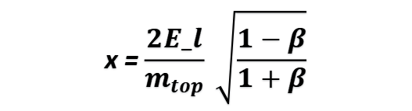
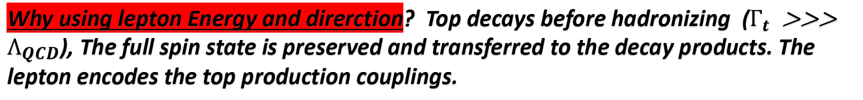
Top Coupling Parameterization
The ttˉ EW couplings are parameterised through the following **vertex function** (v=γ,Z):
Where $A_{υ}$ and $B_{υ}$ are the Standard Model couplings, all anomalous form factors are zero in the Standard Model
The angular and energy distributions of the lepton arising from the ttˉsemileptonic decays is :
x = $$\frac{2E_l}{m_{top}} \sqrt{\frac{1−β}{1+β}}$$
Why using lepton Energy and direrction? Top decays before hadronizing ($Γ_{t}$ >>> $Λ_{QCD}$), The full spin state is preserved and transferred to the decay products. The lepton encodes the top production couplings.

Slide 5

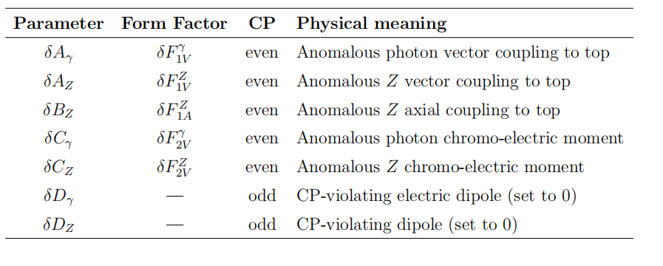
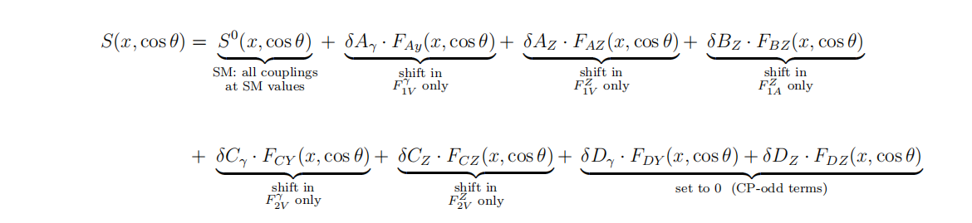
differential Cross Section
The differential cross section decomposes into two parts: the SM baseline and the BSM anomalous form factor contributions i,e $δ_{i}$:
Since the anomalous form factors are assumed to be small, only terms linear in $δ_{i}$​ are kept. This can be written explicitly as:
Where F(x,cosθ) are kinematic shape functions ,each encodes the unique signature of its corresponding form factor.
CP-violating terms ( δDγ​, δDZ​) are set to zero in this analysis.

Slide 6

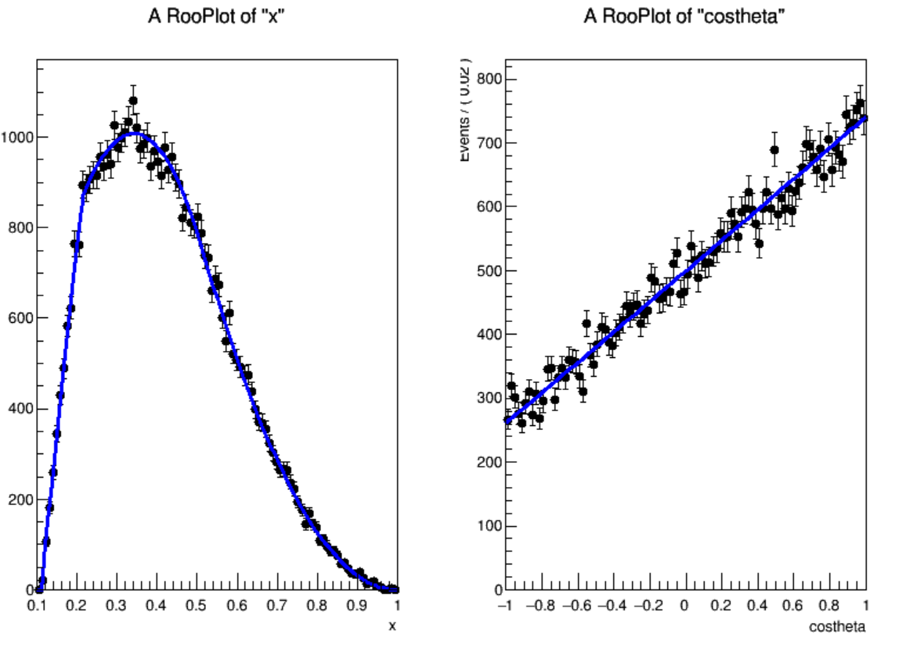
SM Contribution
The Standard Model contribution is given by the following term with a normalisation factor:
Explicit Formulas Backup Slides
Shape of the scaled Lepton energy and Polar Angle by fitting the data:

Slide 7
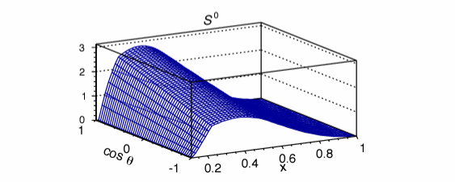
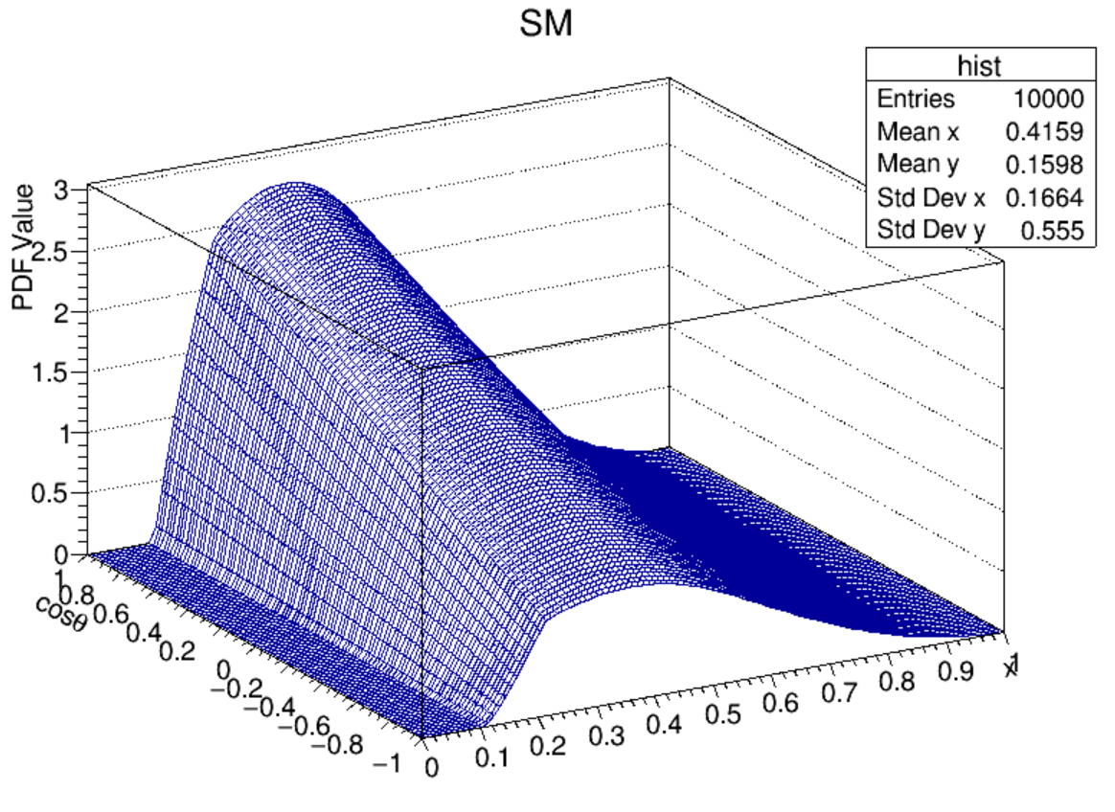
SM Contribution
The Standard Model contribution was fitted using RooFit :
FCC@365 GeV
CEPC@360 GeV
The obtained SM shape is similar to what was obtained for FCC-ee at 365 GeV Validating the Procedure.

Slide 8
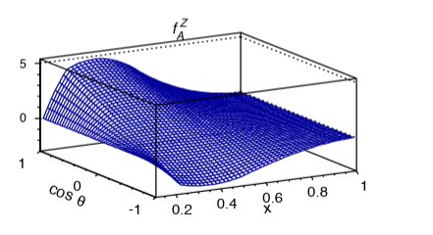
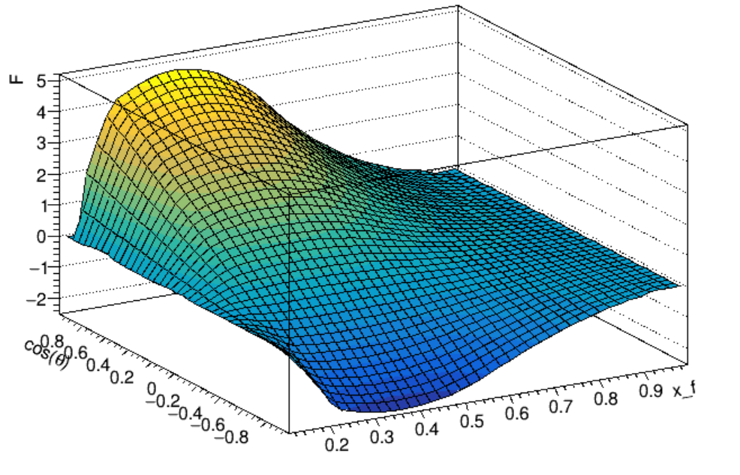
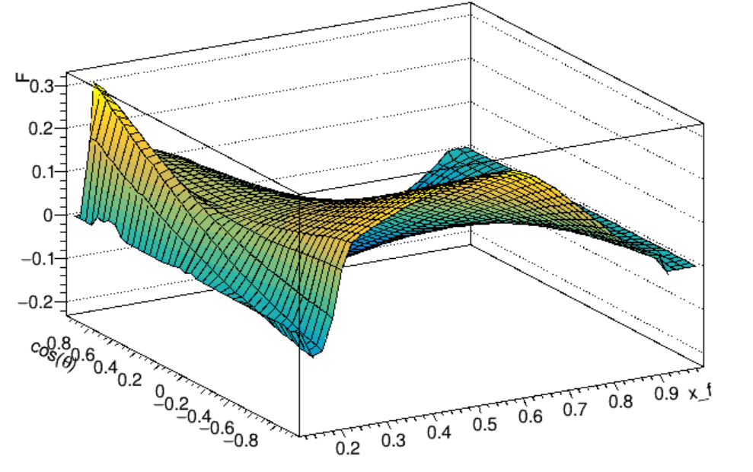
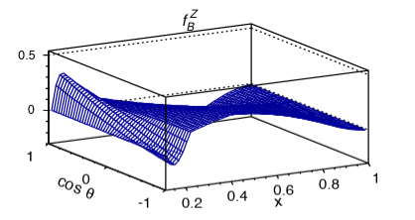
Beyond Standard Model Contributions :
FCC
CEPC
The other distributions are consistent as well (backup slides).

Slide 9


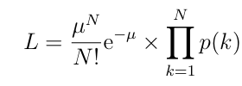

Binned Likelihood
There are 8 form factors to determine simultaneously ${ δ}_{i}$ :
The likelihood to evaluate for the different form factors :
    Minimization
Included the Luminosity in the Likelihood: 1 ${ab}^{−1}$ (Target Lumi).
For a straightforward comparison with FCC-ee (projections) sensitivities, we considerd two configurations:
First Configuration: 3 parameters to fit simultaneously.
Second Configuration: 2 parameters to fit simultaneously.

Slide 10
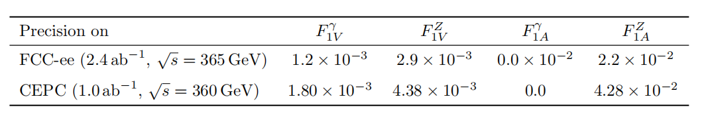
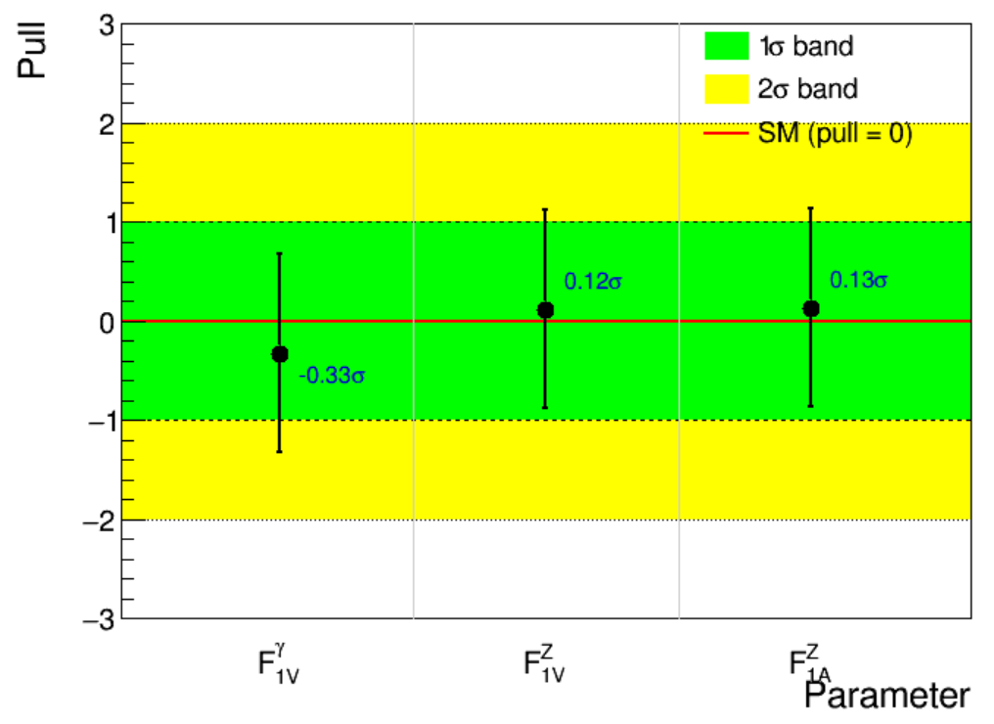
Result: First Configuration
The obtained uncertainties of the floating form factors :
Compared to FCC-ee Results :
Considering a simultaneous fit of the form factors (First Sector):
The pulls are < 1$σ$ ----> Correct implementations/Fit-Setup.
The fit converges and the Hessian matrix was successfully computed.

Slide 11
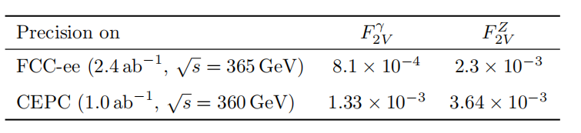
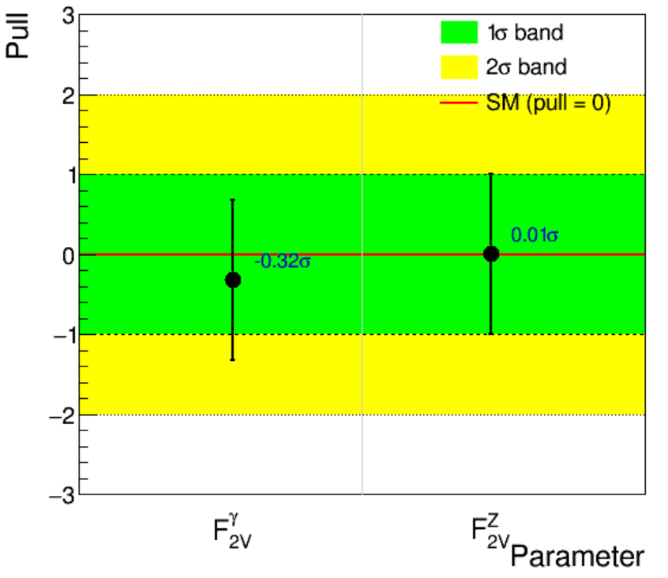
Result: Second Configuration
The obtained uncertainties of the floating form factors :
Compared to FCC-ee Results :
Considering a simultaneous fit of the form factors (Second Sector):
The pulls are < 1$σ$ ----> Correct implementations/Fit-Setup.
The fit converges and the Hessian matrix was successfully computed.

Slide 12
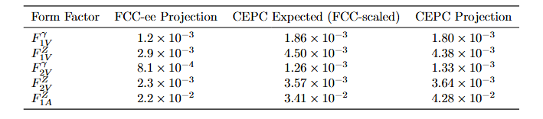
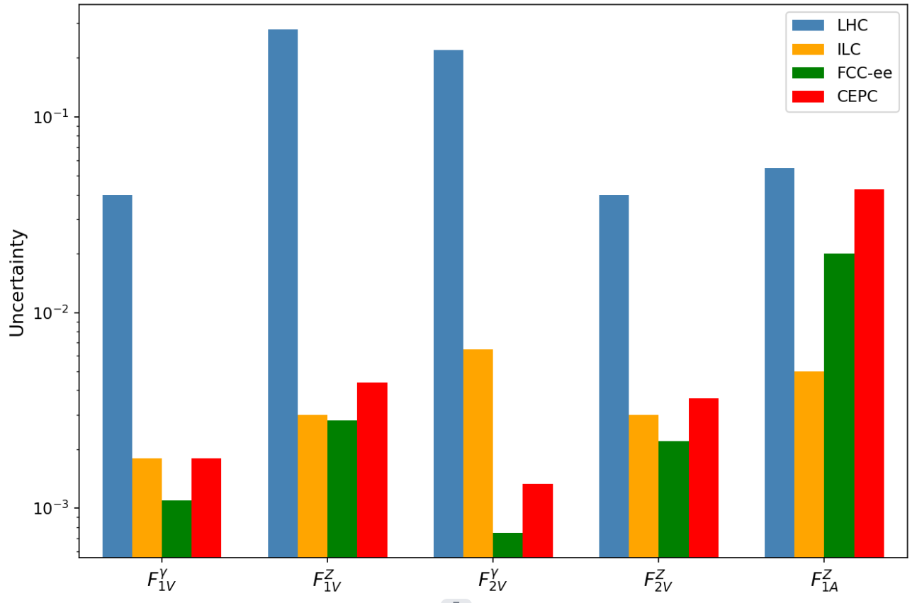
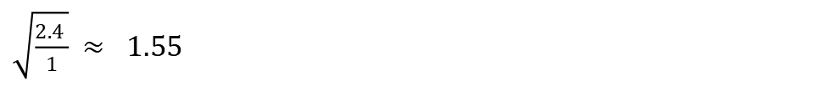
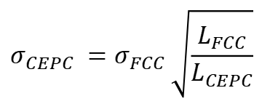
Sensitivity Projection:
$$σ_{CEPC} =σ_{FCC} \sqrt{\frac{L_{FCC}}{L_{CEPC}}}$$
$\sqrt{\frac{2.4 }{1}}$ $≈ 1.55$
Precision on the form factors seems to be reasonable.

Slide 13

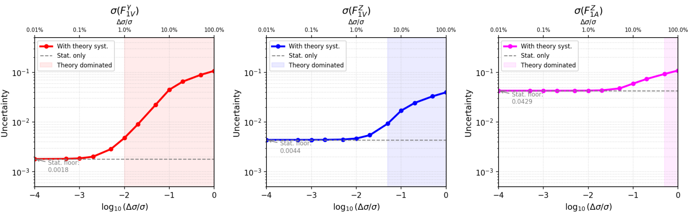
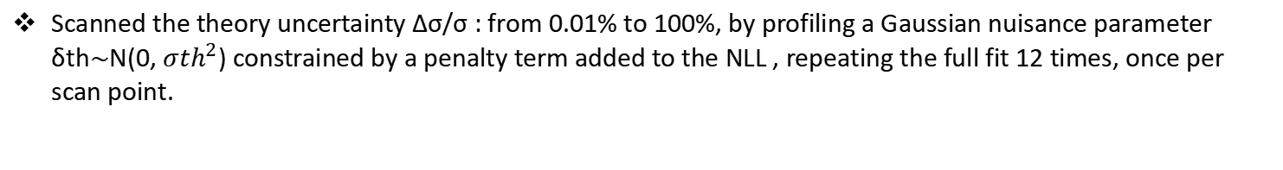
Theoretical uncertainty :
Theoretical uncertainties on the predicted cross-section affect the precision of the form factor measurements.
How the form factor precision degrades as theory gets worse (till 100%).
Scanned the theory uncertainty Δσ/σ : from 0.01% to 100%, by profiling a Gaussian nuisance parameter δth$\sim$N(0, ${σth}^{2}$) constrained by a penalty term added to the NLL , repeating the full fit 12 times, once per scan point.
δth​ is the unknown fractional shift in the predicted cross section.
$$μ_{ij}−>μ_{ij} ∗(1+δth)$$
Theory-dominated : uncertainty > 2 × stat floor

Slide 14
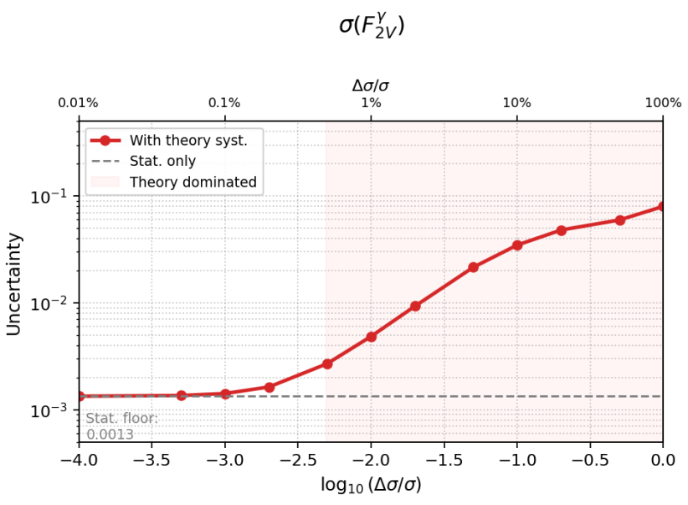
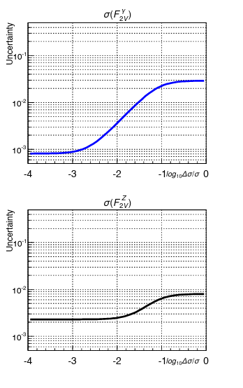
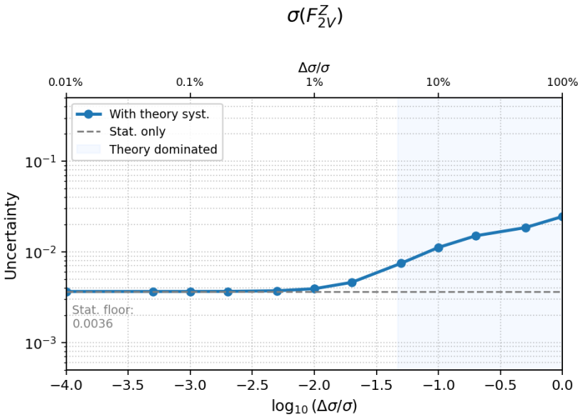
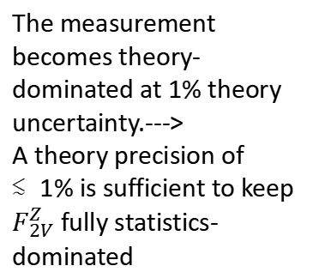
Theoretical uncertainty :
A Comparison of the FCC-ee (LEFT) Derivative Uncertainties and CEPC (RIGHT) for the Second Configurations:
The measurement becomes theory-dominated between 0.3% and 1% theory uncertainty.
The measurement becomes theory-dominated at 1% theory uncertainty.--->
A theory precision of ≲1% is sufficient to keep $F_{2V}^{Z}$ fully statistics-dominated
The theoretical uncertainties of the CEPC affect the form factors and seem to follow those of the FCC-ee.

Slide 15
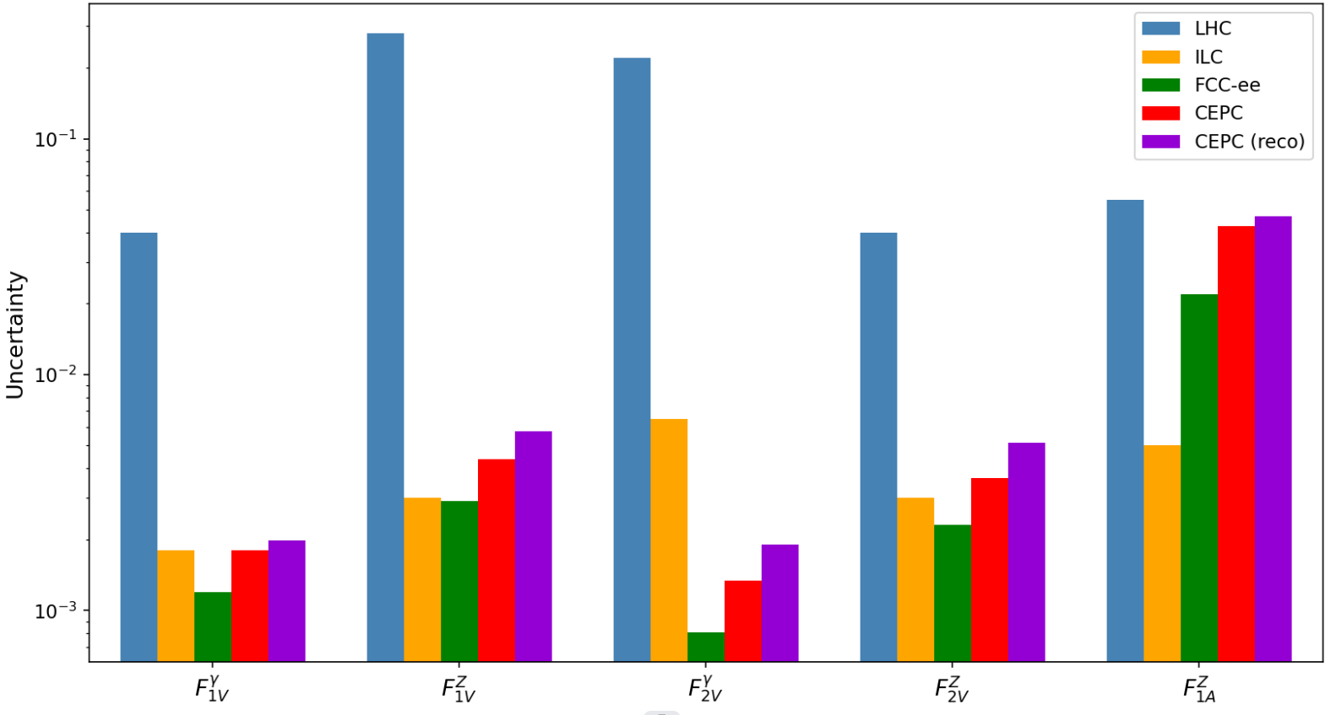

Sensitivity Projection :
Using CEPC-soft :
Tried to obtain the same uncertainties.
The pulls are well below 2$σ$(statistically consistent with the SM).
Processing a larger data sample.
Still, we have a large correlation for the first configuration...

Slide 16
Summary
The top EW couplings were studied at CEPC target Luminosity using the differential cross section (lepton final state).
Dominant Systematic: Theoretical cross-section uncertainty is the primary systematic considered.
Analysis Status: Processing more data at the reconstruction-level to evaluate form factor sensitivity.
Incorporating full efficiency corrections.

Slide 17
Backup slides

Slide 18
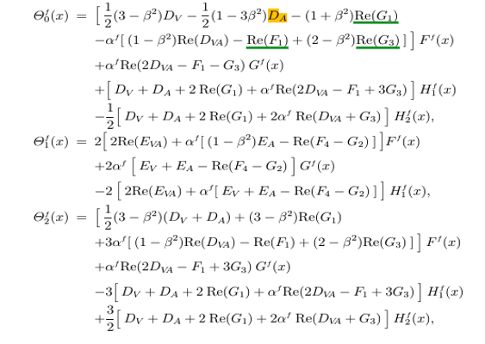
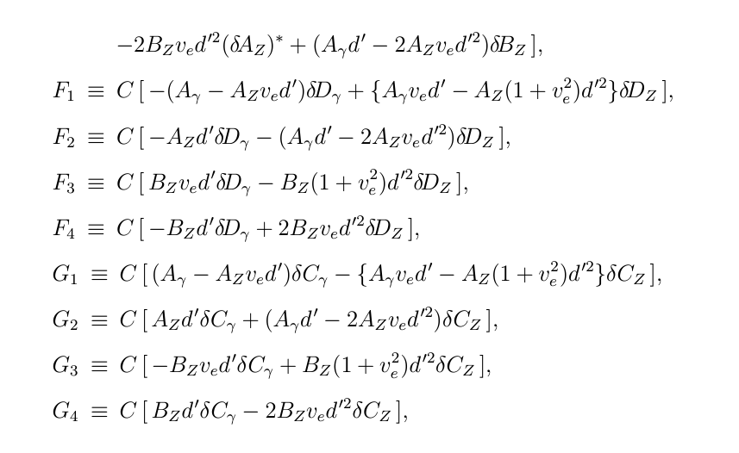
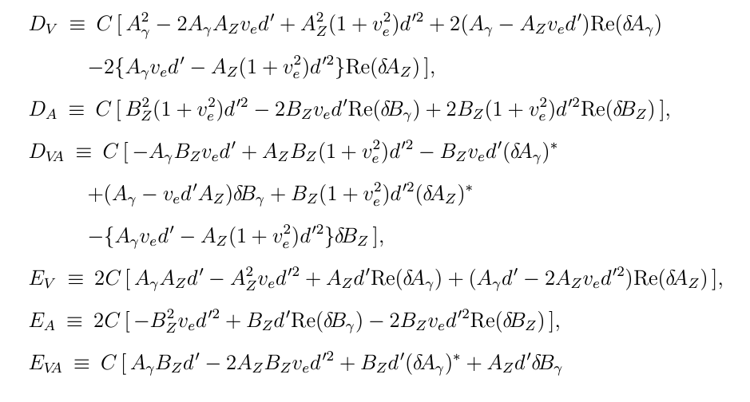
The Explicit Formula describing the energy-dependent coefficients for the angular and energy distributions :
arxiv.org/pdf/hep-ph/9911505
arxiv.org/pdf/hep-ph/9710358
Dv, DA, DVA, EV, EVA, Fi, Gi {i=1,2,3,4} , which are related the Form facotrs in ttZ/$γ$ Couplings !

Slide 19
