Slide 1
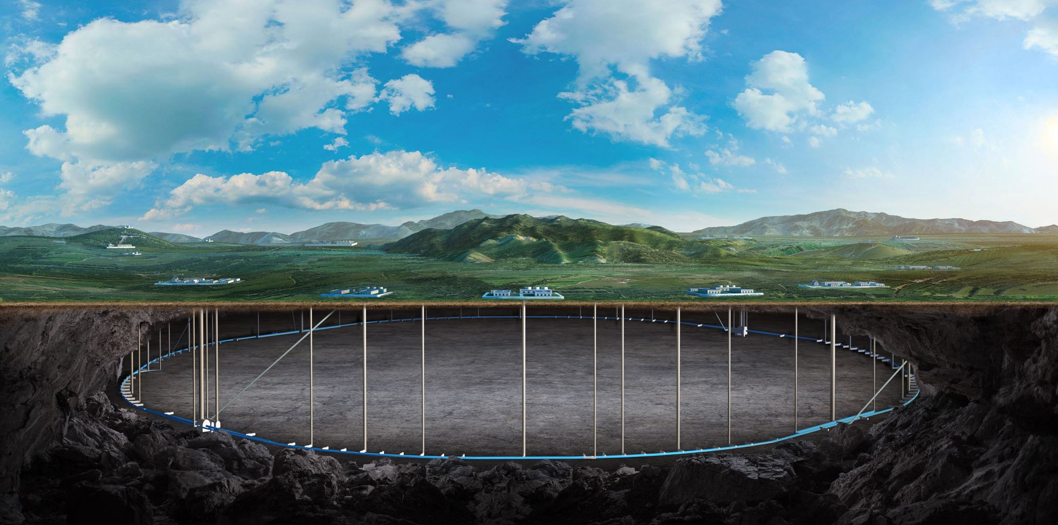


Vertex Detector
Zhijun Liang
(On behalf of the vertex detector team)
2025, CEPC Detector Ref-TDR Review

Slide 2
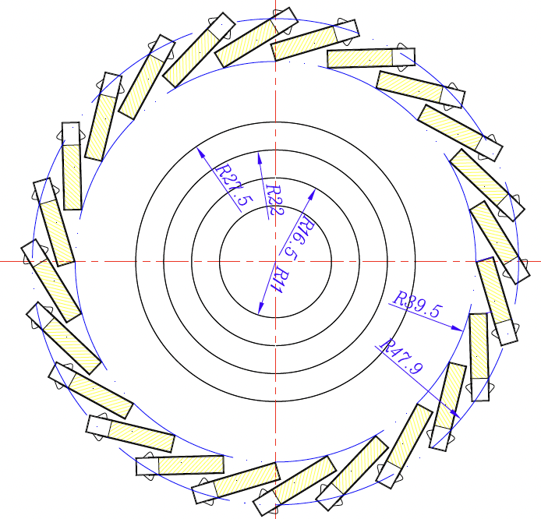
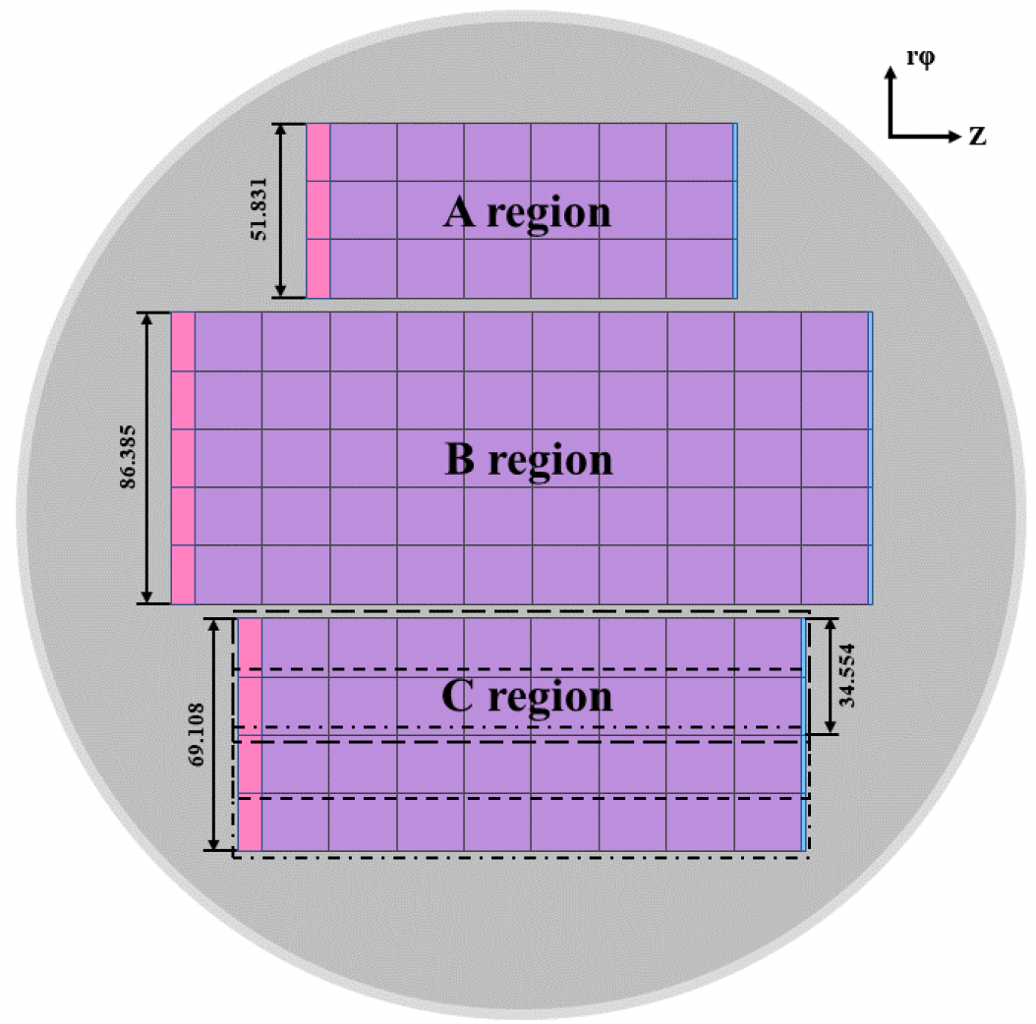
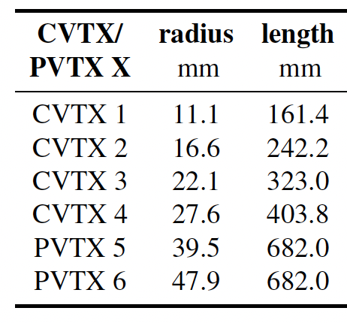
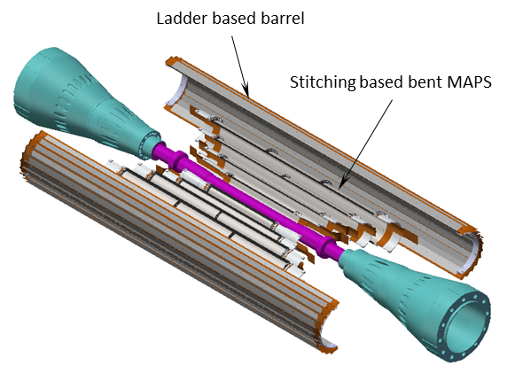
Reminder of ref-TDR design
Baseline :4 single layer of bent MAPS + 1 double layer ladders
Alternative option: 3 double layer ladders
Inner layer: Use single bent MAPS for Inner layer (~0.15m²)
Low material budget 0.06%X0 per layer
Different rotation angle in each layer to reduce dead area
Outer layer: Double layer Ladder (~0.28% X0 per layer)
Figure 4.2
Figure 4.3
Long barrel layout (no endcap disk)
Figure 4.1
Figure 4.3

Slide 3
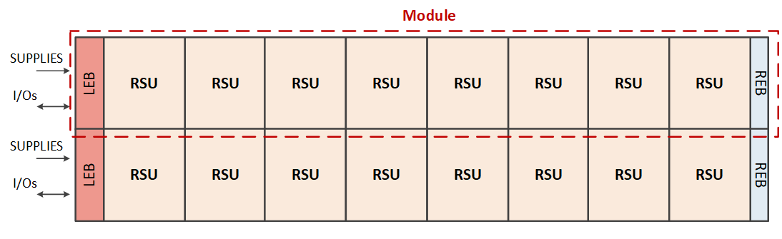
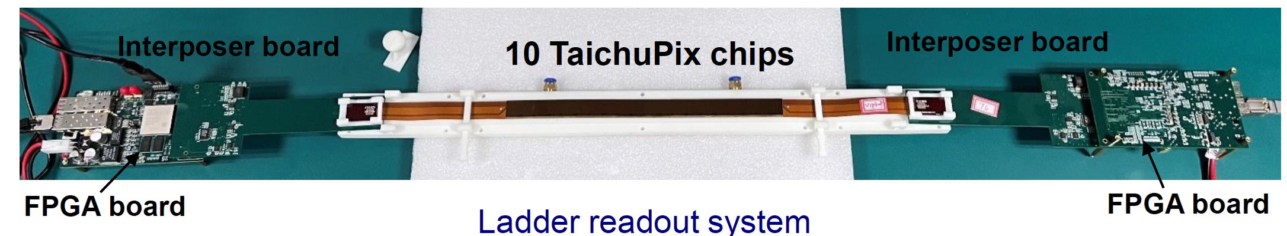
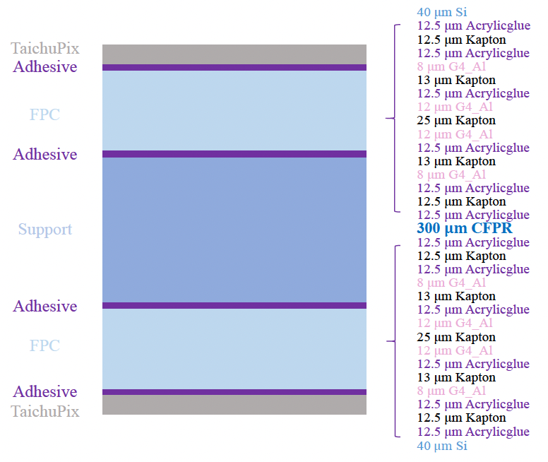
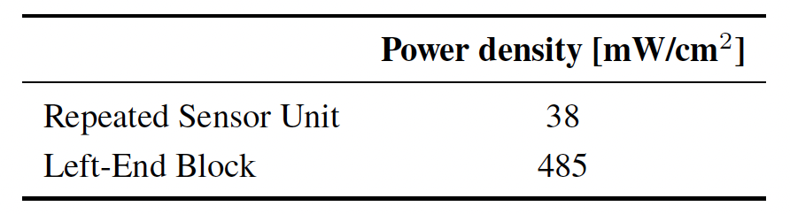
Reminder of ref-TDR design： Electronics
Stitching layer : stitching and RDL metal layer on wafer to replace PCB
Outer layer (L5/L6) : flexible PCB （also used in alternative layout)
Signal, clock, control, power, ground will be handled by control board through flexible PCB
Stitching layers : ALICE ITS3 like stitching
Outer layer (layer 5/6, ) ： flexible PCB
Figure 4.15
Table 4.12, Estimates of average power dissipation per unit area
Figure 4.6
[1] ALICE ITS3 TDR: https://cds.cern.ch/record/2890181

Slide 4
Reminder of IDRC review comment
The committee commends the inclusion of a laser alignment system, which will enable continuous monitoring of mechanical deformations of the vertex detector. It is recommended to construct an early demonstrator that incorporates this feature and reflects the realistic properties of the sensors. → need large detector system
The calculations for cooling performance (required flow rate and pressure drop) should be revisited, taking into account the non-uniform nature of heat dissipation. Building a detailed and realistic thermal mock-up will be essential. → need to develop thermal detector system to validate the cooling performance
The design of power and data lines across the Readout Support Units (RSUs) must ensure sufficient shielding to minimize electromagnetic pickup. → need almost final stitching design
Finally, the expected radiation fluence of approximately 2 × 10¹⁴ nₑ_{q}/cm² is significant for unbiased substrates relying on diffusion charge collection and could strongly impact operation. Since the ITS-3 project faces nearly an order of magnitude lower requirement, dedicated irradiation studies should be undertaken without delay. If substrate biasing proves necessary, the power-service design—particularly at the front-end boards—will need to be adapted accordingly. → this have been validated with TJ180 CIS technology

Slide 5
R&D status and final goal
Key technology | Status | CEPC Final goal
CMOS chip technology | Full-size chip with 180 nm CIS (TaichuPix-3) | 65 nm CIS
Detector integration | Detector prototype with ladder design | Detector with bent silicon design
Spatial resolution | 4.9 μm | 3-5 μm
Detector cooling | Air cooling with 1% channels (24 chips) on | Air cooling with full power
Bent CMOS silicon | Bent Dummy wafer radius ~12 mm | Bent final wafer with radius ~11 mm
Stitching | 11×11 cm² stitched chip with Xfab 350 nm CIS | 65 nm CIS stitched sensor

Slide 6
Requirements vs. domestic candidate
 | Requirements | TPSCo 65 nm (Tower) | HLMC 55 nm (华力) | HC90L
Feature size | 55 – 90 nm | 65 nm | 55 nm | 90 nm
Epitaxial layer thickness | 10 - 25 μm | 10 μm | 3-5 μm | 4 – 8.5 μm (default) Can be changed to 20μm
Resistivity of epi-layer | > 1 kΩ•cm | ~130 Ω•cm | Low resistivity ~10 Ω•cm | 30-50 Ω•cm (default) Can upgraded to 8kΩcm
Availability of deep N-well | Yes | Yes | Yes | Yes
Availability of deep P-well | Yes | Yes | Yes | Optional
Numbers of metal layers | > 6 | Max. 7 | Max. 5 | Max. 5
Availability of stitching | Yes | Yes | Yes | Yes
Cost (NRE) |  | ~7.0 M RMB | ~6.0 M RMB | 2~3 M RMB
Candidate foundry: HC90L

Slide 7
CEPC vertex Working plan
Development of 1st engineering run using MAPSs with HC90L 90nm technology
Prototype full size RSU-like sensor
Validate sensor and electronics performance without stitching
Expect to finalize the design by the end of 2026
Work together with mechanics group on thermal mockup
Test air cooling and the vibration
Longer term: Explore CIS stitching MAPSs HC90L 90nm
Final goal: Built prototype close to ref-TDR design

Slide 8
backup

Slide 9
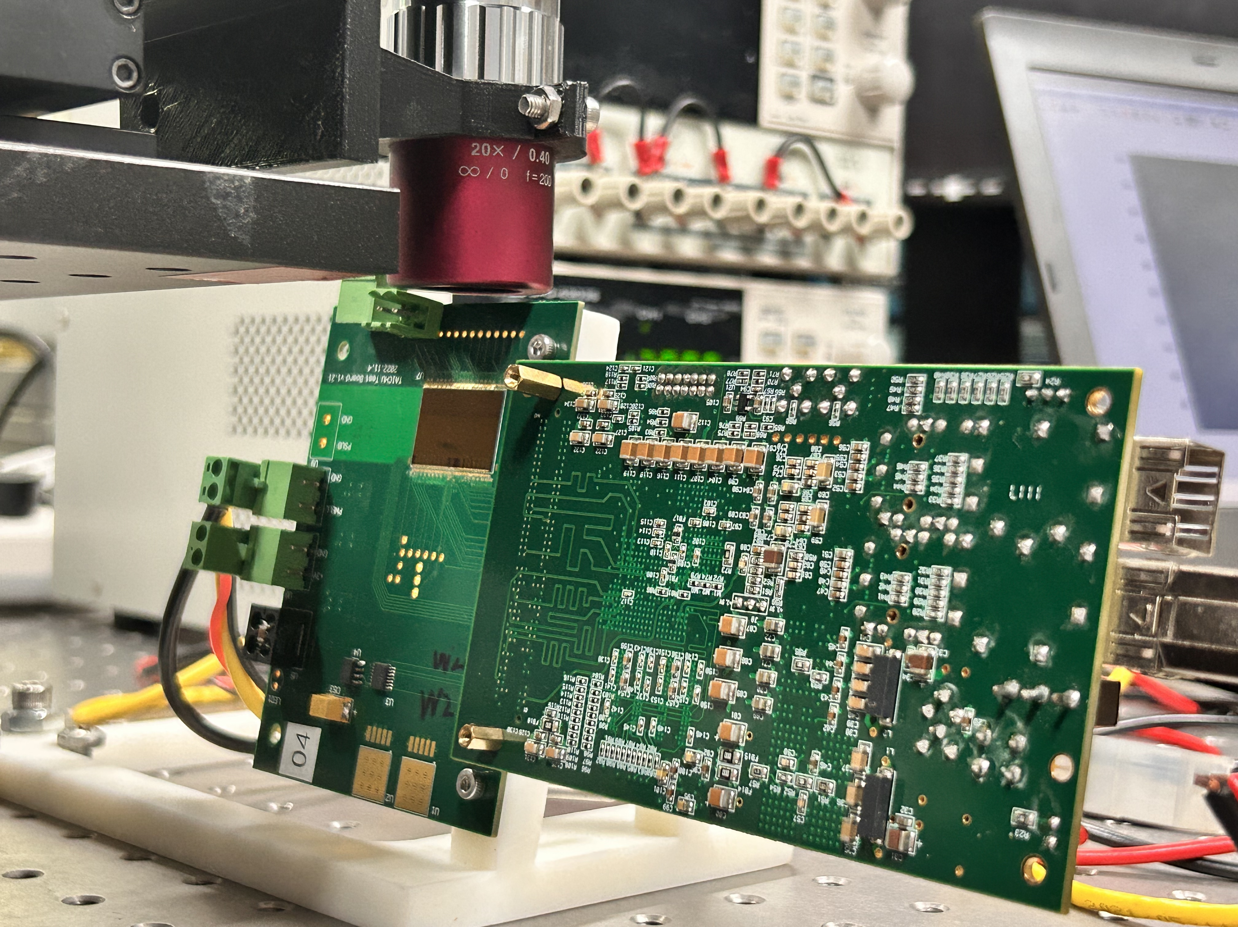
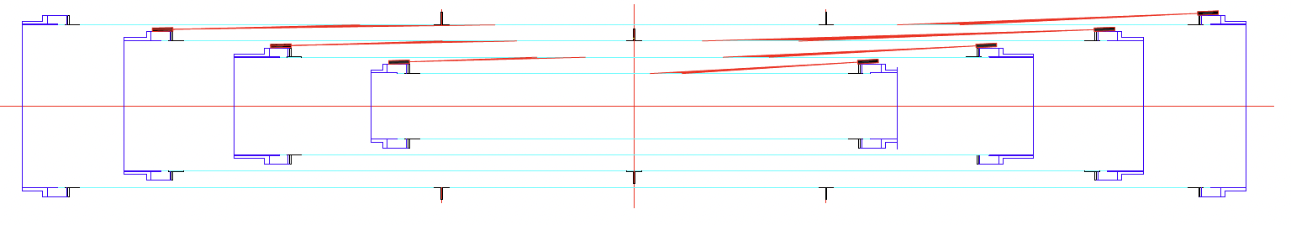
Reply to IDRC comments: Laser alignment
C-B-4-9: Laser alignment is an important tool and if implemented will reveal many unknowns about the mechanical stability of such objects not demonstrated in real experiment before. However, illuminations at shallow angles on almost entirely metalized surfaces are much more complicated that for e.g. strip detectors. Understanding all reflections and ways to induce signals will be a challenge.
→ More recent studies on laser illumination at shallow angles and from the backside have been carried out. Signals from front-side illumination at shallow angles agree with our expectations, while backside illumination shows good results with reduced reflection in laboratory tests.
→ In the current laser alignment scheme, the laser lines on the left use backside illumination (Fig. 4.22). By comparing the beam spots on the left and right, the reflection effect can be reduced.
→ In the longer term, the laser alignment method will be validated using a vertex detector prototype with stitched sensors.
Laser illuminations at shallow angle
Back-side illuminations
Figure 4.22

Slide 10
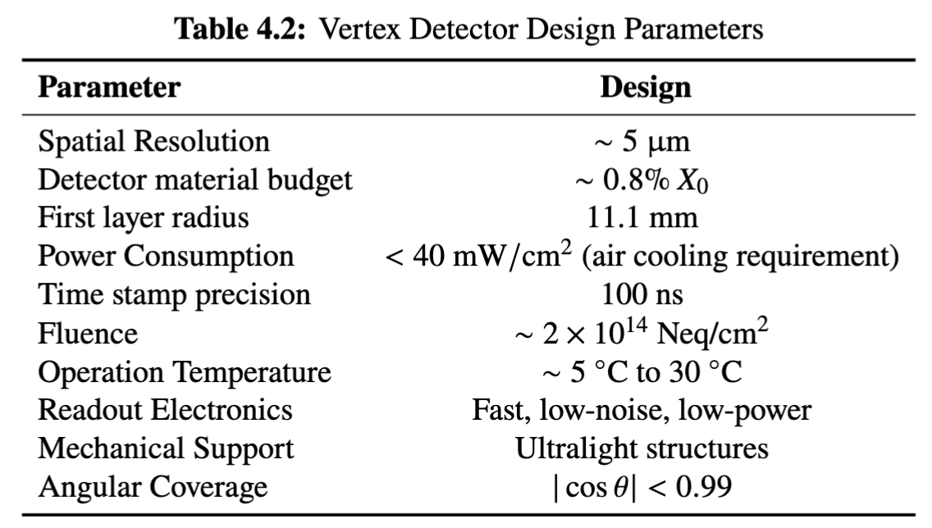
Vertex Requirement
Inner most layer (b-layer) need to be positioned as close to beam pipe as possible
Challenges: Radius (11.1mm) is smaller compared with ALICE ITS3 (18mm)

Slide 11
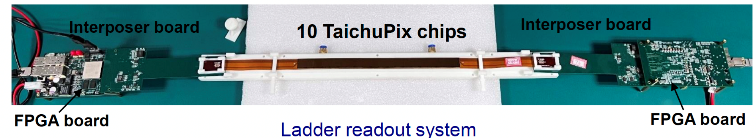
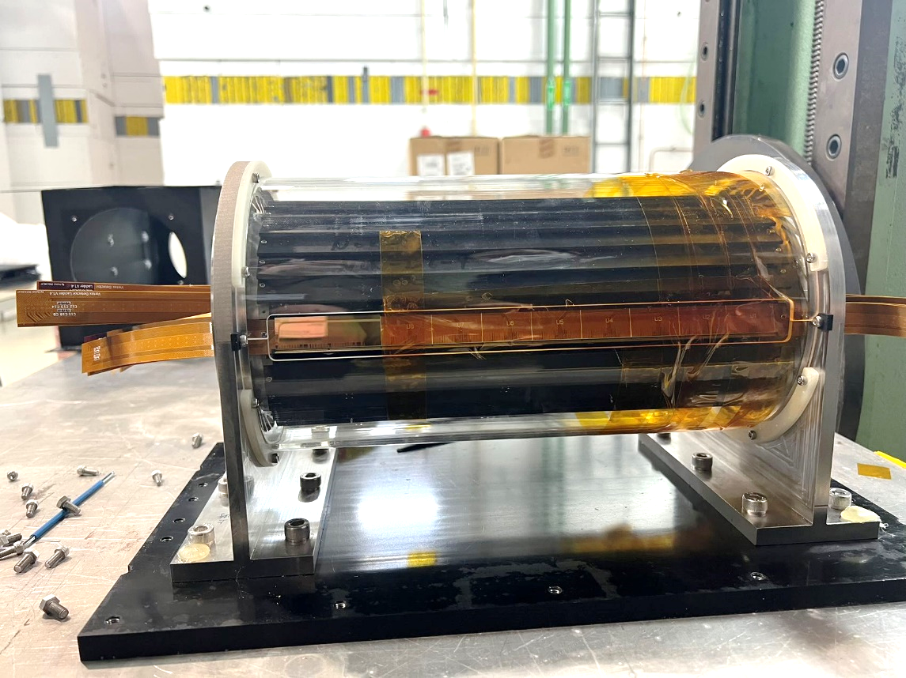
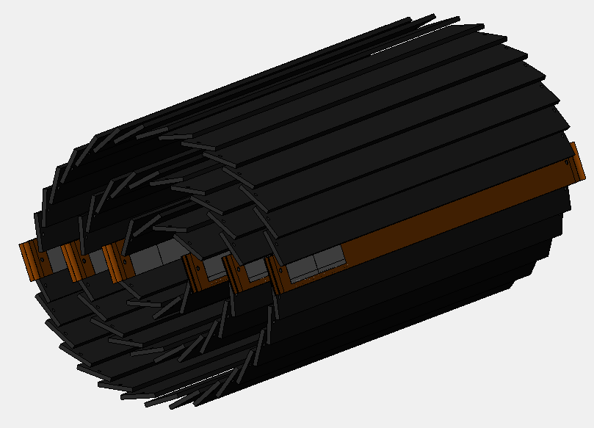
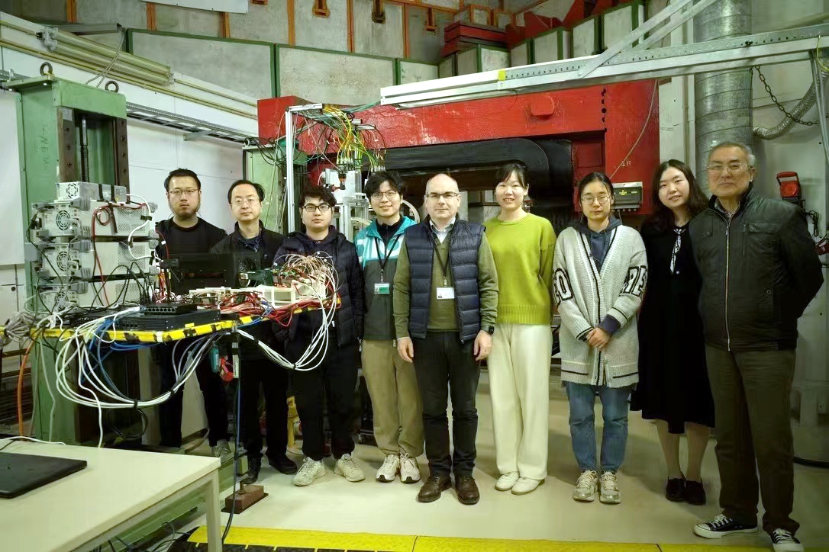
R&D effort: vertex detector prototype
TaichuPix-based prototype detector tested at DESY in April 2023
Spatial resolution ~ 4.9 μm
6 double-sided ladders
 | Status | CEPC Final goal
Detector integration | Detector prototype with ladder design | Detector with bent silicon design

Slide 12
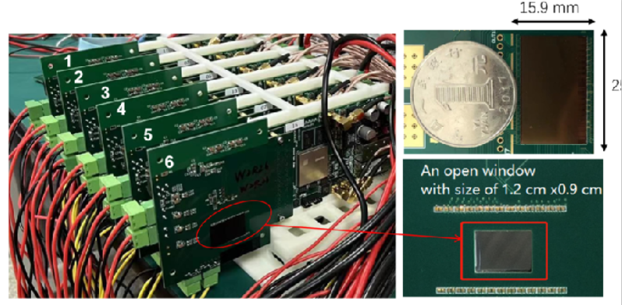
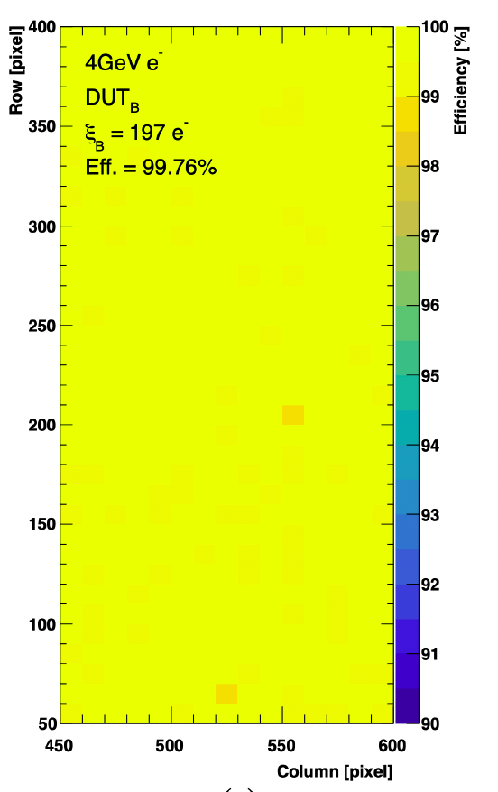
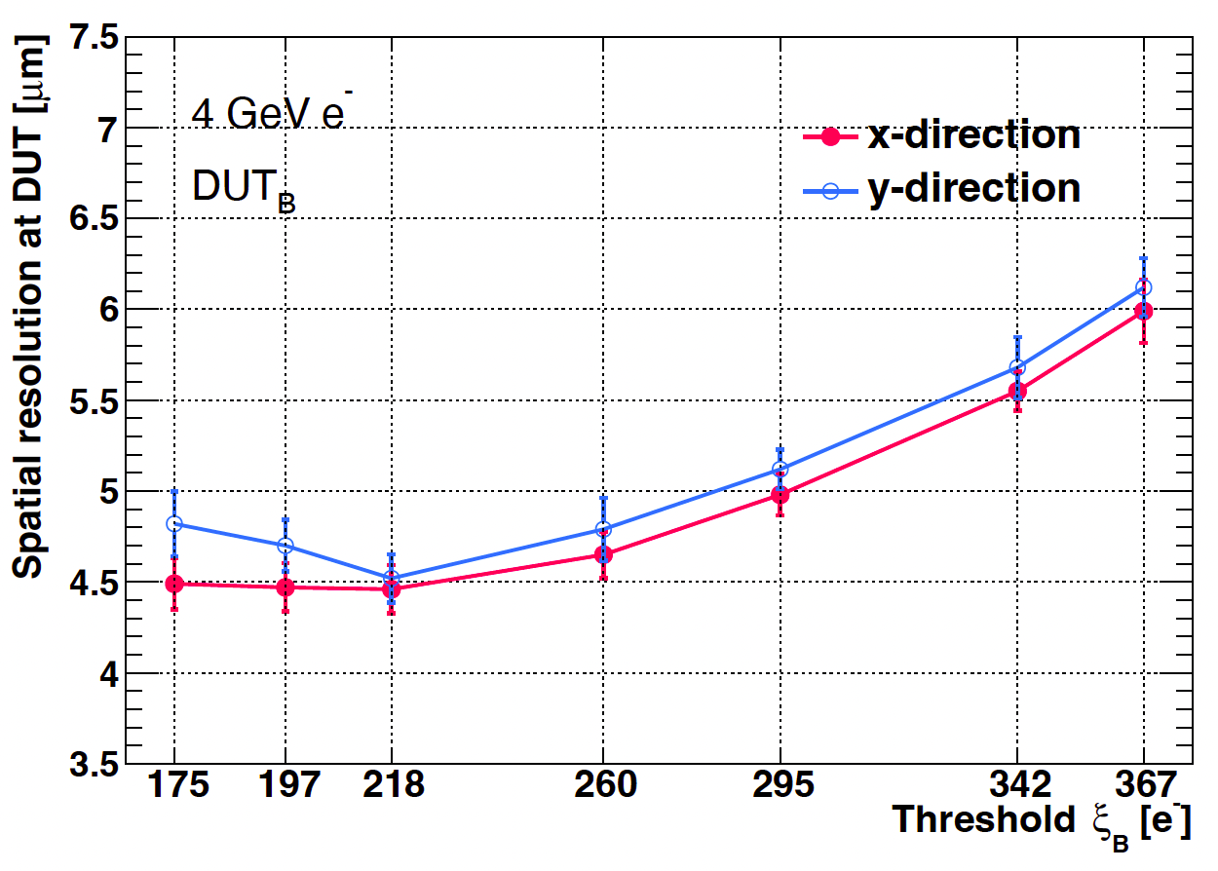
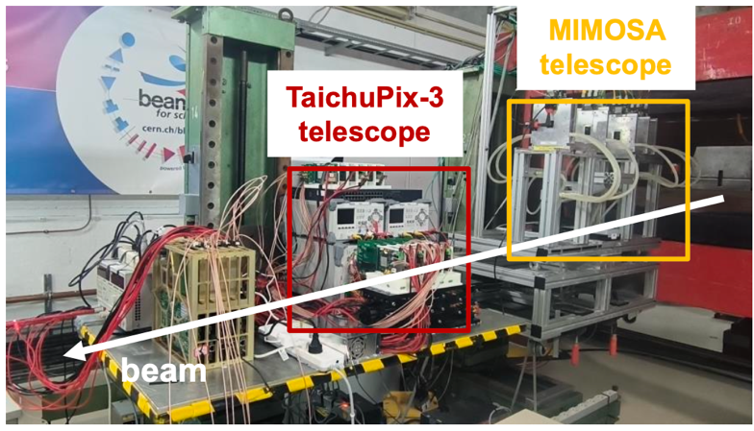
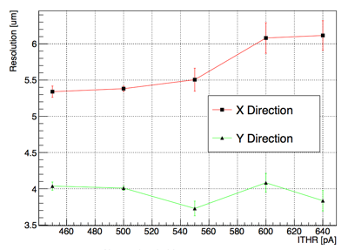
R&D efforts and results: Jadepix3/TaichuPix3 beam test @ DESY
Spatial resolution 4~5um, Efficiency >99%
TaichuPix3 efficiency
TaichuPix3 resolution
JadePix3 resolution
JadePix3
telescope
Collaboration with CNRS and IFAE in Jadepix/TaichuPix R & D

Slide 13
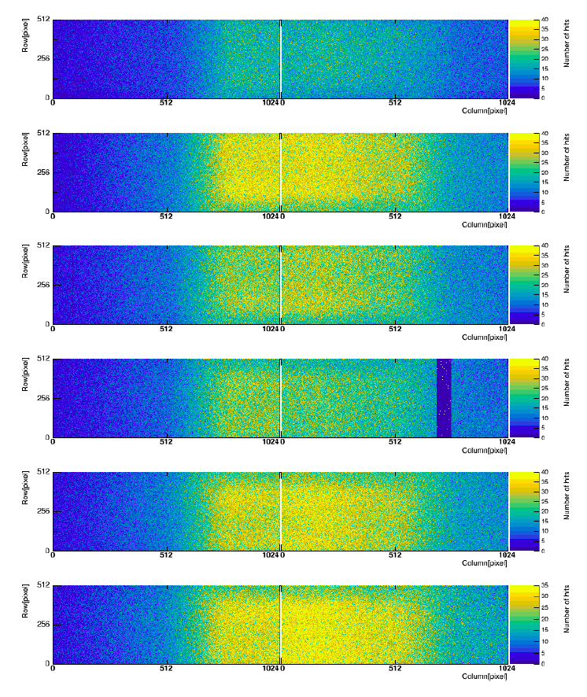
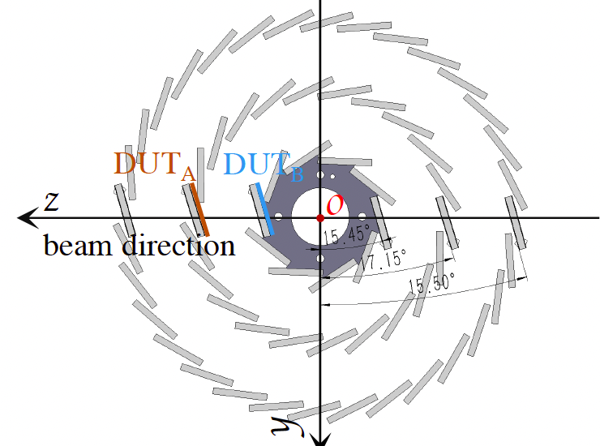
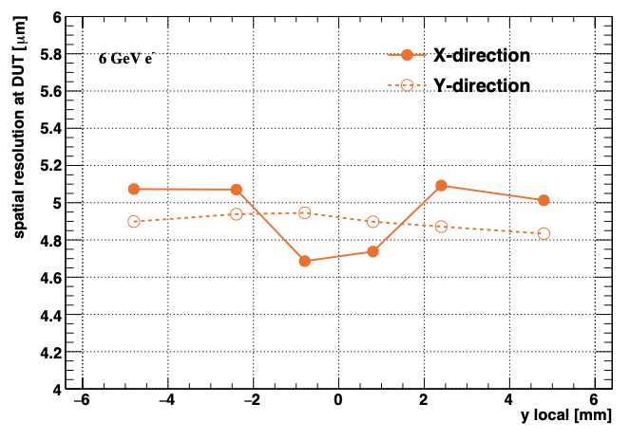
R&D efforts and results: vertex detector prototype beam test
Hit maps of multiple layers of vertex detector
Spatial resolution ~ 5 μm
Beam spot
 | Status | CEPC Final goal
Spatial resolution | 4.9 μm | 3-5 μm

Slide 14
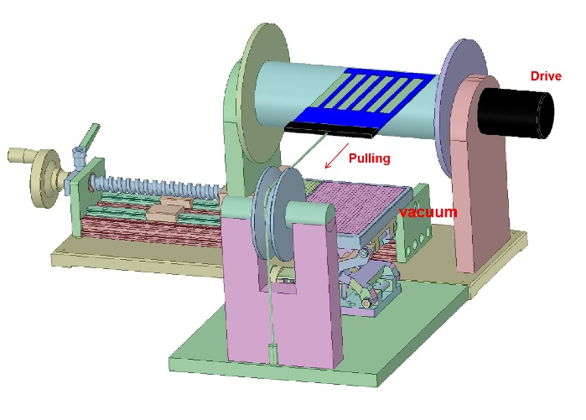
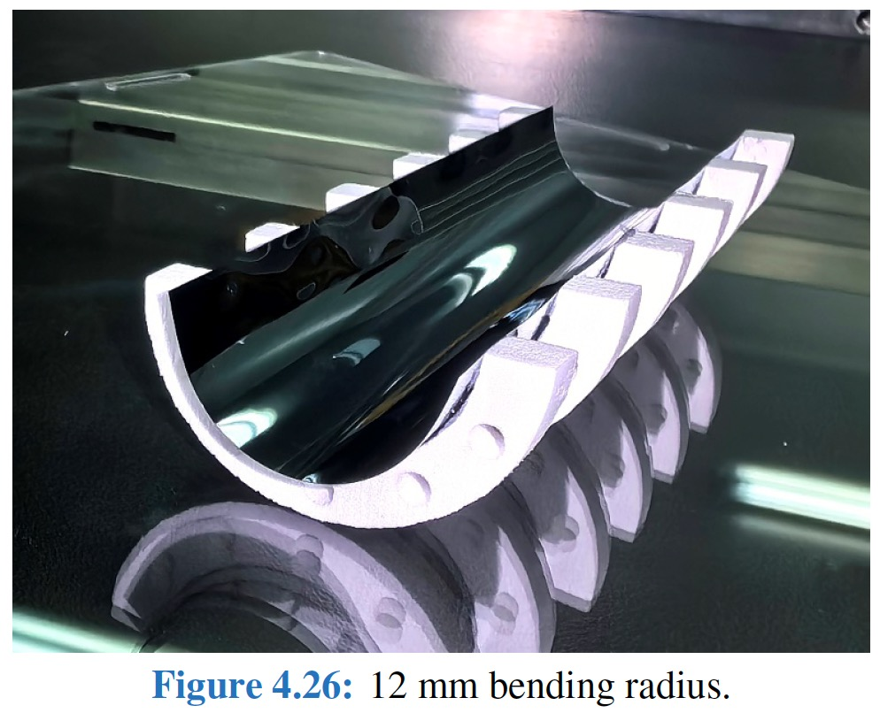
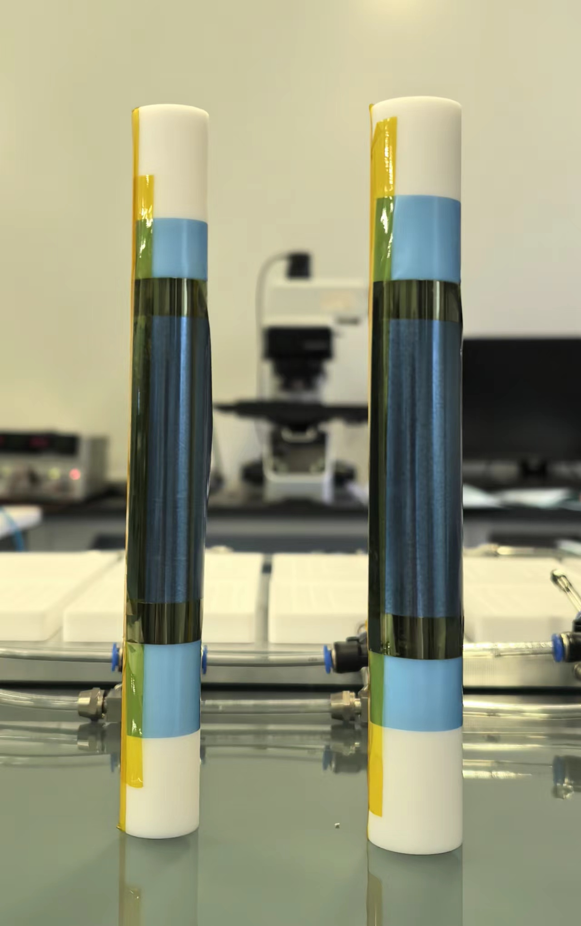
R&D efforts curved MAPS
CEPC b-layer radius (11 mm) smaller compared with ALICE ITS3 (radius = 18 mm)
Feasibility : Mechanical prototype with dummy wafer can curved to a radius of 12 mm
The dummy wafer has been thinned to 40 μm
12 mm
14 mm
 | Status | CEPC Final goal
Bent silicon with radius | Bent Dummy wafer radius ~12 mm | Bent final wafer with radius ~11 mm

Slide 15
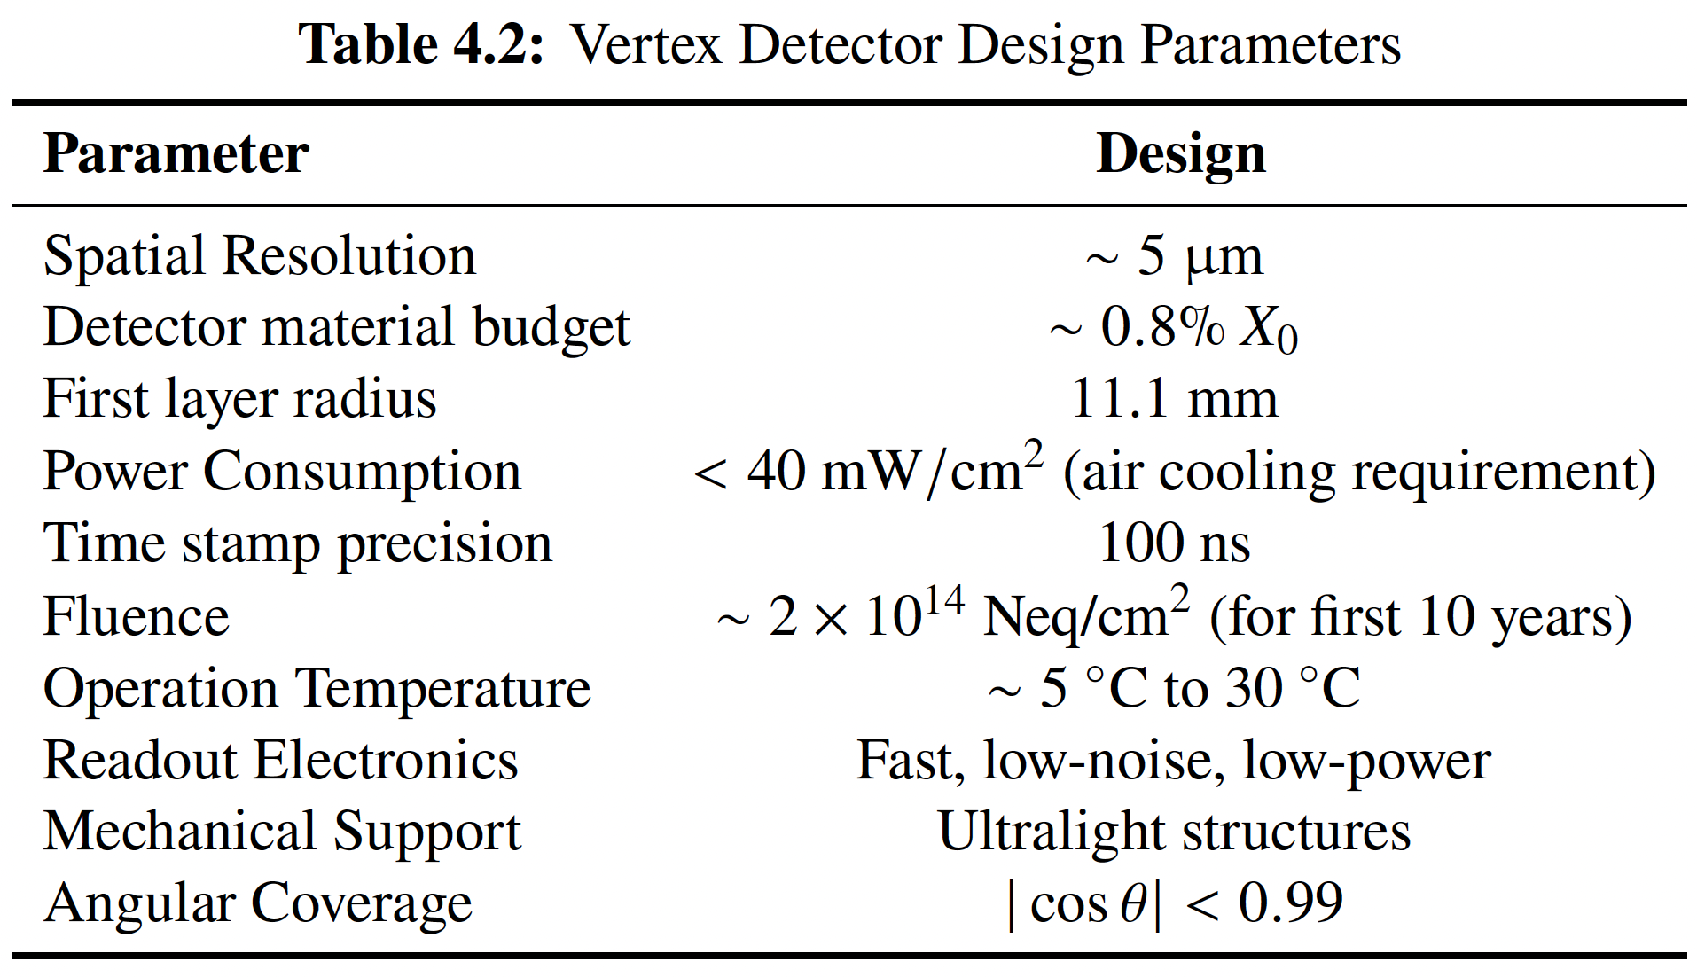
Vertex Requirement in CEPC ref-TDR design
Inner most layer (b-layer) need to be as close to beam pipe as possible
Challenges: b-layer radius (11mm) is smaller compared with ALICE ITS3 (18mm)
CEPC Technical Design Report -- Reference Detector: https://arxiv.org/abs/2510.05260

Slide 16
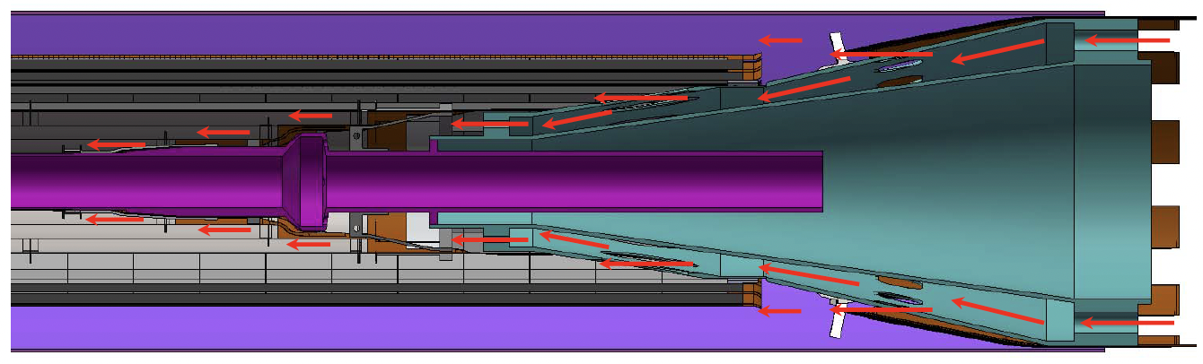
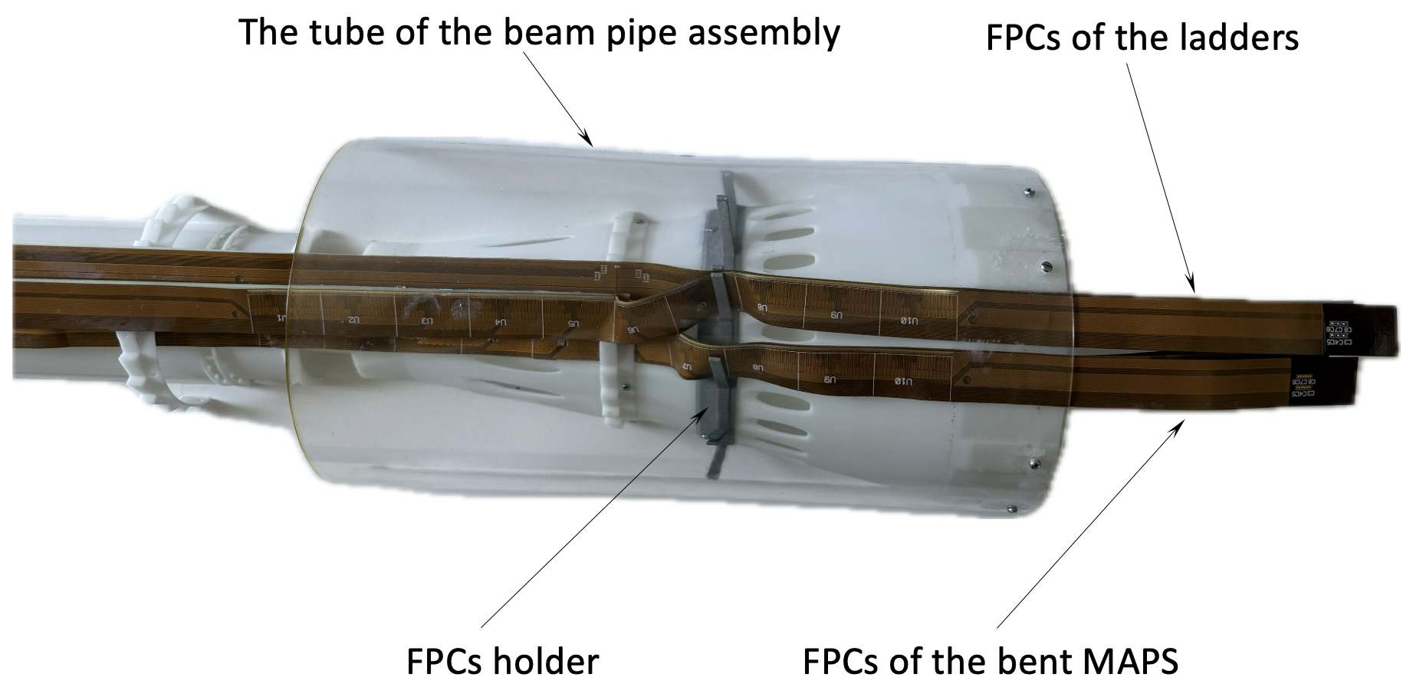
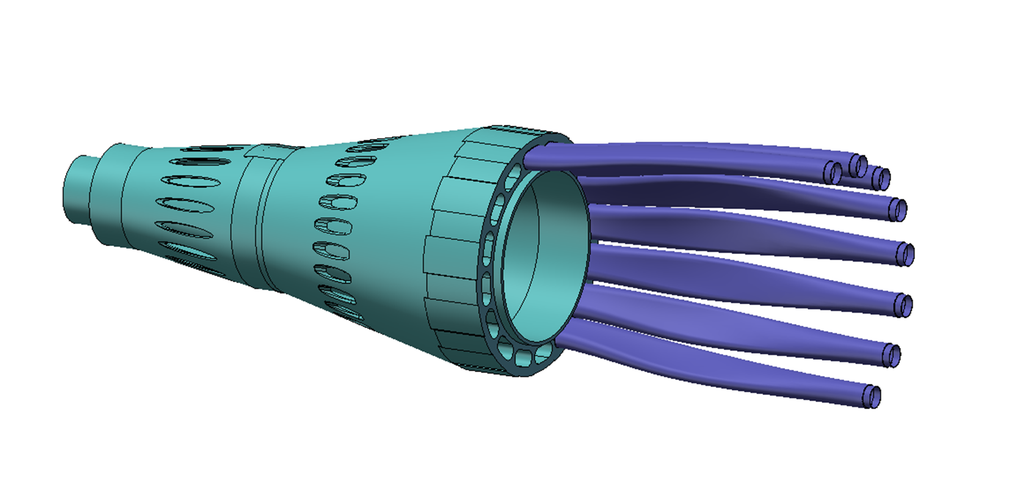
（new) Mockup to validate cable routing
Full-size 3D printed vertex detector and beam-pipe mockup
Validate there is enough space for cable routing and air cooling channel
The effective area for air cooling is 12.6 cm² (stitching layers)+ 28 cm² (between L4/L5)
Figure 4.19
 | Effective cross section for cooling(cm²)
Between stitching layers (L1-L4) | 12.6
Between stitching layer L4 and outer layer L5 | 28
The total volumetric flow for the air-cooling is 3500 L/min.

Slide 17
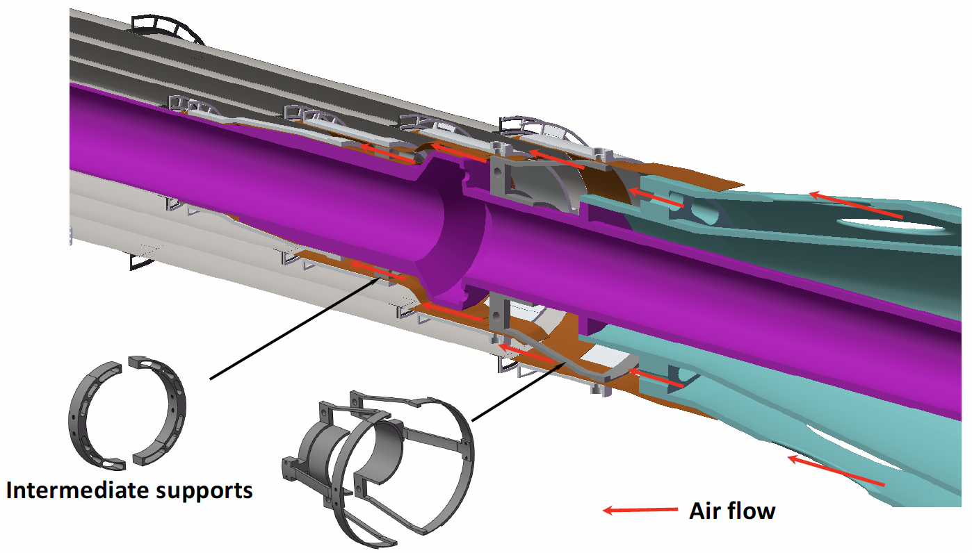
Thermal simulation
New thermal simulation, baseline air speed increased from 3.5m/s to 7m/s
All obstacles and thermal gradients considered (included support structure and flexible cable)
The simulation results indicate that the airflow is turbulent
Maximum temperature in stitching layers
Temp. Gradient in stitching layers
Figure 4.16
This study is to address the IDRC comment:
C-B-4-10-17. A few more sentences are needed here: what flow was simulated (laminar/turbulent), if all obstacles were correctly accounted for. Have the thermal gradients along the flow been taken into consideration?

