Slide 1
Analysis of the Impact of Micro-vibration on Beam Stability in the CEPC Interaction Region
YAN Fang, TAN Xiangyu, WANG Yiwei, Wang Haijing
Accelerator center
20260415
CEPC Day

Slide 2
Outlines
1
Background
2
Simulating results with incoherent vibrations
3
Frequency-related vibration beam dynamics model
4
Vibration influence analysis with frequency-dependent coherence
5
The vibration parameters necessitate definition for the CEPC site
6
Summary

Slide 3
1. Background: task breakdown list
Target: Limit the luminosity degradation due to micro-vibration to less than 2%
Order of magnitude estimation of the vibration level Spec. on ground of IR and Arc area | Random vibrations: 4nm at IR, 25 nm at arc area (1-100Hz) | Impact of displacement deviation on luminosity only | Completed
 |  | Impact of both displacement and angular deviation on luminosity | Partly Completed
Vibration measurement | Ground motion level: PSD at IR, PSD at arc area |  | Assumed
 | Wave velocity: 2km/s |  | Assumed
 | Decay formula |  | Not yet addressed
Magnification factor | Single ring |  | Completed
 | Double ring: IR & Arc |  | Partly Completed
Vibration Specs Allocation： | IR& Arc Areas |  | To be determined
Girders of IR and Arc Area |  |  | To be determined
Vibration Control of Surrounding Sources | Utilities (close to IR) |  | To be determined
 | Surroundings
Iteration

Slide 4
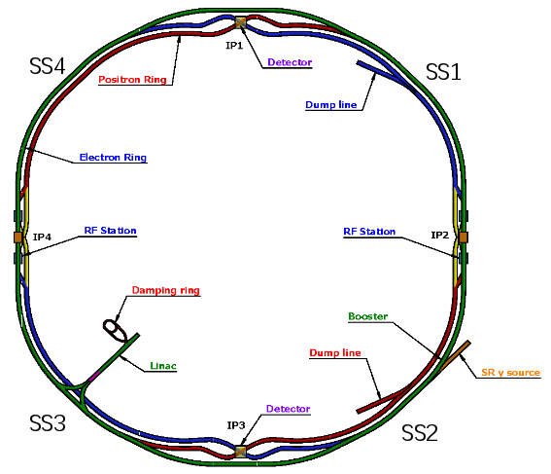
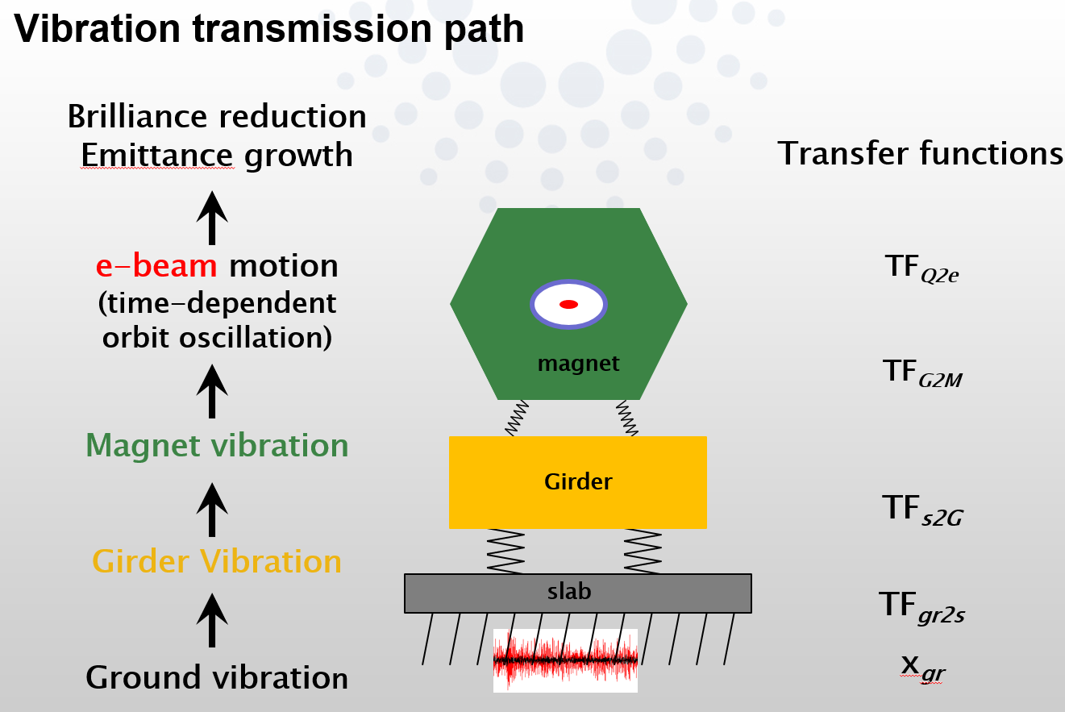
1. Background
Where do the vibrations come from?
Ground motions are the major vibration sources of CEPC.
It transmitted through the slab, girder-magnet assembly propagate to the beam, leading to an emittance growth and brilliance reduction at IP.
Interaction Region
Courtesy of Lin Zhang, GM2017
Arc section
Arc section
Interaction Region

Slide 5
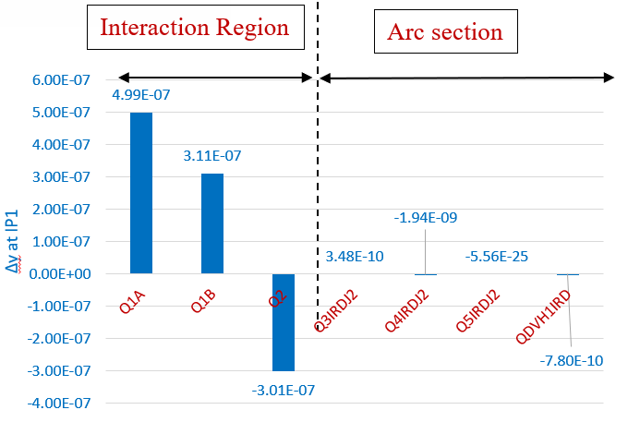

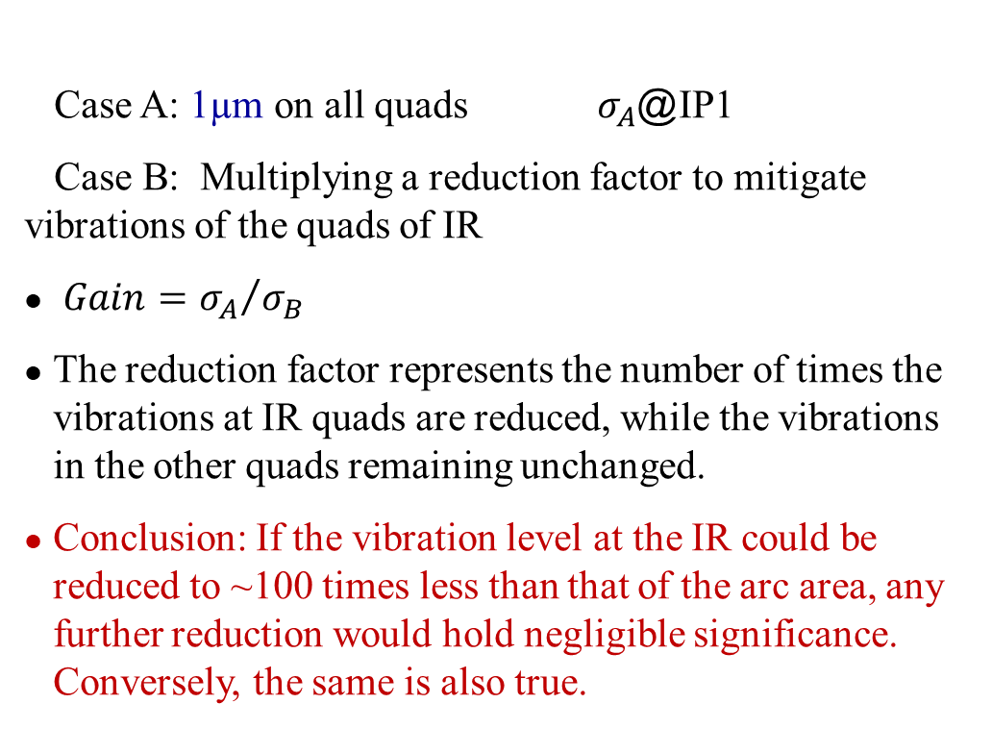
2. Simulating results with incoherent vibrations
To what extent can the reduction in vibration levels at the IR be deemed reasonable?
Random vertical vibrations are introduced:
IP1
Case A: 1µm on all quads $σ_{A}$@IP1
Case B: Multiplying a reduction factor to mitigate vibrations of the quads of IR
$Gain={σ_{A}}/{σ_{B}}$
The reduction factor represents the number of times the vibrations at IR quads are reduced, while the vibrations in the other quads remaining unchanged.
Conclusion: If the vibration level at the IR could be reduced to ~100 times less than that of the arc area, any further reduction would hold negligible significance. Conversely, the same is also true.
IP2
$σ_{B}$@IP1
25nm/4nm
The concept was gracefully introduced by Gaël BALIK from the CNRS during the 7th FCC Physics Workshop.
To be noted: all the simulation is based on an
uncorrelated vibrations.

Slide 6
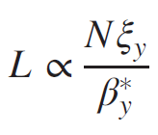


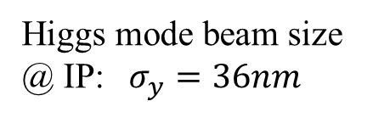
2. Simulating results with incoherent vibrations
Simulating results with incoherent vibrations
Higgs mode beam size @ IP: $σ_{y}=36nm$
RMS 4nm vibrations from the ground of IPs is assumed, based on the vibration levels (1-100Hz) at the IP of CERN tunnel which situated 100 meters underground.
Combined with RMS 25 nm vibrations from the ground in the arc region — not 4nm all along the 100km ring due to the inevitable presence of mined-out areas even at a depth of 100 meters.
Random vibrations, no magnification by girder assembling.
The cumulative effect of these vibrations on the IP position is 10 nm, resulting in a 2% decrease in luminosity.
$$\frac{ΔL}{L}≈−\frac{{Δy}^{2}}{4σ_{y}^{2}}$$
RMS vibration induced in IR | RMS vibration induced in ARC region | RMS Orbit deviation @ IP1/IP2
4nm | 25nm | 10/10nm
$\text{L}\text{: 2\%} ∆y @$IP: 10nm
→
The luminosity drop resulting from angular deviation has not been considered.

Slide 7
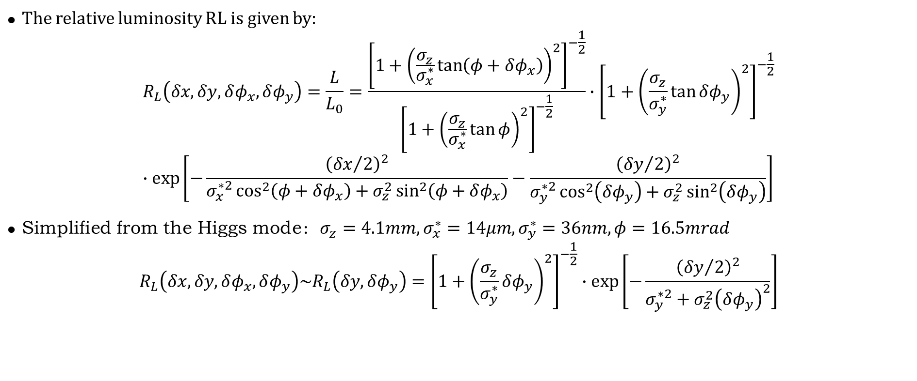
2. Simulating results with incoherent vibrations
Formula for Luminosity Reduction Caused by Displacement and Angular Errors
Reference: O. Napoly, PA 40 (1993) 180
The relative luminosity RL is given by:
$$R_{L}\left(δx,δy,δφ_{x},δφ_{y}\right)=\frac{L}{L_{0}}=\frac{{\left[1+{\left(\frac{σ_{z}}{σ_{x}^{∗}}\tan\left(φ+δφ_{x}\right)\right)}^{2}\right]}^{−\frac{1}{2}}}{{\left[1+{\left(\frac{σ_{z}}{σ_{x}^{∗}}\tan{φ}\right)}^{2}\right]}^{−\frac{1}{2}}}∙{\left[1+{\left(\frac{σ_{z}}{σ_{y}^{∗}}\tan{δφ_{y}}\right)}^{2}\right]}^{−\frac{1}{2}} \\ ∙\exp\left[−\frac{{\left({δx}/2\right)}^{2}}{σ_{x}^{∗2}\cos^{2}\left(φ+δφ_{x}\right)+σ_{z}^{2}\sin^{2}\left(φ+δφ_{x}\right)}−\frac{{\left({δy}/2\right)}^{2}}{σ_{y}^{∗2}\cos^{2}\left(δφ_{y}\right)+σ_{z}^{2}\sin^{2}\left(δφ_{y}\right)}\right]$$
Simplified from the Higgs mode：$σ_{z}=4.1mm,σ_{x}^{∗}=14μm,σ_{y}^{∗}=36nm,φ=16.5mrad$
$$R_{L}\left(δx,δy,δφ_{x},δφ_{y}\right)\sim R_{L}\left(δy, δφ_{y}\right)={\left[1+{\left(\frac{σ_{z}}{σ_{y}^{∗}}δφ_{y}\right)}^{2}\right]}^{−\frac{1}{2}}∙\exp\left[−\frac{{\left({δy}/2\right)}^{2}}{σ_{y}^{∗2}+σ_{z}^{2}{\left(δφ_{y}\right)}^{2}}\right]$$
Key conclusions from the simplification:
Luminosity degradation is primarily caused by vertical (y-direction) displacement and angular errors.
The impact of angular errors on luminosity is significantly more pronounced than that of displacement errors.

Slide 8
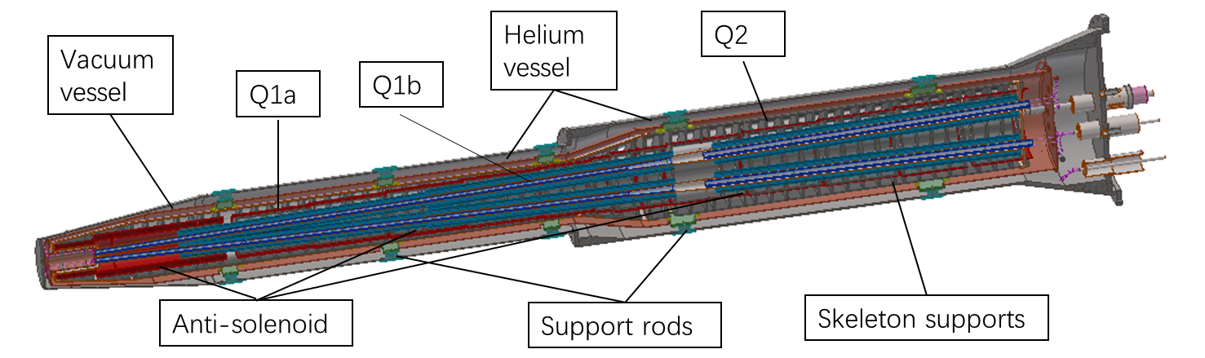
2. Simulating results with incoherent vibrations
Random seeds on two set of IR Quadrupole magnets of Higgs mode: 100 seeds
RMS of Random Vibrations | y_ip1_rms | yv_ip1_rms | RL
1nm | 0.938nm | 1.769μrad | 98.02%
2nm | 1.811nm | 3.591μrad | 92.51%
4nm | 3.750nm | 7.325μrad | 76.67%
8nm | 7.183nm | 14.685μrad | 51.18%

Slide 9
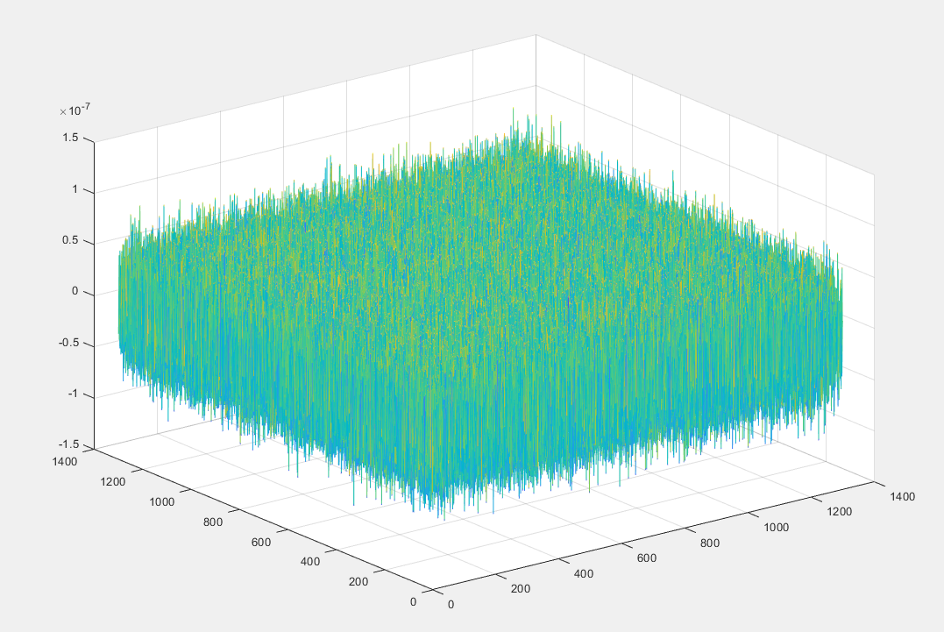
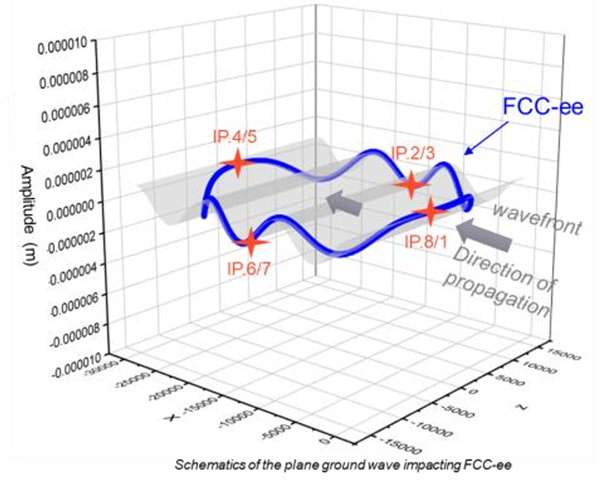




3. Frequency-related vibration beam dynamics model
A vibration beam dynamics model with f-dependent coherence length is needed
Courtesy of Gaël BALIK of CNRS
Model on basis of random vibrations
Model with a infinite coherence length
Coherence length：
$$L_{c}→0$$
$$L_{c}=L\left(f\right)$$
$$L_{c}→∞$$

Slide 10
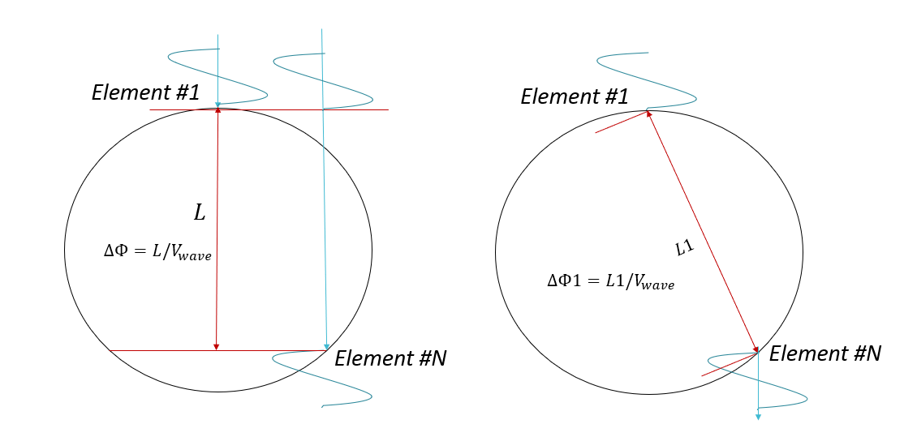


3. Simulating with frequency related correlation
3. Frequency-related vibration beam dynamics model
For nm scale vibration controlling requirement, special cares are mandatory in developing site vibration specifications. To reasonably evaluate the vibration response, a frequency related beam dynamics model
has to be established.
Plane wave model is developed for simulating vibrations far away. Point wave model is developed for
simulating vibrations close by. Wave velocity and wave decay are considered.
$$A\cos\left[ωt+φ\left(θ\right)\right]$$
Plane wave model
Point wave model
*$2πf$
*$2πf$

Slide 11
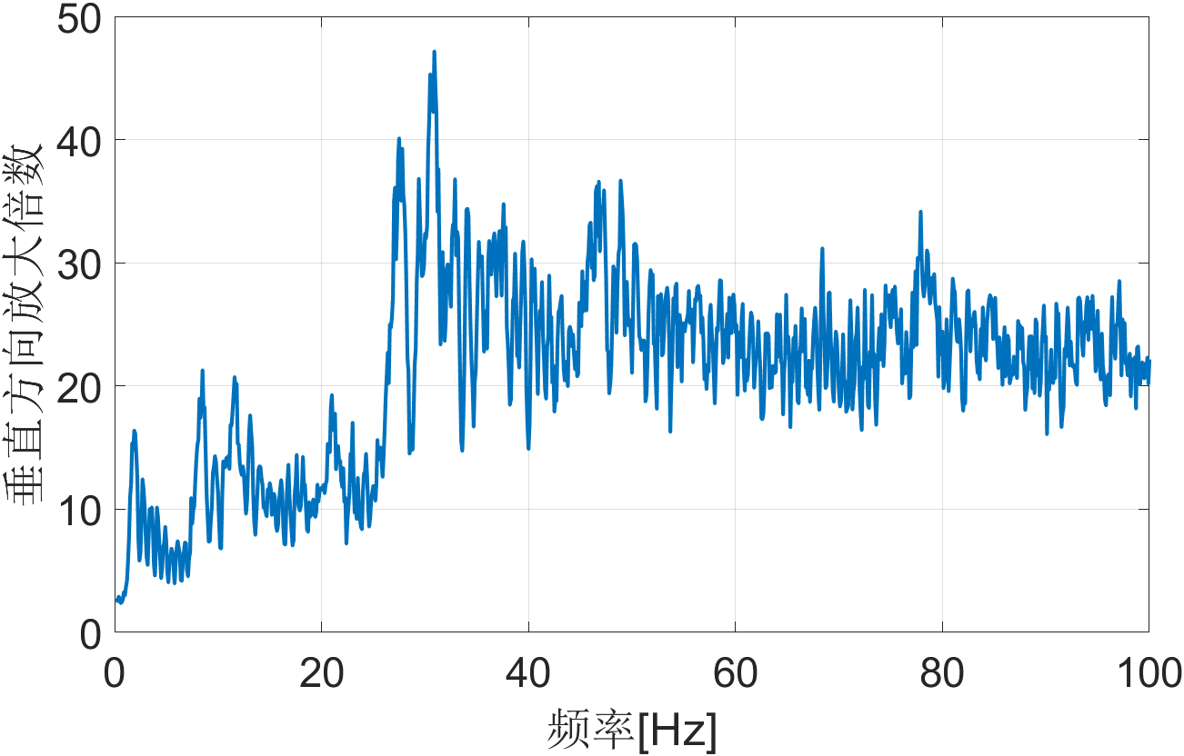
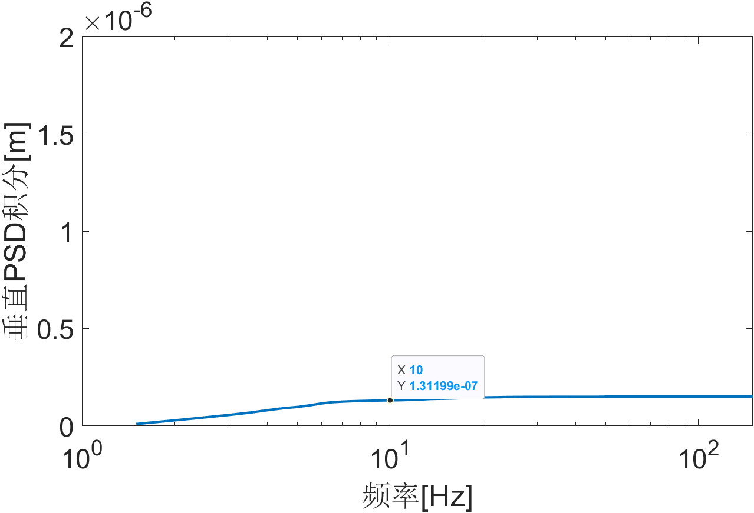
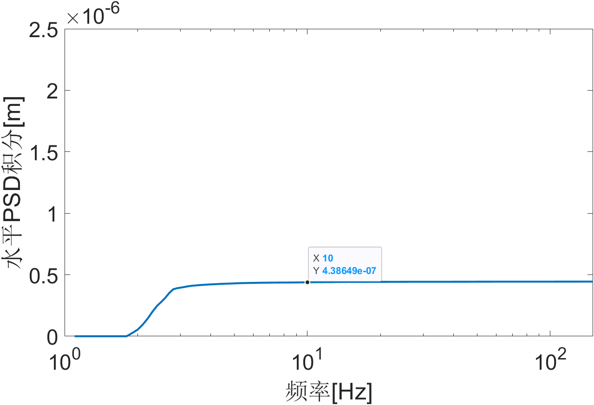
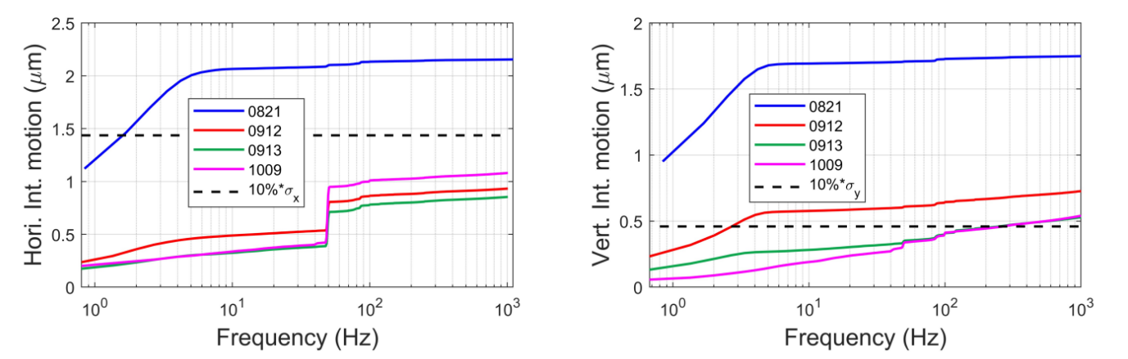
3. Frequency-related vibration beam dynamics model
The beam fluctuation PSD was predicted by combining the amplification factor with HEPS's measured ground motion PSD. Ground motion within 1–10 Hz induced beam fluctuation around 400nm and 100nm horizontal and vertical respectively, showing good agreement with operational data of HEPS BPM.
Vertical RMS: 6.8nm
The prediction showed good agreement with operational data in terms of magnitude and trend.

Slide 12
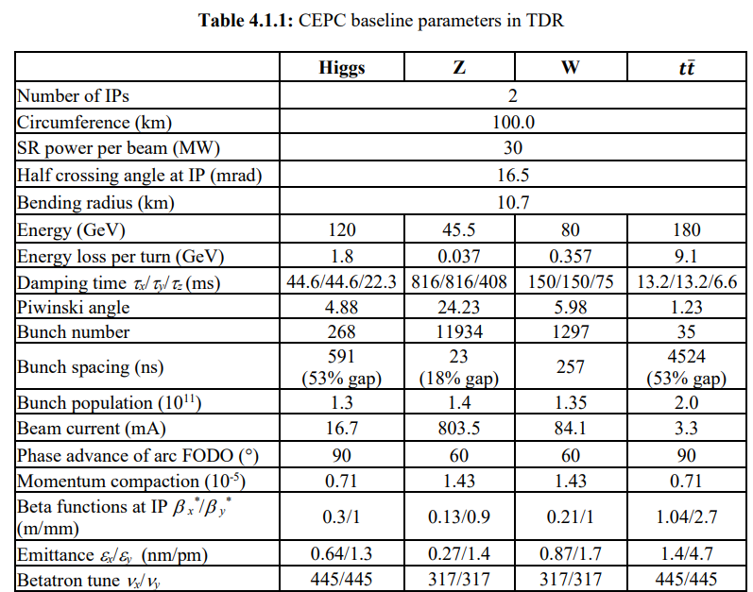
4. Vibration influence analysis with frequency-dependent coherence
The lower frequency limit for the requirement of ground vibrations
The characteristic wavelengths of slow ground motions are far greater than betatron wavelength, the dynamic effects to the beam can be neglected：[courtesy of June-Rong Chen/NSRRC MEDSI2014]
--CEPC Betatron wavelength:
λ_{βy}= C / ν_{y}= 100km / 445(Higgs mode) = 224.7 m
--Assume the wave velocity of CEPC site is: ν_{y}=2000 m/s
--Consider vibrations with wavelength one magnitude higher than
the betatron wavelength, the characteristic frequency is:
f_{βy} = ν_{βy1} / λ_{βy}= 2000 / 2247 = 0.89Hz ≈ 1Hz
For characteristic frequency of ground vibrations smaller than 1Hz, the dynamic effect to the beam can be neglected. Therefore, 1Hz is treated as the lower limit of the ground motion Spec.

Slide 13
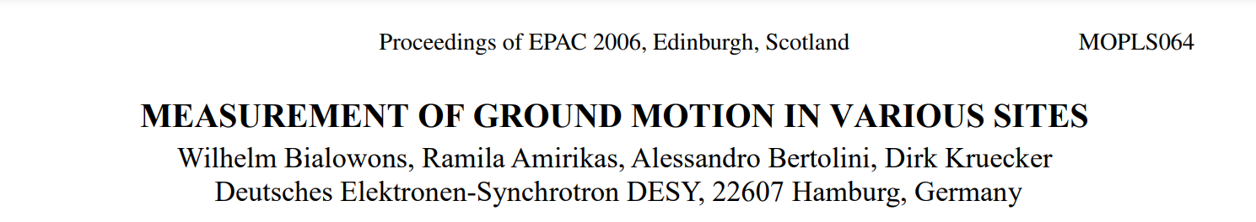
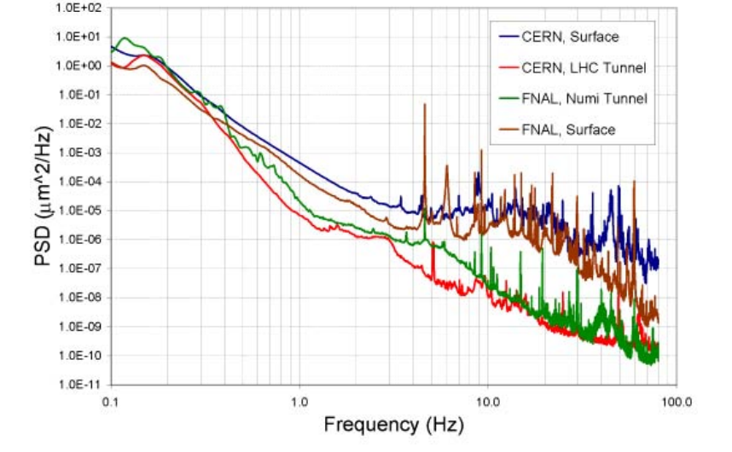
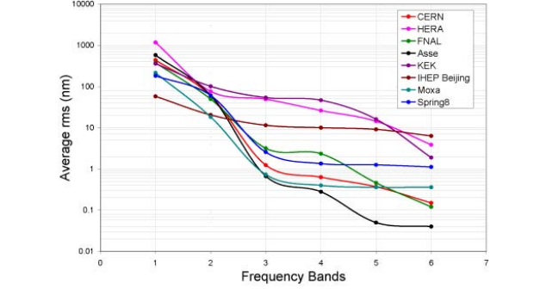
4. Vibration influence analysis with frequency-dependent coherence
CERN LHC tunnel located underground 100m
The displacement RMS of 1-100Hz: ~2nm
The PSD is similar with HEPS site during night (4nm)
HEPS vertical vibration: 1-100Hz of 4nm

Slide 14
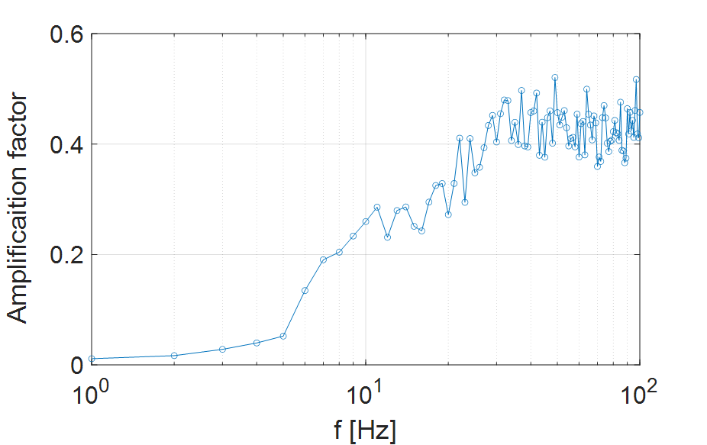
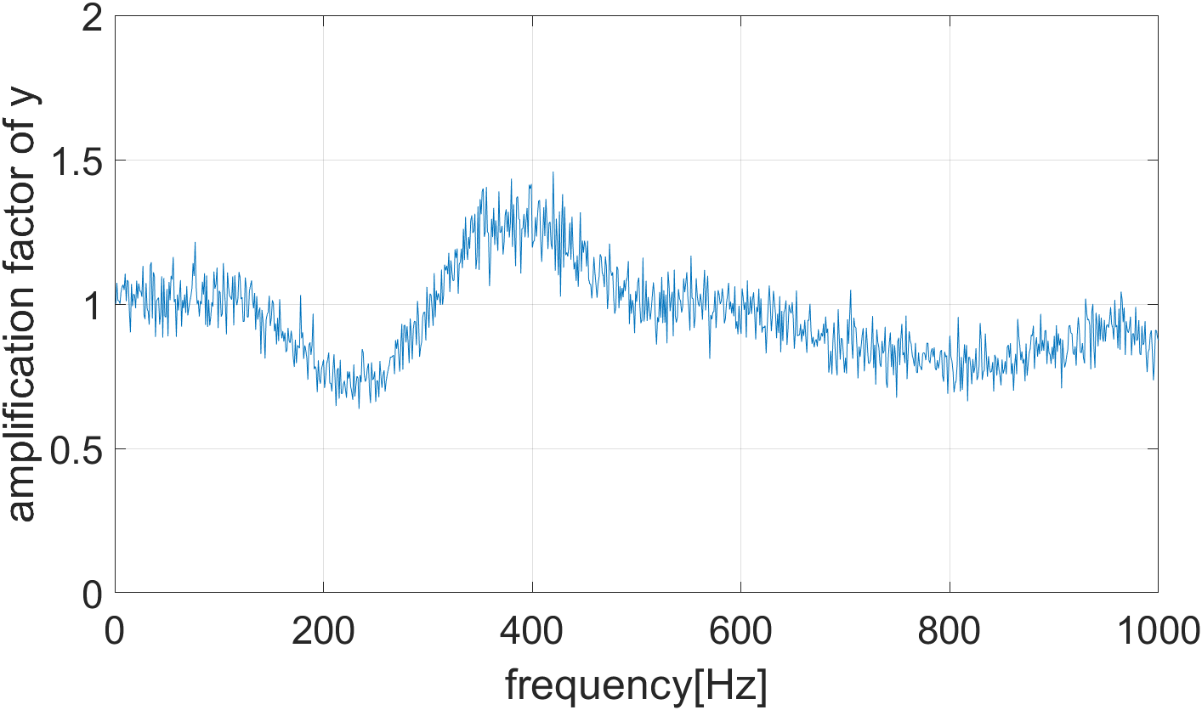
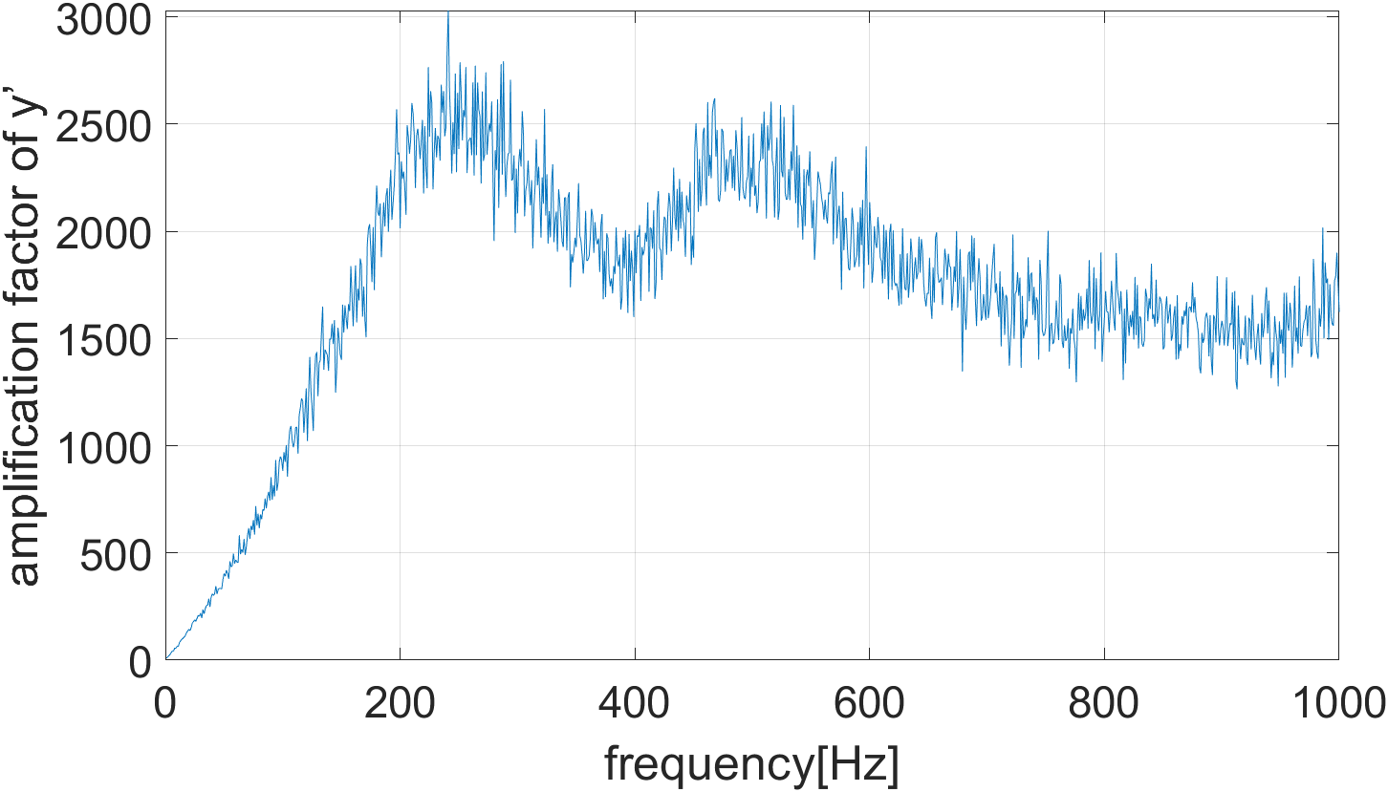
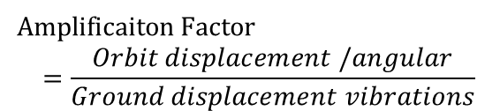
4. Vibration influence analysis with frequency-dependent coherence
Vibration influence on double rings
Amplificaiton$Factor$
$$=\frac{Orbit displacement /angular}{Ground displacement vibrations}$$
Vibration influence only on the single ring
Displacement Amp. Factor
on arc range
Displacement Amp. Factor
on IP
Angular Amp. Factor
on IP

Slide 15
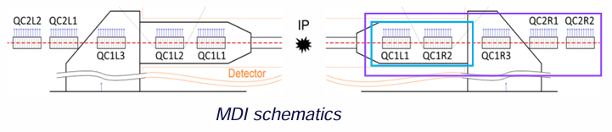
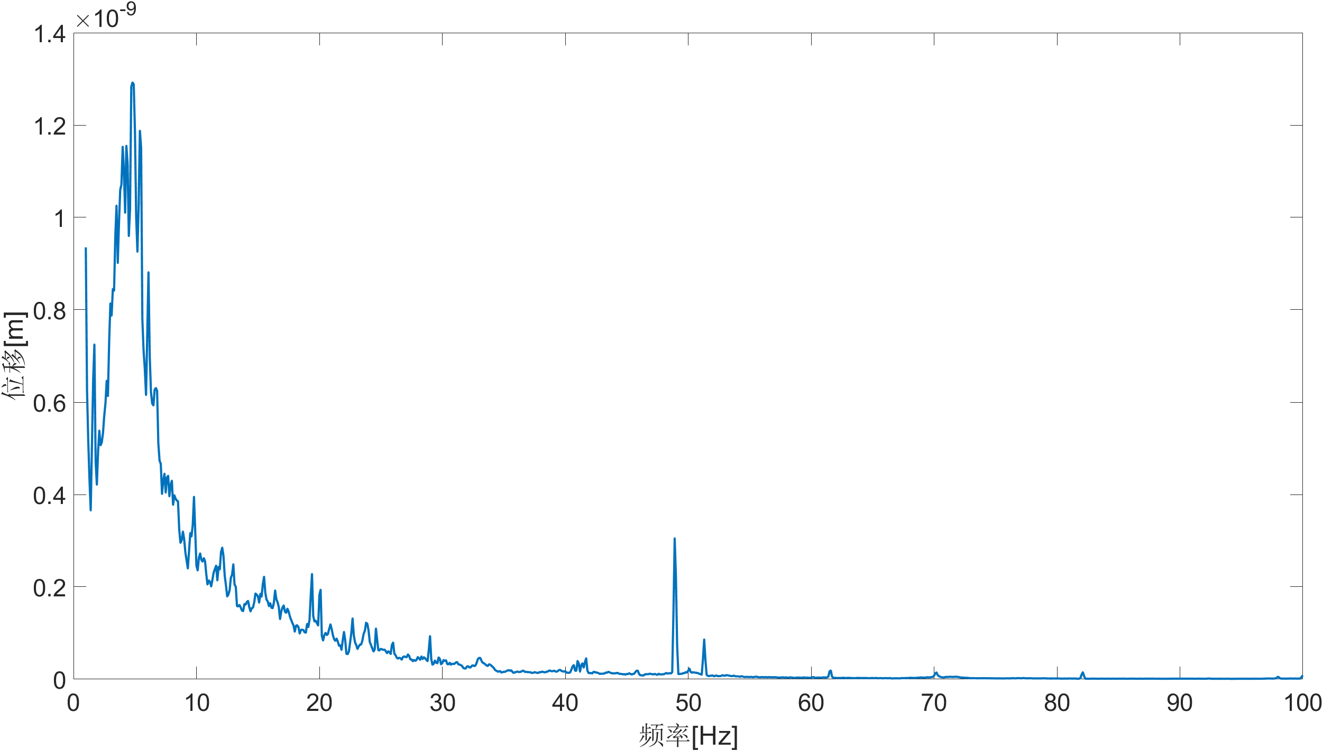
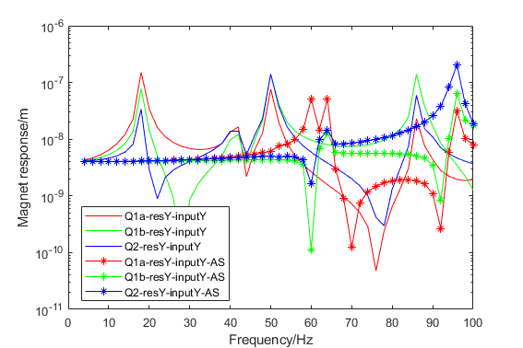
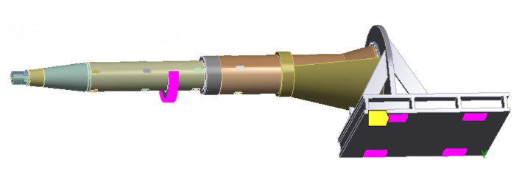
4. Vibration influence analysis with frequency-dependent coherence
Girder design at IR region: option ① >54Hz
CEPC对撞区磁铁支架的稳定性研究
HEPS night vibration as input on magnet ground
RMS: 4.2nm
Dominated f: 4.8Hz
Frequency Response Function
of a Cantilever Structure
 | Displacement @IP1 | Amplification factor
No support | 5.72nm | 1.43
With support | 3.59nm | 0.9
Support position
The auxiliary support design can effectively improve the amplification of ground vibrations comparing with without support:
It is assumed that the auxiliary support is rigidly connected to the ground.
The detector underneath connecting with the auxiliary support can’t magnified the ground vibrations (>54Hz).

Slide 16
4. Vibration influence analysis with frequency-dependent coherence
Girder design at IR region: option ② ~3Hz but resonant factor smaller than 10
HEPS vertical vibration: 1-100Hz of 4nm
Supported by detector with eigen frequency of 3Hz
Frequency range | Vibrations | y_rms | yv_rms | RL | NOTE
1-100Hz | 4.2nm | 5e-3nm | 0.10μrad | 99.993% | Vibration level on HEPS site during night
0.1-100Hz | 47.3nm | 5e-3nm | 0.46μrad | 99.86% | Vibration level on HEPS site during night
1-150Hz | 4.2nm | 5e-3nm | 0.10μrad | 99.994% | Vibration level on HEPS site during night
1-100Hz | 42nm | 51e-3 nm | 1μrad | 99.36% | Assumed vibration at IR magnified 10 times by detector
1-100Hz | 420nm | 510e-3 nm | 10μrad | 66.11% | Assumed vibration at IR magnified 100 times by detector

Slide 17
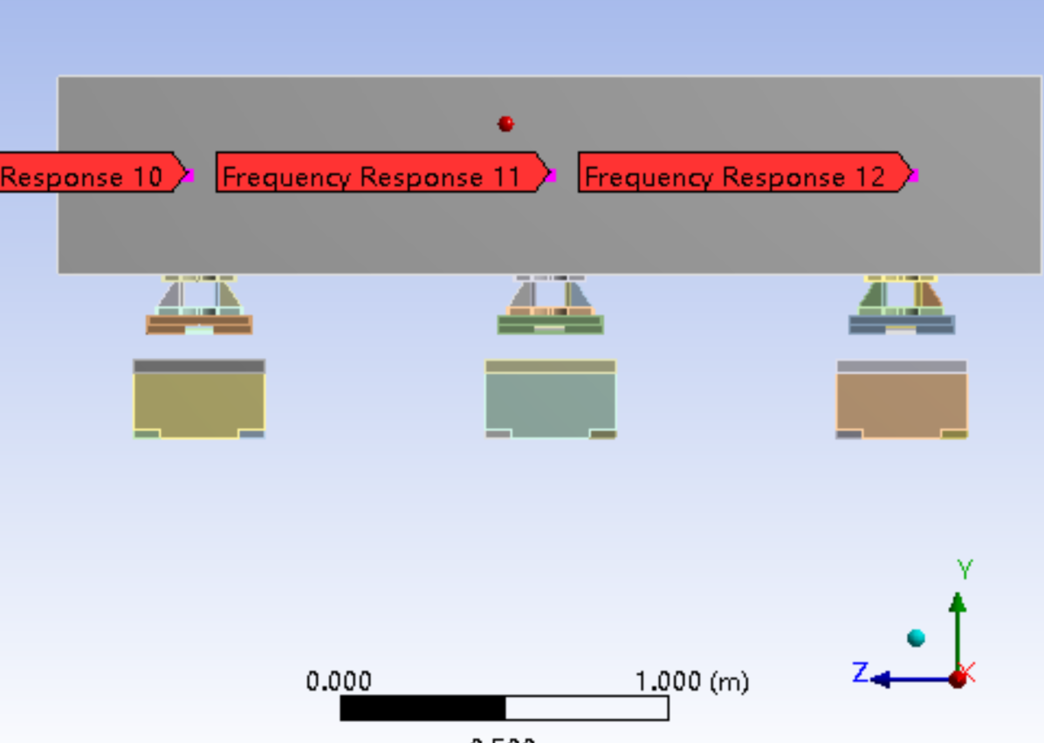
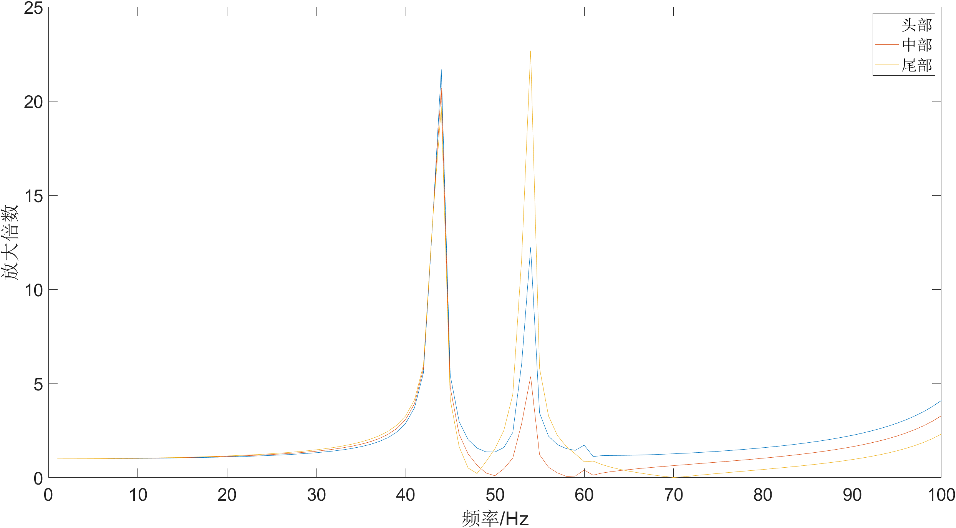
4. Vibration influence analysis with frequency-dependent coherence
Determine the magnification factor of the Arc area for the double ring.
Multiply the lattice magnification factor by the girder amplification factor and the 25nm
ground motion amplitude.
Superimpose the vibration effect of both IR and Arc area: take the root mean square of the
respective contributions.
Calculate the luminosity degradation.
Iterations
CEPC对撞区磁铁支架的稳定性研究
Magnet girder of arc area

Slide 18
5. The vibration parameters necessitate definition for the CPEC site
Actual wave velocity of the site (Currently 2 km/s is assumed) → Complete the vibration beam dynamics model, assess the influence of vibration sources outside CEPC site
Wave attenuation relationship on the site → Complete the vibration beam dynamics model, assess the influence of vibration sources inside of the CEPC site
Vibration level on collision zone (4nm is assumed) → Complete the vibration assessment on collision position
Vibration level on arc area (25nm is assumed)→ Complete the vibration influence on collision position

Slide 19
6. Summary
Vibrations are crucial for luminosity frontier colliders which pursue nanometer scale beam stability at the interaction points.
Ground motion is the usually the major vibrations.
These disturbances originate from both the ground of the interaction region and the arc sections, and the former contributing more substantially to orbit distortion at the IPs. So deducing the vibration levels at the IR could decrease the vibration impact at IP effectively. But there is a limit.
To investigate these vibrations reasonably, a frequency-related vibration beam dynamics model is developed considering coherences at different distances.
The vibration amplification factor at IP has been obtained by introducing vibrations within arc region under the assumption of a 2km/s wave velocity. On basis of the vibration level of 4nm on slab of the IR range the luminosity degradation has been estimated accordingly.
The effectiveness of the auxiliary support design of the Cantilever Structure at the MDI mainly determined by the vibration magnification factor of the detector.
The total luminosity degradation by both vibrations on ground of IR and Arc area will be estimated once the magnification factor of the Arc area is defined.

